Slide 1
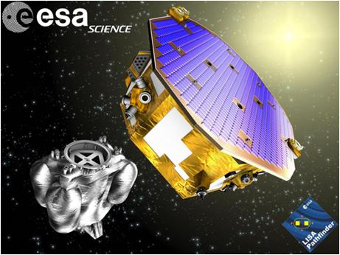
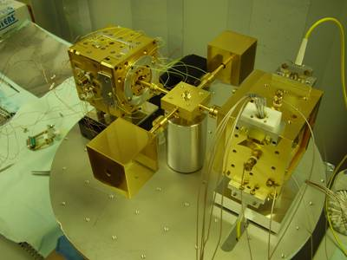


Force Isolation at 1 mHz:
from torsion pendulum ground testing to LISA Pathfinder mission
Rita Dolesi
Università di Trento/INFN
for the LISA Pathfinder collaboration
Notes:
Summarize what do we know so far about force isol…1mHz based on the experimental investigations performed by means of torsion pendulum and the level of testing that LPF is forseen to achieve
LPF is aimed at demonstrating the feasibility of free-fall at least within an order of magnituide from the LISA requirement

Slide 2
LISA gravitational waves measurement concept
the wave is detected by measuring the time-varying
changes of distances between free-falling mirrors.
Two main elements are required:
- free-falling test-masses with very low acceleration of non-gravitational origin
- ability of tracking these test-masses with light-beams with very small instrumental
fluctuations.
Notes:
Gravitational waves induce time-varying
strains in spacetime that can be detected by measuring changes in the separation of fiducial
masses
The LISA concept for directly detecting the oscillating strain in spacetime caused by
gravitational waves underlies all laser interferometer-based gravitational wave detectors and was
suggested by Bondi6: the passage of the wave is detected by measuring the time-varying
changes of distances between free-falling mirrors.
The science instrumentation of LISA fulfills the two main functions described in the previous
section: (1) measure changes in the separation between test masses with the requisite
displacement sensitivity and (2) limit disturbances to those test masses so that their spurious
acceleration will not be confused with the gravitational wave signal. In the subsections that
follow, a functional description of the science instrumentation is given,ith laser interferometry.
While LISA can be thought of as a “Michelson interferometer in space”, its actual implementation
is quite different from a conventional Michelson interferometer. The experimental approach
is closer to that of spacecraft Doppler tracking, in which the observed quantity is the frequency
change in the signal from a distant spacecraft. In LISA, each spacecraft sends a beam of
laser light to each of the other two distant spacecraft, and in turn receives a beam from each of
them. The received laser light is coherently combined at a photodetector with the light from an
onboard reference laser, and the frequency difference is recorded as a beat signal. The beat signals
recorded at each of the three spacecraft are delayed in time and recombined in a technique
called “Time Delay Interferometry” (Tinto 2005), which essentially creates three virtual Michelson
interferometers whose output signals represent the basic LISA science data stream.
Vedi pag 19 LISA probing the Univers

Slide 3
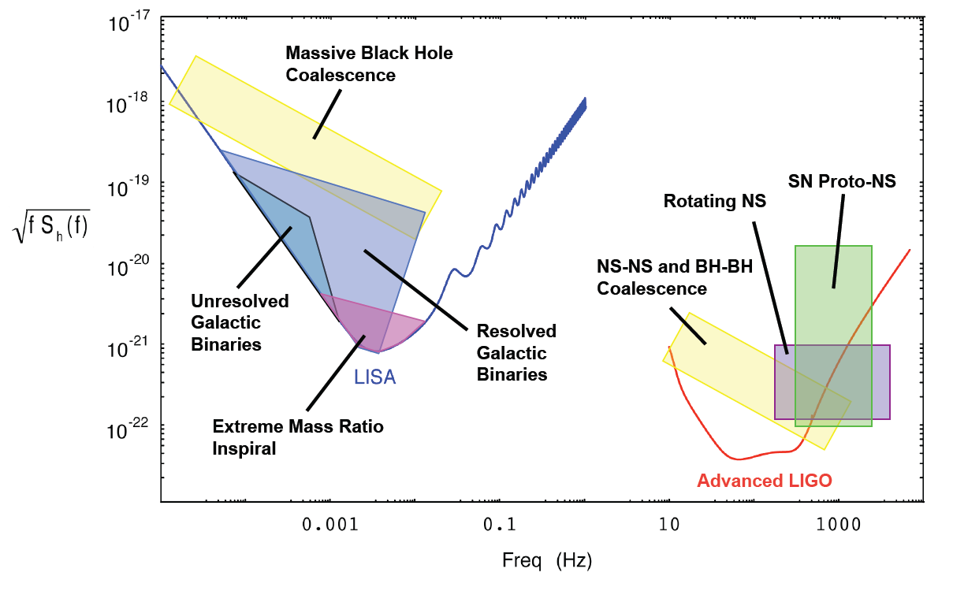
Sensitivity of LISA
LISA acceleration noise requirement
~ 3×10-15 m/(√Hz s2)
Position noise requirement
~ 20pm/√Hz

Slide 4
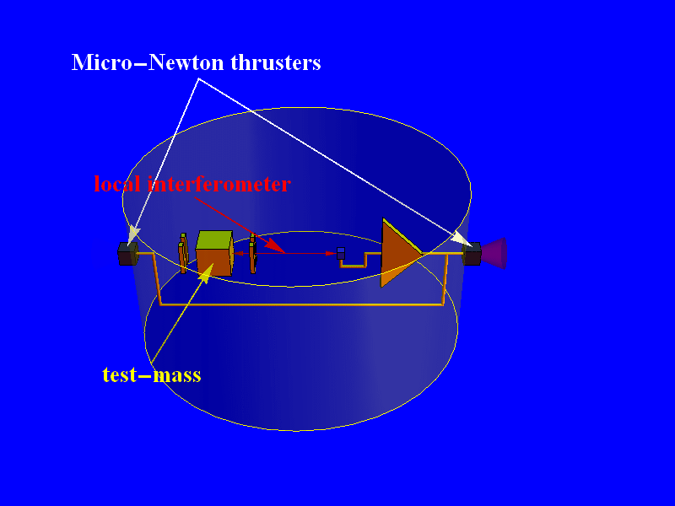
“Drag free” strategy for keeping the TM in “free fall”
Position of spacecraft relative to test-mass is measured by local interferometer
Spacecraft is kept centered on test-mass by acting on micro-Newton thrusters.
F_{ext}
f_{parasitic}
local interferometer
x_{noise}
m_{TM} ω²_{parasitic}
M_{S/C} ω²_{fb}
Force noise

Slide 5
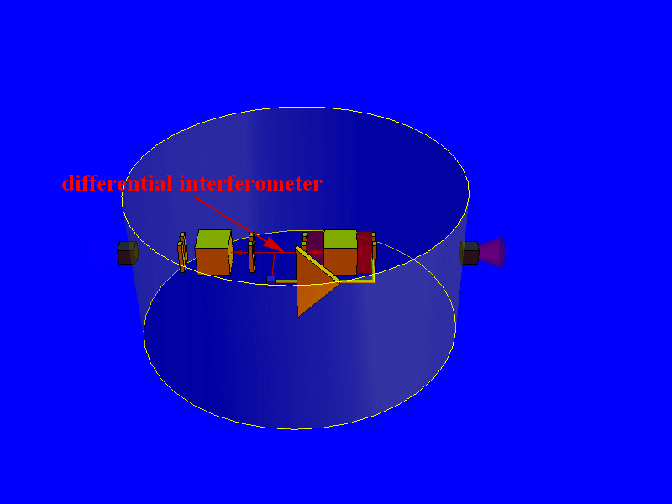
Investigating parasitic forces with LISA Pathfinder
Drag-free
TM1
Actuated TM2
local
interferometer
differential
interferometer
Position of spacecraft relative to TM1 is measured by a local interferometer
Spacecraft is kept centered on test-mass by acting on micro-Newton thrusters
Position of TM2 relative to TM1 is measured by a differential interferometer
TM2 is electrostatically actuated to follow TM1
Notes:
How do we investigate these parasitic forces with LPF?

Slide 6
LPF instrument noise as force measurement test bench
Drag-free
TM1
Actuated TM2
local
interferometer
differential
interferometer
Differential force noise
(for LISA)
Satellite coupling
can be tuned to zero
Baseline distortion
negligible
IFO readout noise
LPF instrument noise
as force measurement test bench
Notes:
The relative position of the two test masses read by a differential interferometer bring information about the stray forces acting on TMs

Slide 7
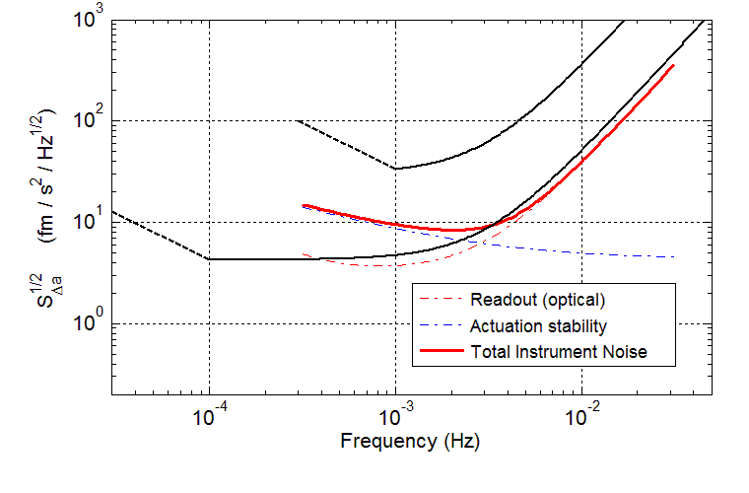
LPF instrument noise as force measurement test bench
LPF instrument limit: fluctuations in actuation force along x
LPF acceleration noise requirement
LISA
acceleration noise requirement
From measurements
with FM+EM of the entire chain
From measurements
with flight model FEE
Notes:
-------------------METTI I NUMERI!!!

Slide 8
LISA Pathfinder current estimation of leading sources
of differential force disturbances @ 1 mHz
Free-flight
moder
30 (LPF requirement)
Notes:
ALSO a large fraction of the entries are supported now by experimental test, in almost all cases with prototype hardware representative of the final flifght hardware.For some parametersteh measurements are integrated with simulations based on th efinal fligth configuration of the system
The rest can only be measured on orbit.
This is the case of all the sorces that involve the coupling to real SC/TM displacement as coupling to spacecraft motion via force gradients, for the spacecraft self gravity, for metrology noidse du eto pick up of motion of differentDOF

Slide 9
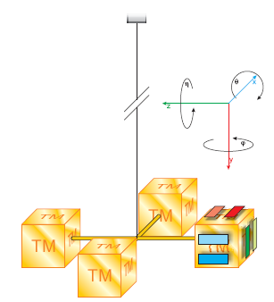
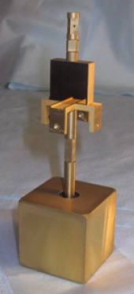
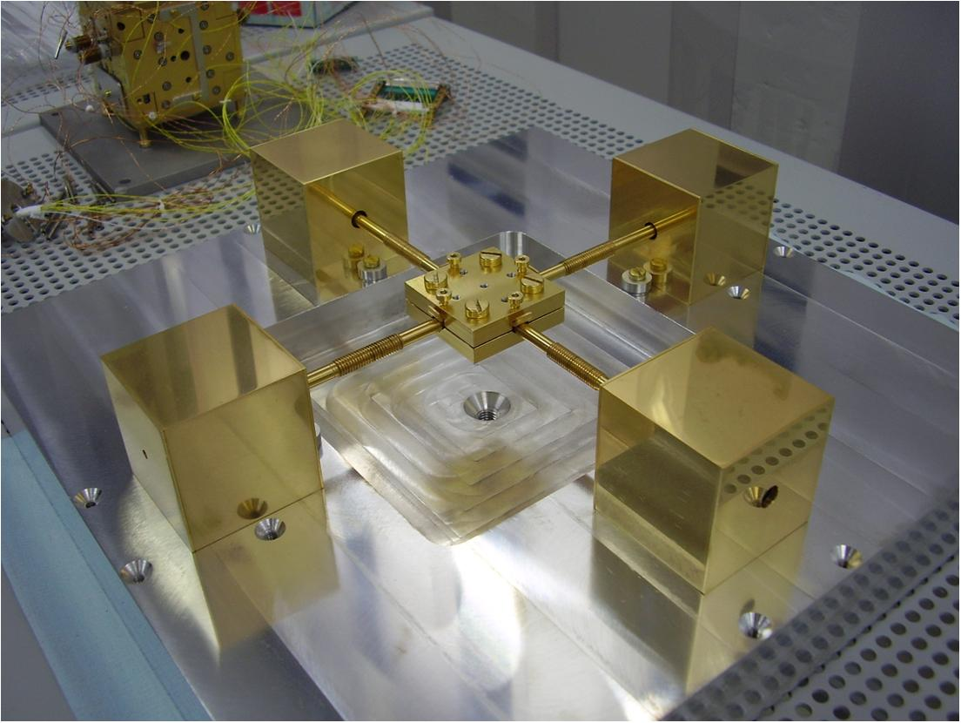
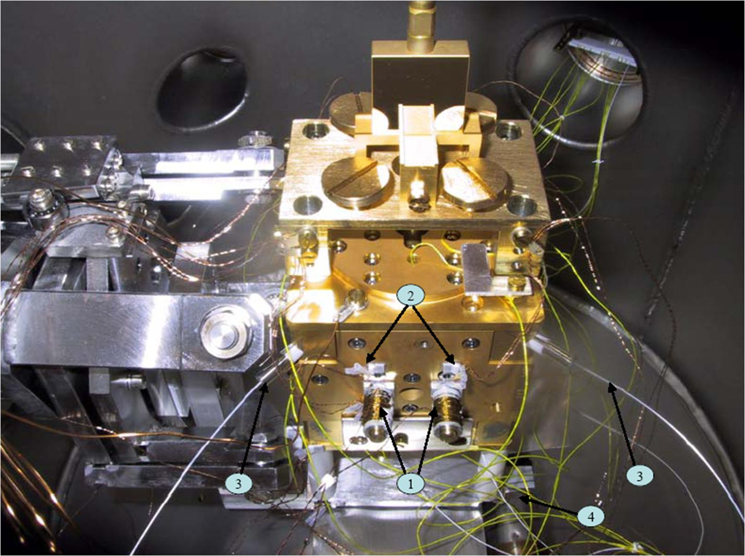
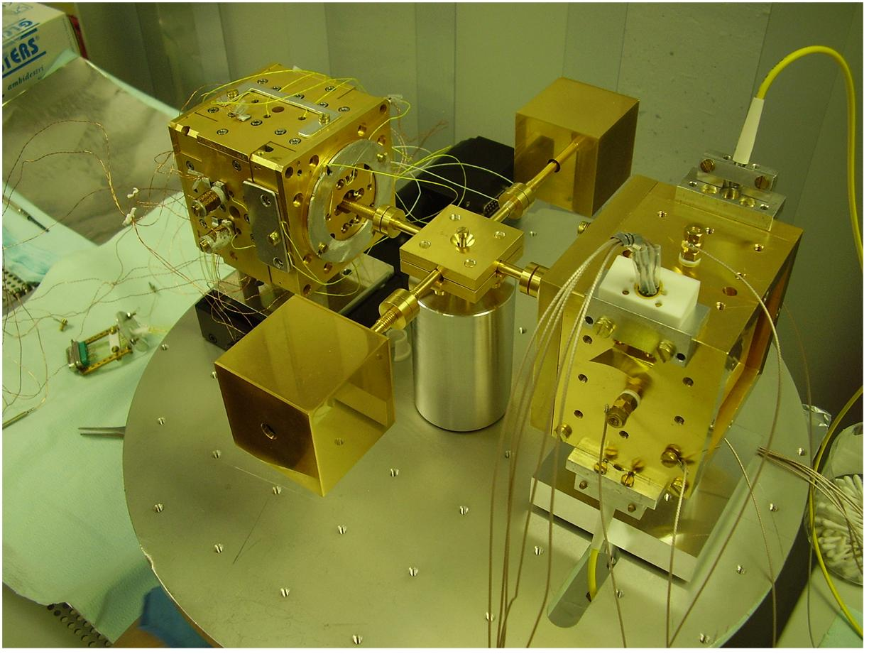
On ground testing with torsion pendulum
1-mass torsion pendulum
Torques → Force
4-mass torsion pendulum
direct force sensitivity
Upper limits on GRS force noise
GRS related
noise sources
Characterizing GRS related noise sources
Not sensitive to bulk forces (gravity, magnetism)…

Slide 10
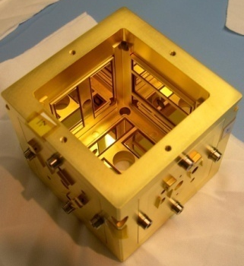

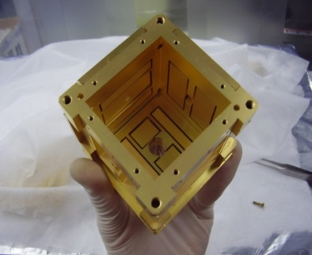
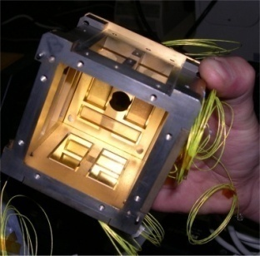
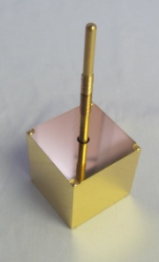
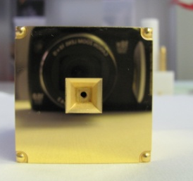
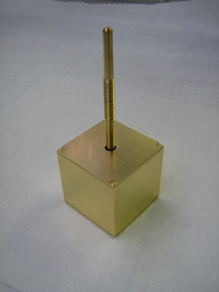
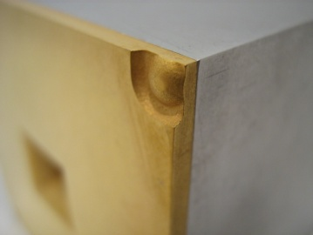
GRS prototypes and LPF-like Test Masses :
increasing representativeness
NOW !
GRS
4 mm gaps,
LPF geometry
Mo / Shapal EM
LPF FM-replica
Mo / Sapphire LPF EM
LPF-like TM
nm roughness !
Lightweight : empty TM in gold coated Al
Same FM TM finishing
Notes:
Given importance of interaction of GRS and TM, will concentrate largely on small force measurements with TM surrounded inside GRS. Different prototypes, most recently and most importantly replica of FM. Two pendulums, more sensitive 1TM and more representative 4TM. Surface forces

Slide 11
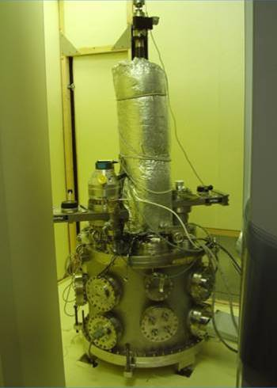
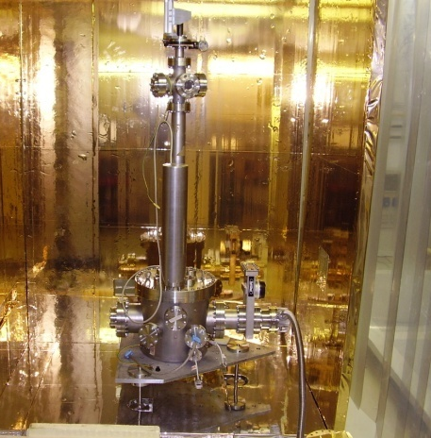

Slide 12
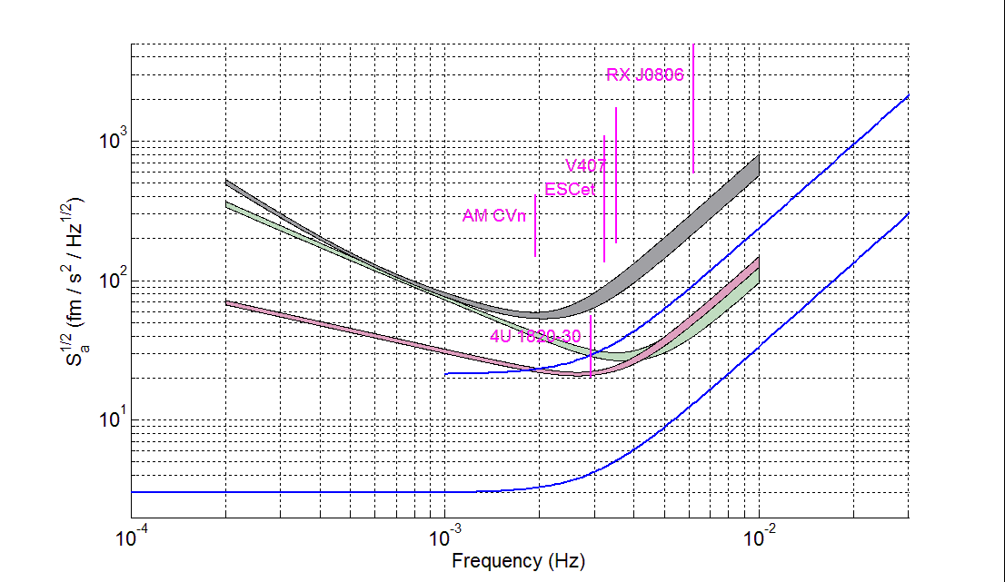
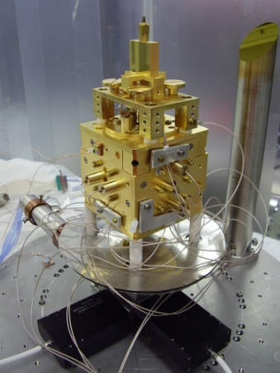
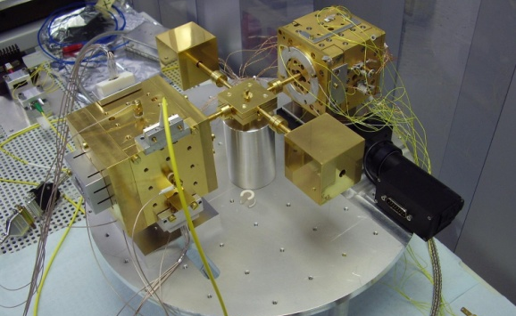
Upper limits on GRS force noise :
conversion from torque → force (acceleration)
4TM
1TM (W)
1TM (Si)
LPF req
LISA req
rule out large class of TM surface disturbances at level of 30 fm/s²/Hz^{1/2} at 1 mHz
  within factor 1.5 of LPF goal
  achieving same levels with LISA would allow observation of galactic binaries
  Not sensitive to bulk forces (gravity, magnetism), coupling to spacecraft coupling / control, space environment → LISA Pathfinder

Slide 13

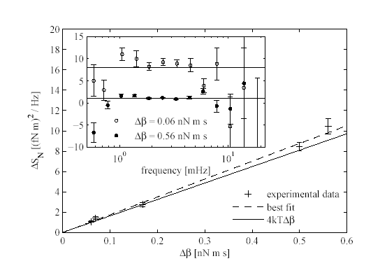
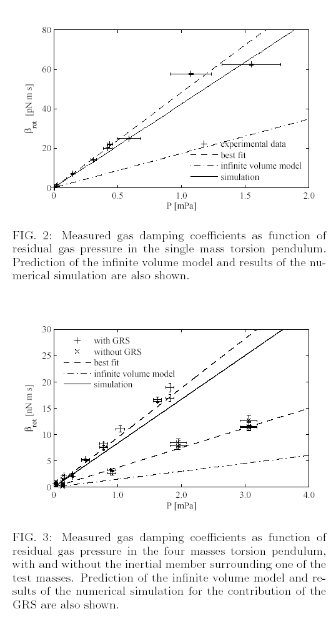
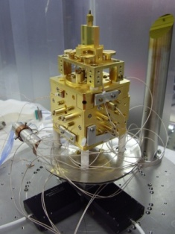


Brownian noise
Residual gas (<10⁻⁵Pa) damps motion, and causes Brownian noise.
In constrained geometries friction is higher than in infinite volume
Measurements of viscous gas damping coefficient
Measurements of torque noise
  Brownian was underestimated of a factor 15
  Acceleration noise for LISA / LPF
  LISA PF still ok @ 10-5 Pa
  Need to improve to 10-6 Pa pressure with LISA
  Agreement within 10% with new numerical simulations

Slide 14
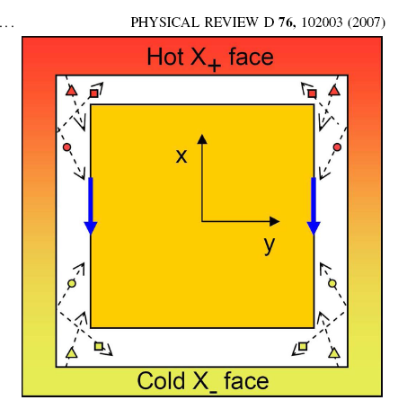




Thermal gradient related forces
(GRS prototype, same geometry and materials of GRS filgth model)
Apply oscillating temperature gradient
-------> measure coherent force on pendulum
Effetto radiometrico (verificato 10%)
Numerical simulations for the specific GRS geometry
Pressione di radiazione
Dipendenza dalla temperatura dell’outgassing (dominante a P=0)
Measured dF/dΔT ~ 100 pN / K @ 1E-5Pa
S_{ΔT}^{1/2} < 4 μK / Hz^{1/2}

Slide 15
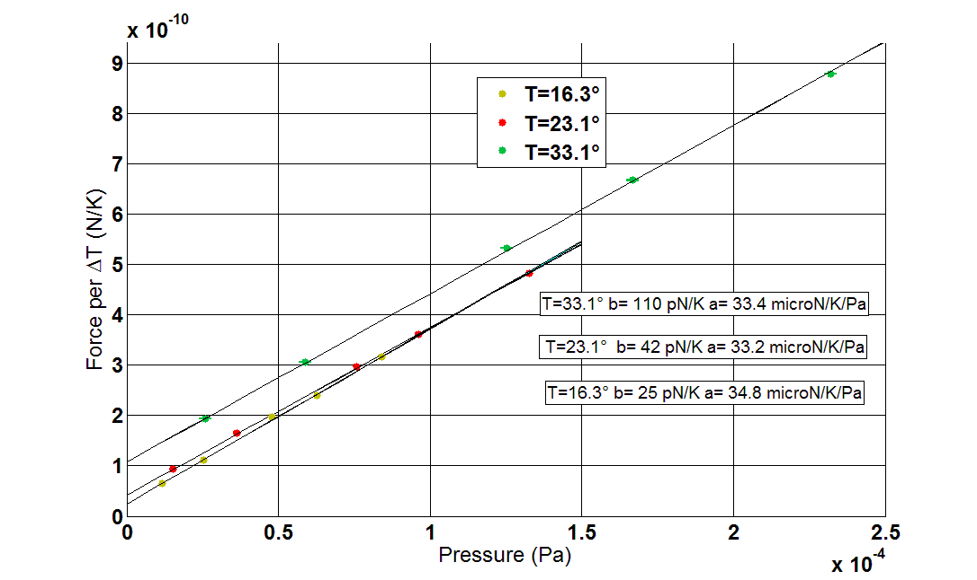
Specific disturbances: Thermal gradient related forces
(GRS REPLICA, a copy of GRS filgth model, before bakeout)
T = 303 K, p = 10⁻⁵ Pa
Spec 130 pN/K
LPF FM-REPLICA
nm roughness !
Rough compatibity with force noise budget (roughly 150 pN/K)
clear evidence of outgassing, but not in excess of budget.
Need for better thermal analysis – radiometric effect nearly 50% larger than expected
We are going to repeat it now after the bakeout (110 C, 1 week)
Same FM TM finishing

Slide 16
Interaction between TM charge and stray electrostatic field
Au coated surfaces can present a spatially/time varying surface potential
stray potentials can couple with the TM charge producing a force
+Veq
-Veq
Force
Force
  Random TM charging
+Veq
-Veq
  stray potentials time fluctuations
  Noisy force
Notes:
The same force would be obtained by polarizing the electrodes along that direction with a lets call equivalent voltage with positive sign…

Slide 17
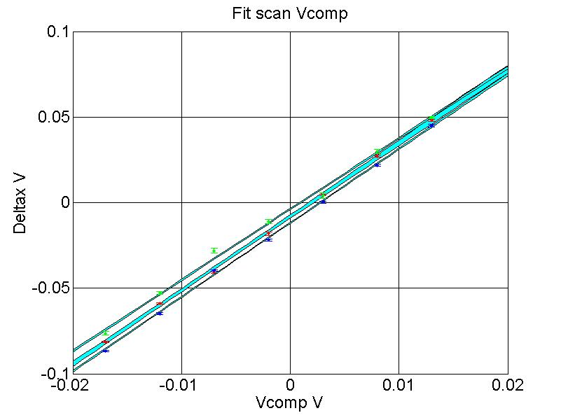
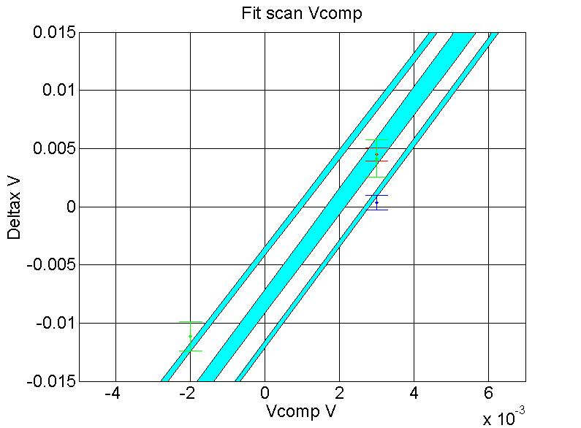
Random TM charging andDC stray potential
Compensazione dc bias
-Vcomp
-Vcomp
+Veq
+Veq
-Veq
+Veq-Vcomp=0
-Veq
+Veq-Vcomp=0
-Veq+Vcomp=0
-Veq+Vcomp=0
+Vcomp
+Vcomp
Force
Force
Force
Force
Force
Force
Force
+Veq-Vcomp=0
+Veq-Vcomp=0
-Vcomp
-Vcomp
-Veq+Vcomp=0
+Veq
+Veq
-Veq+Vcomp=0
+Vcomp
+Vcomp
-Veq
-Veq
compensation to <1 mV demonstrated
Error due to shear force compensation not present with TM charge, order of 10 mV→ control with real TM charge variation

Slide 18
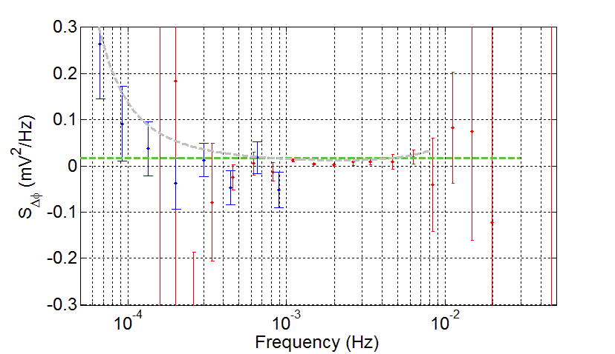
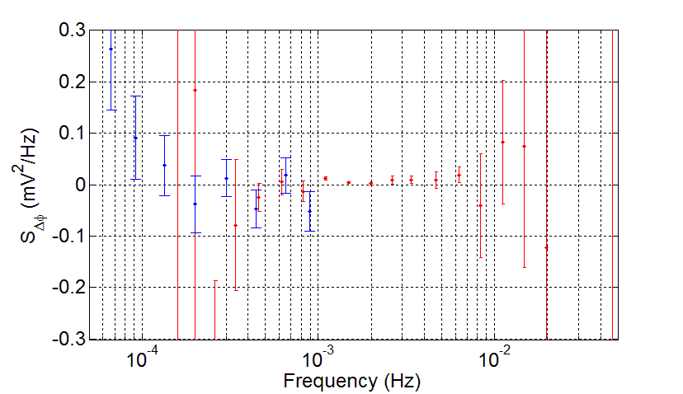
Upper limits on stray potential fluctuations
Two measurement techniques:
(red data) excess force noise with TM charged (4 10⁸ e or 2 V)
(blue data) coherent force detection with modulated TM potential
Conservative experimental upper limit
LISA limit
2 fN/Hz^{1/2}
Q_{TM} = 10⁷ e
Upper limit roughly 100 μV/Hz^{1/2} at 1 mHz (OK for LISA!)
Consistent with a non-detection at 0.1 mHz, upper limit 350 μV/Hz^{1/2}

Slide 19
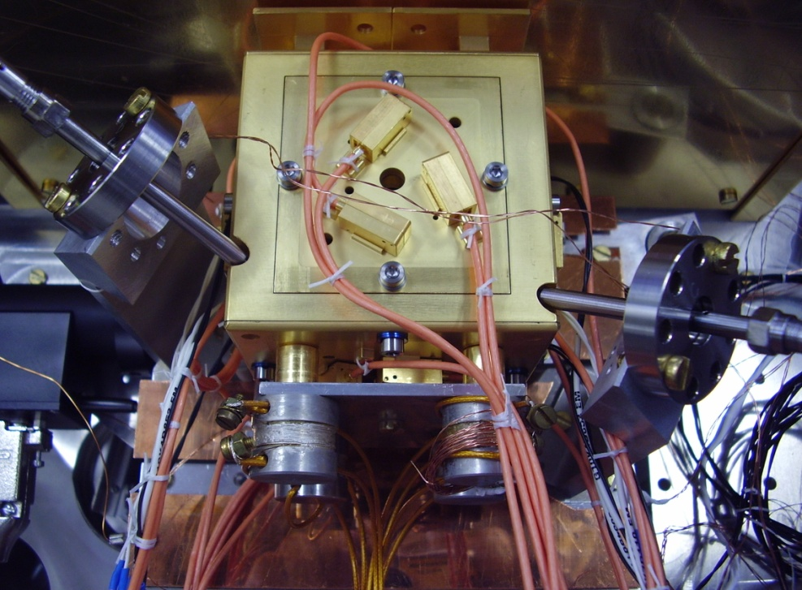
Investigation of the discharging system performance with improved surface/configuration representativness
It is possible to discharge the TM with polarizing voltages and reduced injection voltage
nm roughness !
Same FM TM finishing
LPF FM-replica
Notes:
Parametri: distribuzione della luce, configurazione elettrostatica (potential drop across the gap where electrons are emitted), quantum Yield….
Among these the quantum Yield of the surfaces is crucial
Still possible to bring the VTM=0 V but implementing a particular SC/TMs control scheme in non sceince mode
Investigation of the discharging system performance with improved surface/configuration representativness
Both pendulum results and yield measurements show the possibility to have a mismatch between the Yield of gold coated surfaces commonly of a factor 10, worst case factor 100 (strongly depends upon contaminations)
These make the discharging process strongly dependent upon Vinj and Vactuation
You can discharge the TM to 0 even in the worst observed case, byreducing the Vinj and implementinga particular SC/TMs control scheme
But it would be non compatible with science mode-→ make the system more roubust with high yield option under investigations with (adjustments)
The voltage drop in the gap where there are photo-electrons : 0.6 V the Yapp is zero, use the other electrodes to increas ethe VTM and bring the electrodes of the illuminated gap as much negative as possible
improvement

Slide 20
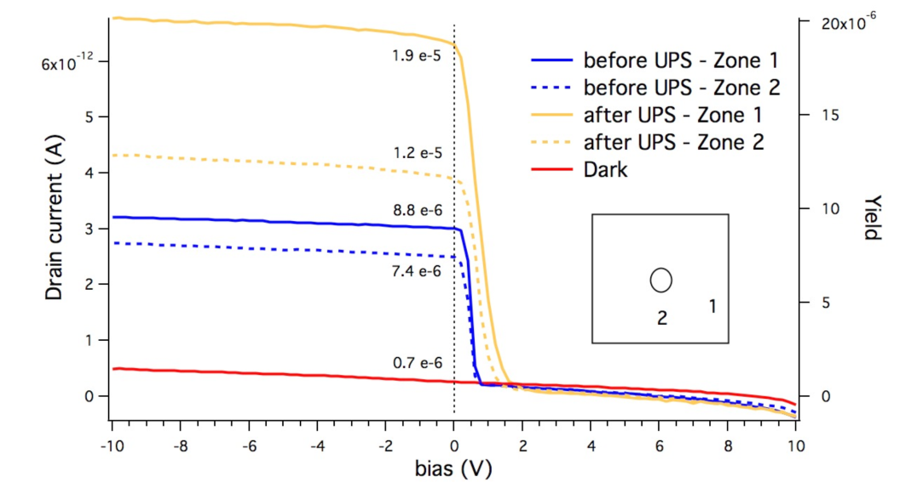
Measuments of the Yield :
number of emitted elementary charge per adsorbed photon
with torsion pendulum from the apparent Yield wrt TM voltage
Also compared with measurements performed in UHV chamber equipped with a hemispherical electron analyser and ultraviolet (21.2 eV) photon ( several gold coated samples characterized by L. Pasquali and M.Montecchi, Modena University )
Fig 2 Quantum yield and photocurrent of Au coated Al plate under illumination with Hg UV photons (L. Pasquali and M.Montecchi Modena University

Slide 21
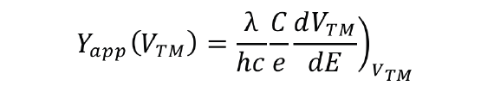
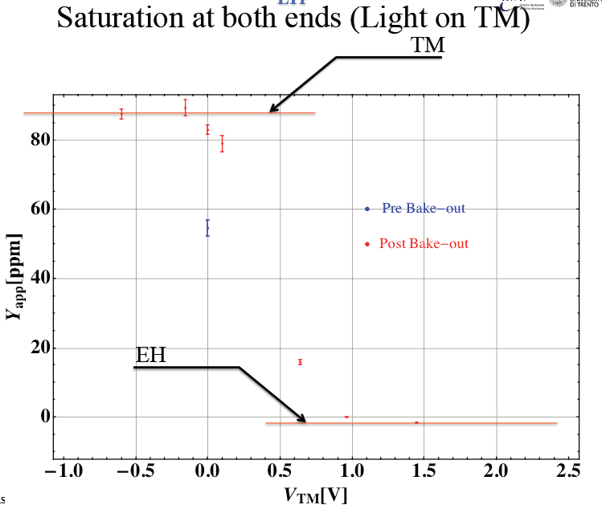
Measuments of the Yield :
number of emitted elementary charge per adsorbed photon
with torsion pendulum from the apparent Yield wrt TM voltage
apparent Yield: number of elementary charges that achieve the TM per entering photon

Slide 22
Measuments of the Yield :
number of emitted elementary charge per adsorbed photon
with torsion pendulum from the apparent Yield wrt TM voltage
apparent Yield: number of elementary charges that achiev the TM per entering photon
V_{TM}<<0
V_{TM}>>0

Slide 23
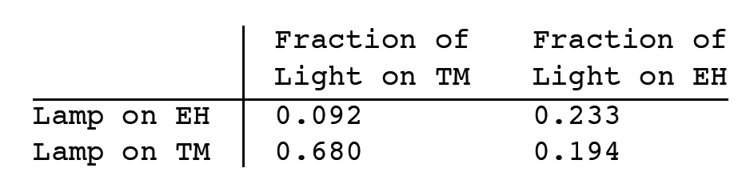

Measuments of the Yield :
number of emitted elementary charge per adsorbed photon
from the apparent Yield normalized by the
fraction of light adsorbed by TM/EH
(calc. byASTRIUM Ger )
---Both pendulum results and Yield measurements show the possibility to find a mismatch the in the Yield of different gold coated surfaces of a factor 10, worst case factor 100 (strongly depends upon contaminations, unavoidable because of integration procedure)
---It has been demostrated that the TM can be discharged to 0 even in the worst observed case, by reducing the Vinj and implementing a particular SC/TMs control scheme
---For making the system more robust high Yield spot surface options are considered
Notes:
Investigation of the discharging system performance with improved surface/configuration representativness
Both pendulum results and yield measurements show the possibility to have a mismatch between the Yield of gold coated surfaces commonly of a factor 10, worst case factor 100 (strongly depends upon contaminations)
These make the discharging process strongly dependent upon Vinj and Vactuation
You can discharge the TM to 0 even in the worst observed case, byreducing the Vinj and implementinga particular SC/TMs control scheme
But it would be non compatible with science mode-→ make the system more roubust with high yield option under investigations with (adjustments)
The voltage drop in the gap where there are photo-electrons : 0.6 V the Yapp is zero, use the other electrodes to increas ethe VTM and bring the electrodes of the illuminated gap as much negative as possible
improvement

Slide 24
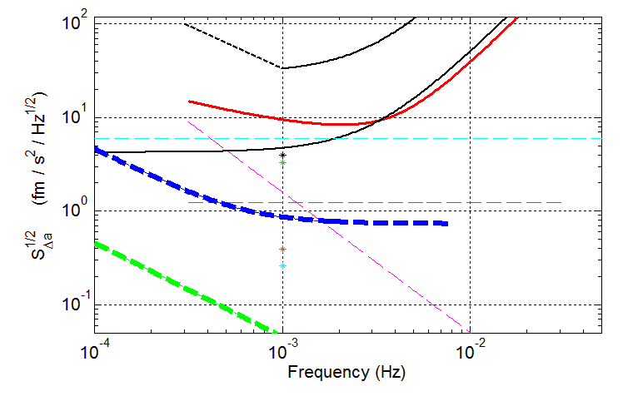
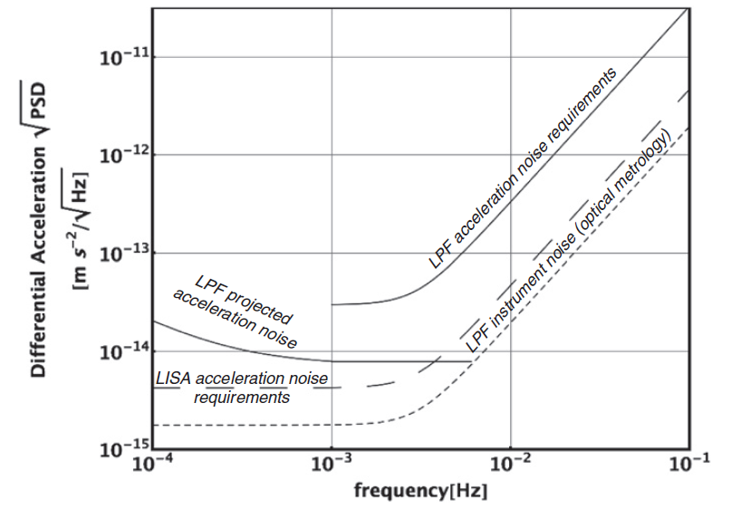
Force noise sources investigation performed with
torsion pendulum+GRS prototypes/FM Replica GRS
Summary !!
LPF
Instrument
Gas damping
Limit of LPF ability to measure acceleration noise:
projected differential acc noise in free-flight mode+ optical metrology diplacement noise noise converted in acceleration noise
LISA
Fluctuations in Δ_{x}
Thermal gradient
Random charging
We are loocking for a post-doc
Thanks to
LPF collaboration
Trento team
Stefano Vitale ,Federica Antonucci, Matteo Benedetti, Daniele Bortoluzzi, Antonella Cavalleri, Rita Dolesi, Luigi Ferraioli, Tu Hai-Bo,Mauro Hueller, Daniele Nicolodi, Antonio Perreca, Peter Wass, Bill Weber

