Slide 1
LCGT Seismic Attenuation System
LCGT-SAS
R. DeSalvo, H. Ishizaki, E. Majorana, T.Sekiguchi, R. Takahashi,
A. Takamori, T. Uchiyama, K. Yamamoto

Slide 2
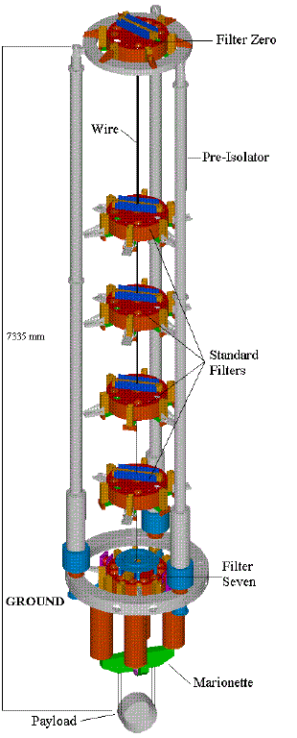
The LCGT-SAS
Seismic Attenuation System
is a modern, simplified and improved version of the
Virgo Superattenuators

Slide 3
Dual tunnel solution
LCGT SAS is mounted between two tunnels due to the restrictions from the reserved space for the cryostat

Slide 4
Alternatives
The alternatives:
  A space frame around the cryostat and larger cavern
    Would have hampered the installation of the cryostat
    Would have been a weaker support
  Hooking the IP support point from the ceiling of a larger cave
    Would have been difficult dangerous and weaker

Slide 5
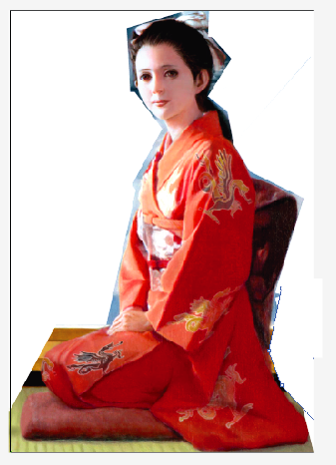
Dual tunnel solution
Mitigates the technical risks and costs associated with digging large caverns
It is a prototype for third generation GWIDs
2.2 m
5m min

Slide 6
LCGT SAS damping strategy
Mode damping is vital for easy locking of the interferometer
One extra filter is added at the beginning of the chain it is coupled with a suspended magnet ring to provide passive
Eddy current damping for the attenuation chain yaw and other internal modes.

Slide 7
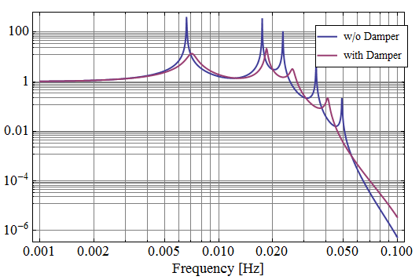
Yaw motion
The transfer function from ground yaw motion to TM yaw motion shows:
Good damping can be achieved

Slide 8
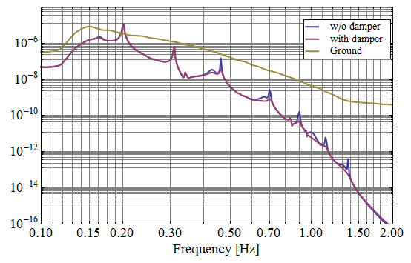
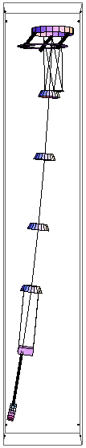
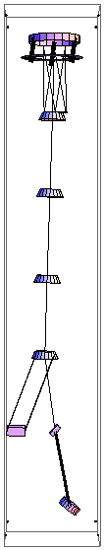
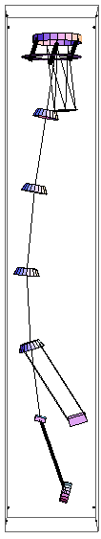
Transversal modes
seismic noise level of TM, with/without eddy current damping

Slide 9
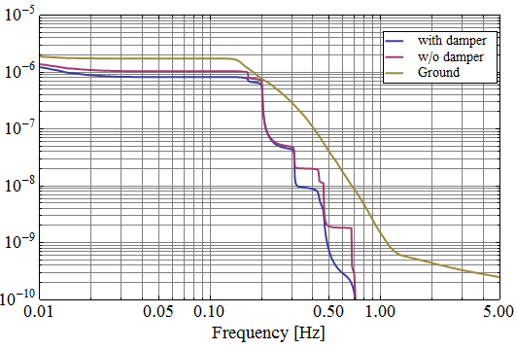
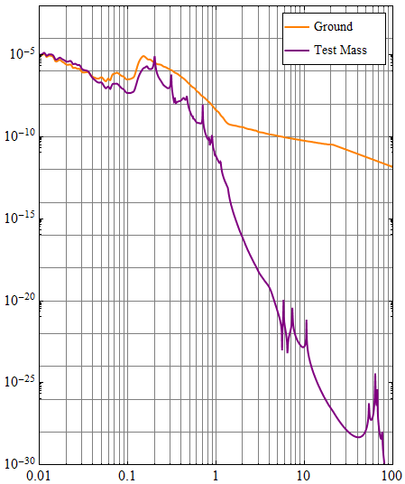
First mode damping
RMS amplitude reduction
  using shadowmeter

Slide 10
Alternative damping
accelerometers
TAMA accelerometers
Improved at AEI and Salerno
active seismic attenuation

Slide 11
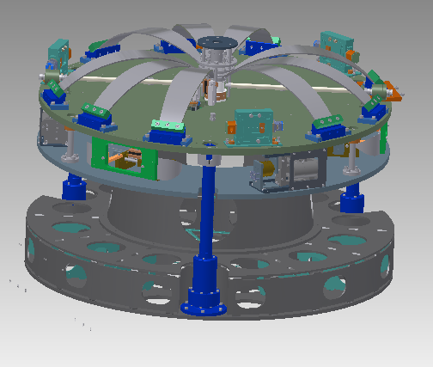
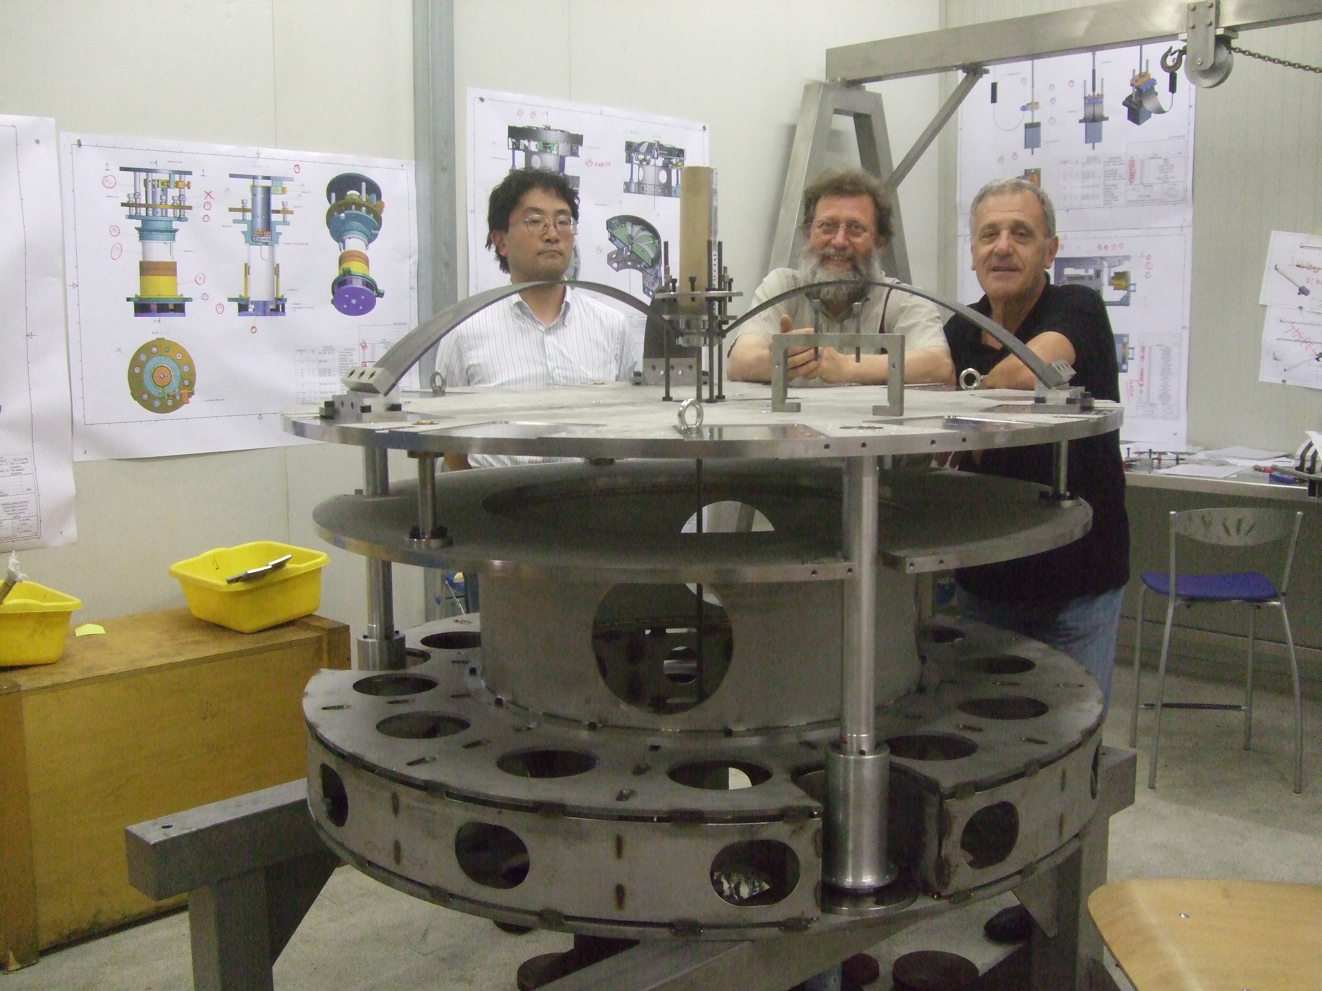
Pre-attenuation strategy
LCGT SAS has an Inverted pendulum-top filter pre-attenuator stage, to deal with:
  Microseismic noise
  Tidal movements
  Active seismic attenuation

Slide 12
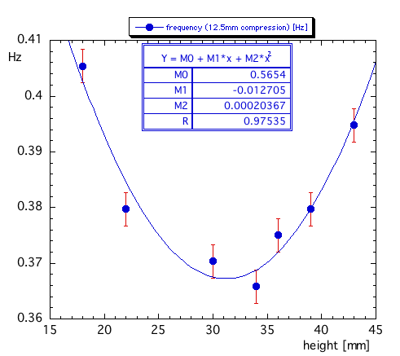
Top Filter / Inverted Pendulum
Prototyped, undergoing tests

Slide 13
Expected reliability and performance

Slide 14
LCGT SAS pre-attenuation pedigree
The LCGT SAS Inverted pendulum was successfully tested in the a-LIGO HAM SAS*
The LCGT SAS top filter was developed for the
a-LIGO BSC SAS
Performs the same functions of all three a-LIGO active stages.
* Further tested in the AEI SAS and Virgo-NIKHEF SAS

Slide 15
Attenuation strategy
Topologically LCGT-SAS is a Virgo-clone with 1.5 less stages than Virgo (damping stage)
OK because better seismic weather underground
LCGT SAS is expected to have same or better attenuation capabilities than Virgo

Slide 16
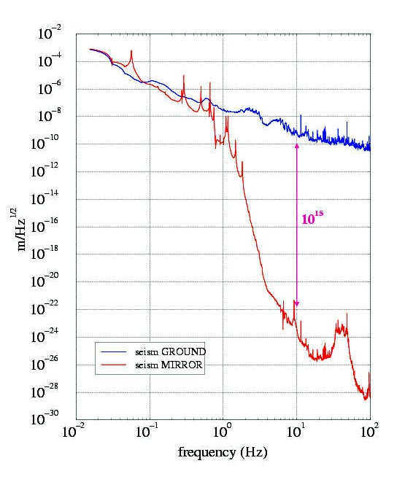
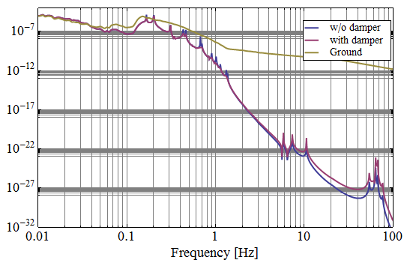
Passive attenuation measurements/CIT .
Thermal Noise
Measured Upper Limit
courtesy
F. Frasconi

Slide 17
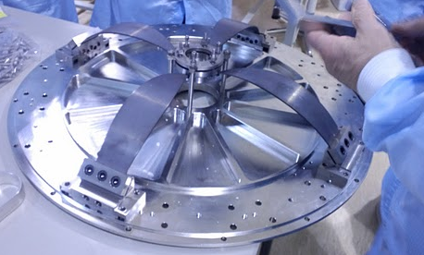
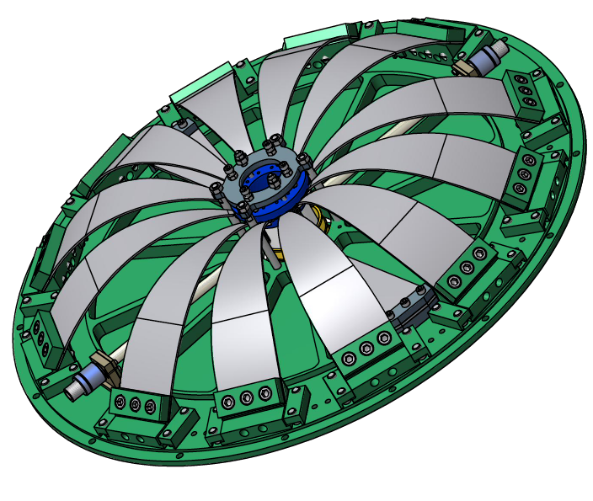
LCGT standard filter
The LCGT SAS standard filter was successfully developed and tested in the
a-LIGO HAM SAS*
Is a simpler, lower frequency, and higher attenuation evolution of the Virgo SA filter
73 cm diameter
* also tested in the AEI SAS and Virgo-NIKHEF SAS

Slide 18
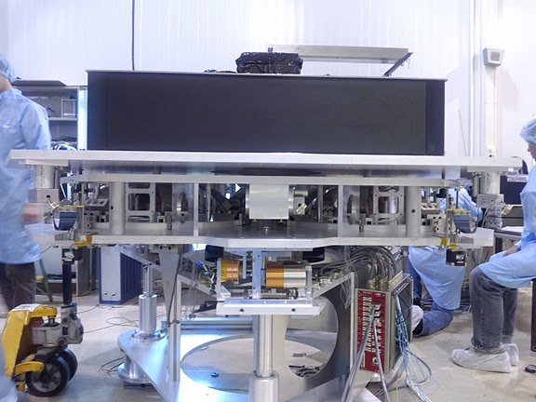
LCGT SAS external support
Development of LCGT SAS in close collaboration with NIKHEF and with Albert Eistein Institute in Hannover
Most parts in
common
Some parts
interchangeable
Shared electronics
control programs

Slide 19
Payload strategy
The payload is defined to be 300 kg
Cryogenic payload is ultimate goal
See separate presentation for Cryogenic payload development
Warm advanced-like payload (if cryogenics is delayed)
Heavier masses possible
100
kg
100
kg
100
kg

Slide 20
Payload strategy
Virgo design
Bottom filter supporting:
  Intermediate mass
  Intermediate recoil mass
Intermediate mass supporting:
  Test mass
  Coaxial recoil mass

Slide 21
Payload strawman design
Plan to use BOSEM for sensing and actuating

Slide 22
Auxiliary optics
LCGT designed with recycler telescopes in mind
Dedicated TAMA-like attenuation towers for individual mirrors

Slide 23
Auxiliary optics external structure
Inverted pendulum table on space frame surrounding vacuum chamber

Slide 24
Auxiliary optics payload
10 kg mirrors from LIGO
Coaxial recoil mass in tandem because
  No side occupancy for folded beams
  Transmitted beam clearance

Slide 25
Pre-commissioning of LCGT SAS
LCGT is planning to reconfigure the TAMA facilities to pre-commission as much of LCGT SAS as possible

Slide 26
LCGT SAS summary
LCGT SAS design and construction is well under way
The top filter/Inverted Pendulum and the standard filter units already prototyped

Slide 27
LCGT SAS summary
Simulations, installation scheme design and procedures well underway
Expected cost of seismic for entire interferometer under 2 M€
Expected time of delivery March 2013

