Slide 1
Payloads at cryogenic temperature for 3rd generation g.w. detectors
Issues and Open Problems
Paola Puppo – INFN Roma

Slide 2
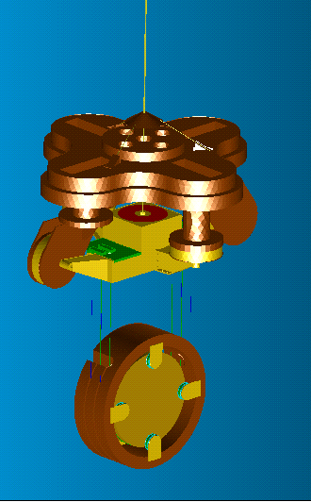
The test mass Last Stage suspension
The role of the Last Stage Suspension is to compensate the residual seismic noise and to steer the optical components maintaining the relative position of the interferometer mirrors.
Components:
Marionette reaction Mass (MRM): Marionette actuation; it provides mechanical and thermal isolation from the Superattenuator;
Marionette: Angular control with actuators (coil-magnets, electrostatic) on the MRM;
Reaction Mass (RM): Mirror steering with (coil-magnets, electrostatic) actuators on the RM; Mirror protection;
Mirror: monolithic suspension.

Slide 3
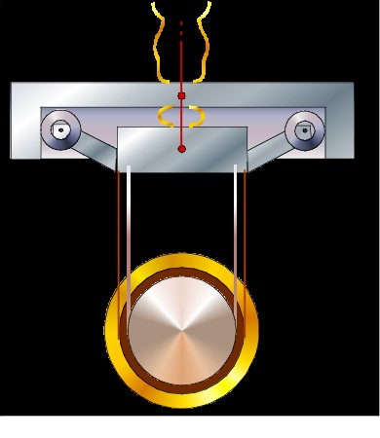
Conceptual scheme
Q from refrigerator
Vacuum Chamber and Cryostat Thermal Shields
Different stage temperatures at the
steady state.
Marionetta Reaction Mass:
Thermal Shield
High Efficiency Soft Thermal Links
(e.g. pure Al, copper)
Silicon Monolithic Suspension
Mirror Reaction Mass:
Thermal Shield
Q from laser beam

Slide 4
Requirements
Materials:
    UHV compatible;
    Amagnetic;
    No electrostatic charges;
    Internal Frequencies above the antenna bandwidth;
    Low frequencies of the system controllable;
Design Issues:
  Big Masses:
    reduces the recoils (control and suspension thermal noise)
    increases the violin modes frequencies
  Wires Length Increment:
    reduces the pendulum frequencies (suspension thermal noise)
  Wires Diameter Increment:
      cooling time reduction

Slide 5
Requirements for cryogenic temperatures
Materials:
    High thermal conductivities → reduction of cooling time
    Low mechanical and optical losses → high perfomances coatings
    Low thermal expansions → negligible thermal lensing effects; reduction of position offsets
    Soft heat links → reduction of cooling noise transmission.
A promising material both as mirror substrate and wire is silicon having
    high thermal conductivity
    very low thermal expansion (zero below 17K)

Slide 6
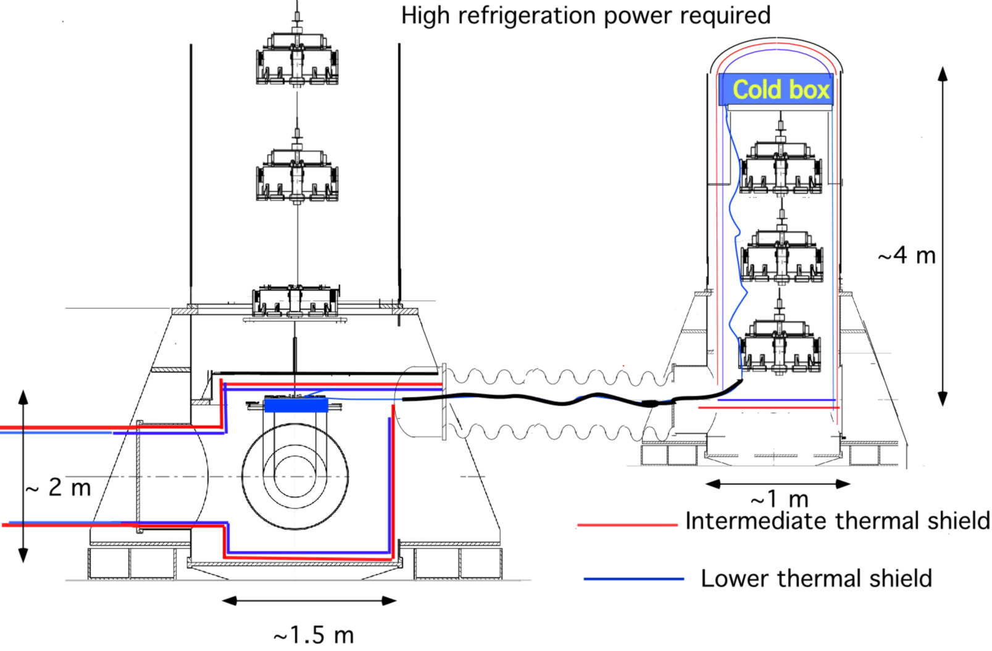
Design of the cooling system
The upper part
(~15 m)
is at room temperature
and
insulated to the lower part by thermal screen
Cryo-Compatible Superattenuator
design
Tanks to R. Passaquieti
3

Slide 7
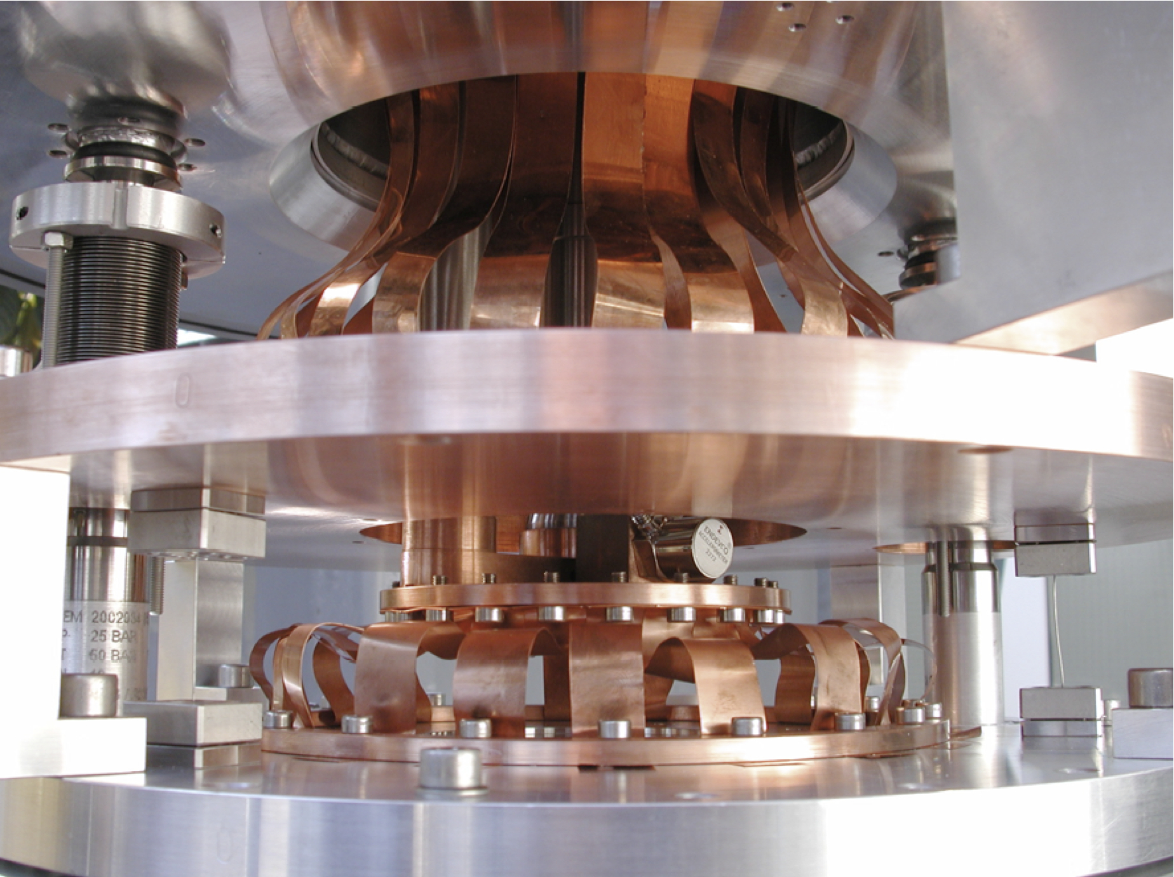
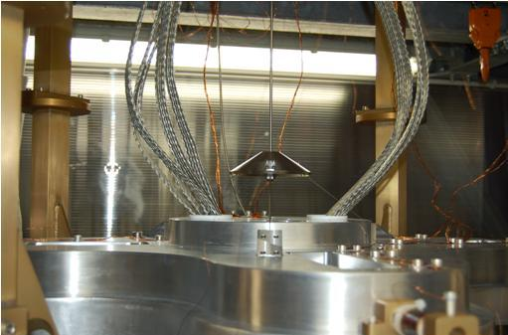
Thermal Links I
A corona of thin beams (hardening problems with thermal cycles )
Long Braids (higher stiffness)

Slide 8
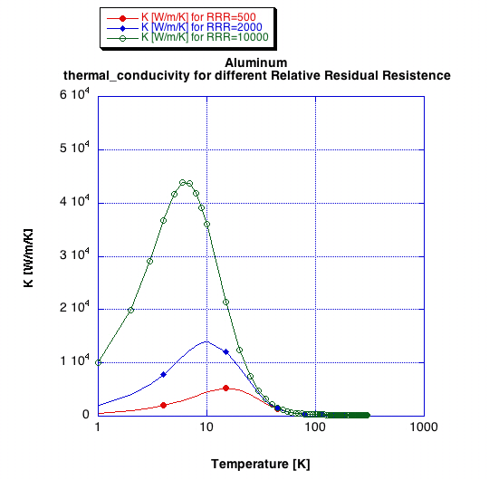
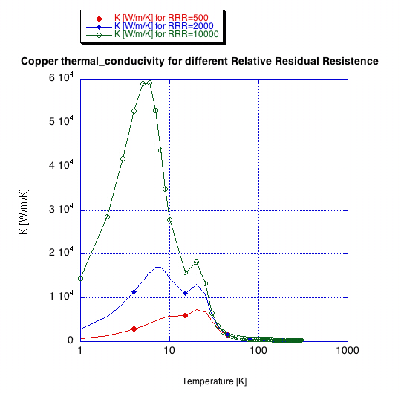
Thermal Links III
Pure Materials as aluminum and copper
          RRR = ρ_{room temperature /} ρ_{o} where ρ_{o} resid. resist. at T~0 K

Slide 9
Thermal Links IV
Solution for the stationary state
(low stiffness and reliability when thermally cycled)
Use of a high purity material
k~2000 W/m/K in the range 1-10 K
Thermal link length 20 m
Thermal difference at the link ends ~ 1K
LF Int. ~200 mW ~8 wires r~1 mm

Slide 10
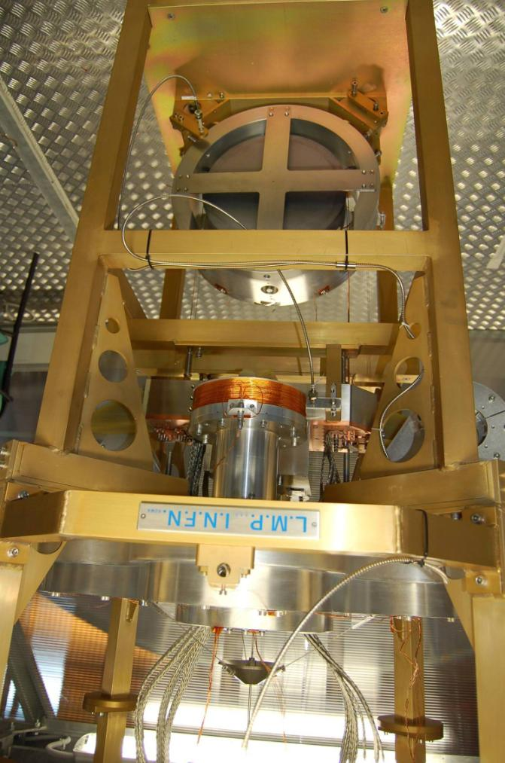
Experimental data
Cryogenic Payload Prototype:
    Silicon mirror suspended by using two Be-Cu wires loops (1.25mmX2.5mm section);
    Marionette with copper clamps,connected to the cooler by copper heat links, suspended with a titanium alloy cable;
    Reaction mass of the mirror and marionette position monitored with fiber bundle sensors to measure the system modes (suspended with copper wires);
    Reaction mass of the marionette holding the Virgo-like electromagnetic actuators (macor support, copper wire kapton insulated);
    MRM suspended with three titanium wires;
“A cryogenic payload for the 3rd generation of gravitational wave interferometers”, F. Basti, F. Frasconi, E. Majorana, L.Naticchioni, M. Perciballi, P. Puppo, P. Rapagnan, F. Ricci (accepted on Astroparticle Physics)”

Slide 11
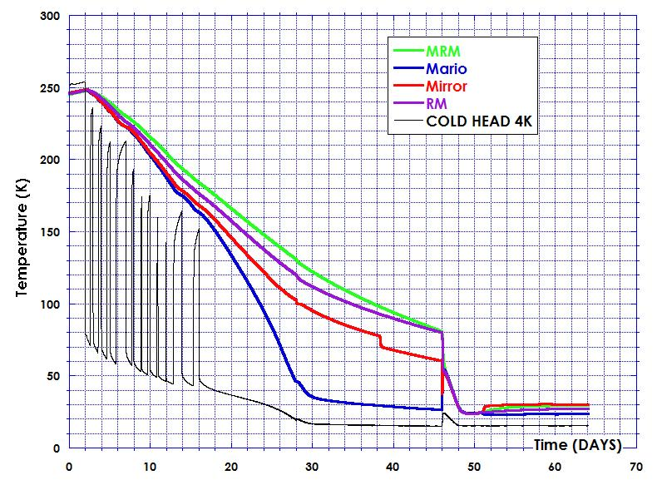
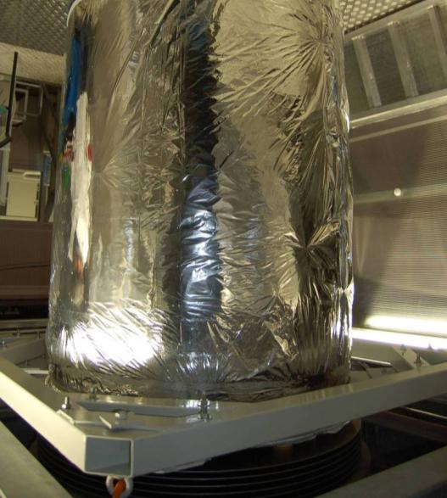
Payload Cooling
During the cooling several times the PT cryo-coolers were stoppes, because of failure in the water refrigeration system of the compressors.
Helium gas filling
Helium gas pumped out
The final mirror temperature results to be 30 K while the cold head is at 15 K.

Slide 12
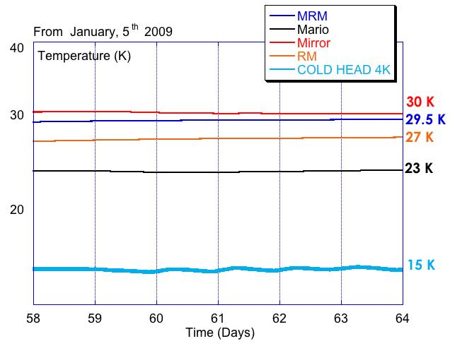



Thermal inputs
Estimations
26/05/11
PT cold head 15 K
29.5 K
23 K
Mirror: 1.9 mW (CoBe3 wires)
Recoil Mass: 1 mW (Steel c70 wires)
Marionette: 6 mW (Ti6Al4 wires)
Most of the thermal power (>10W) is lost in the cooling process of the whole cryostat;
Thermal Gradient along the vacuum tank;
Improvement of the thermal overall insulation is needed;
27 K
30 K
Experimental vacuum chamber 30 K

Slide 13
Transfer Functions
Longitudinal
Torsions
very low influence of the thermal links on the dynamic of the mechanical system.
Pitch

Slide 14
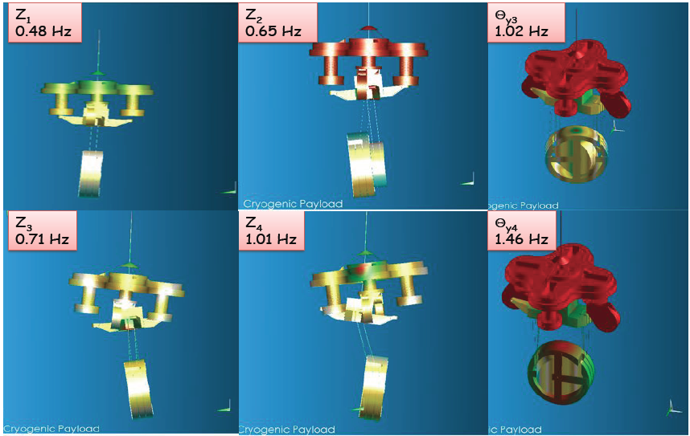
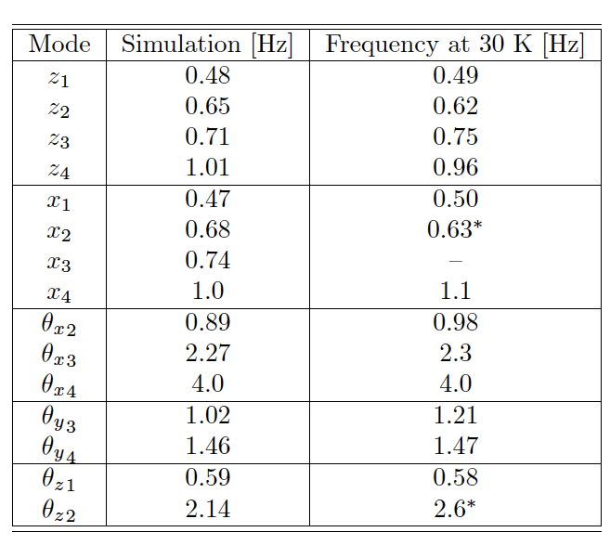
Mechanical modes identification:
agreement with the simulation without links
very low influence of the thermal links on the dynamic of the mechanical system.

Slide 15
Thermal drift: coils Joule effect
Significant thermal drift of the whole apparatus at low temperature has been induced (we measured ∼ 3·10⁻² K/s on the silicon plate) during TF measurements (mainly for pitch )

Slide 16
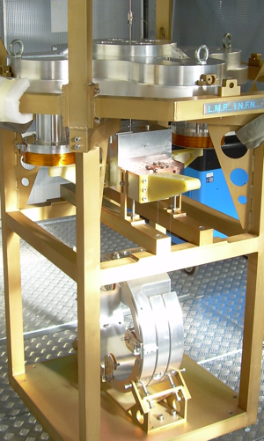
What we learnt
Very low influence of the thermal links on the dynamic of the mechanical system.
Development of the displacement monitoring at low temperature (LVDT, Fiber Bundles)
Need of a new actuator: coils made of Nb-Ti wires with an inner core made of copper. The inner core will insure an efficient use of the actuators at room temperature, while below the critical temperature of 10 K the superconducting Nb-Ti alloy will cancel the Joule effect.
Use Epoglass material for marionetta arms (reliability at low temperature).

Slide 17
Coil-magnet actuation noise
Barkausen noise measurements
on a SmCo magnet at 4 K
P. Falferi Class. Quant. Grav. in press (2011)

Slide 18
Parameters of a Payload for ET:
(from small to big masses)
Cryo Prototype
Cryo Payload
 | Mirror | RM | Mario | MRM
Mass (kg) | 22 | 31 | 114 | 132
Wire L (m) | 0.6 | 0.6 | 0.45 | 0.46
Wire Φ(mm) | 2 | 0.6 | 3 | 4
Wire Mat | Co-Be2 | Steel C70 | Ti6Al4V | Ti6Al4V
Ixx (kg m²) | 0.19 | 0.77 | 0.77 | 6.7
Iyy (kg m²) | 0.19 | 0.74 | 1.7 | 11.4
Izz (kg m²) | 1.34 | 1.37 | 1.7 | 8.3
Last SA Filter | Mirror | RM | Mario | MRM
500 | 211 | 211 | 422 | 422
2 | 2 | 2 | 2 | 1
5 | 2 | 3 | 3 | 4
Ti6Al4V | Si | Si | Ti6Al4V | Ti6Al4V
65 | 8.38 | 13.7 | 21 | 19
45 | 8.38 | 13.7 | 35 | 30
65 | 5.2 | 15 | 21 | 22

Slide 19
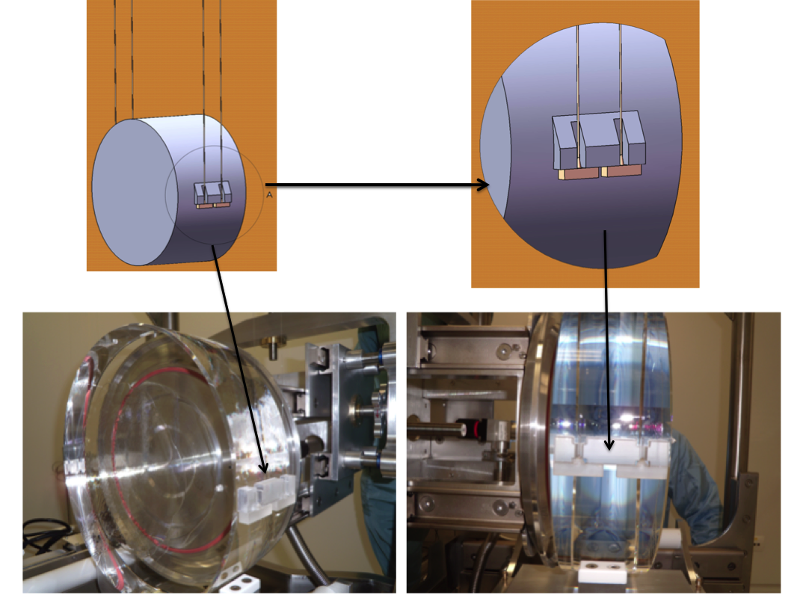
Monolithic suspensions: present technology 20-40 kg masses suspended with SiO₂ wires
Ears and anchors attached with
silicate bonding
Fused silica wires produced with
laser machine
Silicate bonding
Virgo+ NI test mass

Slide 20
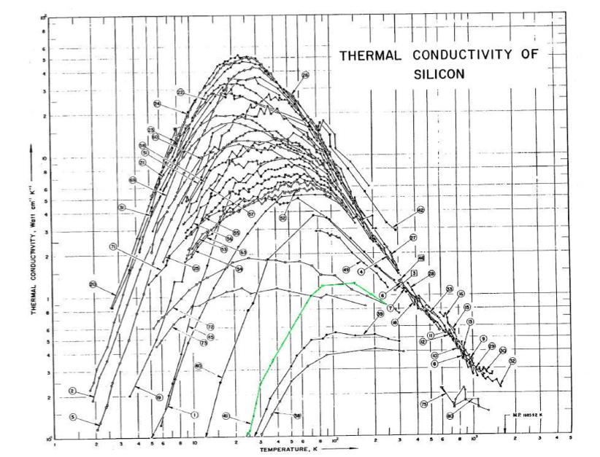
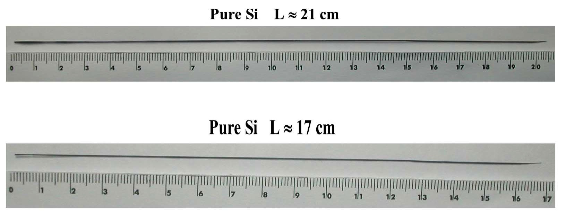
Silicon sample prepared by micropulling
Silicon fiber : the thermal conductivity
R&D is required:
Fiber payload
~ 200 cm long

Slide 21
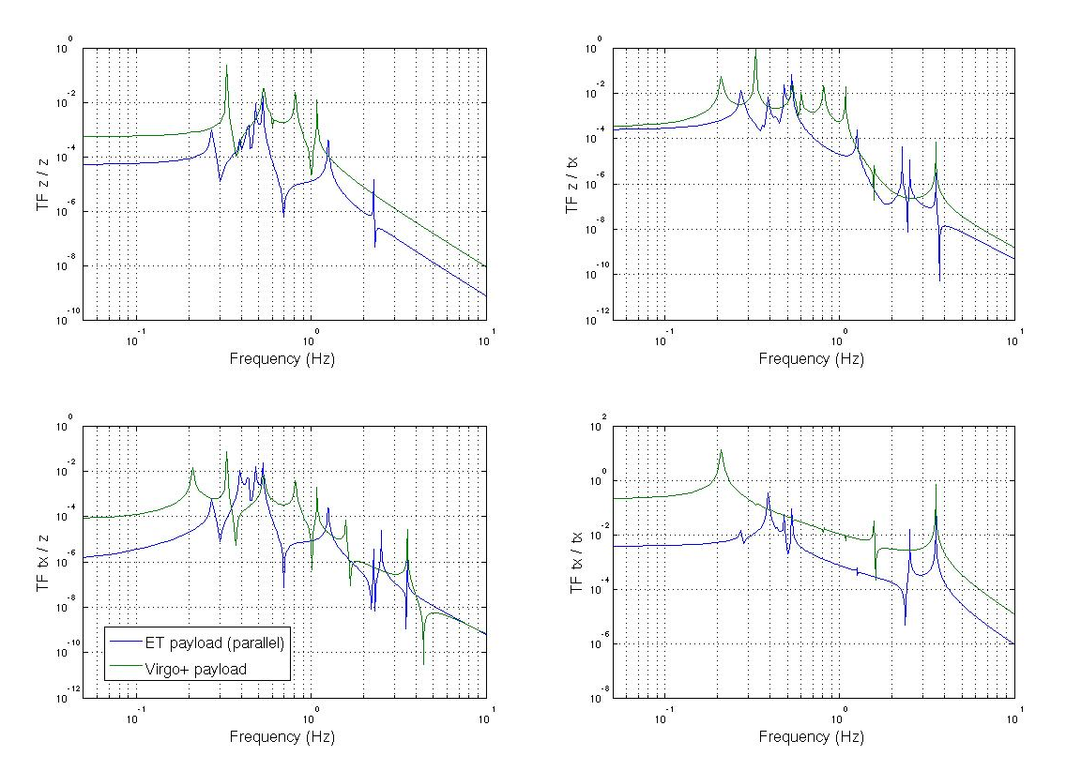
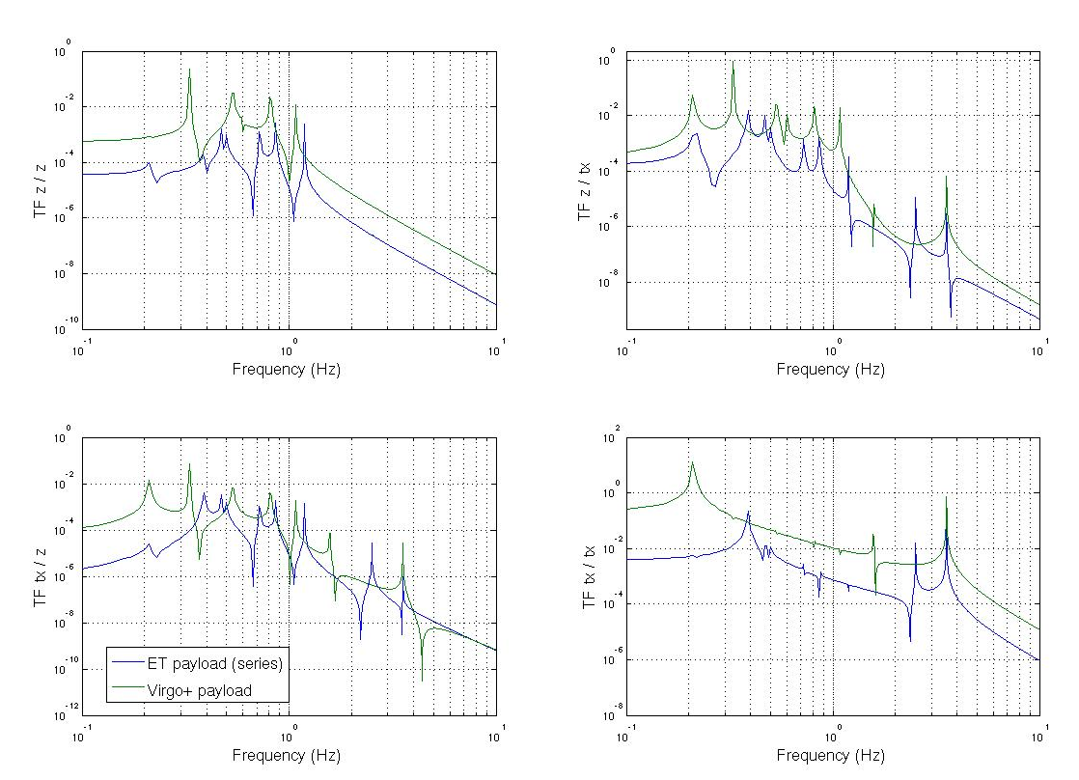
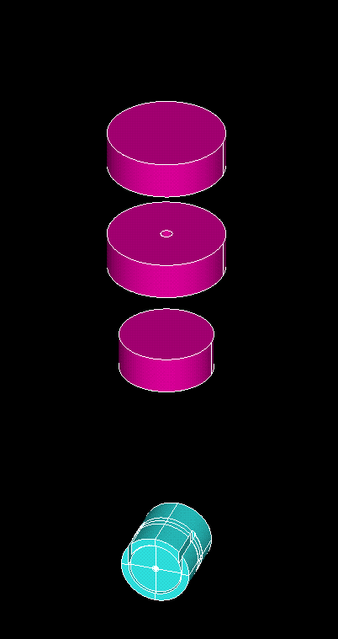
Transfer function studies
Marzia Colombini with Octopus (P. Ruggi)
Parallel
Comparison with the present payloads, in
which the position of the suspension points
are optimized to reduce the coupling between
the d.o.f.
Parallel
Series
MRM
MRM
Series
Marionette
Marionette
RM&Mirror
RM&Mirror

Slide 22
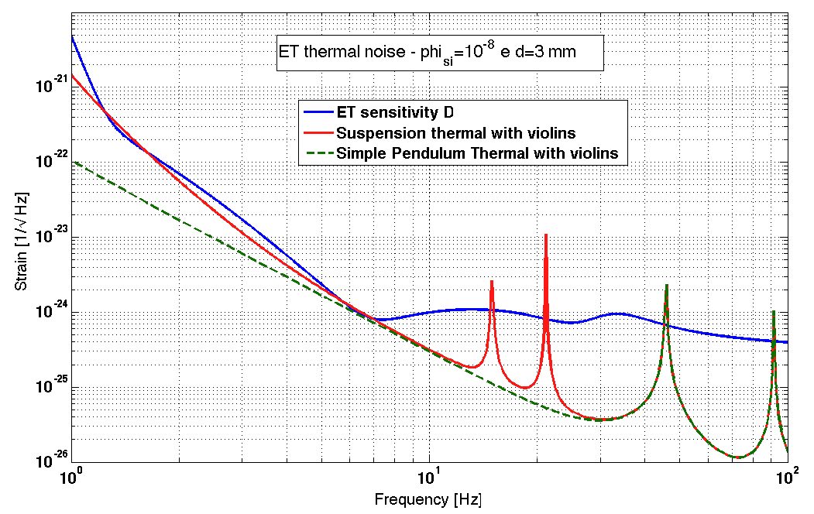
ET Payload
Suspension thermal noise for ET
Payload
Marionette: (Ti6Al4V wire)
d = 3 mm, M₁: 422 kg, L=2 m T=5 K
Mirror (silicon wire)
dimensions: diam 45cm, thickness 57cm
d = 3 mm (pure Si cristal), M₂: 211 kg, L=2 m T=10 K (only 18kW in cavity, 600 μm isotopically enriched Si)
Recoil Mass (silicon wire)
d = 3 mm, M₃: 211 kg L=2 m T=10 K
SA filter
MRM
Marionette
The effect of the MRM on the thermal
noise is negligible.

Slide 23
Conclusions
Informations gained from the study on the prototype:
    Different steady state temperatures
    Mechanical model useful for predictions (effect of the thermal links negligible)
    Transfer function prediction useful for checking the controllability
    Thermal noise model of the three last elements, the MRM act as mechanical isolation
    Use superconductive actuators
Open Problems:
    Silicon monolithic suspensions: silicate bondings, fiber production
    Improvement on the cooling time of payload

