Slide 1

GWADW 2011 gravitational Waves Advanced Detectors Workshop
Summary
A personal view of the workshop
Harald Lück
Notes:
How to summarise?

Slide 2
Technical summary
65 (partial) talks
1860 min talks & discussion
Nominally 111 participants
  (A few fell victim to the volcano and were compensated by highschool students)

Slide 3
The artist´s summary
´Twas once „will be“;
its now being done.
What once was „now“
is long since gone.
Notes:
Everybody wonders what the guy intends to express…
We are moving forward and what we planned at some of our past GWADW workshops we have now reached
Other things we were doing had become reality and are now already past like initial LIGO which is mostly dismantled
And gone elsewhere, parts even into museums.

Slide 4
How to summarise?
GWADW workshops have ( at least) two aspects worth summarizing
the surroundings
the scientific aspects (chronologically)
Notes:
It an honour to summarize this workshop.
How to summarise?

Slide 5
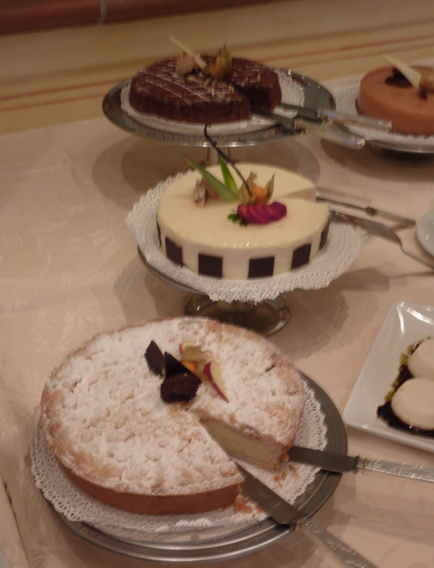
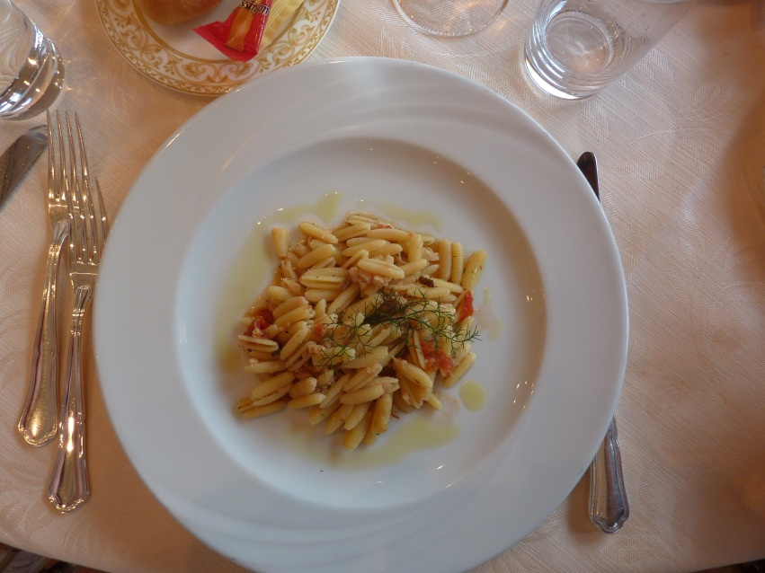
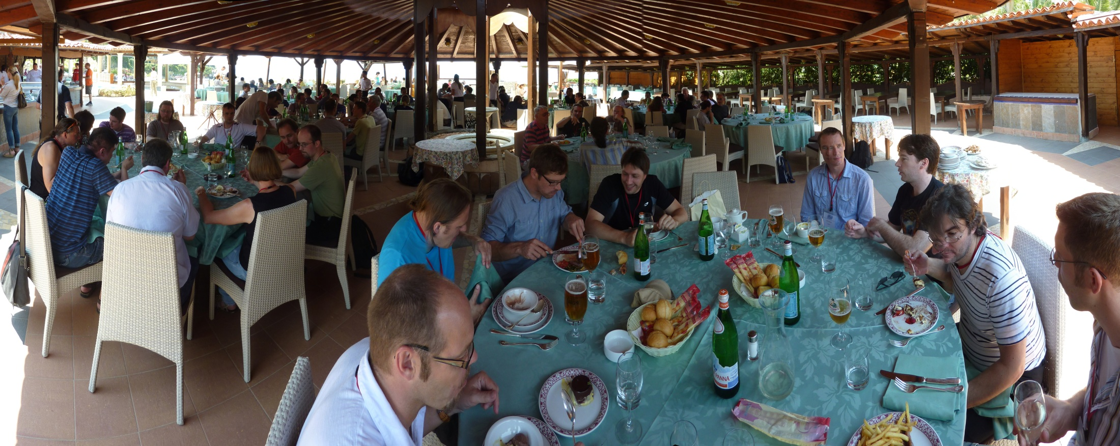
Excellent
food

Slide 6
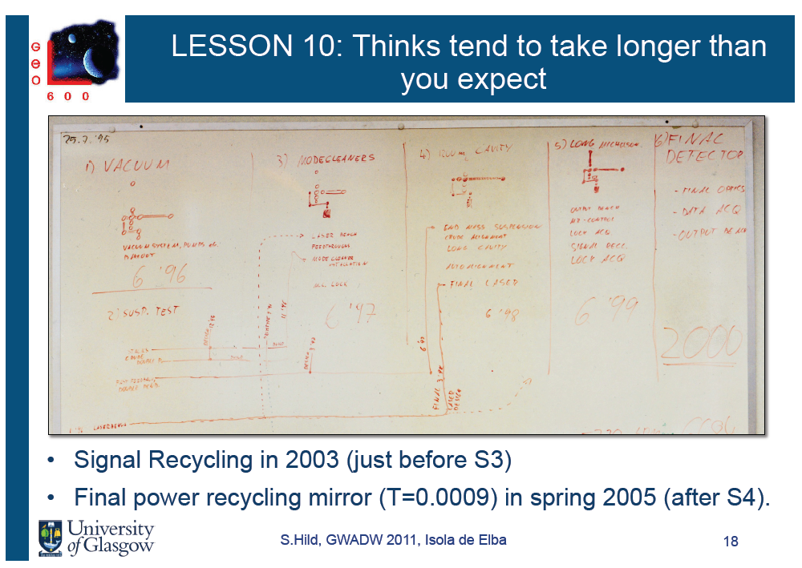
Things
Thinking = Planning
Lessons learned
Notes:
Unfortunately I missed this session…
When looking ahead and planning the future it is always important to look back and learn from what went wrong in the past

Slide 7
Lessons learned:
We all had, have, and will all have the same problems in our detectors. Let´s distribute the work and solve them together.
Learn lessons from Clio and LCGT for the 3rd generation
  Underground operation
  Cryogenic operation

Slide 8
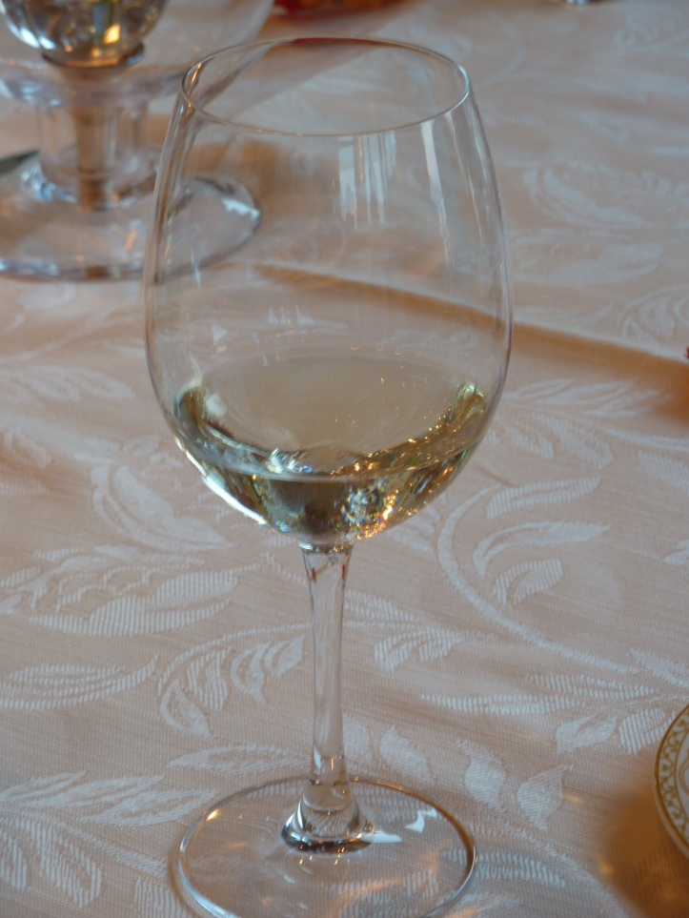
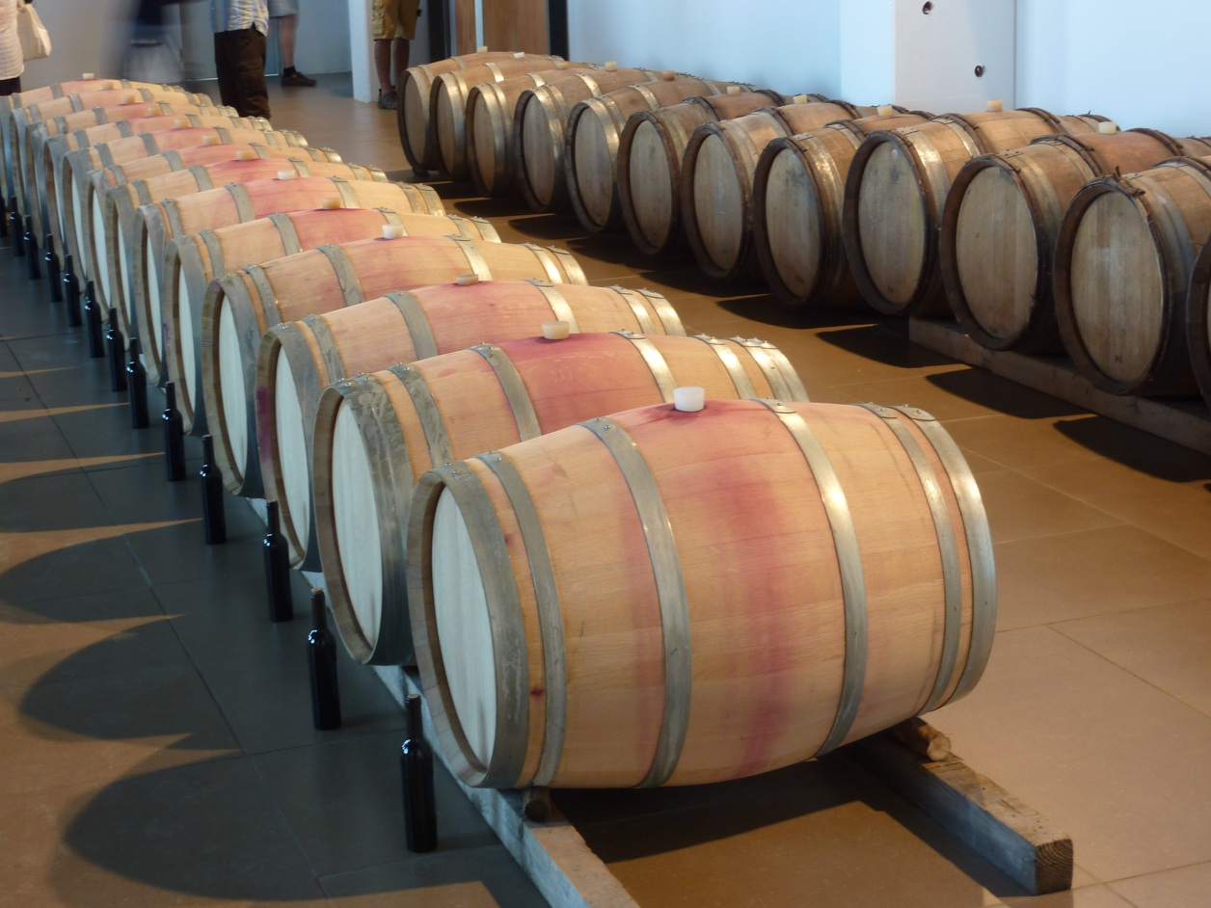
An abundance of good wine…

Slide 9
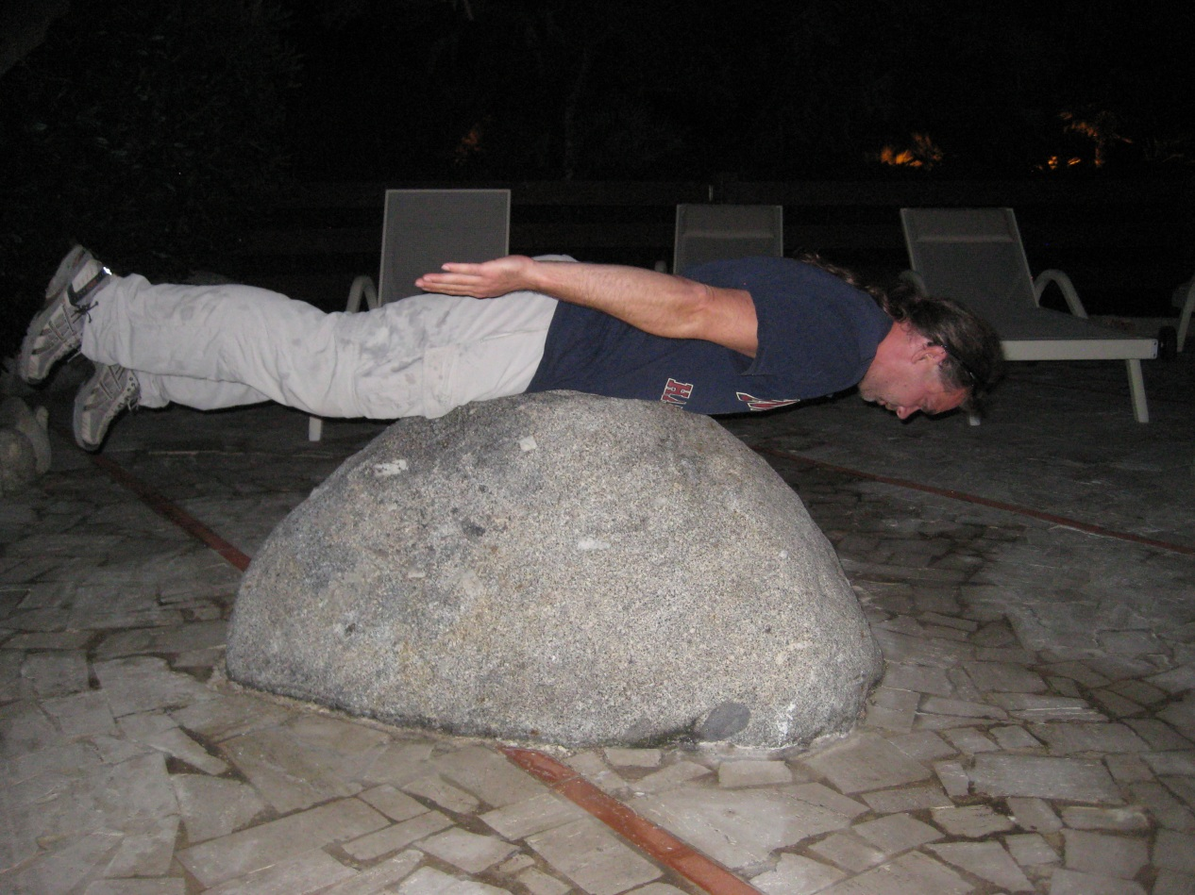
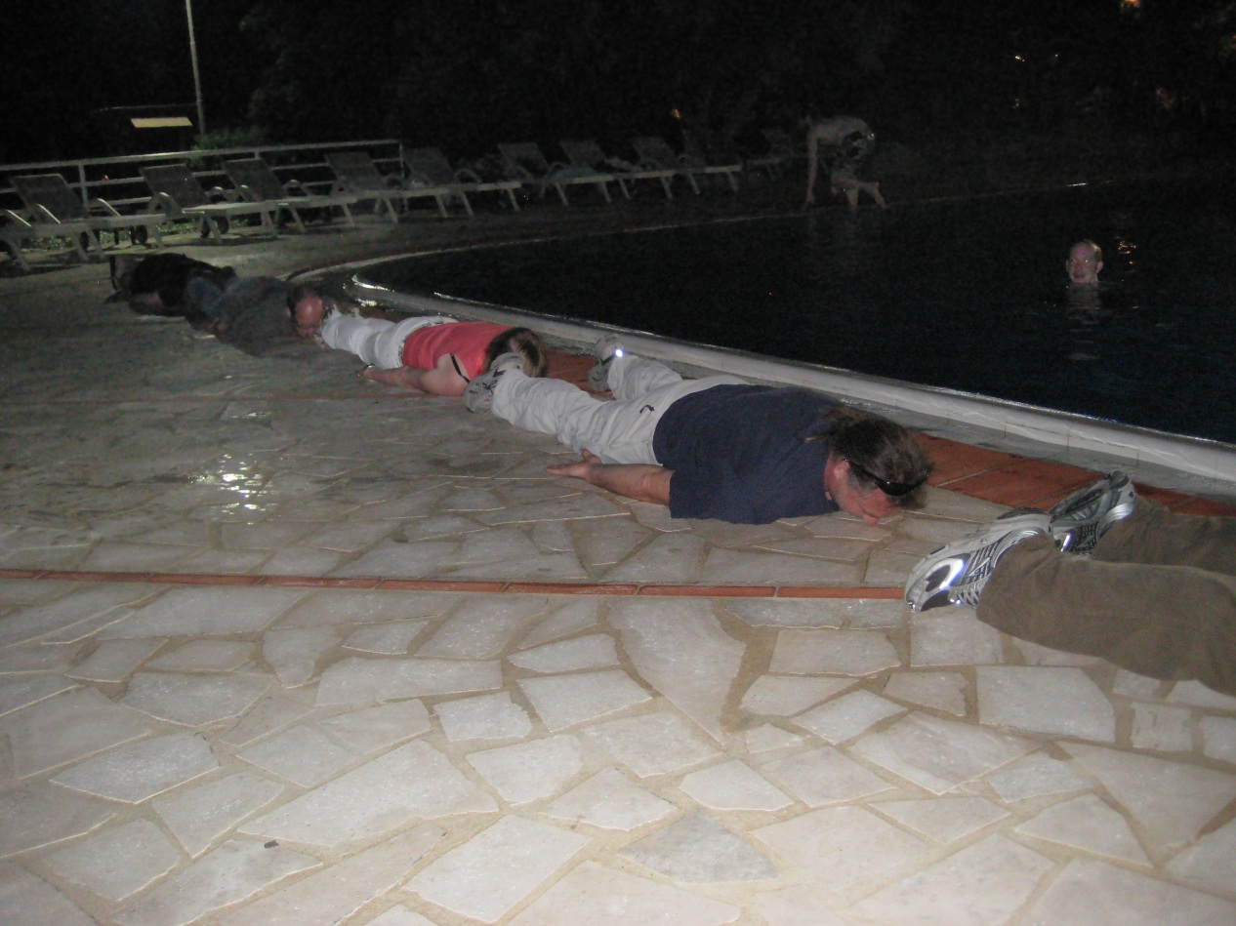
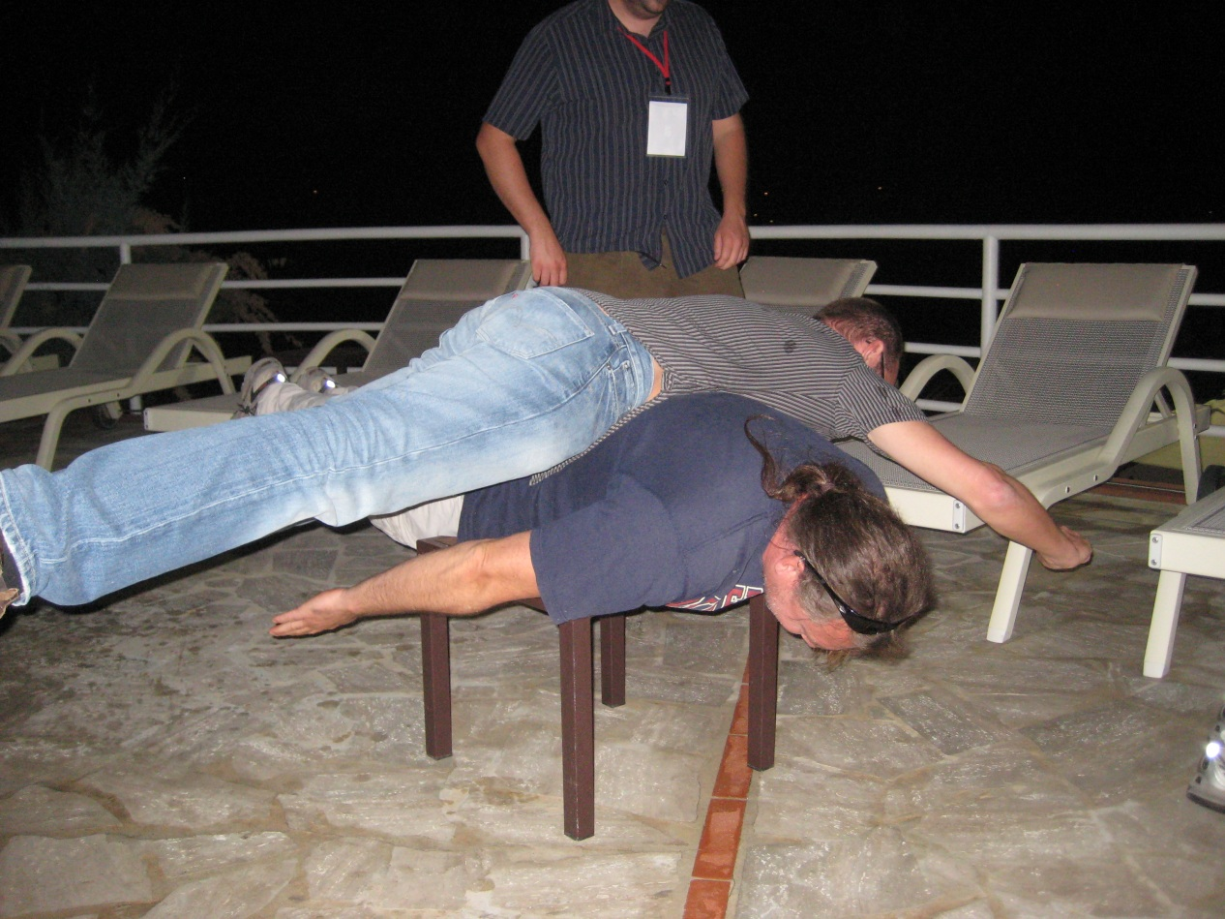
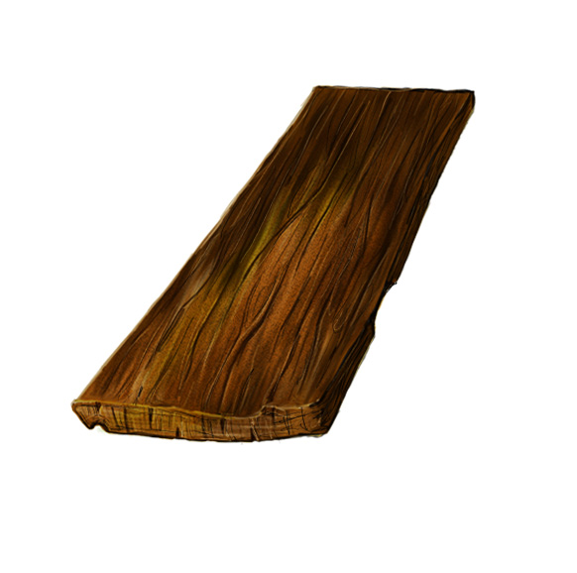
… leading to another Lesson:
… leading to another Lesson:
Internationality i s important to learn new things:
What is Planking?
Image credit: Connor
Everyone knows a plank
Planking= pretend being a plank
(Australian national sport)
[shown here with alcohol enhancement]
Classical Planking
Squeezed Planking
Using expert squeezing

Slide 10
Advanced Detectors
Advanced Detectors are now being built, i.e. are now what the initial detectors used to be in our minds;
In the sense of this workshop they are no longer what they used to be.
„There will be more interesting history in the future“

Slide 11
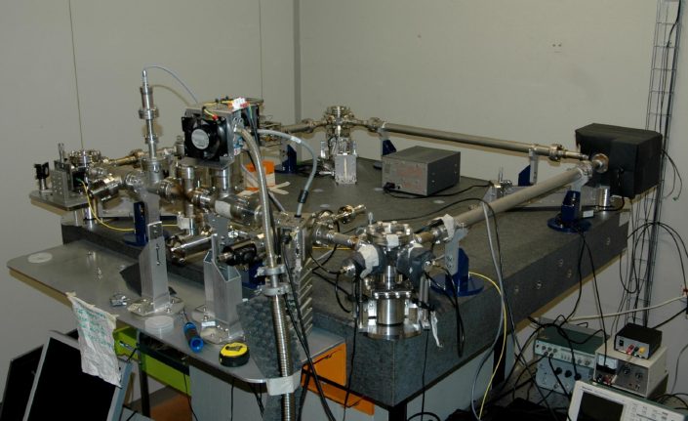
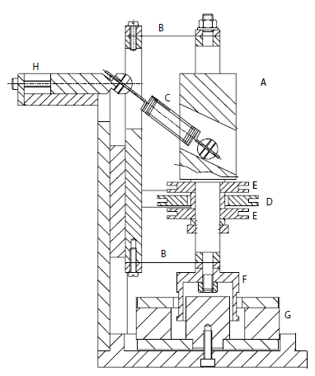
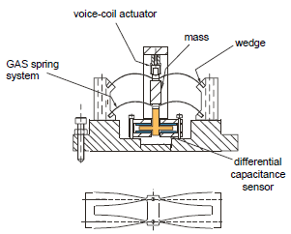
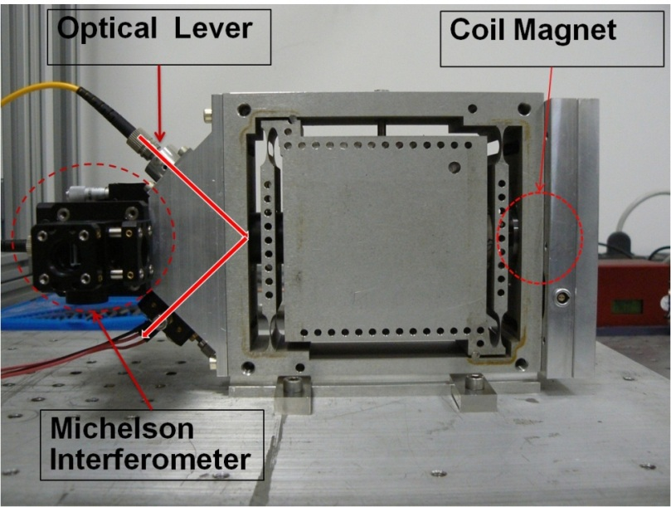
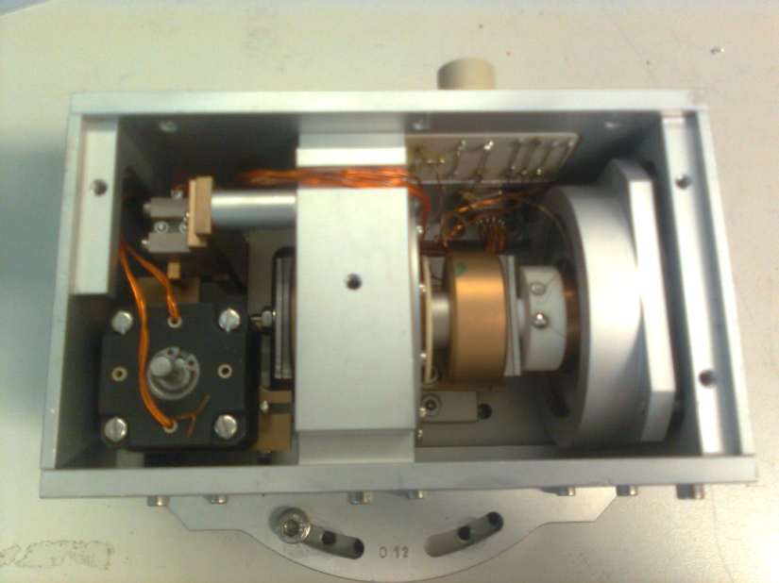
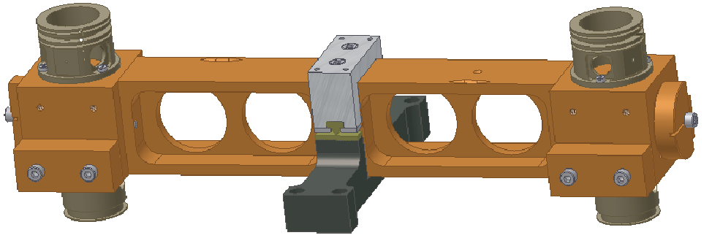
Inertial Sensors
Notes:
Becomes more and more important to provide quiet platforms
Keeping optics quiet eases lock acquisition and ameliorates scatering problems.
Having good sensors will become more and more important as we learn to use MIMO control systems to use the sensors for FF or FB systems.

Slide 12
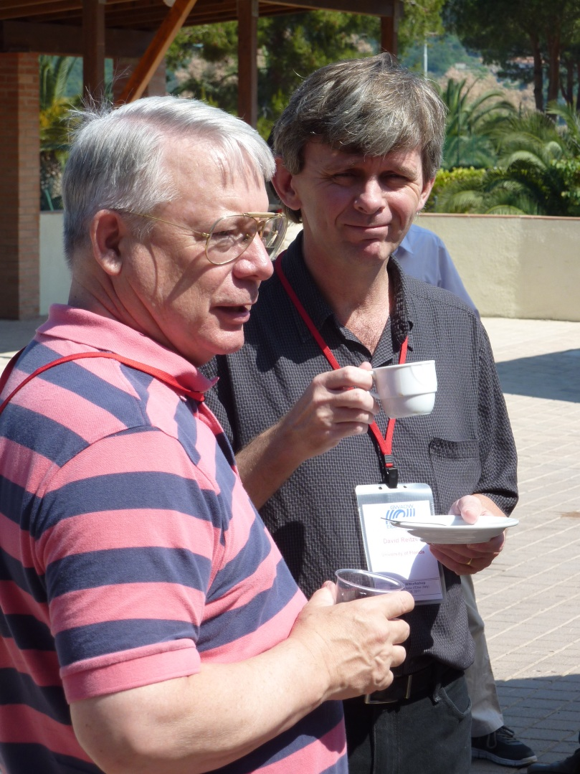
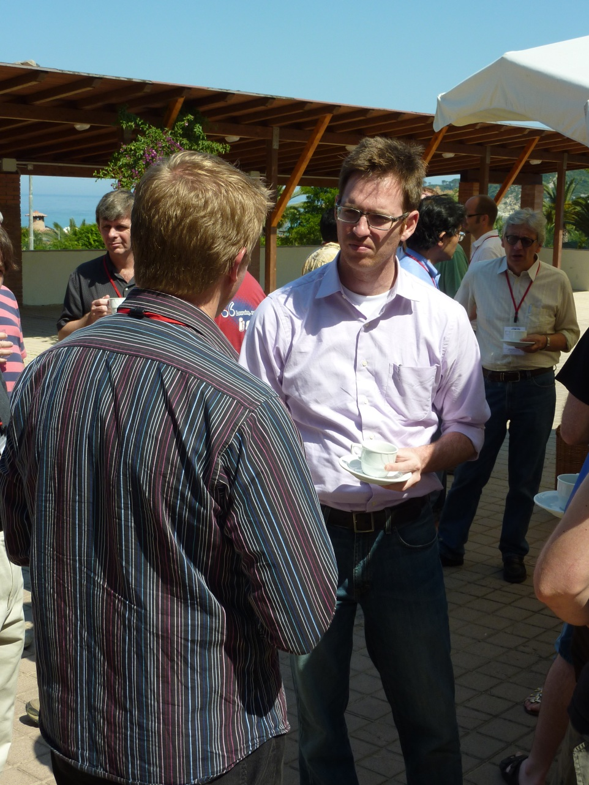
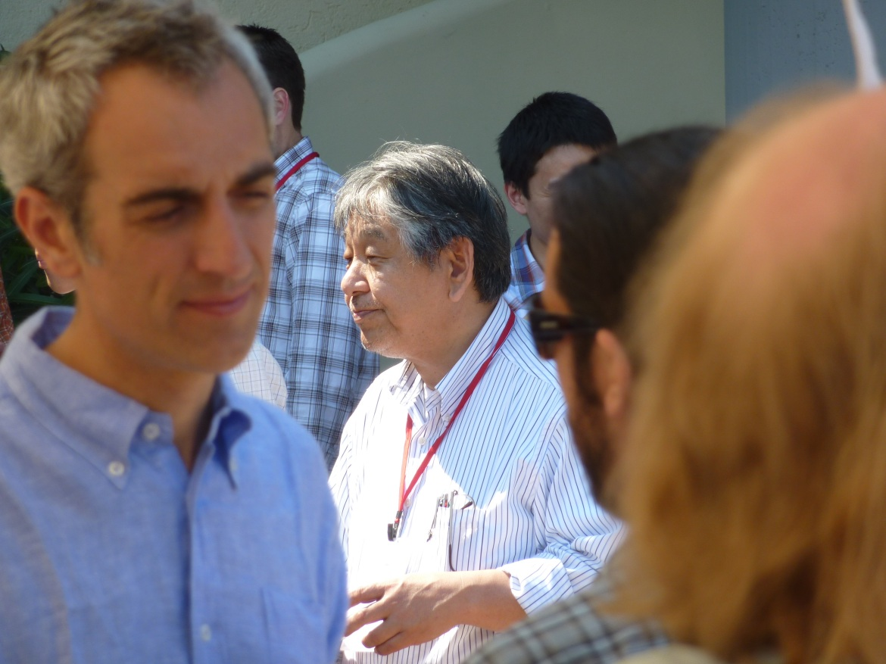
Coffee breaks &
Discussions
Notes:
The presentations are only one side of this workshop. At least equally important are the breaks where we discuss questions triggered by the presentations

Slide 13
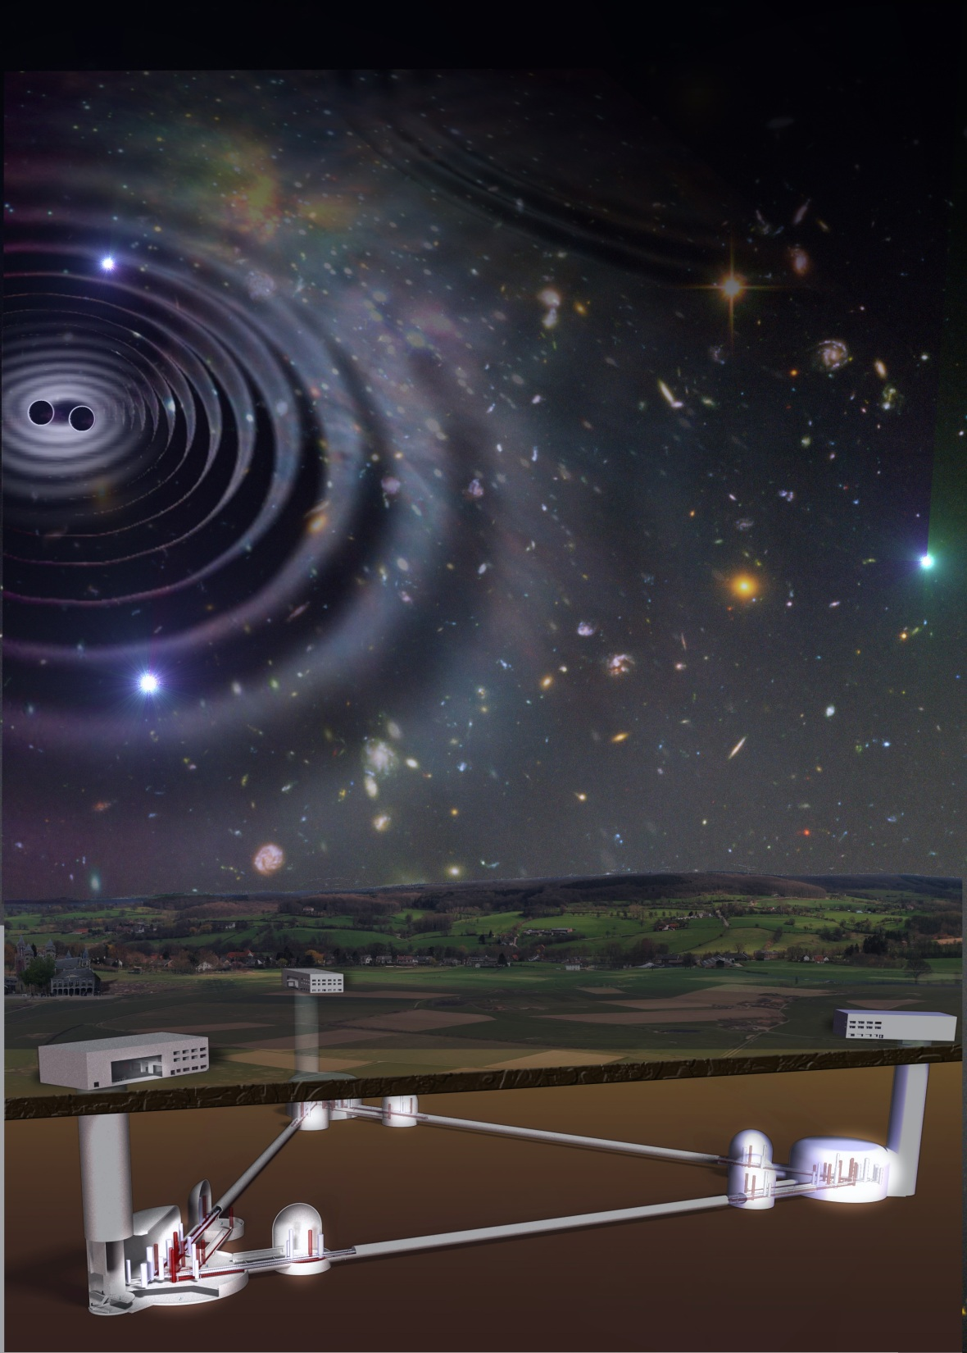

Today´s „advanced detectors“:
The third generation
ET the Einstein Telescope
Read the book!
Notes:
Most techniques there
Silicon research being done
GGN being investigated (I remain doubtful)

Slide 14
The bigger the projects grow
the longer they take
→ Start planning and do R&D in time
 | ´06 | ´07 | ´08 | ´09 | ´10 | ´11 | ´12 | ´13 | ´14 | ´15 | ´16 | ´17 | ´18 | ´19 | ´20 | ´21 | ´22 | ´23 | ´24 | ´25
Virgo
GEO
LIGO
E.T.
Virgo+
Advanced Virgo
GEO 600
Hanford
E-LIGO
Advanced LIGO
Livingston
DS
PCP
Site Prep.
Construction
Comm.
data
Agreement that we should improve the
world wide coordination of planning the 3rd generation

Slide 15
Start now training young scientists (that will become PhDs and Post Docs at the time ET will take data)
in the proper environment
* Gives a too negative note to the talk

Slide 16
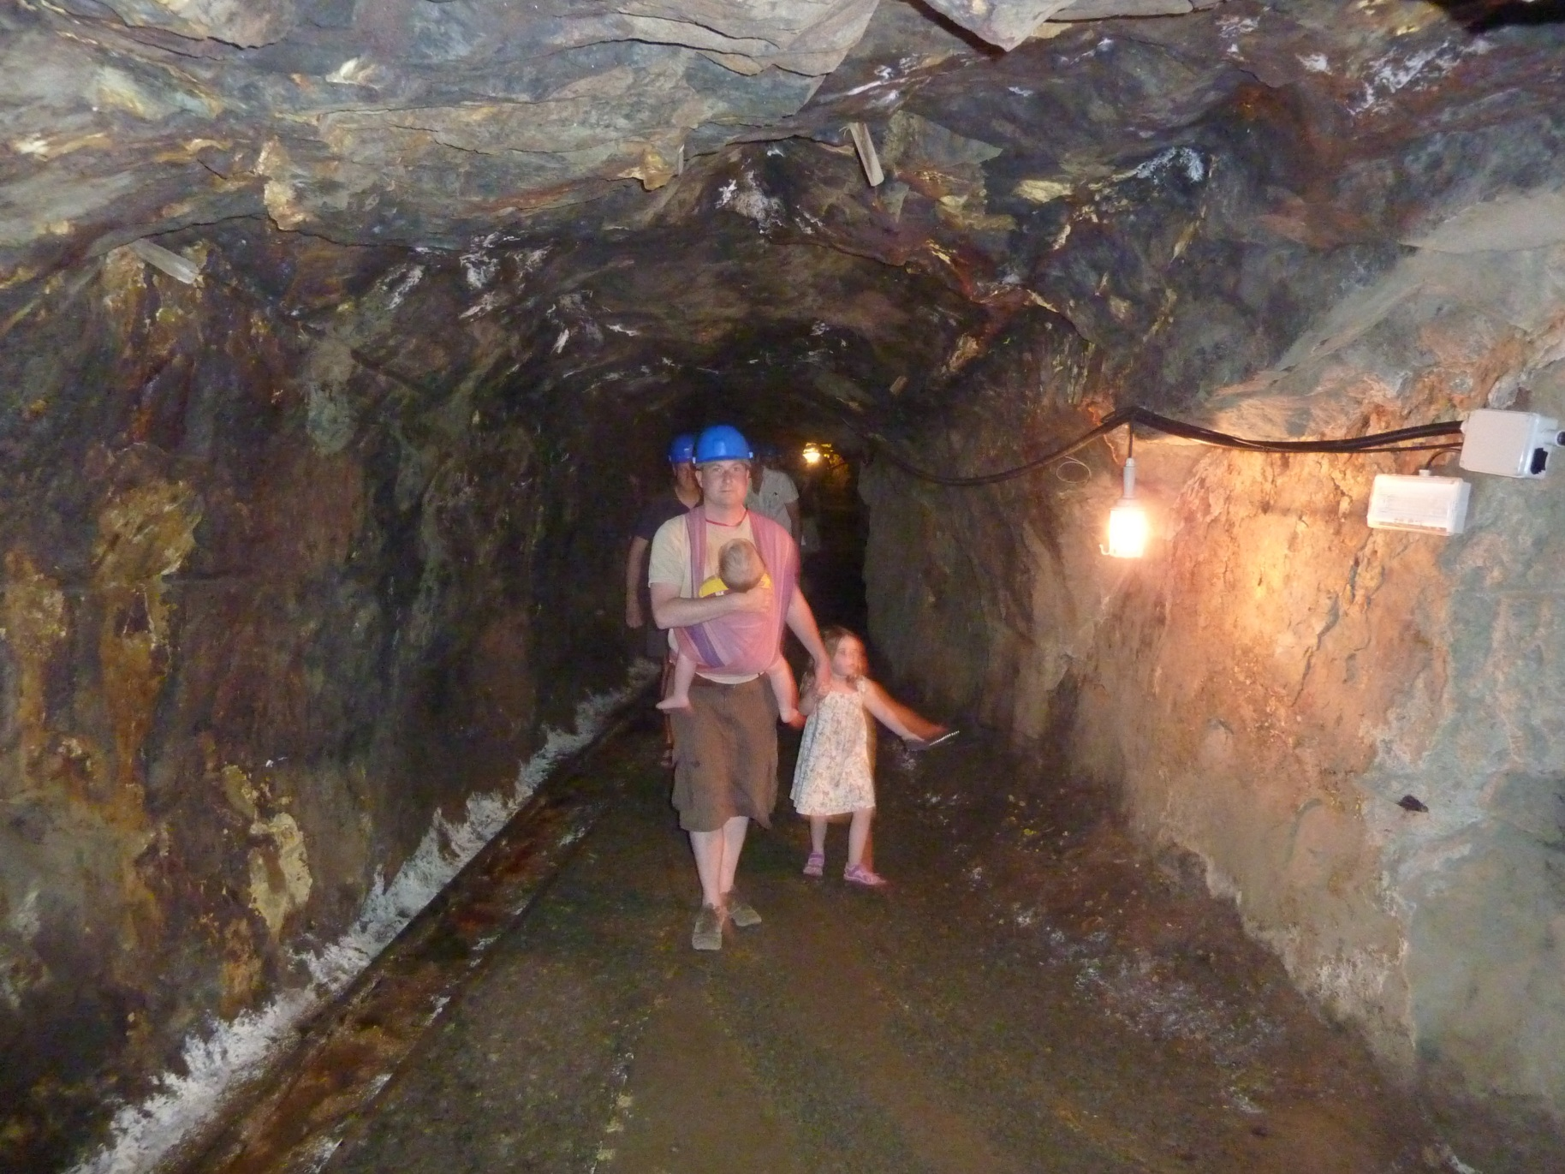
Start now training young scientists
in the proper environment …

Slide 17
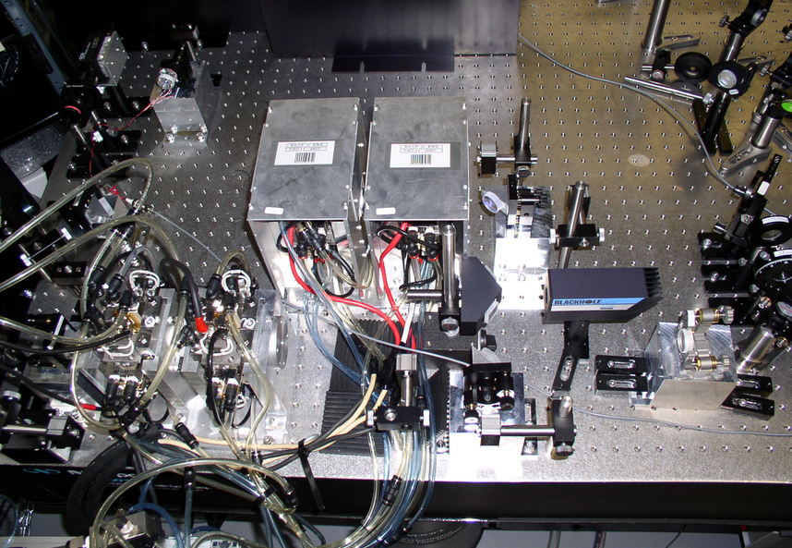
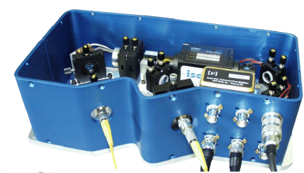
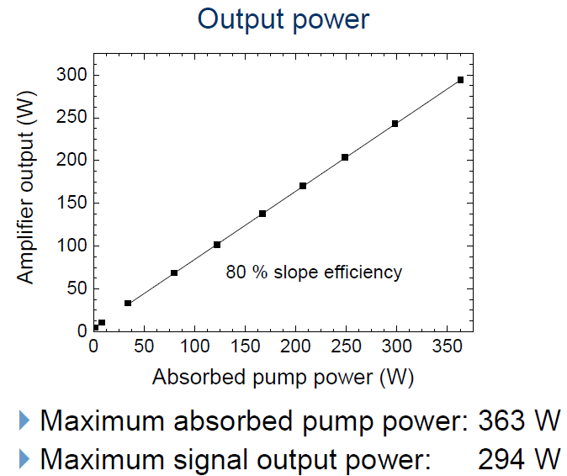
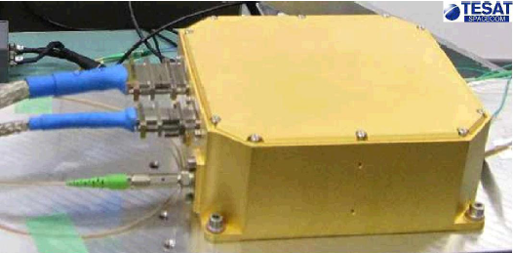
Light sources for the future
(spanning the generations)
are already almost there
LISA
LCGT
LZH
LISA Pathfinder

Slide 18
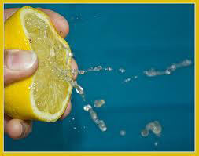
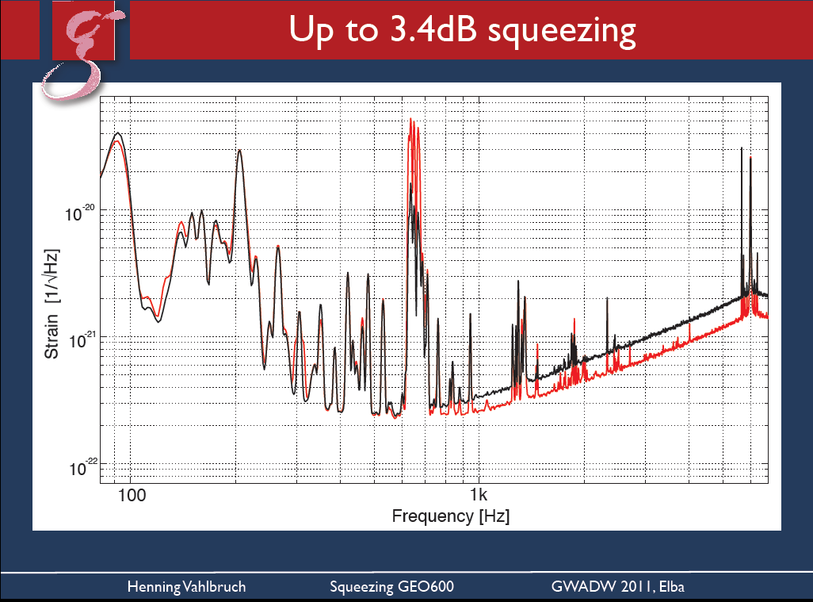
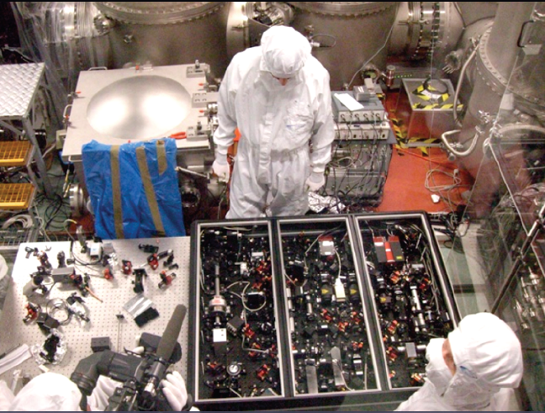
SQUEEZING
Who would have thought we get this far 5-10 years ago?
We are now using squeezing in generation 1.5
And should keep using it.
Glitch performance studies in Virgo/GEO data run that starts soon

Slide 19
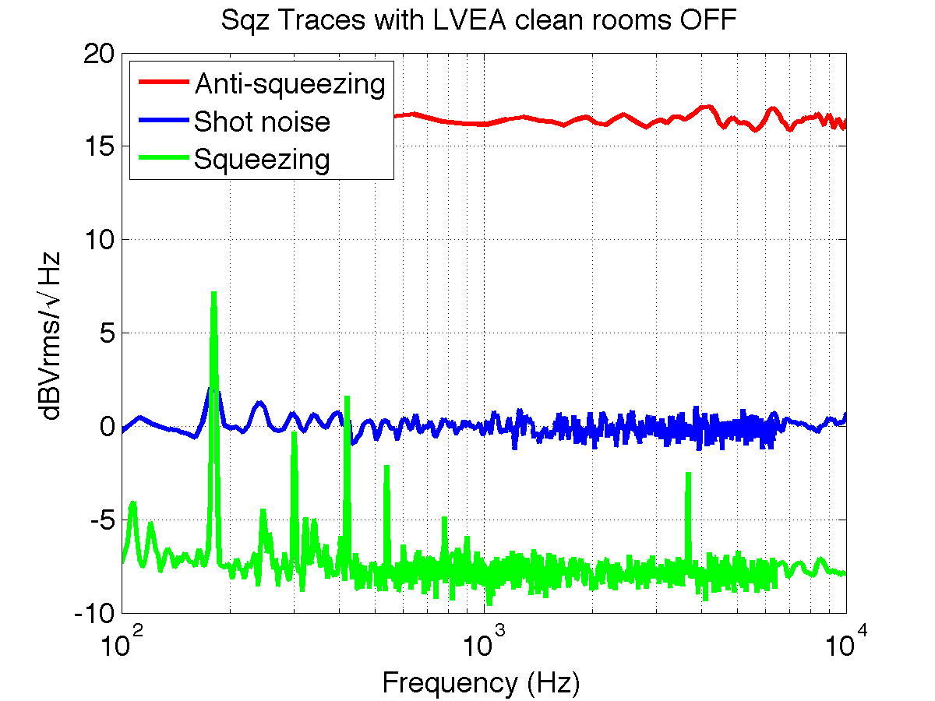
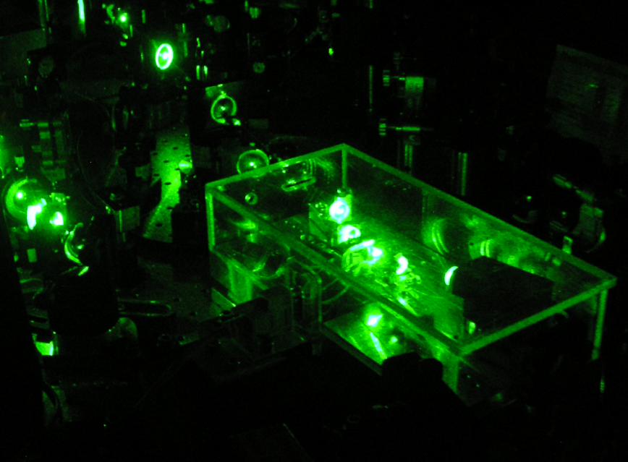
A squeezed H1:
By the end of August
We are here
June 2011
August
2011
December 2011
H1 taken apart
LIGO Squeezer
When to build it into LIGO?
More confidence will be gained and
Then it will be implemented as
soon as possible.
We need R&D on filter cavities soon
Adjust losses of cavities
Notes:
We had a long discussion on when to implement Squeezing into LIGO. More confidence will be gained and then it will be implemented as soon as possible.

Slide 20
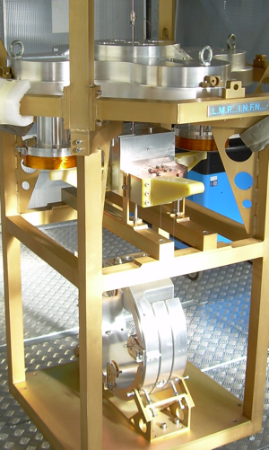
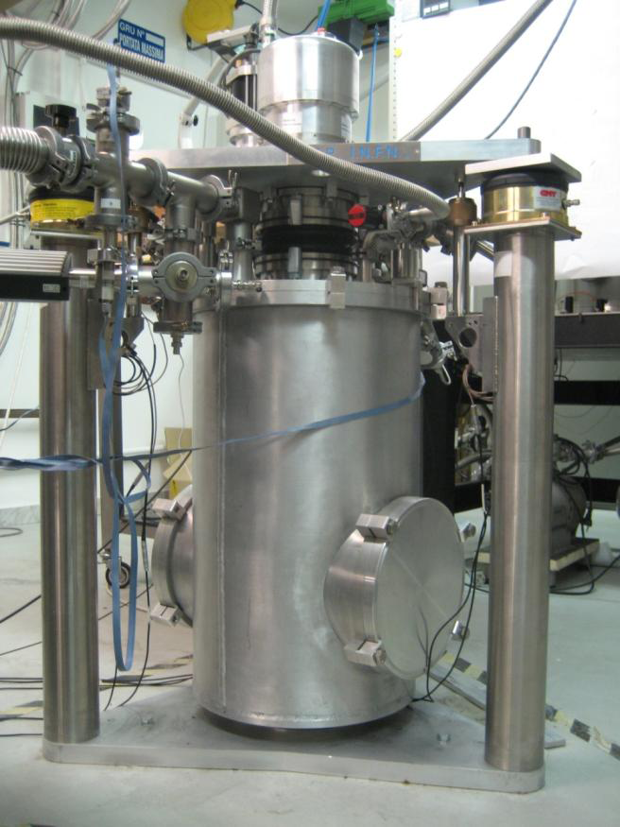
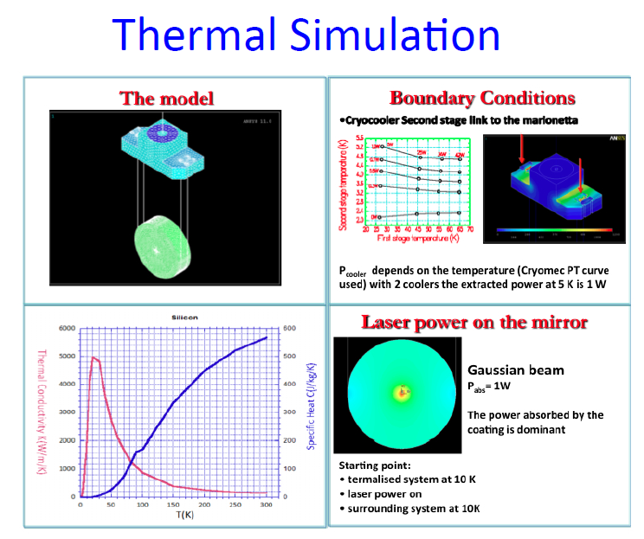
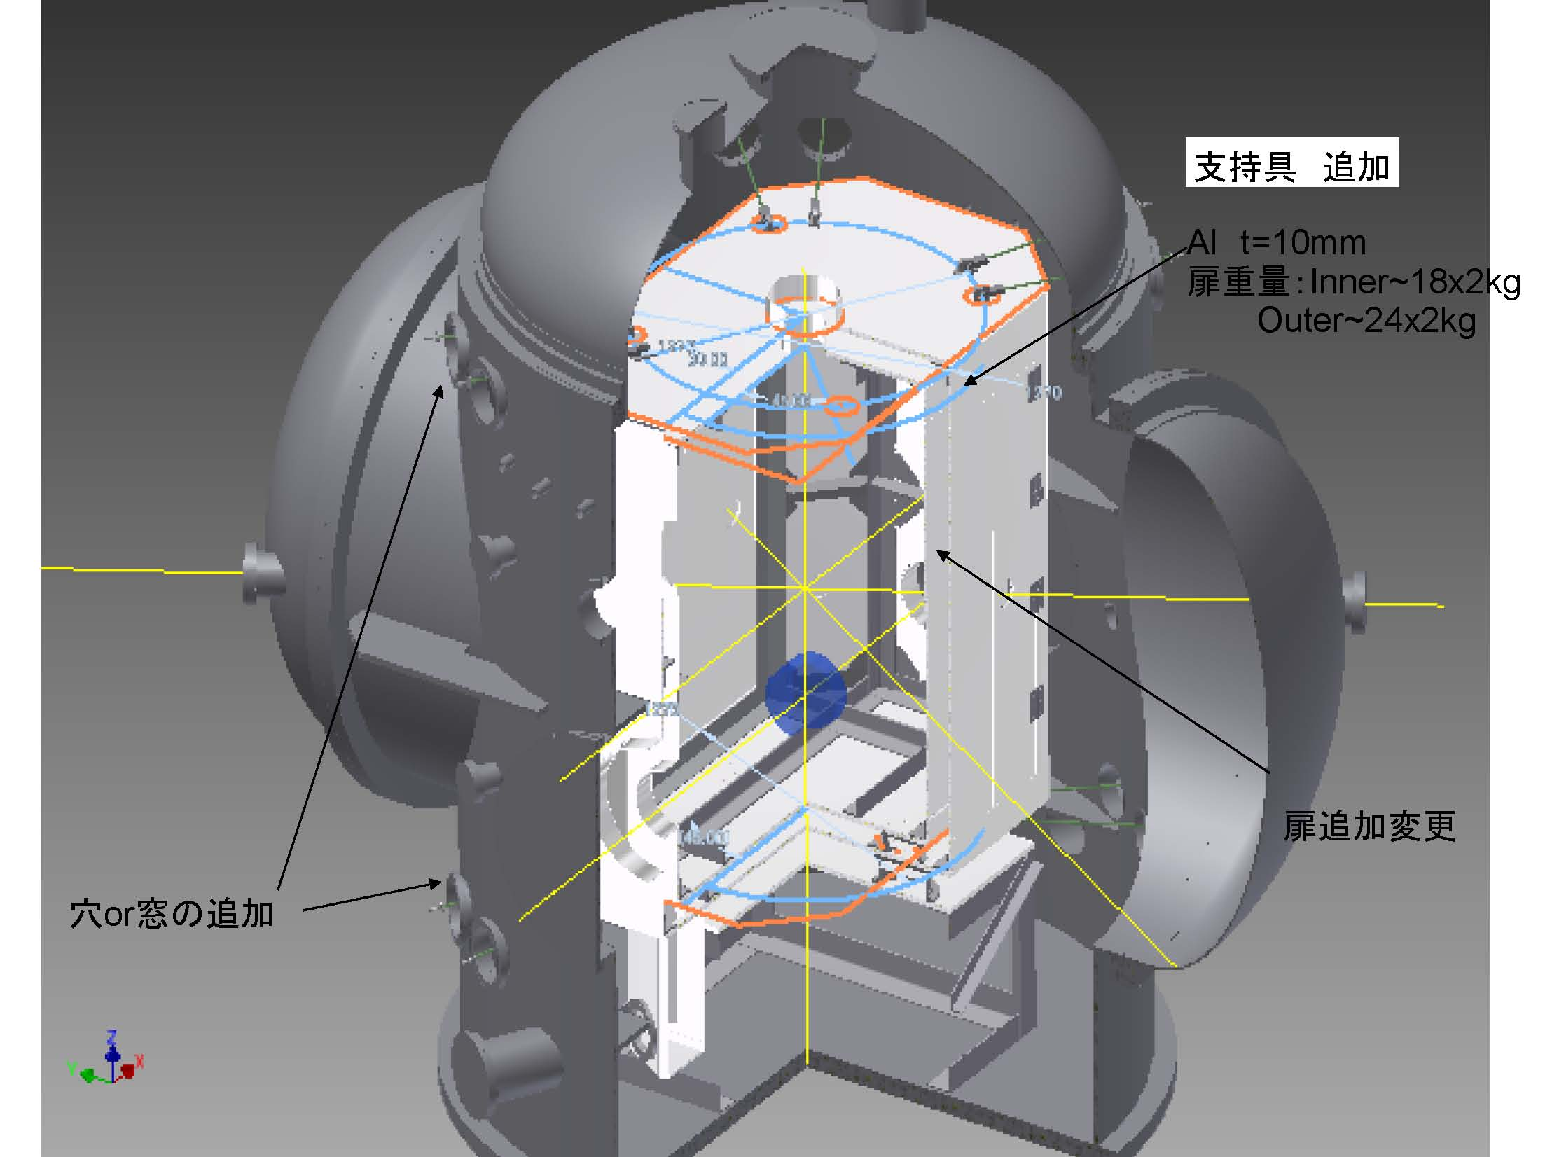
Cryogenics:
Learn from / together with
Clio / LCGT
ET last stage
Notes:
LCGT: Going into the details of a real project:
Are even thinking about risk management

Slide 21
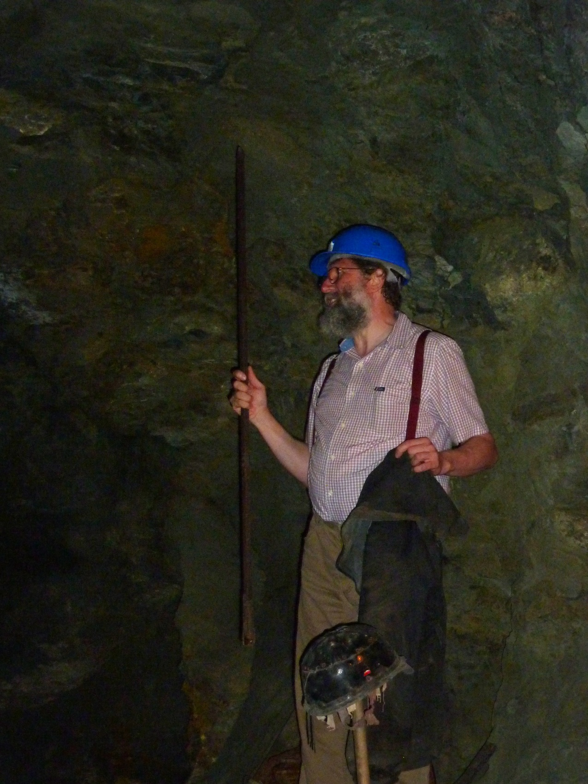
That‘s what you call a
WORKshop
Riccardo already
started hands-on
3rd generation
work…

Slide 22
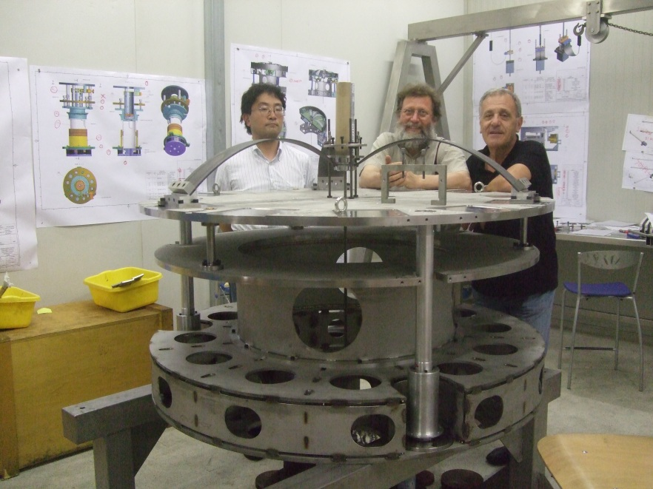
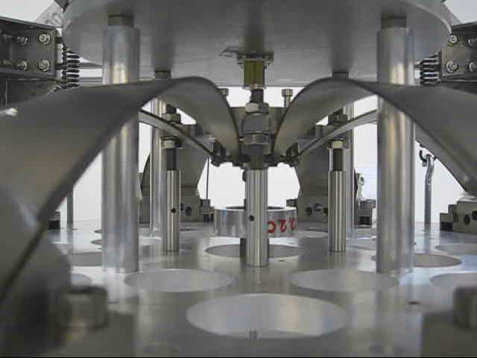
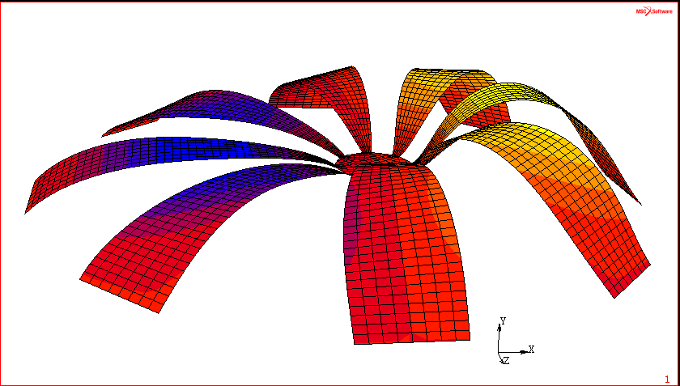
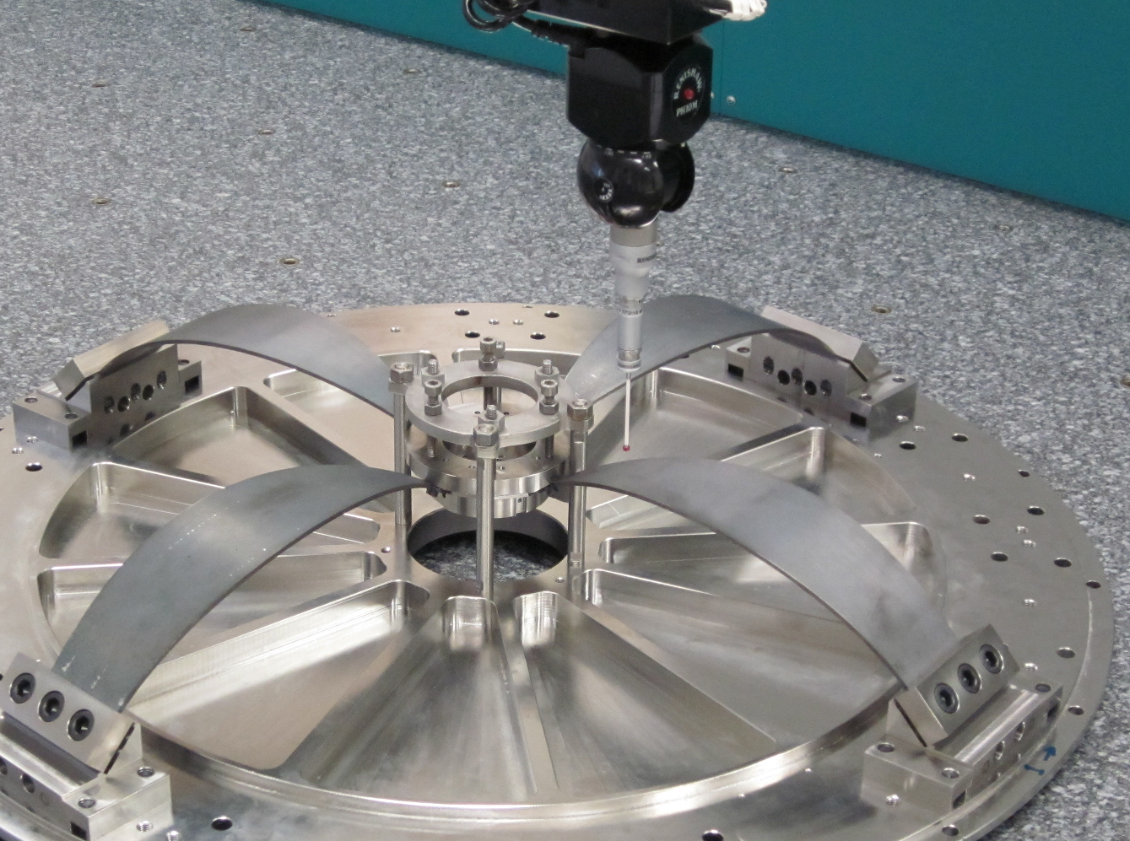
Filter for future generations?
GAS filters used/studied in
LIGO, AEI, Virgo, LCGT

Slide 23
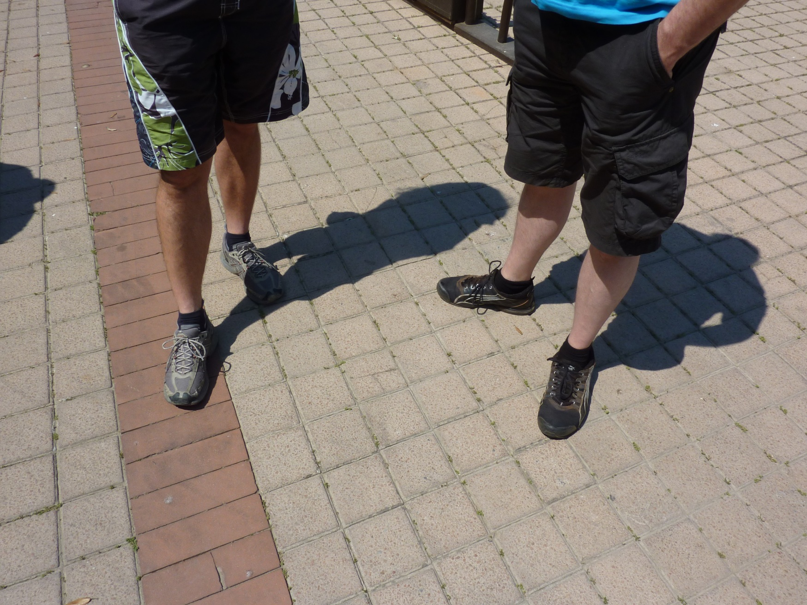
The dress-code

Slide 24
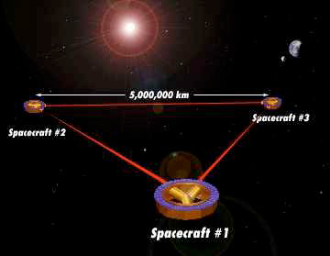
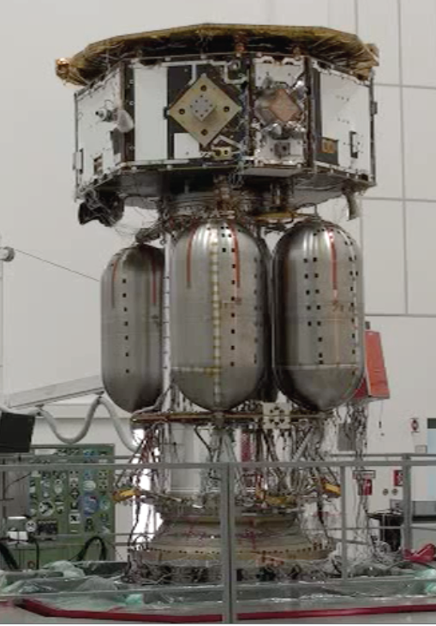

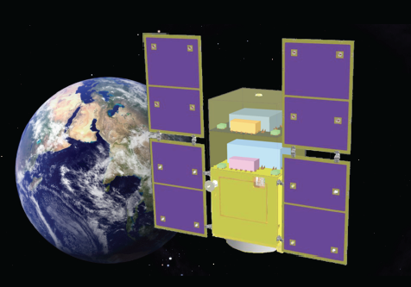
Spaceborne GW detectors
Another
´Freudian´
typo ☺
LISA pathfinder
Redefining LISA
Don‘t rename it
If not absolutely
needed for political
reasons
Notes:
Some projects are coming so close to launch and people are getting into realistic tests that the feeling of almost running the mission comes up.
When hearing about LISA pathfinder you get the impression of a really imminent experiment
People get ready to perform the experiments
Simulated runs done with mission simulator
The typo nicely shows what the pathfinder missions are for: making the final project better

Slide 25
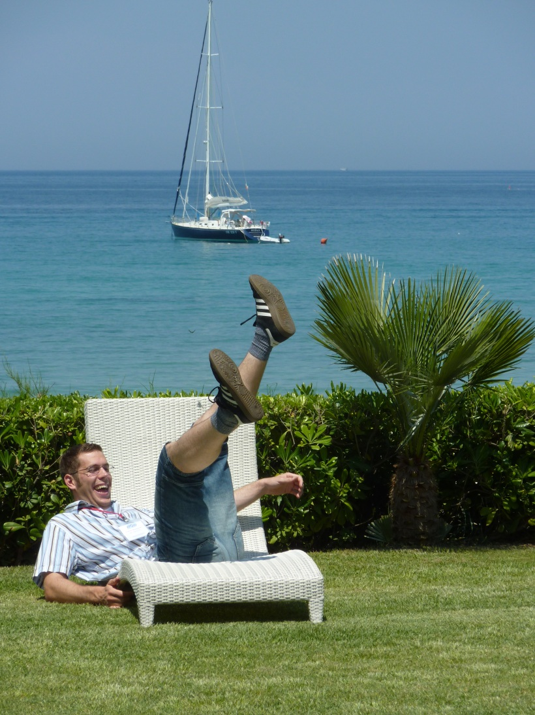
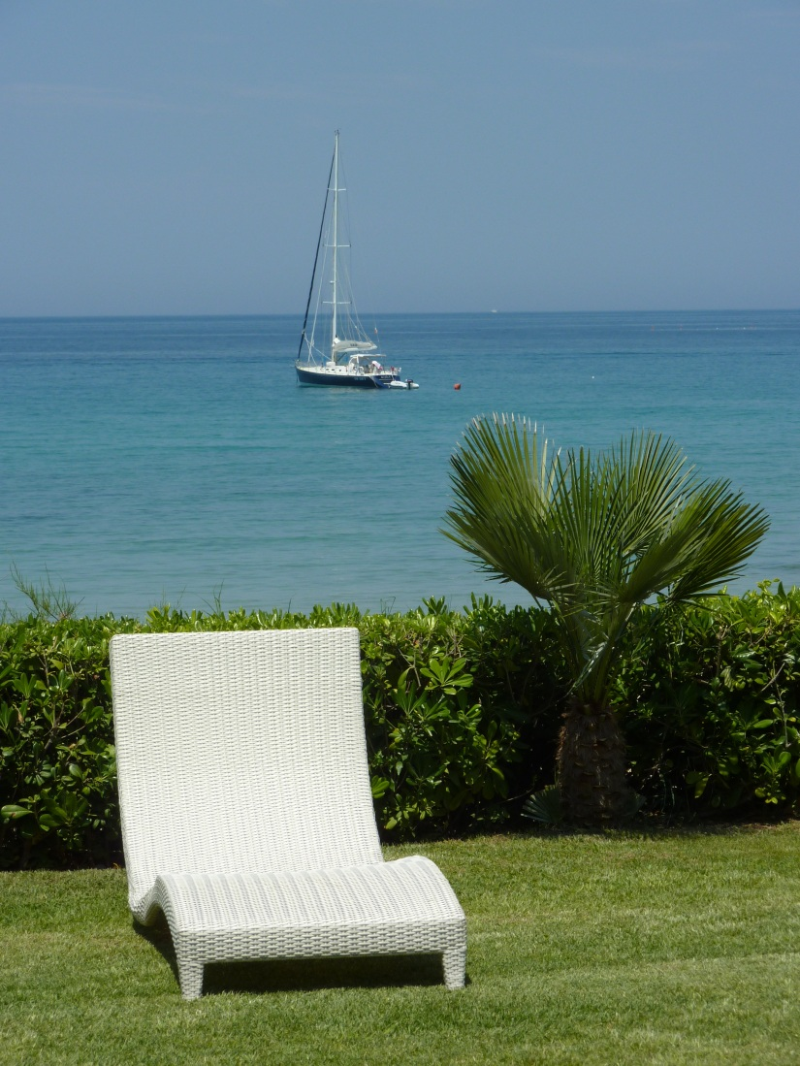
Places to find peace and quiet for deep thoughts
Well, you can at least give it a try…

Slide 26
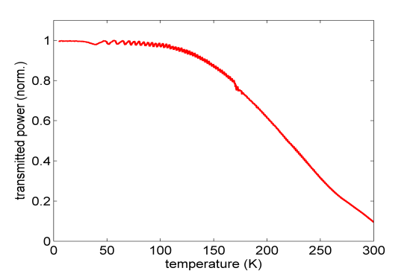
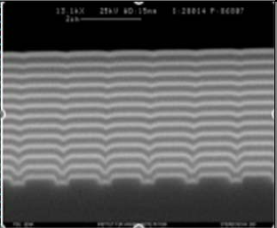
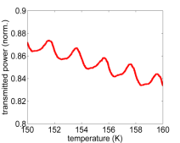
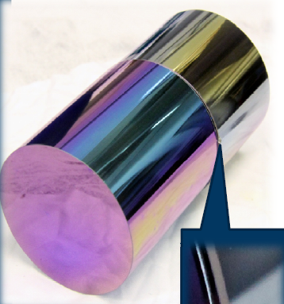
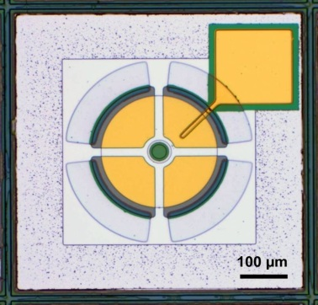




How to summarize the rest?
A wealth of information, ideas, challenges….

Slide 27
Simulations
Instruments become increasingly more complex.
No chance any more for back-of-the-envelope calculations and intuitive decisions.
We need the numerical analyses for predicting and solving problems.
Simulations become increasingly more important
and powerful.
One problem: which tools are out there?
Share your simulation tools (it is of benefit for both sides)
Advertise your simulation tools.
Simulations evolve along with the experiments and gain in complexity.
Keep in mind that these complex simulations are also complex to run.

Slide 28

Optomechanical coupling:
Radiation pressure forces
We do not have much practical experience with radiation pressure yet,
but we will soon enough
have to cope with it.
It can be useful as a
readout technique in
Gen. 3+ instruments.

Slide 29
The Future of GWADW
Leave (most) status reports to the LVC meetings
Concentrate on future techniques
Initiate irregular 2 day dedicated workshops,
e.g. squeezing?
Try to increase workshop character again?
Come to GWADW also with your problems
Long lunch breaks good for informal discussions
(here you are allowed to talk physics at lunch and dinner)
Instead of conclusions, post remaining
questions and discuss at posters
Advance discussions to times when people are still fresh
Syd: If it ain‘t broke don‘t fix it
Notes:
My impression is that most people we pretty happy with the workshop character
and the discussions outside the sessions are very well accepted and welcome.

Slide 30


Let us thank the organizers
of this great workshop…

Slide 31


… for a really enjoyable week and perfect logistics!

Slide 32


Have a good trip home
See you next year
on Hawaii
☺

