Slide 1
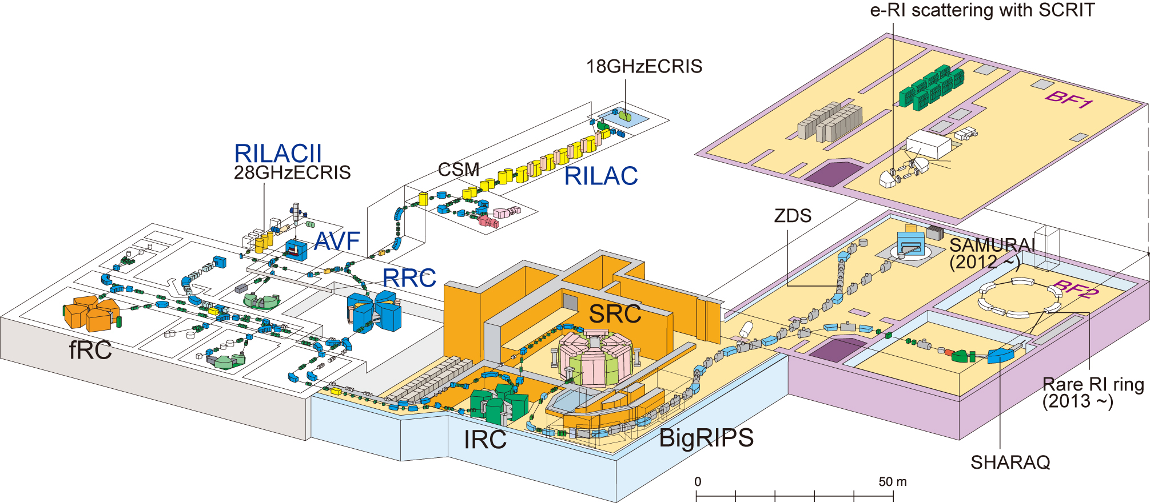
Present status of Rare-RI ring project
in RIKEN RI Beam Factory
1. Introduction 4. Optics for injection
2. Isochronous design 5. Specification
3. Fast response kicker 6. Summary
Isochronous Ring
RIKEN Nishina Center
Yoshitaka Yamaguchi

Slide 2
Target performances
Motivation
- Study of the nuclear structure for exotic nuclei
- Contribute to understanding of the r-process
nucleosynthesis
Systematic mass measurements
with accuracy of 10⁻⁶ is essential !
Target performances
- Measurement by only one particle
- Measurement time is less than 1ms
- Measurement limit is A/Z=3
A/Z=3

Slide 3
Conceptual design
Isochronism of 10⁻⁶
- Self-trigger individual injection
transmission cable
identification
dE, E
SRC
trigger signal
power
supply
selection
Bρ, TOF
particle
Kicker
Isochronous
ring δB₀/B₀ ~ 10⁻⁶
F0
F3
magnet
BigRIPS
β measurement
TOF δT/T < 10⁻⁶
δβ/β ~ 10⁻⁴
Injection line
200
MeV/u
Significant challenges
- Design which ensure the isochronism of 10⁻⁶
- Fast response kicker-system

Slide 4
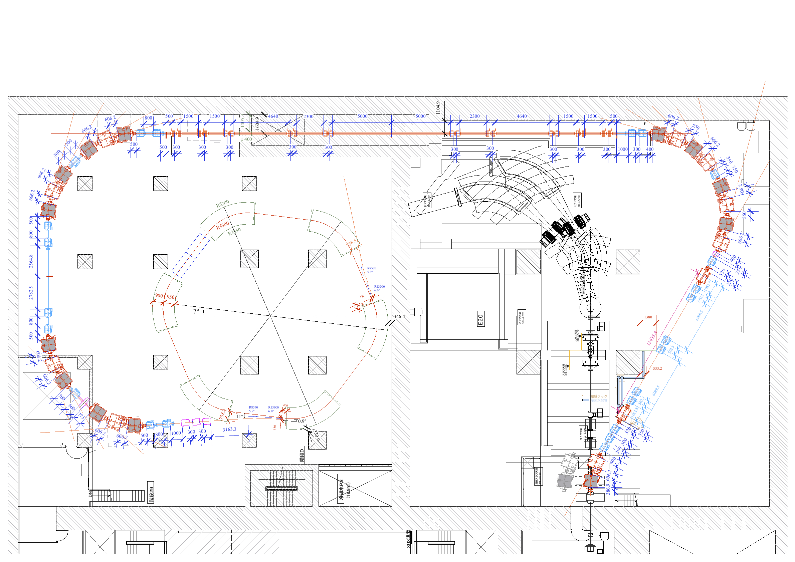
Previous floor arrangement plan
2009
Long injection line
Kicker
Isochronous
Ring
SHARAQ
Septum

Slide 5
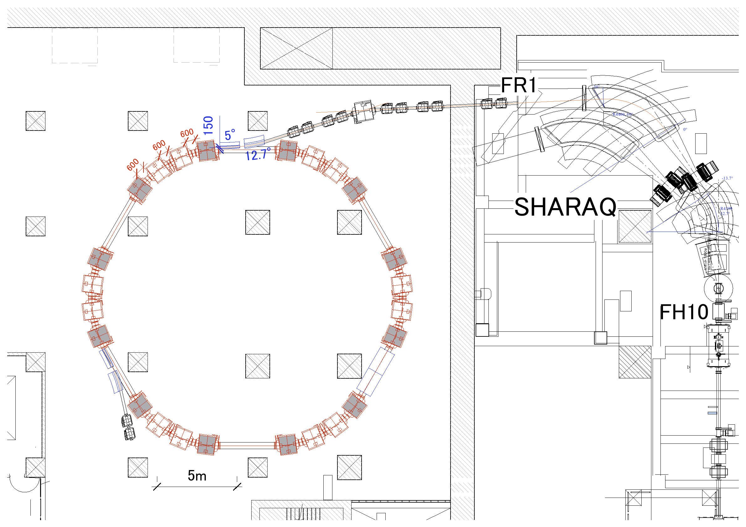
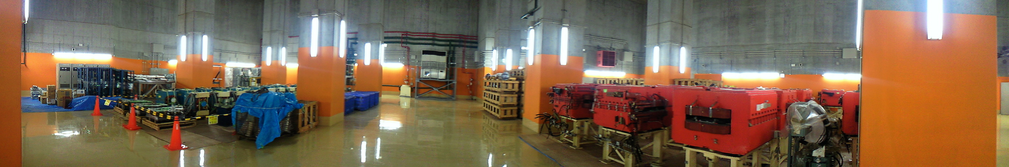
Floor arrangement plan
2011
Injection line
septum
SHARAQ
Isochronous Ring
kicker

Slide 6
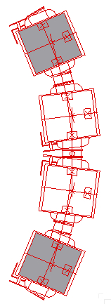
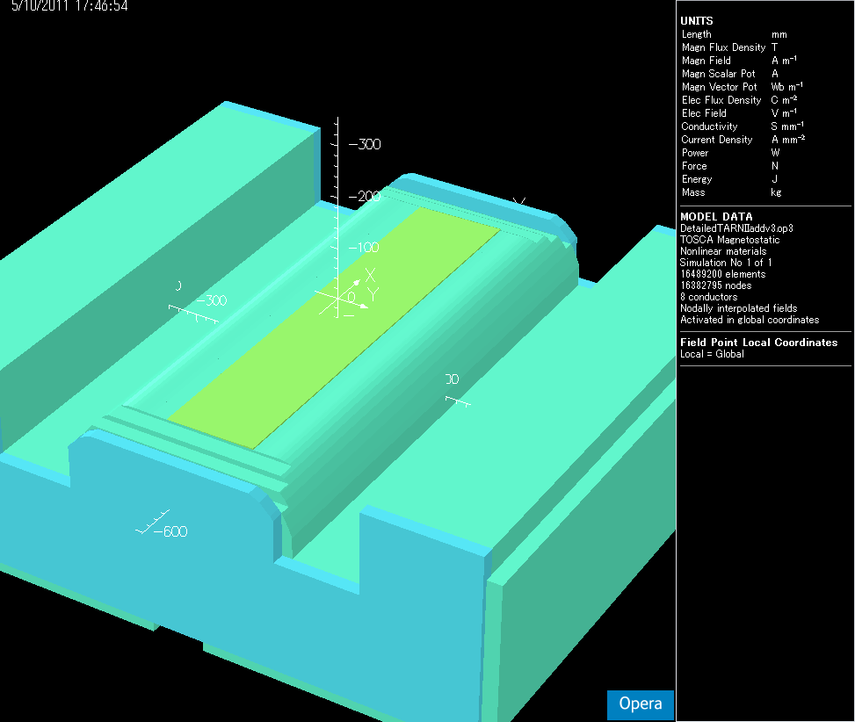
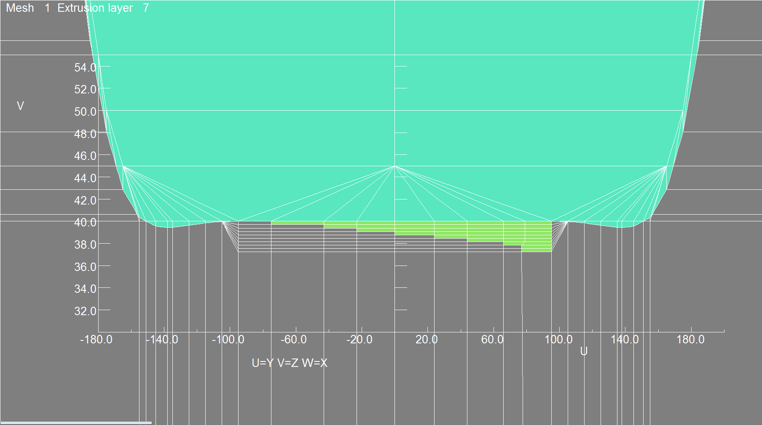
Isochronous design
- Ring consists of 6 sector
- 1 sector consists of 4 TARNII dipoles
- Outer 2 dipoles are modified
to achieve a precise isochronism
for outer 2 dipoles
The laminated iron plate is
arranged on the pole face.
The laminated iron plate is
arranged on the pole face.
40mm
- thickness of 0.3mm
- 9 layers

Slide 7
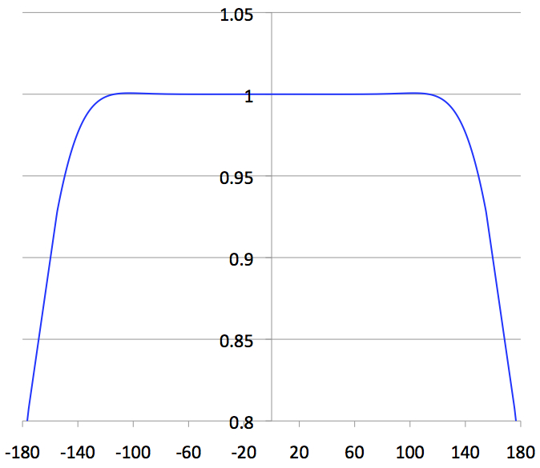
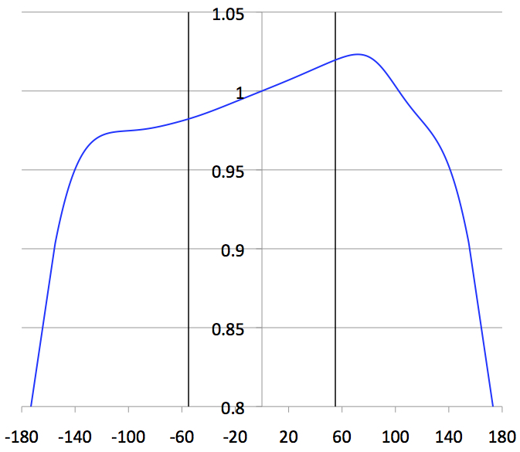
Isochronous design
Radial distributions of field strength
normal
B(r)/B₀ [T]
modified
B(r)/B₀ [T]
r [mm]
r [mm]

Slide 8
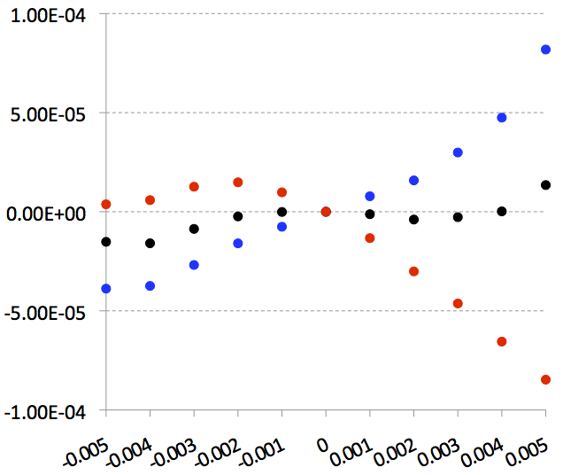
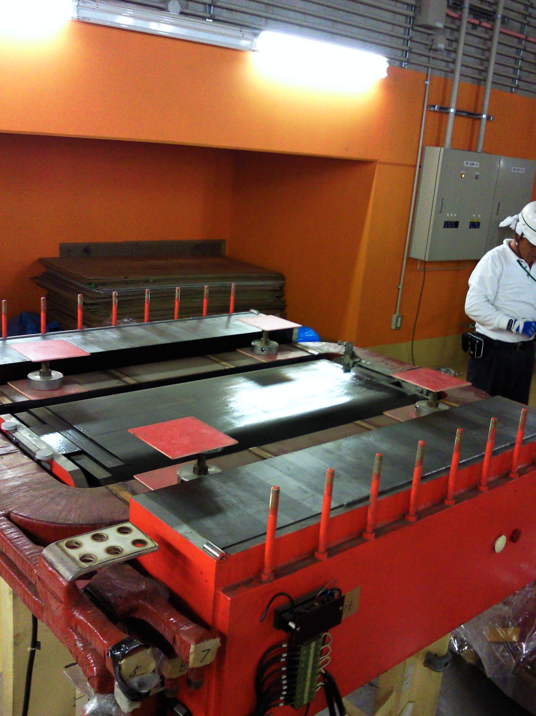
Isochronous design
Shape of the laminated iron plate is optimized to 1.5T.
δT/T₀
Field measurement
a/q= 2 ~ 3
B₀: 1.0T ,1.6T
dp/p
δB/B₀ < 10⁻⁴ in momentum spread 1%

Slide 9
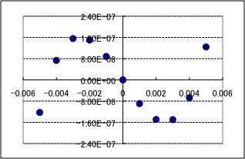
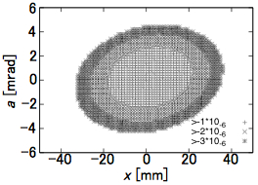
Isochronous design
- Trim-coils play a role of fine tuning.
under design now.
Optimization of the trim-coils
Simulation results (ideal case)
Fine tuning by trim-coils
(Manually adjusted the fields)
δT/T₀
~50π mm mrad
(vertical ~30π)
dp/p
δB₀/B₀ < 10⁻⁶ in momentum spread 1%
eigen-ellipse
Ensure δB₀/B₀ ~ 1x10⁻⁶ at any momenta

Slide 10
How to check the isochronism ?
- Measure the revolution frequency of primary beam
by schottky pick-up system
isochronism ~10⁻⁴
by adding laminated iron plate
before fine tuning by trim-coils
after fine tuning by trim-coils
~10⁻⁶
r
Schottky
pick-up
r
~110mm
δf
RF
Stored primary beam
Fabricate the schottky pick-up
~10⁻⁴

Slide 11
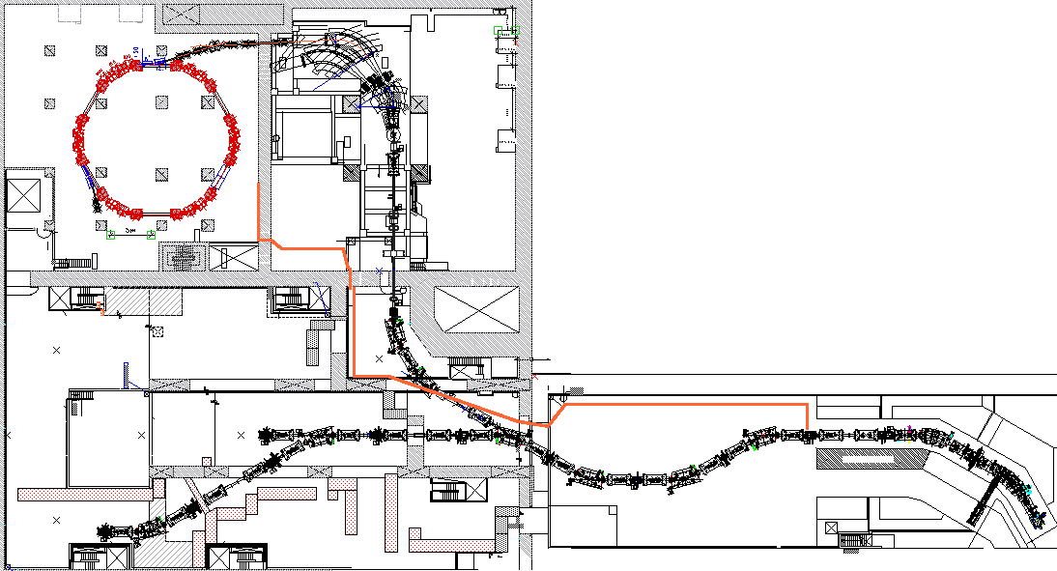
Fast response kicker-system
Flight time is 945ns
for 200MeV/u particle
from F3 to kicker magnet (161.5m)
kicker
Response time of kicker power supply should make less than 290ns.
Delay from thyratron out
to flat-top center : 230ns
370ns (105m)
55ns
F3

Slide 12
Fast response kicker-system
- Response time < 290ns
to establish the self-trigger individual injection method
Pulsed power supply of model kicker
Control
Unit
Thyratron
gate
Unit
New
circuit
board
Thyratron
Kicker
magnet
Trigger input
Trigger input
CT out
4μs
550ns
?ns

Slide 13
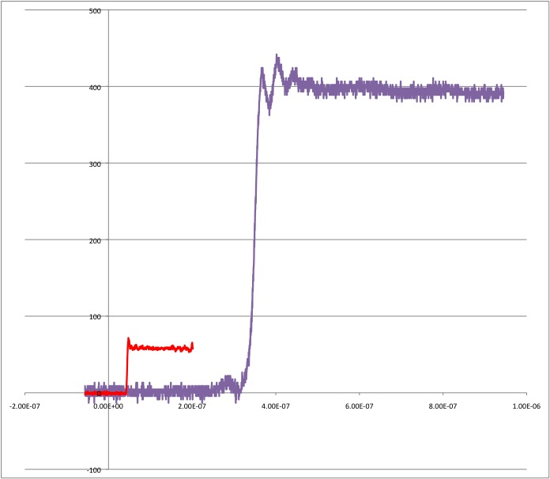
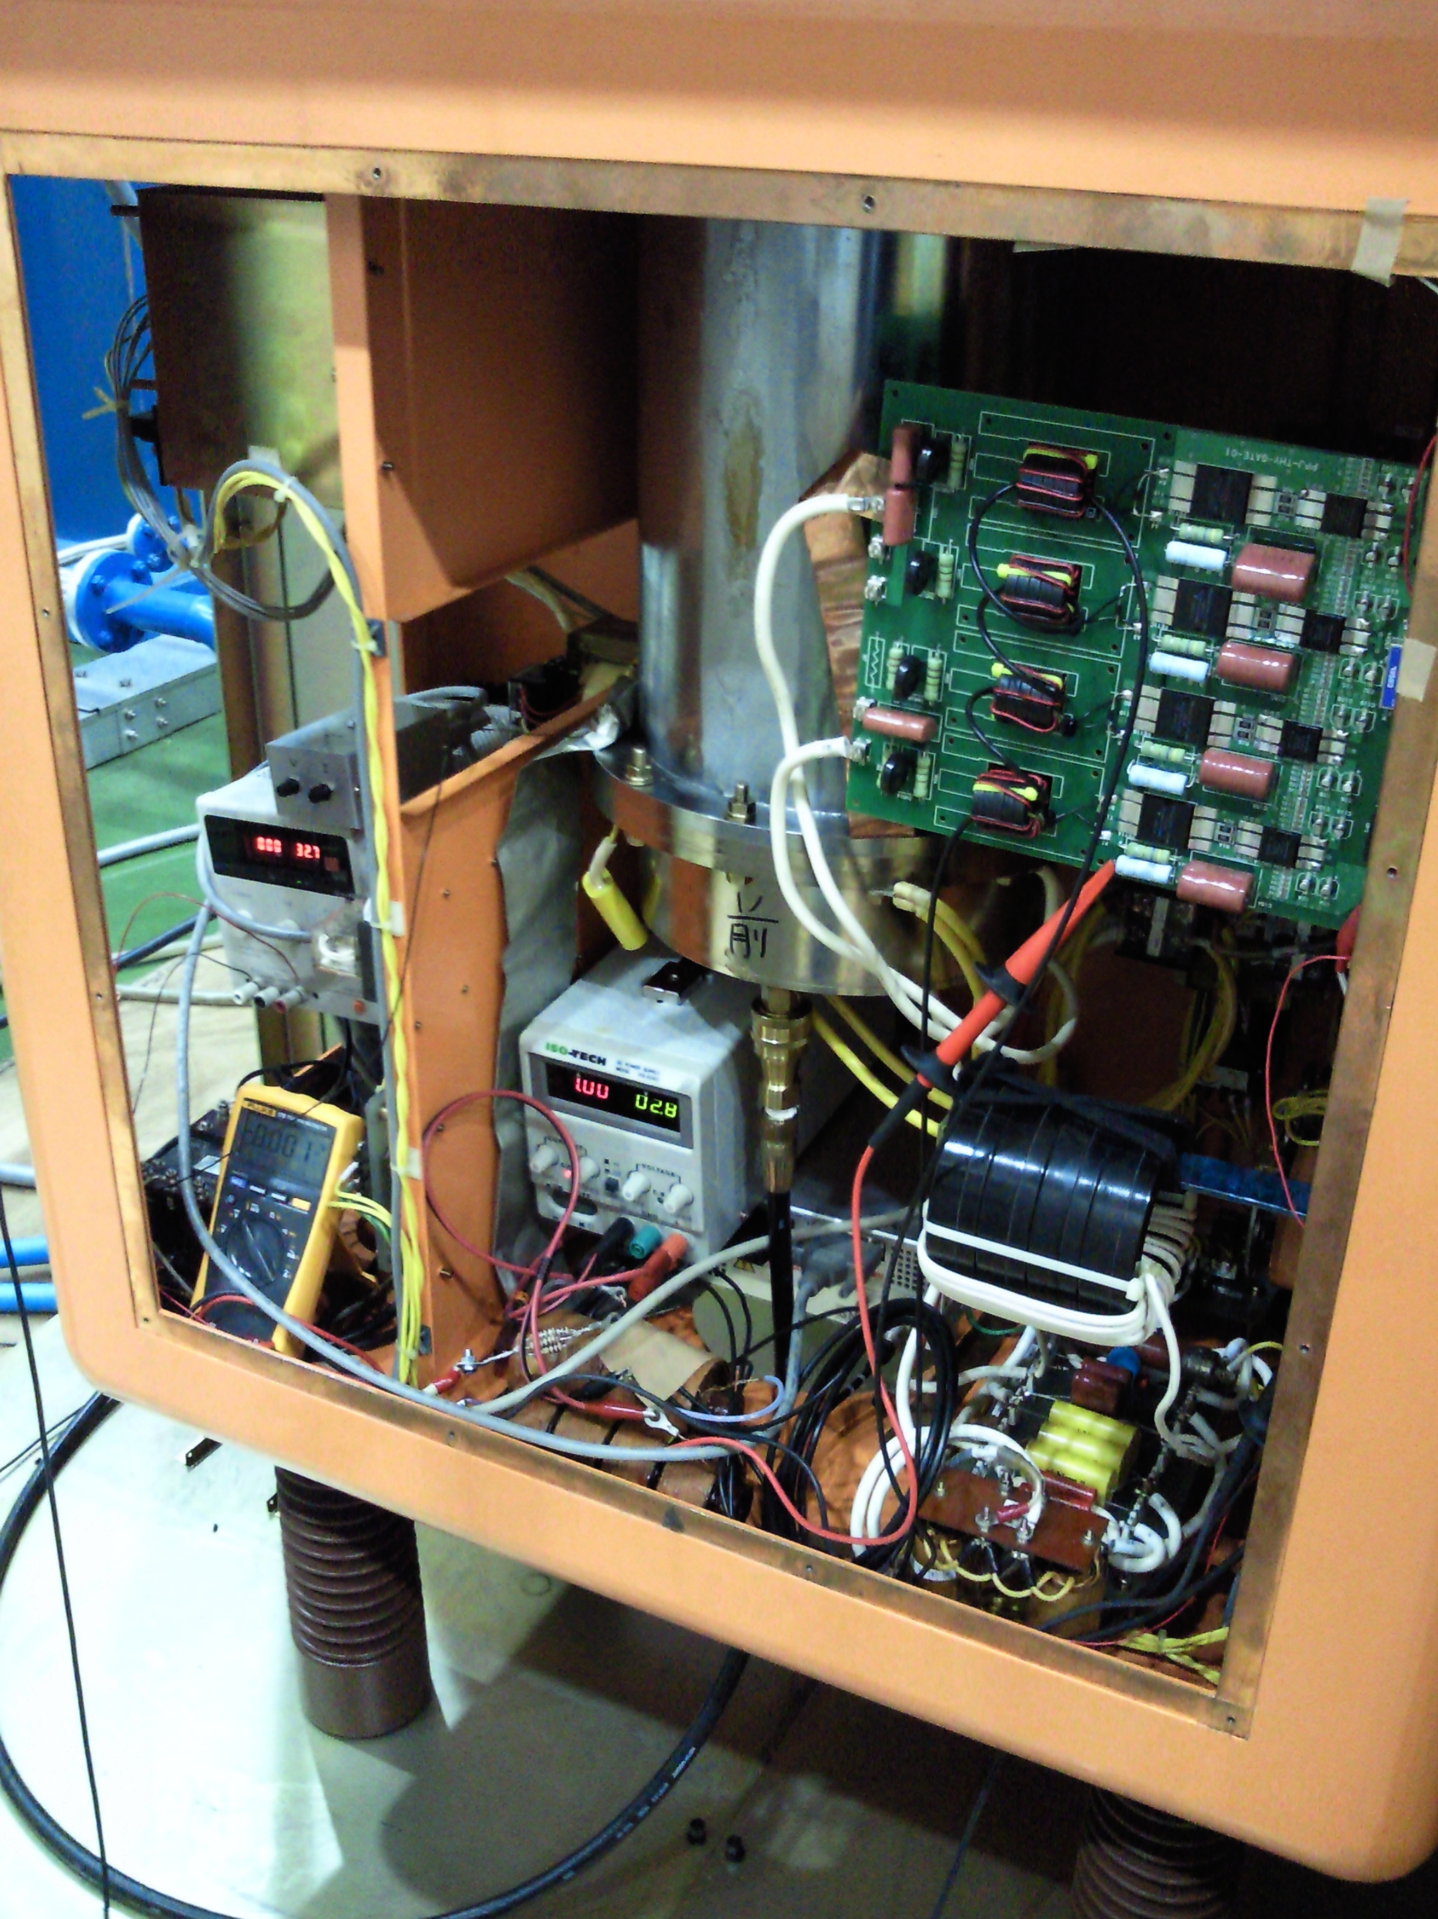
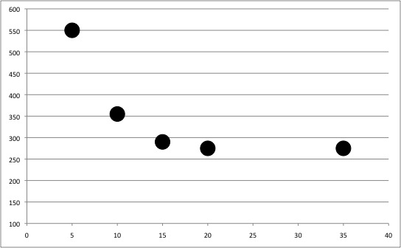
Fast response kicker-system
[V]
New thyratron
gate board
Thyratron CT out
Trigger input
? [ns]
[ns]
550ns (5kV)
4 PTs are used in parallel
for the primary side,
and in series for the
secondary side.
355ns (10kV)
290ns (15kV)
275ns (20kV & 35kV)
Charging voltage dependence
[kV]

Slide 14
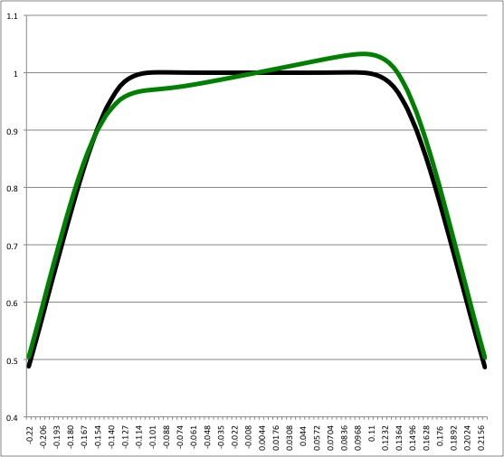
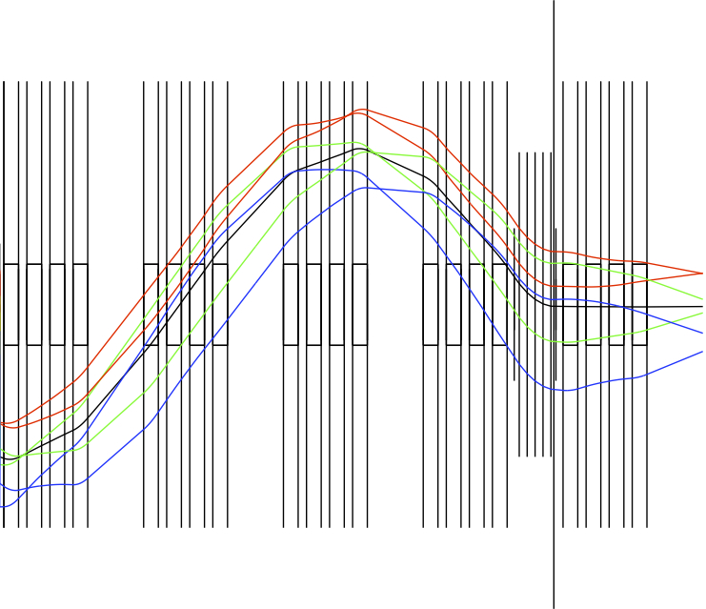
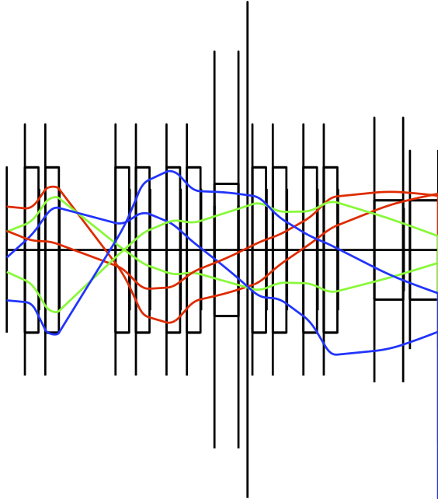
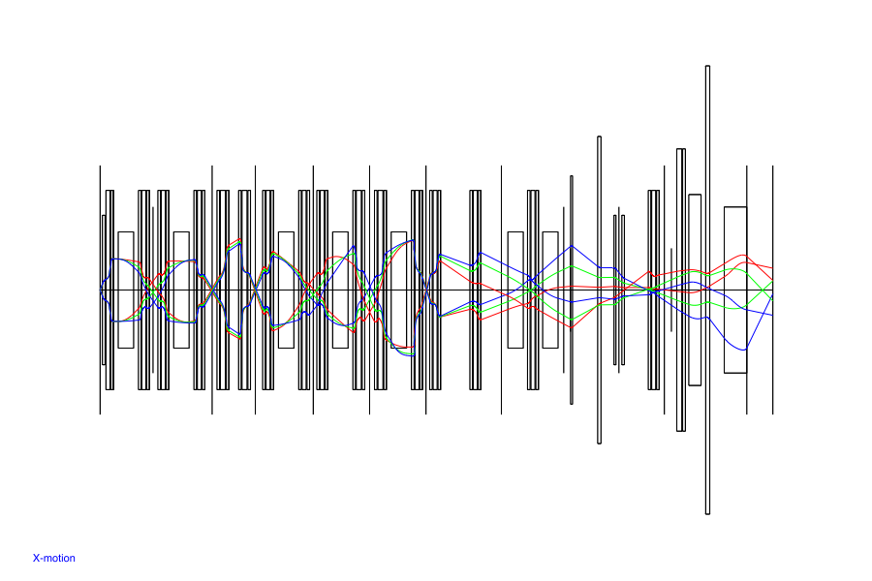
Toward an efficient injection
- Optimize the injection trajectory by 3rd-order calculation
B(r)/B₀ [T]
outer 2 dipoles
inner 2 dipoles
a₀ = ±15mrad
dp/p = -0.5%, 0.0%, 0.5%
(200MeV/u,m/q=3)
radial distributions
of field strength
Injection point
SHARAQ
Kicker
High-resolution
beam line
BigRIPS
F0
F3
F5
FH7
FH10
FR1
Injection line
Septum
1,2
FR1
- Kick angle is 19mrad
- Dispersion matching
Isochronous ring

Slide 15
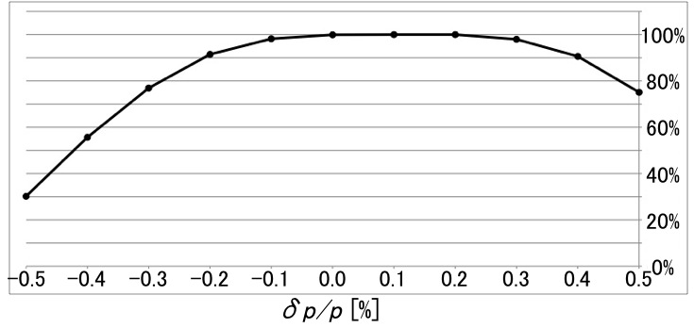
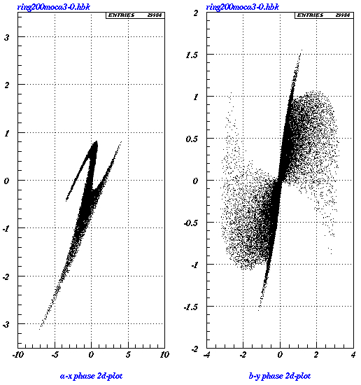
Toward an efficient injection
- Optical transmission efficiency
from BigRIPS-F0 to kicker part
for dp/p=0 particles
a [mrad]
b [mrad]
Injection beam emittance
Horizontal : ε_{x} = 30π mm mrad
Vertical : ε_{y} = 10π mm mrad
eigen-ellipse
50π mm mrad
eigen-ellipse
30π mm mrad
x [cm]
y [cm]

Slide 16
Specification
- Beam energy : 200 MeV/u
- Lorentz factor γ : 1.2147
- Circumference : 60.3507 m
- Momentum acceptance : 1.0%
- Harmonics : 13
- Revolution frequency : 2.82 MHz
- Revolution time : 355 ns
- Normalised gradient k1 : 0.074 m⁻²
transition γ_{tr} = 1.2146 ≒ γ at dp/p=0
- Betatron tune : Q_{x} = 1.22 , Q_{y} = 0.88
- Max. β fuction : β_{x} = 8.1 m , β_{y} = 12.5 m
- Dispersion of straight part : 66.91 mm/%

Slide 17
Summary
We solved two significant challenges and
finalized the basic design of this project
To do list (in this fiscal year)
- Magnetic field measurement for dipole
- Optimization of the trim-coils
- Design study for schottky pick-up
- Feasibility study for kicker
- Design study for septum
~ 2013 construction
2014 ~ machine study
2016 ? mass measurement of ⁷⁸Ni

Slide 18
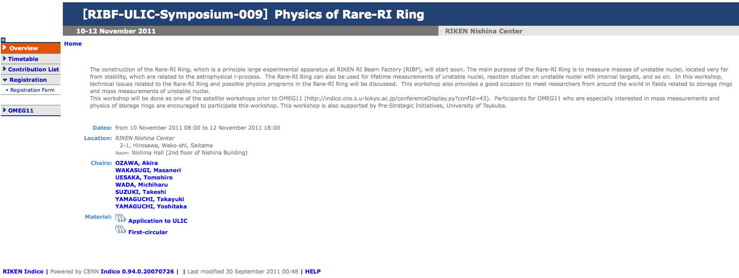
RIKEN :
M. Wakasugi, T. Uesaka, Y. Yamaguchi H. Suzuki, T. Fujinawa, Y. Yano
University of tsukuba : A. Ozawa, D. Nagae
Saitama university : T. Yamaguchi, T. Suzuki
Nagaoka university of technology : W. Jiang, T. Kikuchi, A. Tokuchi
Physics of Rare-RI Ring
10-12 November 2011
http://indico.riken.jp/indico/conferenceDisplay.py?confId=527
Invited speakers from abroad
Dr. Klaus Blaum (Heidelberg)
Dr. Peter Egelhof (GSI)
Dr. Markus Steck (GSI)
Dr. Yuhu Zhang (IMP)
Dr. Meng Wang (AMDC)

Slide 19
Possibility
¹³⁶Xe (350MeV/u , 1pμA) +Be → ¹²³Nb
A/Z=3
Production rate
@LISE++
Mo
~ 1particle / day
~ 1particle / 2days
~ 1particle / week
~ 1particle / month
Nb
r-process path
Zr
N=82
Momentum acceptance (momentum-slit) : 1%
Angular acceptance : hori. 30mrad, vert. 10mrad
Transmission of ¹²³Nb from F0 to F5 : 30% by LISE++
Average of optical transmission efficiency : 80%
¹²³Nb come to the ring 1particle / month

Slide 20
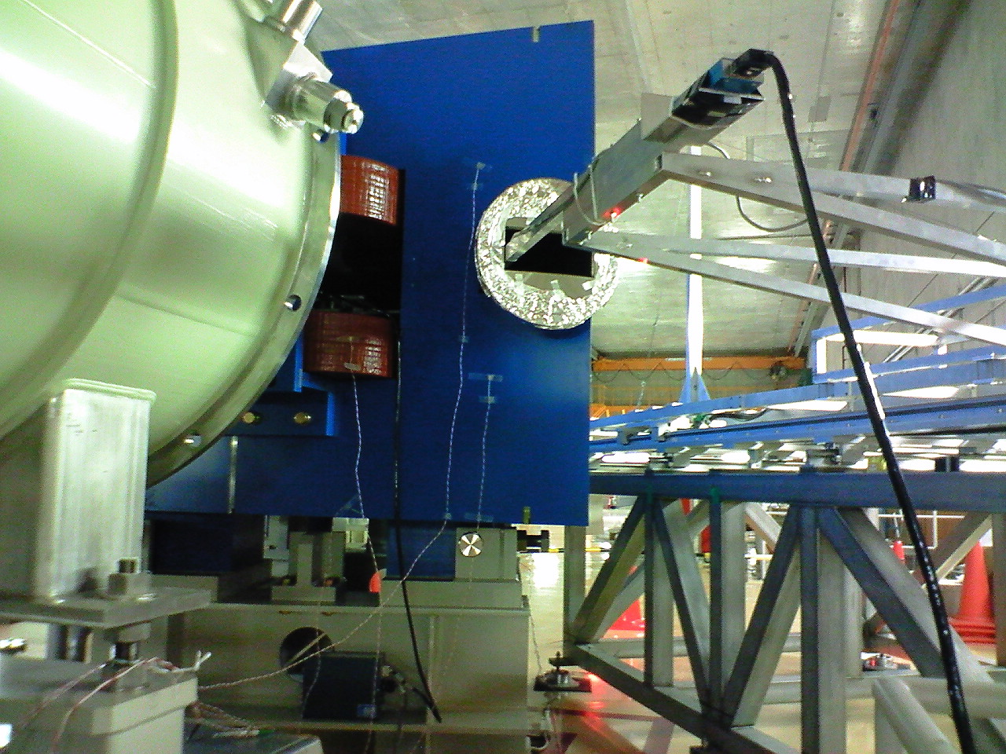
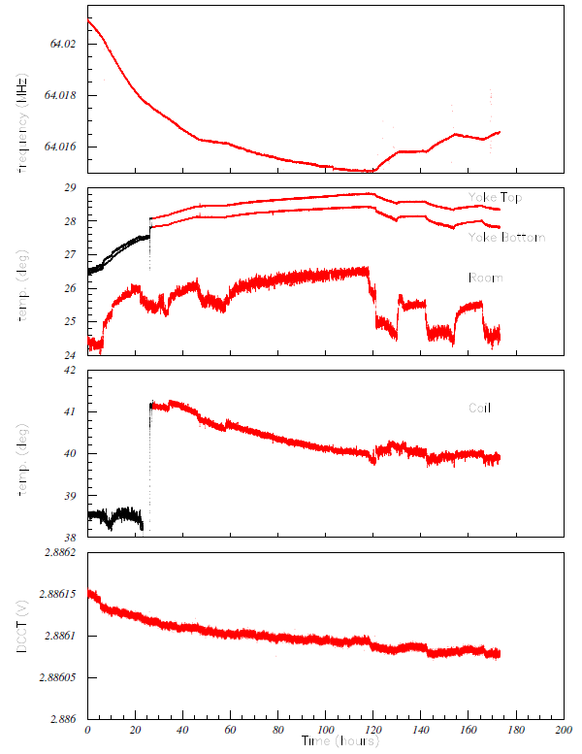
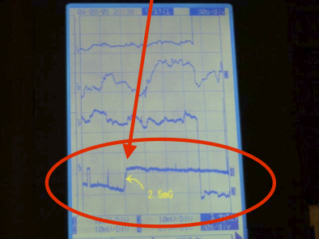
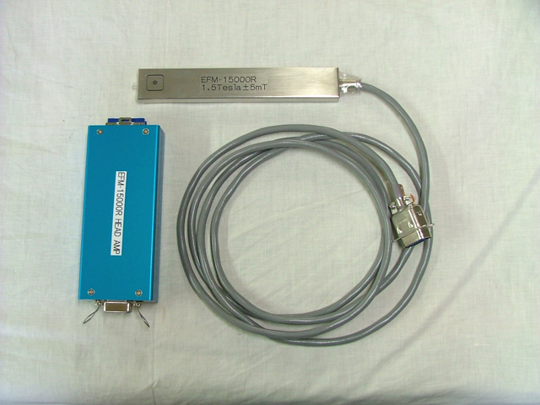
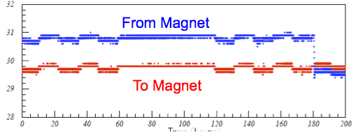
High-precision NMR probe
Checking the long-term field stability
of ZDS-D8 (~180 hours)
[MHz]
Developed for MRI
2.5mG observed in 1.5T
NMR freq.
[℃]
yoke temp.
room temp.
[℃]
Precision ~10⁻⁷
coil temp.
[V]
power supply
DCCT
[℃]
- Magnetic field stability was influence by Yoke
temperature (=room temperature)
Should be keep K4 room temperature!
water temp.
Time [hours]

Slide 21
Principle of mass measurement
: cyclotron frequency
Based on
Isochronous optics
For
Isochronism is no longer fulfilled

Slide 22
Principle of mass measurement
For non-isochronous particles
Difference of m/q ~1% (diff. of T ~1%)
k ~ 10⁻²
β measurement with uncertainty of 10⁻⁴
distance from F3 to FH10
is about 83.33m

Slide 23
Transmission time of trigger signal
Transmission time of trigger signal is about 930ns
from F3 to kicker magnetic field flat-top center
Flight time is 945ns for 200MeV/u particle
from F3 to kicker magnet (161.5m)
- Generate the trigger signal at F3 55ns
(detector: plastic + PMT,
module: discri. + level adapter)
- Transmission cable (105m from F3 to kicker) 370ns
(Relative propagation velocity 95%)
- Response time of kicker power supply 275ns
(results of measurements)
- Thyratron CT out to kicker magnetic field flat-top center 230ns
(results of measurements and estimation)
Total 930ns

Slide 24
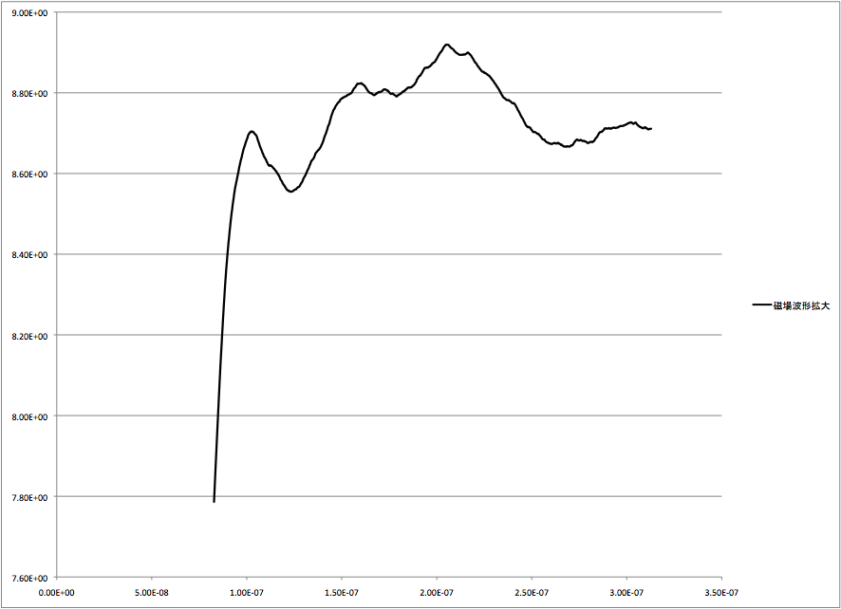
Feasibility study for kicker-system
Kicker is also used for extraction !
- For efficient injection and extraction
- Interval from injection to extraction is about 1.0ms
repetition rate of charge should make less than 1.0ms
(minimum repetition rate of charge of model kicker is about 100ms)
5%
flat-top 200ns
(stability ~ 1%)
200ns
rise-time
100ns
fall-time
100ns
0 [Tesla]
Full flat-top duration
of model kicker is 1μs
Impedance mismatch

Slide 25
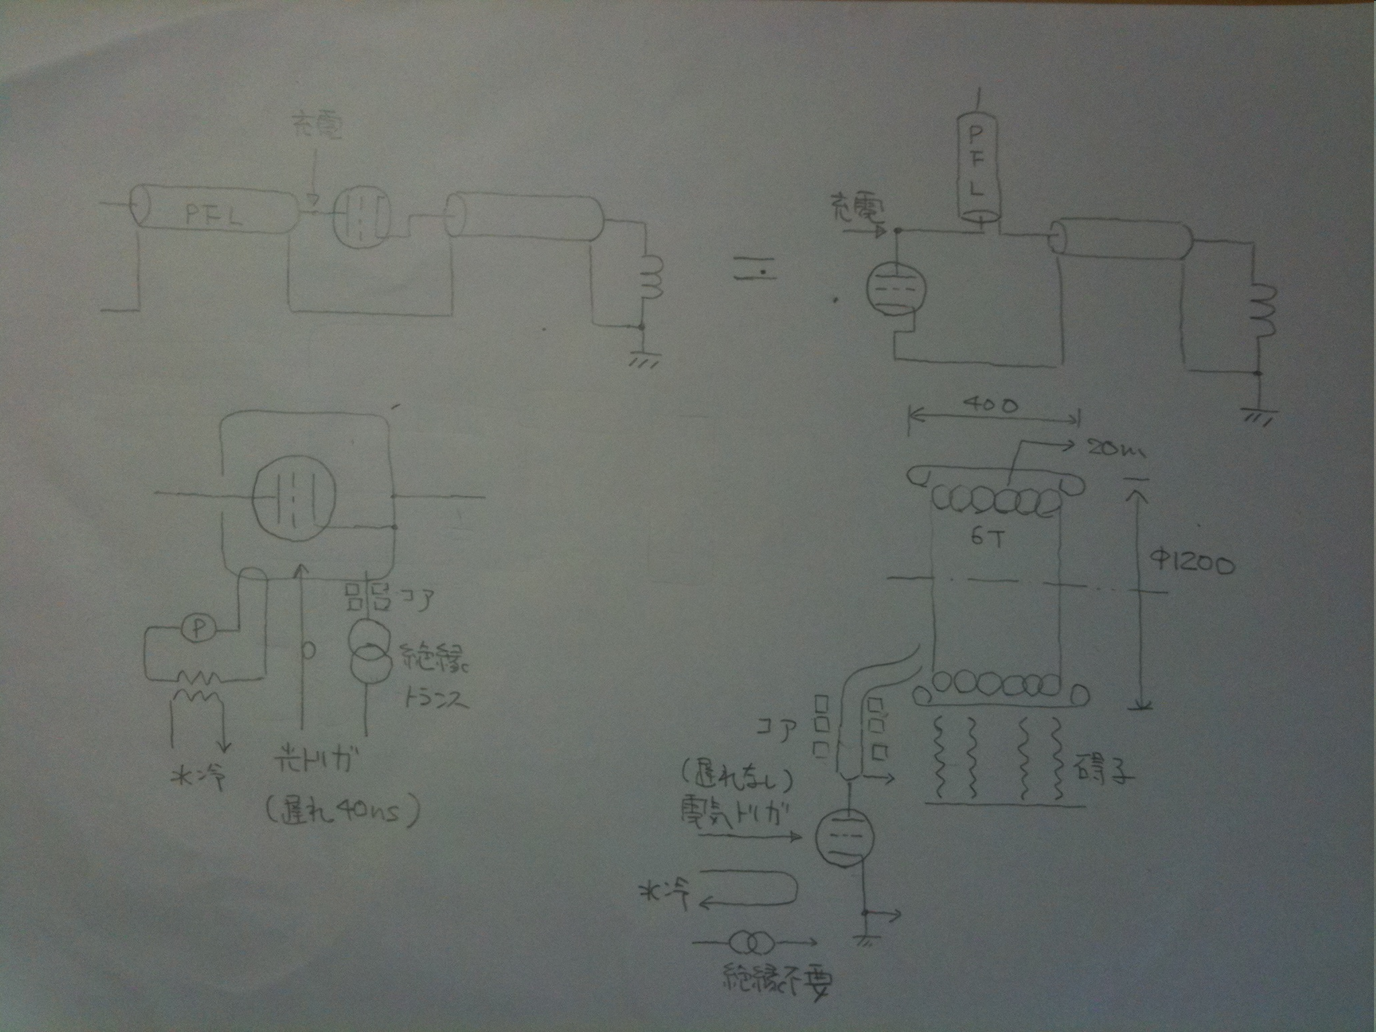
change the ground connection
charge
charge
insulation
optical trigger signal
electric trigger signal
(delay of 40ns)
(no delay)
Response time
275ns 235ns
no insulation

Slide 26
Specification of kicker system
- Kick angle : 19 mrad
- Number of Kicker : 5
- Kick angle / 1kicker : 3.8mrad
- Field strength : 0.05818 Tesla
- Aperture : h=50 mm, w=150 mm
- Impedance : 12.5 Ω
- Number of cell / 1kicker : 14
- Effective length / 1kicker : 0.42 m
- Inductance / 1cell : 57 nH
- Capacitance / 1cell : 230 pF
- Propagation time / 1cell : 5.06 ns (including stray 25%)
- Propagation time / 1kicker : 70.81 ns
- Charging voltage : 60 kV
- Current : 2400 A
- Repetition : 1Hz ~ 100Hz

Slide 27
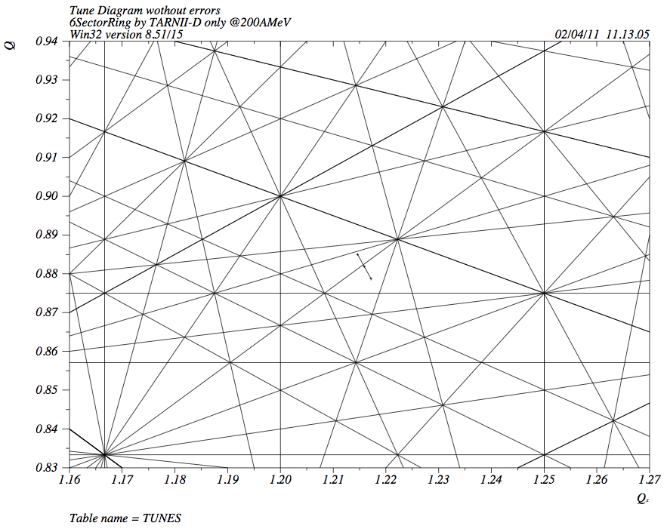
Tune diagram
Q_{y}
6th-order resonance line
Q_{x}

Slide 28
How to check the isochronism ?
- Development of Cluster ion-source
as the calibrator of Rare-RI Ring
Principle and methods
- Rigidity of atomic cluster can be matched to Rare-RI in the storage ring.
- By the cluster we can measure the flight length.
- If we measure the flight length with 10⁻⁶, we can determine the magnetic
field with 10⁻⁶ in the storage ring.
Liq. N₂ (77K)
Ar, He
R&D items
- Production of large sized clusters (Cu_{n=800} or W_{n=300}).
- Realizing a good timing resolution (<10⁻⁶).
- Realizing stable (<10⁻⁶) high-voltage system.
Magnetron Sputtering

