Slide 1
Precursor experiments to search for permanent electric dipole moments (EDMs) of protons and deuterons at COSY
October 14, 2011 Frank Rathmann (with help from Andreas, Bernd, Bill, Ed, and Kolya)
8th Int. Conference on Nuclear Physics at storage rings STORI11, Frascati, Italy

Slide 2
Topics
Why EDMs?
Search for EDMs using storage rings
Spin coherence
Siberian snake
Possible Precursor Experiments
Depolarization using Snake and RF E Fields
Resonance Method with RF E-fields (Morse)
Dual beam method (g-2 dμ)
Resonance Method in a magnetic SR (Orlov, Morse, Semertzidis)
Summary

Slide 3
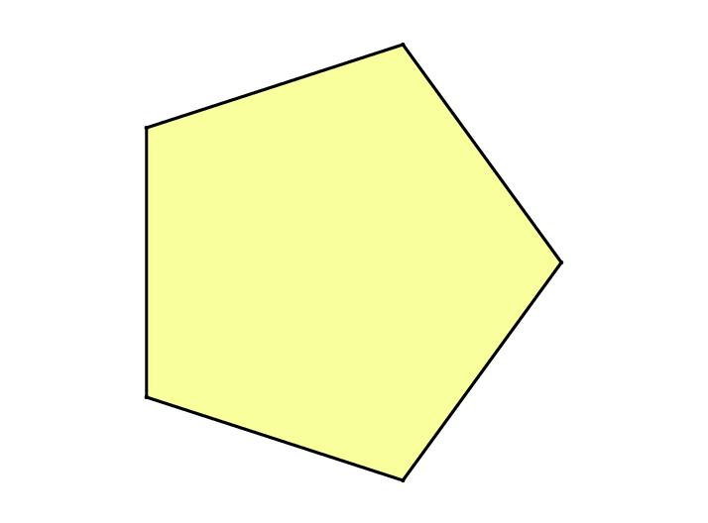
Mega-ton
Detectors
Stability (p-decay)
Neutrino physics
LHC
Super-beam
Factories
Intensity
Mass (Higgs)
Supersymmetry
Extra Dimensions
The
Scientific
Frontiers
to address
well-defined questions
about the physics
of our World
Energy
CKM
ν Mass
QGP
Cosmic Particles
Dark Matter
Dark Energy
Dedicated
Small-scale
Facilities
Precision
Cosmic
Underground
Labs,
Non-accelerator
Symmetries
(TRV, EDM)
Complexity
RHIC
Matter → Materials
QCD phase diagram
Radiation Facilities

Slide 4
What caused the Baryon asymmetry?
Carina Nebula: Largest-seen star-birth regions in the galaxy
Observed | 6×10⁻¹⁰ | WMAP+COBE (2003)
SM expectation | ~10⁻¹⁸
Sakharov (1967): Three conditions for baryogenesis
B number conservation violated sufficiently strongly
C and CP violated, B and anti-Bs with different rates
Evolution of universe outside thermal equilibrium

Slide 5
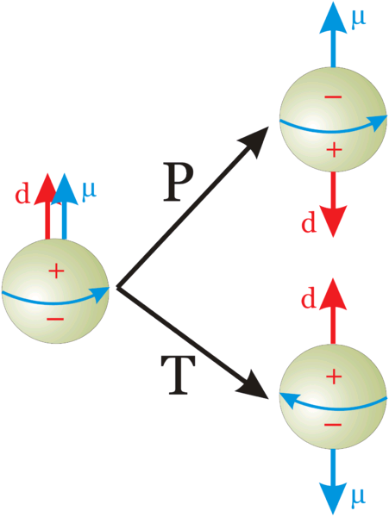
Electric Dipole Moments (EDMs)
Permanent EDMs violate parity P and time reversal symmetry T
Assuming CPT to hold,
combined symmetry CP violated as well.
EDMs are candidates to solve mystery of matter-antimatter asymmetry
→ may explain why we are here!
Notes:
5
5

Slide 6
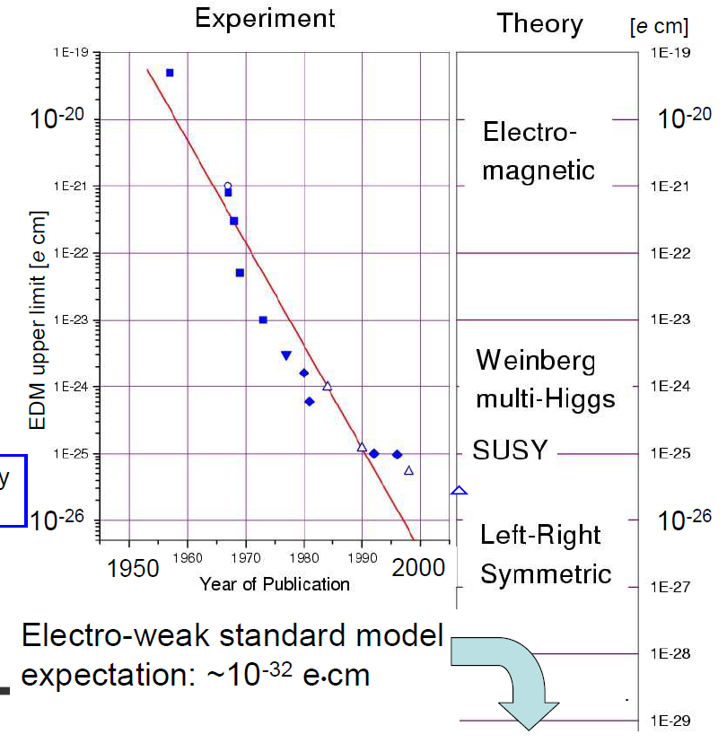
History of neutron EDM limits
Smith, Purcell, Ramsey PR 108, 120 (1957)
RAL-Sussex-ILL (d_{n} < 2.9 ×10⁻²⁶ e⋅cm) PRL 97,131801 (2006)
Adopted from K. Kirch

Slide 7
Limits for Electric Dipole Moments
EDM searches - only upper limits up to now (in e⋅cm):
Particle/Atom | Current EDM Limit | Future Goal | ∼ d_{n} equivalent
Neutron | < 3 ×10⁻²⁶ | ∼10⁻²⁸ | 10⁻²⁸
¹⁹⁹Hg | < 3.1 ×10⁻²⁹ | ∼10⁻²⁹ | 10⁻²⁶
¹²⁹Xe | < 6 ×10⁻²⁷ | ∼10⁻³⁰ – 10⁻³³ | ∼10⁻²⁶ – 10⁻²⁹
Proton | < 7.9 ×10⁻²⁵ | ∼10⁻²⁹ | 10⁻²⁹
Deuteron | ? | ∼10⁻²⁹ | 3 ×10⁻²⁹ – 5 ×10⁻³³
Huge efforts underway to improve limits / find EDMs
Sensitivity to NEW PHYSICS beyond the Standard Model
485. WE-Heraeus-Seminar (July 04−06, 2011)
Search for Electric Dipole Moments (EDMs) at Storage Rings http://www2.fz-juelich.de/ikp/edm/en/
Notes:
7
7

Slide 8
Why also EDMs of protons and deuterons?
Proton and deuteron EDM experiments may provide one order higher sensitivity
In particular the deuteron may provide a much higher sensitivity than protons
Consensus in the theoretical community:
Essential to perform EDM measurements on different targets (p, d, ³He) with similar sensitivity to unfold the underlying physics and to explain the baryogenesis.

Slide 9
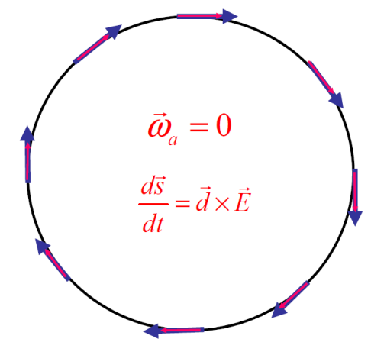
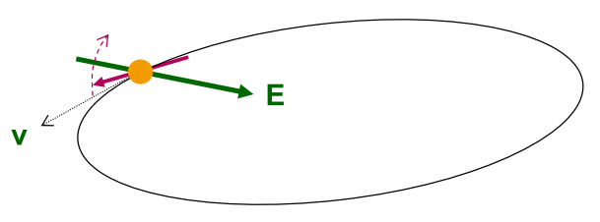
Search for Electric Dipole Moments
NEW: EDM search in time development of spin in a storage ring:
“Freeze“ horizontal spin precession; watch
for development of a vertical component !
Notes:
9
9

Slide 10
The frozen spin Method
For transverse electric and magnetic fields in a ring ( ),
anomalous spin precession is described by
x
Magic condition: Spin along momentum vector
For any sign of G, in a combined electric and magnetic machine
For G>0 (protons) in an all electric ring
(magic)

Slide 11
Magic condition: Protons
E-field only

Slide 12
Magic condition: Deuterons
E and B fields

Slide 13
Magic condition: Helions
E and B fields

Slide 14
Search for Electric Dipole Moments
NEW: EDM search in time development of spin in a storage ring:
“Freeze“ horizontal spin precession; watch
for development of a vertical component !
A magic storage ring for protons (electrostatic), deuterons, …
particle | p (GeV/c) | E (MV/m) | B (T)
proton | 0.701 | 16.789 | 0.000
deuteron | 1.000 | -3.983 | 0.160
³He | 1.285 | 17.158 | -0.051
One machine with r ~ 30 m
Notes:
14
14

Slide 15
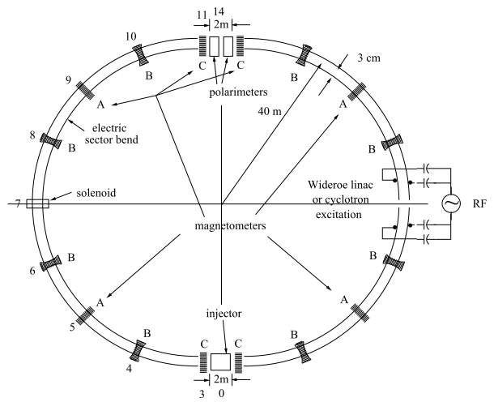
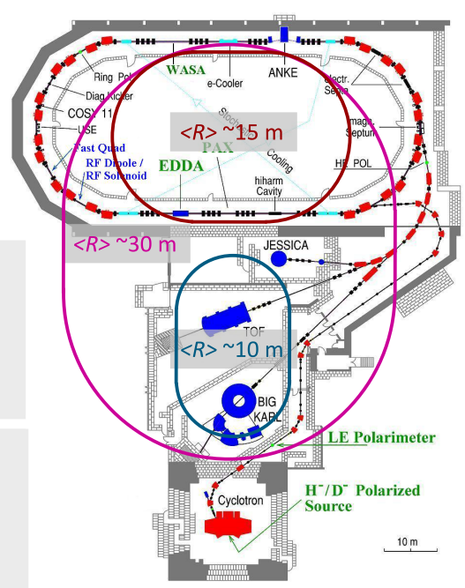
Two storage ring projects being pursued
BNL for protons all electric machine
Jülich, focus on deuterons, or a combined machine
CW and CCW propagating beams
(from R. Talman)
(from A. Lehrach)

Slide 16
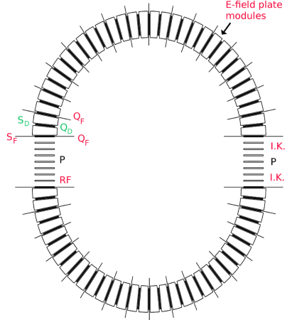
BNL Proposal
2 beams simultaneously rotating in a ring (CW, CCW)
Approved BNL-Proposal: Goal for protons
Circumference
~ 200 m
Technological challenges !
Spin coherence time (1000 s)
Beam positioning (10 nm)
Continuous polarimetry (< 1ppm)
E - field gradients (~ 17MV/m at 2 cm)
Carry out proof of principle experiments (demonstrators) at COSY
Notes:
16
16

Slide 17
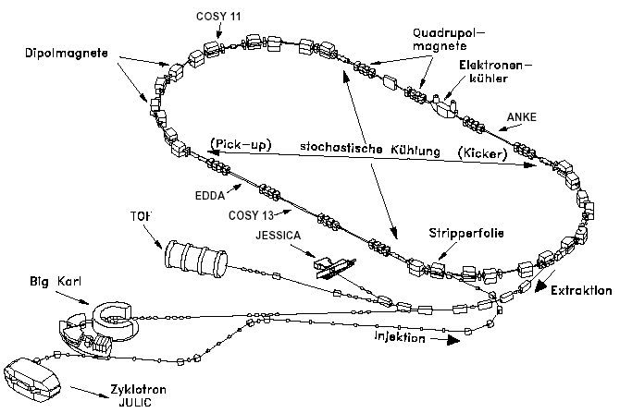
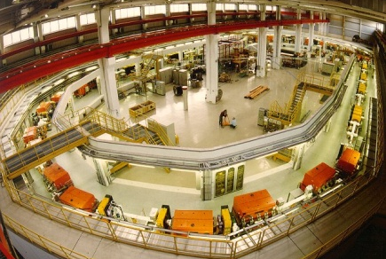
EDM at COSY – COoler SYnchrotron
Cooler and storage ring for (polarized) protons and deuterons
p = 0.3 – 3.7 GeV/c
Phase space
cooled internal &
extracted beams
COSY
… the spin-physics machine
for hadron physics
Injector cyclotron
Notes:
17

Slide 18
EDM at COSY – COoler SYnchrotron
Cooler and storage ring for (polarized) protons and deuterons
p = 0.3 – 3.7 GeV/c
Phase space
cooled internal &
extracted beams
COSY
… an ideal starting point
for a srEDM search
Injector cyclotron
Notes:
18

Slide 19
Spin closed orbit
one particle with
magnetic moment
makes one turn
“spin closed orbit vector”
“spin tune”
stable polarization
ring
if ║
A
Adopted from H.O. Meyer

Slide 20
Spin coherence
We usually don‘t worry about coherence of spins along
Polarization not affected!
At injection all
spin vectors aligned (coherent)
After some time, spin vectors get out of phase and fully populate the cone
Situation very different, when you deal with ⊥
Longitudinal polarization vanishes!
At injection all spin vectors aligned
After some time, the spin vectors are all out of phase and in the horizontal plane
In an Edm machine with frozen spin, observation time is limited.

Slide 21
Estimate of spin coherence times (Kolya Nikolaev)
One source of spin coherence are random variations of the spin tune
due to the momentum spread in the beam
and
is randomized by e.g., electron cooling
Estimate:
Spin coherence time for deuterons may be ~100 larger than for protons

Slide 22
First measurement of spin coherence time
Test measurements at COSY
Polarimetry:
Spin coherence time:
5 s
25 s
5 s
decoherence
time
oscillation
capture
from E. Stephenson

Slide 23
Topics
Why EDMs?
Search for EDMs using storage rings
Spin coherence
Siberian snake
Possible Precursor Experiments
Depolarization using Snake and RF E Fields
Resonance Method with RF E-fields (Morse)
Dual beam method (g-2 dμ)
Resonance Method in a magnetic SR (Orlov, Morse, Semertzidis)
Summary

Slide 24
COSY: Concept for Snake
Should allow for flexible use at two locations
Fast ramping (< 30s), with injection of P_{y}
Cryogen-free system
Should be available in 2012
ANKE
ANKE
PAX
PAX
 | B⋅dl (Tm)
pn→{pp}_{s}π⁻ at 353 MeV | 3.329
PAX at COSY 140 MeV | 1.994
PAX at AD 500 MeV | 4.090
T_{max} at COSY 2.88 GeV | 13.887

Slide 25
PE 1: Use a combination of a snake and RF fields
Snake
Snake only
Siberian snake turns spin closed orbit along longitudinal axis

Slide 26
PE 1: Use a combination of a snake and RF fields
RF E-field
Snake
RF E-field
Snake + RF E-field, odd turns

Slide 27
PE 1: Use a combination of a snake and RF fields
RF E-field
Snake
RF E-field
Snake + RF E-field, even turns
2α
Snake + reversed RF E-fields → depolarization

Slide 28
PE 1: Use a combination of a snake and RF fields
RF E-field
Snake
RF E-field
Parameters of a proton EDM measurement:
T_{p}=140 MeV
E_{RF}=1 MV/m, L_{cavity}=0.5 m
Time of store ∼24h → 6.3⋅10¹⁰ turns
α=1 ⋅10⁻⁷ rad
Sensitivity:
d_{p}=10⁻¹⁷ e⋅cm → τ_{p}=5.9 ⋅10⁵ s
d_{p}=10⁻¹⁸ e⋅cm → τ_{p}=5.9 ⋅10⁷ s
2α
P(n)
d_{p}=10⁻¹⁸ e⋅cm
d_{p}=10⁻¹⁷ e⋅cm
n (number of turns)

Slide 29
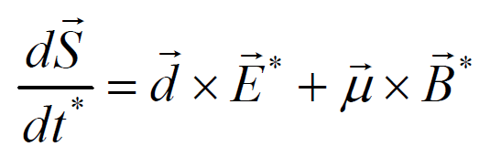
PE 2: Resonance Method with RF E-fields
(Bill and Kolyas variation of PE1)
spin precession governed by:
(* rest frame)
Two situations:
B*=0 ⇒ B_{y} = β×E_{R} (= 70 G for E_{R}=30 kV/cm) EDM effect
E*=0 ⇒ E_{R} = -β× B_{y} no EDM effect
vertical polarization
RF E-field
stored d
Polarimeter (dp elastic)
This way, the Edm signal gets accumulated during the cycle.
Statistical improvement over PE 1 is about: .
Brings us in the 10⁻²⁴ e⋅cm range for d_{d}

Slide 30
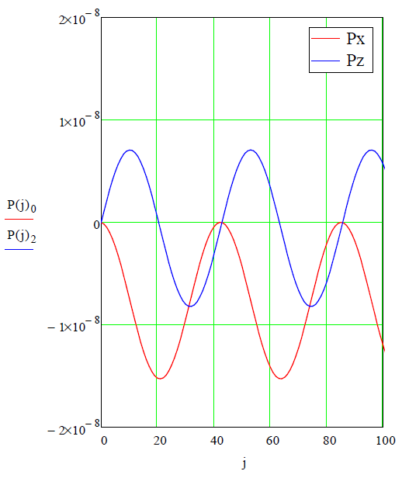
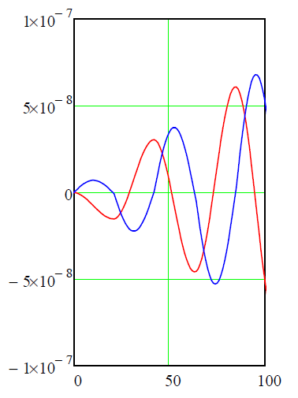
PE 2: Simulation of resonance Method with RF E-fields
and deuterons at COSY
Parameters: beam energy T_{d}=50 MeV
assumed EDM d_{d}=10⁻²⁰ e⋅cm
E-field 10 kV/cm
E-field reversed every -π/(G⋅γ) ∼ 21 turns
Constant E-field
Number of turns
Number of turns

Slide 31
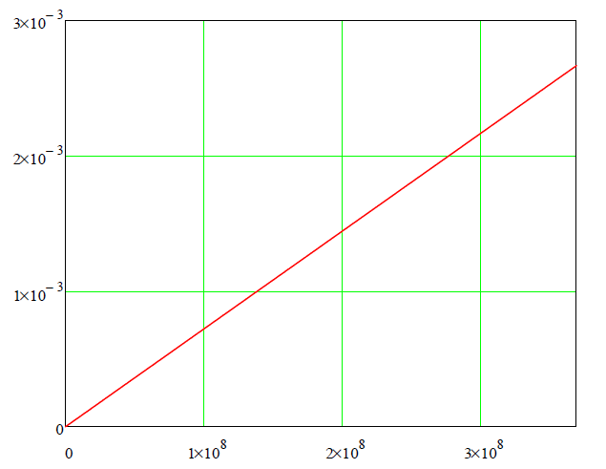
PE 2: Simulation of resonance Method with RF E-fields
and deuterons at COSY
Parameters: beam energy T_{d}=50 MeV
assumed EDM d_{d}=10⁻²⁰ e⋅cm
E-field 10 kV/cm
Linear extrapolation of for a time period of τ_{sc}=1000 s (=3.7⋅10⁸ turns)
EDM effect accumulates
Polarimeter determines
P_{x}, P_{y} and P_{z}
Number of turns

Slide 32
PE 3: Dual Beam Method (equivalent to g-2 d_{μ})
It seems possible to store protons and deuterons in COSY simultaneously.
p and d at same momentum
Polarimeter
(determines pp and dp elastic)
Assume d_{p}=10⁻²⁴ e⋅cm.
Determine invariant spin axis of protons using polarimeter.
Not clear whether one can get away with radial components of P only.
Determine invariant spin axis for deuterons using polarimeter.
Difference between the two invariant spin axes sensitive to d_{d.}
Sensitivity similar to g-2 d_{μ}: d_{d}=10⁻¹⁹ e⋅cm.

Slide 33
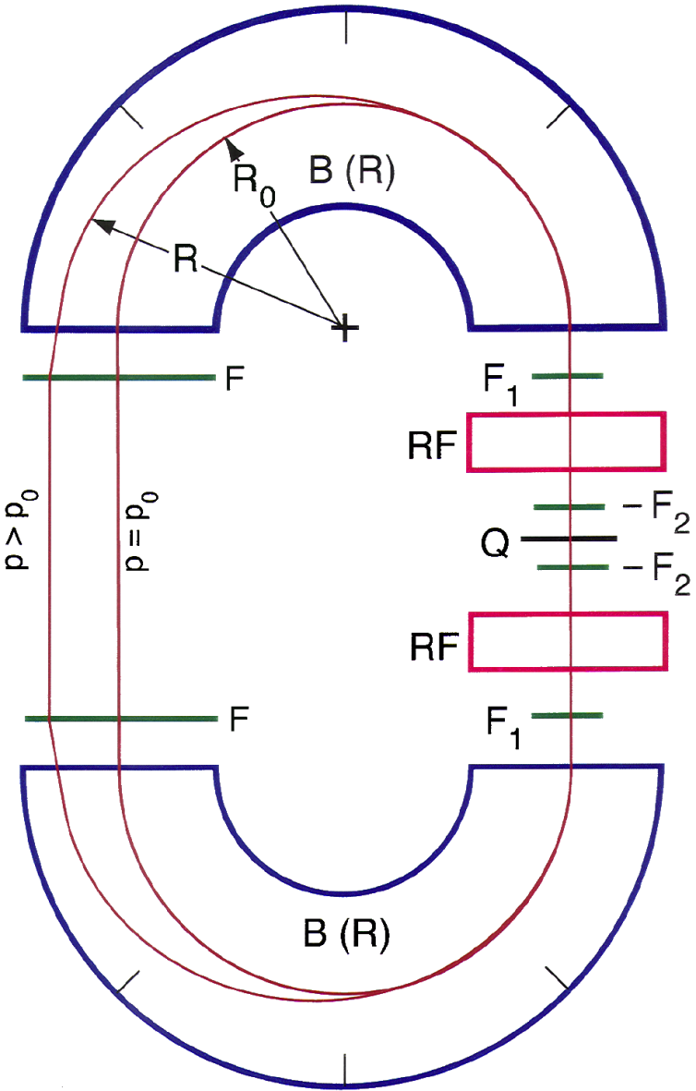
PE 4: Resonance Method of EDM Measurements in SR
Measurement using an all magnetic ring
Sideways P, EDM produces growing P_{y}
Using two sub-beams with different v and modulating v allows one to isolate d.
Sensitivity d_{d}=10⁻²⁹ e⋅cm/yr
Idea was no longer pursued at BNL because systematic error is much larger.
Orlov, Morse, Semertzidis PRL 96 (2006)

Slide 34
srEDM cooperations
International srEDM Network
Institutional (MoU) and Personal (Spokespersons …) Cooperation, Coordination
srEDM Collaboration (BNL)
srEDM Collaboration (FZJ)
Common R&D
RHIC EDM-at-COSY
Beam Position Monitors Polarimetry
(…) Spin Coherence Time
Cooling
Spin Tracking (…)
Study Group
DOE-Proposal
Precursor; Ring Design
CD0, 1, …
HGF Application(s)
pEDM Ring at BNL
JEDI

Slide 35
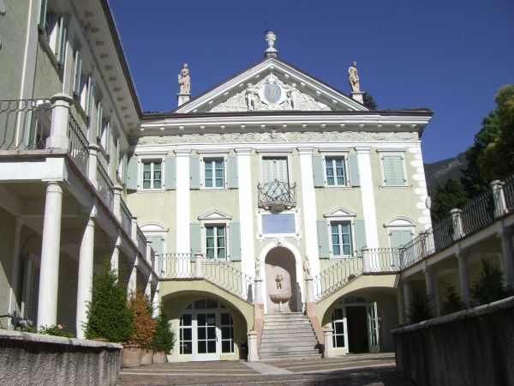
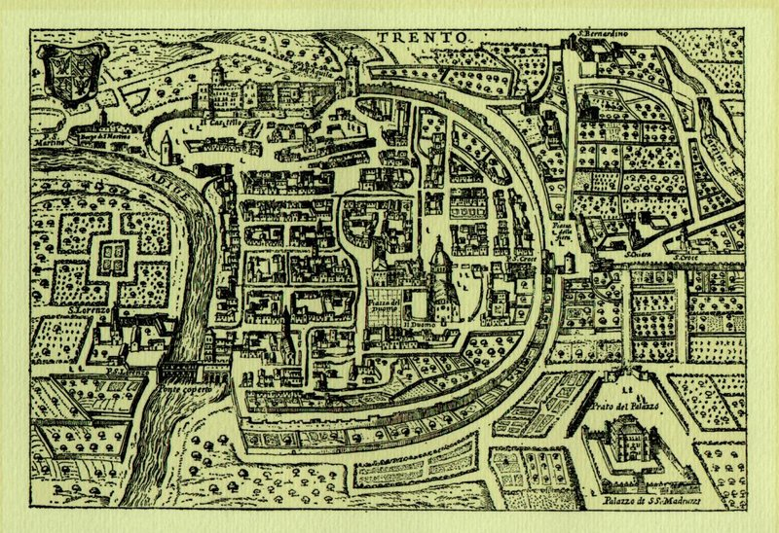
EDM Workshop at ECT* (Trento)
Approved, but exact date in the fall of 2012 not yet known
Organizing committee
Jülich
Hans Ströher h.stroeher@fz-juelich.de
Frank Rathmann f.rathmann@fz-juelich.de
Andreas Wirzba a.wirzba@fz-juelich.de
Brookhaven
Mei Bai mbai@bnl.gov
William Marciano marciano@bnl.gov
Yannis Semertzidis yannis@bnl.gov

Slide 36
Summary
Measurement of EDMs extremely difficult, but the physics is fantastic!
Systematic error estimates for all PEs require reliable spin tracking tools. Top priority to make them available ASAP!
Next steps:
Scrutinize further potential of different PEs
Identify PE with best systematic limit on d_{p,d}.
Pursue spin coherence time measurements at COSY
New collaboration „JEDI“ being formed

Slide 37
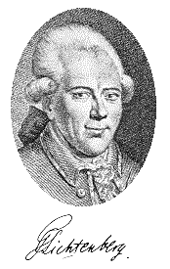
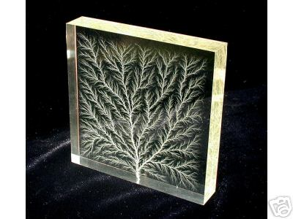
Georg Christoph Lichtenberg (1742-1799)
“Man muß etwas Neues machen, um etwas Neues zu sehen.”
“You have to make (create) something new,
if you want to see something new”

Slide 38
Spare transparencies
Notes:
38
38

Slide 39
One backup slide for olrov

Slide 40
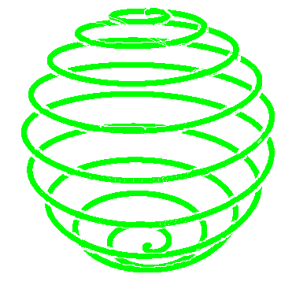
spin manipulation
180º
snakes
there is an for every point of the orbit
Snakes (non-vertical B field) affect
flippers
spin closed orbit
ramping through a resonance reverses

Slide 41
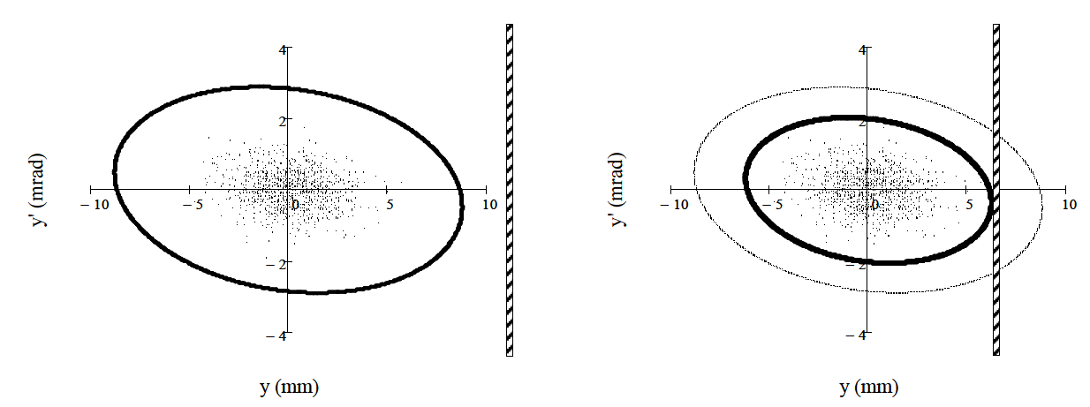
Machine acceptance
In an ideal machine (like TSR-HD)
→ Single-Coulomb scattering at the target dominates beam loss
cooled
beam
ring acceptance
target
lost
K. Grigoriev et al., NIMA 599,130 (2009)
Notes:
Vertical phase space: A_{y} = 25 π mm mrad, and a beam emittance of ε_{y} = 3.8 π mm mrad

Slide 42
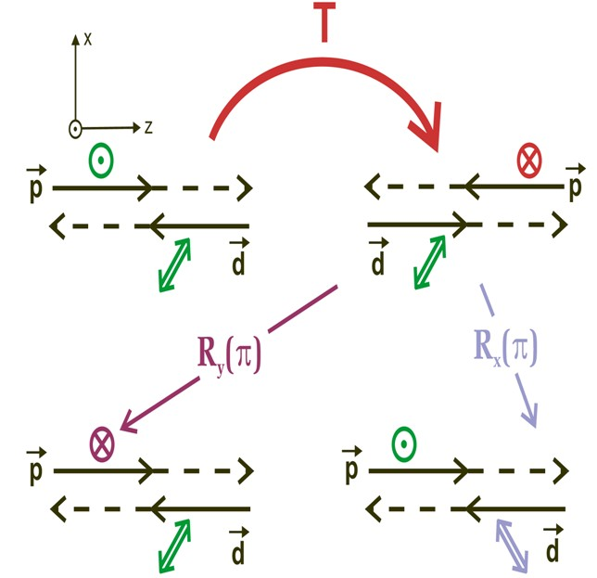
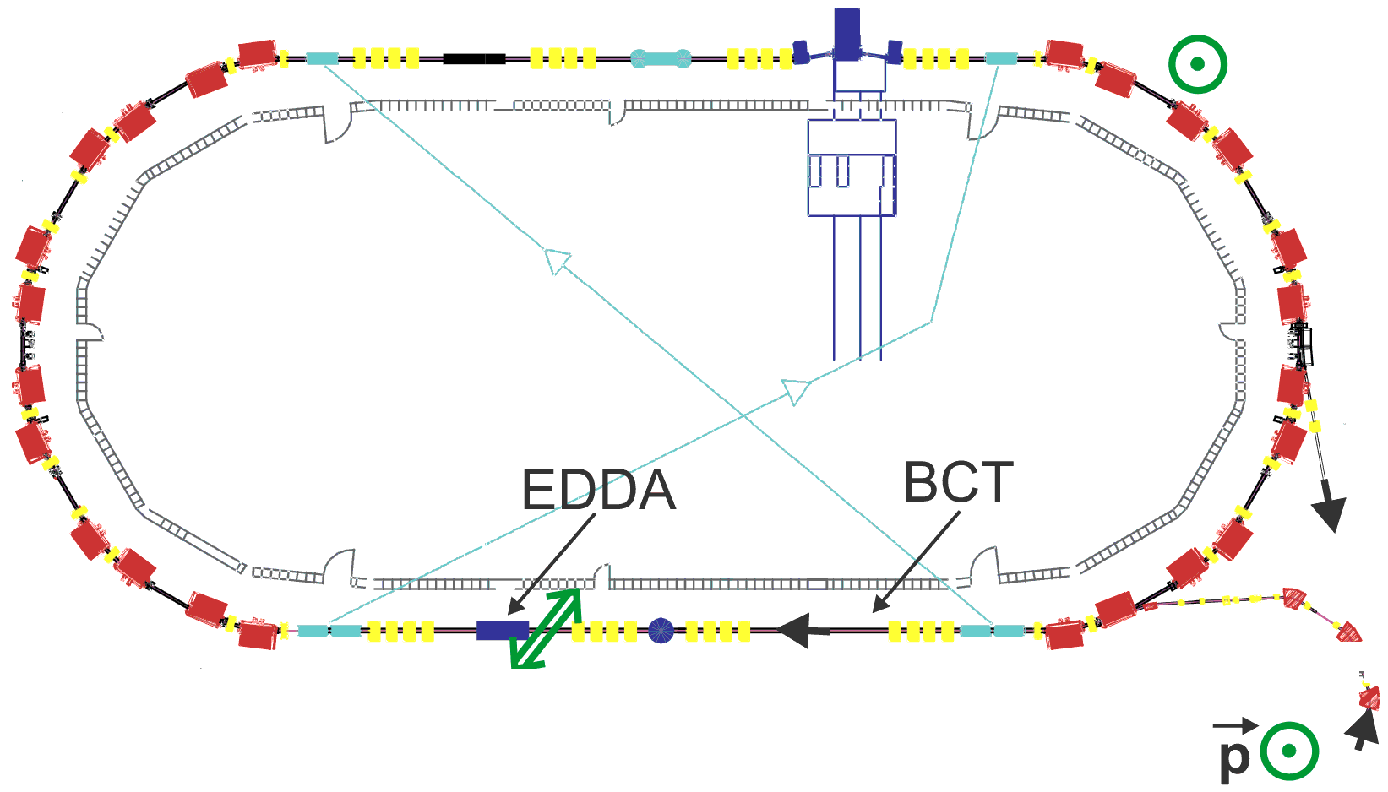
Future: Time Reversal Invariance Test
COSY-TRIC: P-even, T-odd
COSY used as accelerator and detector:
Total polarization correlation coefficient A_{y,xz} leads to relative difference of current slopes
I_{Beam}
time
PAX
Milestone: Operation of Precision BCT with ΔI/I<10⁻⁴

Slide 43
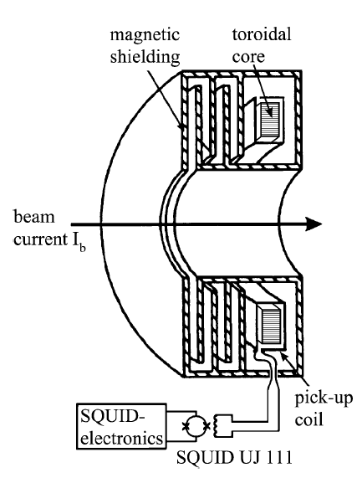
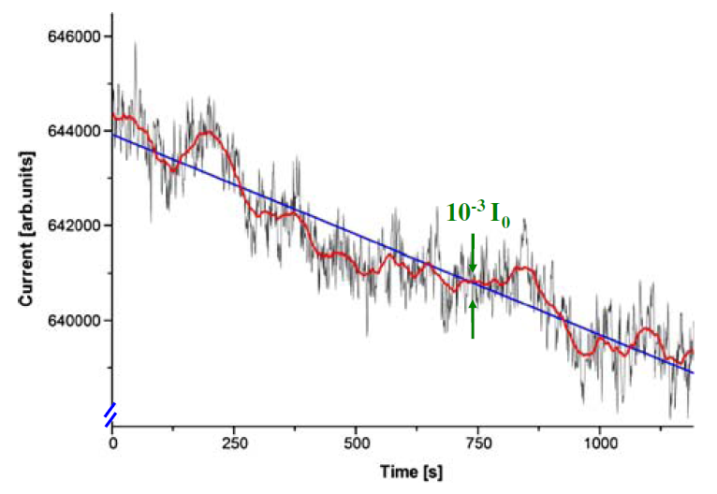
Need for a high precision BCT
Status TRI Test at COSY
Slow fluctuations in the measured BCT signal exceed the noise band at higher frequencies
Possible solution:
Cryogenic Current Comparator, read out by low-temperature super-conducting quantum interference device
D. Eversheim Hyperfine Interact 193 (2009)
A. Steppke, IEEE Trans. Appl. Superc. (2009)
Highest resolution achieved: 250 pA/√Hz

Slide 44
Freezing Spin Precession with E-Fields
G > 0 for γ > 1, if only electric fields are applied
Magic momentum for protons: p = 700.74 MeV/c
μ_{p} / μ_{N} = 2.792 847 356 (23) → G_{p} = 1.7928473565
μ_{d} / μ_{N} = 0.857 438 2308 (72) → G_{d} = -0.14298727202
μ_{He-3} / μ_{N} = -2.127 497 718 (25) → G_{3He}= -4.1839627399
Nuclear magneton: μ_{N} = eħ / (2m_{p}c) = 5.050 783 24 (13) · 10⁻²⁷ J T⁻¹

Slide 45
WE-Heraeus Seminar: Search for EDMs at Storage Rings
Physikzentrum Bad Honnef, July 4-6, 2011
16
Lower limit on electron-cooled SCT from January run
RF-solenoid produces small polarization kicks about longitudinal direction.
(Kicks vary as cosine with maximum < 4 μrad.)
On (1‒Gγ) resonance, this produces continuously reversing vertical P_{Y}.
Set process to turn RF-solenoid ON, OFF, then ON again.
During this time the
polarization is in the
ring plane and free
to decohere.
If oscillation returns,
beam is still
polarized, and (2) the
RF-solenoid was
still in phase (thus
this is a lower limit).
Lines added
to guide
the eye.
5 s
25 s
5 s
reference
oscillation
decoherence
time
oscillation
capture

Slide 46
WE-Heraeus Seminar: Search for EDMs at Storage Rings
Physikzentrum Bad Honnef, July 4-6, 2011
17
3 ON-OFF-ON runs had usable data.
“No lattice” model in which betatron
oscillation effects included by a
path lengthening mechanism, scaled
to match the measured emittance.
Band represents Monte Carlo errors
for 1000 particles in model.
Using a Gaussian shape, “half life”
represented by this point is 75 s.
We could not have seen this effect
for uncooled beam as synchrotron
oscillations inside beam bunch
damped reference oscillation pattern.
Curve is “no lattice” model.
Expected half life 5-10 s.

Slide 47
WE-Heraeus Seminar: Search for EDMs at Storage Rings
Physikzentrum Bad Honnef, July 4-6, 2011
18
3 ON-OFF-ON runs had usable data.
Distribution of synchrotron amplitudes
Cooled
Uncooled

Slide 48
WE-Heraeus Seminar: Search for EDMs at Storage Rings
Physikzentrum Bad Honnef, July 4-6, 2011
19
3 ON-OFF-ON runs had usable data.
Distribution of synchrotron amplitudes
Cooled
… to be continued.
Uncooled

