Slide 1
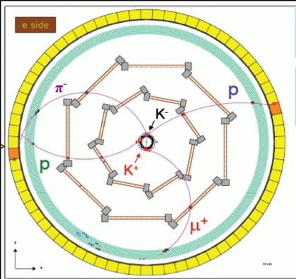
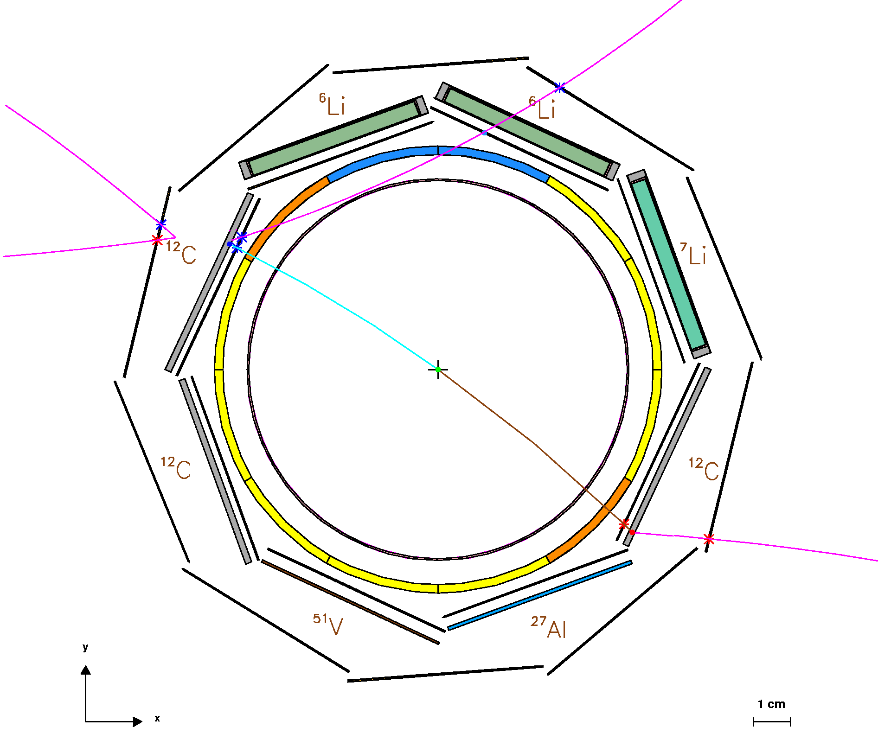
Study of the K⁻_{stop} + A → Σ± + π∓ + A' reaction on light nuclei
Paolo Camerini
University of Trieste and
INFN - sez. Trieste
FINUDA collaboration

Slide 2
K⁻_{stop} + A → Σ± + π∓ + A' reaction on light nuclei
K- nucleus interaction still unsettled
Yet relevant in many fields (neutron star matter and kaon condensation,
in medium Λ(1405), deeply bound kaonic states…)
Role of subthreshold K⁻ p amplitudes crucial, but dominated by Λ (1405),
whose nature and in medium characteristics still poorly known
K⁻ nuclear potential studied by FINUDA by K- absorption on light nuclei
Λ-hypernuclear spectroscopy (K⁻_{stop} , π⁻)
search for deeply bound kaonic states & multinucleon absorption
(K_{stop},Λp/Λd/Λt/ Σ⁻p…)
K⁻_{stop} A → Σ± + π∓A’ quasi-exclusive measurement
Advantages:
>Under threshold sensitivity (bound proton)
>minimize FSI distortions & bckgnd, No 2-body contrib.
>Construct R₊₋ = π⁻Σ⁺ / π⁺Σ⁻ little dependence on nuclear structure, but sensitive
to under threshold amplitudes

Slide 3
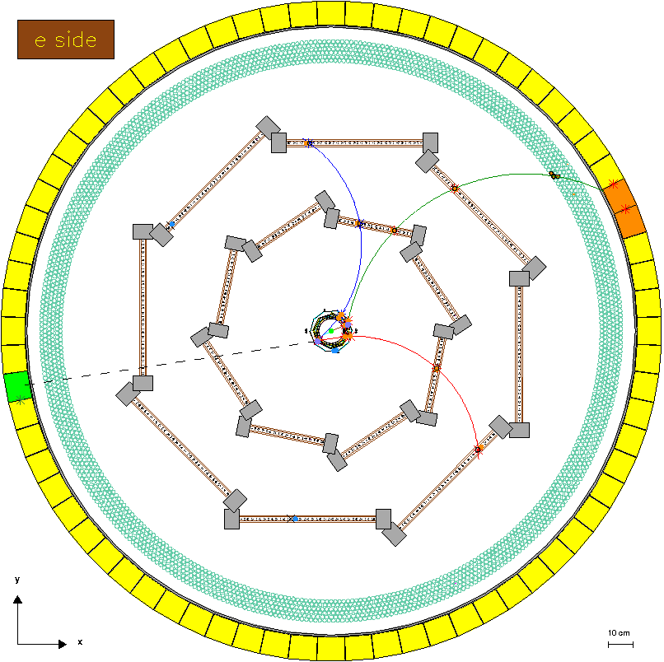
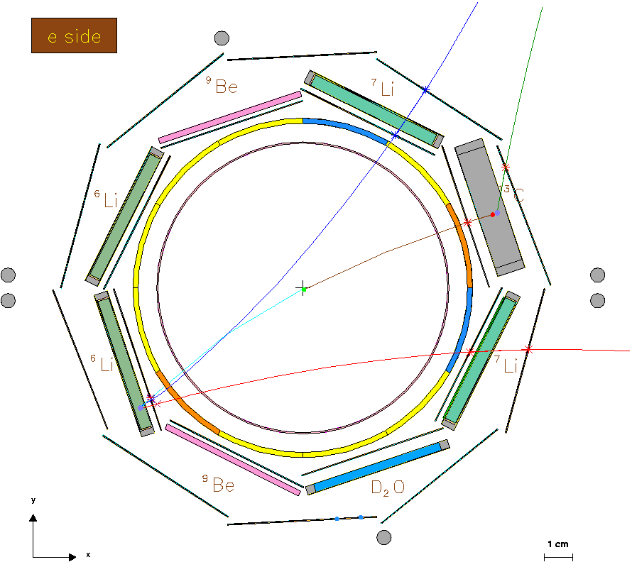
K⁻_{stop} + A → Σ± + π∓ + A' reaction on light nuclei
The DAΦNE e⁺ - e⁻ collider provides ~16 MeV back-to-back K⁺K⁻ pairs from the
(1020) decay.
FINUDA studied the Σπ production
via the K⁻_{stop} A→ nπ⁺π⁻A’ reaction.
μ⁺ ν
K⁺ Φ K⁻ A π⁻ n π⁺ A’
TGTS: 2×⁶Li, 2×⁷Li,¹³C, 2×⁹Be, D₂O; ρ~0.25gcm⁻²
Σ⁻ Σ⁺
FINUDA spectrometer
Central region
π⁻
μ⁺
μ⁺
π⁻
n
K⁺
π⁺
K⁻
π⁺

Slide 4
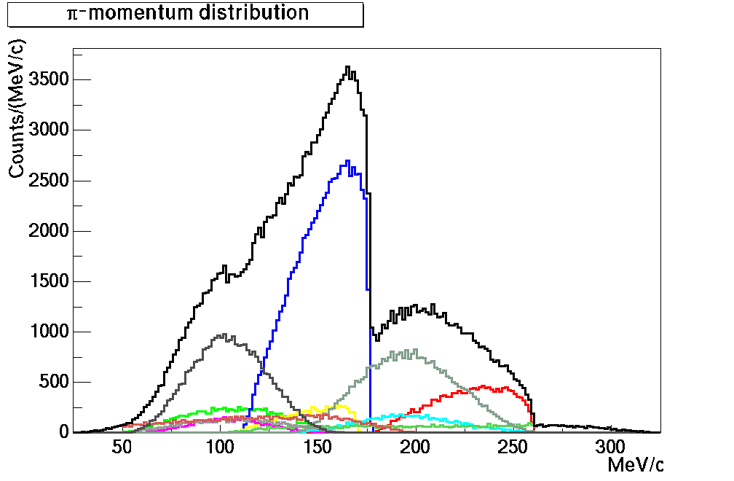
Inclusive vs. quasi-exclusive π⁻ spectra
Simulated π⁻ momenta from ¹²C (K⁻_{stop} ,π⁻) quasifree reactions
Sum
K⁻ p→Σ⁺ π⁻
(K⁻_{stop} ,π⁻ )
Λ→p π⁻
K⁻ n→Σ⁰ π⁻
(K⁻_{stop} ,nπ⁻ π⁺)
K⁻ n→Σ⁻ π⁰
Σ⁻ → n π⁻
K⁻ n→Λ π⁻
Σ-Λ conversion neglected
π CEX neglected
FSI neglected
Σ-Λ conversion neglected
π CEX neglected
FSI neglected
K⁻ p→Σ⁻ π⁺
Σ⁻ → n π⁻
K⁻ (NN)→Σ⁻ N
Σ⁻ → n π⁻

Slide 5
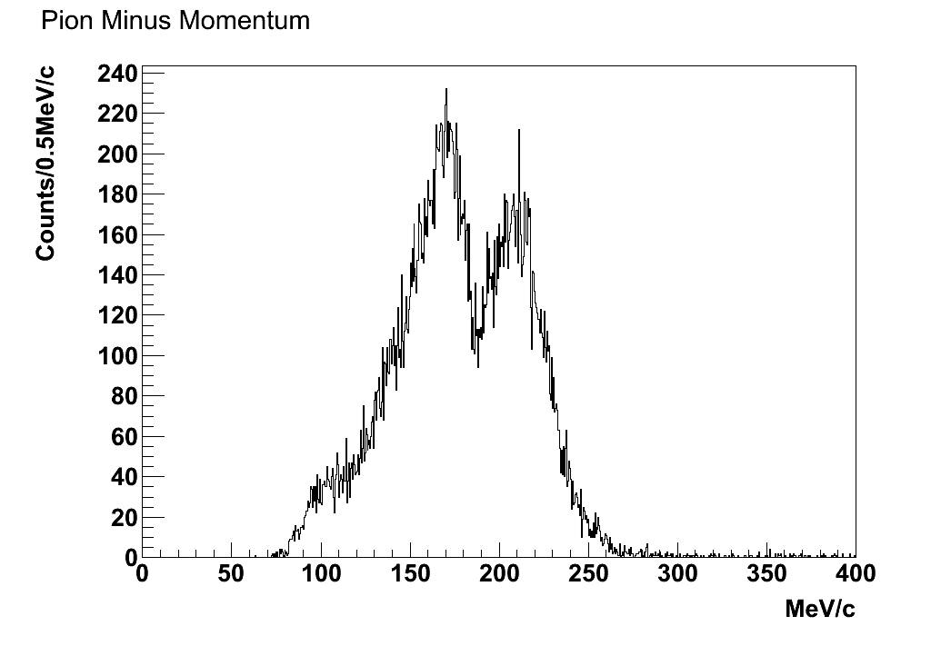
π⁻ momenta from K⁻_{stop} ⁶Li→ nπ⁺π⁻X with FINUDA
Σ⁺ formation
Σ⁻ decay
Main contributions to
π⁻ spectrum:
Σ production and decay
Background from
2-step reactions, involving:
Σ N → Λ N (conversion reaction)
π N → π' N (single charge exchange, others)
K⁻ p→Σ⁺ π⁻
K⁻ p→Σ⁻ π⁺
Σ⁻ p→Λn
Λ→pπ⁻
K⁻ p→Σ⁻ π⁺
Σ⁻ → n π⁻
K⁻ n→Σ⁻ π⁰
Σ⁻ → n π⁻
π⁰ p→ π⁺ n

Slide 6
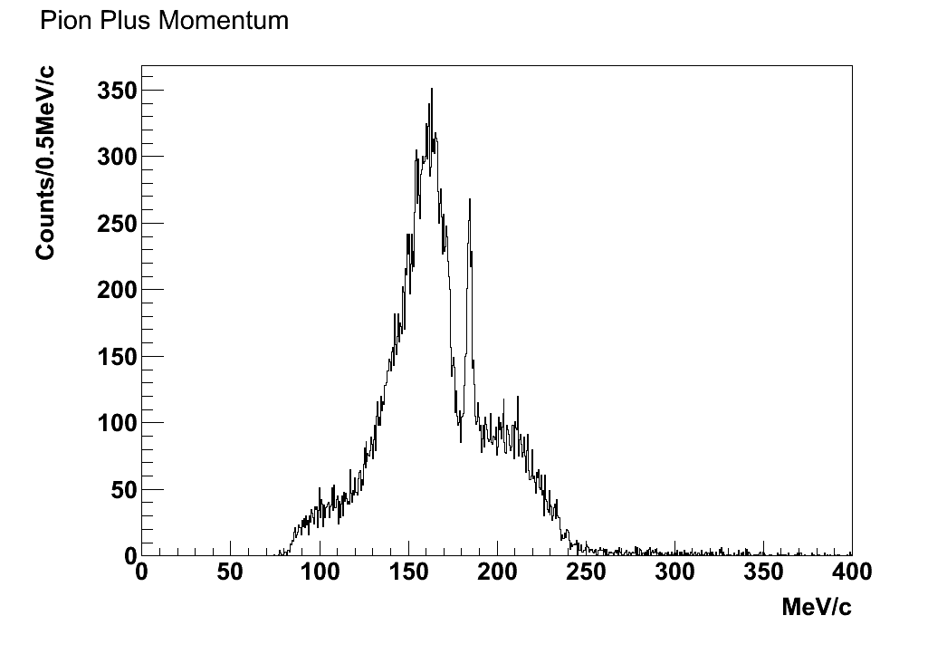
K⁻ ⁶Li → nπ⁺π⁻ X
Aim: study of the Σ± formation in nuclear matter
emission
Necessary to
- clean Σ formation pion spectra from other backgrounds
Method
Quality cuts on formation pions
Topological (vertex) and phase space cuts on Σ-decay pions.
Identification of Σ’s with high Signal/Background ratio
π⁻ momentum
π⁺ momentum
Σ⁺ formation
Σ⁻ decay
Σ⁻ formation
Σ⁺ decay
Σ⁺ decay
at rest

Slide 7
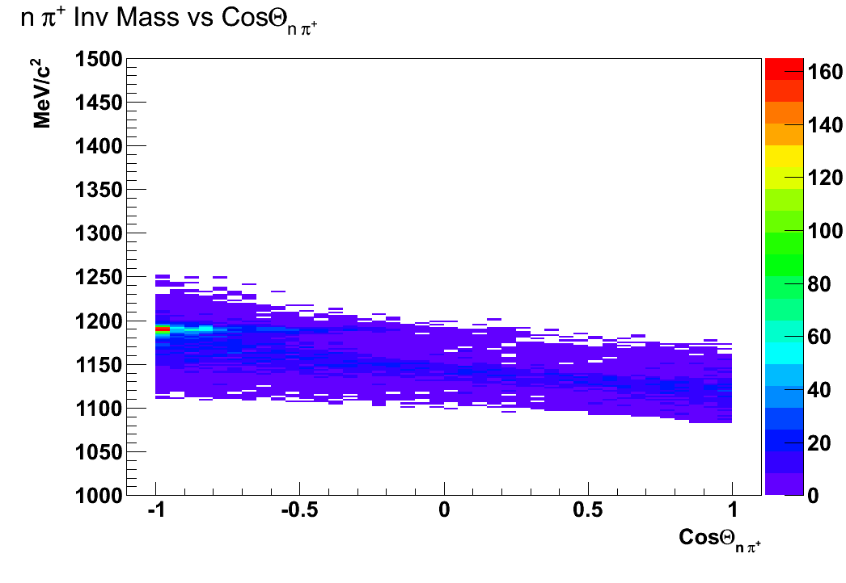
nπ⁺ invariant mass vs cos θ_{nπ+}
K⁻ ⁶Li → nπ⁺π⁻ X
Σ⁺ decay
at rest
Easy identification of n π⁺ pairs from Σ⁺ decay at rest
Useful for calibration of n and π⁺

Slide 8
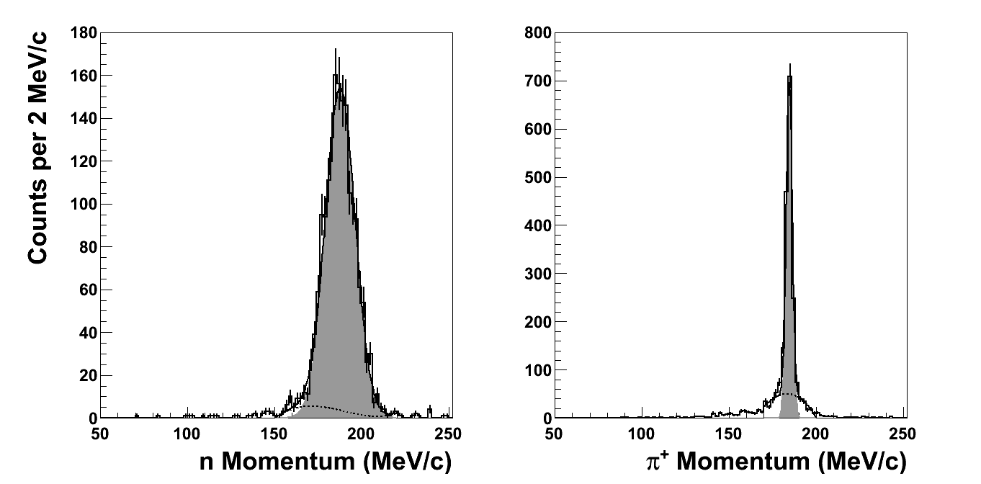
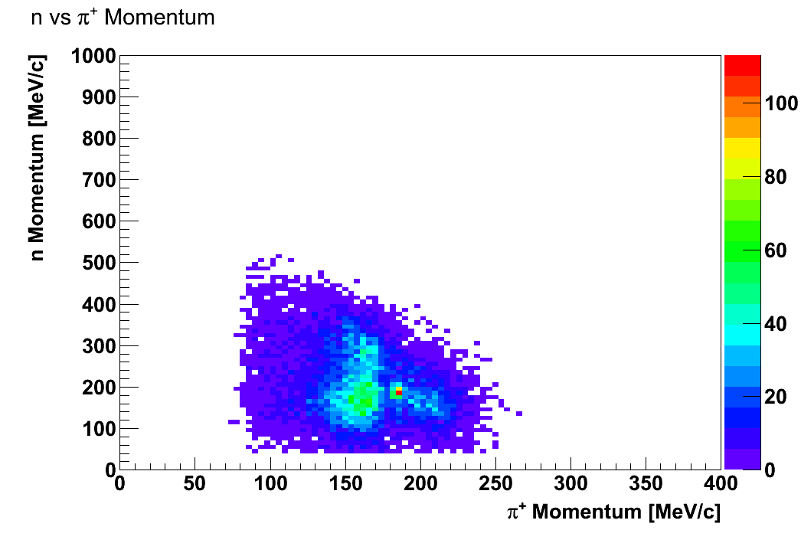
n, π⁺ resolution @ 185 MeV/c
σ_{n} = 8.4 ± 0.2 MeV/c
σ_{π+} = 1.72 ± 0.06 MeV/c

Slide 9
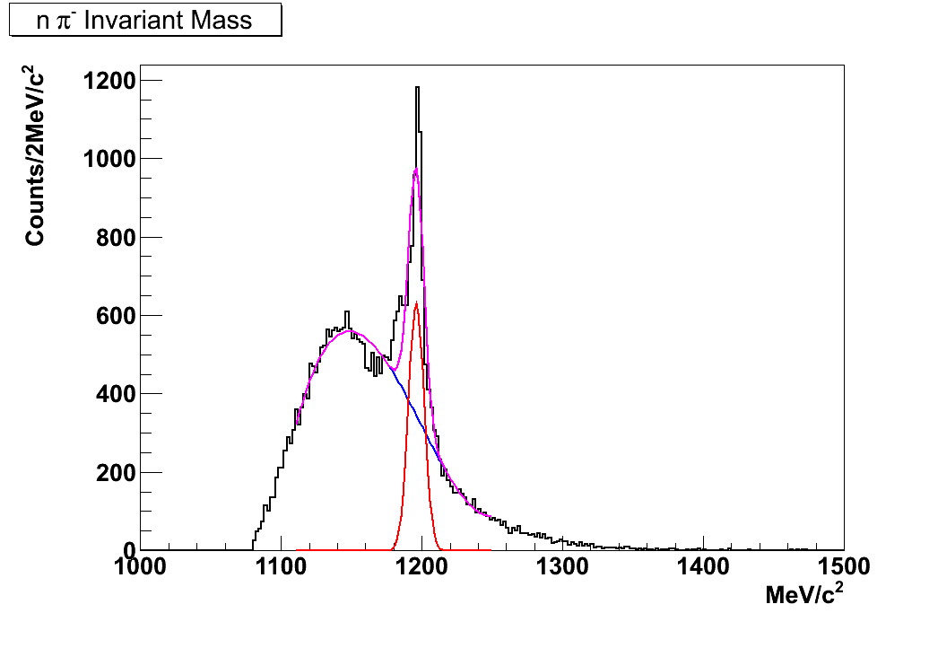
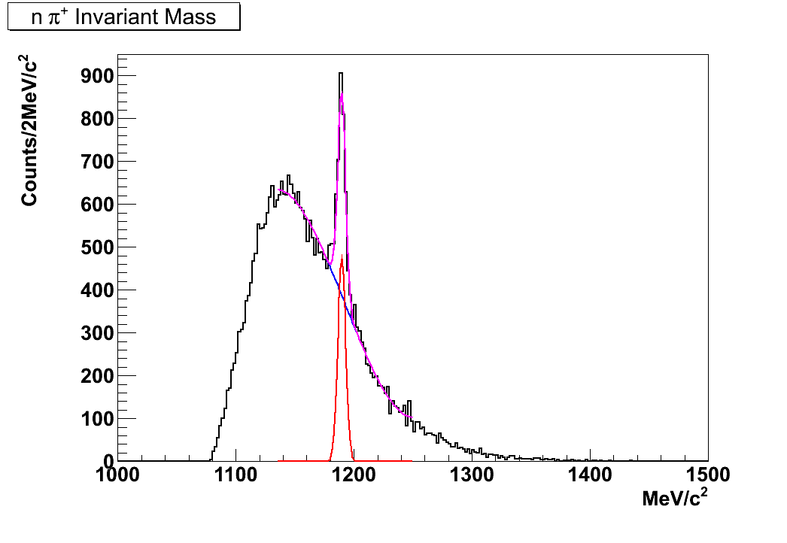
K⁻ ⁶Li → nπ⁺π⁻ X, Σ± identification
S/B~1.0
S/B~0.7
Σ⁻ signal
Σ⁺ signal
nπ± combinatorial + incoherent background
Discard events with unphysical missing mass (ex., γ contamination, scattered neutrons)
Σ⁻ : remove π⁻ from Σ⁺ production; Σ⁺ : remove π⁺ from Σ⁻ production
Σ⁻ : cos θ_{nπ-} <-0.2 and Σ⁺ : cos θ_{nπ+} <-0.2
Quality cuts on track fitting and vertex selection

Slide 10
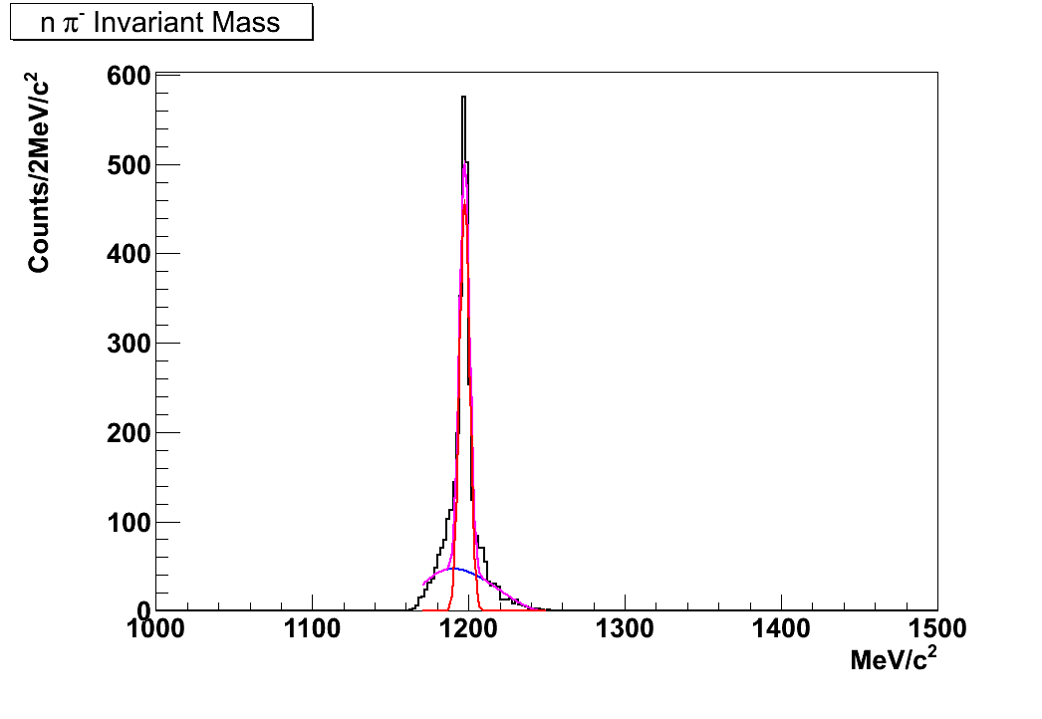
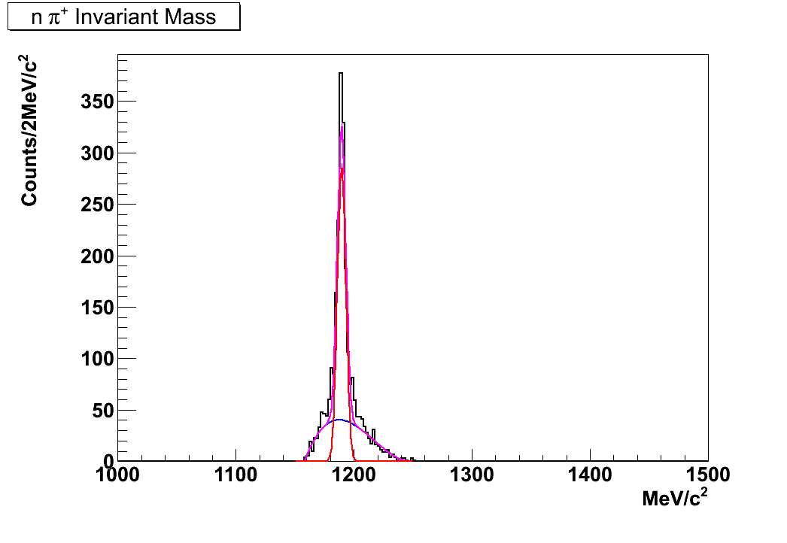
K⁻ ⁶Li → nπ⁺π⁻ X, Σ± identification
S/B~4.5
S/B~3.6
Σ⁻ signal
Σ⁺ signal
m = 1197.0 ± 0.1 MeV/c²
σ = 3.4 ± 0.1 MeV/c²
m = 1189.20 ± 0.2 MeV/c²
σ = 3.50 ± 0.2 MeV/c²
A promising start for a reliable Σ physics
Discard events with unphysical missing mass (ex., γ contamination, scattered neutrons)
Σ⁻ : remove π⁻ from Σ⁺ production; Σ⁺ : remove π⁺ from Σ⁻ production
Σ⁻ : cos θ_{nπ-} <-0.2 and Σ⁺ : cos θ_{nπ+} <-0.2
Quality cuts on track fitting and vertex selection

Slide 11
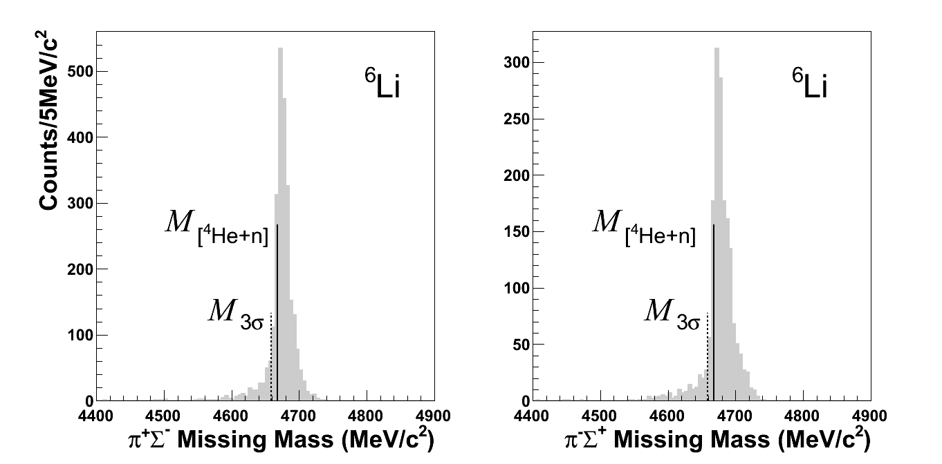
Σπ missing mass for ⁶Li
Width ~20MeV (FWHM)
Peaked at ~10 MeV above physical threshold
Indication of pure Quasi-Free Σ formation, [⁴He + n] little unseen energy (excitation of remnant nucleus, energy loss of outgoing Σ,…).
No missing pions nor unseen energetic particles (~exclusive measurement)
Negligible FSI

Slide 12
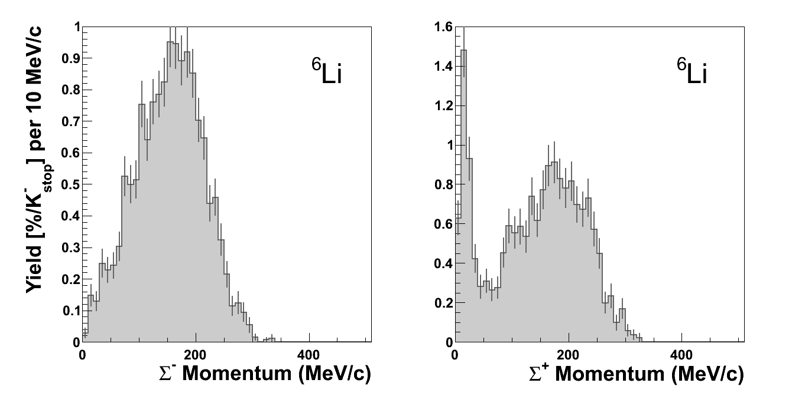
Σ momentum spectra for ⁶Li
Σ⁺ decay
at rest
Σ⁻ decay
in-flight
No decay at rest
Σ⁺ decay
in-flight
Σ⁻_{stop} ⇒ absorbed by “external” conversion: Σ⁻ p → Λ n
Σ⁻_{loss} /Σ⁻_{in-flight} ≈ Σ⁺_{stop} /Σ⁺_{in-flight}

Slide 13
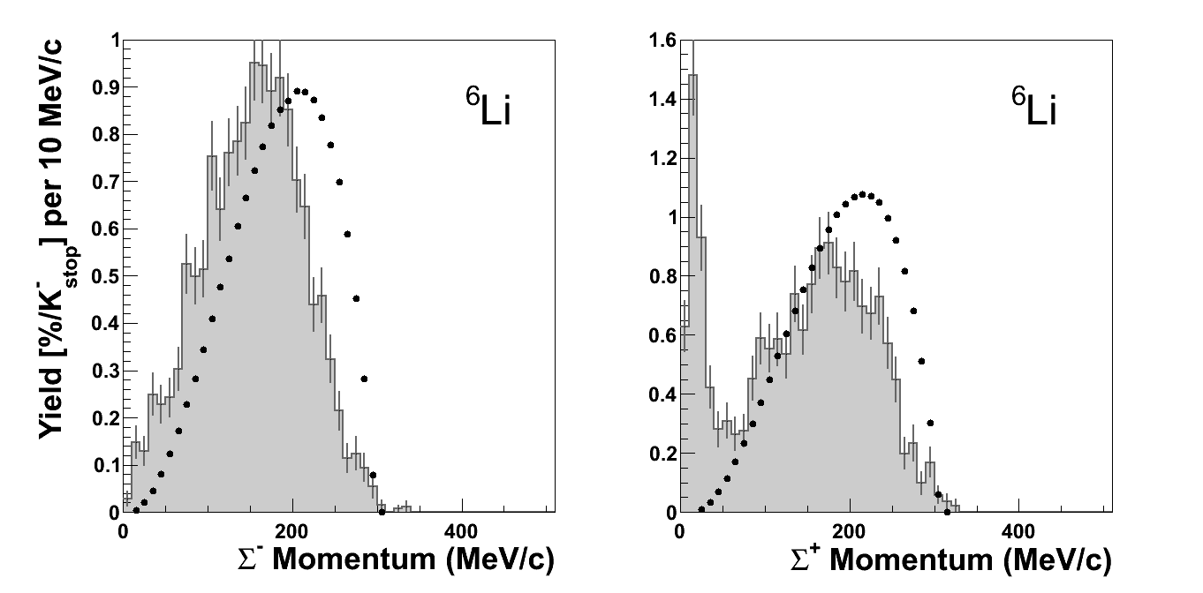
K⁻ ⁶Li → ΣπX, Σ momentum spectra
MC generated Σ⁻
MC generated Σ⁺

Slide 14
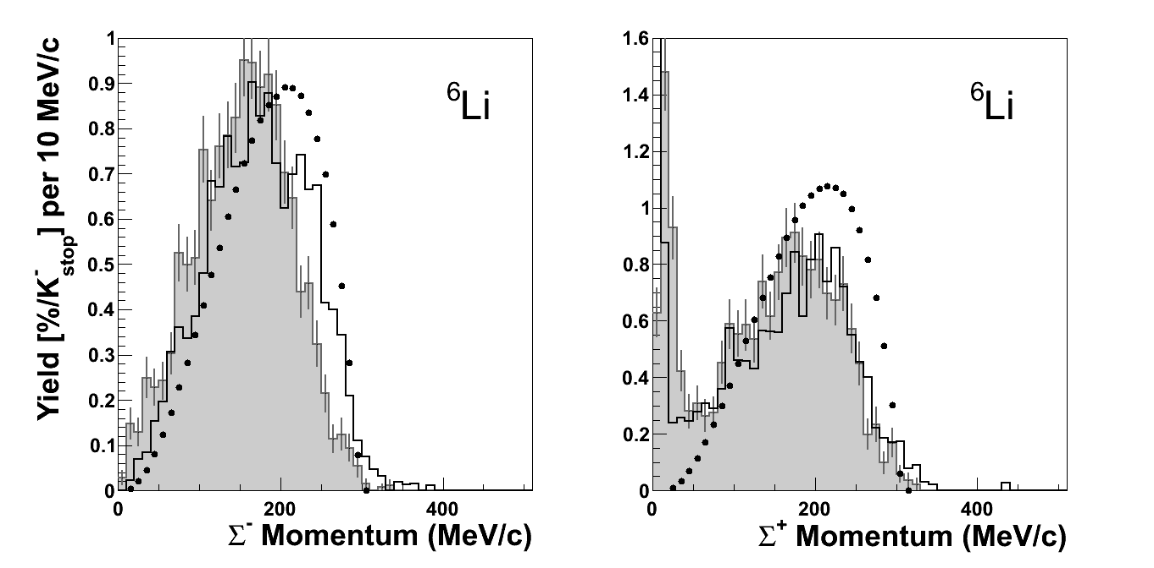
K⁻ ⁶Li → ΣπX, Σ momentum spectra
MC generated Σ⁻
MC generated Σ⁺
Reconstruction of MC generated Σ⁻and filtered by FINUDA
Reconstruction of MC generated Σ⁻ and filtered by FINUDA
Monte Carlo code: generation of K⁻_{stop} + A ⇒ Σ± + π∓ + A' quasi-free reactions
Reconstruction of generated Σ± filtered through FINUDA geometry
Σ± momentum distributions distorted by target media (also Σπ inv mass and Σπ tot mom)

Slide 15
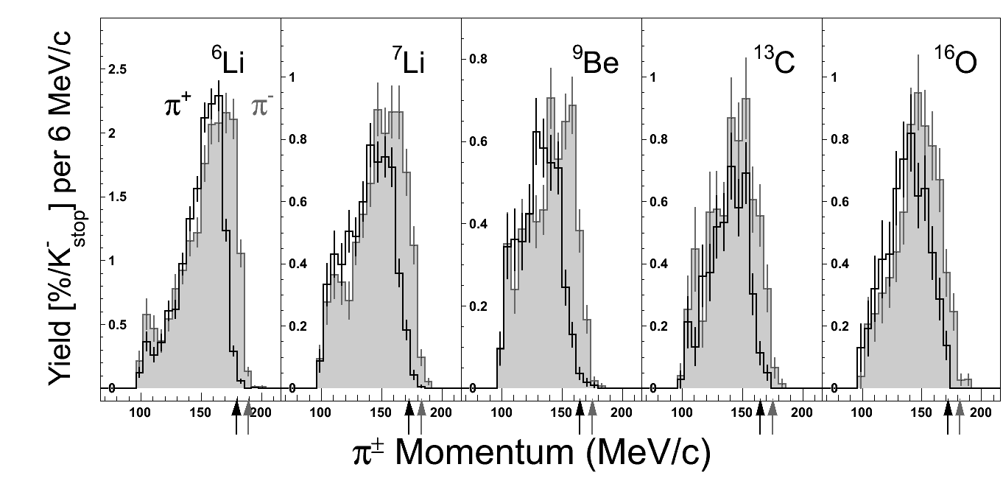
K⁻ ⁶Li → ΣπX, pion momentum spectra
π spectra sharply end at threshold; lower momentum cut 100 MeV/c
π⁺ π⁻ main difference related to threshold
π momentum negligibly distorted by tgt media, not distorted by Σ−Λ conversion
no analysis related bias
good test for models

Slide 16
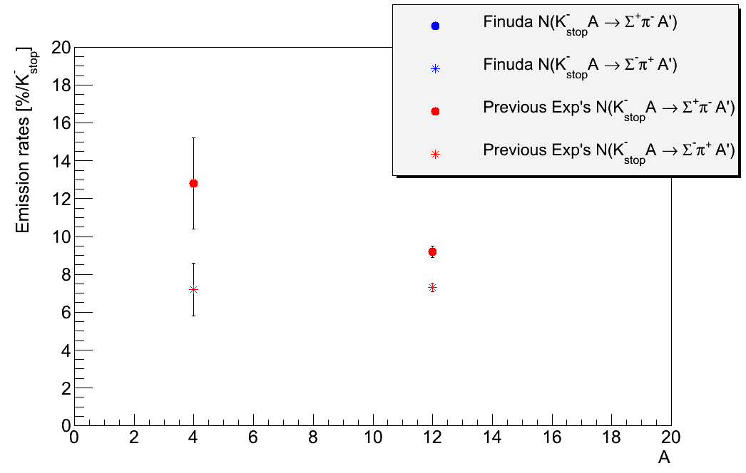
Emission rates [%/K⁻_{stop}]
P.A. Katz et al., Phys. Rev. D1 (1970) 1267
C. Vander Velde-Wilquet et al., Nucl. Phys. A241 (1975) 511
C. Vander Velde-Wilquet et al., Nuovo Cim. 39A (1977) 538

Slide 17
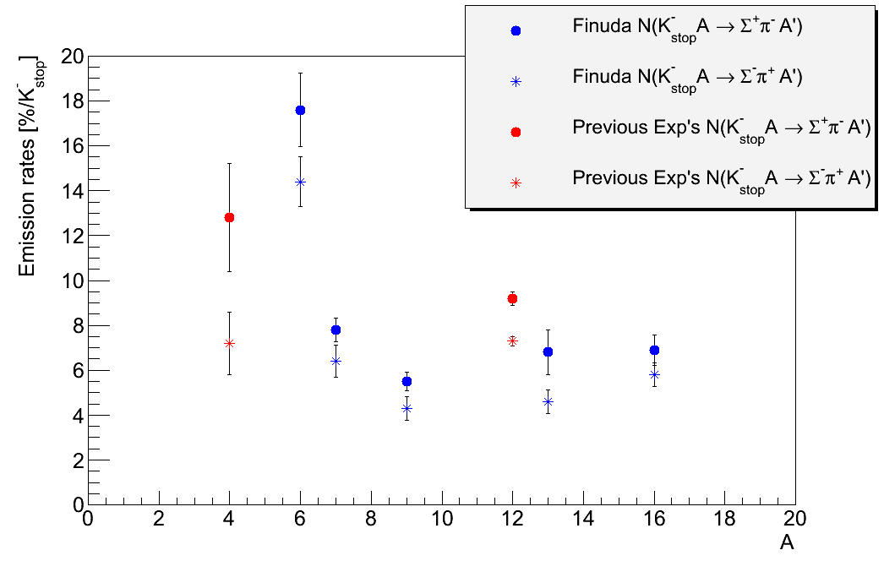
Emission rates [%/K⁻_{stop}]
⁶Li
¹²C
⁷Li
¹³C

Slide 18
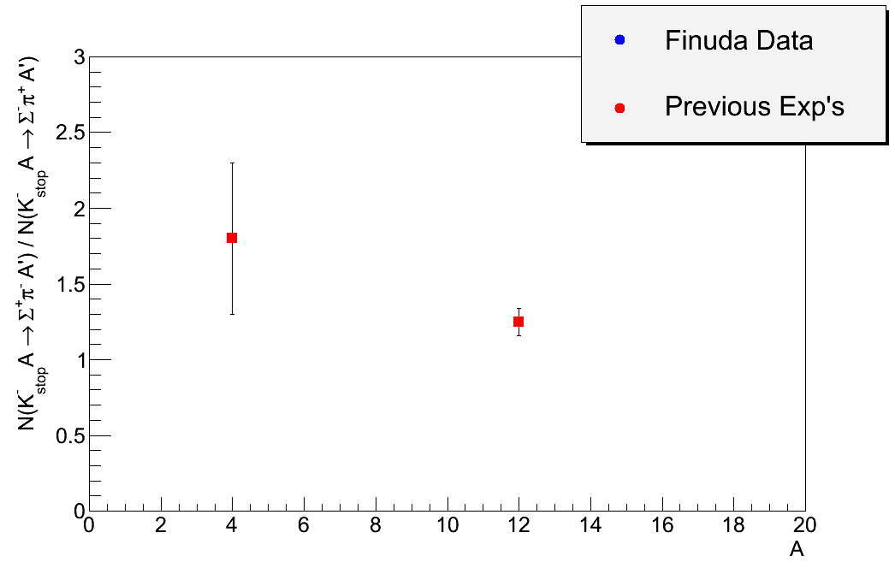
Ratios [Σ⁺π⁻/Σ⁻π⁺]

Slide 19
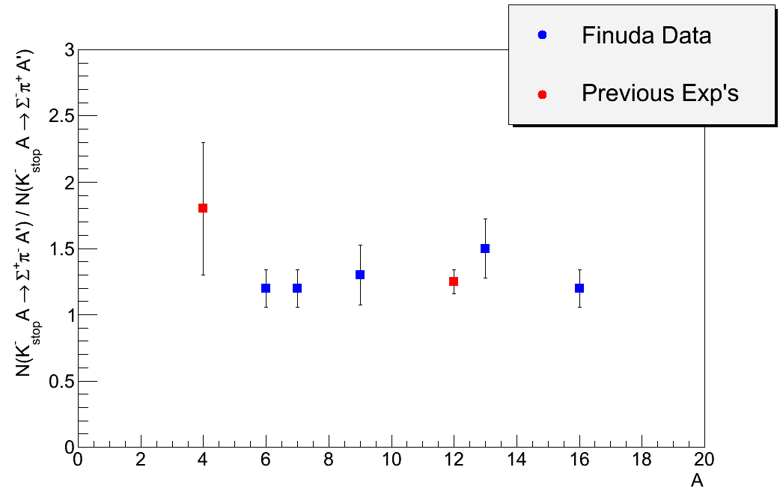
Ratios [Σ⁺π⁻/Σ⁻π⁺]

Slide 20
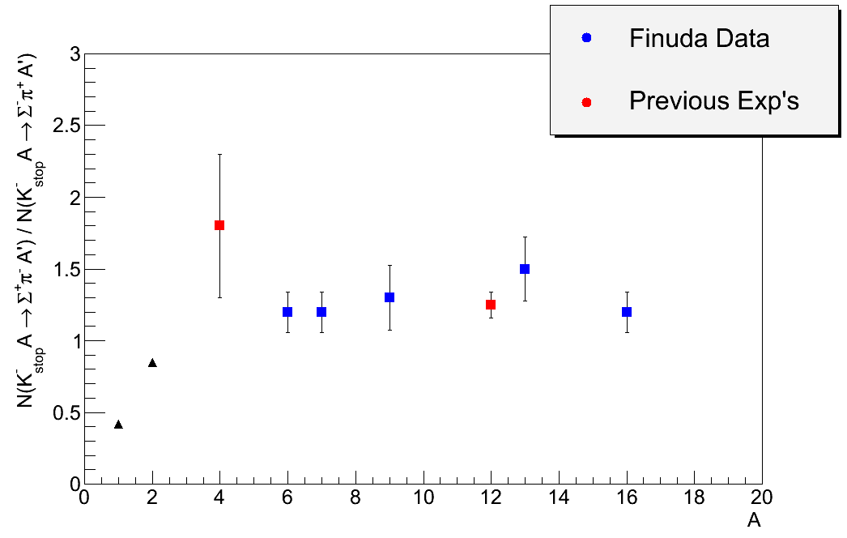
Ratios [Σ⁺π⁻/Σ⁻π⁺]
R. J. Nowak et al., Nucl. Phys. B139 (1978) 61

Slide 21
Emission rates [%/K⁻_{stop}] and ratios
A | π⁻Σ⁺ | π⁺Σ⁻ | Σ⁻ _{loss} | R₊₋
4He | 12.8±2.4 | 7.2±1.4 | - | 1.8±0.5
6Li | 17.6±1.0±1.3 | 14.4±1.1±0.2 | 30±2 | 1.2±0.1±0.1
7Li | 7.8±0.5±0.2 | 6.4±0.4±0.6 | 26±2 | 1.2±0.1±0.1
9Be | 5.5±0.3±0.3 | 4.3±0.3±0.5 | 38±3 | 1.3±0.1±0.2
12C | 9.2±0.3 | 7.3±0.2 | - | 1.25±0.09
13C | 6.8±0.8±0.6 | 4.6±0.5±0.2 | 12±1 | 1.5±0.2±0.1
16O | 6.9±0.6±0.3 | 5.8±0.5±0.3 | 36±3 | 1.2±0.1±0.1
π⁻Σ⁺ and π⁺Σ⁻ emission rates: (not corrected for pion attenuation nor for Σ-Λ conversion;
π⁺Σ⁻ values account for Σ⁻_{loss} )
Strong A dependence (K- interaction @nuclear surface, isospin dependence of FSI,...)
R₊₋ = π⁻Σ⁺ / π⁺Σ⁻
almost independent on A for A≥6:
Strong difference between free proton (R₊₋ = 0.42) and bound proton (R₊₋ > 1.2),
subthreshold modification of the K̅N interaction
agreement with S. Wycech, Nucl. Phys. B28 (1971) 541 predictions

Slide 22
Summary and conclusions
Study of in medium K⁻ p interaction @threshold
-relevant role of subthreshold amplitudes dominated by Λ(1405),
expected to be strongly modified in the nuclear medium
-Σπ dominant channel
study of Σπ production on bound p, via A(K⁻_{stop} ,Σπ)
- Emission rates : dependence on nuclear structure, K⁻absorp. orbital , FSI…
- R₊₋ = π⁻Σ⁺ / π⁺Σ⁻ : much less dependent, but sensitive to Λ(1405)
- q.exclusive A(K⁻_{stop} ,Σπ): minimize FSI distortions, No 2-body contrib.
The K⁻ _{stop}A→ nπ⁺π⁻X reaction was studied with FINUDA@DAFNE on
A=⁶Li,⁷Li,⁹Be, ¹³C, ¹⁶O, and the π∓ Σ± channel analyzed.

Slide 23
Summary and conclusions
First time measurement of:
• the π∓ prompt in coincidence with the Σ± (→nπ±)
• the elementary process K⁻_{stop} p→Σπ with p bound in A
• emission rates from A=6 to A=16
• R₊₋ = π⁻Σ⁺ / π⁺Σ⁻
Reaction is essentially Q.free
Measured pion momentum spectra reliable test for theories
Emission rates show strong A dependence
R₊₋ constant with A but ~3 times bigger than hydrogen value
- Accurate Theoretical predictions missing, but difference between free and
nuclear production most likely related to in medium modifications of K- p
Interaction.

Slide 24
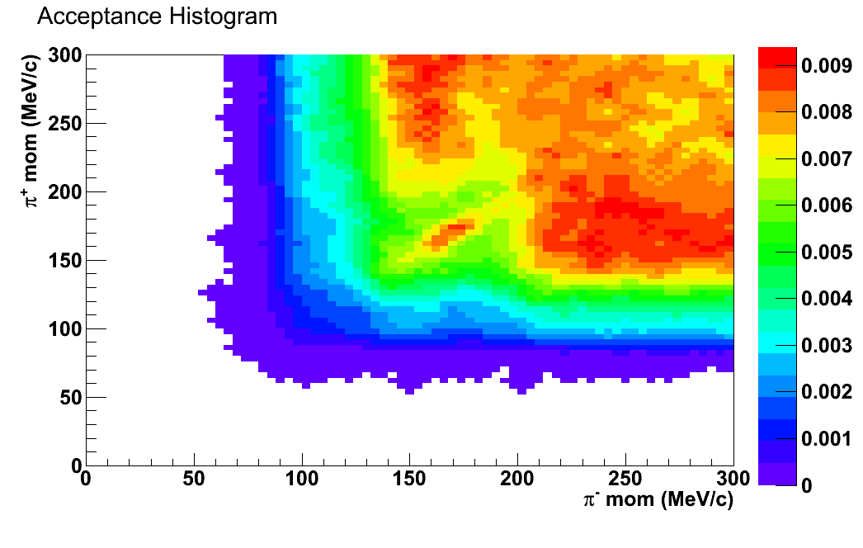
Acceptance

