Slide 1
Results from the kaonic hydrogen X-ray measurement
at DAFNE and outlook to future experiments
Michael Cargnelli, Stefan Meyer Institute, Austrian Academy of Sciences, Vienna
On behalf of: The SIDDHARTA collaboration
Notes:
Good afternoon ladies and gentlemen.
It‘s a pleasure to me to report on the Kaonic atoms studies at DAFNE.
I speak on behalf of the siddharta collaboration which consists of ~ 40 persons affiliated to the above listed institutions from Italy, Germany, Austria, Japan, Canada and Romania..
I will first talk about the physics motivation and relevance, then introduce the experiment and results, finally I will come to plans for the future

Slide 2
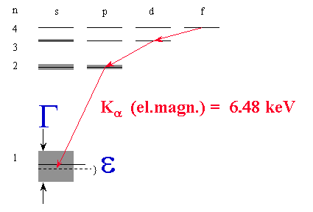
SIDDHARTA¹⁾
What, why.. ? how ?
Goal: measure the shift and broadening of X ray transition energies in light kaonic atoms.
The ground state is affected by the
strong interaction between the kaon and the
nucleus. ε, Γ are input for effective
theories in low energy QCD
SDDs
X
SDDs
K⁻
Scint
Φ
e⁺
e⁻
Scint
Triple coincidence:
SDD_{X} * Scint_{K} * Scint_{K}
K⁺
New X-ray detectors (SDD silicon drift detectors)
timing capability → background suppression
excellent energy resolution
high efficiency, large solid angle
performance in accelerator environment
E (2-1) el.mag. = 6.480 keV
1s level shifted and broadened
1) Silicon Drift Detectors for Hadronic Atom Research with Timing Application
Notes:
2
A kaonic atom is formed when a negative kaon enters a medium, loses its kinetic energy through ionization and excitation of the atoms and molecules and eventually is captured, replacing the electron, in an excited orbit (n~25). Via different cascade processes (Auger transitions, Coulomb deexcitation, scattering) the kaonic atom deexcites to lower states. When the kaon reaches a low n state with small angular momentum, strong interaction with the nucleus causes its absorption. The strong interaction is the reason for a shift in the energies of the low lying levels and a short lifetime corresponding to an increase of the observed level width.
Note: radiationless transitions are possible KH(n,l) + H → KH(n’,l’) + H + E_{kin}
Doppler broadening is a correction in the πιH case where the width ~1 eV, in KH width= ~500 eV

Slide 3
Hadronic atoms
_ _
Objects of type (K X), (π⁻, X) with X = p, d, ³He, ⁴He,.. or π⁺ π⁻ π K p He
Bound electromagnetically, binding well known
Strong interaction (mediated by QCD) → modify binding
→ decay of object
in some cases: small perturbation
energy shift and width can be related to T-matrix elements at threshold
(Deser¹ type formulas)
compare to results from low energy scattering experiments²
Low energy phenomena in strong interaction can not be described in terms of quarks and gluons, instead effective theories are used (they have some degrees of freedom)
¹ original Deser relation in some cases not sufficient to compare to high precision experimental data
² problems: extrapolation to E=0 and quality of old experimental data
Notes:
Consider objects of the type (antikaon X) or (pi-minus X) with X a proton, a deuteron a He-3 or He-4 or even more exotic things like pi+ pi- or pi K
An other type of hadronic atoms involve antiprotons, for example antiprotonic helium where one of the 2 electrons is replaced by an antiproton.
The hadronic atoms are bound by the electromagnetic interaction, the energy of the unshifted levels (strong interaction switched off) can be predicted with a precision of eV for example in case of kaonic hydrogen by solving the Klein-Gordon equation and applying corrections e.g. vacuum polarization effects.
The strong interaction, mediated by QCD causes a modification of the binding and finally the decay of the object.
In some cases it can be treated as a small perturbation and then the shift and width can be related to the T-matrix elements of QCD at threshold. This leads to the Deser type formulae known since long.
Experiments of this type are the pionic hydrogen experiment at PSI, using a crystal spectrometer, to measure the tiny shift and width of 7 eV and 1 eV.
For kaonic hydrogen the DEAR experiment at DAFNE was the most precise up to now.
The strong amplitudes derived from atomic shift and width can be compared to results obtained from low energy scattering. K-p scattering data for p < 250 MeV/c are usually analyzed in terms of s-wave scattering lengths. The simplest model uses constant scattering lengths, it has 6 parameters. More elaborate is the use of the K-matrix (9 parameters) or K-matrix with effective range for I=0 (12 parameters). In any case the existing data on KN and Kbar N scattering lengths at low energies are rare, very poor in statistics and partly contradictory.
The importance of the hadronic atom experiments lies in the fact that here high precision low energy QCD predictions can be confronted with (high precision) data.
Low energy phenomena in strong interaction can not (yet?) be described in terms of quarks and gluons. Instead, effective field theories are used that contain the appropriate degrees of freedom to describe the physical phenomena at a chosen length scale, but ignore the substructure and degrees of freedom at shorter distances (corresponding to higher energy).

Slide 4
Theory and experiment
Chiral perturbation theory was extremely successful in describing
systems like πH, but can not be used for KH. Main reason is the
presence of the Λ(1405) resonance only 25 MeV below threshold.
scattering data
Effective field theories atomic X ray data
energy, width of resonances
.. needs input from experimental data
.. aims at accomodating all experimental evidence
High precision low-energy-QCD results can be compared with experimental data
There exist non-perturbative coupled channel techniques which are able to generate the Λ(1405) dynamically as a Kbar N quasibound state and as a resonance in the π Σ channel
Notes:
About the QDC predictions:
Chiral perturbation theory was extremely successful in describing systems like pionic atoms, however it is not applicable for kaonic systems. The main reason is the presence of the Lam(1405) just below threshold.
But:
There are non-perturbative coupled-channel techniques based on the driving terms of the chiral effective Lagrangian which generate the Lam(1405) dynamically as a Kbar N quasibound state and as a resonance in the pi Sigma channel. They have proved useful and successfull.
High precision K- p threshold data set important constraints for such theoretical approaches.
--------------------------------------------------------------
Non-perturbative coupled-channel techniques based on the driving terms of the chiral SU(3) effective Lagrangian have proved useful and successful in dealing with this problem by generating the Lam(1405) dynamically as an I=0 Kbar N quasibound state and as a resonance in the pi Sigma channel.

Slide 5
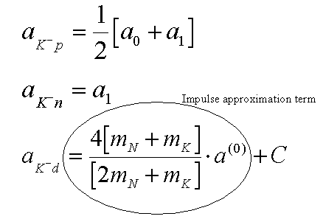
Scattering lengths – Deser formula
_
With a₀, a₁ standing for the I=0,1 S-wave KN complex scattering lengths in the isospin limit (m_{d} = m_{u}), μ being the reduced mass of the K⁻p system, and neglecting isospin-breaking corrections, the relation reads:
… a linear combination of the isospin
scattering lengths a₀ and a₁
to disentangle them, also the
kaonic deuterium scattering length is needed
(contains a different combination of a0 a1
Notes:
Now here is the Deser formula for kaonic hydrogen. Please note we use as definition of the shift: E(measured) – E(electromagnetic)
For high precision checks there are relations including isospin breaking corrections needed.
I quote here from a paper of Meißner, Raha and Rusetsky of 2004 confirming that there are good ways to extract scattering lengths from kaonic atom data.
„By using the non-relativistic effective Lagrangian approach a complete expresson
for the isospin-breaking corrections can be obtained;
in leading order parameter-free modified Deser-type relations exist and can be used to
extract scattering lenghts from kaonic atom data“²
²Meißner,Raha,Rusetsky, 2004
KD ... Elaborate procedures needed to connect the observables with the underlaying physics parameters.
“To summarize, one may expect that the combined analysis of the forthcoming high-precision data from DEAR/SIDDHARTA collaboration on kaonic hydrogen and deuterium will enable one to perform a stringent
test of the framework used to describe low–energy kaon deuteron scattering, as well as to extract the values of a0 and a1 with a reasonable accuracy. However, in order to do so, much theoretical work related to the systematic calculation of higher-order corrections within the non-relativistic EFT is still to be carried out.” (from: Kaon-nucleon scattering lengths from kaonic deuterium, Meißner, Raha, Rusetsky, 2006, arXiv:nucl-th/0603029)

Slide 6
Summary of physics framework and motivation
Exotic (kaonic) atoms – probes for strong interaction
hadronic shift ε_{1s} and width Γ_{1s} directly observable
experimental study of low energy QCD.
Testing chiral symmetry breaking in strangeness systems
Kaonic hydrogen
Kp simplest exotic atom with strangeness
more precise experimental data important
atomic physics: new cascade calculations
Information on Λ(1405) sub-threshold resonance
responsible for negative real part of scattering amplitude at threshold
important for the search for the controversial „deeply bound kaonic states”
Determination of the isospin dependent KN scattering lengths
no extrapolation to zero energy
kaonic deuterium needed, never measured before
Notes:
Let me summarize now the physics framework and motivation:

Slide 7
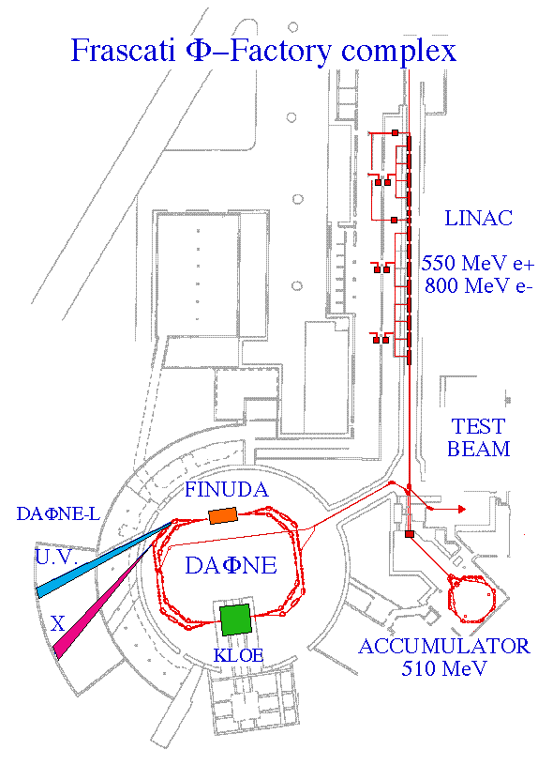
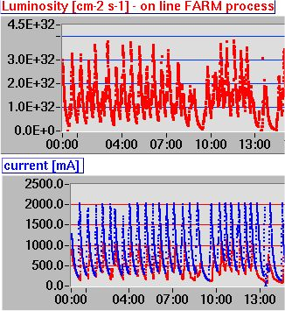
D AΦ N E
electron-positron collider, energy at phi resonance
phi produced nearly at rest.
(boost: 55 mrad crossing angle → 28 MeV/c)
charged kaons from phi decay: E_{k} = 16 MeV
degrade to < 4MeV to stop in gas target
Φ production cross section ~ 3000 nb (loss-corrected)
Integr. luminosity 2009 ~ 6 pb⁻¹ per day ¹⁾ (~ 10⁷ K± )
(increased by crabbed waist scheme)
Peak luminosity ~ 3 × 10³² cm⁻² s⁻¹ ⁼ 450 Hz K±
¹⁾ we can not use kaons produced during
injections.
SIDDHARTA was set up here
compare situation during DEAR data taking (2002)
currents ~ 1200/800 ~ 1 pb⁻¹ per day, peak ~ 3×10³¹ cm⁻² s⁻¹
Notes:
Coming to the situation at DAFNE we are very happy about the good working conditions reached.

Slide 8
The experimental challenge
... to do low energy X ray spectroscopy at an accelerator
The radiation environment produces a lot of charge in Si detectors (dE > 150 keV)
„Beam background“ Touschek- Babha- and beam-gas-scattering,
stray high-energy e± => e.m. showers. not correlated to charged kaon pairs:
(1) „accidentals“
μ, π, e from K decay; Λ, π,.. from K⁻ absorption, kaonic X rays from K⁻ wallstops synchronous background – has trigger signal – remains in triggered setup
(2) kaonic X-ray lines
(3) continous kaon correlated background
S: Signal, B: background,
T: trigger rate,
S_{T} : signal per trigger
Δt: coincidence width
A: accidental rate
B_{T}: background in ROI, per trigger (lines+continous)
Notes:
Coming to the SIDDHARTA experimental technique now.
--------------------------------------------------
Test measurements:
SDD timing relative to e⁻ beam scintillation counter
Accidental suppression tested (coincidence with beam counter)
Energy resolution in an accelerator environment

Slide 9
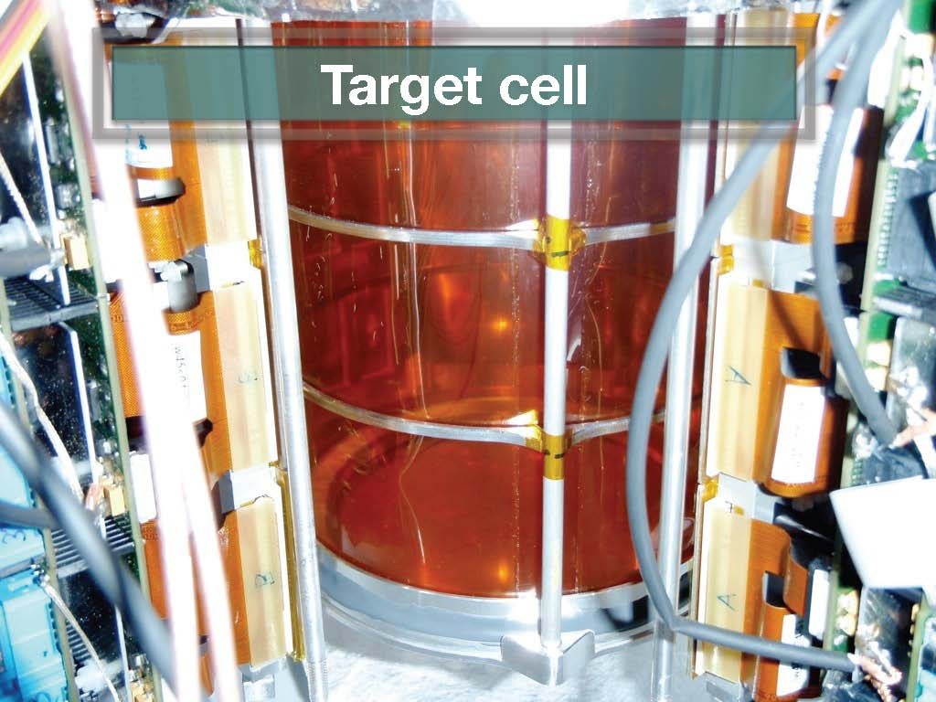
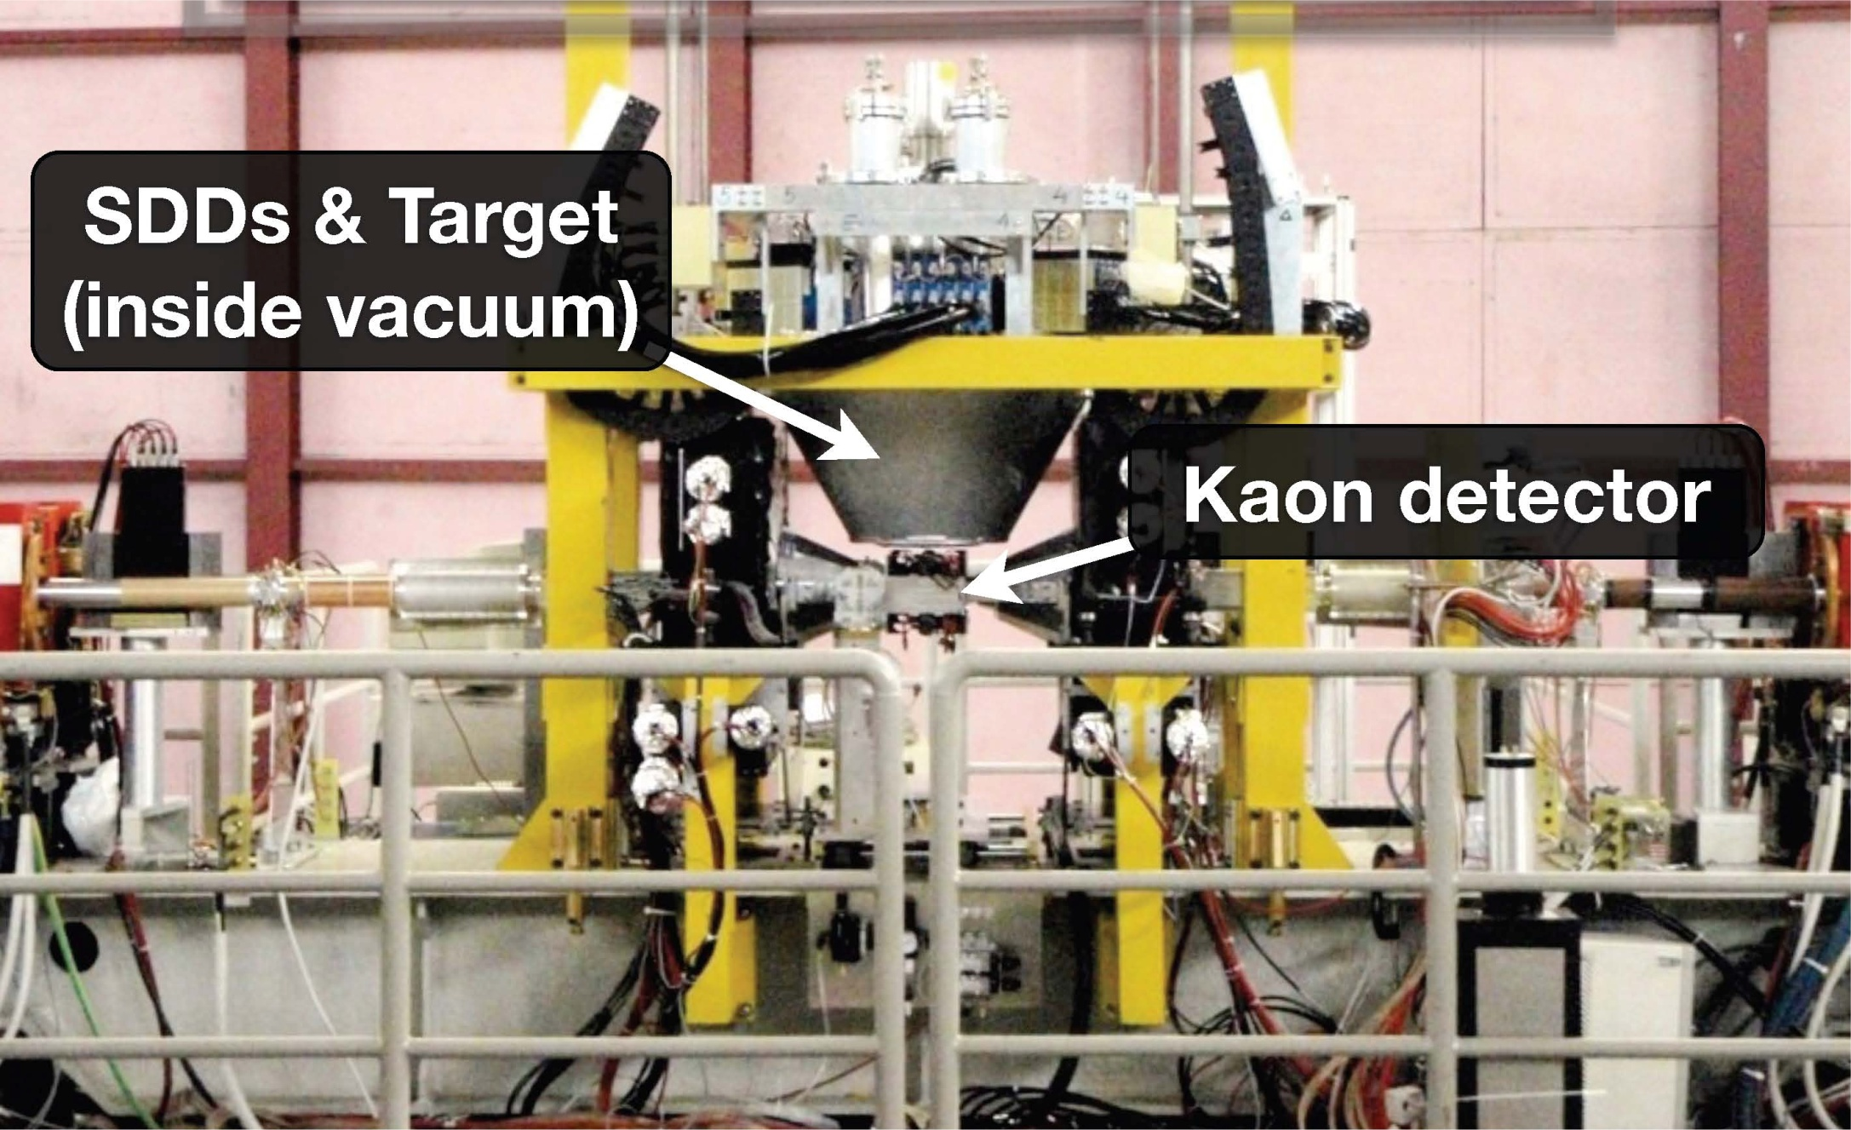
Experimental
setup
SDDs
X
SDDs
K⁻
Scintillator
Φ
e⁺
e⁻
Scintillator
K⁺
2 scintillators
remote controlled
mechanism to remove
during calibrations

Slide 10
Data analysis
Data aquisition:
- energies and detector numbers of X ray hits
- event id-number, time-tag
if a kaontrigger happend: - the time correlation between X-ray and kaon
- the kaon detector parameters
- DAFNE beam-current values
From this we derive in off-line analysis:
- the kaondetector TOF to discriminate against MIPS
- kaondetector position information from the timedifference of the PMs at both ends
- sdd rates (e.g. counts during last second)
- kaon rates ( -- „ --)
- number of hits without vs. hits with kaon coincidence
- multiplicity of hits
- kaons per X-ray
Analysis tasks:
- periodically calibrate the >100 individual detectors (gain alignment), discard ‚bad‘ ones
- determine the energy resolution (response shape) of the summed detectors
- fit the spectrum with signal-components, background lines and continous background
Notes:
10

Slide 11
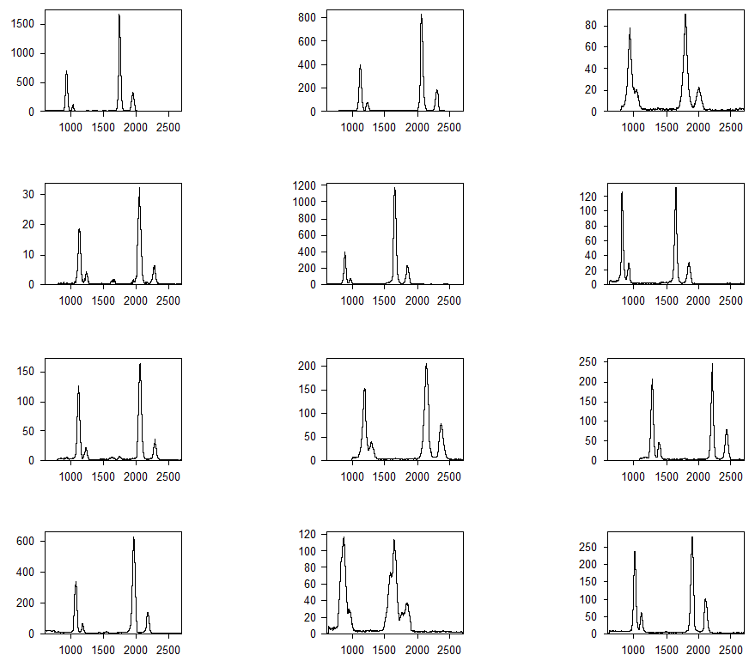
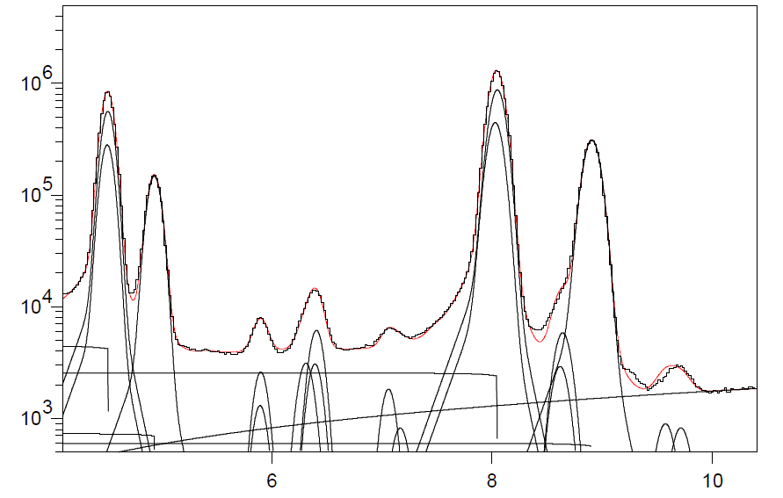
Calibration
every ~ 6h calibration run with X-ray tube + beam
summed spectrum of 1 calibration run ~ 100 detectors
Ti: Ka1,2 Kb
Mn: Ka1,2
Fe: Ka1,2 Kb
Cu: Ka1,2 Kb escKa, escKb
Zn: Ka1,2 Kb
Au: La1,2
Cu K_{α}
Ti K_{α}
Cu K_{β}
Ti K_{β}
Fe K_{α}
Mn K_{α}
Fe K_{β}
Zn
K_{α}
Au L_{α}
keV
excellent statistics, many lines identifyable
deviation from pure gaussian shape !
different approximations possible.
Here: convolution of with exponential tails:
in 10 min enough counts on each of the 133 detectors !
derive ADC channel of Ti Kα and Cu Kα position
calibrate each (channel => keV)
fit with gaussians
automatically select detectors using resolution- and
chisquare cuts
z_{i} = Σ w_{i-j} y_{j}
N exp( – k λ₋) k < 0
w_{k} = 1 – ε k = 0
N exp( – k λ₊) k > 0
Σ w_{k} = 1

Slide 12
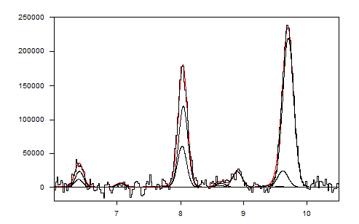
Calibration cont‘d
gain slightly changing with detector rate
and with presence of large signals
=> used X-ray tube DURING beam
studied rate dependance by varying X ray tube intensity
final energy adjustment at exact data-taking conditions
possible by looking at
a) the selftriggerspectra => Cu, Au
fluorescense lines excited by background ε < 1 eV
b) the coincidence spectra = kaonic lines from wallstopps KC,..
ε ~ 2 eV
Remark on the response shape of the SDDs
consider edge effects
charge transport depends on distance from anode
sum of gauss functions is not a gauss function
(adding different resolutions)
=> measured response understood
most precise response-shape from low rate X-tube measurement
selftrigger spectrum,
continous background subtracted
Au L_{α}
Cu K_{α}
Fe K_{α}
Cu K_{β}
Fe K_{β}
Zn K_{α}
energy (keV)
FWHM @ Cu Kα = 174 eV consistant with X-tube measurement (with low intens.)
position of Cu Kα ~ slightly shifted as compared to the periodic X-tube calibrations
Notes:
12

Slide 13
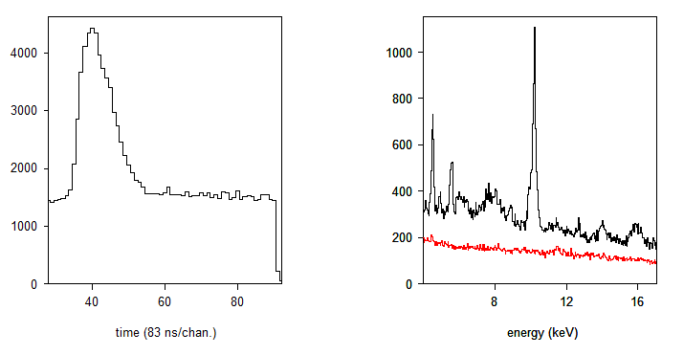
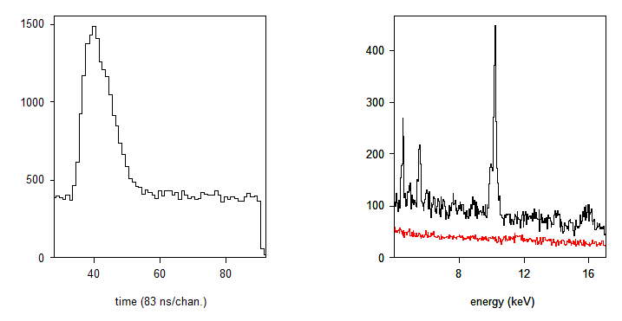
Coincidence data
kaon
correlated
accidentals
hydrogen
K correlated background:
decay secondaries from K⁺, K⁻
K⁻ absorption secondaries
K⁻ kaonic X-rays, wallstops, gasstops
Region of
kaonic
hydrogen
K lines
kaon correl.
accidental background:
electromagnetic showers resulting
from lost e⁺ e⁻
accidentals
(normalized)
deuterium
kaon correl.
acc.

Slide 14
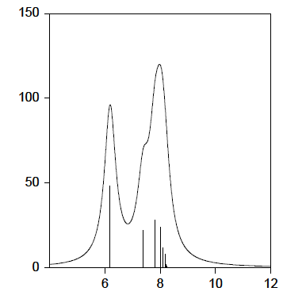
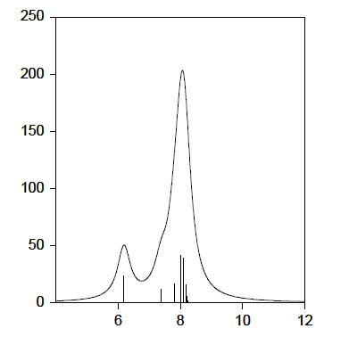
Fit model for the signal
yields from theory:
(shift and width: this exp.)
Transition | unshifted energy (keV)
KH (2-1) | 6.480
KH (3-1) | 7.677
KH (4-1) | 8.096
KH (5-1) | 8.299
KH (6-1) | 8.395
KH (7-1) | 8.458
... | ...
KH (inf.) | 8.634
K_{high}
Jensen
(2-1)
(3-1)
intensity (arb.units)
overlapped distributions !
Intensity ratios not known precisely
=> fixing would introduce theory
dependance
the individual intensities of the high
transitions have large fit errors
..influence shift and width
=> focuse fit on Kα Kβ,
K_{high} transitions influence only via
their low energy tail (overlap)
Koike
5 fitparameters:
I₄ = yield(4→1)
I₅ = yield(5→1)
I₆ = yield(6→1)
I₇ = yield(7→1)
I₈ = yield(8→1)
(3-1)
(2-1)
keV
Notes:
how to define the fit functions for the kaonic hydrogen signal?
what we know for sure are the energy differences of the transitions (e.m. values) We see we have largely overlapped distributions, especially for the high transitions

Slide 15
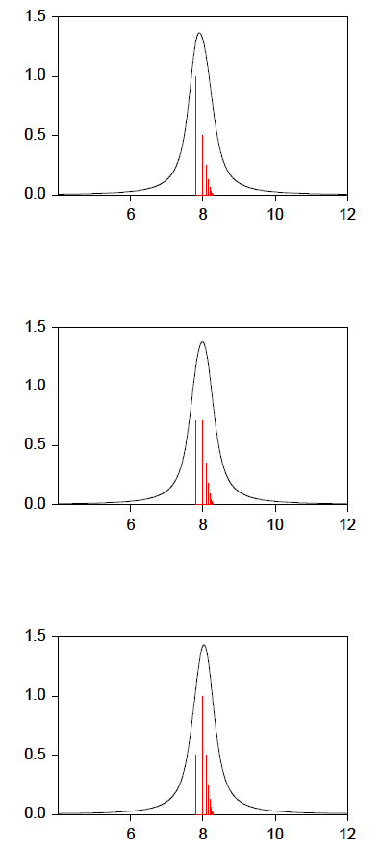
K_{high}
parametrized K_{high} for various P,Q
iterative fit
step 1:
with all transition energies coupled, fit: I₁,I₂,I₃,I₄,I₅,I₆,I₇,I₈, ε, Γ
step 2:
fix positions of K_{high}, (E₄,..E₈ )
using ε from previous step, fit again
step 3:
resume at step 2
after a few loops consistancy for all transitions !
P=4.0
Q=0.5
keV
P=4.5
Q=0.5
alternatively:
parametrization of
K_{high} yields
y(i→1) / y(P → 1) = Q ^{abs(i-P)}
I_{high} total intensity of K_{high}
Fit: I₁,I₂,I_{high},P,Q, ε, Γ
keV
P=5.0
Q=0.5
keV
STORI‘11 - M. Cargnelli - 15

Slide 16
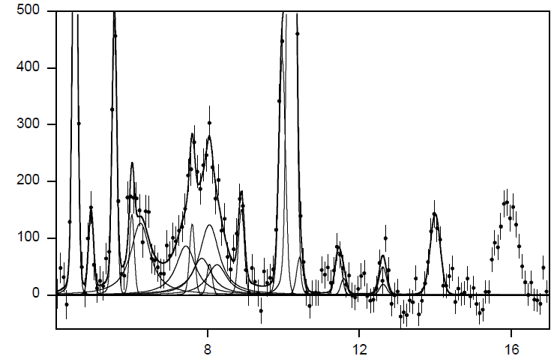
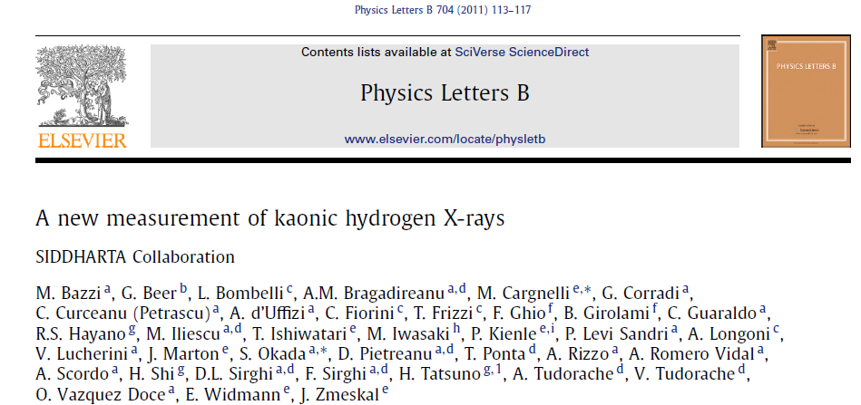
X ray spectrum for coincidence time-gate.
continous background fit component is subtracted
Fit of the data
Ti K_{α}
KC (6-5)
KC (5-4)
KO (6-5)
background lines
Transition | Energy (keV)
KC (6-5) | 5.545
KO (7-6) | 6.007
KN (6-5) | 7.596
Cu Kα | 8.04
KC (7-5) | 8.888
KO (6-5) | 9.965
KC (5-4) | 10.217
KAl (9-7) | 10.435
KN (5-4)
KO (7-6)
KC (7-5)
Ti K_{β}
KAl (6-4)
KAl (8-7)
KC (6-4)
Au L_{β}
Pb L_{β}
KN (6-5)
kaonic hydrogen:
shift= 283 ± 36 ± 6 eV width = 541 ± 89 ± 22 eV
intensities from simultaneous
fit of the deuterium data,
where the lines stand clear.
K_{β} K_{high}
kaonic hydrogen
K transitions
K_{α}
X ray energy (keV)
fit with K_{high} parametrization:
=> yield max at P = 5.3 +- 0.97
yield ratio: Q = 0.42 +- 0.28
shift and width consistent with the
results from the iterative fit

Slide 17
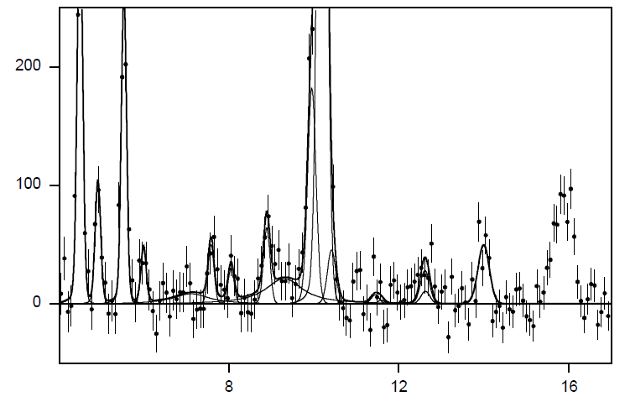
X ray spectrum for coincidence time-gate.
continous background fit component is subtracted
Deuterium
Ti K_{α}
KC (5-4)
KC (6-5)
Transition | unshifted energy (keV)
KD (2-1) | 7.81
KD (3-1) | 9.25
KD (4-1) | 9.76
.. | ..
KD (inf.) | 10.41
KO (6-5)
KN (5-4)
Ti K_{β}
KAl (6-4)
KC (7-5)
KC (6-4)
KO (7-6)
KN (6-5)
Pb L_{β}
kaonic deuterium:
for fixed shift= 700 eV width = 1000 eV Kα / (K_{β}+K_{high} ) = 0.4
.. 2 sigma hint of a signal
Cu K_{α}
Au L_{β}
kaonic deuterium K transitions ?
K_{β}+K_{high}
upper limit for K-series yield of kaonic deuterium:
y(Kd) < 0.25 y(Kp)
K_{α}
X ray energy (keV)

Slide 18
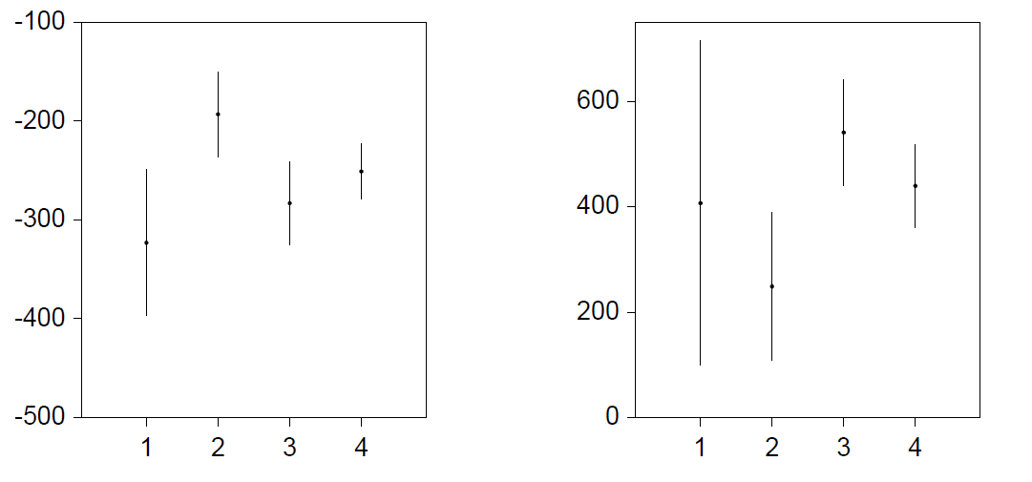
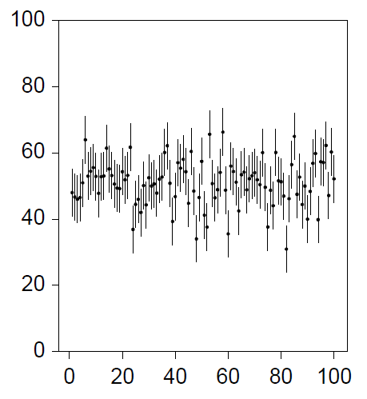
Consistancy of KH experimental results ?
shift (eV)
width (eV)
KpX
DEAR
KpX
DEAR
average
average
SIDDHARTA
SIDDHARTA
Example of
statistical fluctuations
No significant (3 σ) inconsistancy !
looking at the deviation of the 3 experimental
points from the average:
reduced chi-square for 2 degrees of freedom
=> ~ 20 % propability
Note: stat. and syst. error where linearly added

Slide 19
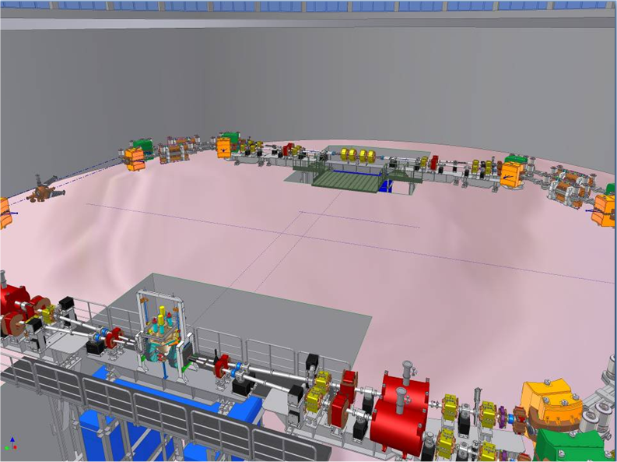
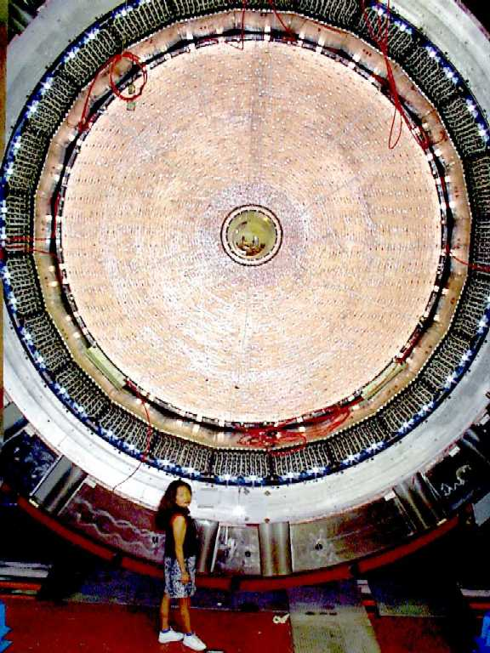
Towards SIDDHARTA-2
proposed new operation scheme of DAFNE:
Experiments in both interaction zones.
After 1st KLOE data taking period done, eventual beam slots for SIDDHARTA-2 in 2012,2013 .. ?
SIDDHARTA 2

Slide 20
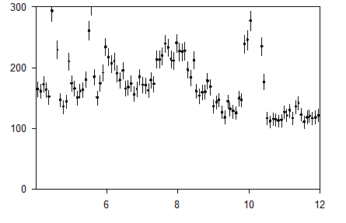
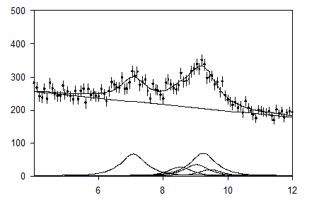
Requirements for a Kd measuremant
SIDDHARTA Oct 2009 data
Lum = 100 pb⁻¹
I(2-1) ~ 700 events
SIDDHARTA-2 simulation for
shift = -800 eV width = 800 eV
intens: 1000, 500, 200, 1200, 600, 100
Fit precision:
shift: ~ 67 eV width ~ 165 eV
(A)
(B)
X ray energy (keV)
X ray energy (keV)
for yield ~ 1/10 of Kp yield and width ~ 2 Kp width
we need
~ 20 times reduction of background to get similar S/B
~ 1000 pb⁻¹ to get 1000 events in Kd (2-1) if efficiency of the setup is doubled

Slide 21
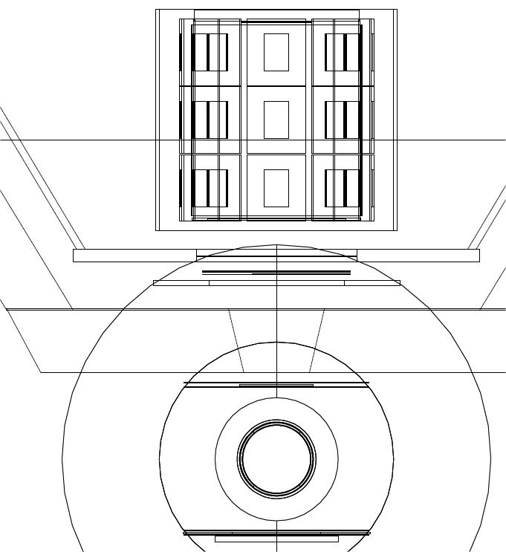
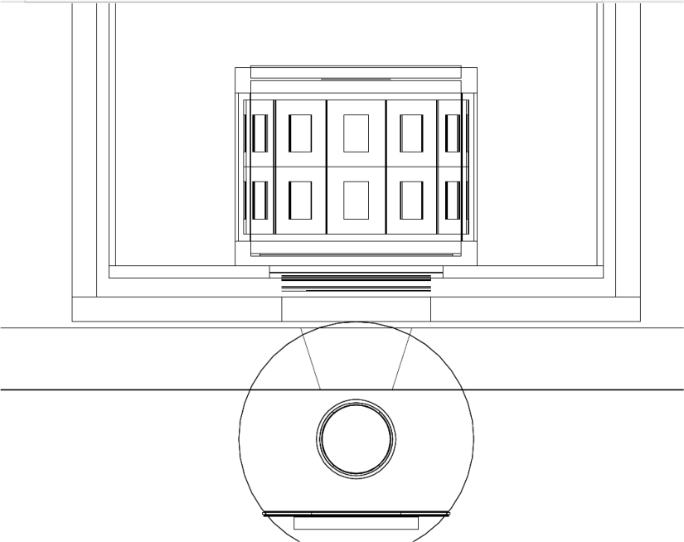
Compilation of changes
Siddharta Oct. 2009 proposed SIDDHARTA-2 setup
SDD modules
target cell
target cell
K⁻ stopped
X
π or p
19.7 cm
13 cm
15 cm
7 cm
6 cm
4 cm
kaon trigger
6 cm
kaon trigger
6 cm
beam pipe
K⁺ stopped
μ or π
changed geometry and gas-density:
closer, doubled gas density, upper kaon trigger DIRECTLY in front of target, smaller then entry window
added kaon livetime detector for K⁺⁻ discrimination:
identify K⁺ by delayed secondaries (τ=12.8 ns)
added surrounding scintillators:
„active shielding“, anticoincidence during SDDs time window (~500 ns), except
coincidence during „gas-stop-time (~ 5 ns, K⁻ absorption secondaries) , not „behind X ray hit“
SDDs operated at lower temp. to improve timing resolution

Slide 22
 | new geometry & gas density | better timing resolution | K± discrimination | del‘d anti-coincidence | prompt anti-coincidence | total improvement factor
Signal | 2.5 |  | 0.8 |  |  | 2.0
kaonic X-rays from wallstops /Signal | 20 |  |  |  |  | 20
continuous background /Signal /keV at ROI | 3.8 (ratio of gasstops vs. decay+wallstops increased) |  | 2 (events due to decay of K⁺ removed) |  | 2 (charged particle veto) | 15.2
beam background (asynchron) | 4.8 (less trigger per signal) | 1.5 (smaller coincidence gate) |  | 3 („active shielding“) |  | 21.6
kaon-correlated
„delayed anticoincidence“: the timewindow of the kaon-stopping is left out. Events during that time are K⁻ absorption secondaries, which are welcome.
„prompt anticoincidence“: if the topological distance of the SDD and the scintillator seeing the particle is small, then remove the events, it is likely to be a MIP passing the SDD.
Large distance: The SDD hit may be a kaonic X-ray signal, kaon absorption secondary in scintillator
CONCLUSION: IF the future DAFNE background in the FINUDA pit is comparable to the 2009 background at the KLOE side, and the Kd yields are not much smaller then 1/10 of the Kp yields
THEN a quantitative Kd measurement is feasible (with ~ 1000 pb⁻¹)

Slide 23
Preparatory measurements
Even without collisions in „our“ IP, important things can be learned for SIDDHARTA-2
topology of background radiation – improve shielding geometry, materials
test active shielding – efficiency, rates
SDD tests: in IP zone and using BTF electrons: setup: SDD + scintillator:
temperature dependance timing vs. energy resolution
response to MIPs: low energy tails in SDD-response to traversing MIP
X-ray or e± produced nearby in SDD module
X-ray or e ± produced from showers in massive material

Slide 24
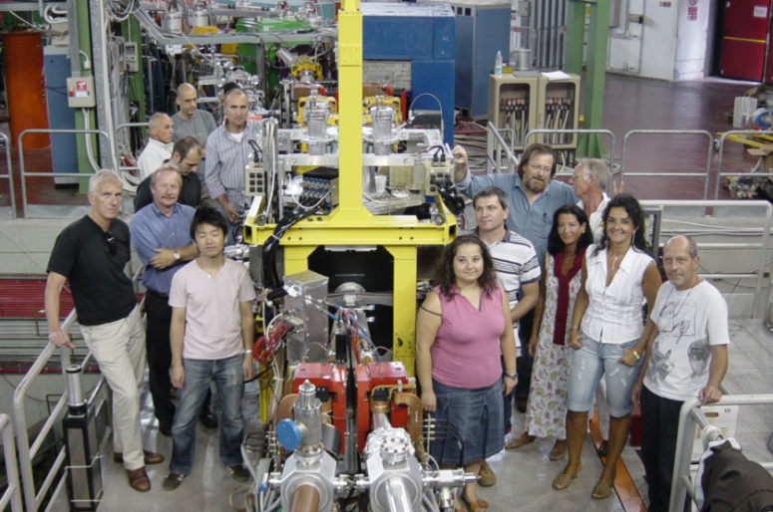
Summary and Outlook
Measurements of kaonic He-3 and He-4 see talk of D. Sirghi, this conf. (Thursday)
L_{α} shifts published in Phys. Lett. B
K⁻p results:
shift ε_{1s} = -283 ± 36 ± 6 eV width Γ_{1s} = 541 ± 89 ± 22 eV
Physics Letters B 704 (2011), 113-117
K⁻d first measurement ever, exploratory measurement, signal hints, significance ~ 2σ
upper limit for K-series yield.
hopefully.. extension of the experimental program: SIDDHARTA-2
with improved technique - measure Kd, other light atoms, heavys, Kp → γ Λ*
Preparations under way. Start 2012,13 ?
Thanks for your attention !

Slide 25
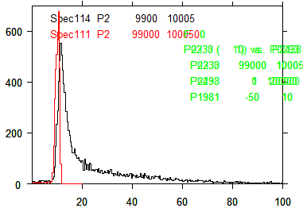
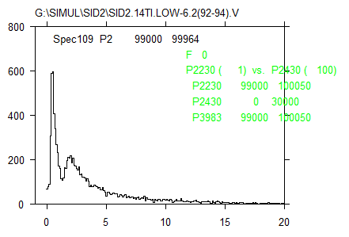
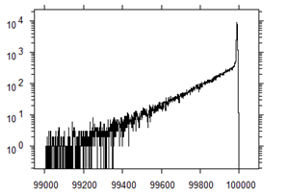
K⁺⁻ discrimination
deposited energy in the
kaonstopper
red: from kaon energy loss
black: total, including pileup with
K⁻ absorption products
SDDs
X
SDDs
K⁻
Scint_{Up}
Φ
e⁺
K⁺
e⁻
Scint_{Lo}
Scint
„Kaonstopper“
MeV
μ⁺
for a double pulse resolution of 2 ns:
if the stopped Kaon was a K⁺ we will see the
decay particles with high propability: e^{-2/12.2} = 0.85
time of last hit in the kaonstopper
deposited energy in the kaonstopper
... delayed gate
from delayed
K secondaries:
μ, π from K+ decay
A flash-ADC
with 100 ns range
and < 1 ns resolution
can give double hit and
energy information
MeV
-time (0.1 ns)

Slide 26
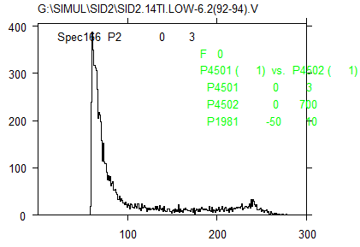
Kaon correlated continous background
w/o with
prompt topological anticoincidence^{*)}
dep. Energy 0.1 keV / chan
dep. Energy 0.1 keV / chan
*) muons and pions from kaon
decay or absorption, passing through
SDD and anticounter behind are removed.
Detected signal KD X-rays accompanied
by a pion from kaon absorption remain,
because the pion goes another direction
(big distance of the hits)
distance SDDhit - Anticounterhit
(mm)

Slide 27
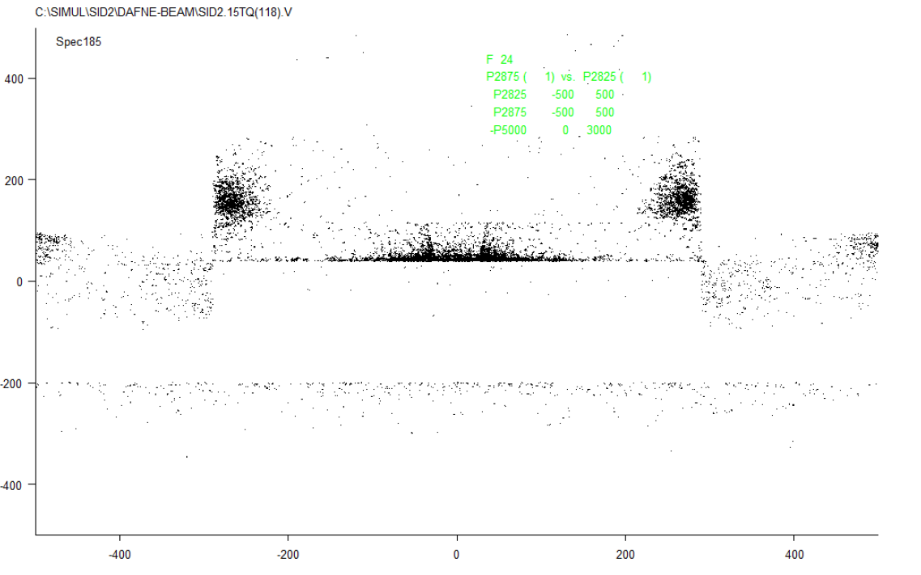
simulation of the spatial distribution of beam-background secondaries
for events with a signal in the SDDs
shielding
perm.
magnet
perm.
magnet
beam
axis
floor
collimator

Slide 28
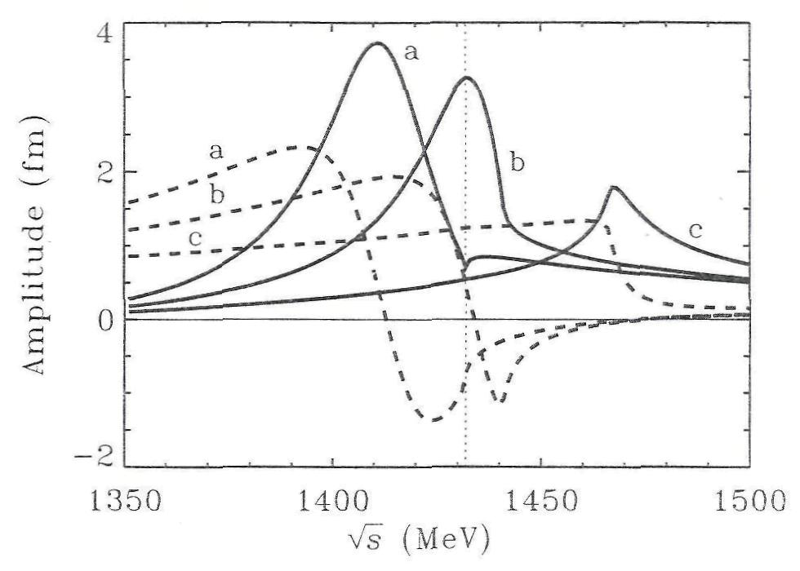
Kbar N interaction may cause kaon-nucleon clusters ?
Kpp, Kppn,.. „deeply bound“ ?
- highly controversial
- new experiments planned
understanding of KN at theshoild
essential !
T. Waas, N. Kaiser, W. Weise, Phys. Lett. B 365 (1996) 12
In free space, at threshold,
real part of a_{K}-_{p} < 0 (point A)
→ repulsive interaction
In nuclear matter at rather low density (∼0.2 ρ₀), at threshold, point B, real a_{K}⁻_{p} > 0
→ attractive interaction
B
A
K⁻ p threshold
1432
Real (dashed lines) and imaginary parts (solid lines) of the K⁻ p scattering amplitude in nuclear matter at different values of the Fermi momentum p_{F} = (3π² ρ/2^{)1/3}, as a function of the total c.m. energy √s
free space, p_{F} = 0; b) ~ 0.2 ρ₀, p_{F} = 150 MeV/c; c) ~ 1.4 ρ_{0,} p_{F} = 300 MeV/c;
ρ₀ = 0.17 fm⁻³
28
Notes:
I put this here to illustrate the relevance of the understanding of the antikaon nucleon interaction at threshold for the search for kaon nucleon clusters as predicted by the model of Akaishi and Yamazaki. Their model relies on the Lam(1405) being an antikaon-nucleon quasibound state which acts as a „doorway“ for the formation Kpp Kppp Kppn Kpnn deeply bound states. The existence of these kaonic clusters is still highly controversial, the experimental evidence is not yet clear.
Here the I=0 Kbar N scattering amplitude is plotted as a function of the c.m. energy sqrt(s) for 3 values of p-fermi. In this work by Waas, Kaiser and Weise a separable interaction was used to fit the available Kbar N low energy scattering and reaction data. The free space amplitude (p-fermi=0) exhibits the typical resonance shape, where the imaginary part peaks at about sqrt(sr)=1405 MeV, some 27 MeV below the K-p threshold of 1432 MeV and the real part changes sign from attractive below sqrt(sr) to repulsive above sqrt(sr).
In contrast, for the in-medium amplitude at (p-fermi=300MeV) the resonance is weaker and it‘s energy lies well above the K-p threshold, so that V-opt is attractive at the corresponding energy.

Slide 29
Kaonic hydrogen
Kaonic hydrogen: formation, level transitions
Negative kaons stopped in H₂ → initial atomic capture (n ~ 25) →
→ electromagnetic cascade → X-ray transitions
n
s p d f
4
3
E_{2p}
Shift and width
of states n>1
negligible
2
K_{γ}
Γ_{1s}
K_{α} ∼ 6.2 keV
ε_{1s} = E_{2p-1s}(meas.) – E_{2p-1s}(e.m.)
1
ε_{1s}
E_{1s}
}
As the kaon interacts strongly with the nucleus the 1s energy level is shifted and broadened
Note: radiationless transitions: KH(n,l) + H → KH(n’,l’) + H + E_{kin}
Doppler broadening is a correction in the πH case where the width ~1 eV, in KH width= 300-500 eV
29
Notes:
A kaonic atom is formed when a negative kaon enters a medium, looses its kinetic energy through ionization and excitation of the atoms and molecules and eventually is captured, replacing the electron, in an excited orbit (n~25). Via diffrent cascade processes (Auger transitions, Coulomb deexcitation, scattering) the kaonic atom deexcires to lower states. When the kaon reaches a low n state with small angular momentum, strong interaction with the nucleus causes its absorption. The strong interaction is the reason for a shift in the energies of the low lying levels and a short lifetime corresponding to an increase of the observed level width.

Slide 30
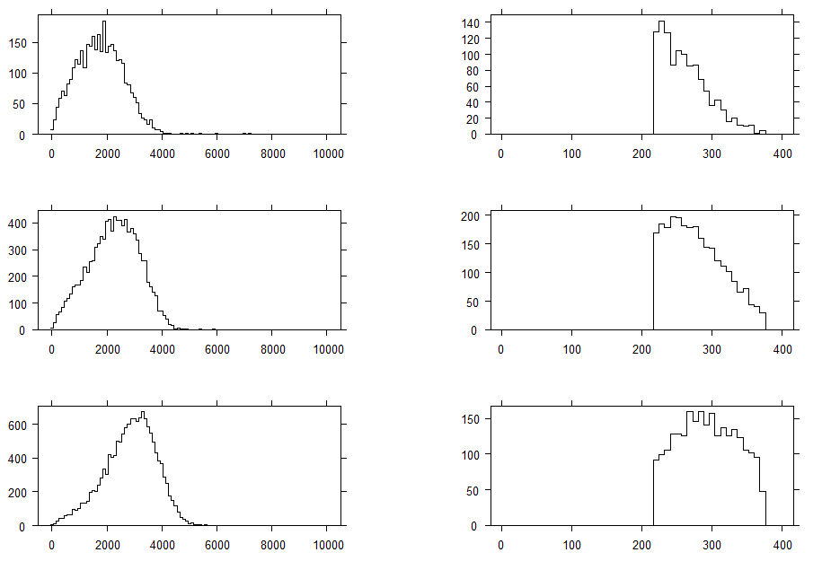
DAFNE tune: simulation of kaon energy at entering target, stopping distribution
Note: width of Φ resonance = 4.5 MeV
E(Φ) = 1019.0 MeV
kaon energy eV
vertical position (mm)
E(Φ) = 1019.4 MeV
kaon energy eV
vertical position (mm)
E(Φ) = 1019.8 MeV
kaon energy eV
vertical position (mm)

Slide 31
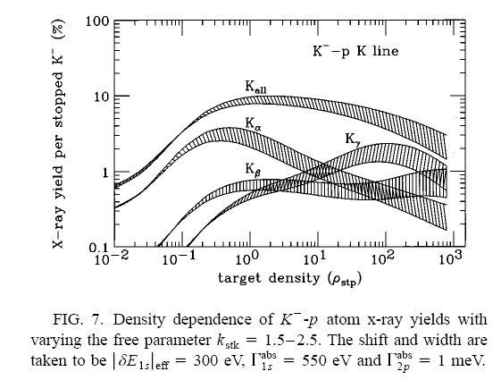

Slide 32
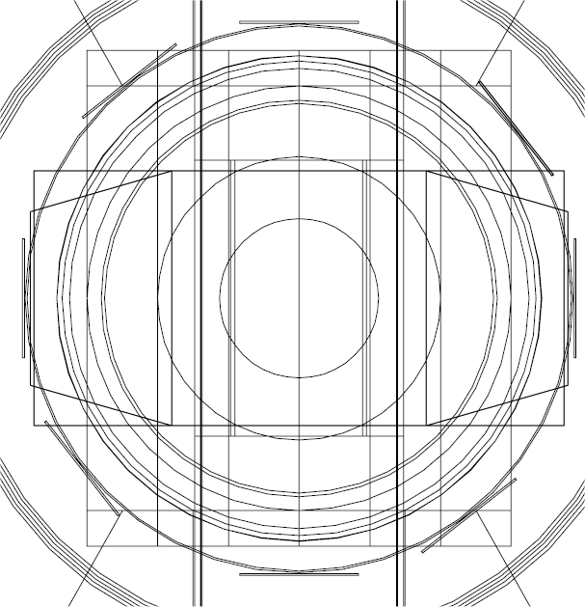
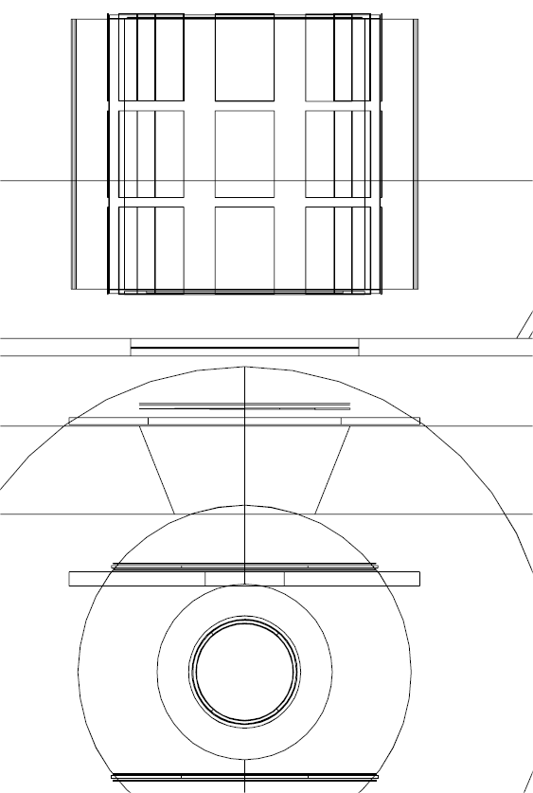
SIDDHARTA Monte Carlo simulation
1. GEANT geometry model for siddharta-cell-2-close
target entrance
at 216 mm height
entrance cone:
diameter 80-120 mm
Degrader at 150 mm vertical
z
mask
upper scintillator
beam pipe
window
320 micron Al
scintillators: 1.45 mm
wrapping for each scintillator:
2x 253 micron tape, 2x 3 micron Al
y
Degrader at 150 mm vertical position.
Foils: mylar (=hostaphan)
+overall 0.100, 0.200,.. mm
overall: 0.050 mm
Y: -60 -40 : 0.100 mm
Y: -40 -20 : 0.200 mm
Y: -20 0 : 0.400 mm
Y: 0 20 : 0.600 mm
Y: 20 40 : 0.700 mm
Y: 40 60 : 0.800 mm
lower scintillator
vacuum window: kapton 125 micron + paper 120 micron
target window: 100 micron Hostaphan
scintillator wrapping tape: taken as kapton¹
the mask: 8 mm plexiglass, hole diameter= 45 mm, cylindr.
¹) no essential difference in result if mylar is assumed
32

Slide 33
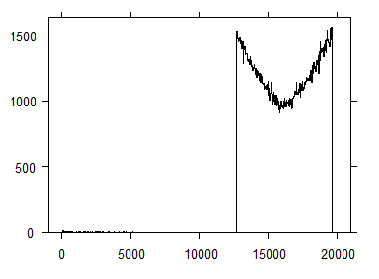
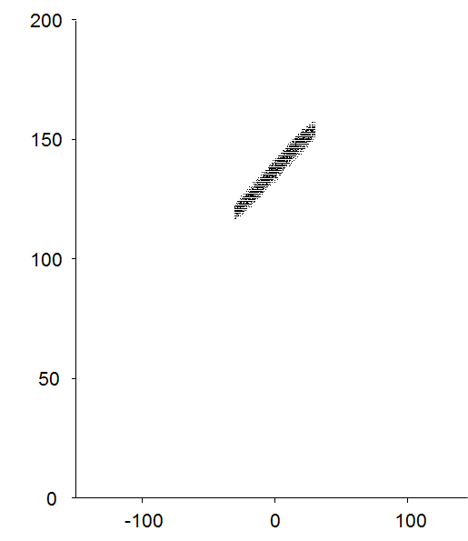
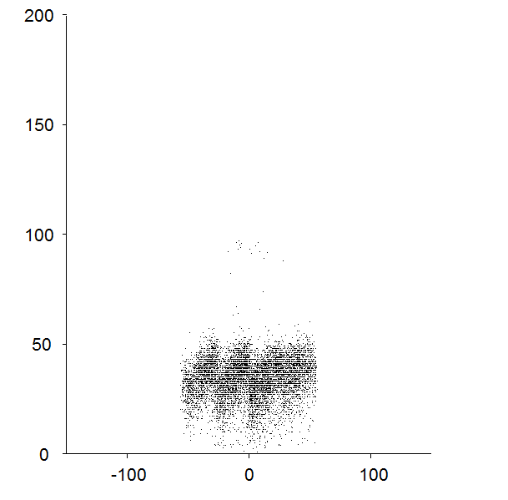
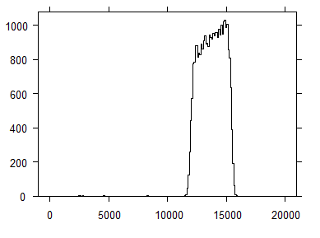
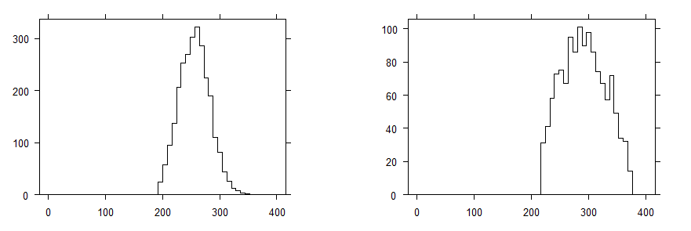
SIDDHARTA Monte Carlo simulation
(2) kaon stopping, boost compensation
K energy vs.
position
at the upper
scintillator
k energy vs.
position at
entering target
(after passing the
shaped degrader)
original
kaon energy
Kaon energy (0.1 MeV)
energy (eV)
energy of
kaons arriving
at the upper
scintillator
Y (mm)
Y (mm)
3 % LHD
1.6 % LHD
energy (eV)
degrader optimization needs experimental
fine tune ± 100 μm: material budget and
dafne tune known with limited accuracy.
z stop position (mm)
z stop position (mm)
33

Slide 34
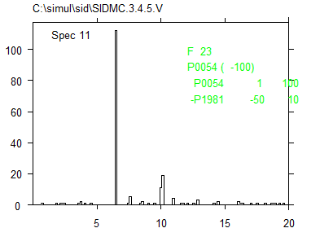
SIDDHARTA Monte Carlo simulation,
(3) stopping and signal in SDDs for He 2% LHe density, yield KHe L_{α} = 20%
trigger: 9.3% per kaonpair,
K⁻ gasstops: 0.78% per kaonpair
8.3% per trigger
KHe L_{α} Xrays for y=100%
0.56e-3 per kaonpair
845 per pb⁻¹
7.3% solid angle of SDDs
with respect to stopped kaons
z (mm)
y (mm)
z (mm)
KHe L_{α}
KHe L_{α}
w/o trigger
with trigger
KC (5-4) 10.2 keV
keV
keV
keV
Notes:
242e3 kaonpairs
22.5e3 trigger
1875 gasstops (with trigger)

Slide 35
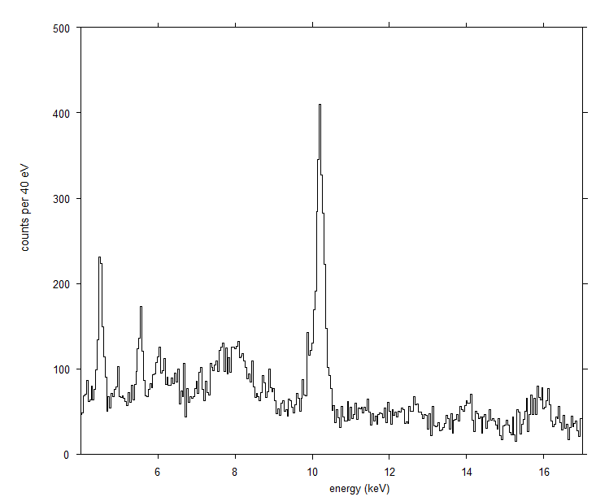
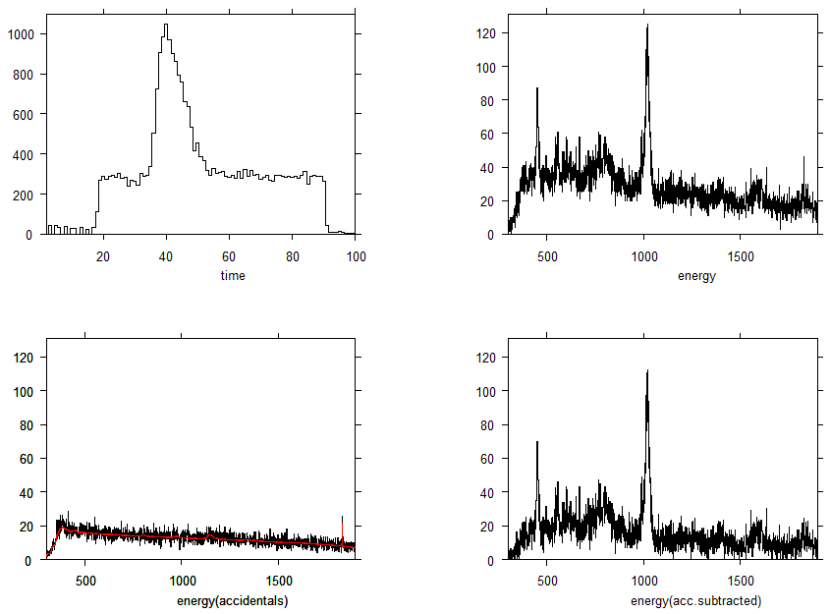
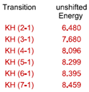
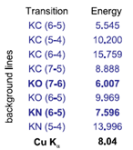
kaonic hydrogen – data October 2009
KC (5-4)
Ti K_{α}
Region of
kaonic hydrogen
lines
KO (6-5)
KC (6-5)
11.76e6 det‘d kaonpairs
126.5e6 prod‘ kaonpairs
84 pb⁻¹ 780 X/ pb⁻¹
65.5e3 KH K_{α} ev. for y=100%
=> y~ 0.012 * timecutfactor *
deadtimefactor *..
KO (7-6)
KC (7-5)
KN (5-4)
KAl (6-4)
Pb L_{β}
KC (6-4)
35

Slide 36
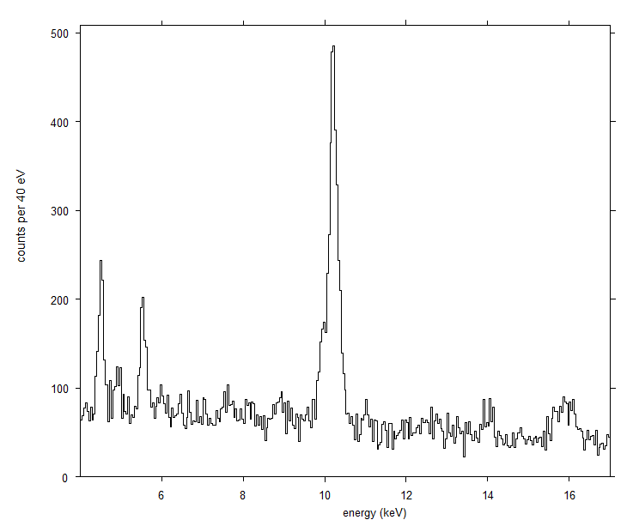
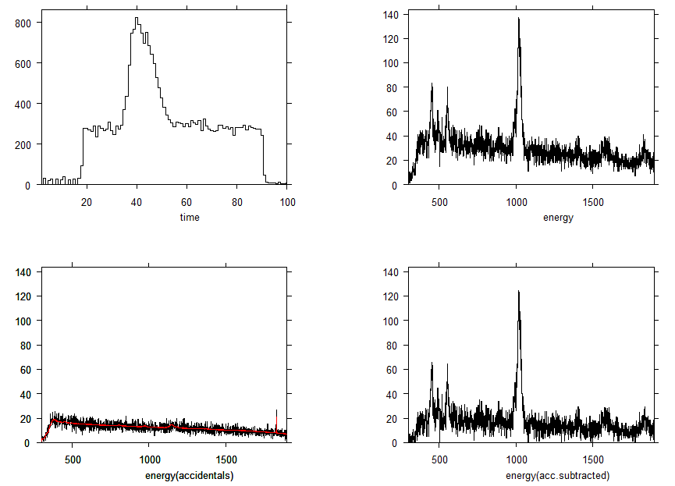
kaonic deuterium - data Sept/Oct 2009
KC (5-4)
Ti K_{α}
expected KD
pattern for
ε=-700 eV
Γ=1200 eV
KO (6-5)
KC (6-5)
11.9e6 det‘d kaonpairs
128e6 prod‘ kaonpairs
85.3 pb⁻¹ 780 X/ pb⁻¹
66.5e3 KD K_{α} for y=100%
for y=2.e-3 expect
130 *timecutfactor *
deadtimefactor
KO (7-6)
KN (6-5)
KC (7-5)
KN (5-4)
Cu K_{α}
KAl (6-4)
Pb L_{β}
KC (6-4)
36

Slide 37
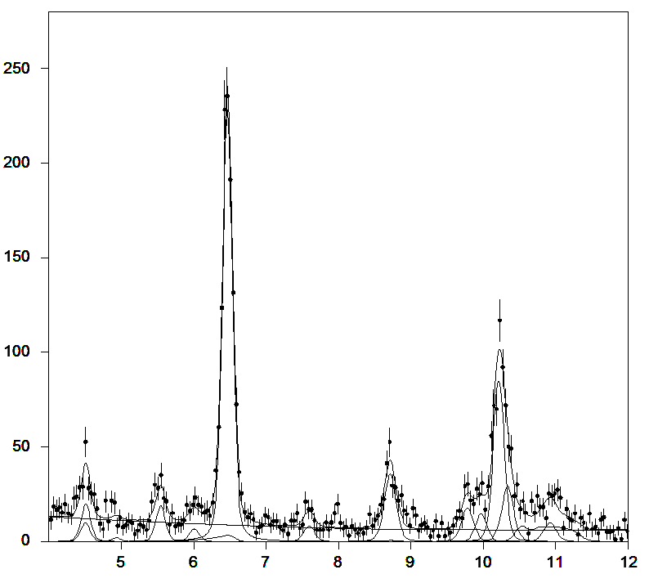
Fit of Kaonic Helium 4
KHe used for
gasstop optimization
+ physics interest¹)
data from setup 2
(no Fe55 source)
transition e.m.energy events
(3-2) 6.464 1047 ± 37
(4-2) 8.722 154 ± 21
(5-2) 9.767 91.8 ± 19
(6-2) 10.333 82.4 ± 25
higher < 11.63 131 ± 41
KHe (3-2)
p r e l i m i n a r y
Counts / bin
shift = + 2.1 eV
+- 2.9 eV (stat.)
+- 4 eV (syst.)
KC (5-4)
Ti K_{α}
KHe (4-2)
KHe (6-2)
KC (6-5)
KHe (5-2)
KO (6-5)
KHe L_{high}
KO (7-6)
KN (5-4)
¹) compare KEK E570
KHe L lines in liquid He,
consistent result,
first measurement in gas
X ray energy (keV)
37

Slide 38
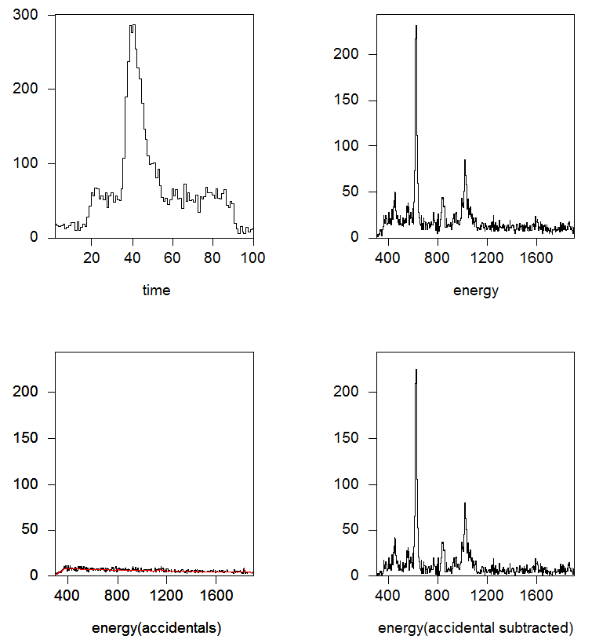
Kaonic Helium 3 data
energy spectrum
for timewindow
ch. 37-46 (830 ns)
10 eV per chan.
time correlation
(83 ns per chan.)
subtracted spectrum
only correlated
background remains
energy spectrum
for timewindow
out of correlation
data of ~ 15 pb⁻¹
taken 3.-7.11.2009
38

Slide 39
Fit of Kaonic Helium 3
transition e.m.energy events
(3-2) 6.224 1209 ± 40
(4-2) 8.399 220 ± 22
(5-2) 9.406 90.0 ± 18
(6-2) 9.953 65.8 ± 24
higher < 11.4 397 ± 40
KHe3
never measured before !
KHe (3-2)
p r e l i m i n a r y
Counts / bin
shift = - 1.7 eV
+- 2.7 eV (stat.)
+- 4 eV (syst.)
KC (5-4)
2.06e6 det‘d kaonpairs
22.15e6 prod‘d kaonpairs
14.8 pb⁻¹ 845 X/ pb⁻¹
12.1e3 KHe3 L_{α} for y=100%
=> y~ 0.1 * timecutfactor *
deadtimefactor *..
y~ 0.15
KHe (6-2)
Ti K_{α}
KHe (4-2)
KC (6-5)
KHe (5-2)
KN (5-4)
KHe L_{high}
KO (7-6)
KO (6-5)
continous hadronic background in 3-20 keV:
7850 (total) – 3006 (lines) =
4844 => 322 / pb⁻¹
X ray energy (keV)
39
Notes:
compare 322 / pb**-1 with 60 / pb**-1 from Monte Carlo!

Slide 40
Kaonic hydrogen fit
from the kaonic hydrogen spectrum the KD specturm was subtracted to get rid of the
kaonic background lines KO, KN. 290 pb⁻¹ KH
For the signal 8 voigtians with
given gauss resolution and free identical
lorentz width are used for (2-1),.. (9-1)
The position pattern is fixed by the QED values.
The intensities of (2-1),(3-1) and (4-1)
are free, those of the higher transitions are
coupled according to theoretical expectatuions
(cascade calculation, Koike‘s values)
KH
(4-1),..
(9-1)
KH
(2-1)
KH
(3-1)
siddharta
preliminary
p r e l i m i n a r y
Note: K_{high}
yield pattern
energy (keV)
In the final analysis the backgound
can be determined from fitting the KD data
and then include the pattren in the KH fit.
40

Slide 41
Transition | unshifted energy
KH (2-1) | 6.480
KH (3-1) | 7.677
KH (4-1) | 8.096
KH (5-1) | 8.299
KH (inf.) | 8.640
Transition | unshifted energy
KD (2-1) | 7.81
KD (3-1) | 9.25
KD (4-1) | 9.76
KD (inf.) | 10.41
KC (5-4)
KC (5-4)
KO (6-5)
KO (6-5)
Ti K_{α}
Region of
kaonic hydrogen
K lines
Ti K_{α}
KC (6-5)
KC (6-5)
Pb L_{β}
KN (5-4)
KN (5-4)
KO (7-6)
Pb L_{β}
KAl (6-4)
KN (6-5)
KC (7-5)
KC (6-4)
KC (7-5)
KAl (6-4)
KO (7-6)
KC (6-4)
KN (6-5)
KD pattern for
ε=-700 eV Γ=1200 eV
kaonic hydrogen
K X ray lines
(4-1)
siddharta
preliminary
(2-1)
(3-1)
(5-1)
- (20-1)
energy (keV)
41

Slide 42
Published results
Kaonic Helium-4 publication
confirming the KEK E570 result using a gaseous target
- KHe4 publication concerning yields of the transitions:
under preparation
- KHe3 paper: work in progress
[1,2,3] liquid He, [5] liq. He, Compton scattering corrected, [This] gaseous He, Compton negligable
42
Notes:
42

Slide 43
The Kaon trigger
tdc3
adc3
kaons dE > 3 MeV
mips: dE ~ 100 keV
kaon trigger scintillators v.3
upper: 49 x 60 mm²
tdc1
adc1
(tdc3+4)/2
meantime up low
adc thresholds to cut mips,
leave kaons
tdc4
adc4
adc3,4 geom. mean
tdc start = DAFNE 380 MHz
bunch frequency / 2
tdc2
adc2
TOF
kaons
kaons
(tdc1-tdc2) = PosA
900 ps
mips
mips
(tdc3-tdc4) = PosB
(tdc1+2+3+4) / 4.
43

Slide 44
He-3
He-4
KHe (3-2)
KHe (3-2)
KC (5-4)
KO (6-5)
KC (5-4)
KHe (6-2)
KC (6-5)
KHe (4-2)
KHe (4-2)
KO (6-5)
KHe (6-2)
KHe (5-2)
KAl (8-7)
KC (6-5)
KHe (5-2)
KHe L_{high}
KO (7-6)
KC (7-5)
KHe L_{high}
KN (6-5)
KO (7-6)
KN (6-5)
KC (7-5)
KAl (8-7)
X ray energy (keV)
X ray energy (keV)
time
energy
accidentals
subtracted
timecorrelation (83 ns/chan.)
X ray energy (keV)
X ray energy (keV)

Slide 45
fitrange: 4-17keV exclude 9.0-10.4 keV D spectrum subtracted normalized to KC 10.2 keV line
Y(2-1) free 1621
Y(3-1) free 1100
Y(4-1) free 439
Y(5-1)/Y(4-1) = 2.0 877
Y(6-1)/Y(5-1) = 0.7 614
Y(7-1)/Y(5-1) = 0.28 245
Y(8-1)/Y(5-1) = 0.16 136
Y(9-1)/Y(5-1) = 0.037 32
Y(10-1)/Y(5-1) = 0.02 17
Y(11-1)/Y(5-1) = 0.01 8
Y(2-1) free 1577
Y(3-1) free 1076
Y(4-1) free 741
Y(5-1)/Y(4-1) = 1.0 741
Y(6-1)/Y(5-1) = 0.7 518
Y(7-1)/Y(5-1) = 0.28 207
Y(8-1)/Y(5-1) = 0.16 115
Y(9-1)/Y(5-1) = 0.037 27
Y(10-1)/Y(5-1) = 0.02 15
Y(11-1)/Y(5-1) = 0.01 7
Alternatively: unsubtracted =>

Slide 46
Fit
kaonic hydrogen X-ray line pattern:
Lorentzians for shift= 283 eV width = 541 eV
Intensities for fit
Transition | unshifted energy
KH (2-1) | 6.480
KH (3-1) | 7.677
KH (4-1) | 8.096
KH (5-1) | 8.299
KH (6-1) | 8.395
KH (7-1) | 8.458
... | ...
KH (inf.) | 8.634
intensity (arb.units)
(5-1)
(2-1)
(3-1)
(6-1)
(4-1)
(7-1)
keV

Slide 47
Fit
kaonic hydrogen X-ray line pattern:
Lorentzians for shift= 283 eV width = 541 eV
Intensities for fit
Transition | unshifted energy
KH (2-1) | 6.480
KH (3-1) | 7.677
KH (4-1) | 8.096
KH (5-1) | 8.299
KH (6-1) | 8.395
KH (7-1) | 8.458
... | ...
KH (inf.) | 8.634
(2-1)
(5-1)
intensity (arb.units)
(3-1)
(6-1)
(4-1)
(7-1)
keV

Slide 48
calibration cont‘d
gain slightly changing with detector rate
and with presence of large signals
=> used X-ray tube DURING beam
studied rate dependance by varying X ray tube intensity
final energy adjustment at exact data-taking conditions
possible by looking at
the selftriggerspectra => Cu, Au
fluorescense lines excited by background
the coincidence spectra = kaonic lines from wallstopps KC,..
Remark on the response shape of the SDDs
consider edge effects
broadening due to charge transport depends on distance from anode
sum of gauss functions is not a gauss function (adding different resolutions)
=> measured response understood
selftrigger spectrum
Fe K_{α}
Cu K_{α}
Au L_{α}
Cu K_{β}
energy (keV)
FWHM @ Cu Kα = 174 eV consistant with X-tube measurement (with low intens.)
position of Cu Kα ~ slightly shifted as compared to the periodic X-tube calibrations
48
Notes:
48

Slide 49
Hydrogen
Transition | unshifted energy
KH (2-1) | 6.480
KH (3-1) | 7.677
KH (4-1) | 8.096
KH (5-1) | 8.299
KH (6-1) | 8.395
KH (7-1) | 8.458
... | ...
KH (inf.) | 8.634
Deuterium
KC (5-4)
Transition | unshifted energy
KD (2-1) | 7.81
KD (3-1) | 9.25
KD (4-1) | 9.76
KD (inf.) | 10.41
KC (5-4)
Ti K_{α}
KO (6-5)
Ti K_{α}
KO (6-5)
Region of
kaonic
hydrogen
K lines
KC (6-5)
KN (5-4)
KC (6-5)
KN (5-4)
KC (7-5)
Pb L_{β}
KC (6-4)
KO (7-6)
KC (7-5)
KAl (6-4)
Pb L_{β}
KAl (6-4)
KN (6-5)
KC (6-4)
KD pattern for
ε=-700 eV Γ=1000 eV
energy (keV)
energy (keV)
Kp-Kd
kaonic
hydrogen
K X-ray lines
(4-1)
(3-1)
(5-1) - (20-1)
(2-1)
energy (keV)

Slide 50
Our X ray detectors
The small capacitance results in a large amplitude and a short rise time of the signal
Compared to conventional photodiodes SDDs can be operated at higher rates and have better
energy resolution.
A lateral field makes the produced charge drift to
the collecting anode.
different from standard electronic devices:
- double sided structure
- not passivated
- large area chips
arrangement of bond pads in the center
I3 Hadron Physics EU FP6 –
Joint Research Activity: SIDDHARTA - in cooperation with LNF, MPG, PNSensor, Politecnico Milano, IFIN-HH.

Slide 51
Luminosity
siddharta can work only between
injections (blue dots, yellow line)
under good conditions during
siddharta DAQ ~ 2.8e32 – 1.0e32 cm⁻² s⁻¹
luminosity
compare to 2002 DEAR experiment:
~ 3.0e31 cm⁻² s⁻¹
now up to 10 times higher !
siddharta integrated luminosity
on 23 Oct 2009: ~ 8 pb⁻¹ !
calibration run
Notes:
51

Slide 52
Fit model for the signal
Transition | unshifted energy
KH (2-1) | 6.480
KH (3-1) | 7.677
KH (4-1) | 8.096
KH (5-1) | 8.299
KH (6-1) | 8.395
KH (7-1) | 8.458
... | ...
KH (inf.) | 8.634
kaonic hydrogen X-ray K-line pattern:
Lorentzians
shift= 283 eV width = 541 eV
Intensities: this experiment
K_{high}
intensity (arb.units)
(5-1)
overlapped distributions !
Intensity ratios not known precisely
=> fixing would introduce theory
dependance
the individual intensities of the high
transitions have large fit errors
..influence shift and width
=> focuse fit on Kα Kβ,
K_{high} transitions influence only via
their low energy tail (overlap)
(2-1)
(3-1)
(6-1)
(4-1)
(7-1)
(8-1)
keV
Notes:
how to define the fit functions for the kaonic hydrogen signal?
what we know for sure are the energy differences of the transitions (e.m. values) We see we have largely overlapped distributions, especially for the high transitions

Slide 54
D AΦ N E
... „Double Annular Phi-factory for
Nice Experiments“
at Laboratory Nazionalidi Frascati dell‘INFN
Notes:
Coming to the situation at DAFNE we are very happy about the good working conditions reached.

Slide 55
Detection of K⁻ absorption secondaries by the scintillators
times of all SDD hits
We know the time window for kaons stopping in the gas.
Detection of delayed secondary
identifies a K⁺ which can be rejected.
A „very prompt“ secondary means that the K- was stopped and absorbed before reaching the gas ..reject.
need large solid angle!
these events
can be signal or
background.
Backgr. be rejected by
„topological
anticoincidence“
these events
from wallstops
can be rejected
these events from K⁺ decay
can be rejected
-time (0.1 ns)
KH signalarrival time
= Kminus stop time
(for Oct. 2009
configuration)
5
ns
-time (0.1 ns)
Notes:
sidmc(small1)15-20.v

Slide 56
Content
Intro
Physics framework
Experiment
Data analysis
Gain alignment
Energy resolution
Fit
Results
SIDDHARTA-2
Requirements for Kd
Improvements
Summary and outlook
Notes:
After telling briefly what we measure, I want to put the experiment in a physics framework.
Then about the experiment: DAFNE, our setup and detectors, data analysis and results.
In the second part I will introduce our plans for a SIDDHARTA future
And then finally: Summary and outlook

Slide 57
Geometry and gas-density
scintillator
shielding
degrader
gas
cylindrical wall
vacuum
window
target windows
colli-
mator
gas
vertical position of kaonstops (mm)
radial position¹⁾ of kaonstops (mm)
Simulation of kaon stopping (triggered events only)
for the configuration of Sept./Oct. 2009
gas density ~ 1.5 % LHD
upper kaon trigger scintillator
49 x 60 mm²
60 mm above IP
¹⁾ for stops in the vertical range of the target cell

Slide 58
Geometry and gas-density (cont‘d)
Simulation of kaon stopping (triggered events only) for the configuration of SIDDHARTA-2.
gas density 3 % LHD upper kaon trigger scintillator: 90 mm diameter, near target window
scintillator
vaccum
window
target window
cylindrical
wall
gas
gas
vertical position of kaonstops (mm)
radial position of kaonstops (mm)
the fraction of triggered Kaons stopping in wall
materials can be reduced drastically;
The background from kaonic lines per signal is reduced by ~ 20

Slide 59
Example for preparatory measurements
512 MeV electrons from BTF, SDD + scintillator, get response to MIPS !
scintillator
case 1:
low energy tails in SDD-
response to traversing MIP
e⁻
SDD
scintillator
case 2:
X ray or e produced nearby,
in SDD module
e⁻
SDD
scintillator
case 3:
X ray or e produced from
showers in massive material
e⁻
SDD

