Slide 1
The SuperB Project
A major new
particle physics centre
Fergus Wilson, RAL/STFC
On behalf of the SuperB Project
STORI 2011, October 11th 2011

Slide 2
Outline
Key Features
Tour of SuperB Physics
Accelerator Design Status
Detector Design Status
Project Funding
Latest News
Conclusion and Outlook

Slide 3
Key Features
New European Accelerator Facility to be sited in Italy, ready by ~2016
At Υ(4S), 6.7 GeV positrons on 4.18 GeV electrons, 1.3 km circumference
Υ(4S) decays primarily to B-meson pairs.
High Luminosity (100 x current records)
≥10³⁶ cm⁻² s⁻¹ : 15 ab⁻¹/year rising to 40 ab⁻¹/year in later years
1 ab⁻¹ => 1 billion B-meson pairs, 1 billion D-mesons and 1 billion tau pairs
75 ab⁻¹ by ~2022
Polarization
60%-85% polarization of electron beam
Improves physics reach by factor of 2 in some regions
ψ(3770) to ϒ(5S) and beyond
Can scan a large energy range.
Charm Threshold Running
~4 months running at 10³⁵ cm⁻² s⁻¹ equivalent to 20 x future BES-III dataset.
Light Source
30 x brighter than ESRF or Diamond Light Source.
Computing
On the scale of a non-upgraded LHC experiment.

Slide 4
SuperB Physics Goals – Executive Summary
Identify the flavour structure of New Physics.
Sensitive to New Physics through flavour properties; CP Violation asymmetries in B and D decays; and rare decays.
Probe New Physics scales up to 10-100 TeV through indirect measurements.
Different New Physics models predict a different hierarchy of results => multiple measurements needed.
Search in both the quark and lepton sectors.
Golden Channels (good SM prediction + good experimental resolution) e.g. inclusive b→sγ, B→Kυυ, B→τυ, τ→μυυ
Physics capabilities published in arXiv:1008.1541 and arXiv:1109.5028
Notes:
Dark Matter : DM -> gamma x, e+ X; excess of gammas and positrons seen by EGRET,PAMELA. DM decay ok if lifetime > 10^17 secs but best signal if mass > 300 gev.

Slide 5
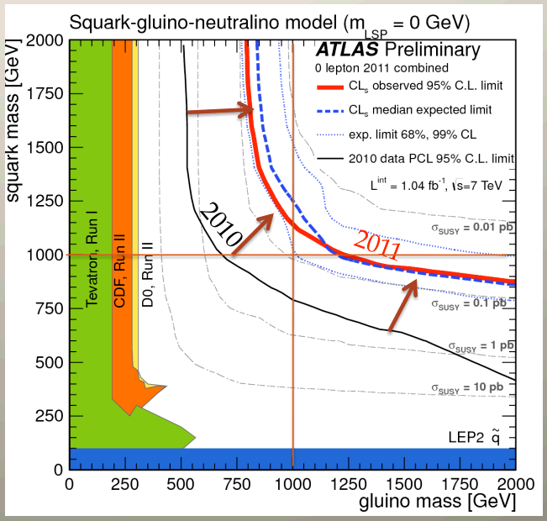
Higgs / SUSY after Summer 2011
Low Mass Higgs: compatible with Standard Model and SUSY
High Mass Higgs or no Higgs: need to probe higher mass scales.
“Trivial” SUSY is looking increasingly unlikely – need to probe more parameters

Slide 6
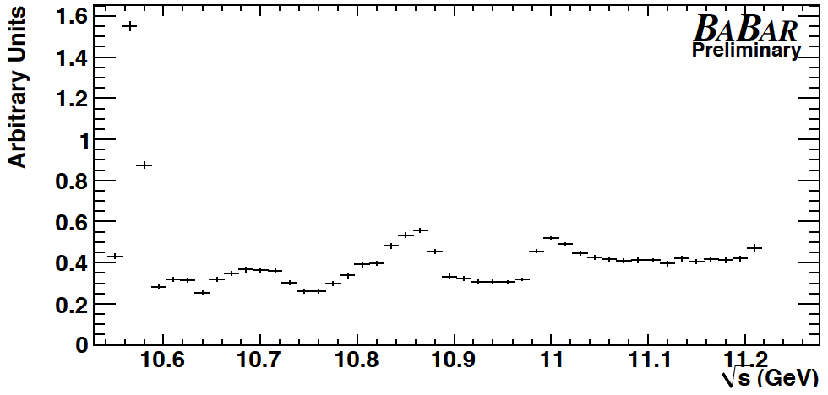
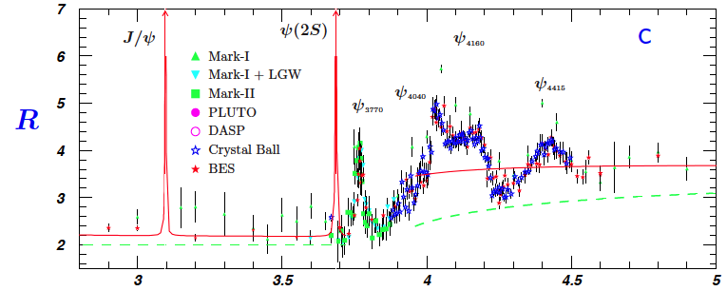
The SuperB data sample
ϒ(4S) region:
75ab⁻¹ at the Υ(4S)
Also run above / below the Υ(4S)
~75x10⁹ B, D and τ pairs
ψ(3770) region:
~150 fb⁻¹ per month at threshold running
Also run at nearby resonances
~2 x 10⁹ D pairs

Slide 7
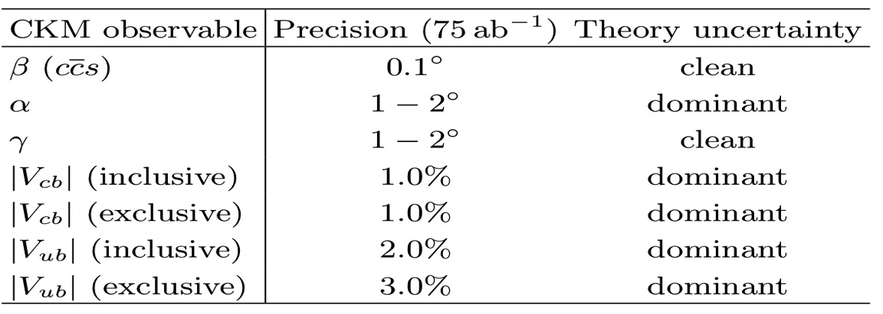
Physics: What will the CKM matrix look like in 2022?

Slide 8
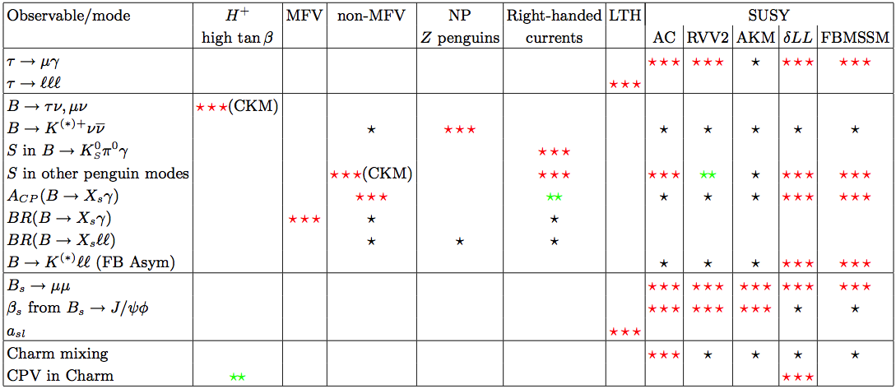
Physics: Interplay – The Golden Matrix
Combine measurements to elucidate structure of new physics.
✓
✓
✓
✓
✓
✓
✓
✓
✓
✓
✓
✓
✓
✓= SuperB can measure these modes
More information on the golden matrix can be found in arXiv:1008.1541, arXiv:0909.1333, and arXiv:0810.1312.

Slide 9
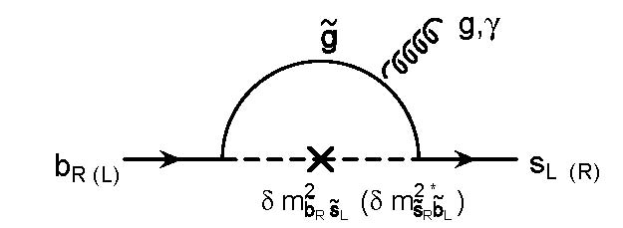
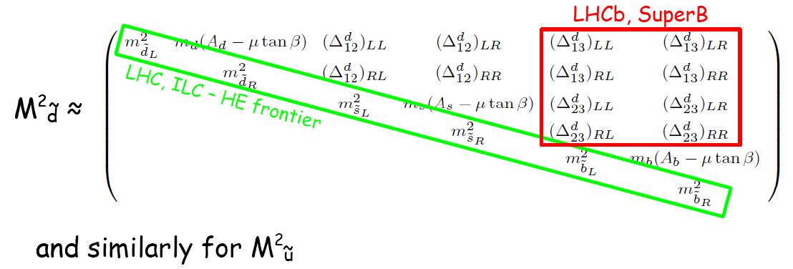
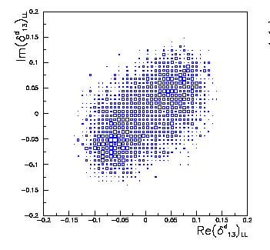
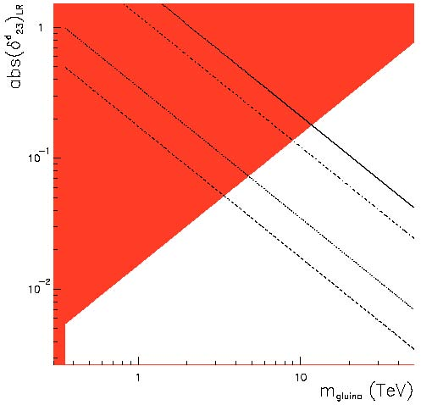
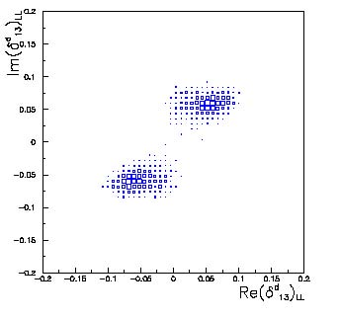
Physics: Overlap with the LHC
75 ab⁻¹ Integrated Luminosity important
10 ab⁻¹
tanβ=60
tanβ=5
Sensitive region (>3σ)
b→d transitions
b→s transitions
Notes:
B->xsgamma in MFV; L,R= helicity of susy squarks, generic squark mass matrix. MSSM has 124-160 couplings most are flavour related.

Slide 10
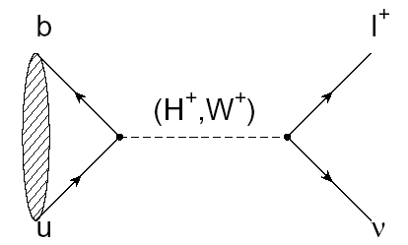
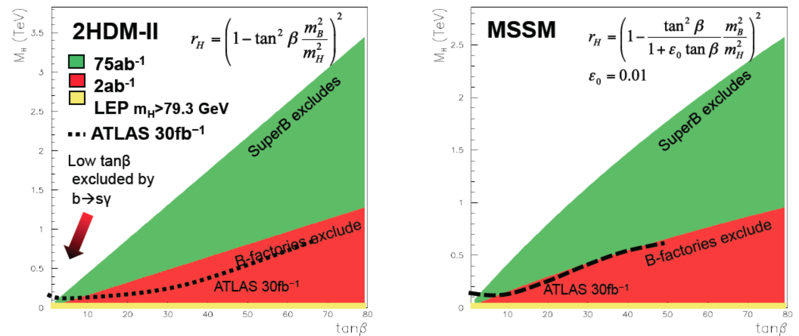
Physics: Charged Higgs (2HDM and MSSM)
Higgs-mediated Minimal Flavour Violation
Multi-TeV search capability for large tan(β).
Includes SM uncertainty ~20% from V_{ub} and f_{B}.
B⁰→l⁺l⁻ and B⁰→l⁻τ⁺ also sensitive to non-SM Higgs
2HDM-II
MSSM
SuperB excludes
SuperB excludes
Notes:
MSSM = SUSY model

Slide 11
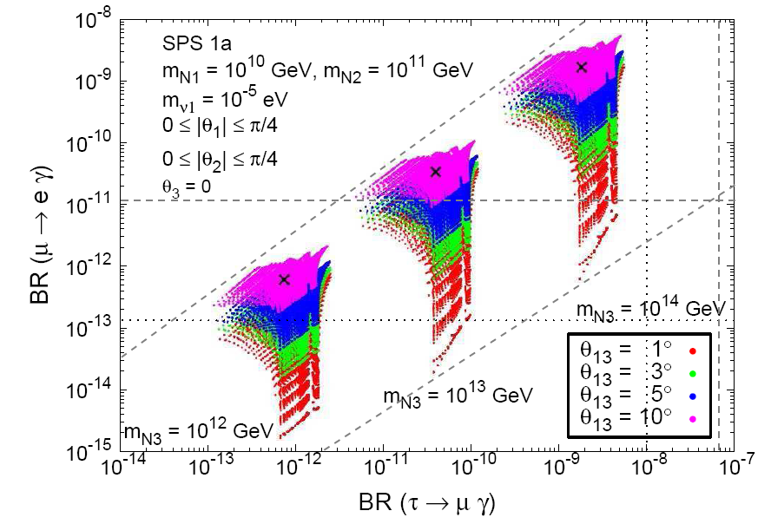
Physics: τ→μγ
τ->μγ upper limit can be correlated to θ₁₃ (neutrino mixing/CPV, T2K etc.) and also to μ->eγ (MEG).
SUSY seasaw model
MEG 2011
Correlated results from T2K, MEG and SuperB
Arganda et al., JHEP, 06:079, 2008.

Slide 12
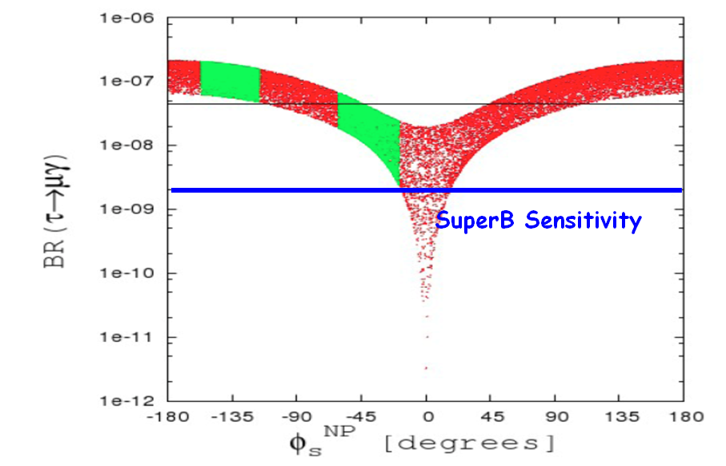
Physics: Lepton Flavour Violation
Many models predict LFV at the level that can be detected at SuperB
LFV also sensitive to other observable such as μ->eγ (MEG),θ₁₃ (T2K) and B_{s} mixing phase (LHCb)
Polarization doubles sensitivity (not included in numbers below)
Model | BF(τ→μγ)
mSUGRA+seesaw | 10⁻⁷
SUSY+SO(10) | 10⁻⁸
SM+seesaw, Z’ | 10⁻⁹
SUSY+Higgs | 10⁻¹⁰
SM + υ mixing | 10⁻⁴⁰
Over 50 τ decays can be measured (not to mention spectral functions, second class currents, α_{s} etc...)
Example: SU(5) SUSY GUT

Slide 13
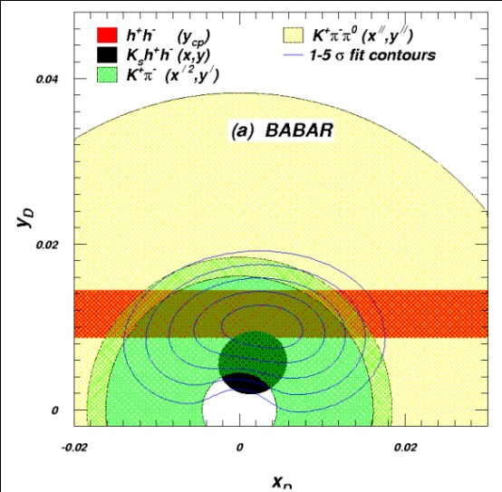
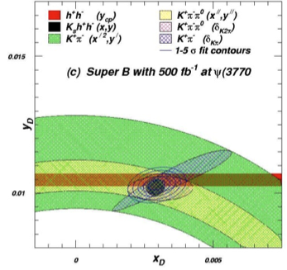
Physics: Charm and Charm CPV
2022
y_{D}
x_{D}
CPV in SM very small (<1%)=> CPV indicates New Physics
Charm Unitarity Triangle (β_{c}, |V_{cd}|, |V_{cs}|) and more
 | Now | 2022
x (x 10³) | ±3 | ±0.2
y (x 10³) | ±2 | ±0.1
δ_{kπ} | ±10º | ±1º
δ_{kππ} | ±20º | ±1º
See arXiv:1106.5075

Slide 14
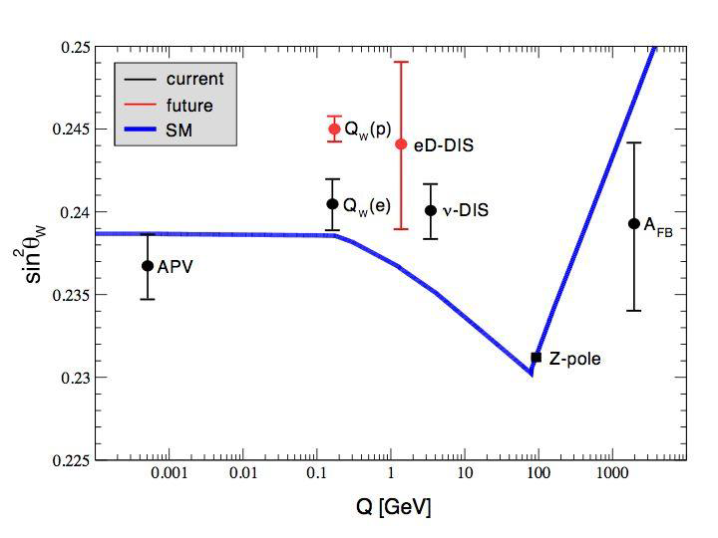
Physics: Benefits of Polarized Electron Beam
3) τ CP Violation:
Angular distributions
1) LFV: Doubles Precision
SuperB
2) τ EDM, τ g-2:
Measurement could prove or disprove discrepancy in Δα_{μ} due to New Physics.
EDM sensitivity ~ 2 x 10⁻¹⁹ e cm
Δα_{τ} (SM) ~ 10⁻⁶
Δα_{τ} (SUSY) <~ 10⁻⁵
Δα_{τ} (SuperB) precision~ 10⁻⁶
4) Electroweak:
Investigate LEP A_{FB} v. SLD A_{LR} discrepancy.
Investigate NuTev discrepancy.
Constrain Higgs mass
Sin²θ_{w} resolution ±0.00018
Perhaps measure even at ψ(3770)
Notes:
Weinberg angle, NuTev disagreement, Atomic Paraity Violation (APV), NuTev (nu-dis), z-pole (LEP/SLD), NC/CC could show new physics but subject to hadronic corrections and nuclear structure functions, radaiative corrections 10-6, loop corrections to rho ~0.5%. Leptoquarks could be seen a nucleon colliders but not at e+e-.
Tau g-2 affects angular distribution and polarization

Slide 15
Physics: B_{s} decays
SuperB will complement LHCb in some areas
Can cleanly measure A^{s}_{SL} using Υ(5S) data
SuperB can study rare decays with many neutral particles, such as , which can be enhanced by SUSY.
Little Higgs (LTH) scenario

Slide 16
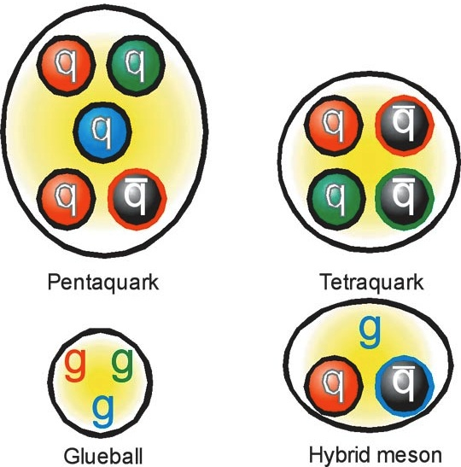
Physics: Spectroscopy and exotic resonances
Ideal laboratory for testing high- and low-energy QCD.
Search for hybrids, molecules and tetraquarks.

Slide 17
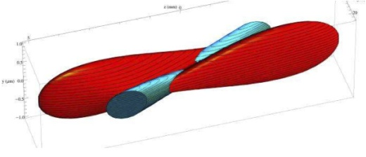
Accelerator: Parameters are stable
arXiv:1009.6178
Tau/charm threshold running
Flexibility built in, no single critical element
Upgradable to 4x higher lumi
Piwinski angle and crab-waist crossing test at DaΦne
Low power < 20MW

Slide 18
Photon Light Source

Slide 19
Detector: Design [arXiv:1007.4241]
Reuses much of BaBar e.g. CsI crystals
Improve Vertex resolution x 2
Improved hermiticity
SuperB baseline
TOF Forward PID
SuperB with options
Cluster counting in drift chamber (improves dE/dx)
Backward EMC
Optimized Muon Detector

Slide 20
SuperB – Funding and Developments
SuperB approved through primary law by Italian parliament, December 14th/15th 2010.
Parliament also approved INFN “Piano Triennale” 2010-2012 funding profile which includes SuperB.
SuperB is an Italian national flagship project.
Funding:
19M€ in 2010, 50M€ per year thereafter until EOY 2015. SuperB is the only project receiving multi-year funding so far.
~120M$ in-kind contribution from US through use of PEP-II machine components and BaBar detector.
50M€ allocated for Tier 2 Grid computing centres in Southern Italy.
Italian Institute of Technology (IIT) may contribute to beam-lines for photon science.
Only ~25M€ needed from international collaborators for detector

Slide 21
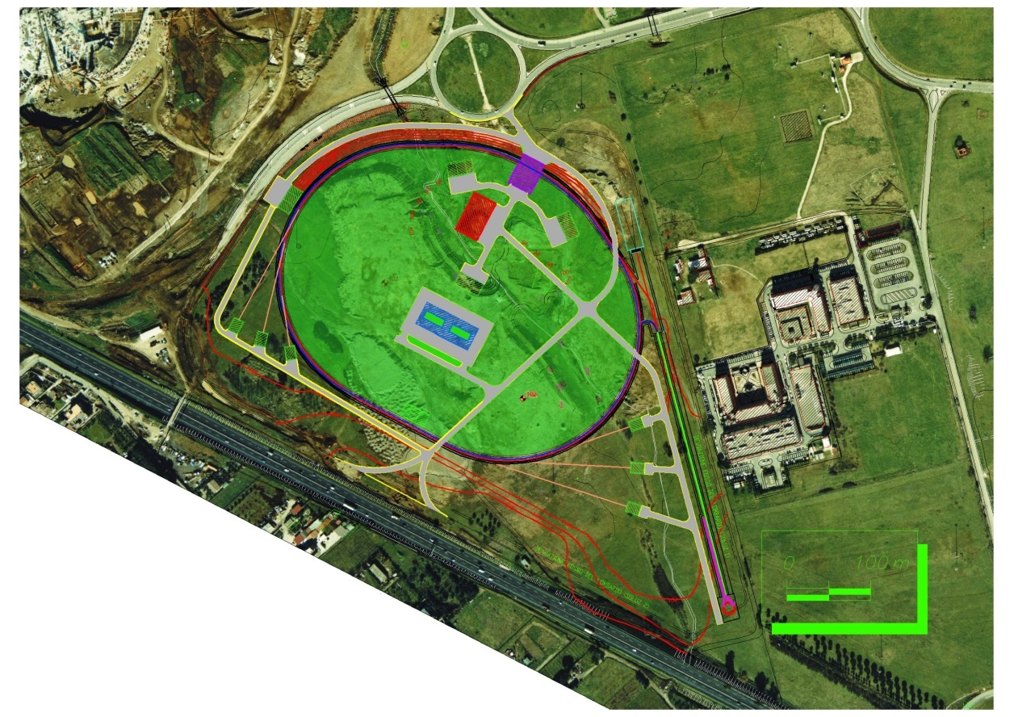
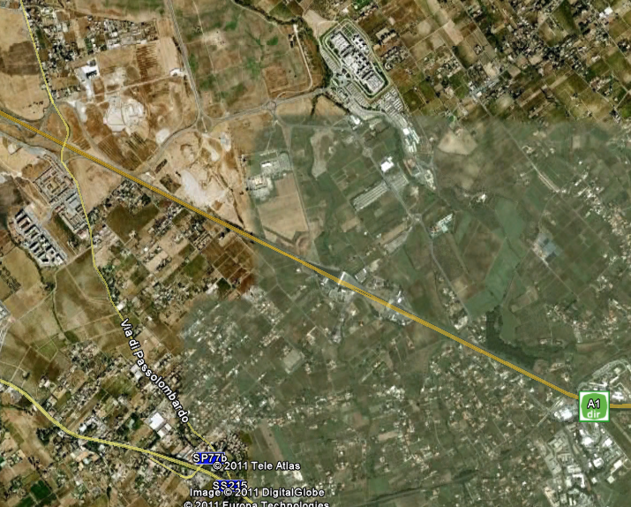
Site Decision announced May 30th 2011
Tor Vergata University Campus
“N. Cabibbo Laboratory”
About 4.5 Km
Italian Government approval given on September 29 2011
You are here !

Slide 22
Conclusion and Outlook
August 2010: Physics, Accelerator, Detector reports published.
December 2010: SuperB approved by the Italian Government, as a “Flagship” project.
May 30th 2011: Site selection announced.
September 29th 2011: N. Cabibbo Lab approved by Government
A unique opportunity for Europe and International Collaboration.
The necessary funding is in place.
First beams in 5 to 6 years. 15 ab⁻¹/year rising to 40 ab⁻¹/year.
Collaboration is still growing. Working towards TDR. Opportunities in detector, accelerator, computing and physics.

Slide 23
Backup

Slide 24
Golden measurements: General
Benefit from polarised e⁻ beam
very precise with improved detector
Statistically limited: Angular analysis with >75ab⁻¹
Right handed currents
SuperB measures many more modes
systematic error is main challenge
control systematic error with data
SuperB measures e mode well, LHCb does μ
Clean NP search
Theoretically clean
b fragmentation limits interpretation

Slide 25
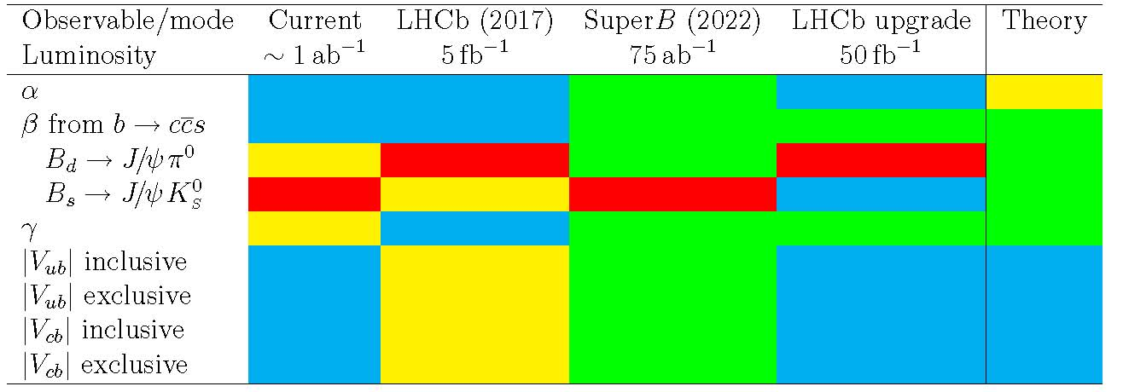
Golden Measurements: CKM
Comparison of relative benefits of SuperB (75ab⁻¹) vs. existing measurements and LHCb (5fb⁻¹) and the LHCb upgrade (50fb⁻¹).
LHCb can only use ρπ
β theory error B_{d}
β theory error B_{s}
Need an e⁺e⁻ environment to do a precision measurement using semi-leptonic B decays.

Slide 26
CKM Matrix and Unitarity Triangle
Complex and unitary
B⁰ →π⁺π⁻ B⁰ →ρ⁺ρ⁻
b → ulν
B⁰B⁰ mixing
α
If angles and sides disagree then Standard Model is wrong
V_{ud}V_{ub}*
V_{td}V_{tb}*
γ
V_{cd}V_{cb}*
β
B⁰ → D*π
B⁺ → D⁰_{CP} K⁺
B → ψK_{S}
B → φK_{S}
b → clν

