Slide 1
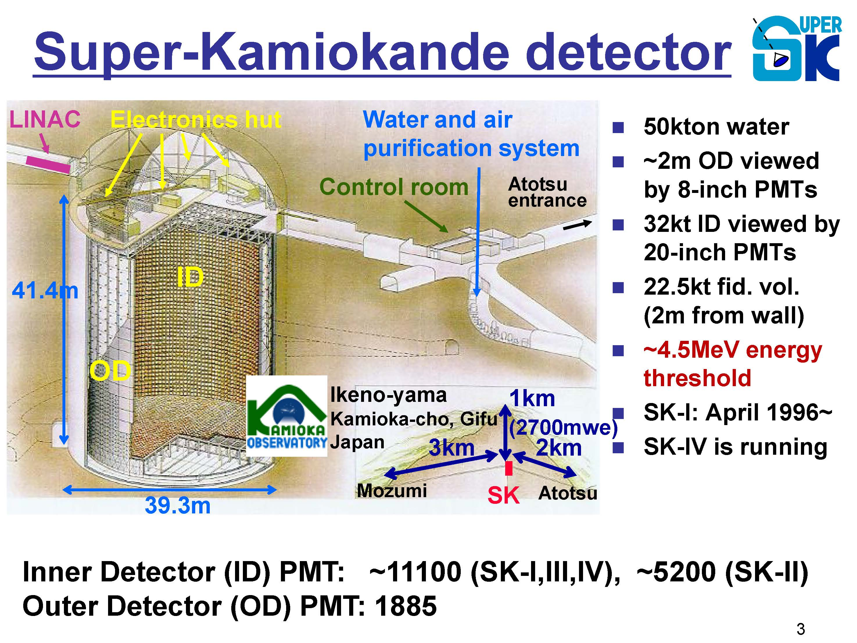
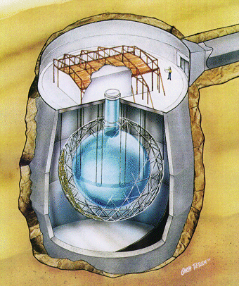
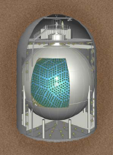
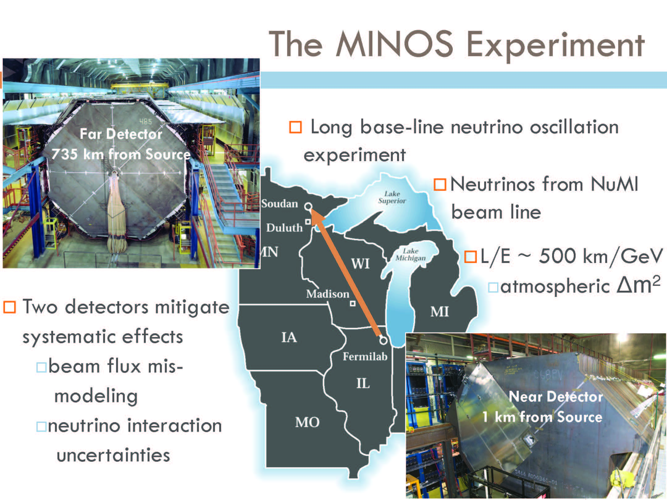
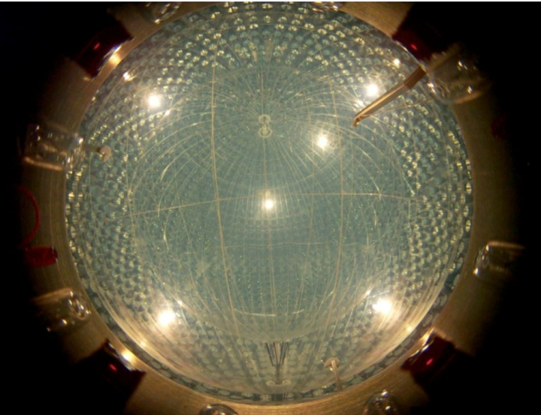
Neutrino Oscillation Measurements,
Past and Present
Art McDonald
Queen’s University
And
SNOLAB

Slide 2
Early Neutrino Oscillation History
1940’s to 1960’s:
Neutrino oscillations were proposed by Pontecorvo in 1957 motivated by initial reports of measurements by Davis with a Chlorine detector at a reactor. At that point, the transitions being considered were electron neutrino to electron anti-neutrino.
Interestingly, in a originally classified 1946 Chalk River report, Pontecorvo had proposed the detection of neutrinos from reactors and from the sun with a chlorine detector.(At that point, the distinction between neutrino and anti-neutrino was unknown.)
In 1962, Maki, Nakagawa and Sakata considered the representation of electron and muon neutrinos in terms of ν₁ and ν₂ states.
In 1968, Gribov and Pontecorvo suggested that one possible reason for low neutrino fluxes from the sun in Davis’ experiment could be oscillation of electron neutrinos into muon neutrinos, undetectable by the chlorine detector.

Slide 3
Neutrino Oscillation History
1970’s:
  Accelerator based oscillation measurements CHORUS, NOMAD, CDHSW… No oscillation effects seen.
  Solar neutrinos: Davis continues at Homestake
1980’s:
  Kamiokande solar neutrinos: Confirms deficit
  Mikheyev, Smirnov (Wolfenstein) describe the MSW effect that modifies the behaviour of oscillations through matter interactions
  The Atmospheric neutrino anomaly: IMB, Kamiokande: The ratio of total muon neutrinos to total electron neutrinos is low by about a factor of two. Not seen in FREJUS, NUSEX.
  <100m reactor based measurements find no oscillation evidence: Bugey, Krasnoyarsk, ROVNO, Goesgen, ILL
1990’s:
  Palo Verde, CHOOZ: no oscillation seen at ~ I km from reactor.
  SAGE, GALLEX, GNO confirm solar neutrino deficit for pp neutrinos.
  LSND finds small effect for muon neutrino to electron neutrino conversion, with restrictions by KARMEN, E776/BNL.
  SuperKamiokande finds clear disappearance of atm. mu neutrinos as a function of zenith angle that fits well the pattern for oscillations.

Slide 4
Neutrino Oscillation History
2000’s:
  SNO observes clear flavor change for solar neutrinos. Appearance of muon or tau neutrinos
  KamLAND observes clear disappearance of electron anti-neutrinos from reactors with same oscillation parameters as electron neutrinos from the sun (with MSW effect applied).
  The number of experiments and results associated with neutrino oscillations expands greatly:
    Muon Neutrinos: KARMEN, K2K, MINOS, MiniBoone…
    Muon anti-neutrinos: MINOS, MiniBoone
    Solar Neutrinos: Borexino
2010’s:
  A dominant mechanism for neutrino flavor change appears to be oscillations among three active flavors of massive neutrinos. Parameters for these oscillations are becoming increasingly accurate and future experiments seek θ₁₃, Hierarchy, Low Energy solar…..
  Other questions remain from results at the few sigma level in several experiments: Sterile neutrinos, CPT violation…

Slide 5
Oscillation of 3 massive active neutrinos is a dominant mechanism for flavor change. Neutrinos have a finite mass but only differences are known.
If neutrinos have mass:
Neutrino types e, μ, τ
Mass states 1,2,3
Maki-Nakagawa-Sakata-Pontecorvo matrix
?
(Double β decay only)
?
?
Atmos., Accel
CP Viol. Phase
Reactor, Accel
Solar, Reactor
Majorana Phases
Range defined for Δm₁₂, Δm₂₃
For two neutrino oscillation in a vacuum: (a valid approximation in many cases)

Slide 6
Matter Effects – the MSW effect
(Mikheyev, Smirnov, Wolfenstein)
The extra term arises because solar ν_{e} have an extra interaction
via W exchange with electrons in the Sun or Earth.
In the oscillation formula:
MSW effect can produce an energy spectrum distortion
and flavor regeneration in Earth giving a Day-night effect.
If observed, matter interactions define the mass hierarchy.

Slide 7
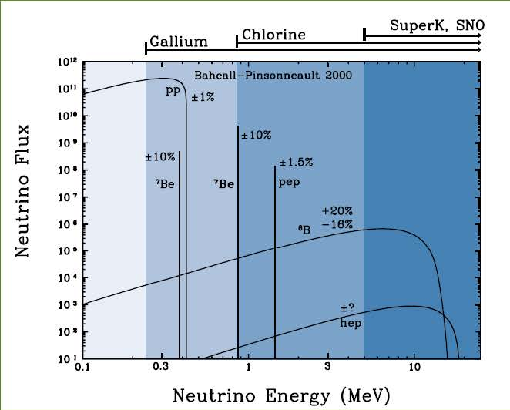
As of 1997: “The Solar Neutrino Problem”
Solar Neutrinos
Is The “Problem” Neutrino Flavor Change or Solar Models?

Slide 8
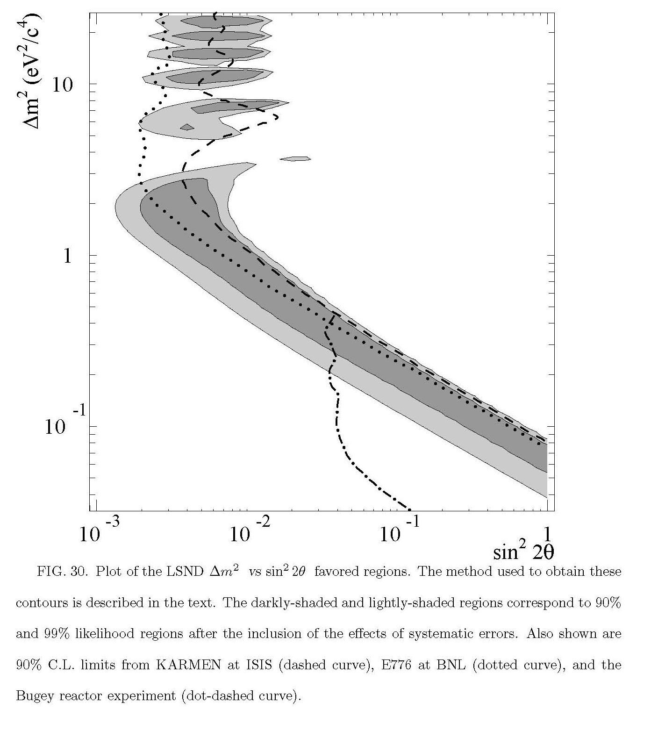
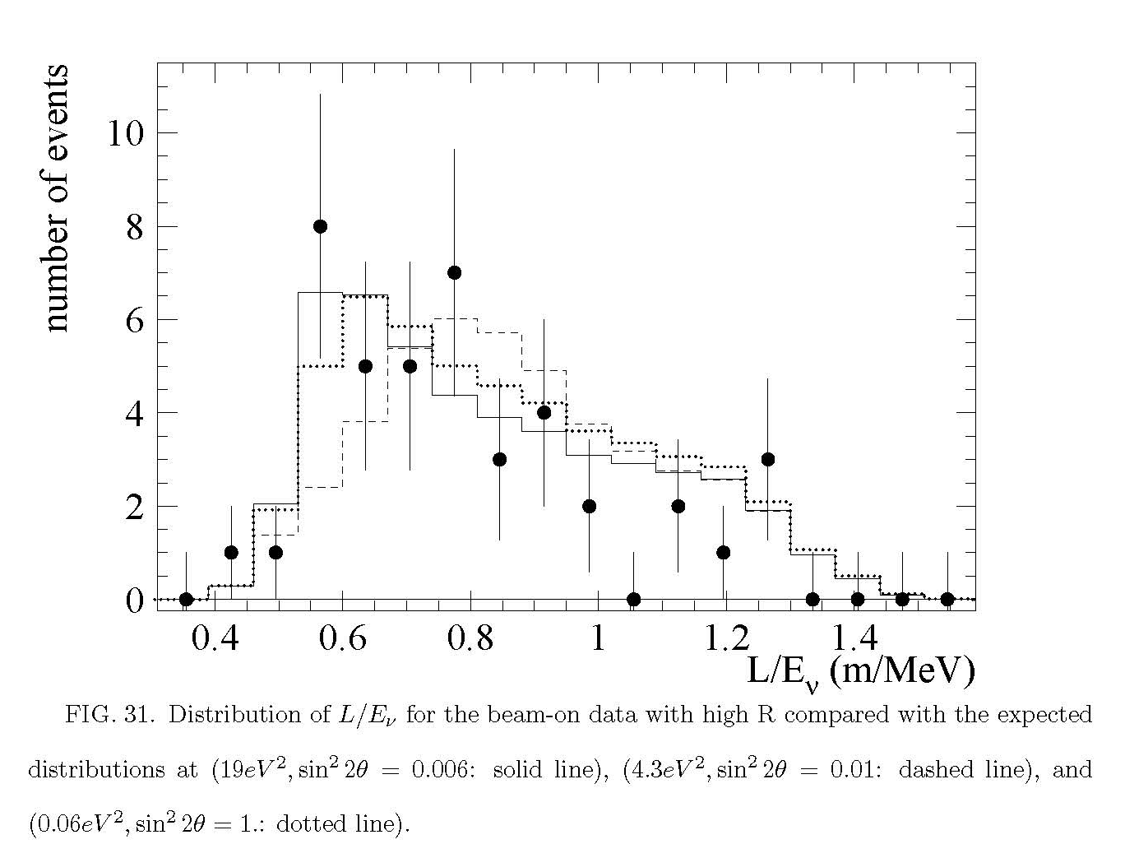
LSND 1996
Shaded: LSND accepted region
Dashed: KARMEN exclusion
Dotted: E776/BNL Exclusion
DOT-DASH: Bugey Exclusion
Measurement of muon antineutrino to electron antineutrino conversion at LAMPF facility:
Excess of events.

Slide 9
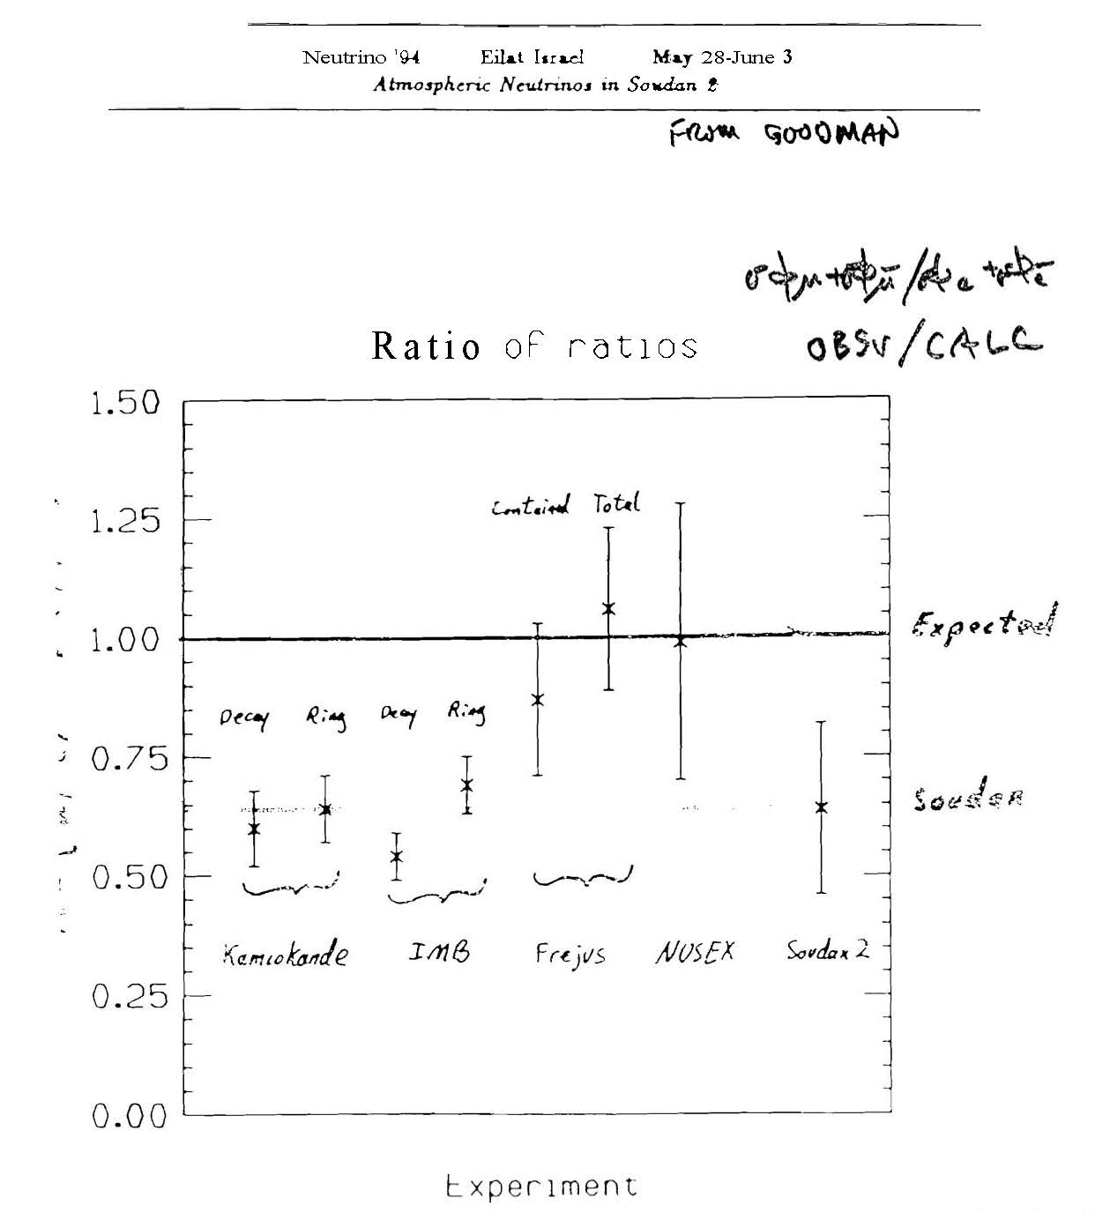
Atmospheric
Neutrinos

Slide 11
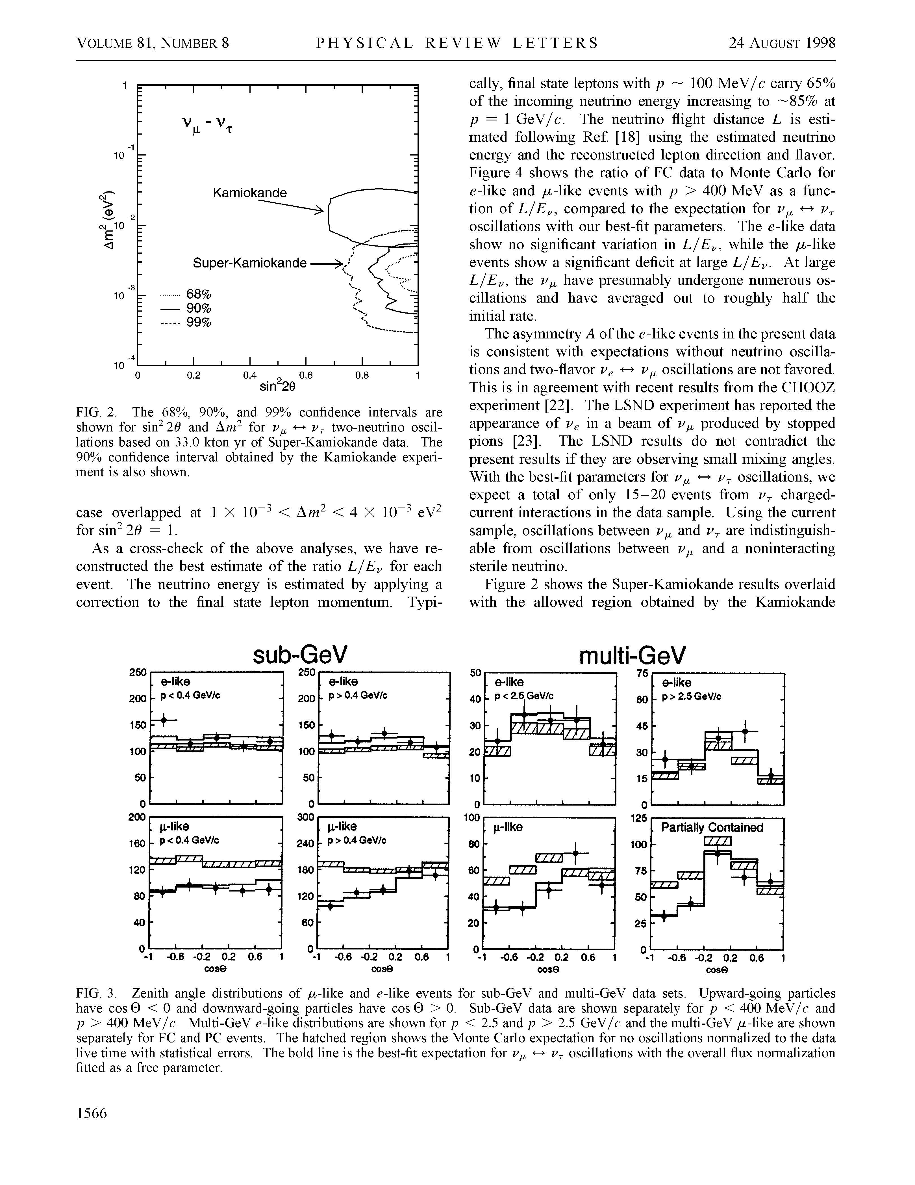
SUPERKAMIOKANDE 1998:
Atmospheric Neutrinos
“The data are consistent with two-flavor
ν_{μ} −> ν_{τ} oscillations with sin² θ > 0.82 and
5 x 10⁻⁴ < Δm² < 6 x 10⁻³ eV² at the 90% confidence level.”

Slide 12
SNO Results: Pure Heavy Water: 2001, 2002
where x = e, μ,τ
Equal sensitivity for NC,
6 times larger for e in ES

Slide 13
First SNO paper in 2001 obtains 3.3 σ variance from null oscillation hypothesis by comparing SNO CC with ES from SuperK.
Clear indication of oscillation from ν_{e} to other active neutrinos (ν_{μ} or ν_{τ})

Slide 14
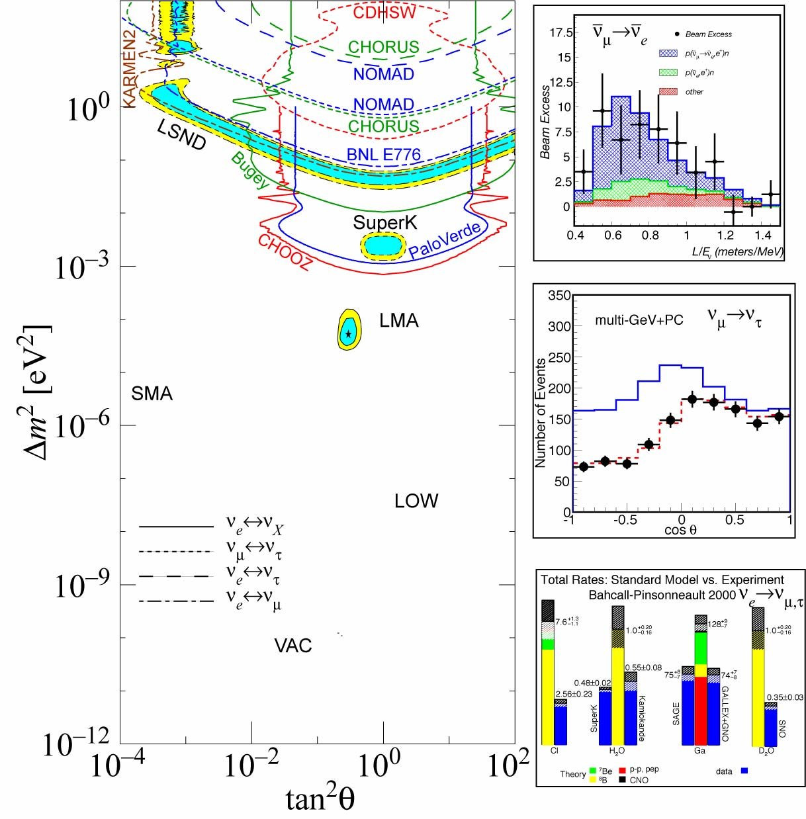
LSND
CHOOZ + SK Provides restriction on θ₁₃
Super-K
Δm₂₃
Neutrino Data
2002
Solar
Δm₁₂

Slide 15
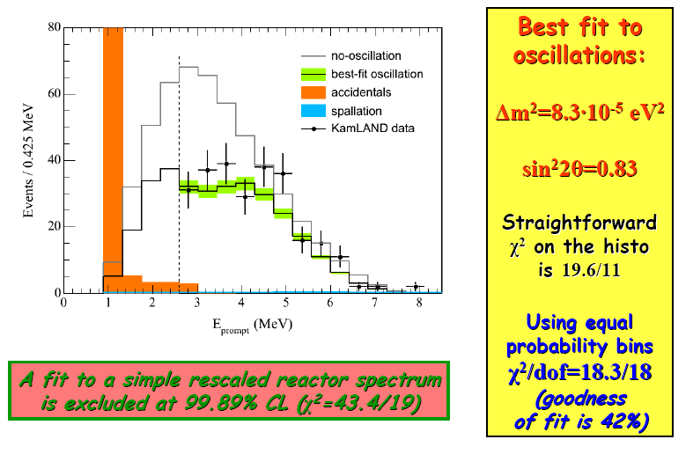
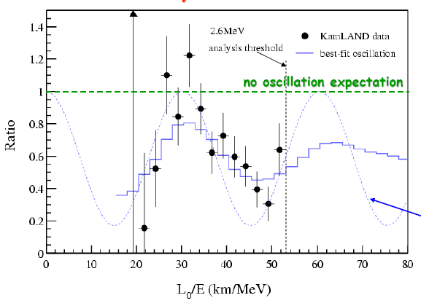
KamLAND 2002, updated in 2004:
  182 GW of reactor power in Japan, Korea
  Average distance 180 km
  515 days vs 145 days in 2002 paper
  258 events vs 365 +- 24 expected for no oscillations

Slide 16
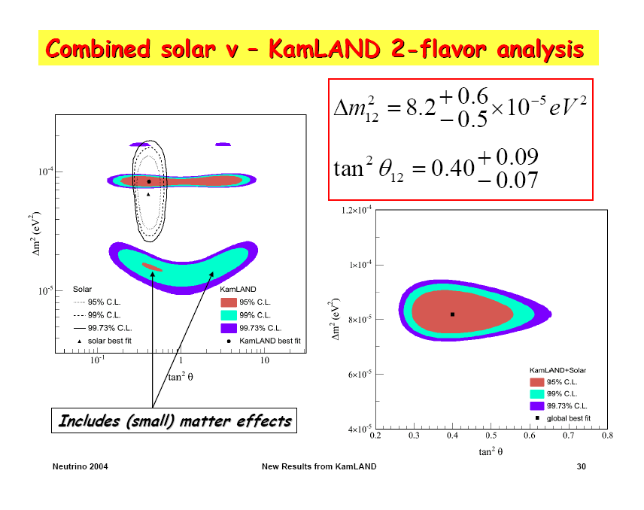

Slide 17
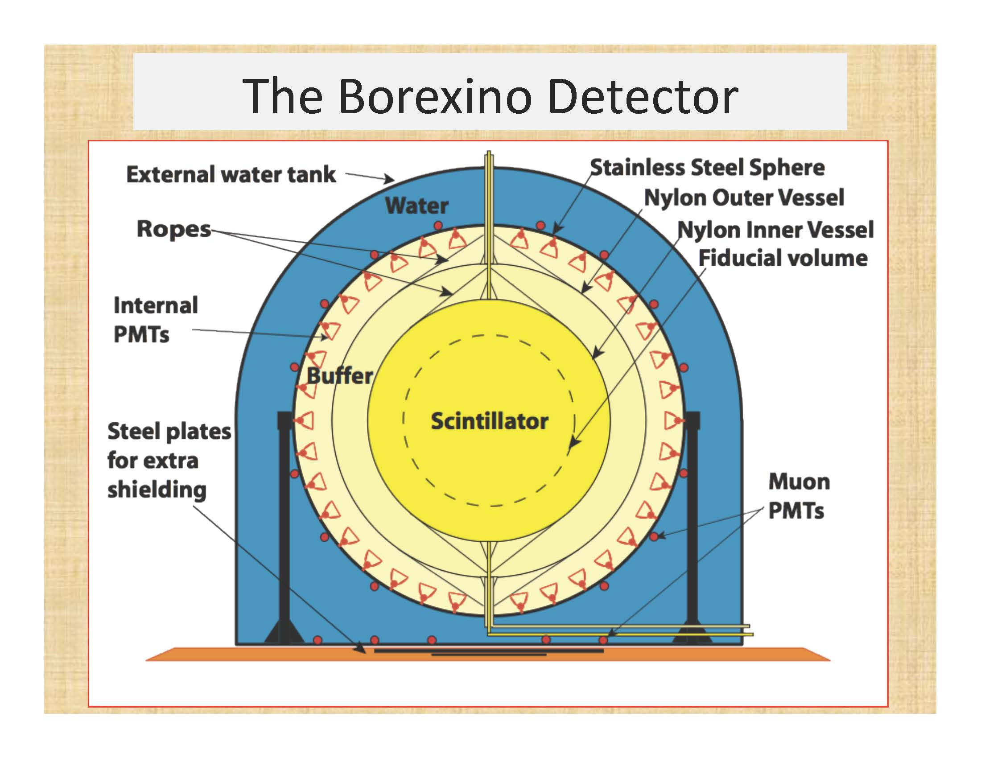

Slide 18
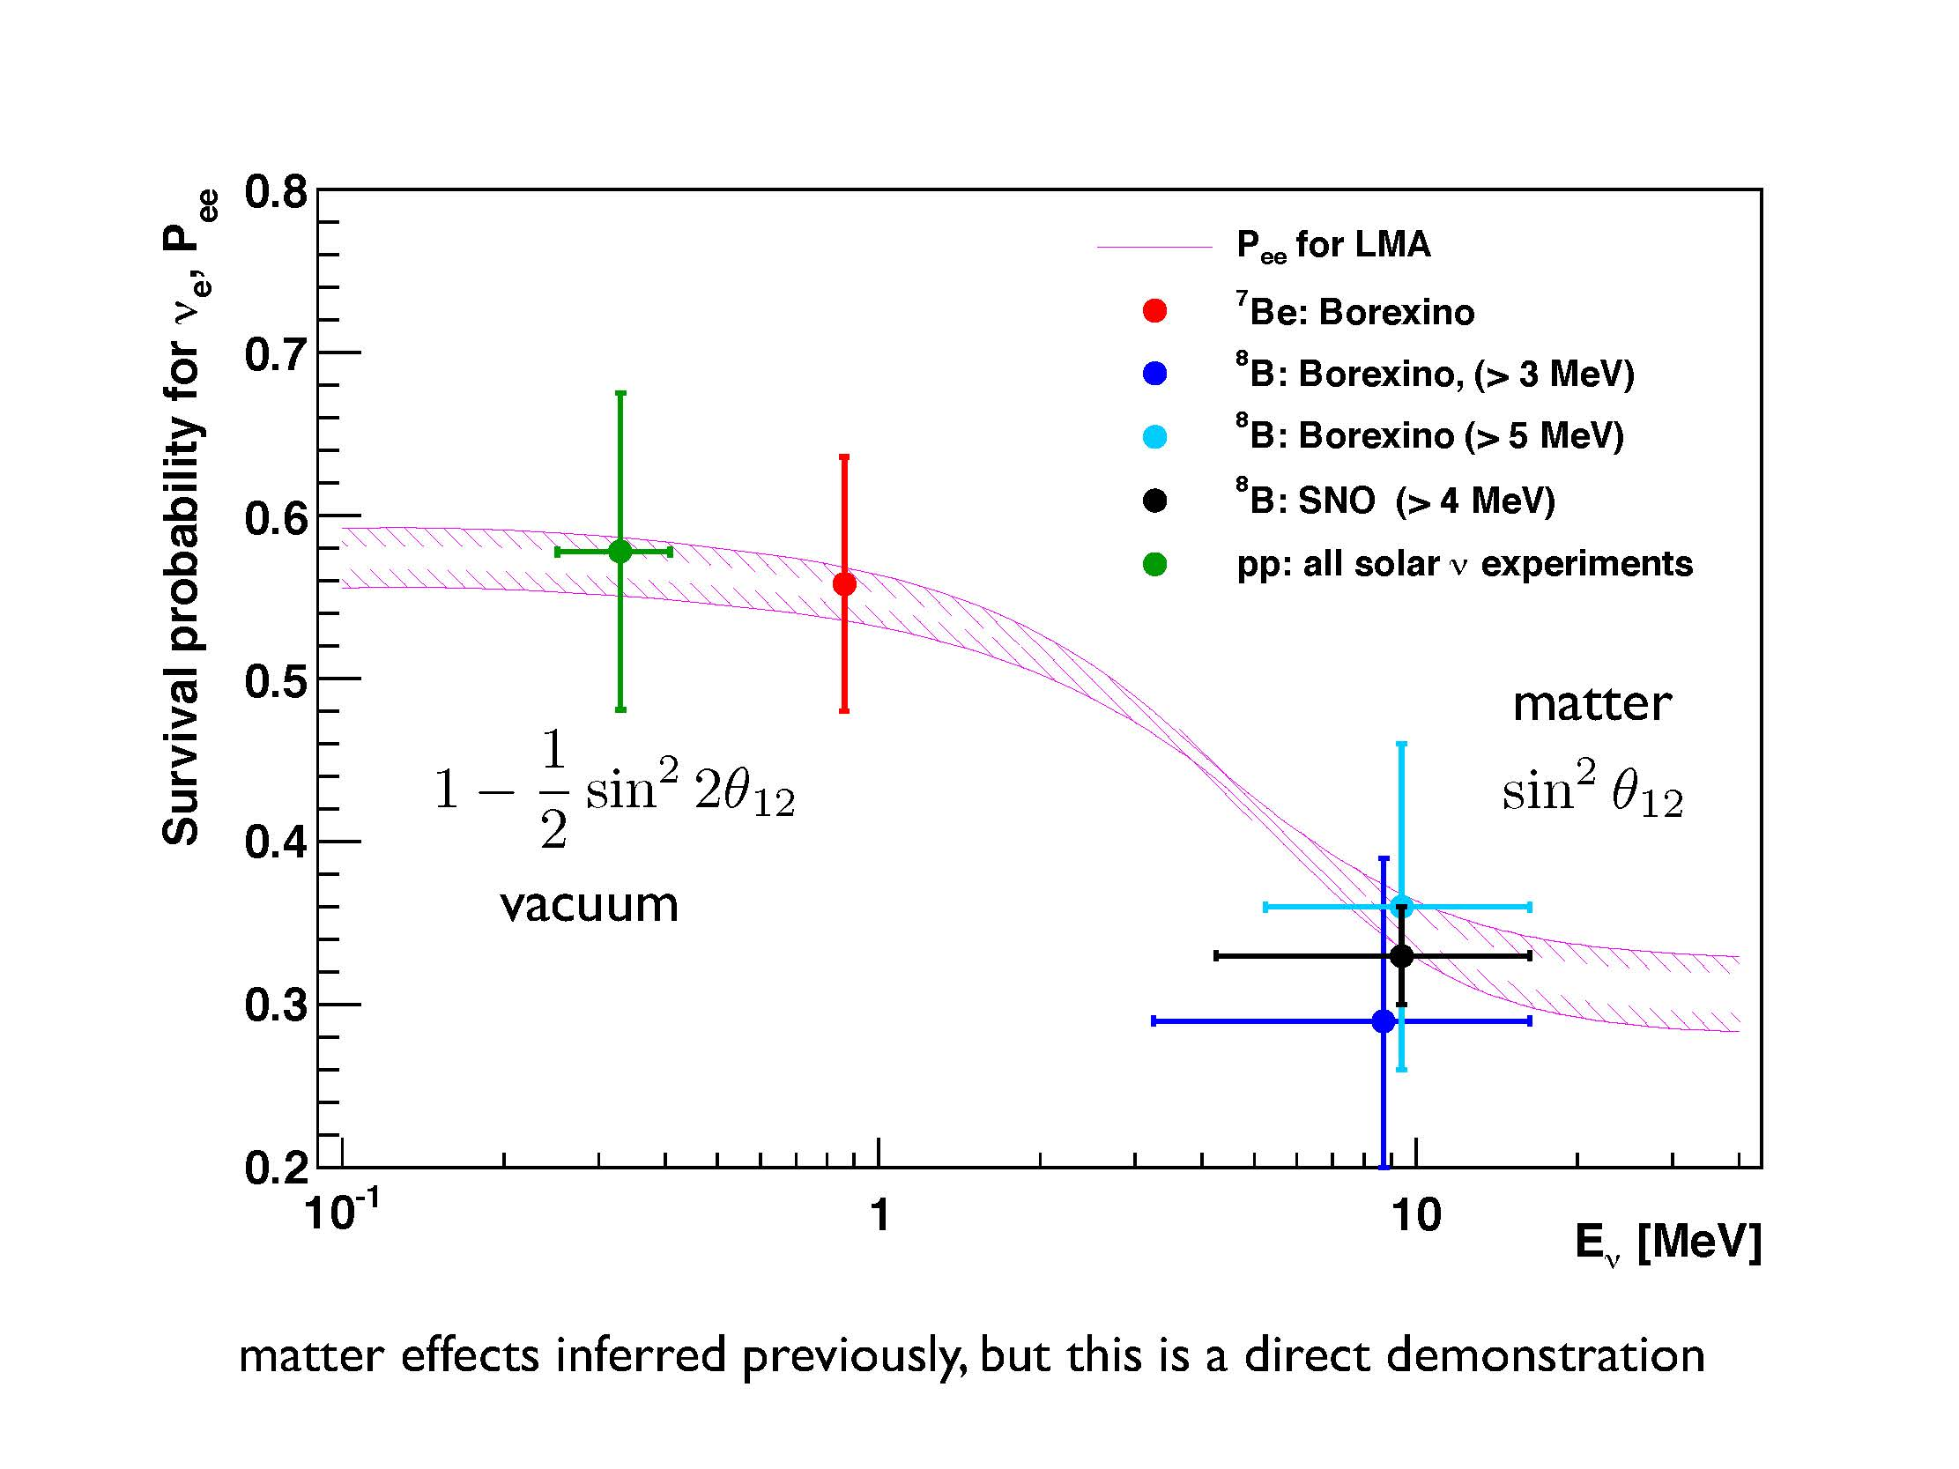
Solar Neutrinos

Slide 19
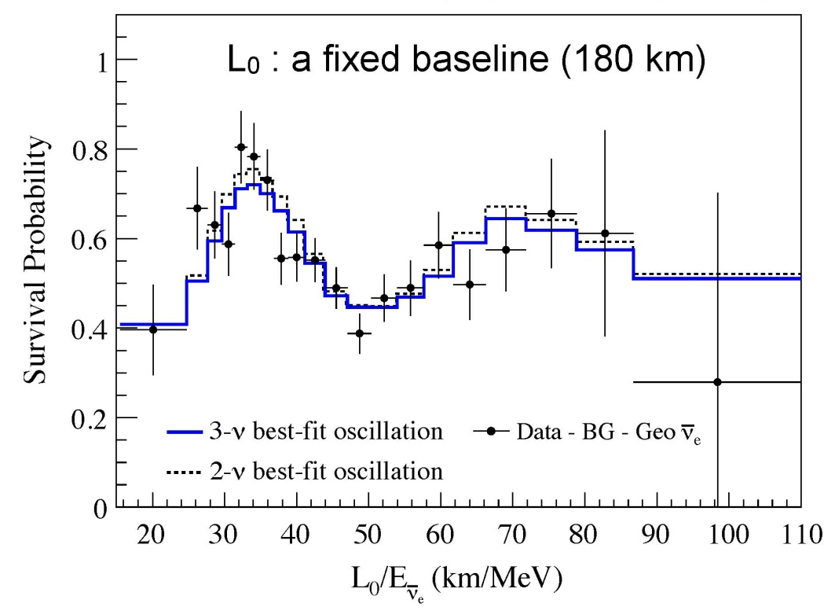
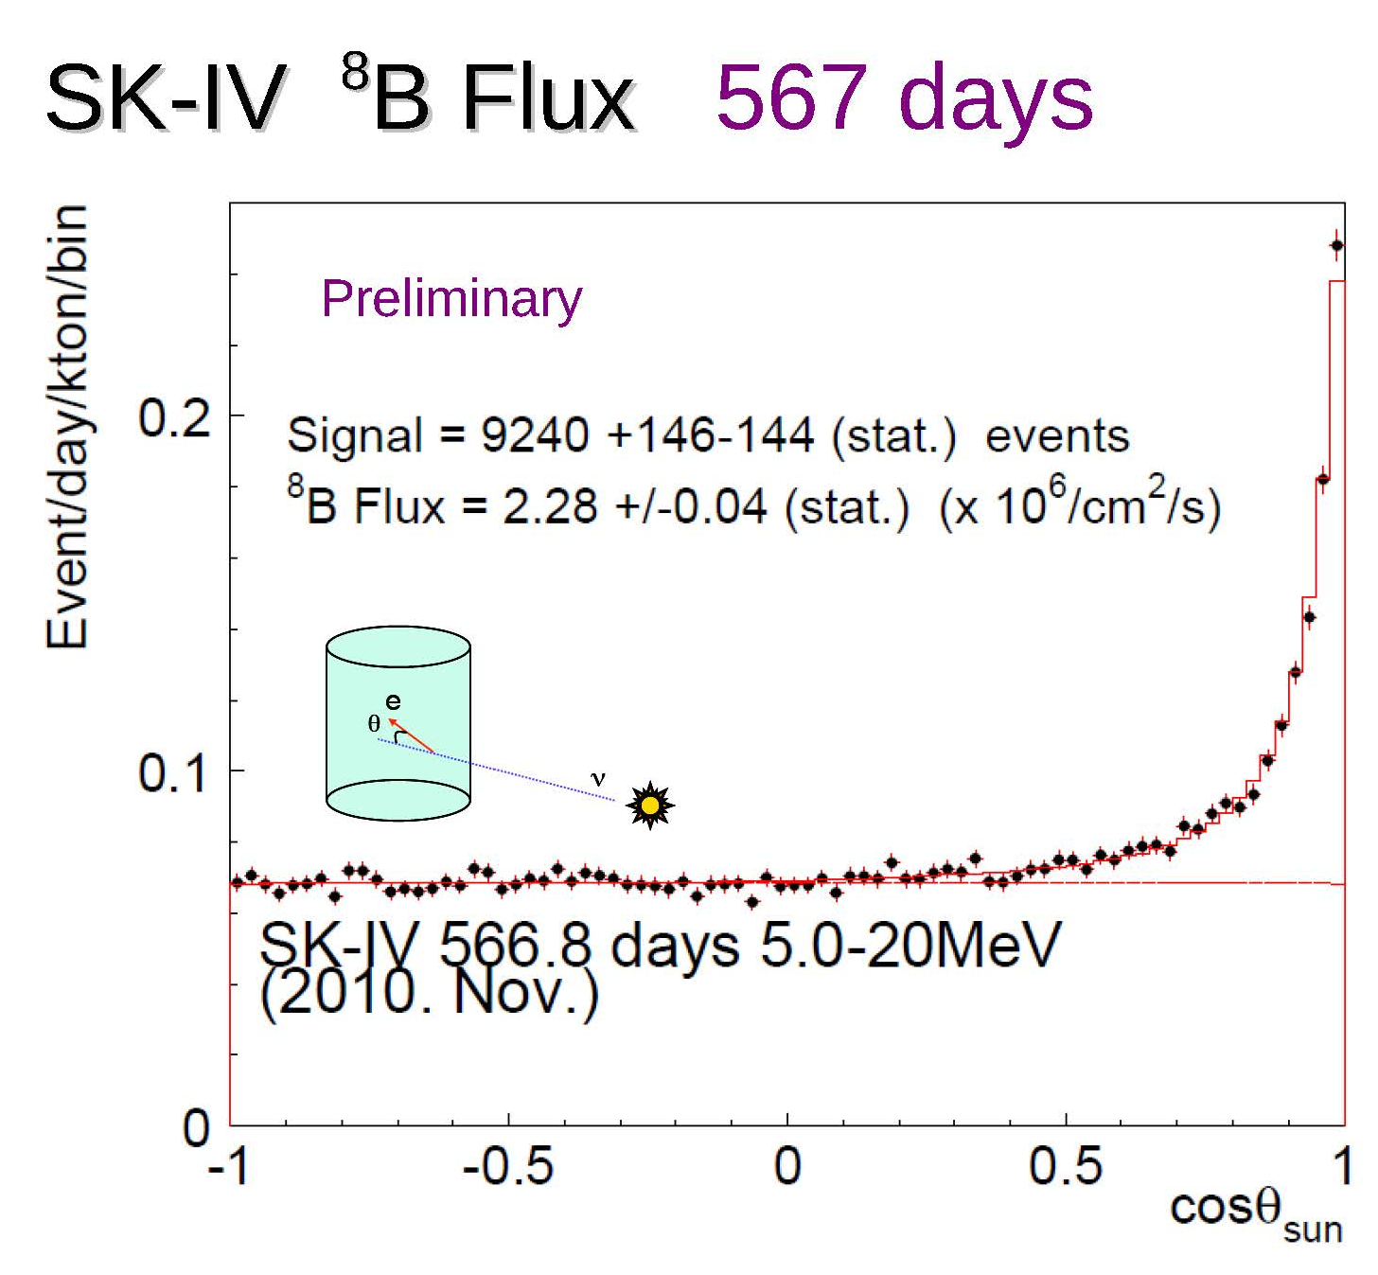
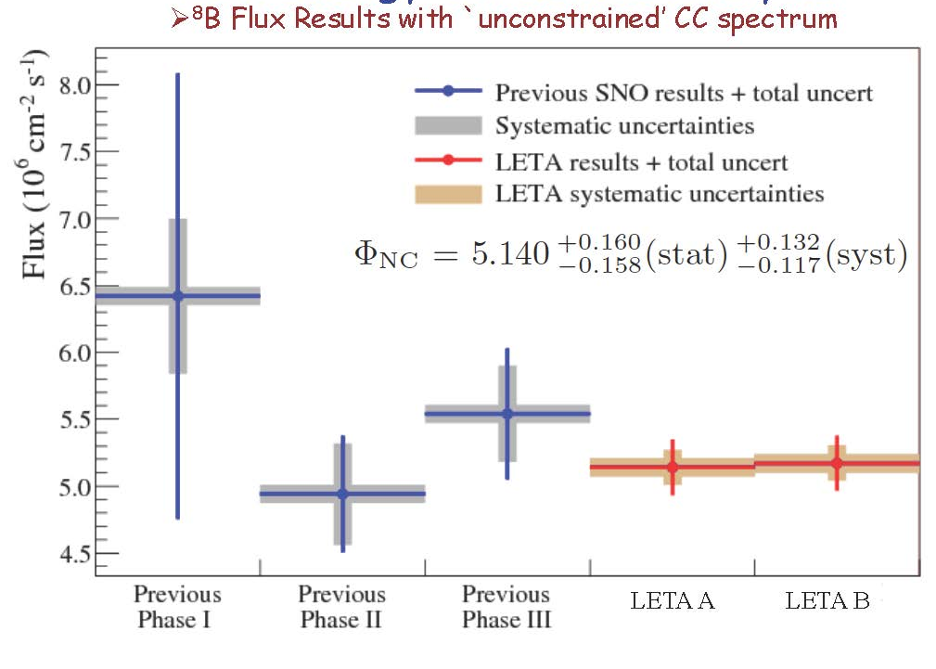
KamLAND Reactor
Improves accuracy of Δm²
2000’s: SNO, Kamland, SuperK, SAGE, Borexino continue to improve their statistics and/or analyses providing further restrictions on the m₁₂ parameters:
SNO NC: All active ν’s
Improves accuracy of sin² θ₁₂

Slide 20
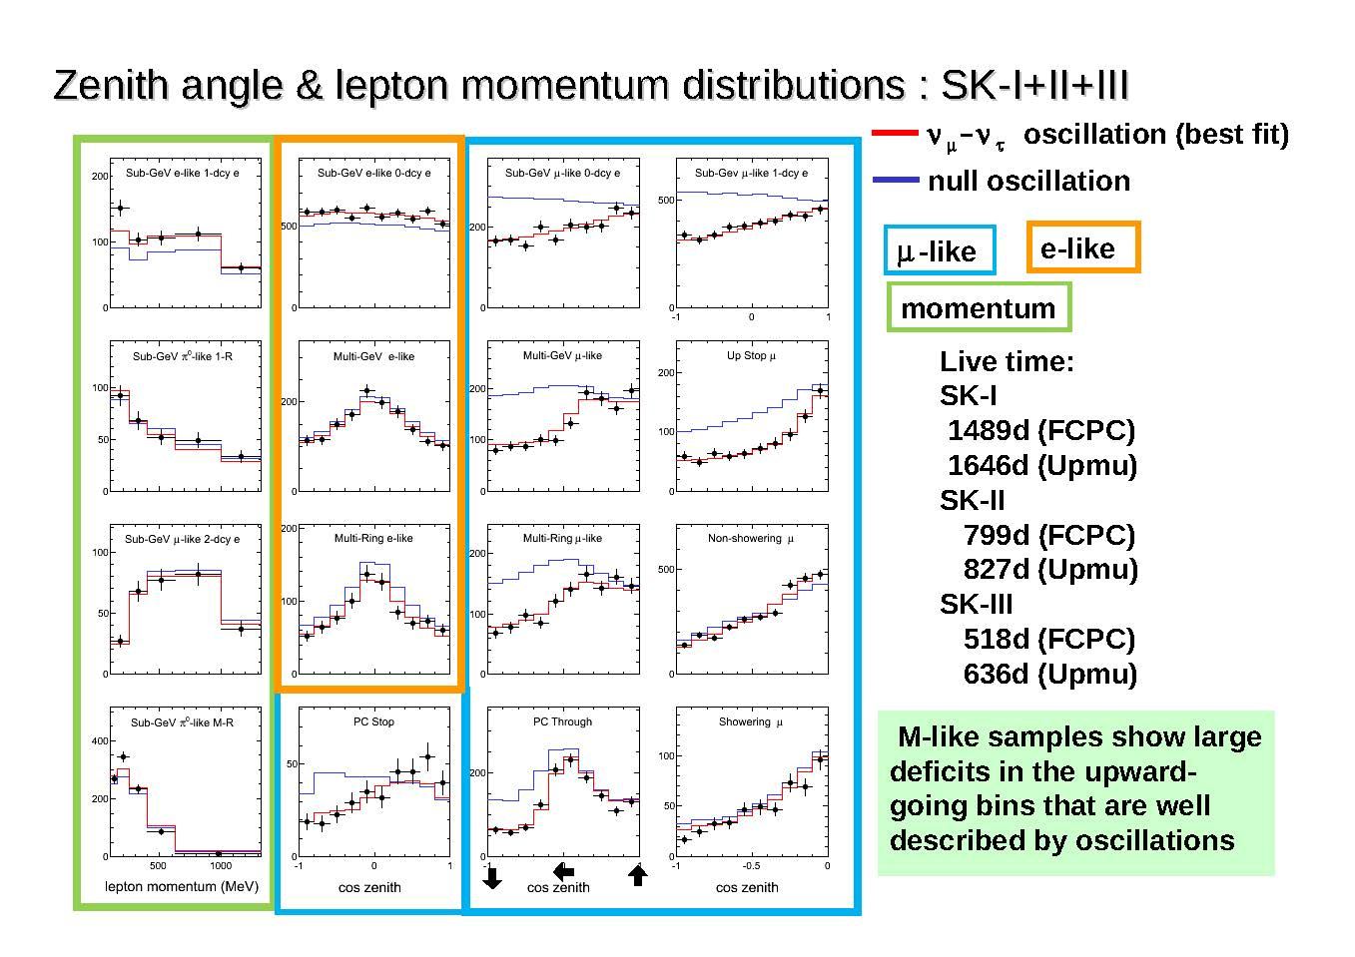
SuperKamiokande Atmospheric Neutrinos
μ−like samples show large deficits in the upward-going bins that are well described by oscillations.

Slide 21
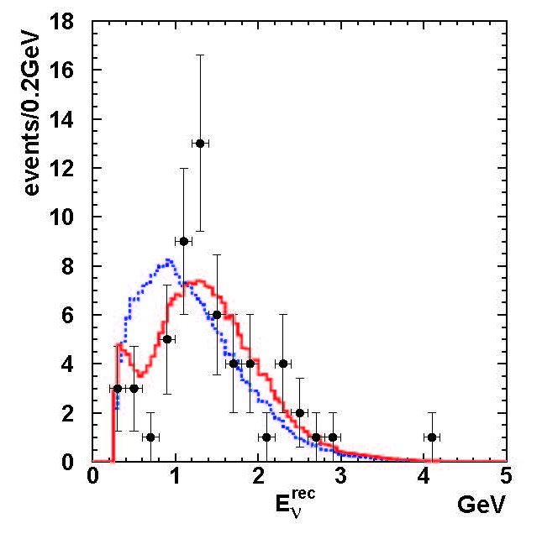
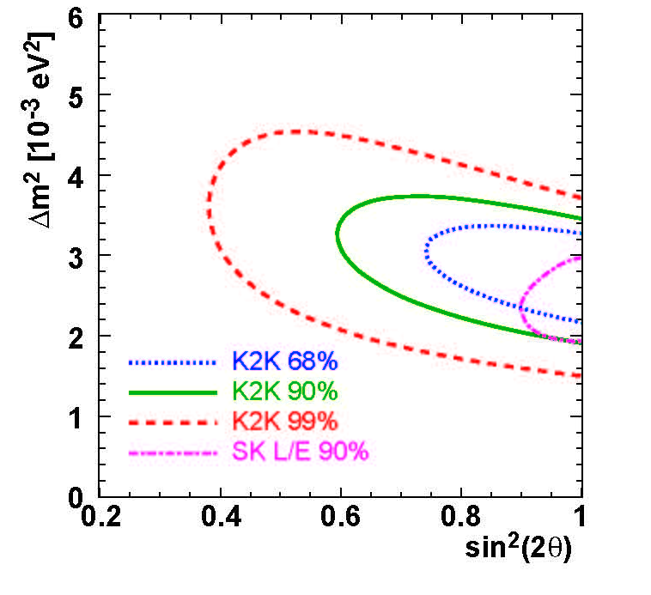
Continuing with the discussion of further experiments observing oscillations of active neutrinos related to m₂₃ mixing:
K2K has provided a very nice confirmation of the SuperK Atmospheric results by shooting a neutrino beam 250 km from the KEK accelerator to SuperK and observing ν_{μ} disappearance.
No oscillation
Best fit oscil.
for no oscillation,
observed

Slide 23
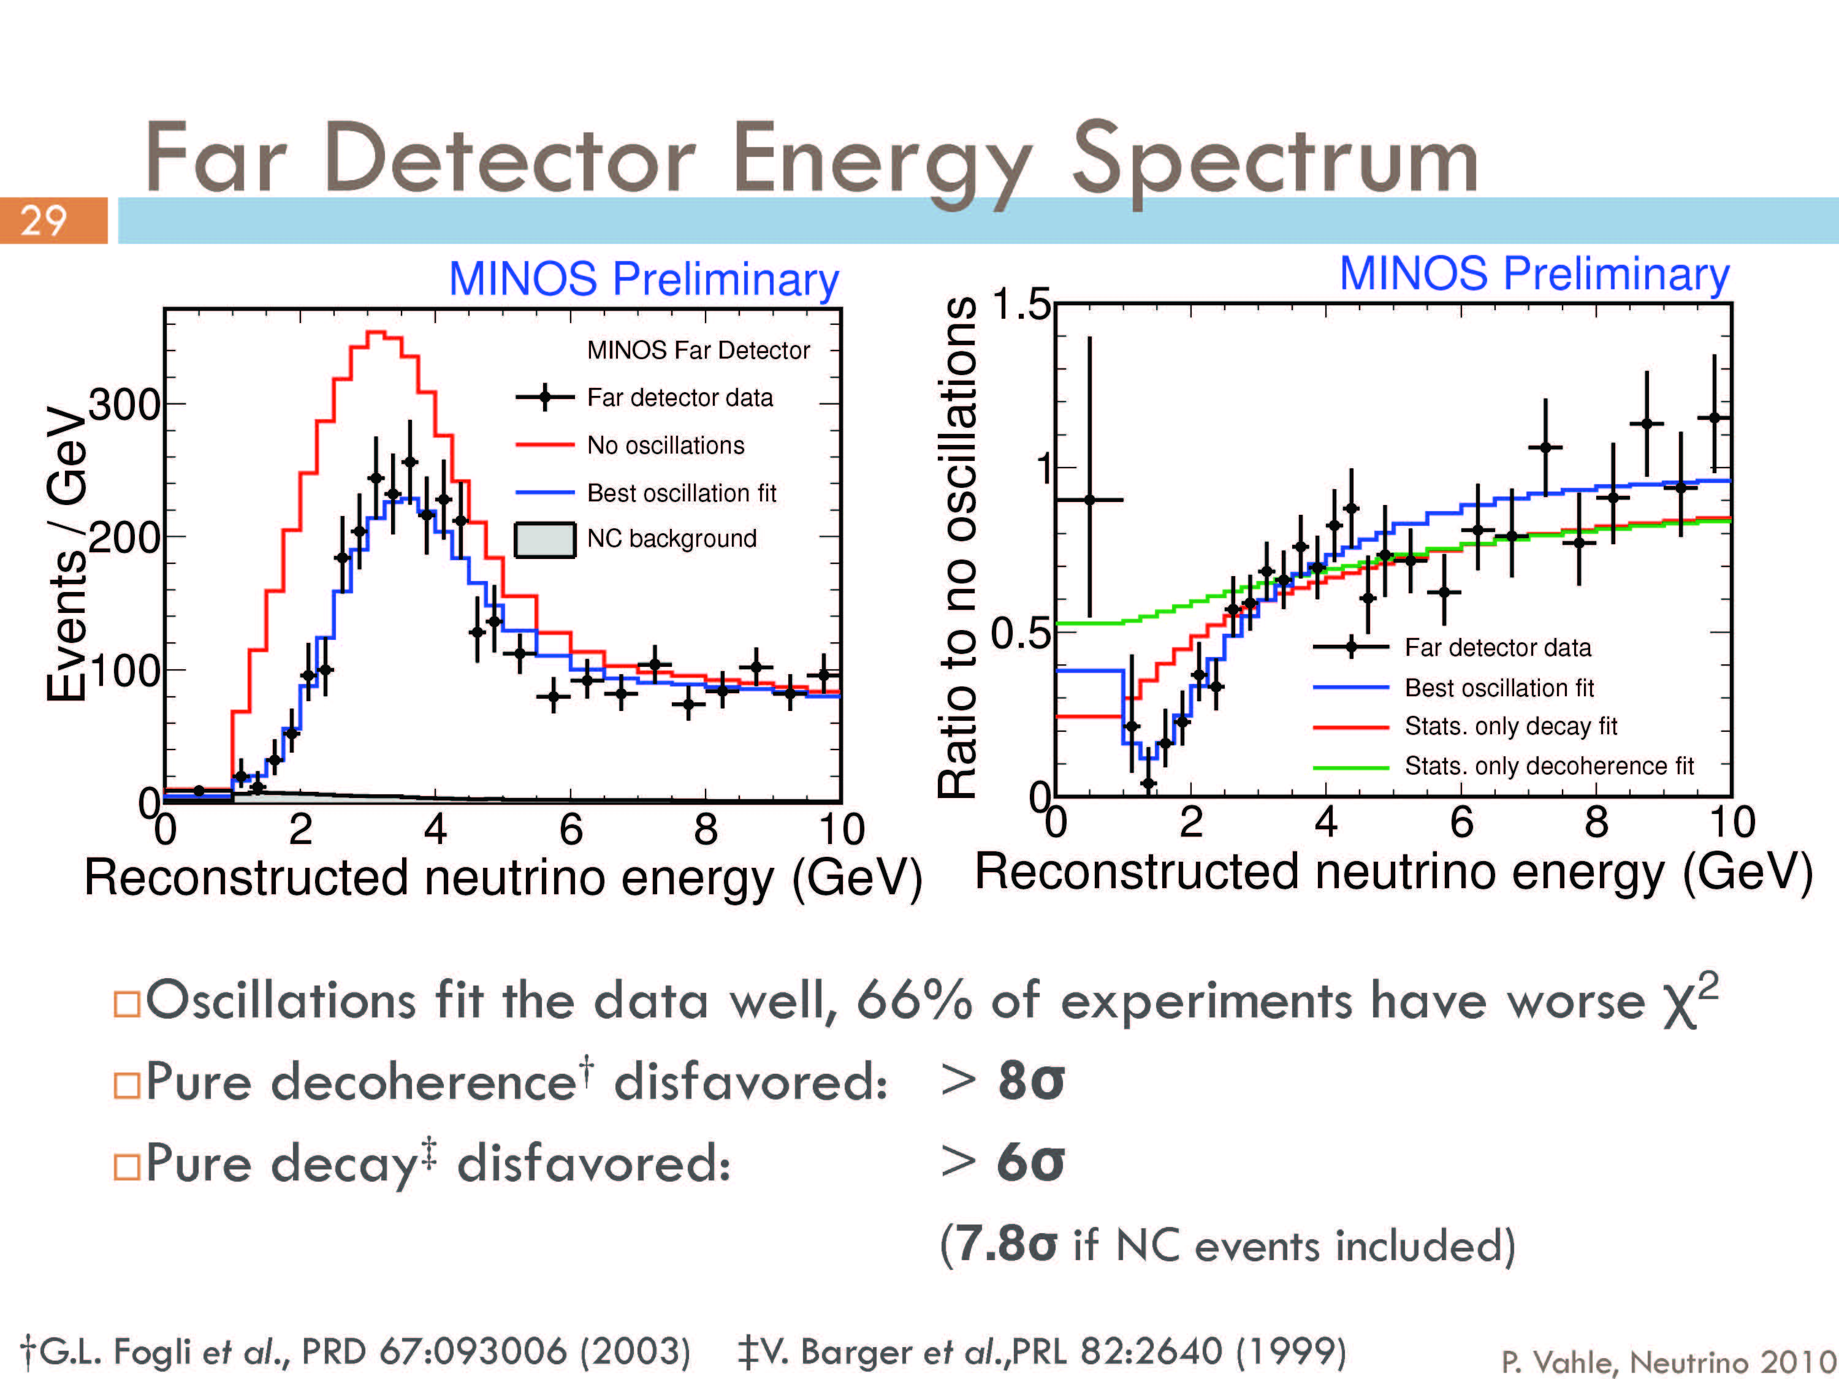
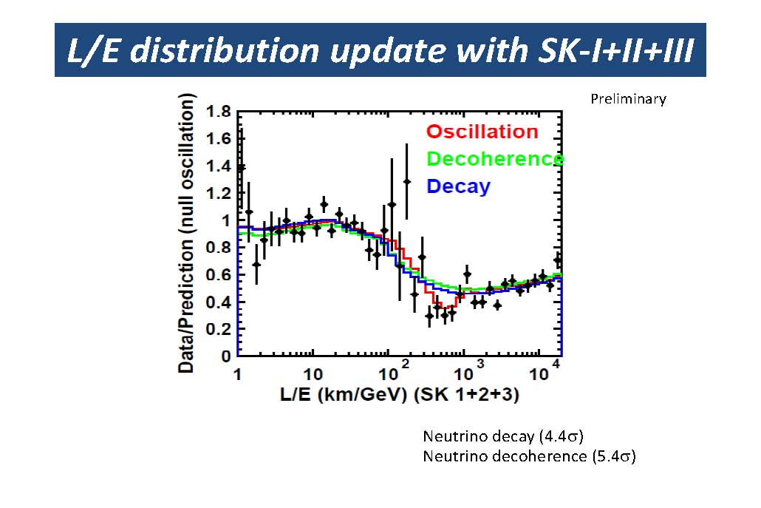
SuperKamiokande

Slide 24
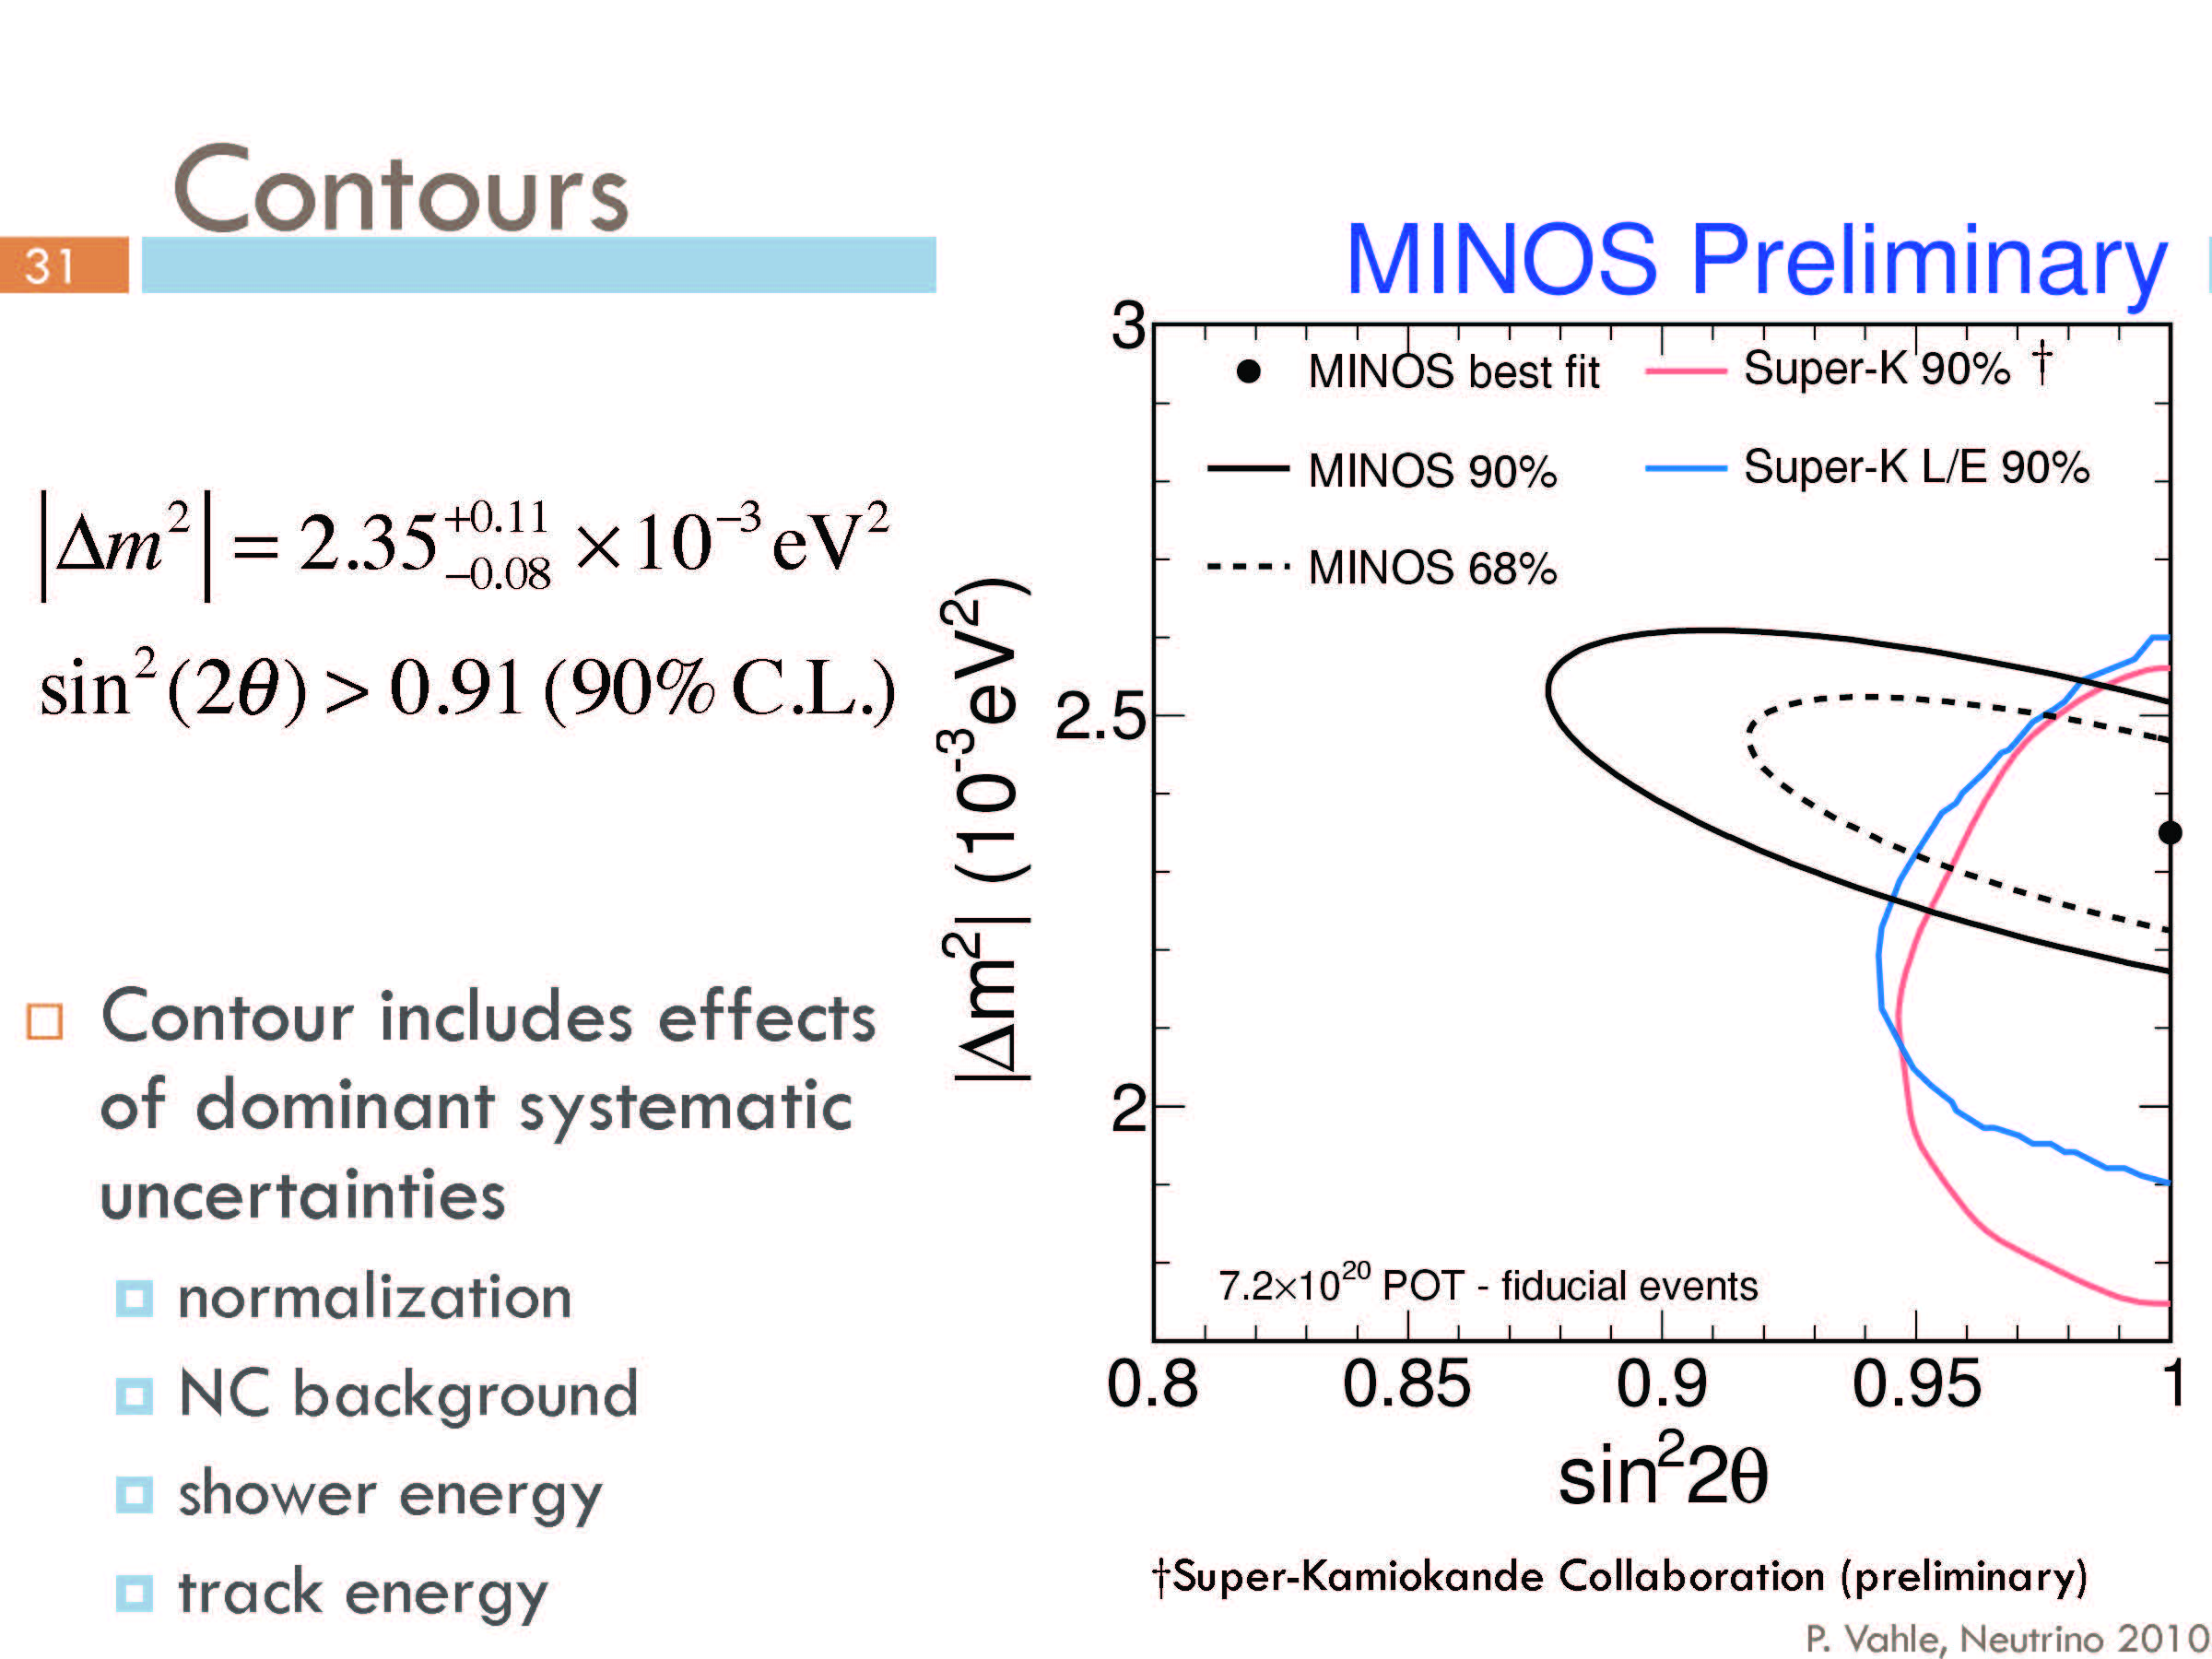
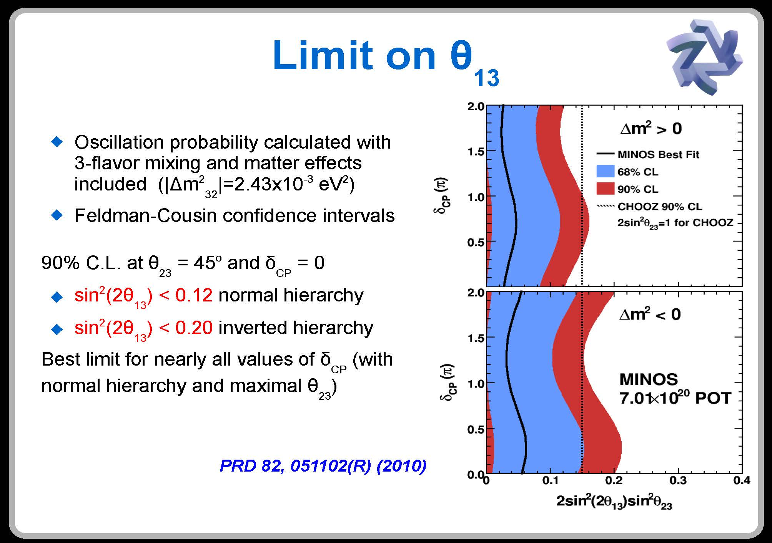

Slide 25
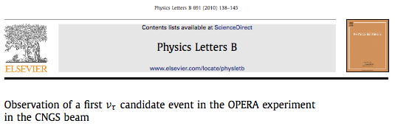
The first ν_{μ ->} ν_{τ} candidate event was found
OPERA
Event number 9234119599,
taken on 22 August 2009, 19:27 (UTC), opened June 10, 2010
If one considers all τ decay modes which were included in the search, the probability to observe 1 event for a background fluctuation is 4.5%. This corresponds to a significance of 2.01 σ.
OPERA expects about 2 events per year with a total running period of about 5 years.

Slide 26
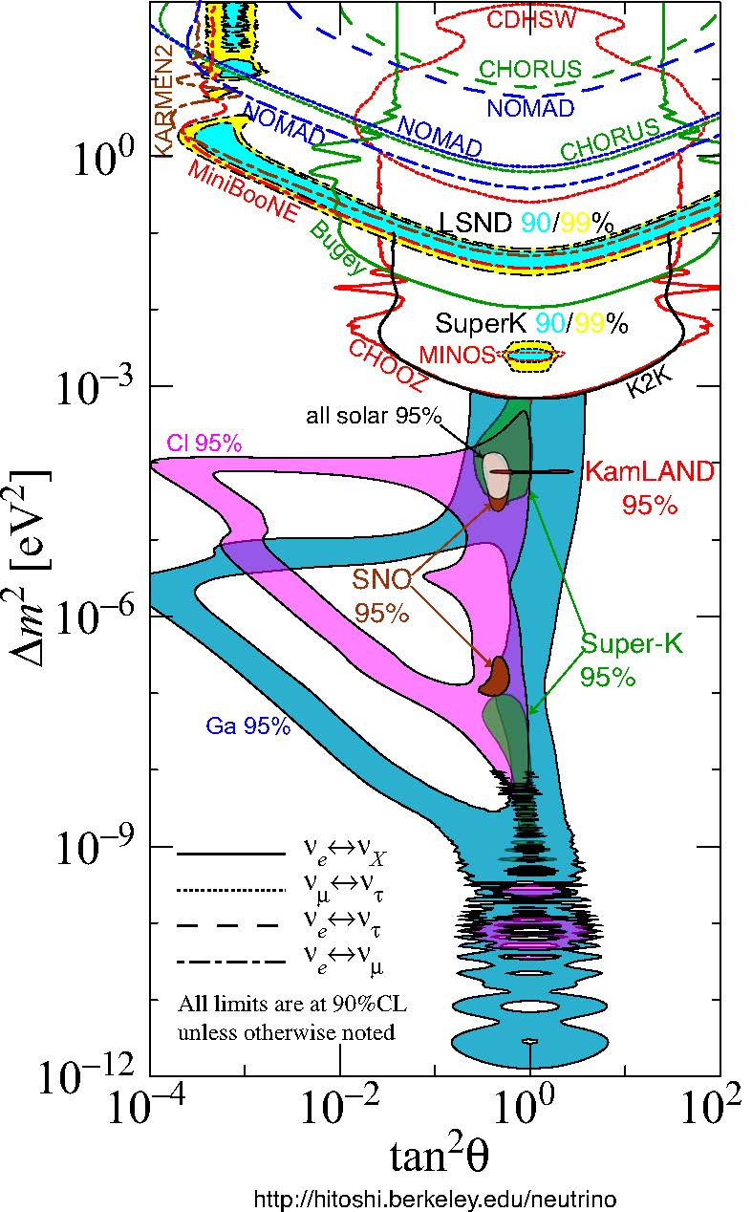
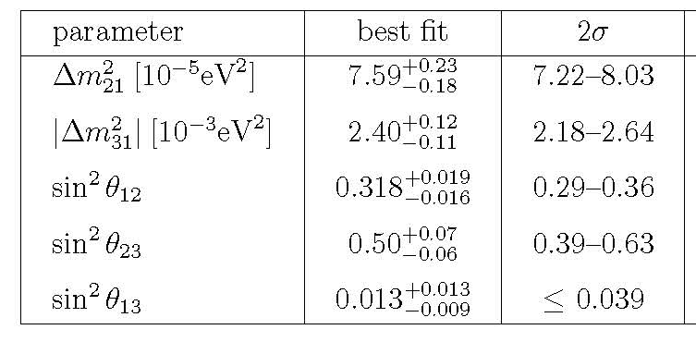
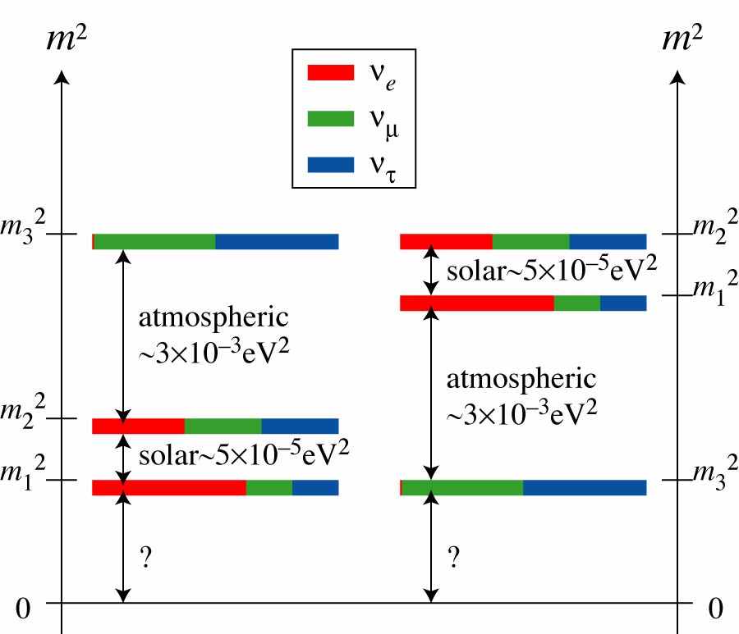
SUMMARY OF RESULTS FOR THREE ACTIVE ν TYPES
Mass Hierarchies
Normal
Inverted

Slide 27
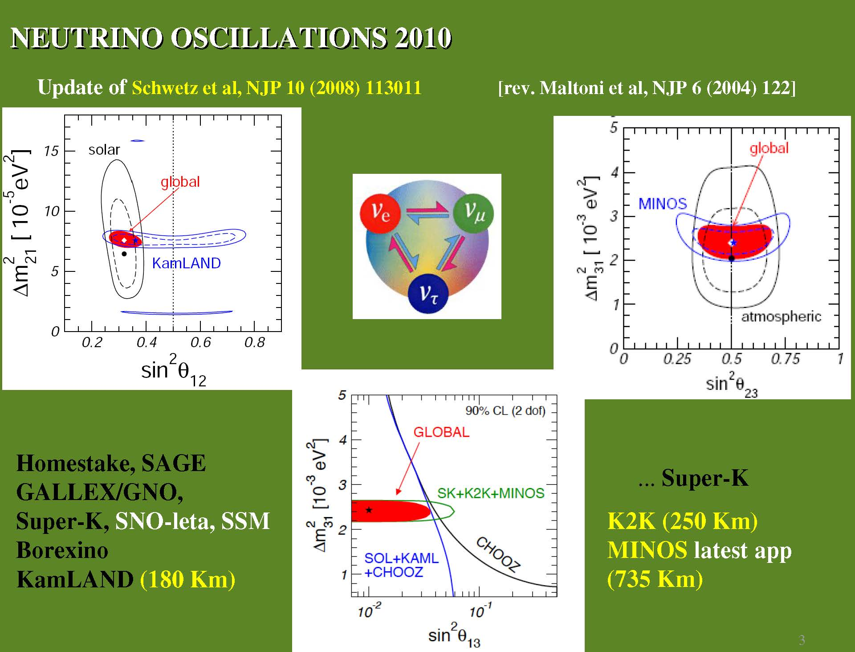
Valle Nu2010

Slide 28
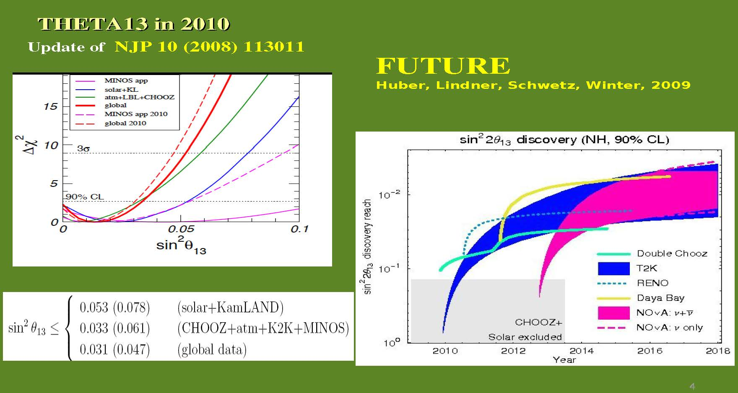
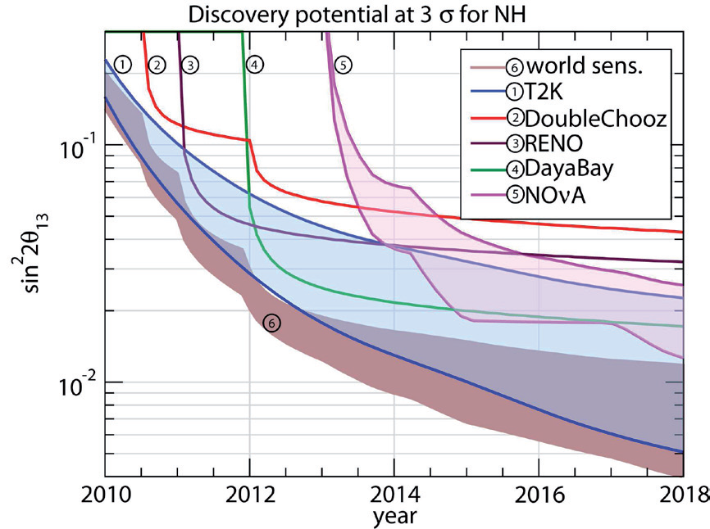
Mezzetto,Schwetz, 2010

Slide 29
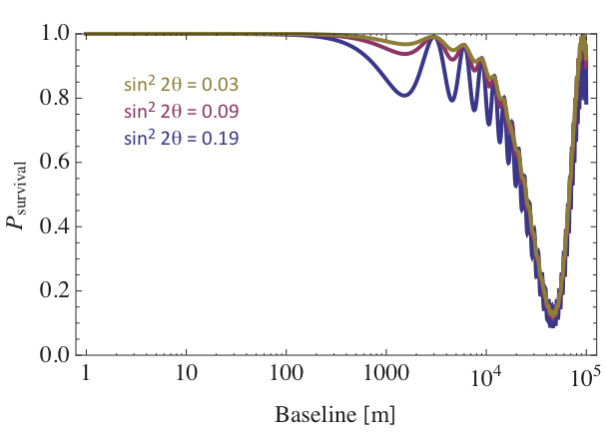
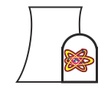
Precision Reactor Experiments
L. Mikaelyan, arXiv:hep-ex/0008046v2 (Krasnoyarsk)
Objective: Determine θ₁₃
Sub-Dominant θ₁₃ Oscillation
E_{ν}≈3 MeV
Dominant θ₁₂ Oscillation
Detector 1
Detector 2
build nearly identical detectors with nearly identical efficiency
Kearns NUFACT09

Slide 30
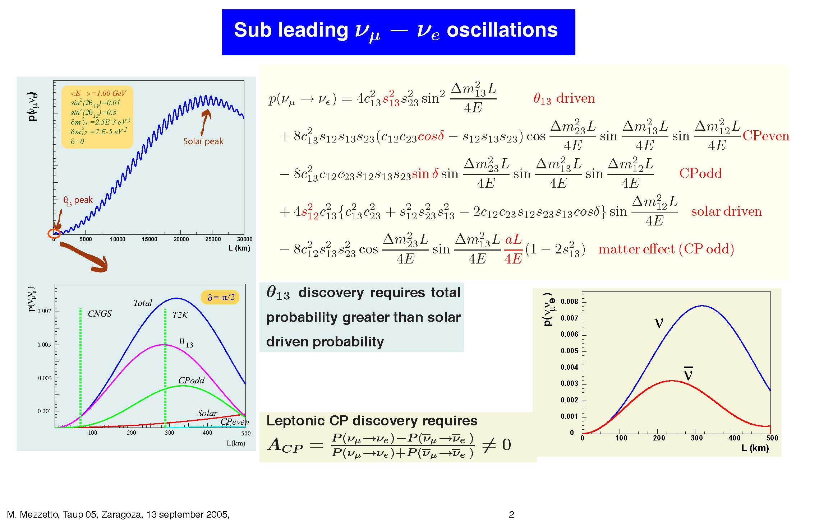
Long Baseline Oscillations for: θ₁₃, Hierarchy (Matter), CP Violation, (also θ₂₃ from ν_{μ} −> ν_{μ})

Slide 31
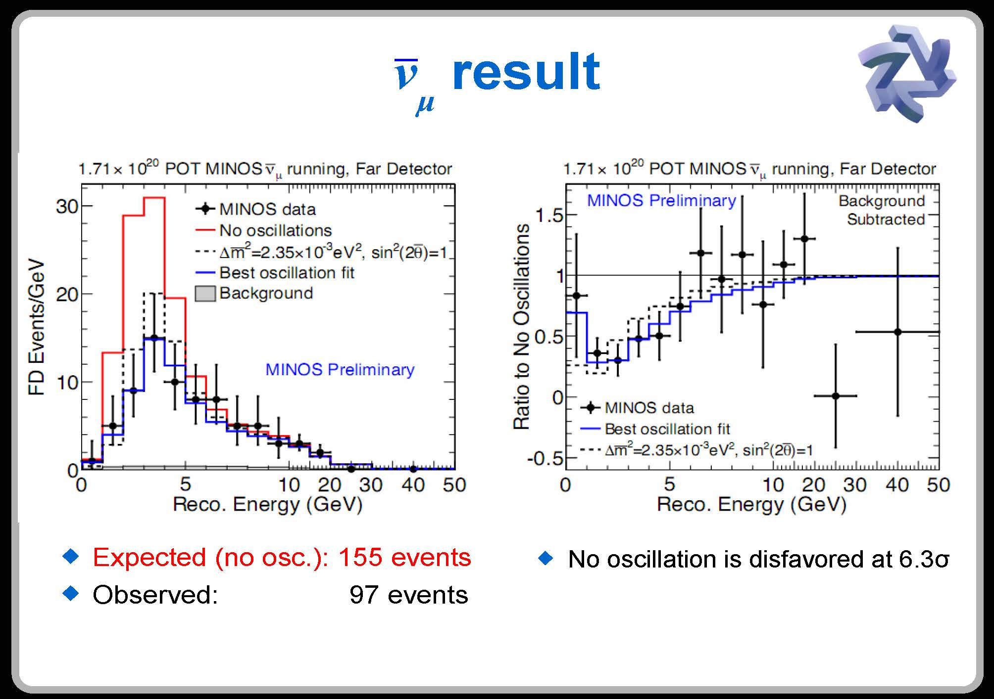
Now for some surprises…
MINOS
Danko NNN2010

Slide 32
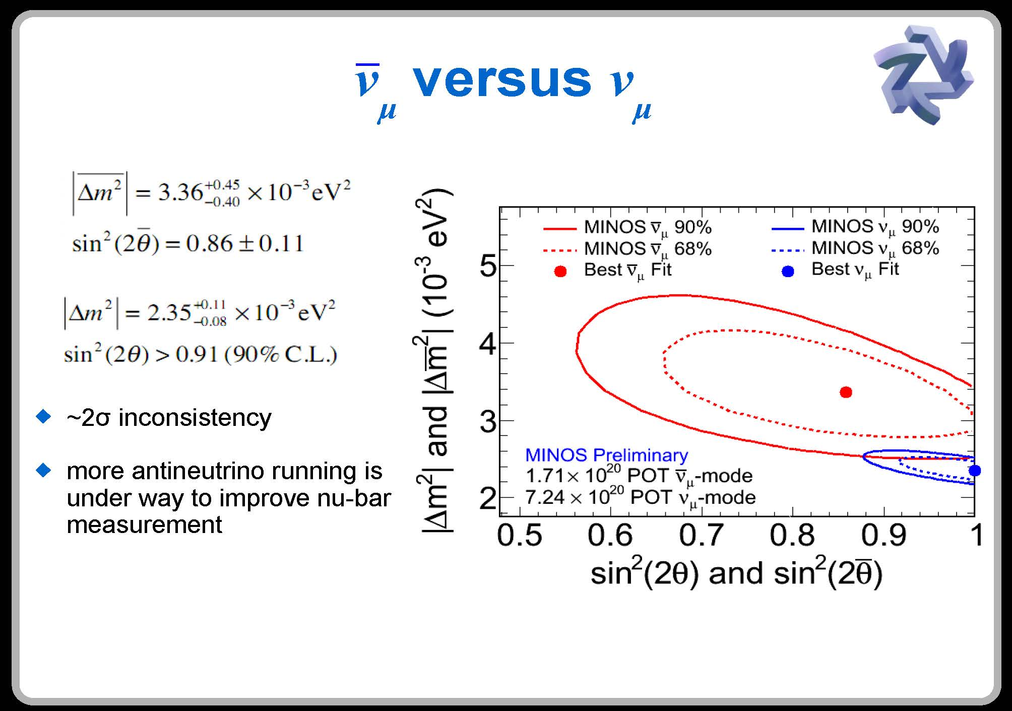
See also SuperK: Jeff Wilkes at 11:15 today
Danko NNN2010

Slide 33
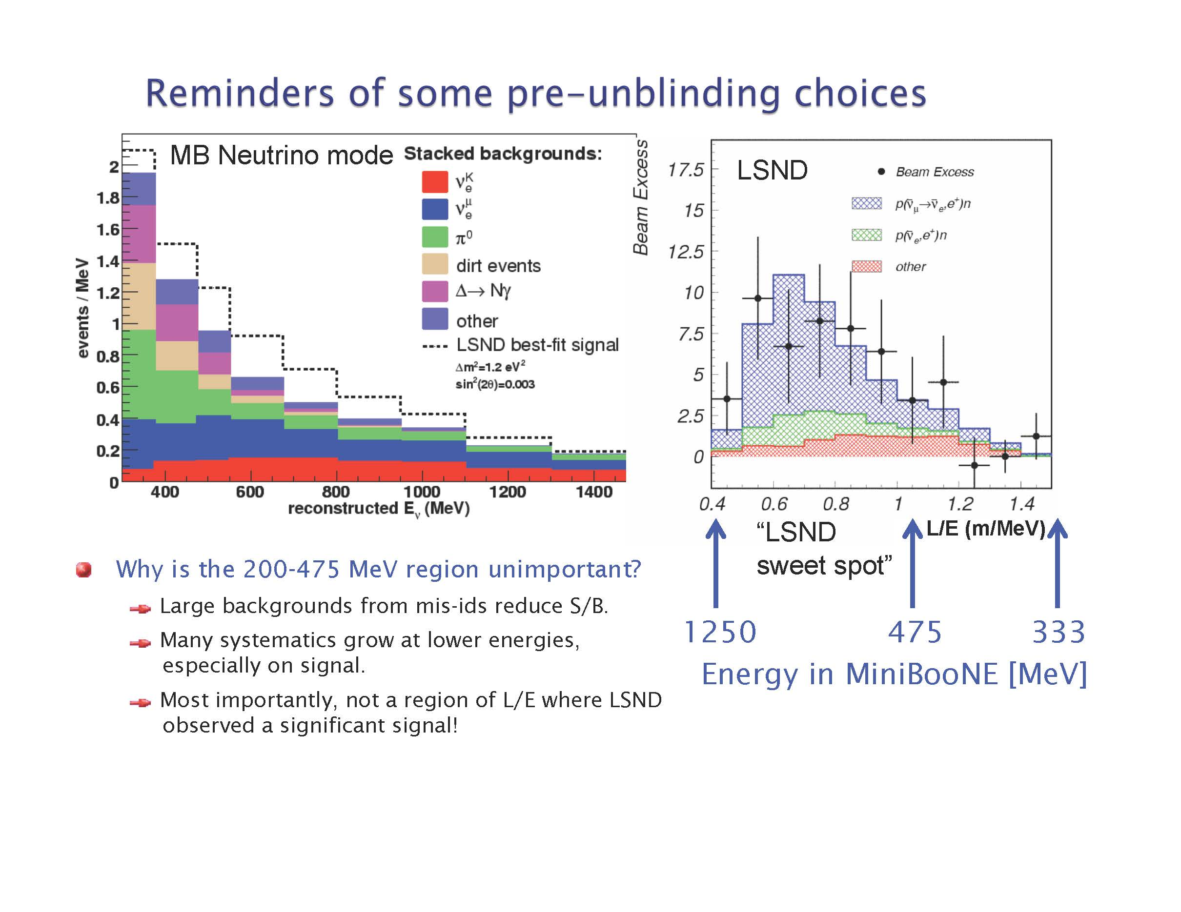
MiniBoone
R. Van de Water Nu2010

Slide 34
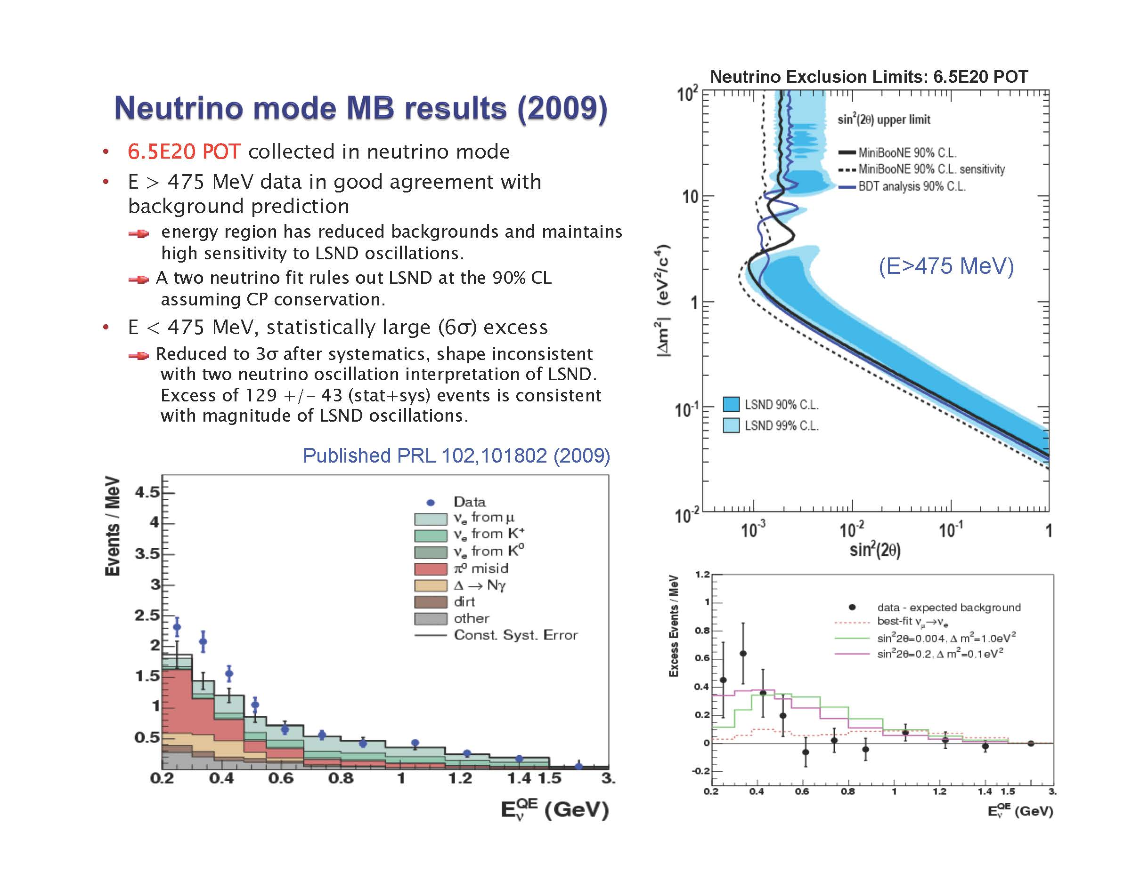
MiniBoone
475 MeV
R. Van de Water Nu2010

Slide 35
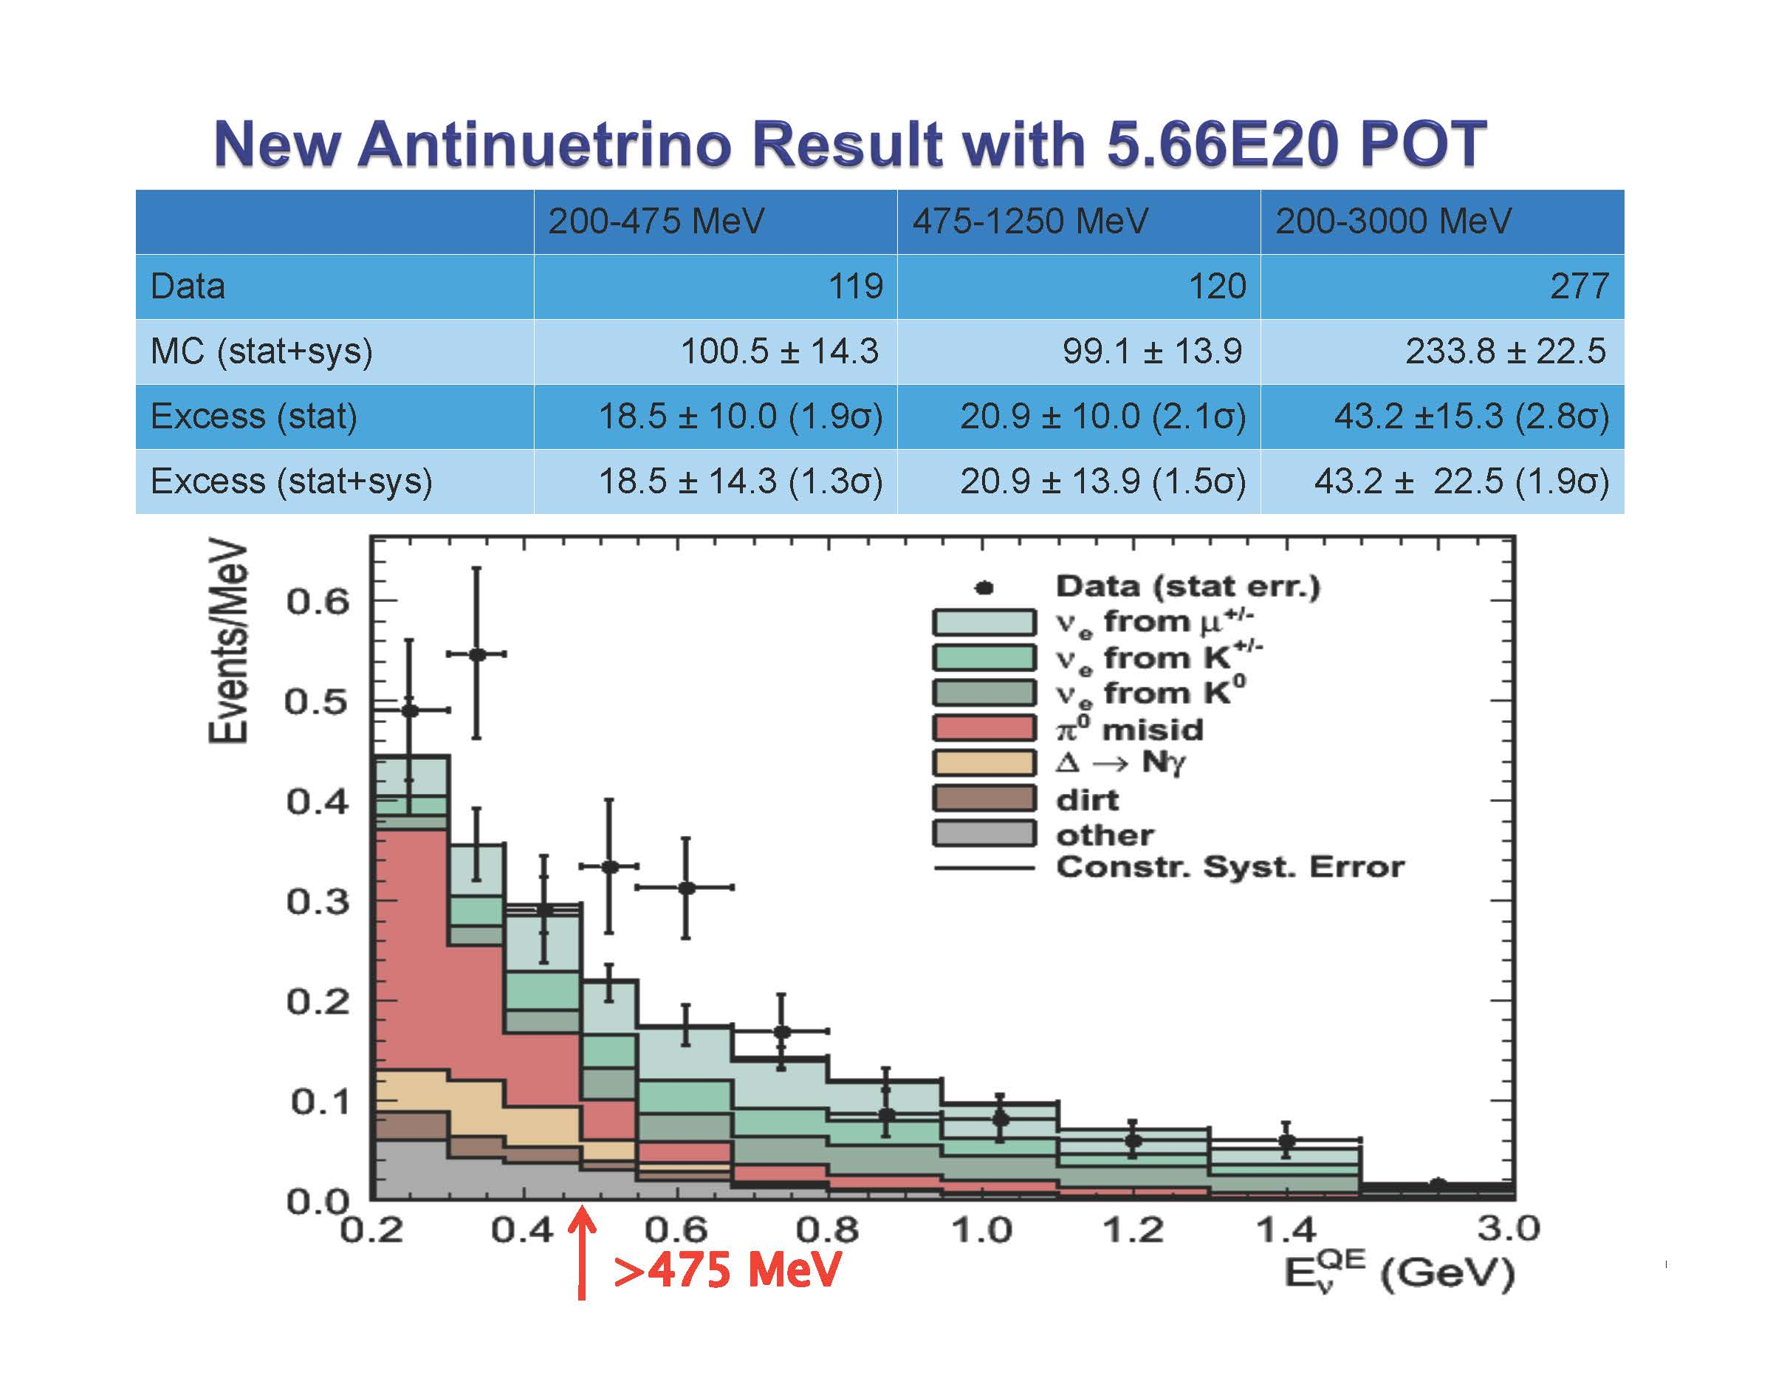
MiniBoone
Consistent with LSND
R. Van de Water Nu2010
More running has been approved

Slide 36
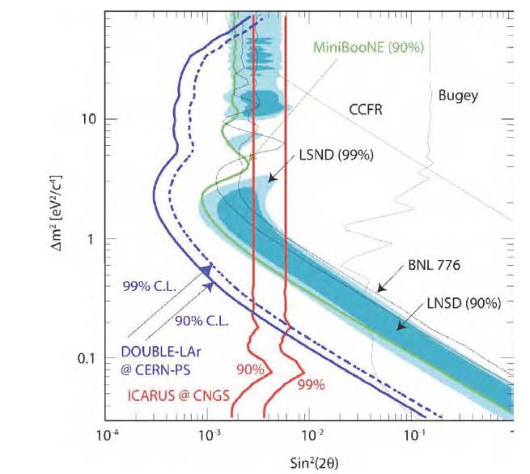
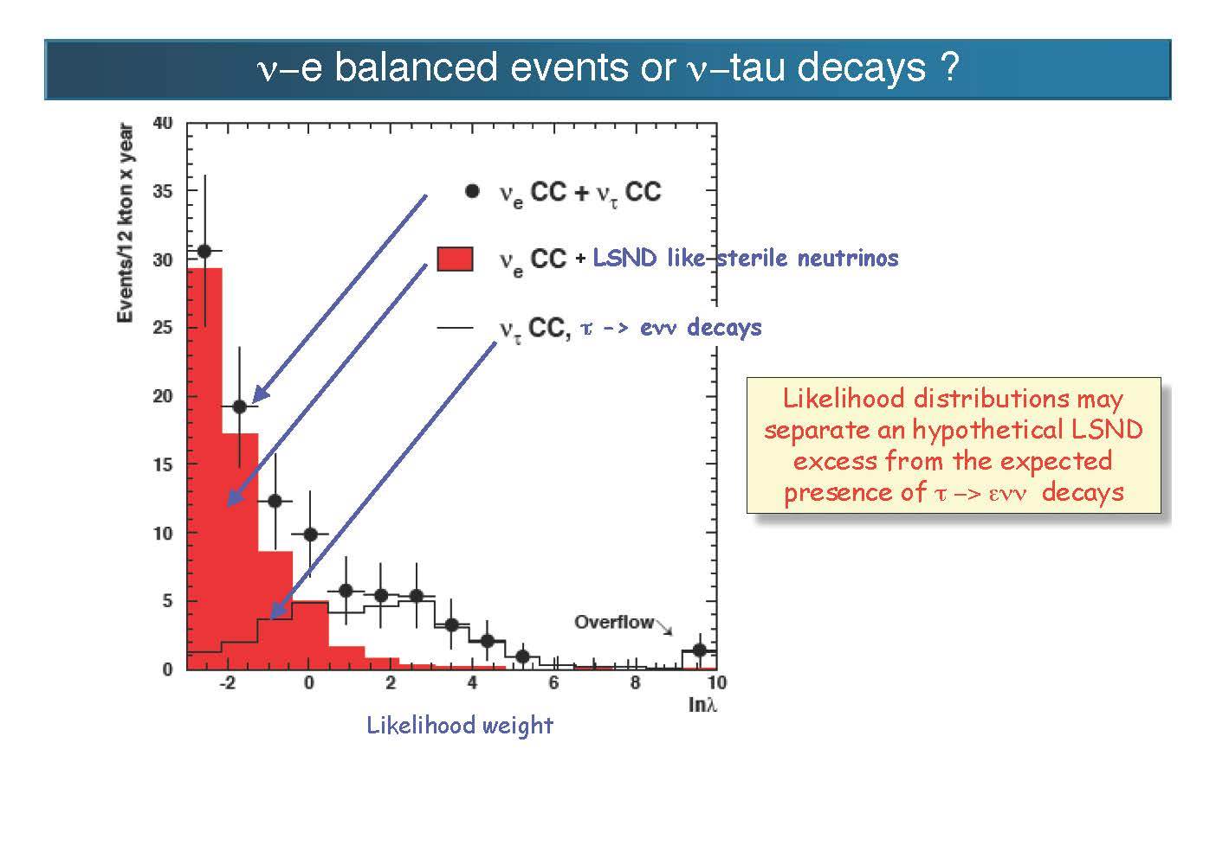
ICARUS – 600 Tons of Liquid Ar now in operation at Gran Sasso observing the neutrino beam from CERN.
Can observe ν_{τ} similar to OPERA.
Can observe ν_{μ} −> ν_{e} to study LSND and MiniBoone physics.
20 year simulation
Two Years of operation
planned for
ICARUS at Gran Sasso
C. Rubbia NNN2010

Slide 37
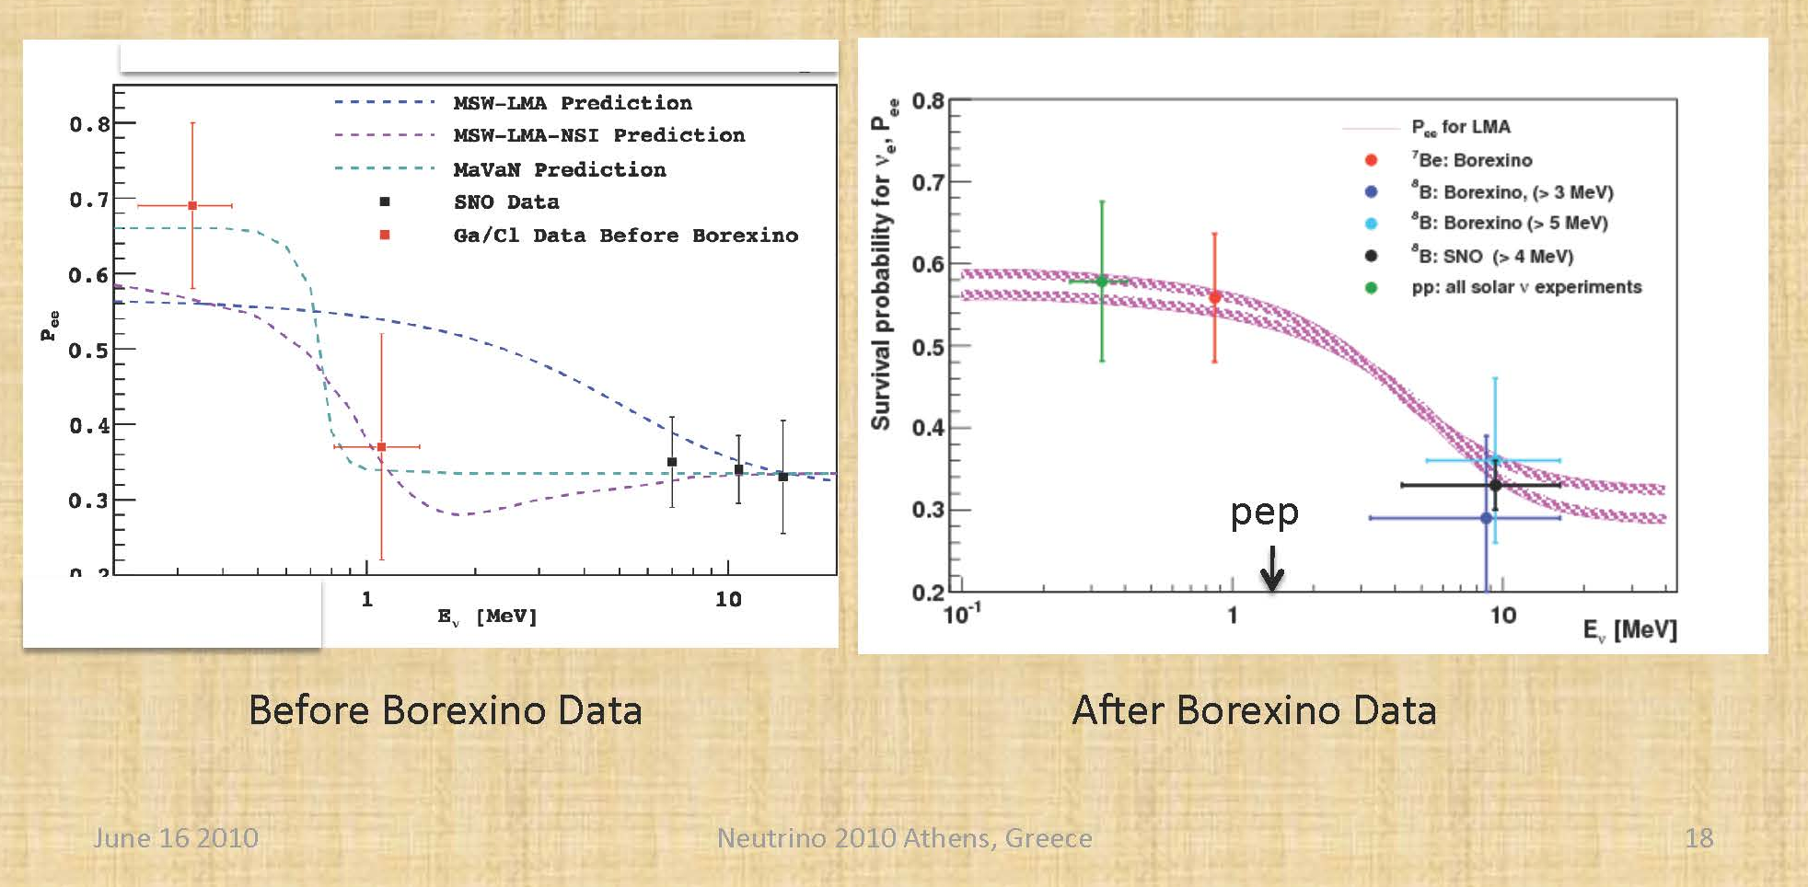
Improved data for solar neutrinos also restricts possible sub-dominant oscillation effects such as:
  Mass varying neutrinos
  Flavor changing neutral currents
  Low mass sterile neutrinos
SAGE
Continuing
Future
Calaprice

Slide 38
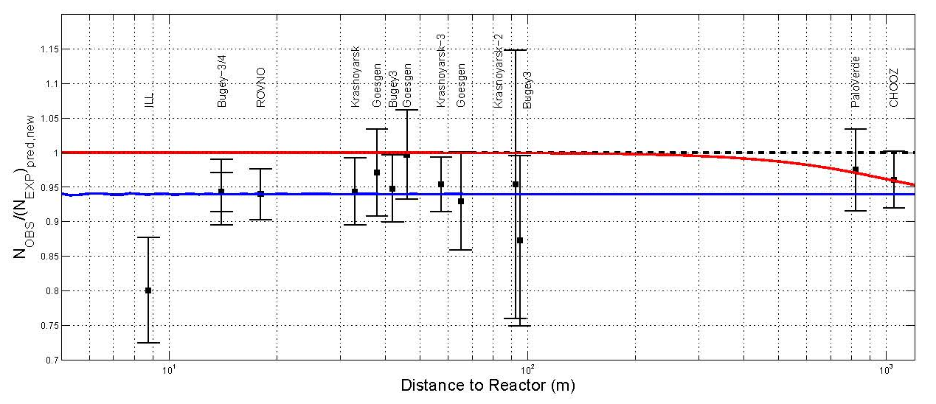
The Reactor Antineutrino Anomaly: G. Mention et al: arXiv:0179257
(Th. A. Mueller et al: arXiv:1101.2663)
Jan 14,2011
Assuming oscillation with sin² 2θ₁₃ = 0.06
Assuming θ₁₃ = 0 and suppression due to sterile neutrino with sin² 2θ₁₄ ∼ and |Δm²| > 1.5 eV²
Observed/Predicted =
For < 100m.
See T. Lasserre Wed: 14:45
Very careful, detailed work by the authors who also state: “We would like to stress here that other explanations are also possible, such as a correlated artifact in the experiments, or an erroneous prediction of the antineutrino flux from the nuclear reactor cores.”
Reactor Flux normalization is increased by over 3% in the new calculation mainly due to change in calculation of Coulomb and Weak Magnetism corrections for fission product beta decay. Uncertainty still assigned as < 1% for these corrections because of stated improvements in the calculations.
2.7% total reactor flux uncertainty mainly via 1985 measurements of fission product electron spectra.
Average of experimental measurements assigned 1% uncertainty, dominated by Bugey4 with 1.4 % result.
The authors also call for future experiments for verification, such as short baseline reactor neutrino measurements or neutrino source measurements in a detector with energy and spatial resolution.

Slide 39
Other experiments cited in the Reactor antineutrino anomaly paper with effects possibly arising from a sterile neutrino with |Δm²| > ~ 1 eV² :
⁵¹Cr and ³⁷Ar source measurements for SAGE and GNO experiments:
Observed/Predicted =
MiniBoone (C. Giunti, M. Laveder, Phys. Rev. D82 (2010) 053005)
Numbers of Neutrinos fit for Cosmological data:
  WMAP + BAO: , WMAP + Atacama:
  Non-standard Big Bang Nucleosynthesis:
Assuming a 3+1 sterile neutrino scenario (2+2 is disfavored by solar+KamLAND+ atmospheric), the effects in other experiments from a sterile neutrino with sin² 2θ₁₄ ∼ 0.2 and |Δm²| ~ 1.5 eV² would be:
Small change in CHOOZ limit (They had used BUGEY4 to normalize).
Very small effect on mass 1-2 and 2-3 mixing parameters except a small reduction in the θ₁₃ value derived from KamLAND and solar.
Contribution to KATRIN ν mass measurement at ~ 0.2 eV level.
Contribution to neutrino-less double beta decay at ~ 0.02 eV² level.
About 8% reduction in the expected active solar neutrino flux.

Slide 40
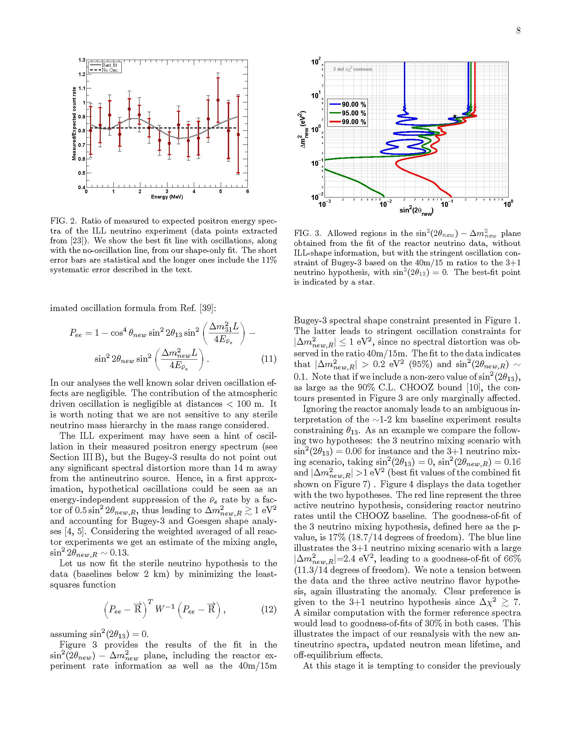

Slide 41
Summary of Experiments:
(Weapons of Mass Instruction)
Known Knowns
Known Unknowns
Semi-known previously unknowns
Unknown Unknowns??
Stay tuned as running proceeds
(neutrino)
(and mixing)
2-3 Hierarchy, absolute mass, Majorana/Dirac, θ₁₃, δ
Sterile ν, CPT violation??
Who Knows?? That’s the fun!!
Copyright: D. Rumsfeld

