Slide 1
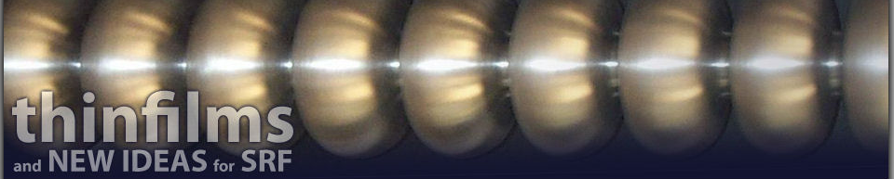


Slide 2
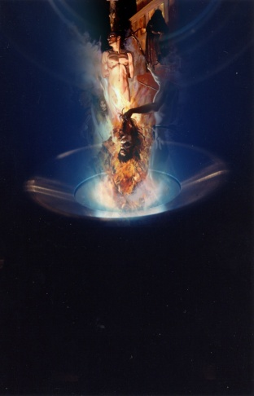
3 full days
46 presentions
70 delegates
11 countries

Slide 3
Th
RF Superconductivity THEORY

Slide 4
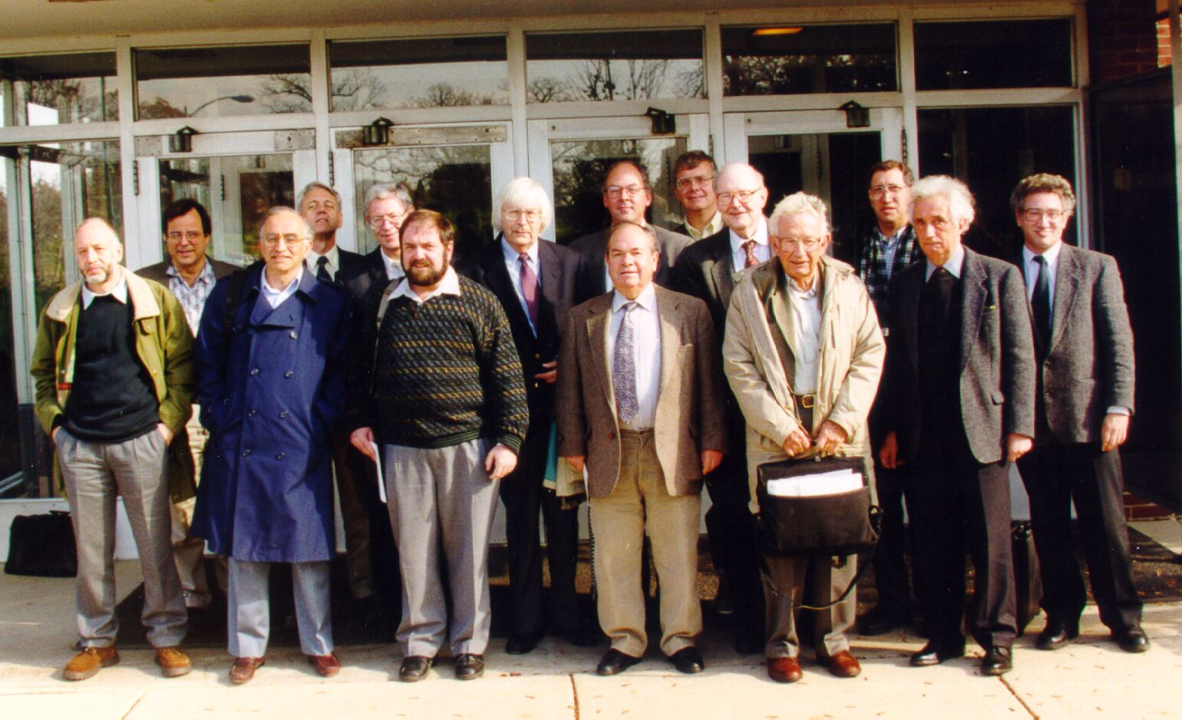
Richard
Klemm
George
Crabtree
Ernst Helmut
Brandt
Lev
Gor'kov
David
Bishop
David
Nelson
Michael
Tinkham
Valerii
Vinokur
David
Khmel'nitskii
Grigorii
Volovik
Boris
Shklovskii
Boris
Altshuler
Alexei
Abrikosov
Phil W.
Anderson
Igor'
Dzyaloshinskii

Slide 5
Th
Superconductors and Vortices at
Radio Frequency Magnetic Fields
Ernst Helmut Brandt
Max Planck Institute for Metals Research, Stuttgart

Slide 6
Abrikosov Vortices in superconductors are usually repulsive, but can be attractive in Nb, forming clusters, lamellae, chains

Slide 7
Into sc with planar surface, vortices penetrate via a barrier at H_{p} ≈ H_{c}
But at sharp corners vortices penetrate much more easily, at H_{p} << H_{c1}

Slide 8
Ideal diamagnet, corner with angle α :
Near corner of angle α the magnetic field diverges as H ~ 1/ r^{β}, β = (π – α)/(2π - α)
Magnetic field H at the equator of:
cylinder
sphere
H/H_{a} = 2
H/H_{a} = 3
Ellipsoid
b
a
H/H_{a} = a/b
b << a
rectangle
2b
H/H_{a} ≈ (a/b)^{1/2}
(strip or disk)
2a
b << a

Slide 9
Ideal diamagnet, corner with angle α :
Near corner of angle α the magnetic field diverges as H ~ 1/ r^{β}, β = (π – α)/(2π - α)
H_{a}
r
vacuum
H ~ 1/ r^{1/3}
sc
α
α = π
H_{a}
H ~ 1/ r^{1/2}
α = 0
Large thin film in tilted
mag. field: perpendicular
component penetrates
in form of a vortex lattice

Slide 10
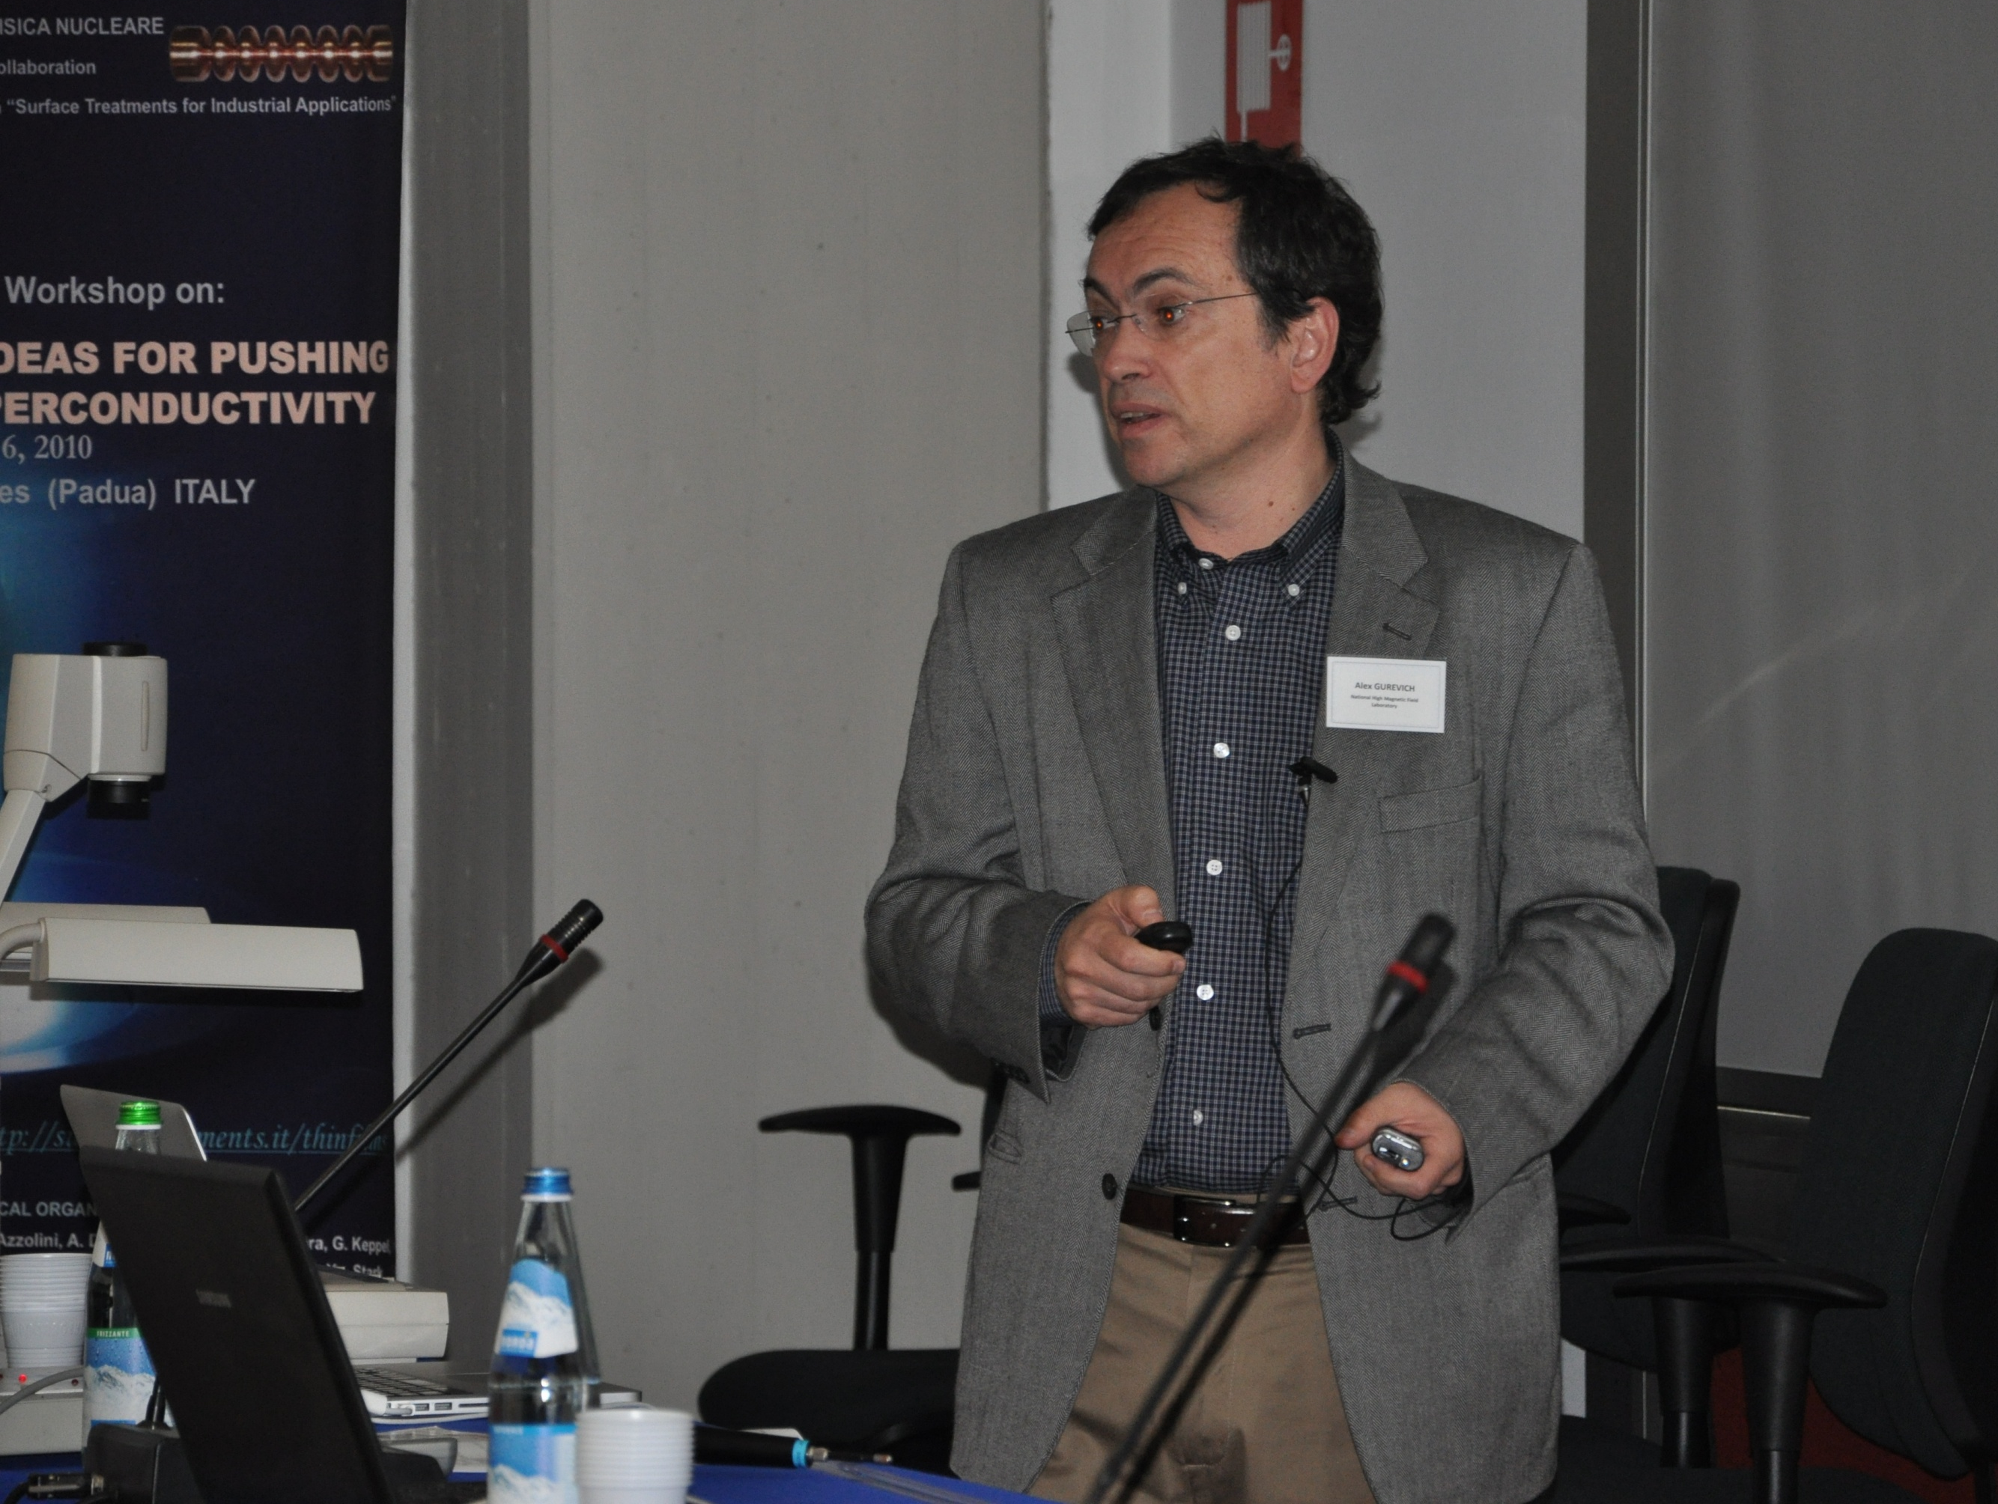

Slide 11


Th
Nonlinear Meissner Effect and Enhancement of the Field Onset of Penetration of Vortices in Dirty Nb Films Under RF and DC Fields
Alex Gurevich
National High Magnetic Field Laboratory, Tallahassee, FL 32310
6-th Thin Film SRF Workshop, Padova, Italy, Oct. 4-6, 2010

Slide 12
Field range of the Meissner state is greatly increased in a thin film with d < λ
Enhancement of parallel B_{c1} in a thin film
with d << λ (Abrikosov, 1964)
NLME can also reveal the enhancement of the vortex penetration field by thin film coating

Slide 13
Superconducting current
Superfluid current density n_{s} is independent of current density at J << J_{s}: linear Meissner effect
Any dependence of n_{s}(J) on current density results in the nonlinear Meissner effect

Slide 14
Dependence of the SC gap on current
Clean limit (l >> ξ₀)
Dirty limit (l << ξ₀)
Δ²(J)/Δ²(0)
Δ²(J)/Δ²(0)
T << T_{c}
T << T_{c}
1
1
2/3
2/3
T ≈ T_{c}
T ≈ T_{c}
0.54
1
J/J_{d}(0)
0.54
1
J/J_{d}(0)
In the clean limit the gap Δ(J) is independent of RF field at low T
J. Bardeen, Rev. Mod. Phys. 34, 667 (1962).

Slide 15
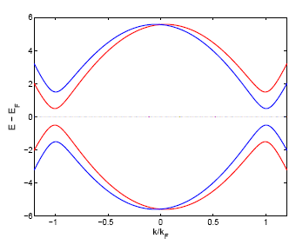
Thermal activation in rf field in the clean limit
Reduction of the gap
Δ(v_{s}) = Δ - p_{F}|v_{s}|
2Δ - 2vp_{F}
2Δ + 2vp_{F}
Increases the density of thermally-activated normal electrons n_{r}(J), thus increasing R_{s}
(Kulik and Palmieri; 1997; Gurevich)

Slide 16
Nonmagnetic impurities are pairbreakers at high fields
nonmagnetic impurities are pairbreakers at high fields, reducing the superconducting gap
Increase of R_{s} as the field increases
R_{s} ∝ λ³(H)Δ(H)exp[-Δ(H)/T]
∝ exp [C_{Δ}(H/H_{c})² ]Δ /T]

Slide 17
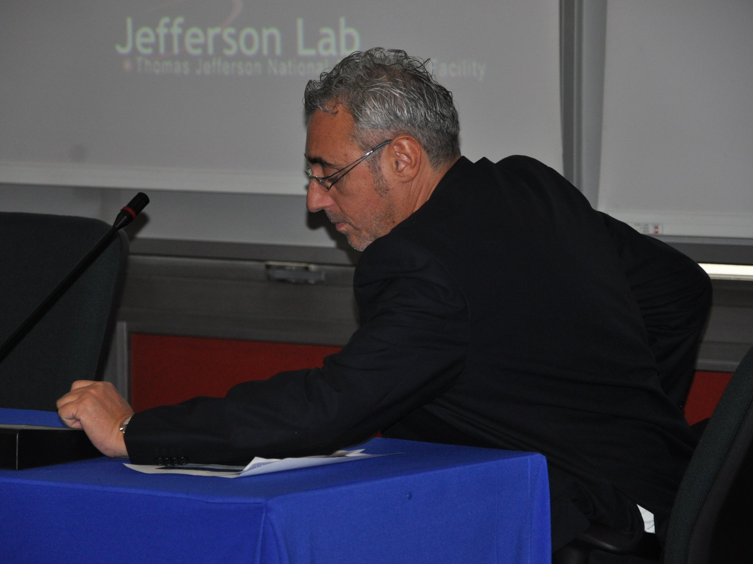

Slide 18
Th
RF Losses due to incomplete
Meissner – Ochsenfeld effect:
Difference between Bulk Nb and Nb/CU
Enzo Palmieri
Legnaro National Laboratories
ISTITUTO NAZIONALE DI FISICA NUCLEARE
and
University of Padua

Slide 19
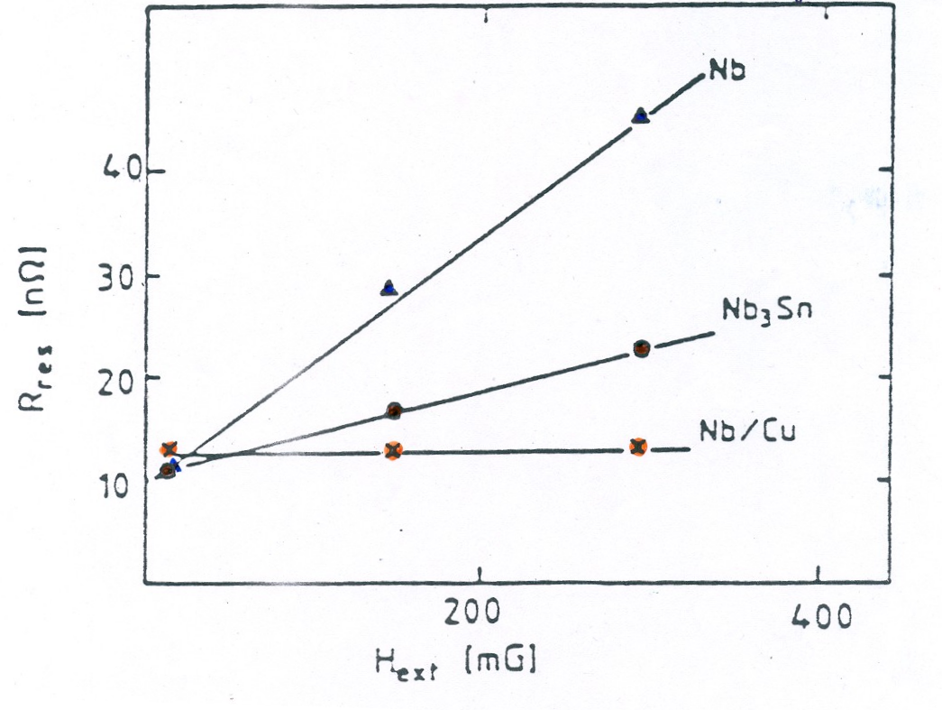
Residual Resistance versus
the magnetic field left during cooling
After W. Weingarten 1986 CERN

Slide 20
Bardeen and Stephen - Phys Rev 140 A1197 (1965)
but also
Kim, Hempstead and Strnad - Phys Rev 139 A1163 (1965)
have shown that
The well known equation of the damped forced oscillator can be used for describing the oscillation of a vortex from and to a pinning center

Slide 21

If u is the displacement of a single flux line respect to the pinning center
Where
M is the effective Mass of the Vortex per unit lenght
η is the flow Viscosity
K is the elastic constant of the linearized pinning force in the approximation of small displacements
Φ_{o} is the vortex quantum
J is the current density induced by rf fields

Slide 22
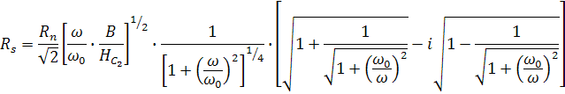
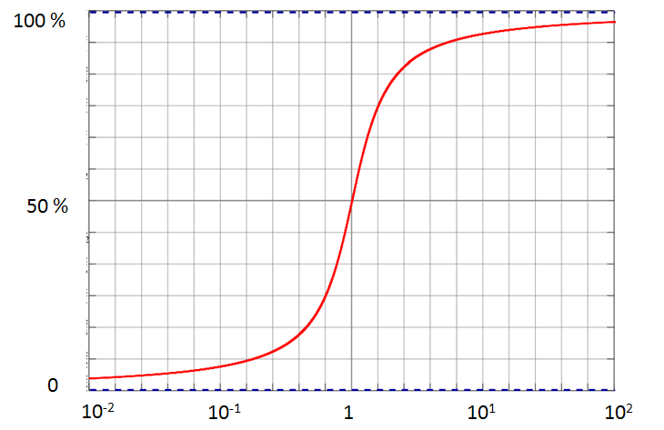
Th
ω / ω₀

Slide 23
Th
Free to move
Pinned by Grain Boundaries
Vortex
Vortex
Bulk Niobium
Niobium film
Low depinning frequency ω₀
High depinning frequency ω₀

Slide 24
SP
Conventional Sputtering and Energetic Condensation for Superconducting Cavity Applications
L. Phillips, D. Bowring, C. Reece, J. Spradlin, Anne Marie Valente-Feliciano, and Xin Zhao

Slide 25
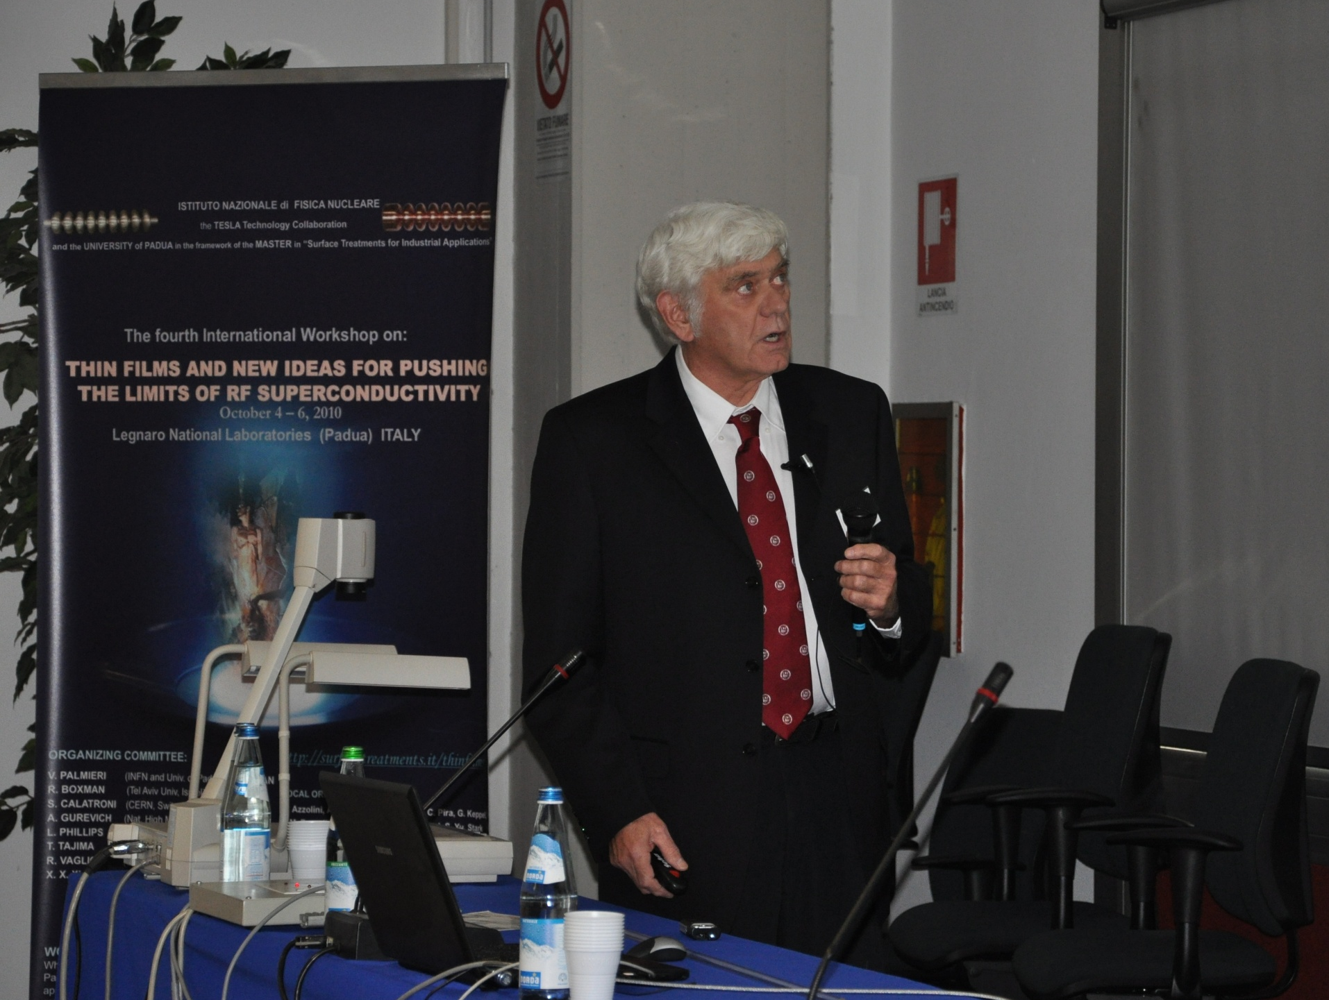

Slide 26

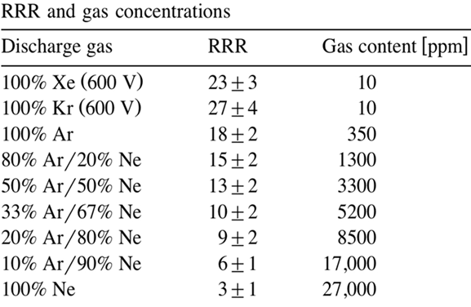
Microstructure and Defect Density in Sputtered Films
Defect Sources:
Impurity scattering from background impurities and sputtering gas
Figure 2
-In CERN studies, somewhat better high field performance was obtained with Krypton than Argon raising the film RRR from 18 to 27

Slide 27
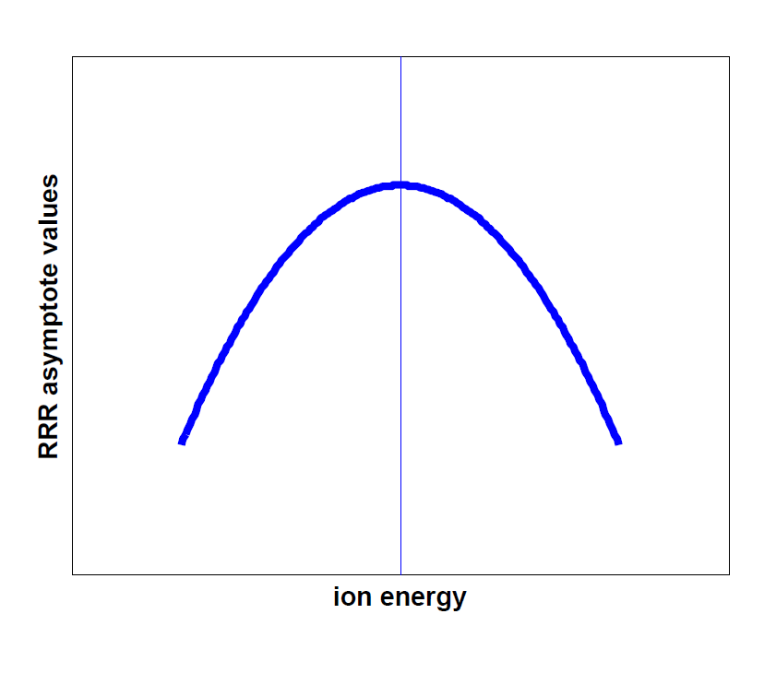
What do we need to know?
maximum RRR in the film as a function of ion energy for both film structures
curve may differ for differing degrees of lattice mismatch in the case of heteroepitaxy
How does a large degree of lattice mismatch affect RRR at the RF surface?
How does the local RRR vary from substrate to RF surface for energies of interest?
Figure 5

Slide 28
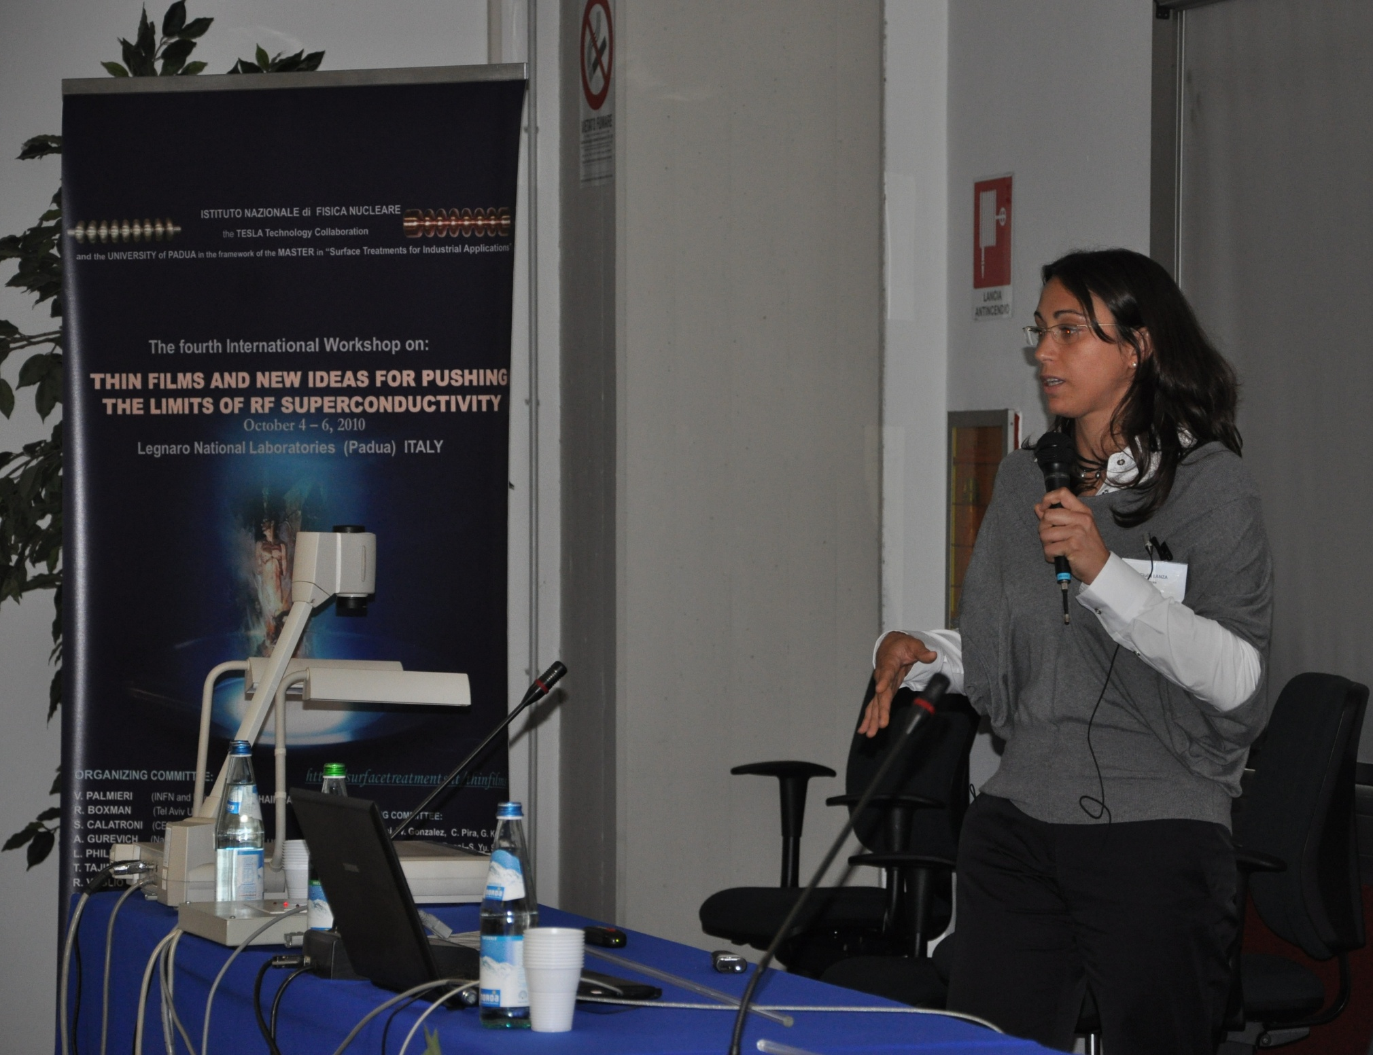

Slide 29
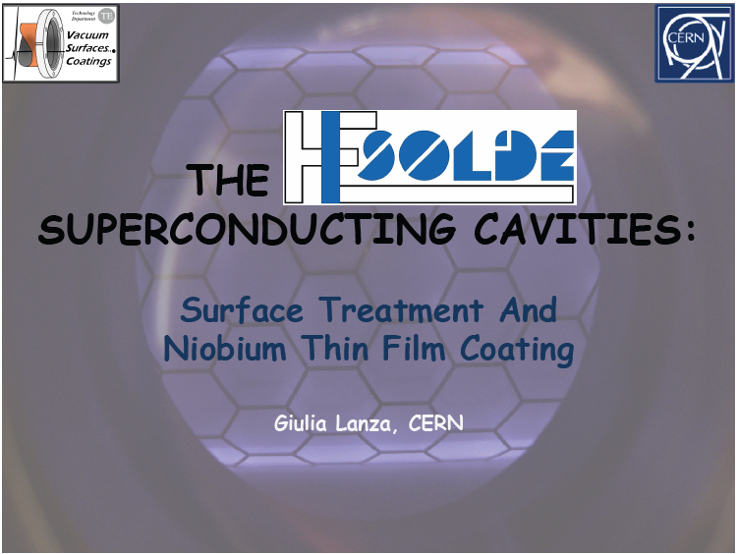
SP

Slide 30
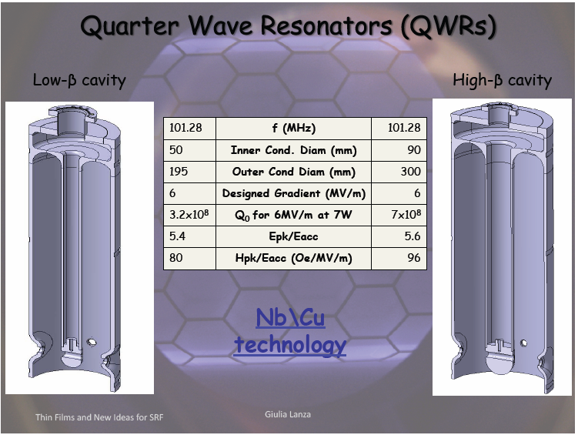

Slide 31
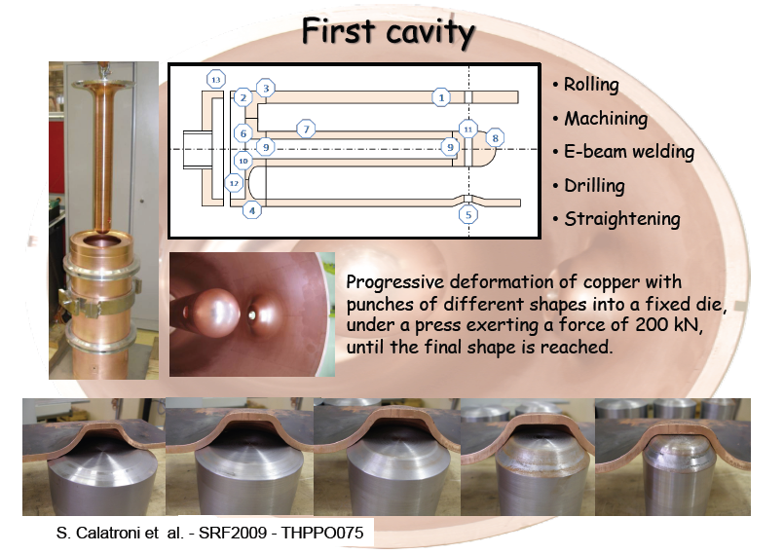

Slide 32
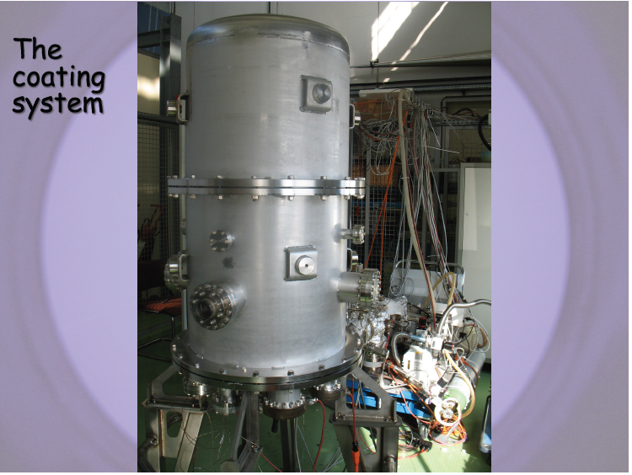

Slide 33
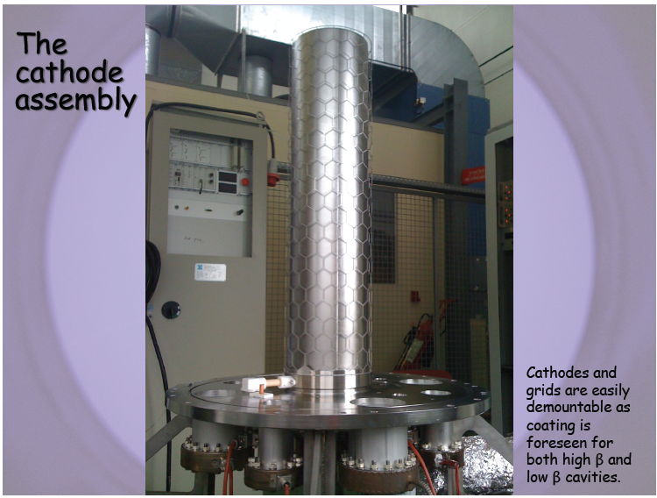

Slide 34
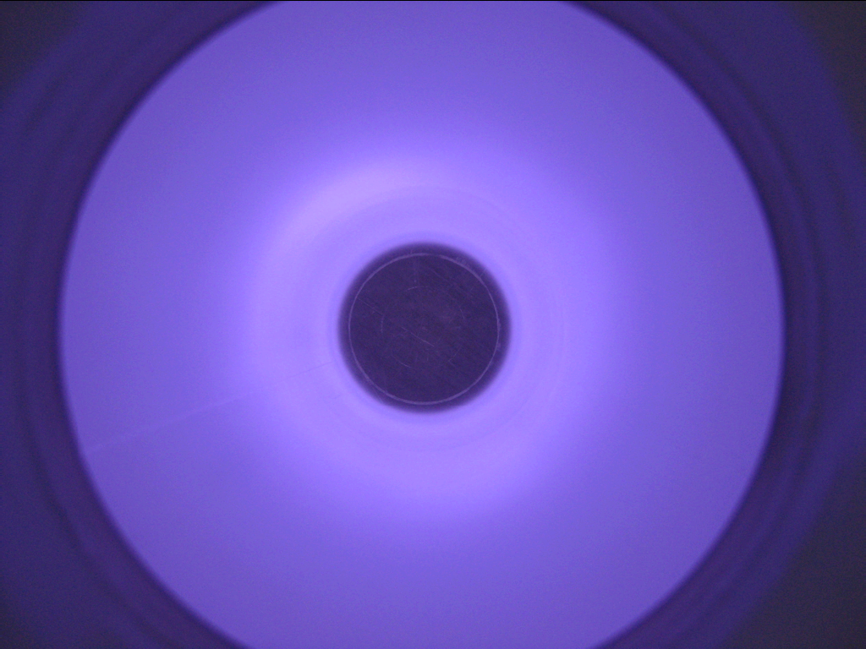

Slide 35
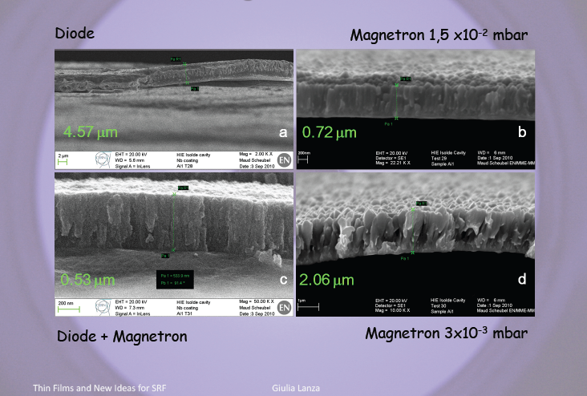

Slide 36
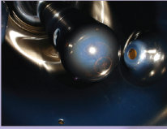

Slide 37
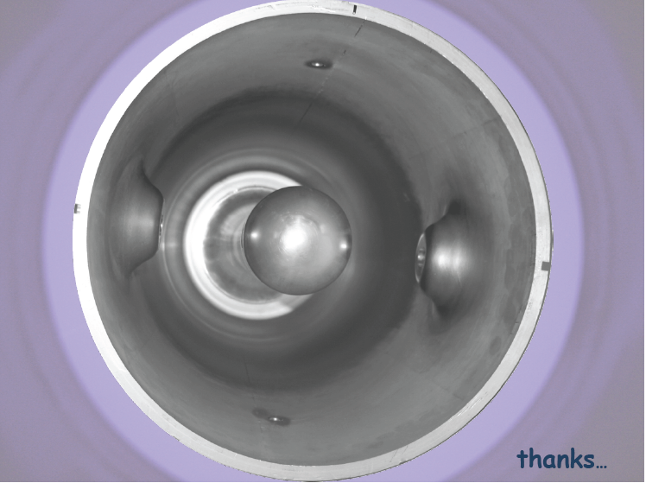


Slide 38
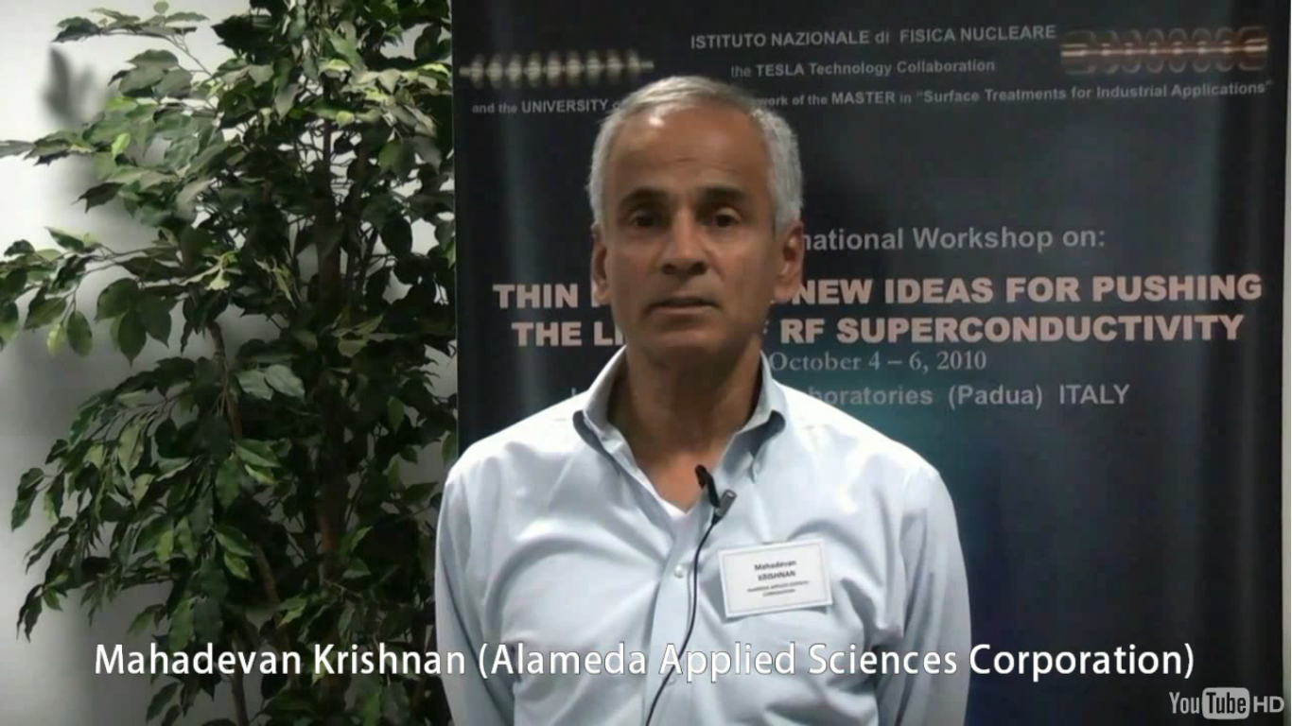

Slide 39
Energetic Condensation Growth of Nb films
for SRF Accelerators
EC
M. Krishnan, E. Valderrama, C. James, B. Bures and K. Wilson Elliott
Alameda Applied Sciences Corporation (AASC), San Leandro, California 94577
X. Zhao, L. Phillips, B. Xiao and C. Reece
Thomas Jefferson National Accelerator Facility (Jefferson Lab), Newport News, Virginia 23606
K. Seo
Norfolk State University (NSU), Norfolk, Virginia 23504

Slide 40
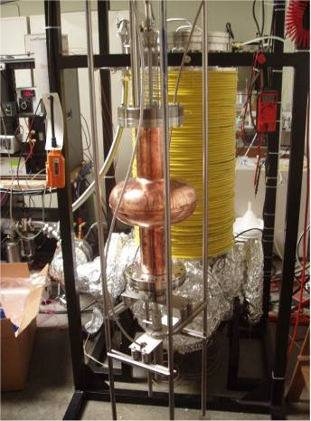
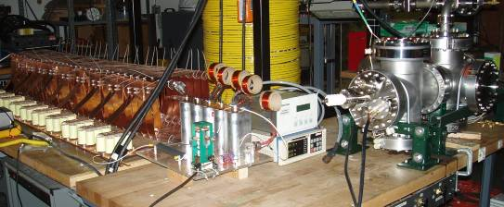
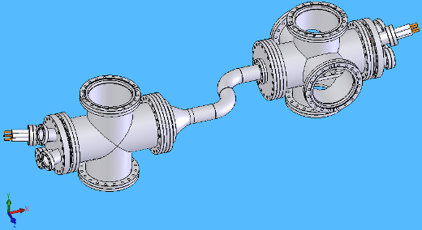
Three different Coaters at AASC
Cathodic Arc Deposition (CAD)
Coaxial Energetic Deposition (CEDTM)
Filtered Cathodic Arc Deposition (FCAD)
Notes:
40
40

Slide 41
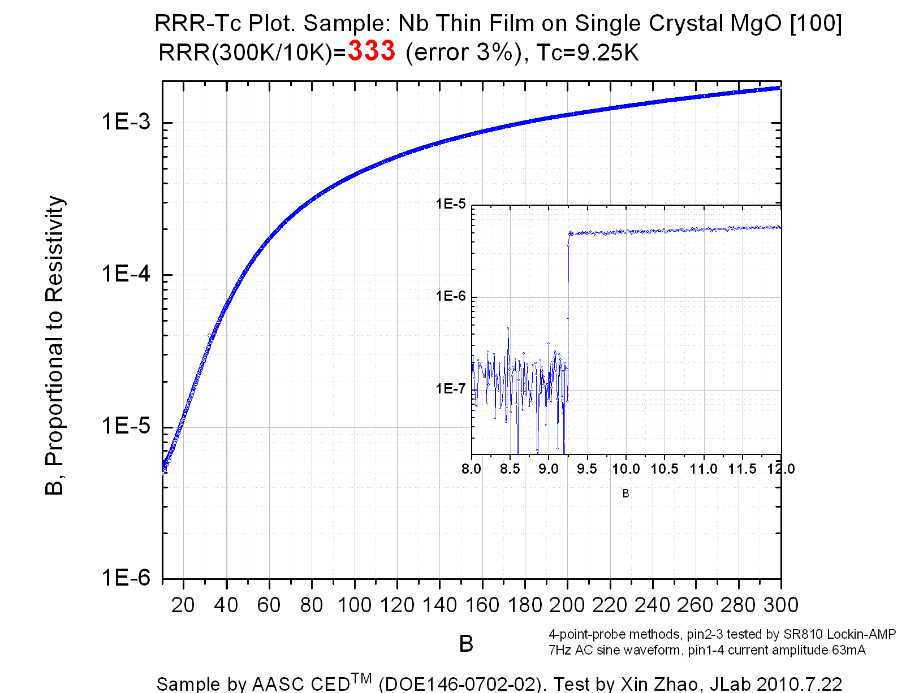

Slide 42
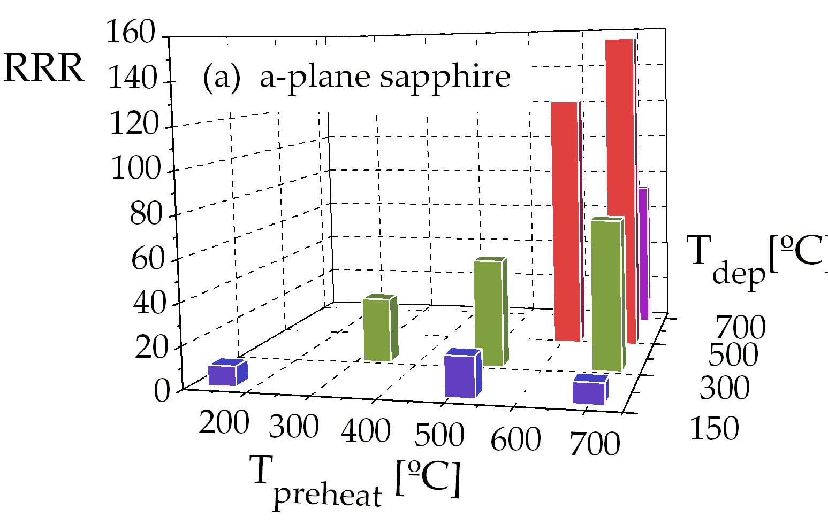

Slide 43
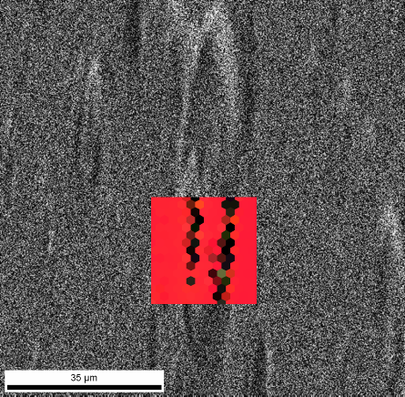
Nb on MgO: macro-particles show same orientation as flat surface
RRR = 316, 700/700
High RRR has been achieved despite macroparticles
EBSD demonstrates that macroparticles have the same orientation as the Nb (100) thin film elsewhere
Macroparticle
Nb (100)
35µm

Slide 44
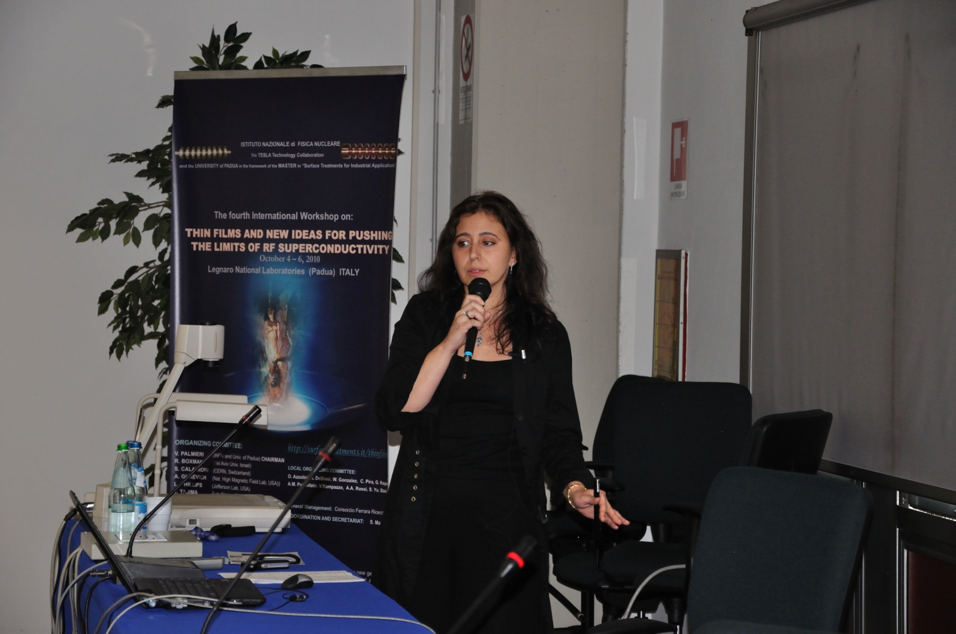

Slide 45




SRF thin films by
energetic condensation
EC
Anne-Marie VALENTE-FELICIANO
J. Spradlin, L. Phillips, C. Reece, B. Xiao, X. Zhao
R.A. Lukazew, D. Beringer
D. Gu
K. Seo

Slide 46
Structure vs. Bake Temperature- Al₂O₃ (11-20)
T_{bake}[°C] | 360 | 700 | 900
T_{c} [K] | 9.20 | 9.19 | 9.23
ΔT_{c}[K] | 0.04 | 0.03 | 0.02
RRR | 179.8 | 213.3 | 71.5
PF | (110) | (110) | (110)
Orientation spread [°] | 0.115 | 0.025 | 3.575
Thickness [nm] | 840 | 1140 | 270
(Bias -120V)

Slide 47
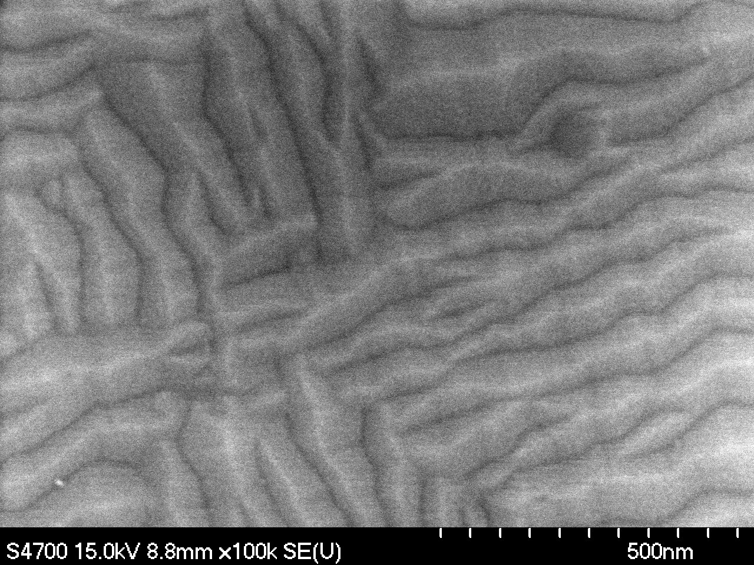
Nb/MgO (100)

Slide 48
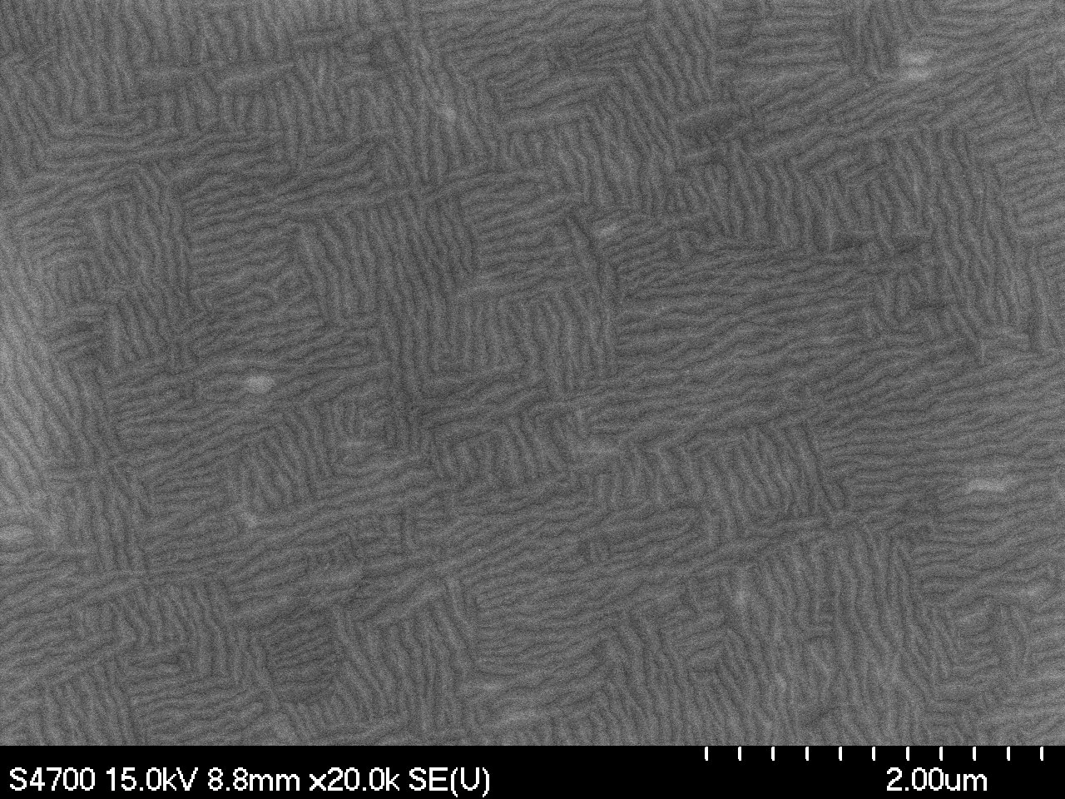
Nb/MgO (100)
ECR, bias -120V, 30 minutes, Bake-out (24h) and coating at 360ºC

Slide 49
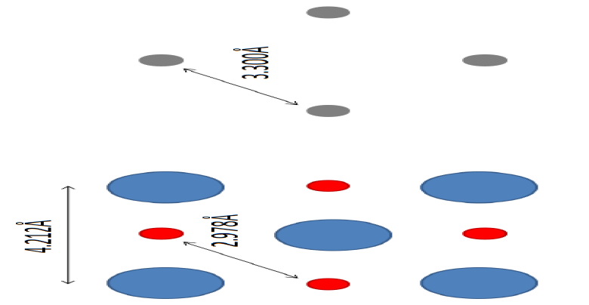
Nb/MgO (100)
10.8% mismatch

Slide 50
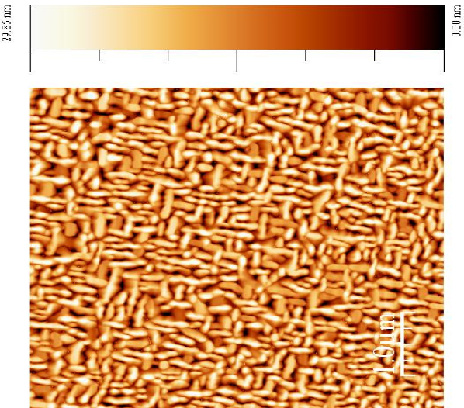
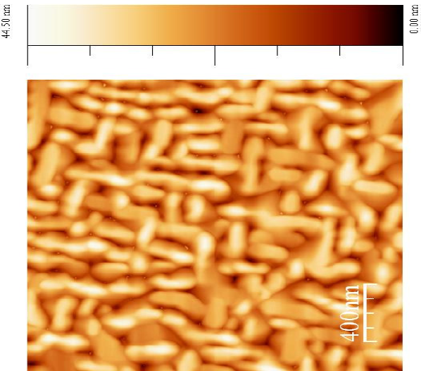
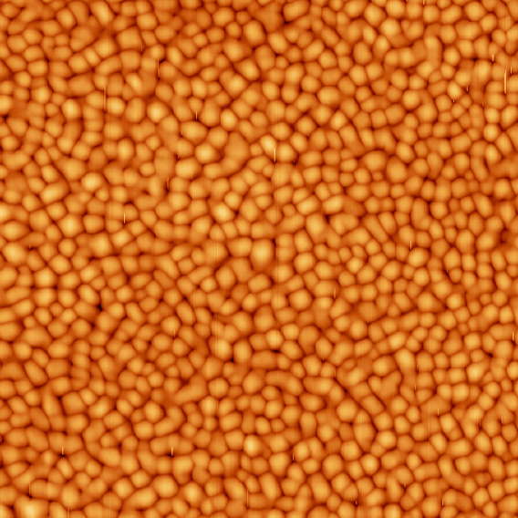
Nb/MgO
RMS Roughness = 6.6nm
600 nm Nb/MgO
RMS Roughness = 1.42nm
30 nm Nb/MgO
RMS Roughness = 6.5nm
400nm
Magnetron sputtering 600nm , 600C, 7h, RRR~47 ,
ECR 620nm , 360°C, 30’, RRR~50

Slide 51
RMS Roughness = 6.6nm

Slide 52
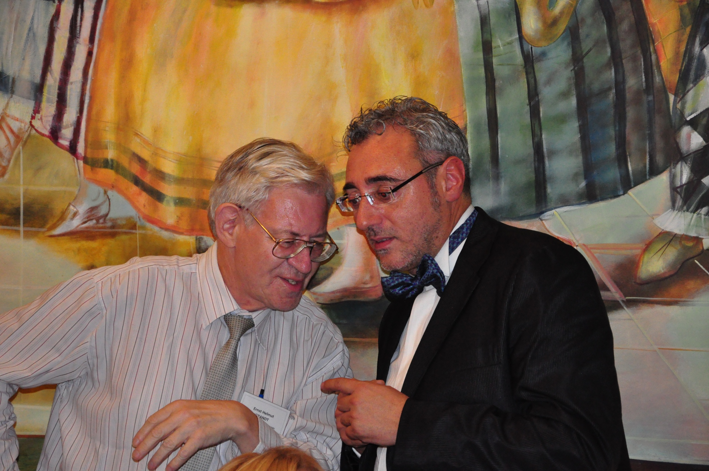

Slide 53
Ideal diamagnet, corner with angle α :
Near corner of angle α the magnetic field diverges as H ~ 1/ r^{β}, β = (π – α)/(2π - α)
Magnetic field H at the equator of:
cylinder
sphere
H/H_{a} = 2
H/H_{a} = 3
Ellipsoid
b
a
H/H_{a} = a/b
b << a
rectangle
2b
H/H_{a} ≈ (a/b)^{1/2}
(strip or disk)
2a
b << a

Slide 54
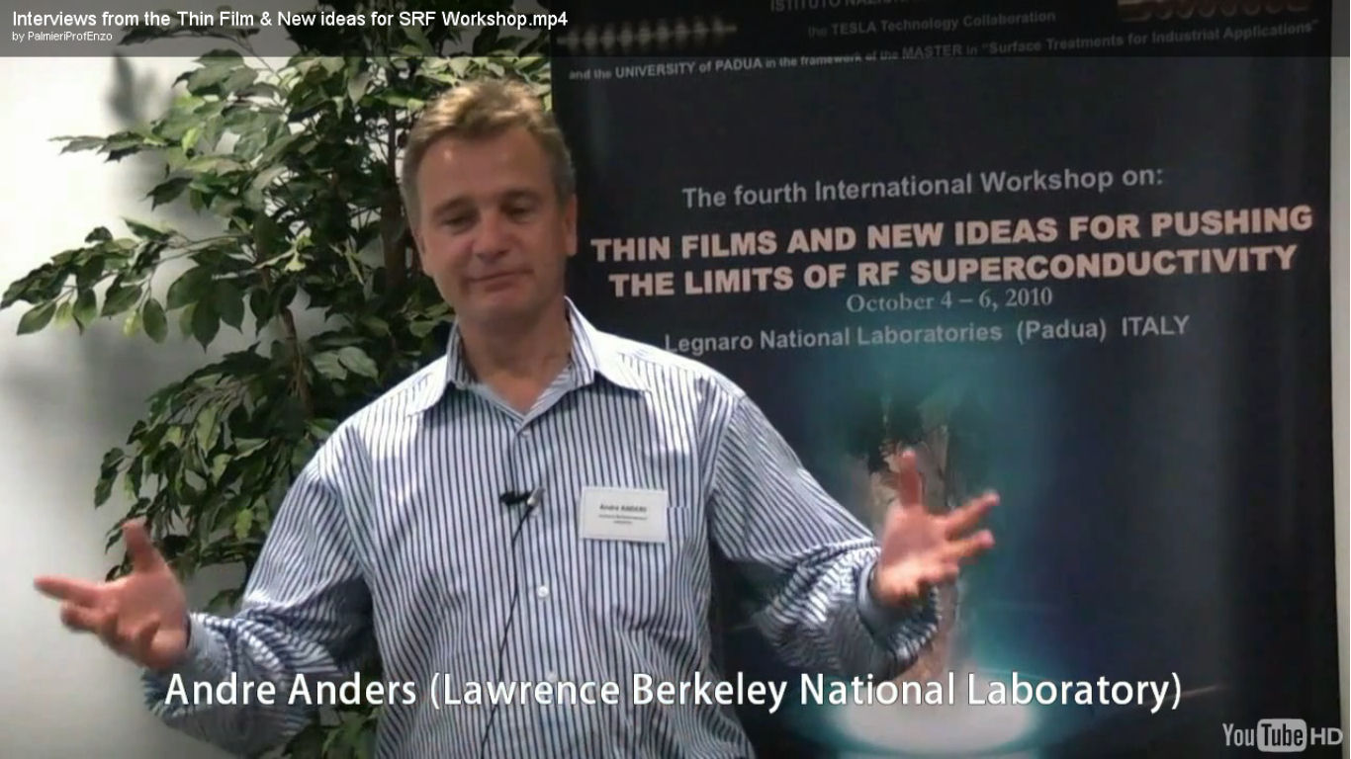

Slide 55
Niobium Films for SRF by
High Power Impulse Magnetron Sputtering
André Anders
aanders@lbl.gov
Lawrence Berkeley National Laboratory, Berkeley, California
This work was supported by the U.S. Department of Energy under Contract No. DE-AC02-05CH11231.
EC

Slide 56
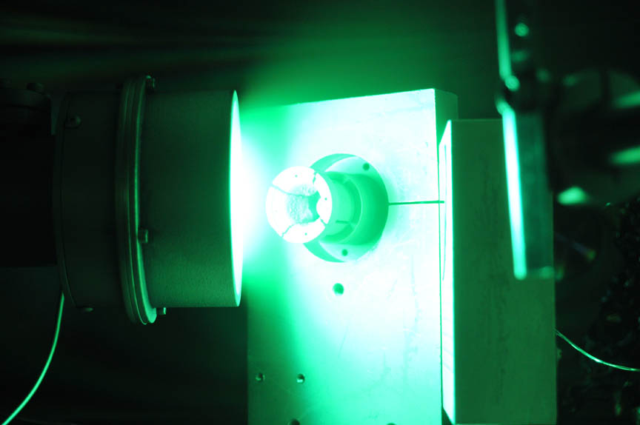
HIPIMS without any gas: Pure Self-Sputtering in Vacuum
Arc “kickstarter”
Ion
collector
2” magnetron
J. Andersson and A. Anders, Appl. Phys. Lett. 92 (2008) 221503
J. Andersson and A. Anders, Phys. Rev. Lett. 102 (2009) 045003

Slide 57
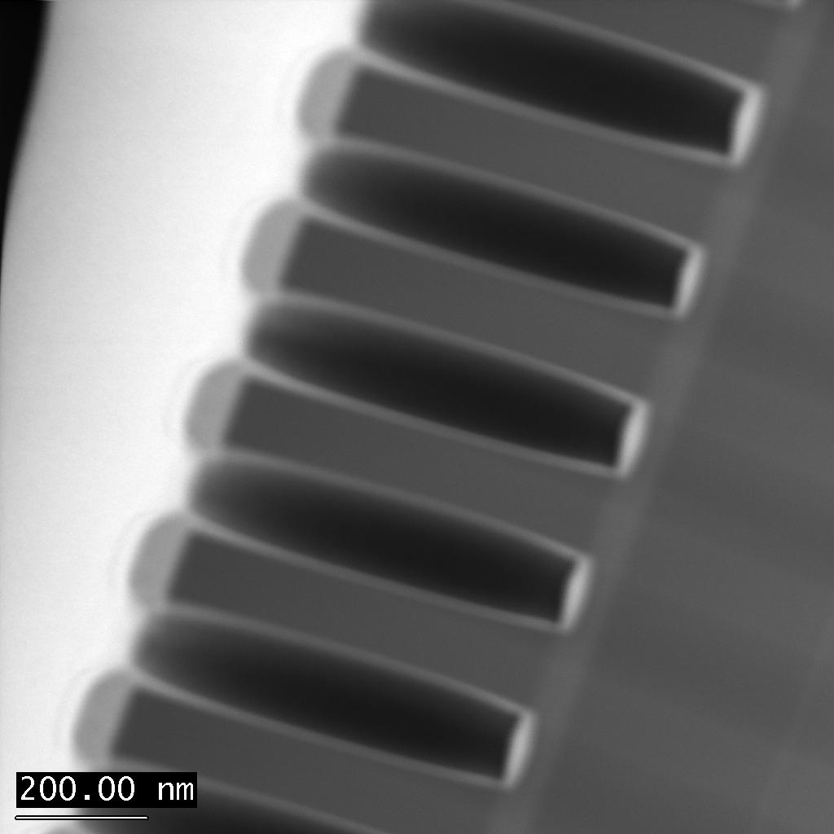
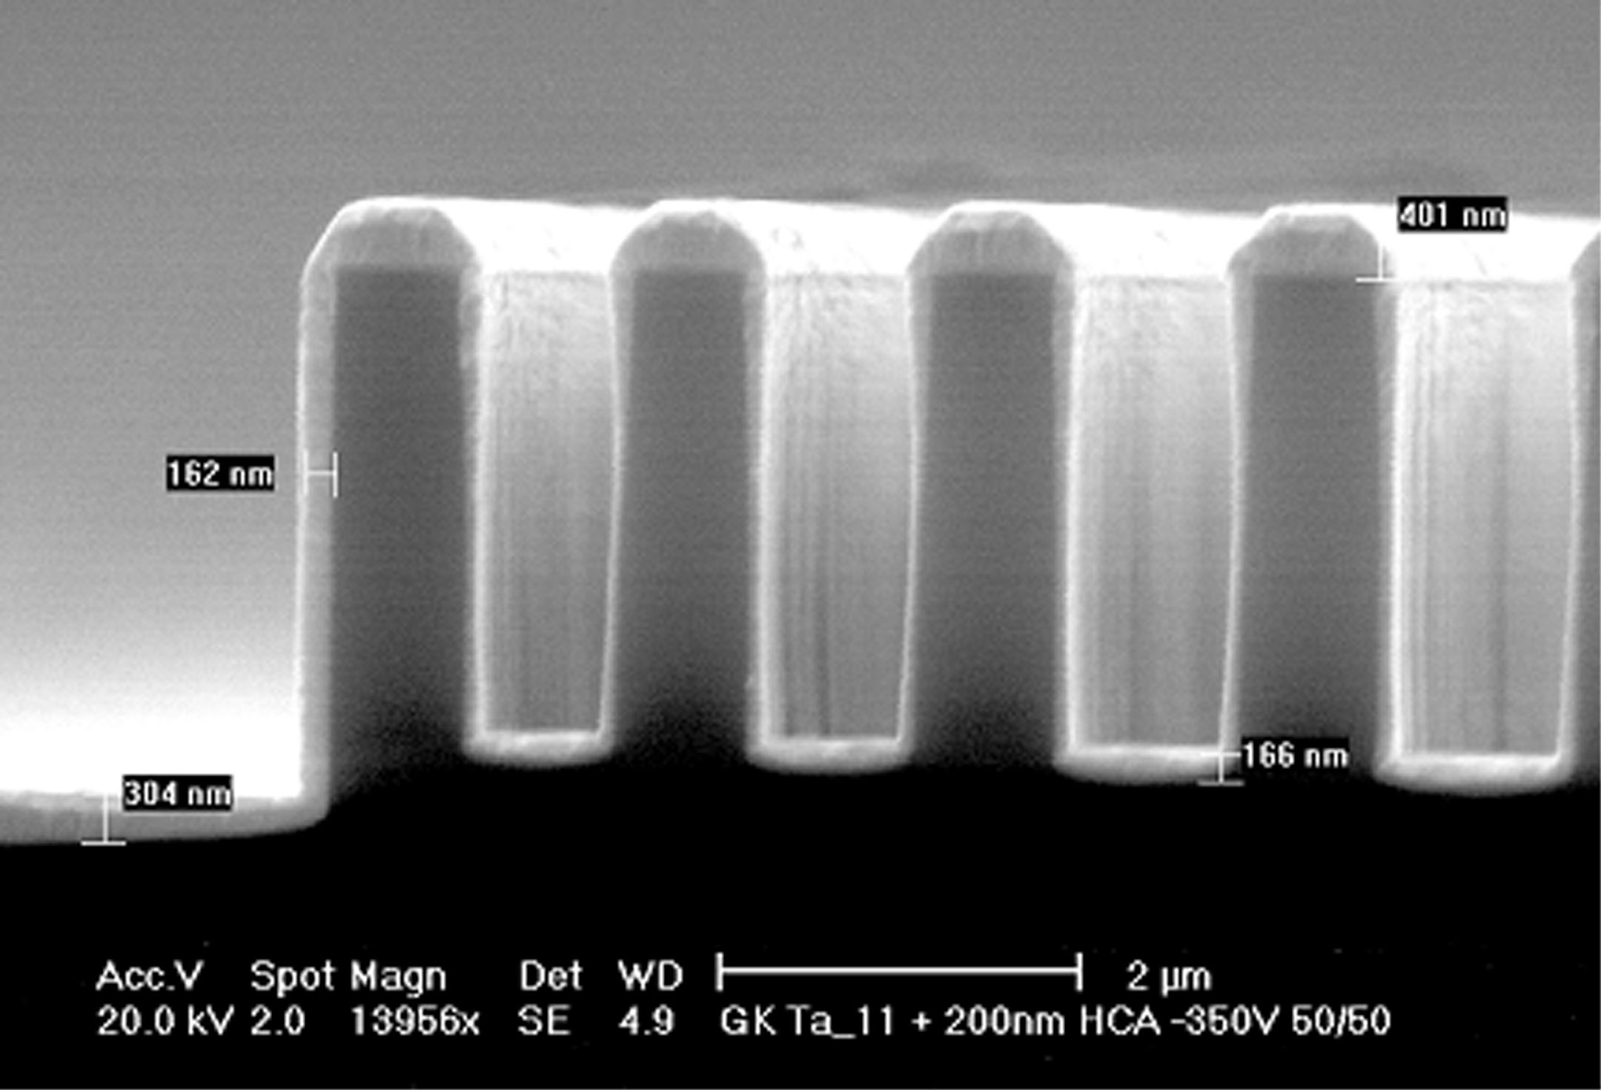
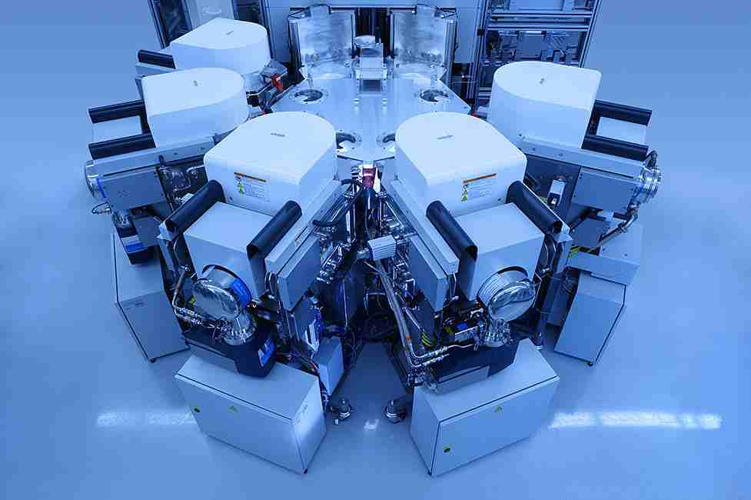
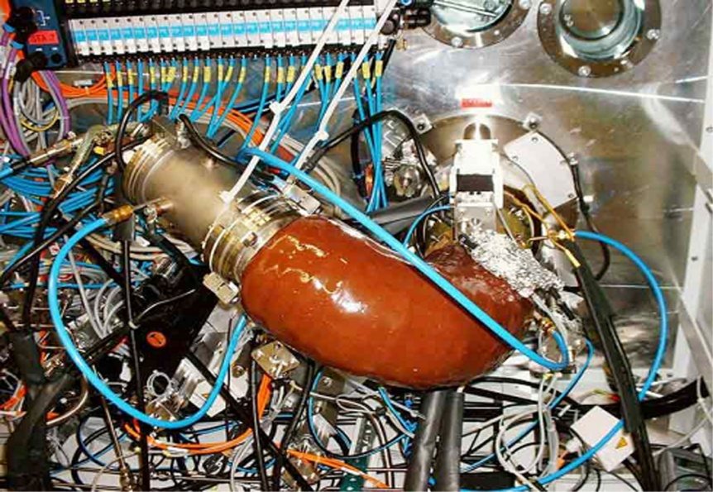
Conformal Coating by Energetic Condensation have been demonstrated
HIPIMS
  Oerlikon Balzers (2009)
Pulsed Arc
  Siemroth et al. (1997)
30 % bottom coverage
6:1 aspect ratio
P. Siemroth, et al., Thin Solid Films 308, 455 (1997), and Surf. Coat. Technol. 133-134, 106 (2000).
HIPIMS Dep. of Ti, STEM 250 nm vias

Slide 59
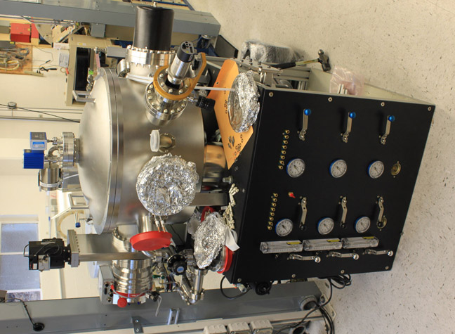
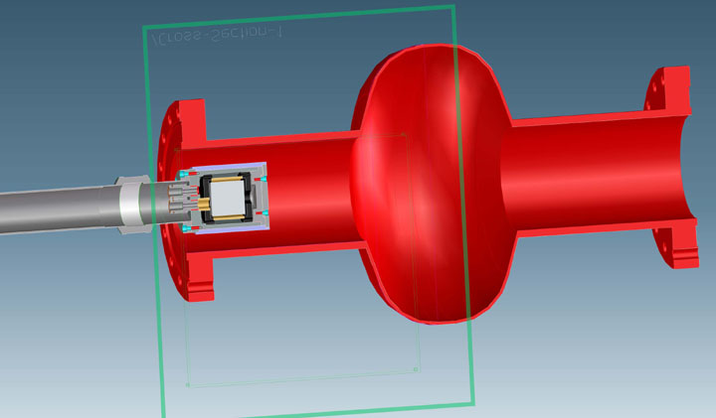
Dedicated Nb-HIPIMS chamber under construction @ Berkeley

Slide 60

Material Science and Technology Research Group (STM)
Dipartimento di Ingegneria Meccanica e Industriale
Università Roma TRE
Nano-mechanical and microstructural characterization of MS-PVD Nb thin films
Edoardo Bemporad, Marco Sebastiani, Fabio Carassiti
Giulia Lanza and Enzo Palmieri
Notes:
Saluti
collaudo strumenti 24/3/1997
laboratorio sta andando a regime
ultimi problemi relativamente al locale che li ospita, approvata da poco la spesa per la ristrutturazione
gli strumenti hanno subito un invecchiamento precoce

Slide 61
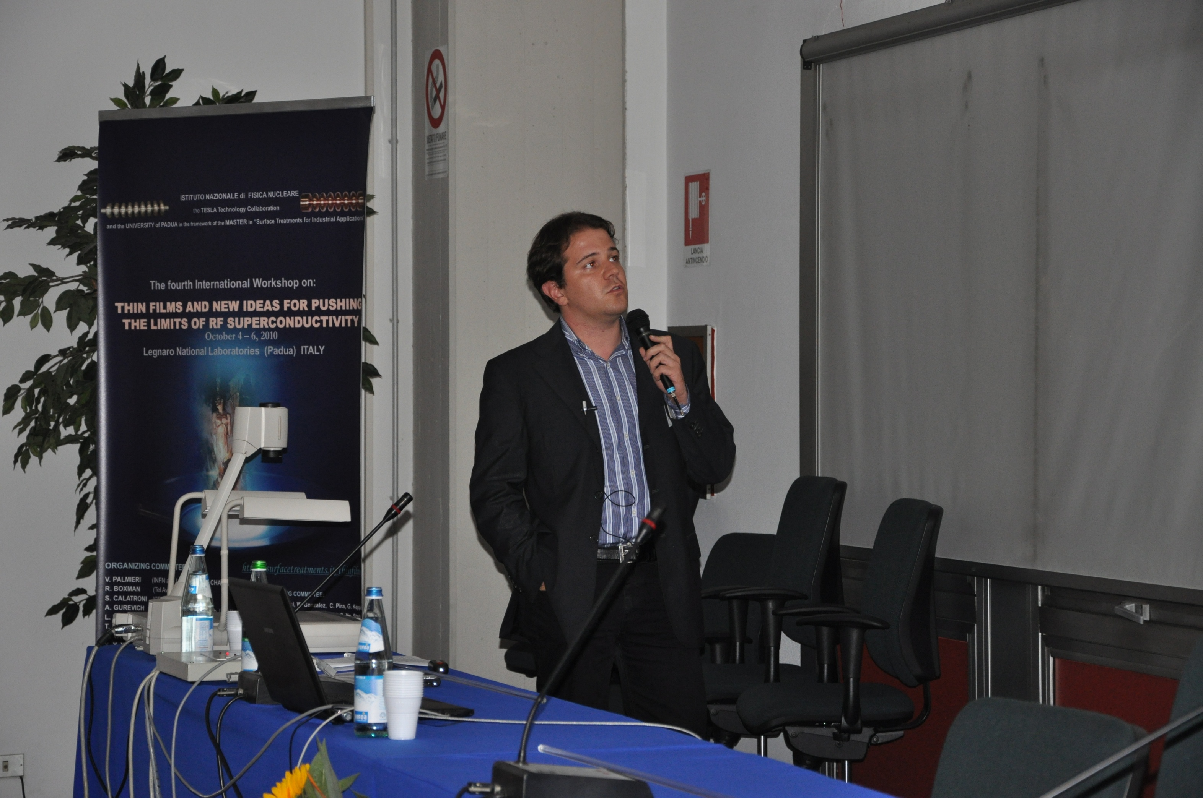
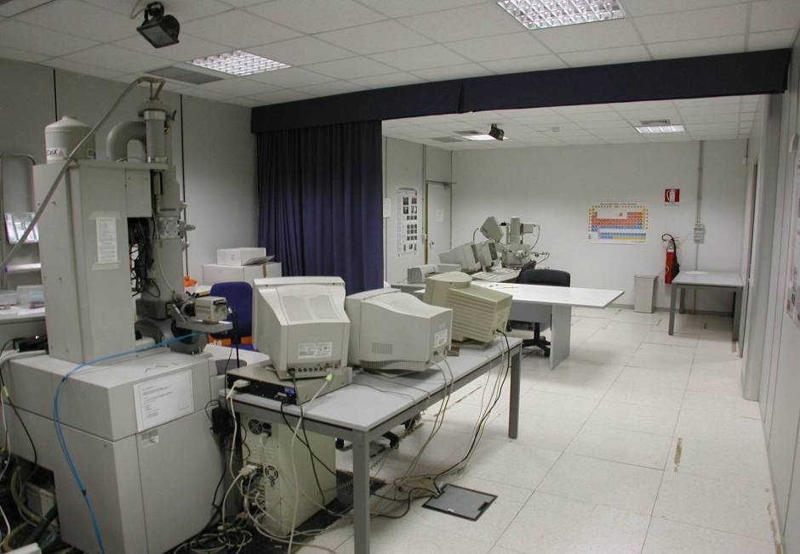
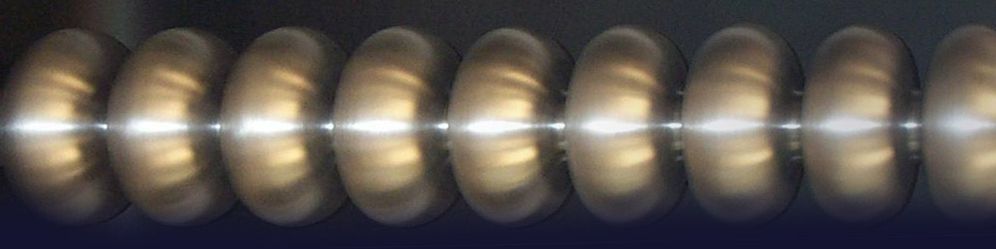
Material Science and Technology Research Group (STM)
Dipartimento di Ingegneria Meccanica e Industriale
Università Roma TRE
Nano-mechanical and microstructural characterization of MS-PVD Nb thin films
Edoardo Bemporad, Marco Sebastiani, Fabio Carassiti
Giulia Lanza and Enzo Palmieri
The fourth international Workshop on:
THIN FILMS AND NEW IDEAS FOR PUSHING THE LIMITS OF RF SUPERCONDUCTIVITY
October 4-6, 2010
Legnaro National Laboratories (Padua) ITALY
Notes:
Saluti
collaudo strumenti 24/3/1997
laboratorio sta andando a regime
ultimi problemi relativamente al locale che li ospita, approvata da poco la spesa per la ristrutturazione
gli strumenti hanno subito un invecchiamento precoce

Slide 62
Material Science and Technology Research Group (STM)
Dipartimento di Ingegneria Meccanica e Industriale
Università Roma TRE
Nano-mechanical and microstructural characterization of MS-PVD Nb thin films
Edoardo Bemporad, Marco Sebastiani,
Fabio Carassiti
Giulia Lanza and Enzo Palmieri
Ch

Slide 63
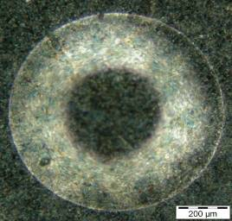
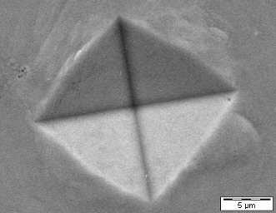

Hardness – Scale of indentation
10 N
10 mN
Load
Macro-hardness
Micro-hardness
Nano-hardness

Slide 64
Instrumented Indentation Testing

Slide 65


Deposition of coatings
R20 | 797 | CERN type sputtering on QUARTZ
R20 | 796 | CERN type sputtering on COPPER
R30 | 804 | BIAS type sputtering (100V) on QUARTZ
R30 | 803 | BIAS type sputtering (100V) on COPPER

Slide 66

on Cu substrate
BIASED (a-b) and UNBIASED (CERN, c-d)

Slide 67

Th

Slide 68

Ch

Slide 69

7.5 GHz Sapphire loaded TE₀₁₁ Nb cavity

Slide 70


Slide 71


Slide 72


Slide 73

Ch

Slide 74


Slide 75


Slide 76


Slide 77
Thermal activation in rf field in the clean limit
Reduction of the gap
Δ(v_{s}) = Δ - p_{F}|v_{s}|
2Δ - 2vp_{F}
2Δ + 2vp_{F}
Increases the density of thermally-activated normal electrons n_{r}(J), thus increasing R_{s}
(Kulik and Palmieri; 1997; Gurevich)

Slide 78


Magnesium Diboride Thin Films for Superconducting RF Cavities
Xiaoxing Xi
Department of Physics
Temple University, Philadelphia, PA
Contributors
Chenggang Zhuang, Alex Krick, Teng Tan, Ke Chen, Ed Kaczanowicz
Collaborators
Enzo Palmieri (INFN), Som Tyagi (Drexel), Steven Alage (Maryland)
October 5, 2010
Workshop on Thin Film RF
Padua, Italy
Supported by DOE/HEP

Slide 79
Magnesium Diboride Thin Films for Superconducting RF Cavities
Xiaoxing Xi
Department of Physics
Temple University, Philadelphia, PA
Contributors
Chenggang Zhuang, Alex Krick, Teng Tan, Ke Chen, Ed Kaczanowicz
Collaborators
Enzo Palmieri (INFN), Som Tyagi (Drexel), Steven Alage (Maryland)
HTc
Supported by DOE/HEP

Slide 80
Hybrid Physical-Chemical Vapor Deposition
Schematic View
get rid of oxygen
prevent oxidation
make high Mg
pressure possible
H₂ (~100 Torr)
B₂H₆ (~ 5 - 250 sccm)
pure source of B
B supply (B₂H₆ flow rate) controls growth rate
generate high
Mg pressure: required by thermodynamics
Mg
Substrate
550–760 °C
Pure source of Mg
high enough T
for epitaxy
Susceptor
Notes:
80

Slide 81

Microwave Properties vs Cleanness of MgB₂ Films
Surface Resistance @ 18 GHz
Dielectric single-crystal sapphire puck resonator at 18 GHz.
Cleaner films (low resistivity) leads to lower surface resistance, shorter penetration depth, and smaller πband gap (less interband scattering).
Jin et al, SC Sci. Tech. 18, L1 (2005)

Slide 82

Large Area HPCVD Films Using STI Pocket Heater
B₂H₆
Differences from reactive co-evaporation:
B₂H₆ used as boron source instead of e-beam evaporation
Hydrogen used as the carrier gas instead of HV
Deposition temperature in broader range
Advantages:
Large area and double sided films
Potential for scale up for wires
Wang et al. Supercond. Sci. Tech. 21, 085019 (2008)

Slide 83

Scaling up HPCVD for Large Area Films
Penn State
Peking University
Temple University
B₂H₆
B₂H₆
B₂H₆
Mg
Mg
Mg
550–760°C
Resistive
Heater
Resistive
Heater
Susceptor
Inductive heater
Successful
5mm x 5mm
Resistive heater
Successful
15mm x 15mm
Resistive heater
Designed for 2" dia.
Notes:
83

Slide 84


HPCVD Reactors at Temple
Two HPCVD reactors with resistive heaters
Smaller reactor for 15mm x 15mm films
Larger reactor for 2” diameter films

Slide 85


Cavity Coating Setup at Temple
Integrated HPCVD system: Two HPCVD systems, one sputtering system, and one distribution chamber connected together.
Cavity Up
Cavity Down
Resistive tube furnace will be installed in the existing HPCVD system

Slide 86
Coating SRF Cavity with a Two-Step Process
H₂, B₂H₆
Mg vapor
Coating cavity with B layer at ~400-500°C using CVD
Reacting with Mg to form MgB₂ at ~ 850-900 °C in Mg vapor

Slide 87


6 GHz

Slide 88


Slide 89


Slide 90
Plasma etching of Nb SRF Cavities
Anne-Marie Valente-Feliciano
for Janardan Upadhyay
Jefferson Lab
PE

Slide 91



Flat Samples - Microwave Glow Discharge System

Slide 92
Flat Samples - Etching Rate Dependence on Discharge Parameters
M. Rašković, S. Popović, J. Upadhyay, and L. Vušković, L. Phillips, A. M. Valente-Feliciano, “High etching rates of bulk Nb in Ar/Cl₂ microwave discharge,” J. Vac. Sci. Technol. A. 27 (2), 301 (2009)

Slide 93

Flat Samples - Surface Roughness
As received
BCP 1:1:2, 20 μm
RMS=254nm
Ra=210 nm
RMS =286nm
Ra=215nm
BCP + PE
RMS =215nm
Ra=169 nm
3-steps PE ,120 mm
RMS=234nm
Ra=174 nm
120 μm
AFM scans (50 μm × 50 μm)

Slide 94


Sample cavity setup with fiber optics

Slide 95
Atmospheric Microwave Plasma Torches for Advanced Cleaning
A. A. Rossi, G. Terenziani
F. Stivanello and V. Palmieri
PA

Slide 96

Plasma Flames
10 cm
17 cm

Slide 97


Slide 98

Bended Quartz Tube

Slide 99

See you at Jlab in 2012

