Slide 1

IFAE 2011
Incontri di Fisica delle Alte Energie
27-29 aprile 2011, Perugia
Primi risultati dell’esperimento LHCf per la fisica a piccolo angolo nelle interazioni protone-protone a 7 TeV
Lorenzo Bonechi (INFN – Firenze)
per la collaborazione LHCf

Slide 2






The LHCf international collaboration
O.Adriani^{a,b}, L.Bonechiª, M.Bongiª, G.Castellini^{a,b}, R. D’Alessandro^{a,b}, A.Faus^{n}, K.Fukatsu^{d}, M.Haguenauer^{f}, Y.Itow^{d,e}, K.Kasahara^{g}, K. Kawade^{d}, D.Macina^{h}, T.Mase^{d}, K.Masuda^{d}, Y. Matsubara^{d}, H.Menjo^{a,e}, G.Mitsuka^{d}, Y.Muraki^{d}, M.Nakai^{g}, K.Noda^{j}, P.Papiniª, A.-L.Perrot^{h}, S.Ricciarini^{a,c}, T.Sako^{d,e}, Y.Shimitsu^{g}, K.Suzuki^{d}, T.Suzuki^{g}, K.Taki^{d}, T.Tamura^{i}, S.Torii^{g}, A.Tricomi^{j,k}, W.C.Turner^{l}, J.Velasco^{n}, A.Vicianiª, K.Yoshida^{m}
INFN Section of Florence, Italy
University of Florence, Italy
Centro Siciliano di Fisica Nucleare e Struttura della Materia, Catania, Italy
Solar-Terrestrial Environment Laboratory, Nagoya University, Japan
Kobayashi Maskawa Institute for the Origin of Particles and the Universe, Nagoya University, Nagoya, Japan
Ecole Polytechnique, Palaiseau, France
RISE, Waseda University, Japan
CERN, Switzerland
Kanagawa University, Japan
INFN Section of Catania, Italy
University of Catania, Italy
LBNL, Berkeley, California, USA
Shibaura Institute of Technology, Japan
IFIC, Centro Mixto CSIC-UVEG, Spain

Slide 3
Outline
The Physics of LHCf
  Cosmic rays in the atmosphere and hadronic interaction models
  Open issues on the HE Cosmic Ray spectrum
Overview of the experiment
  Detection of neutral particles at low angle at LHC
  Description of detectors
Data analysis for 7 TeV data
  Relevant items
Results
Systematic uncertainties
Conclusions

Slide 4
PART 1
The Physics of LHCf

Slide 5
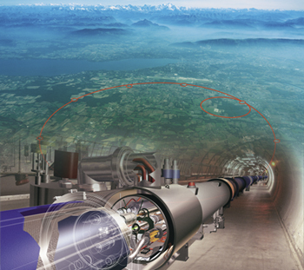

Main topics
Experimental measurement:
  Precise measurement of neutral particle (γ, π⁰ and n) spectra in the very forward region at LHC
7 TeV + 7 TeV in the c.m. frame → 10¹⁷ eV in the laboratory frame:
  We are going to simulate in the biggest’s world laboratory what happens in nature when a Very High Energy Cosmic Ray interacts in the atmosphere
Why in the very forward region?
  Because the dominant contribution to the energy flux in the atmospheric shower development is carried on by the very forward produced particles
LHC

Slide 6
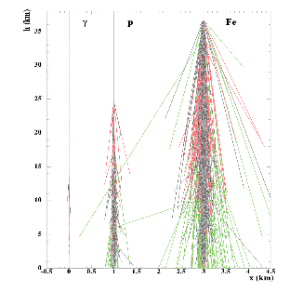
Cosmic ray showers
Air shower developments
Extensive air shower observation
longitudinal distribution
lateral distribution
Timing
Air shower development
Type of primary
Energy
Arrival direction
The hadronic interaction models used in air shower simulations have a big uncertainty due to the lack of experimental data in the energy range over 10¹⁵eV
Astrophysical parameters
Spectrum
Composition
Source distribution

Slide 7
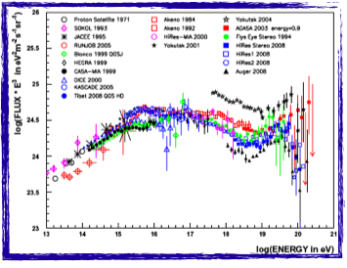
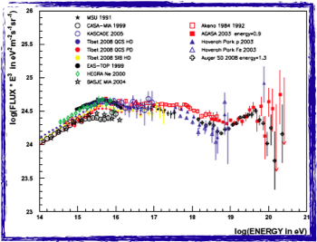
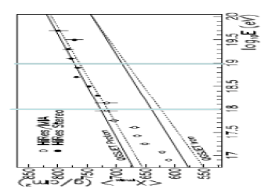
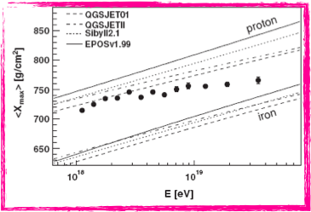
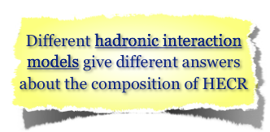
Open Issues on HECR spectrum
Difference in the energy scale between different experiments???
M Nagano
New Journal of Physics 11 (2009) 065012

Slide 8
PART 2
Overview of method and detectors

Slide 9
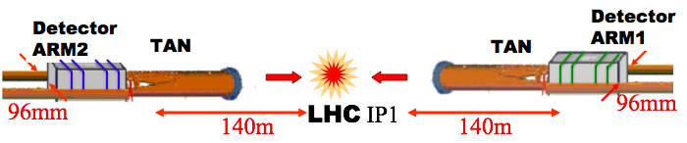
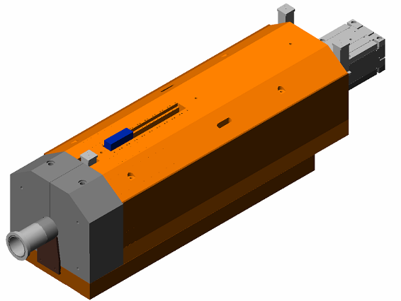
Method and location
Recombination Chamber
Detectors measure energy and
impact point of γ from π⁰ decays
e.m. calo tracking layers
Located Inside the
TAN, absorber for
neutral particles
Protons
Charged particles
Two independent detectors on both
sides of IP1
Redundancy
Background rejection (esp. beam-gas)
Neutral
particles
96mm
Beam pipe

Slide 10
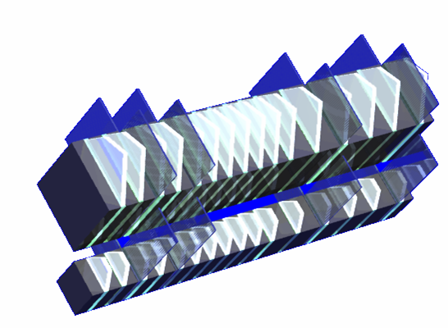
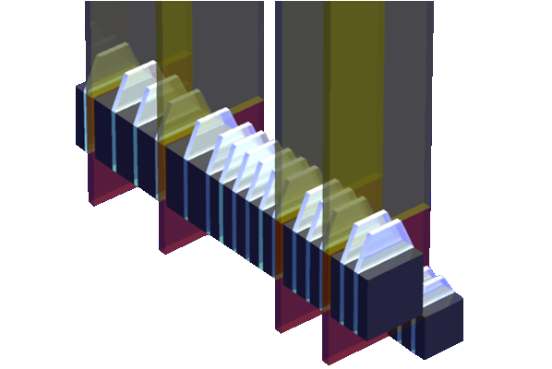
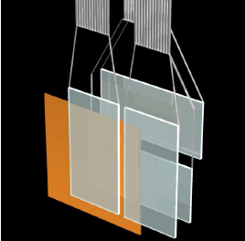
The LHCf detectors
Arm1
Sampling and imaging E.M. calorimeters
Absorber: W (44 r.l , 1.55λ_{I} )
Energy measurement: plastic scintillator tiles
4 tracking layers for imaging:
XY-SciFi(Arm#1) and XY-Silicon strip(Arm#2)
Each detector has two calorimeter towers,
which allow to reconstruct π⁰
40mm
20mm
Performances
Energy resolution (> 100GeV)
< 5% for photons and ∼ 30% for neutrons
Position resolution
< 200μm (Arm#1) and ∼ 40μm (Arm#2)
Arm2
32mm
Front Counters
thin scintillators 80x80 mm
monitoring of beam condition
background rejection
Van der Meer scan
25mm

Slide 11
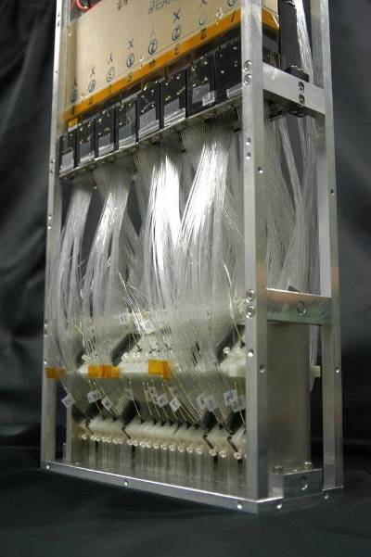
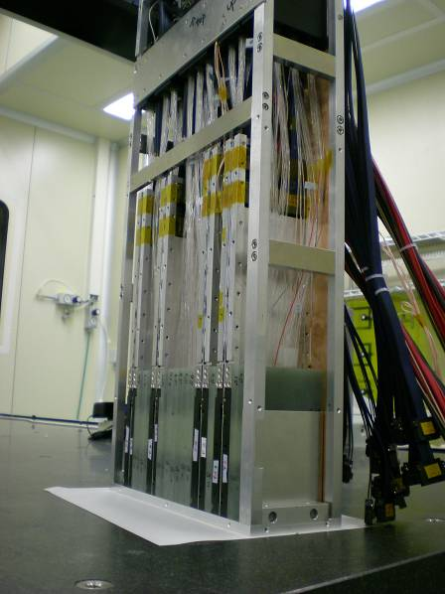
290mm
Arm#1 Detector
90mm
Arm#2 Detector

Slide 12
PART 3
SINGLE PHOTON SPECTRUM
ANALYSIS
Paper has been submitted on Physics Letters B and is available on the CERN Document Service (CDS): http://cdsweb.cern.ch/record/1344790
It has been also submitted to arXiv.

Slide 13

Summary of operations in 2009 and 2010
Data taking with Stable Beam at (450 + 450) GeV
Dec 6th – Dec 15th 2009 and May 2nd – May 27th 2010
Total of 42 hours for physics
About 10⁵ showers events in Arm1+Arm2
Data taking with Stable Beam at (3.5 + 3.5) TeV
Mar 30th – Jul 19th 2010
Total of 150 hours for physics with different setups
  Different vertical positions to increase the accessible kinematical range
  Runs with or without 100 μrad beam crossing angle
∼ 4·10⁸ shower events in Arm1+Arm2
∼ 10⁶ π⁰ events in Arm1+Arm2

Slide 14
Analysis strategy
Selection of a clean sub-set of data with nominal configuration of detectors, zero beam crossing angle and low luminosity
  Measurement of luminosity by means of thin plastic scintillators in front of the detectors (front counters)
Particle identification by using longitudinal shower development
  Study of transition curve by means of the scintillator tiles
Selection of single gamma events
  Identification and rejection of multiple hit events by means of the tracking detectors (scintillating fibers and silicon μ-strip layers)
Selection of a common region of rapidity and interval of azimuth angle for Arm1 and Arm2
  It makes possible to compare and combine the results from the two detectors

Slide 15
Data set for this analysis
Data
  Date : 15 May 2010 17:45-21:23 (Fill Number : 1104)
  except runs during the VdM luminosity scan.
  Luminosity : (6.3-6.5)×10²⁸cm⁻²s⁻¹,
  DAQ Live Time : 85.7% for Arm1, 67.0% for Arm2
  Integrated Luminosity : 0.68 nb⁻¹ for Arm1, 0.53nb⁻¹ for Arm2
  Number of triggers : 2,916,496 events for Arm1
  3,072,691 events for Arm2
  Detectors in nominal positions and normal gain
Monte Carlo
  QGSJET II-03, DPMJET 3.04, SYBILL 2.1, EPOS 1.99 and PYTHIA 8.145: about 10⁷ pp inelastic collisions each

Slide 16
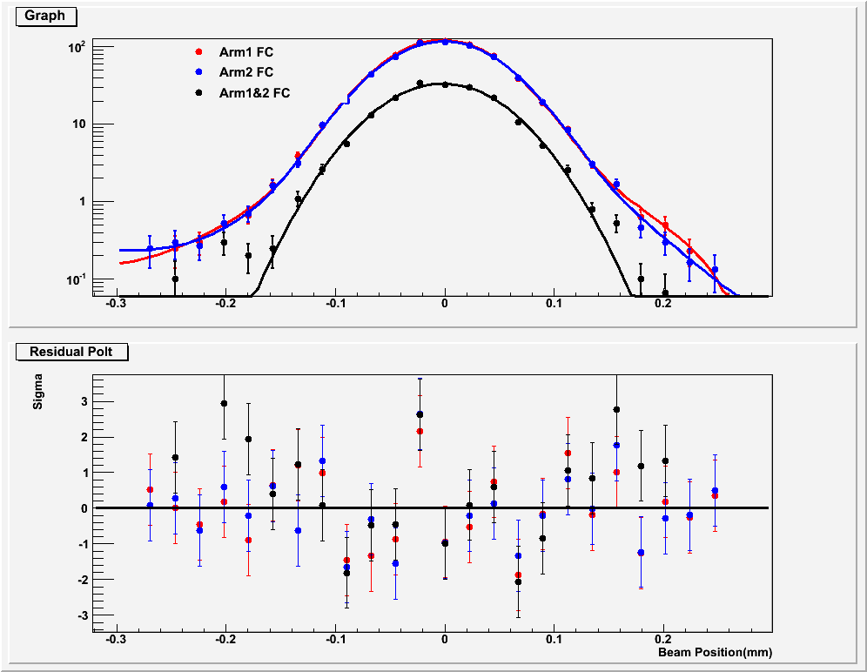
Luminosity
Luminosity for the analysis is calculated from Front Counter rates:
The conversion factor CF is estimated from luminosity measured
during VdM scan
VDM scan
Beam sizes σ_{x} and σ_{y} measured directly by LHCf

Slide 17

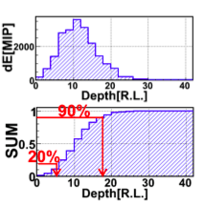
Particle Identification (PID)
PID criteria based on transition curve
L_{90%} variable is the depth at which 90% of
the signal has been released
MC/Data comparison done in many energy bins
QGSJET2-gamma and -hadron are normalized to data(/collision) independently
LPM effects are switched on

Slide 18
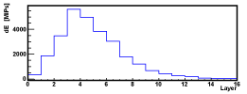
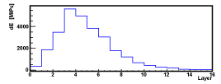
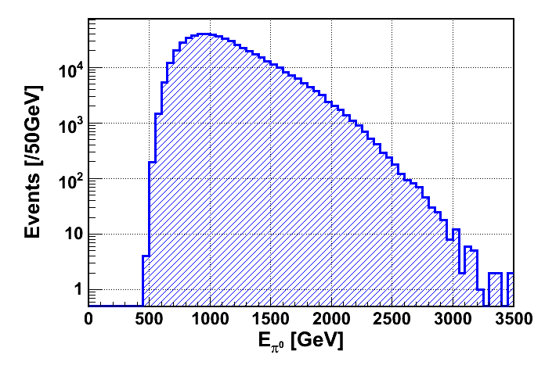

π⁰ mass and energy scale issue (I)
An example of event (Arm2)
Energy spectrum (Arm2)
25mm
32mm
preliminary
Silicon strip-X view
γ₁(E₁)
R
140m
π⁰’s are the main source of electromagnetic secondaries in high energy collisions
The mass peak is very useful to check the detector performances and to estimate the systematic error on the energy scale
θ
γ₂(E₂)
I.P.1

Slide 19
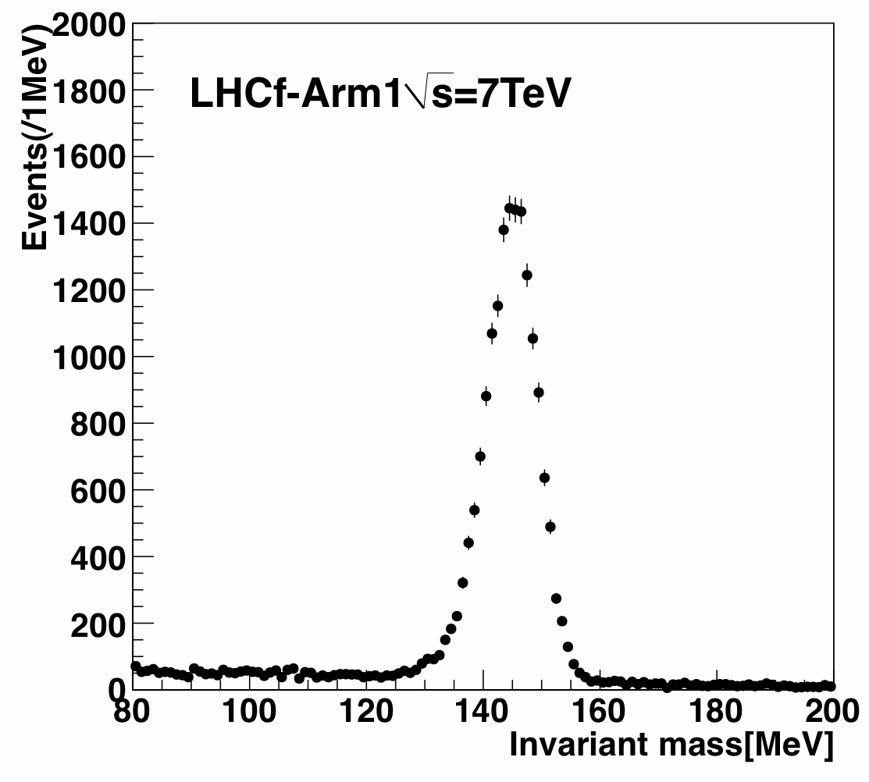
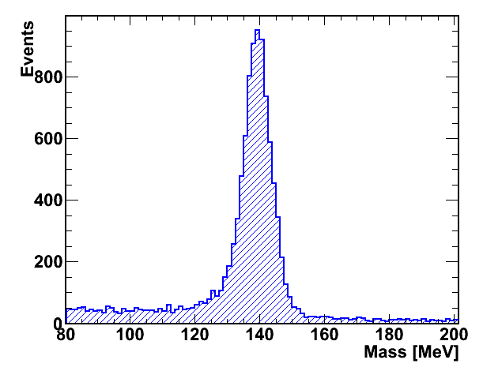
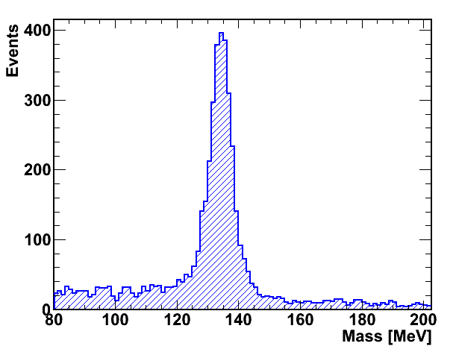
π⁰ mass and energy scale issue (II)
Disagreement in the peak position
  Peak at 145.8 ± 0.1 MeV for ARM1 (7.8% shift)
  Peak at 140.0 ± 0.1 MeV for ARM2 (3.8% shift)
No ‘hand made correction’ is applied for safety
Main source of systematic error → see later
Peak at
145.8 ± 0.1 MeV
Arm1
Data
7.8 % shift
Many systematic checks have been done to
understand the energy scale difference
Arm2
Data
Arm2 MC
(QGSJET2)
Peak at
140.0 ± 0.1 MeV
3.8 % shift
Peak at
135.0 ± 0.2 MeV
3.8 % shift

Slide 20
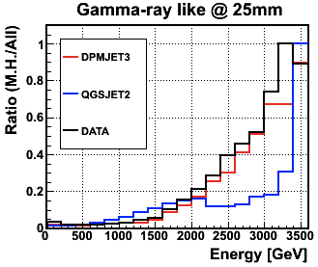
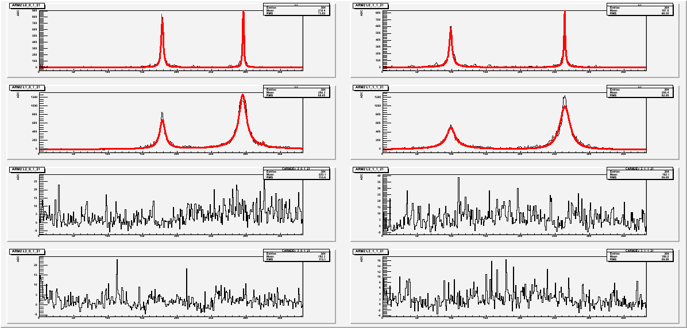
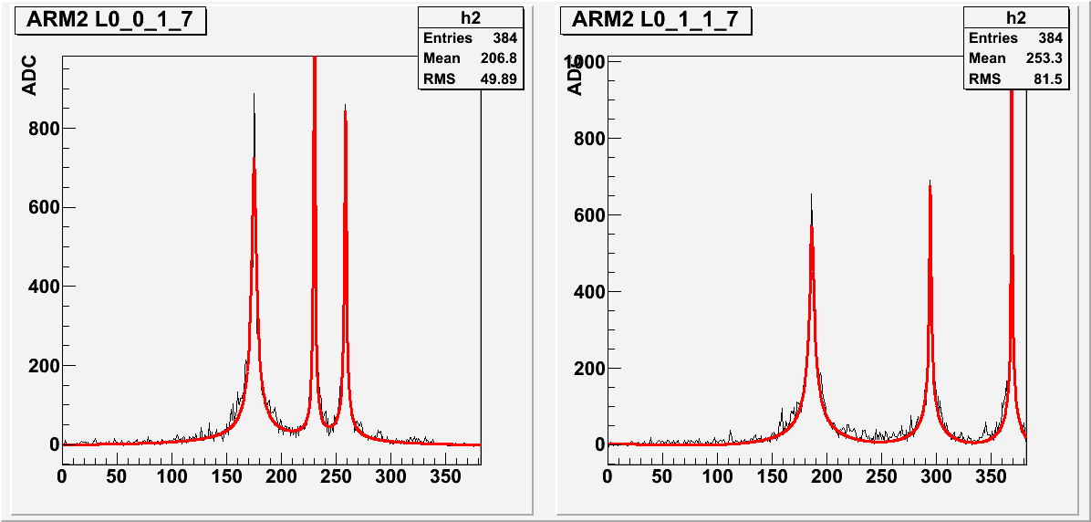
Multiple hit (MHIT) event rejection (I)
Rejection of MHIT events is mandatory especially at high energy (> 2.5 TeV)
One event with two hits in Arm2
One event with three hits in Arm2
MHIT events are identified thanks to position sensitive layers in Arm1 (SciFi) and Arm2 (Si-μstrip)

Slide 21
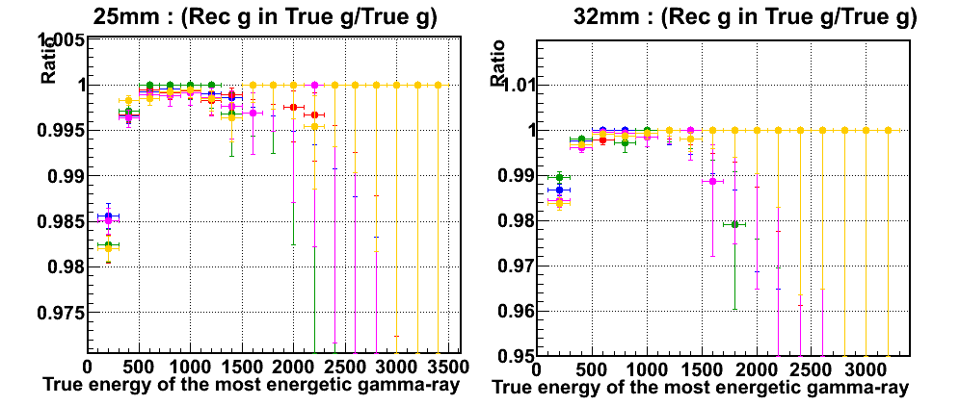
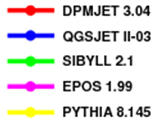
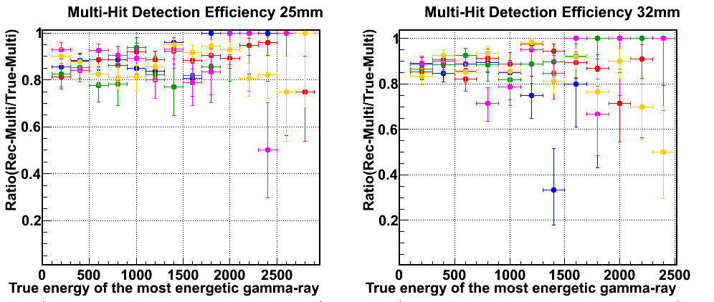
Multiple hit (MHIT) event rejection (II)
Single γ detection efficiency for various MC models
Multi γ detection efficiency for various MC models

Slide 22
PART 4
RESULTS

Slide 23
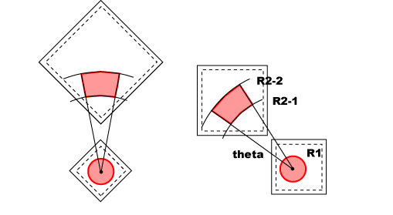
Acceptance cut for combined Arm1/Arm2 analysis
For a comparison of the Arm1 and Arm2 reconstructed spectra we
define in each tower a region of pseudo-rapidity and interval of
azimuth angle that is common both to Arm1 and Arm2.
As first result we present two spectra, one for each acceptance region,
obtained by properly weighting the Arm1 and Arm2 spectra
R1 = 5mm
R2-1 = 35mm
R2-2 = 42mm
θ = 20º
For Small Tower
η > 10.94
For Large Tower
8.81 < η < 8.99

Slide 24
Comparison Arm1/Arm2
(small tower)
(large tower)
Multi-hit rejection and PID correction applied.
Energy scale systematic (correlated between Arm1 and Arm2) has not been plotted to verify the agreement between the two detectors within the non correlated uncertainties.
Deviation in small tower is still not clear. Anyway it is within systematic errors.

Slide 25
Comparison of combined spectra with models
(small tower)
(large tower)

Slide 26
PART 5
SYSTEMATIC UNCERTAINTIES

Slide 27
Summary of systematics (I)
`
Uncorrelated uncertainties between ARM1 and ARM2
- Energy scale (except π⁰ shift) : 3.5%
- Beam center position : 1 mm
- PID : 5% for E<1.7TeV, 20% for E>1.7TeV
- Multi-hit selection :
  Arm1 small tower: 1% for E<1TeV, 1%→20% for E>1TeV
  Arm1 large tower: 1% for E<2TeV, 1%→30% for E>2TeV
  Arm2 small tower: 0.2% for E<1.2TeV, 0.2%→2.5% for E>1.2TeV
  Arm2 large tower: 0.2% for E<1.2TeV, 0.2%→4.8% for E>1.2TeV
Correlated uncertainties
- Energy scale (π⁰ shift): 7.8% for Arm1 and 3.8% for Arm2 (asymmetric)
- Luminosity : 6.1%
Estimated for Arm1 and Arm2
by same methods but independently

Slide 28
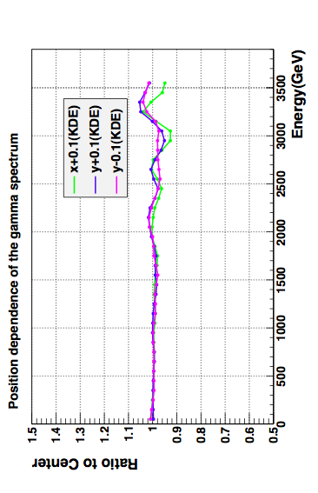
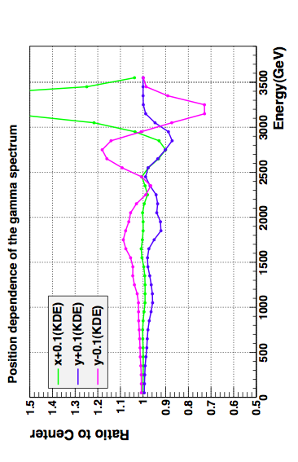
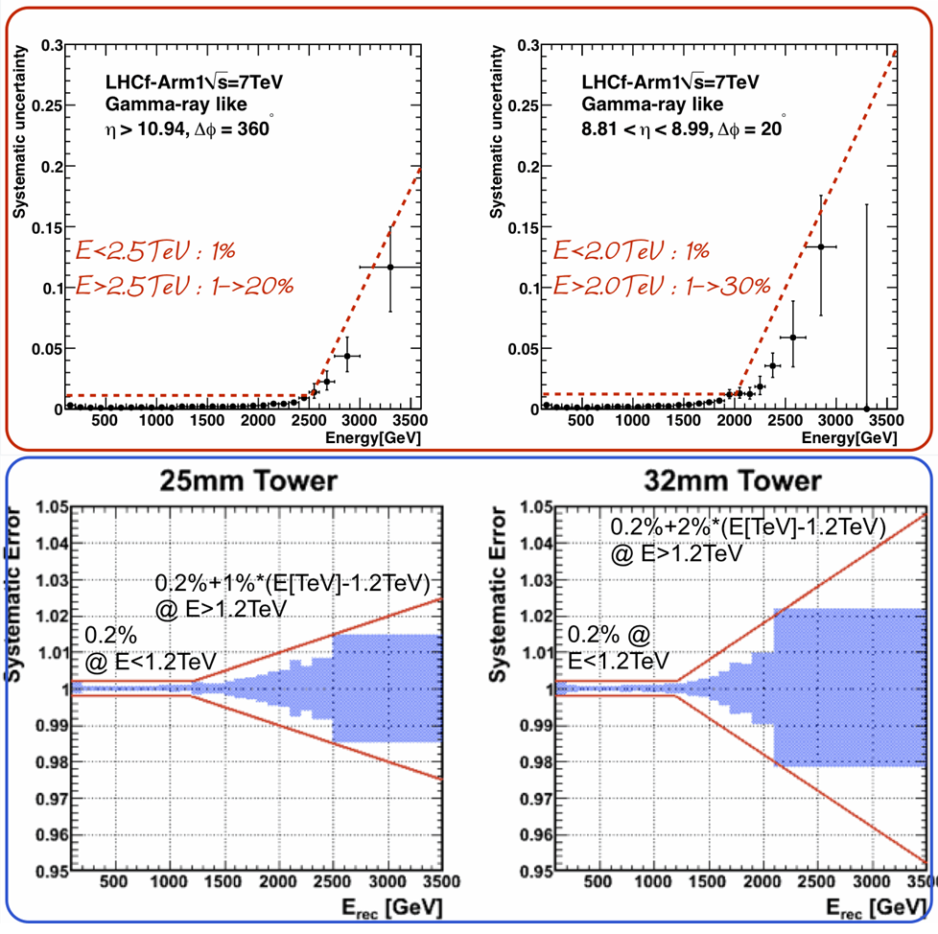
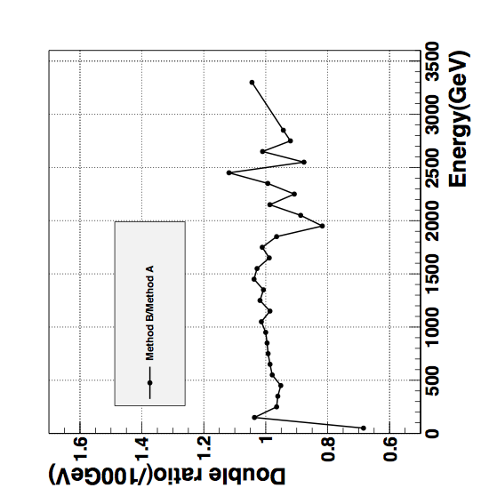
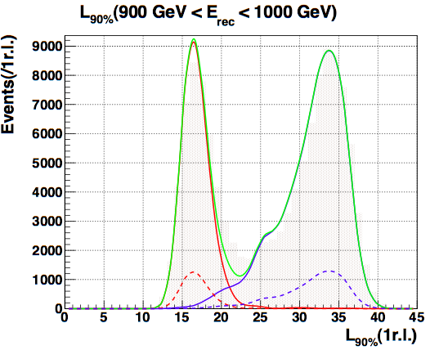
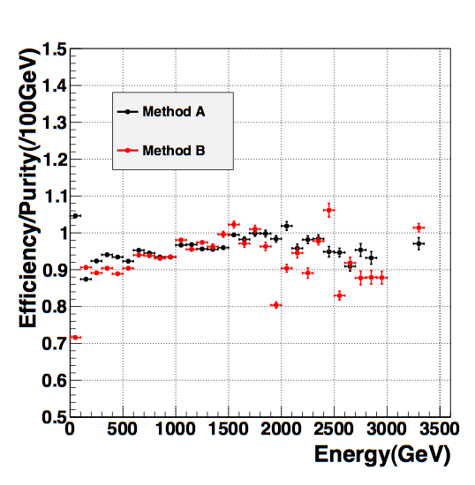
Summary of systematics (II)
`
`
Beam center position
Multiple hit cut
`
Particle ID
More details in paper
Measurement of zero degree single photon energy spectra for √S=7TeV proton-proton collisions at LHC
Submitted to Physics Letters B

Slide 29
Conclusions
Analysis of LHCf single photon spectra has been completed
      Many detailed systematic checks were necessary!
      First comparison of various hadronic interaction models with experimental data in the phase space region 8.81 < η < 8.99 and η > 10.94
      Important contribution to the study of atmospheric showers
  Other analysis are in progress (hadrons, P_{T} distributions, different η coverage, interactions at 900 GeV etc.)
  We are upgrading the detectors to improve their radiation hardness (GSO scintillators) and to correct some minor problem
  Discussion are under way to come back in the TAN for the possible p-Pb run in 2013 (LHCC, Alice, LHC, Atlas etc.)
  LHCf detectors will be re-installed again for the 14 TeV run, to complete its physics program with upgraded detectors

Slide 30
Backup slides

Slide 31
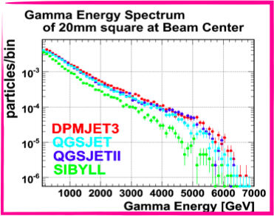
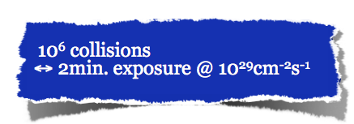
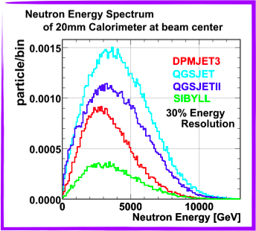
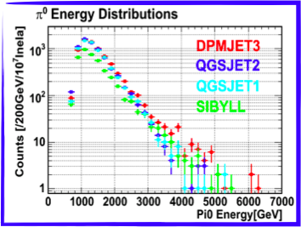
What do we expect from LHCf?
Energy spectra and transverse momentum distribution of
γ (E>100GeV, ΔE/E<5%)
Neutrons (E> few 100 GeV, ΔE/E∼30%)
π⁰ (E>500GeV, ΔE/E<3%)
in the pseudo-rapidity range η>8.4
γ
π⁰
n

Slide 32
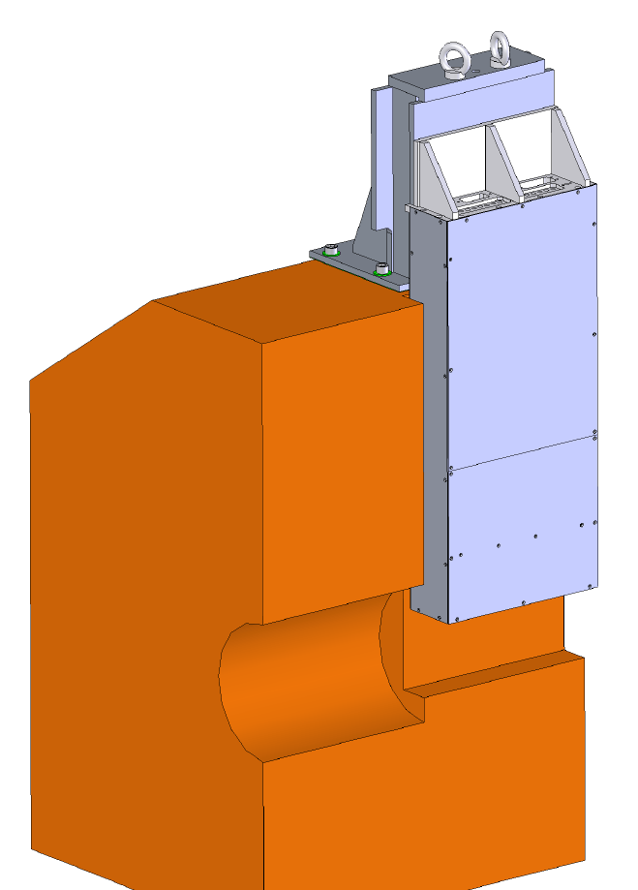
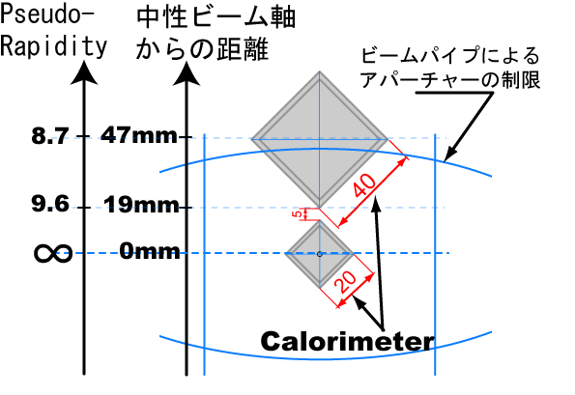
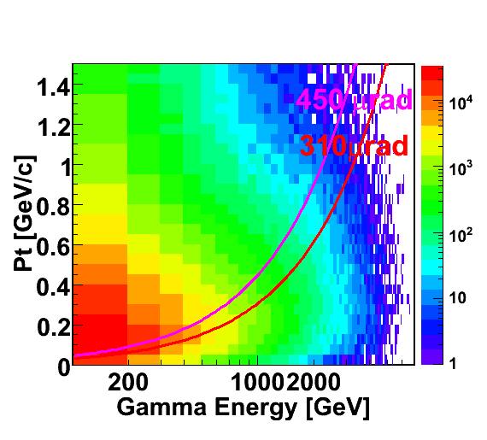
Detector vertical position and acceptance
Remotely changed by a manipulator( with accuracy
of 50 μm)
Data taking mode
with different position
to cover P_{T} gap
Viewed from IP
G
Distance from neutral center
Beam pipe aperture
N
Neutral flux center
L
All γ from IP
7TeV collisions
L
Collisions with a crossing angle lower the neutral flux center thus enlarging P_{T} acceptance
N

Slide 33
Front counters
Thin scintillators with 8x8cm² acceptance,
which have been installed in front of each main detector.
Schematic view of
Front counter
To monitor beam condition.
For background rejection of beam-residual
gas collisions by coincidence analysis
To study the luminosity by VdM scan

Slide 34
Linearity of PMTs (Hamamatsu R7400)
PMTs R7400 are used in current LHCf system coupled to the scintillator tiles
Test of linarity was held at HIMAC using Xe beam
PMT R7400 showed good linearity within 1% up to signal level corresponding to 6TeV showerMAX in LHCf.

Slide 35
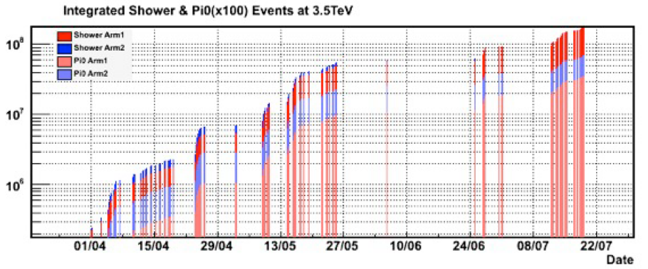
Accumulated events in 2010
10⁸ events!
LHCf removal

Slide 36
Pile-up events
When the configuration of beams is 1x1 interacting bunches, the probability of N collisions per crossing is
The ratio of the pile up event is
The maximum luminosity per bunch during runs used for the analysis is 2.3x10²⁸cm⁻²s⁻¹
So the probability of pile up is estimated to be 7.2% with σ of 71.5mb
Taking into account the calorimeter acceptance (~0.03) only 0.2% of events have multi-hit due to pile-up. It does not affect our results

Slide 37
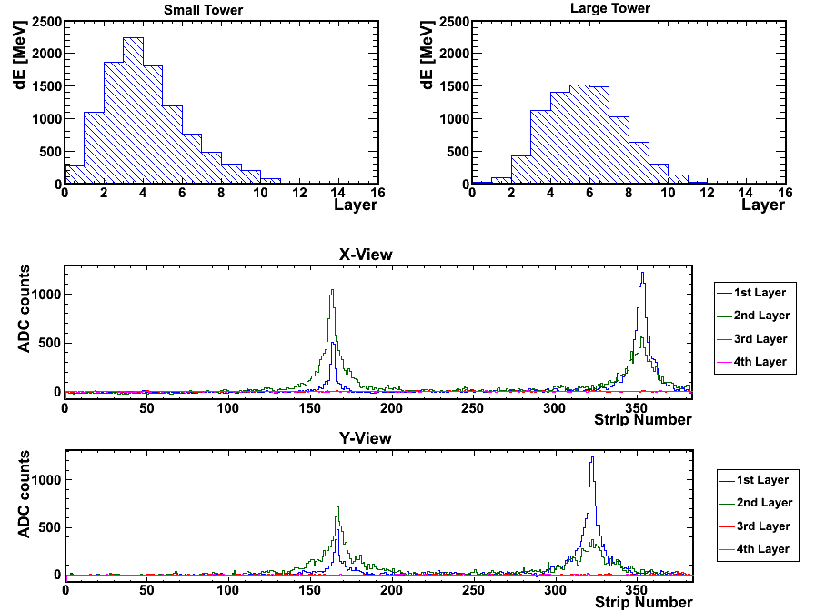
π⁰ candidate event @ 1 TeV
Longitudinal profile
(scintillator tiles)
π⁰ event:
599 GeV γ-ray
in 25mm tower
419 GeV γ-ray in 32mm tower
Transverse profile
(μ-strip silicon layers)

Slide 38
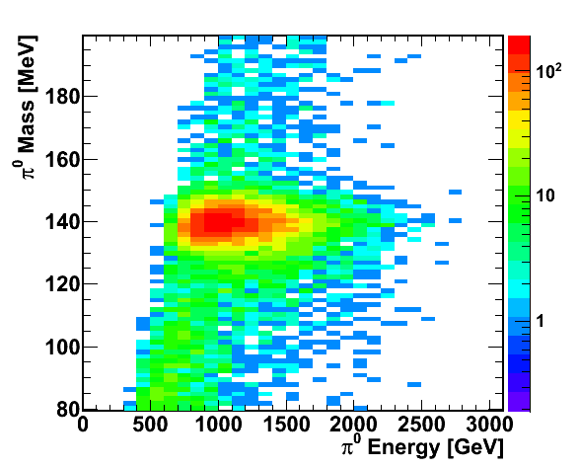
π⁰ mass versus π⁰ energy
Arm2 Data
No strong energy dependence of reconstructed mass

Slide 39
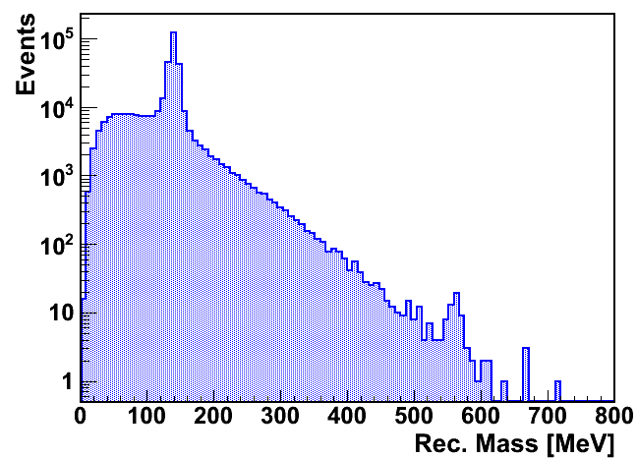
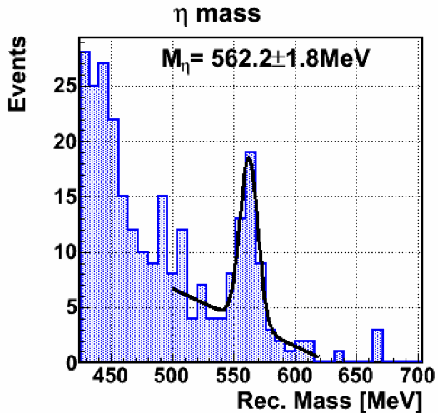
2γ invariant mass and η mass
Arm2 detector: all runs with zero crossing angle
True η Mass: 547.9 MeV
MC Reconstructed η Mass peak: 548.5 ± 1.0 MeV
Data Reconstructed η Mass peak: 562.2 ± 1.8 MeV (2.6% shift)
π⁰ candidate
candidate
(∼50 events)

Slide 40
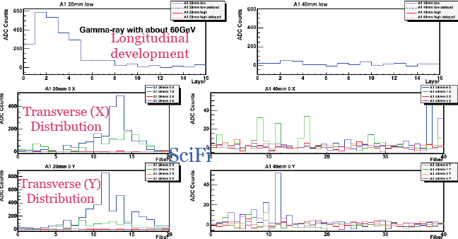
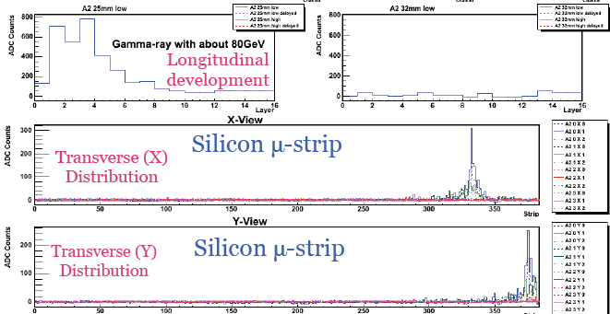
Analysis of events @ 900 GeV
Event sample
@ Arm1
Event sample
@ Arm2

Slide 41
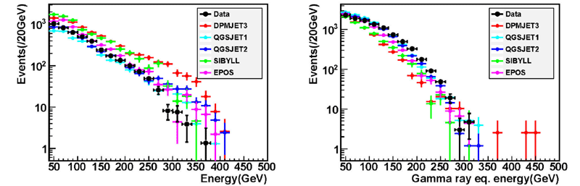

Spectra @ 900GeV
preliminary
preliminary
Arm1
Gamma-ray like
Hadron like
`
preliminary
Arm2
preliminary
Gamma-ray like
Hadron like
Only statistical
errors are shown
Spectra are normalized by # of gamma-ray and hadron like events. Response for
hadrons and systematic errors (mainly absolute energy scale) are under study.

Slide 42


Beam-gas backgroud @ 900 GeV
2009
2010
Very big reduction in the Beam Gas contribution!!!!
Beam gas ∼ I, while interactions ∼ I²

Slide 43




Beam test @ SPS
Detector
Energy Resolution
for electrons with 20mm cal.
p,e-,mu
- Electrons 50GeV/c – 200GeV/c
Muons 150GeV/c
Protons 150GeV/c, 350GeV/c
Position Resolution (Silicon)
Position Resolution (Scifi)
σ=172μm
for 200GeV
electrons
σ=40μm
for 200GeV
electrons

Slide 44


Energy reconstruction @ SPS
Difference of energy reconstruction at SPS between data and MC is < 1%.
Systematic error for gain calibration factor layer by layer is 2%

Slide 45

Particle and energy flow vs rapidity
Multiplicity@14TeV
Energy Flux @14TeV
Low multiplicity !!
High energy flux !!
simulated by DPMJET3

Slide 46

Radiation damage
Scintillating fibers and scintillators
Expected dose: 100 Gy/day at 10³⁰ cm⁻²s⁻¹
Fewmonths @ 10³⁰ cm⁻²s⁻¹: 10 kGy
50% light output
Continous monitor and calibrationwith Laser system!!!
1 kGy
30 kGy

Slide 47
Uncertainty on the energy scale
`
Two components:
- Relatively well known: Detector response, SPS => 3.5%
- Unknown: π⁰ mass => 7.8%, 3.8% for Arm1 and Arm2.
Please note:
- 3.5% is symmetric around measured energy
- 7.8% (3.8%) are asymmetric, because of the π⁰ mass shift
- No ‘hand made’ correction is applied up to now for safety
Total uncertainty is
-9.8% / +1.8% for Arm1
-6.6% / +2.2% for Arm2
Systematic Uncertainty on Spectra is estimated from difference between normal spectra and energy shifted spectra.

Slide 48

Uncertainty on the beam center
`
Error of beam center position is estimated to be 1 mm from comparison between our results and the BPM results
The systematic errors on spectra were estimated from the difference between spectra with 1 mm shift of acceptance cut area.
Arm1 Results - true single gamma events
100 GeV<E<3.5 TeV : 5%
5% to 20% linear rise from
100 GeV to 3.6 TeV

Slide 49
Uncertainty from PID
`
Efficiency and purity are estimated with two different approaches
Template fitting A:
1 degree of freedom:
- Absolute normalization
Template fitting B:
3 degrees of freedom:
- Absolute normalization
- Shift of L90% distribution
- Width of L90% distribution
Hatched : data
Red : true-gamma
Blue : true-hadron
Green : Red+Blue
Hatched : data
Red : true-gamma
Blue : true-hadron
Green : Red+Blue
Arm1
Systematic error from PID are
assumed:
5% for 100GeV < E < 1.7TeV
20% for E > 1.7TeV
Both on small and large tower

Slide 50
Uncertainty from Multiple Hit corrections
`
ARM1
ARM2

