Slide 1
Physics at the future B Factories
Francesco Forti
INFN e Università di Pisa
Incontri di Fisica delle Alte Energie
Perugia, 27-29 Aprile 2011

Slide 2
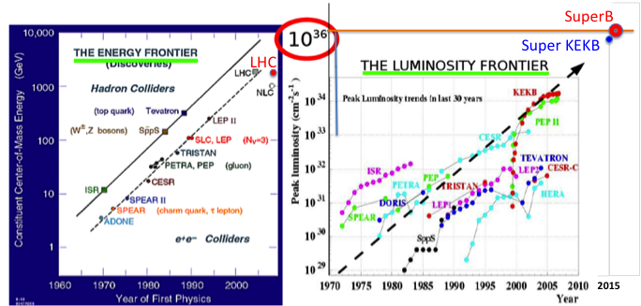
2-way street to New Physics

Slide 3
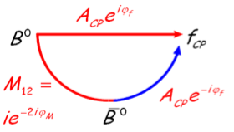
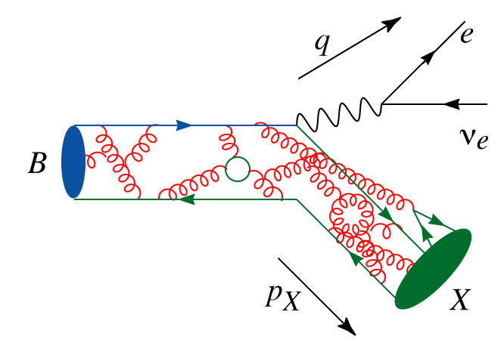
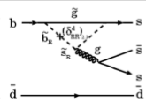

Why flavour physics
Explore the origin of CP violation
  Key element for understanding the matter content of our present universe
  Established in the B meson in 2001
  Direct CPV established in B mesons in 2004
Precisely measure parameters of the standard model
  For example the elements of the CKM quark mixing matrix
  Disentangle the complicated interplay between weak processes and strong interaction effects
Search for the effects of physics beyond the standard model in loop diagrams
  Potentially large effects on rates of rare decays, time dependent asymmetries, lepton flavour violation, …
  Sensitive even to large New Physics scale, as well as to phases and size of NP coupling constants
Statistics

Slide 4

Questions
Are KEK-B and SuperB discovery machines in the LHC era ?
Why is a luminosity > 10³⁶ required ?
Why LHCb is not enough for flavor studies ?
Is it important to run at the charm/tau threshold ?
Is it important to have polarization ?

Slide 5
Future Super B Factories
 | SuperB | Super KEKB
Peak Luminosity | >10³⁶ | 0.8 x 10³⁶
Integrated Luminosity | 75 ab⁻¹ | 50 ab⁻¹
Site | Green Field | KEKB Laboratory
Collisions | mid 2016 | 2015
Polarization | 80% electron beam | No
Low energy running | 10³⁵ @ charm threshold | No
Approval status | Approved | Approved

Slide 6

SuperB Luminosity model
75 ab⁻¹

Slide 7

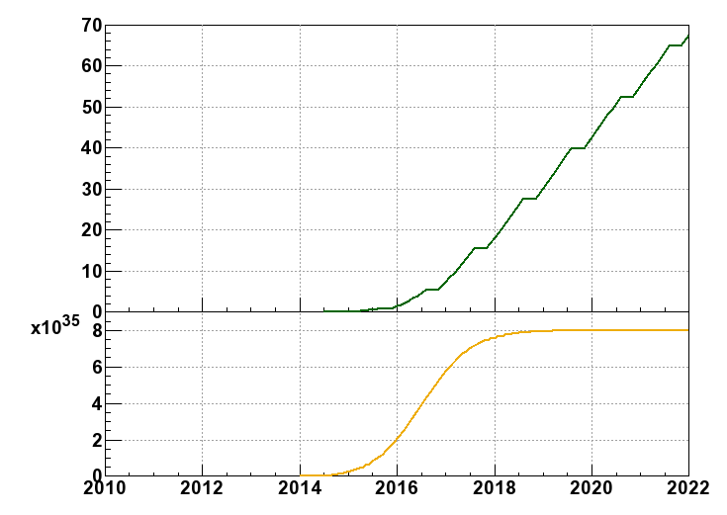
Luminosity upgrade projection
Milestone of SuperKEKB
Plan: reach 50 ab⁻¹
in 2020~2021
9 month/year
20 days/month
Integrated Luminosity
(ab⁻¹)
5 ab⁻¹ in 2016
Commissioning starts
mid of 2014
Peak Luminosity
(cm⁻²s⁻¹)
Shutdown
for upgrade
Year

Slide 8
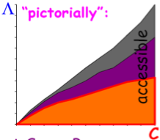
Power of Intensity
Precision measurements in the flavour sector are sensitive to New Physics (NP)
  Intereference effects in known processes
  SM Rare or forbidden decays
NP effects are controlled by
  NP scale Λ and effective couplings: C
    Different coupling intensity (different interactions)
    Differente patterns (e.g. because of simmetries)
With 5 to 10 x 10¹⁰ bb, cc, ττ pairs (50-100 ab⁻¹) one can:
LHC finds NP(Λ)
Determine detailed structure of couplings of NP
Look for heavier startes
Study NP flavour structure
LHC does not find NP(Λ)
Look for indirect NP signals
Connect them to models
Exclude regions in parameters space
Some channels, such as the LFV decays of τ are unambiguous signals of NP
L~10³⁴ cm⁻² s⁻¹ ↔ EW scale ~100GeV
L~10³⁶ cm⁻² s⁻¹ ↔ TeV scale

Slide 9
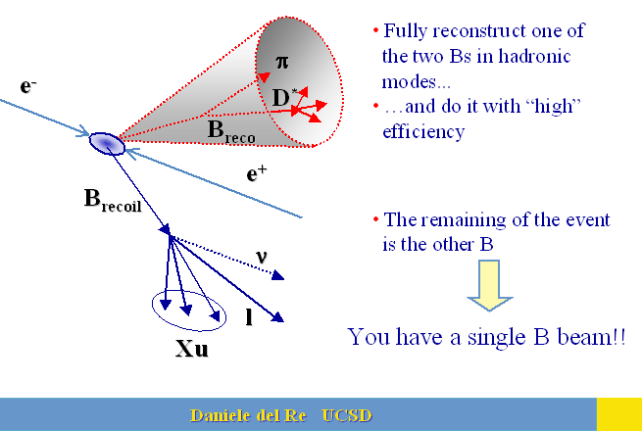
Cross section is not everything
Hadron machines do have the advantage of an enormously larger B production cross section, ….BUT…
SuperB has a super-easy ½ track trigger
Initial state is coeherent, allowing interference measurements
SuperB can do t physics.
Has access to states with a loss of missing energy
B-Beam Method
Fully reconstruct one the two Bs in hadronic modes
  High efficiency: a few per mille
  > 10⁷ recoil Bs in 10ab⁻¹
Obtain a pure B Beam on
the other side
  High purity sample
  Can look at channels with a lot of missing energy.
  For example BR(B→nothing) measured.
Recoil cinematics well known
Recoil flavor and charge is determined

Slide 10
Notes:
NOTA: DA RECUPERARE CON RISOLUZIONE MIGLIORE

Slide 11
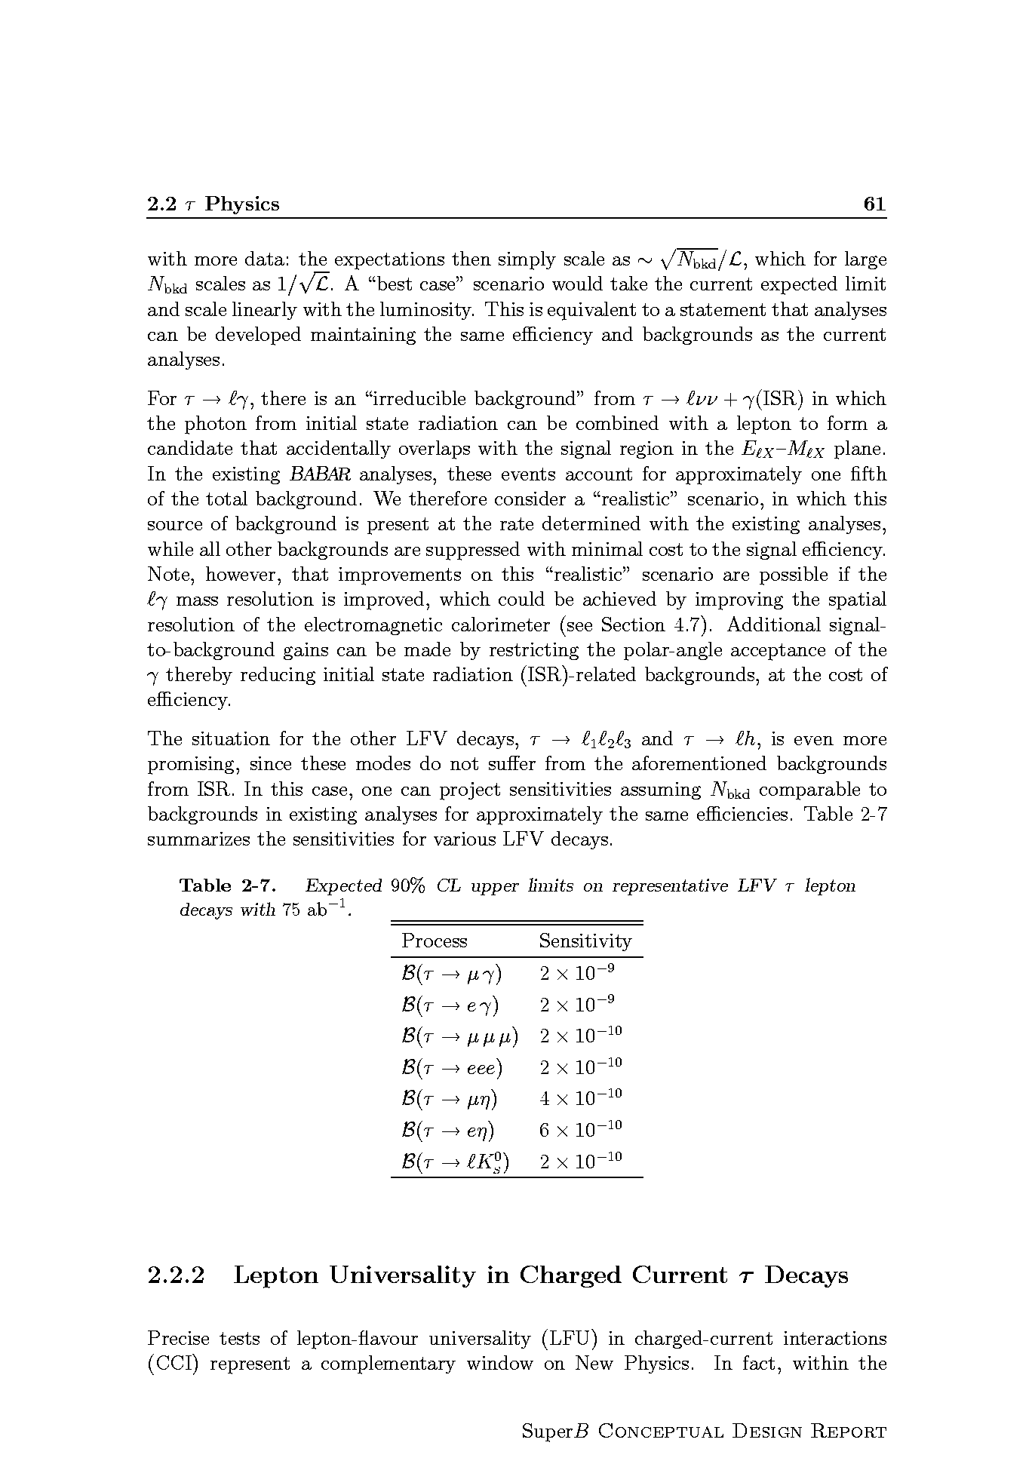
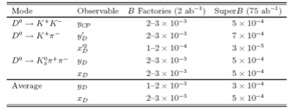
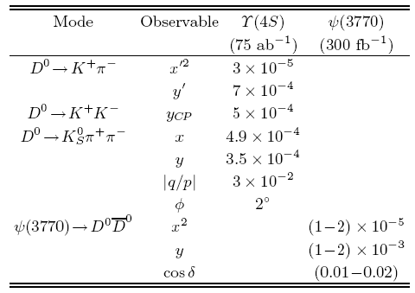
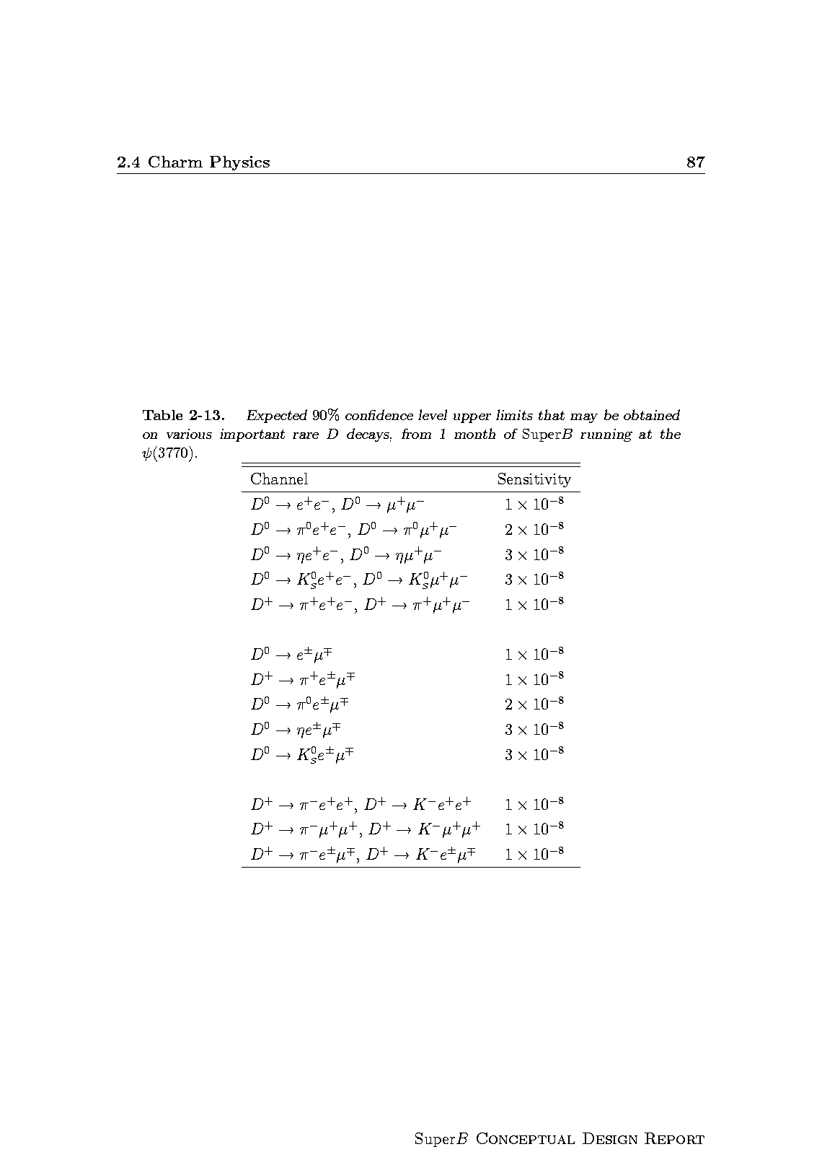
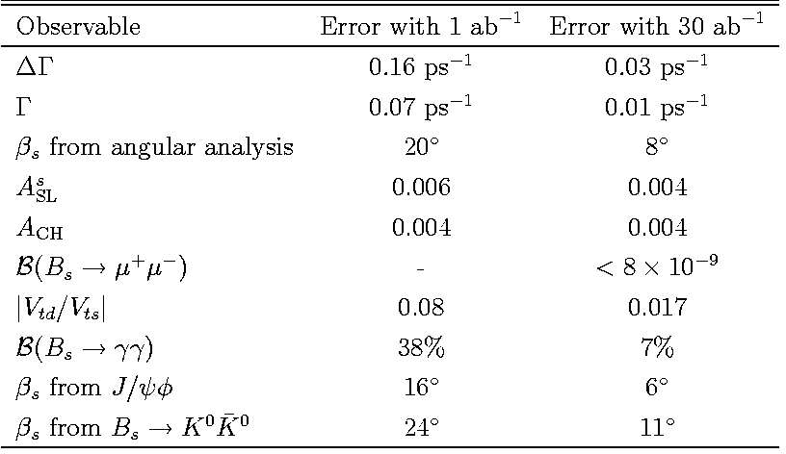
τ physics (polarized beams)
Charm at Y(4S) and threshold
To be evaluated
at LHCb
B_{s} at Y(5S)
Bs : Definitively better at LHCb

Slide 12
Notes:
Da RECUPERARE

Slide 14
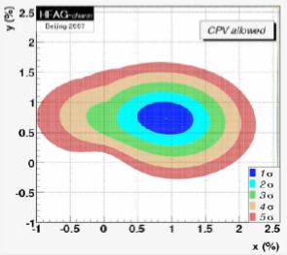
Charm Physics
Running at charm threshold
(SuperB specific)
Charm physics using the charm produced at Υ(4S)
Charm physics at threshold
0.3 ab⁻¹
Consider that running 2 month at threshold
we will collect 500 times the stat. of CLEO-C
Strong dynamics and CKM measurements
@threshold(4GeV)
ξ~1%,
exclusive V_{ub} ~ few %
syst. error on γ from Dalitz Model <1º
D decay form factor and decay constant @ 1%
Dalitz structure useful for γ measurement
Rare decays FCNC down to 10⁻⁸
D mixing
Better studied using
the high statistics
collected at Υ(4S)
@threshold(4GeV)
CP Violation in mixing could now addressed

Slide 15
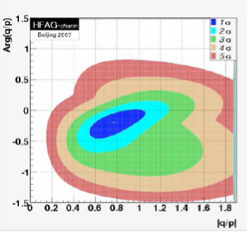
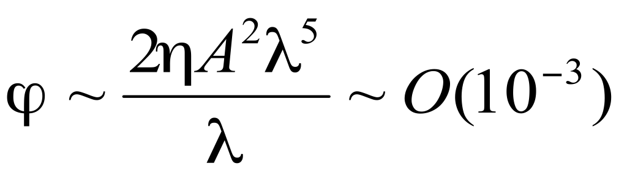
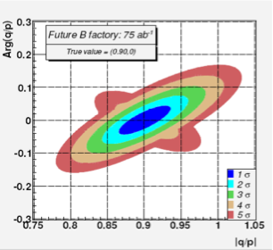
CP Violation in charm
NOW
CPV in D system negligible in SM
SuperB
CPV in D sector is a
clear indication of New Physics !

Slide 16
Notes:
DA RECUPERARE

Slide 17
Notes:
DA RECUPERARE

Slide 18
Notes:
DA RECUPERARE

Slide 19
Physics
A luminosity of 50 – 100 ab⁻¹ (100 times that of existing B-Factories) open windows on NP:
  Precision measurements allowing to detect discrepancies from the standard model
  Rare decay measurements, Lepton flavour violation
  CP violation in Charm
Polarized e- beam:
  τ CPV, EDM, g-2
Possibility to run at tau/charm threshold
Complementarity and synergy with LHC program

Slide 20
BACKUP

Slide 21
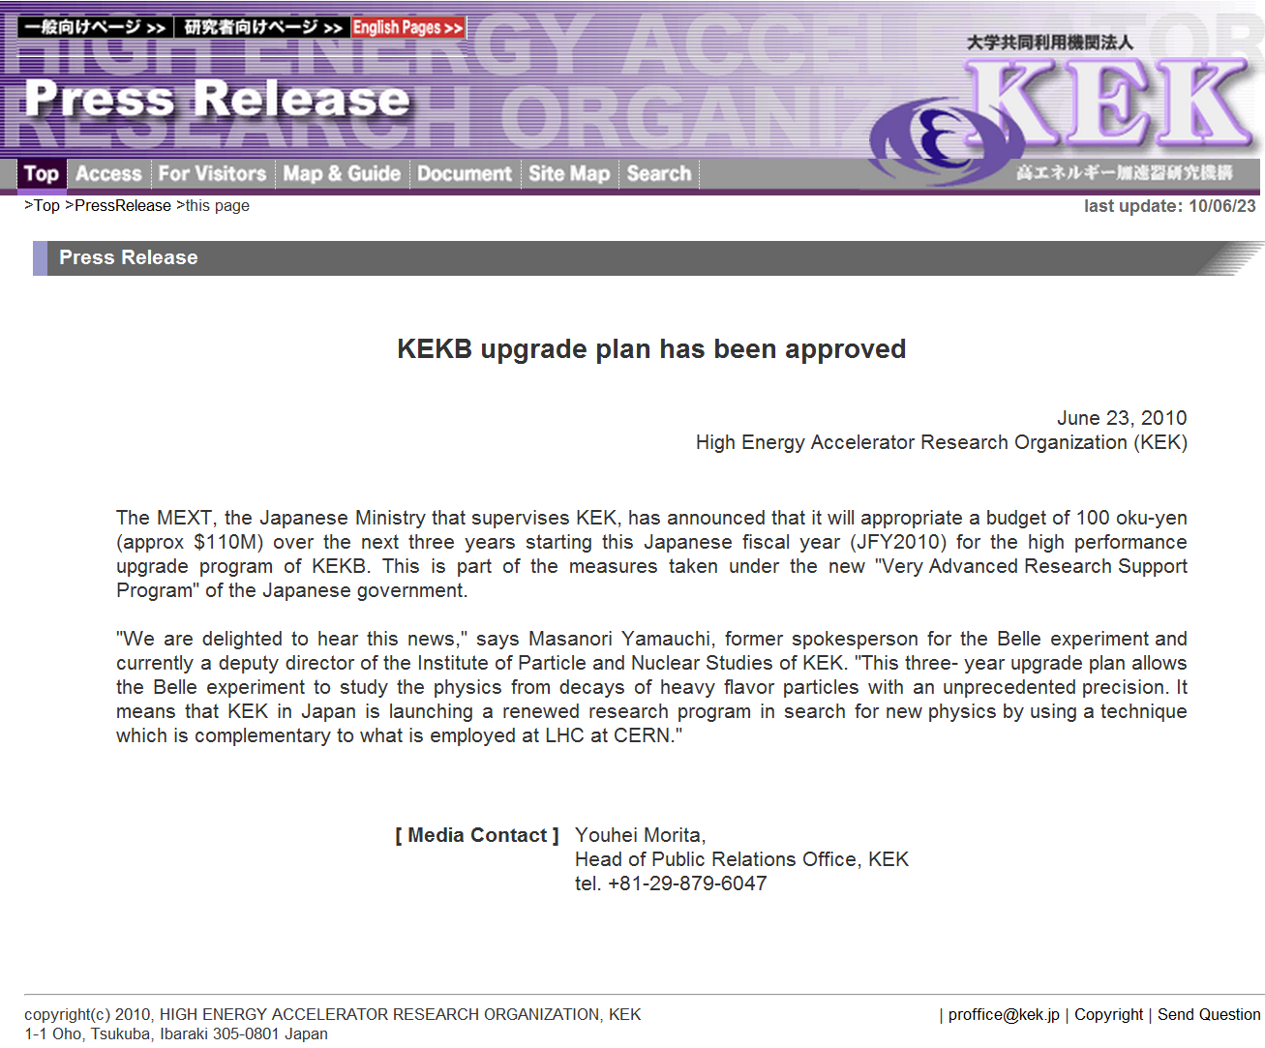
SuperKEKB/Belle II funding Status
KEKB upgrade has been approved
5.8 oku yen (~MUSD) for Damping Ring (FY2010)
100 oku yen for machine -- Very Advanced Research Support Program (FY2010-2012)
Full approval by the Japanese government by December 2010; the project is in the JFY2011 budget as approved by the Japanese Diet end of March 2011
Several non-Japanese funding agencies have also already allocated sizable funds for the upgrade.
→construction started!

Slide 22
Construction Schedule of SuperKEKB/Belle II
FY2009
FY2010
FY2011
FY2012
FY2013
FY2014
Linac
e+ new matching & L-band acc.
R&D
Construction
RF-gun & laser system
A1 gallery
extension
e+ beam commissioning
Design study
move to A1
Commissioning at test stand
e- beam commissioning
Damping Ring
Facilities
Tunnel construction
DR commissioning
Components
Building construction
R&D, Design
Mass Fabrication
Installation
Main Ring
Facilities
Building construction
Components
R&D, Design
MR commissioning
Mass Fabrication
Installation
BEAST II
Belle II Detector
Ad-hoc detector for MR commissioning
R&D
Mass Production
Construction
Belle roll-out in Dec. 2010
Installation (KLM)
Installation (E-cap)
Ready to Roll-in
Installation (Barrel)
Cosmic Ray Test

Slide 23
KEKB/Belle status: official statement
As is now well known, Japan suffered a terrible earthquake and tsunami on March 11, which has caused tremendous damage, especially in the Tohoku area. Fortunately, all KEK personnel and users are safe and accounted for.
The injection linac did suffer significant but manageable damage, and repairs are underway. The damage to the KEKB main rings appears to be less serious, though non-negligible. No serious damage has been reported so far at Belle. Further investigation is necessary.
We would like to convey our deep appreciation to everyone for your generous expressions of concern and encouragement.

Slide 24
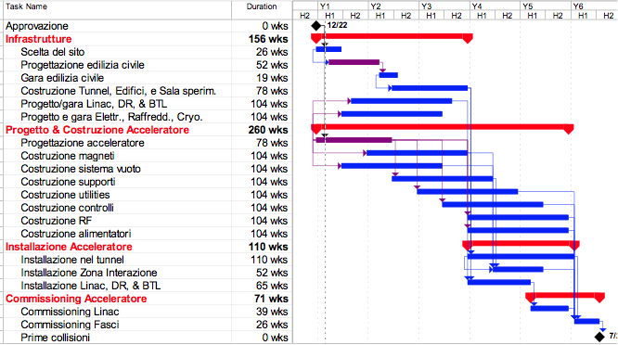
SuperB Accelerator Schedule

