Slide 1
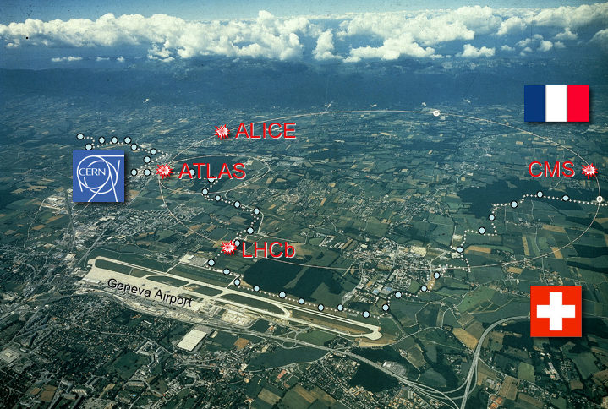
The CERN Physics Programme
IFAE 2011
Perugia
April 27, 2011
Sergio Bertolucci
CERN
LHC

Slide 2
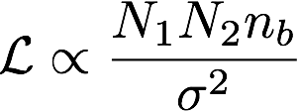
Just a reminder….
Collisions at the LHC: counter-rotating, high-intensity bunches of protons or heavy ions.
The rate of new particle’s production is proportional to the luminosity:
Key parameters: Ni = bunch intensity
nb = number of bunches
σ = colliding beam size
Nominal LHC parameters (7 TeV): 2808 bunches of 1.1x10¹¹ protons, 16 micron size.
Units for the luminosity: Peak luminosity given in event rate per unit of area cm⁻²s⁻¹ : 2010 goal = 10³²cm⁻²s⁻¹
Integral luminosity (prop. to number of collisions) fb⁻¹ : 2011 goal = 1 fb⁻¹

Slide 3
Bunch intensity - bunch spacing
Nominal bunch intensity
1.15 x 10¹¹
Colliding this bunch intensity is surprisingly easy!
Nominal number of bunches: 2808
Nominal bunch spacing: 25 ns (~7.5 m)
Worked in 2010 with trains of 150 ns
up to 368 bunches
Aim for either 75 or 50 ns in 2011
Maximum number of bunches 900 or 1400
Decided on April 13

Slide 4
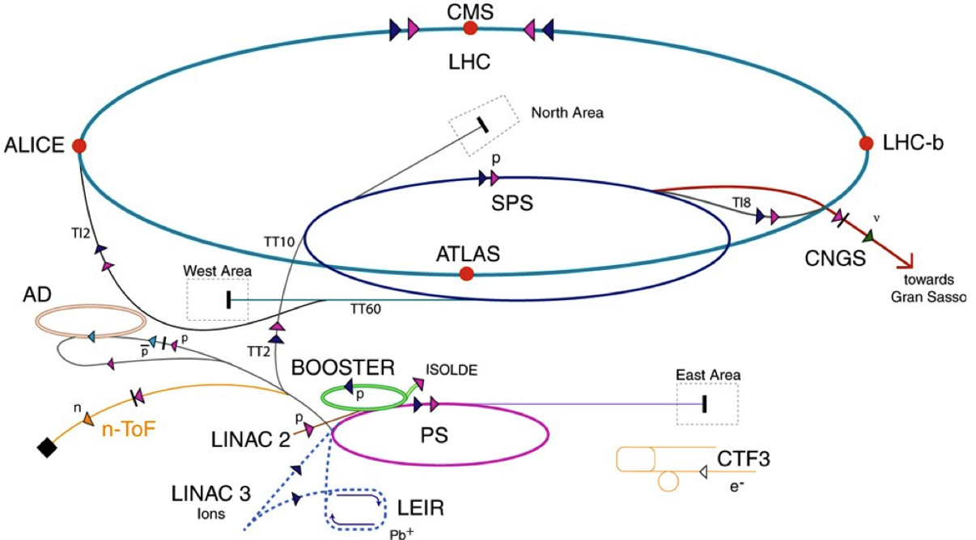
Performances in 2010: LHC injectors
Beam 1
Beam 2
TI8
TI2
LHC proton path
Excellent performance of the LHC injection chain: - Provided the variety of beams needed for commissioning and physics; - Bunch intensities and beam sizes better than nominal.

Slide 5
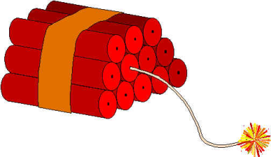
Goals of 2010 LHC operation
Lay foundations for the 2011 goal of 1 fb⁻¹. 2010 target: peak luminosity = 10³² cm⁻² s⁻¹.
Steady run around 1-2 MJ for an extended period of time.
Safe, phased increase up to ~ 30 MJ.
Gain a solid operational experience on the critical machine phases (injection, energy ramp, squeeze, collisions, ...).
✓
✓
✓
✓
30 MJ is equivalent to ~7 kg of TNT

Slide 6
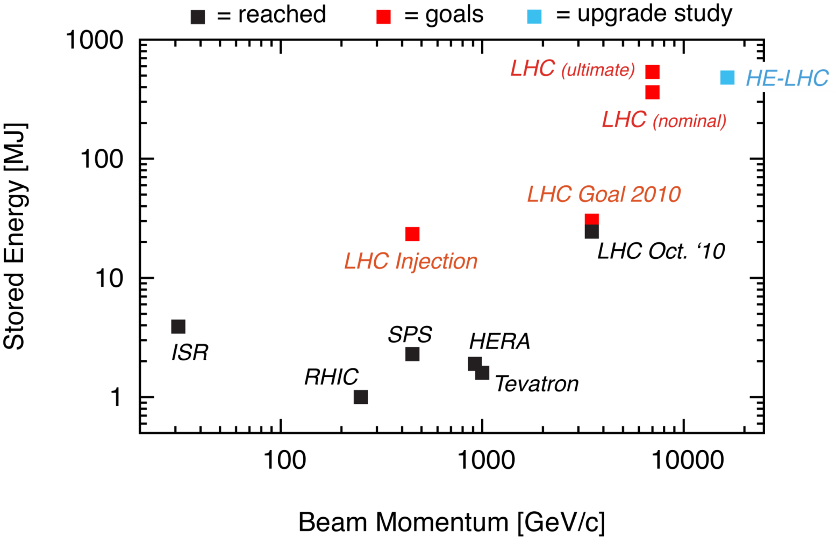
What does this means in practice?
80 kg TNT
28 MJ
R. Assmann
Achieved 28 MJ (24 MJ with collisions)!
In the first year of operation we needed to achieve:
Factor ~10 above state-of-the-art.
Factor ~15 above the Tevatron.

Slide 7
Overall LHC efficiency in 2010
65% availability!
Great achievement for the first year of operation!
W. Venturini

Slide 8
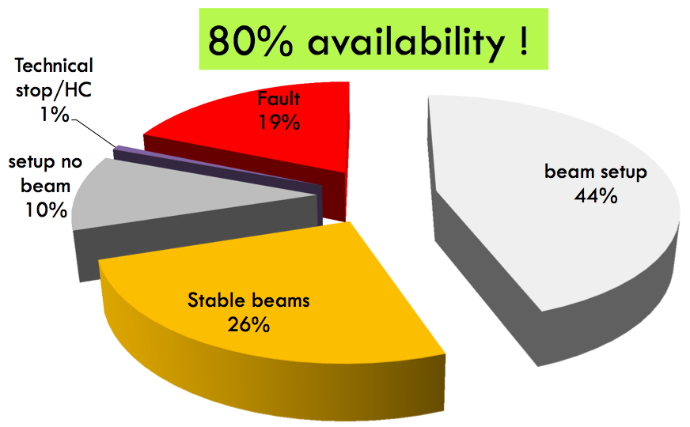
Best month: November (with ions)
Well-trained ion operation at the end of the proton run!
W. Venturini

Slide 9
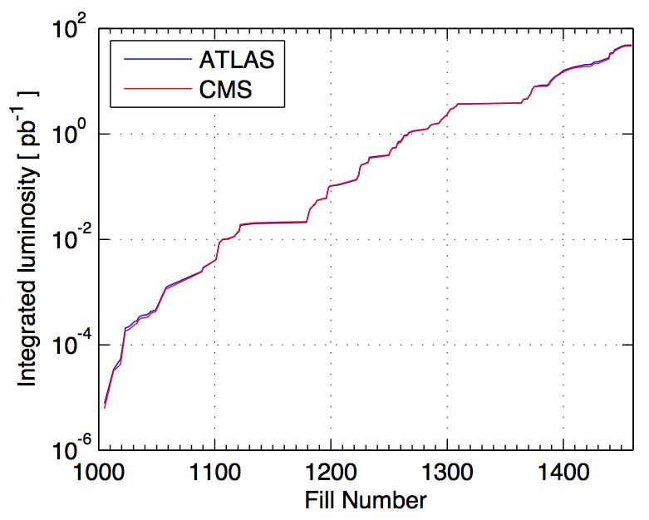
Luminosity: 3 running periods
Performance ramp-up (368 bunches)
Nominal bunch operation (up to 48)
Bunch trains
Performance ramp-up made possible by a safe, staged commissioning.
Meticulous preparation for unsafe beams!
Initial luminosity run
Nominal bunch commissioning

Slide 10
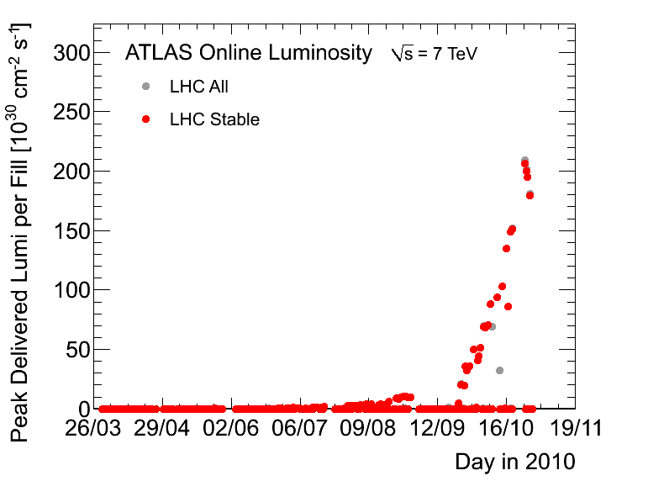
Peak luminosity performance
2 x goal!!
2010 Goal
2010 goal:
10³² cm⁻²s⁻¹
Main parameters: 368 bunches of 1.2 x 10¹¹ protons. Colliding beam sizes = 40 microns.

Slide 11
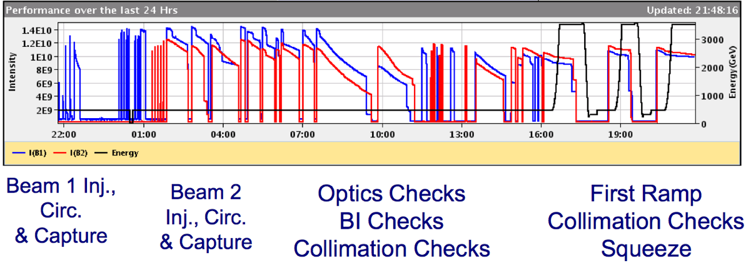
2010 Pb ion run - commissioning
1 day
Achieved ion collisions after 3 days of commissioning (impressively fast)!
This indicates the maturity and performance of controls, instrumentation, operational experience.

Slide 12
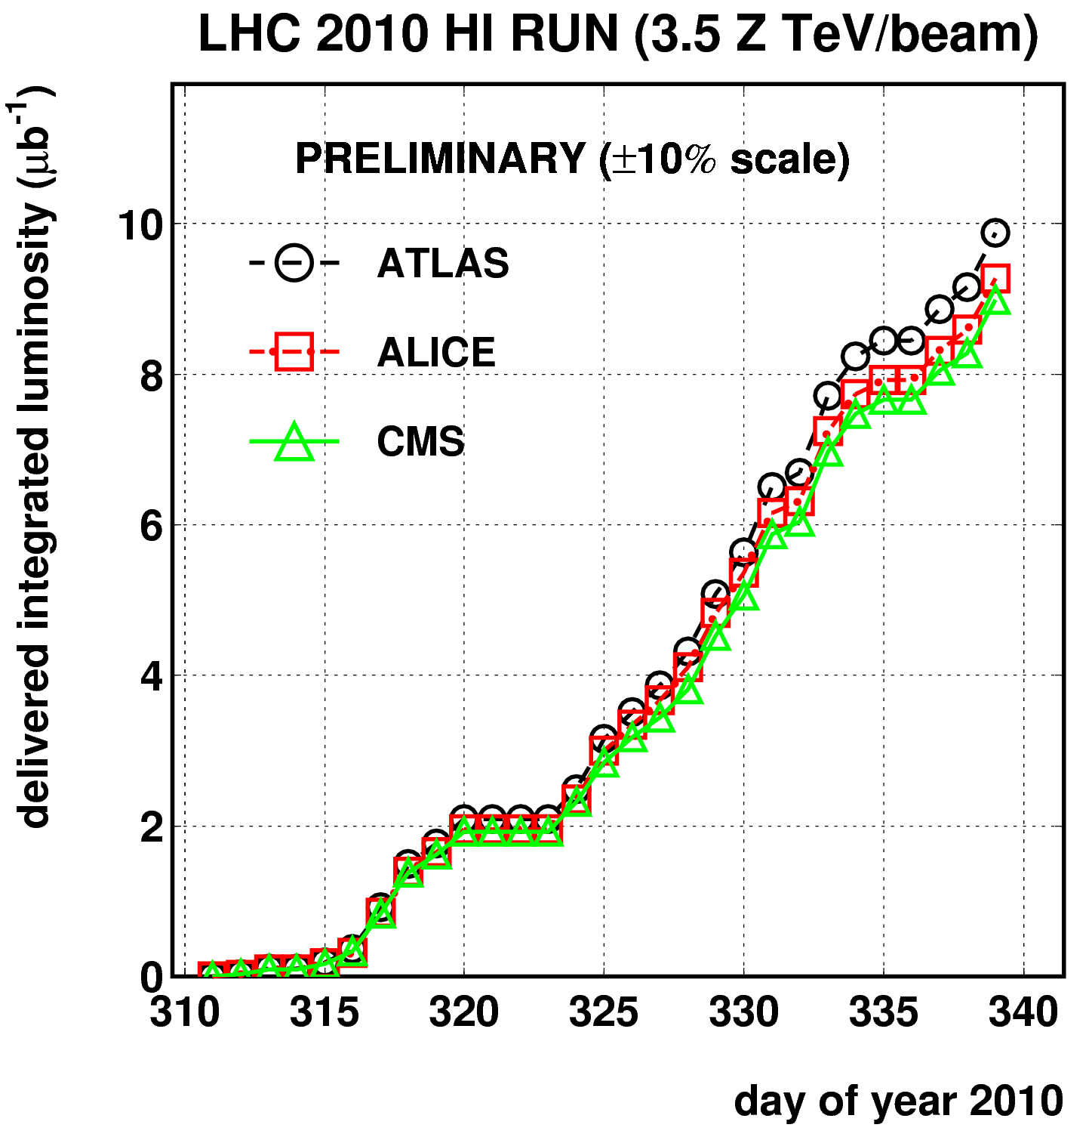
Ion luminosity performance
Gained a factor 100 of peak luminosity in 6 days!
M. Ferro-Luzzi
1 month

Slide 13
LHC 2010 - summary
Excellent single beam lifetime
Ramp & squeeze essentially without loss
No quenches with beam above 450 GeV
Excellent performance of Machine Protection
Optics close to model (and correctable)
Excellent reproducibility
Aperture as expected
Better than nominal from injectors
Emittances, bunch intensity
Beam-beam: can collide nominal bunch currents
With smaller that nominal emittances
And surprisingly good availability…

Slide 14
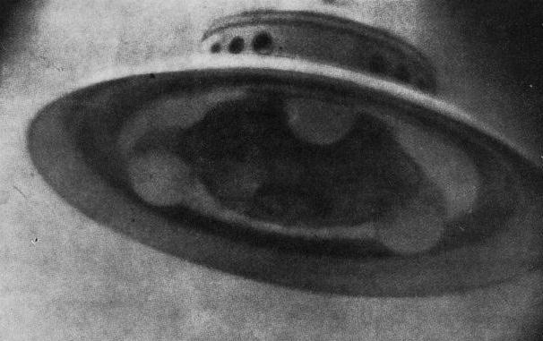
Outstanding problems encountered
(only mention potential performance limits for 2011)
UFOs - Unidentified FALLING objects Sudden fast losses (t < 0.001s). Potentially caused by falling dust particles. No danger for the super-conducting magnets, but trigger preventive beam dumps; More frequent with larger beam intensities!
Electron cloud “Clouds” of electrons generated in the vacuum pipe if the bunches are too close longitudinally. Can limit the total intensity (bunch num.): vacuum problems; instabilities; growth of the beam size. Can be cured by “scrubbing” the chamber.

Slide 15
2011: main goals
Motivation is clear!
1 fb⁻¹ delivered to each of IP1, IP5 and IP8 at 3.5 TeV
It will be a challenge to deliver 1 fb⁻¹ to IP8
Maximum luminosity : from 2e32 to 3e32 cm⁻² s⁻¹
Luminosity leveling via separation required to get close
Alice
pp run: 5e29 < L < 5e30 cm⁻² s⁻¹, µ < 0.05
fast, secure and far-reaching

Slide 16
2011 potential
Energy: 3.5 TeV Chamonix workshop in Jan. 2011 – still splice concerns
Bunch intensity Baseline 1.2 x 10¹¹ protons, higher possible from injectors.
Number of bunches 450 to 930 bunches (75 ns spacing): potential factor 2. (possibly more with 50 ns spacing)
Colliding beam sizes Maintain excellent beams from injectors: 50% smaller than nominal “Squeeze” beams further: another factor 2
Working with beta* = 1.5 m in Atlas, CMS; 3 m in LHCb; 10 m in Alice

Slide 17
Estimated Peak and Integrated Luminosity
Energy | 3.5 TeV
Beta* | 1.5 m
Bunch spacing | 75 ns
Bunch intensity | 1.2 x 10¹¹
Stored beam energy | 75 MJ
Days at peak luminosity | 135
Hübner factor | 0.2
Emittance [mm.mrad] | Beam-beam parameter | Peak Luminosity [cm⁻² s⁻¹] | Integrated Luminosity [fb⁻¹]
2.5 | 0.006 | 1.3 x 10³³ | ~2.7
2.0 | 0.007 | 1.6 x 10³³ | ~3.3

Slide 18
2011 - baseline scenario
Beam commissioning: 3 weeks
Exit - stable beams with low number of bunches
Ramp-up to ~200 bunches (75 ns): 2 weeks
Multi-bunch injection commissioning continued
Stable beams
Intermediate energy run: 4 -5 days ✓
Technical Stop: 4+1 days
Scrubbing run: 10 days
finished...
Resume operation for physics and increase number of bunches:
300 – 400 – 600 – 800 – 900 – …1400
Machine protection qualification at each step
✓
✓
✓
✓

Slide 19
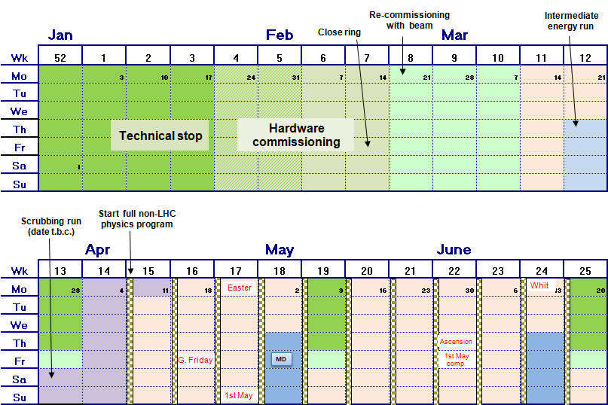
Draft LHC schedule Q1 & Q2

Slide 20
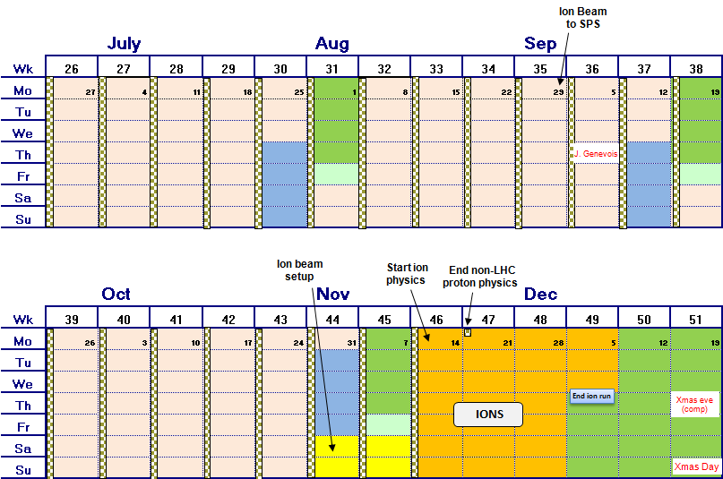
Draft LHC schedule Q3 & Q4

Slide 21
2011 – progress so far
19 February | First beam, circulating beams established.
3 March | First collisions at 3.5 TeV, beta*=1.5 m. with pilot beams
5 March | Nominal bunches at 3.5 TeV, start collimator set-up, injection and beam dump set-up & validation
13 March | First stable beams, 3 bunches per beam, initial luminosity 1.6e30 cm-2s-1
18 March | 32 bunches per beam, initial luminosity ~3e31 cm⁻²s⁻¹
19 March | 64 bunches per beam, initial luminosity ~6e31 cm⁻²s⁻¹
20 March | 200 bunches : 2.5e32 cm⁻²s⁻¹
24 – 27 March | Intermediate energy run successful
28 – 31 March | Technical stop
1 – 13 April Now | Scrubbing Restarted Physics

Slide 22
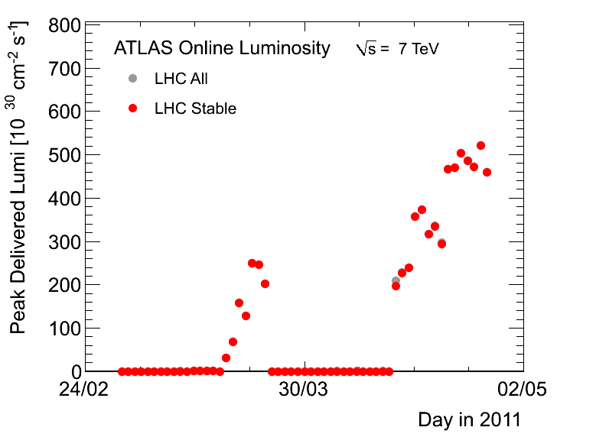
Peak luminosity 2011
2010

Slide 23
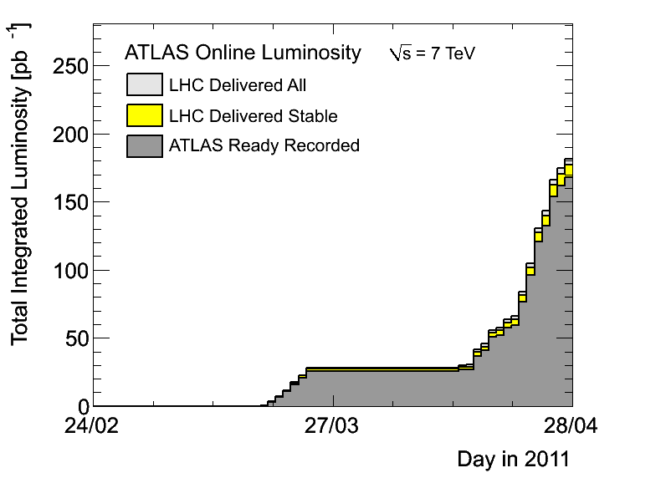
…and integrated luminosity 2011

Slide 24
2011 summary
Impressively fast re-commissioning with improvements across the board
Operation cycle now well optimized: faster ramp & squeeze, excellent operational efficiency
Fast ramp back in intensity
Up to 200 bunches with record luminosity
Integrated 28 pb-1 already (over 50% of last year’s total)
Looking very encouraging
Hiatus for:
1.38 TeV; technical stop; scrubbing
Back into physics last week, new records !

Slide 25
General considerations on experiments
Technical stop efficiently used by the experiments to perform maintenance, install new equipment, make some fixes….
….while not relaxing the effort on data analysis…
…helped in that by WLCG

Slide 26
Prospects for the Higgs Boson
in 2011-2012 run

Slide 27
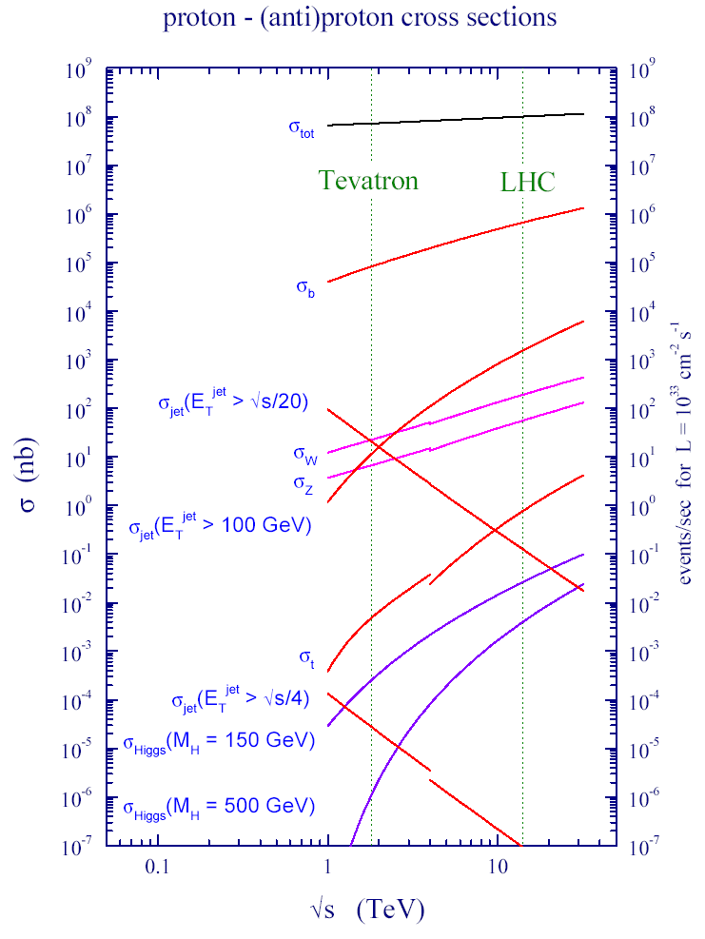
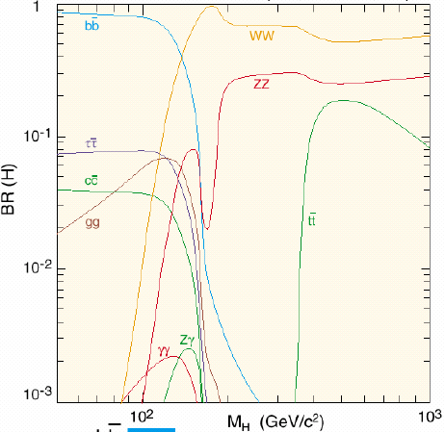
Search for the Higgs-Boson at the LHC
Production rate
of the Higgs-Bosons
depends on its mass
as well as its decay possibilities
(“Signature (or picture)”
as seen in the detector)

Slide 28
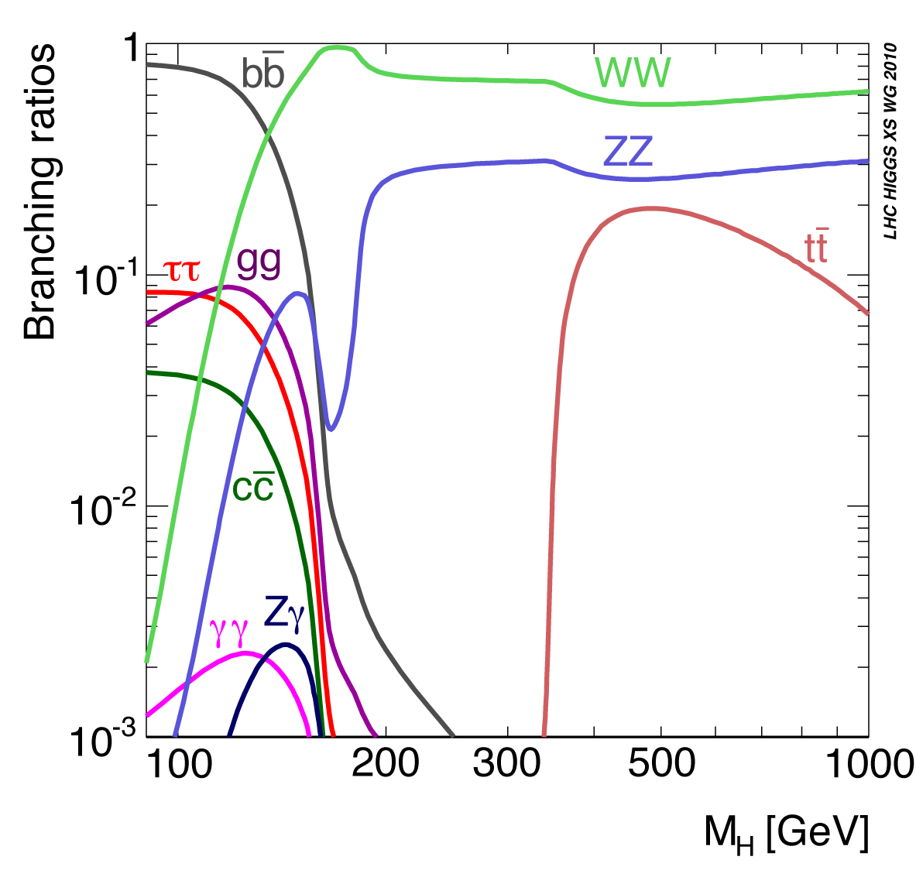
Higgs Decay Modes vs Its Mass

Slide 29
The Higgs Search Landscape: LHC Joins The Fray !
95% CL Excluded Mass range
LEP
+
Tevatron
Tevatron
158
173
0
100
200
300
400
500
600
114
Low Mass
( M_{H}≈ 120 GeV )
H→γγ
H → WW
qqH→ττ
V+ H→bb
qqH→bb
V+ H→WW
Mid Mass
( M_{H} ≈ 160 GeV )
H→WW
H→ZZ
High Mass
( M_{H}≈ 400 GeV )
H→ZZ
H→WW

Slide 30
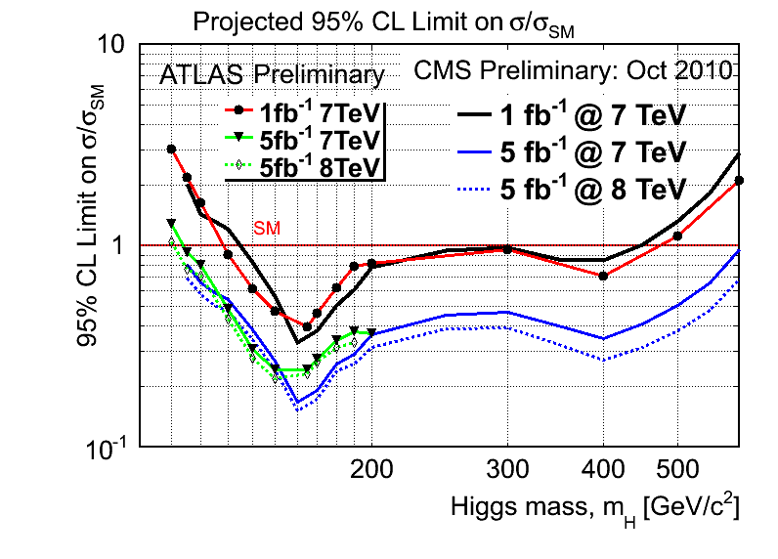
CMS & ATLAS Projections Compared

Slide 31
Experiments well prepared to exploit ALL decay channels accessible
Experiments are cross-checking each other
Experiments are preparing to combine their results

Slide 32
Summary of Prospects
Higgs Boson, if it exists between masses of (114 - 600 GeV) will either be discovered or ruled out in
≈ next two years
→ Decided to run in 2011 and 2012
Sergio Cittolin
SM Higgs Search Prospects (Mass in GeV)
ATLAS + CMS ≈ 2 x CMS | 95% CL exclusion | 3 σ sensitivity | 5 σ sensitivity
1 fb⁻¹ | 120 - 530 | 135 - 475 | 152 - 175
2 fb⁻¹ | 114 - 585 | 120 - 545 | 140 - 200
5 fb⁻¹ | 114 - 600 | 114 - 600 | 128 - 482
10 fb⁻¹ | 114 - 600 | 114 - 600 | 117 - 535

Slide 33
…not only searches
2010 LHCb results show exciting prospects for 2011

Slide 36
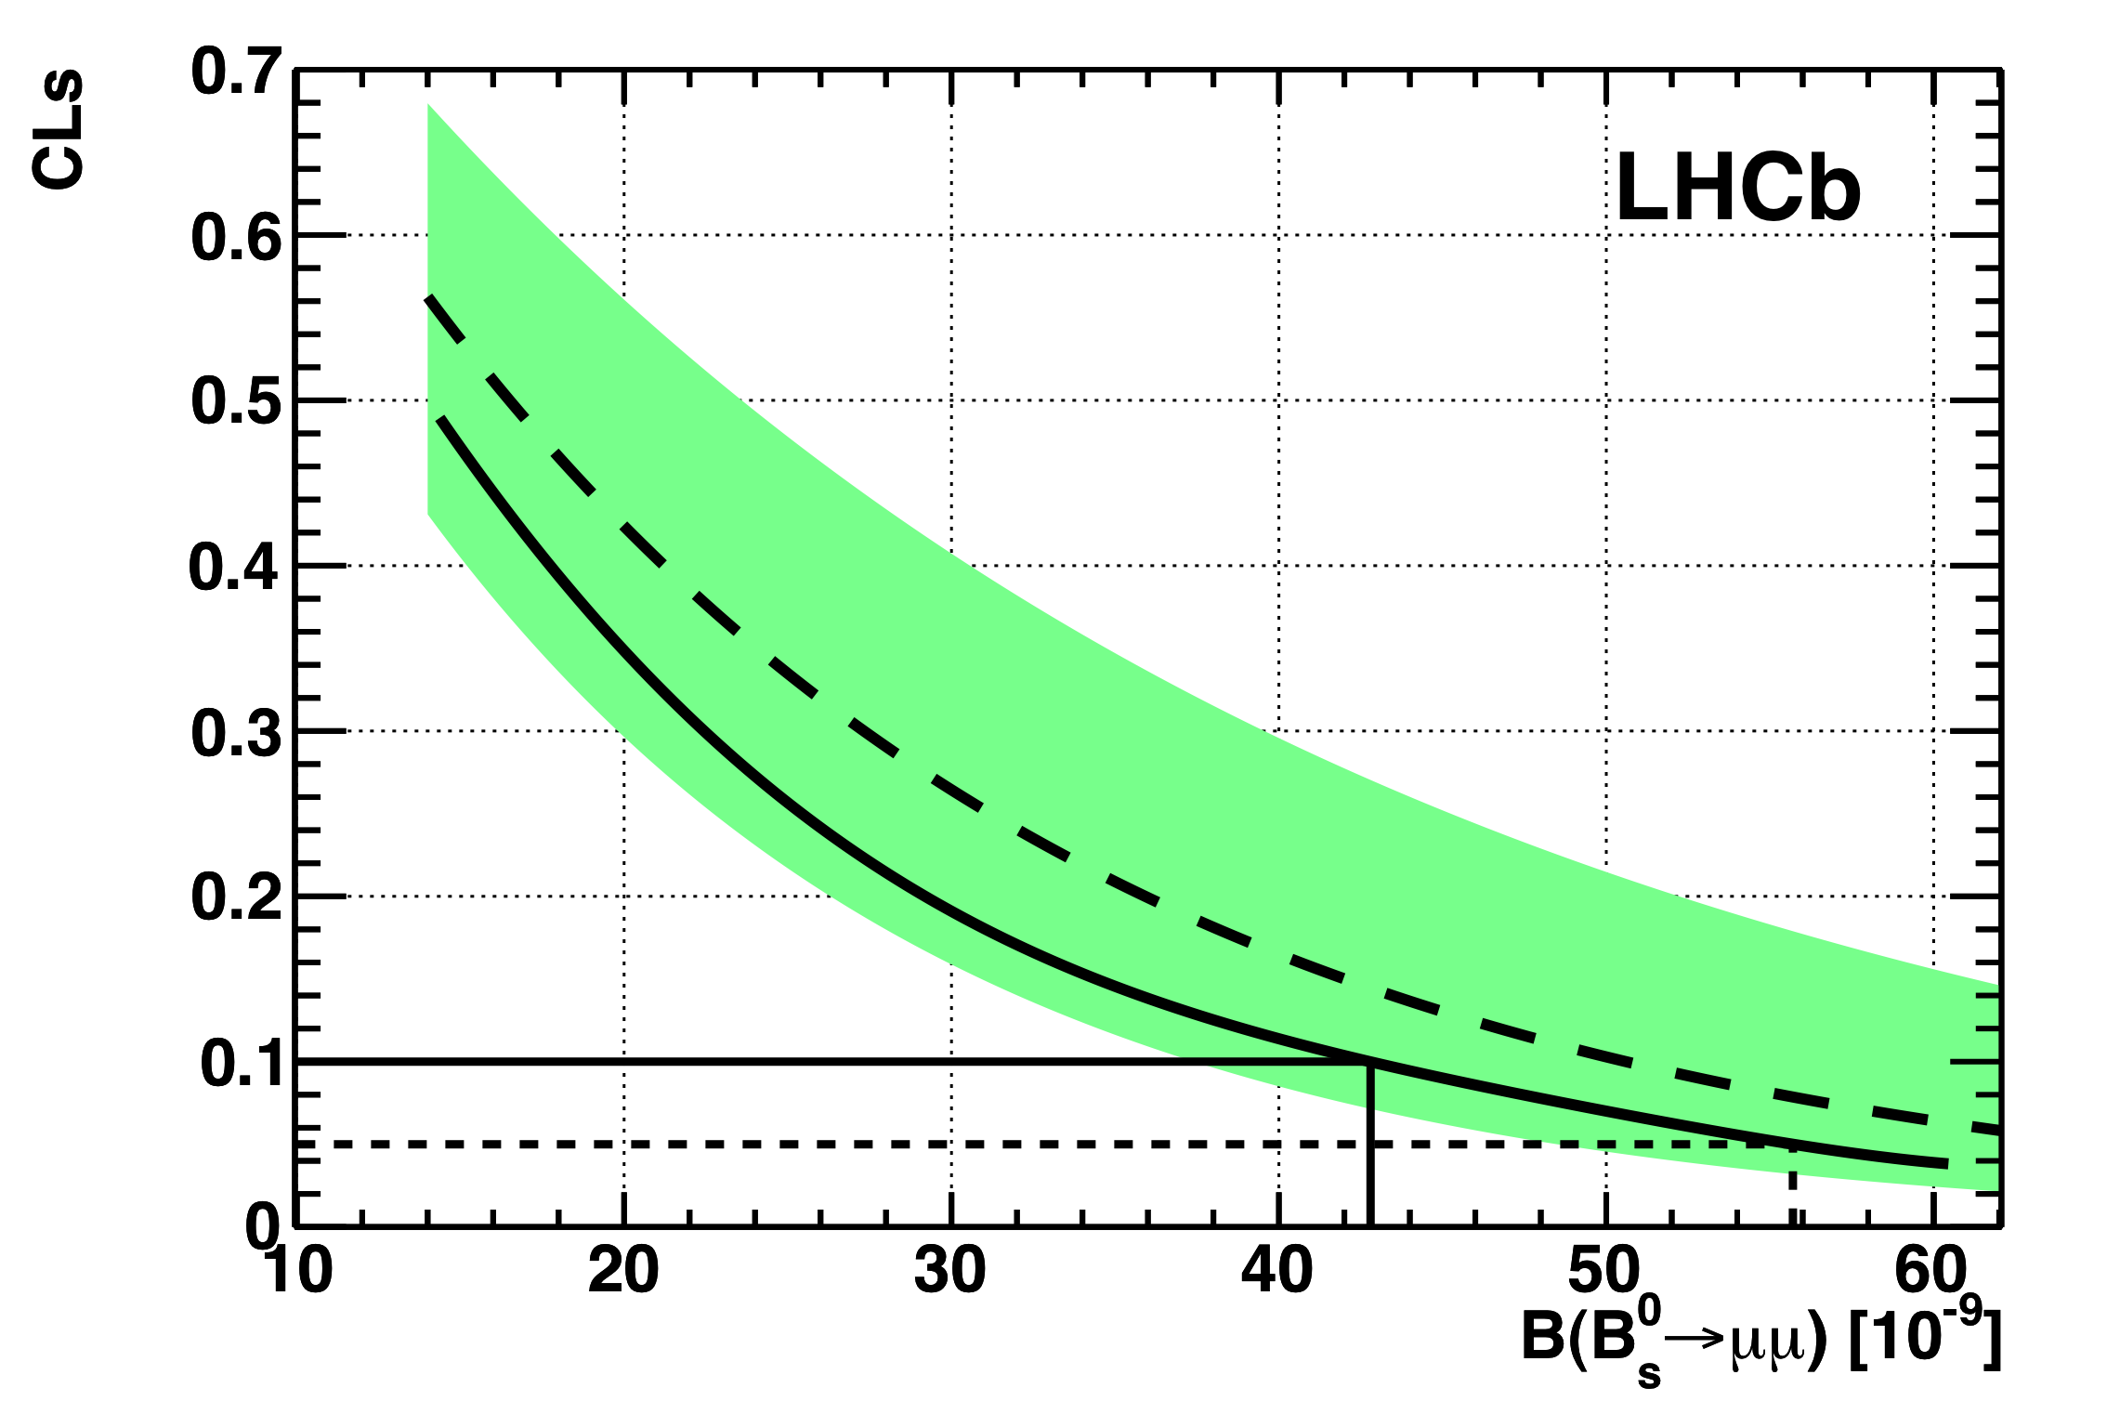
Search for B_{s} → μμ
Paper submitted to
Phys. Lett. B
Expected upper limit
68% of possible experiments
compatible with expected limit
Observed upper limit
90% exclusion
95% exclusion
 |  | @ 90% CL | @ 95% CL
LHCb | Today, 37 pb⁻¹ | < 43 x10⁻⁹ | < 56 x10⁻⁹
D0 | World best, 6.1 fb⁻¹ PLB 693 539 (2010) | < 42 x10⁻⁹ | < 51 x10⁻⁹
CDF | Preliminary, 3.7 fb⁻¹ Note 9892 | < 36 x10⁻⁹ | < 43 x 10⁻⁹

Slide 37
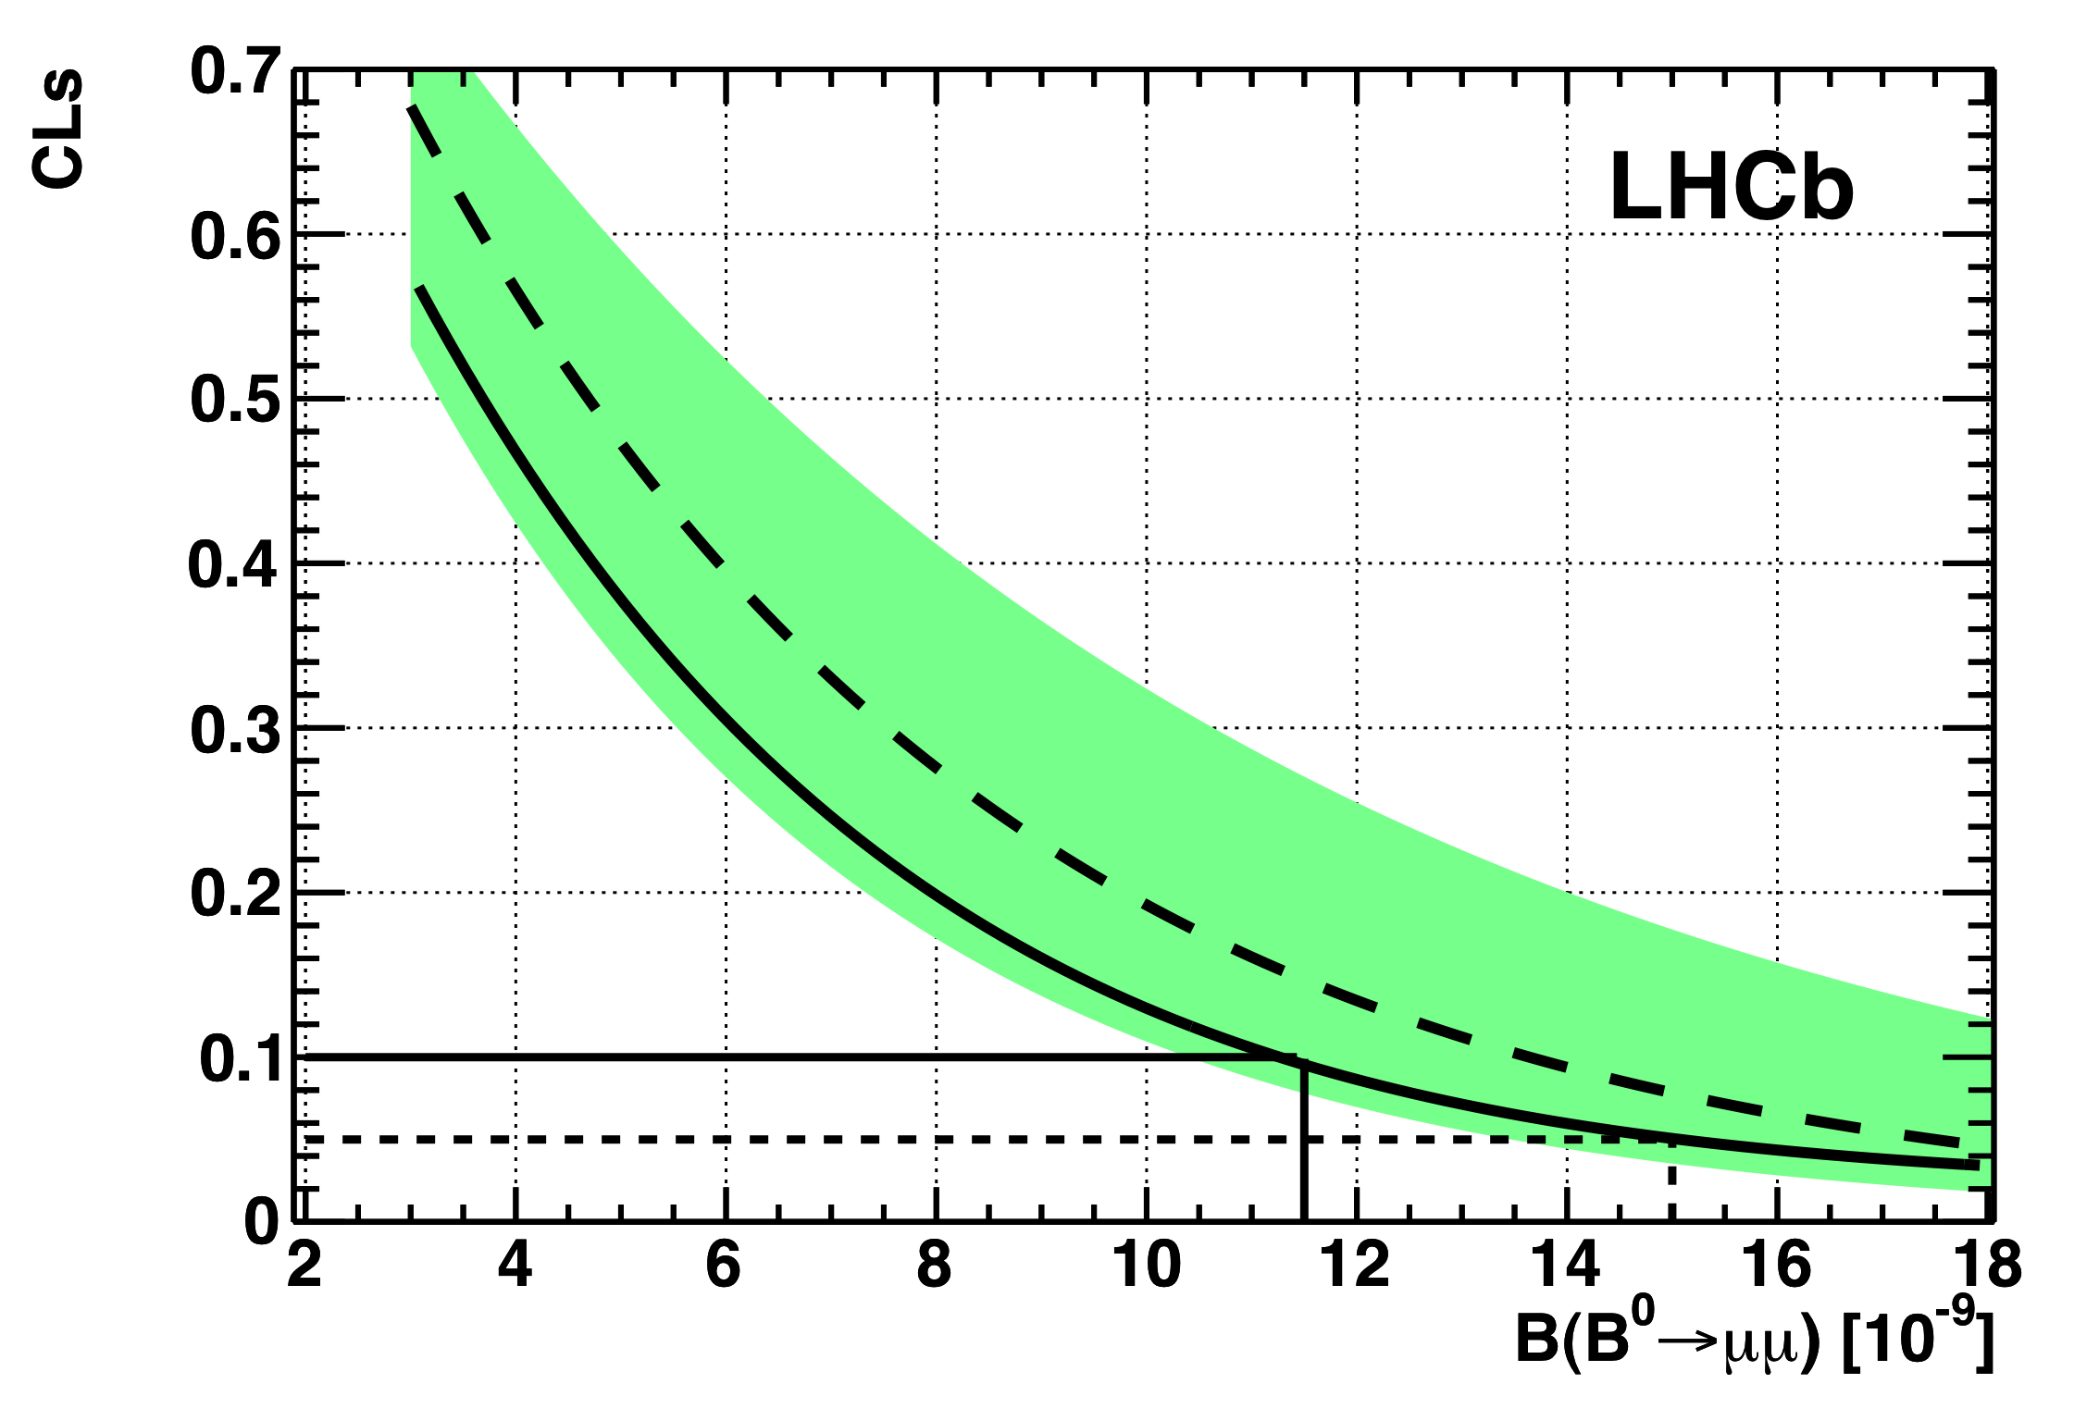
Search for B_{d} → μμ
Expected upper limit
68% of possible experiments
Compatible with expected limit
Observed upper limit
90% exclusion
95% exclusion
 |  | @ 90% CL | @ 95% CL
LHCb | Today, 37 pb⁻¹ | < 12 x10⁻⁹ | < 15 x10⁻⁹
CDF | World best, 2 fb⁻¹ PRL 100 101802 (2008) | < 15 x10⁻⁹ | < 18 x10⁻⁹
CDF | Preliminary, 3.7 fb⁻¹ Note 9892 | < 7.6 x10⁻⁹ | < 9.1 x 10⁻⁹

Slide 38
A possible LHC Time-line
2009
Start of LHC
Run 1: 7 TeV centre of mass energy, luminosity ramping up to few 10³³ cm⁻² s⁻¹, few fb⁻¹ delivered
LHC shut-down to prepare machine for design energy and nominal luminosity
2013/14
Run 2: Ramp up luminosity to nominal (10³⁴ cm⁻² s⁻¹), ~50 to 100 fb⁻¹
2017 or 18
Injector and LHC Phase-I upgrades to go to ultimate luminosity
Run 3: Ramp up luminosity to 2.2 x nominal, reaching ~100 fb⁻¹ / year accumulate few hundred fb⁻¹
~2021/22
Phase-II: High-luminosity LHC. New focussing magnets and CRAB cavities for very high luminosity with levelling
Run 4: Collect data until > 3000 fb⁻¹
2030
ILC, High energy LHC, ... ?

Slide 39
In summary
So far so good
Keep pushing
Keep finger crossed
Keep cool!

Slide 40
Thank you!

