Slide 1



The RICH Detector of the NA62 Experiment at CERN
Antonio Cassese
Università degli Studi di Firenze
INFN Sez. di Firenze
On behalf of the NA62 RICH Working Group: CERN,INFN Firenze, INFN Perugia

Slide 2
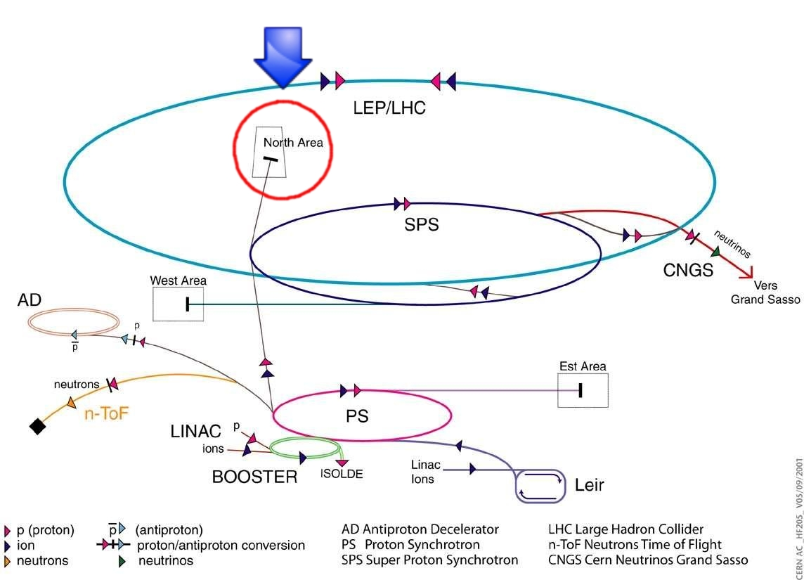
The NA62 Experiment at CERN
New generation experiment at CERN
K physics
Will collect data from 2012
Now under construction
Measurement at 10% level of the BR (K⁺→π ⁺ νν)≈ 10⁻¹⁰
  ”Golden” channel, theoretically very clean
  Sensitive to physics beyond SM
NA62

Slide 3
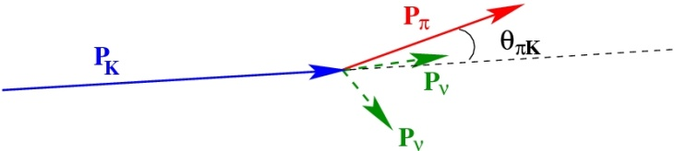
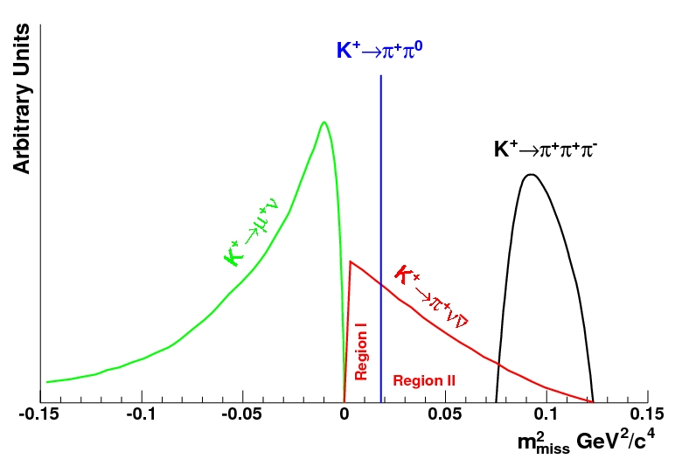
Background rejection
Main backgrounds:
  (K⁺→μ ⁺ ν)=63.4%
  (K⁺→π ⁺ π ⁰)=21%
 | π ⁺ νν | μ ⁺ ν | π ⁺ π ⁰
BR | 8*10⁻¹¹ | 63% | 21%
m_{miss} | 14.4% | 8*10⁻⁶ | 1.2*10⁻⁴
γ Veto | - | - | 3.5*10⁻⁸
μ Veto | - | 10⁻⁵ | -
RICH | - | 5*10⁻³ | -
Total | 1.15*10⁻¹¹ | 2.5*10⁻¹³ | 8.8*10⁻¹³
Ratio | 1 | 2.2% | 7.5%
m²_{miss}=(P_{K}−P_{π})²
RICH needed to suppress K_{μ2} decays
Precise π-K coincidence timing:
Time resolution: ≤ 100 ps

Slide 4
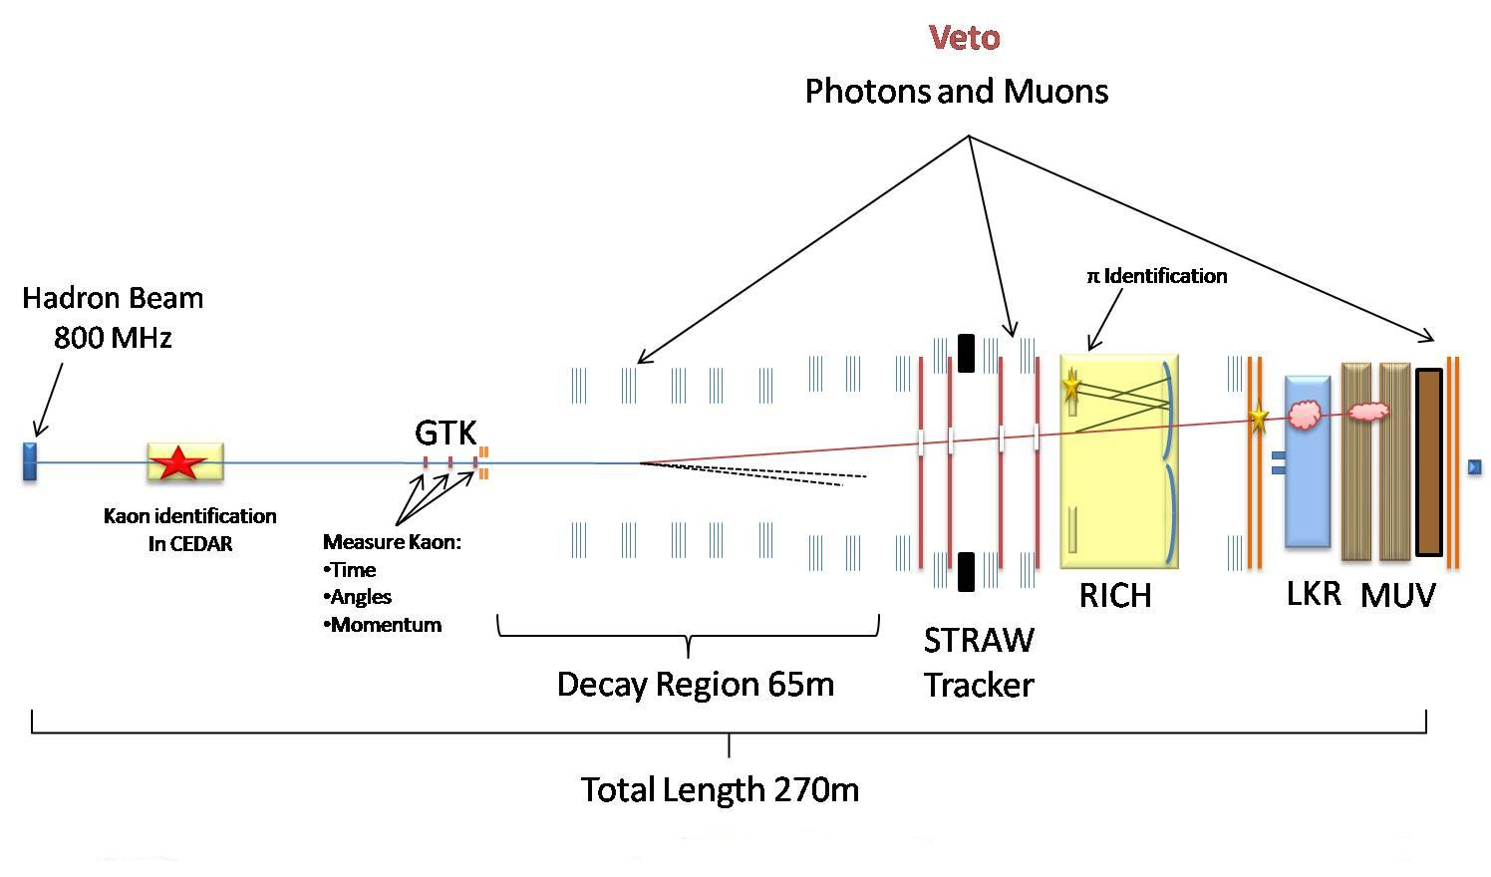
Detector Layout
SPS primary proton beam: 400 GeV, ~5*10¹² ppp → expected signal events ~50/year
Decay in flight technique, unseparated beam π/K/p (~6% K⁺)
Kaon momentum: 75 GeV/c (Δp/p ~1%), Kaon flux ~4.8 × 10¹² decay/year
(1 “year”: 100 days/year, 60% overall efficiency)

Slide 5
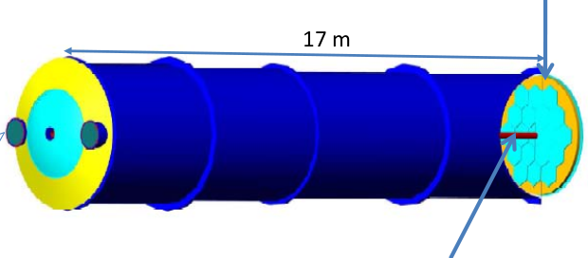
The NA62 RICH Detector
Mirror Mosaic (17 m focal length)
Neon Gas at atmospheric pressure
Beam
Vessel diameter 4→3.4 m
2 × ~1000 PM
Beam Pipe
Separate π-μ at 5*10⁻³ for 15<p<35 GeV/c
Measure pion crossing time with a resolution ≤100 ps
Provide the Level Ø trigger for charged tracks

Slide 6
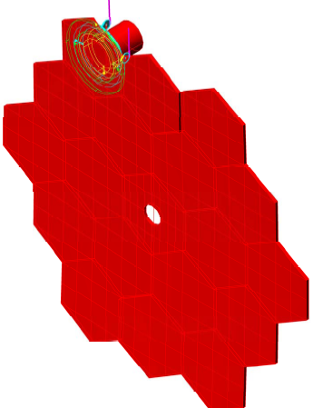
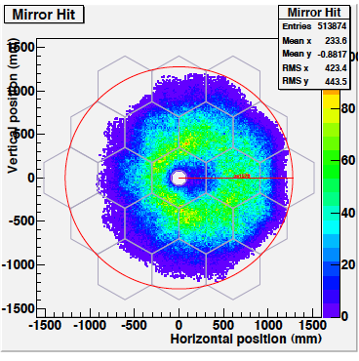
The RICH mirror layout
Mirrors from MARCON company
Spherical mirrors, nominal radius of curvature 34 m (±20 cm maximum), 17 m focal length
Glass substrate 2.5 cm thick, aluminum coat with thin dielectric film (MgF₂) deposit
Hexagonal shape (35 cm side): 18 hexagons + 2 half hexagons (beam pipe)
Average reflectivity better than 90% in 195-650 nm wavelenght range, D₀ < 4 mm
Honeycomb structure for mirror support, piezo actuators for alignment
Mirrors pointing toward left and right of the beam pipe (2 PM regions)
Initial alignement with laser, check with data
D₀
Il diametro della più piccola immagine ottenuta da una sorgente puntiforme posta nel centro di curvatura che contiene il 95% della luce
MC Simulation (Geant4): photon distribution on the mirrors (15-35 GeV/c momentum)

Slide 7
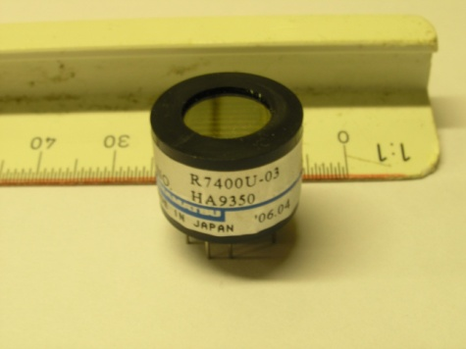
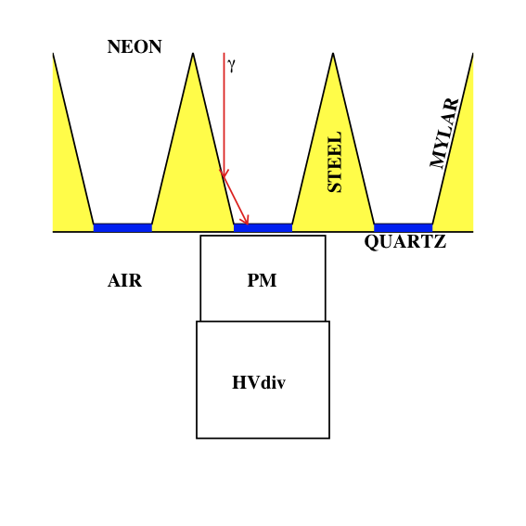
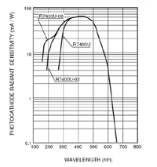
The light detection
Hamamatsu R7400 U03 Photomultiplier
Fast single anode photomultiplier
Metal package tube, bialkali cathode, 8 dynodes
UV glass window, 16 mm ϕ (8 mm active ϕ)
Sensitivity range 185–650 nm, 420 nm peak sensitivity
Gain: minimum 7x10⁵ @800 V (~1.5x10⁶ @900 V)
Transit time: 5.4 ns, transit time spread: 0.28 ns
Operating Voltage: 900 V (1000 V maximum)
Light Collection
Winston Cones covered
with aluminized Mylar foils
22 mm high
7.5 to 18 mm wide
1 mm thick quartz window

Slide 8
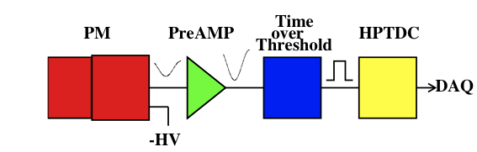
Front End and Readout
Front End:
Custom made current amplifier
NINO ASIC as fast Time-over-Threshold discriminator: LVDS output, 50 ps intrinsic resolution
Readout:
A TDCB equipped with 128 ch of HPTDC (100 ps LSB) has been developed by INFN Pisa
A FPGA based TEL62 mother board (development of TELL1 boards from LHCb) houses 4 TDCB (512 ch.)
The trigger primitives are built in parallel with the readout on the same TEL62 board (1 MHz input to L1, implemented in software)
The TDC CAEN V1190 (based on HPTDC, 97.7 ps LSB, 128ch) was used for test purposes

Slide 9
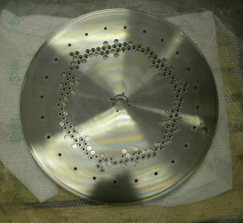

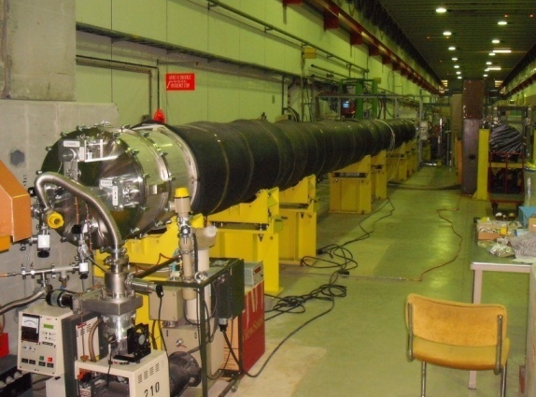
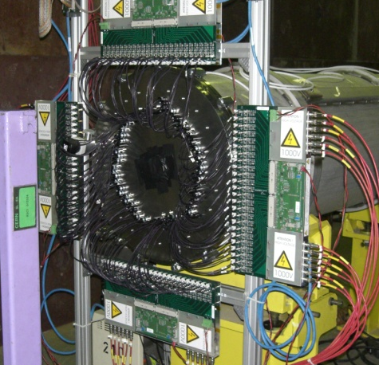
The RICH-100 prototype
17 m long, 60 cm wide vessel filled with Neon at atmospheric pressure
Mirror by MARCON: f = 17m, d = 50 cm, 2.5 cm thick
Test beam 2007: RICH-100 prototype
96 PMT Hamamatsu R7400 U03/U06
200 GeV hadron beam
Test results in agreement with MC expectation:
  Number of PM hit per event N_{Hits} ≈ 17
  Time resolution ∆t_{Event} ≈ 70 ps
  Cherenkov angle resolution ∆θ_{c} ≈ 50 μrad
  NIM A 593 (2008) 314

Slide 10
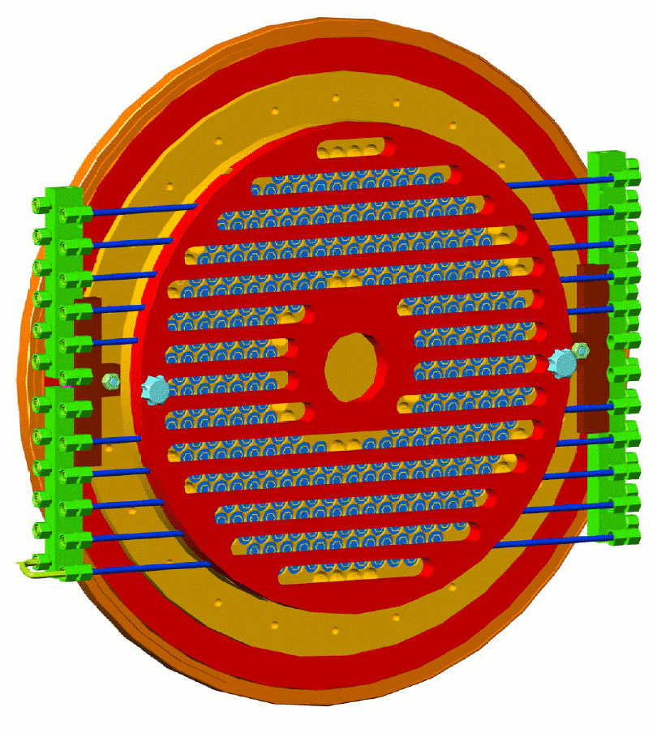
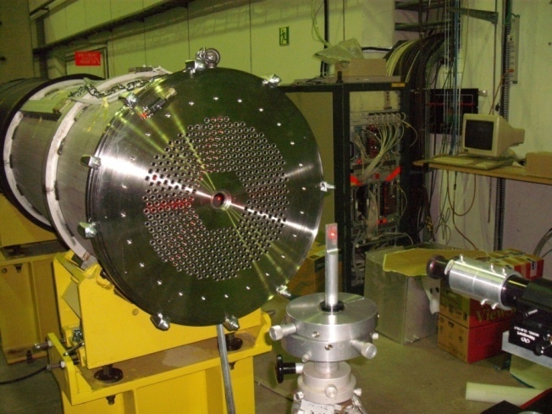
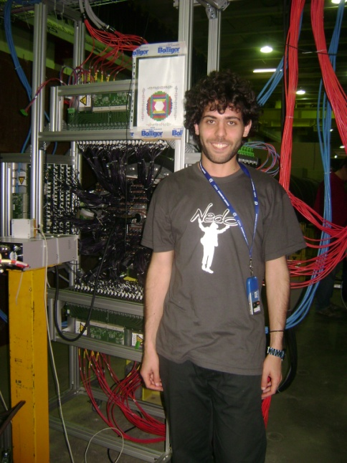
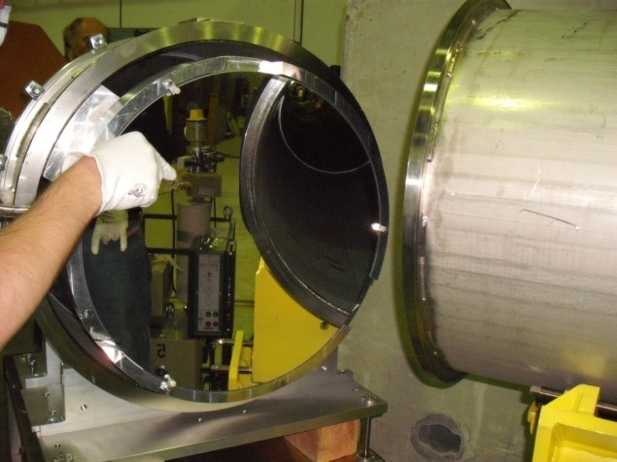
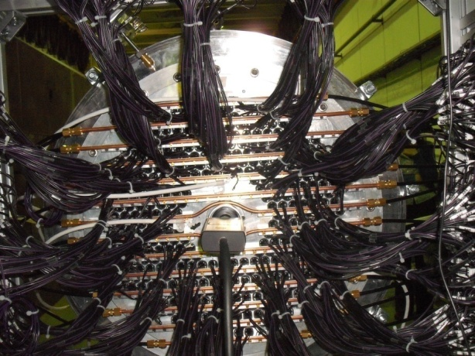
The RICH-400 prototype
PM endcap with 414 PM (~20% of final detector)
Test Beam in2009, aiming at:
  Validate π-μ separation @ 15<p<35 GeV/c
  Test PM cooling system
  Test new mirror
  Test new readout (Tell1 based)
  NIM A 621 (2010)

Slide 11
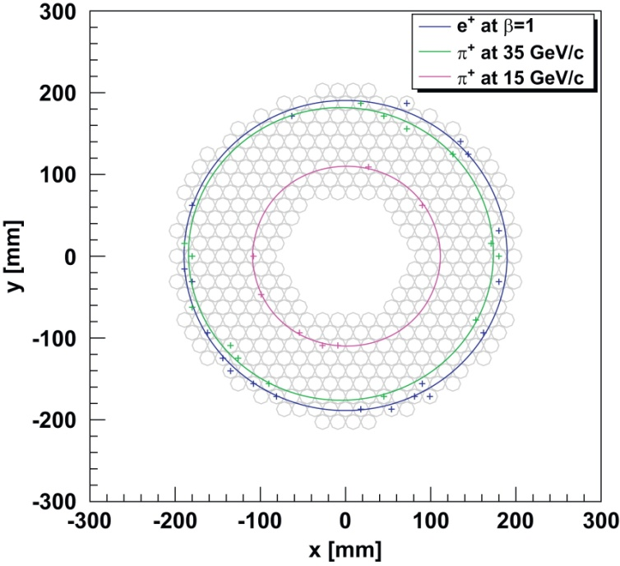
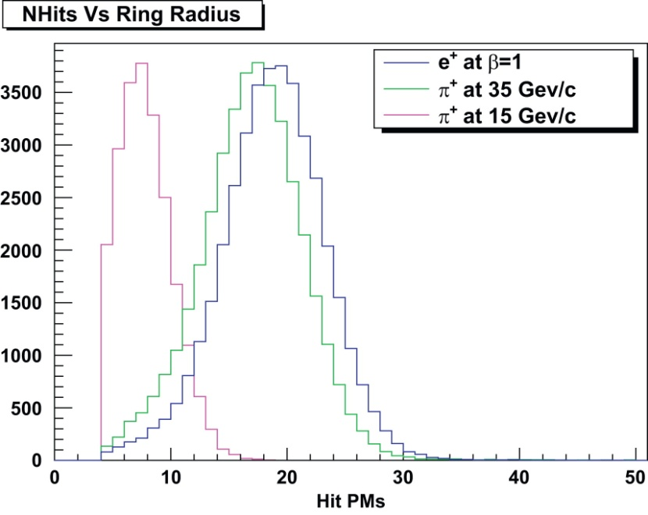
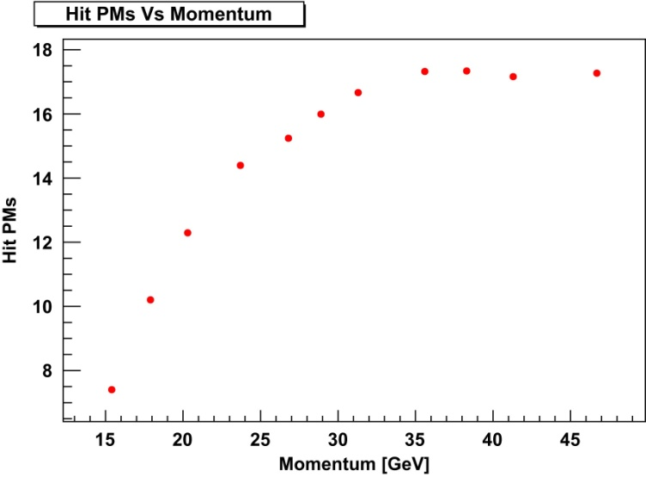
Results (1)
Positrons at β=1
Pions at 35 GeV/c
Pions at 15 GeV/c
Typical data events with fitted rings
Number of hit PMs for a single ring (cut at 4 due to the software trigger algorithm)
Pions at 15 GeV/c: N_{Hit PM} ≈ 8
Pions at 35 GeV/c: N_{Hit PM} ≈ 17
Positrons at β=1: N_{Hit PM} ≈ 20
Results in agreement with MC expectations
Average number of hit PMs for a single ring as a function of momentum in the range 15-35 GeV/c

Slide 12
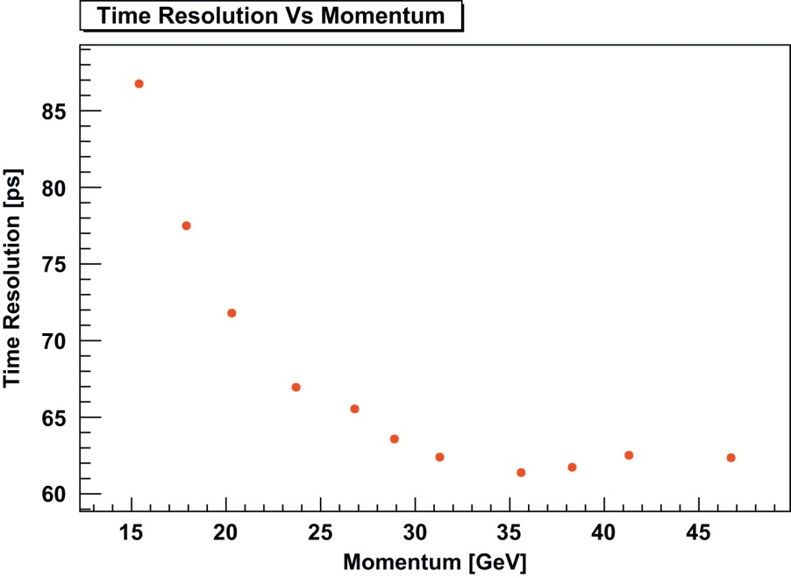
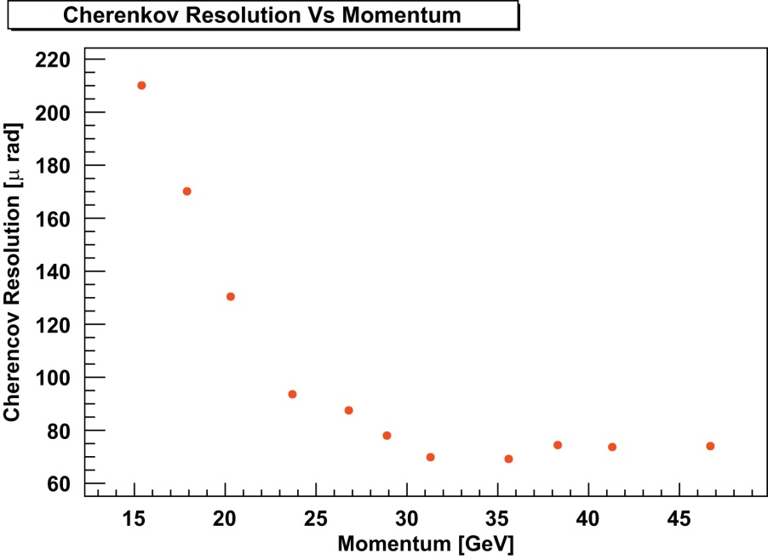
Results (2)
Time resolution as a function of the π momentum: average r.m.s. of the selected hit time with respect to the average hit time
Cherenkov angle resolution as a function of the π momentum: the standard deviation σ is estimated by a Gaussian fit to the radius distribution
The results fulfill the requirement for the NA62 RICH detector and are compatible with those of the 2007 beam test held at CERN, both for the standard readout system and for the new readout prototype
Data are in agreement with Montecarlo simulation

Slide 13
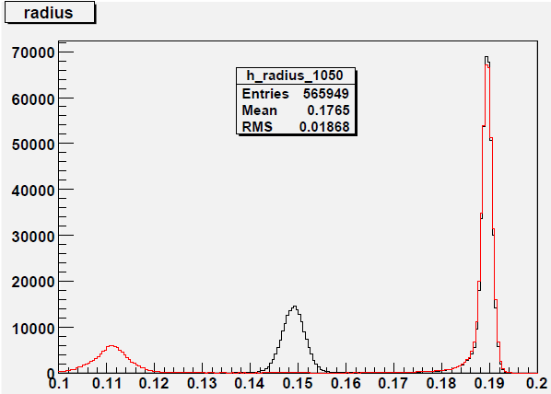
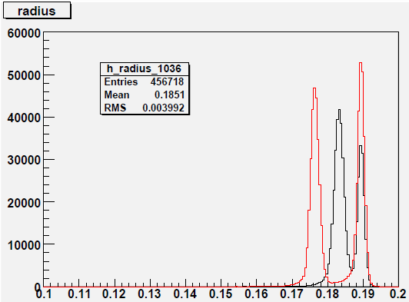
RICH400 pion-muon separation
e
e
π
“μ”
15 GeV/c
35 GeV/c
“μ”
π
Fitted ring radius R(m)
RICH REQUIREMENT: muon suppression ≤10⁻²
  Measure the probability to misidentify a μ as a π integrated between 15 and 35 GeV/c (assuming the expected spectrum of µ from K_{µ2})
  Repeat the measurement changing mirror orientation and analysis cuts
  Calculate: μ contamination and π loss (under different conditions) in momentum bins
  Use: ring radius distribution and the reconstructed squared mass of the particle

Slide 14
Conclusions
A very demanding RICH is needed for NA62
The results of the prototype test beams fulfill the design requirements:
  Time and Cherenkov angle resolution
  Hit PM’s per ring
  π-μ separation and μ suppression factor
The construction of the NA62 detector has already started:
the first data taking will take place at the end of 2012

Slide 16
Backup

Slide 17
RICH 400
Beam: mainly π⁺, 15% p, few % K⁺, variable % of e⁺
  1.5% Δp/p, negligible angular spread
Momentum range: 10 to 75 GeV/c
Many momentum points to measure μ-π separation using only π: each next point is a π with the same β of the μ of the actual point (μ-π equivalent)
  1° scan: 15.2, 20.1, 26.5, 35.0, 46.2, 61.2 GeV/c
  2° scan: 17.7, 23.4, 31.0, 41.0, 54.2 GeV/c
  3° scan: 28.7, 38.0, 50.3 GeV/c
Test prototype performance under different conditions:
  Moving the mirror, different rates, different Tell1 firmware versions, polluting the gas (air and CO₂), etc…
Repeat measurements with the new mirror (final device, made by Marcon, aluminized and coated at CERN):
Special runs:
  check trigger algorithms and accidentals at higher intensities
  measure efficiency for ring fitting methods

Slide 18
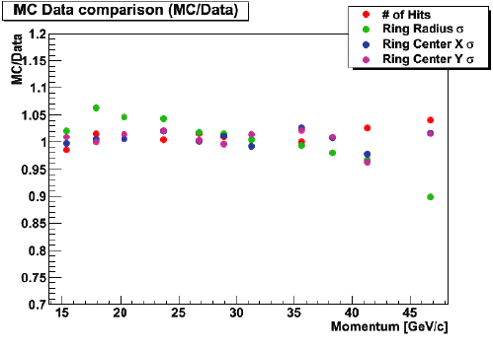
MC/Data comparison
NA62 Detector Simulation: GEANT4 based
RICH beam test results in good agreement with Monte Carlo simulation expectations in 15-35 GeV/c

