Slide 1
Crystal collimation of hadron beam at CERN, the UA9 experiment
Gianluca Cavoto
INFN Roma
IFAE 2011
Perugia

Slide 2
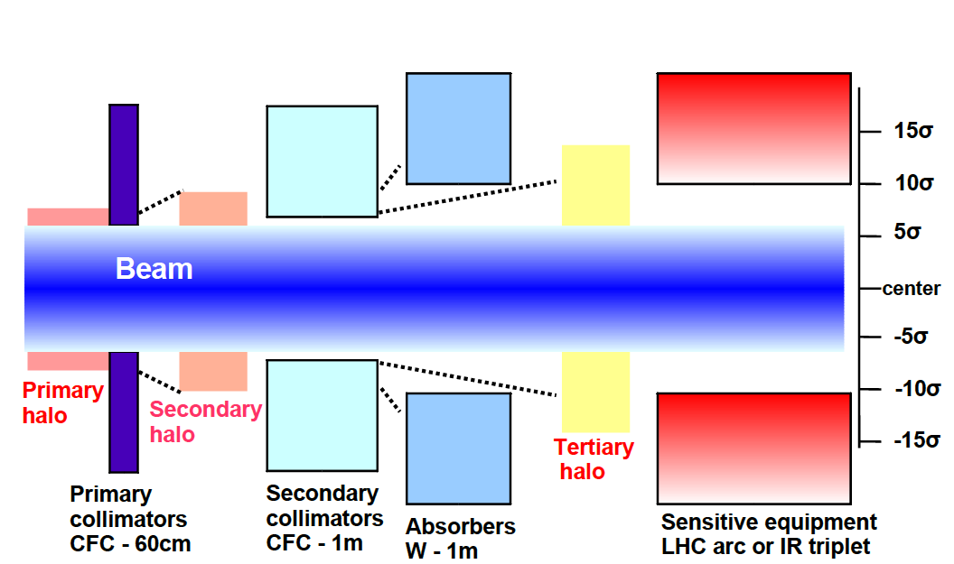
Collimation at colliders
      Passive protection for
      fast losses
      Cleaning and absorption for
      slow losses
      Defense against radiation
      Reduction of physics
      background
    High luminosity requires (eventually) high currents
At 7 TeV 1/50.000 proton lost makes a SC magnet quench!
Cleaning Efficiency

Slide 3
Traditional concept
How it works ?
A short scatterer deflects the primary halo
A long collimator intercepts the secondary halo
The amplitude of the halo particles increases via multiple scattering and multi-turn effects.
Beam Core
Primary
halo (p)
r₁
r₂
Beware of the diffractive events in the primary
They are a limiting factor for current LHC collimation
system
Secondary halo
π
p
<δx’²>~ L
e
Secondary collimator
(massive absorber)
Primary collimator
(scatterer)
p
Shower
Tertiary halo

Slide 4
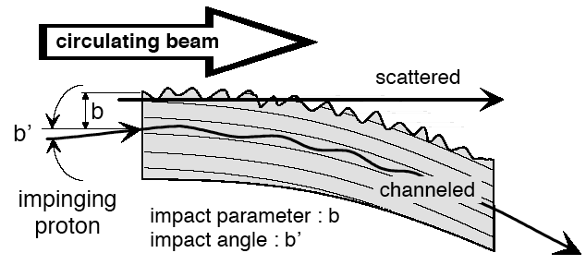
A new idea!
E. Tsyganov & A. Taratin (1991)
Beam propagation
Beam Core
Primary
halo (p)
Crystal channeling
Crystal
p
<δx’> ≈ 10² µrad
L ≈ a few mm
Absorber
Tertiary halo
Coherent deviation of the primary halo
Very small probability of inelastic interaction in the crystal
Larger collimation efficiency
Less impedance
Reduced tertiary halo

Slide 5
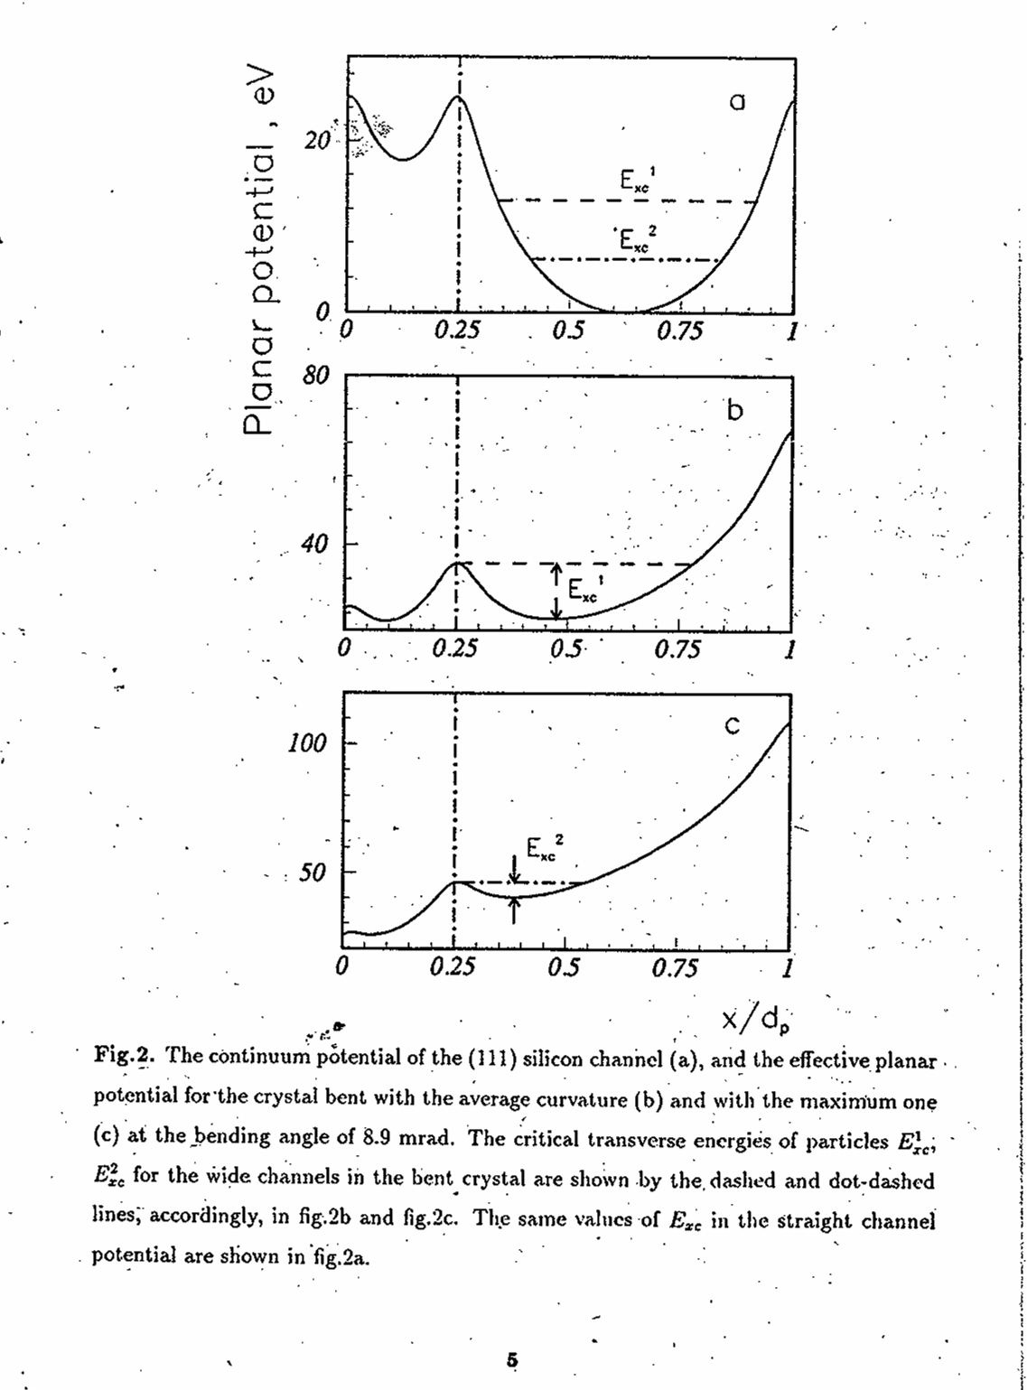
Crystal channeling
J. Lindhard, Phys. Lett. 12, 126 (1964)
E. Tsyganov , Fermilab, TM-682 (1976)
Charged particle entering crystal
with angle wrt lattice place smaller than
a critical angle
Oscillation within the lattice planes!
Particles trapped!
If the crystal is BENT, additional
centrifugal potential.
Charged particles are deflected!
In silicon (110) 400 GeV protons
θ_{c} ~ 10 μrad

Slide 6
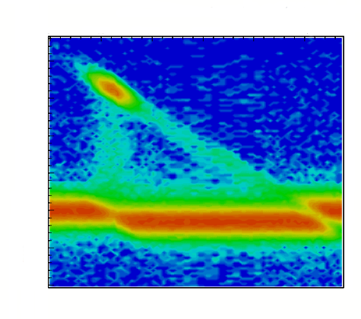
Crystal behaviour
Rotation angle [μrad]
0
50
100
150
200
250
Amorphous
behavior
-200
Angular profile [μrad]
-150
W. Scandale et al. PRL 98, 154801 (2007)
W. Scandale et al. PRST 11, 063501 (2008)
-100
-50
0
Detector
-200
50
-150
100
-100
Bended Crystal
-50
Beam
0
Beam source
(Accelerator)
Goniometer
50
100

Slide 7
Crystal behaviour
Rotation angle [μrad]
0
50
100
150
200
250
Amorphous
behavior
-200
Angular profile [μrad]
-150
W. Scandale et al. PRL 98, 154801 (2007)
W. Scandale et al. PRST 11, 063501 (2008)
-100
-50
0
Detector
-200
50
-150
100
-100
Bended Crystal
-50
Beam
0
Beam source
(Accelerator)
Goniometer
50
100

Slide 8
Crystal behaviour
Rotation angle [μrad]
0
50
100
150
200
250
Channeling
behavior
-200
Angular profile [μrad]
-150
-100
W. Scandale et al. PRL 98, 154801 (2007)
W. Scandale et al. PRST 11, 063501 (2008)
-50
0
Detector
-200
50
-150
100
-100
Bended Crystal
-50
Beam
0
Beam source
(Accelerator)
Goniometer
50
100

Slide 9
Crystal behaviour
Rotation angle [μrad]
0
50
100
150
200
250
Channeling
behavior
-200
Angular profile [μrad]
-150
-100
W. Scandale et al. PRL 98, 154801 (2007)
W. Scandale et al. PRST 11, 063501 (2008)
-50
0
Detector
-200
50
-150
100
-100
Bended Crystal
-50
Beam
0
Beam source
(Accelerator)
Goniometer
50
100

Slide 10
Crystal behaviour
Rotation angle [μrad]
0
50
100
150
200
250
Reflection
behavior
-200
Angular profile [μrad]
-150
-100
W. Scandale et al. PRL 98, 154801 (2007)
W. Scandale et al. PRST 11, 063501 (2008)
-50
0
Detector
-200
50
-150
100
-100
Bended Crystal
-50
Beam
0
Beam source
(Accelerator)
Goniometer
50
100

Slide 11
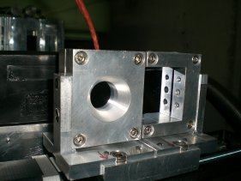
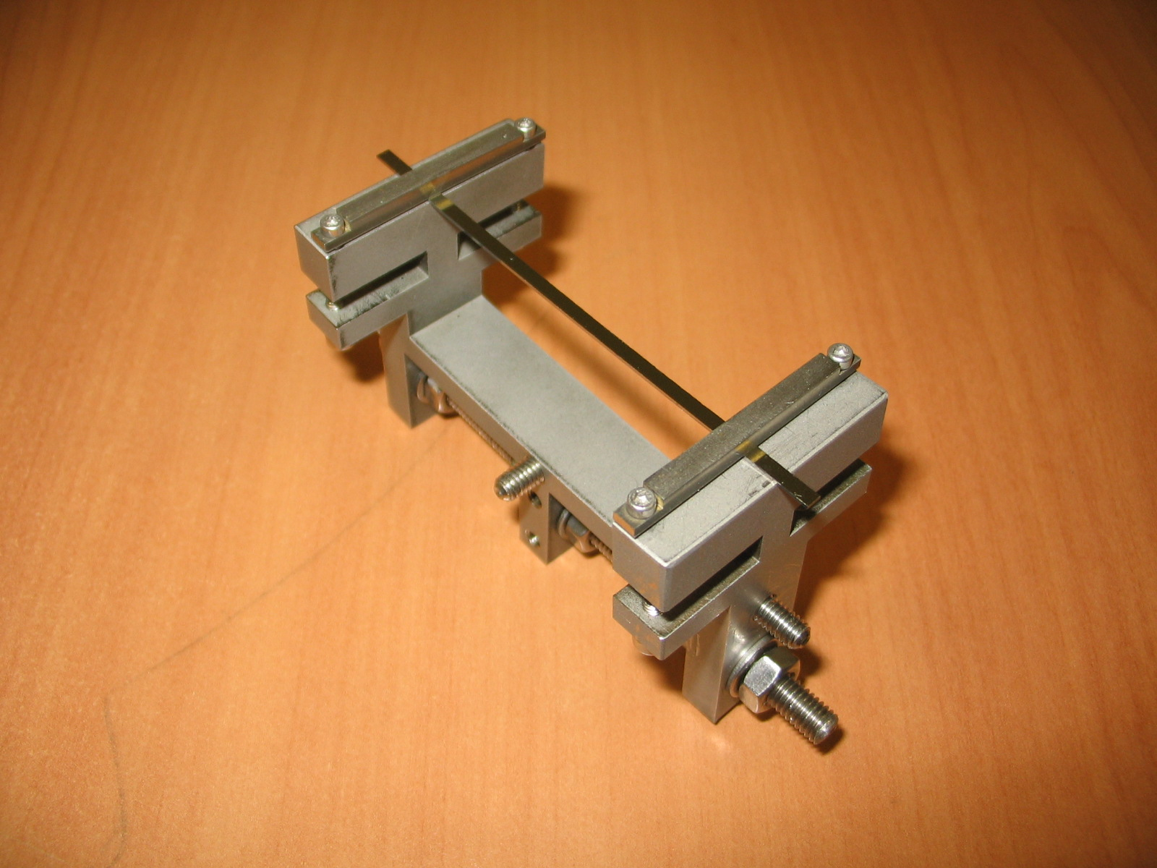
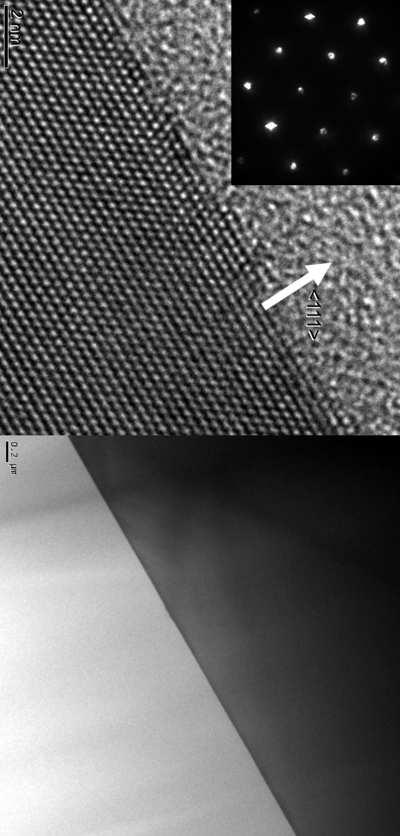
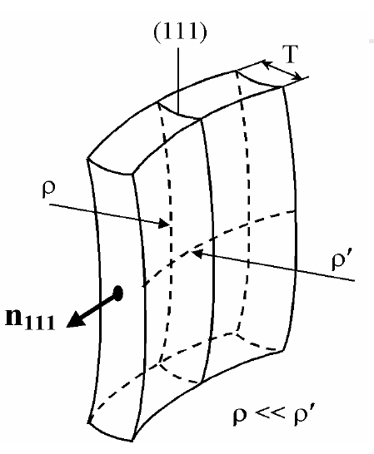
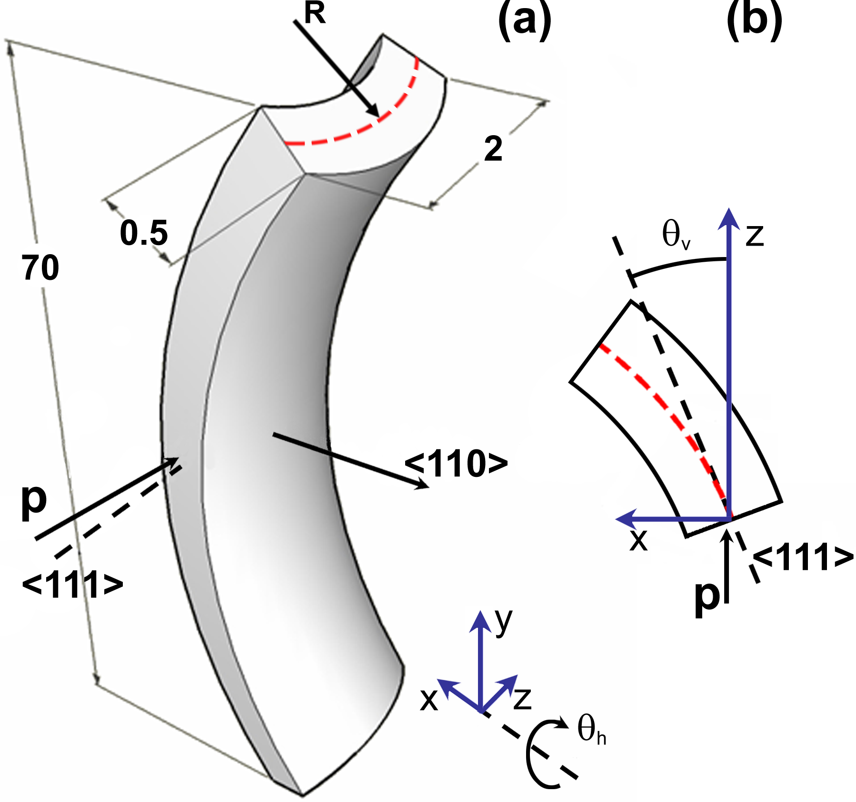
Crystals
Quasimosaic crystals
Chemical etching
Strip crystals
O.I.Sumbaev - PNPI (1957)
A. G. Afonin et al., JETP Lett. 67, 781 (1998)
R
Quasimosaic bending
Main bending
Anticlastic bending
S. Baricordi et al., Appl. Phys. Lett. 91, 061908 (2007)
Bending driven solely by anisotropy
Bending driven by 2-D elasticity law

Slide 12
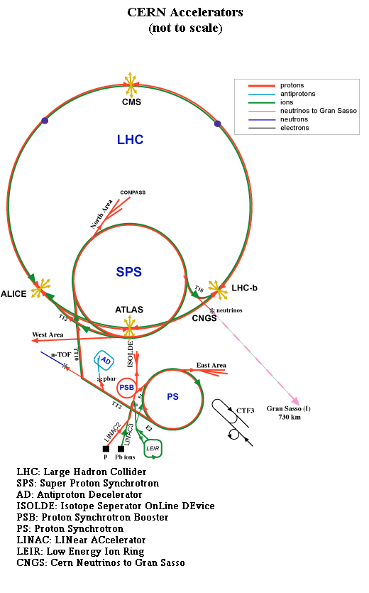
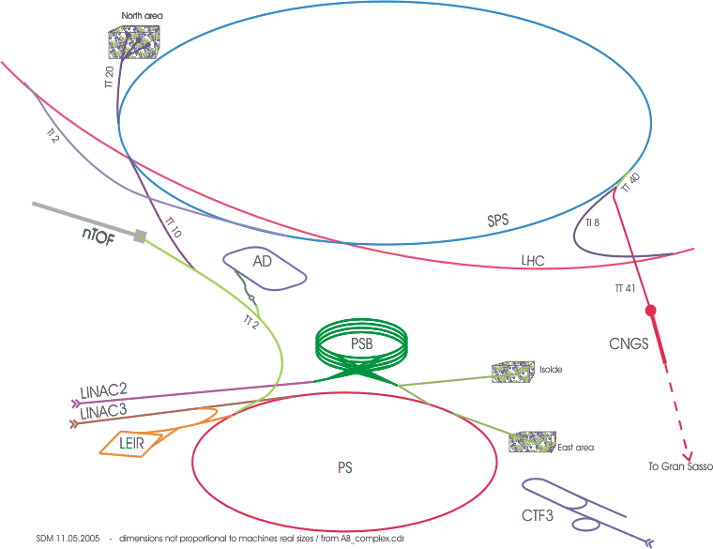
UA9 @ SPS
An international collaboration
60 people
CERN, Italy, Russia,UK, US
[INFN FE, LNF,LNL, NA, RM]
Circumference : 6.9 km
UA9 collimation
region
Data-taking during dedicated Machine Development days
with SPS beam in coast mode (~5 in a year, in 2010
4 with protons and 1 with Pb ions
Extracted beam (microbeam at H8) tests.

Slide 13
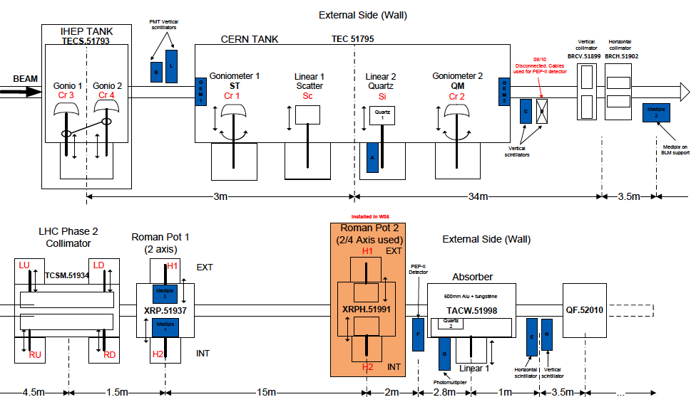
Collimation region
Protons
hitting
the crystal
BLM Scint
Inelastic interaction of protons
in the crystal
✖
Deflected beam
BLM GEM
65 m
Intercepted by LHC collimator
Absorbed
by secondary collimator
(TAL)
Imaged by
Medipix
BLM Scint
BLM Cerenkov

Slide 14
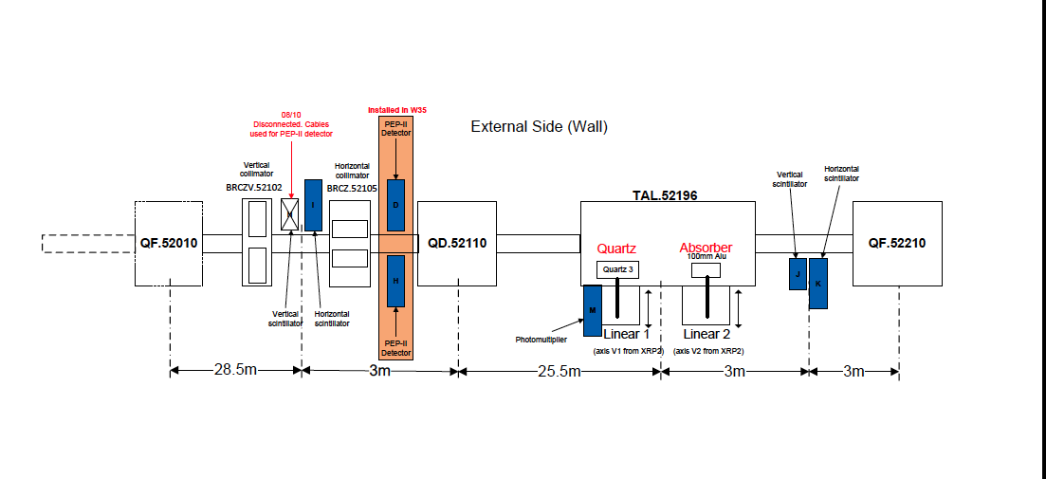
Out of collimation region
TAL2 Al scatterer
New scatterer + BLM (scint, Cerenkov, ionization ch.)
in highly dispersive region to detect
1) off-momentum particles (produced in the crystals)
which are displaced lateraly
2) any not absorbed secondary halo
Observe the spray rate as a function of scatterer lateral position

Slide 15
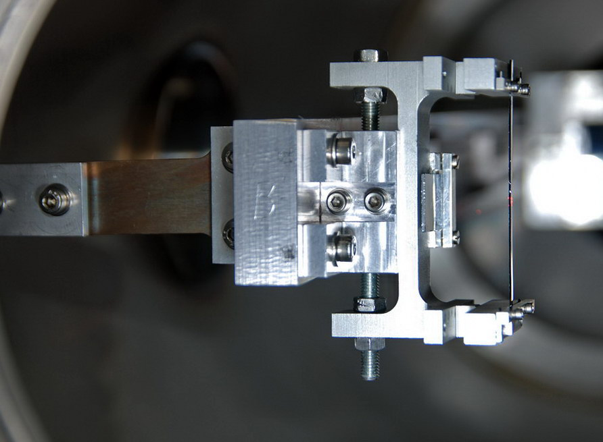
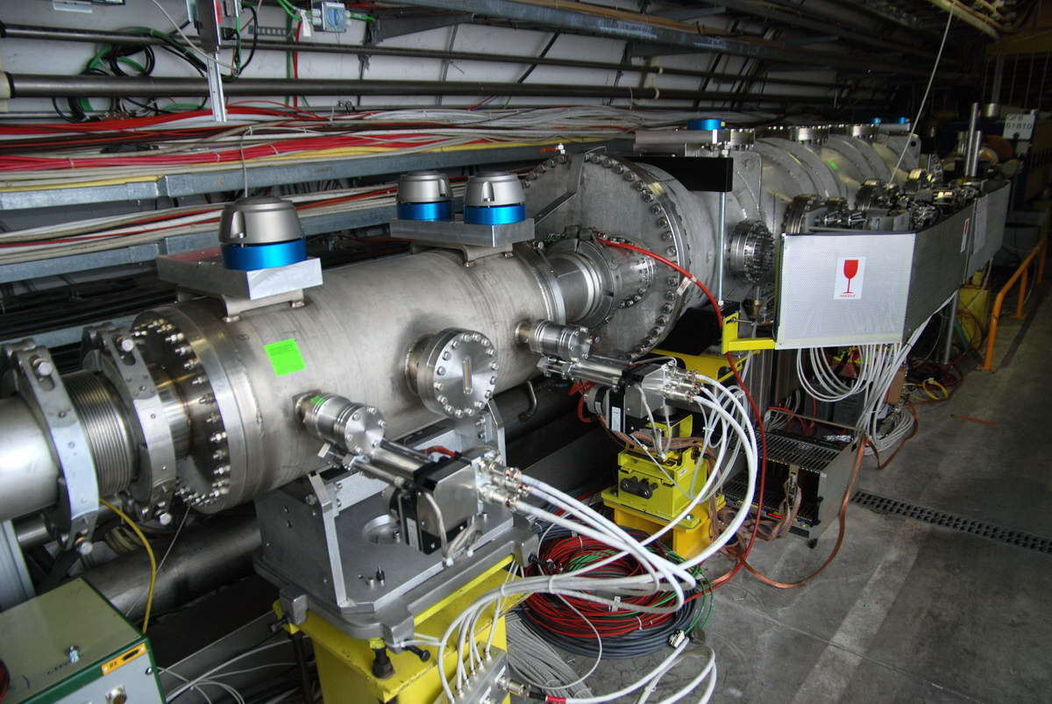
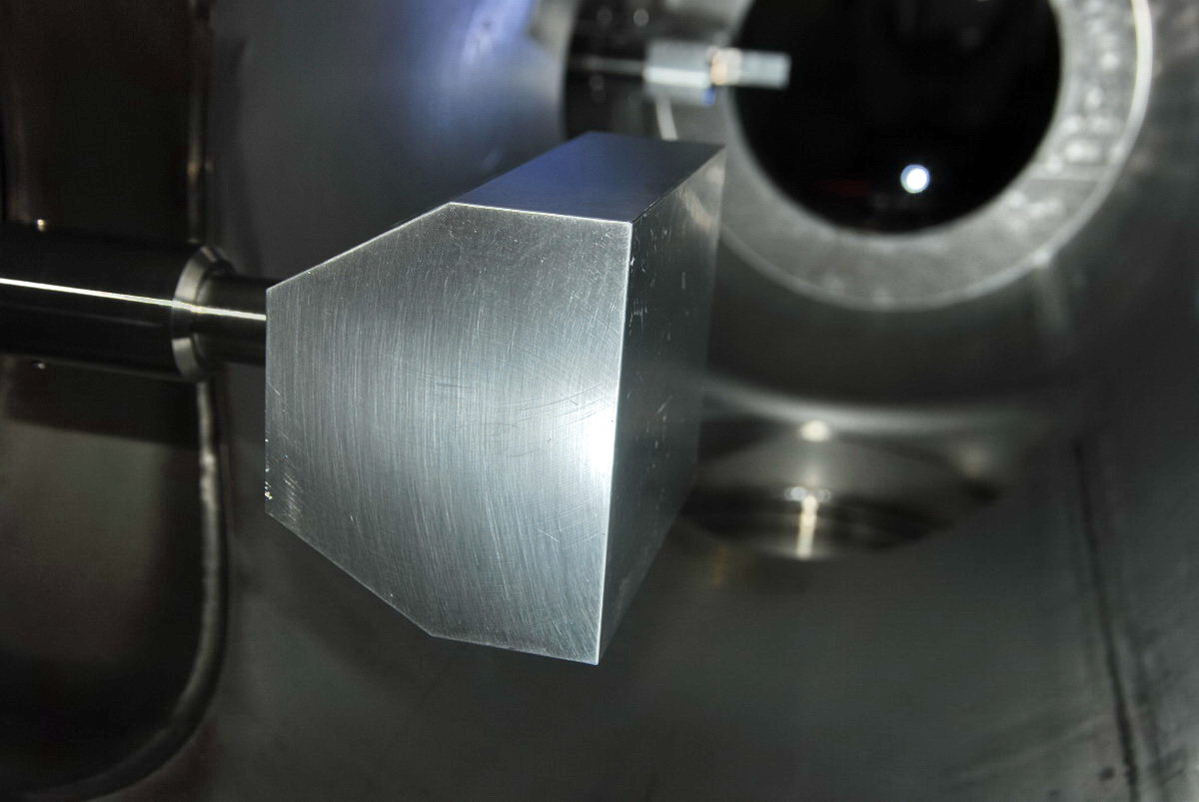
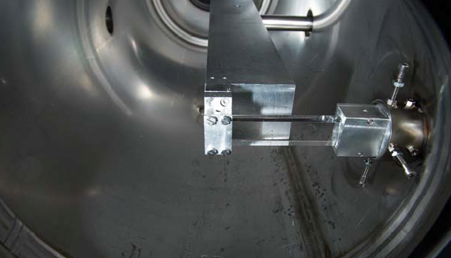
SPS UA9 devices
IHEP tank with goniometers
Angular resolution ± 10 µrad
Strip crystal in IHEP tank
TAL2 Al scatterer
TAL absorber & Quartz Cerenkov detector
High quality mechanical devices, accurate motion system

Slide 16
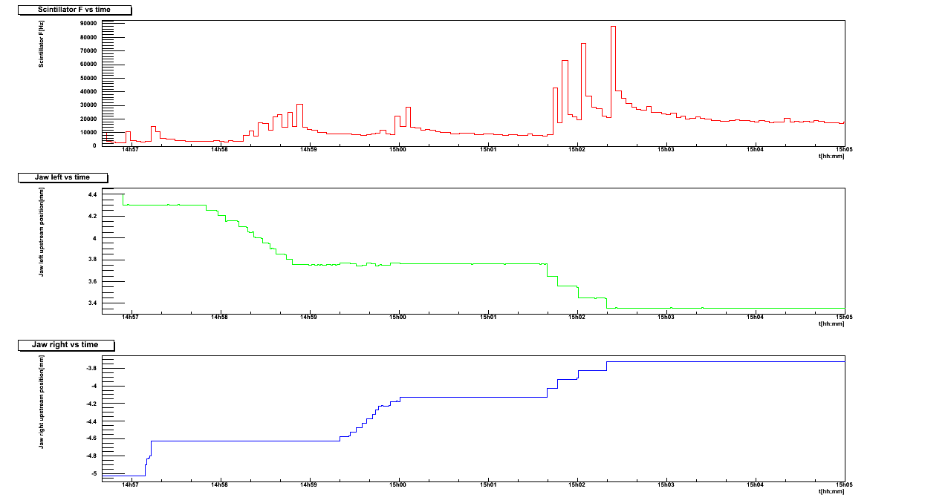
Alignment procedure
1) Search of the closed orbit, 2) redefine the beam at how many sigma we want.
Crystal and all UA9
movable devices are aligned during each fill.
Standard and fast procedure to find
channeling configuration and
collimation!
BLM rate
1
Same distance from closed orbit
Collimator jaws positions
2
Alignment position

Slide 17
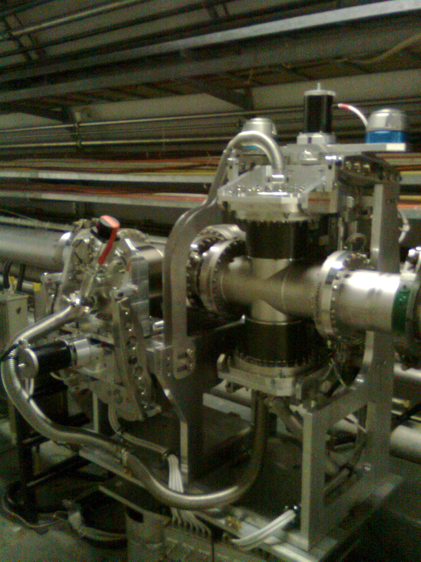
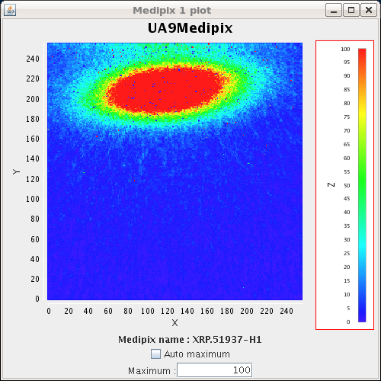
Roman pots
      Movable device housing
      detectors in secondary
      vacuum
        Used to acquire images
        of channeled beam
        Relevant to measure
        channeled beam
        direction (from centroid)
        and flux of proton of channeled
        beam
Vertical displacement
Horizontal displacement
Online picture with Medipix

Slide 18
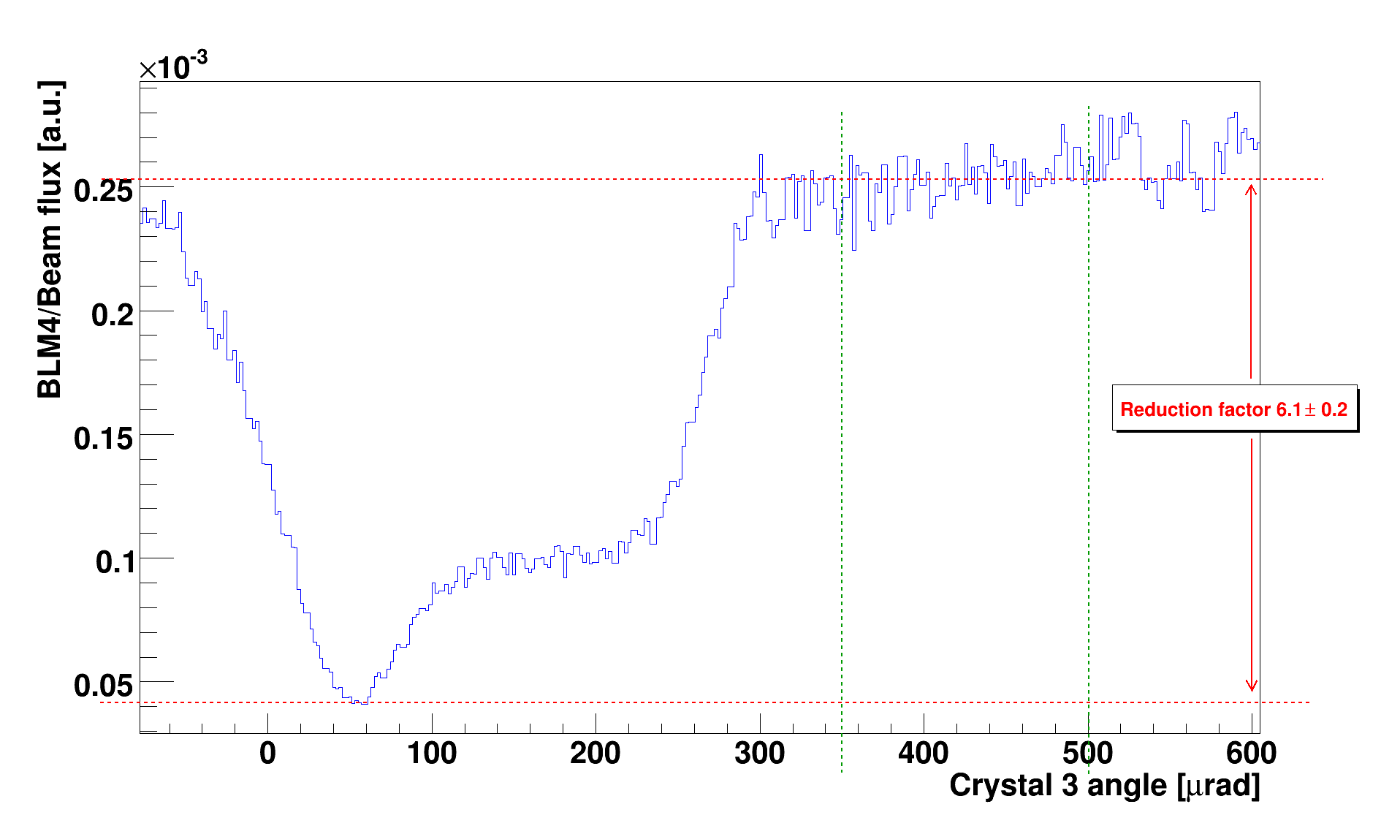
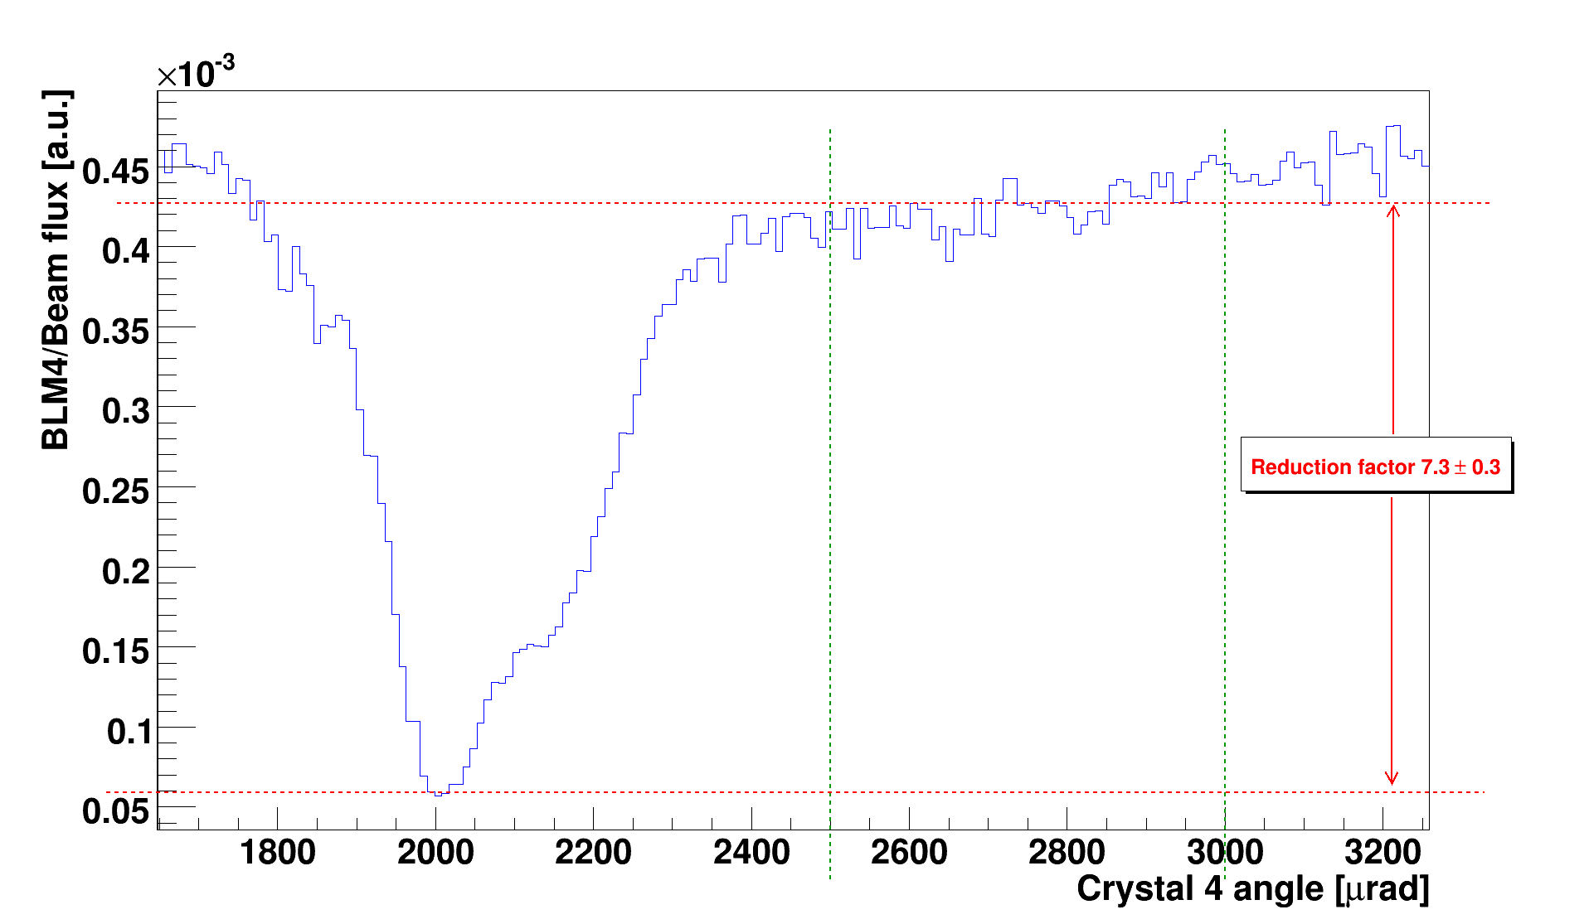
Angular scans
    Reduction factor of the inelastic losses due to inelastic interactions in channeling versus amorphous orientations.
      Measured with LHC-BLM and GEM detectors
      Very reproducible in several scans and fills
Losses in amorphous regime
channeling
channeling
Volume reflection
Volume
reflection
Depending on crystals 5 – 9 reduction factor (protons)
NEW: measurement also with Pb ions: 2-4 factor
Still off with respect to simulation

Slide 19
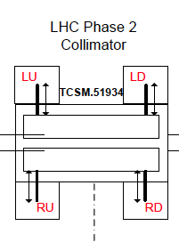
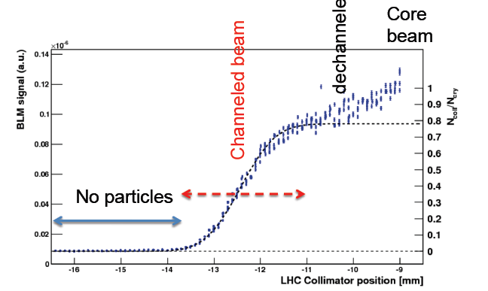
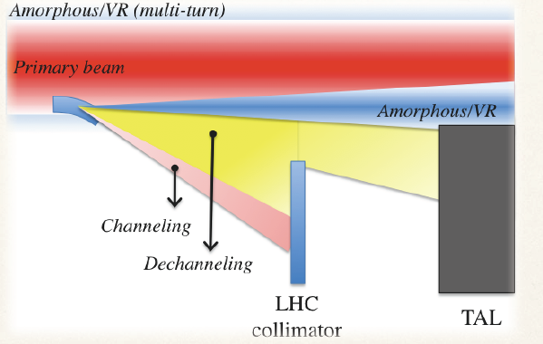
LHC collimator scans
Core
beam
dechanneled
Channeled beam
Protons
No particles
Moving jaw!
      Measurement of channeled beam position and width
        σ_{beam} ~0.6mm
      Comparison of plateau with core beam
        Deflection efficiency ~80%,
      Close to expectation (92% and 0.33mm)

Slide 20
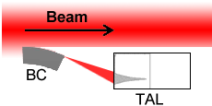
Collimation leakage
AM=amorphous orientation
CH=channeling orientation
Paper in preparation
A: beam tails (off-momentum and betatronic)
(r.u.)=count rate/circulating intensity
B: multiple Coulomb scattering area
C: shadow of the TAL absorber
Reduction of TERTIARY HALO almost 5 times larger !
Better cleaning efficiency
A
B
Halo leakage
C
Spray of TAL2
TAL2
BLM

Slide 21
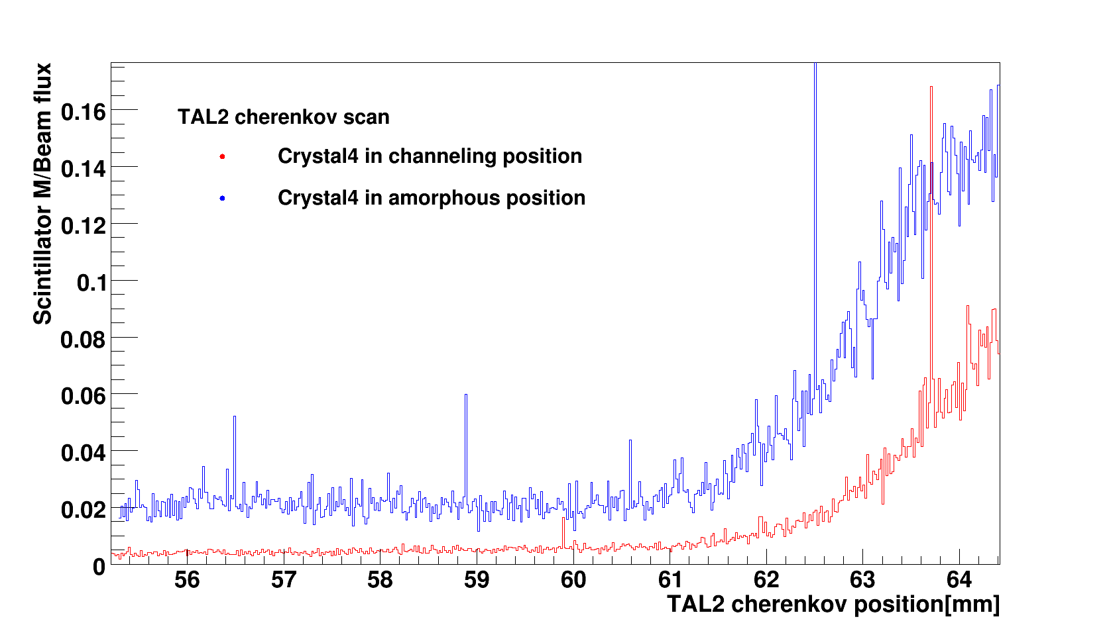
Collimation leakage with ions
Paper in preparation
Only one set of scans made by Cherenkov detector mounted on TAL2.
beam
TAL
TAL2
MD 16th November 2010
Tertiary halo reduction
4-6 times better!

Slide 22
Summary & Outlook

Slide 23
Summary of 2010 SPS test
Crystal collimation works very well based on channeling process
    Optimal crystal alignment easily detected and achieved
Nuclear loss rate (including diffractive) strongly depressed
in channeling versus amorphous orientation.
Observed for both protons and ions!
Estimate of cleaning efficiency of collimation region
Leakage is a factor 5 better in aligned orientation versus amorphous
Next for 2001:
Better goniometer accuracy
Thinner Cerenkov detector to resolve proton pile-up
More accurate analysis of tertiary halo [new Medipix]
disentagling betatron from synchrotron tertiary halo
Notes:
Further comparison with simulation
Redetermine
deflection efficiency and
multipass efficiency
Check extracted
beam direction and shape

Slide 24
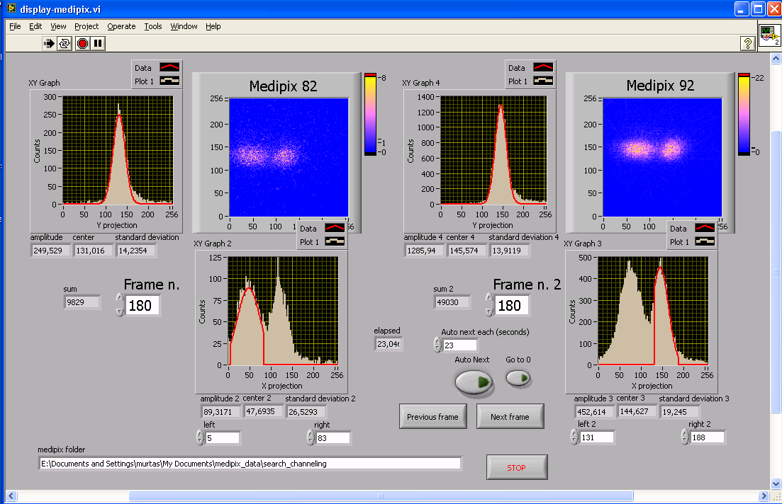
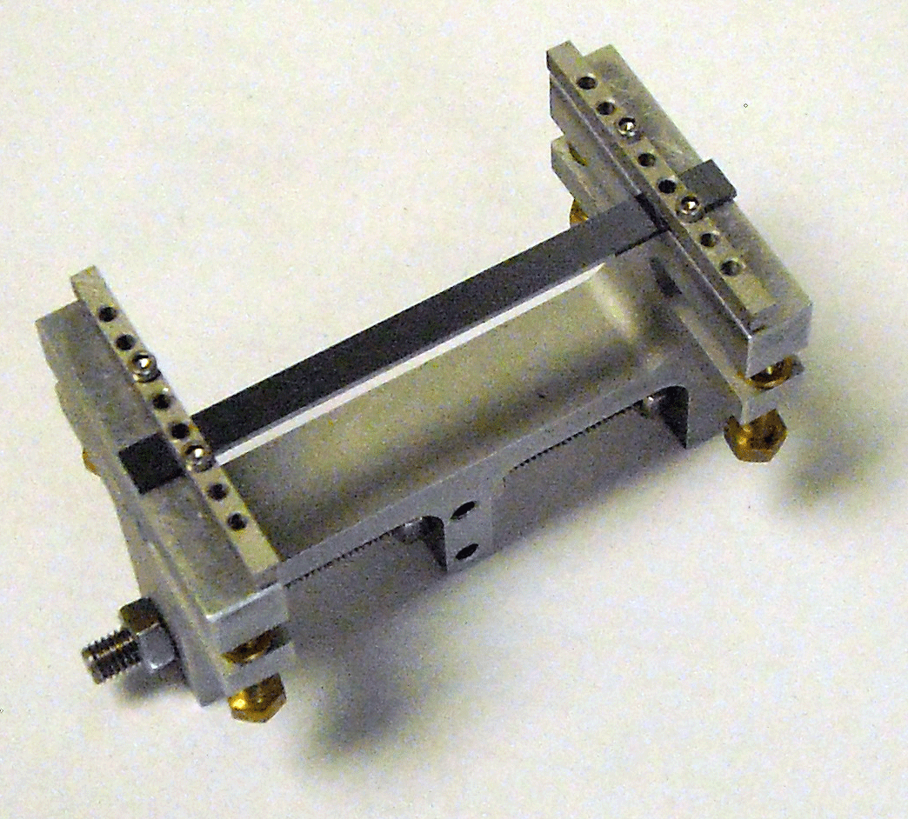
Crystal test station at SPS H8
  Silicon strip telescope and gas chamber
  to characterize new crystals
Study more exotic crystals
for different collimation scheme
Si crystal
for LHC
Thin Crystals
Study new particle coherent
interaction effects
PXR
Si, (110 plane ), miscut: 22 μrad
Deflection angle: 100 μrad
size: 55x5x2 mm³
Torsion : holder can regulate
torsion within 0.2 μrad/mm
Study ion Pb₈₂ channeling

Slide 25
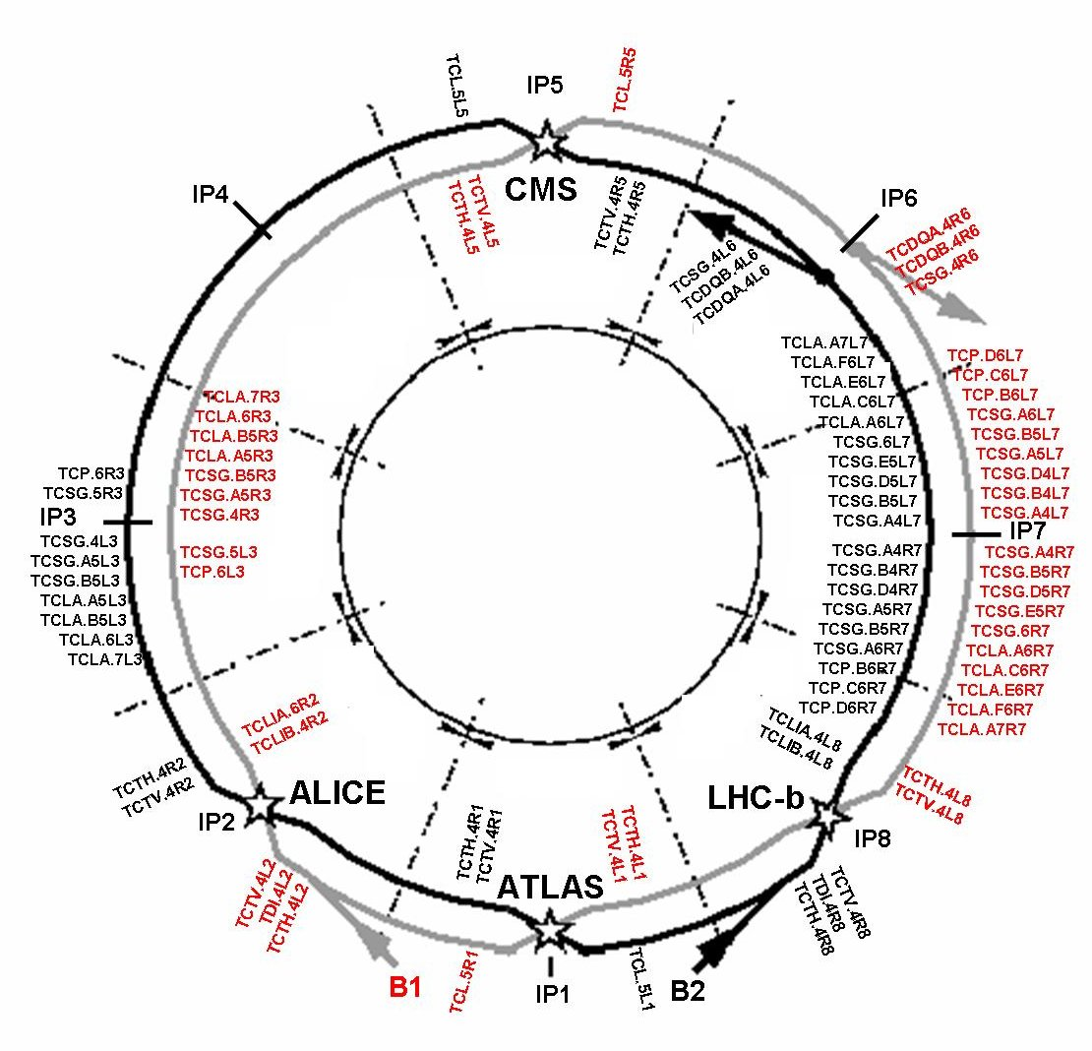
LHC Phase 2 collimation
Overall ~150 collimator locations in LHC and transfer lines
Two warm insertions dedicated to collimation:
IR3 momentum cleaning
IR7 betatron cleaning
Layout has been optimized for phase 1
Phase 1 means
30-40% of nominal beam intensity
Assman. R. et al, “The final collimation
system for the LHC”, EPAC 2006
Letter of Intent for LHCC in preparation
Plan is to install a crystal collimation region on LHC in 2012

Slide 26
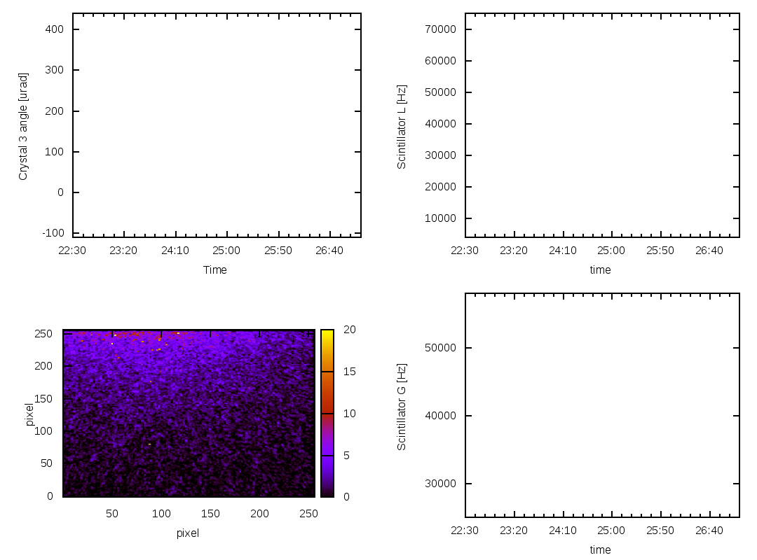
Rotating crystal in the beam
Crystal angle
(around a vertical axis)
BLM rate
close to
crystal
Periphery of circulating beam
Appearance of 120 GeV/c proton beam
deflected by crystal channeling

Slide 27
Road-map for a test in LHC
Parameters | Obtained in 2009 | Obtained in 2010 | Required for LHC
Channeling efficiency | 75 | 80 | 90÷95 | ★★
Nuclear loss reduction | 5 | 5-10 | 20÷30 | ★★
Goniometer: angular accuracy [µrad] | 30÷40 | 10 | 1÷2 | ★
Crystal bend [µrad] | 140÷150 | 150÷170 | 50÷100 | ★★★
Crystal torsion [µrad] | 20÷30 | 0.1÷1 (*) | 0.1÷1 | ★★★
Amorphous layer on crystal | About zero | About zero | About zero | ★★
Collimation leakage reduction | - | 5 | Should be analyzed | ★★
(*) On external beam test

Slide 28
Backup
Notes:
Movie of appearance of two beam with Medipix
Summary of results on crystals
A crystal as a giant dipole

