Slide 1
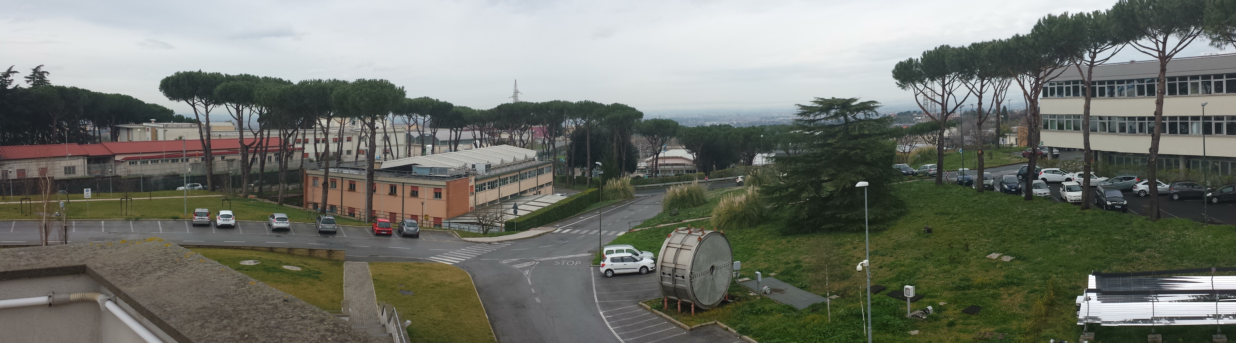
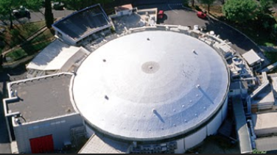
3D Structure of the Nucleon: from JLab12 to JLab24
Harut Avakian (JLab)
LNF-INFN, 15 Dec 2020
Studies of 3D structure
  New understanding of the transverse momentum distributions in SIDIS and the role of Vector Mesons
  Possible new interpretation of some SSAs (correlations of hadrons)
  Critical role of JLab24 (evolution, large transverse momentum, non-perturbative sea)
Summary
Notes:
JLAB on Understanding the large transverse momenta of SIDIS Measurement.
I will start with a broad introduction to the importance of Semi-Inclusive Deep Inelastic scattering and will present you data obtained by different collaborations with particular emphasis on results obtained at JLAB by the CLAS collaboration we are part of. I will discuss studies on transverse momentum of Hadrons and their interpretation and challenges and finally provide you a summary of our work.

Slide 2
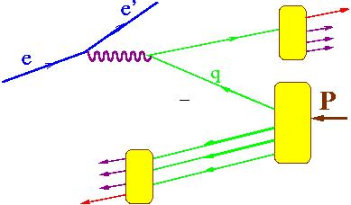
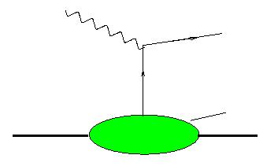
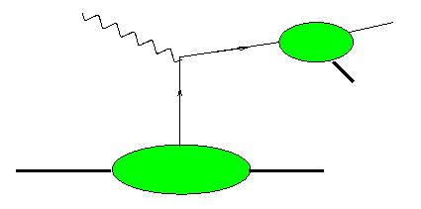
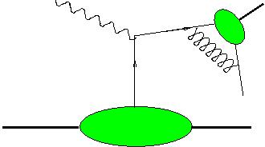
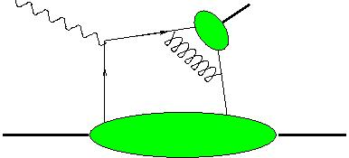
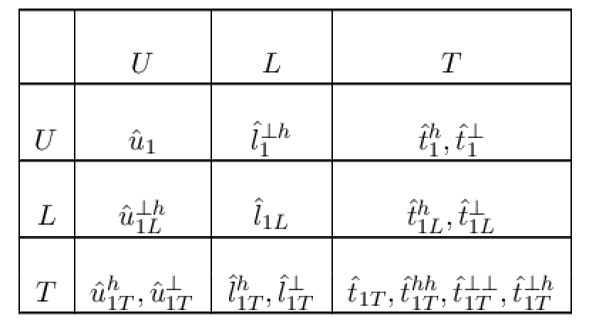
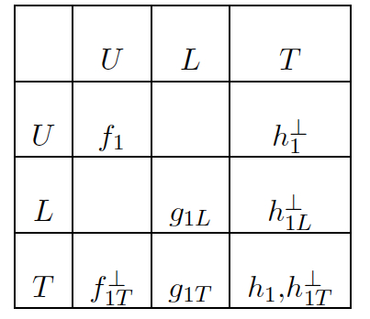
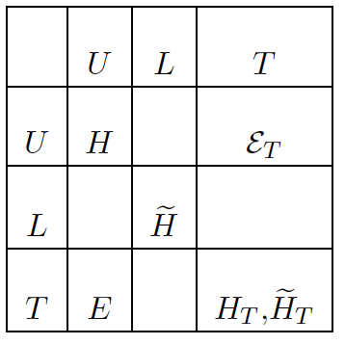
Electroproduction: extending 1D PDFs
x_{F} – fractional momentum in the CM frame
h
x_{F}>0 (current fragmentation)
x_{F}<0 (target fragmentation)
h
FF
FF
h
DA
DA
h
h
h
q
h
M
TMD
PDF
GPD
-1
Fracture Functions (target fragmentation)
0
Semi-exclusive production
1
x_{F}
N/q
N/q
N/q
X
X
X
X
Wide kinematic coverage of large acceptance detectors allows studies of semi-inclusive and exclusive processes simultaneously
Notes:
The real electroproduction is more complex, as we have to deal with hadrons produced both in the direction of the struck quark, and also target remnants involving different correlations which show up as we will see later in variety of observables. Here in addition to TMDs and GPDs you can see the fracture functions describing the target fragmentation and also so called semi-exclusive processes, which may be complicate analysis of exclusive and semi-inclusive processes, but may also be a key in understanding of higher twists (discussed in more details later).

Slide 3
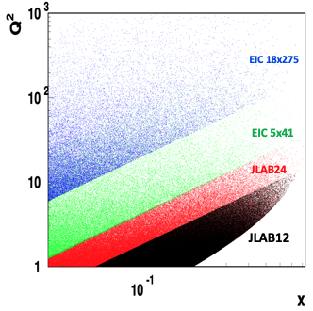


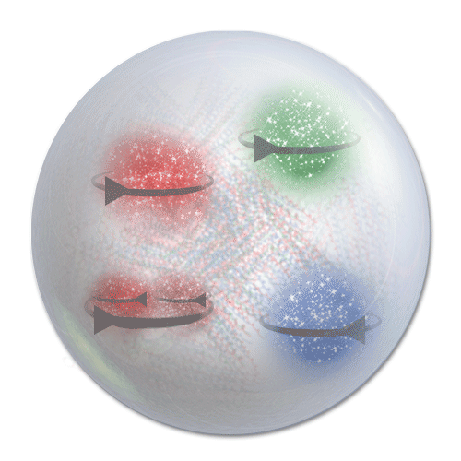

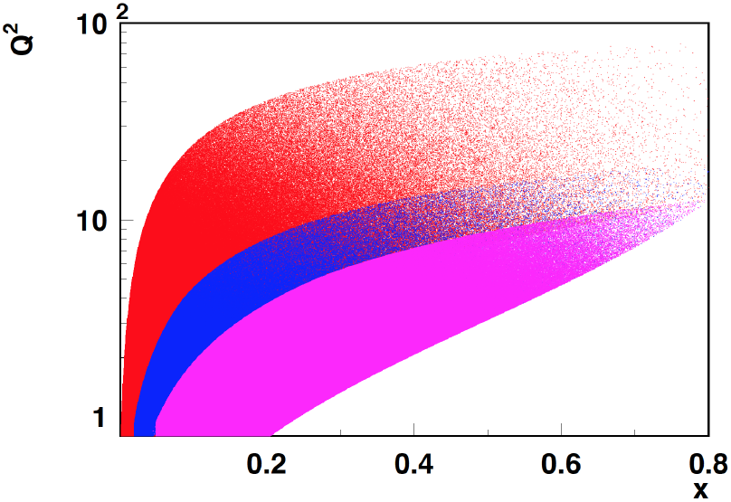

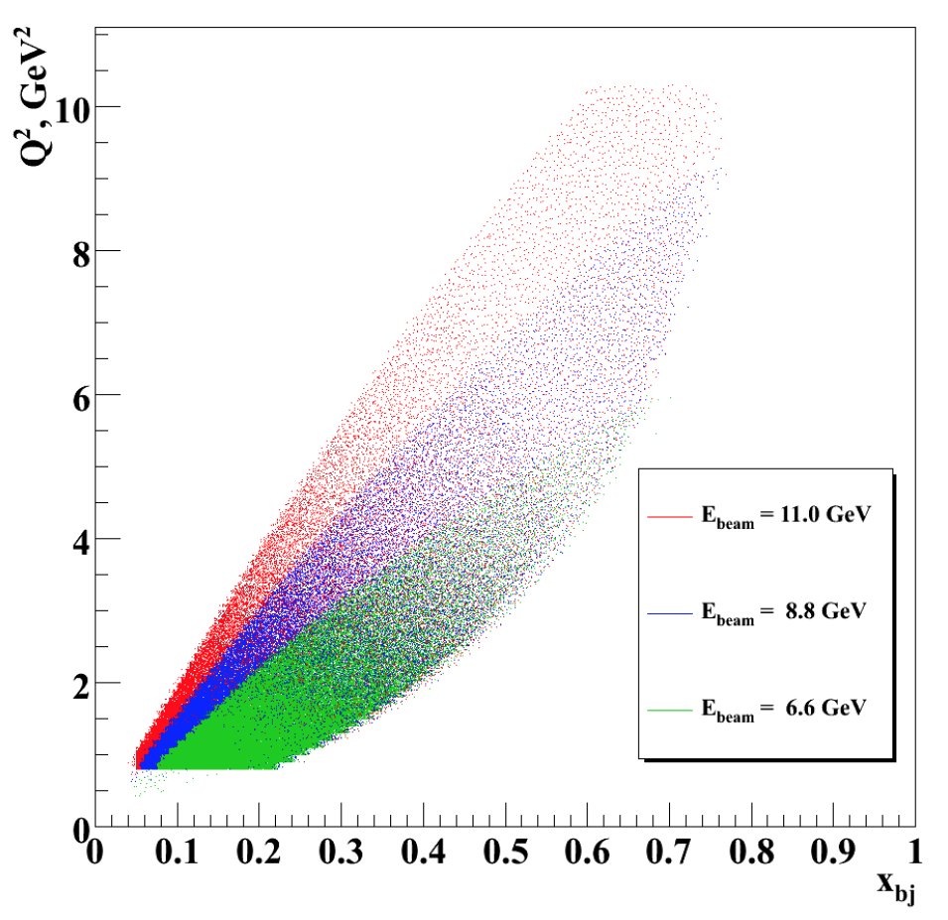
SIDIS kinematical coverage and observables
(E’,p’)
(E,p)
x
z
y
q
ρ⁰
u
q
N
π⁺
u
d
h
COMPASS
HERMES/JLab24
B
JLab12
EIC
JLab7/9/11
Studies of azimuthal modulations give access to underlying 3D partonic distributions
Notes:
Here is SIDS process with detection of a lepton and final state hadrons and all major facilityies in the game starting with lower beam energies of JLab, HERMES, COMPASS and finally the EICs
Theory studies the variety of structure functions in the x-section describing all kind of spin observables accessible with polarized beams and targets, depending on fractions of momentum transfer from object to another the x,y,z and the transvers momentum PT and the azimuthal angle in the CM frame.
The variable that theorist like so much was also a source of confusion for last few years and certainly requires more attention.

Slide 4
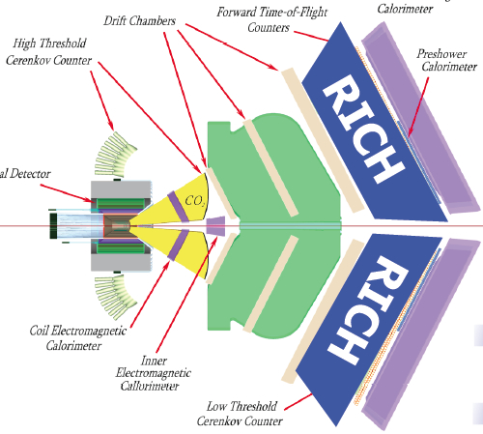
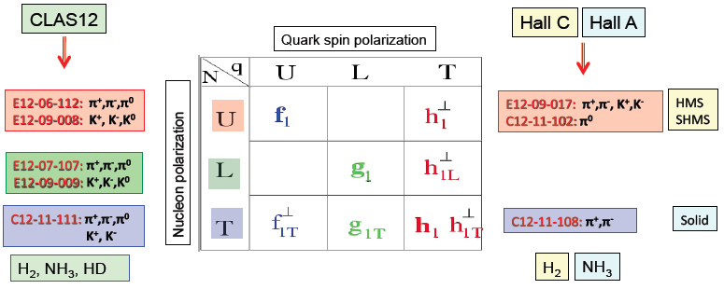
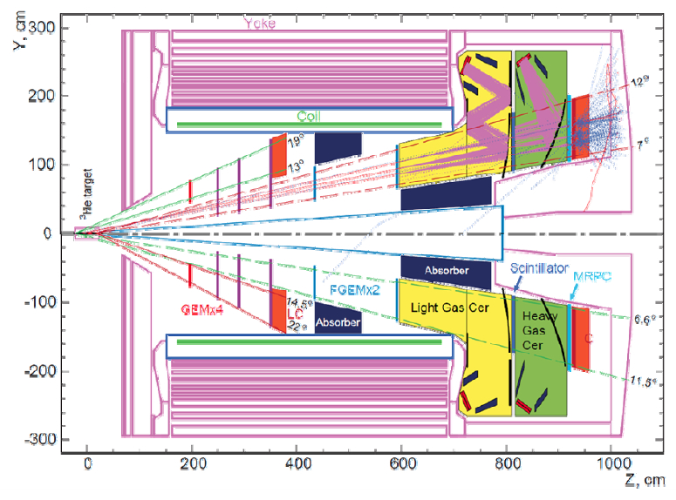
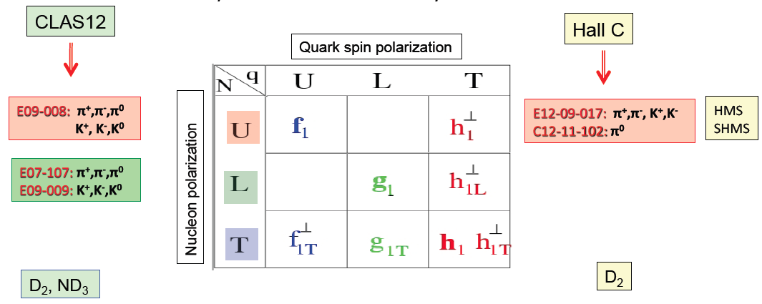

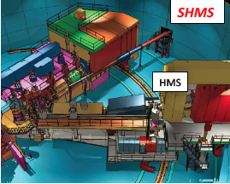
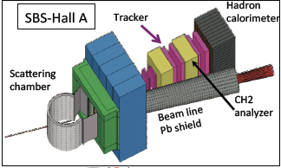

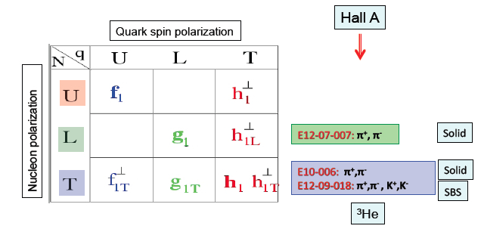
SIDIS at JLab12
C12-20-002
π⁺,π⁻.π⁰,Κ+
Notes:
The list of TMD related observables in 3 JLab Halls with different types of targets 4 detectors involved. Colors orange/green/blue correspondingly for unpolarized, longitudinally polarized and transversely polarized proposals.
The latest one is the proposals with H3 at CLAS12.
-------
Hall C requires three superconducting quadrupole magnets (Q1, Q2, and Q3), an HB dipole and a superconducting dipole magnet for the Super High Momentum Spectrometer (SHMS) to be installed within its Continuous Electron Beam Accelerator Facility (CEBAF).

Slide 5
12 GeV Approved Experiments by Physics Topics
(status: May 2021)
Topic | Hall A | Hall B | Hall C | Hall D | Other | Total
Hadron spectra as probes of QCD | 0 | 2 | 1 | 4 | 0 | 7
Transverse structure of the hadrons | 7 | 4 | 3 | 1 | 0 | 15
longitudinal structure of the hadrons | 1 | 3 | 7 | 1 | 0 | 12
3D structure of the hadrons | 5.5 | 9 | 6.5 | 0 | 0 | 21
Hadrons and cold nuclear matter | 9 | 6 | 7 | 1 | 0 | 23
Low-energy tests of the Standard Model and Fundamental Symmetries | 3 | 1 | 0 | 1 | 1 | 6
Total | 25.5 | 25 | 24.5 | 8 | 1 | 84
Total Experiments Completed | 9.0 | 9.7 | 7.3 | 1.5 | 0 | 27.5
Total Experiments Remaining | 16.5 | 15.3 | 17.2 | 6.5 | 1.0 | 56.5
~10
years
JLab 2015 Science & Technology review closeout bullets:
develop an integrated picture of what measurements are necessary and will be conducted in determining the GPDs and TMDs
develop milestones for extraction of GPDs and TMDs from experiment
Notes:
As you can see the dominant part of approved proposal, some of them already completed are dedicated to studies of partonic picture of the matter. As stated in the Science & Technology review development of milestones for extraction of GPDs and TMDs is one of main goals.

Slide 6
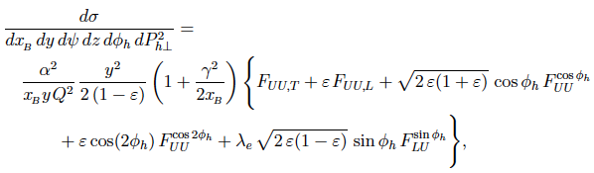
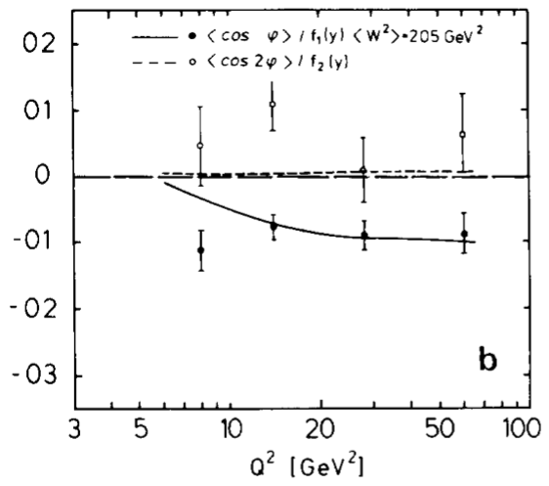
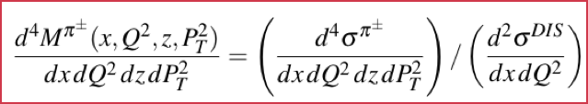
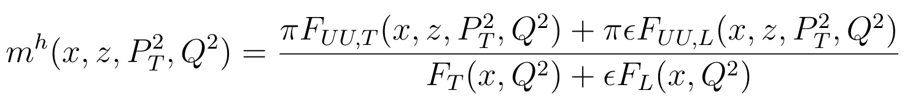
Azimuthal distributions in SIDIS (unpolarized)
H.T.
H.T.
H.T.
EMC-1983 (PL,v130,118)
Observables: - Azimuthal Moments - Multiplicity
- SIDIS experiments measure the φ-dependent cross sections (multiplicities)
- Quark-gluon correlations are significant in electro production experiments (even at high energies).
- Large cosφ modulations observed in electroproduction (EMC, COMPASS, HERMES) may be a key
in understanding of the QCD dynamics.
Notes:
If we look at the simpler case of an unpolarized target. the cross section reads as the first formula. Where we have a part that doesn’t depend by any phi modulation ,a cosphi, cos2phi and sinphi modulation. Commonly experiments extract Azimutahl moments and multiplicity. The multiplicity is the ratio to the SIDIS cross section (integrad over phi) to the DIS cross section and is represented by the ratio of the cros section in the last equation. Experiments have shown that that quark-gluon correlations are significant in electro production experiment, since azimuthal moments related to H.T. are . As an example I am showing here a plot from EMC collaboration that highlight how the higher twist cosphi azimuthal moment is sizable also at high energy.. Understanding these modulation may be a key in understanding the QCD dynamic.

Slide 7
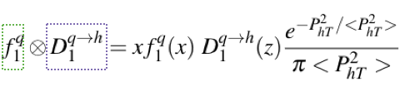
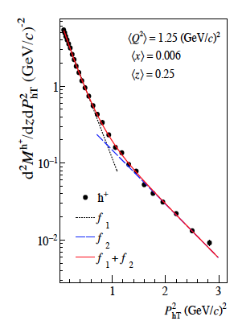
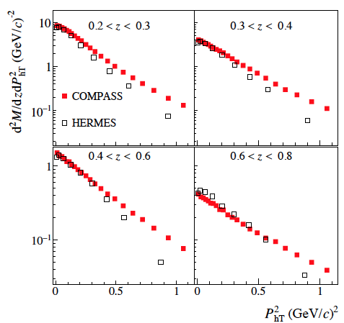
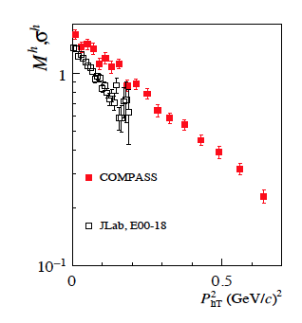
Multiplicities of hadrons in SIDIS
Gaussian Ansatz
TMDs universal, so what is the origin of the differences observed ?
COMPASS:1709.07374
High PT
What is the origin of the “high” PT tail?
1) Perturbative contributions?
2) Non perturbative contributions? (TMDs dependence not 1 Gaussian)
TMDs evolution makes distribution wider
Lower the beam energy, less phase space for high P_{T}
Notes:
On the other hand, the multiplicity clearly show the PT dependence of the SIDIS cross section. Here for example are shown the multiplicities extracted by Compass, Hermes and the JLAB on a lograritmic scale. In the convolution of the TMDs, it is convenient to assume a Gaussian Ansatz for the transverse momentum description. The transverse momentum of quark is then extracted using a Fit with a Gaussian PT dependence on the data. But how can you see from the plot on the right, the distribution follow a Gaussian in PT for low PT (meaning below 0.8) and another for higher PT. High PT in the context of this presentation means above the 0.8 GeV^2 region. In addition different experiment at different energies shows a different PT distribution as can be seen from the plots on the left side where the multiplicity of Compas. Hermes and JLAB are compared. However TMD are universal functions and therefore the extraction should be universal among all experiments. It is important to understand the origin of these discrepancies, The different slope can be due to TMD evolution that makes the distribution wider and to the lower phase space available for the hadron production. The origin of the high PT tale can be due to perturbative contributions or non perturbative contributions.

Slide 8

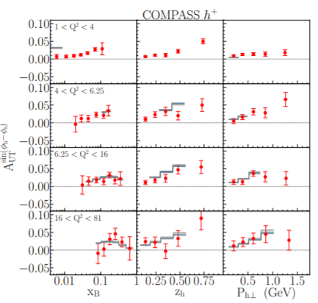
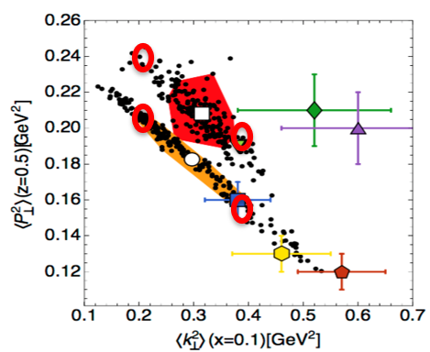
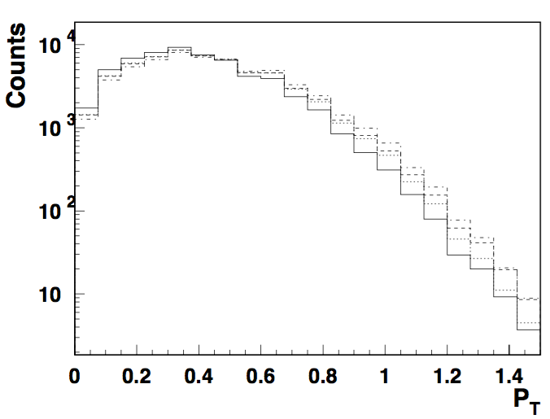
Extracting the average transverse momenta
Sivers functions at NLO+NNLL
Echevarria,Kang&Terry: JHEP01(2021)126
LUND-MC
Fits even for COMPASS include only the small fraction of the low PT-data, with trivial linear dependence
What exactly we learn about high P_{T}, and can we extrapolate?
Extraction very sensitive to input (replicas)
Most sensitive to parameters is the large P_{T} region
Large k_{T}-behavior of f1,g1 practically unknown!!!
Requires wider k_{T} for LUND-MC

Slide 9
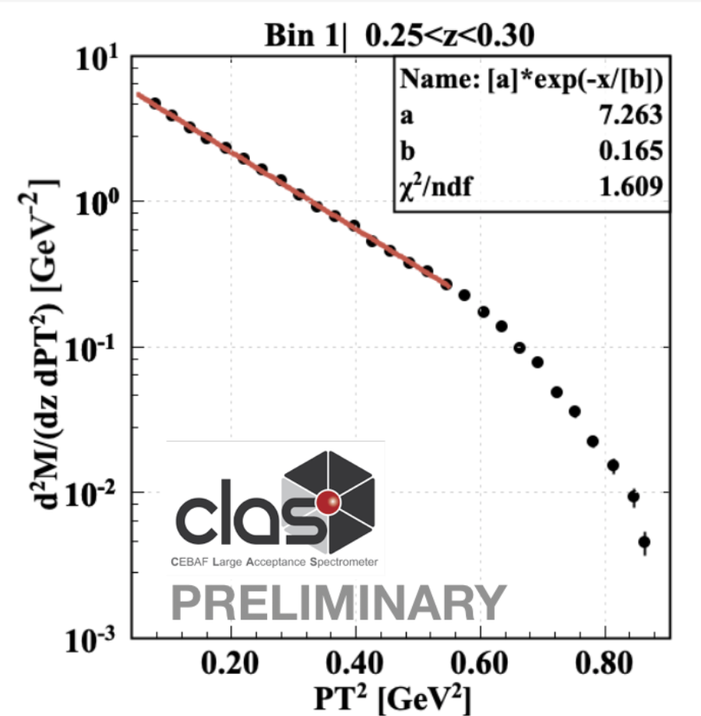
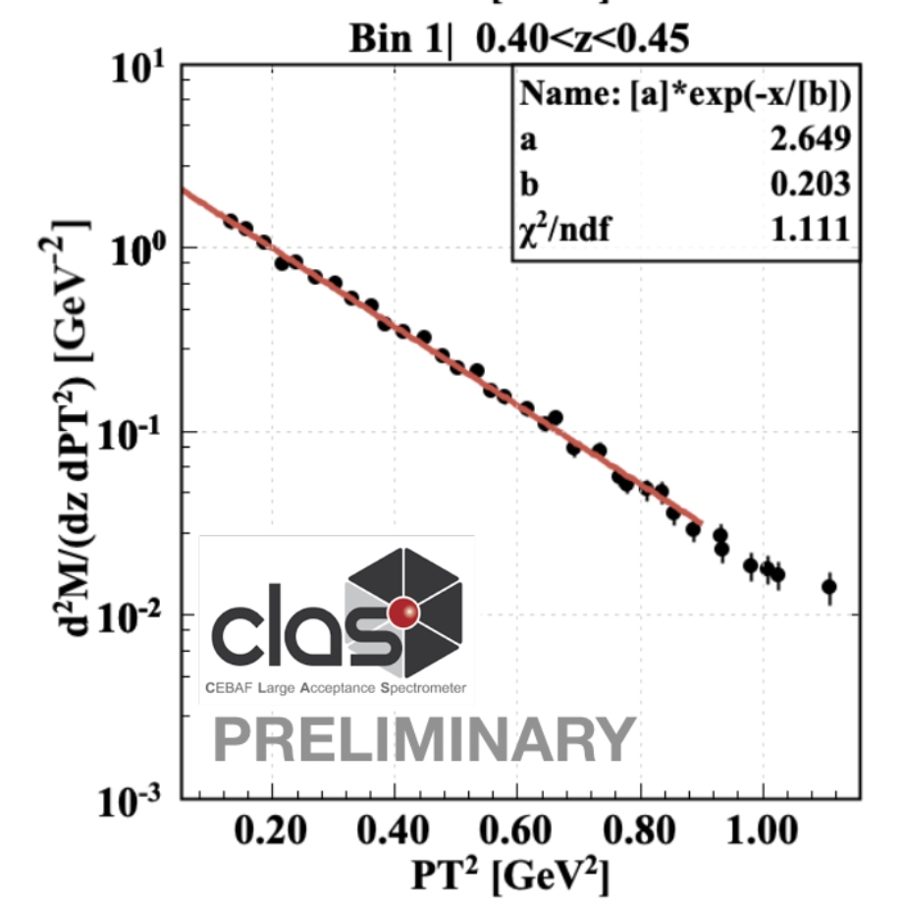
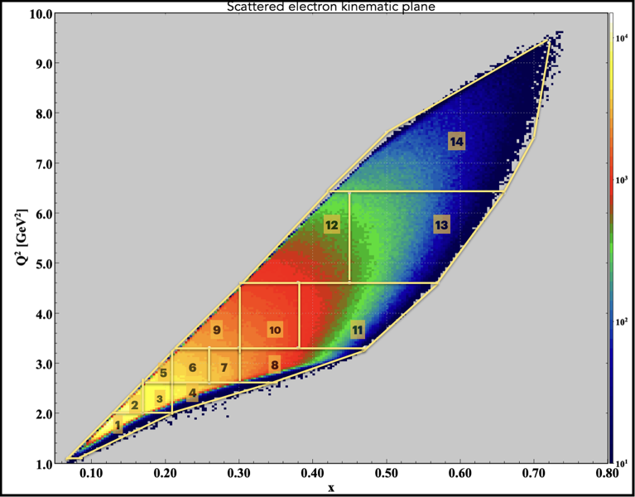
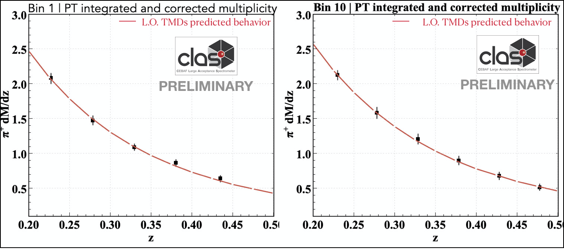
CLAS12 1h Multiplicities: high P_{T} & phase space
PRELIMINARY
<Q^2> = 1.8 GeV^2
<x>= 0.13
<Q^2> = 1.8 GeV^2
<x>= 0.13
For some kinematic regions,
at low z, the high P_{T} distribution appear
suppressed: there is no enough energy
in the system to produce hadron with high
transverse momentum (phase space effect).
If the effect is accounted, the CLAS data
follows global fits.
PDF & FF used:
CTEQ PhysRevD.103.014013 &
DeFlorian-Sassot PhysRevD.91.014035
PDF & FF used:
CTEQ PhysRevD.103.014013 &
DeFlorian-Sassot PhysRevD.91.014035
Notes:
The second measurement I want to point out is the multiplicity one. This is a preliminary analysis where we are able to provide a multidimensional multipliciuty analysis. You can see that Q^2 , x plane reach and the division in 14 bins, For one of those bin the multiplicity is shown as function of the transverse momenta. The red line is a fit done with a Gaussian and the dotted line is a continuation of that fit. You can see how at low z there is a suppression of momenta. While there is not at higher z. How to interpret these behavior for larget transverse momenta? We did in MC studies and once accounted the data follow Global Fit as shown in the two plots where for two bin of our phase space we follow the prediction of LO TMDs.

Slide 10
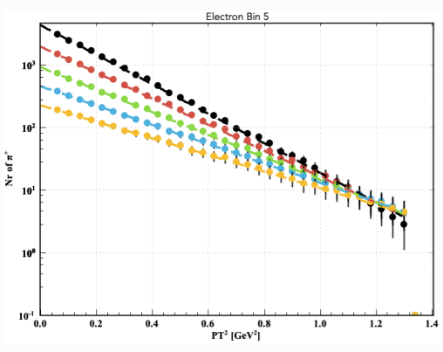
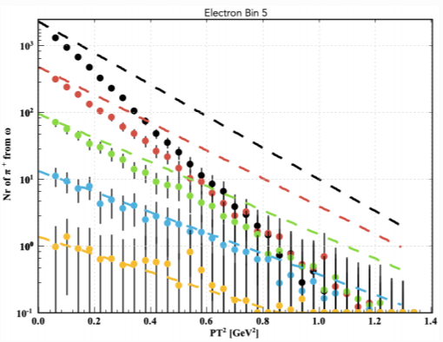
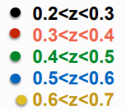
CLAS12 1h Multiplicities: high P_{T} & phase space
The same Gaussian Ansatz for transverse momentum used for pions and VMs to see the impact on P_{T} distribution.
ep→e’π+(ω)X
ep→e’π+X
Phase space limitations for direct pion production more significant at lower W, and lower z
Decayed pions have a much steeper P_{T} distribution at the same z (smaller average k_{T}!)
JLab24 would allow to extend measurements to higher P_{T}, to support the novel understanding of hadronization process suggested by the CLAS12 measurements
Notes:
As I said we studied those effect with a single hadron MC. We produce pions directly from string (That are the red dots) and we produce VM and then we let them decay. The pions decayed are the triangle. The cross section follows the SIDIS one and the transverse momentum the Gaussian fit with weights from the extracted Kperp from data. As you can see. while in some kinematic bin even the low z follow the input distribution (the dashed line) in other it is not the case. This is more significant at low W. Decayed pions across all the kinematic range have much steeper distribution at same z. In this plot I have renormalized the counts so to have them on the same scale. In reality at lower transverse momentum the majority of the pion comes from VM while at high momemntum they come from direct pion.

Slide 11
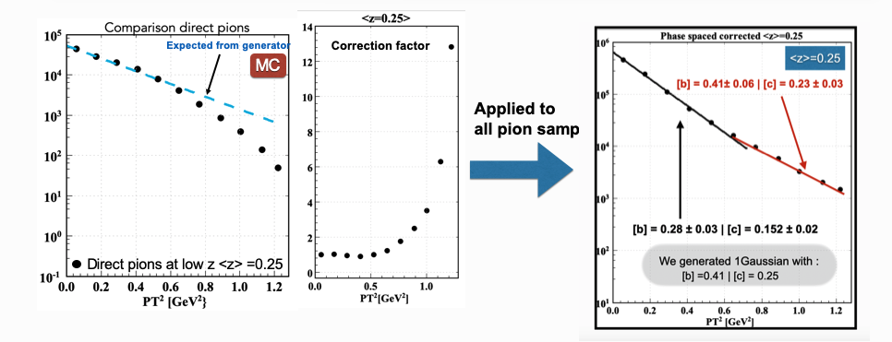

CLAS12 Multiplicities: the role of high P_{T}
LUND MC at 12 GeV using a single Gauss for all hadrons
G. Angelini (GW)
Corrections due to phase space (energy needed to produce a hadron with a given z,P_{T} at given x,Q²) are detector and model independent
Corrections due to fraction of fragmentation VMs and diffractive VMs are model dependent, but can be extracted from MC
At low z, only the high P_{T} shows the generated Gaussian transverse momentum distribution.

Slide 12
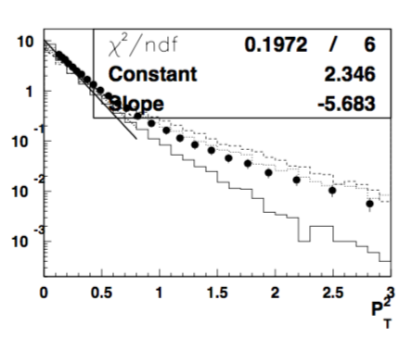
Origin of non-Gaussian tails
1 hadron 2 Gausses or 1 Gauss 2 hadrons?
the “real” multiplicity may be lower with most hadrons produced from struck quark with large z, and low z fraction filled by VM decay pions
  intrinsic k_{T} may be higher
  the z-dependence enhanced at large z (may be tuned better to describe single and di-hadron distributions)
  contributions to pions from target fragmentation may be less relevant
2) Combined increase of average transverse momentum and fraction of VMs allows description of non Gaussian tails at large P_{T} indicating most hadrons come from TMD region
direct pions?
COMPASS
1709.07374
The same width will be extracted for all cases for P_{T}<0.8 GeV
Extractions of k_{T}-widths ignoring VMs will underestimate the <k_{T}²>

Slide 13

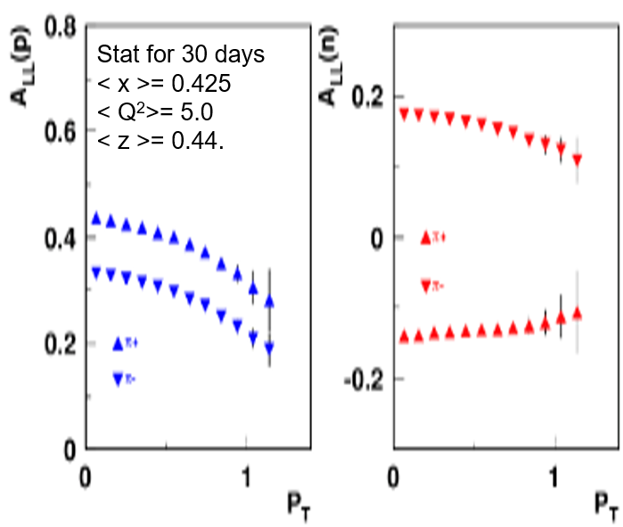
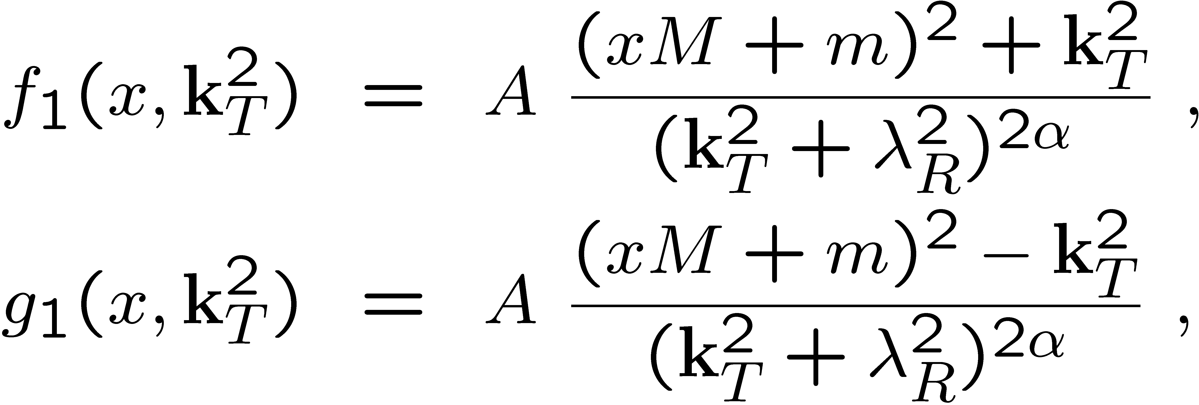
Unknown “known” f₁,g₁ TMDs
(dipole formfactor), J.Ellis, D-S.Hwang, A.Kotzinian
Δu/u
Effect of the orbital motion on the q- may be significant (H.A.,S.Brodsky, A.Deur, F.Yuan 2007)
q
JMR model
Dq
CLAS-C12-20-002
He3 target
M_{R}, R=s,a
Models and lattice predict very significant spin and flavor dependence for TMDs
Large transverse momenta are crucial to access the large k_{T} of quarks
A dedicated to g1(x,k_{T})-studies CLAS12 proposal with He3 target approved by PAC
Notes:
The lattice predictions of significant dependence of the k_T-distributions on the spin are also supported by a number of non-perturbative models, predicting significant spin and flavor dependence for k_T-distributions of partons.
u+/- are probability distribution, so g_1 is a difference of those, and clearly is not supposed to be positive as shown in the top right plot, with \Delta u going to negative at large k_T.
----------
JMR is a simple diquark model. Top right is still diquark with dipole calculation using dipole form factor.

Slide 14
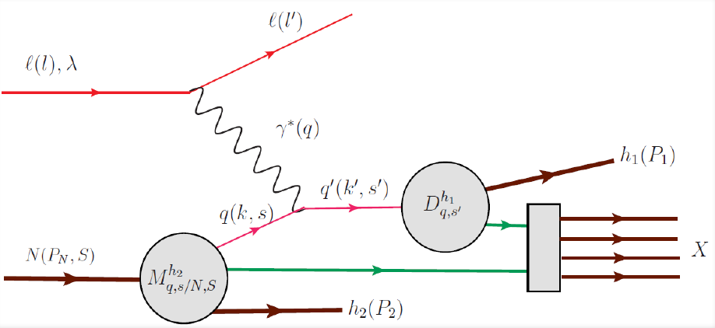
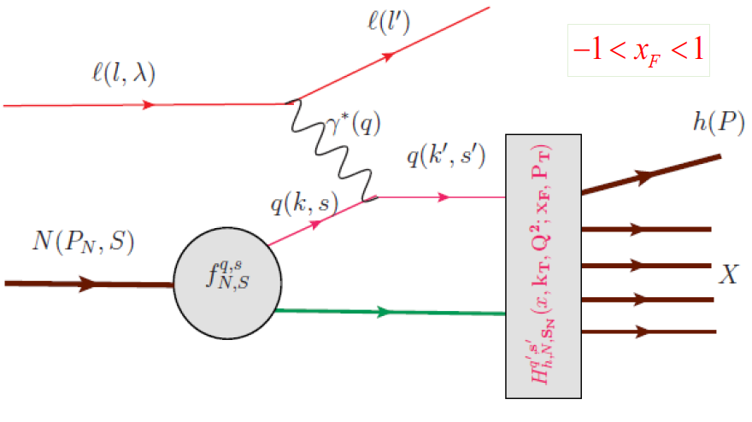
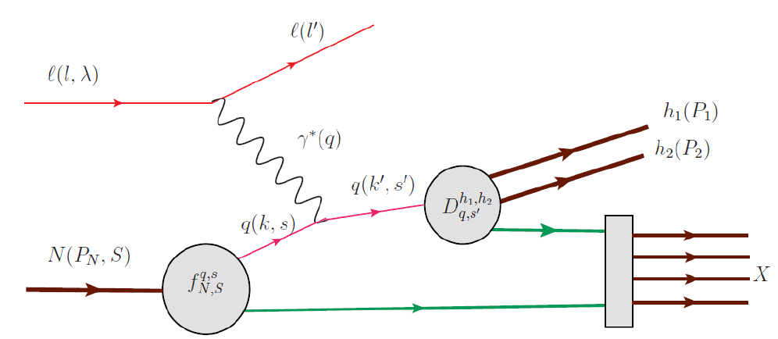
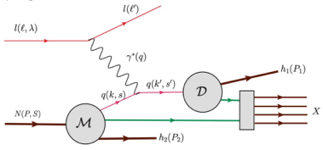

MC simulations: Why LUND works?
A single-hadron MC with the SIDIS cross-section where widths of k_{T}-distributions of pions are extracted from the data is not reproducing well the data.
LUND fragmentation based MCs were successfully used worldwide from JLab to LHC, showing good agreement with data.
So why the LUND-MCs are so successful in description of hard scattering processes, and SIDIS in the first place?
The hadronization into different hadrons, in particular Vector Mesons is accounted (full kinematics)
Accessible phase space properly accounted
The correlations between hadrons, as well a as target and current fragments accounted
….
subsamples
To understand the measurements we should be able to simulate, at least
the basic features we are trying to study (P_{T} and Q²,-dependences in particular)
The studies of correlated hadron pairs in SIDIS may be a key for proper interpretation !!!
Notes:
In order to understand such effects we decided to start by looking at MC simulations. We developed a single-hadron MC generator with the SIDIS cross section in which the transverse momentum follow the Gaussain Ansatz, the widths of the kperp distributions of pions are extracted from the data. However these MC aren’t capable to reproduce the data. Instead, the LUND fragmentation based MC are able to successfully reproduce the data from Jlab to LHC. So why the LUND MC are so successful? In our view the fact that the hadronization account for different hadrons especially for vector mesons (as will discuss in the next slides), the phase space is properly accounted and correlations between hadrons and target and current are accounted. Our idea is that if we want to understand what we measure and extract from measurement one should be able to simulate at least the basic feature we are trying to study. The incapability of reproduce the data by single hadron MC can be in the absence of the features with discuss. This is also suggested by studies of correlated hadron pair in SIDIS. This has been the first publication we produced with the CLAS 12.

Slide 15
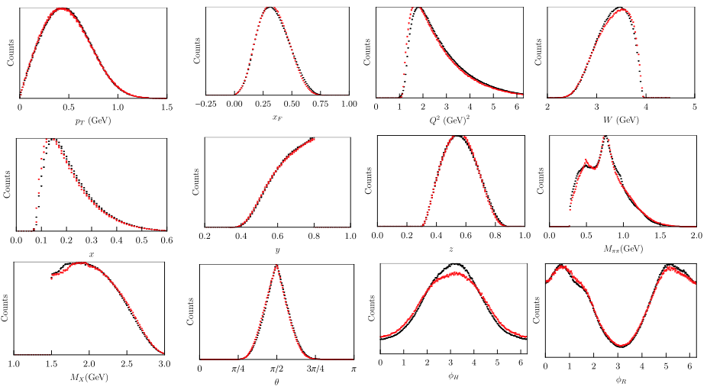
SIDIS ehhX: CLAS12 data vs MC
CLAS12 dihadron production ep→ehhX
CLAS12 MC, based on the PEPSI(LEPTO) simulation with most parameters ”default” is in a good agreement with CLAS12 measurements for all relevant distributions
Notes:
A similar picture for dihedron production distributions over all relevant variables are perfectly described (black are the data and red MC)

Slide 16
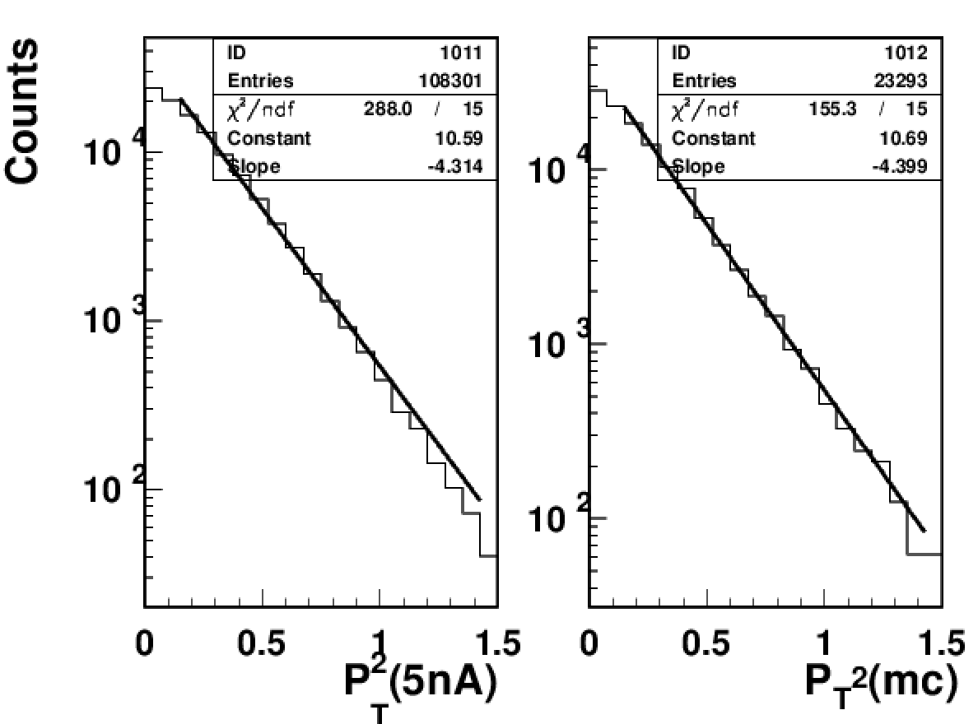
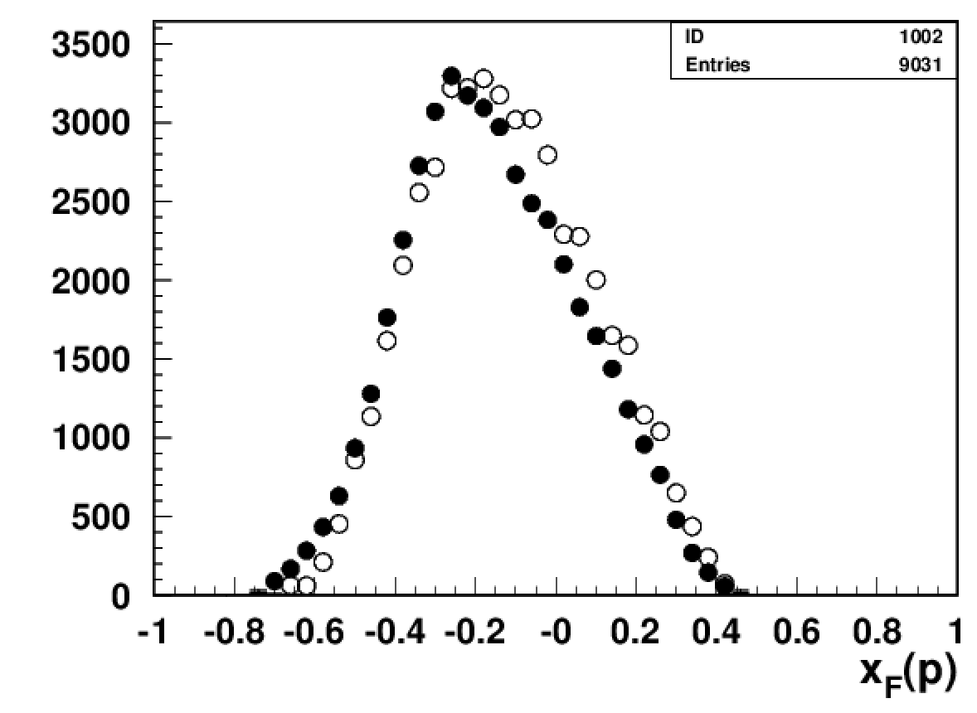

CLAS12 Studies: Data vs MC
Using PEPSI (LUND) generator
Filled symbols data
Open symbols MC
Kinematic distributions, z,x_{F},P_{T}-distributions of protons, and widths are in good agreement with LEPTO
TFR may be a valuable source for studies of widths in hadronization
Expect significantly better separation of TFR and CFR at JLab24
Notes:
One more slide showing perfect agreement between data and experiment for inclusive protons, which are predominantly produced in the target fragmentation region.

Slide 17







Observation of SSAs in ep→e’π⁺π⁻X
T. Hayward et al. Phys. Rev. Lett. 126, 152501 (2021)
Bacchetta&Radici: arXiv:hep-ph/0311173
Matevosyan et al, arXiv:1707.04999
clas6
clas12
Doubling the JLab beam energy, opens the phase space for SIDIS dihadrons
Quark gluon correlations may be very significant
PDF e describes the force on the transversely polarized quark after scattering
Extended range in Q² for JLab24 will be crucial in interpretation of higher twist effects
Notes:
First measurements from CLAS12 indicate the correlations of hadrons in the current fragmentation are very significant, with this particular modulation providing access to the collinear twist-3 PDF e, which was linked to the force on a transversely polarized quark struck by photon. The recent extraction of this PDF from Lattice indeed indicates a very large value>60%.

Slide 18



Sources of inclusive pions: CLAS12 MC
Detection of π⁰s allows also studies of
High P_{T} pions at large Mππ
π+ from string
ρ+
ρ⁰
ρ−
string
string
π+&π− from string
ω
ρ⁰
ρ⁰
ρ+
Dominant fraction of 2 pion combinations come from VM decays
ρ
All measured 2 pion combinations are dominated by VM decays, indicate that all inclusive pions are dominated by VM decays at small P_{T}s, and in particular at lower z!!!
string
ω
Notes:
The same picture you can see here for pi- and pi0 pairs, now dominated by the rho-

Slide 19


Impact of strange VM fraction
Fraction of spin 1 strange mesons JETSET parj(12)
Wiser fit (SLAC)
frac VMs 40%, no s-quark suppression
frac VMs 40%, with s-quark suppression x2
CLAS12 MC
frac VMs 75-80%, no s-quark suppression
Increased fraction of strange VMs in JETSET reduces the effective Kaon fragmentation (more consistent with data)

Slide 20


Comparing data with strange VM
Fraction of spin 1 strange mesons parj(12)= 0.75
frac VMs 40%, no s-quark suppression
frac VMs 40%, with s-quark suppression x2
frac VMs 75-80%, no s-quark suppression
Suppression of strangeness and increasing the strange VM fractions lead to similar suppression of K/π ratio

Slide 21



CLAS12 MC vs Data for Kaons
MC
data
Overall agreement after increasing the fraction of spin 1 VMs within CLAS12 acceptance OK, more high energy kaons in the MC at higher momenta (to be sorted out)

Slide 22



SSA from CLAS12
S. Diehl et al (in publication) arXiv:2101.03544
CLAS Preliminary
Superior statistics in large x-region most relevant for spin-orbit correlation studies
Unexpected Q²-dependence is under study in fine multidimensional bins x,z,P_{T}
Notes:
First single hadron paper from JLab on beam spin SSAs, where you can see the significant improvement in statistics compared to JLab at 6 GeV, but most importantly the first attempt to extract the Q^2-dependence, which is not obvious to interpret, as is the Q^2-dependence of COMPASS <cos> moments.

Slide 23



HT at COMPASS and CLAS12
A. Moretti: https://arxiv.org/pdf/2107.10740.pdf
The ratios of SFs (to F_{UU}) are increasing with Q!!!
The HT observables, don’t look much like HT observables, something missing in understanding
Understanding of these behavior can be a key to understanding of other inconsistencies
Notes:
Now we turn to cosine moments. First studies from COMPASS indeed indicate that the Q^2-dependence of what we call higher twist effects is not trivial (certainly doesn’t look like falling with Q^2), and will require some more effort and collaboration of experimentalist and theorists to sort it out.

Slide 24




Azimuthal Asymmetries in semi-exclusive limit
Phys.Lett.B 347 (1995) 413-418
Higher twists (Berger 1980, Brandenburg et al 1995) z→1 dominant contribution u+e- →e- π+ d
Significant contributions at large z and P_{T} also for H₁/F_{UU}
Notes:
Another important contribution to <cos> moment, which didn’t get much attention is the Berger-Brodsky higher twist. The main reason it didn’t get much attention, was the expectation that it will be significant only at very large z. With our current understanding of hadronization going primarily through large z ( high energy ) VM production, the Berger-Brodsky contribution will deserve more attention.
Another important contribution may be the correction to the multiplicity at large P_T, eventually providing the missing strength at large P_T/q_T

Slide 25




Correlations in 2 hadron production
M. Anselmino, V. Barone and A. Kotzinian, Physics Letters B 713 (2012)
Fracture Functions define the probability for hadron production (P2) given the struck quark q. Combined with the fragmentation function (defining probability for quark q to produce a hadron (P1) defines the x-section for 2 hadron production.
correlation
modulation
Preliminary
SSA increasing in TFR
Spin-azimuthal correlations in hadron pair production in CFR and TFR are very significant
Phase space accessible at JLab24 would allow the coverage in high P_{T}s
Phase space accessible at JLab24 would allow the coverage in wider rapidity gaps
Notes:
The first measurement we published is the measurement of she sin phi R in the di-hadron channel. Phi_R is azimuthal angle defined by the plane given by the two pion momentum and virtual photon. It is related to the convolution of the PDF and FF shown in the equation where e is a high twist PDF linked to the the force on the transversely polarized quark after the scattering, H is a leading twist FF, f1 is leading PDF and G is higher twist.
The observed asymmetry is large, showing how the spin-azimuthal correlation in hadron pair production are very significant. This was observed also with the previous era of CLAS but as you can see with much less statistical power, now the data are very clearl In addition If we look at the invariant mass of the hadron pair, shown by the circle it is well described by our LUND based MC solide lines. You can see that the hadron pairs have a significant contributions from VM decays how can you see from the different colored histogram. These data suggests that hadrons are correlated and mostly come from VM decays. This is a relevant information in understanding the single hadron multiplicity transverse momentum distribution since the single hadron. Is important also to point how how the hadron pair produced directly from string are at higher transverse momentum while the one from decayed are at lower transverse momentum

Slide 26


Struck quark content
ep→e’qX (proton)
en→e’qX (neutron)
u-dominance works for proton, and also neutron at 0.1<x<0.3

Slide 27



Struck quark content
eN→e’qX (all)
eN→e’pqX
eN→e’nqX
Neutron detection significantly enhances d-quark contribution

Slide 28


From JLab12 to JLab24 and EIC: complementarity
x=0.3,z-0.7,P_{T}=0.3
Understanding of Q²-dependence of multiplicities crucial for interpretation
Proper evaluation of systematics, will require definition of fiducial kinematics
JLab at 24 GeV will provide critical input in evolution studies of TMDs
Higher Q²-coverage of “Low s” EIC running will provide validation of evolution studies at JLab at large x
Notes:
Last 3 slides are dedicated to future projects, where measurements of Q^2-dependence of observables, and their P_T-dependence will be the main focus.
Main contributors of polarized SIDIS, in addition to very valuable data accumulated by COMPASS collaboration (currently running) will the the future Electron-Ion Collider and the JLab data at 12 GeV, and in future measurements at upgraded to 24 GeV JLab.
Cross sections for different configurations of JLab and EIC are shown in the left plot.
We note that that is just the x-section the real luminosities, which are higher at jlab by 1-2 orders of magnitude will change the relative contributions.
Another important factor to clarify, is the set of events used in the EIC simulations. As you can see from the left plot, there are a lot of counts at large x expected at EIC, and more at higher s, however all those events are all in the tiny kinematical region of very small y, which is normally being cut to ensure the reliability of measured kinematics.
A typical cut may be y>0.05, or even y>0.1. “In fact COMPASS is using even higher y cuts”. At smaller y there are bunch of problems including the challenging to control resolutions and radiative corrections. The symbols in the left plot with y>0.05 cut applied are shown for EIC with different color. As you can see that reduces the total statistics by 3-7 orders of magnitude. Another important factor is obviously the size of the measured effects, and the right plots shows the example of the Sivers SSA vs Q^2.
Production of realistic projections will be crucial for optimization of efforts and defining the complementarity between two facilities.
While Major advantage of the JLab24 will obviously be the valence region, the EIC data can provide valuable information on gluon distributions.

Slide 29

From JLab to EIC: complementarity
The ratio of radiative cross (σ_{RC}) section to Born (σ_{B}) in SIDIS
T. Liu et al
JHEP 11 (2021) 157
Gaussian F_{UU} (φ_{h}=0)
The radiative effects in SIDIS may be very significant and measurements in multidimensional space at different facilities will be crucial for understanding the systematics in evolution studies.
Notes:
Last 3 slides are dedicated to future projects, where measurements of Q^2-dependence of observables, and their P_T-dependence will be the main focus.
Main contributors of polarized SIDIS, in addition to very valuable data accumulated by COMPASS collaboration (currently running) will the the future Electron-Ion Collider and the JLab data at 12 GeV, and in future measurements at upgraded to 24 GeV JLab.
Cross sections for different configurations of JLab and EIC are shown in the left plot.
We note that that is just the x-section the real luminosities, which are higher at jlab by 1-2 orders of magnitude will change the relative contributions.
Another important factor to clarify, is the set of events used in the EIC simulations. As you can see from the left plot, there are a lot of counts at large x expected at EIC, and more at higher s, however all those events are all in the tiny kinematical region of very small y, which is normally being cut to ensure the reliability of measured kinematics.
A typical cut may be y>0.05, or even y>0.1. “In fact COMPASS is using even higher y cuts”. At smaller y there are bunch of problems including the challenging to control resolutions and radiative corrections. The symbols in the left plot with y>0.05 cut applied are shown for EIC with different color. As you can see that reduces the total statistics by 3-7 orders of magnitude. Another important factor is obviously the size of the measured effects, and the right plots shows the example of the Sivers SSA vs Q^2.
Production of realistic projections will be crucial for optimization of efforts and defining the complementarity between two facilities.
While Major advantage of the JLab24 will obviously be the valence region, the EIC data can provide valuable information on gluon distributions.

Slide 30




X vs Q² from JLab to EIC
y_{min}>0.05
EIC 10x275
y_{F}
y_{F}>0.05
EIC 5x41
y_{F}>0.01
All
JLab12
Large x events all in region of small y_{F}=1.0-E’/Ebeam
Non overlapping ranges of EIC (machine dedicated to gluon studies) and JLab may be a problem for evolution studies, which are most critical for the 3D structure

Slide 31

From JLab to EIC: complementarity
x=0.3
To compare directly the lumi should be applied (10^35-10^37 for JLab)
With latest lumi: 5x41 will decrease >200 times, 18x275 >10 times
Proper evaluation of systematics, will require definition of fiducial kinematics
JLab at 24 GeV will provide critical input in evolution studies of TMDs
Higher Q²-coverage of “Low s” EIC running will require higher lumi to provide validation of evolution studies at JLab at large x
Notes:
Last 3 slides are dedicated future projects, with measurements of Q^2-dependence of observables, and their P_T-dependence will be the main focus.
Main contributors of polarized SIDIS, in addition to very valuable data accumulated by COMPASS collaboration (currently running) will the the future Electron-Ion Collider and the JLab data at 12 GeV, and in future measurements at upgraded to 24 GeV JLab.
We note that that is just the x-section the real luminosities, which are higher at jlab by 1-2 orders of magnitude will change the relative contributions.
Another important factor to clarify is the set of events used in the EIC simulations. As you can see from the left plot, There are a lot of counts at large x expected at EIC, however all those events
Production of realistic projections will be crucial for optimization of efforts and defining the complementarity between two facilities.
While Major advantage of the JLab24 will obviously be

Slide 32



From JLab to EIC: complementarity
Pavia grids
x=0.3
z=0.7
P_{T}=0.3
x=0.3
z=0.7
P_{T}=0.3
JLAB24
Sivers
x=0.3
z=0.7
P_{T}=0.3
JLAB12
EIC 18x275
EIC 18x275
EIC 5x41
y>0.05
L=0.5*10³⁴
The counts in a given bin, and the size of the effect will define the expected sensitivity.
Proper evaluation of systematics, will require definition of fiducial kinematics, and the impact of the multidimensionality
JLab at 24 GeV will provide critical input in evolution studies of TMDs
Higher Q²-coverage of “Low s” EIC running will provide validation of evolution studies at JLab at large x (will require high luminosity)
Notes:
Last 3 slides are dedicated to future projects, where measurements of Q^2-dependence of observables, and their P_T-dependence will be the main focus.
Main contributors of polarized SIDIS, in addition to very valuable data accumulated by COMPASS collaboration (currently running) will the the future Electron-Ion Collider and the JLab data at 12 GeV, and in future measurements at upgraded to 24 GeV JLab.
Cross sections for different configurations of JLab and EIC are shown in the left plot.
We note that that is just the x-section the real luminosities, which are higher at jlab by 1-2 orders of magnitude will change the relative contributions.
Another important factor to clarify, is the set of events used in the EIC simulations. As you can see from the left plot, there are a lot of counts at large x expected at EIC, and more at higher s, however all those events are all in the tiny kinematical region of very small y, which is normally being cut to ensure the reliability of measured kinematics.
A typical cut may be y>0.05, or even y>0.1. “In fact COMPASS is using even higher y cuts”. At smaller y there are bunch of problems including the challenging to control resolutions and radiative corrections. The symbols in the left plot with y>0.05 cut applied are shown for EIC with different color. As you can see that reduces the total statistics by 3-7 orders of magnitude. Another important factor is obviously the size of the measured effects, and the right plots shows the example of the Sivers SSA vs Q^2.
Production of realistic projections will be crucial for optimization of efforts and defining the complementarity between two facilities.
While Major advantage of the JLab24 will obviously be the valence region, the EIC data can provide valuable information on gluon distributions.

Slide 33

Contributions for 3D structure studies: Sivers
y>0.05
JLab24 will be crucial to bridge the TMD studies between JLab12 and EIC in the valence region
33
Notes:
To summarize the current status some observations and items that will be discussed are listed here
It is important that theory, which is more flexible will move in the direction of kinematics accessible in current experiments, where large effects were observed.

Slide 34
Making projections: data set
Pseudo data set
(counts)
Some prediction
(parameterization?)
Extraction procedure
Projection for measurements
Data set
Quality
Cross sections + geometrical cuts
Generated events (real phase space)
Generated + radiative effects
GEANT simulation + resolutions+ID
Reconstructed after GEANT (ideal)
Reconstructed with real efficiencies (trigger, tracking, ID,….)
Full statistics
Fiducial volume
Full cuts (E_{min},y_{min},y_{max},…) may reduce the sample from
~50% to 1-2%
Notes:
To summarize the current status some observations and items that will be discussed are listed here
It is important that theory, which is more flexible will move in the direction of kinematics accessible in current experiments, where large effects were observed.

Slide 35


TMDs sensitivity to transversity: large x
Plots from : “SoLID DOE review (H. Gao)”
SOLID measurements with transversely polarized targets will provide crucial input at large x
Complementarity of JLab and EIC at large x should be carefully examined for better coordination (theory+experiment)
Systematics from parameterizations, providing fake sensitivity to kinematical regions not covered by data should be carefully evaluated
Notes:
The projections for precision measurements of different TMDs and PDFs at large x with EIC, should be revisited to provide more clear understanding of complementarity of JLab and EIC.

Slide 36
Making projections: extraction procedure
Pseudo data set
(counts)
Some prediction
(parameterization?)
Extraction procedure
Projection for measurements
Extraction procedure should have clear definition of systematics
The role of multidimensional measurements should be well defined, accounted in the extraction
The same parameterization used in extraction will obviously have practically unconstrained systematics
Notes:
To summarize the current status some observations and items that will be discussed are listed here
It is important that theory, which is more flexible will move in the direction of kinematics accessible in current experiments, where large effects were observed.

Slide 37






Extending to small x, large Q² and large P_{T}
Non-perturbative sea (“tornado”/³P₀) in nucleon is a key to understand the nucleon structure
Spin-Orbit correlations so far were shown (measurements and model calculations) to be significant in the region where non-perturbative effects dominate (x>0.02)
Large transverse momenta of hadrons most relevant for understanding the non-perturbative QCD dynamics
P.Schweitzer et al. arXiv:1210.1267
0 0.5 1.0
Upgrade to 24 GeV will qualitatively increase the JLab phase space, opening access to large P_{T}, high Q² and low x (sea) region
37
Notes:
And a final slide on possibilities with JLab at 24 GeV, crucial for extending kinematics to the full region, where the
non-perturbative sea effect are relevant,
higher Q^2 accessible
and higher transverse momenta of hadrons .

Slide 38



Deeply Virtual Meson Production
V. Kubarovsky, A.Kim
y>0.01
Large Q² accessible at JLab24 will be crucial to sort out different contributions to DVMP x-section
Lower energy EIC could extent further the Q² range
y>0.05

Slide 39





DVCS and BH
S. Niccolai
CLAS12
x=0.3
CLAS24
x=0.5
x=0.4
x=0.3
BH
x=0.2
Higher twist contributions are relevant in GPD studies
Large Q² accessible at JLab24 will be crucial to sort out different contributions from BH and DVCS
DVCS

Slide 40

ECT* workshop to develop the 24 GeV physics program
https://www.overleaf.com/read/hvfthmqxvxhd
Approved for September 26-30, 2022
JLab Halls + Users+Theory+Lattice.. (wide community support) !!!
40
Notes:
And a final slide on possibilities with JLab at 24 GeV, crucial for extending kinematics to the full region, where the
non-perturbative sea effect are relevant,
higher Q^2 accessible
and higher transverse momenta of hadrons .

Slide 41
Critical measurements with JLab upgrade to 24~GeV
3D structure of the nucleon
Emergence of hadron mass from combined studies of the meson and baryon structure
Charm production near the threshold, gluon polarization via open charm production.
Photo- and electroproduction of high-P_{T} hadron pairs
Nucleon structure at high x - role of quark-quark correlations.
Probing the hidden color and its relation to the nuclear core.
Medium modifications of fundamental QCD, extract the 3D imaging of nuclei.
An extensive hadron spectroscopy
Parity-violation in DIS at higher Q² and extraction of the weak mixing angle Strange hadron spectroscopy accessible by a secondary K-long beam
Complementarity between JLab at 24~GeV, COMPASS measurements, and future EIC measurements on a broad range of scientific topics, including the 3D nucleon structure, hadronization, spectroscopy,...
41
Notes:
And a final slide on possibilities with JLab at 24 GeV, crucial for extending kinematics to the full region, where the
non-perturbative sea effect are relevant,
higher Q^2 accessible
and higher transverse momenta of hadrons .

Slide 42
Summary
Upgrade to 24 GeV will qualitatively increase the JLab phase space, opening access to high Q² and low x (sea) region, as well as large P_{T}, t,…
Much wider range in Q² and P_{T} will be crucial in separation of higher twist contributions, critical for understanding the QCD dynamics
Measurements of dihadron multiplicities and asymmetries at large transverse momenta provide qualitatively new possibilities for understanding the structure of the nucleon, and the process of hadronization, including understanding of correlations leading to spin-azimuthal asymmetries in SIDIS
Extraction of multiplicities and spin-azimuthal asymmetries in multidimensional space is critical for interpretation of results and understanding of the systematics of extractions of 3D PDFs from SIDIS/DVMP
Defining the complementarity of measurements at JLab12/24,COMPASS and EIC will require development of extraction procedures with controlled systematics
Notes:
Either read few, or the one starting from Understanding contributions…
Series of workshops are planned in 2021 and 2022 to come up with a strong physics program for JLab upgrade and everybody is very welcome to contribute.
Thanks for attention.

Slide 43
support

Slide 44


π+ parents in ep→e’pπ⁺X events
ρ0ρ+ω
Δ++
string
string
ρ0 ρ+ ω
ρ0 ρ+
Tiny fraction of pions come from Δ++ at z~0.2, and at large z mainly from string and ρ

Slide 45

Nucleon structure: “q_{T}-crisis”
Large effects observed at relatively large x, relatively large P_{T} and relatively low Q²
Theoretical framework works better, and is “trustworthy” at higher Q² and lower P_{T}
TMD Fragmentation functions poorly known and understood, systematics not controlled well
Higher twist SSAs are significant, indicating strong quark-gluon correlations, issues theory has, may become a key to resolve the problems
Real experiments have “phase space limitations” due to finite energies, introducing correlations between kinematical variables
Impact of radiative corrections with full account of azimuthal moments in the polarized x-sections still in development
theory
experiment
The main goal of SIDIS measurements is the study of non-perturbative QCD (or find a corner of kinematics where the current “TMD theory” works?) , through spin-orbit correlations, where they are significant enough to be measurable
Understanding of the limitations of the current TMD framework with all its assumptions and approximations, is important for predictions, and projections for future experiments
what
45
Notes:
To summarize the current status some observations and items that will be discussed are listed here
It is important that theory, which is more flexible will move in the direction of kinematics accessible in current experiments, where large effects were observed.

Slide 46







3D structure of the nucleon
Semi-Inclusive processes and transverse momentum distributions
up
quark polarization
h
N/q
Pasquini & Yuan
down
nucleon pol.
TMDs
Hard exclusive processes and spatial distributions of partons
N/q
γ,h
GPDs
The quark-gluon dynamics manifests itself in a set of non-perturbative functions describing all possible spin-spin and spin-orbit correlations
(QCDSF)
Notes:
While the QCD dynamics is pretty complex, the first step to multidimenional distributions of partons was the extension of 1D distributions versus the longitudinal momentum to transverse degrees of freedom. At leading twist those distributions are encoded in this two tables of functions describing transverse momentum and space distributions of quark with different polarizations of nucleon and quarks. Calculations of density distributions for transversely polarized quarks in an umpolarized proton are shown on the right column for TMDs and GPDs (bottom). You can see the polarizations of quarks pointing in the x-direction and shifts to up (positive y) for b_T and down for k_T(negative y). In both cases we have non perturbative pieces and hard scattering, with GPDs accesible in exclusive processes and TMDs in SIDIS.

Slide 47








Exclusive π/ρ production at large x/t
?
p,n
Implications
x-section of measured exclusive process at large t exhibit similar pattern
ρ+>ρ⁰ →Diffractive production suppressed
at large t production mechanism most likely is similar to SIDIS
Slightly higher rho x-sections indicate the fraction of SIDIS pions from VM > 60%
consistent with LUND-MC in fraction of pions from VMs
Integrating in total counts (different Q²-dependence)?
…......

Slide 48

Correlations in 2 hadron production
M. Anselmino, V. Barone and A. Kotzinian, Physics Letters B 713 (2012)
correlation
modulation
Preliminary
Spin-azimuthal correlations in hadron pair production in CFR and TFR are very significant
Phase space accessible at JLab24 would allow the coverage in high PTs
Phase space accessible at JLab24 would allow the coverage in wider rapidity gaps
Notes:
The first measurement we published is the measurement of she sin phi R in the di-hadron channel. Phi_R is azimuthal angle defined by the plane given by the two pion momentum and virtual photon. It is related to the convolution of the PDF and FF shown in the equation where e is a high twist PDF linked to the the force on the transversely polarized quark after the scattering, H is a leading twist FF, f1 is leading PDF and G is higher twist.
The observed asymmetry is large, showing how the spin-azimuthal correlation in hadron pair production are very significant. This was observed also with the previous era of CLAS but as you can see with much less statistical power, now the data are very clearl In addition If we look at the invariant mass of the hadron pair, shown by the circle it is well described by our LUND based MC solide lines. You can see that the hadron pairs have a significant contributions from VM decays how can you see from the different colored histogram. These data suggests that hadrons are correlated and mostly come from VM decays. This is a relevant information in understanding the single hadron multiplicity transverse momentum distribution since the single hadron. Is important also to point how how the hadron pair produced directly from string are at higher transverse momentum while the one from decayed are at lower transverse momentum

Slide 49


RGB SSAs: ed→e’pπ−X vs ed→e’nπ−X
RGB-inb+outbending (10%)
RGB ed→e’pπ+X ed→e’nπ−X seem to have opposite signs for low z crucial to have a good neutron ID !!!

Slide 50



Hall-A:DVCS off the neutron (en→enγ)
C.M. Camacho
JLab Hall A experiment E08-025: DVCS off an LD2 target
Quasi-free p events subtracted using normalized LH2 data
Coherent DVCS off d separated using ed → eγ X missing mass
x_{B}=0.36
Q²=1.75 GeV²
1st observation of DVCS off the neutron
Sizeable cross section (significantly larger than BH)
Higher twists may be significant
Wide Q² coverage will be important
Nature Physics 16, 191 (2020)
Notes:
Shown here are latest measurements of DVCS on neutron published by Hall-A collaboration in Nature, provided by Carlos.
Extraction of DVCS on neutron requires proper normalization of deuteron and proton and separation of the coherent deuteron part.
Left plot shows the extracted neutron and deuteron x-sections compared to expected BH for the same kinematics and some GPD based calculations. The proper description requires introduction of some HT contributions. The flavor separation of underlying Compton Form Factors

Slide 51


DVCS and BH
S. Niccolai

Slide 52

CLAS12 Studies: Data vs MC
Using PEPSI (LUND) generator
Filled symbols data
Open symbols MC
P_{T}-distributions of protons, and widths are in good agreement with LEPTO
May be a source for widths in hadronization
Better separation of TFR and CFR at JLab24
Notes:
One more slide showing perfect agreement between data and experiment for inclusive protons, which are predominantly produced in the target fragmentation region.

Slide 53
From JLab to EIC: complementarity
2D → slice in x=0.3
JLAB24
L=10³⁵
x=0.3
z=0.7
P_{T}=0.3
EIC 18x275
y>0.01
L=10³⁴
JLAB12
L=10³⁵
EIC 5x41
y>0.05
L=0.5*10³⁴
Understanding of Q²-dependence of multiplicities crucial for interpretation
JLab at 24 GeV will provide the most critical input in evolution studies of TMDs, allowing studies of observables in multidimensional bins
Higher Q²-coverage of “Low s” EIC running will provide validation of evolution studies at JLab at large x
Notes:
Last 3 slides are dedicated to future projects, where measurements of Q^2-dependence of observables, and their P_T-dependence will be the main focus.
Main contributors of polarized SIDIS, in addition to very valuable data accumulated by COMPASS collaboration (currently running) will the the future Electron-Ion Collider and the JLab data at 12 GeV, and in future measurements at upgraded to 24 GeV JLab.
Cross sections for different configurations of JLab and EIC are shown in the left plot.
We note that that is just the x-section the real luminosities, which are higher at jlab by 1-2 orders of magnitude will change the relative contributions.
Another important factor to clarify, is the set of events used in the EIC simulations. As you can see from the left plot, there are a lot of counts at large x expected at EIC, and more at higher s, however all those events are all in the tiny kinematical region of very small y, which is normally being cut to ensure the reliability of measured kinematics.
A typical cut may be y>0.05, or even y>0.1. “In fact COMPASS is using even higher y cuts”. At smaller y there are bunch of problems including the challenging to control resolutions and radiative corrections. The symbols in the left plot with y>0.05 cut applied are shown for EIC with different color. As you can see that reduces the total statistics by 3-7 orders of magnitude. Another important factor is obviously the size of the measured effects, and the right plots shows the example of the Sivers SSA vs Q^2.
Production of realistic projections will be crucial for optimization of efforts and defining the complementarity between two facilities.
While Major advantage of the JLab24 will obviously be the valence region, the EIC data can provide valuable information on gluon distributions.

Slide 54
From JLab to EIC: complementarity
Pavia grids
x=0.3
z=0.7
P_{T}=0.3
JLAB24
x=0.3
z=0.7
P_{T}=0.3
Sivers
JLAB12
EIC 18x275
EIC 5x41
y>0.05
L=0.5*10³⁴
The counts in a given bin, and the size of the effect will define the expected sensitivity.
Proper evaluation of systematics, will require definition of fiducial kinematics, and the impact of the multidimensionality
JLab at 24 GeV will provide critical input in evolution studies of TMDs
Higher Q²-coverage of “Low s” EIC running will provide validation of evolution studies at JLab at large x (will require high luminosity)
Notes:
Last 3 slides are dedicated to future projects, where measurements of Q^2-dependence of observables, and their P_T-dependence will be the main focus.
Main contributors of polarized SIDIS, in addition to very valuable data accumulated by COMPASS collaboration (currently running) will the the future Electron-Ion Collider and the JLab data at 12 GeV, and in future measurements at upgraded to 24 GeV JLab.
Cross sections for different configurations of JLab and EIC are shown in the left plot.
We note that that is just the x-section the real luminosities, which are higher at jlab by 1-2 orders of magnitude will change the relative contributions.
Another important factor to clarify, is the set of events used in the EIC simulations. As you can see from the left plot, there are a lot of counts at large x expected at EIC, and more at higher s, however all those events are all in the tiny kinematical region of very small y, which is normally being cut to ensure the reliability of measured kinematics.
A typical cut may be y>0.05, or even y>0.1. “In fact COMPASS is using even higher y cuts”. At smaller y there are bunch of problems including the challenging to control resolutions and radiative corrections. The symbols in the left plot with y>0.05 cut applied are shown for EIC with different color. As you can see that reduces the total statistics by 3-7 orders of magnitude. Another important factor is obviously the size of the measured effects, and the right plots shows the example of the Sivers SSA vs Q^2.
Production of realistic projections will be crucial for optimization of efforts and defining the complementarity between two facilities.
While Major advantage of the JLab24 will obviously be the valence region, the EIC data can provide valuable information on gluon distributions.

Slide 55

SIDIS ehX: CLAS12 data
CLAS12 single hadron distributions ep→e’π⁺X
LUND
Notes:
Few plots supporting the claim that LUND fragmentation based MC indeed describes well the CLAS12 data (black points), without any tune of parameters defined to describe the higher energy experiments

Slide 56







P_{T} distributions in the rho region
P_{T}- distributions of pions in the rho region look like Gaussian
Inclusive π+
π+ from ρ-region

Slide 57





Dihadron production
Matevosyan et al arXiv:1307.8125(NJL-jet)
What is the origin of dihadrons?
What is a single hadron?
HERMES-note-96.059
R. Seidl et al. arXiv: 1706.08348
Matevosyan et al, arXiv:1312.4556

Slide 58



Azimuthal Asymmetries: impact of rho
Cahn HT for rho
Berger(semi-exclusive) HT for rho
For the 0.2<z<0.4, P_{T}<0.5 there will be a significant dilution in azimuthal modulations for decay pions(polarization not accounted).
Notes:
This was checked using the simulation involving rho-0s, with cos modulation of Cahn and Berger types. The input moments are the solid lines, and the dashed lines are for the corresponding decay pions. With that presence of VMs in the fragmentation, may significantly change the original cos modulations of hadrons.

Slide 59

B2B SSAs ep→pπ+X” the cross check
Open circles T.Hayward
Croses 0.2<z<0.7
preliminary
preliminary
0.2<z<0.3
0.3<z<0.4
0.4<z<0.6
0.2<z<0.3
0.3<z<0.4
0.4<z<0.6
correlation
modulation
May be canceling out in large x
(true for u-quark dominance)
No significant z-dependence below z~0.7
Extractions of SSA consistent between 2 completely independent analysis (minimizing the negative log of the likelihood)

Slide 60

π− parents in ep→e’pπ⁻X events
ρ0ρ+ω
Δ++
string
string
ρ0 ρ+ ω
ρ0 ρ+
Tiny fraction of pions come from Δ at z~0.2, and at large z mainly from string and ρ

Slide 61
Critical measurements with JLab upgrade to 24~GeV
3D structure of the nucleon
Emergence of hadron mass from combined studies of the meson and baryon structure
Charm production near the threshold, gluon polarization via open charm production.
Photo- and electroproduction of high-P_{T} hadron pairs
Nucleon structure at high x - role of quark-quark correlations.
Probing the hidden color and its relation to the nuclear core.
Medium modifications of fundamental QCD, extract the 3D imaging of nuclei.
An extensive hadron spectroscopy
Parity-violation in DIS at higher Q² and extraction of the weak mixing angle Strange hadron spectroscopy accessible by a secondary K-long beam
Complementarity between JLab at 24~GeV, COMPASS measurements, and future EIC measurements on a broad range of scientific topics, including the 3D nucleon structure, hadronization, spectroscopy,...
61
Notes:
And a final slide on possibilities with JLab at 24 GeV, crucial for extending kinematics to the full region, where the
non-perturbative sea effect are relevant,
higher Q^2 accessible
and higher transverse momenta of hadrons .

Slide 62
TMDs sensitivity to transversity: large x
Plots from : “SoLID DOE review (H. Gao)”
SOLID measurements with transversely polarized targets will provide crucial input at large x
Complementarity of JLab and EIC at large x should be carefully examined for better coordination (theory+experiment)
Systematics from parameterizations, providing fake sensitivity to kinematical regions not covered by data should be carefully evaluated
Notes:
The projections for precision measurements of different TMDs and PDFs at large x with EIC, should be revisited to provide more clear understanding of complementarity of JLab and EIC.

Slide 63

Azimuthal modulations in SIDIS: decay pions
Significant fraction of pions are from VM decays.
VM decays dominates the low
P_{T} region and shows steeper
P_{T} distributions.
What is the impact on azimuthal distributions?
What is the impact on SSAs?
We may fit the multiplicities given some reasonable FF(z,p_{T}), how about the spin-orbit correlations?
Notes:
We pointed out the impact of the VMs on the shapes of mutilicity, and as expected the VMs can have much more significant impact on the azimuthal moments.

Slide 64


From JLab to EIC: complementarity
JLAB24
JLAB12
EIC 18x275
Sivers
EIC 5x41
The counts in a given bin, and the size of the effect will define the expected sensitivity.
Proper evaluation of systematics, will require definition of fiducial kinematics, and the impact of the multidimensionality
JLab at 24 GeV will provide critical input in evolution studies of TMDs
Higher Q²-coverage of “Low s” EIC running will provide validation of evolution studies at JLab at large x (will require high luminosity)
Notes:
Last 3 slides are dedicated to future projects, where measurements of Q^2-dependence of observables, and their P_T-dependence will be the main focus.
Main contributors of polarized SIDIS, in addition to very valuable data accumulated by COMPASS collaboration (currently running) will the the future Electron-Ion Collider and the JLab data at 12 GeV, and in future measurements at upgraded to 24 GeV JLab.
Cross sections for different configurations of JLab and EIC are shown in the left plot.
We note that that is just the x-section the real luminosities, which are higher at jlab by 1-2 orders of magnitude will change the relative contributions.
Another important factor to clarify, is the set of events used in the EIC simulations. As you can see from the left plot, there are a lot of counts at large x expected at EIC, and more at higher s, however all those events are all in the tiny kinematical region of very small y, which is normally being cut to ensure the reliability of measured kinematics.
A typical cut may be y>0.05, or even y>0.1. “In fact COMPASS is using even higher y cuts”. At smaller y there are bunch of problems including the challenging to control resolutions and radiative corrections. The symbols in the left plot with y>0.05 cut applied are shown for EIC with different color. As you can see that reduces the total statistics by 3-7 orders of magnitude. Another important factor is obviously the size of the measured effects, and the right plots shows the example of the Sivers SSA vs Q^2.
Production of realistic projections will be crucial for optimization of efforts and defining the complementarity between two facilities.
While Major advantage of the JLab24 will obviously be the valence region, the EIC data can provide valuable information on gluon distributions.

Slide 65


From JLab to EIC: complementarity
JLAB24
JLAB12
EIC 18x275
Sivers
EIC 5x41
The counts in a given bin, and the size of the effect will define the expected sensitivity.
Proper evaluation of systematics, will require definition of fiducial kinematics, and the impact of the multidimensionality
JLab at 24 GeV will provide critical input in evolution studies of TMDs
Higher Q²-coverage of “Low s” EIC running will provide validation of evolution studies at JLab at large x (will require high luminosity)
Notes:
Last 3 slides are dedicated to future projects, where measurements of Q^2-dependence of observables, and their P_T-dependence will be the main focus.
Main contributors of polarized SIDIS, in addition to very valuable data accumulated by COMPASS collaboration (currently running) will the the future Electron-Ion Collider and the JLab data at 12 GeV, and in future measurements at upgraded to 24 GeV JLab.
Cross sections for different configurations of JLab and EIC are shown in the left plot.
We note that that is just the x-section the real luminosities, which are higher at jlab by 1-2 orders of magnitude will change the relative contributions.
Another important factor to clarify, is the set of events used in the EIC simulations. As you can see from the left plot, there are a lot of counts at large x expected at EIC, and more at higher s, however all those events are all in the tiny kinematical region of very small y, which is normally being cut to ensure the reliability of measured kinematics.
A typical cut may be y>0.05, or even y>0.1. “In fact COMPASS is using even higher y cuts”. At smaller y there are bunch of problems including the challenging to control resolutions and radiative corrections. The symbols in the left plot with y>0.05 cut applied are shown for EIC with different color. As you can see that reduces the total statistics by 3-7 orders of magnitude. Another important factor is obviously the size of the measured effects, and the right plots shows the example of the Sivers SSA vs Q^2.
Production of realistic projections will be crucial for optimization of efforts and defining the complementarity between two facilities.
While Major advantage of the JLab24 will obviously be the valence region, the EIC data can provide valuable information on gluon distributions.

Slide 66
Sources of inclusive pions: CLAS12 vs MC
High P_{T} pions at large Mππ
π+ from string
CLAS12
MC-all
ρ⁰
ρ⁰
π+&π− from string
ω
string
π+ from
π+ and π− from
ρ0
string
Dominant fraction of inclusive pions come from VM decays
Relative fraction by default in JETSET ~50%
ρ+
ω
Very important to have multidimensional TMD Fragmentation Functions!
Notes:
This plot shows the same on the left, showing on the right the actual fractions of pions for different invariant mass regions, indicating that direct pions show up mainly at large invariant masses.

Slide 67



Sources of inclusive pions: CLAS12 vs MC
Detection of π⁰s allows studies of
High P_{T} pions at large Mππ
CLAS12
ρ+
string
ρ+
ρ+
Dominant fraction of inclusive pions come from VM decays
string
ρ0
CLAS12 due to unique capability for precision measurements of neutral pions, will provide measurements of multiplicities of variety of semi-inclusive and exclusive hadron pairs (could be also VMs).
ω
Notes:
Large acceptance of the CLAS12, and capability to measure all charged and neutral hadrons, allows for the first time to look at charged rhos.
The same picture you can see here for pi+ and pi0 pairs, now dominated by the rho+

Slide 68

Sources of inclusive pions: CLAS12 vs MC
Detection of π⁰s allows studies of
High P_{T} pions at large Mππ
CLAS12
CLAS12
ρ−
ρ−
ω
ρ0
π− from:
Dominant fraction of π−π0 pions come from VM decays
ρ−
All 2 pion combinations dominated by VM decays, indicate that all inclusive pions are dominated by VM decays at small P_{T}s, and in particular at lower z!!!
string
ρ0
ω
Notes:
The same picture you can see here for pi- and pi0 pairs, now dominated by the rho-

Slide 69
From JLab to EIC: complementarity
x=0.3
To compare directly the lumi should be applied (10^35-10^37 for JLab)
With latest lumi: 5x41 will decrease >200 times, 18x275 >10 times
Proper evaluation of systematics, will require definition of fiducial kinematics
JLab at 24 GeV will provide critical input in evolution studies of TMDs
Higher Q²-coverage of “Low s” EIC running will require higher lumi to provide validation of evolution studies at JLab at large x
Notes:
Last 3 slides are dedicated future projects, with measurements of Q^2-dependence of observables, and their P_T-dependence will be the main focus.
Main contributors of polarized SIDIS, in addition to very valuable data accumulated by COMPASS collaboration (currently running) will the the future Electron-Ion Collider and the JLab data at 12 GeV, and in future measurements at upgraded to 24 GeV JLab.
We note that that is just the x-section the real luminosities, which are higher at jlab by 1-2 orders of magnitude will change the relative contributions.
Another important factor to clarify is the set of events used in the EIC simulations. As you can see from the left plot, There are a lot of counts at large x expected at EIC, however all those events
Production of realistic projections will be crucial for optimization of efforts and defining the complementarity between two facilities.
While Major advantage of the JLab24 will obviously be

Slide 70


From JLab to EIC: complementarity (jet version)
x=0.3
(at small x)
y>0.01 (for jets)
Proper evaluation of systematics, will require definition of fiducial kinematics, in particular challenges with low y for low s
To compare directly the lumi should be applied (10^35-10^37 for JLab)
With latest lumi: 5x41 will decrease >200 times, 18x275 >10 times
Notes:
Last 3 slides are dedicated future projects, with measurements of Q^2-dependence of observables, and their P_T-dependence will be the main focus.
Main contributors of polarized SIDIS, in addition to very valuable data accumulated by COMPASS collaboration (currently running) will the the future Electron-Ion Collider and the JLab data at 12 GeV, and in future measurements at upgraded to 24 GeV JLab.
We note that that is just the x-section the real luminosities, which are higher at jlab by 1-2 orders of magnitude will change the relative contributions.
Another important factor to clarify is the set of events used in the EIC simulations. As you can see from the left plot, There are a lot of counts at large x expected at EIC, however all those events
Production of realistic projections will be crucial for optimization of efforts and defining the complementarity between two facilities.
While Major advantage of the JLab24 will obviously be

Slide 71

From JLab to EIC: complementarity
Pavia SFs
x=0.3,z-0.7,P_{T}=0.3
LEPTO
Understanding of Q²-dependence of multiplicities crucial for interpretation
JLab at 24 GeV will provide critical input in evolution studies of TMDs
Higher Q²-coverage of “Low s” EIC running will provide validation of evolution studies at JLab at large x
Notes:
Last 3 slides are dedicated to future projects, where measurements of Q^2-dependence of observables, and their P_T-dependence will be the main focus.
Main contributors of polarized SIDIS, in addition to very valuable data accumulated by COMPASS collaboration (currently running) will the the future Electron-Ion Collider and the JLab data at 12 GeV, and in future measurements at upgraded to 24 GeV JLab.
Cross sections for different configurations of JLab and EIC are shown in the left plot.
We note that that is just the x-section the real luminosities, which are higher at jlab by 1-2 orders of magnitude will change the relative contributions.
Another important factor to clarify, is the set of events used in the EIC simulations. As you can see from the left plot, there are a lot of counts at large x expected at EIC, and more at higher s, however all those events are all in the tiny kinematical region of very small y, which is normally being cut to ensure the reliability of measured kinematics.
A typical cut may be y>0.05, or even y>0.1. “In fact COMPASS is using even higher y cuts”. At smaller y there are bunch of problems including the challenging to control resolutions and radiative corrections. The symbols in the left plot with y>0.05 cut applied are shown for EIC with different color. As you can see that reduces the total statistics by 3-7 orders of magnitude. Another important factor is obviously the size of the measured effects, and the right plots shows the example of the Sivers SSA vs Q^2.
Production of realistic projections will be crucial for optimization of efforts and defining the complementarity between two facilities.
While Major advantage of the JLab24 will obviously be the valence region, the EIC data can provide valuable information on gluon distributions.

Slide 72
From JLab to EIC: complementarity
2D → slice in x=0.3
LEPTO
Understanding of Q²-dependence of multiplicities crucial for interpretation
JLab at 24 GeV will provide critical input in evolution studies of TMDs
Higher Q²-coverage of “Low s” EIC running will provide validation of evolution studies at JLab at large x
Notes:
Last 3 slides are dedicated to future projects, where measurements of Q^2-dependence of observables, and their P_T-dependence will be the main focus.
Main contributors of polarized SIDIS, in addition to very valuable data accumulated by COMPASS collaboration (currently running) will the the future Electron-Ion Collider and the JLab data at 12 GeV, and in future measurements at upgraded to 24 GeV JLab.
Cross sections for different configurations of JLab and EIC are shown in the left plot.
We note that that is just the x-section the real luminosities, which are higher at jlab by 1-2 orders of magnitude will change the relative contributions.
Another important factor to clarify, is the set of events used in the EIC simulations. As you can see from the left plot, there are a lot of counts at large x expected at EIC, and more at higher s, however all those events are all in the tiny kinematical region of very small y, which is normally being cut to ensure the reliability of measured kinematics.
A typical cut may be y>0.05, or even y>0.1. “In fact COMPASS is using even higher y cuts”. At smaller y there are bunch of problems including the challenging to control resolutions and radiative corrections. The symbols in the left plot with y>0.05 cut applied are shown for EIC with different color. As you can see that reduces the total statistics by 3-7 orders of magnitude. Another important factor is obviously the size of the measured effects, and the right plots shows the example of the Sivers SSA vs Q^2.
Production of realistic projections will be crucial for optimization of efforts and defining the complementarity between two facilities.
While Major advantage of the JLab24 will obviously be the valence region, the EIC data can provide valuable information on gluon distributions.

Slide 73
X vs Q² from JLab to EIC
y_{min}>0.05
EIC 10x275
y_{F}>0.05
y_{F}
EIC 5x41
y_{F}>0.01
All
JLab12
Large x events all in region of small y_{F}=1.0-E’/Ebeam
Non overlapping ranges of EIC (machine dedicated to gluon studies) and JLab may be a problem for evolution studies, which are most critical for the 3D structure

Slide 74

DIS kinematics: fiducial region
Fiducial kinematics
For Electron ( only using Energy and angle of the scattered electron) method it is 0.95<y<0.1
Using jet( hadrons) information - it could be dropped to 0.01- 0.05.
Notes:
Last 3 slides are dedicated future projects, with measurements of Q^2-dependence of observables, and their P_T-dependence will be the main focus.
Main contributors of polarized SIDIS, in addition to very valuable data accumulated by COMPASS collaboration (currently running) will the the future Electron-Ion Collider and the JLab data at 12 GeV, and in future measurements at upgraded to 24 GeV JLab.
Cross sections for different configurations of JLab and EIC are shown in the left plot.
We note that that is just the x-section the real luminosities, which are higher at jlab by 1-2 orders of magnitude will change the relative contributions.
Another important factor to clarify is the set of events used in the EIC simulations. As you can see from the left plot, there are a lot of counts at large x expected at EIC, and more at higher s, however all those events are all in the tiny kinematical region of very small y, which is normally being cut to ensure the reliability of measured kinematics.
A typical cut may be y>0.05, or even y>0.1. In fact COMPASS is using even higher y cuts. At smaller y there are bunch of problems including the challenging to control resolutions and radiative corrections. The symbols in the left plot with y>0.05 cut applied are shown for EIC with different color. As you can see that reduces the total statistics by 3-7 orders of magnitude. Another important factor is obviously the size of the measured effects, and the right plots shows the example of the Sivers SSA vs Q^2.
Production of realistic projections will be crucial for optimization of efforts and defining the complementarity between two facilities.
While Major advantage of the JLab24 will obviously be the valence region, the EIC data can provide valuable information on gluon distributions.

Slide 75


CLAS12 high P_{T} : impact of vector mesons
G.Angelini (Sardinia 2021)
We consider the ratio of Decayed to Direct pions from the LEPTO MC (that well describes our data) and reweighted the distribution of pions accordingly.
By combining the directly produced pions and the decayed pions, two Gaussian slopes are effectively generated even if we started with one single gaussian
Notes:
Using the ratio of Decayed pions to direct pions obtained from the LEPTO MC that well represent the CLAS data, we see the followng distribution as function of the transverse momentum: at low PT we have more decayed pion while at higher transverse momentum the majority of the pions are directly produced. If we weight our MC properly we obtain the distribution on the right. From one single Gaussian at generator level, we produce a distribution that Is very different where a fit at lower PT is dominated by the PT distribution of pions decayed from VM and at higher momentum from pions that were directly produced from strings.

Slide 76
CLAS12 Studies: Data vs MC
Using PEPSI (LUND) generator
Filled symbols data
Open symbols MC
P_{T}-distributions of protons, and widths are in good agreement with LEPTO
May be a source for widths in hadronization
Notes:
One more slide showing perfect agreement between data and experiment for inclusive protons, which are predominantly produced in the target fragmentation region.

Slide 77



B2B hadron production in SIDIS: Theory
M. Anselmino, V. Barone and A. Kotzinian, Physics Letters B 713 (2012)
Fracture Functions define the probability for hadron production (P2) given the struck quark q. Combined with the fragmentation function (defining probability for quark q to produce a hadron (P1) defines the x-section for 2 hadron production.
Probability to produce a hadron for a given longitudinally polarized quark
Notes:
{\cal{F}}_{LU}^{\sin(\phi_1-\phi_2)}=\frac{\mid\vec{P}_{1\perp}\vec{P}_{2\perp}\mid}{m_Nm_2} {\cal{C}}[w_5M_L^{\perp,h}D_1]

Slide 78

Azimuthal Asymmetries in semi-exclusive limit
Higher twists (Berger 1980, Brandenburg et al 1995) z→1 dominant contribution u+e- →e- π+/ρ0 d/u
Semi-exclusive production of pions and even more for VMs will be crucial to understand
Dominant contribution to meson wave function is the perturbative one gluon exchange and approach is valid at factor ~3 lower Q² than in case of hard exclusive scattering (Afanasev & Carlson 1997)
Notes:
As you can see from predictions based on Berger-Brodsky HT, the contributions can be significant also at moderate z.
One important observation from Afanasev and Carlso, related to semi-exclusive production, was that applicability of this approach may require Q^2 much lower that the traditional GPD based formalism for hard exclusive hadron production.

Slide 79

B2B SSA ep→pπ+X: SF ratio
Open circles T.Hayward
Crosses 0.2<z<0.7
preliminary
No indication for a significant P_{T}-dependence for the sample integrated up to z=0.7
The long range correlation observed between hadrons in target and current fragmentation is directly related to the ratio( >16%)

Slide 80





Limitations of current TMD theory
SIDIS+DY
Full
Non perturbative
Fixed order
Non perturbative
SIDIS only
Log divergent
Crucial to extend the theory to large q_{T}
Higher Twist account may help
Linking SIDIS with exclusive
Semi-exclusive production

Slide 81


Making projections
Pseudo data set
(counts)
Some prediction
(parameterization?)
Extraction procedure
Projection for measurements
the data set
Equally weighted?
Need separate samples
what
81
Notes:
To summarize the current status some observations and items that will be discussed are listed here
It is important that theory, which is more flexible will move in the direction of kinematics accessible in current experiments, where large effects were observed.

Slide 82

Sorting priorities
JLab24 to measure the wider sea →
P.Schweitzer et al. arXiv:1210.1267
0 0.5 1.0

Slide 83


RC in the low y region (large x and low Q2)
EIC-white-paper.1108.1713
What are the RC in the region of y<0.05 (x>0.02) for SIDIS case ?

Slide 84



Projections from 1D to 4D
“affinity”→ how well theory works
https://arxiv.org/pdf/1108.1713.pdf (2010)
Projected error on Sivers?
y=0.01
Projections should contain the size of the effect and the counts for a given interval of time
For SIDIS the x-section is defined by F_{UU}, for Sivers effect F_{UT}/F_{UU}

Slide 85

Low Q² and large x kinematics in EIC: P_{T}-distributions
EIC 5x41
x>0.01
For large x(x>0.05) large y cuts can significantly change P_{T}-distributions making them non-uniform in P_{T}

Slide 86

From JLab to EIC: complementarity
x=0.3
x=0.3 (MC 0.3+/-0.05)
z=0.7 (MC 0.7+/-0.05)
Q=2.6 (MC 2<Q<3)
Understanding of Q²-dependence of multiplicities crucial for interpretation
Proper evaluation of systematics, will require definition of fiducial kinematics
JLab at 24 GeV will provide critical input in evolution studies of TMDs
Higher Q²-coverage of “Low s” EIC running will provide validation of evolution studies at JLab at large x
Notes:
Last 3 slides are dedicated future projects, with measurements of Q^2-dependence of observables, and their P_T-dependence will be the main focus.
Main contributors of polarized SIDIS, in addition to very valuable data accumulated by COMPASS collaboration (currently running) will the the future Electron-Ion Collider and the JLab data at 12 GeV, and in future measurements at upgraded to 24 GeV JLab.
We note that that is just the x-section the real luminosities, which are higher at jlab by 1-2 orders of magnitude will change the relative contributions.
Another important factor to clarify is the set of events used in the EIC simulations. As you can see from the left plot, There are a lot of counts at large x expected at EIC, however all those events
Production of realistic projections will be crucial for optimization of efforts and defining the complementarity between two facilities.
While Major advantage of the JLab24 will obviously be

Slide 87



Mean relative deviation in z
Mean relative deviation in pT
Preparing a detailed writeup on EIC at large x
https://indico.jlab.org/event/439/contributions/8315/attachments/6924/9454/dilks_EIC_TMD.pdf

Slide 88



Lattice calculations and b_{T}-space
(PDFs in terms of Lorenz invariant amplitudes
Musch et al, arXiv:1011.1213)
c₂
σ₂
(fm)
<2/σ₂>~0.4GeV
Expect better knowledge from quasi-PDF and pseud-PDF approaches
Notes:
Here are some lattice predictions for the transverse momentum widths. The latest developments in lattice may provide more precise info on distributions and widths which can be eventually used as input in the phenomenology.

Slide 89
Limitations of current TMD theory
SIDIS+DY
Full
Non perturbative
Fixed order
Non perturbative
SIDIS only
Log divergent
Crucial to extend the theory to large q_{T}
Higher Twist account may help
Linking SIDIS with exclusive
Sea is not divided to perturbative and non-perturbative
Semi-exclusive production

Slide 90
From JLab to EIC: complementarity
x=0.3,z-0.7,P_{T}=0.3
x=0.3
z=0.7
P_{T}=0.3
Sivers
Understanding of Q²-dependence of multiplicities crucial for interpretation
Proper evaluation of systematics, will require definition of fiducial kinematics
JLab at 24 GeV will provide critical input in evolution studies of TMDs
Higher Q²-coverage of “Low s” EIC running will provide validation of evolution studies at JLab at large x
Notes:
Last 3 slides are dedicated to future projects, where measurements of Q^2-dependence of observables, and their P_T-dependence will be the main focus.
Main contributors of polarized SIDIS, in addition to very valuable data accumulated by COMPASS collaboration (currently running) will the the future Electron-Ion Collider and the JLab data at 12 GeV, and in future measurements at upgraded to 24 GeV JLab.
Cross sections for different configurations of JLab and EIC are shown in the left plot.
We note that that is just the x-section the real luminosities, which are higher at jlab by 1-2 orders of magnitude will change the relative contributions.
Another important factor to clarify, is the set of events used in the EIC simulations. As you can see from the left plot, there are a lot of counts at large x expected at EIC, and more at higher s, however all those events are all in the tiny kinematical region of very small y, which is normally being cut to ensure the reliability of measured kinematics.
A typical cut may be y>0.05, or even y>0.1. “In fact COMPASS is using even higher y cuts”. At smaller y there are bunch of problems including the challenging to control resolutions and radiative corrections. The symbols in the left plot with y>0.05 cut applied are shown for EIC with different color. As you can see that reduces the total statistics by 3-7 orders of magnitude. Another important factor is obviously the size of the measured effects, and the right plots shows the example of the Sivers SSA vs Q^2.
Production of realistic projections will be crucial for optimization of efforts and defining the complementarity between two facilities.
While Major advantage of the JLab24 will obviously be the valence region, the EIC data can provide valuable information on gluon distributions.

Slide 91
3D PDF Extraction and VAlidation (EVA) framework
SIDIS,DY,e+/e-)
experiments
Hard Scattering MC (GEANT, FASTMC,…)
EVA meetings at JLab to finalize goals and coordinate efforts
event selection
e’hX, e’hhX,..
Grid operations
QCD fundamentals
Library for Structure Function (SF) calculations
3D PDF and FF (models,
parametrizations)
Radiative
x-section
x-section calculations
SF calculations
Data Counts
(x-sections, multiplicities,….)
Defined set of assumptions
Defined set of assumptions
Extract 3D PDFs
extract
x-section
Extract SFs
Validation of extracted SFs or 3D PDFs (for a given set of assumptions)
Development of a reliable techniques for the extraction of 3D PDFs and fragmentation functions from the multidimensional experimental observables with controlled systematics requires close collaboration of experiment, theory and computing

Slide 92

From JLab to EIC: complementarity
Understanding of Q²-dependence of multiplicities crucial for interpretation
Proper evaluation of systematics, will require definition of fiducial kinematics
JLab at 24 GeV will provide critical input in evolution studies of TMDs
Higher Q²-coverage of “Low s” EIC running will provide validation of evolution studies at JLab at large x (with ~50 lower lumi will contineu the JLab24)
Notes:
Last 3 slides are dedicated future projects, with measurements of Q^2-dependence of observables, and their P_T-dependence will be the main focus.
Main contributors of polarized SIDIS, in addition to very valuable data accumulated by COMPASS collaboration (currently running) will the the future Electron-Ion Collider and the JLab data at 12 GeV, and in future measurements at upgraded to 24 GeV JLab.
Cross sections for different configurations of JLab and EIC are shown in the left plot.
We note that that is just the x-section the real luminosities, which are higher at jlab by 1-2 orders of magnitude will change the relative contributions.
Another important factor to clarify is the set of events used in the EIC simulations. As you can see from the left plot, there are a lot of counts at large x expected at EIC, and more at higher s, however all those events are all in the tiny kinematical region of very small y, which is normally being cut to ensure the reliability of measured kinematics.
A typical cut may be y>0.05, or even y>0.1. In fact COMPASS is using even higher y cuts. At smaller y there are bunch of problems including the challenging to control resolutions and radiative corrections. The symbols in the left plot with y>0.05 cut applied are shown for EIC with different color. As you can see that reduces the total statistics by 3-7 orders of magnitude. Another important factor is obviously the size of the measured effects, and the right plots shows the example of the Sivers SSA vs Q^2.
Production of realistic projections will be crucial for optimization of efforts and defining the complementarity between two facilities.
While Major advantage of the JLab24 will obviously be the valence region, the EIC data can provide valuable information on gluon distributions.

Slide 93
From JLab to EIC: complementarity
Understanding of Q²-dependence of multiplicities crucial for interpretation
Proper evaluation of systematics, will require definition of fiducial kinematics
JLab at 24 GeV will provide critical input in evolution studies of TMDs
Higher Q²-coverage of “Low s” EIC running will provide validation of evolution studies at JLab at large x (with ~50 lower lumi will contineu the JLab24)
Notes:
Last 3 slides are dedicated future projects, with measurements of Q^2-dependence of observables, and their P_T-dependence will be the main focus.
Main contributors of polarized SIDIS, in addition to very valuable data accumulated by COMPASS collaboration (currently running) will the the future Electron-Ion Collider and the JLab data at 12 GeV, and in future measurements at upgraded to 24 GeV JLab.
Cross sections for different configurations of JLab and EIC are shown in the left plot.
We note that that is just the x-section the real luminosities, which are higher at jlab by 1-2 orders of magnitude will change the relative contributions.
Another important factor to clarify is the set of events used in the EIC simulations. As you can see from the left plot, there are a lot of counts at large x expected at EIC, and more at higher s, however all those events are all in the tiny kinematical region of very small y, which is normally being cut to ensure the reliability of measured kinematics.
A typical cut may be y>0.05, or even y>0.1. In fact COMPASS is using even higher y cuts. At smaller y there are bunch of problems including the challenging to control resolutions and radiative corrections. The symbols in the left plot with y>0.05 cut applied are shown for EIC with different color. As you can see that reduces the total statistics by 3-7 orders of magnitude. Another important factor is obviously the size of the measured effects, and the right plots shows the example of the Sivers SSA vs Q^2.
Production of realistic projections will be crucial for optimization of efforts and defining the complementarity between two facilities.
While Major advantage of the JLab24 will obviously be the valence region, the EIC data can provide valuable information on gluon distributions.

Slide 94

DIS kinematics: fiducial region
“affinity”
Notes:
Last 3 slides are dedicated future projects, with measurements of Q^2-dependence of observables, and their P_T-dependence will be the main focus.
Main contributors of polarized SIDIS, in addition to very valuable data accumulated by COMPASS collaboration (currently running) will the the future Electron-Ion Collider and the JLab data at 12 GeV, and in future measurements at upgraded to 24 GeV JLab.
Cross sections for different configurations of JLab and EIC are shown in the left plot.
We note that that is just the x-section the real luminosities, which are higher at jlab by 1-2 orders of magnitude will change the relative contributions.
Another important factor to clarify is the set of events used in the EIC simulations. As you can see from the left plot, there are a lot of counts at large x expected at EIC, and more at higher s, however all those events are all in the tiny kinematical region of very small y, which is normally being cut to ensure the reliability of measured kinematics.
A typical cut may be y>0.05, or even y>0.1. In fact COMPASS is using even higher y cuts. At smaller y there are bunch of problems including the challenging to control resolutions and radiative corrections. The symbols in the left plot with y>0.05 cut applied are shown for EIC with different color. As you can see that reduces the total statistics by 3-7 orders of magnitude. Another important factor is obviously the size of the measured effects, and the right plots shows the example of the Sivers SSA vs Q^2.
Production of realistic projections will be crucial for optimization of efforts and defining the complementarity between two facilities.
While Major advantage of the JLab24 will obviously be the valence region, the EIC data can provide valuable information on gluon distributions.

Slide 95

Projections from 1D to 4D
4 energies, with some weights(equal) with average Q² ~10-15 (Elke)

Slide 96

Projections from 1D to 4D
Even better for tensor charge (full range in x up to 0.8)

Slide 97

COMPASS: multiplicity W-dependence

Slide 98


Distributions from grids
x=0.6,z=0.5,pt=0.55
x=0.6,z=0.5,pt=0.9

Slide 99

Distributions from grids

Slide 100

Flavor dependent TMD Fragmentation functions
https://www.phy.anl.gov/nsac-lrp/Whitepapers/StudyOfFragmentationFunctionsInElectronPositronAnnihilation.pdf
Even simple approximations require an additional set of parameters
Matevosyan:PRD85,014021 (2012)
Measurements of flavor and spin dependence of transverse momentum dependent fragmentation functions will provide critical input to TMD extraction
Notes:
Another important missing piece of mosaic is the flavor and spin dependence of the fragmentation functions. FFs in principle should come from e+e- collisions, but given their need in multidimensional space the high precision SIDIS data could also be used to probe them.
The plots show the data and model predictions of shapes in P_T and average transverse momentum from model predictions.
----------------------------
Using the model of Nambu and Jona-Lasinio to provide a microscopic description of both the structure of the nucleon and of the quark to hadron elementary fragmentation functions: also find that <P2⊥> has a sizable z dependence, in contrast with the naive Gaussian ansatz for the fragmentation functions from H. Matevosya et al: https://arxiv.org/abs/1111.1740
dihadron fragmentation, fragmentation functions, NJL-jet model, dihadron evolution
model scale to a typical experimental scale of 4 GeV
https://arxiv.org/pdf/1207.4267.pdf
F_{UU} \propto \sum_{q} f_{1,q}(x,k_{\perp}) \otimes D_{1}^{q\rightarrow h}(z,p_{\perp})
f_{1,q}(x,k_{\perp}) = f_{1,q}(x)\times \frac{e^{-\frac{k_{\perp}^2}{\langle k_{\perp,q}^2(x) \rangle }}}{\pi \langle k_{\perp,q}^2(x)\rangle }
D_{1}^{q\rightarrow h}(z,p_{\perp}) = D_{1}^{q\rightarrow h}(z)\times \frac{e^{-\frac{p_{\perp}^2}{\langle p_{\perp, fav }^2(z) \rangle }}}{\pi\langle p_{\perp,fav}^2(z) \rangle }
D_{1}^{q\rightarrow h, unf}(z,p_{\perp}) = D_{1}^{q\rightarrow h}(z)\times \frac{e^{-\frac{p_{\perp}^2}{\langle p_{\perp, unf }^2(z) \rangle }}}{\pi\langle p_{\perp,unf}^2(z) \rangle }

Slide 101

Back-to-back SSAs ep→pπ⁺X
Fracture Functions define the probability for hadron production (P2) given the struck quark q. Combined with the fragmentation function (defining probability for quark q to produce a hadron (P1) defines the x-section for 2 hadron production.
CLAS6 preliminary
5.7GeV
M. Anselmino, V. Barone and A. Kotzinian, Physics Letters B 713 (2012)
CLAS12 10.6 GeV
Projected <z>
0.25
0.35
0.45
0.55
Significant SSA observed consistent with linear behavior with P_{T}-product
Indicates significant correlations between hadrons in SIDIS in CFR and TFR
Superior statistics of CLAS12 allows multidimensional binning (x,z,P_{T},..)
Notes:
Here is another example of correlations between the current fragmentation pi+ and a target fragment proton.
The asymmetry shows up as a sinusoidal modulation of differences of azimuthal angles, showing strong correlation, increasing with the product of transverse momenta of two particles as predicted by the theory based on fracture functions, which seem to the right framework to study correlations.

Slide 102

M. Arratia
Where this 4% Sivers at Q²=450GeV² comes?

Slide 103



JLEIC (5x50) 2-hadron mass spectra
Sin-1/spin-0=0.3
Spin-1/spin-0=0.7
z_{π+}>0.15
z_{π+}>0.15
all
z_{π+}>0.35
z_{π+}>0.15
z_{π-}>0.15
z_{π+}>0.35
z_{π+}>0.15
z_{π-}>0.15
The rho peak is not increasing visually with increase of the fraction of VMs, as most of the background comes from
low momentum particles at large Mππ

Slide 104



Observation of SSAs in ep→e’π⁺π⁻X
T. Hayward et al. Phys. Rev. Lett. 126, 152501 (2021)
Bacchetta&Radici: arXiv:hep-ph/0311173
Engelhardt: TMDs from JLab to EIC
clas6
clas12
Quark gluon correlations may be very significant
PDF e describes the force on the transversely polarized quark after scattering
Doubling the JLab beam energy, opens the phase space for SIDIS dihadrons
Notes:
First measurements from CLAS12 indicate the correlations of hadrons in the current fragmentation are very significant, with this particular modulation providing access to the collinear twist-3 PDF e, which was linked to the force on a transversely polarized quark struck by photon. The recent extraction of this PDF from Lattice indeed indicates a very large value>60%.

Slide 105


Observation of SSAs in ep→e’π⁺π⁻X
T. Hayward et al. Phys. Rev. Lett. 126, 152501 (2021)
Matevosyan et al, arXiv:1707.04999
Large Mππ pions with P_{T} >0.5 GeV
ρ⁰
ω
ρ+
string
The 2 hadron sample is dominated by correlated hadrons (VM-decays)
Spin-orbit correlations change with the source of the hadrons
TMD theory can’t handle currently the P_{T} of hadrons >~0.5 GeV
Notes:
Here is a leading twist modulation for 2 hadrons giving access to polarized TMD fragmentation function.
As you can see the asymmetry changes the sign as a function of the invariant mass of 2 hadrons. Dependence on the transverse momentum and z of hadrons clearly has different signs.
Closer look at the invariant mass of 2 hadrons reveals the simple fact that at relatively low transverse momenta of pions the counts are completely dominated by vector mesons. Rho0 is sticking out in pi+pi- invariant mass, but most of other pi+ come either from rho+ or omega. Clear understanding of all consequences of that will be absolutely crucial for interpretation of SIDIS at low transverse momenta.

Slide 106


Correlated hadron production in hard scattering
Dedicated CLAS12 proposals: E12-06-112B/E12-09-008B
2 hadrons in current fragmentation
hadrons in current & target fragmentation
With φ_{S}, φ₁, φ₂, φ_{R}, φ_{h} several observables have been identified to study correlations
φ_{R}−φ_{S}, φ_{R} -accessing transversity and quark-gluon correlations Radici & Bacchetta
φ_{R}−φ_{h} -accessing leading twist polarized fragmentation functions Matevosyan,Kotzinian,Thomas
φ₁−φ₂ -accessing correlations in current and target regions Anselmino, Barone, Kotzinian
2h production in SIDIS provides access to correlations inaccessible in simple SIDIS
Notes:
While dihadron production was originally proposed for transversity studies, it appeared to be an important source of information on QCD dynamics, showing up in various correlations of final state hadrons.
More hadrons, more azimuthal angles, now we have 3 combinations of hadronic azimuthal angles with spin. In addition we can
Can study the correlations of hadrons in the current fragmentation, and curent and target fragmentation correlations as well.
{\cal{F}}_{LU}^{\sin(\phi_1-\phi_2)}=\frac{\mid\vec{P}_{1\perp}\vec{P}_{2\perp}\mid}{m_Nm_2} {\cal{C}}[w_5M_L^{\perp,h}D_1]

Slide 107




TMD formalism applicability and the impact of q_{T} cut
quark transverse momentum
q_{T} =P_{T}/ z_{ρ}
Q²>2
perturbative?
q_{T}=P_{T}/ z_{π}
The measurements disagree with leading order and next-to-leading order calculations most significantly at the more moderate values of x close to the valence region.
understanding the fraction of pions from “correlated dihadrons” will be important to make sense out of q_{T} distributions
Gonzalez-Hernandez et al, PRD 98, 114005 (2018)

Slide 108



Disecting the SSA in ep→e’πX
COMPASS
SSA from CLAS12
0.2<zπ-<0.5
0.5<zπ-<0.6
0.6<zπ-<0.7
0.7<zπ-<0.8
VM contributions may change significantly the interpretation of Collins analyzing power
A. Kerbizi: TMD Studies: from JLab to EIC
Observed SSA for the inclusive π+ changes significantly with the π- z
The polarization of the ρ itself may be relevant (no SSA for symmetric case)

Slide 109



FO vs data for q_{T} ≳ Q
quark transverse momentum
Gonzalez-Hernandez et al, PRD 98, 114005 (2018)
The measurements disagree with leading order and next-to-leading order calculations most significantly at the more moderate values of x close to the valence region.

Slide 110
Unpolarized x-section: F_{UU}^{Cahn}
F_{UU,T}
Neglecting the flavor dependence
→
Cahn effect, if dominating the cosine moment in the x-section can be the most sensitive observable for intrinsic k_{T}
Notes:
The cosine moments if understood can infact become a valuable source on the intrinsic k_T. as they are supposed to be more sensitive to it than multiplicities.
-----
$\frac{d^5\sigma}{dxdQ^2dzd\phi_h dP_T^2}=\frac{2\pi \alpha^2}{xQ^4}\frac{y^2}{2(1-\epsilon)}(1+\gamma^2/2x)\{F_{UU,T}+\epsilon F_{UU,L}\}$
$F_{UU}^{\cos\phi}=-2<k_\perp^2>{zP_T\over Q}\sum_q{e_q^2xf_1D_1\frac{e^{-P_T^2/< P_T^2>}}{\pi<P_T^2>^2}} $
$A_{UU}^{cos\phi}=-\frac{2zP_T<k_T^2>}{Q<P_T^2>}$

Slide 111




CLAS12 Multiplicities: high P_{T} & phase space
G. Angelini (GW)
Generate direct pions with Gaussian
Higher W
ep→e’π+X
Lower W
Phase space limitations for direct pion production more significant at low W, and low z
At low z, and high P_{T} there is no enough energy in the system even for reproducing the Gaussian fall of (problem for studies of high P_{T} tails)

Slide 112






Current theory limitations (q_{T}/Q )
JLab12
P_{T}/(zQ)<1
P_{T}/(zQ)<0.5
The q_{T}=P_{T}/z theory “trustworthy” cut:
Suppresses moderate Q² and large P_{T} (sensitive to k_{T}), where all kind of azimuthal modulations are most significant
Enhances large z region (ex. Exclusive Events) in TMD and low z in FO calculations
3) Cuts not only most of the JLab data, but practically all accessible in polarized SIDIS large P_{T} samples , including ones from HERMES COMPASS, and even EIC.
P_{T}/(zQ)<0.25
https://arxiv.org/pdf/1709.07374.pdf
Details available from https://indico.jlab.org/event/439/
JLab/HERMES/COMPASS/EIC talks
P_{T}²
Notes:
Some impact of the limitation on the experimental data you can see from the two plots for JLab and COMPASS at lower and higher energy ranges. The cut excludes practically all PTs starting from ~1GeV the region, where the effects are large and measurable

Slide 113
Limitations of current TMD theory
SIDIS+DY
Full
Non perturbative
Fixed order
Non perturbative
SIDIS only
Log divergent
Crucial to extend the theory to large q_{T}
Higher Twist account may help
Linking SIDIS with exclusive
Sea is not divided to perturbative and non-perturbative
Semi-exclusive production

Slide 114



From JLa12 to JLab24 Larger Q² at large P_{T}
JLab12
P_{T}/(zQ)<1
P_{T}/(zQ)<0.5
Events in the same time interval in CLAS12 acceptance
P_{T}/(zQ)<0.25
JLab12
JLab24
Cleaner pion sample at large P_{T}
π+
π−
JLab24 will significantly increase the the Q² range, allowing detailed separation of higher twist SFs, needed for understanding the QCD

Slide 115



B2B hadron production in SIDIS: First measurements
M. Anselmino, V. Barone and A. Kotzinian, Physics Letters B 713 (2012)
modulation
kinematics
Correlation
e1f
e16
CLAS12
Significant single-spin asymmetries observed by CLAS12 (talk by T. Hayward) indicating strong correlations between hadrons
Notes:
{\cal{F}}_{LU}^{\sin(\phi_1-\phi_2)}=\frac{\mid\vec{P}_{1\perp}\vec{P}_{2\perp}\mid}{m_Nm_2} {\cal{C}}[w_5M_L^{\perp,h}D_1]

Slide 116


CLAS12 Studies: pions
Using PEPSI (LUND) generator rapidity in Breit frame
Boglione et al
https://arxiv.org/pdf/1904.12882.pdf
CLAS12
MC
Open symbols MC
Filled symbols CLAS12 data
Distributions of pions vs rapidity in good agreement with LUND-MC (LEPTO) in most of the kinematics

Slide 117
Opportunities with 24 GeV
Significantly wider phase space would allow
  Enhance the range in transverse momentum P_{T} of hadrons
    Access to P_{T}-region where the dependence of the k_{T}-dependences of different flavors (valence and sea) and polarization states is most significant
  Enhance the Q² range
    Increase significant the range of high Q2, where the theory is supposed to work better, and allow studies of evolution properties
  Enhance the x-range
    Access the the full kinematical range (x>0.03-0.04) where the non-perturbative sea is expected to be significant

Slide 118

MC Generator to simulate SIDIS output
SIDIS MC in 7D (10D)
p┴
Theory
Provide a set of SF_{l}
step-1
For a given model/theory based on underlying non-perturbative input and assumptions calculate SF_{l}
step-2 (for a given E_{beam},λ,Λ)
step-3 (detected for a given Detector configuration)
Need criteria to compare the input and output parameter spaces (validate)
Notes:
$\frac{d\sigma_{\lambda\Lambda}^{eN \rightarrow e^\prime h X}}{dxdQ^2 dz dP_{hT}^2 d\phi_h d\phi_l d\phi_s}$

Slide 119
π+ parents in ep→e’pπ⁺X events
ρ0,ρ+,ω
Δ++
z
string
string
ρ0 ρ+ ω
ρ0 ρ+
Tiny fraction of pions come from Δ++ at z~0.2, and at large z mainly from string and ρ

Slide 120








CLAS12: Evolution and k_{T}-dependence of TMDs
~10 years old
Aybat, Prokudin & Rogers
C12-11-111
E12-07-107
C12-11-111
Aybat, Prokudin & Rogers
CLAS12 kinematical coverage
k_{T}-dependence of
Q²-dependence of Sivers,
Large acceptance of CLAS12 allows studies of P_{T} and Q²-dependence of SSAs in a wide kinematic range (most critical for TMD studies)
Comparison of JLab12 data with HERMES, COMPASS and EIC will pin down transverse momentum dependence and the non-trivial Q² evolution of TMD PDFs in general, and Sivers function in particular.

Slide 121







CLAS24 as HERMES++
HERMES, out for 10 years, still dominates the 3D landscape
https://arxiv.org/pdf/1212.5407.pdf (2013)
Max<Q²>~3-4 GeV²
https://arxiv.org/abs/1006.4221
e-Print: 1204.4161
Due to limited luminosity HERMES was not able to collect enough statistics in the region most relevant for understanding of non-perturbative structure of the nucleon (P_{T}>0.8 GeV)
CLAS24 could collect years of HERMES data in days, even without a major detector upgrade

Slide 122

Hadronic long-range correlations
x_{F} - momentum in the CM frame
x_{F}=p_{L(CM)}/p_{Lmax}>0 (current fragmentation)
X. Artru & Z. Belghobsi
h
L
FSI
x_{F}<0 (target fragmentation)
2-hadron correlations in CFR studied in EMC(1986) and COMPASS(2015)
CLAS6&CLAS12
Karliner, Kharzeev , Ellis & Kotzinian
Strikman,Weiss & Schweitzer
Anselmino, Barone, Kotzinian
L
What is a “pion tornado”?
Modeling of q-q-bar correlations with spins and momenta in the process (not in PYTHIA) will be important for understanding of the dynamics

Slide 123
Measuring Spin-Orbit correlations
Spin-Orbit correlations so far were shown (measurements and model calculations) to be significant in the region where non-perturbative effects dominate
  Relatively large x (x>0.02)
  Relatively low Q² (Q²<40-50 GeV² )
  Relatively large z of hadrons (z>0.2-0.3)
  Medium P_{T} of hadrons (0.3<P_{T}<1.5)
L
“pion tornado”

Slide 124


Low Q2 events for evolution studies
Large x events all in region of small y=1.0-E’/Ebeam*cos²(θ_{e}/2)
EIC 5x41
y>0.05
y>0.01
Large x are washed out with y cut

Slide 125


EIC: Major challenges at large x
Mean relative deviation in pT
Mean relative deviation in z
T. Liu et al,arXiv:2008.02895
Significant loss of events in relevant P_{T} range at large x
Resolutions out of control for large x, and relatively low Q² dominated by small y

Slide 126

Extending to small x and large P_{T}
Non-perturbative sea in nucleon is a key to understand the nucleon structure
Spin and momentum of struck quarks are correlated with remnant
Correlations of spins of q-q-bar with valence quark spin and transverse momentum will lead to observable effects
Spin-Orbit correlations so far were shown (measurements and model calculations) to be significant in the region where non-perturbative effects dominate
  Relatively large x (x>0.02)
  Relatively low Q² (Q<5-7 GeV² )
  Relatively large z of hadrons (z>0.2-0.3)
  Medium P_{T} of hadrons (0.3<P_{T}<1.5)
P.Schweitzer et al. arXiv:1210.1267
0 0.5 1.0
JLab24 will fully cover the kinematical range where the non-perturbative sea is relevant
126

Slide 127



COMPARISON WITH DRELL-YAN DATA
Bacchetta
Vladimirov
Fitting STAR data seem to require leaving out all high P_{T} SIDIS data with q_{T}/Q<0.25!!

Slide 128

PAC request for reevaluation
From PAC review of CLAS12 Long.Pol. experiment:
…the [DIS/SIDIS] proponents should come back to the PAC after the significance of the different experiments addressing PDFs, helicity PDFs and TMDs has been reevaluated.
Indication of a gap between theory and experiment?
Understand the source, and evaluate the impact of q_{T} limitations!
Discussed in the workshop TMD Studies: from JLab to EIC--> need a development of theory and more realistic projections
https://indico.jlab.org/event/439/
Notes:
Some disconnect between theory and experimental communities was finally formulated by the JLab PAC requesting to re-evaluate the impact of experiments given the limitations in the current theory framework. The theory concern formulated here, triggered that request. So what are this q_T limitations, where they come from and how should we deal with them.

Slide 129


Slide 130




CLAS24 as HERMES++
HERMES out for 10 years, still dominates the 3D landscape
e-Print: 0907.2596 (pi+)
1508.07612 (omega)
Huge asymmetry sinφ_{S} (higher twist)

Slide 131
Projections from 1D to 4D
“affinity”→ how well theory works
Projected error on Sivers?
Projections should contain the size of the effect and the counts for a given interval of time
For SIDIS the x-section is defined by F_{UU}, for Sivers effect F_{UT}/F_{UU}

Slide 132
Low Q² and large x kinematics in EIC: P_{T}-distributions
EIC 5x41
x>0.01
For large x(x>0.05) large y cuts can significantly change P_{T}-distributions

Slide 133

Experimental data: Collins
https://arxiv.org/pdf/1005.5609.pdf
No indication of significant effects for x<0.05

Slide 134


Low Q² and large x kinematics in EIC
The same binning covers JLab and EIC
EIC 5x41
y>0.03
y>0.02
y>0.01
Small y are critical to access wide range in Q2 for large x, where the non-perturbative effects are relevant

Slide 135
Low Q2 events for evolution studies
Large x events all in region of small y=1.0-E’/Ebeam*cos²(θ_{e}/2)
EIC 5x41
blue y>0.01
red y>0.05
Large x are washed out with y cut

Slide 136

The role of PDFs in the systematics (Vladimirov)

Slide 137



https://indico.jlab.org/event/439/contributions/8353/attachments/6927/9459/JLab2EIC-2021_gunar.schnell.pdf
(G.Schnell)
JLab25 will provide the same kinematics x100 more events

Slide 138


COMPASS transversity
https://arxiv.org/pdf/1408.4405.pdf
x>0.03
No significant effects for x<0.05, and P_{T}<0.5

Slide 139

A. Martin COMPASS vs q_{T}-cuts
q_{T}/Q<0.25

Slide 140

Chris Dilks
PID at smaller P_{T}
Large x at smaller y

Slide 141

J.C. Peng
No significant effects expected below x~0.03 (within JLab25 )

Slide 142
summary
To address in details some of the raised question there was a proposal to have 3 dedicated meetings
1) Discussions on details of TMD extractions, and validation of parameterizations, in particular in the kinematics used for projections for the new measurements
a) The role of PDFs and TMD FFs in the systematics of TMD PDF extraction
b) assumptions and cuts (ex. q_T/Q<0.25 leading to dominance of DY in the large x,P_{T}-kinematics
c) the role MC can play in understanding different limitations and approximations
d) comparison of parameterizations used for projections, and availability of grids in public access
2) The Radiative Corrections in hard scattering
a) advantages and disadvantages of "old RC"
b) advantages and disadvantages of new RC (JLab)
c) impact of RC on the SIDIS at small y of EIC (y<0.05)
d) impact of RC on large y for EIC and JLab
e) impact of RC on e+e- extractions at large P_T
d) impact of radiative photons on detector performances, which may require having the radiative photons properly accounted in MC, both for internal and external radiation
3) The scope of events to be considered when studying x-sections, multiplicities, and asymmetries. The main items could be:
a) Diffractive exclusive vector mesons, may or may not be properly accounted for in the fragmentation functions
b) Does the current SIDIS framework allow to properly account for exclusive processes, and diffractive VMs, in particular, Nobuo and Ted are suggesting to keep in the data sample?
b) The role of VMs, and possibilities to study experimentally VMs separately from pions, and using the VM multiplicity and SSA data in the interpretation of the pion data

Slide 143
Multiplicities in SIDIS
COMPASS:1709.07374
Theory only describing low P_{T}
Lower the beam energy, less phase space for high P_{T,}
Impact can be simulated, more significant for heavier VMs
Main question: What is the origin of the tail starting at P_{T}~0.6-0.7?
Notes:
Available theory unfortunately describes the low P_T fraction of the SIDIS data
The phase space limitations, which become even more important for fragmentation to heavier than pions VM, is important to understand and could be accounted in simulations.

Slide 144


COMPASS Sivers
https://arxiv.org/pdf/1408.4405.pdf
x>0.03

Slide 145


Experiment measure the full x-section with RC
I. Akushevich et al (LDRD-2018)
Due to radiative corrections, φ-dependence of x-section will get multiplicative R_{M} and additive R_{A} corrections, which could be calculated from the full Born (σ₀) cross section for the process of interest
Due to radiative corrections, φ-dependence of x-section will get more contributions
Some moments will modify
New moments may appear, which were suppressed before in the x-section
Simplest rad. correction
Correction to normalization
Correction to SSA
Correction to DSA
Simultaneous extraction of all moments is important also because of correlations!
Notes:
\sigma=\sigma_{UU}+\sigma_{UU}^{\cos\phi}cos\phi +S_T\sigma_{UT}^{\sin\phi_S}\sin\phi_S+....
F_{XY}^{h}(x,z,P_T) \rightarrow F_{XY}^{B,h}(x,z,P_T)\times R(x,z,P_T,\phi_h) +F_{XY}^{R,h}(\dots)
So far the analysis of the asymmetry or the ratio of the differences and the sums of yield for two spin orientation was perform assuming no cross contributions from different structure functions to specific
observable. The yield indeed is more complicated and as you can see the azimuthal structure for transverse target in addition to Collins and Sivers, has several other contributions.
In case there are no radiative corrections or acceptance effects all moments are orthogonal and separation of moments could be done using standard procedures (ex. weighting with corresponding moments or fitting with corresponding functions).
However, radiative effects change the original simplicity, introducing addition azimuthal dependence. One important consequence here is not as much the correction to extracted structure fiunction from itself, but the
contrubutions to observables from other structure functions which may be much bigger. An example of the contribution of sin\phi_S term to Collins and sivers asymmetries will be discussed later on.

Slide 146
3D PDF Extraction and VAlidation (EVA) framework
SIDIS,DY,e+/e-)
experiments
Hard Scattering MC (GEANT, FASTMC,…)
TED meetings at JLab to finalize goals and coordinate efforts
event selection
e’hX, e’hhX,..
Grid operations
QCD fundamentals
Library for Structure Function (SF) calculations
3D PDF and FF (models,
parametrizations)
Radiative
x-section
x-section calculations
SF calculations
Data Counts
(x-sections, multiplicities,….)
Defined set of assumptions
Defined set of assumptions
?
Extract 3D PDFs
extract
x-section
Extract SFs
Validation of extracted SFs or 3D PDFs (for a given set of assumptions)
Development of a reliable techniques for the extraction of 3D PDFs and fragmentation functions from the multidimensional experimental observables with controlled systematics requires close collaboration of experiment, theory and computing

Slide 147




Studies of 1D PDFs
F. Aaron et al., JHEP 1001 (2010)
P. Jimenez-Delgado et al (2014), 1403.3355.
JAM (standard)
inspired by the OAM
Avakian et al
Strong model and parametrization dependence observed already for 1D PDFs
Different assumptions (positivity requirement,…) may change significantly the PDF (need self consistent fits of polarized and unpolarized target data!!!)

Slide 148
Dihadron production
Matevosyan et al arXiv:1307.8125(NJL-jet)
What is the origin of dihadrons?
What is a single hadron?
HERMES-note-96.059
R. Seidl et al. arXiv: 1706.08348
Matevosyan et al, arXiv:1312.4556

Slide 149

Low Q² and large x kinematics in EIC: P_{T}-distributions
PEPSI
PYTHIA
EIC 5x41
For large x(x>0.05) large y cuts can significantly change P_{T}-distributions

Slide 150





Quark distributions at large k_{T}: lattice
q
B.Musch et al arXiv:1011.1213
JMR model
M_{R}, R=s,a
Dq
Δu/u
Sign change of Δu/u consistent between lattice and diquark model
150

Slide 151

SIDIS dilution factor

