Slide 1


“The NA62 experiment @ CERN”
Discrete 2010 Roma 09.12.2010
Gianluca Lamanna
CERN

Slide 2
Outline
The K→πνν in the SM and beyond
NA62 experimental technique
NA62 experiment:
  Signal & background
  Detectors
  Trigger
  Sensitivity
Conclusions
..at the heart of LHC
NA48 NA62
NA62 Collaboration
Bern ITP, Birmingham, Bristol, CERN, Dubna, Ferrara, Fairfax, Florence, Frascati, Glasgow, IHEP, INR, Liverpool, Louvain, Mainz, Merced, Naples, Perugia, Pisa, Rome I, Rome II, San Luis Potosi, SLAC, Sofia, TRIUMF, Turin

Slide 3
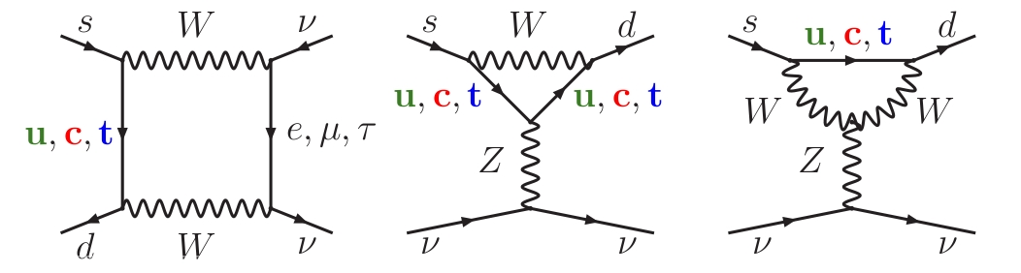
K⁺→π⁺νν in the Standard Model
FCNC process forbidden at tree level
Short distance contribution dominated by Z penguins and box diagrams
Negligible contribution from u quark, small contribution from c quark
Very small BR due to the CKM top coupling → λ⁵
Amplitude well predicted in SM (measurement of V_{td}) [see E.Stamou]
Residual error in the BR due to parametric uncertainties (mainly due to charm contributions): ~7%
Alternative way to measure the Unitarity Triangle with smaller theoretical uncertainty
ρ
α
 | Γ_{SD}/Γ | Irr. theory err. | BR x 10⁻¹¹
K_{L}→πνν | >99% | 1% | 3
K⁺→π⁺νν | 88% | 3% | 8
K_{L}→π⁰e⁺e⁻ | 38% | 15% | 3.5
K_{L}→π⁰μ⁺μ⁻ | 28% | 30% | 1.5
K⁺→π⁺νν
K⁰→π⁰νν
γ
β
K_{L}→μ⁺μ⁻
η
charm

Slide 4
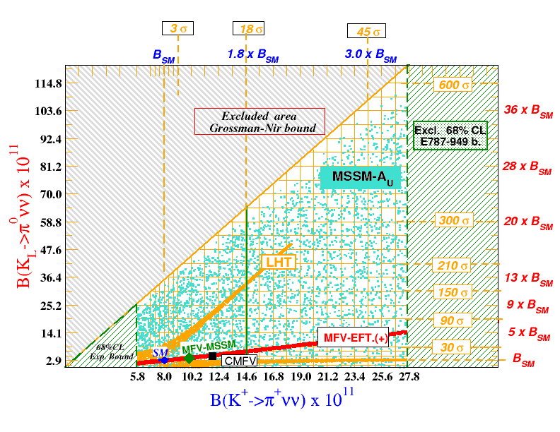
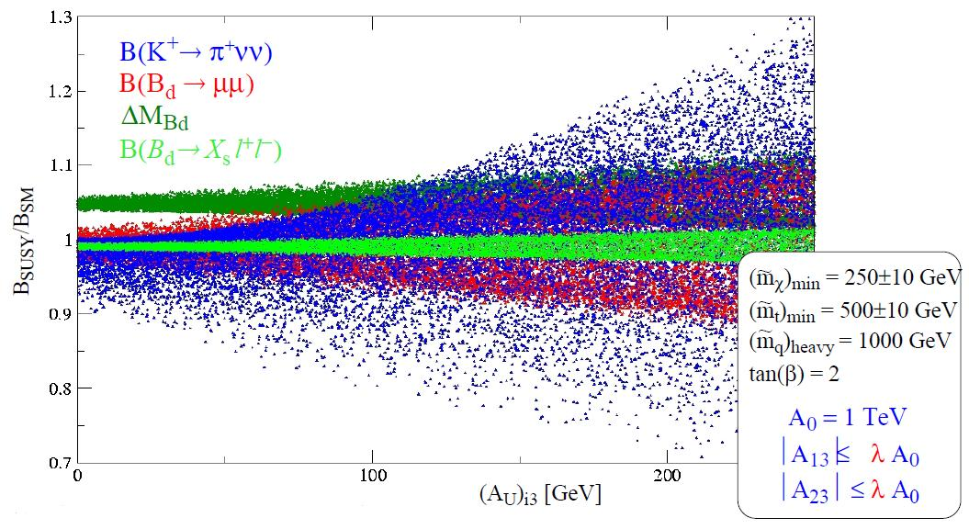
K⁺→π⁺νν beyond the SM
Stringent test of the SM
Several SM extensions predict different value for the BR
Possibility not only to identify new physics but also to distinguish among different models: SUSY, MSSM (with or without new sources of CPV or FV), 5-dim split fermions, topcolor, multi Higgs, light sgoldstino, extra-dimensions, ...
Example: in MSSM the departure from the SM should reach 10%-20% for reasonable parameters values
Higher effects with respect to the B decays

Slide 5
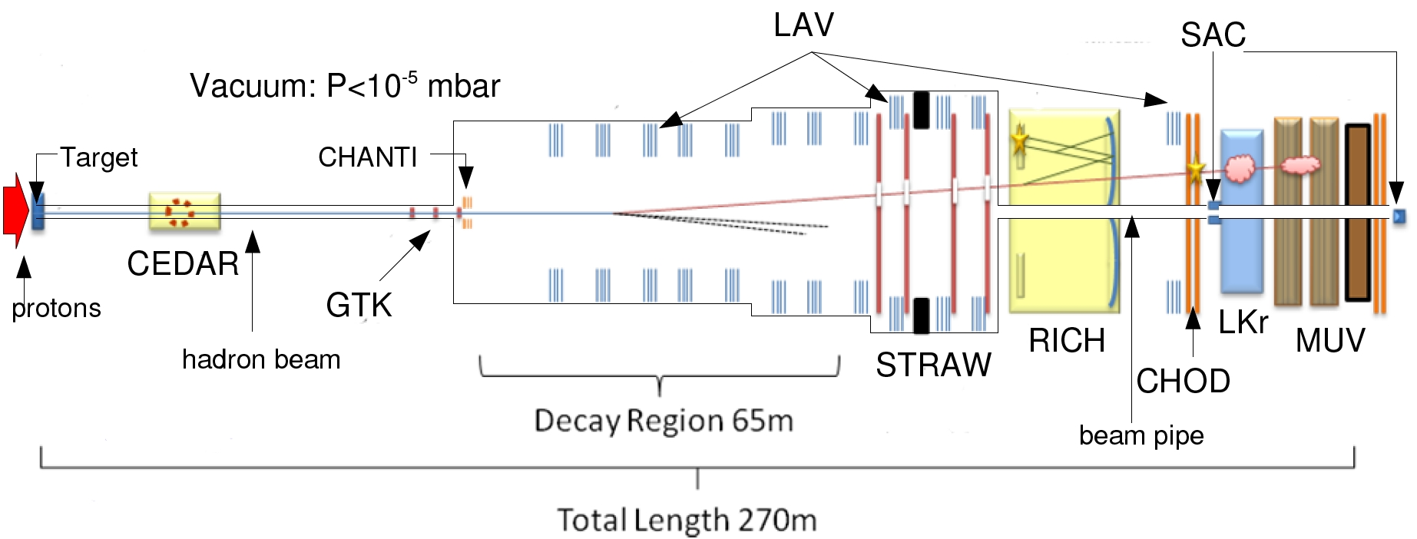
Experimental technique
Kaon decay in-flight from an unseparated 75 GeV/c hadron beam, produced with 400 GeV/c protons from SPS on a fixed berilium target
~800 MHz hadron beam with ~6% kaons
The pion decay products in the beam remain in the beam pipe
Goal: measurement of O(100) events in two years of data taking with % level of systematics
Present result (E787+E949): 7 events, total error of ~65%.

Slide 6
Experimental technique
Advantages w.r.t. decay at rest (i.e. E949@BNL):
  Easy to veto higher energy photons
  Easy to have high intensity beam
Disadvantages:
  Long detector and decay region
  Event by event measurement of the kaon momentum
  Unseparable hadron beam
Decay | BR
μ⁺ν (K_{μ2}) | 63.5%
π⁺π⁰ (K_{π2}) | 20.7%
π⁺π⁺π⁻ | 5.6%
π⁰e⁺ν (K_{e3}) | 5.1%
π⁰μ⁺ν (K_{μ3}) | 3.3%
π⁺π⁰π⁰ | 1.8%
μ⁺νγ (K_{μ2γ}) | 0.62%
π⁺π⁰γ | 2.7×10⁻⁴
π⁺π⁻e⁺ν (K_{e4}) | 4.1×10⁻⁵
π⁰π⁰e⁺ν (K_{e4}⁰⁰) | 2.2×10⁻⁵
e⁺ν (K_{e2}) | 1.5×10⁻⁵
π⁺π⁻μ⁺ν (K_{μ4}) | 1.4×10⁻⁵
Very challenging experiment:
  Weak signal signature: BR_{SM}=8x10⁻¹¹
  Potentially huge background from kaon decays
Key points:
  Kinematic rejection
  Vetos
  Particle identification
  Trigger

Slide 7
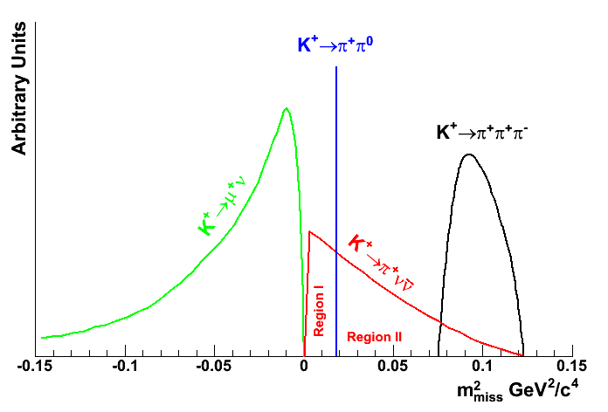
1) Kinematic rejection
92% Kinematically constrained
The missing mass will be used to identify two regions with lower background level
Very important to have high resolution missing mass reconstruction
Measurement of kaon and pion momenta
Very light spectrometers to keep the multiple scattering as low as possible.

Slide 8
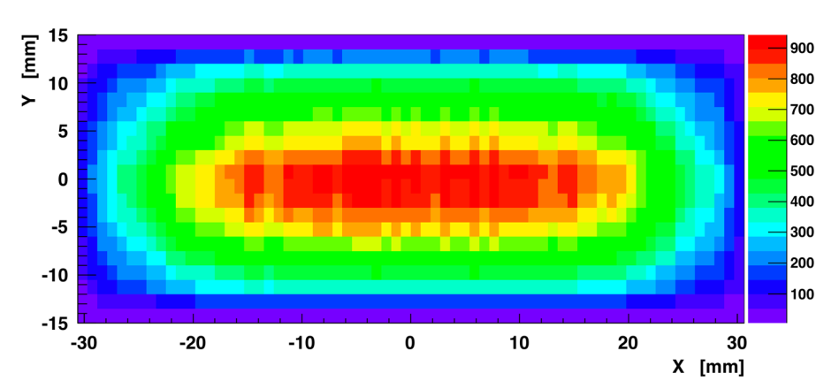
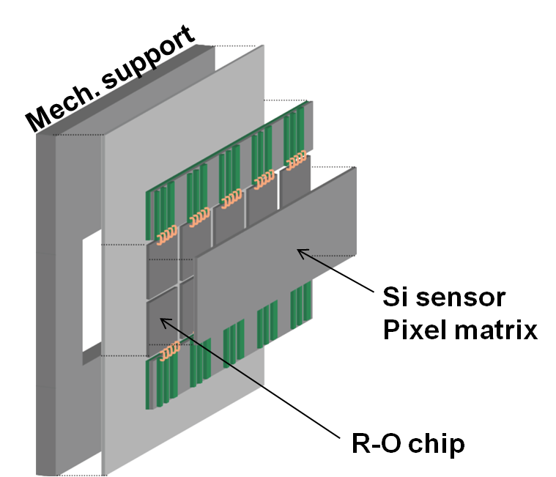
1) Kinematic rejection: Gigatracker
13.2 m
9.6 m
GTK1
60 mm
GTK3
GTK2
Momentum reconstruction on high intensity beam → three stations in an achromath dipole system
Thin detector → 200 μm pixel sensor+100 μm readout chip (<0.5% X/X₀ per station)
18000 pixels, 150 kHz rate per single pixel in the central part
Excellent time resolution to match the measurement with the other detectors → <200 ps achieved in test beam
Cooling system to control the leakage current given by the radiation damage → microchannel cooling or standard cooling in light material vessel.
σ(P_{K})/P_{K}~ 0.2% σ(dX/dZ)/(dX/dZ)~16 μrad

Slide 9
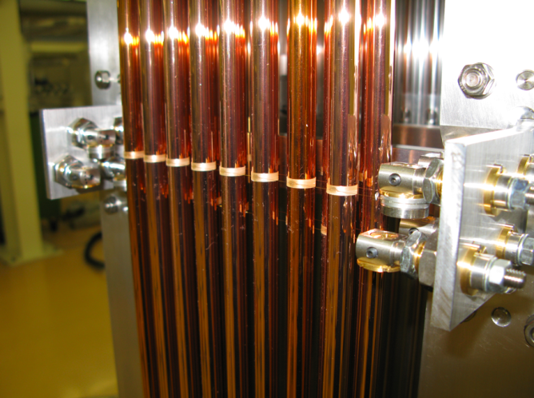
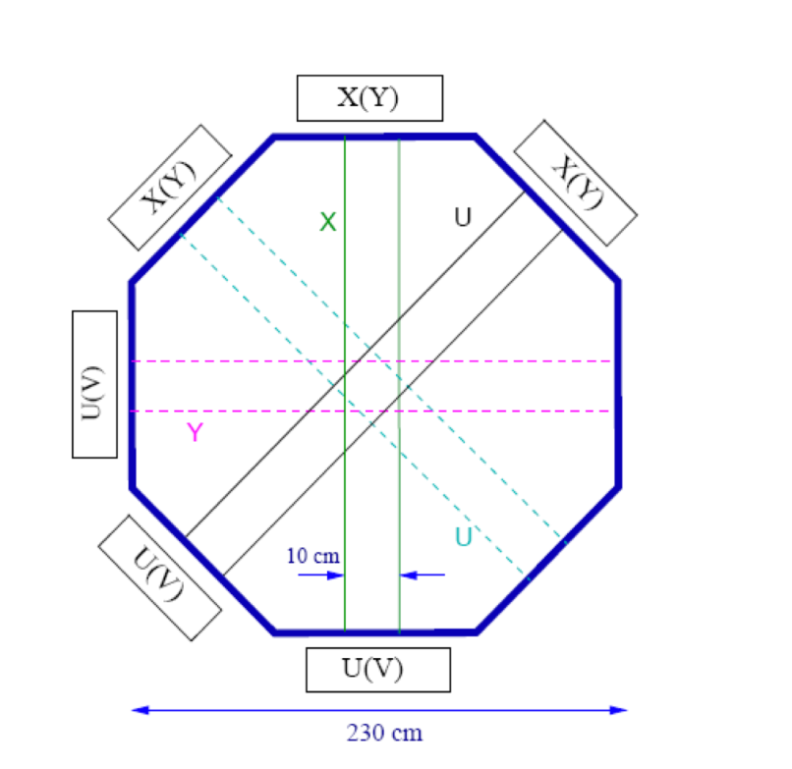
1) Kinematical rejection: Straws tracker
Spectrometer in vacuum to decrease MS effects
4 chambers with 4 redundant views each (4 staggered layer per view)
Magnet with P_{tkick} = 256 MeV/c
2.1 m long straws, 9.6 mm mylar tubes
<0.1% X/X₀ per view
Central “hole” (6 cm radius) for the beam obtained removing straw tubes in the central region
Full length prototype built and tested in vacuum at SPS@CERN in 2007 and 2010
σ(P_{π})/P_{π}~ 0.3% ⊕0.007%*P_{π} (GeV/c)
σ(dX/dZ)/(dX/dZ)~ 45-15 μrad
Rejection power: 10⁴ (K→ππ⁰), 10⁵ (K→μν)

Slide 10
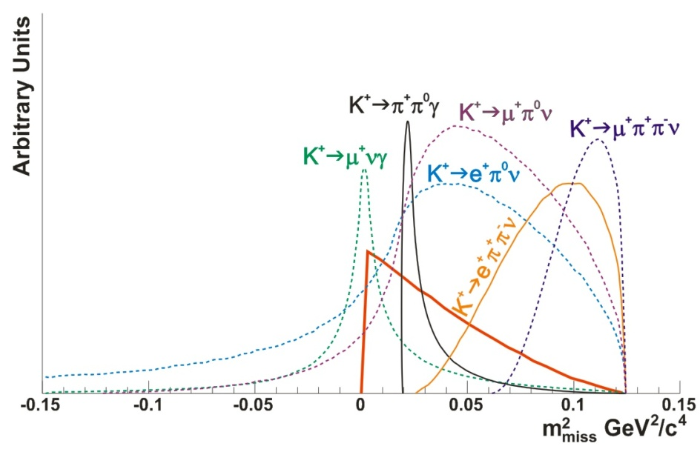
Not kinematically constrained background
~8% of the Kaon decays is not kinematically constrained.
Rejection is based solely on veto and particle identification.
The veto and PID are exploited to reach the 10⁸ rejection factor in the kinematical constrained background
8% Not Kinematically constrained
Veto system requirements:
  Large angle (8.5-50 mrad): inefficiency <10⁻⁴ for γ between 100 MeV and 35 GeV
  Forward veto (1-8.5 mrad): inefficiency <10⁻⁵ for E>10 GeV
  Small angle (<1 mrad): <10⁻³ for E>10 GeV
PID system requirements:
  Positive kaon identification in the hadron beam
  π−μ separation: 10⁻³ mis-identification probability

Slide 11
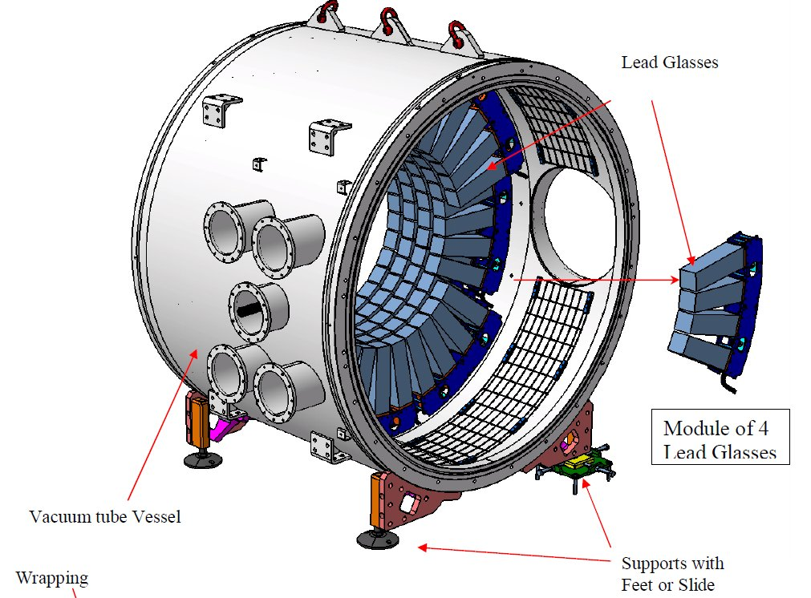
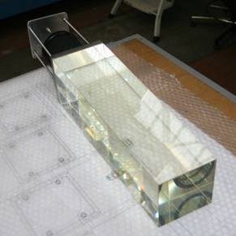
2) Vetos: LAV
12 rings along the decay region (in vacuum)
Fully angular coverage in the 8.5-50 mrad range
OPAL calorimeter lead glass reused: 5 staggered rings per station
more than 2500 cristals in total
Block tested at BTF@Frascati: inefficiency < 10⁻⁴ for 476 MeV e⁺
Time resolution: 700 ps
Large dinamic range → double threshold readout with clamping diode and ToT technique
3 rings built and tested.

Slide 12
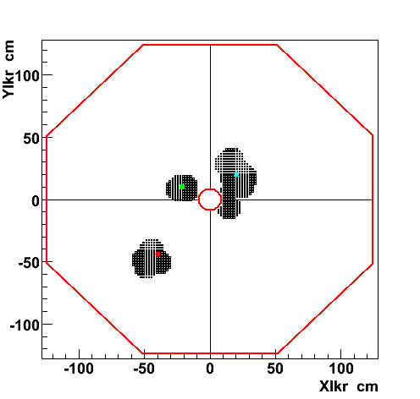
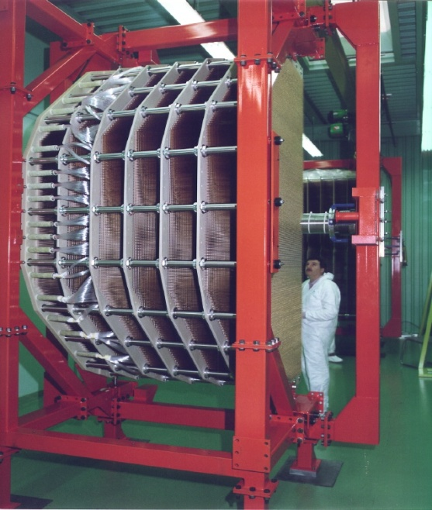
2) Vetos: LKr
LKr : old NA48 electromagnetic calorimeter, cryogenic liquid kripton
Quasi homogeneous ionization chamber
more than 13000 channels
27 X₀
Excellent energy resolution
very good time resolution: 100 ps
New readout electronics: 14 bits 40 MHz ADC with large buffers
γ
π
γ
The performances as photon veto has been measured in a special run with 75 GeV kaon decays:
Energy(GeV) | Inefficiency
2.5-5.5 | 10⁻³
5.5-7.5 | 10⁻⁴
7.5-10 | 5x10⁻⁵
>10 | 8x10⁻⁶

Slide 13
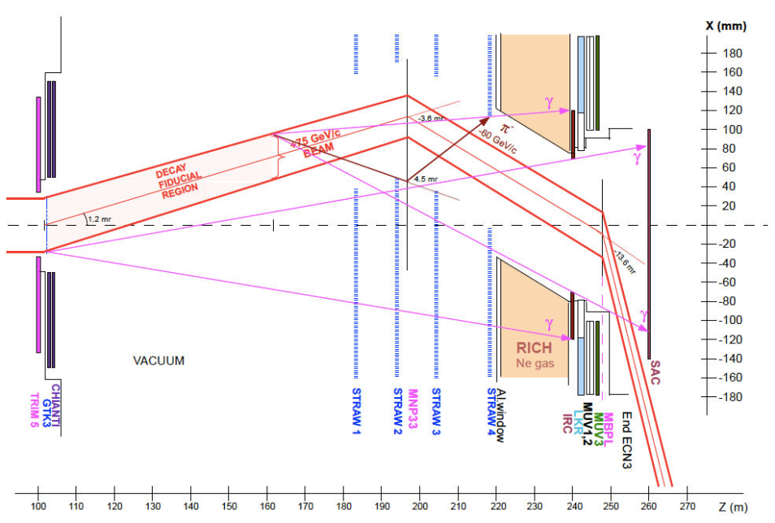
2) Vetos: CHANTI,SAC & IRC
Small angle calorimeters: IRC & SAC
IRC: to increase the acceptance for small angle γ in the region not covered by the LKr
SAC: to detect γ in the beam pipe region
The IRC is located around the beam pipe in front of the LKr, the SAC is located in the beam dump, at the very end of the experiment.
The CHANTI is located after the GTK station three in order to detect interaction in the beam spectrometer
IRC, SAC and CHANTI are in advanced R&D status

Slide 14
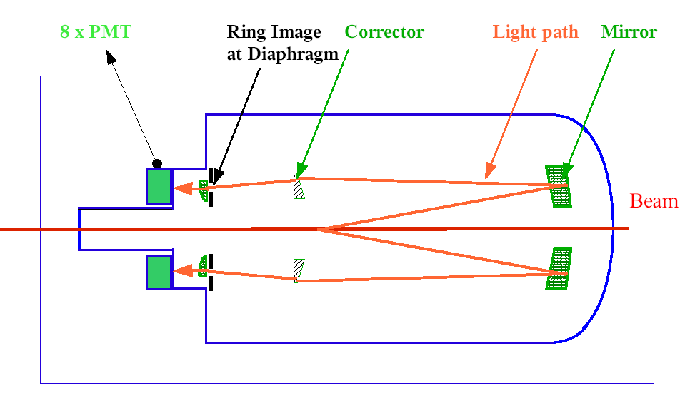
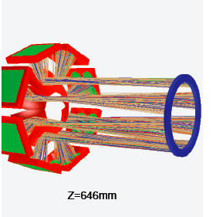
3) PID: CEDAR
Positive identification of the kaon in the hadron beam
Purpose: tagging the kaon to decrease the requirements for the vacuum in the decay region (10⁻⁵ mbar).
Technique: differential H₂ cherenkov detector.
Old detector built at CERN in the ’70
New readout (PMs and electronics)
New deflecting mirrors system to decrease the rate per single channel on the readout.

Slide 15
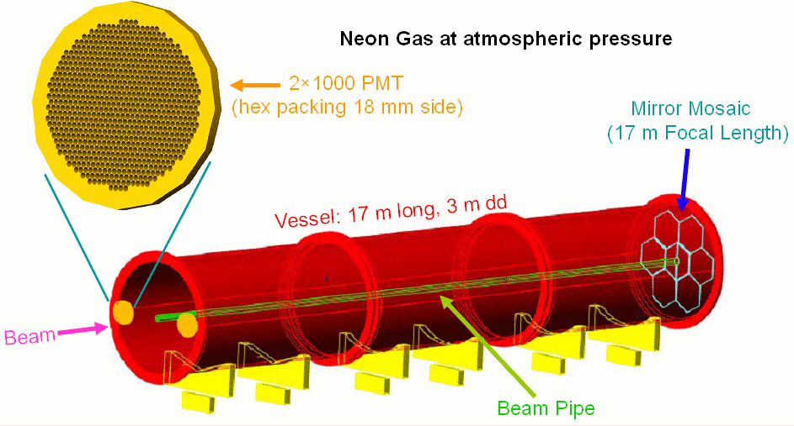
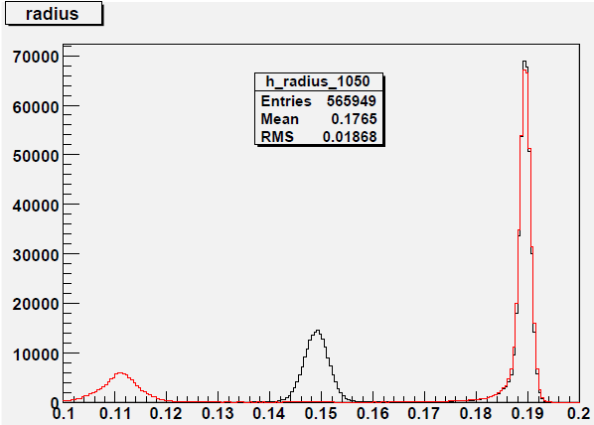
3) PID: RICH
17 m long, 3 m in diameter
Filled with 1 atm Neon
π−μ separation in the 15-35 GeV/c range
Cherenkov light collected in two spots: 1000 PM each
Full length prototype tested in 2009
Average time resolution: 70 ps
Integrated mis-indentification probability: ~5x10⁻³
e
p = 15 GeV/c
μ
π

Slide 16
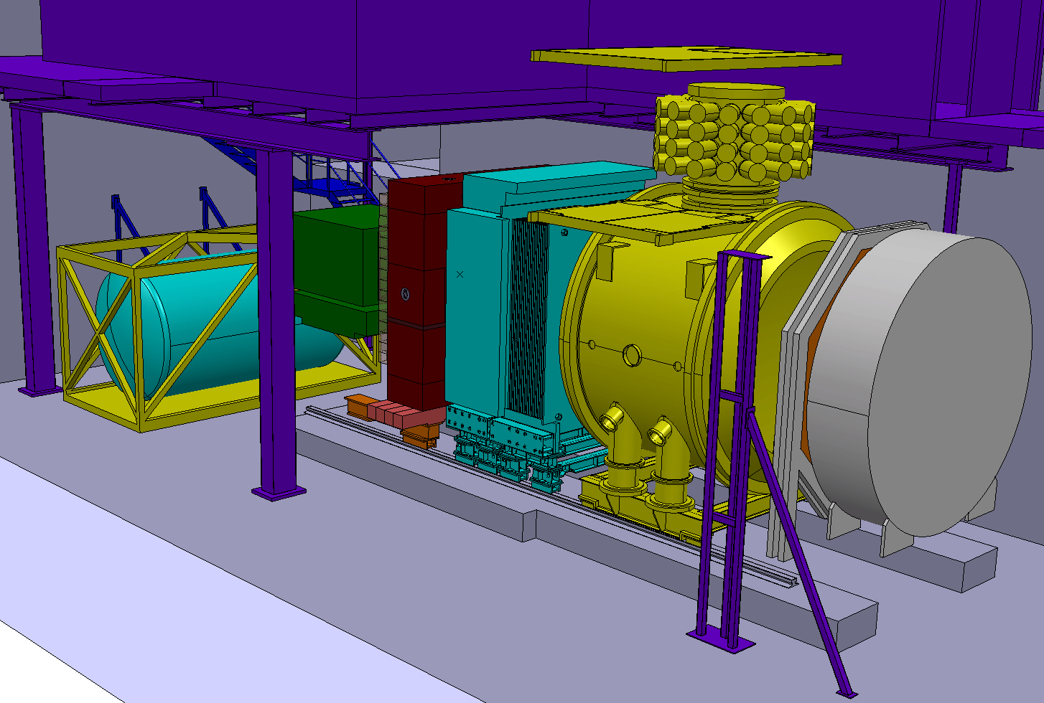
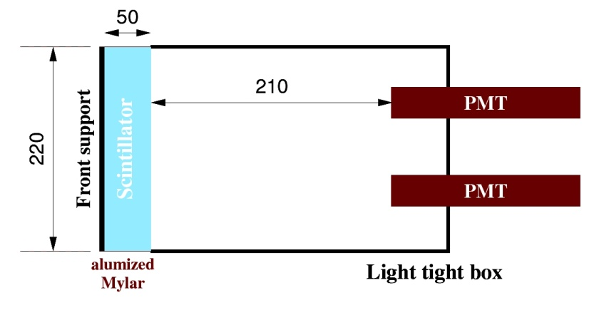
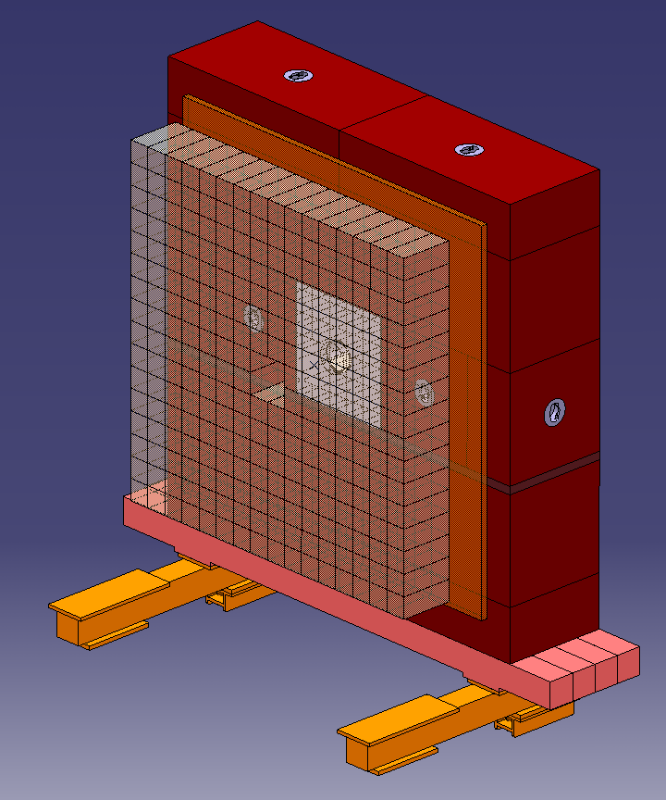
3) PID: MUV
MUV 3
MUV 1-2
LKr
MUV1-2 : to reach a factor of 10⁶ in muon rejection (combined with the RICH)
  Partially reused the NA48 Hadron calorimeter
  Iron and scintillator
MUV3: fast muon identification plane for trigger
  modules of 22x22 cm² with 5 cm thick scintillator readout with 2 PMs
  <1ns time resolution achieved in test beam

Slide 17
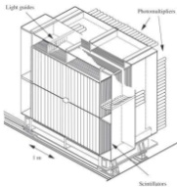
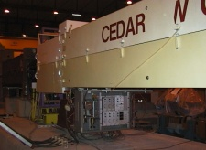
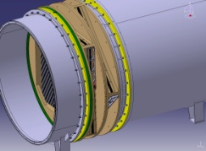
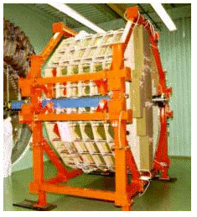
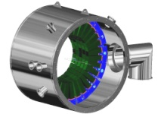

4) Trigger
10 MHz
L0: Hardware level. Decision based on primitives produced in the RO card of detectors partecipating to trigger
L1: Software level. “Single detector” PCs
L2: Software level. The informations coming from different detectors are merged together
RICH
MUV
CEDAR
STRAWS
LKR
LAV
1 MHz
1 MHz
L0TP
1 MHz
L0
PC
PC
PC
PC
PC
PC
L1
GigaEth SWITCH
PC
PC
PC
PC
PC
PC
PC
PC
PC
PC
PC
PC
PC
PC
L2
L0 trigger
PC
PC
PC
PC
CDR
O(KHz)
Trigger primitives
EB
Data

Slide 18
4) Trigger
 | Initial rate (MHz) | After L 0 (MHz)
ππ⁰ | 1.9 | 0.22
μν | 5.7 | 0.04
πππ | 0.5 | 0.1
πππ⁰ | 0.16 | 0.002
π⁰eν | 0.3 | 0.05
π⁰μν | 0.2 | 0.002
TOT | 6.7 | 0.4
πνν (eff.) |  | 82%
L0 selection: RICH+!LKR+!MUV3
  RICH: hit multiplicity positive signal
  !LKR: no 2 clusters more than 30 cm apart
  !MUV3: no signal in MUV3
Very good time resolution is required to avoid random veto
At the software levels a more complete analysis will be performed (missing mass, Z vertex,…)
 |  | Input (max) | Output (max) | latency
L0 | hw,sync | ~10 MHz | ~ 1 MHz | 1 ms
L1 | soft,async | ~ 1 MHz | ~ 100 kHz | undefined
L2 | soft,async | ~ 100 kHz | O(kHz) | undefined

Slide 19
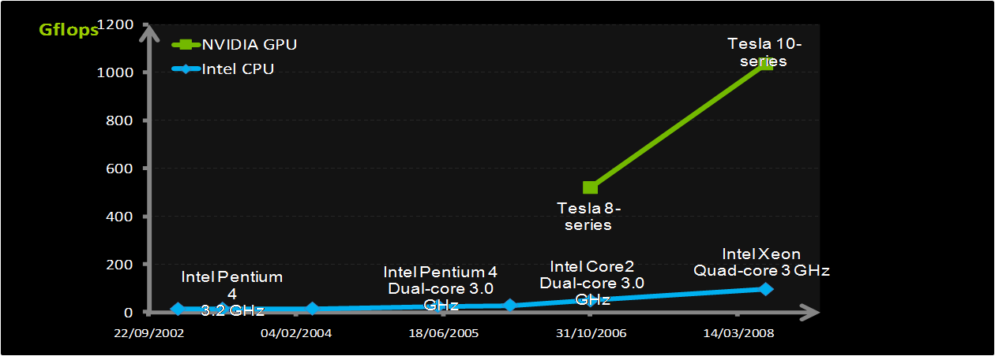
4) GPU trigger
The idea: exploit GPUs (standard video card processors) to perform high quality analysis at trigger level
GPU architecture: massive parallel processor SIMD
Easy at L1/2, challenging at L0
Real benefits: increase the physics potential of the experiment at very low cost!
Profit from continous develops in technology for free (Video Games,…)
GPUs | 1 Tesla GPU
Single Precision Performance | 933 Gigaflops
Double Precision Performance | 78 Gigaflops
Memory | 4 GB DDR3
Memory speed | 800 MHz
Bandwidth | 102 GB/s

Slide 20
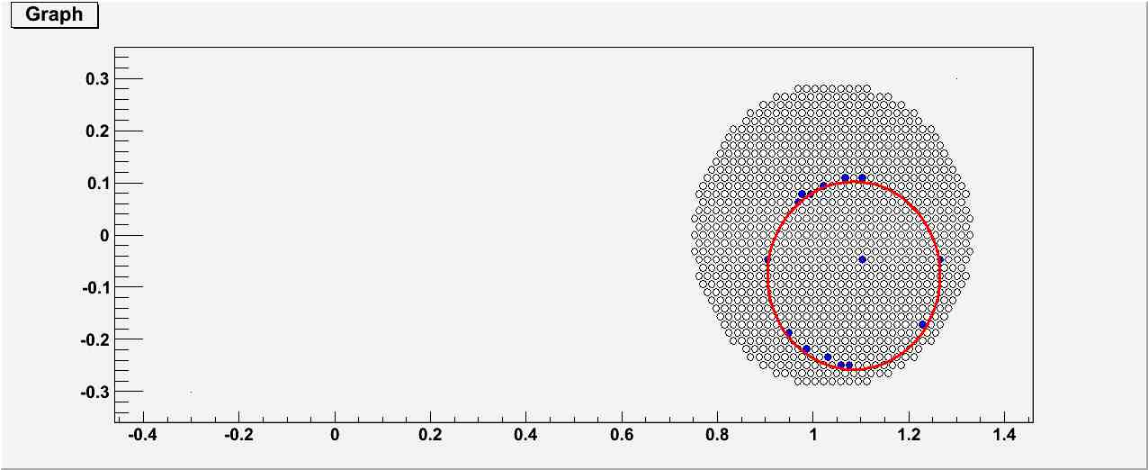
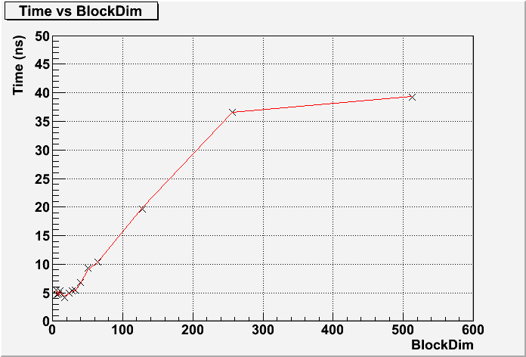
4) GPU trigger
Natively built for pattern recognition problems
First attempt: ultra-fast ring reconstruction in RICH detector.
GPU 12 hits
Best ring
Hits generated NA62 - G4 MC
Several algorithms tested → best result 5 ns/per ring .
Long latency in data transfer from PC to Video Card → avoided transfering a packet of 1000 events.
Total processing time well below 1 ms (per 1000 events) in a single PC!
Problems with jitter due to CPU should be avoided using real-time OS (to be done)
Pilot project, very promising R&D.

Slide 21
NA62 sensitivity
K⁺→π⁺νν (signal) | 55 events/year
K⁺→π⁺π⁰ | 4.3% (2.3 evts)
K⁺→μ⁺ν | 2.2% (1.2 evts)
K⁺→π⁺π⁻eν | <3% (1.7 evts)
3 tracks | <1.5% (0.8 evts)
K⁺→π⁺π⁰γ | 2% (1.1 evts)
K⁺→μ⁺νγ | 0.7% (0.4 evts)
others | negligible
Expected bkg | <13.5% (7.4 evts)
4.8·10¹² decay per year
x50 wrt NA48 flux (same amount of protons from SPS)
π⁰ rejection 2·10⁸
O(10%) signal acceptance
100% trigger efficiency assumed

Slide 22
Conclusions
Clear physics case: K→πνν
Goal to reach O(100) SM events in 2 years of data taking.
Very challenging experiment:
  High intensity beam
  High resolution in kinematical reconstruction
  High time resolution in all the detectors
  High veto efficiency
  Good particle identification
  Online selection
Schedule:
  2006-2009: R&D
  2010-2012: Construction
  11/2011: synchronization run
  11/2012: physics run

Slide 23
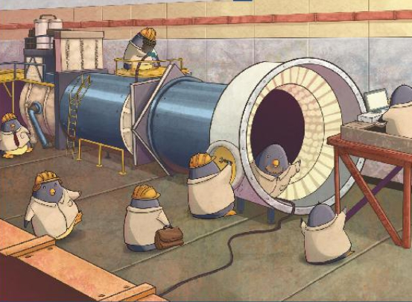
NA62: work in progress!

Slide 24
spares

Slide 25
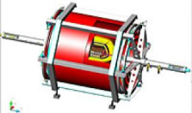
GPU
PCI-E x16
INTEL PRO/1000 QUAD GBE
4 GB/s
(20 MHz)*
CPU
RAM
TESLA
PCI-E gen2 x16
VRAM
CPU
GPU
30 GB/s
(150 MHz)*
100GB/s
(500 MHz)*
8 GB/s
(40 MHz)*
“quasi-triggerless” with GPUs
PCs+GPU
FE
Digitization + buffer + (trigger primitives)
L1
PCs+GPU
L0

Slide 26
GPU
Data arrive
… protocol stack possibly managed in the receiver card
Transfer in the RAM
… the non deterministic behavior of the CPU should be avoided (real time OS)
Transfer of a Packet of data in GRAM in video card
… the PCI-ex gen2 is fast enough. Concurrent transfer during processing.
Max 100 us
Processing
… as fast as possible!!!
Send back to PC the results
… done!

Slide 27
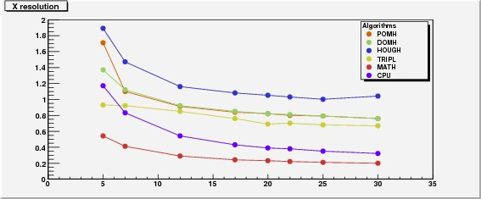
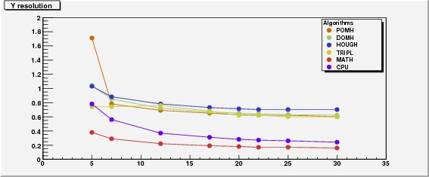
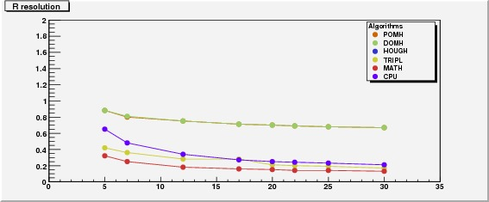
GPU resolution
The resolution depends slightly on the number of hits
The difference in X and Y is due to the different packing of the PMs in X and Y
In the last plot the HOUGH result is out of scale
The MATH resolution is better than the CPU resolution!
Nhits
Algo | R resol. (cm)
POMH | 0.7
DOMH | 0.7
HOUGH | 2.6
TRIPL | 0.28
MATH | 0.15
CPU | 0.27
Nhits
Nhits

Slide 28
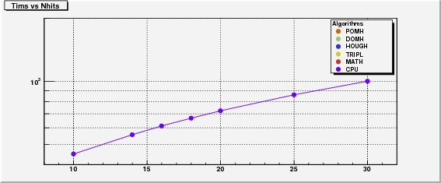
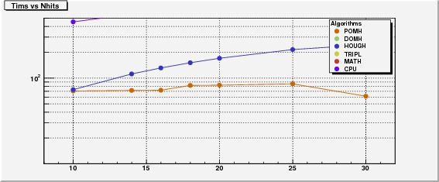
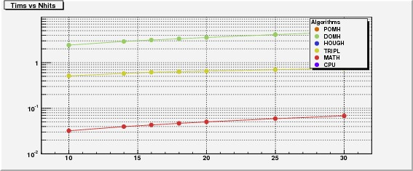
GPU time results
The execution time depends on the number of hits
This dependence is quite small in the GPU (at least for the 4 faster algorithms) and is higher in the CPU
The best result, at the moment is 50 ns for ring with MATH, but… can be optimized changing the number of events per packet -> 5 ns!

