Slide 1
Milestone 2021
INFN – Sezione di Catania
Sviluppo di modelli di microdosimetria nell’ambito dell’Advanced example «Radioprotection» applicata a: i) Terapia con protoni e ioni (simulazione di un microdosimetro al diamante mono-stadio e doppio stadio); ii) Terapia medico-nucleare e imaging radiologico con mezzi di contrastoad alto Z (dicembre 2021).
Implementazione di un esempio di applicazione di GEANT4 per dosimetria interna di radionuclidi attraverso l’uso di un modello ellissoidale di target biologici (dicembre 2021).
Implementazione in GEANT4 dello studio della propagazione dei fotoni all'interno del Central Detector di JUNO (dicembre 2021).

Slide 2
Simulation of diamond microdosimeters in the Radioprotection advanced example
Backgrund and detector description:
Diamond microdosimetry considered as an alternative to more established silicon detectors:
  Large bandgap and smaller leakage current
  High carrier mobility allowing for fast response
  Large breakdown field and high radiation hardness
  Fairly tissue-equivalent → attractive for radiobiology and medical applications
Simulated detector:
  CVD (Chemical Vapour Deposition) diamond microdosimeters realized by University of Rome “Tor Vergata”
  → agreement with the Producers in the framework of a scientific collaboration for including the microdiamonds simulation in the Radioprotection advanced example publicly distributed
  Collaboration with University of Surrey for the detector simulation and the experimental activities and for cross-comparisons of simulated vs experimental data: two PhD students (J. Magini and G. Parisi) supervised by G. Schettino and F. Romano
  → a set of single and double-stage microdiamonds designed and realized, based on our requirement

Slide 3
Simulation of diamond microdosimeters in the Radioprotection advanced example
Microdosimeter details:
Well-defined confinement of the response within the sensitive volume with a good uniformity of charge collection efficiency
Linear response on a wide range of incident particle LET
Two prototypes investigated and simulated (1 and 10 μm thick)
Different areas realized and simulated: 50x50, 100x100, 200x200 and 300x300, μm².
50
300
100
C. Verona et al., Journal of Applied Physics, vol. 118, 2015
C. Verona et al., Radiation Measurements, vol. 110, 2018.
200

Slide 4
Simulation of diamond microdosimeters in the Radioprotection advanced example
Microdosimeter simulation:
INFN Section of Catania sharing the responsibility of the Radioprotection advanced example with the University of Wollongong since 2020 → Responsible developers: S. Guatelli (UOW) and F. Romano (INFN)
Simulation of the diamond microdosimeters (full geometry implementation, including contacts, non-sensitive layers, etc…) inside the Radioprotection example → completed
Implementation of simple macro commands for easy management of the geometrical configuration from Users:
  Possibility of changing geometrical parameters run-time for investigating the response → completed/ in progress
  Possibility of changing the different simulated microdosimeters (Silcon vs microdiamond) via → completed
Publication of the first version in the Geant4 release → completed
Cross-comparison with experimental data → in progress (Dec 2021?)
Simulation of double-stage microdiamond for particle identification (crucial for proton and ion therapy) → in progress (Dec 2021)
Python scripts for microdosimetric spectra and data analysis (first version) → in progress
Diamond microdosimeters
Silicon microdosimeters

Slide 5
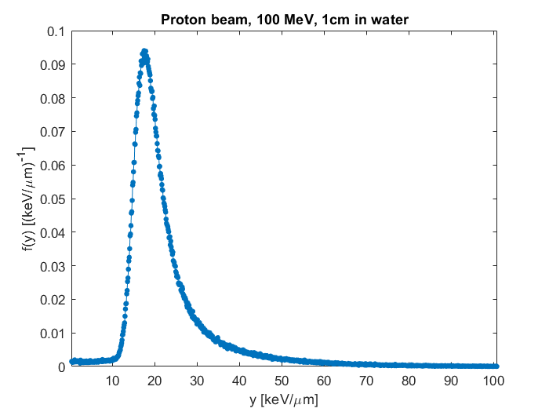
Simulation of diamond microdosimeters in the Radioprotection advanced example
Example of simulation results:
1 μm thick microdiamond
10 μm thick microdiamond

Slide 6
Preliminary plan for 2022 (to be further refined)
Coordination of the Geant4 Advanced example WG (Coord.: S. Guatelli, Dep. Coord.: F. Romano) and general maintenance of the examples.
Microdosimetry simulations in the Radioprotection advanced example:
Python scripts for microdosimetric spectra and data analysis (advanced version)
Simulation of a mini-TEPC (tissue equivalent proportional counter) microdosimeter, which is one of the most consolidated technology for microdosimetry
  Agreement with the technology producers at INFN Legnaro Laboratories, in the framework of a scientific collaboration, for the implementation of the mini-TEPC simulation inside the Radioprotection advanced example
Estimation of uncertainties through Monte Carlo simulations using Radioprotection for clinical translation
Radioprotection example as a general purpose application for microdosimetry studies in different fields
IORT-therapy advanced example simulations:
Previously developed by IBFM-CNR LATO (Cefalu’)
INFN Section of Catania responsible of the example since 2021 → Responsible developer: F. Romano
Maintenance and update of the IORT-therapy advanced example:
  Adaptation of the IORT-therapy example for FLASH radiotherapy studies → simulation of the modified machine
  Modification for the simulation of FLASH electron beams by dedicated accelerators for FLASH Radiotherapy

