Slide 1
Future and Prospects for Heavy Flavour Physics at LHC
15 October 2010
Pascal Perret
LPC Clermont
On behalf of the ATLAS, CMS & LHCb Collaboration

Slide 2
Content
The present:
LHC & Detector performances highlight
First LHC Heavy Flavour Results
The future (selected topics)
Prospects: LHCb upgrade
Conclusions
Disclaimers:
Many topics not cover!
More details in other talks
LHC: ATLAS, CMS, LHCb
Tevatron: CDF, D0
Babar, Belle
…

Slide 3
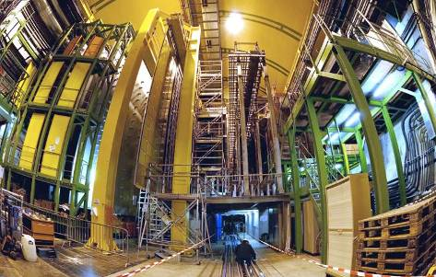
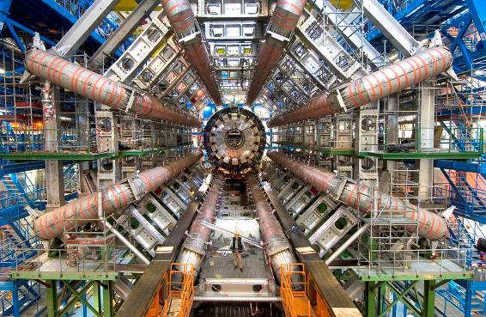
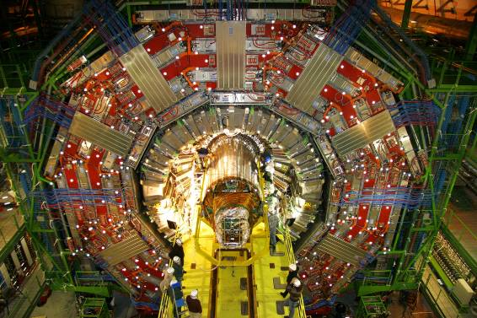
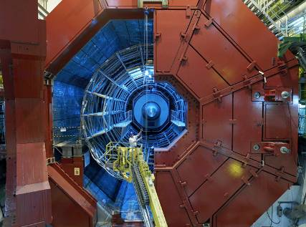
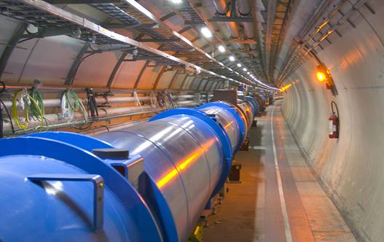
LHCb
Mont Blanc
jet d‘eau
Geneva
lake
airport
CMS
ATLAS
LHCb
CERN
ATLAS
ALICE
CMS
ALICE
:
27 km LHC ring
LHC Tunnel
~ 100m under ground.
B = 8 Tesla (@ 14TeV)
Operating temperature: 1.9K

Slide 4
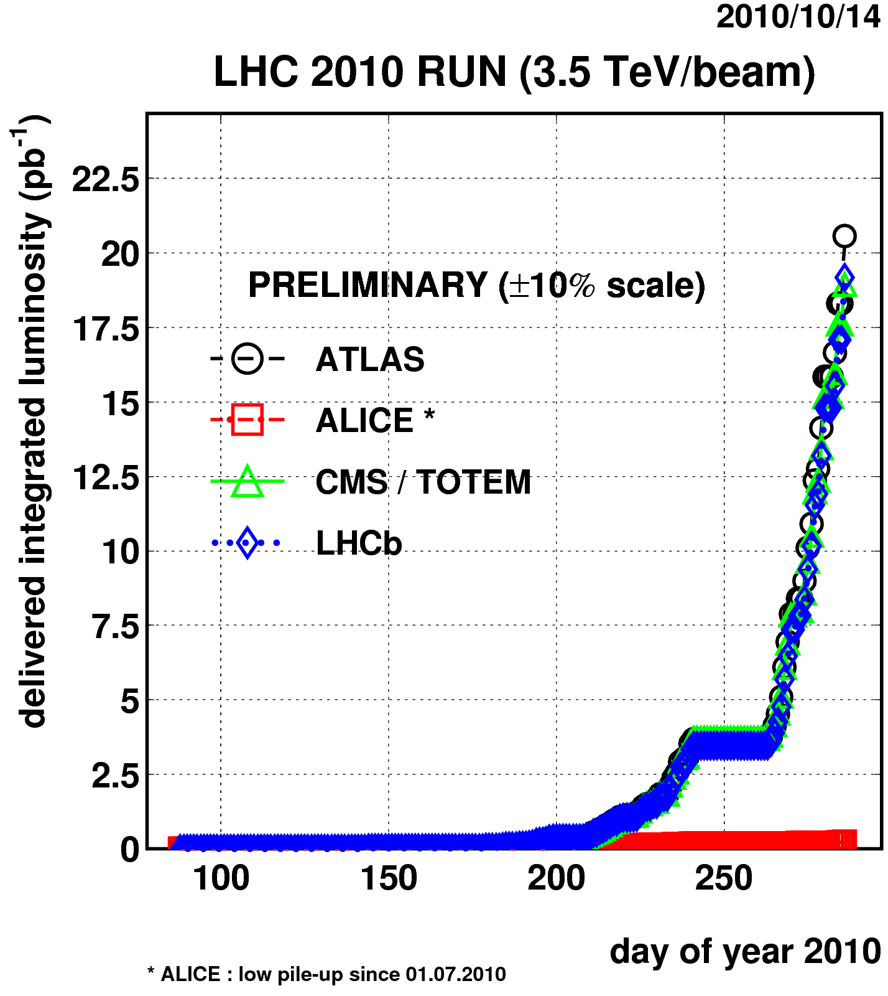
LHC Performance
Current program
Data taking at 7 TeV since March 2010
Alternating periods of machine LHC commissioning and physics data taking
Initial collisions with 2×10¹⁰p/bunch
Now: 10¹¹p/bunch
Last week:
N= 248 bunches in trains with 233 bunches colliding (nominal LHC 2808/beam)
48bunches added in LHC beam each week!
L^{peak}= 1.03x10³² cm⁻²s⁻¹ yesterday!
Future aims
L=10³² cm⁻²s⁻¹ by end 2010: Achieved!
We should collect ~30-50 pb⁻¹/experiment
1 fb⁻¹ by end 2011
Excellent machine performances!
Development of Bunch Trains
Delivered luminosity increasing exponentially!

Slide 5
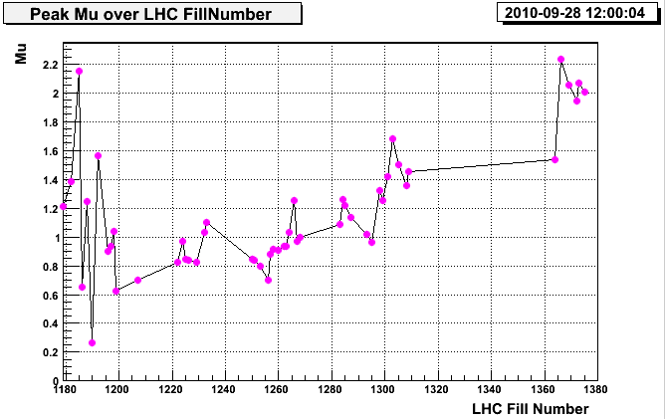
LHC Performance
LHC experiments will operate at different nominal luminosities:
ATLAS/CMS: L_{Nominal}=L_{LHC}=10³⁴ cm⁻²s⁻¹
LHCb: L_{LHCb}=2x10³² cm⁻²s⁻¹
by focusing less than at ATLAS and CMS
with β* = 10 m ~ 0.4 pp visible interactions per bunch crossing
However, the present running conditions are different:
LHC is reaching L=10³² cm⁻²s⁻¹ soon
All experiments (but Alice) are running at the same luminosity
This is close to LHCb nominal luminosity
But with fewer bunches and with β* = 3.5 m ⇒ ~ 2.0 pp visible interactions per crossing
LHCb use flexibility of trigger to adapt to actual conditions
Design value

Slide 6
Heavy Flavours @ LHC
LHC is a B- and D-mesons super factory:
Large bb cross section (~300 µb – 500 µb @ √s=7 – 14 TeV):
LHC @ 50 pb⁻¹ [delivered per experiment]
~ 1.5 x 10¹⁰ B mesons [all species produced, B⁰,B⁺,B_{S},..]
~ 2.5 x10¹¹ D mesons
B factories @ Y(4S) full statistics [delivered, Babar+Belle]:
~1.5 x10⁹ B⁺,B⁰ mesons
~2 x 10⁹ D mesons
However, there are also challenges:
High multiplicity of tracks (~30 tracks per unit of rapidity)
High rate of background events (σ_{vis. Inel.} ~ 60 mb at √s =7 TeV)
1/200 event contains a b quark, typical interesting BR < 10⁻³

Slide 7
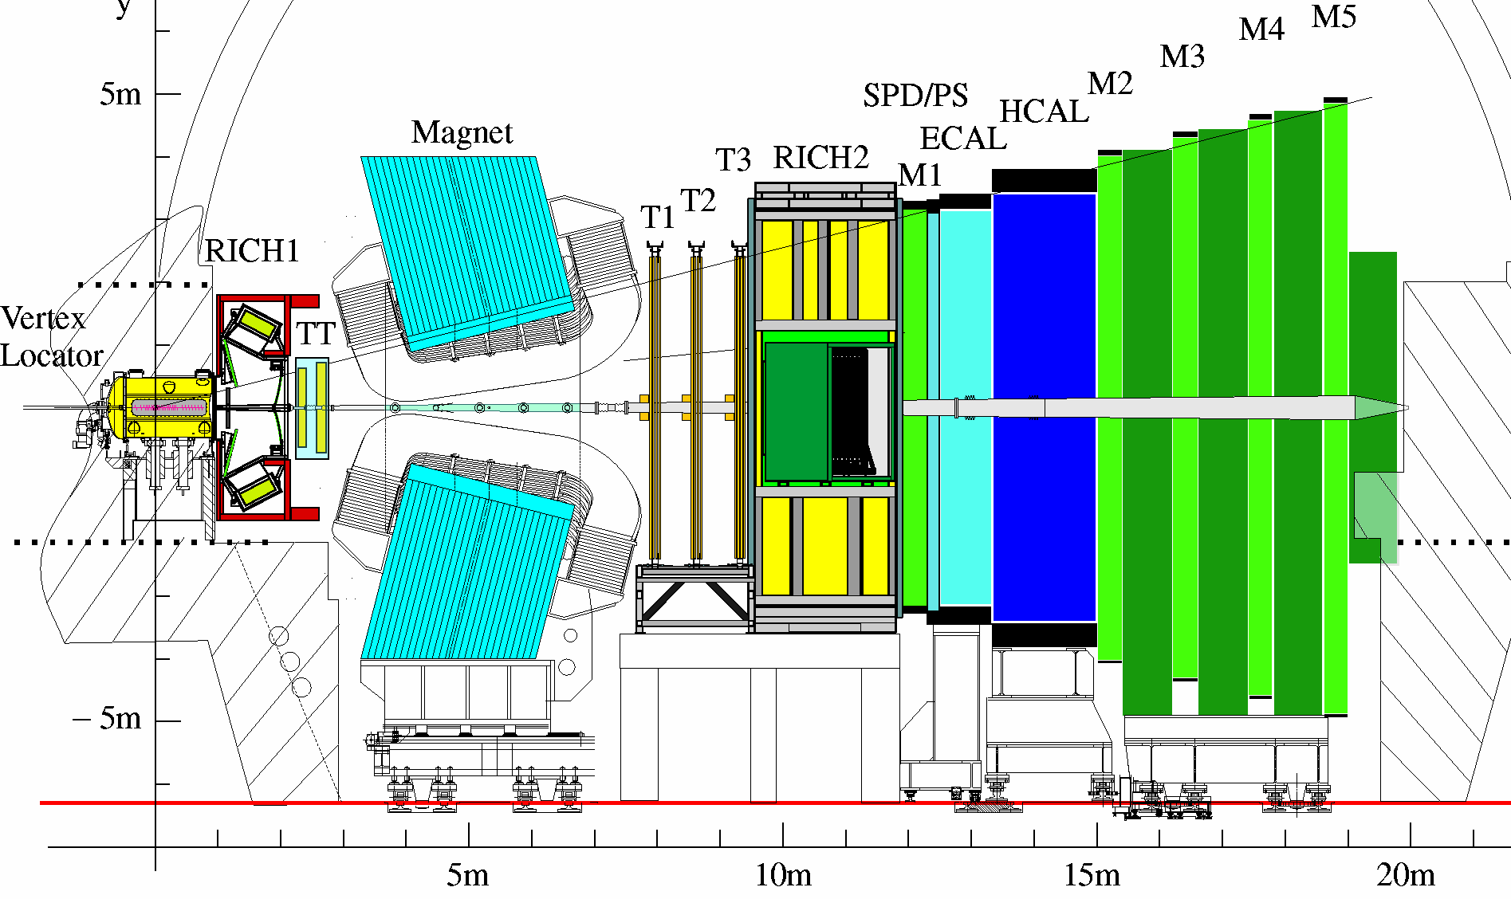
Heavy Flavours @ LHC
LHC is a B- and D-mesons super factory:
bb produced mostly forward/backward
Detectors have different acceptance:
ATLAS/CMS |η|<2.5
LHCb forward spectrometer covering η=[2,6]
~30% in LHCb acceptance
An efficient trigger is essential

Slide 8
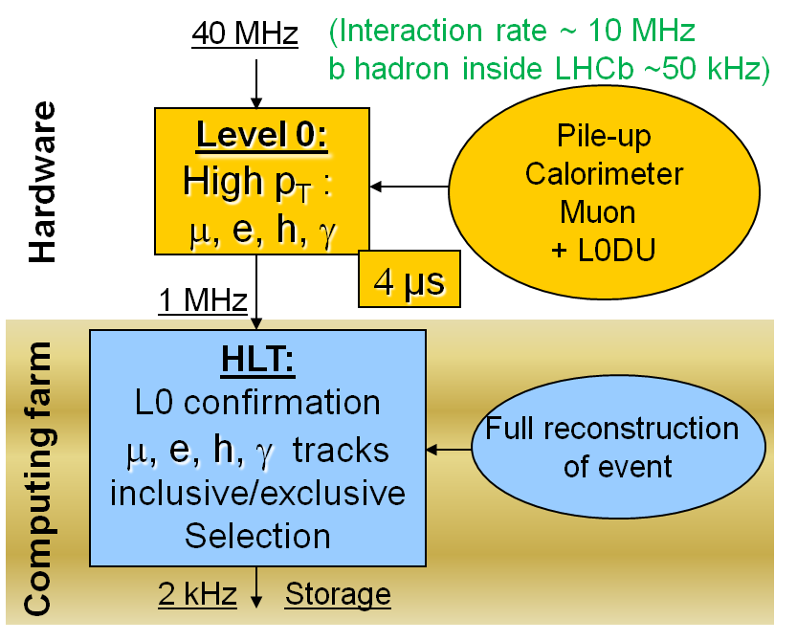
Trigger
ATLAS/CMS
Search for new physics
High p_{T}/E_{T} trigger or E_{Miss}
Try to keep a “low” p_{T} muon trigger for b-physics: single or dimuon
B-Physics is accounted for 5÷10% of total trigger resources
Event storage @ 200Hz
LHCb
Dedicated to b-physics!
Moderate p_{T} signals in calorimeter & muon systems
Highest p_{T}^{μ} ∼ 1 GeV
Event storage @ 2kHz (small event size)
Triggers are highly configurable:
evolve to match LHC luminosity & physics requirements

Slide 9
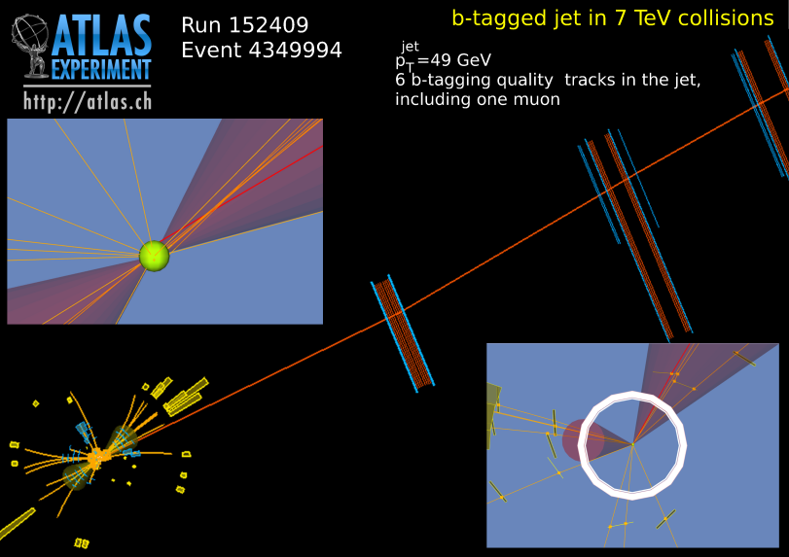
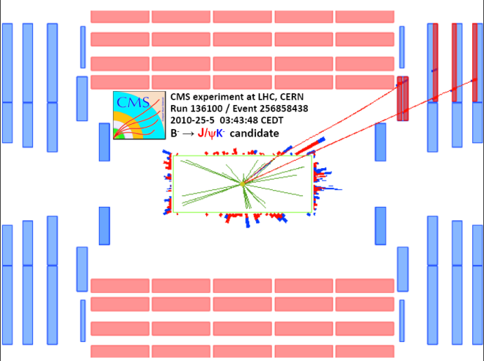
Detector performance highlight & First LHC Heavy Flavour Results
Detector and trigger
understanding and
Calibration
Early measurements: cross sections, …
2010 Now
Start-up O(10 pb⁻¹)

Slide 10
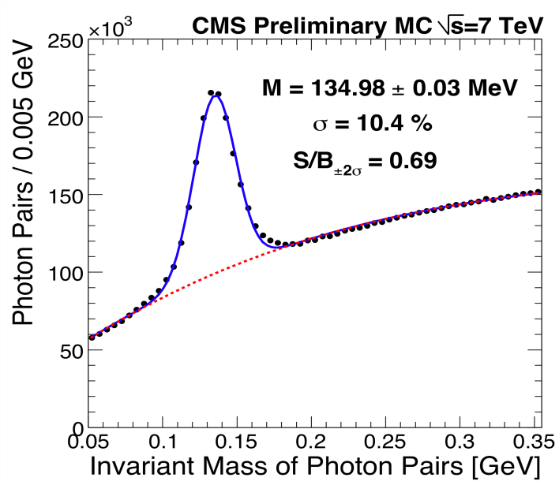
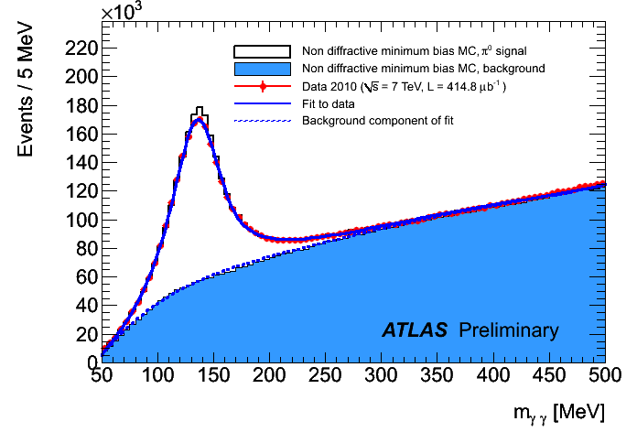
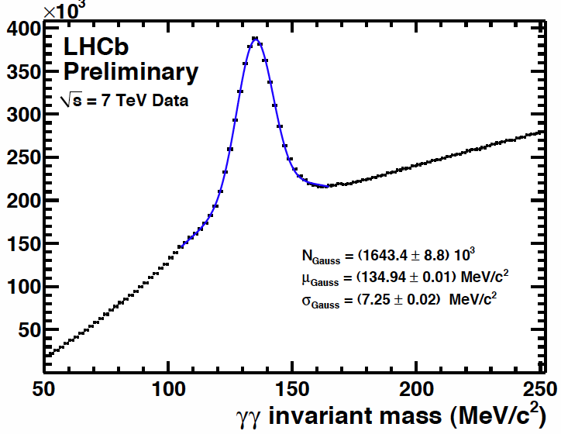
Detector performances
Electromagnetic calorimeters:
First detectors to be calibrated
The π⁰ →γγ candle:
E_{T} (γ) > 400 MeV
E_{T} (γγ) > 900 MeV
 | ATLAS | CMS | LHCb
σ(Mπ⁰) | 20 MeV | 14 MeV | 7.2 MeV
ECAL calibrated to 1- 2% level
π⁰ resolution close to expectation
Even better for LHCb!

Slide 11
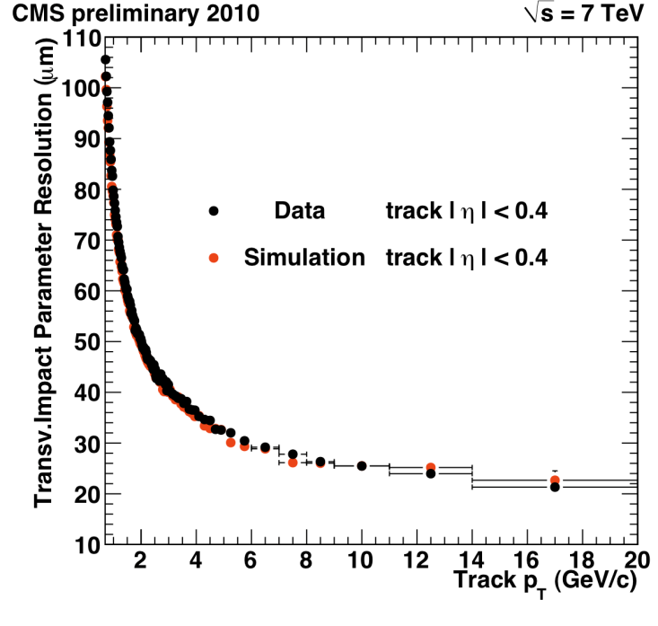
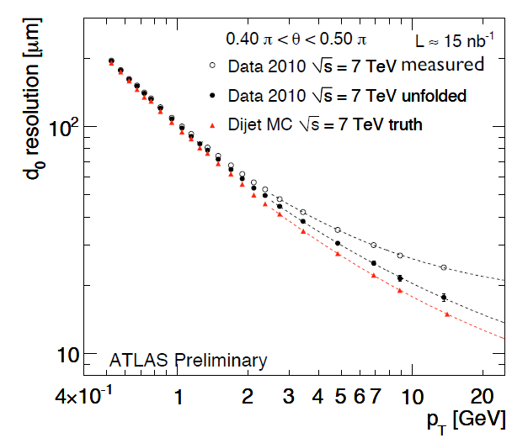
Detector performances (cont’)
Tracking performances
@2GeV | ATLAS | CMS | LHCb
σ (IP) | 60 µm | 50 µm | 25 µm *
Better performance expected:
Alignment on-going
* single hit resolution 4µm!

Slide 12
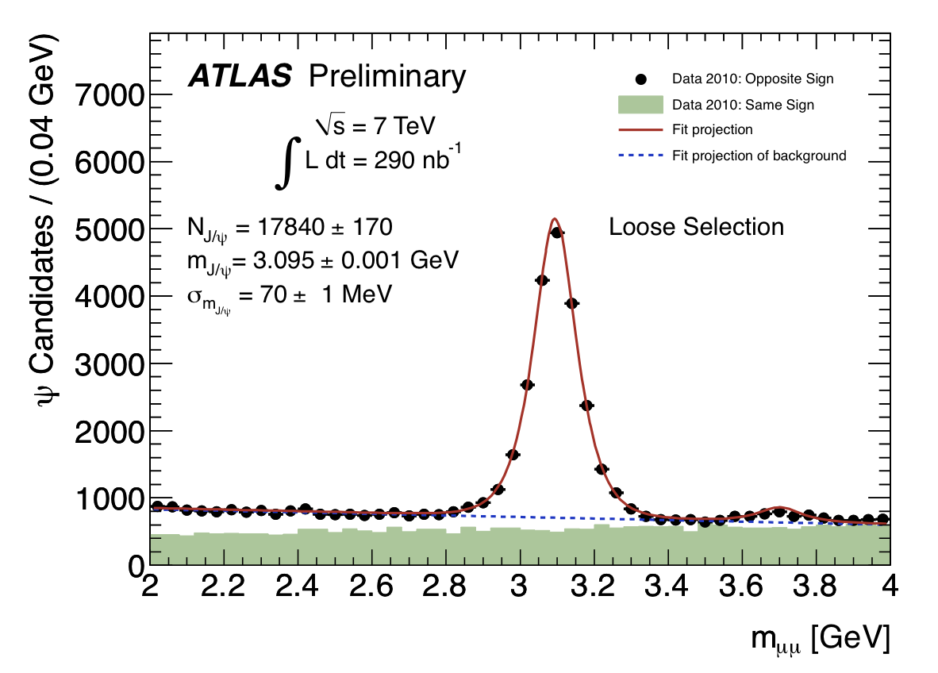
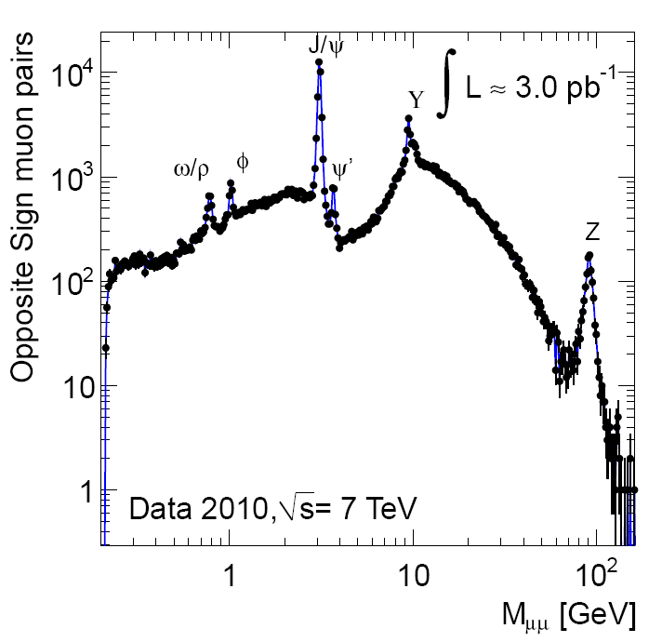
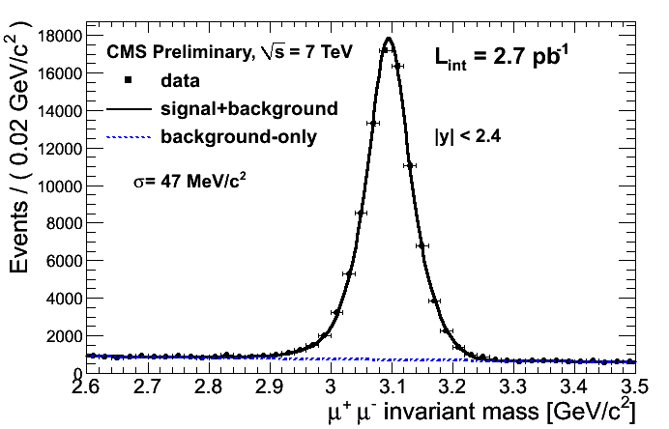
Detector performances (cont’)
Di-muon spectrum (J/ψ → µ⁺µ⁻ candle)
ATLAS Preliminary
LHCb preliminary
Mean 3094.5
σ = 13.9 MeV
 | ATLAS | CMS | LHCb
σ (MJ/ψ) | 70 MeV | 47 MeV | 14 MeV

Slide 13
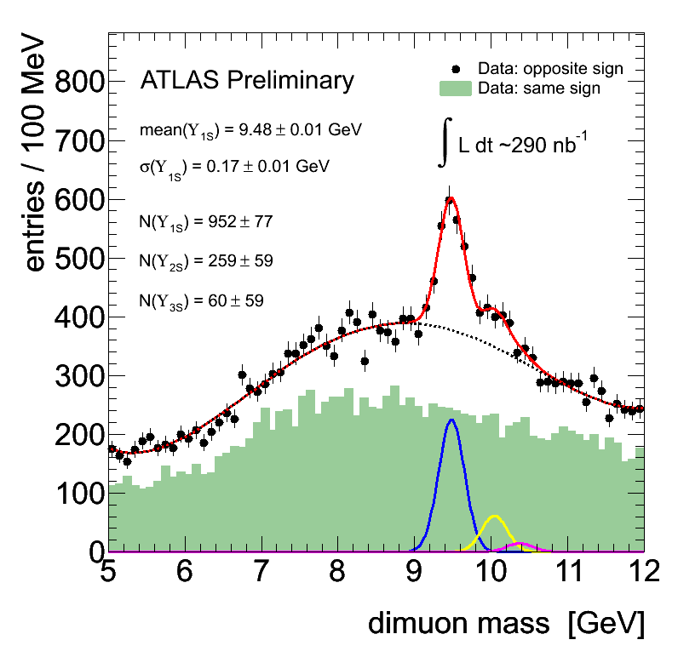
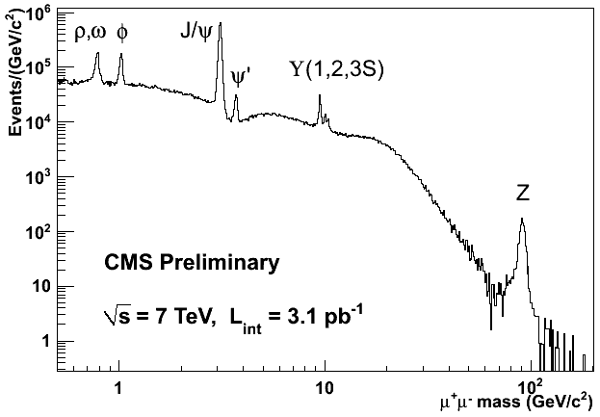
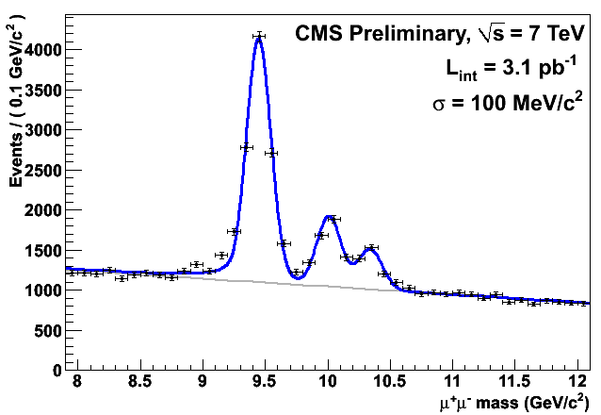
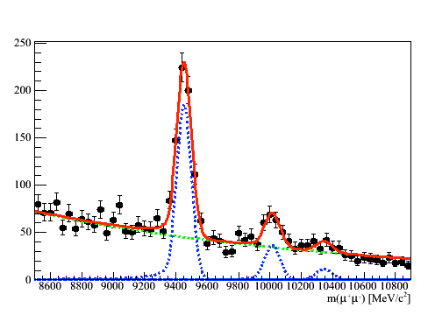
Detector performances (cont’)
Di-muon spectrum
|η| < 2.4
 | ATLAS | CMS | LHCb
σ (M_{ϒ}) | 170 MeV | 100 MeV | 47 MeV
LHCb preliminary
Mean = 9452
σ = 47 MeV
Mass resolution approaching MC expectation

Slide 14
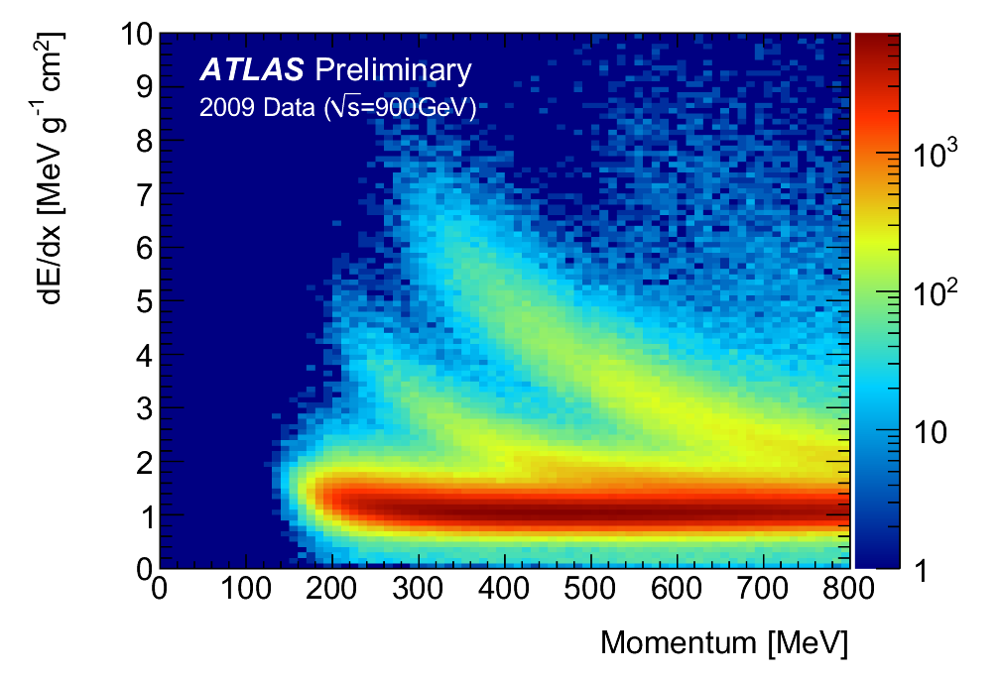
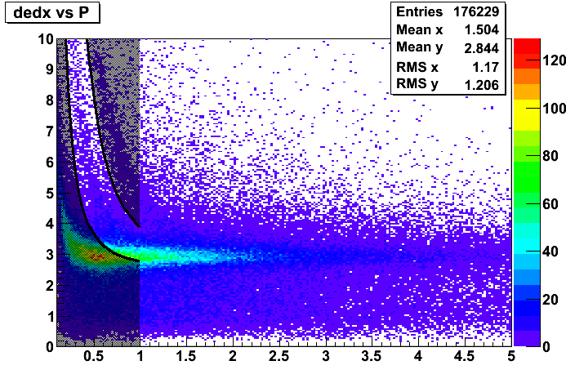
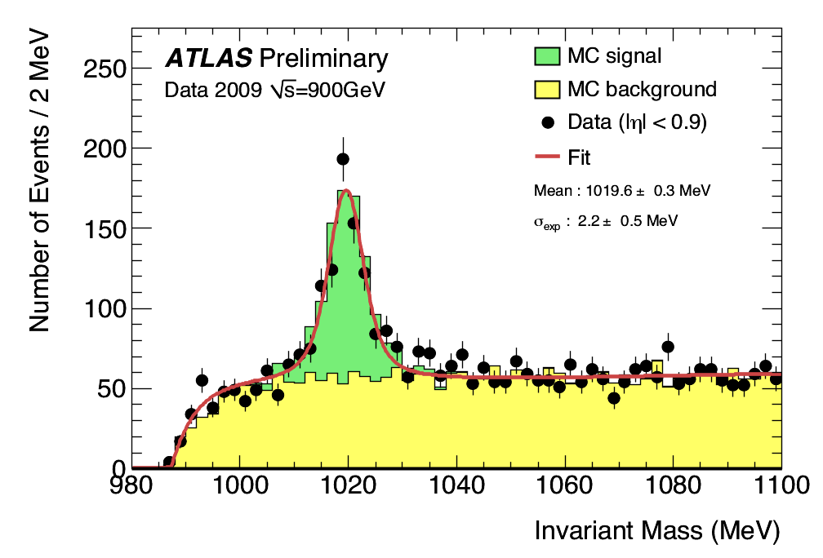
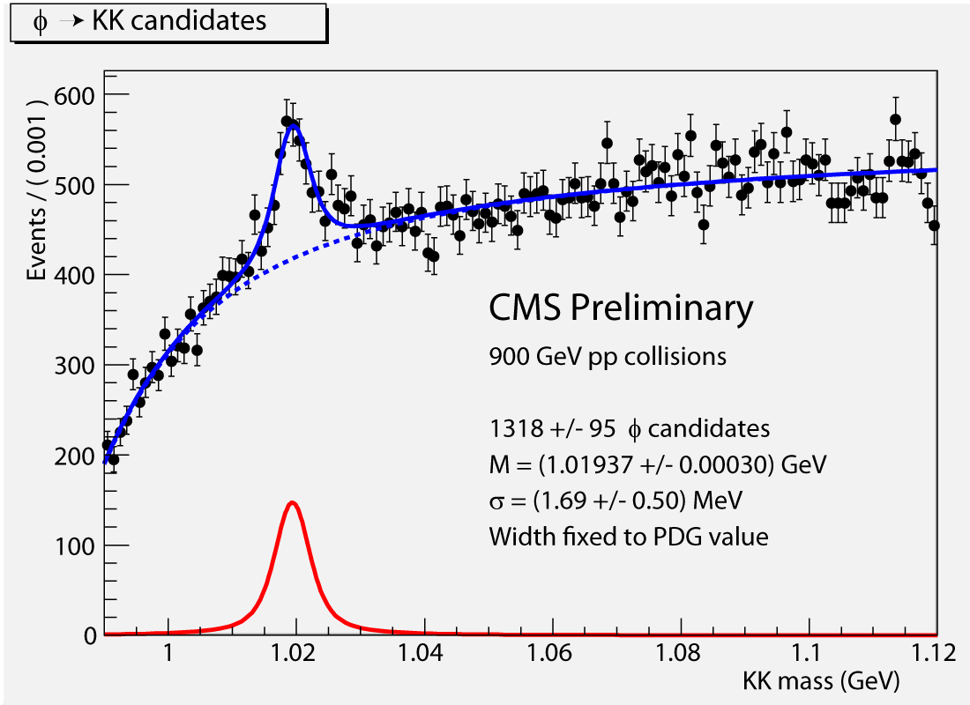
Detector performances (cont’)
Particle Identification:Φ→ K⁺ K⁻ using dE/dx
CMS
ATLAS
Pixel dE/dx
p
K
π
Normalized to data
Stat errors only
Φ → K⁺K⁻

Slide 15
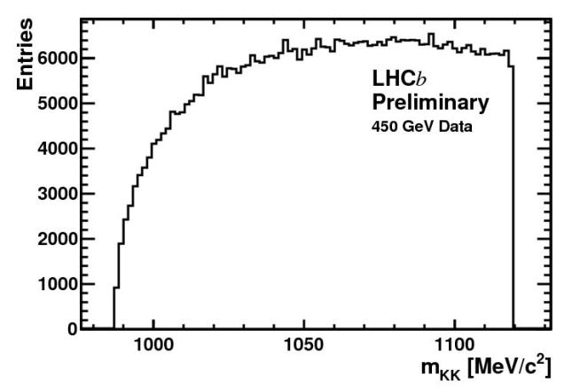
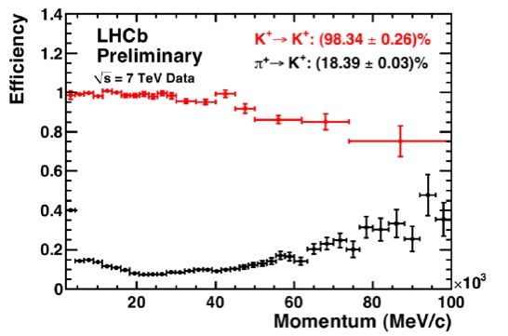
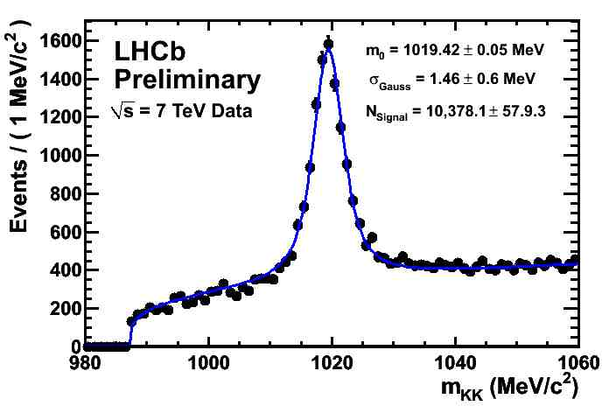
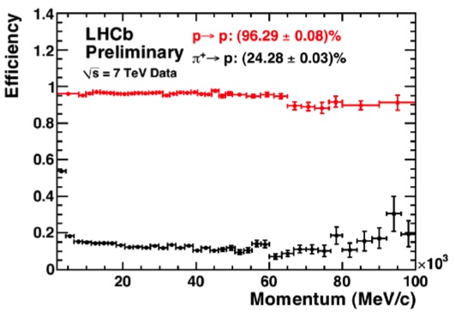
Detector performances (cont’)
Particle Identification
Performance still improving, getting close to MC
LHCb:
φ → K⁺ K⁻ using RICH detectors
K-π separation
Without PID
Φ → KK ?
Alignment and Calibration ongoing
2009
p-π separation
with PID
Φ → KK !
2010

Slide 16
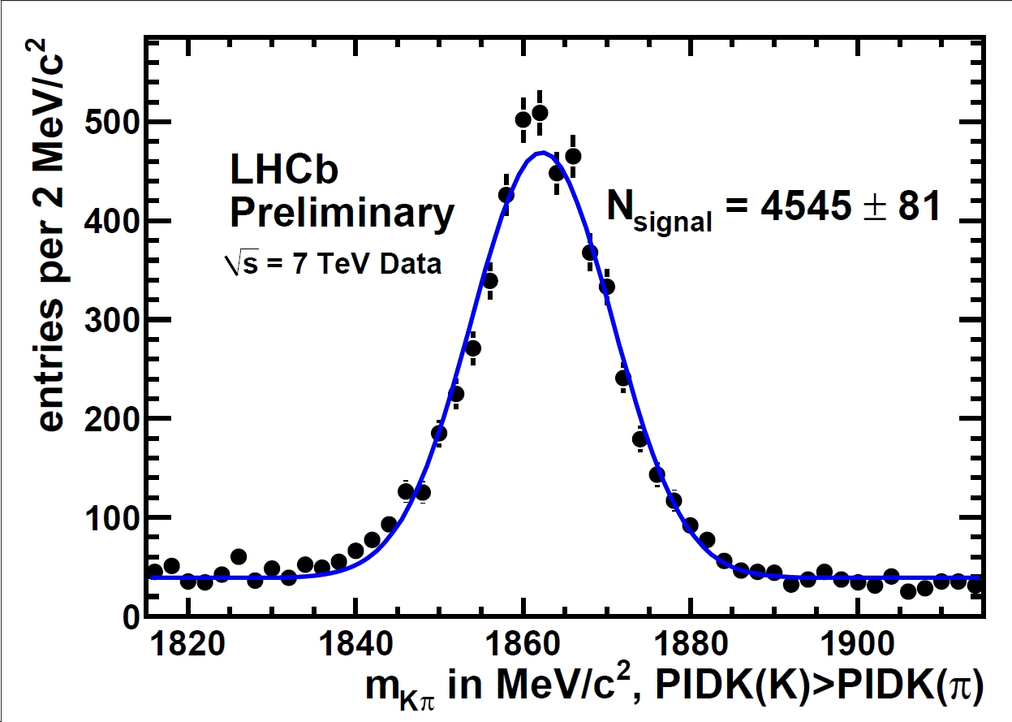
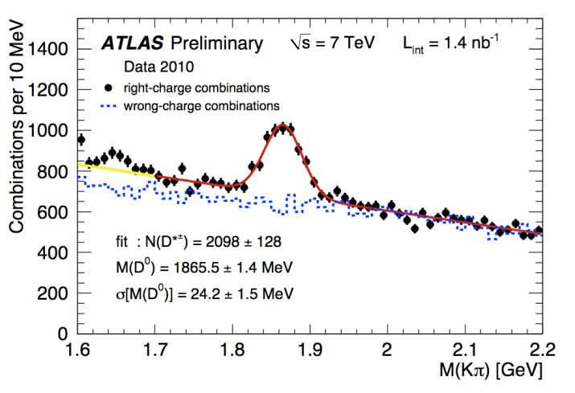
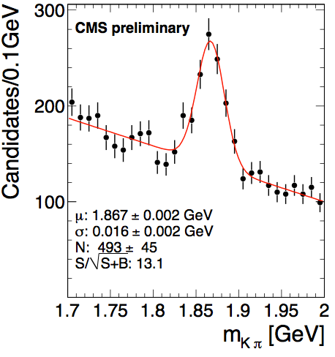
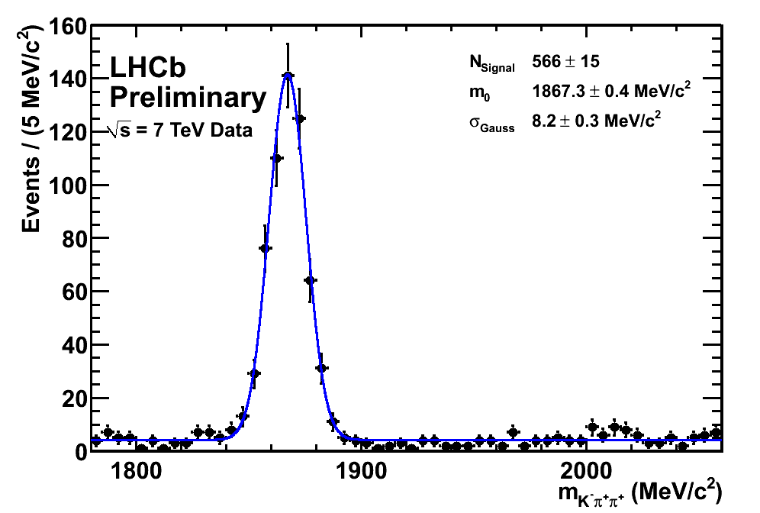
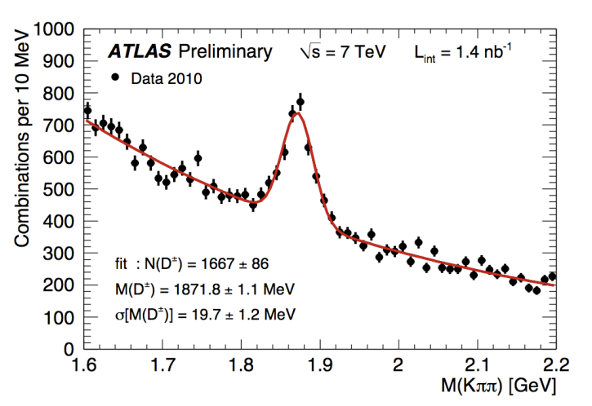
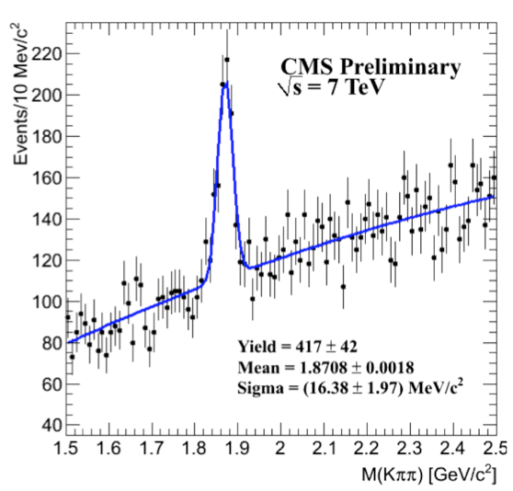
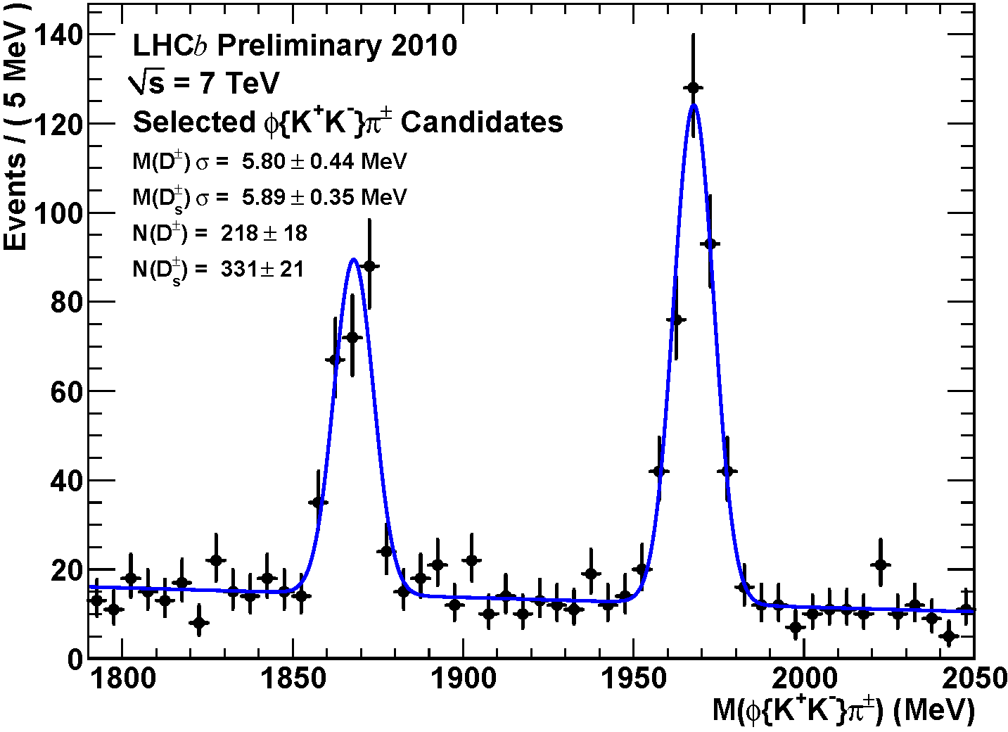
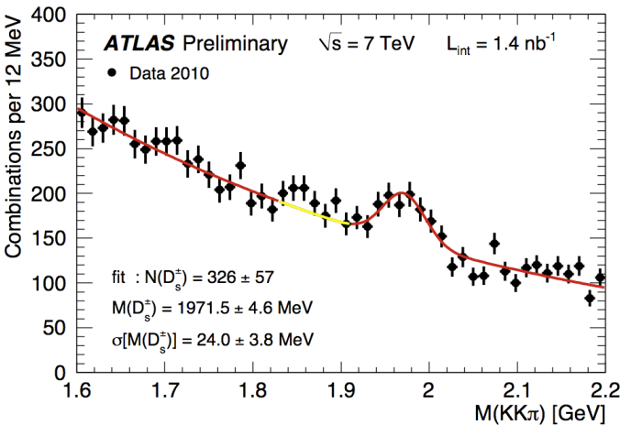
First LHC Heavy Flavour Results
Charm physics: Huge charm production!
D⁰ → K⁻ π⁺
Adrian’s talk
D⁰ → K⁻ π⁺
Johan’s talk
D⁰ → K⁻ π⁺
1.8 nb⁻¹
D⁺ → K⁻ π⁺ π⁺
D⁺ → K⁻ π⁺ π⁺
1.8 nb⁻¹
D⁺ → K⁻ π⁺ π⁺
D_{(s)}⁺ → φ (K⁺ K⁻)π⁺
D_{s}⁺ → Φ π⁺ → (K⁺ K⁻)π⁺
1.8 nb⁻¹
Clear selection of Cabibbo-suppressed decay

Slide 17
First LHC Heavy Flavour Results (cont’)
Charm physics: Huge charm production!
From plots to cross-sections: LHCb
Open charm production cross-sections are being studied vs y and p_{T} in forward region (2 < y < 5) for D*, D⁰, D⁺ and D_{s} by LHCb :
Used small sub-sample of collected data :~ 2 nb⁻¹ with unbiased trigger
Measurement of σ(pp→D⁺X) /σ(pp→D_{s}X)=2.32 ± 0.27 ± 0.26
many systematics drop out in the ratio: in agreement with PDG: 3.1±0.7
J/ψ → µ⁺µ⁻ production: ATLAS/CMS/LHCb
Measurement of the differential (p_{T}) inclusive cross-section (prompt + from b) and the overall fraction of J/ψ from b
b production cross-section from b → D⁰µνX events: LHCb
Measure cross-section in four bins of η (admitted to PLB)
σ(pp → H_{b}X) = (75.3 ± 5.4 ± 13.0)μb for 2<η<6, any p_{T} √s=7 TeV
Use MC and Pythia to extrapolate to 4π and averaging with prel. Result from b→J/ψ:
σ(pp → bbX) = (292 ± 15 ± 43)μb
Conor’s talk
Roberto’s talk
Conor & Rob’s talk
LHCb assumed in MC ~ 250 μb

Slide 18
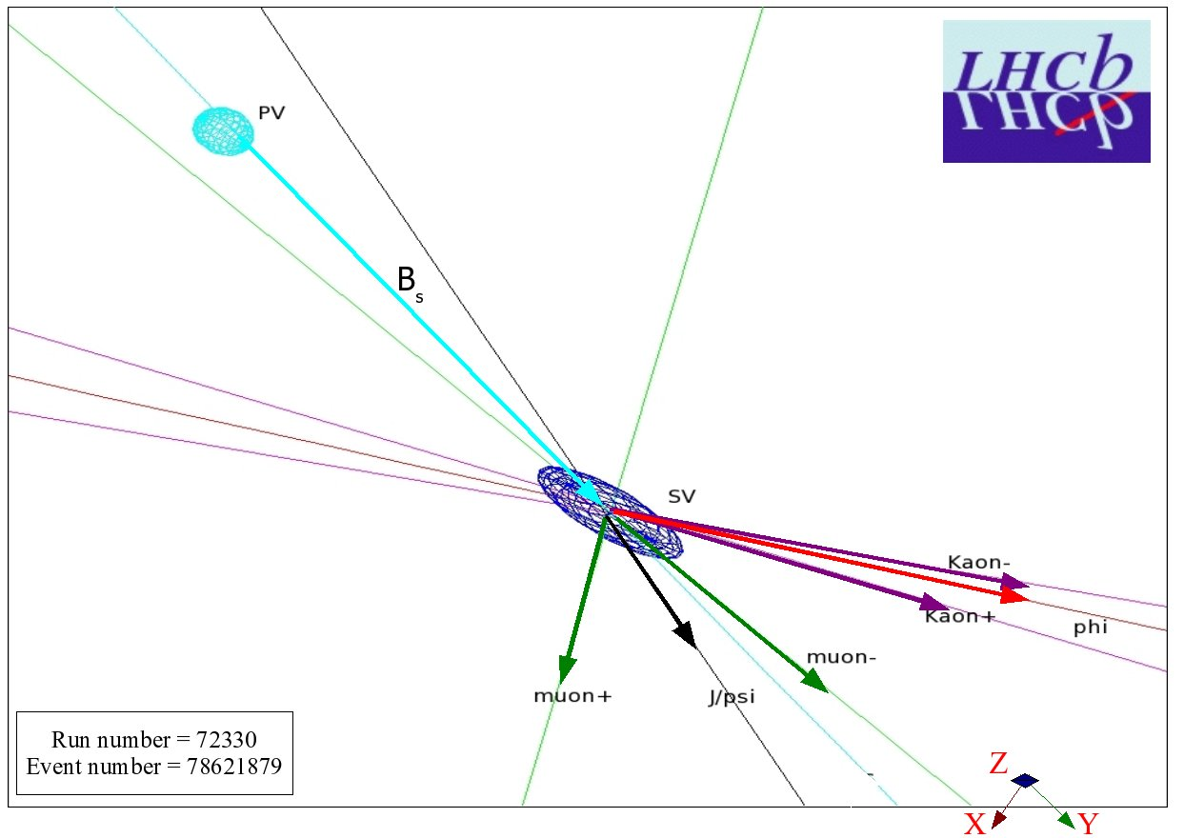
Future
B-hadron properties
New decay limits
Understand back-grounds for rare decays
LHCb: O(100 pb⁻¹) O(1 fb⁻¹) O(6 fb⁻¹)
Start-up End 2010 2011 2015
ATLAS: O(100 pb⁻¹) O(1 fb⁻¹) O(30 fb⁻¹)
CMS
Rare decay searches
Searches for CP violation in weak decays of B mesons

Slide 19
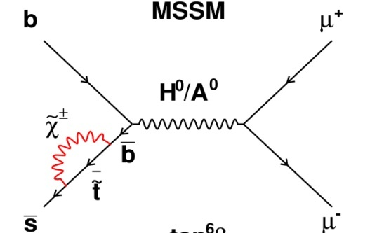
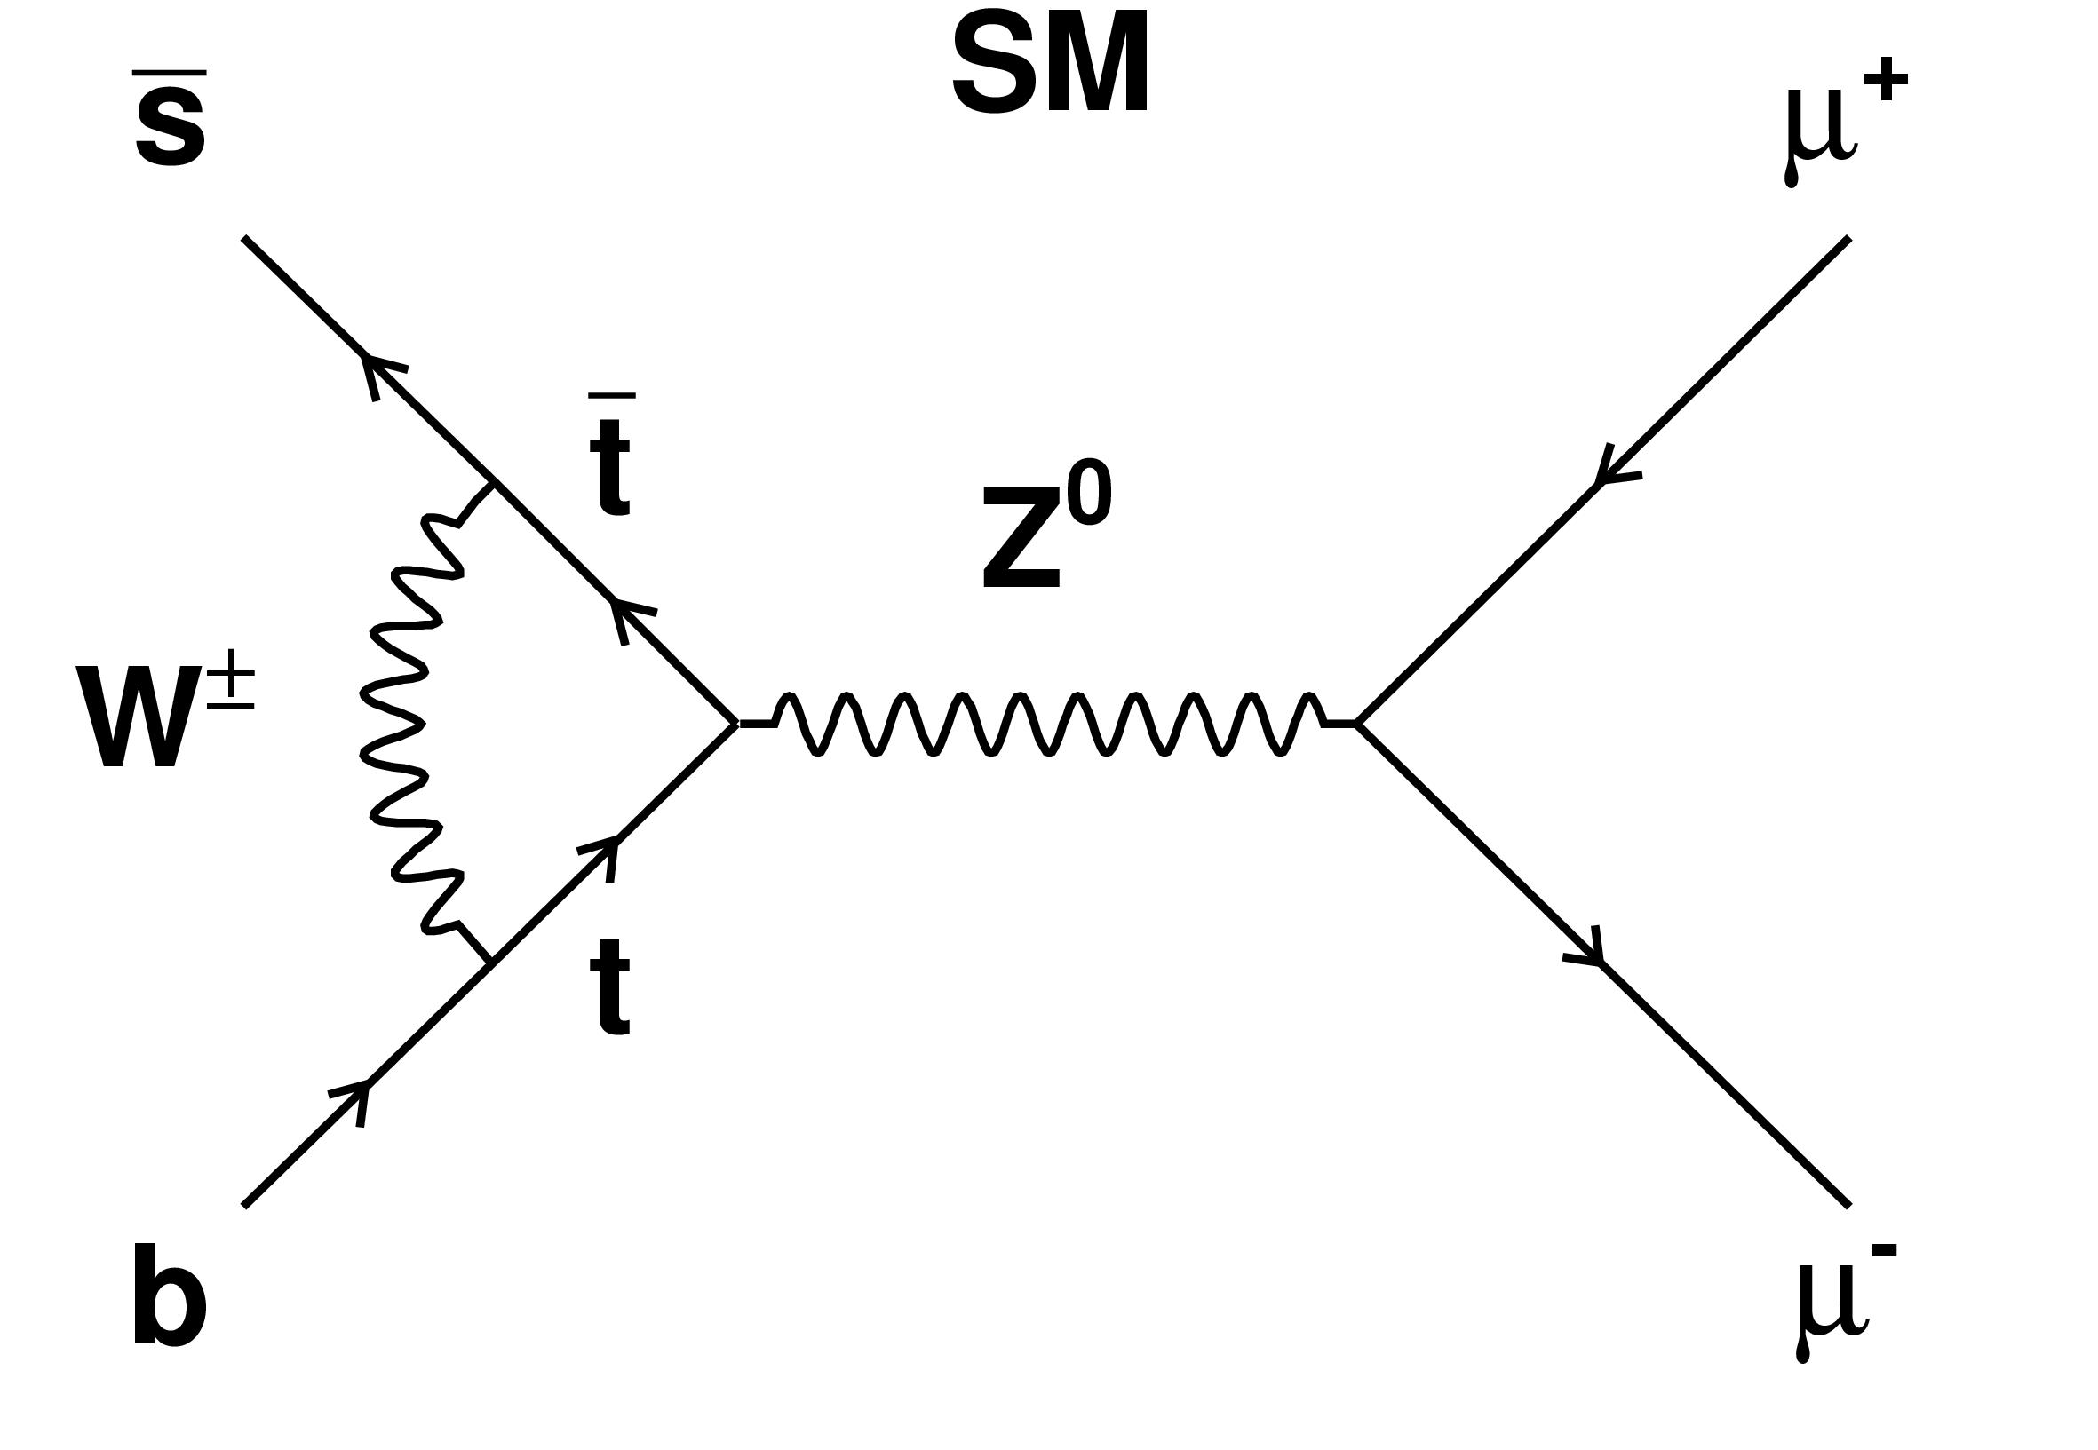
New Physics in B_{s}→μ⁺μ⁻
Morning session
SM
?
SM
MSSM
?
~ tan⁶β/M_{H}²
A.Buras, EPS09, arXiv:0910.1032
Helicity suppressed and in SM: BR(B_{s} → μ⁺μ⁻)=(3.6 ± 0.3) ×10⁻⁹
sensitive to New Physics; could be strongly enhanced in SUSY
Current best limit from CDF: BR(B_{s} → μ⁺μ⁻) < 3.6 ×10⁻⁸ @90%CL
BR(B_{s} → μ⁺μ⁻) < 4.2 ×10⁻⁸ from D0 @90%CL
Event selection
Main issue is background rejection:
dominated by B → μ⁺X, B → μ⁻ X decays
good mass resolution, vertex resolution and PID are essential

Slide 20
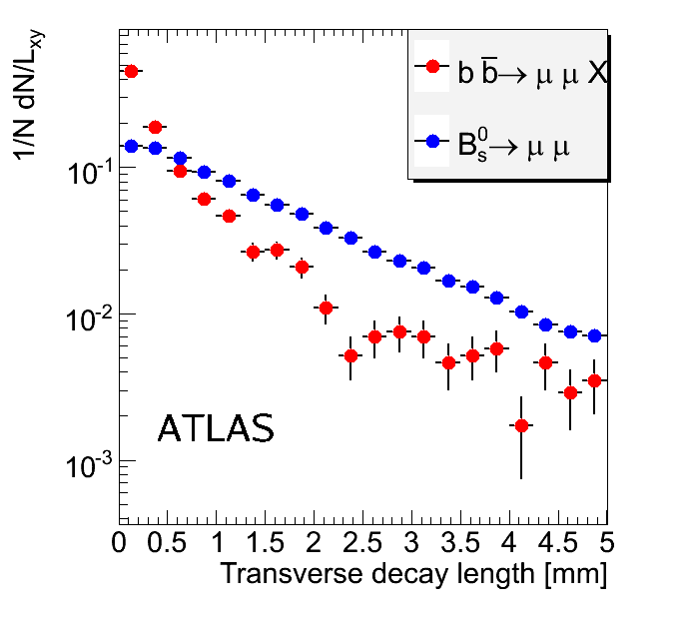
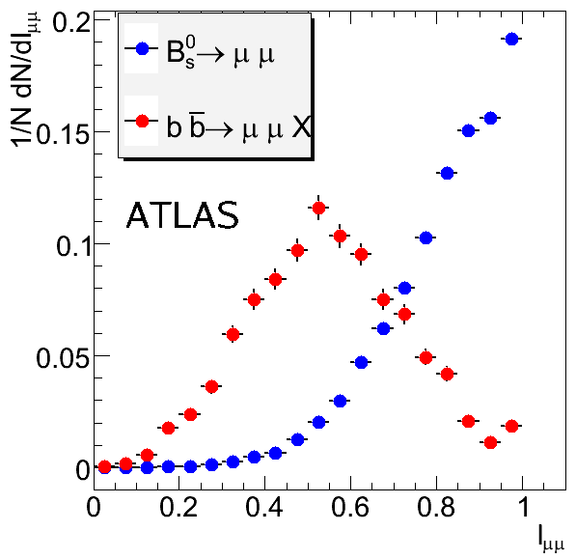
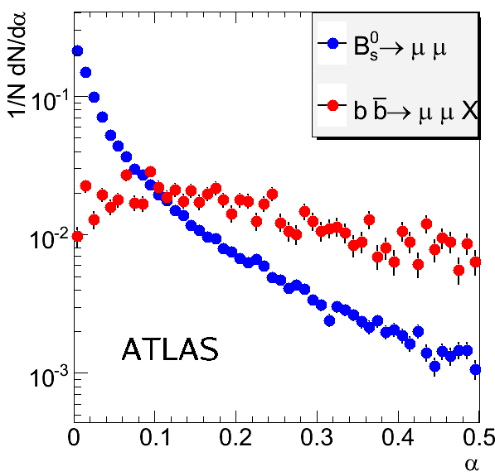
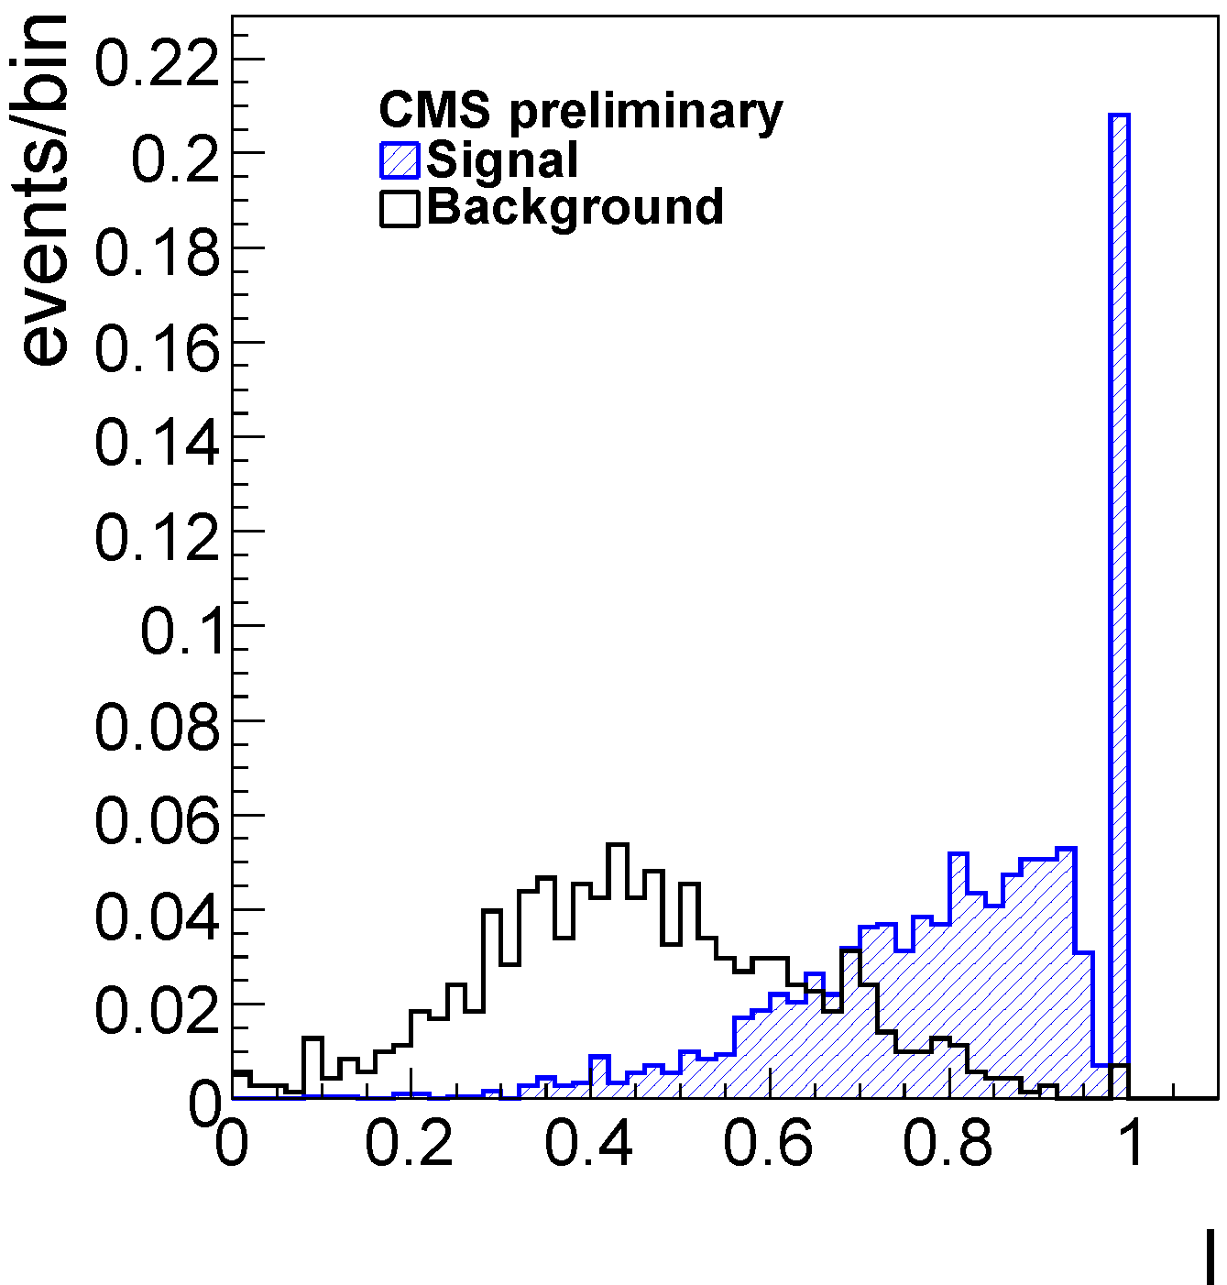
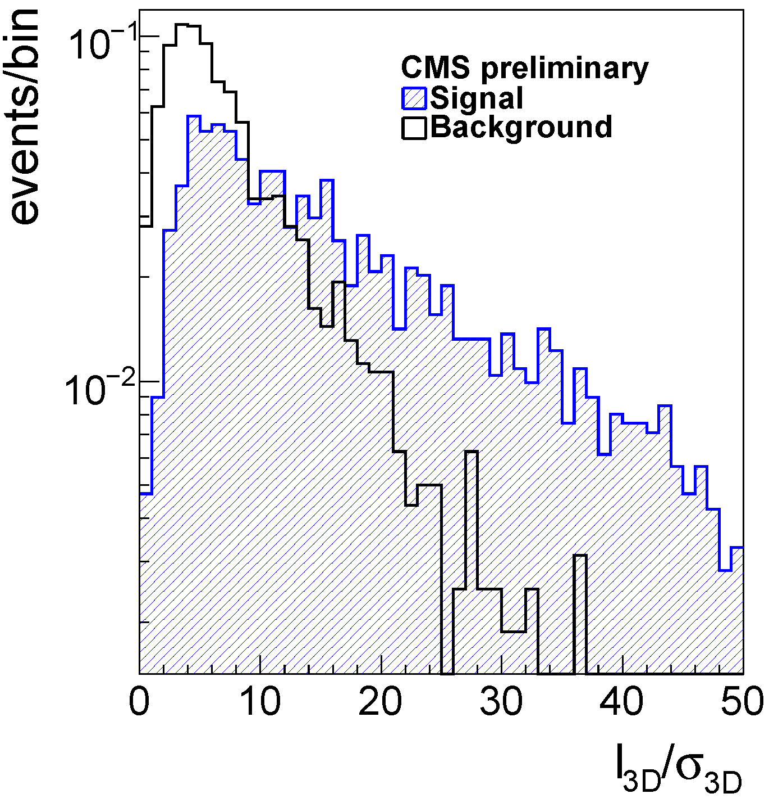
B_{s}→μ⁺μ⁻: ATLAS/CMS
« Easy » for the trigger: hight p_{T} (di-)muons
ATLAS/CMS have similar discriminating variables
They perform cut based analysis to separate signal from background, using:
isolation of the muon pair
decay length significance
angle between di-muon momentum and direction to PV
mass window around m(B_{s})
Valentin’s talk
Luca’s talk
ATLAS
MC
CMS
Trans. decay length
Isolation
Pointing angle
Isolation
Flight-length sig.

Slide 21
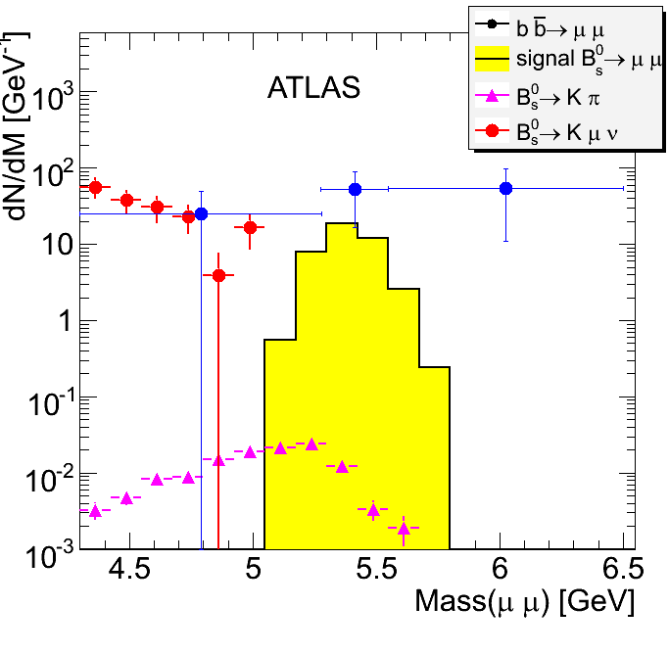
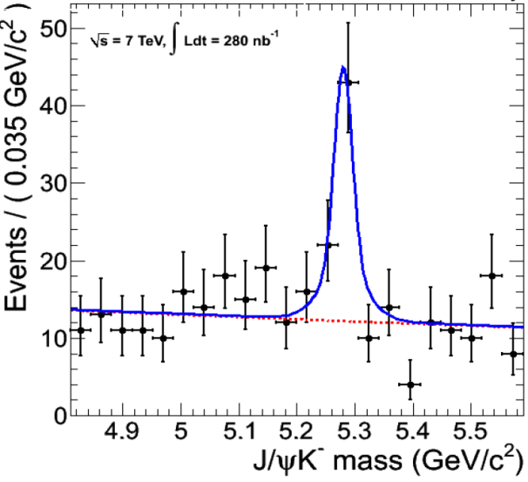
B_{s}→μ⁺μ⁻: ATLAS/CMS
Expected results (assuming σ(pp → bbX) = 500 µb) @14TeV:
MC
 | N sig | N bkg | 90% CL
ATLAS (10 fb⁻¹) | 5.6 | 14 | ---
CMS (1 fb⁻¹) | 2.4 | 6.5 | <1.6 10⁻⁸
with 10 – 20 fb⁻¹ SM prediction region
• 3σ evidence after 3 years@10³³
• 5σ observation after 1 years@10³⁴
2.1 10^{-8 *}
Uncertainty coming from limited amount of MC
B → J/ψ K is used for normalization to translate the signal cross section to a BR
Well measure BR
Only 1 additional track compare to signal decay
CMS
Prel.
N_{sig} = 48
σ_{M} = 32 MeV/c²
280 nb⁻¹
* Scaling quoted result by ratio of LHCb measured x-sec
at √s = 7 TeV to 14 TeV value assumed in MC study.

Slide 22
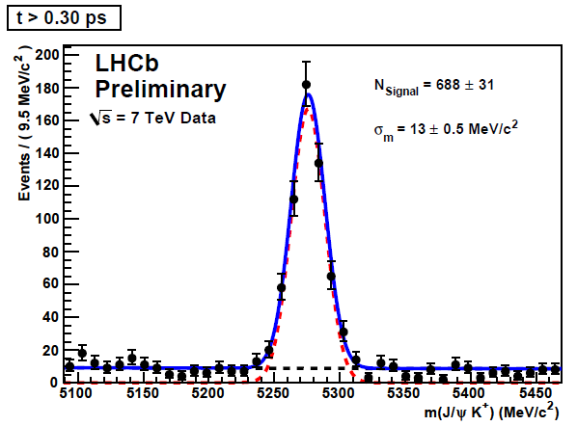
B_{s}→μ⁺μ⁻: LHCb
Niels’ talk
LHCb approach is philosophically similar to Tevatron’s:
loose selection and then construction of global likelihood:
Analysis in 3 Parameter Space
production fraction is the larger systematic (13%)
Prospects from Data:
Mass resolution measured on B → ππ, πK, … now 24 MeV/c²
Getting closer to MC expectation (22 MeV/c²)
Nice B⁺→J/ψK⁺ signal
IP resolution in agreement to MC for p_{T} > 2 GeV
Background at the expected level
Invariant Mass
IP
lifetime
Isolation
PID
Geometry GL
N_{sig} = 688
σ_{M} = 13 MeV/c²
~3 pb⁻¹
no events in sensitive region and general properties of background as expected
280 nb⁻¹
Invariant Mass
expected ~ 6 signal events and ~ 30 background events for 1 fb⁻¹
sensitive region
Geometry Likelihood
Notes:
Sensitive region: ± 60 MeV/c2 & GL>0.5

Slide 23
B_{s}→μ⁺μ⁻
ATLAS/CMS & LHCb should be complementary for such a measurement
Very soon LHC should be able to approach or surpass world best sensitivity
With 50 pb⁻¹ possible already to approach new limit:
LHCb alone:
BR(B_{s} → μ⁺μ⁻) < 3.4 ×10⁻⁸ @90%CL
5σ observation down to BR = 5 x SM with 1 fb⁻¹ (BR(B_{s} → μ⁺μ⁻) > 1.7 ×10⁻⁸)
For a 5σ measurement at SM value a combination of all LHC observations will help!
Exclusion limit at 90% CL at √s=7TeV
D0 (6.1 fb⁻¹)
CDF (3.7 fb⁻¹)
D0 (11 fb⁻¹)
CDF (11 fb⁻¹)
CMS
LHCb MC
Close to CDF limit possible already end of the year
2011

Slide 24
β_{s} measurements from B_{s} → J/ψ φ
Wednesday session
The interference between B_{s} decay to J/ψφ with or without mixing gives rise to a CP violating phase Φ.
It is a sensitive probe of New Physics:
It is well predicted in the SM: Φ=-2β_{s}= -0.0368±0.0017
New particles can contribute to the B_{s}-B_{s} box diagrams and significantly modify the SM prediction
It is not a pure CP eigenstate (VV decay)
2 CP even, 1 CP odd amplitude
Initial states must be tagged
Final states need to be statistically separated through angular analysis
Mistag and proper time resolution are crucial…
TEVATRON:
B_{s}
J/ψφ
B_{s}
+NP?
CDF and D0 set confidence level bounds on
ΔΓs - φs
SM at ~1σ

Slide 25
β_{s} measurements from B_{s} → J/ψ φ
ATLAS/CMS:
use Bs lifetime cuts
main background is long-lived
main systematics: control of acceptance
LHCb:
Does NOT use Bs lifetime cuts
main background is prompt
Main systematics are mistag and proper-time resolution
Expected LHCb sensitivity
10TeV - σ(pp → bbX) = 292 µb
LHCb MC
First result possible already with 50 pb⁻¹ data
2011
LHCb: yield for 0.2 fb⁻¹: ~ 7 k
comparable to CDF @ 5.2 fb⁻¹

Slide 26
β_{s} measurements from B_{s} → J/ψ φ
Prospects at LHCb from Data:
Johan’s talk
Signal starts to show up
yield in ≈ agreement with expectation
B⁰→ D*μν
~ 1.9 pb-1
B_{s} → J/ψ φ
N_{sig}= 78±11
σ_{M} = 13 MeV/c²
First signal of flavour oscillation from B⁰_{d} → D*⁻(D⁰ π⁻)μ⁺ν events.
“Out of the box” un-calibrated tagging performance already at 60% of expected performance.
~2 pb⁻¹
Propertime resolution not yet as in MC :~50-60 fs. Still very good for B_{s} physics (would give a ~20% decrease in sensitivity). Work on-going on alignment …

Slide 27
γ Measurements
B_{(s)}→Kπ,KK, ππ…
Two body charmless B decays are core to LHCb programme: γ angle, loop effects etc.
Penguin amplitudes:
Interference of b→u tree & b→d(s) penguin diagrams
CP time-dependent measurements from B_{d}→ππ and B_{s}→KK allow to extract γ relying on U-Spin.
Crucial use of PID from RICH and very good mass resolution
Denis’ talk
B_{s}→KK
~3.1 pb⁻¹
B_{d}→ π π
~3.1 pb⁻¹
B_{d}→Kπ
~3.1 pb⁻¹
Yields so far ~match expectations. In 2011 running LHCb will get largest world samples both in B⁰ and B_{s}.

Slide 28
γ Measurements
Multibody hadronic final states: First look @ LHCb
Clean samples with high S/B at ~ expected rate
B⁺→D(K π) π ~300 nb⁻¹
B⁰→D(K π π) π
~750 nb⁻¹
B⁰+ B⁺→D(Kπ, Kππ) πππ
~0.4 pb⁻¹
B_{s} → D_{s}(KKπ) π
~0.75 pb⁻¹
6 track final state !
2011:
1fb⁻¹ @ 7 TeV
σ(γ) < 10° ?
Many channels and strategies will give a complete picture for γ measurements

Slide 29
prospects: LHCb upgrade
Very rare decays
CP violation
NP studies
LHCb: O(6 fb⁻¹) O(100 fb⁻¹)
2015 2022
ATLAS: O(30 fb⁻¹) O(500 fb⁻¹)
CMS

Slide 30
LHCb Upgrade
LHC physics in ~2015
New Physics (NP) will hopefully be discovered by ATLAS/CMS and LHCb
New Physics will very likely show up in Flavour observables: LHCb should see it!
LHCb Sensitivities (2 fb⁻¹ @14TeV)
Observable | Sensitivity | SM
CPV(B_{s}→J/ψφ) (2β_{s}) | 0.03 | 0.04
γ tree | 5º | 67.2°
B(B_{s}→μ⁺μ⁻) | Observed at 3σ | 3.6 ×10⁻⁹
A_{FB}(B→K*μ⁺μ⁻) | 0.5 GeV² | 4.36 GeV²
CPV(B_{s}→φγ) | 0.22 | 0.10

Slide 31
LHCb Upgrade
Better Flavour Physics will be required to elucidate the NP flavour structure or probe NP at higher mass scale
LHC is a Super Flavour factory: 10⁶ Hz of b-quarks produced
LHCb exploits only a small fraction of LHC:
L_{LHCb}=2x10³² cm⁻²s⁻¹ / L_{LHC}=10³⁴ cm⁻²s⁻¹
LHCb Upgrade will be complementary to Super B(Belle) factory!
LHCb Upgrade Strategy
Running at 10 times design luminosity, i.e. at ~ 2x10³³ cm⁻²s⁻¹
Upgrade planned in 2 phases matching LHC schedule :
Phase 1: ~ 2016 L = 10³³ cm⁻²s⁻¹ : R&D has started
Phase 2: L = 2x10³³ cm⁻²s⁻¹
read out full experiment at 40 MHz, currently at 1 MHz
Gain a factor 2 in the trigger efficiency for hadronic channels
vertex and photon detector needs to be replaced

Slide 32
LHCb Trigger
40 MHz
Hardware
Pile-up
Calorimeter
Muon
+ L0DU
Level 0:
High p_{T} :
μ, e, h, γ
4 µs
1 MHz
Computing farm
HLT:
L0 confirmation μ, e, h, γ tracks inclusive/exclusive Selection
Full reconstruction
of event
2 kHz
Storage

Slide 33
LHCb Trigger: new scheme
Very flexible software trigger
Can be adapted to any kind of scenarii
Highly selective for b-mesons:
Reduction factor of 10⁵ on minimum bias
Hardware
40 MHz
Computing farm
HLT:
L0 confirmation μ, e, h, γ tracks inclusive/exclusive Selection
Full reconstruction
of event
20 kHz
Storage
Readout the detector at 40 MHz
Replace all front-end electronics
Replace all very front-end ASIC with a readout speed limited to 1 MHz

Slide 34
The high luminosity challenge
L = 10³² cm⁻²s⁻¹
Average number of interactions per crossing: 0.4
Most crossings don’t have an interaction

Slide 35
The high luminosity challenge
L = 10³² cm⁻²s⁻¹
Average number of interactions per crossing: 0.4
Most crossings don’t have an interaction
L = 10³³ cm⁻²s⁻¹
Average number of interactions per crossing: 2.3
With 15% of empty crossings
L = 2x10³³ cm⁻²s⁻¹
Average number of interactions per crossing: 4.6
With all crossings with at least one interaction
Handle higher occupancy and radiation dose
Redesign the inner part of the tracking system (VELO, TT, IT)

Slide 36
LHCb detector evolution in Phase I
Vertex detector: new pixel system
Tracking system: new TT& IT, new electronics for OT
Some electronics replacement for
Hadron id:
New photon detectors
Calorimeter
Muon detector
Replace all the front-end electronics + DAQ network

Slide 37
LHCb sensitivities
With 100 fb⁻¹ error in 2β_{s} decreases to ±0.003 (only L improvement), useful to distinguish among Supersymmetry (or other) models, where the differences are on the order of ~0.02
LHCb Sensitivities (100 fb⁻¹ @14TeV)
Observable | Sensitivity | SM
CPV(B_{s}→J/ψφ) (2β_{s}) | 0.003 | 0.04
γ tree | 1º | 67.2°
B(B_{s}→μ⁺μ⁻) | 5-10% of SM | 3.6 ×10⁻⁹
A_{FB}(B→K*μ⁺μ⁻) | 0.07 GeV² | 4.36 GeV²
CPV(B_{s}→φγ) | 0.02 | 0.10
+ many more observables:
φ_{s} in B_{s}→φφ, γ mediated by loops, cos 2β in B_{d} → J/ψ K_{S}, …
The upgrade strategy is SLHC independent
Letter of Intent → end 2010

Slide 38
conclusionS

Slide 39
Conclusions
Excellent LHC & detectors start-up
Progressing very well to design performances
LHCb is dedicated to b-physics and designed for it!
It has the best performances in terms of: Momentum and mass resolution, PID (π/K separation), Proper time resolution, Trigger
ATLAS/CMS:
will complement the b-physics program of LHCb
Fully profit from muon trigger capabilities at high luminosity
LHC is entering into the game!
First data collected are very promising
Many significant measurements will be achieved in the b and c-quark sectors in a near future
LHCb is preparing a challenging upgrade aiming at an integrated luminosity of 100 fb⁻¹ complementary to a Super B factory
We are poised for a long and exciting physics program !!!

Slide 40
Thank you!

