Slide 1
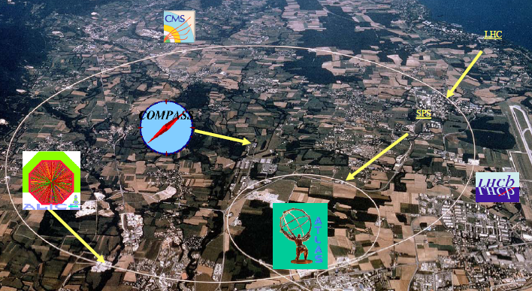
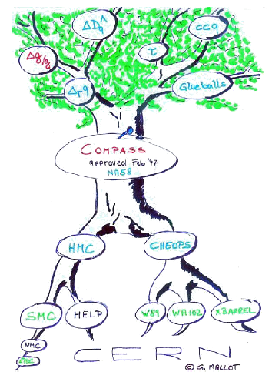
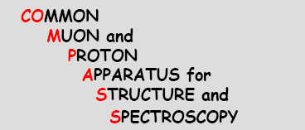

Recent Results on Hadron Spectroscopy at COMPASS
Reiner Geyer for the COMPASS collaboration

Slide 2

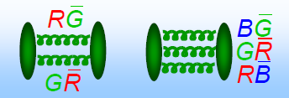
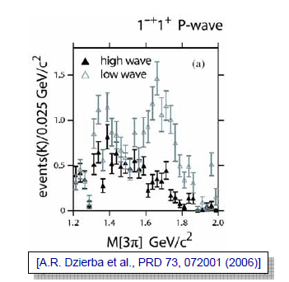
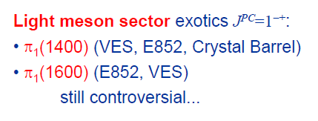
Hadron Spectroscopy @ COMPASS
Goal: explore hadron spectrum up to 2.5 GeV/c²
Search for exotic mesons (hybrids, glueballs, multiquark hadrons).
Clarify exotic nature of π₁(1400)and π₁(1600).
Settle properties of f₀(1500) (0⁺⁺ glueball candidate).
Investigate other disputed mesonic states.
Hybrid candidates with exotic Quantum numbers

Slide 3


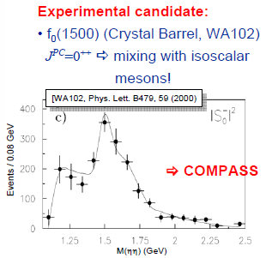
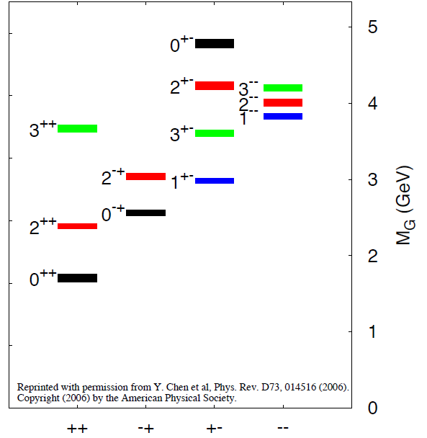
Search for Glueballs
The ground state is predicted at1710 ± 100 MeV with conventional quantum numbers.
The first odd glueball lies around 4 GeV → Physics at Fair.
Flavor blind coupling for a pure glueball state expected.
The f₀(1500) and the f₀(1710) have been proposed as the scalar glue balls. But 0⁺⁺ can mix with other singlet scalar mesons and can drastically change properties.

Slide 4
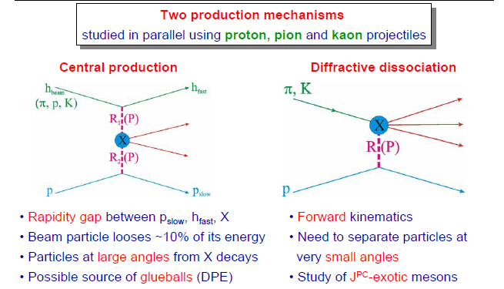
Production mechanisms for exotics @ COMPASS
Diffractive Dissociation and Central Production

Slide 5
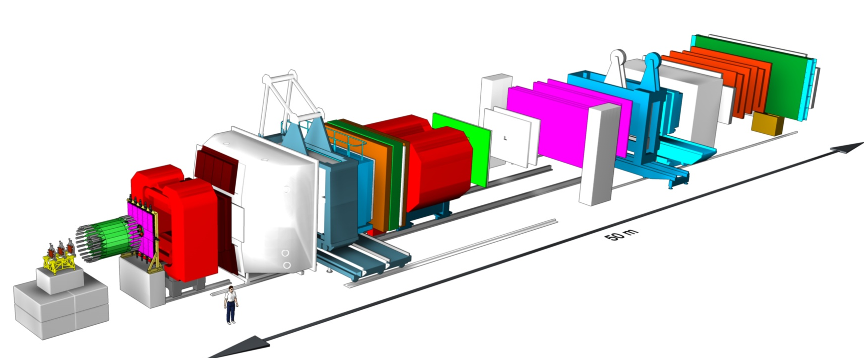
The COMPASS Spectrometer:
A fixed Target experiment at SPS
Beam properties:
190 GeV/c, 5·10⁷ hadrons/spill
Composition:
Beam ID with CEDARS
µ-Identification
E/Hcal-2
E/Hcal-1
SM2
Rich
SM1
Target Region
Beam
-Two stage spectrometer with large acceptance
-LH2 and solid targets, Recoil trigger, vertex reconstruction
-Particle ID: Rich and µ-Identification
-Neutral particle detection with ECal & HCal
-250000 channels readout
-About 1 PByte of data per year

Slide 6
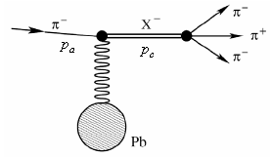





Diffraction Reactions at COMPASS
Example:
Beam momentum 190 GeV/c
Trigger: Charged multiplicity increase.
Selection of exclusive π⁻π⁺π⁻ events.
Photo production

Slide 7
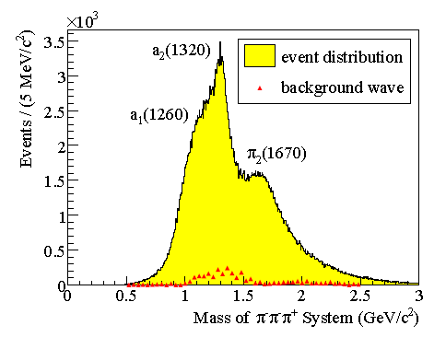
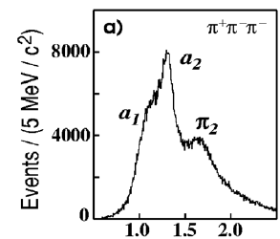
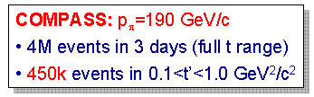

First Results from the 2004 Pilot Run
PRL 104, 241803 (2010)

Slide 8
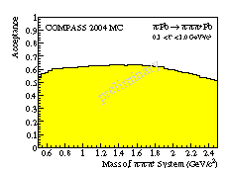
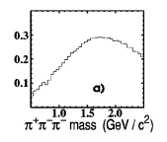
First Results from the 2004 Pilot Run
PRL 104, 241803 (2010)

Slide 9
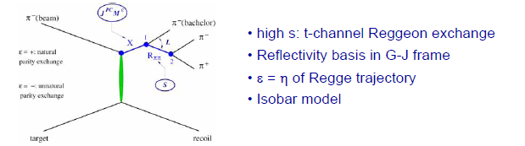
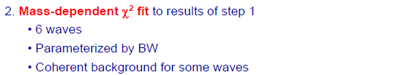
PWA Technique
J^{PC}M^{ε}

Slide 10
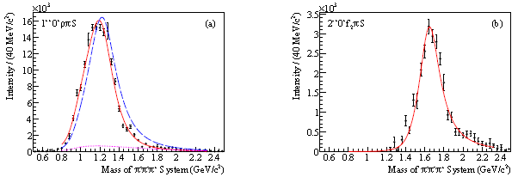
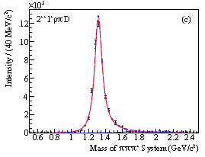
PW-Analysis results: Major Waves
PRL 104, 241803 (2010)
1⁺⁺0⁺ρπS
2⁻⁺0⁺f₂πS
a₁(1260)
π₂(1670)
2⁺⁺1⁺ρπD
a₂(1320)

Slide 11
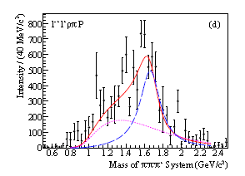
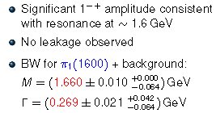
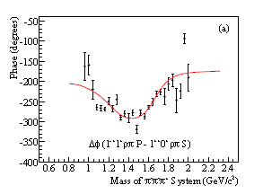
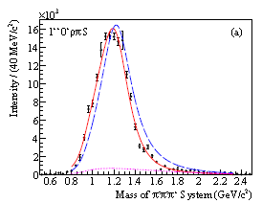
Exotic wave 1⁻⁺1⁺ρπP: π₁(1600)
PRL 104, 241803 (2010)
1⁻⁺1⁺ρπP
π₁(1600)
1⁺⁺0⁺ρπS
a₁(1260)

Slide 12
COMPASS Spectroscopy 2008 & 2009
2004 Pilot Run
  190 GeV/c π⁻ beam on Pb for 2 weeks. Few days effective data taking.
  Charged multiplicity increase trigger. Full t-range.
  No E-Calorimetry.
2008 & 2009
  190 GeV/c π⁻, K⁻, p, π⁺ beams on LH₂, Pb and Ni targets.
  About 100x higher integrated luminosity compared to 2004.
  E-Calorimetry operational → Neutral Channels accessible.
  Recoil particle trigger for charged and neutral final states. t>0.1 GeV²/c².
  Additional data taking with “charged multiplicity increase” trigger at low t.
Analysis of 2008&2009
  Some preliminary results available from data pre-productions.

Slide 13
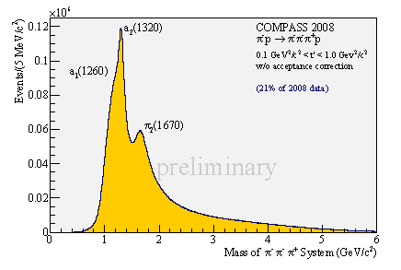
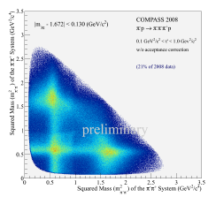
First View into 2008: π⁻p→ π⁻ π⁺π⁻p
96 M events for t’>0.1 GeV²/c², 5.8 M events for a2(1320)
  Acceptance corrections have still to be finalized (MC description)
  Wave set for PWA to be optimized (high statistics).
  New released results promised for next year!
M=1 waves for Pb enhanced compared to LH2 (nuclear effects)?
    See also Poster of Boris Grube
|M_{3π}-1.672| < 0.130 (GeV/c²)
ρ
f₂

Slide 14
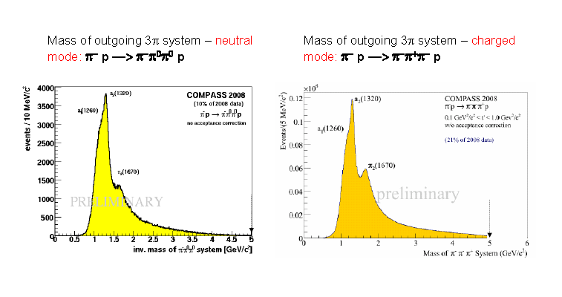
Preliminary Results 2008: π⁻p→ π⁻ π⁰ π⁰p

Slide 15
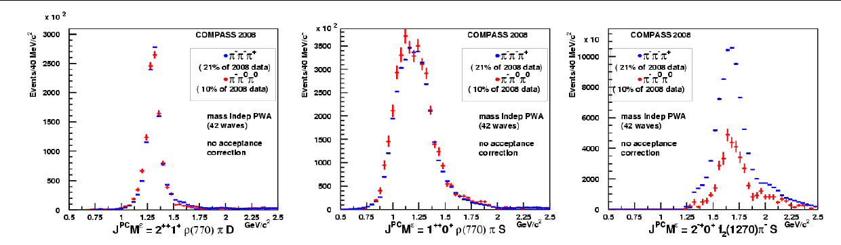
π⁻p→ π⁻π⁰π⁰p:
Main waves consistent with π⁻π⁺π⁻
Used for normalization
2⁺⁺1⁺ρπD
a₂(1320)
1⁺⁺0⁺ρπS
Preliminary
a₁(1260)
2⁻⁺0⁺f₂πS
Preliminary
Preliminary
π₂(1670)
π⁻π⁰π⁰ : 10% of 2008 data. π⁻π⁺π⁻ : 21% of 2008 data.
From Isospin symmetry:
  Expect same intensities for isovector isobars (e.g. ρ)
  Expect half the intensity in neutral mode for isoscalar isobars (f₀, f₂)
Not acceptance corrected! a₂ used for normalization.
Comparison allows for systematic tests. Different detectors and reconstruction codes are involved in both analysis!
Data production to be repeated with new optimized calorimeter reconstruction before going for details.

Slide 16

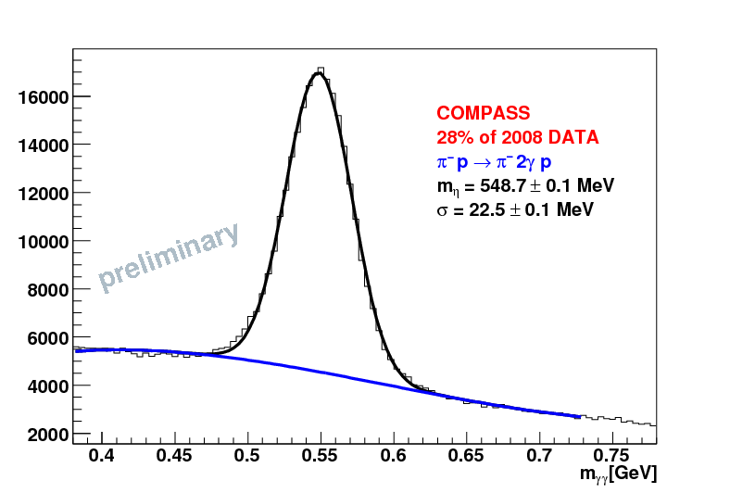
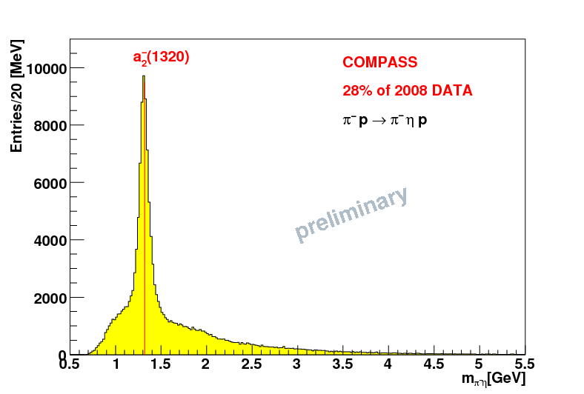

Other final states for hybrid searches
π⁻p → π⁻η, π⁻η’, π⁻f₁, π⁻b_{1, …}
η nicely reconstructed in γγ and π⁻π⁺π⁰.
η’ clear signal in π⁻π⁺η.
f₁(1285) seen in π⁻π⁺η and .
b₁ seen in πω.
η
π1(1400)?
PWA needed
M_{γγ}[GeV/c²]
M_{π}⁻_{η}[GeV/c²]

Slide 17

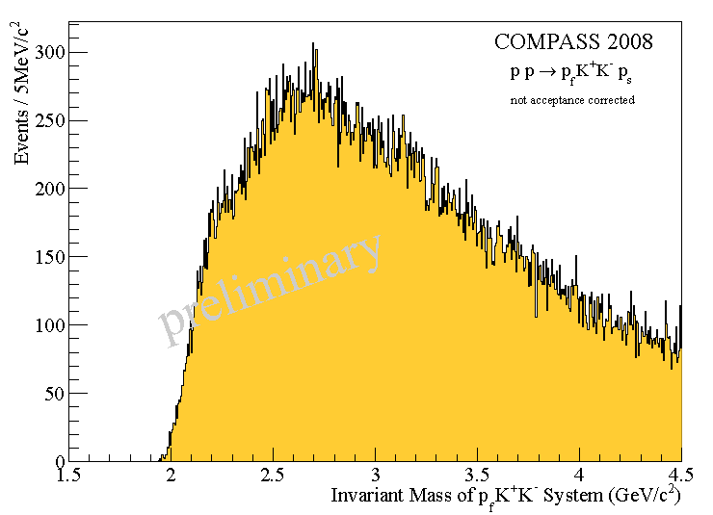
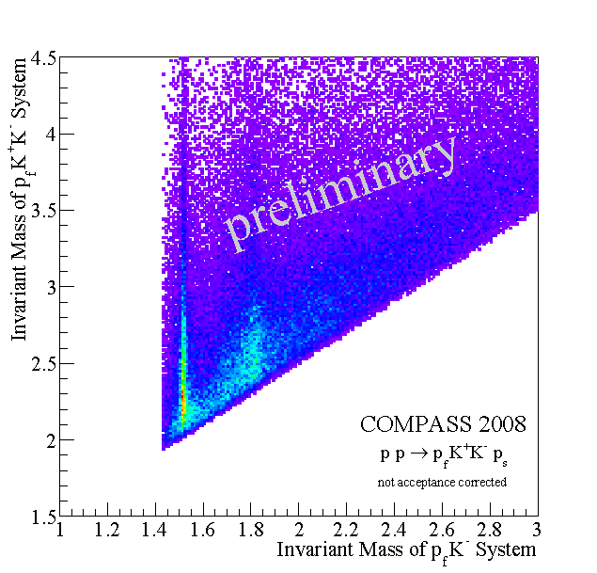

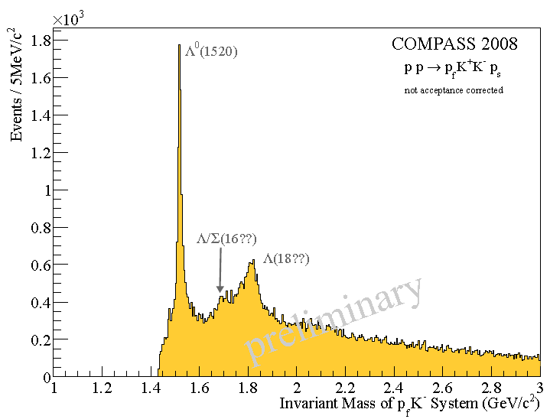
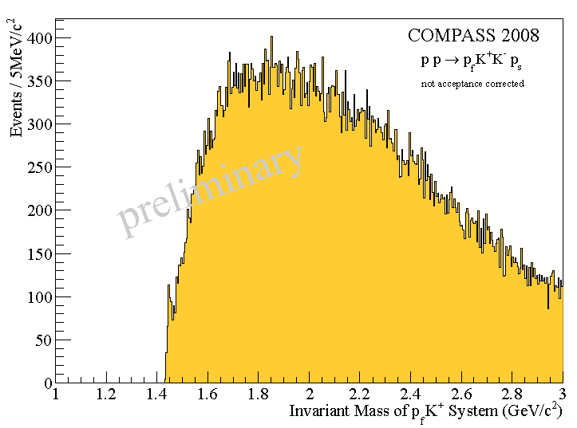




Slide 18
K⁺K⁻ Invariant Mass

Slide 19

Summary and Outlook
First published results on π⁻(1600) from π⁻Pb → π⁻π⁺π⁻Pb.
Data from 2008&2009 will exceed the world statistic in this channel by about a factor 100.
Neutral channels are now accessible at COMPASS as demonstrated by π⁻π⁰π⁰.
Next data production should start in a few weeks with an new optimized code for calorimetry.
Hopefully new PWA results soon - also from final states with η, η’, f₁, b₁, … .
Analysis on final states has started.

