Slide 1
High-Performance Computing with NVIDIA Tesla GPUs
Chris Butler NVIDIA

Slide 2

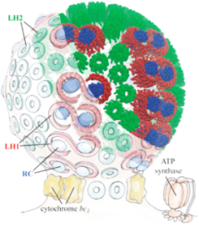
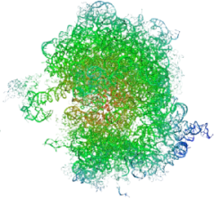
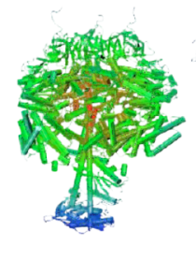
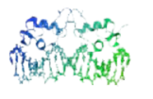

Science is Desperate for Throughput
Gigaflops
1,000,000,000
1 Exaflop
1,000,000
1 Petaflop
Bacteria
100s of
Chromatophores
Chromatophore
50M atoms
1,000
Ribosome
2.7M atoms
F1-ATPase
327K atoms
Ran for 8 months to simulate 2 nanoseconds
1
Estrogen Receptor
36K atoms
BPTI
3K atoms
1982
1997
2003
2006
2010
2012

Slide 3
Power Crisis in Supercomputing
Household Power
Equivalent
Exaflop
City
25,000,000 Watts
7,000,000 Watts
Petaflop
Town
Jaguar
Los Alamos
850,000 Watts
Teraflop
Neighborhood
60,000 Watts
Gigaflop
Block
1982
1996
2008
2020

Slide 4

“Oak Ridge National Lab (ORNL) has already announced it will be using Fermi technology in an upcoming super that is ‘expected to be 10-times more powerful than today’s fastest supercomputer.’
Since ORNL’s Jaguar supercomputer, for all intents and purposes, holds that title, and is in the process of being upgraded to 2.3 Petaflops …
… we can surmise that the upcoming Fermi-equipped super is going to be in the 20 Petaflops range.”
September 30 2009
Notes:
1 Peta Flops = 10¹² = one thousand billion floating point operations / sec
http://www.hpcwire.com/blogs/NVIDIA-Changes-the-Calculation-with-Fermi-GPU-63016337.html
Mega Flops = 10 6 = million
Tera Flops = 10 9 = billion
Peta Flops = 10 12 = thousand billion = 1 000 000 000 000 000

Slide 5
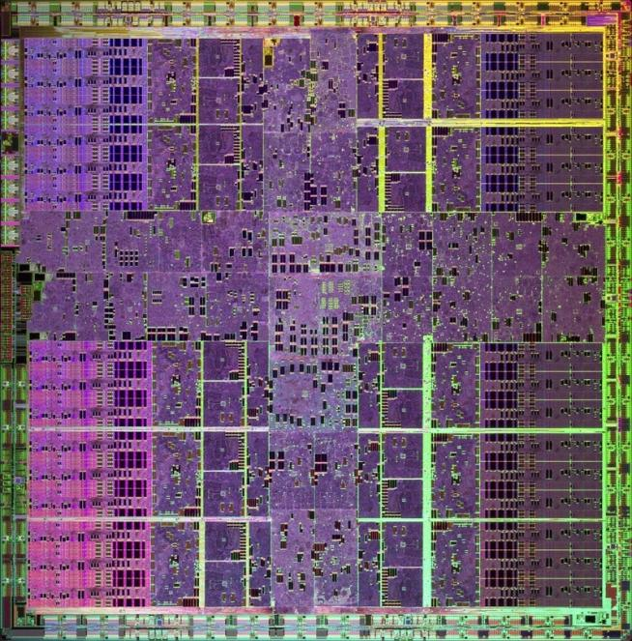
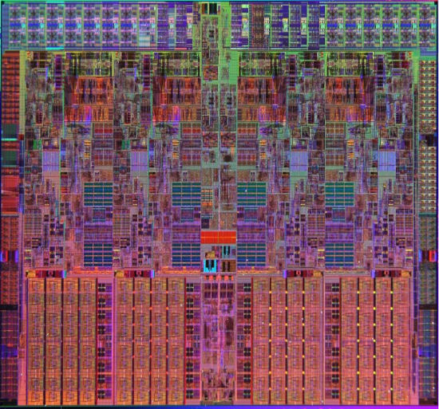

What is GPU Computing?
x86
PCIe bus
GPU
Computing with CPU + GPU
Heterogeneous Computing

Slide 6
Low Latency or High Throughput?
CPU
  Optimised for low-latency access to cached data sets
  Control logic for out-of-order and speculative execution
GPU
  Optimised for data-parallel, throughput computation
  Architecture tolerant of memory latency
  More transistors dedicated to computation
Control
ALU
ALU
ALU
ALU
Cache
DRAM
DRAM

Slide 7


NVIDIA GPU Computing Ecosystem
ISV
NVIDIA Hardware Solutions
CUDA SDK & Tools
GPU Architecture
TPP / OEM
CUDA Training Company
CUDA Development Specialist
Hardware
Architect
VAR
Customer Application
Deployment
Customer
Requirements
Hardware Architecture

Slide 8

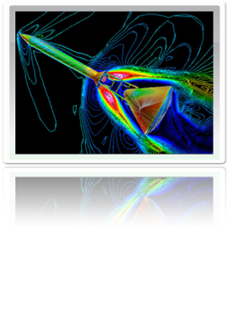
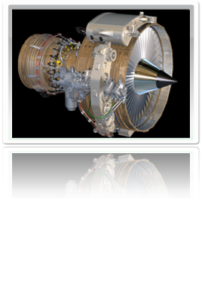


NVIDIA GPU Product Families
GeForce®
Entertainment
TeslaTM
High-Performance Computing
Quadro®
Design & Creation

Slide 9

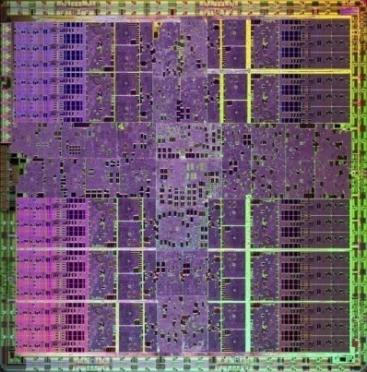

Many-Core High Performance Computing
NVIDIA’s 10-series GPU has 240 cores
Each core has a
  Floating point / integer unit
  Logic unit
  Move, compare unit
  Branch unit
Cores managed by thread manager
  Thread manager can spawn
  and manage 30,000+ threads
  Zero overhead thread switching
NVIDIA 10-Series GPU
1.4 billion transistors
1 Teraflop of processing power
240 processing cores
NVIDIA’s 2nd Generation
CUDA Processor

Slide 10
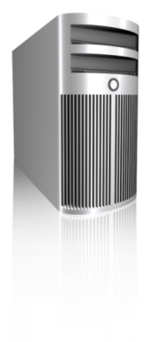
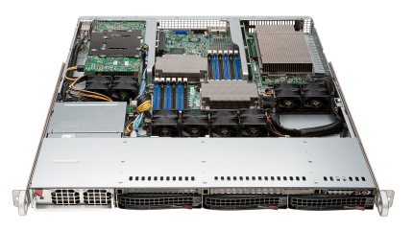
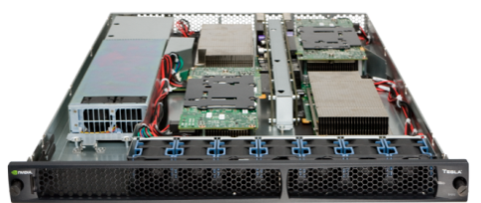
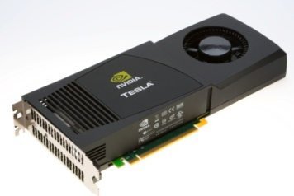
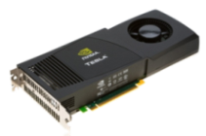
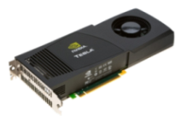
Tesla GPU Computing Products
SuperMicro 1U
GPU SuperServer
Tesla S1070
1U System
Tesla C1060
Computing Board
Tesla Personal Supercomputer
GPUs | 2 Tesla GPUs | 4 Tesla GPUs | 1 Tesla GPU | 4 Tesla GPUs
Single Precision Performance | 1.87 Teraflops | 4.14 Teraflops | 933 Gigaflops | 3.7 Teraflops
Double Precision Performance | 156 Gigaflops | 346 Gigaflops | 78 Gigaflops | 312 Gigaflops
Memory | 8 GB (4 GB / GPU) | 16 GB (4 GB / GPU) | 4 GB | 16 GB (4 GB / GPU)

Slide 11

Tesla C1060 Computing Processor
Processor | 1 × Tesla T10
Number of cores | 240
Core Clock | 1.296 GHz
Floating Point Performance | 933 Gflops Single Precision
 | 78 Gflops Double Precision
On-board memory | 4.0 GB
Memory bandwidth | 102 GB/sec peak
Memory I/O | 512-bit, 800MHz GDDR3
Form factor | Full ATX: 4.736″ x 10.5″ Dual slot wide
System I/O | PCIe ×16 Gen2
Typical power | 160 W

Slide 12
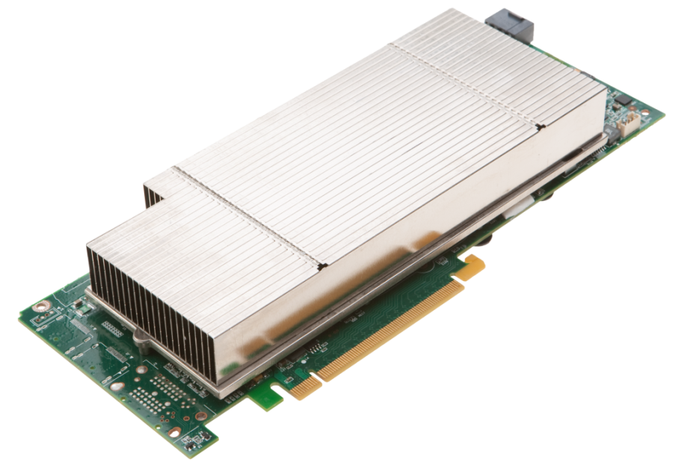
Tesla M1060 Embedded Module
Processor | 1 × Tesla T10
Number of cores | 240
Core Clock | 1.296 GHz
Floating Point Performance | 933 Gflops Single Precision
 | 78 Gflops Double Precision
On-board memory | 4.0 GB
Memory bandwidth | 102 GB/sec peak
Memory I/O | 512-bit, 800MHz GDDR3
Form factor | Full ATX: 4.736″ x 10.5″ Dual slot wide
System I/O | PCIe ×16 Gen2
Typical power | 160 W
OEM-only product
Available as integrated product in OEM systems

Slide 13
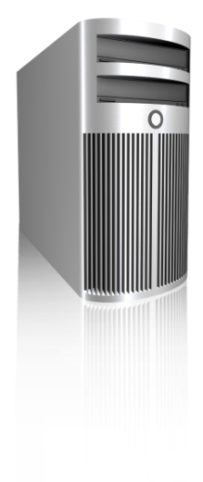
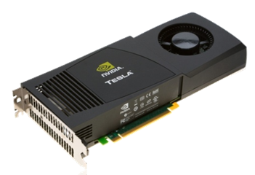
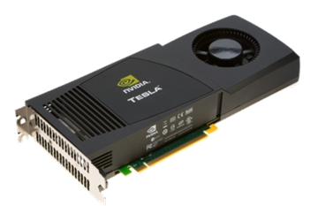
Tesla Personal Supercomputer
Supercomputing Performance
Massively parallel CUDA Architecture
960 cores. 4 Teraflops
250× the performance of a desktop
Personal
One researcher, one supercomputer
Plugs into standard power strip
Accessible
Program in C for Windows, Linux
Available now worldwide under $10,000

Slide 14
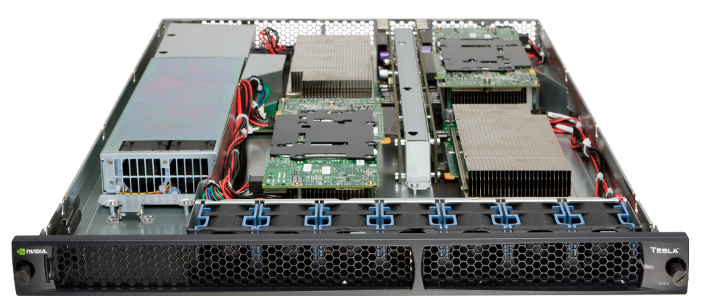
Tesla S1070 1U System
Processors | 4 × Tesla T10
Number of cores | 960
Core Clock | 1.44 GHz
Performance | 4 Teraflops
Total system memory | 16.0 GB (4.0 GB per T10)
Memory bandwidth | 408 GB/sec peak (102 GB/sec per T10)
Memory I/O | 2048-bit, 800MHz GDDR3 (512-bit per T10)
Form factor | 1U (EIA 19″ rack)
System I/O | 2 PCIe ×16 Gen2
Typical power | 700 W

Slide 15
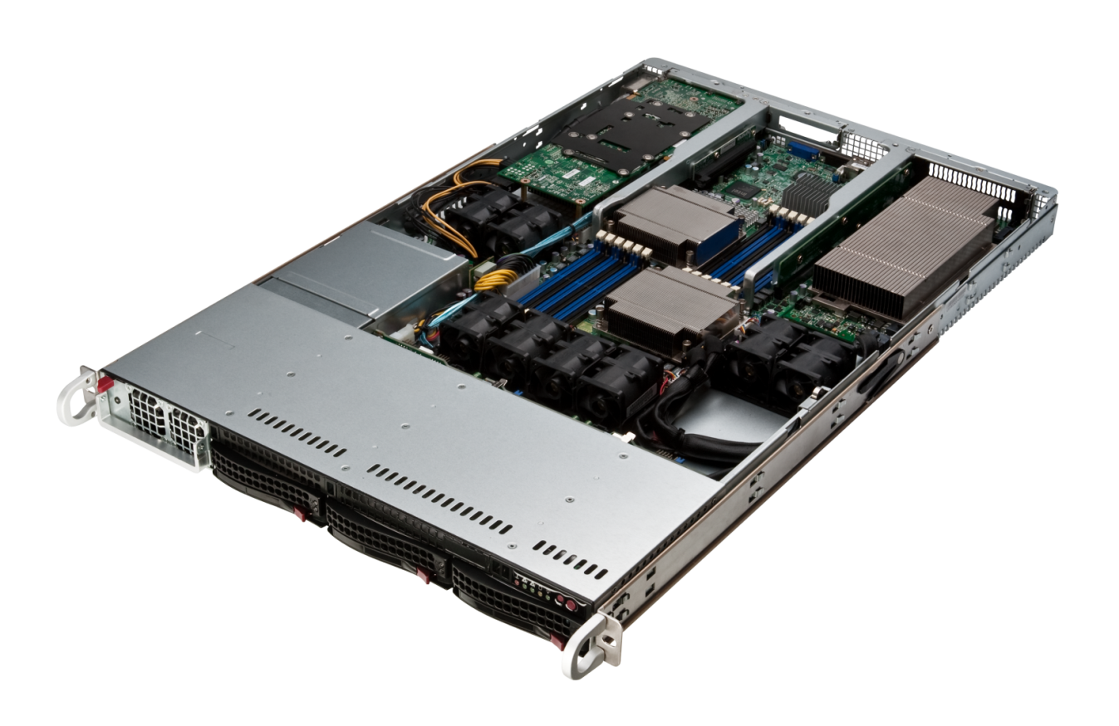
SuperMicro GPU 1U SuperServer
M1060 GPUs
Two M1060 GPUs in a 1U
Dual Nehalem-EP Xeon CPUs
Up to 96 GB DDR3 ECC
Onboard Infiniband (QDR)
3× hot-swap 3.5″ SATA HDD
1200 W power supply

Slide 16
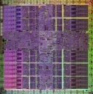

CUDA Parallel Computing Architecture
GPU Computing Applications
CUDA C
OpenCL™
DirectCompute
CUDA Fortran
Java and Python
NVIDIA GPU
with the CUDA Parallel Computing Architecture
OpenCL is trademark of Apple Inc. used under license to the Khronos Group Inc.

Slide 17
NVIDIA CUDA C and OpenCL
CUDA C
Entry point for developers who prefer high-level C
Entry point for developers who want low-level API
OpenCL
Shared back-end compiler and optimization technology
PTX
GPU

Slide 18
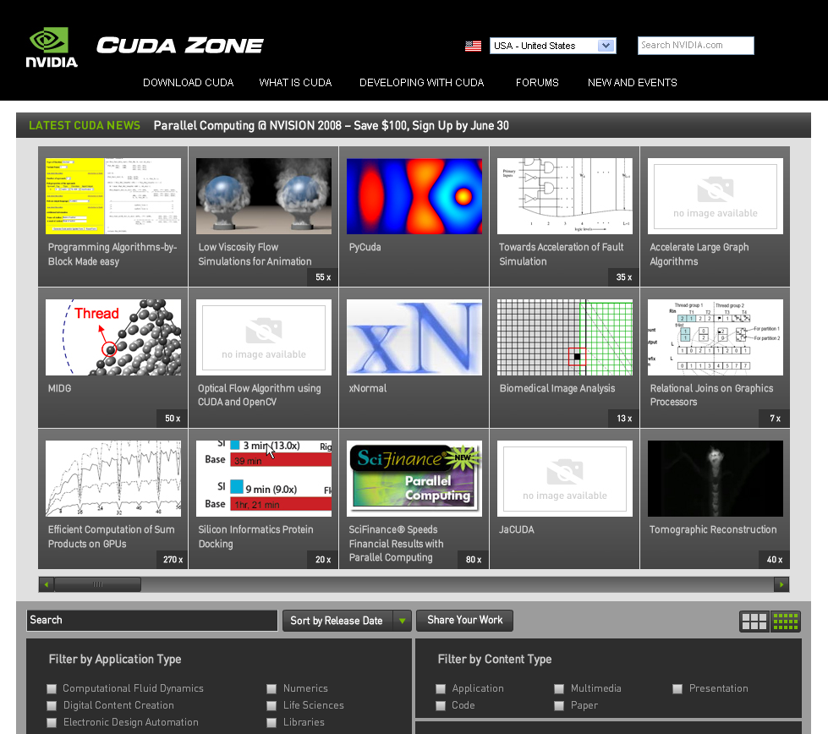
CUDA Zone: www.nvidia.com/CUDA
CUDA Toolkit
  Compiler
  Libraries
CUDA SDK
  Code samples
CUDA Profiler
Forums
Resources for CUDA developers

Slide 19



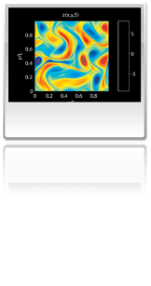

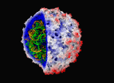
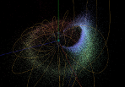

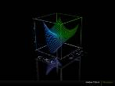



Wide Developer Acceptance and Success
146X
36X
19X
17X
100X
Interactive visualization of volumetric white matter connectivity
Ion placement for molecular dynamics simulation
Transcoding HD video stream to
H.264
Simulation in Matlab using .mex file CUDA function
Astrophysics N-body simulation
149X
47X
20X
24X
30X
Financial simulation of LIBOR model with swaptions
GLAME@lab: An M-script API for linear Algebra operations on GPU
Ultrasound medical imaging for cancer diagnostics
Highly optimized object oriented molecular dynamics
Cmatch exact string matching to find similar proteins and gene sequences

Slide 20
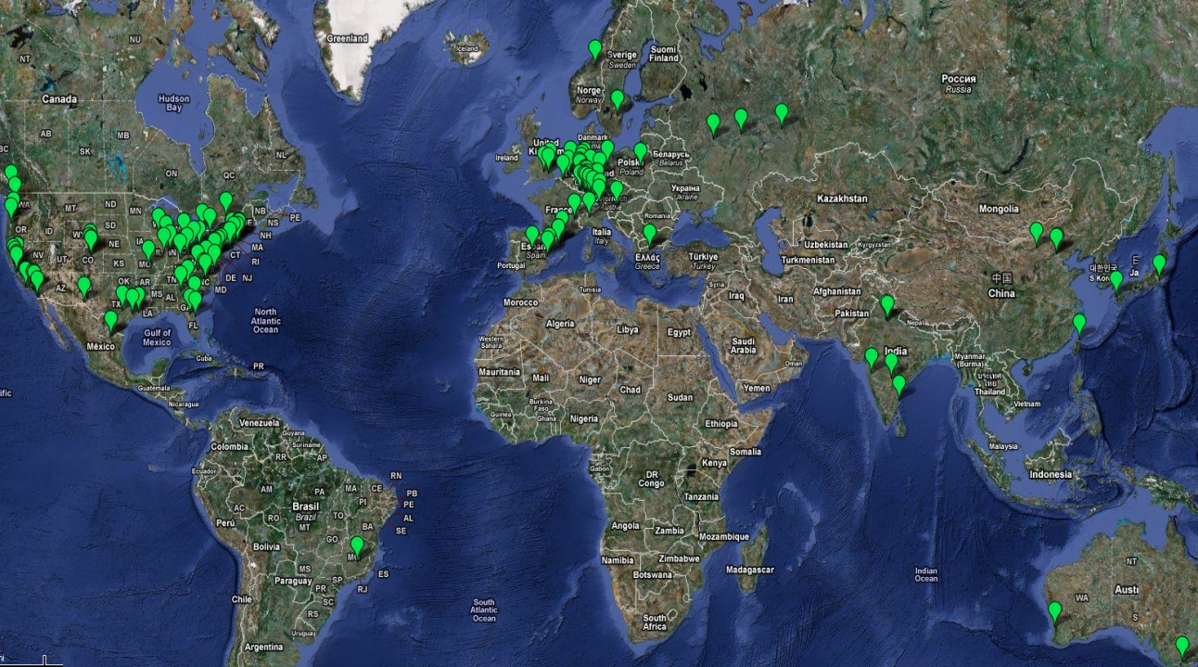






























CUDA Co-Processing Ecosystem
Over 200 Universities Teaching CUDA
Languages
C, C++
DirectX
Fortran
Java
OpenCL
Python
Compilers
PGI Fortran
CAPs HMPP
MCUDA
MPI
NOAA Fortran2C
OpenMP
UIUC
MIT
Harvard
Berkeley
Cambridge
Oxford
…
IIT Delhi
Tsinghua
Dortmundt
ETH Zurich
Moscow
NTU
…
Applications
Libraries
FFT
BLAS
LAPACK
Image processing
Video processing
Signal processing
Vision
Consultants
OEMs
Oil & Gas
Finance
CFD
ANEO
Medical
Biophysics
Imaging
Numerics
DSP
EDA
GPU Tech

Slide 21
Next-Generation GPU Architecture — ‘Fermi’

Slide 22
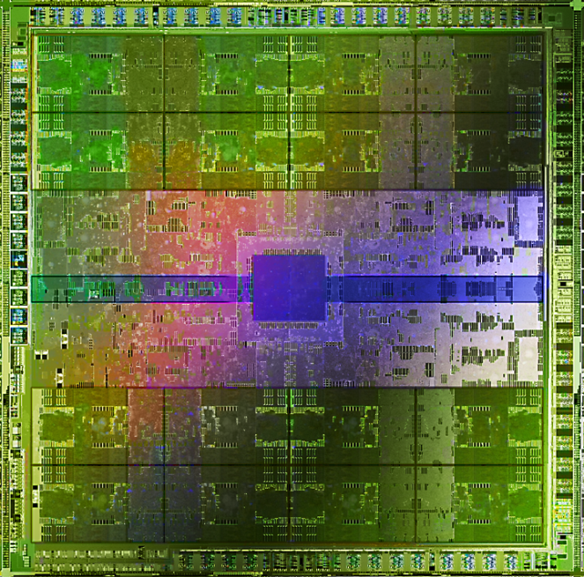




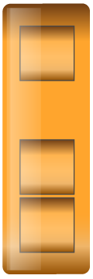
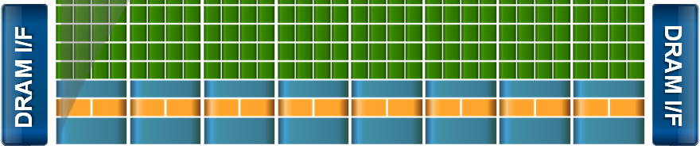
Introducing the ‘Fermi’ Architecture
The Soul of a Supercomputer in the body of a GPU
3 billion transistors
Over 2× the cores (512 total)
8× the peak DP performance
ECC
L1 and L2 caches
~2× memory bandwidth (GDDR5)
Up to 1 Terabyte of GPU memory
Concurrent kernels
Hardware support for C++
DRAM I/F
DRAM I/F
HOST I/F
DRAM I/F
L2
Giga Thread
DRAM I/F
DRAM I/F
DRAM I/F

Slide 23
Design Goal of Fermi
Expand performance sweet spot of the GPU
Bring more users, more applications to the GPU
Data
Parallel
GPU
Instruction
Parallel
CPU
Many Decisions
Large Data Sets
Notes:
Expand performance sweet spot of the GPU
Caching
Concurrent Kernels
FP64
Bring more users, more applications to the GPU
C++
Visual Studio Integration
ECC

Slide 24
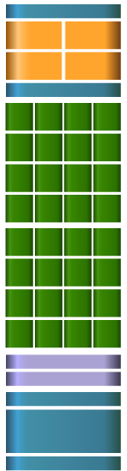
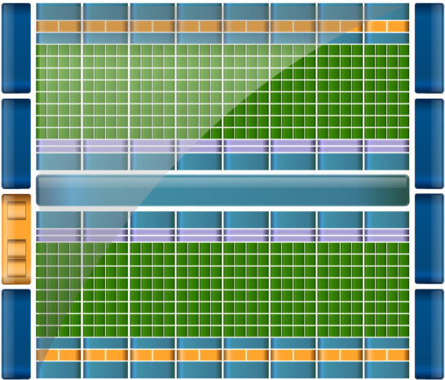

Streaming Multiprocessor Architecture
Instruction Cache
Scheduler
Scheduler
Dispatch
Dispatch
  32 CUDA cores per SM (512 total)
  8× peak double precision floating point performance
    50% of peak single precision
  Dual Thread Scheduler
  64 KB of RAM for shared memory and L1 cache (configurable)
Register File
Core
Core
Core
Core
Core
Core
Core
Core
Core
Core
Core
Core
Core
Core
Core
Core
Core
Core
Core
Core
Core
Core
Core
Core
Core
Core
Core
Core
Core
Core
Core
Core
Load/Store Units x 16
Special Func Units x 4
Interconnect Network
64K Configurable
Cache/Shared Mem
Uniform Cache

Slide 25

CUDA Core Architecture
Instruction Cache
Scheduler
Scheduler
Dispatch
Dispatch
New IEEE 754-2008 floating-point standard, surpassing even the most advanced CPUs
Fused multiply-add (FMA) instruction
for both single and double precision
Newly designed integer ALU
optimized for 64-bit and extended
precision operations
Register File
Core
Core
Core
Core
Core
Core
Core
Core
Core
Core
Core
Core
CUDA Core
Core
Core
Core
Core
Dispatch Port
Core
Core
Core
Core
Operand Collector
Core
Core
Core
Core
Core
Core
Core
Core
FP Unit
INT Unit
Core
Core
Core
Core
Load/Store Units x 16
Result Queue
Special Func Units x 4
Interconnect Network
64K Configurable
Cache/Shared Mem
Uniform Cache
Notes:
Each CUDA processor has a fully pipelined integer arithmetic logic unit (ALU) and floating point unit (FPU). Prior GPUs used IEEE 754-1985 floating point arithmetic. The Fermi architecture implements the new IEEE 754-2008 floating-point standard, surpassing even the most advanced CPUs.
It supports fused multiply-add (FMA) instructions for both single and double precision arithmetic. FMA improves over a multiply-add (MAD) instruction by doing the multiplication and addition with a single final rounding step, with no loss of precision in the addition. FMA is more accurate than performing the operations separately.

Slide 26



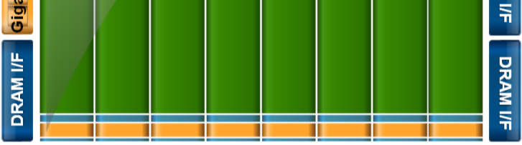
Cached Memory Hierarchy
First GPU architecture to support a true cache hierarchy in combination with on-chip shared memory
L1 Cache per SM (32 cores)
  Improves bandwidth and reduces latency
Unified L2 Cache (768 KB)
  Fast, coherent data sharing across all cores in the GPU
DRAM I/F
DRAM I/F
HOST I/F
DRAM I/F
Parallel DataCache™
Memory Hierarchy
L2
Giga Thread
DRAM I/F
DRAM I/F
DRAM I/F

Slide 27
Larger, Faster Memory Interface
GDDR5 memory interface
  2× speed of GDDR3
Up to 1 Terabyte of memory attached to GPU
  Operate on large data sets
DRAM I/F
DRAM I/F
HOST I/F
DRAM I/F
L2
Giga Thread
DRAM I/F
DRAM I/F
DRAM I/F

Slide 28
Error Correcting Code
ECC protection for
  DRAM
    ECC supported for GDDR5 memory
  All major internal memories are ECC protected
    Register file, L1 cache, L2 cache

Slide 29
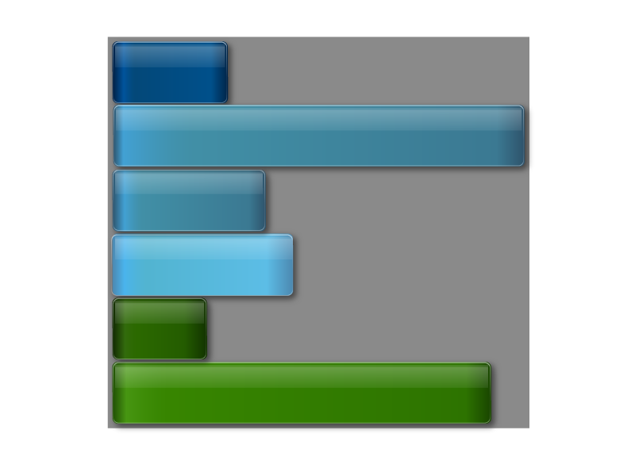
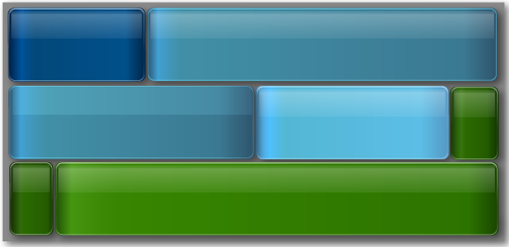
GigaThread Hardware Thread Scheduler
Concurrent Kernel Execution + Faster Context Switch
Kernel 1
Kernel 1
Kernel 2
Kernel 2
Kernel 2
Kernel 3
Ker
4
Kernel 2
nel
Kernel 5
Time
Kernel 3
Kernel 4
Kernel 5
Serial Kernel Execution
Parallel Kernel Execution
Notes:
Fermi supports concurrent kernel execution, where different kernels of the same application context can execute on the GPU at the same time. Concurrent kernel execution allows programs that execute a number of small kernels to utilize the whole GPU. For example, a PhysX program may invoke a fluids solver and a rigid body solver which, if executed sequentially, would use only half of the available thread processors. On the Fermi architecture, different kernels of the same CUDA context can execute concurrently, allowing maximum utilization of GPU resources. Kernels from different application contexts (e.g. a game with graphics + PhysX) can still run sequentially with great efficiency thanks to the improved context switching performance.

Slide 30
Enhanced Software Support
Full C++ Support
  Virtual functions
  Try/Catch hardware support
System call support
  Support for pipes, semaphores, printf, etc
Unified 64-bit memory addressing

Slide 31

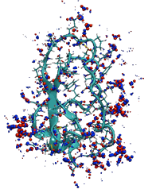





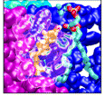




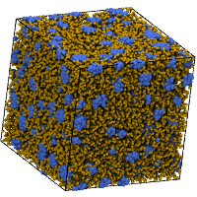


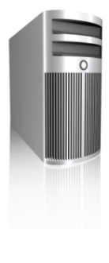





Introducing Tesla Bio WorkBench
TeraChem
  Applications
LAMMPS
GPU-AutoDock
MUMmerGPU
  Community
Download,
Documentation
Technical
papers
Discussion
Forums
Benchmarks
& Configurations
Tesla Personal Supercomputer
Tesla GPU Clusters
  Platforms

Slide 32
Tesla Bio Workbench Applications
AMBER (MD)
ACEMD (MD)
GROMACS (MD)
GROMOS (MD)
LAMMPS (MD)
NAMD (MD)
TeraChem (QC)
VMD (Visualization MD & QC)
Docking
  GPU AutoDock
Sequence analysis
  CUDASW++ (SmithWaterman)
  MUMmerGPU
  GPU-HMMER
  CUDA-MEME Motif Discovery

Slide 33
AMBER Molecular Dynamics
Alpha
now
Generalized Born
Generalized Born Simulations
Q1 2010
PME: Particle Mesh Ewald
Beta release
Q2 2010
Multi-GPU + MPI support
Beta 2 release
7x
8.6x
Implicit solvent GB results
  1 Tesla GPU 8x faster than 2 quad-core CPUs
More Info
http://www.nvidia.com/object/amber_on_tesla.html
Data courtesy of San Diego Supercomputing Center

Slide 34
ISV status
Developer | Application | Description | Category | STATUS
ORNL | HOMME | High Order Method Modeling Environment | Government | Work in progress
Ames Lab | HOOMD | Molecular dynamics | Life Science | Available
NCI | AutoDock | Molecular dynamics | Life Science | Selected support from third parties, also open source project, need to reach out to them more
ORNL | MADNESS | Computational Chemistry | Life Science | Work in progress
 | Smith-Waterman | DNA sequencing | Life Science | Various versions available such as http://gpu.epfl.ch/sw.html
Stanford | OpenMM | Molecular Library | Life Science | Available with PME in beta
Gaussian | Gaussian | Quant Chem | Life Science | Taking names, no date given

Slide 35
ISV Status:
Developer | Application | Description | Category | STATUS
Harvard and Univ of Delaware | CHARMM | Molecular dynamics | Life Science | Cuda support in library as part of alpha build, working with them to get a beta in Feb
Howard Hughes Med | HMMER | Hidden Markov models for bio | Life Science | Available
IA State | GAMESS | Quant Chem | Life Science | Integration in progress, hopeful of beta in Q1
Scripps | LAMMPS | Molecular dynamics | Life Science | Selected algorithms supported, project ongoing – download availalable
Scripps | AMBER | Molecular dynamics | Life Science | Amber 10 patch for GB today, PME by Dec/Jan
Scripps | AutoDock | Protien Docking | Life Science | Available via 3rd party

Slide 36
ISV Status:
Developer | Application | Description | Category | STATUS
Stockholm Center | GROMACS | Molecular dynamics | Life Science | Available with PME via OpenMM
UIUC | NAMD | Molecular dynamics | Life Science | Namd 2.7 B2 available
UIUC | VMD | Viz of MD | Life Science | Available
Univ of Delaware | Dockig@home | Protein docking | Life Science | Not sure.
Univ of Maryland | MUMmerGPU | DNA sequence alignment | Life Science | Available
Allinea | Allinea DDT | Linux Debugger | Tools - Debug/Profile | Beta this month
TotalView | TotalView Debugger | Linux Debugger | Tools - Debug/Profile | Beta in Q1

Slide 37
GPU Revolutionizing Computing
A 2015 GPU *
~20× the performance of today’s GPU
~5,000 cores at ~3 GHz (50 mW each)
~20 TFLOPS
~1.2 TB/s of memory bandwidth
GFlops
GPU
Fermi
512 core
T10
240 core
T8
128 core
2006
2008
2010
2012
2015
* This is a sketch of a what a GPU in 2015 might look like; it does not reflect any actual product plans.
Notes:
This is a sketch of a what a GPU in 2015 might look like, it does not reflect any actual product plans
37

Slide 38
