Slide 1
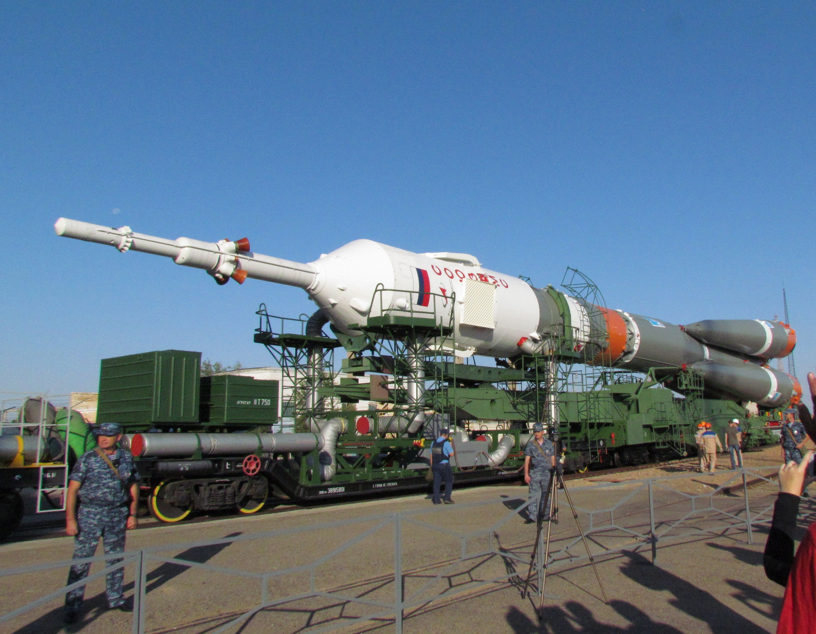



SiPM workshop
Bari
3/10/2019
SiPM on board the International Space Station:
from Lazio-Sirad to Mini-EUSO and SPB2
M. Casolino,
M. Bertaina, F. Cafagna, O. Catalano, R. Caruso, G. Osteria, M. Ricci
on behalf of the Sirad and JEM-EUSO collaborations

Slide 2
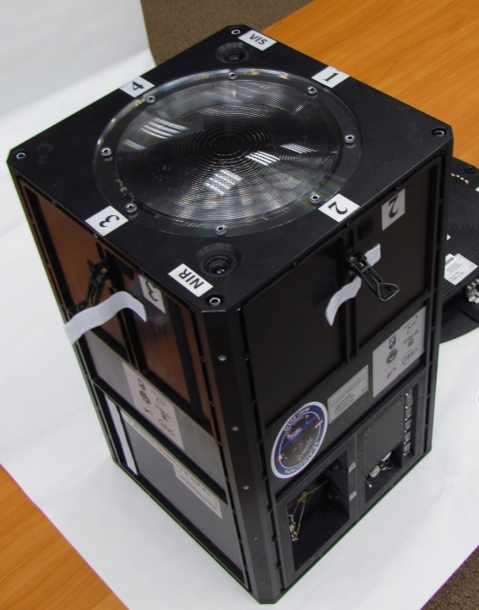
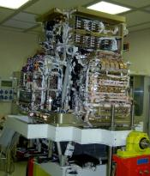
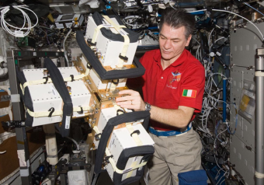
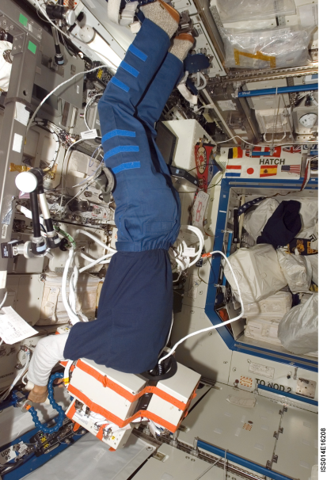

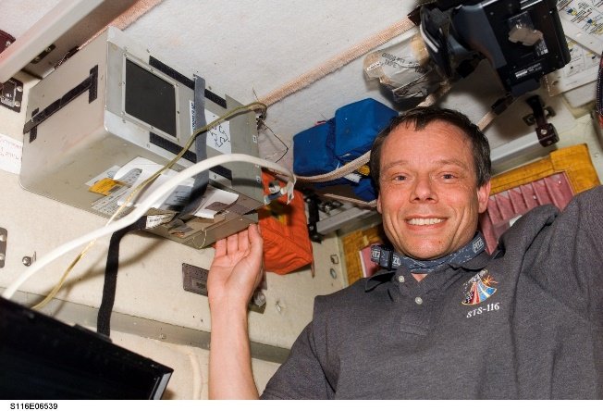
Cosmic ray and radiation studies in space

Slide 3
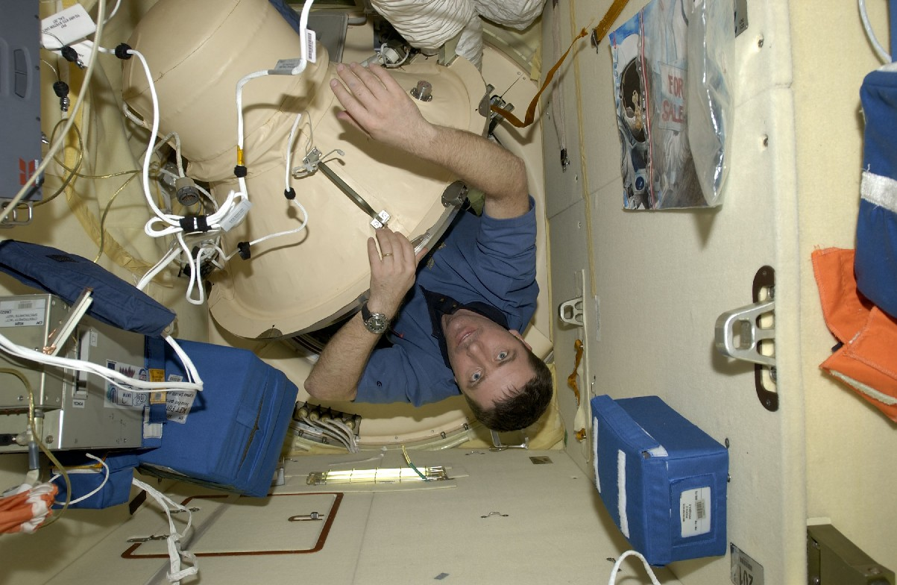
LAZIO-SIRAD
Italian Mission Eneide on ISS, 2005

Slide 4
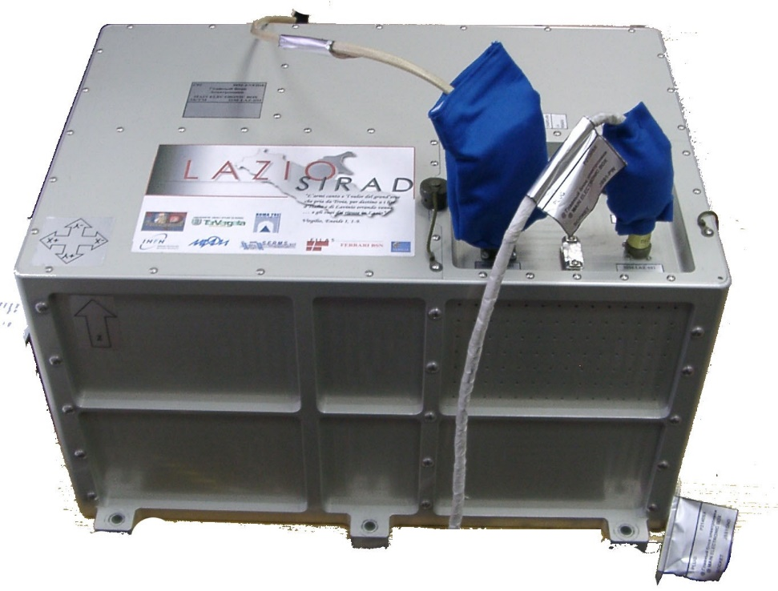
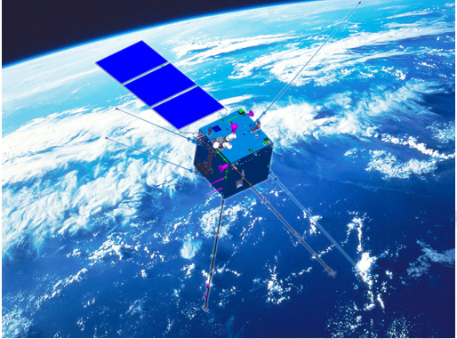
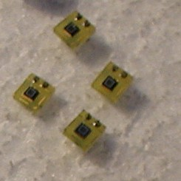
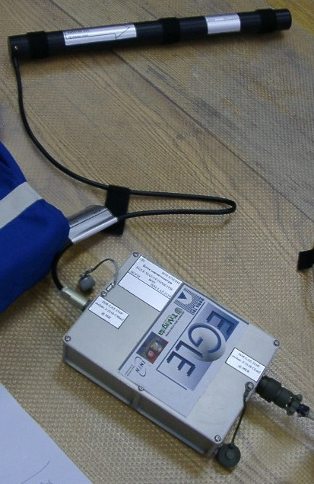
Lazio-Sirad detector
Silicon-Scintillator Tracking Calorimeter
Study of nuclear (>40MeV/n) and electron components inside ISS.
Study of spatial, angular dependence and (in long term) of magnetic perturbations
40cm^2 sr
3 scintillators
4 double sided microstrip detectors 16*7 cm
16 Silicon Photomultiplies Tiles
One-axis magnetometer (EGLE)
PC-104 acquisition with PCMCIA cards
CSES-LIMADOU
(2018)

Slide 5
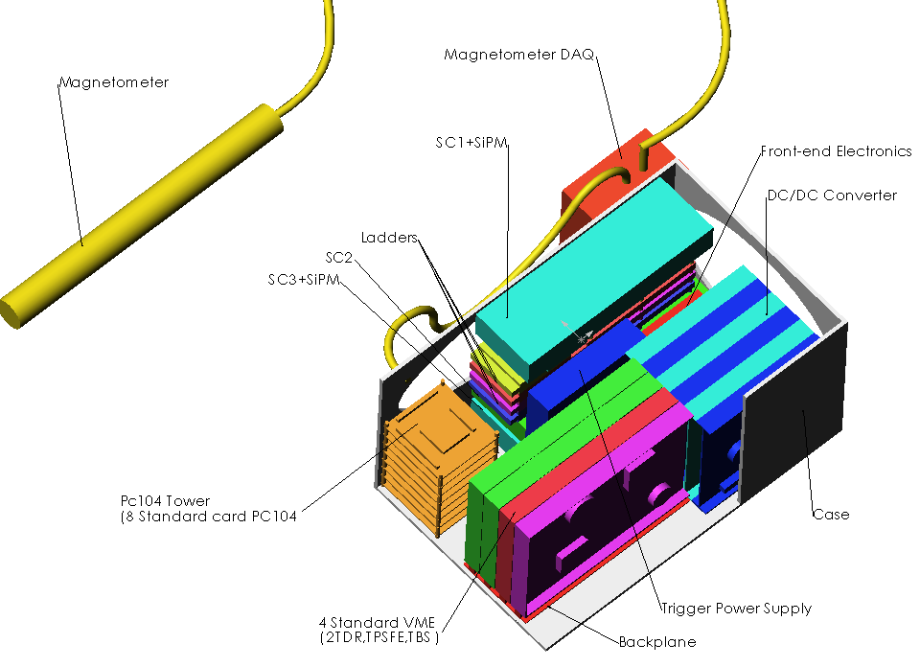
Lazio-Sirad

Slide 6
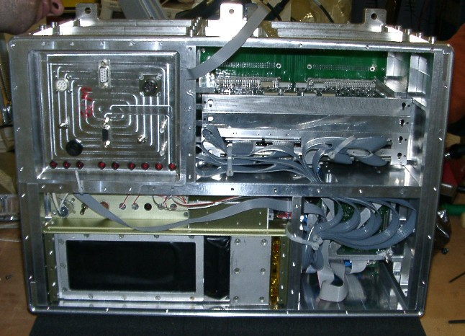
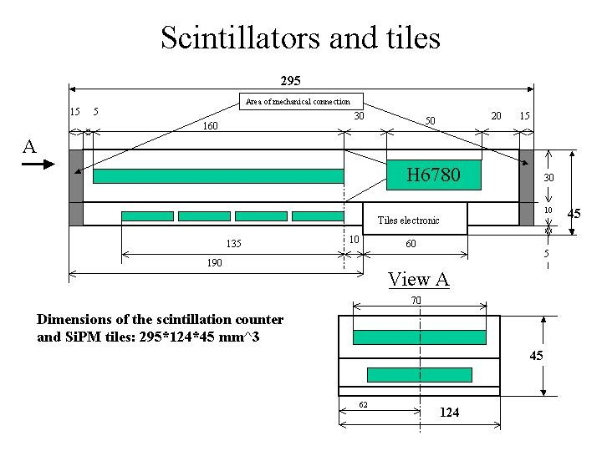
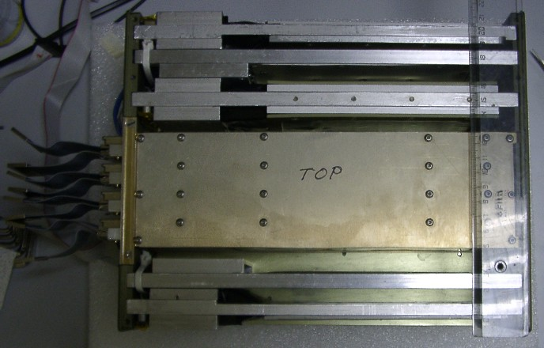
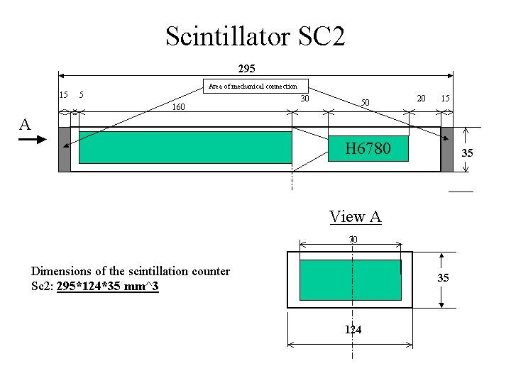
Lazio -MEB

Slide 7
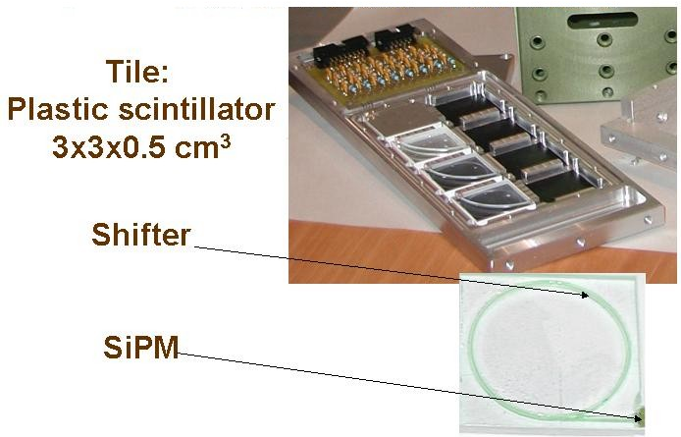

SiPM on Lazio
16 detectors with plastic tiles placed in two layers of the detector
(original Dolgoshein-Mephi SiPM)

Slide 8
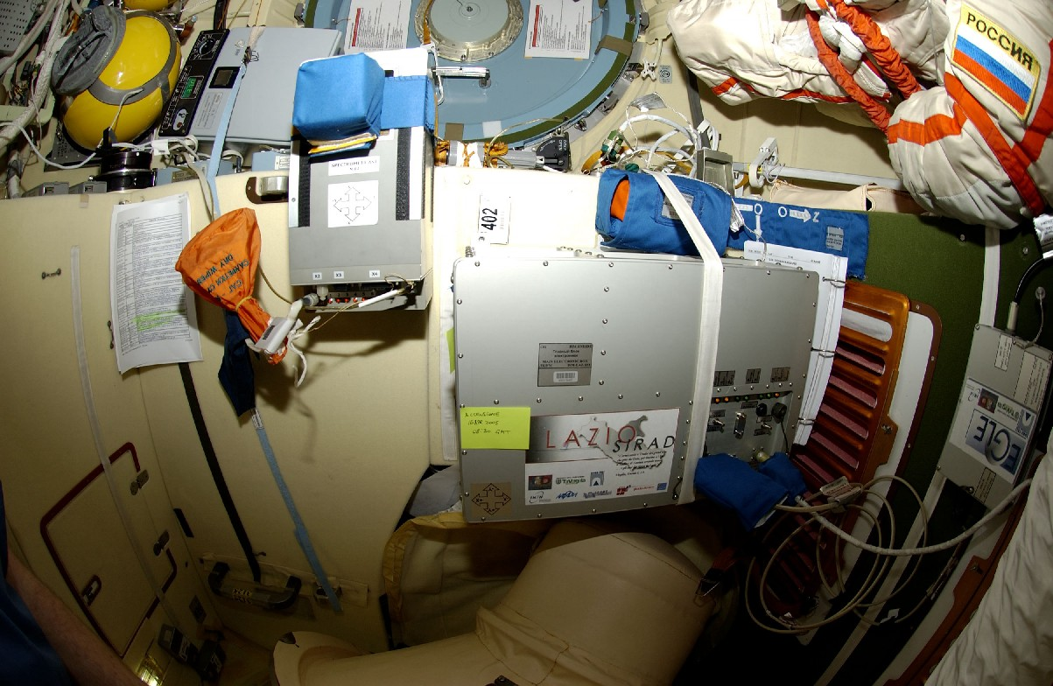
LAZIO and Alteino detectors on ISS (2005)
To main body of ISS
Grounding
PCMCIA
card
28V power
supply
Alteino & Lazio, PIRS module
To Soyuz

Slide 9
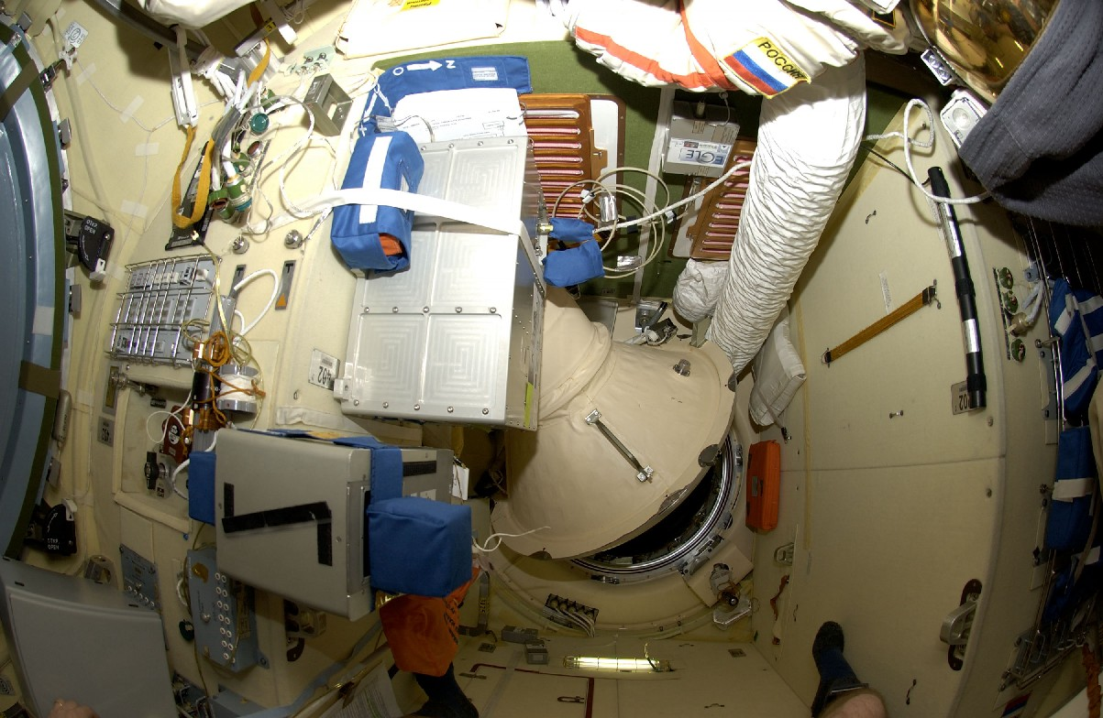
To ISS
To Soyuz
Figure 2: Alteino & Lazio detectors inside PIRS module of ISS

Slide 10
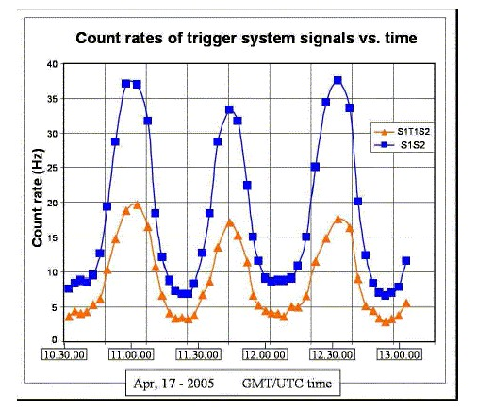
SiPM performance
First (probably) operation of SI-PM in space
Detector size: 1*1 mm^2
0.5 ns, in this case >3 ns due to wavelenght shifter
Excellent agreement with PMTs
No specific problems (inside)

Slide 11
MINI-EUSO
Multiwavelenght Imaging new Instrument
Extreme Universe Space Observatory

Slide 12
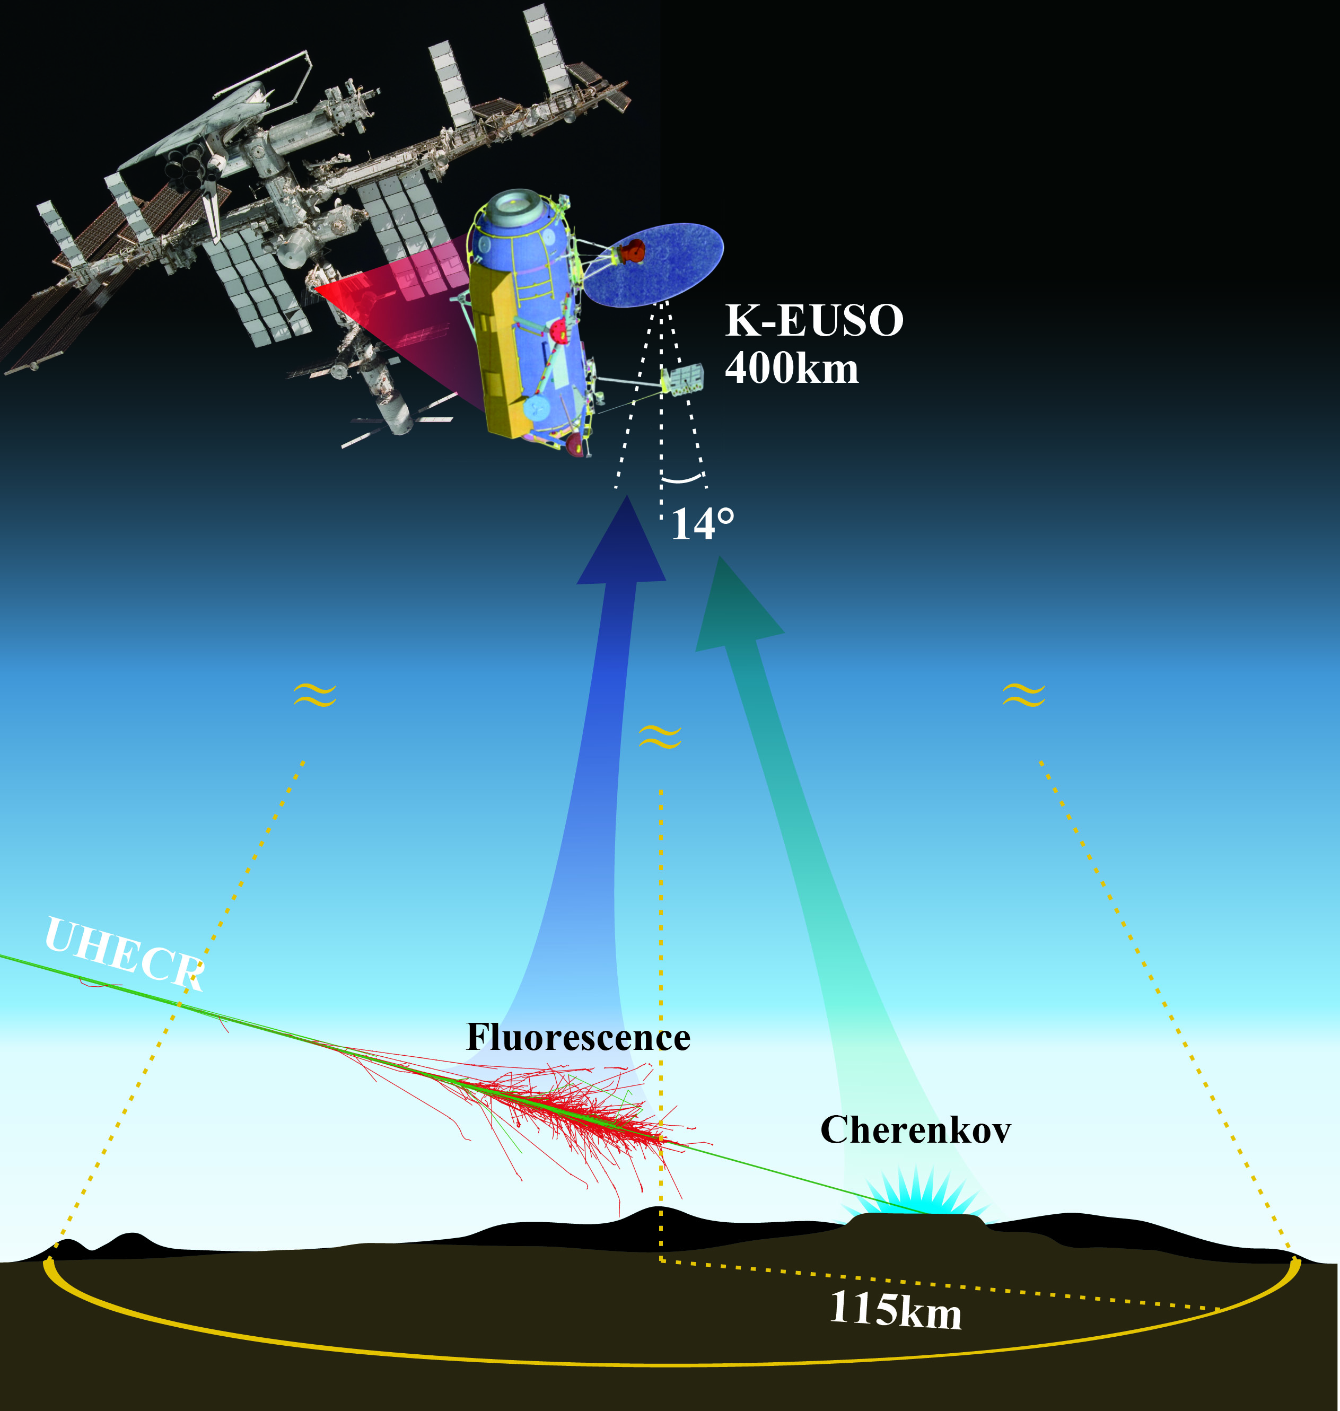
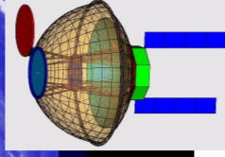
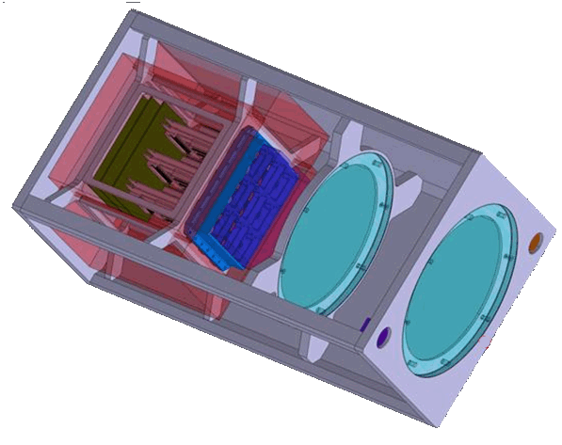
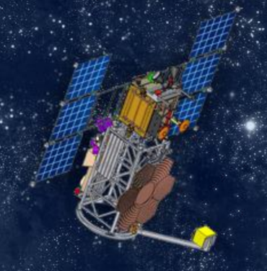
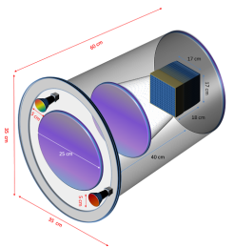
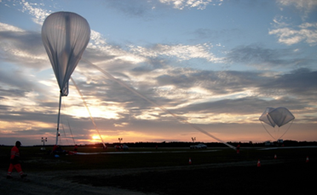
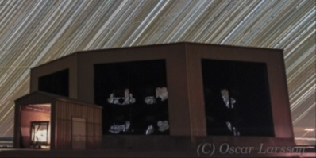

The EUSO program
EUSO-TA: Ground detector installed in 2013 at Telescope Array site: currently operational
EUSO-BALLOONS:
2014, Timmins, Canada
2017 NASA Ultra long duration flight. EUSO-SPB
3. TUS (2016): free-flyer
4. MINI-EUSO (2019): Detector from International Space Station (ISS): 40 kg total.
5. 2022 NASA
EUSO-SPB-2
6. K-EUSO (2022): ISS Approved by Russian Space Agency
7. POEMMA (2025+): NASA twin free-Flyer
POEMMA
(2022)
TUS (2016)
MINI-EUSO
(2019)
400 km
30-40 km
EUSO-BALLOON (2014)
EUSO-SPB (2017)
EUSO-SPB2 (2022)
EUSO-TA
(>2013)
EUSO-TA (2013-)

Slide 13



MINI-EUSO
Multiwavelength Imaging New Instrument for the Extreme Universe Space Observatory
Multi-band,
Multi-Wavelenght telescope inside ISS
Ultraviolet, with Fresnel lenses
Near Infrared camera
Visible camera
SiPM
30kg telescope
10kg ancillary material
60 W
62*37*37 cm
Night observations
From inside UV-transparent window of Zvezda

Slide 14
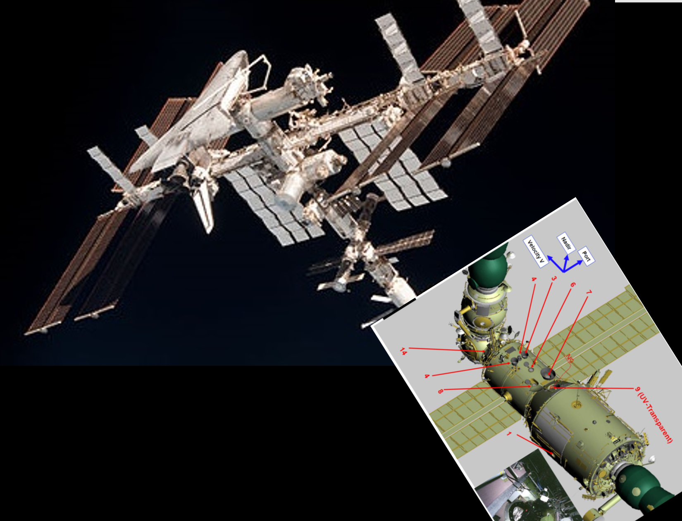
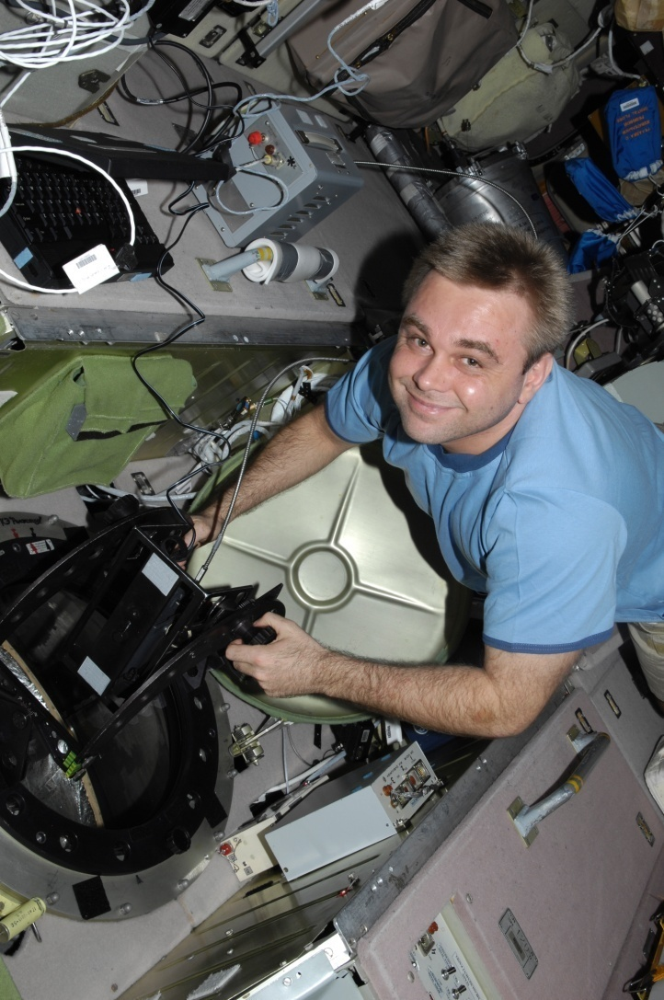
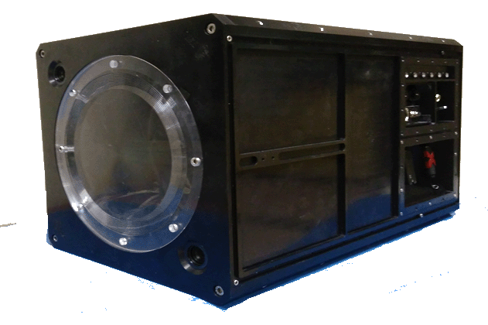
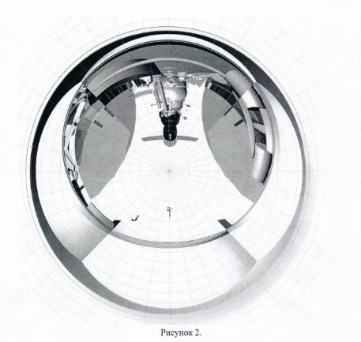
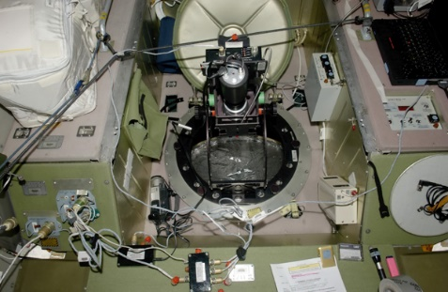
Uv transparent window,
Zvezda module
Field of view from window

Slide 15
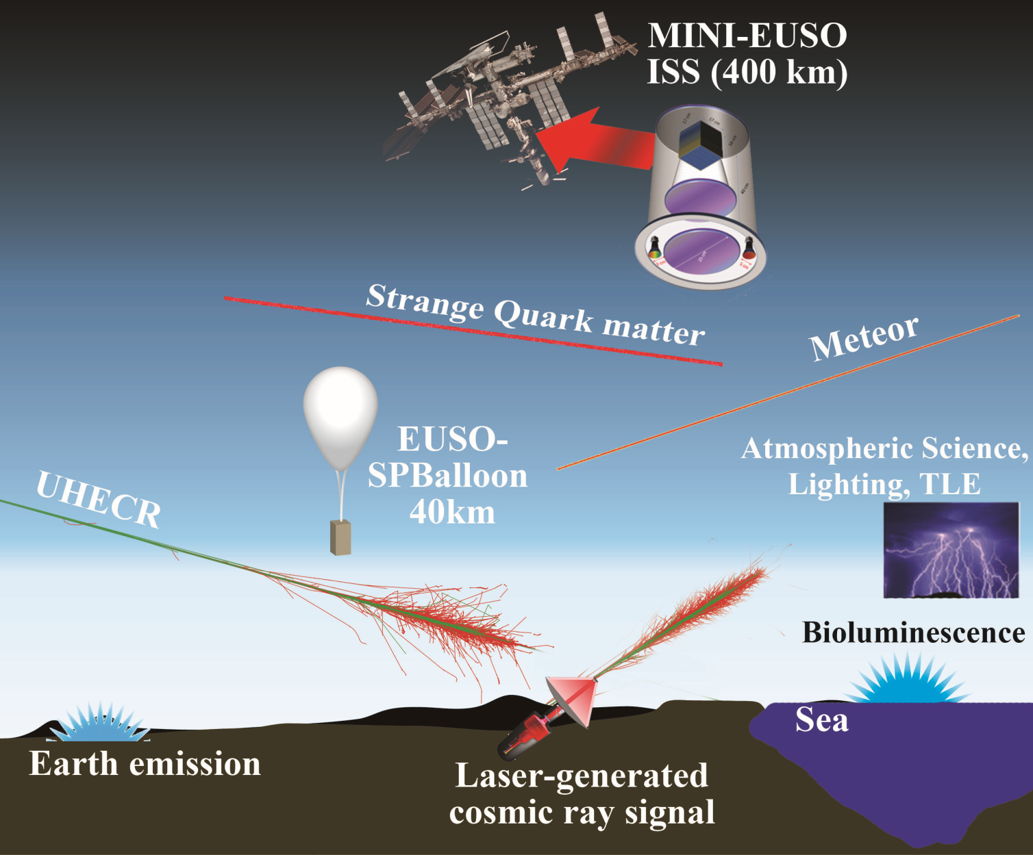
Science Objectives

Slide 16
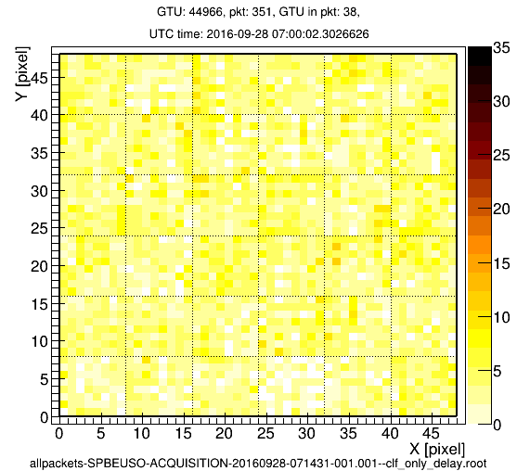
Search for UHECRs
Threshold ≈7E20 eV
FPGA Trigger
TUS-like events
Laser generated events (USA)
UV flasher (Japan)
Data of the PDM of the SuperPressureBalloon EUSO-SPB, ground tests at EUSO-TA
Laser is at 20km from detector
Each frame is 2.5microsecond
Laser beam moves from bottom (ground) to top (toward sky)

Slide 17
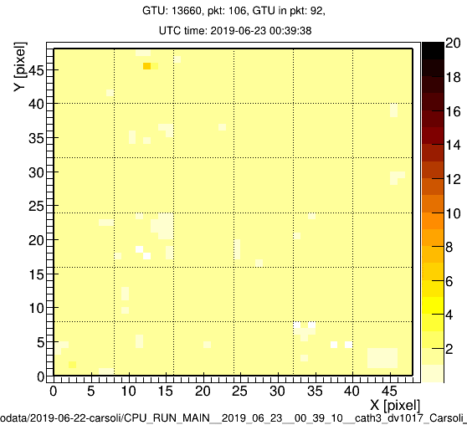
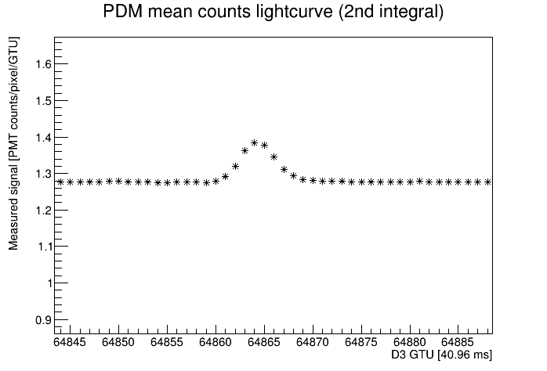
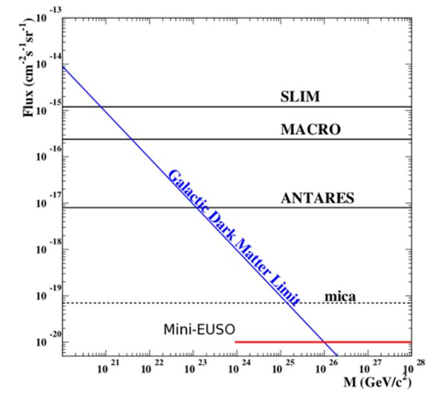
Meteors and Strange quark matter
Meteors: Seconds, Solar system speed
Strange Quark matter (very dense): longer, constant signal, interstellar origin and speed
40ms frames
Light curve
Abruzzo, 26/6/2019
Meteor studies in the framework of the JEM-EUSO program. PLANETARY AND SPACE SCIENCE, 143(SI):245{255, SEP 1 2017.
JEM-EUSO: Meteor and nuclearite observations. Experimental Astronomy, 40:253{279, November 2015.

Slide 18
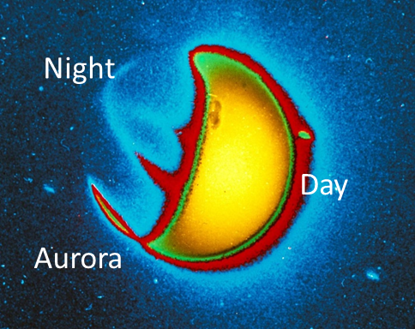
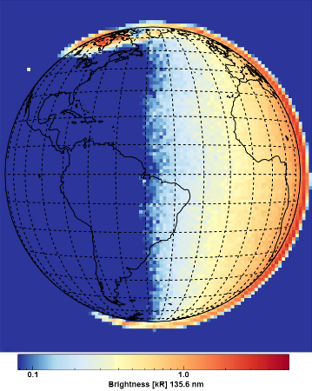
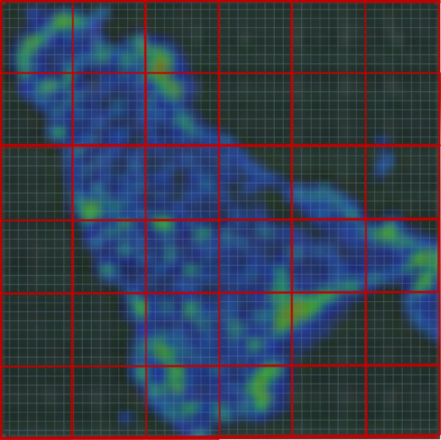
first night UV Map of the Earth
UV emissions from night-Earth
    6.5 km resolution, from 2.5mus and above +-51°
    - from different lighting conditions, moon phase, year
    - from different inclinations
Map of night time Earth in UV
Picture of the Earth from Apollo 16 mission Far Ultraviolet Camera/Spectrograph (UVC)
SES-14 GOLD instrument. It was taken at approximately 6 a.m
Emissions from 160 km
Apollo 16
1050-1260 Å and 1200-1550 Å.
Simulated wiew of Sicily with Mini-EUSO

Slide 19
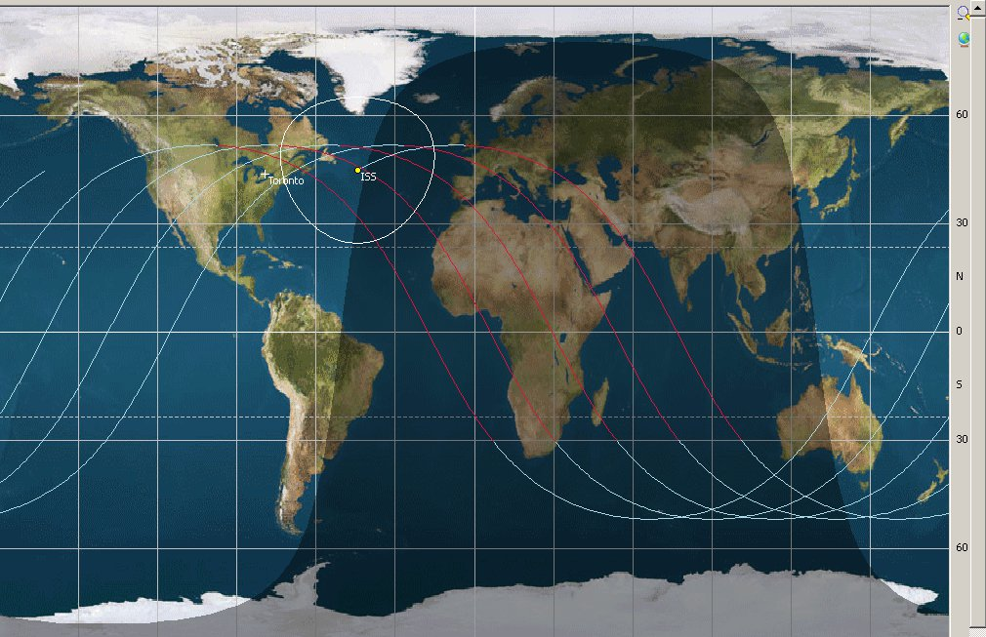
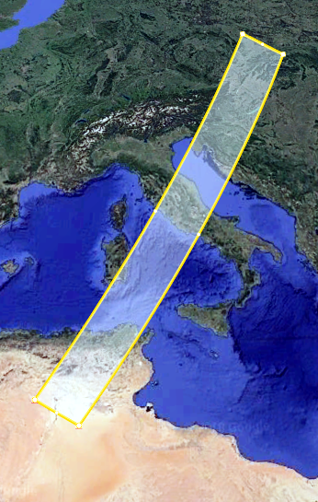
245 km * orbit path
Oversampling down to 2.5km
Possibility of inclining the detector in a second phase of observations
Also use non-nadir window
Mapping night sky in UV

Slide 20
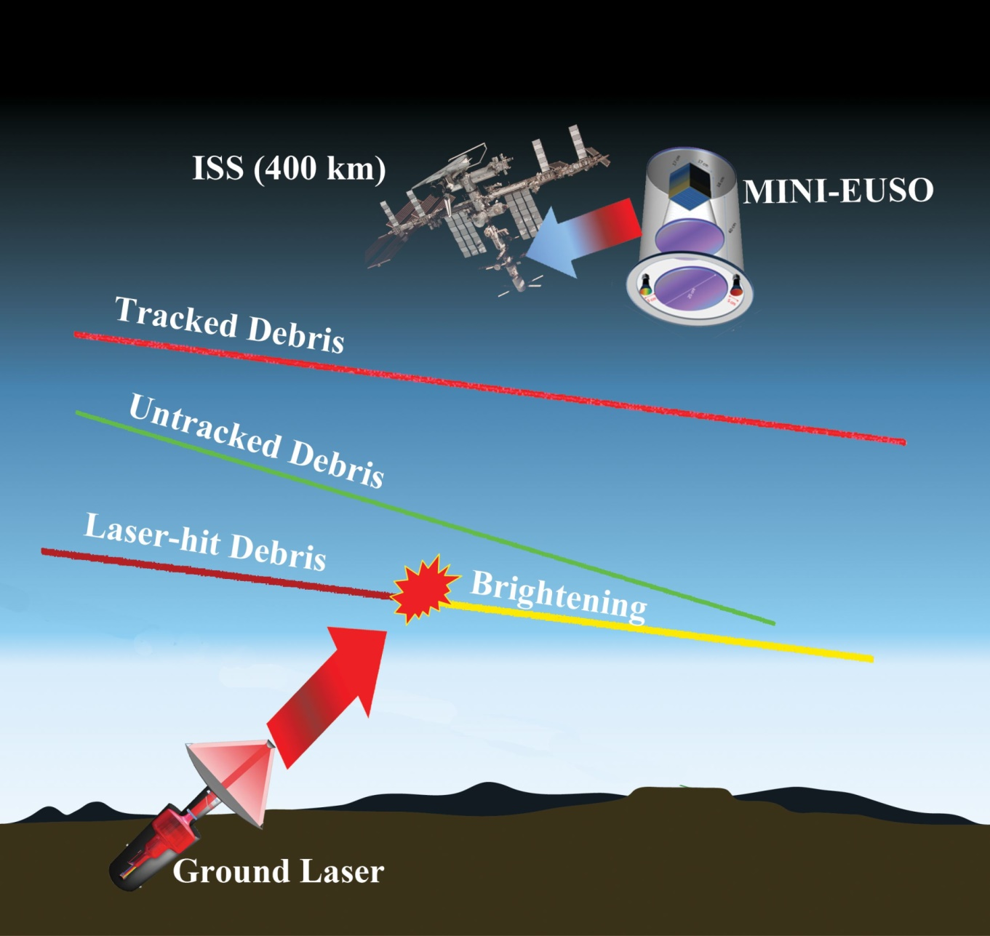
Mini-EUSO & Debris
Norad data of known debris in f.o.v of minieuso (a few – termination line between dark and light)
Look for unknown debris (includes meteors for this purpose)
Laser shooting from ground (US) in f.o.b. of ISS

Slide 21
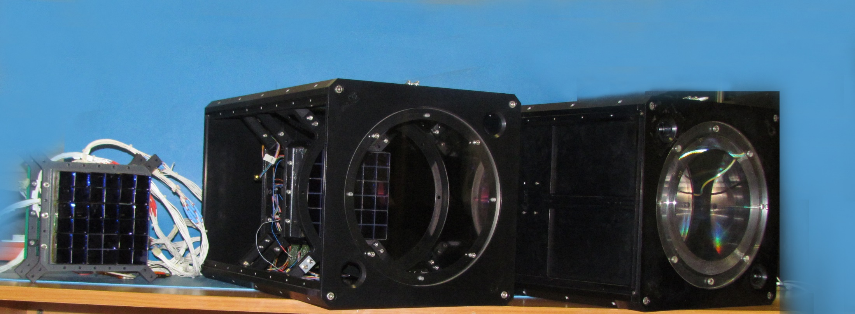
Mini-EUSO elements
Secondary cameras onboard the Mini-EUSO experiment: Control software and calibration. Advances in Space Research, 64(5):1188{1198, Sep 2019.
Mini-EUSO: A high resolution detector for the study of terrestrial and cosmic UV emission from the International Space Station. Advances in Space Research, 62(10):2954{2965, Nov 2018.

Slide 22
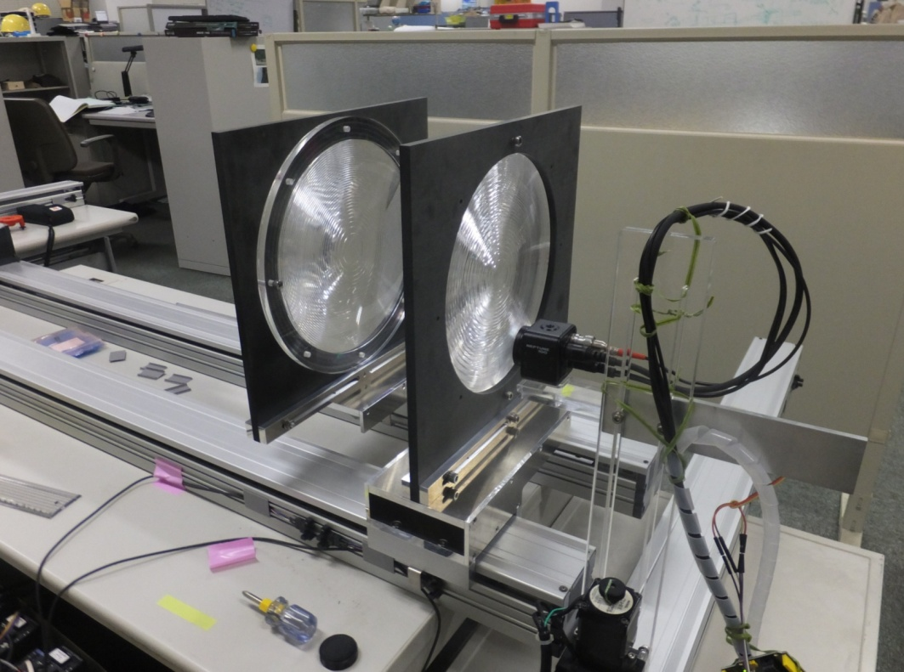
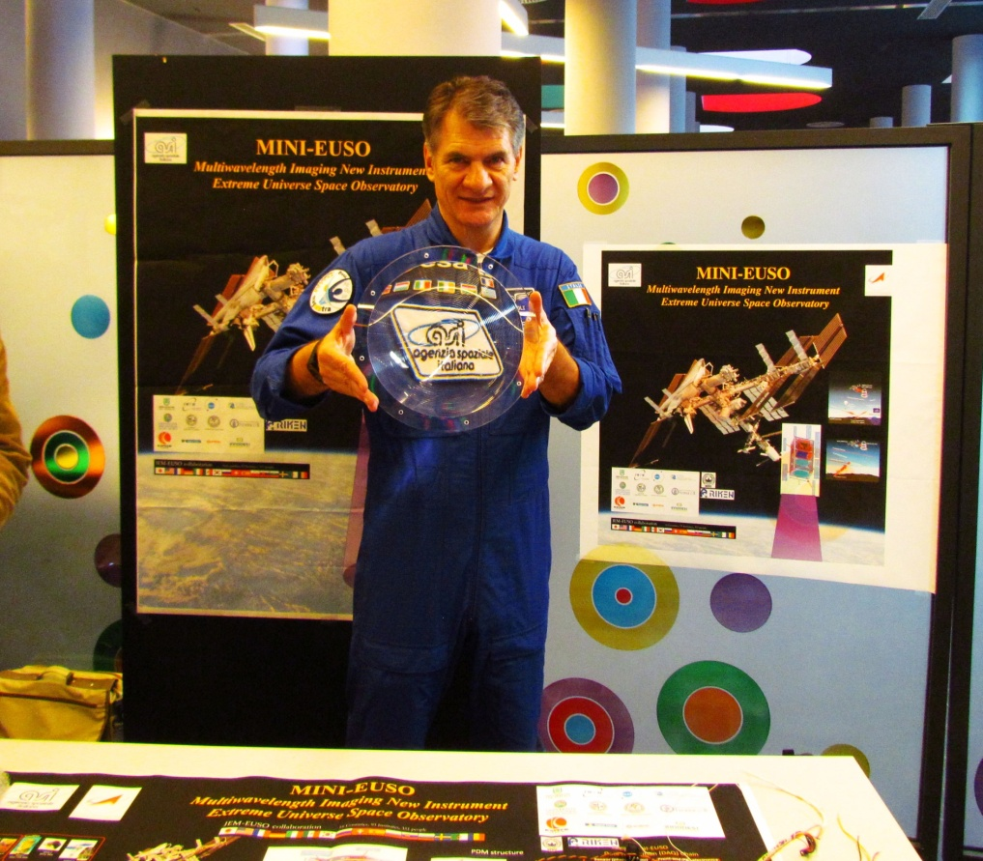
Optics:
Fresnel lens

Slide 23
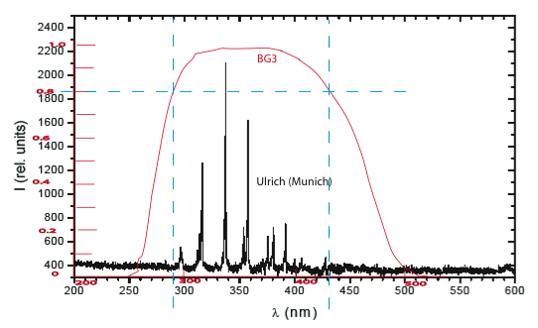
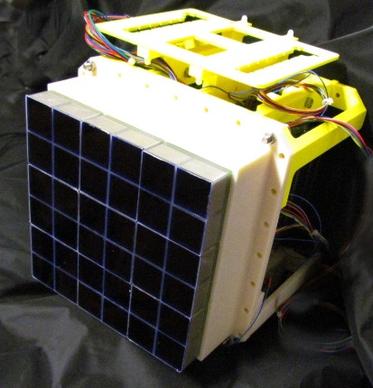
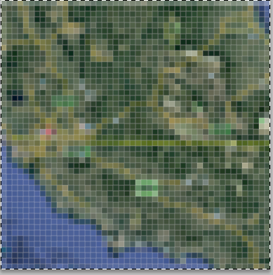
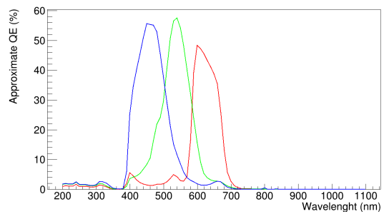



Mini-EUSO sensors
East-West Italy
UV main camera
48*48 pixels
40 deg 243km 5km/pix
2.5mus and above
Rome
RGB camera
1280*960 pixels
33.2*24.8 degrees
231*174 km 180 m/pixel
1s
NIR camera
(BW with phosphor coating)
1280*960 pixels
33.2*24.8 degrees
231*174 km 180 m/pixel
4s

Slide 24



Ancillary detectors
Light photodiodes
UV sensors
Hamamatsu S1226-5BQ log 190-1000nm
ML8511 linear 280-400 nm
Silicon Photomultipliers
C13365 single pixel (used in Day/night assessment)
C14047-3050EA08 8*8 pixel Imaging system
(used in imaging of the Earth, in focal plane, 5km pixel)
Read by Mux
All temp compensated

Slide 25

Mini-EUSO Operations
START
Connect 27V power supply
Connect grounding cable
Insert empty USB stick
Turn on switch
STOP
Turn off switch
Remove and store USB stick
Periodically copy selected files on station computer for later downlink
POWER ON LEDs
27 V POWER Supply
Ground stud
Switch
Storage USB Main
Storage USB Spare
Additional ops include latch/unlatch of instrument
In case of Sunday science, possibility to analyze data
Mini-EUSO control panel

Slide 26

Integration of focal surface, LNF 2019

Slide 27


Integration of focal surface, LNF 2019
SiPM Array
Main Focal Surface
SiPM UV UV

Slide 28
Integration of focal surface, LNF 2019
SiPM Array
Main Focal Surface
SiPM UV UV

Slide 29

Integration of focal surface, LNF 2019
VISIBLE CAMERA
UV CAMERA
NIR CAMERA

Slide 30

FM closed and integrated, May 2019

Slide 31

Mini-EUSO integrated with adapter flange
NADIR

Slide 32



Acceptance tests in Baikonur and integration with Soyuz MS-14

Slide 33

Roll-out of Soyuz MS-14, 19/8/2019

Slide 34

Roll-out of Soyuz MS-14, 19/8/2019

Slide 35

22/8/2019 Launch,
Site 31, Baikonur Cosmodrome

Slide 36



First docking, 24/8/2019 unsuccessful

Slide 37

Relocation of MS-13 from Zvezda to Poisk

Slide 38




Second docking, 27/8/2019 successful

Slide 39




LANFOS
(Large Area Non-destructive Food Sampler)
食品の非破壊放射能検査を可能とする
低コスト検出器の開発
Development of a low cost radiation detector for non-destructive assessment of food contamination
Minamisoma, Fukushima Region
2014-11-01
JST, Japan Science and Technology funding
2012-2014

Slide 40


Signal from Plastic and CsI

Slide 41




Lanfos-H prototype, under test and calibration in RIKEN RNC RI hot-lab
Stainless steel container
Plastic cylinder
Scintillating Fibres

Slide 42


Response of CsI + SiPm
Calibrated ¹³⁷ Cs
Fukushima soil
¹³⁷ Cs + ¹³⁴ Cs

Slide 43


試作機の写真
Notes:
Picture of Detector

Slide 44


Next Steps
Turn on of Mini-EUSO
Fluche - Fluorescence and Cherenkov light detection with SiPM for space applications
Test of SiPms (Hamamatsu, FBK) on SPB2 (TBC)
Mini-EUSO-2 (SiPM, outside the ISS)

