Slide 1
Particle identification capability of Plastic scintillator tiles equipped with SiPMs for the High Energy cosmic-Radiation Detection (HERD) facility
F.Gargano on behalf of the HERD collaboration
INFN-BAri

Slide 2
COLLABORATION
CHINA
Institute of High Energy Physics, CAS, Beijing
Xi'an Institute of Optical and Precision Mechanics, China
Purple Mountain Observatory, CAS, Nanjing
University of Science and Technology of China, Hefei
ITALY
INFN Bari and University of Bari
INFN Firenze and University of Firenze
INFN Perugia and University of Perugia
INFN Pisa and University of Pisa
INFN Lecce and University of Salento
INFN Laboratori Nazionali del Gran Sasso and GSSI Gran Sasso Science Institute
SPAIN
CIEMAT - Madrid
ICCUB - Barcellona
SWITZERLAND
University of Geneva

Slide 3
OVERVIEW
The High Energy cosmic-Radiation Detection (HERD) facility is a China-led international space mission that will start operation around 2026.
The experiment is based on a 3D, homogeneous, isotropic and finely-segmented calorimeter that fulfills the following requirements and goals
Main requirements
 | γ | e | p, nuclei
Energy Range | 0.5 GeV 100 TeV | 10 GeV 100 TeV | 30 GeV 3 PeV
Energy resolution | 1% @ 200 GeV | 1% @ 200 GeV | 20% @ 100 GeV -1 PeV
Effective Geometric Factor | >1 m²sr @ 200 GeV | >3 m²sr @ 200 GeV | >2 m²sr @ 100 TeV
Main Scientific goals
Direct measurement of cosmic rays flux and composition up to the knee region
Gamma-ray monitoring and full sky survey
Indirect dark matter search (e⁺+e⁻, γ,... )

Slide 4
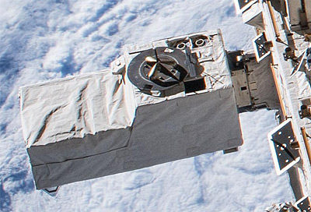
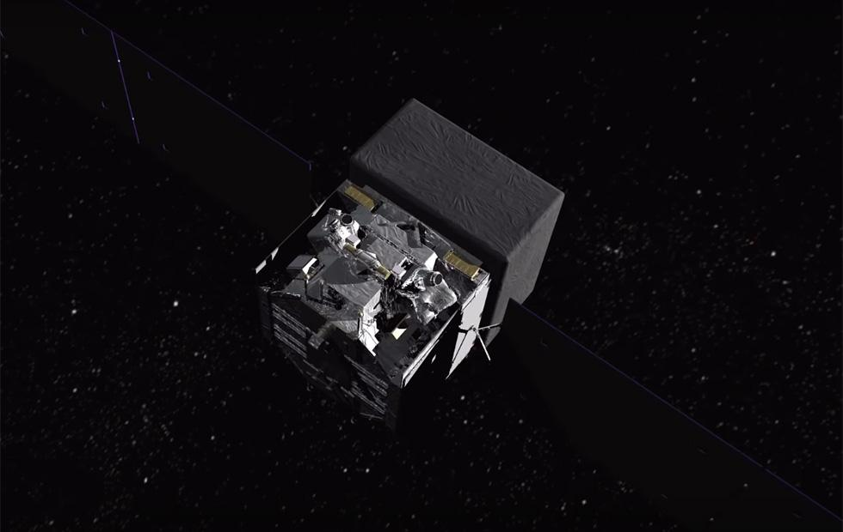
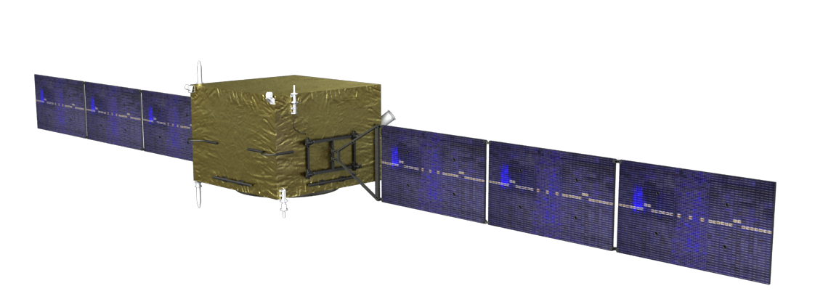
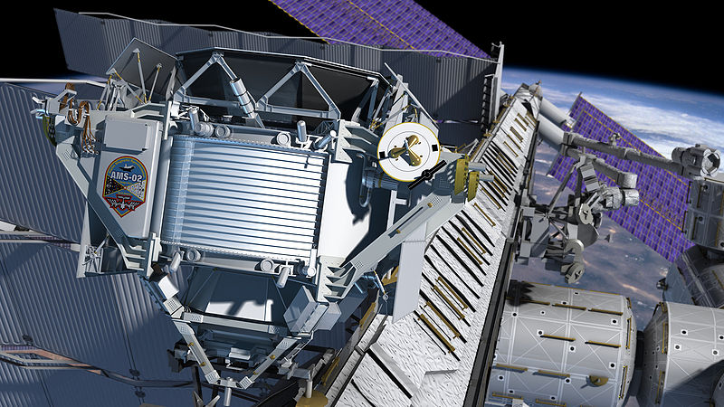
OVERVIEW
 | HERD | DAMPE | CALET | AMS-02 | Fermi LAT
e/γ Energy res.@100 GeV (%) | <1 | <1.5 | 2 | 3 | 10
e/γ Angular res.@100 GeV (deg.) | < 0.1 | <0.2 | 0.2 | 0.3 | 0.1
e/p discrimination | >10⁶ | >10⁵ | 10⁵ | 10⁵ - 10⁶ | 10³
Calorimeter thickness (X₀) | 55 | 32 | 27 | 17 | 8.6
Geometrical accep. (m²sr) | >3 | 0.3 | 0.12 | 0.09 | 1

Slide 5
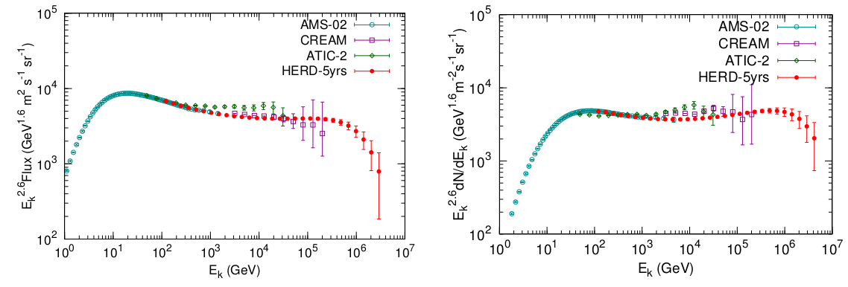
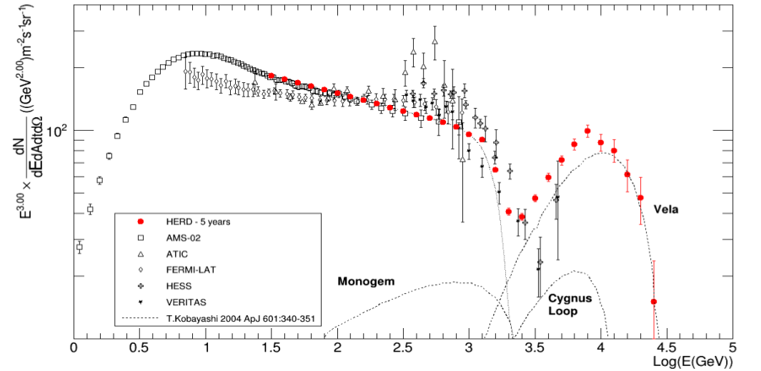
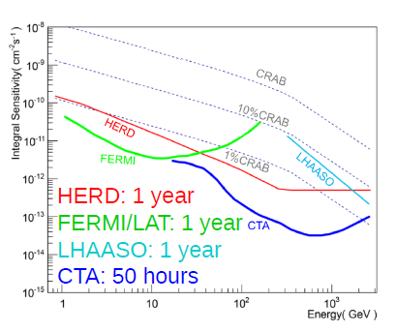
Physics goals
Expected charged particles fluxes in 5 years
Protons
Helium
e⁺+e⁻
HERD will measure the flux of nuclei:
p and He up to a few PeV
nuclei up to a few hundreds of TeV/n
First direct measurement of p and He knees will provide a strong evidence for the knee structure as due to acceleration limit
Expected γ sensitivity
Sky survey @ 5σ level
Targets of Gamma-Ray Sky Survey:
search for dark matter signatures
study of galactic and extragalactic γ sources
study of galactic and extragalactic γ diffuse emission detection of high energy γ Burst
Multi-messenger astronomy
Possible synergy with other experiments designed for γ (CTA), ν (KM3, IceCube), GW (Ligo, Virgo)
HERD will measure the e⁺ e⁻ flux up to several tens of TeV
spectral cutoff at high energy,
local SNR sources of very high energy e⁻
anisotropy measurement

Slide 6
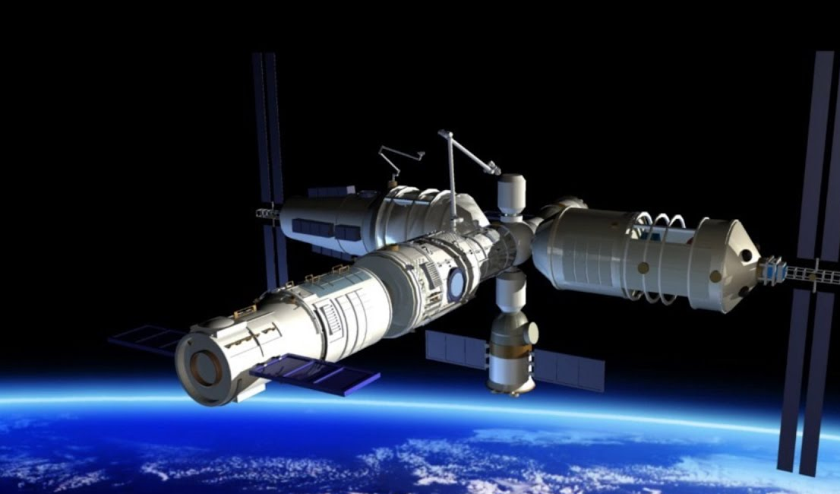
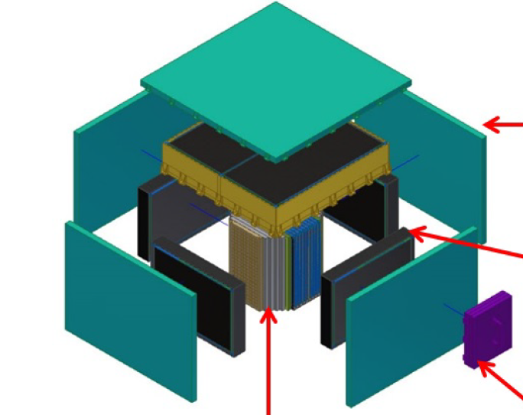
The detector
CSS expected to be completed in 2022
Life time | > 10y
Orbit | Circular LEO
Altitude | 340-450 km
Inclination | 42°
HERD expected to be installed around 2026
Life time | > 10y
FOV | +/- 70°
Power | < 1.5 kW
Mass | < 4 t
PSD
CALO | Energy Reconstruction e/p Discrimination
STK | Trajectory Reconstruction Charge Identification
PSD | Charge Reconstruction γ Identification
TRD | Calibration of CALO response for TeV proton
STK
TRD
CALO

Slide 7
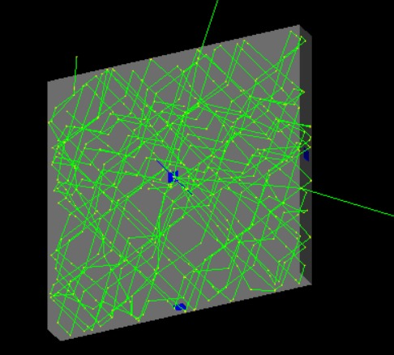
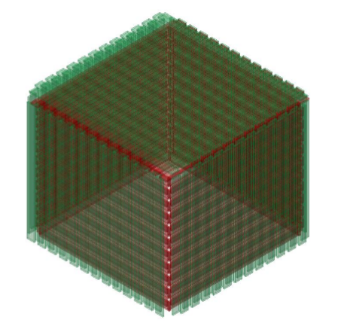
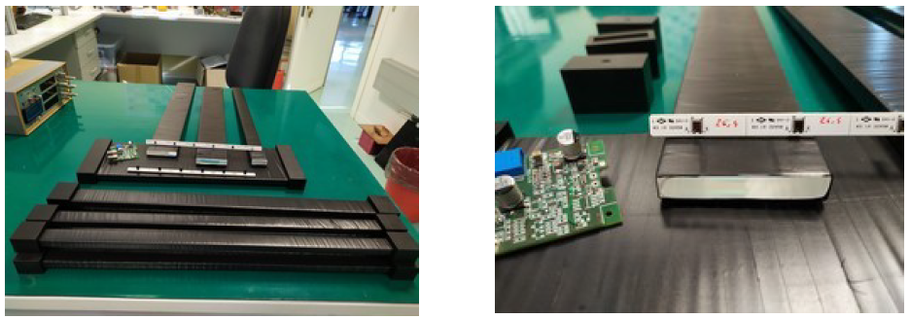
HERD Plastic Scintillator Detector (PSD)
PSD provide γ identification (VETO of charged particles) and nuclei identification ( energy loss ∝ Z²)
Back-scattering can greatly degrade the performances
Bar - option
Tile - option
Long bars 160x3x1 cm³
Each layer made by two staggered sub layer to increase hermeticity
Read-out with 4 SiPM (two for each end)
PRO
Less number of readout channel
CONS
Higher Back-scattering problem
Small square tile 10x10x1 cm³
Two layer of tiles to increase nuclei identification power
Each tile is readout by 4 SiPM (one for each side)
PRO
Reduce back-scattering problem
CONS
Higher number of readout channel
In (Bari and Pavia) there are ongoing activities on this option
In China (IHEP) and Italy (GSSI and Lecce) there are ongoing activities on this option
I will present some results for this option

Slide 8
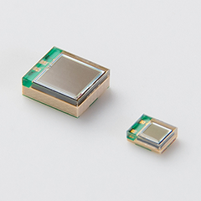
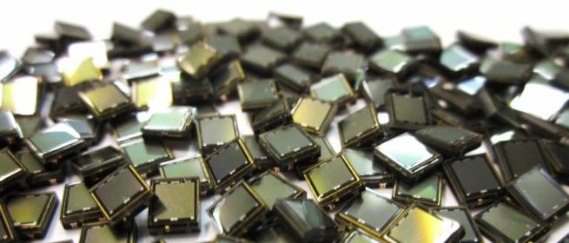
SiPMs
SiPMs suitable to replace PMT
low voltage
compact
Good for space missions
better sensitivity to low light yields
Plastic scintillator + SiPMs are being tested in recent years for future missions.
Requirements:
Overall High efficiency and low dark noise for charged particles rejection (>0.9999)
Good energy resolution for better charge particle detection
High dynamic range for high Z identification

Slide 9
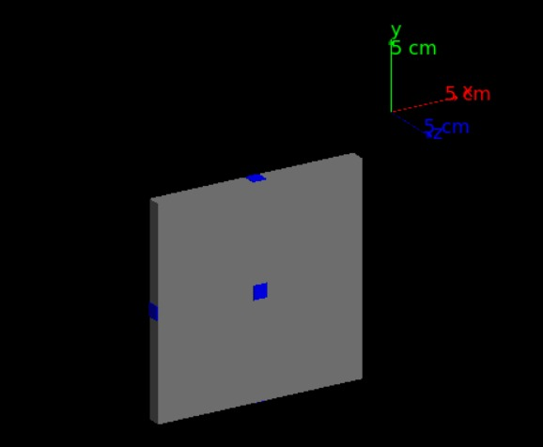
SIMULATION
We have developed a simulation that tracks every optical photon generated by scintillation in a tile. The code is based on GEANT4.
We have simulated a tile 10x10x1 cm³
The tile is equipped with 6 SiPM 4x4 mm² placed on the four sides and on the top and bottom face
In this simulation we can change a lot of parameters such as
Tile size
Number and position of SiPMs
Light Yield and attenuation length of the scintillator
Birks parameters
Physical parameters of the wrapping
1/100 photon is drawn

Slide 10
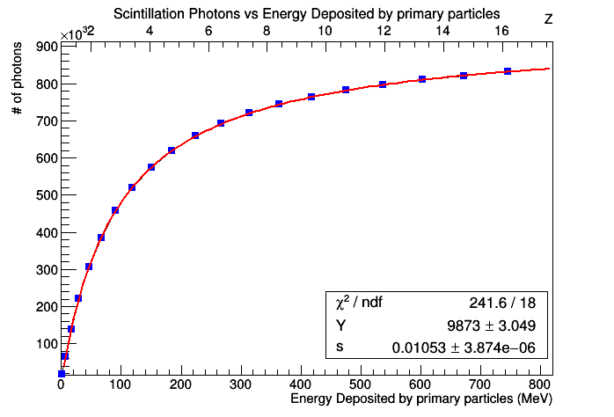
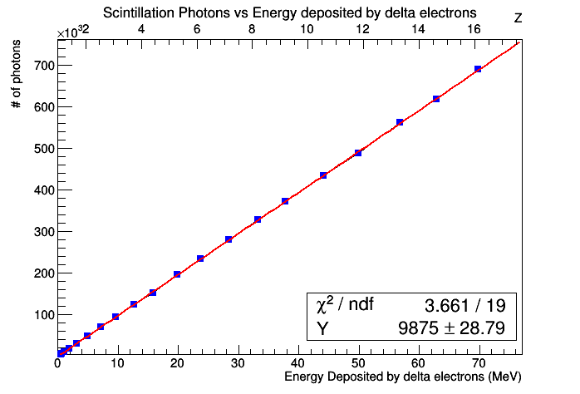
SIMULATION - BIRKS
The simulation code takes into account the Birks saturation effect
Light Yield of primary particle
$$∆N=\frac{Y∙∆E}{1+c0∙∆E}+Y1∙∆E$$
Light Yield of delta-rays

Slide 11
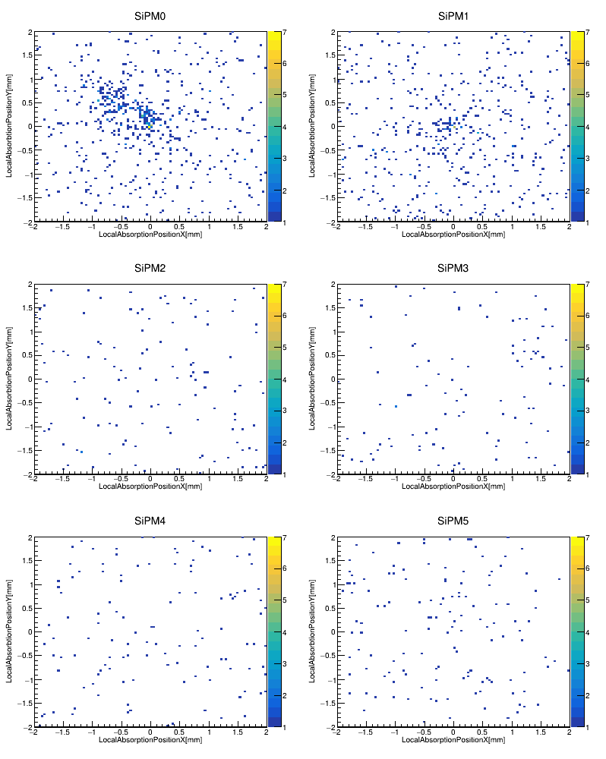
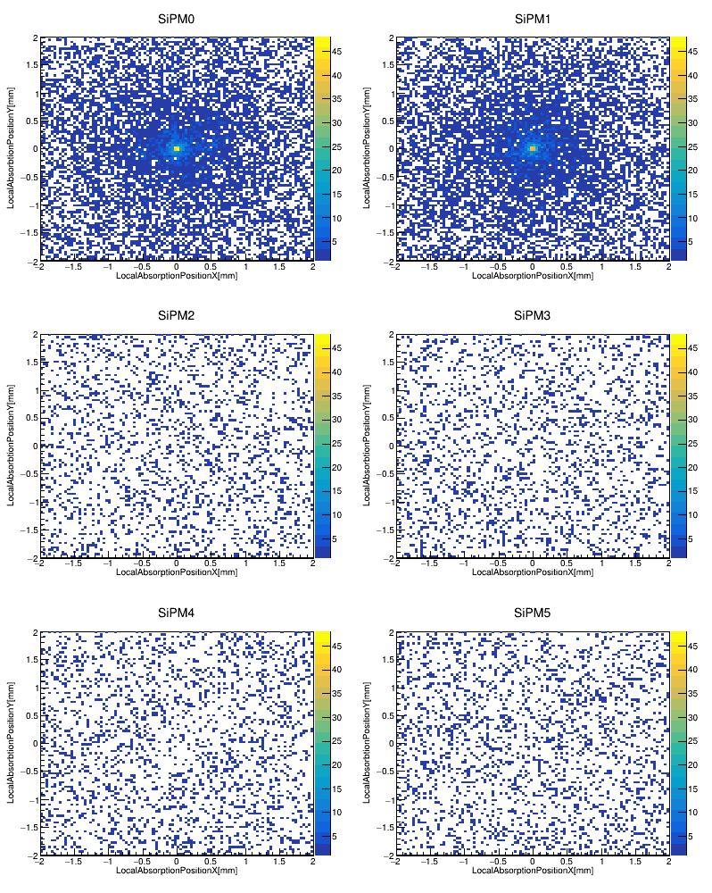
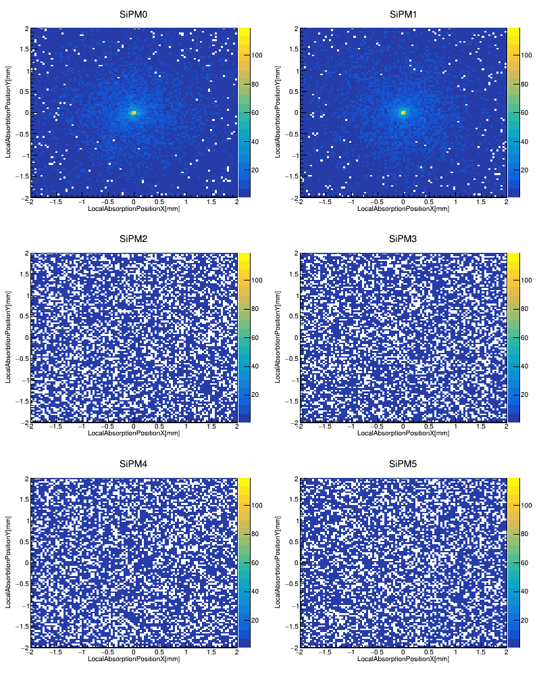
SIMULATION – SiPM OCCUPANCY
We have simulated particles crossing the tile in the center (TiO2 diffuse reflector)
Proton
Carbon
Iron
TOP
Direct + Reflected light
SIDE
Reflected light
TOP
Ph 600
Cell 550
SIDE
Ph 120
Cell 120
TOP
Ph 10000
Cell 5800
SIDE
Ph 2300
Cell 2000
TOP
Ph 48000
Cell 9500
SIDE
Ph 11000
Cell 6500

Slide 12
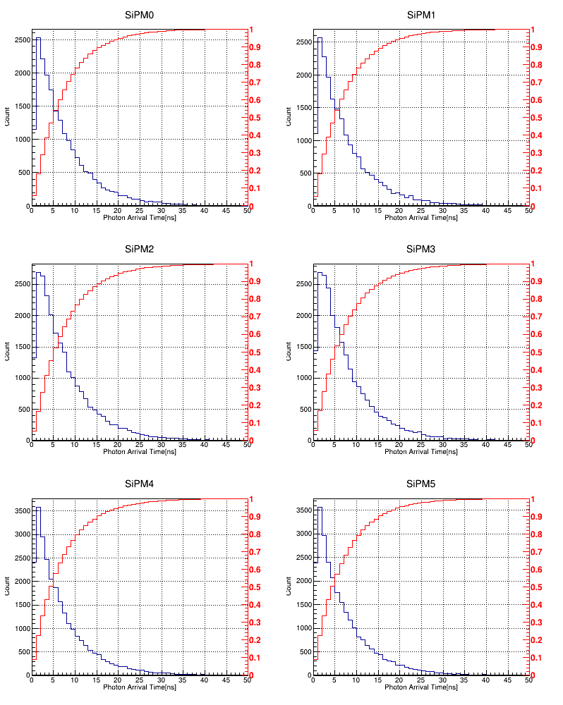
SIMUALTION - TIMING
Protons crossing the tile in the center and in a corner (TiO2 diffuse reflector)
CENTRAL POS
CORNER POS
TOP
Effect of prompt direct light in central position
SIDE
50% of photons are collected in 5ns
80% of photons are collected in 10ns
The collection time does not change with particle type

Slide 13
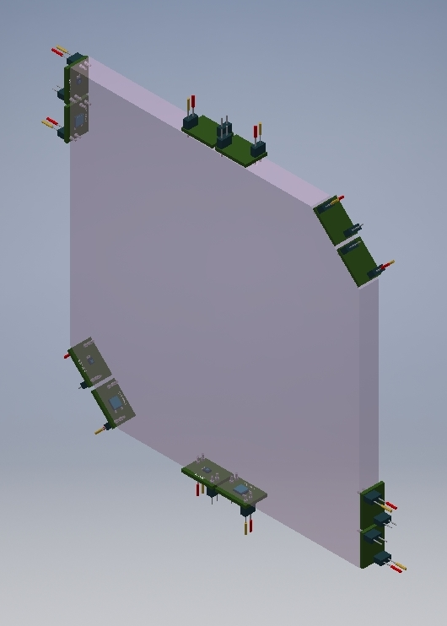
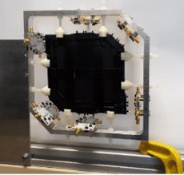
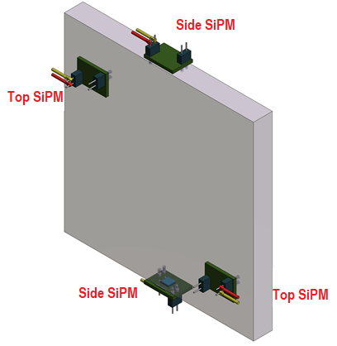
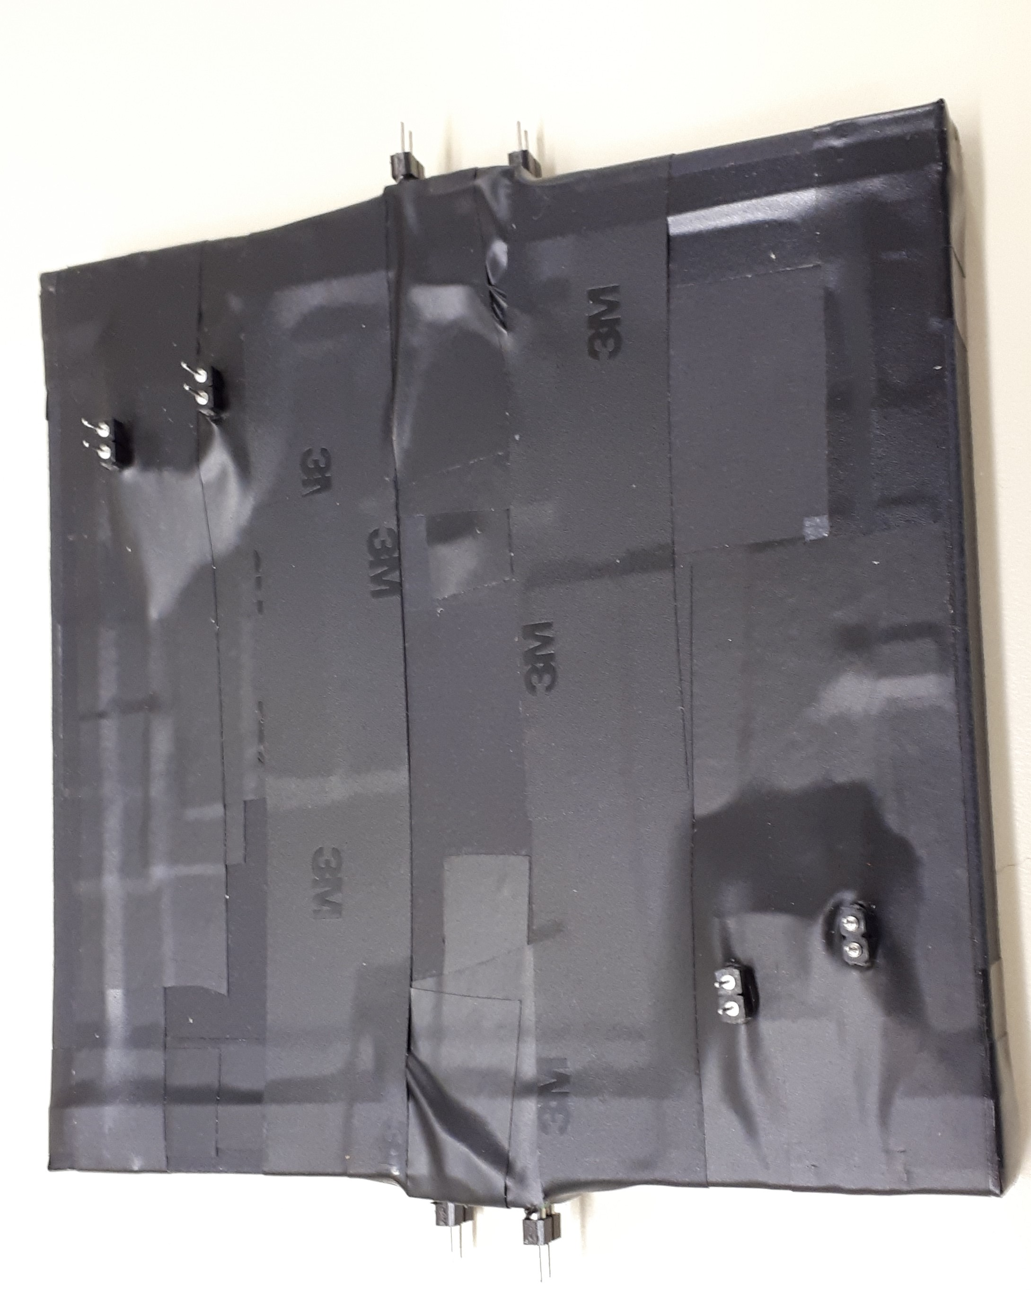
TILE PROTOTYPES
We have built two tile prototypes to test the performances
Tile 1(BC-404)
Squared shape with a side of 15 cm and thickness of 1 cm.
Two angles were cut at 2.5 cm from the corner.
12 ADVANSID NUV SiPMs (40μm cell; Gain 10⁵): n.6 1x1 mm² (Small) n.6 4x4 mm² (Large)
Tile 2 (BC-404)
Squared shape with a side of 10 cm and thickness of 1 cm.
n.4 4x4 mm² ADVANSID NUV SiPMs (40μm cell; Gain 10⁵)
Readout electronics from ADVANSID
Transimpedance amplifier with low and high gain (x5) output
RC filter for tail cancellation
DAQ: CAEN QDC V792
Tile 1
Tile 2

Slide 14
BEAM TEST @ CERN
Tile 1
PS - T10: 5 GeV particles (e/pi)
Scintillator irradiated in different positions → dependence of collected light on beam position
SPS – H8: 20 GeV particles (e/pi)
Scintillator irradiated only in the central position → efficiency studies
Tile 2
SPS – H4: beam line with a beam of selected momentum of 330 GeV/Z, coming from a primary beam of lead, with energy 150 GeV/A, impinging onto a Beryllium target.
Scintillator irradiated in the central position → capability to discriminate ion charges

Slide 15
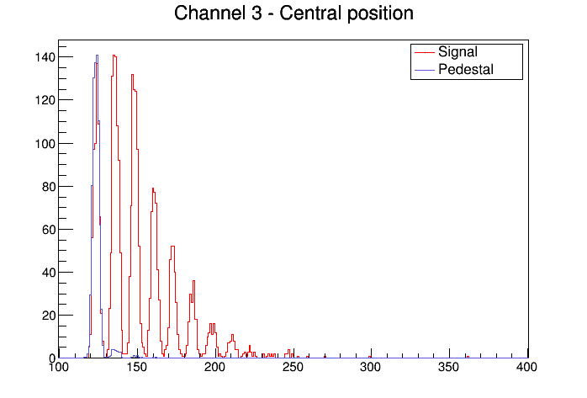
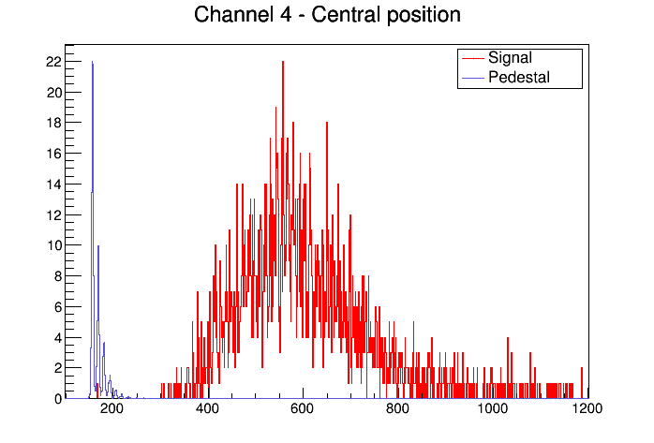
TILE 1 – TEST@PS
Small SiPMs (1x1mm² area):
Charge distributions fitted with multi-gaussian functions
Areas of individual peaks fitted with Poisson distributions
Calibration with dark counts
Large SiPMs (4x4mm² area):
Individual peaks still visible in charge distributions, but difficult to fit due to low statistics
Rebinning of histograms and fit with a Landau distribution folded with a gaussian
Calibration with dark counts
Events
ADC counts
Events
ADC counts
Notes:
Per i test sulla prima tile, abbiamo acquisito i dati dei sipm grandi e piccoli, che vedete qui sovrapposti a dati di piedistallo, utilizzati per la calibrazione del segnale. Per i sipm piccoli abbiamo fittato le distribuzioni con una multigaussiana e per ottenere il numero di fotoni rivelati, e come si vede il numero di fotoni incidenti non è sufficiente per separare il segnale dal piedistallo. Questo ovviamente non si verifica nei sipm grandi, dove il numero di fotoni è nettamente maggiore. In questo spettro sono ancora distinguibili i picchi dei singoli fotoni ma è difficile fare un fit a causa della bassa statistica e del rumore intrinsico maggiore nei 4x4 rispetto agli 1x1. Per questo motivo abbiamo fatto il fit utilizzando una landau convoluta con una gaussiana. Il valore del picco della landau, in canali adc è stato quindi convertito in fotoni per avere il numero di fotoni incidenti.

Slide 16
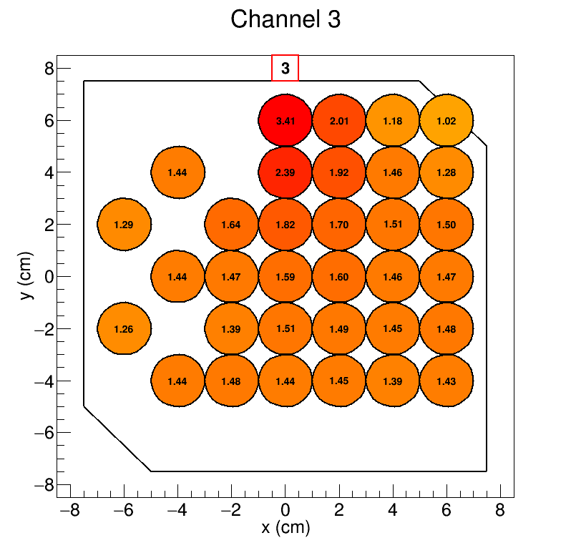
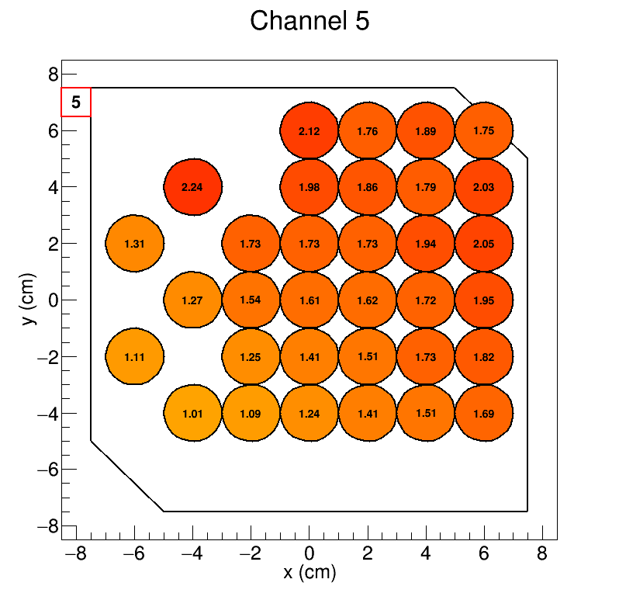
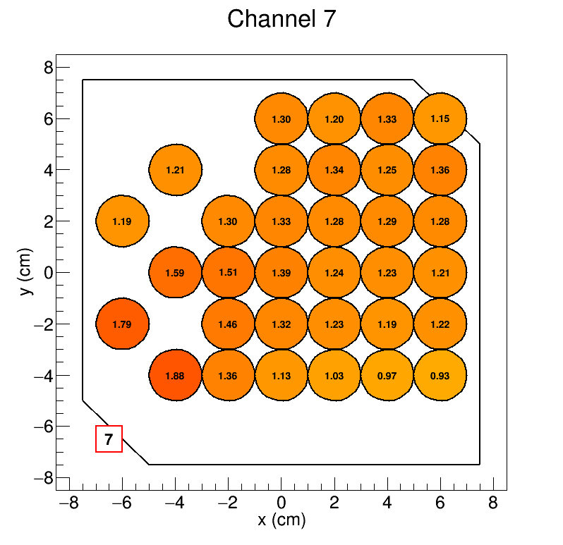
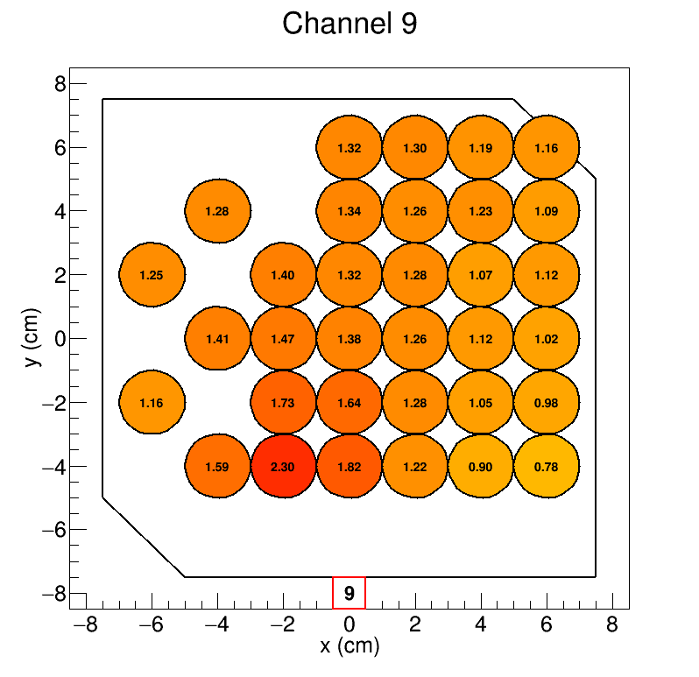
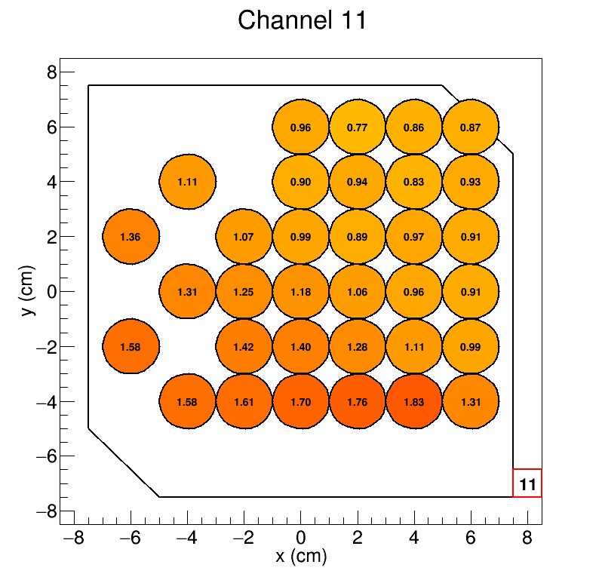
Small SiPMs
Notes:
In queste mappe abbiamo, per ciascun sipm, il numero medio di fotoni rivelato per ciascuna delle posizioni del fascio. Come si vede il numero è all’incirca costante, con valori di poco più alti in corrispondenza delle posizioni più vicine ai sipm. In questa slide vediamo i risultati per i sipm piccoli,

Slide 17
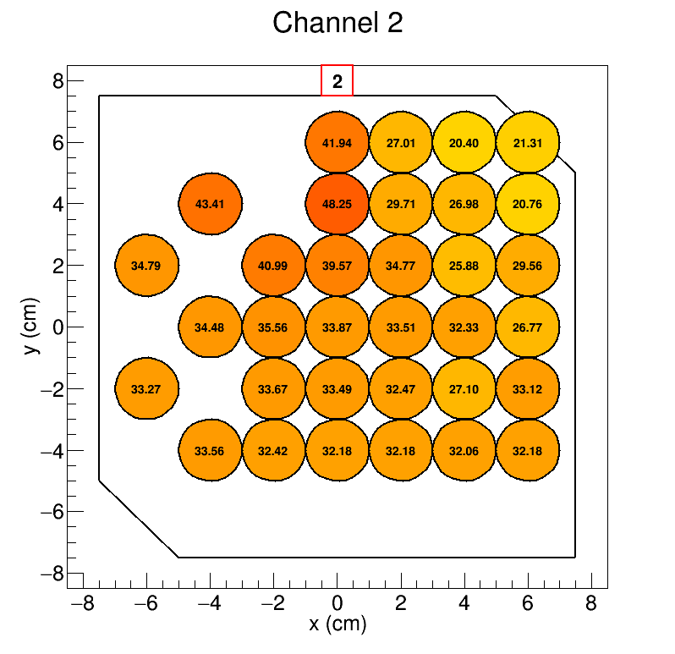
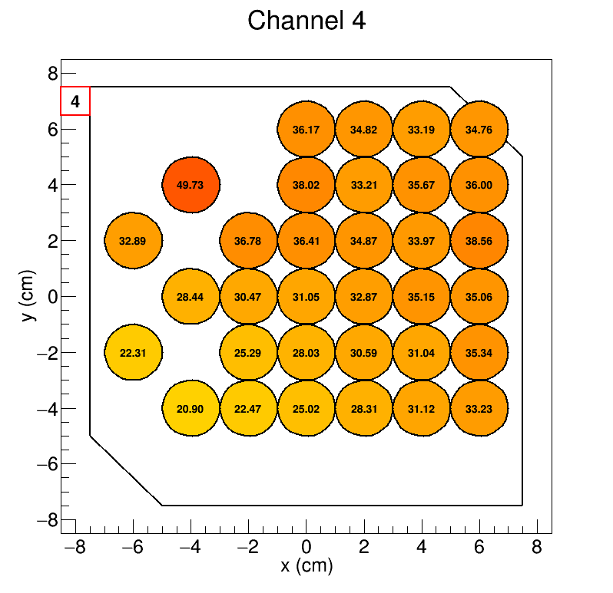
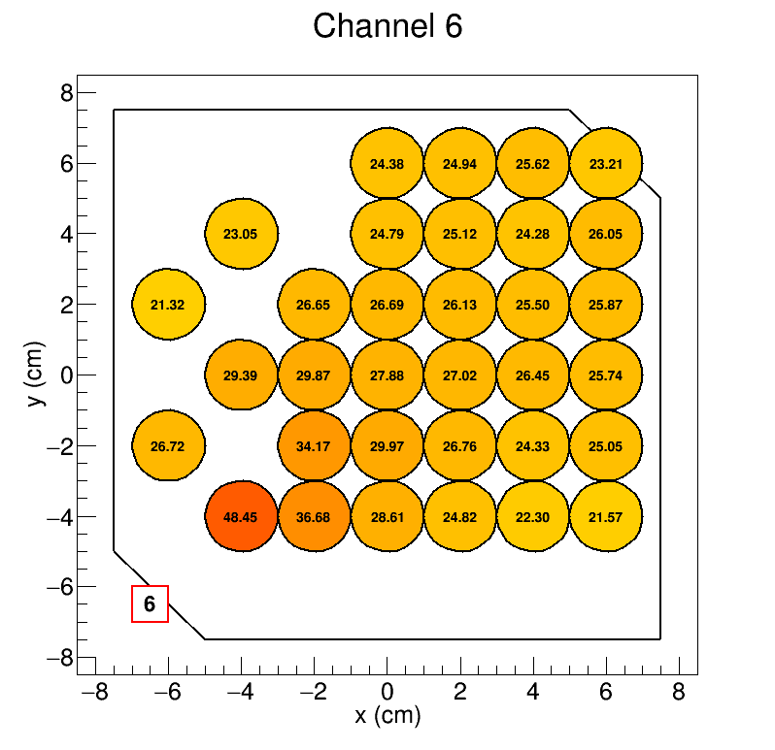
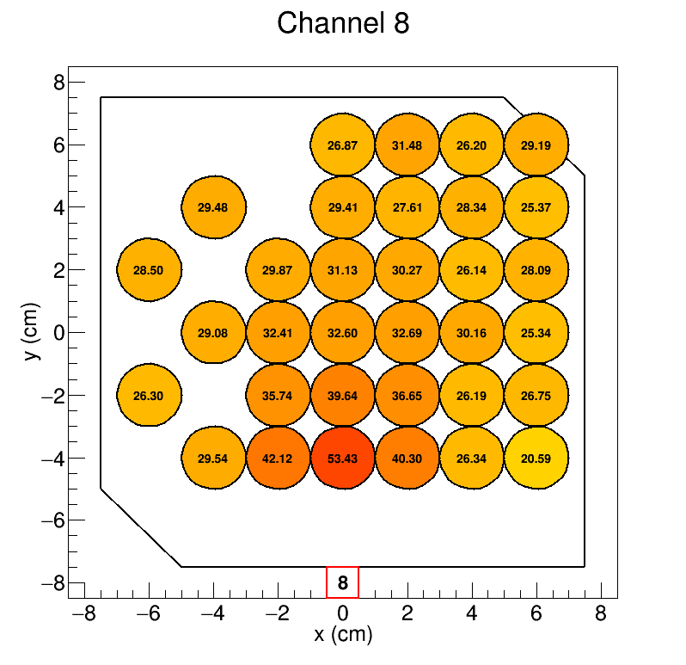
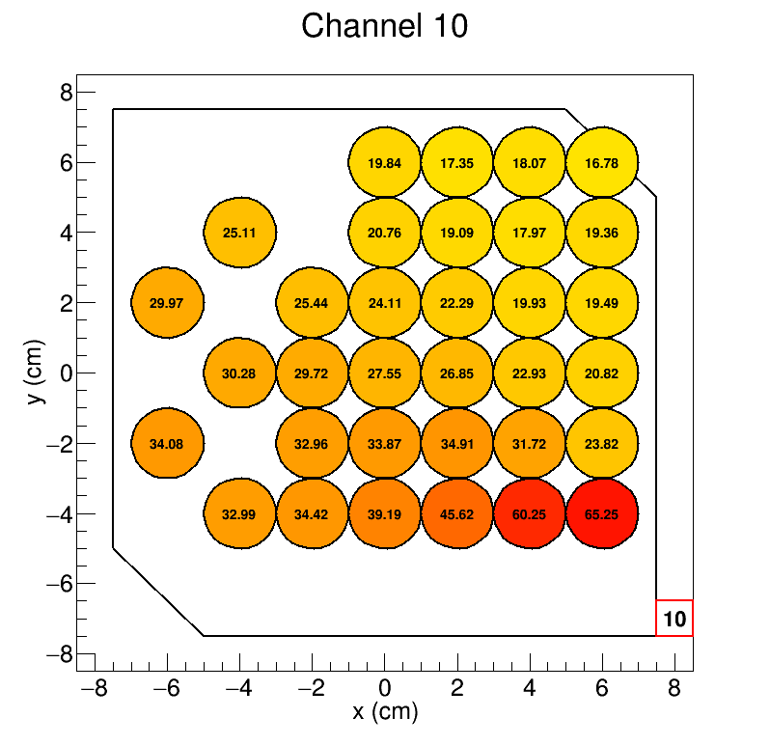
Large SiPMs
Notes:
Mentre qui abbiamo i risultati ottenuti per i sipm grandi. La distribuzione è ancora una volta uniforme, circa 30 fotoni, con picchi di 40 fotoni quando il fascio arrivava in prossimità del sipm.

Slide 18
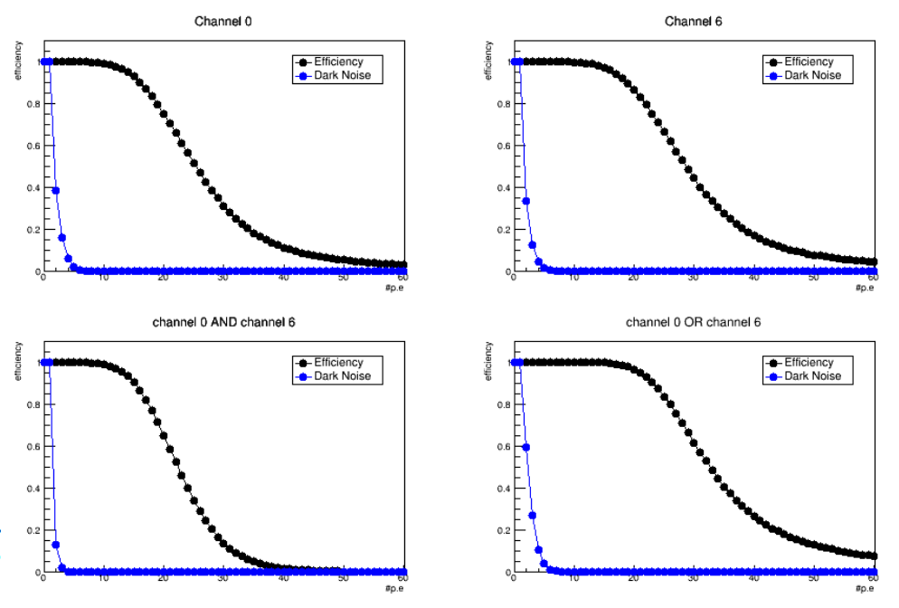
TILE 1 TEST@SPS
Efficiency and dark noise evaluated as function of p.e. in single, AND and OR configuration
Notes:
Sempre sulla prima tile, abbiamo effettuato questi test irradiando la tile solo nella posizione centrale. Nei Sipm large il segnale è ben separato dal piedistallo come abbiamo già visto. Si sono calcolate le distribuzioni cumulative del segnale e del piedistallo al fine di valutare l’efficienza di rivelatione di una particella tramite la lettura del singolo sipm, come vedete nei due plot in alto, e la probabilità di avere un segnale di dark noise.
Questi studi sono stati svolti anche combinando la risposta di due sipm in posizione opposta sulla tile, in configurazione di AND e di OR. Nella configurazione AND si osserva una efficienza più bassa ma anche chiaramente un dark noise minore, mentre nella configurazione OR osserviamo una efficienza maggiore, ma anche un dark noise più alto rispetto alla lettura del singolo sipm.

Slide 19
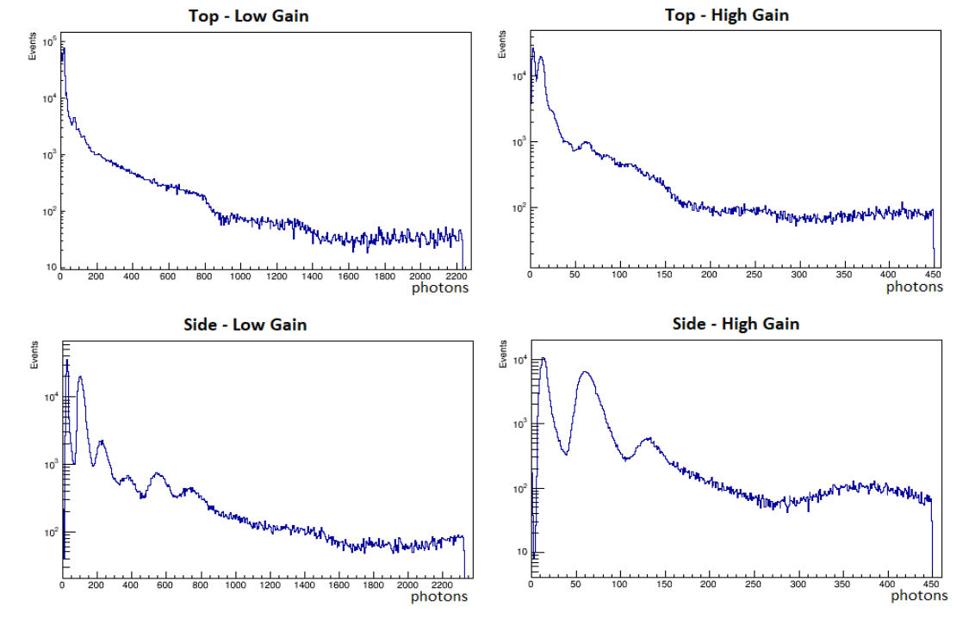
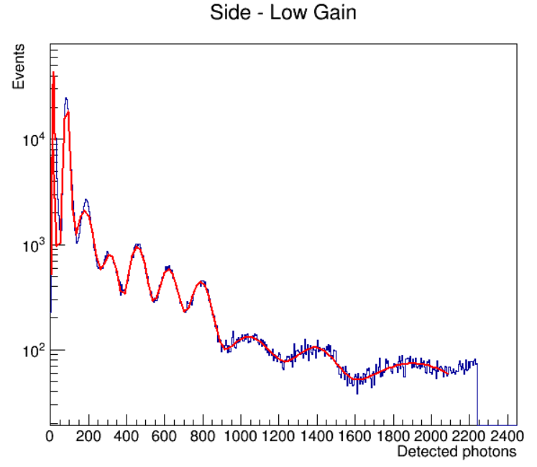
TILE 2 Test@SPS with ions
Preliminary
Side SiPM with low gain show the best performances
H
He
Top SiPMs collect less light than Side SiPMs
Side SiPMs: the high gain amplification appears to be inappropriate, since the readout chain allows resolution up to Z = 3
Top SiPMs: the high gain channels are able to resolve more peaks than the Low gain ones
Preliminary
Li
B
Be
C
N
O
F

Slide 20
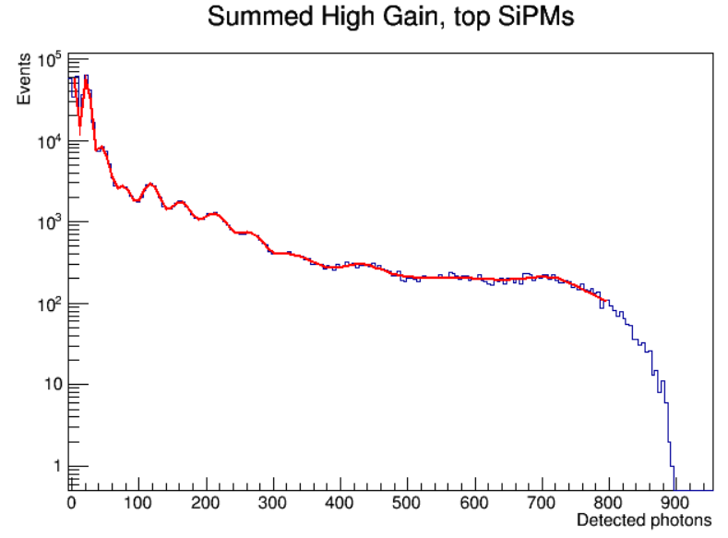
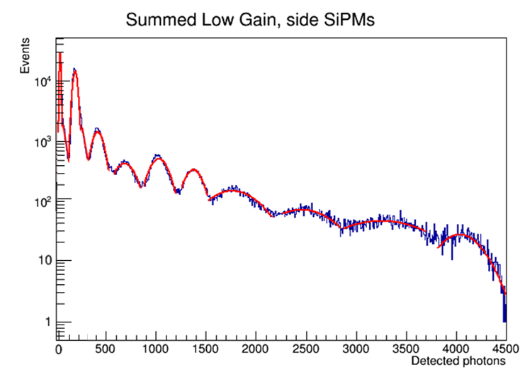
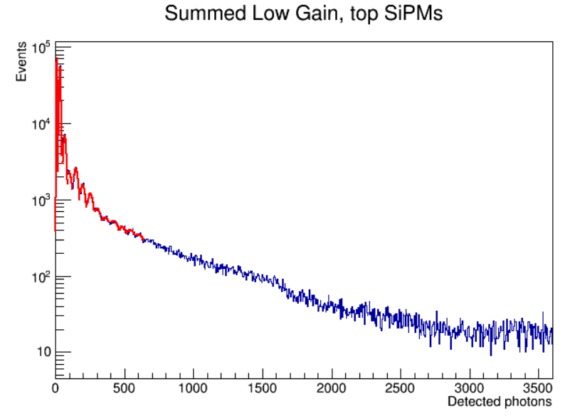
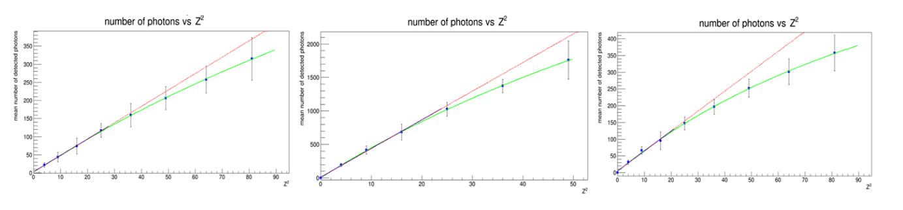
TILE 2 Test@SPS with ions
Some improvement achieved if we sum together the signals from SiPMs
Preliminary
Preliminary
Preliminary
Linear fit
Birks relation
Preliminary
Preliminary
Preliminary

Slide 21
Lesson learned
Tile 1
Small SiPM collects very few photons
Response is almost uniform in the tile (30-40 p.e. for large SiPMs), with peaks in the points closer to the SiPMs
Efficiency reached with this configuration is very high, fulfilling the requirements of anti-coincidence systems in cosmic ray satellites.
Tile 2
nuclei detection and identification up to Z=8 with single channel
Summing up the equivalent channels → clear improvement in the signal
The readout used in these tests limited the dynamics → must be improved.
In conclusion, this study shows that SiPM technology can be used instead of the classical PMTs in space experiment both to reject charged particles and to identify ions.
A lot of work is still needed to design proper readout electronics, to study the timing performances, to study the effect of dark noise and cross talk on resolution and to increase the overall performances
Notes:
Possiamo concludere che i test effettuati con sipm accoppiati agli scintillatori hanno dato risultati soddisfacenti. Nel caso della prima tile, si è osservata una risposta uniforme al variare del punto di impatto, con picchi in corrispondenza del punto di impatto, effetto che chiaramente va tenuto in considerazione quando si valuta l’energia depositata nello scintillatore.
Inoltre, i sipm hanno più grandi hanno mostrato maggior efficienza, maggiore del 99.99%, mentre i sipm piccoli raccolgono troppa poca luce.
I test effettuati sulla seconda tile invece ci dimostrano che siamo in grado di identificare I nuclei fino al neon con un singolo canale, con risoluzione migliore per I sipm posti sui bordi della tile, in quanto sulla parete la luce raccolta fornisce poca statistica e I picchi non sono ben distinti. Inoltre, sommando I canali si riesce a migliorare ulteriormente questo risultato.
Possiamo quindi concludere che I sipm possono essere usati al posto dei classici pmt per l’identificazione degli ioni. Ulteriori studi andranno fatti per ampliare il range dinamico e studiare diverse geometrie.

Slide 22
THANKS!!

Slide 23
Back up slides

Slide 24
TILE 2 Test@SPS with ions - Resolutions
Channel Resolution | Resolution of He peak ( σ/peak position)
Low gain, Side | 0.1601 ± 0.0005
Summed low gain, Side | 0.1296 ± 0.0004
Summed high gain, Side | 0.1355 ± 0.0006
Summed low gain, Top | 0.2042 ± 0.0008
Summed high gain, Top | 0.2813 ± 0.0008

Slide 25
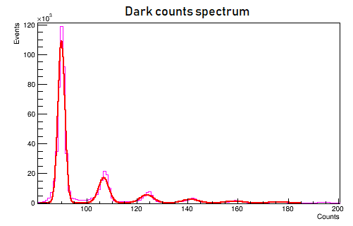
SIGNAL CALIBRATION
Signals collected and calibrated for each SiPM using the dark count distributions measured in runs without particles.
Gain evaluated from the distance between two adjacent p.e. peaks once the pedestal has been subtracted.
To calibrate the signal distribution, we subtracted the pedestal from the raw data, and divided by the gain, allowing the conversion of ADC counts to detected photons.
Notes:
They arise because of the dark SiPM signals due to thermal noise, which causes random creation of electron-hole pairs.
the energy released by charged particles in a dense material is proportional to the square of the charge Z of the particle.

Slide 26
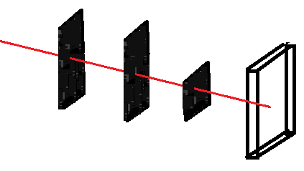
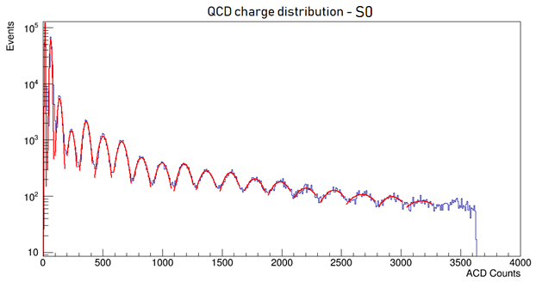
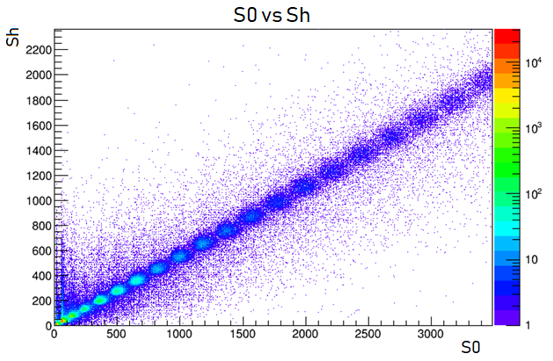
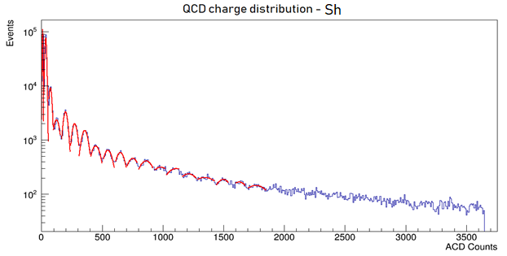
S0 AND SH SIGNALS
To identify the nuclei with a system different from the tile under test the signals from S0 and Sh were used.
The red line is obtained by fitting the peaks with gaussian functions up to the nineteenth peak.
Beam
S0
Sh
S4

