Slide 1
FluChe
An ASIC Front-End for Fluorescence and Cherenkov light detection with SiPM for space/ground applications
Giovanni Contino, INAF / IASF-Palermo
on behalf of FluChe team
1
G. Contino – INAF/IASF PALERMO – SiPM workshop: from fundamental research to industrial applications, Università di Bari 03-10-2019

Slide 2
SCIENTIFIC RATIONAL : SPACE MISSION STATUS
Detection of Ultra High Energy Cosmic Rays (E>10¹⁹ eV)
looking downward at the dark earth atmosphere
Balloon flights: BABY (3 flights from Trapani-Milo ASI base), EUSO-Balloon 1st flight (EUSO/CNES),
EUSO-SPB1 (EUSO/NASA), EUSO-SPB2 (future mission approved by NASA)
Missions proposed in the past : EUSO (Extreme Universe Space Observatory), KLIPVE (Russian)
Path-finder missions: MINI-EUSO (ASI/ROSCOSMOS) August 2019 on going, ISS Russian module
K-EUSO (ROSCOSMOS/EUSO) end of 2022, ISS Russian module
Mission in operation: TUS (ROSCOSMOS): launched, April 2016
Missions proposed in the last years: JEM-EUSO, POEMMA (Probe Of Extreme Multi-Messenger Astrophysics)
2
G. Contino – INAF/IASF PALERMO – SiPM workshop: from fundamental research to industrial applications, Università di Bari 03-10-2019

Slide 3
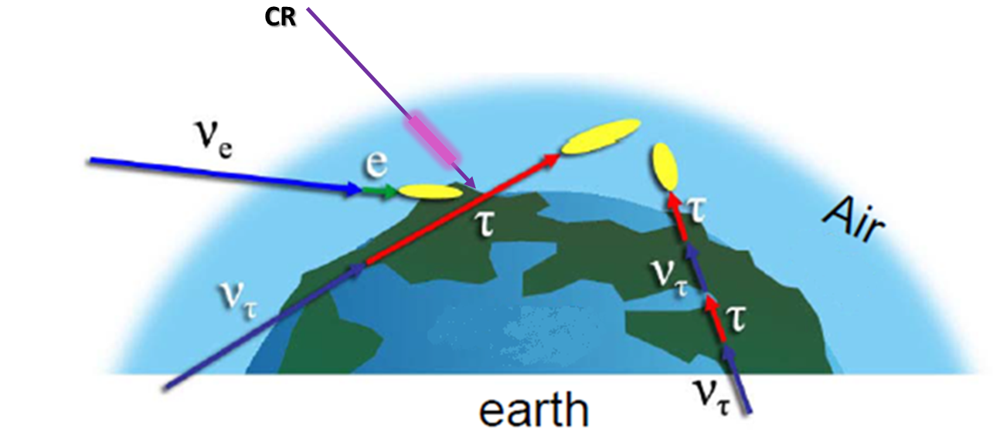
THE OBSERVABLES : RARE EVENTS (UHECR, NEUTRINOS)
A giant detector at planetary scale is required to catch particles
with flux values at the level of 1 particle/100 km²/year (EECR >10²⁰ eV)
or with very low interaction cross section (high energy neutrinos)
A natural detector is represented by the Earth atmosphere
cherenkov
fluorescence
3
G. Contino – INAF/IASF PALERMO – SiPM workshop: from fundamental research to industrial applications, Università di Bari 03-10-2019

Slide 4
SCIENTIFIC RATIONAL : GROUND MISSION STATUS
Detection of Gamma Rays (E<10¹⁴ eV)
Missions in operation: MAGIC (Major Atmospheric Gamma-ray Imaging Cherenkov Telescope),
H.E.S.S. (High Energy Stereoscopic System),
VERITAS (Very Energetic Radiation Imaging Telescope Array System)
Mission proposed: CTAO (Cherenkov Telescope Array Observatory)
Prototype: ASTRI (Astrofisica con Specchi a Tecnologia Replicante Italiana)
4
G. Contino – INAF/IASF PALERMO – SiPM workshop: from fundamental research to industrial applications, Università di Bari 03-10-2019

Slide 5
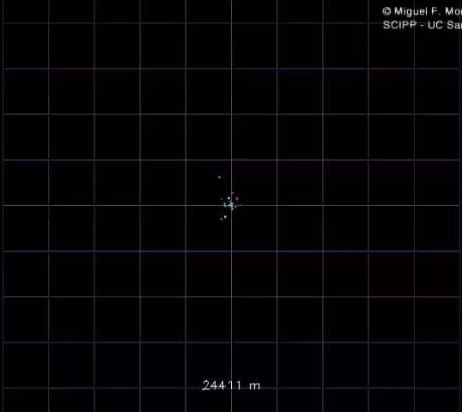
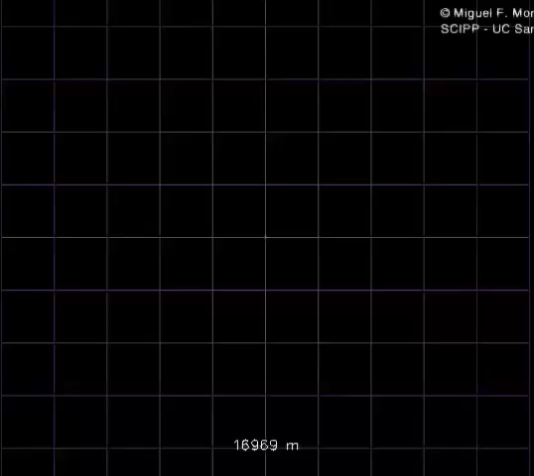
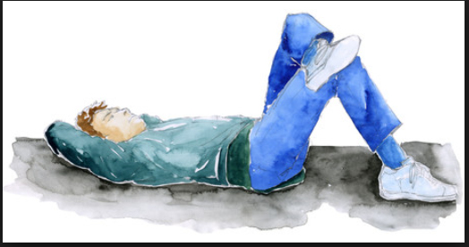
THE OBSERVABLES
electrons and gammas : muons : pions and kaons : protons and neutrons : others, nuclear fragments
Particles component of shower
Fluorescence light emitted isotropically by secondary charged particles
while
Cherenkov light emitted in a beamed cone by charged particles (E_{th_e}± > 20MeV in air)
proton shower
gamma shower
5
G. Contino – INAF/IASF PALERMO – SiPM workshop: from fundamental research to industrial applications, Università di Bari 03-10-2019

Slide 6
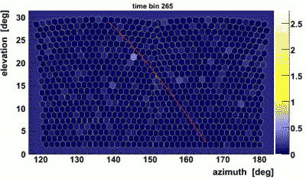
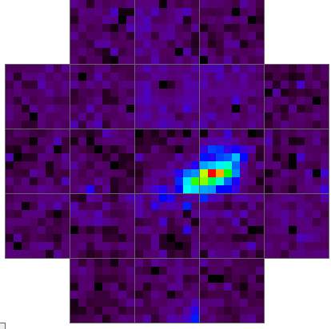
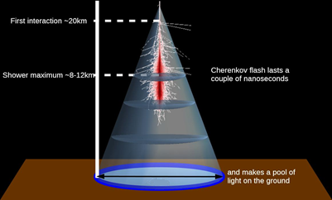

THE OBSERVABLES
≈240 m
Fluorescence track progression lasts tens of microseconds
Cherenkov flash lasts few nanoseconds
considerably different time scale
6
G. Contino – INAF/IASF PALERMO – SiPM workshop: from fundamental research to industrial applications, Università di Bari 03-10-2019

Slide 7
THE DETECTION : BASIC REQUIREMENTS
optical system with large collecting area (because of the faint fluorescence signal) and wide equivalent field of view covering a sizable half opening angle around the local Nadir (to reach geometrical factor of 10⁶ km² sr)
focal plane detector with high segmentation (single photon counting and high pixelization), high resolving time (~ 10 ns), weight and power contained
trigger and read-out electronics prompt, simple, modular, capable to handle hundreds of thousands of channels, and comprehensive of an efficient on-board image processor acting as a trigger.
7
G. Contino – INAF/IASF PALERMO – SiPM workshop: from fundamental research to industrial applications, Università di Bari 03-10-2019

Slide 8
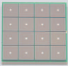
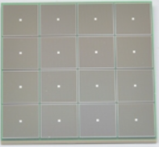
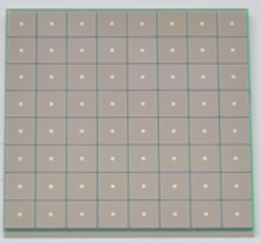
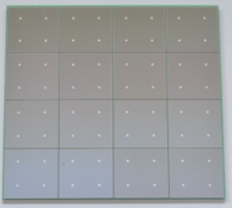
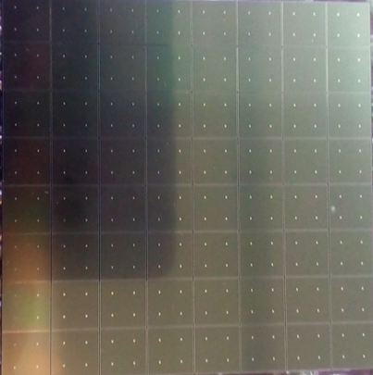
THE DETECTION : SiPM
The 4-side buttable structure allows arraying multiple elements in two dimensions at narrow intervals.
16 pixels
2mm x 2mm
16 pixels
3mm x 3mm
64 pixels
3mm x 3mm
16 pixels
6mm x 6mm
64 pixels
7mm x 7mm
(ASTRI)
8
G. Contino – INAF/IASF PALERMO – SiPM workshop: from fundamental research to industrial applications, Università di Bari 03-10-2019

Slide 9
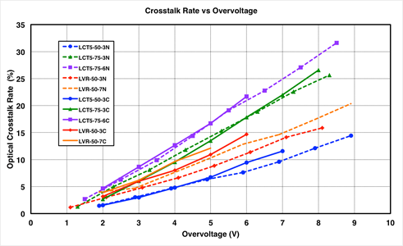
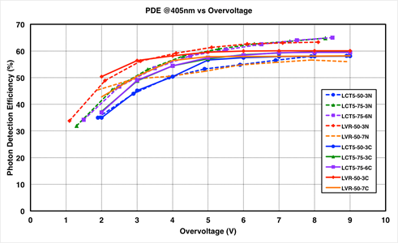
THE DETECTION : SiPM
(a)
(b)
Comparison of (a) the optical crosstalk and (b) photon detection efficiency versus SiPM overvoltage for a variety of SiPM technologies, pixel sizes (3, 6 and 7 mm) and cell sizes (50 and 75 µm), measured by groups in Nagoya, Japan (dashed lines) and Catania, Italy (solid lines).
9
G. Contino – INAF/IASF PALERMO – SiPM workshop: from fundamental research to industrial applications, Università di Bari 03-10-2019
Notes:
Measures done by independent group in Nagoya and Catania: they demonstrate that the SiPM technology is ever upgrading.
The red lines for the classic overvoltage at wihch we work.

Slide 10
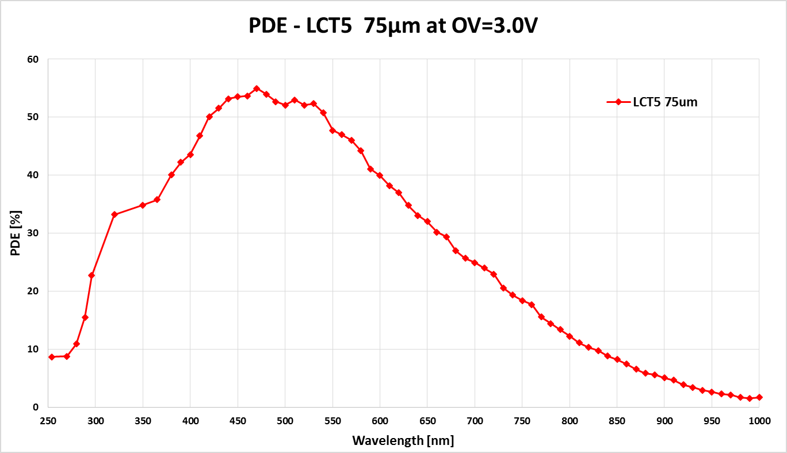
THE DETECTION : SiPM
Fluorescence (300 ÷ 400 nm) : PDE ≈ 35%
Cherenkov (300 ÷600) nm : PDE ≈ 40%
10
G. Contino – INAF/IASF PALERMO – SiPM workshop: from fundamental research to industrial applications, Università di Bari 03-10-2019

Slide 11
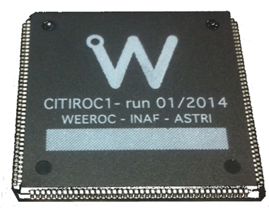
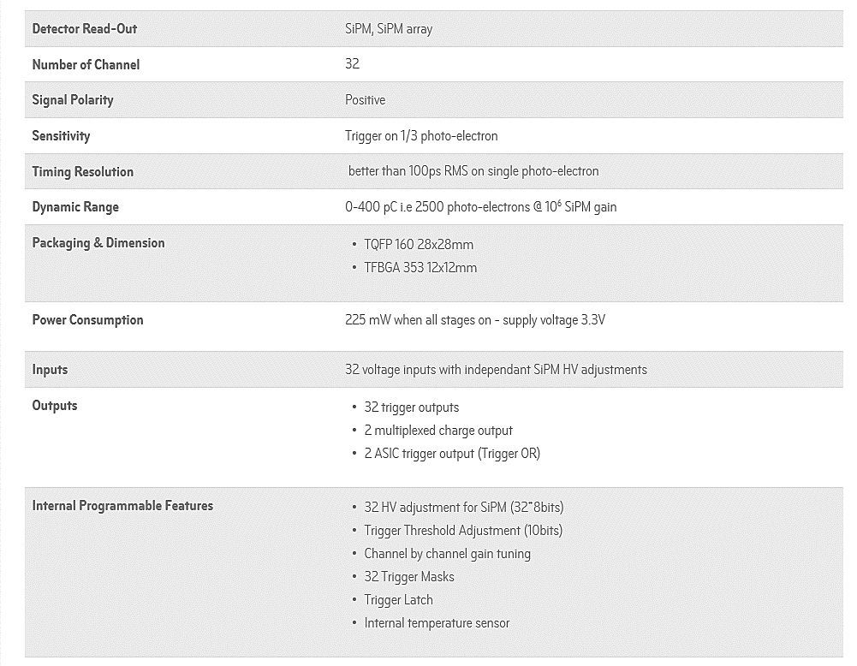
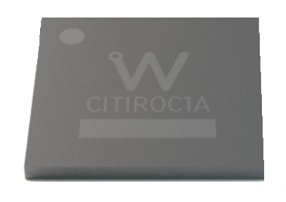
THE DETECTION : FRONT-END
11
G. Contino – INAF/IASF PALERMO – SiPM workshop: from fundamental research to industrial applications, Università di Bari 03-10-2019

Slide 12
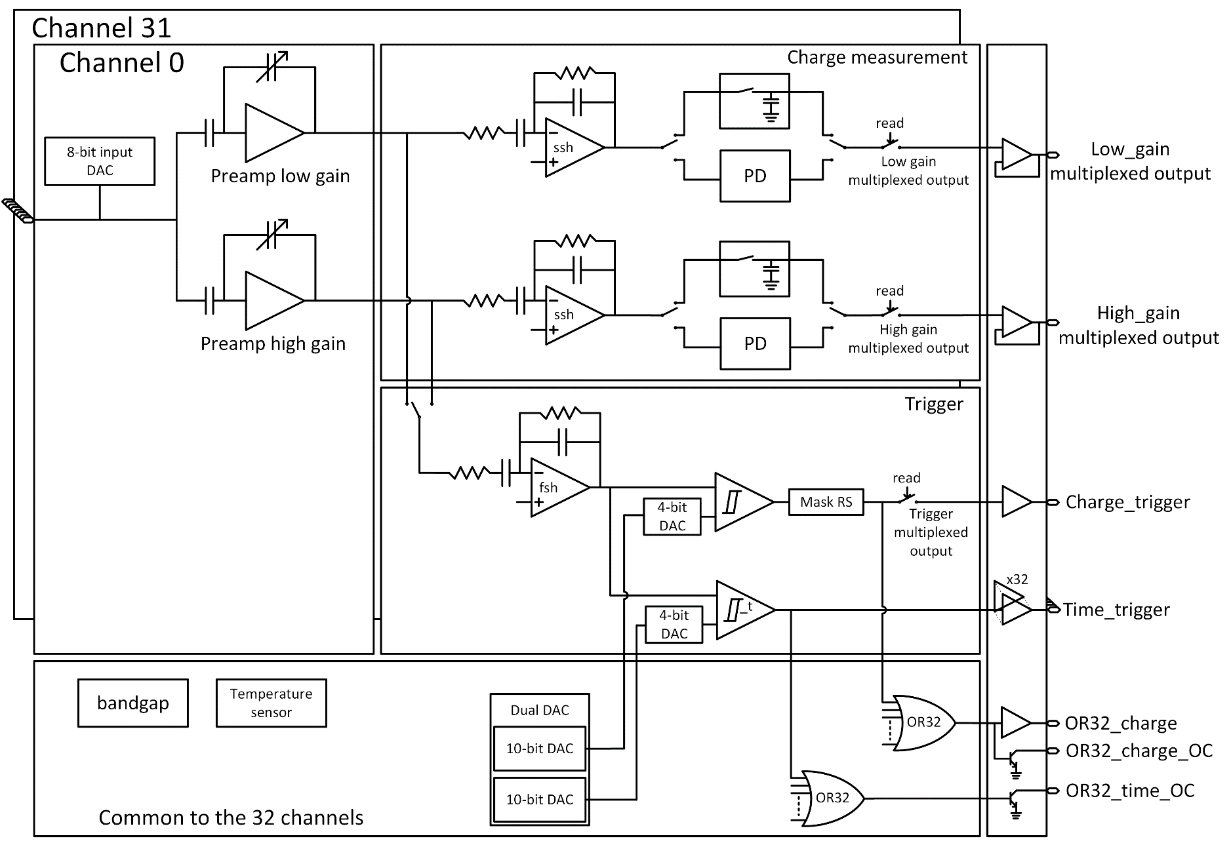
THE DETECTION : FRONT-END
LG
SIPM HV adjust
HG
TRIGGER
12
G. Contino – INAF/IASF PALERMO – SiPM workshop: from fundamental research to industrial applications, Università di Bari 03-10-2019

Slide 13
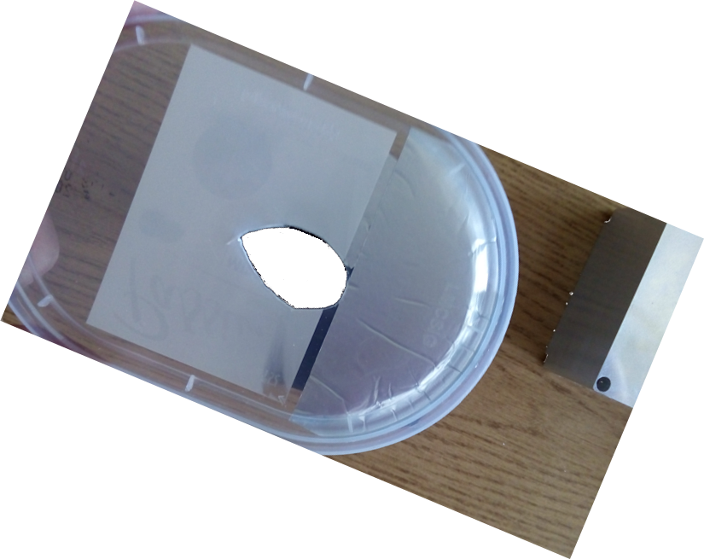
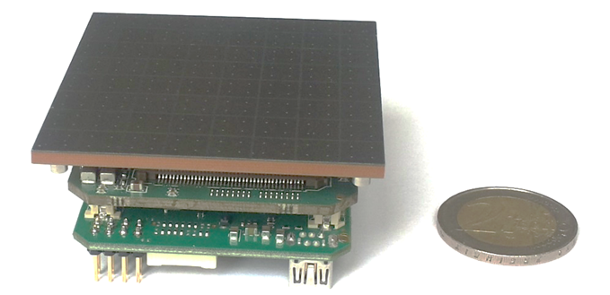
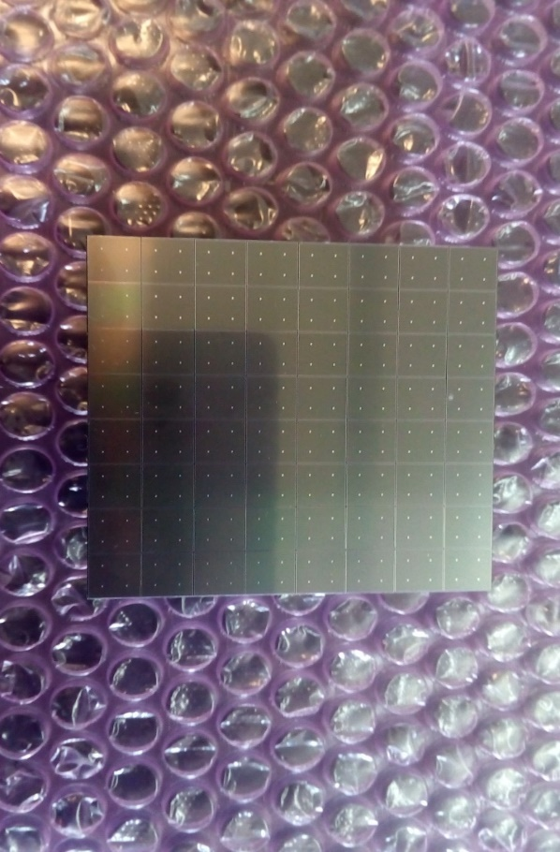
THE DETECTION : Photon Detection Module imaging capability
Real image on a single PDM obtained using a partially opaque PVC mask with an ellipse shaped hole and pulsed LED
PDM SiPM TILE
PVC FOOD COVER
ASTRI PDM
Topological trigger set to 4 contiguous pixels with threshold ≥ 4 pe
13
G. Contino – INAF/IASF PALERMO – SiPM workshop: from fundamental research to industrial applications, Università di Bari 03-10-2019

Slide 14
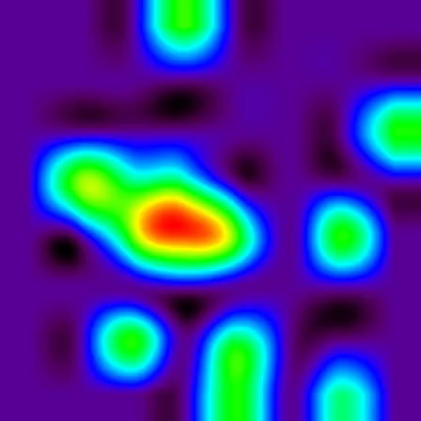
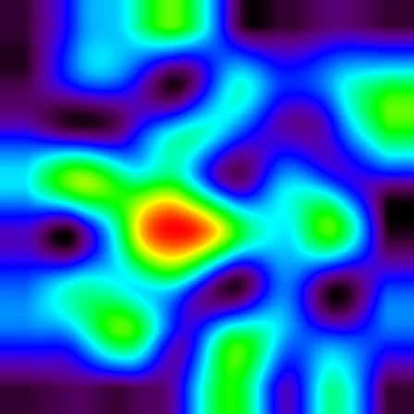
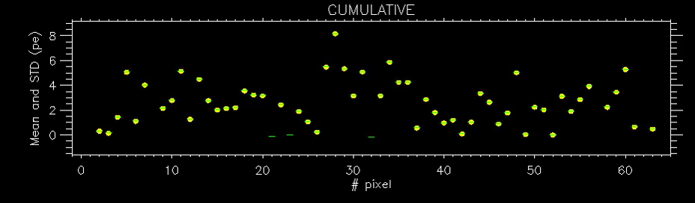
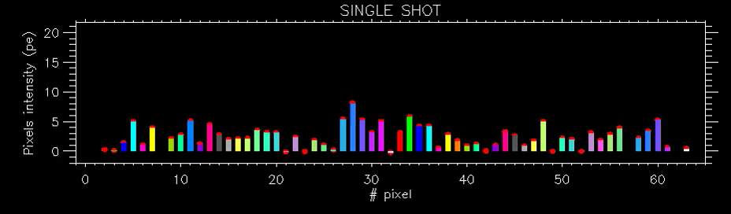
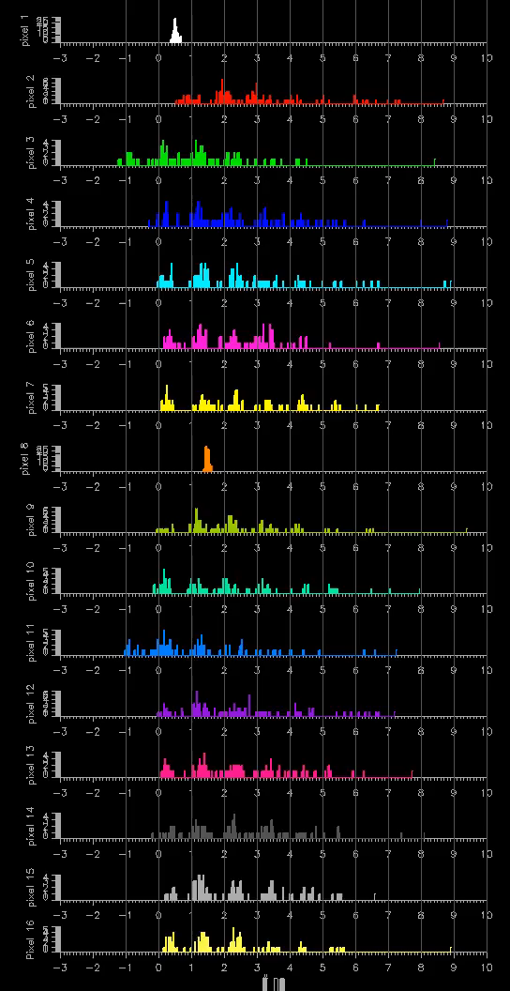
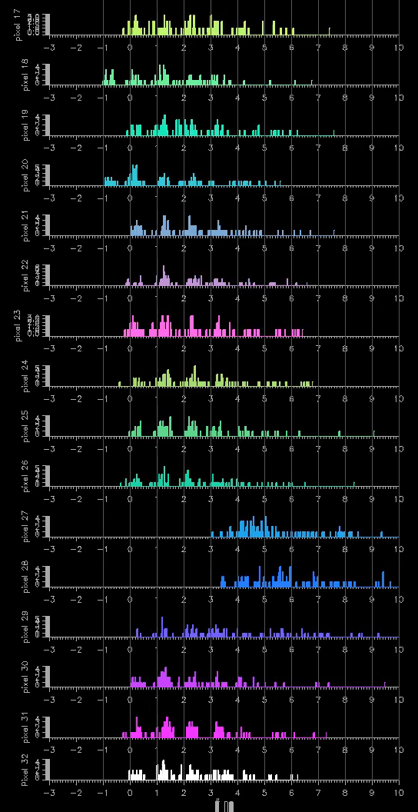
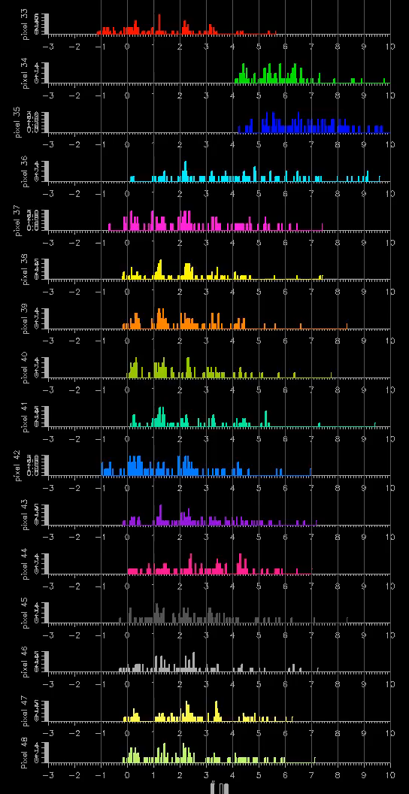
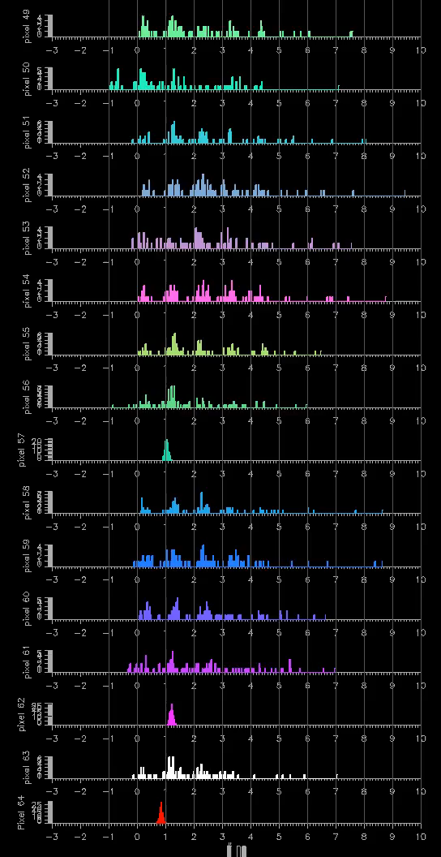
SiPM GAIN & FE GAIN
NOMINAL VALUES APPLIED
pe
pe
pe
pe
14

Slide 15
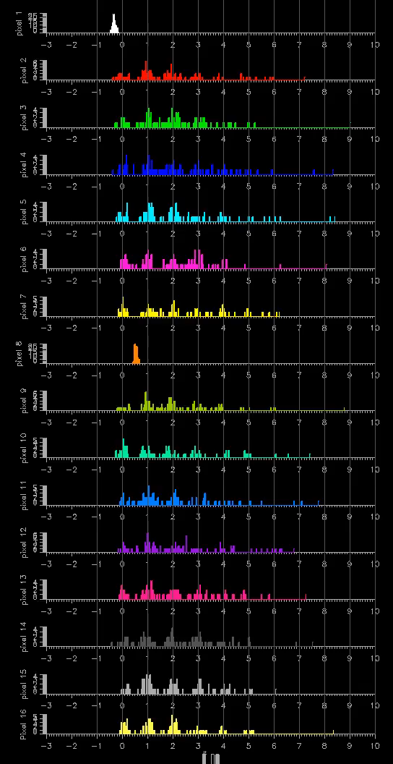
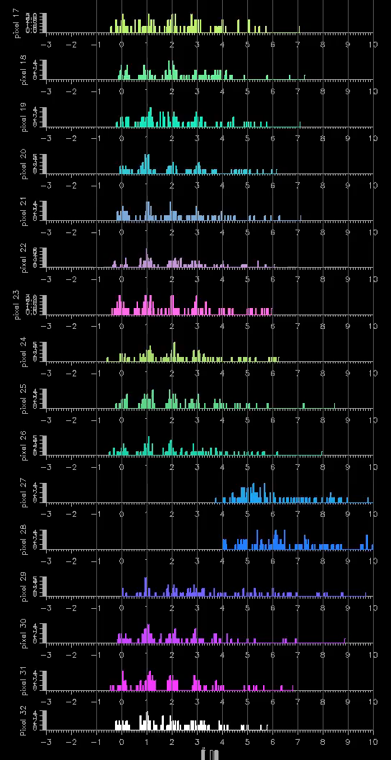
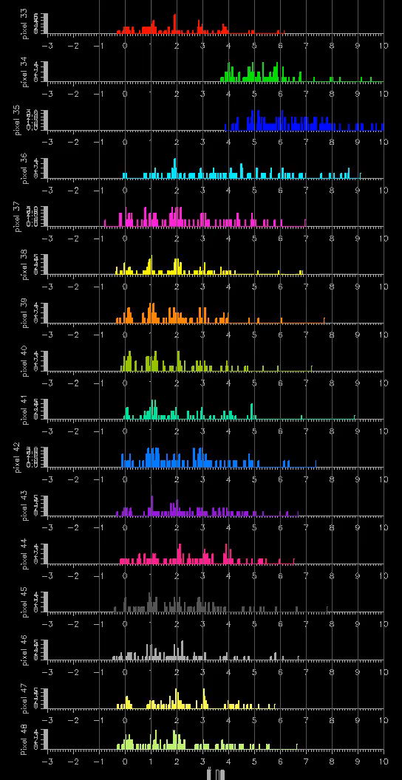
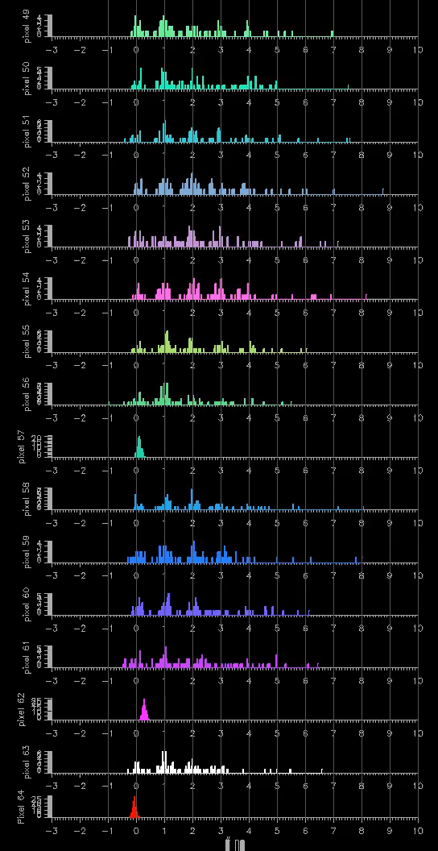
SiPM GAIN & FE GAIN
CALIBRATED VALUES APPLIED
pe
15
pe
pe
pe
pe
pe
pe
pe

Slide 16
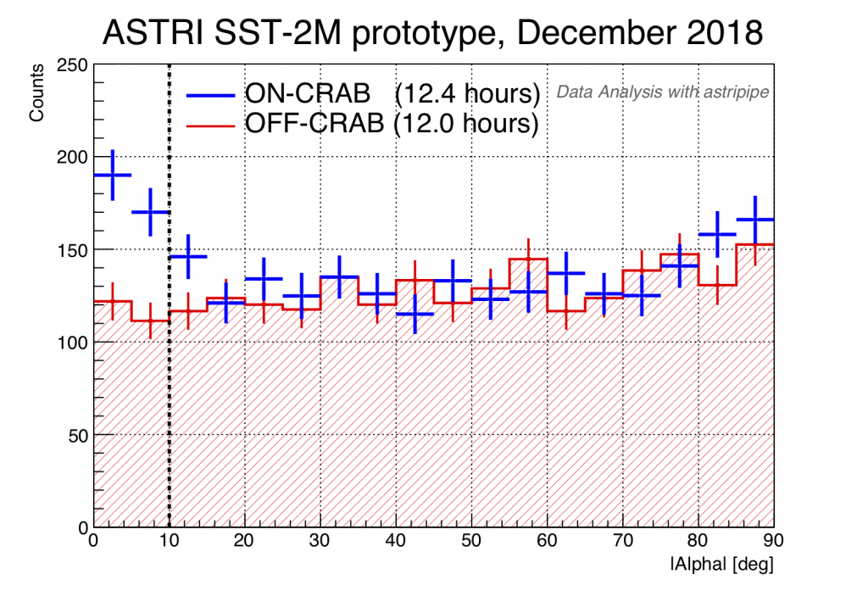
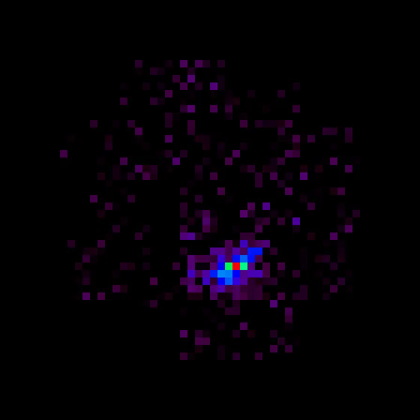

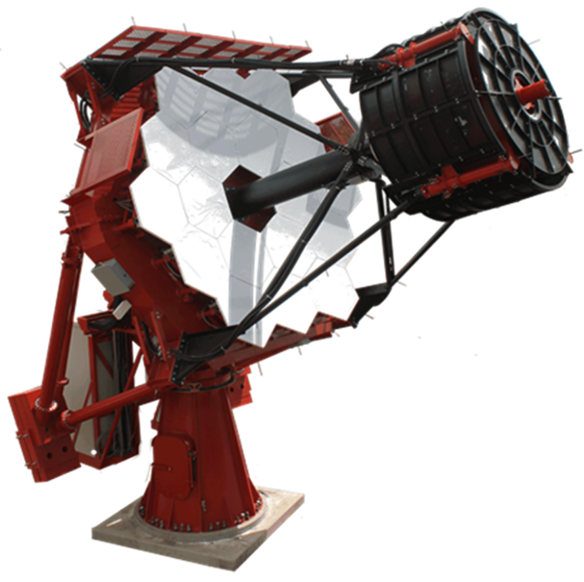
THE DETECTION : 21 PDMs
A few of data taken at Serra La Nave Observatory
Evaluated NSB ≈ 3 times higher than the dark sky light at the final CTA site
ASTRI TELESCOPE
Crab detection achieved on December 2018
16
G. Contino – INAF/IASF PALERMO – SiPM workshop: from fundamental research to industrial applications, Università di Bari 03-10-2019

Slide 17
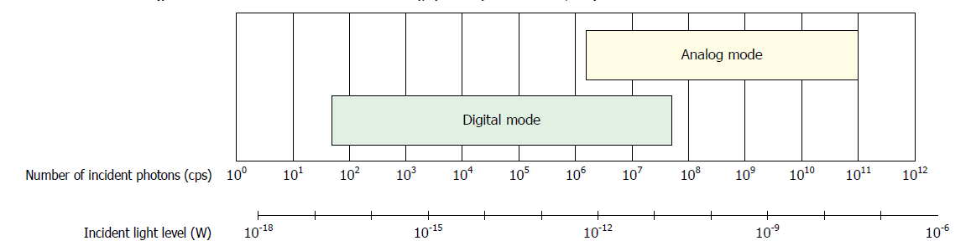
THE PROPOSAL
DETECTION OF VERY FAINT AND INTENSE UV-VIS LIGHT
(charge integration)
(Single photon counting)
17
G. Contino – INAF/IASF PALERMO – SiPM workshop: from fundamental research to industrial applications, Università di Bari 03-10-2019

Slide 18
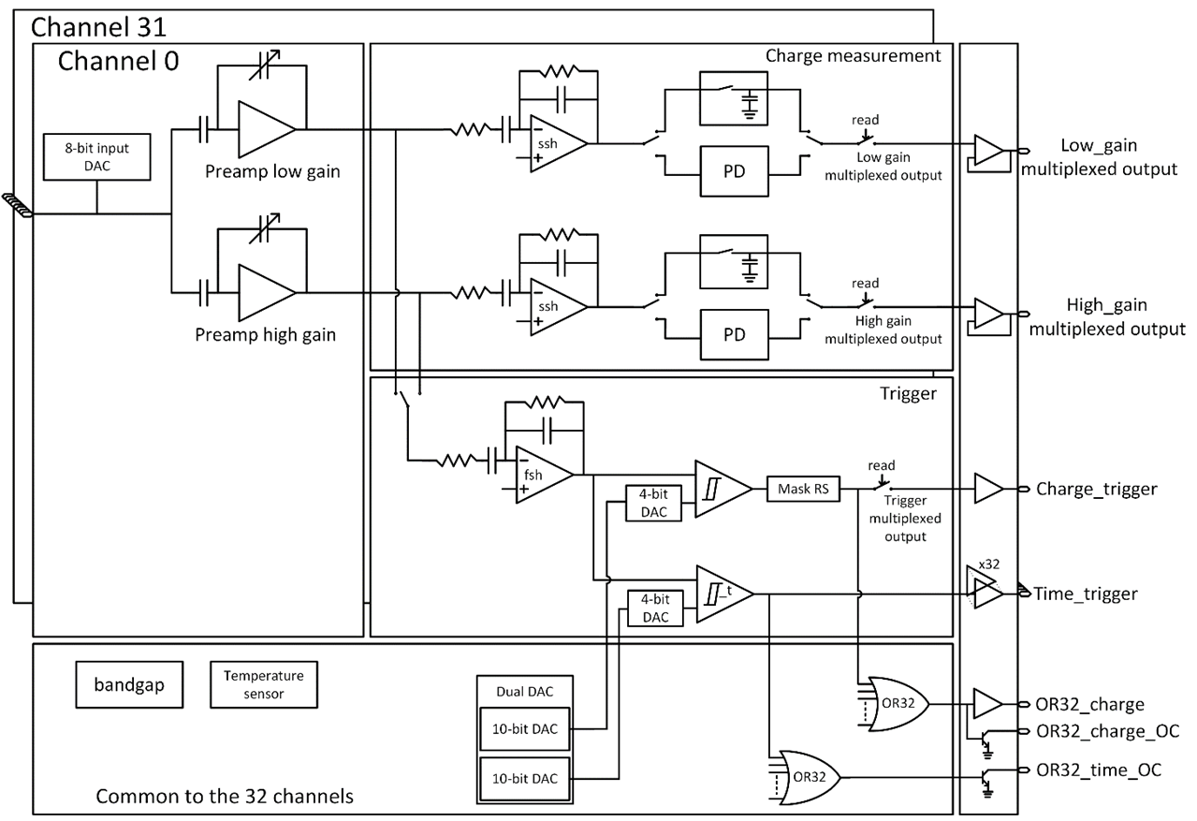

THE PROPOSAL : ASIC MODIFICATION
Redesign Preamp.
Add preamp. Trigger
Redesign trigger fast shaper (using pole zero cancellation)
Preamp trigger
18
G. Contino – INAF/IASF PALERMO – SiPM workshop: from fundamental research to industrial applications, Università di Bari 03-10-2019
Notes:
Redesign the preamplifiers: to let them work with a bigger window of photoelectrons detection
Pole zero cancellation circuit replaces the trigger fast shaper, so we have a trigger pulse at 3 ns (before we had about 18 ns).

Slide 19
THE PROPOSAL : MAIN SPECIFICATIONS
SiPM high-voltage adjustment (with DACs connected to the ASIC inputs)
Double pulse resolution of a few ns (< 10 ns) (is enough to avoid pulses pile-up)
Programmable pole-zero cancellation trigger shaper (to cope with long tail SiPM signals)
Analog pulse height measurement using fast peak detector
Wide energy dynamic range (energy measurement from 1 pe up to several thousand pe)
Analog triggers (summation of analog signals) and digital triggers implementation
Timing measurement better than 100 ps RMS
Masking of the digital triggers (switch off potential noisy pixels)
19
G. Contino – INAF/IASF PALERMO – SiPM workshop: from fundamental research to industrial applications, Università di Bari 03-10-2019

Slide 20
CONCLUSION
As in case of space missions, as well as for ground experiments, measurement of fluorescence and Cherenkov light as well as atmospheric phenomena require detection, with different time scale, of very faint and very intense light
Single-photon-counting as well as charge integration must coexist in the same FE for obtaining optimum performance
CITIROC1A chip lends itself to the changes we have suggested in short time
The suggested integration of SiPM, FE and FPGA in a MPDU (Monolithic Photo Detection Unit) reduce drastically power consumption and mass budgets, very important for any space mission and particularly for the proposed UHECR space missions as EUSO and POEMMA
The progress in SiPM manufacturing, front-end ASIC and system integration associated with System on Chip (SoC) design gives hope that this outcome can be achieved
We acknowledge financial contribution from the agreement ASI-INAF n.2017-14-H.0
These contribution is intended to design and realize a MPDU including the modification of existing ASIC front-end and Lab activities for tests, calibration and measurements
Involved institutes: IASF-Palermo/INAF, INFN Napoli, University of Roma Tor Vergata/INFN, University of Torino/OAT/INFN
20
G. Contino – INAF/IASF PALERMO – SiPM workshop: from fundamental research to industrial applications, Università di Bari 03-10-2019

Slide 21
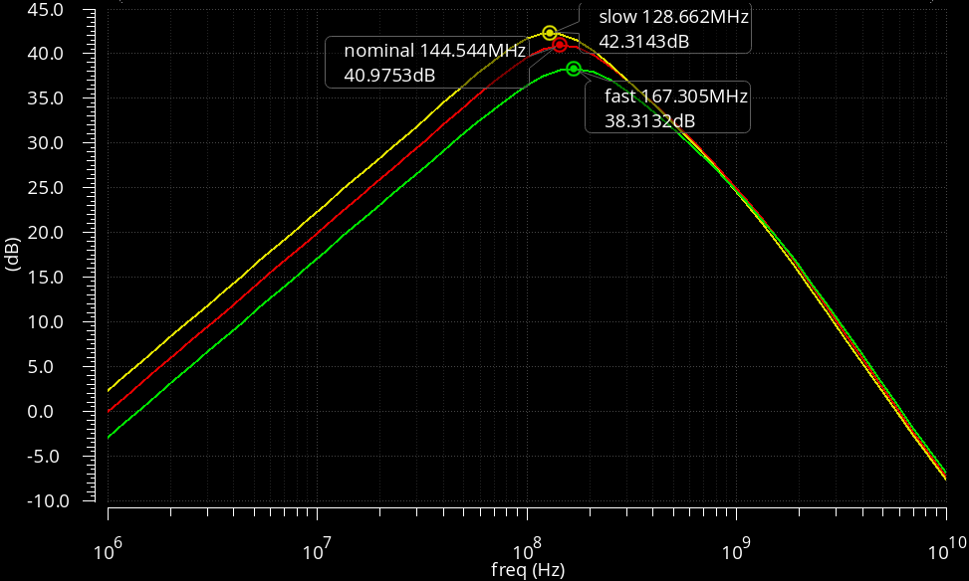
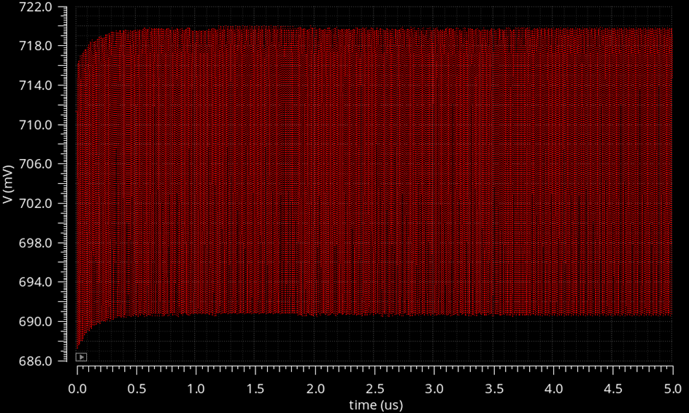
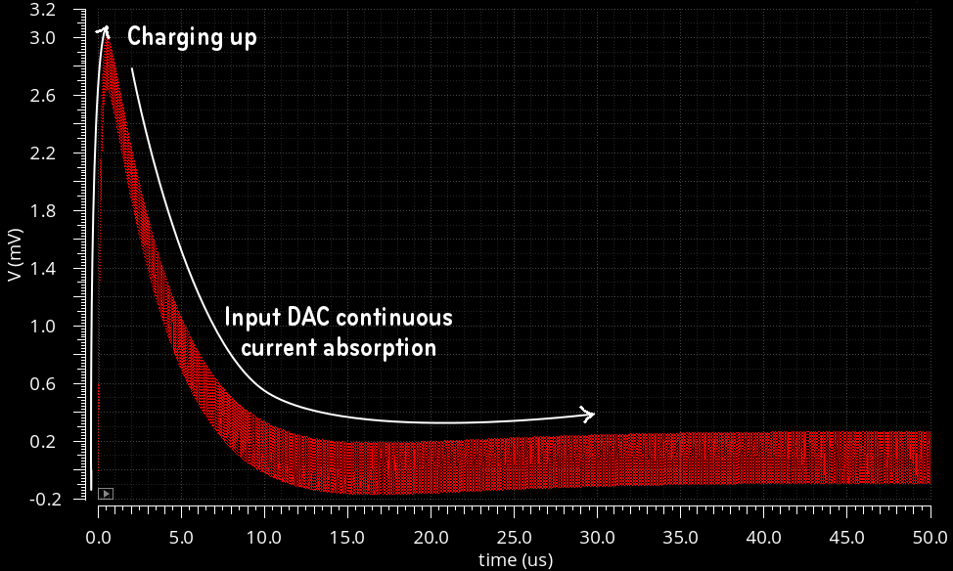
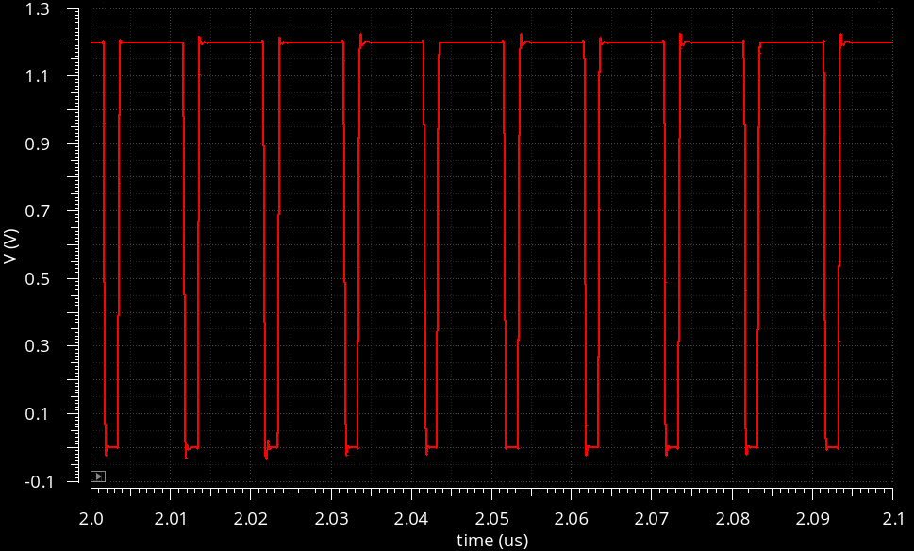
ASIC MODIFICATION - WORK IN PROGRESS
Trigger preamplifier Bode diagram for the 3 corner simulations.
Preamplifier output with a 100 MHz input signal.
Input signal by triggering a photoelectron every 10 ns (100 MHz signal).
10 ns discriminator output.
BY THE END OF THIS YEAR THE NEW ASIC WILL BE TESTED AT THE WEEROC LAB.
21
G. Contino – INAF/IASF PALERMO – SiPM workshop: from fundamental research to industrial applications, Università di Bari 03-10-2019
Notes:
These are tests done by Weeroc, which show the ASIC response sending signals every 10 ns: they obtain very good results.

Slide 22
Thank you for the attention
22
G. Contino – INAF/IASF PALERMO – SiPM workshop: from fundamental research to industrial applications, Università di Bari 03-10-2019

