Slide 1
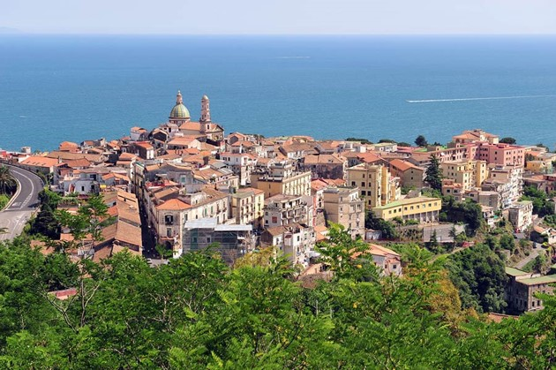
AMICI WP5 INDUSTRIALIZATION
WP5 Workshop
Salerno Jan 22nd 2019

Slide 2
The WP5 4 Tasks
T5.1 Professional training and apprenticeship
Task Leader: C. Madec
T5.2 Harmonization- Material and Component References
Task Leader: M.Fouaidy
T5.3 Harmonization - Cryogenic Safety Procedures
Task Leader: S.Grohman
T5.4 Requirements and conditions for developing prototypes with the industry
Task Leader: M.Michelato (F.Broggi)

Slide 3
The today Task presentations
1) Recall of the objectives of the Task 2) Expected results 3) Work already done 4) Work to be done until the end of AMICI, including possible reformulation of the objectives 5) Critical issues
6) Future perspectives

Slide 4
All reports related to milestones written and almost issued
24
24

Slide 5
All reports related to milestones written and almost issued
24
24

Slide 6
All reports related to deliverable to be done

Slide 7
A preliminary view of critical issues
Activities and objectives reported in the proposal and not done or achieved yet.
Identified major problems
From preliminary discussion:
WP5.1) Training in TI (almost OK) – Training in Industry – Work still to be done WP5.2) Structure of the material/component database not enough clear yet WP5.3) Modelling codes for dynamics of cryogenic incidents still missing?
WP5.4) Critical passage from Industry R&D contract to following step

