Slide 1
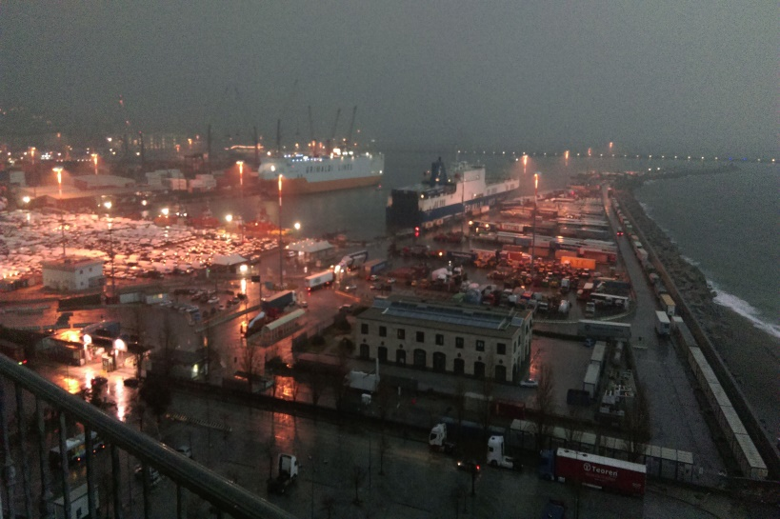
Work Package 3 „Cooperation“
Hans Weise et al.
AMICI Second Annual Meeting
Salerno, 1_2019

Slide 2
Reminder: AMICI WP3 Objectives
The overall goal of this Work Package is to
define the conditions of the coordination of Technology Infrastructures (TI) in the area of accelerators and superconducting magnets
in order
to harmonize their operation and
increase their efficiency,
to adapt to the development of present and future European Research Infrastructures and
establish a co-innovation platform with industry.
Eligibility criteria for the participation and networking of TIs will be investigated in detail, in order to
finally propose an appropriate coordination model.

Slide 3
Deliverables and Milestones
Deliverables
D3.1: Report defining the eligibility criteria for accessing to the core group of large TIs (M18).
D3.2: Report on the networking and coordination model (M30)
D3.3: Report about the proposed model of collaboration agreement (M30).
Milestones
M3.1: First version of the report on eligibility criteria (M9)
M3.2: First version of the report on Networking and Coordination Model (M12)
M3.3: Collection and analysis of existing bi- or multilateral agreements between AMICI members and with other partners (M18)

Slide 4
WP3.1: Definition of eligibility criteria (CEA, DESY, INFN, CNRS)
Task WP3.1, under the lead of CEA Saclay, investigated, identified and appropriately summarized the eligibility criteria for the envisaged network.
Conditions of eligibility for an accelerator or sc magnet European infrastructure to be eligible in the core group of large European Technological Infrastructures were defined.
The selection will be based on
technical spread, accessibility, innovation and
industrial opportunity criteria

Slide 5
WP3.1: Definition of eligibility criteria

Slide 6
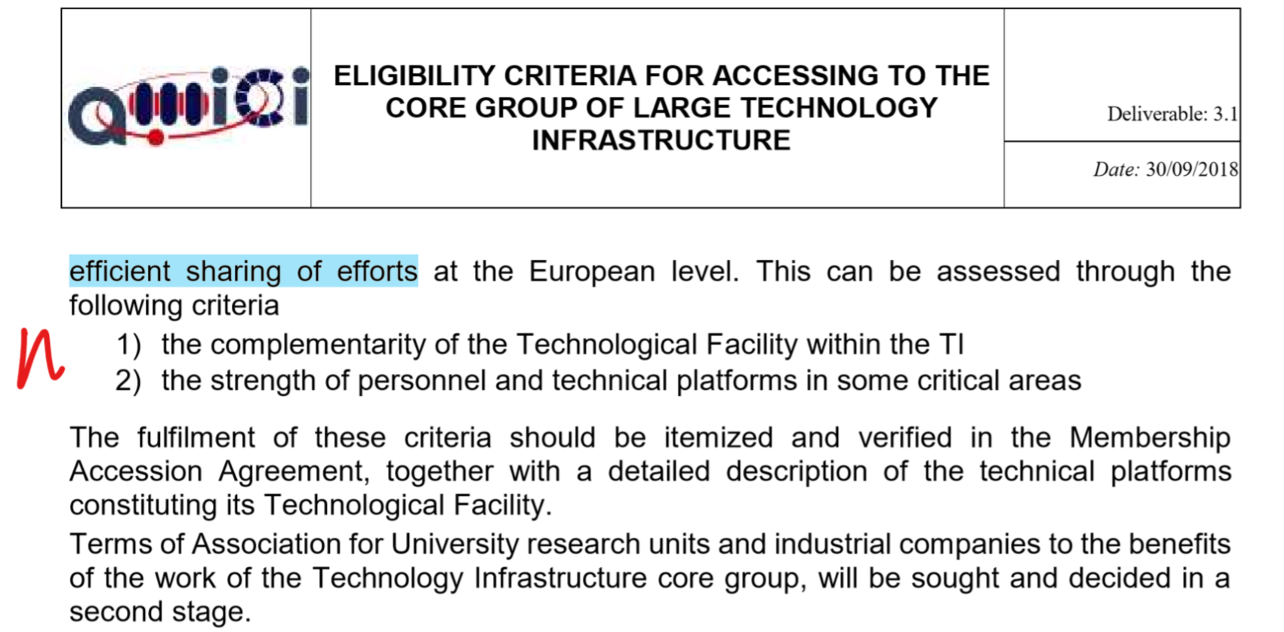
WP3.1: Definition of eligibility criteria

Slide 7
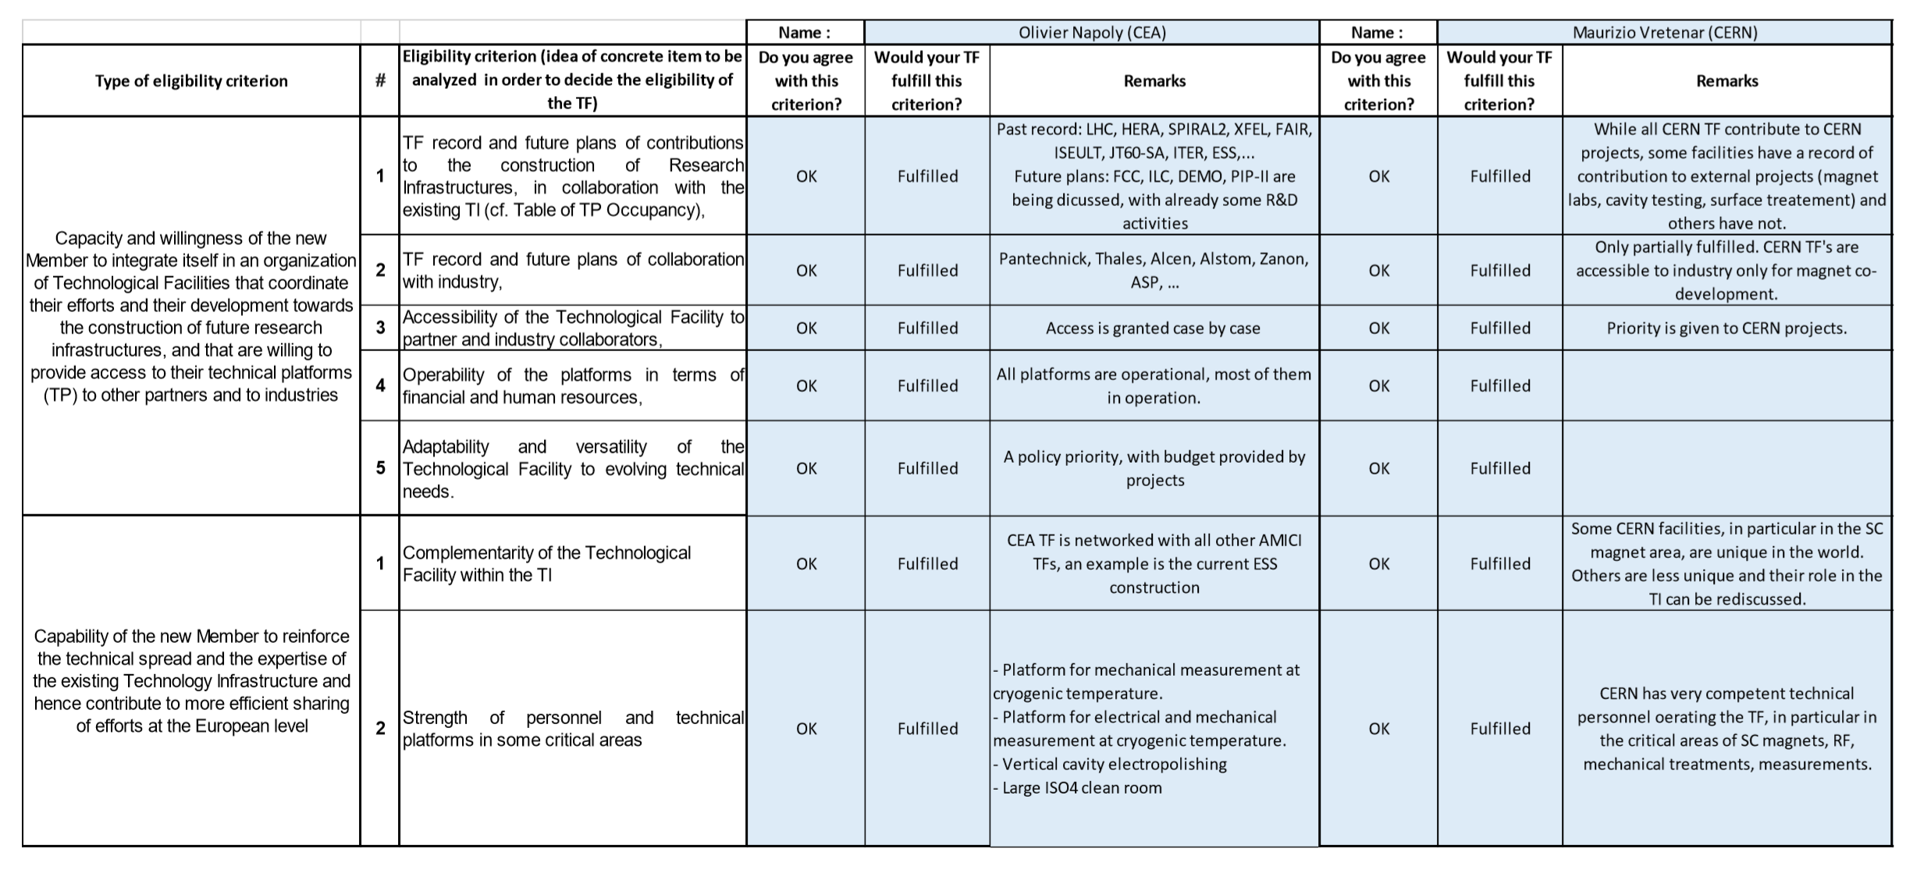
Eligibility Table filled by AMICI core members

Slide 9
WP3.2: Networking and coordination model (IFJ PAN, CEA, DESY)
Organizations have a networking relationship when they exchange information in order to help each individual organization do a better job. Already the least amount of commitment and time from organizations can in itself have significant and positive results.
Organizations have a coordinating relationship when they modify their activities so that together, they provide better services to their constituents. Coordination helps fill in the gaps and also helps prevent service duplication. A coordinating relationship requires more organizational involvement, time, and trust than a networking relationship.
All AMICI core group members are integrated in collaborative efforts, either project related or as a consequence of long-term R&D programs.
Thus a networking relationship exists but AMICI will promote a more systematic analysis of how to improve the actual situation.

Slide 10
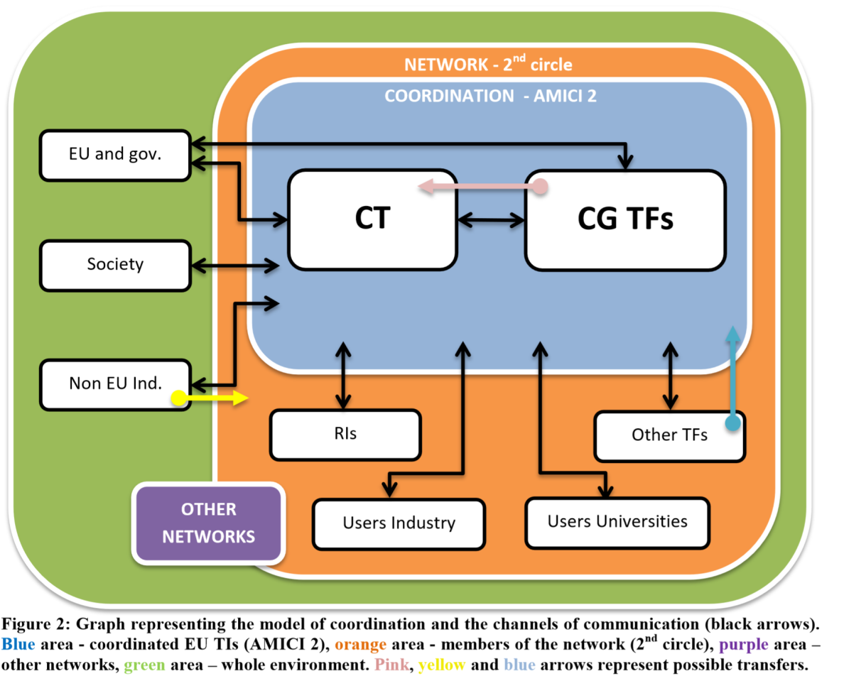
WP3.2: Networking and coordination model (IFJ PAN, CEA, DESY)

Slide 12
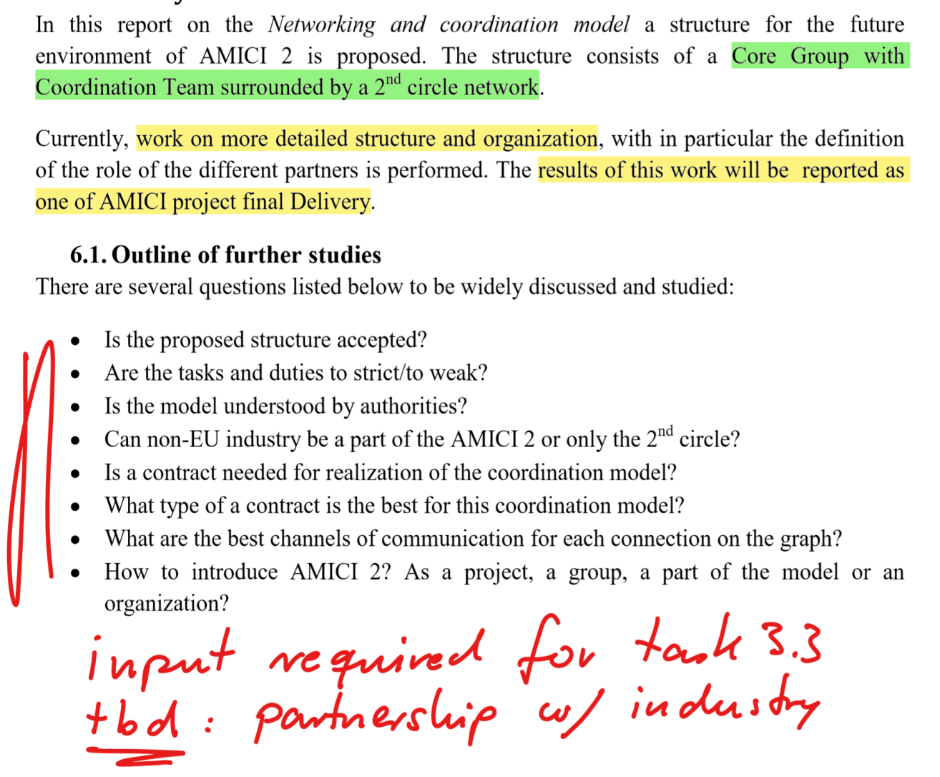

Slide 13
Present situation 1
To discuss on the forthcoming meeting:
Is the proposed structure accepted? [See 5.1 of MS12]
What changes should be made?
Focus on Industry – CT main line.
Are the tasks and duties too strict/too weak? [See 5.1, 5.1.1 and 5.1.2 of MS12]
Is the model understood by authorities?
How it could be made clearer?
Can non-EU industry be a part of the AMICI 2 or only the 2nd circle?
Rather only 2nd circle.
NETWORK - 2nd circle
COORDINATION - AMICI 2
EU and gov.
CT
CG TFs
Society
Non EU Ind.
RIs
Other TFs
OTHER NETWORKS
Users Industry
Users Universities
Figure 2: Graph representing the model of coordination and the channels of communication (black arrows). Blue area - coordinated EU TIs (AMICI 2), orange area - members of the network (2nd circle), purple area – other networks, green area – whole environment. Pink, yellow and blue arrows represent possible transfers.

Slide 15
WP3.3: Reminder - Scope of Task 3 (IFJ PAN, CEA, DESY)
Task 3 : Collaboration Agreement
Variety of agreements / contracts exist
Harmonize “agreements” among research labs with TIs, and industry
Milestones / Deliverable in Task 3:
June 2018: Collection and analysis of existing bi- or multilateral agreements between AMICI members and with other partners
July 2019: Report about the proposed model of collaboration agreement

Slide 16
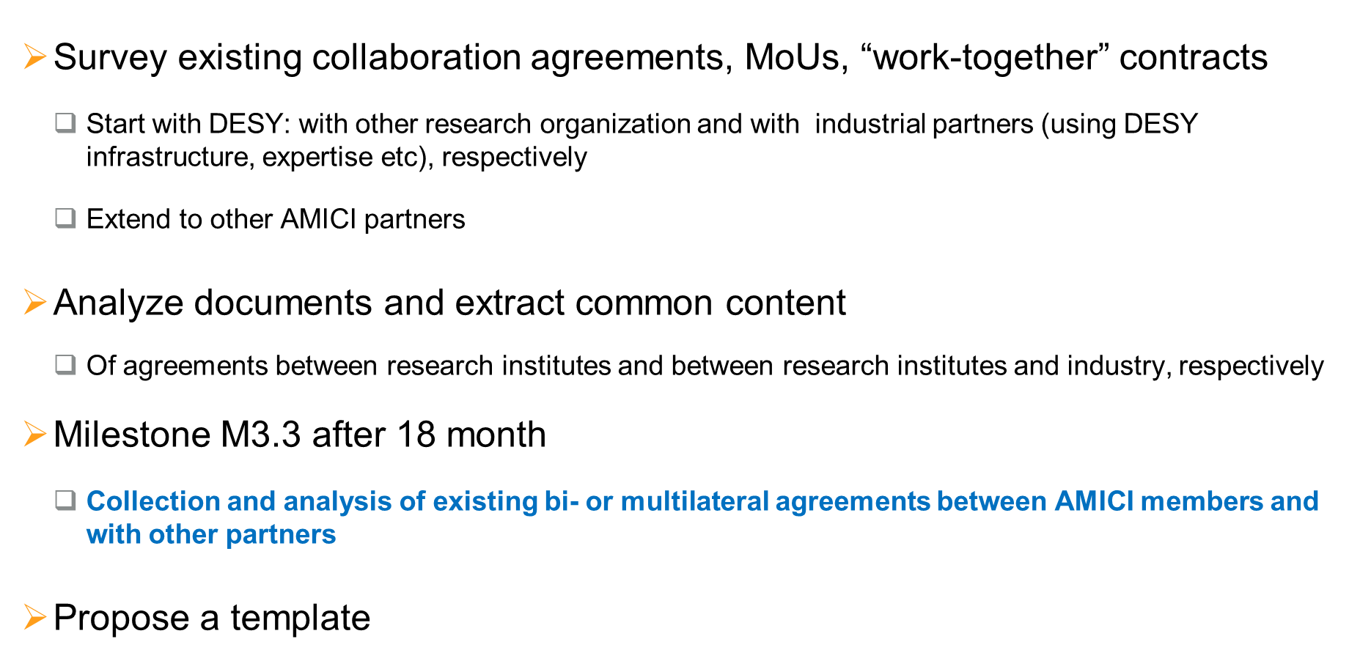
WP3.3 Work Plan and Status
✓
✓
✓
✓

Slide 17
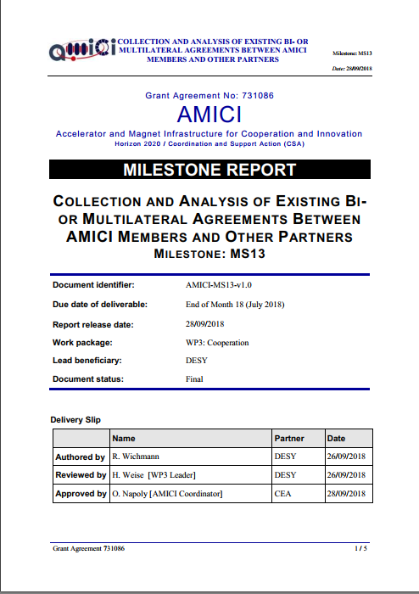
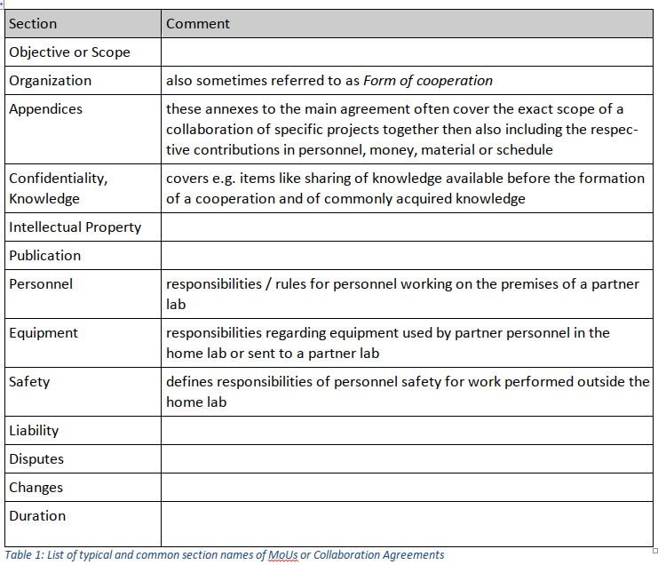
WP3.3 Status
Contracts studied: MoUs, non-commercial and commercial usage of technical / research platforms
Additional topics addressed for non-commercial users: admission to facility, conduction of experiment, access requirements
Including commercial users: Compensation / Payment

Slide 18
WP3.3 Status
Conclusion
Various contract formats of several institutions were studied over the last period of the AMICI project. All analyzed agreements cover essentially the same basis of topics with comparable content. In case of a commercial aspect, additional sections regarding the compensation scheme have to be added, which might be / probably is very specific to the service and the service provider.
From the result of this study so far, it seems reasonable to create a common template for collaboration / work-together agreements which could be used within the core group of AMICI and between core group members and associated partners. The collaboration contract should include a section on the governance of a (future) AMICI collaboration, which still has to be developed.
A proposal for such a contract / template will be developed with the DESY legal department and the department of innovation and technology transfer, and will be distributed for further iterations to AMICI members within WP3.

Slide 19
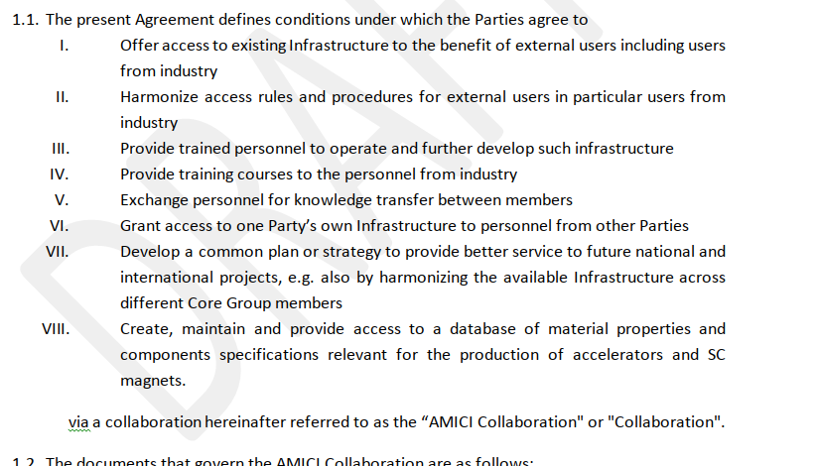
WP3.3 (Future) AMICI Collaboration Agreement
Towards deliverable D3.3 Report about the proposed model of collaboration agreement
Draft available on the AMICI Intranet:
https://espace.cern.ch/amici/wp3 → Documents → WP3.3 → Draft AMICI Collab Agreement

Slide 20
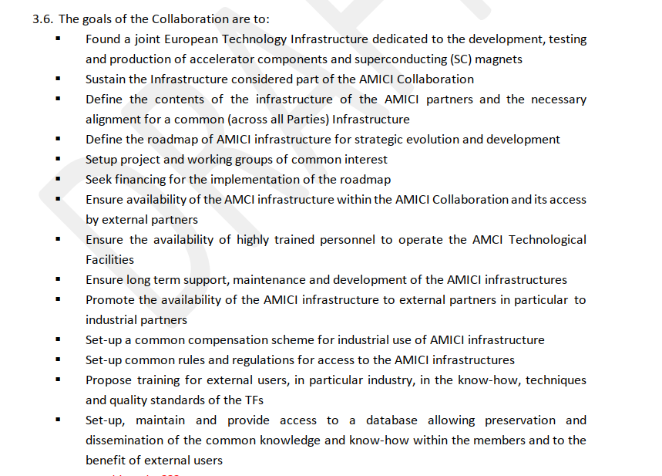
WP3.3 (Future) AMICI Collaboration Agreement
Towards deliverable D3.3 Report about the proposed model of collaboration agreement

Slide 21
WP3.3 (Future) AMICI Collaboration Agreement
Towards deliverable D3.3 Report about the proposed model of collaboration agreement

Slide 22
WP3.3 (Future) AMICI Collaboration Agreement
Towards deliverable D3.3 Report about the proposed model of collaboration agreement

Slide 23
WP3.3 (Future) AMICI Collaboration Agreement
Input from industry partners needed on possible mode of interaction:
Association of private companies foreseen via an „associated industry partnership“
Informal group of associated industry partners elects a representative (1 person) for the AMICI Collaboration Board
To receive information about developments with TFs
To influence future developments of TFs
Is that a conceivable model to industry?
Alternative:
Individual contracts per company with AMICI
Each associated industry partner representative joins the Advisory Group
Chair of the Advisory Group is the industrial representative for the Collaboration Board
To receive information about developments with TFs
To influence future developments of TFs
Towards deliverable D3.3 Report about the proposed model of collaboration agreement

Slide 24
WP3.3 (Future) AMICI Collaboration Agreement
Towards deliverable D3.3 Report about the proposed model of collaboration agreement
Other topics covered in the draft:
Article 5: Financial Provisions
Article 6: Confidentiality
Article 7: Licensing, Property Rights and Publication
Maybe input from WP4.3: Identify existing good practises, and barriers to effective engagement, between Industry and the Technological Infrastructures (INFN, IFJ PAN, PSI)
Article 8: Liability and Insurance
Article 9: General Provisions
Article 10: Withdrawal, Breach and Termination

Slide 25
WP3.3 (Future) AMICI Collaboration Agreement, Annex 2
Towards deliverable D3.3 Report about the proposed model of collaboration agreement
Draft exists as well
Annex 2 covers Governance:
Collaboration Board Meetings
Collaboration Board Chair
Coordinator
Voting Mechanism
Collaboration Meeting

Slide 26
Summary
We expect finishing work in time.
At some point we will deliver the
draft agreement to the Steering Group
and recommend discussion with the lab management.
With the end of AMICI we should be well prepared
for AMICI 2.

