Slide 1
AMICI Advisory Group meeting January 24, 2019 Salerno
Andrew Hutton
Arifé Yildirim

Slide 2
Question 1 :
Can we and should we extend the Spanish ‘Ineustar’ model to European Science Industry?
NO

Slide 3
Questions from WP3
Input from industry partners needed on possible mode of interaction:
Association of private companies foreseen via an “associated industry partnership“
Informal group of associated industry partners elects a representative (1 person) for the AMICI Collaboration Board
To receive information about developments with TFs
To influence future developments of TFs
Is that a conceivable model to industry?
NO

Slide 4
Preferred Organization of the Advisory Group
The Advisory Group recommends that each company participates directly in AMICI, not as part of a consortium
Question:What advantage does a company have as a member of AMICI?
The Advisory Group recommends maintaining the status defined two years ago:
An Advisory Group (AG) will be appointed and steered by the Steering Committee. The AG shall give advice and recommendations on strategic matters to the Steering Committee and report them to the General Assembly.
The chair of the AG will be designated by the Steering Committee and shall be allowed to participate in General Assembly meetings upon invitation but has not any voting rights.
The Advisory Group should be limited to individuals from industry

Slide 5
Questions from WP3

Slide 6
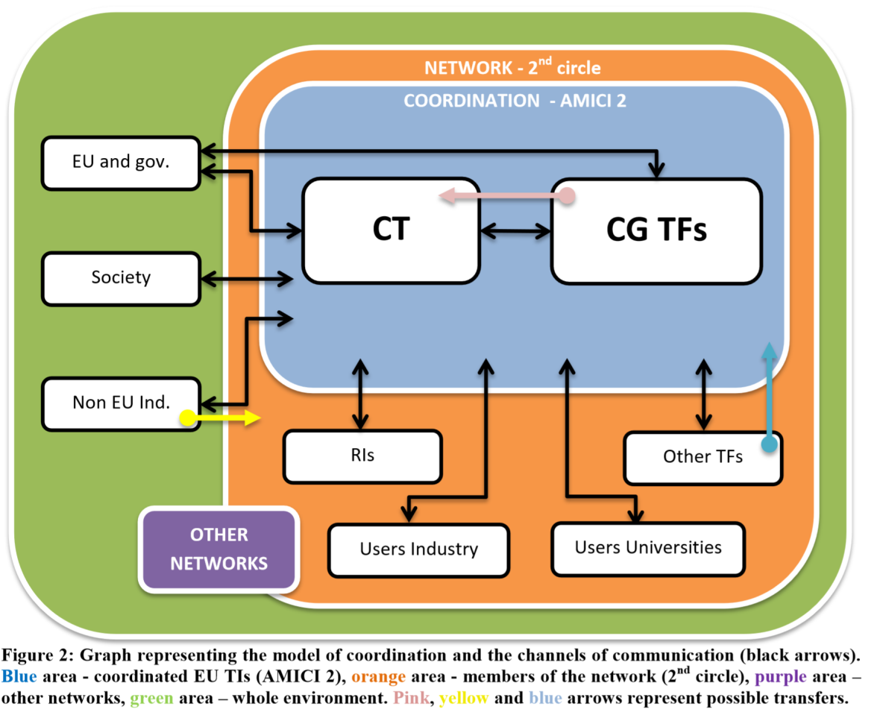
Networking and Coordination Model
The Advisory Group accepts this vision – would like to see more detail e.g. who is in the Coordination Team

Slide 7
WP2: Strategy
Key Technology Areas identified in the WP2 :
Particle sources
‘High precision’ magnets
High field SC magnets
Normal Conducting RF cavities
SRF structures
Radio Frequency power sources
Cryogenics
Beam instrumentation
Question 2:
Are the 8 Key Technology Areas well identified, and does the European Science Industry need to reinforce its strength on a few of them?
Walid to expand SRF, and add modulators to RF Power sources

Slide 8
System Integration
There is no mention of system integration
The Advisory Group recommends developing a statement as to how systems can be included in AMICI goals similar to the list of Key Technologies Areas
The Advisory Group will submit a recommendation when to “build-to-print,’ when to build to performance and when industry should participate in design
We will also make a recommendation regarding prototyping and series production relating to IP rights

Slide 9
WP3: Coordination
Progress:
We formulated the eligibility criteria to access the core group of the Technology Infrastructure (D3.1) and drafted an Collaboration Agreement model for its core group members, supporting a set of ambitious goals.
Focus:
Finalize the Collaboration Agreement model and obtain the recommendations from the AMICI Institute directorates.
Formulate terms of University and Industry partnerships with the core group.

Slide 10
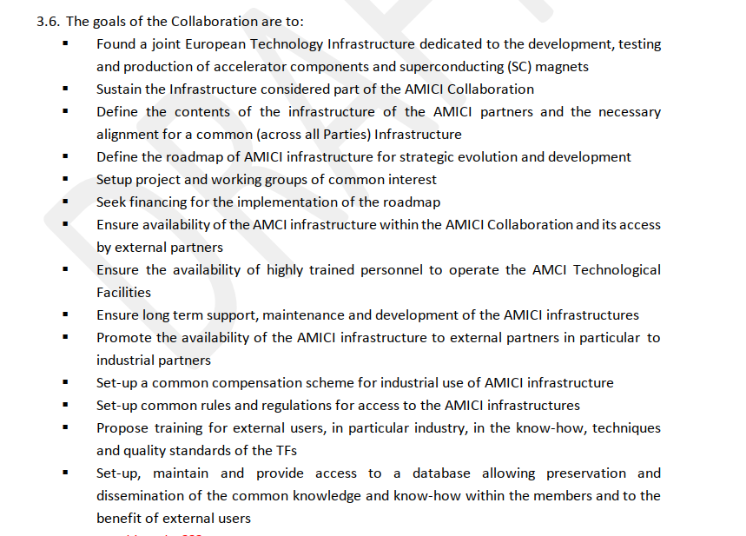
WP3: Coordination

Slide 11
Question 3:
Are these goals attractive enough to stimulate the participation of European Science Industry, and how should partnership and liaising be organized?

Slide 12
WP5: Industrialization
The Industrialization-related activities aim at keeping European Science Industry at the forefront of the international competition, in terms of technology, quality and costs, in view of the construction of future scientific research instruments in Europe and elsewhere.
Question 4 :
Is there some other crucial aspect of Industrialization of Research Infrastructures which is not scrutinized by WP5?

Slide 13
Goal of the 2nd Annual Meeting
This is the last Meeting before the end of the AMICI project.
Our overarching goal should be to gain the support of the EC and Agencies to our findings and proposals.
For that, we have to:
Demonstrate the central and irreplaceable role of the Technology Infrastructure for the European Research Infrastructures, and
Demonstrate its benefit to European Science Industry.
Question 5 (optional):
Do you have any suggestion how to reinforce these ‘demonstrations’ ?

Slide 14
Examples
Demonstrate the central and irreplaceable role of the Technology Infrastructure for the European Research Infrastructures
RIs should provide examples
Demonstrate its benefit to European Science Industry
Industry should provide examples

Slide 15
WP1.2: Organization of the participation of industry
A European Forum on accelerators and magnets TI gathering scientists, engineers and industry that will be organized in Brussels on Month 24 to present the work done in the different WPs and discuss the long-term strategy for TIs
Question 6 (optional):
Do you have any suggestion about the content and the format of this forum ?
2nd Annual Meeting
18

