Slide 1
AMICI Second Annual Meeting Work Package 2:
Walid KAABI- LAL/IN2P3/CNRS
Salerno, January 23rd 2019

Slide 2
Goals of Strategy Working Group:
Provide the European industries with a clear view of the strategic science and technology roadmaps for the future accelerator and SC magnet based Research Infrastructures worldwide.
Identify the Key Technology Areas (KTAs) that need special support and important technical development to meet the future projects challenging requirements.
Identify the European Technological Infrastructures (TIs) where technical development on KTAs could be performed, identify the needs on new TIs → Set up a TI roadmap.
Identify the elements necessary for a successful implementation of a sustainable cluster of TIs in partnership with industry.

Slide 3
Organization of WP2:
The WP2 will be subdivided in 3 sub-tasks:
WP2.1: Key Technological Area (CNRS, IFJ PAN, CEA, STFC)
WP2.2: Global Landscape (CEA, CERN, INFN, CNRS)
WP2.3: Accelerator and SC Magnet Technology Infrastructures Sustainability (UU, DESY, CEA, CNRS, CERN)
WP2: Strategy W. Kaabi
WP2.1: Key Technological Area | WP2.2: Global Landscape | WP2.3: Technology Infrastructures Sustainability
W. Kaabi - CNRS | O. Napoly - CEA | T. Ekelöf – Uppsala Univ.

Slide 4
WP2 Milestones and deliverables:
Milestones:
M2.1: Updating of the Key Technological Areas (M9).
M2.2: Collection of the scientific Roadmaps (M12).
M2.3: Intermediate report on sustainability (M18).
Deliverables:
D2.1: Report on Key Technological Areas (KTA) and prospective outlook (M24→ M27).
D2.2: Report on the Technological Roadmaps for the different KTA (M27→ M29).
D2.3: Report on propositions to guarantee the long term sustainability of TIs (M30).

Slide 5
How to proceed?
Collect and analyse the scientific roadmaps and the agendas of the research infrastructures in Europe and worldwide (WP 2.2),
Regarding the future project needs and the technical development effort made by accelerator and SC magnet communities, identify the KTAs in which the most performances progress are expected (WP 2.1),
Collect and analyse information about the available European TIs (funding, manpower, link to an RI, link to local facility, operation and sustainability model…), via AMICI partners census (WP 2.3).
→ The cross-reference of these analysis will allow to define the technological roadmap for the different identified KTAs, showing thereby the opportunities and needs that could orient and sustain the activity of the TI.
5

Slide 6
Global Landscape of Future Accelerator Project:
HE LHC, FCC-ee, FCC-hh, LHeC, CLIC
PIP II
UK XFEL, Diamond II
CEPC, SPPC
ISOL@MYRRHA
SSRS4
MYRRHA
DONES
BELA
DEMO Eu*
RAON
ISIS-2
DEMO K*
SONATE
HIAF
JPARC upgrade
LCLS-II HE
eRHIC
EuSPARC, Elettra 2.0
CADS & DEMO C*
ILC
JLEIC
LNS Cyclotron upgrade
Turkish XFEL
HEPS,
Shanghai XFEL
DTT
ISNS
High Energy Physics
Light Sources
Nuclear Physics
Australien Synchrotron
Neutron Sources
Energy

Slide 7
Future Accelerator Project Timelines:
CEPC (China)
LHeC (CERN)
HE-LHC (CERN)
ILC (JP)
FCC-ee (CERN)
FCC-hh (CERN)
PIP II (US)
CLIC (CERN)
SPPC (China)
EuSPARC & Elettra 2.0 (Italy)
SSRS4 (Russia)
Shanghai XFEL (China)
UK-XFEL & Diamond II (UK)
LCLSII-HE (US)
High Energy Physics
ISOL@MYRRHA (Belgium)
Light Sources
HIAF (China)
eRHIC (USA)
Nuclear Physics
LNS upgrade (Italy)
JLEIC (USA)
Neutron Sources
Energy
BELA I (Russia)
BELA II
BELA SC
ISIS 2 (UK)
DONES (Europe)
DEMO Eu (Europe), DEMO C (china) & DEMO K (Korea)
MYRRHA (Belgium)
2018
2020
2025
2030
2035
2040
2045

Slide 8
Global Landscape of Future Medical Accelerator (Proton-therapy):
1 Synchrotron (Russia)
1 Cyclotron (Belgium)
1 Cyclotron (Netherland)
1 C-Ion Synchrotron (Sth Korea)
1 Cycl + 1 Syn (Spain)
1 Cycl, 2 Syn & 1 SC Syn (USA)
1 Cycl + 1 SC Syn (Switzerland)
1 Cyclotron (India)
1 SC Cycl, 1 Cyclo & 2 Synch (China)
1 Cyclotron (Egypte)
1 SC Cyclotron (Singapore)
1 Synchrotron (Australia)
1 Cyclotron (Argentina)
Medical application
Machines to be build on 2018-2020

Slide 9
Future accelerator projects & main technical areas :
Leptons Accelerators
Hadrons Accelerators
Particle source
Cavity shape
Pulsed machines
CW machines
RF source efficiency
Cryoplant efficiency
Normal conducting technology
Cavity materials & performances
Superconducting technology
High precision Magnet
SC Magnet
Linear accelerators
Circular Accelerators
Beam diagnostics
Small machines
Large machines
Wide range of beam parameters

Slide 10
Cutting-edge technology of high interest for accelerator or SC magnet communities
Critically dependent on single/very few vendor(s)
Widely needed for the future projects
KTAs choice criteria
High technical development potential to reduce construction & operation costs
High technical development potential to meet future machine requirements

Slide 11
List of identified Key Technology Areas:
Particle sources (ions sources ECR, EBIS, …)
High precision magnets (permanent & NC iron magnets for 4th generation synchrotron, FFAG, ion separators…)
High field SC magnets (Nb3Sn material and conductor development, HFM technologies)
Normal Conducting RF cavities (RFQ & pill-box structures, very high surface fields, manufacturability, conditioning…)
SRF structures (high Q₀, high gradient, HTC materials, fabrication methods, SRF guns)
RF power sources (high efficiency Klystrons, continuous wave RF sources, solid state amplifiers)
Cryogenics (high efficiency cryo-plants, cryogenic distribution, cryostat insulation, cryo-coolers)
Beam instrumentation (non-invasive and RF diagnostics, beam control systems)

Slide 12
WP2.1: Guidelines for Key Technology Areas report preparation:
For each KTA, we have to go through the following items:
Justification of the choice of the KTA according to the criteria (one or many).
State of the art in each KTA.
Targeted performances beyond state of the art regarding future project needs.
Technical development paths to improve the performances (or reduce cost) and meet future project needs.
Deliverable D2.1: Report on Key Technological Areas (KTA) and prospective outlook
(M24→ M27)

Slide 13
Example 1: High Efficiency Klystrons
Justification of the choice of the KTA according to the criteria:
RF demands of proposed large scale particle accelerators (FCC-ee, ILC, CLIC, CEPC): In the of 10-100 MW range (For comparison LHC has a total RF drive of 5 MW).
With the current RF source efficiency, significant amount of energy is effectively wasted as heat
➔ Improving the efficiency is therefore of critical importance to reducing the overall costs (construction and operation) and improving the carbon footprint of the installation.

Slide 14
Example 1: High Efficiency Klystrons
State of the art klystrons:
Few devices deliver efficiencies over 65% (Exp: LHC uses 300 kW, 400 MHz, 65% efficiency klystrons).
Multiple-beam klystrons (MBK’s)- theoretical efficiency of 80%.
Targeted performances beyond state of the art regarding future project needs:
Focus on high efficiency, rather than high power: 80 to 90% efficiency targeted.
Reliable, robust vacuum tubes.
Operation ~0.4-12 GHz.
Technical development paths to improve the performances (or reduce cost) and meet future project needs:
Novel electron bunching mechanisms: The Core Oscillation Method (COM), Bench Alignment collection (BAC)
Improve power conversion efficiency at the output cavity: Congregated Bunch
Improve resonant cavity production process to reduce global cost.

Slide 15
Example 2: High field SC magnets
Justification of the choice of the KTA according to the criteria:
Increasing the field of SC magnets is a must to achieve the future machine requirements (16T for FCC). This need an important development effort in the upcoming years.
Large scale accelerator and SC magnet based projects result in dramatic demands, occasional and time-bound of Low Temperature Superconducting (LTS) material, which need to be accommodated:
LHC required 1300 tons of Nb-Ti (300 t/year peak production)
ITER requires 300 tons of Nb-Ti and 685 tons of Nb₃Sn (150 t/year peak production)
FCC will require 7000-9000 tons of Nb3Sn
Knowing that the production is of 600 t/year for Nb-Ti and 10 t/year for Nb₃Sn: 10 t/year.
➔ Absolute need to investigate new ways to push the performance limits.

Slide 16
Example 2: High field SC magnets
State of the art:

Slide 17
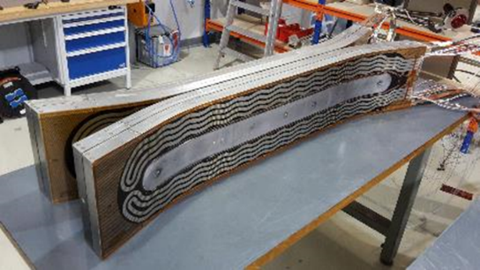
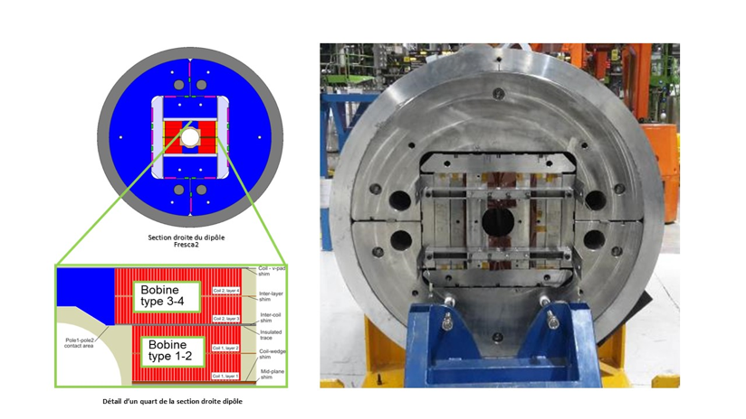
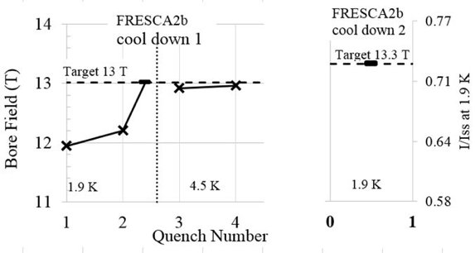
Example 2: High field SC magnets
State of the art- Accelerator type magnet:
FRESCA 2 Nb3Sn dipole – 100mm aperture – field homogeneity % - length 540mm
Coils fabrication @ CEA, cold mass integration @ CERN
Testing @ CERN (12.1 T achieved in August 2017➔ 14.6 T in 2018 after mechanical structure modification)

Slide 18
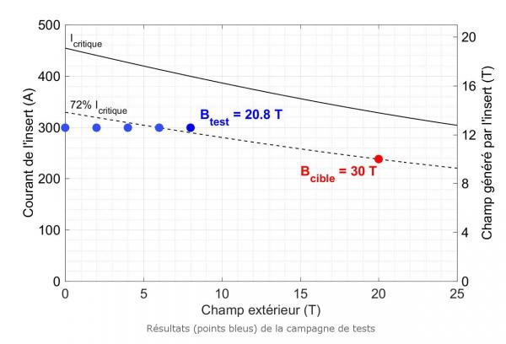
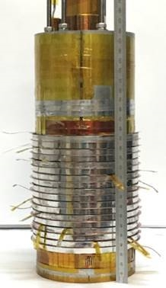
Example 2: High field SC magnets
State of the art: HTS high field magnet example
Insert made of 9 double pancake (ReBCO) (inner diameter of 50 mm) using an innovative MI insulation (Metal-as-Insulation)
20.8 T obtained for 45 minutes (12.8T created by the HTS insert with a background field of 8T @ LCNMI Grenoble)
Next step: > 30 T (> 10 T obtained from the insert in a 20 T background field).

Slide 19
Example 2: High field SC magnets
Targeted performances beyond state of the art regarding future project needs:
Increase the magnetic field in large volumes using new innovative superconductors in order to build bigger and stronger magnets
Technical development paths to improve the performances (or reduce cost) and meet future project needs:
Development and use of ultimate performance Nb3Sn conductors is the most mature option for magnets on future accelerators (i.e. FCC) and high field magnets;
Development and use of HTS conductors still need high tech R&D (from material science to electromagnetic/electromechanical engineering) to be implemented in high field magnets at affordable costs
Increase the operating temperature and simplify the cryogenics
Reinforce conductor mechanical strength and protect the coils against quenches.

Slide 20
WP2.2: Guidelines for KTAs technical roadmap report preparation:
Once all the KTAs defined, we have to go through the following items for each one:
KTA development plan.
Where KTA technical development/testing is (or could be) made in the AMICI technological Infrastructures (TIs) or European companies.
From these inputs, describe KTAs technological roadmap and the (in)adequacy of the existing European Technology Infrastructure.
Deliverable D2.2: Report on the Technological Roadmaps for the different KTA (M27→ M29).

Slide 21
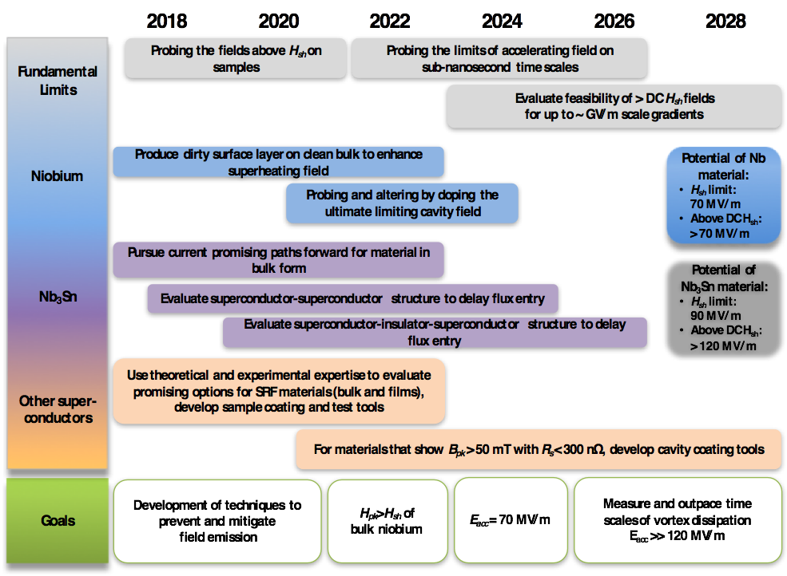
Example of KTAs roadmaps: SRF cavities
Courtesy to E. Jensen

Slide 22
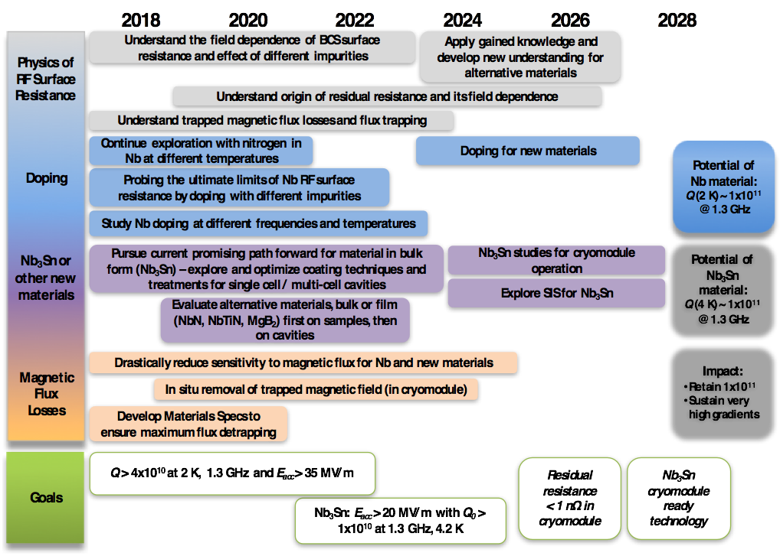
Example of KTAs roadmaps: SRF cavities

Slide 23
WP2.3: Technological Infrastructures Sustainability
Intermediate report on sustainability of the AMICI Technological Facilities (TFs) was delivered.
Census on the FTE allocated to the TFs and their funding (governmental, public or other) was addressed to the AMICI partners.
Currently, a new questionnaire is in preparation, focused on typical case: the contribution of Technical Plateforms (TPs) to the ESS project, to point out the significance of the AMICI TPs for the development and build-up of current and future large RIs.
Deliverable D2.3: Report on propositions to guarantee the long term sustainability of TIs (M30).

Slide 24
Thanks to all for the attention

