Slide 1
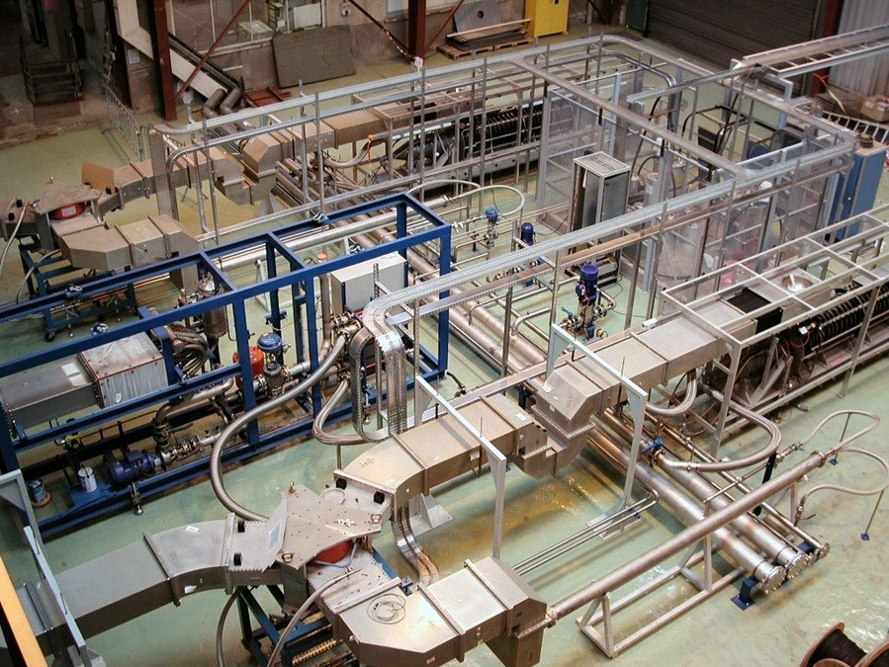

H2020 AMICI
Workpackage 4 - Innovation

Slide 2


WP4 Innovation – Scene Setting
AMICI Second Annual Meeting
Salerno, 22-24 Jan. 2019
The AMICI H2020 project is charged by the European Commission with the challenging task of building the conditions for consolidating and exploiting such collaboration to strengthen the capabilities of European companies to compete on the global market, not only as qualified suppliers of components for accelerators and big superconductor magnets, but also in the development of innovative applications in advanced sectors such as healthcare and space.
“How can the coordinated Technology Infrastructures of the major European accelerator research labs help industry?”

Slide 3
WP4 - Benefits for industry
AMICI Second Annual Meeting
Salerno, 22-24 Jan. 2019
AMICI will enable easier access to coordinated, cutting edge infrastructure for industrial product development
Industry partners can identify themselves as proactive participants in developing the coordinated infrastructures
Opportunity for industry to host/integrate their equipment and skills within the technology infrastructures (if required)
Identify and access new high-value markets outside of the national laboratories
Should be driven by industry’s demands

Slide 4
Talk outline
AMICI Second Annual Meeting
Salerno, 22-24 Jan. 2019
WP4.1: Industry Survey – Accelerator technologies
WP4.2: Industry Survey – Superconducting magnets
WP4.3: Identify existing good practices, and barriers to effective engagement, between Industry and the Technological Infrastructures

Slide 5
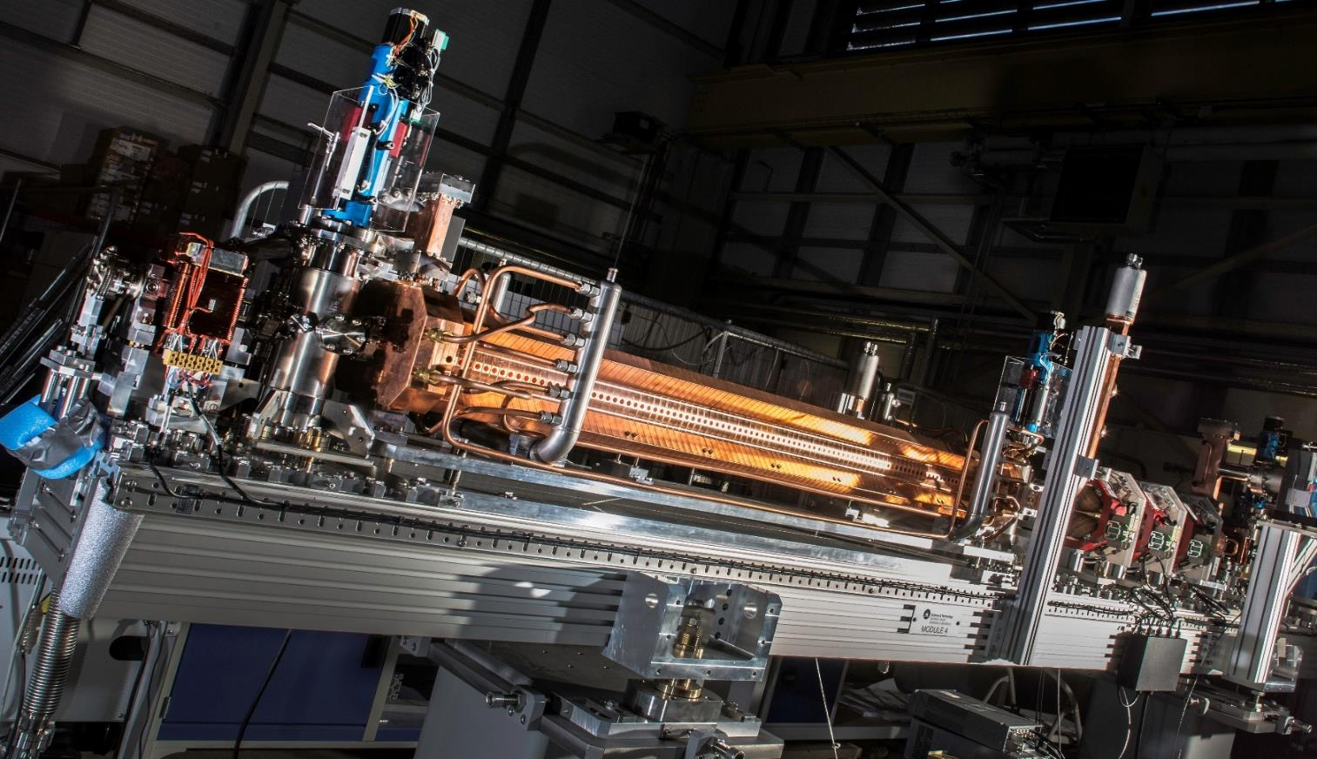

Task 4.1 Innovation – Accelerator Technologies
Anthony Gleeson, STFC Daresbury Laboratory, UK
anthony.gleeson@stfc.ac.uk +44 1925 603911

Slide 6
Task WP4.1 - Industry Survey – Accelerator Technologies
AMICI Second Annual Meeting
Salerno, 22-24 Jan. 2019
Output
A report identifying specific domains of societal applications and European commercial organisations that have the current capability, and future potential, to innovate and develop solutions in the fields of mature Accelerator technologies through the use of Technology Infrastructures will be delivered at the end of the project (month 30).
Milestones and Deliverables
M4.1: 3rd Party selected for survey on accelerator technologies (M15)
M4.4: Survey on accelerator technologies received from 3rd party (M27)
D4.1: Report on accelerator market study (M30)

Slide 7
WP4.1 Survey Timeline
AMICI Second Annual Meeting
Salerno, 22-24 Jan. 2019
Conducted by external survey company
Procured through UK government processes
Open tender issued
Contract awarded to Qi3, March 2018
Specification kick-off meeting, April 2018
Report delivered, Nov 2018

Slide 8
WP4.1 Survey Methodology
AMICI Second Annual Meeting
Salerno, 22-24 Jan. 2019
Industry Supply Chain Market Needs (“component and sub-system suppliers”)
  Telephone interviews – qualitative deep dive to understand key market drivers / dynamics (6 interviews)
  Web survey – semi-quantitative broad survey to understand variations across the market (37 responses)
Lateral Markets Requirements of the Supply Chain (“application system integrators e.g radiotherapy systems, cargo screening equipment)
  Telephone interviews – qualitative deep dive to understand key market requirements (5 interviews)
Particle Accelerator Research Institutes Requirements of the Supply Chain
  Telephone interviews – qualitative deep dive to understand key market drivers / dynamics (8 interviews)
Synthesis of Findings, Analysis and Recommendations
Industry Liaison Offices of several of the AMICI partners provided advice on the telephone interviews and web survey

Slide 9
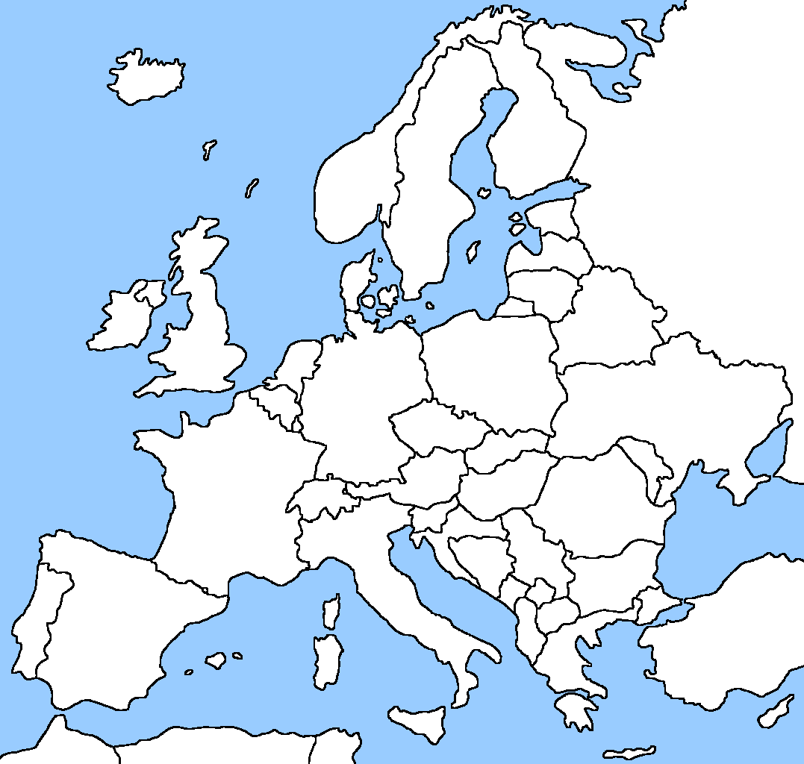
European Particle Accelerator Technology Supply Companies
AMICI Second Annual Meeting
Salerno, 22-24 Jan. 2019
The European supply chain of companies providing systems and sub-systems to the particle accelerator Technology Infrastructure is highly fragmented, by technology, system complexity, location, company size, and other criteria.
At one end of the “market specialism” spectrum, there is a cohort of companies that supply systems and components especially developed for particle accelerators, while at the other end, there are companies supplying small quantities of their standard products for commoditised applications. Between these two ends of the supply chain spectrum, there are a range of companies supplying systems and components with various degrees of specialisation for the sector.
The analysis has focused on identifying companies which either focus on the Technology Infrastructure sector, or which develop and customise their products to meet the sectors needs.
Companies for which the Technology Infrastructure sector is a very small part of their business and which sell standard products for commoditised applications have not been included.
An analysis of companies distributed by technology and geography is on the next slide.
2 (Japan)
5
8
38
14
1
2
51
6
30
7
43
47
1
European Accelerator Technology Supply Chain Distribution

Slide 10
European Particle Accelerator Technology Supply Companies
AMICI Second Annual Meeting
Salerno, 22-24 Jan. 2019

Slide 11
Summary of supply chain interviews
AMICI Second Annual Meeting
Salerno, 22-24 Jan. 2019
By working closely with companies on new technologies and systems, the Research Institutes can help the companies to upskill their capabilities and people to meet future wider industry needs. They believe that the Research Institutes need to maintain a core of expertise in-house, but that this should be complemented and supported by collaborations with industry.
Demand from the Research Institutes is highly variable, both in overall demand and between different institutes. The relationship between the Research Institutes and industry goes through cycles depending on the level of budgets and the size / number of accelerator projects being funded.
From the industry perspective, it is often best if the Research Institutes act as innovators, developing new technologies and then outsourcing system design manufacture, installation and support to industry once they are proven/mature.
Regardless of the technology, the main value industry can bring to the Research Institutes is expertise and innovation in the industrialisation of high technology products: serial manufacturing, cost reduction, optimisation of resources etc.
Industry also believes that the Research Institutes should outsource the majority of their maintenance needs as this provides a commercial platform for companies to plan their business continuity.

Slide 12
Summary of supply chain interviews
AMICI Second Annual Meeting
Salerno, 22-24 Jan. 2019
A better framework for long-term supply relationships is needed. Companies with active collaborations will be well positioned to supply Research Institutes requirements. Research Institutes relying mainly on competitive tender for manufacture of systems already designed will be heavily dependent on the commercial interest and manufacturing capacity availability of suppliers.
A more open, collaborative culture between the Research Institutes and suppliers will lead to better forward planning, better improvement of technologies, and a stronger more reliable supply chain. In-house design and engineering teams can be seen as competitors to the suppliers. Closer co-operation and engagement with the suppliers will help to overcome this.
Earlier engagement with the designs and IP (under confidentiality agreements) will allow the supply chain to engage more constructively with the Research Institutes.
Better access to facilities and verification instruments is really important. Testing and product validation is a major issue as companies often can’t afford to have their own facilities. Access to TI facilities is often too expensive and restricted; a better approach would benefit both sides.
Sharing performance data with manufacturers will help improve design, manufacture, and support of future systems.
Training by the Research Institutes for Industry through training courses, personnel exchanges, research grants etc. should be considered.

Slide 13
Summary of supply chain interviews
AMICI Second Annual Meeting
Salerno, 22-24 Jan. 2019
Type approval of mature systems, components and operating procedures should be undertaken to enable different Research Institutes to easily purchase “standard” approved products and services. This will enable industry to standardise considerable proportions of its output improving productivity and commercial sustainability.
Often companies will need a short piece of consultancy work to solve a particular issue or training to up-skill staff. If this is easily available as and when needed it will be very valuable. Longer term collaboration programmes may work for the Research Institute but often don’t work well for an SME. Finding the right people to approach to help with consultancy work is a problem for SMEs. If a portal outlining expertise were available, SMEs could find these people even if they are outside of the SME network.
Transfer of IP is only relevant occasionally. Making it easier to understand what IP is available / relevant to SMEs and easier to acquire will be helpful.
Collaborative research projects – short term projects on specific issues where Research Institute expertise will be invaluable.

Slide 14
Supply chain – web survey results
AMICI Second Annual Meeting
Salerno, 22-24 Jan. 2019
  Industry Sector size 267
  Survey Population (no of companies mailed) 133
  (Sample size (no of respondents) 37
  Confidence level 95%
  Margin of error +/- 7%
The web survey population size was 133 companies for which contact details are available from AMICI partners, Industry Liaison Offices, Qi3, or publicly. The sample size (no of respondents) was 37.

Slide 15
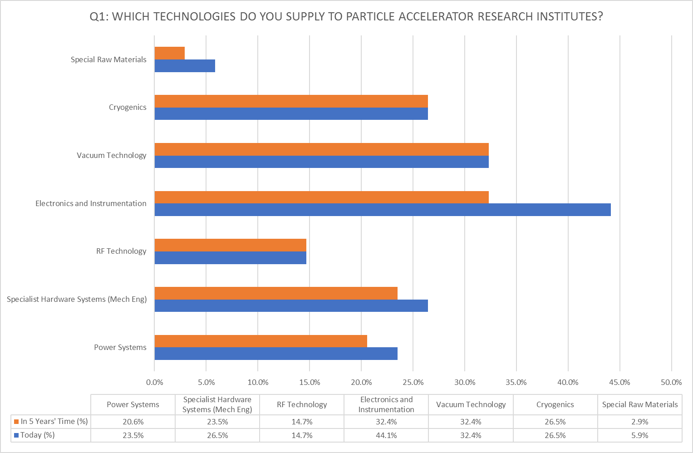
AMICI Second Annual Meeting
Salerno, 22-24 Jan. 2019

Slide 16
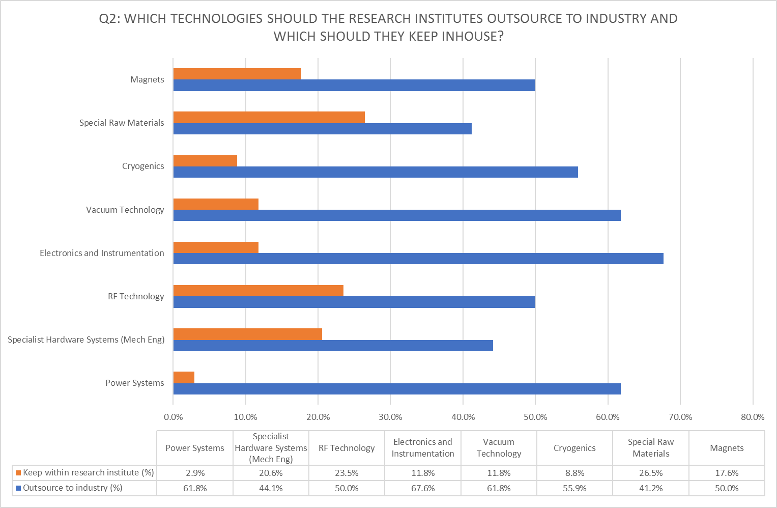
AMICI Second Annual Meeting
Salerno, 22-24 Jan. 2019

Slide 17
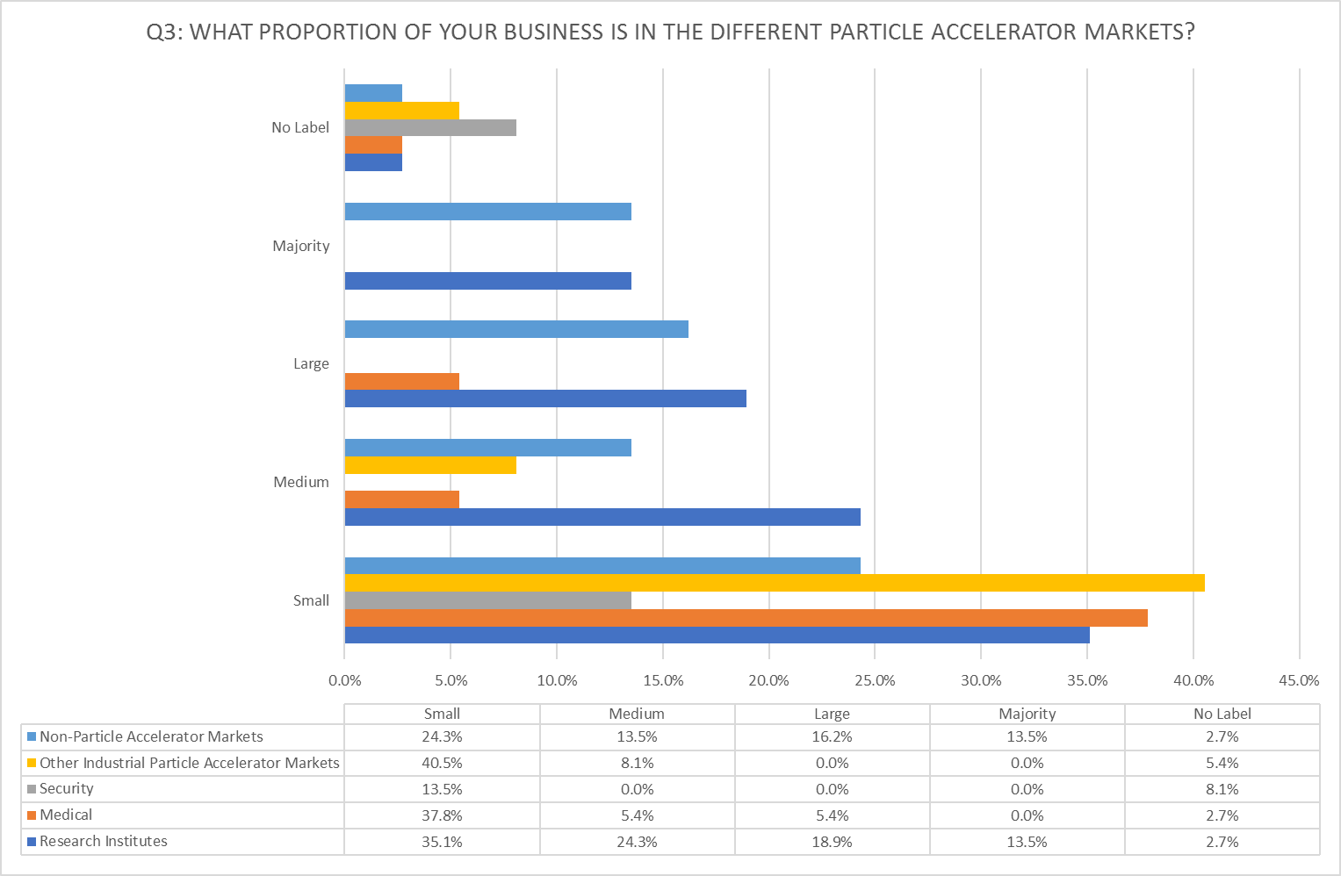
AMICI Second Annual Meeting
Salerno, 22-24 Jan. 2019
All
All

Slide 18
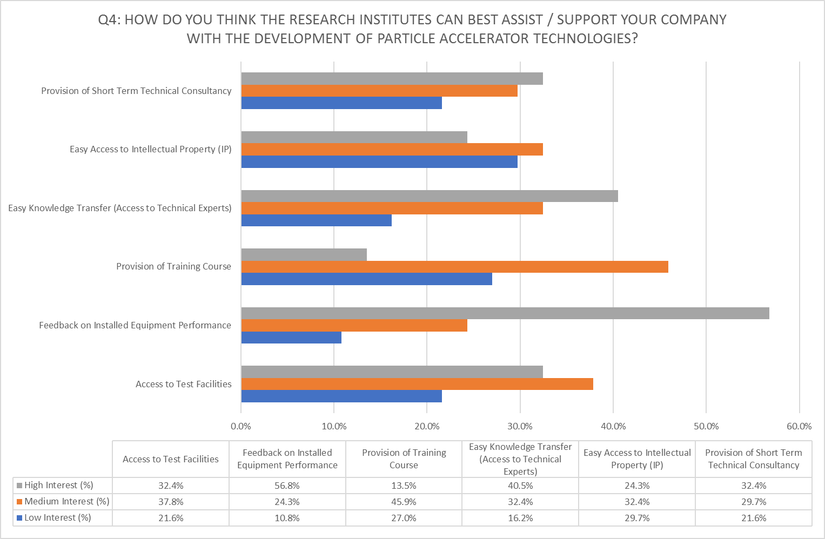
AMICI Second Annual Meeting
Salerno, 22-24 Jan. 2019

Slide 19
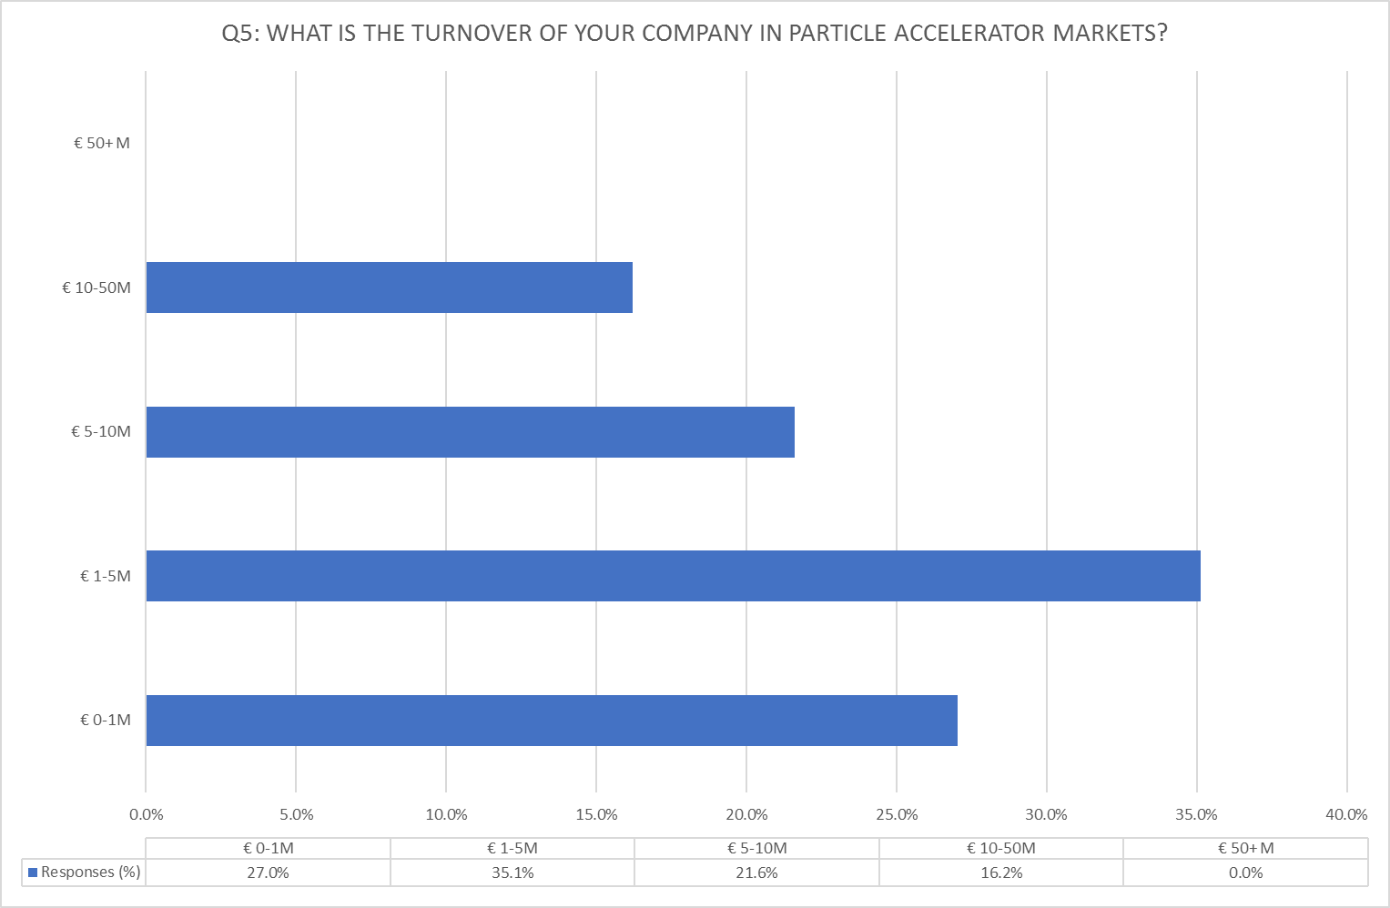
AMICI Second Annual Meeting
Salerno, 22-24 Jan. 2019

Slide 20
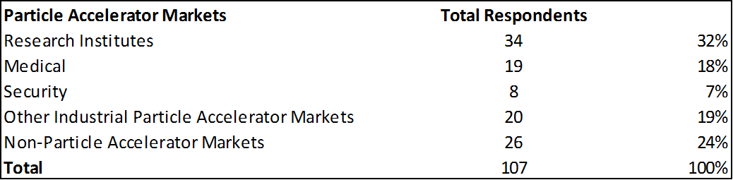
Key Findings of the Web Survey
AMICI Second Annual Meeting
Salerno, 22-24 Jan. 2019
There will be further (although small) consolidation of the supply chain over the next five years. This will be in Specialist Raw Materials, Electronics & Instrumentation, Specialist Hardware and Power Systems.
Industry believes approximately 80% of work should be outsourced by the Research Institutes. The technology areas most likely to have elements kept inhouse are Special Raw Materials, RF, and Specialist Hardware Systems
Support activities from the Research Institutes of high interest are Short Term Technical Consultancy, easy Knowledge Exchange and Feedback on equipment performance. Those of medium interest are Training Courses, Access to Test Facilities, and easy Access to IP
Company turnover is distributed as follows: €0-1m – 27%: €1-5m – 35%: €5-10m – 22%: €10-50m – 16%
The supply chain activity split across different segments of the particle accelerator market is:

Slide 21
Lateral Markets summary
AMICI Second Annual Meeting
Salerno, 22-24 Jan. 2019
Companies in the medical and security sectors tend to be very large. In the industrial manufacturing sector, the companies tend to be quite small (although sometimes owned by very corporates) and they are afraid of their supply chain being swamped if there is a major new Research Institute project.
There is concern about the very tight supply chains for certain key technologies. This supply chain could be threatened if there is a company / supply chain consolidation in this sector and the new organisation decides to focus on other markets.
Companies would benefit from some supply chain consolidation, enabling supplier companies to move up the “Bill of Materials” chain to provide higher level sub-systems. However, such consolidation is difficult to control and may have unforeseen consequences. It is unlikely that these companies will go the final step and outsource the manufacture of full systems.
Companies using the “system purchase” model are primarily systems integrators who focus on applications development. They typically buy the Linacs from commercial suppliers, and develop the control / applications software, imaging systems and customer specials in-house. Any supply technology improvements will need to be through their suppliers

Slide 22
Lateral Markets summary
AMICI Second Annual Meeting
Salerno, 22-24 Jan. 2019
Some companies are considering bringing the manufacture of key technologies in-house in order to strength their technology brand, protect their supply chain and freedom to operate, and to manage customer expectations / concerns about supply security.
Many of these companies have little understanding of what benefits the particle accelerator Research Institutes could offer it. There is a need for the Research Institutes to make the value proposition to such SMEs much clearer. A key issue with relation to IP from the Research Institutes is easy availability and Freedom to Operate. Exclusivity is often not an issue.
Many companies supplying specialist systems to the Research Institutes don’t have the facilities or management capability to scale up for industrial demand. This may require consolidation in these parts of the supply chain in order to form organisations with the capabilities needed.
Some companies have outsourced a lot of manufacturing to the Far East in the past. They are now starting to move some of this back to Eastern Europe as costs rise and supply chains need shortening. However the number of EU companies with the specialist expertise and technologies needed in Europe is limited.

Slide 23
European Particle Accelerator Research Institutions
AMICI Second Annual Meeting
Salerno, 22-24 Jan. 2019
(Source: http://www-elsa.physik.uni-bonn.de/accelerator_list.html)
AMICI Partners
CERN (Geneva)
CEA (Paris)
CNRS (Paris)
DESY (Hamburg)
IFJ (Krakow)
INFN (L’Aquila)
KIT (Karlsruhe)
PSI (Villigen)
STFC (Daresbury)
Uppsala Universitet (Uppsala)
Other European Accelerator Technology Infrastructure Facilities
(see Appendix F for Details)

Slide 24
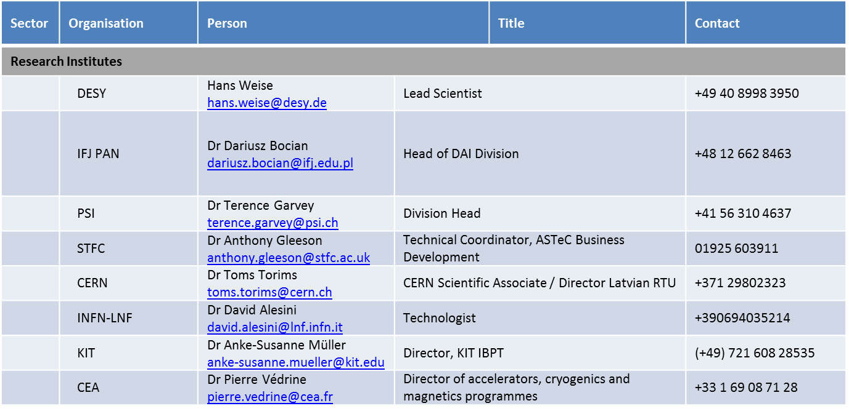
AMICI Second Annual Meeting
Salerno, 22-24 Jan. 2019
Organisations Telephone Interviewed

Slide 25
Gap Analysis - Market Weaknesses
AMICI Second Annual Meeting
Salerno, 22-24 Jan. 2019
The weaknesses in the particle accelerator supply chain ecosystem stem from the different requirements of each of the three stakeholder groups for successful operations:
Research Institutes require significant numbers of technically sophisticated companies in each of the six technology areas with the ability to manufacture large / small volumes and one-offs to high quality.
Lateral Markets (which are a small number of very large companies) require a small number of technically sophisticated companies capable of manufacturing large volumes consistently to quality and delivery requirements.
Supply Companies require markets with a good customer spread, predictability, reasonable profit margins, and consistent demand.
This gap between stakeholder needs creates major weaknesses in the supply chain ecosystem. The different stakeholders have taken actions to mitigate these weaknesses, which in turn have exacerbated the weaknesses further:
Research Institutes have taken more design, test, and even manufacture inhouse, thus reducing demand
Lateral markets have focused their purchasing on a small number of suppliers reducing the number of viable companies
Supply companies have focused on niche technology areas where they can create and defend a viable business reducing the breadth of the supply chain

Slide 26
Strategies & Recommendations
AMICI Second Annual Meeting
Salerno, 22-24 Jan. 2019
Operational Level - Align / Standardise Procurement and Industry Support Policies
Align / standardise procurement and Industry Support policies between the Research Institutes as far as is practically sensible. This may include:
  Introduction of a “type approvals” system for proven technologies to enable higher volumes of standard products
  Outsourcing of maintenance contracts to keep industry engaged
  Implementation of suggested actions by the Research Institutes to strengthen industry (effective IP transfer / training / collaborative research / access to test facilities / feedback of operational data). Key company requirements are:
    High Interest - Short Term Technical Consultancy / easy Knowledge Exchange / Feedback on equipment performance.
    Medium Interest - Training Courses / Access to Test Facilities / easy Access to IP

Slide 27
AMICI Second Annual Meeting
Salerno, 22-24 Jan. 2019
Leadership Level - Build Supply Chain / Company Strengths
Implement policies to build the strengths and capabilities of supply chain segments perceived as weak. This may include:
  Proactive programmes to make the supply chain and lateral markets aware of RIs capabilities
  An ‘open innovation’ (https://en.wikipedia.org/wiki/Open_innovation) approach to technology innovation (e.g. permanent magnets and RF sources),
  Pre-competitive (https://en.oxforddictionaries.com/definition/precompetitive) (competition rules compliant) collaborative R&D contracts in areas of need (e.g. permanent magnets)
  Actions to maintain the long-term skills base in the sector through peaks and troughs in the Research Institute demand cycle

Slide 28
AMICI Second Annual Meeting
Salerno, 22-24 Jan. 2019
Visionary Level - Sector Initiatives to Transform the Future
Create a European Particle Accelerator Sector initiative, bringing together the different stakeholders (Research Institutes, Lateral markets, supply chain companies) to create a collaborative and transformational programme for the future. This may include:
  Incorporate of the best approaches from other sectors (e.g. space, aerospace,), whilst recognising that the particle accelerator sector is structurally different (scale, primes, % of Research Institute spend going to industry etc.)
  Move to a new engagement model with industry (based on the space industry approach), changing from technical specification to performance specification and stimulating an ecosystem of prime contractors to work closely with
  Encourage market restructuring in weak areas e.g. with too many players where sufficient levels of business to promote long term profitable engagement can’t be maintained
  Become a catalyst for European leadership of the world market in 3 areas – component technologies, supply chain best practice for the Research Institutes, and stimulation of lateral markets
  Engage with particle physicists to identify the big science questions they wish to address that will require radical new technical approaches that will attract funding and in which industry can proactively participate.

Slide 29
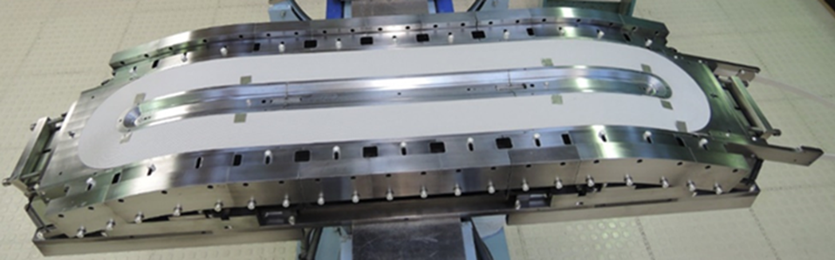

Task 4.2 Innovation – Magnet Technologies
Pierre Vedrine, CEA Paris Saclay, FR
pierre.vedrine@cea.fr +33 6 85 40 40 78

Slide 30

Task WP 4.2
Industry Survey – Magnet Technologies
“..Survey a broad range of European commercial organizations, including both large companies and SMEs, to establish their current capability, and future potential, to innovate and develop technology solutions in the field of mature Magnet technologies and identify domains of societal applications and potential markets beyond Research Infrastructures…
For instance, the work done in the Working Group FuSuMatech to examine the synergies between industrial areas of MRI, NMR as well as other relevant applications and HL-LHC and FCC (Future Circular Collider) investments in the superconducting magnets technologies will be used.
Output
A report identifying European commercial organizations that have the current capability, and future potential, to innovate and develop solutions in the fields of mature Magnet technologies will be delivered at the end of the project.
The report will also identify domains of societal applications and potential markets beyond Research Infrastructures in this area of technology.
M4.2: Interim report on survey results in the field of SC Magnet Technologies (M15)

Slide 31
WP 4.2 Activities
Using sources such as TIARA, FCC output, ILOs, RIs, identify a list of companies to survey
Done
Solicit ideas for potential societal applications from TIARA output, ILOs, RIs.
Done
Perform survey of industry and provide an analysis of their findings :
  Their technical capabilities in identified technology areas- equipment/skills/capacity/network,
  Their appetite for commercial innovation -past history/attitude to risk,
  Their ideas regarding potential market opportunities for societal applications
  Specific questions for magnet technologies inserted in WP4.3 survey part 6 has been sent, answers received and additional interviews are ongoing
Review existing reports of societal applications by research bodies :
  TIARA and ARIES output
  EUCARD2 Applications for Particle Accelerators in Europe – June 2015
  Fusumatech (Future Superconducting Magnet Technology)
  US Magnet Development Plan 2016
  ……
Reports have been collected and extraction of potential applications ongoing
Wait for the final Fusumatech report in April 2018

Slide 32
Survey

Slide 33
Survey

Slide 34
First Results (cont’d)

Slide 35
First Results (cont’d)

Slide 36
First Results (cont’d)

Slide 37
First Results (cont’d)

Slide 38
First Results (cont’d)

Slide 39
WP 4.2. – Industry survey : magnet technologies
Questionnaires for magnet survey are collected
There are very few questionnaires and answers to elaborate = > interview with each company
If we cannot get appointments before the Second Annual Meeting, we will interview them in Salerno

Slide 40

WP 4.3
Status, Next Steps and Discussion
Andrea Liedl, David Alesini
(INFN-LNF, Frascati, Italy)
WP4.3:Identify existing good practices, and barriers to effective engagement, between Industry and the Technological Infrastructures
AMICI Second Annual Meeting
Salerno, 22-24 Jan. 2019

Slide 41
WP 4.3 – Second Annual Meeting, Status and next steps
Apr’17: AMICI Industrial Partner Meeting
Jul ’17: Industrial Survey First Draft
Oct-Nov’17: Revision and Approval by Industries
Jan ’18: Survey Integration by WP 4.2
Mar ’18: First Survey e-mail to the Industries
May ‘18: Partecipation to «Intellectual Property Workshop» at CERN
Jul ’18: Initial Analysis of received answers
Sep ’18: EU Projects Responsibles (NFFA.EU, CALIPSOplus) and ILO Offices (ELETTRA) interview/discussion (Thanks to A. Taffara)
Dic ‘18: Conclusion of Data Analysis
Next Steps
Mar-Apr ’19: DESY IP/TT meeting (proposal to be discussed)
Jun ’19: Final Report

Slide 42
INDUSTRIAL SURVEY ANALYSIS
WP 4.3 : Good practices and barriers to engagement between industry and TIs

Slide 43
Part 0:
Survey Timeline
Geographical Distribution of contacted industries
Survey Structure

Slide 44
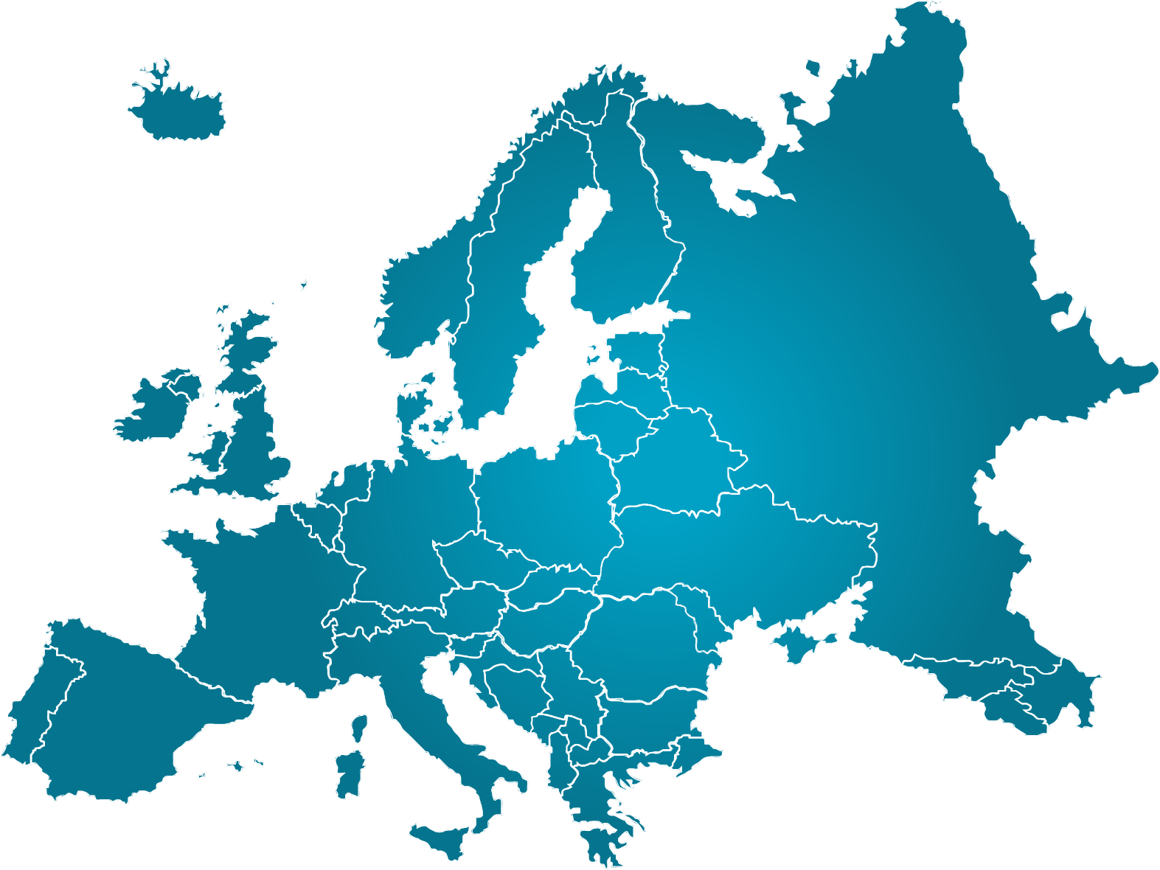
Requests VS Answers
Comments
Best results from Personal Invitation approach of survey
No answers from UK
Few answers from Italy, France And Germany
2-0
2-1
6-0
Answer Rate=21%
4-1
2-0
14-2
1-0
14-3
4-0
2-0
5-5
22-5
1-0

Slide 45
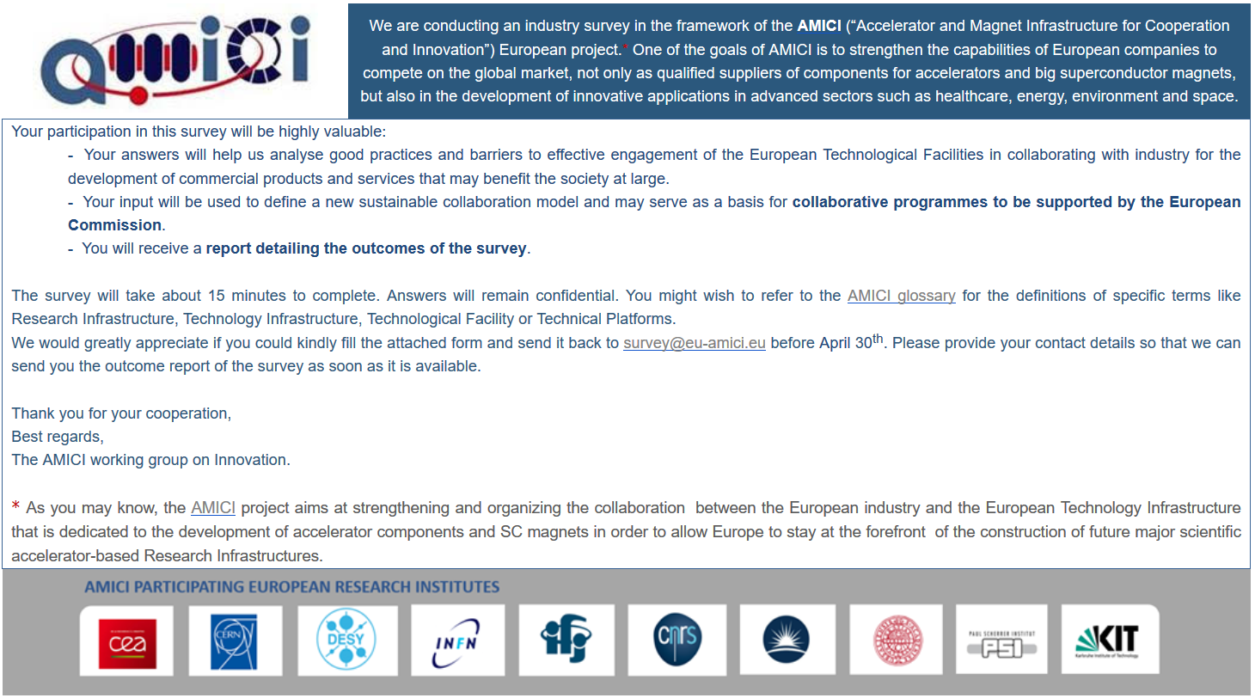
Cover Letter

Slide 46
Survey for Industry Structure
Part 1 – Industry General Information (10 questions)
Part 2 – Collaboration: Description, Results, Agreement (17)
Part 3 – Access to Technological Facility of Research Institutes (11)
Part 4 – Participation to Tenders and/or National/European funding Calls (14)
Part 5 – The collaboration I wish! (6)
+
WP 4.2
Part 6 – The magnet technology market I wish! (9)
Total Questions 58+9
Only for Partner on Magnet Field

Slide 47
Part 1: Industry Information

Slide 48
Q1.3: Company Commercial Operating Field (17 answ.)

Slide 49
Q1.5, Q1.6 : What is the annual company % of turnover related to accelerator and magnet technology?
C. Few companies have magnet technology as main commercial field

Slide 50
Q1.7, Q1.8: What is the % of personnel dedicated to R&D? (17 answ.)
C. No correlation between Number of Employees and R&D Human resources investments

Slide 51
Part 2: Industry and Research Institute
Collaboration and Agreements

Slide 52
Q1.9: Do you collaborate with…?
(17 answ.)
C. Almost all companies collaborate with CERN and CEA
C. No collaboration with IFJ and Uppsala University
Q2.1: Who is your contact within the RI?
(17 answ.)
Other Collaboration
CIEMAT
NCBJ GSI,
ESS
MAX IV
Cambridge Uni
Dresden Uni
ALBA
ESRF
ITER
LMJ
Ganil
IFMIF
F4E
Fusion for Energy
Consorzio RFX
C. “Transfer Technology” Offices are never the first choice

Slide 53
Q2.3: How much do you fell the interactions with RI problematic?
(16 answ.)
Q2.4: In which case did you have an immediate interaction with RI?
Design, engineering and testing phases
Information about tenders
Providing services
Public tender mainly, collaboration
immediate answers to questions
modifying and proposing improvements on design
Purchasing, Project Manager (CEA),
Group Responsible Research activities
Q2.5: In which case did you have problematic interaction??
extra work discussions because of change of scope
R&D collaboration contract
IP specification, delivery time
Implement collaboration
C. The feelings about the RI collaboration are quite good…

Slide 54
Q1.10: What is the object of the collaboration? (16 answ.)
Q2.6: At the end…what is the result?
(16 answ.)
Number of…
Apart the output of the collaboration itself…
Publications are a consistent number
A lot of prototype but few commercial products
Other: Maintenance Service (13%)

Slide 55
Q2.9, Q2.10: There is personnel dedicated to the collaboration?
Who pay for them? And after the collaboration? (11 answ.)
Other Comments…
A PhD in collaboration….hired
….personal has been hired
After collaboration the personnel has been hired
…physicists and engineers have been hired
C. Usually the company pays for the personnel, students who work on the project….and it is not strange to hire them after

Slide 56
Q2.16 (15 answ.), Q2.17 (11 answ.): There were issues about Intell. Property and Patenting?
There was a standard model for the agreement?
Q2.18: After all…How was your satisfaction about agreement? (12 answ.)
More than 50% of companies declare problem about Intellectual Properties

Slide 57
Part 3: Technological Infrastructure

Slide 58
Q3.2: What is the reason to use Technology Infrastructure? (10 answ.)
Q3.3: Do you think it is useful? What about the access to this TI? (10 answ.)
Q3.9 (9 answ.):
C. Very good feedback about the utility of TI but some problems to time

Slide 59
Q3.6: There was some kind of involvement of the TI personnel?
(10 answ.)
Q3.7, Q3.8: : How was the collaboration with them?
(9 answ.)
C. The TI personnel is actively involved and this involvement is appreciated

Slide 60
Part 4: Participation to tender and
Calls

Slide 61
Q4.2 How was your experience with Institute Tenders? (17 answ.)
Q4.3: What were the main issues for these tenders? (12 answ.)

Slide 62
Q4.4->4.12
How was the participation to local and European calls?
11 answ.
9 answ.
C. There is a problem about the promotion and clarity!

Slide 63
Q4.8, Q4.13: Some Suggestions/Comments from the companies for the improvement of National and European Call
we're a Dutch company; the Netherlands doesn't like national funding of science....
For low TRL level national call, working with the institute on the return on investment. It sometimes difficult to have enough elements to calculate the ROI and promote advantages of National Call for companies.
Decrease paperwork, a lot of time for little result
we do not know of any such calls
networking , promoting the company inside the institute
organize meeting and info day
kill the bureaucracy
Maybe periodical general presentations of incoming calls (also though the web);
more clear and standardized web sites.
organize meeting and info day

Slide 64
Preliminary Conclusions
  Not high rate of answers from the Companies and long time to obtain them: Do the Companies consider useful the survey?
  European Calls are not clear and well promoted: the exploitation is not easy
  Technology Infrastructures are exploited and appreciated
  Access to Technology Infrastructures takes more than a month in a half of cases
  Outputs of collaboration are composed by a lot of prototypes but few Commercial Product
  There are issues about Intellectual Property, but at last the final agreements are generally appreciated
  Transfer Technology Office are not the main bridge between RI and Industries
This statements suggest a deeper analysis/research of best practices

Slide 65
Mar ‘19: DESY IP/TT meeting (proposal to be discussed/organized)
to analyze an already existing «Technology Transfer structure»
First Contact was at “Intellectual Property Workshop” (CERN, 16th May 2018)
Issues pointed out by the Survey
From the presentation of Lan Fimmen (DESY)
  Difficulties to understand TI potential
  Difficulties to participate to the call
  Prototype into Commercial Products
  Access to the TI
  Innovation Days – Industrial Days
  Funding Program
  Market Screening – Patent Strategy
  Unique Access Point and Clear Procedure
Purpose of the eventual meeting -> more details about
Events Organization
Funding System
Interactions and “Agreements Template” with Companies
Technology Infrastructure Organization
Internal “Innovation Strategy” for the use of Technology Infrastructures
To integrate into feasible proposals of “EU innovation models”

Slide 66
Thank you for attention
Andrea Liedl, David Alesini
(INFN-LNF, Frascati, Italy)
WP4.3: Identify existing good practices, and barriers to effective engagement, between Industry and the Technological Infrastructures

