Slide 1


Second Annual Meeting
23 January 2019
University of Salerno, Italy
Olivier Napoly, coordinator
CEA/Irfu

Slide 2
Outline
Introduction to AMICI project
Review of WP Progress and Focus
Set the goal of the 2nd Annual Meeting
Bring some most pressing questions to the Advisory Group (AG), for their meeting on Thursday.

Slide 3
Outline
Introduction to AMICI project
Review of WP Progress and Focus
Set the goal of the 2nd Annual Meeting
Question #1 to AG

Slide 4
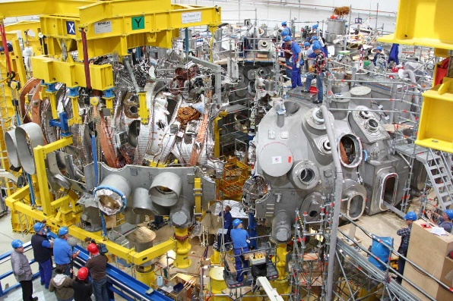
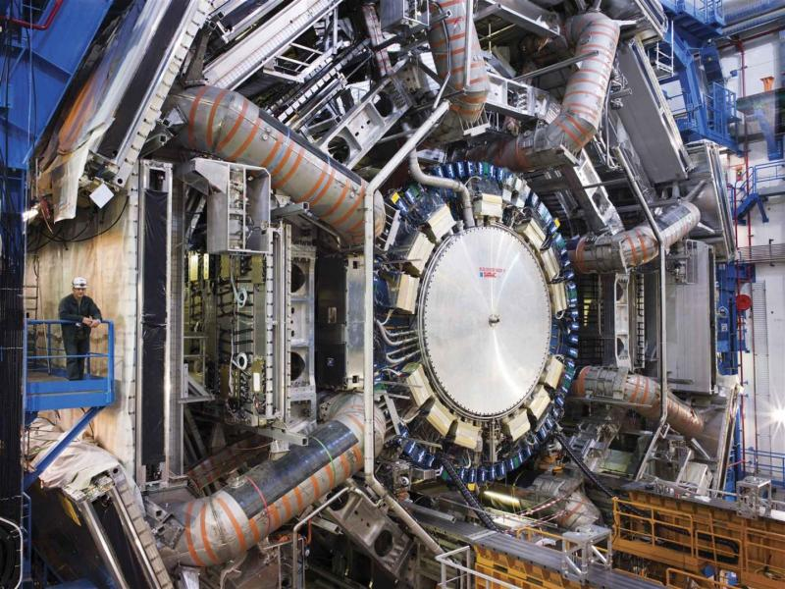
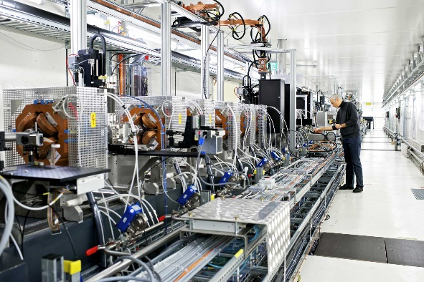
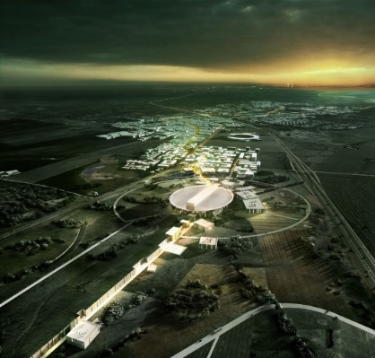
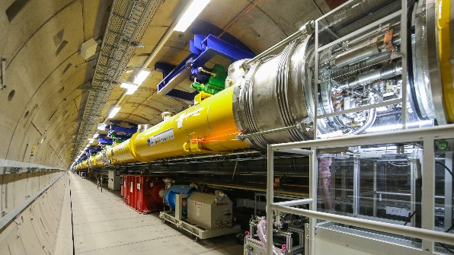
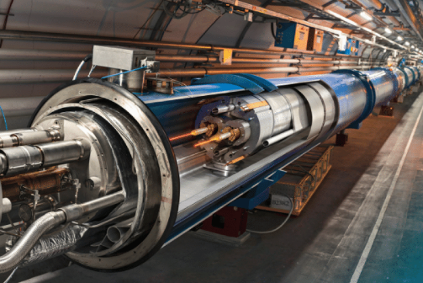
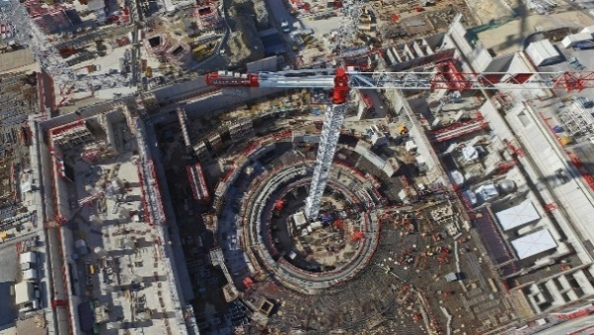
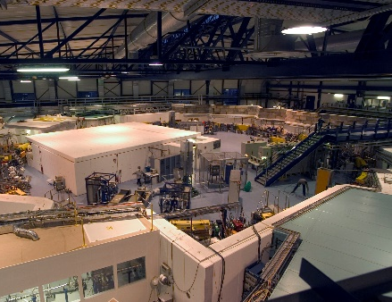
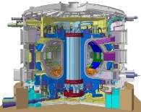
European Research Infrastructures
The collaboration between European Technological Facilities and Industry has been seminal for the realization of unprecedented scientific endeavors, like LHC, W7X, EU-XFEL, SwissFEL, ESS and ITER, that have recently projected Europe to an undisputed position of worldwide leadership.

Slide 5
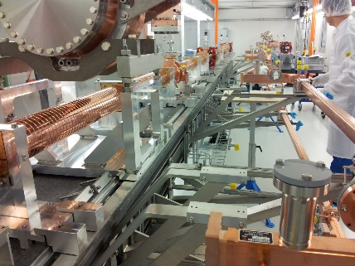
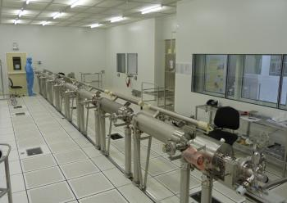
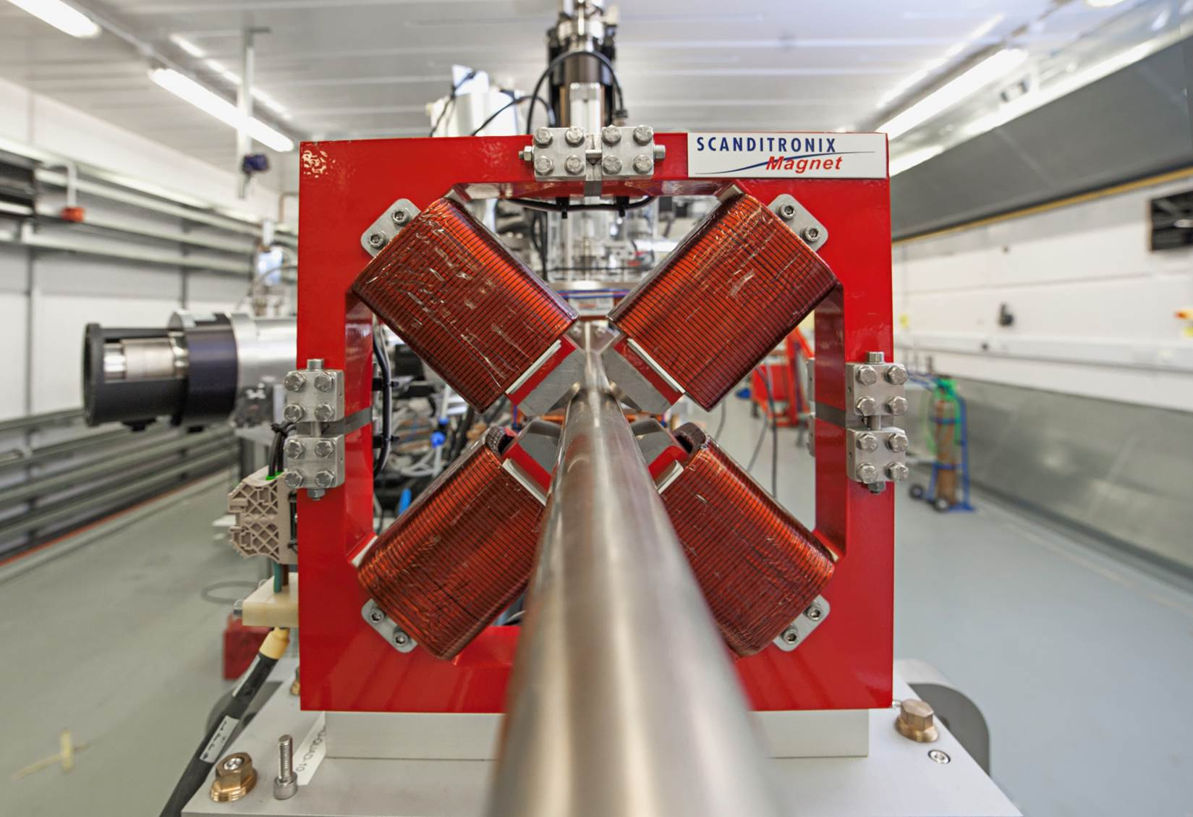
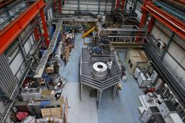
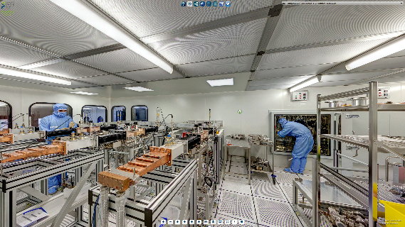
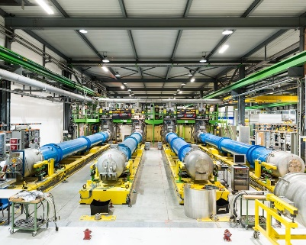
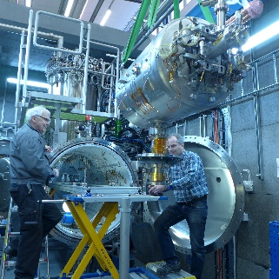
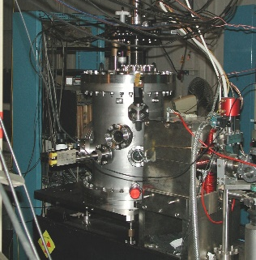
European Technology Infrastructure
The construction of such projects was made possible by the ‘de facto’ realization of a large and distributed accelerator and SC magnet Technology Infrastructure (TI).
It includes several technological facilities, located at research laboratories and industrial sites, and encloses:
sophisticated R&D platforms for key technologies,
large-scale facilities for assembly, integration and verification,
large concentrations of dedicated, highly-skilled personnel and,
long-standing relationships between laboratories and industry.
This TI represents a major investment for laboratories and asset for Europe.

Slide 6
AMICI (1/01/17 – 30/06/19)
AMICI, for ‘Accelerator and Magnet Infrastructure for Cooperation and Innovation’, is an H2020 ‘Coordination and Support Action’ project.
Its general goal is to propose a model for the profitability and sustainability of the Technological Facilities dedicated to Accelerators and Superconducting Magnets in Europe, based on the engagement of the European Commission, the National Agencies and the Industry, and serving innovation and scientific research.
AMICI is charged with the challenging task of building the conditions for consolidating and exploiting these Technological Facilities :
to strengthen the capabilities of European companies to compete on the global market, as qualified suppliers of components for accelerators and big superconductor magnets,
and also in the development of innovative applications in advanced sectors such as healthcare, energy, environment and space.

Slide 7










H2020 Consortium: an Academic Community

Slide 8
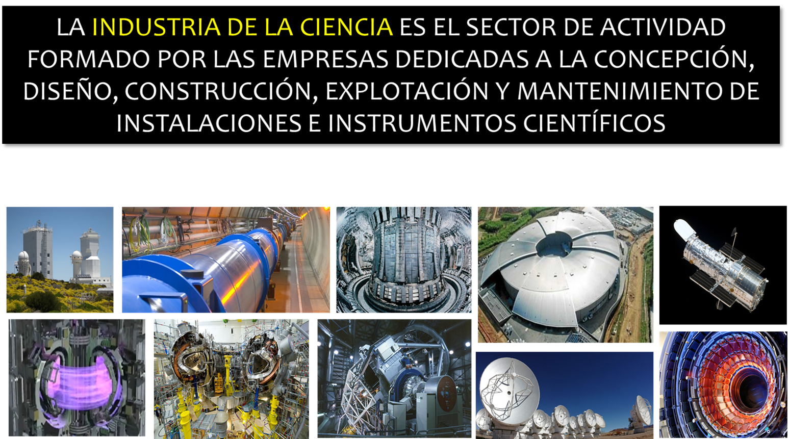
Science Industry
SCIENCE INDUSTRY is the economic sector which includes the companies devoted to the design, engineering, construction, updating and keeping of scientific research facilities, its equipment and other related instruments
Courtesy, Fco. Javier Cáceres

Slide 9

A Spanish Association
The industrial, non-profit associations, devoted to promote -with short, medium and long-term visions- the Science Industry sector, are a very efficient tool
INEUSTAR, the Spanish Science Industry Association, is one of those organizations which help to bridge the gaps between Science and Industry
Courtesy, Fco. Javier Cáceres

Slide 10
Ineustar Associates

Slide 11
Virtue of Partnership
More efficiency
Science
system
Less permanent costs
More economic impact
Fast technology transfer
When these collaborate…
More activity and jobs
Industrial companies
Better social role projection
Boost of R&D promotion
New activities attraction
Courtesy, Fco. Javier Cáceres

Slide 12
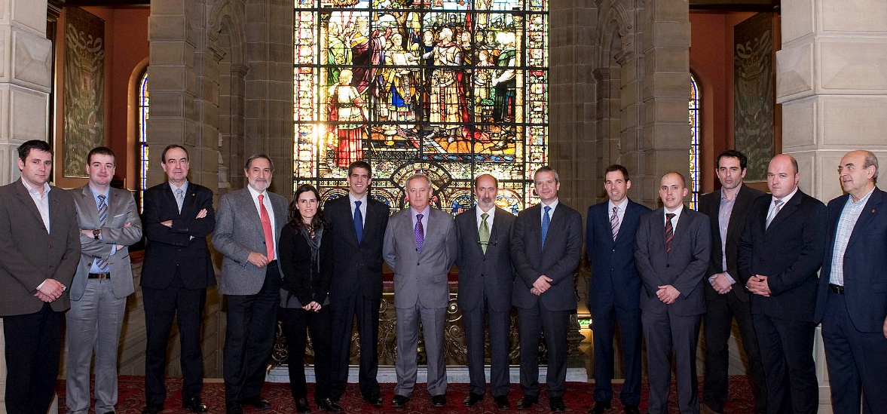
Question to the Advisory Group
INEUSTAR was founded in 2010
Private, non-profit, made-up of industrial companies related to Scientific Research Facilities as suppliers
The first European Science Industry Association
Courtesy, Fco. Javier Cáceres
Q1: Can we and should we extend the Spanish ‘Ineustar’ model to European Science Industry ?

Slide 13
Outline
Introduction to AMICI project
Review of WP Progress and Focus
Goal of the 2nd Annual Meeting
Questions #2-4 to AG

Slide 14
WP1: Coordination
Progress:
The AMICI Mid-Term Report has been submitted with one month delay and has been approved by EC.
Following a remark of our EC Officer about the AMICI Mid-Term Report, we improved the AMICI Website to better illustrate the connection between Research Infrastructures – Technology Infrastructure – European Science Industry.
The same cartographic tool will be used by WP2.2 ‘Global Landscape’ to illustrate the technology components of future Accelerator and SC Magnet projects, and the possible connection to Technology Infrastructure.
Focus:
Extend the H2020 AMICI project duration by 3-4 months, past June 2019, pending the support of the General Assembly and the approval from EC.
Hold the ‘European Forum on accelerators and SC magnets Technology Infrastructure’ at Brussels in the summer 2019 to describe the outcome of the AMICI Tasks to the EC and the European Science Industry .
Hold the 3rd AMICI Annual Meeting in the fall 2019.

Slide 15
WP2: Strategy
Progress:
We identified a set of 8 Key Technology Areas (KTAs) based on the criteria presented in Uppsala, and we started drafting Deliverable 2.1 Report that describes their needs and their potential for progress in performance and/or cost savings
We described the conditions prevailing to the sustainability of the Technological Facilities at the ten AMICI Institutes, and the significant differences between: 1- Institutes hosting/operating EU research infrastructures, 2- Institutes hosting national accelerator facilities, 3- Institutes providing components and services to RIs.
Focus:
Describe the technological roadmaps of the KTAs and characterize the adequacy or inadequacy of the current TI (D2.2).
Formulate propositions to guarantee the long-term sustainability of TI based on e.g.: 1 – improving the technical adequacy between external needs vs. services of technical platforms, 2 – improving their availability/usability, 3 – demonstrating the cost/timing impact of TI vs green field based construction of RIs(D2.3).

Slide 16
Question to the Advisory Group
Key Technology Areas
Particle sources
‘High precision’ magnets
High field SC magnets
Normal Conducting RF cavities
SRF structures
Radio Frequency power sources
Cryogenics
Beam instrumentation
Q2: Are the 8 Key Technology Areas well identified, and does the European Science Industry need to reinforce its strength on a few of them?

Slide 17
WP3: Coordination
Progress:
We formulated the eligibility criteria to access the core group of the Technology Infrastructure (D3.1) and drafted an Collaboration Agreement model for its core group members, supporting a set of ambitious goals.
Focus:
Finalize the Collaboration Agreement model and obtain the recommendations from the AMICI Institute directorates.
Formulate terms of University and Industry partnerships with the core group.

Slide 18
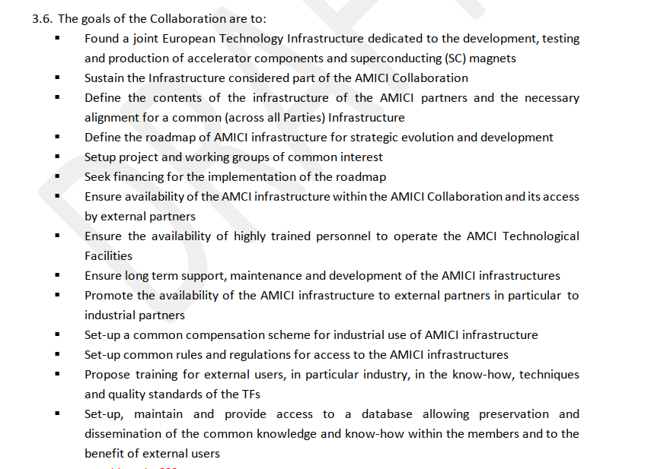
Question to the Advisory Group
Q3: Are these goals attractive enough to stimulate the participation of European Science Industry, and how should partnership and liaising be organized?

Slide 19
WP4: Innovation
Progress:
We obtained the responses from the 3 market surveys (accelerator components/SC magnets/good practices and barriers).
However, input from the major European SC Magnet manufacturers is missing.
Focus:
Synthetize the outcome of the market surveys and draw recommendations for improving the Innovation potential of European Science Industry.
Further refine AMICI offering to Industry.

Slide 20
WP5: Industrialization
Progress:
We selected training and development of material database as services provided by the TI to European Science Industry.
We identified Intellectual Property as a hard point.
We coordinate and contribute to a multi-national working group at the CEN to draft a European standard on safety of cryogenic equipment.
Focus:
Set the basis of a database on material properties (D5.1).
Catalog the potential training and apprenticeship programs in the Technology Infrastructure (D5.2, D5.4).
Formulate the conditions for prototyping in Industry (D5.5).

Slide 21
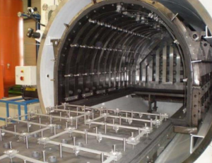
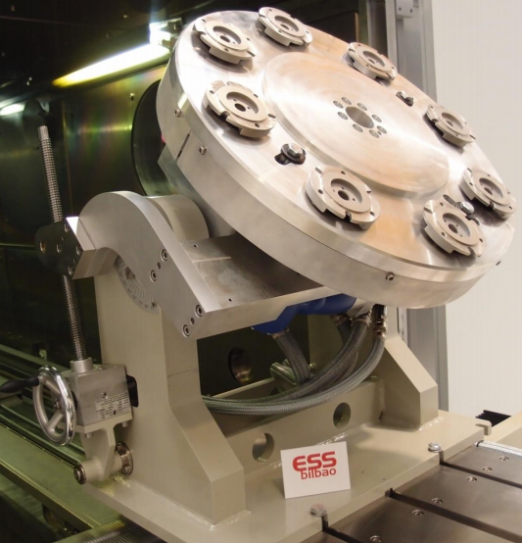
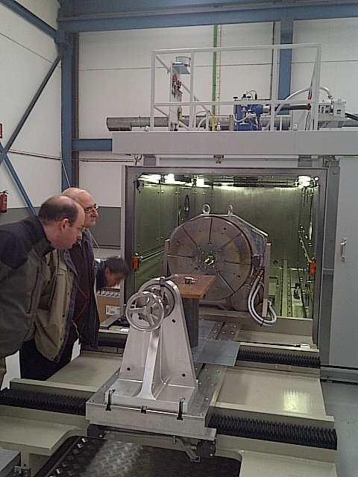
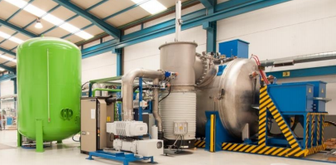
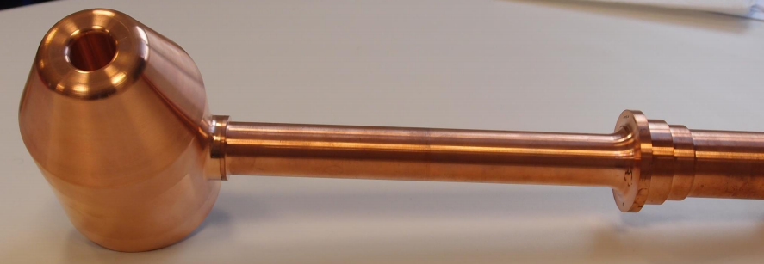
TT in Spain
EXAMPLES OF INEUSTAR PROGRAMS (V)
Joint Facility-Industry collaboration in common manufacturing processes
  Advanced Welding Facility. Vitoria.
  https://web.essbilbao.org/index.php/en/technology-dept/infrastructures/item/307-awf-advanced-welding
Courtesy, Fco. Javier Cáceres

Slide 22
Question to the Advisory Group
The Industrialization-related activities aim at keeping European Science Industry at the forefront of the international competition, in terms of technology, quality and costs, in view of the construction of future scientific research instruments in Europe and elsewhere.
Q4: Is there some other crucial aspect of Industrialization of Research Infrastructures which is not scrutinized by WP5?

Slide 23
Outline
Introduction to AMICI project
Review of WP Progress and Focus
Goal of the 2nd Annual Meeting
Question #5 to AG

Slide 24
Goal of the 2nd Annual Meeting
This is indeed the last Meeting before the end of the AMICI project.
Our overarching goal should be to gain the support of the EC and Agencies to our findings and proposals.
For that, we have to:
demonstrate the central and irreplaceable role of the Technology Infrastructure for the European Research Infrastructures, and
demonstrate its benefit to European Science Industry.
Optional Question to AG:
Do you have any suggestion how to reinforce these ‘demonstrations’ ?

Slide 25
European Technology Infrastructure
The Technology Infrastructure is the basement of any future large-scale accelerator and SC magnet projects, spanning activities
from Design to Construction and Operation
R&D
Prototyping
Assembly
Verification
Installation
Support
It spans the whole TRL spectrum, from R&D to fabrication, with an emphasis on the Preparation and Construction phases, corresponding to Prototyping (3-5) and Industrial Production (>5) of components.

Slide 26
Thank you for your attention
Have a productive and inspiring meeting !

