Slide 1
WP8: ColMat
Ralph W. Aβmann
Steering Meeting of EuCARD
Frascati – November 4-5, 2009

Slide 2
ColMat Participants (EuCARD WP8 – Joint Research Activity)

Slide 3
ColMat Collaborators
LHC Accelerator Research Program (US government funding):
To be approved (German government funding, BMBF):

Slide 4
Reminder ColMat Objectives Part I
Coordination and scheduling of the WP tasks.
Monitoring the work, informing the project management and participants within the JRA.
WP budget follow-up.
Design collimation systems for high-intensity proton and ion beams, adequate for achieving the performance goals of LHC and FAIR.
Predict energy deposition from different sources for LHC and FAIR.

Slide 5
Reminder ColMat Objectives Part II
Identify and fully characterize in experiment and simulation materials that are adequate for usage in high power accelerators.
Predict residual dose rates for irradiated materials and their life expectancy due to accumulated radiation damage.
Design, construct and test a collimator prototype for upgraded LHC performance.
Design, construct and test one cryogenic collimator prototype for use in FAIR and possibly LHC.
Develop crystal engineering solutions for collimation.

Slide 6
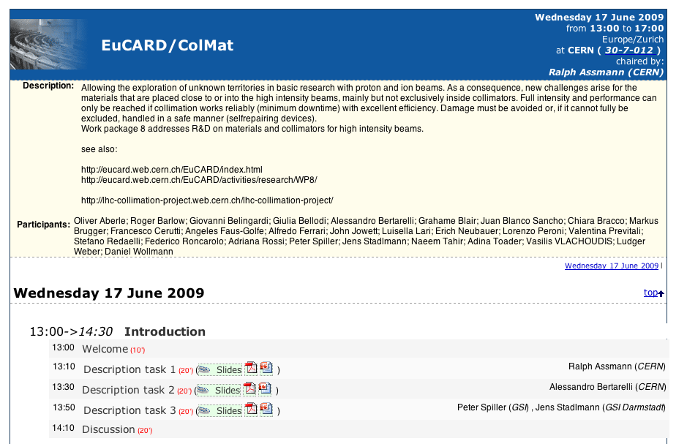
Kick-Off Meeting June 09

Slide 7
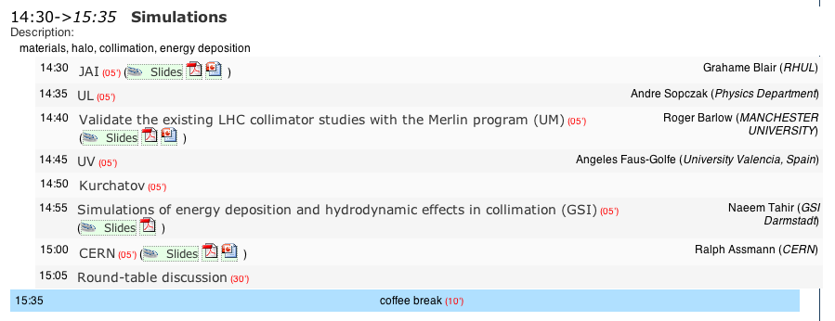
Kick-Off Meeting June 09

Slide 8
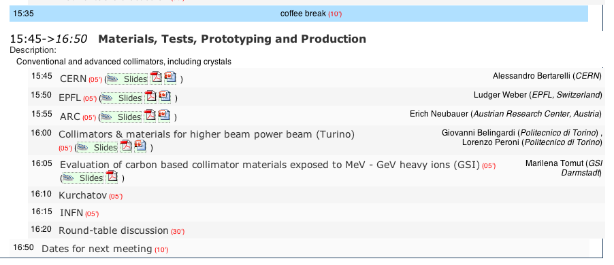
Kick-Off Meeting June 09

Slide 9
Progress Summary (GSI see Jens Stadlmann)
JAI: BDSIM for LHC energy deposition.
UL/UM: Merlin to study wakefields, different materials and positions. First paper published at PAC09: http://epubs.cclrc.ac.uk/bitstream/3502/WE6RFP012.pdf
IFIC Valencia: Work defined and post opened.
Kurchatov: Measurement program for new collimator materials. Materials to be sent. Simulation program.
EPFL: See slide on Al/C.
ARC: See slide on machining.
Malta: Work defined and post to be opened.
CERN to GSI: Materials sent for beam testing.

Slide 10
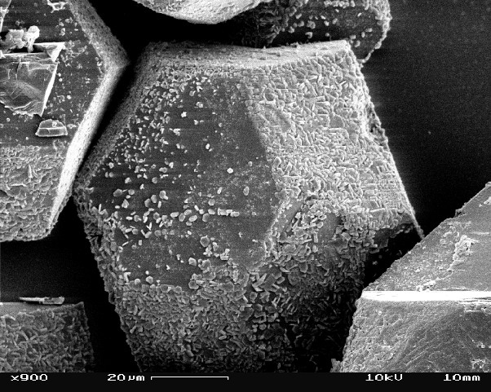
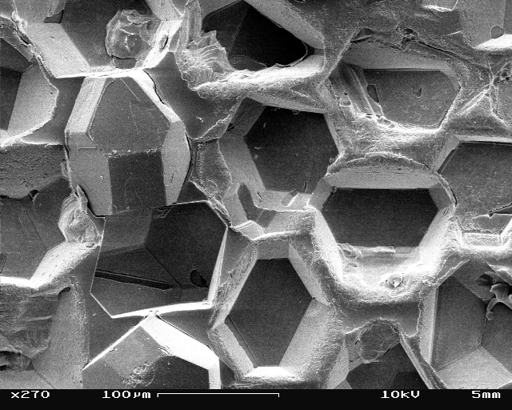
Interface study of Al-Diamond composites
Comparison of GPI and Squeeze Casting
EPFL

Slide 11
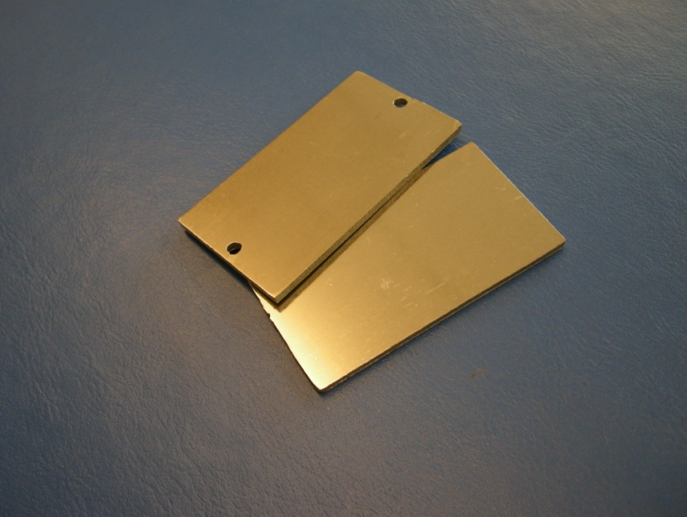
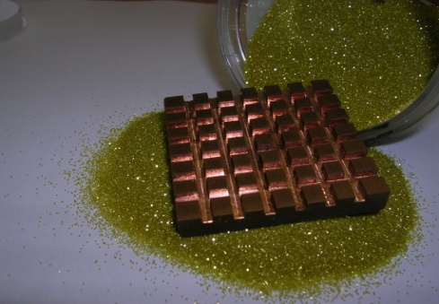
ARC
Task V: Shaping/Surface Finishing
Good surface quality can be realised by:
preparation of sandwich structures
or bi-layer structures
“Machining/Cutting” of composites is possible by:
Water Jet Cutting
Laser Cutting
Electro Discharge Machining
11

Slide 12
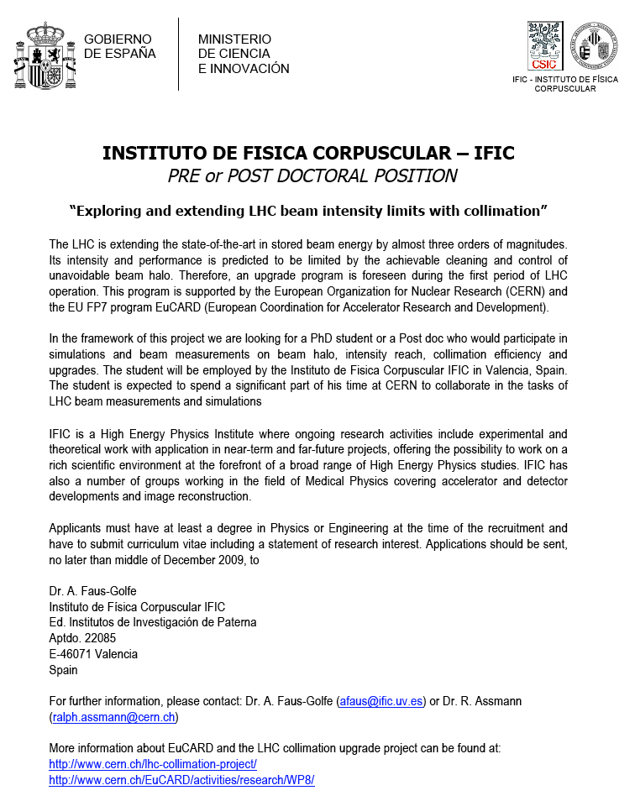
Jobs
University of Malta (PhD):

Slide 13
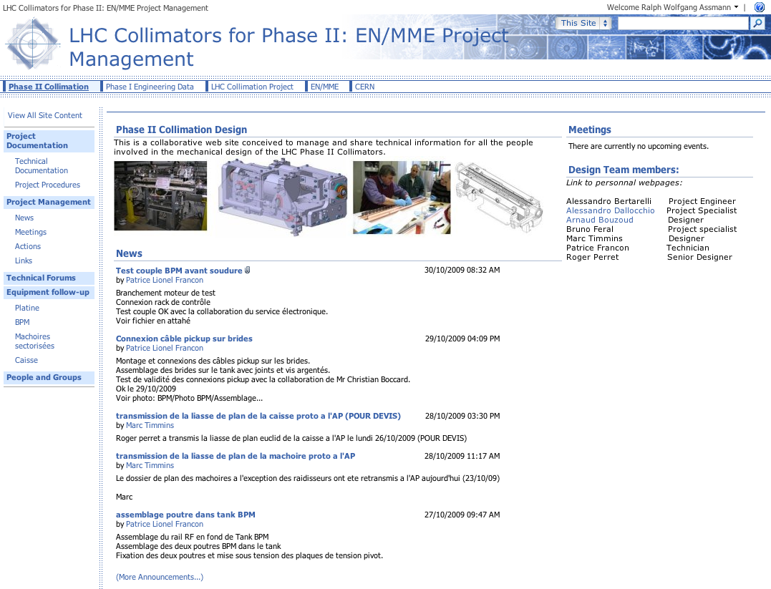
CERN Highlights
Note:
EuCARD complements the CERN effort.
EuCARD results from partners channel directly into this prototyping work.
Expect 2-3 iterations.

Slide 14
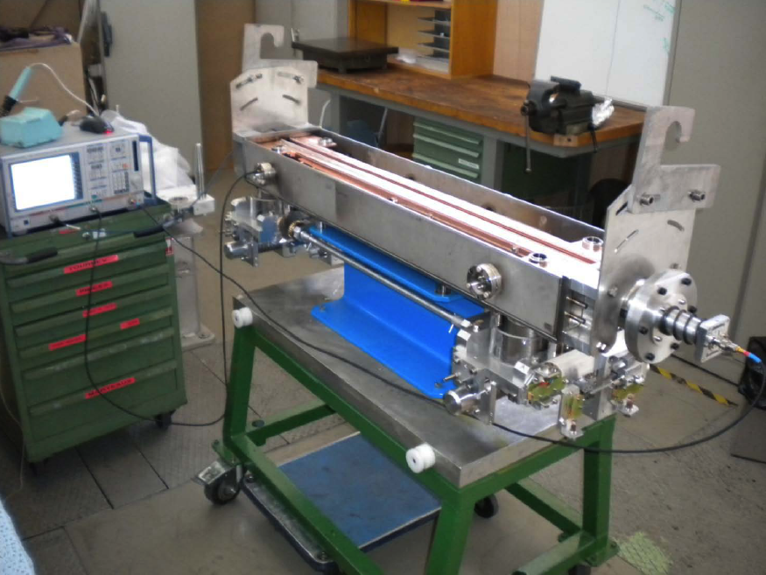
Deliverable Phase II LHC Collimator
Prototype Phase II collimator being finalized for installation into the SPS end of January 2010.
Material: CFC
Phase II: BPM buttons in jaw.
Lab tests completed very satisfactory.

Slide 15
Lab Measurements (beam represented by stretched wire)
C. Boccard
M. Gasior

Slide 16
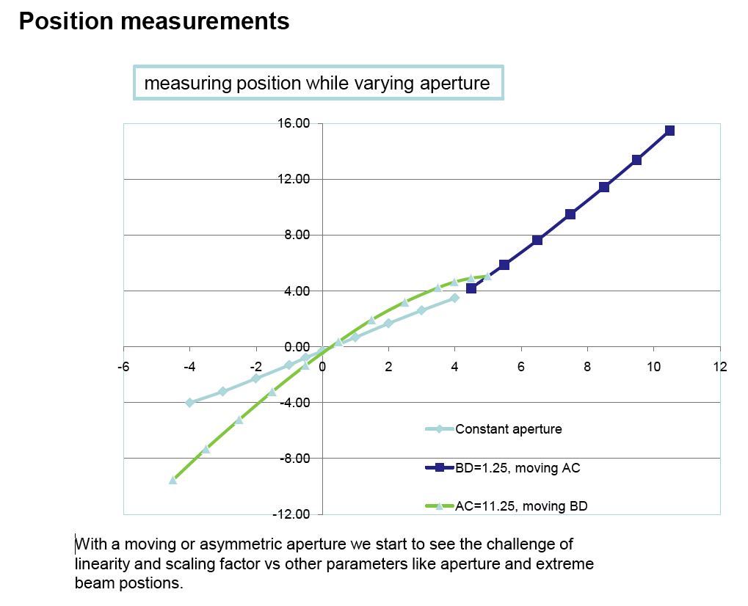
Lab Measurements (beam represented by stretched wire)
C. Boccard
M. Gasior

Slide 17
Conclusion
Apologize to all ColMat partners if I did not mention their activity in more detail. All work is very important for the overall success.
Results are coming together very nicely.
First “EuCARD/ColMat hardware” to be installed for beam tests end of January 2010.
Additional important work is done by collaborators in the US.
GSI related work to be reported on by Jens.

