Slide 1
WP9 – NCLinac
Status 5th November 2009
Grahame Blair/RHUL
Erk Jensen/CERN
3rd EuCARD SC Meeting
LNF, 5-Nov-2009

Slide 2
NCLinac: people (Task and Partner matrix)
 | Coordination | High Gradient | Stabilisation | BDS | Phase control
CERN | Jensen | Riddone | Modena, Hauviller, Mainaud-Durand, Vorozhtsov |  | Andersson, [Needed]
CIEMAT |  | Toral, Carillo
CNRS/LAPP |  |  | Jeremie
INFN/LNF |  |  |  |  | Marcellini, Franzini
PSI |  |  |  |  | Dehler
RHUL | Blair |  |  | Blair, Boogert
STFC/ASTEC |  |  |  | Angal-Kalinin
UH |  | Österberg, Nordlund, Djurabekova, Pohjonen, Houpana
UNIMAN |  | Jones, D’Elia |  | Appleby
UOXF-DL |  |  | Burrows, Urner
UU |  | Ziemann, Ruber

Slide 3
Planning Updated mpp file:

Slide 4
Task 9.2: Normal Conducting High Gradient Cavities
Sub-tasks (Co-ordination: CERN):
PETS (CIEMAT)
HOM Damping (UNIMAN)
Breakdown simulation (UH)
Instrumentation (UU)
Precise Assembly (UH)
There was a review 22-June-09 (see http://indico.cern.ch/conferenceDisplay.py?confId=62294)

Slide 5
9.2.1: PETS/CIEMAT
The technical design of the “double length PETS” was completed by CIEMAT.
… includes 3-dB splitter with choke mode flanges.
Technical specifications available in EDMS.
Klystron + PC (optional)
82(72) MW
78 (68.7) MW
10(12) A
108 (81) MW
78 (68.7) MW
Existing 1 m PETS with re-circulation
0.5 m PETS
7 (10) MW
65 MW
65 MW
10 MW
10 MW

Slide 6
9.2.2: HOM damping/UNIMAN
UNIMAN has investigated an alternate design using strong detuning and moderate damping (so-called manifold damping).
During the first 6 months of EuCARD, UNIMAN investigated wake function suppression in structures.
Another approach followed was to place wake zero-crossings near the locations of subsequent bunches.
Studies were also initiated on relaxed parameters with an 8 λ bunch spacing (baseline: 6 λ).
Technical note on the residual stresses analysis during fabrication of accelerating structure disks.
The design of a set of accelerating structures to suppress the wake fields in the CLIC linac has been performed.
A 3-D model and 2-D drawings for the prototype phase of the symmetrical disks of the RF accelerating structures were prepared.
The drawings are available in EDMS.

Slide 7
9.2.3: Breakdown simulations/UH
UH is developing a multi-scale model to understand the electrical breakdown in CLIC components. Two activities are pursued in parallel:
Understanding the energetics and dynamics of surface asperities (“tips”) using a novel hybrid electrodynamic-molecular dynamics model,
Simulation of the plasma development and surface damage during the breakdowns.
During the last months, the Joule heating effect of tips has been integrated. The initial results clearly show heating, as expected.
In collaboration with Ralf Schneider and Konstantin Matyash (IPP Greifswald), a 1-D particle-in-cell (PIC) plasma simulation has been implemented. This describes the development of the arc plasma after the onset of the plasma development.

Slide 8
9.2.4: Instrumentation/UU
UU mainly focused on the definition and preparation of the new MTV OTR stations near the end of TBTS for emittance measurements. The mechanical engineering is presently ongoing in Uppsala.
For the TBTS upgrade, the electrical design of detector plates of the new flashbox has been carried out.

Slide 9
9.2.5: Precise assembly/UH
For the high-precision assembly of RF structures, several activities are on-going in parallel:
The study of the assembly test using the elastic averaging method for high precision alignment has been completed for the accelerating structures made of quadrants. Investigation for the PETS octants is under way.
A finite element modelling of residual stresses in manufacturing and assembly has been developed to understand the mechanical behaviour of the manufactured disks and the final accelerating structure assembly.
The design of the support for the accelerating structures and the PETS in the CLIC module has been started.
A Technical note on the residual stresses analysis during fabrication of accelerating structure disks. The note is available in EDMS.

Slide 10
Task 9.3: Linac & FF Stabilisation
Sub-tasks:
CLIC quadrupole module (CERN, LAPP)
  Stabilisation/CERN
  Stabilisation/LAPP
  Prealignment/CERN
  Magnets/CERN
Final Focus Test Stand
  Interferometry at ATF2 (UOXF-DL)
  Beam Dynamics simulations & Feedback (CERN, LAPP)

Slide 11
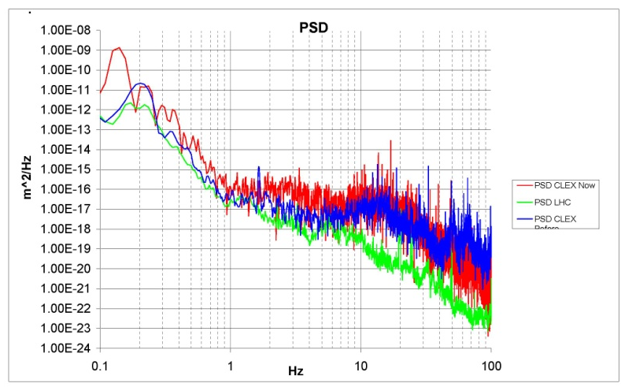
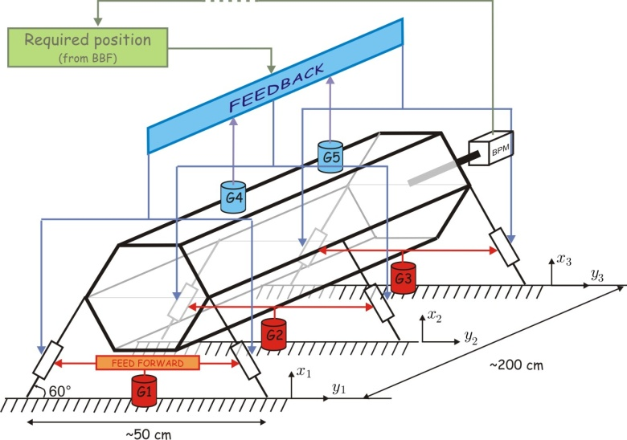
9.3.1.: Stabilisation/CERN
Measurements of vibrations have been performed in different sites, at CERN and other accelerators, both in surface buildings and in underground tunnels. Analysis of these measurements together with a precise estimation of the noise levels has led to reference curves in all the three special directions.
Design of various components of the CLIC quadrupole module (magnet, supports, alignment system, and stabilization system) is advancing well together with the study of their integration. Small demonstration mock-ups are being developed and tested; on one of them, the RMS value of the displacement with stabilization on has already been measured to 1.2 nm, the best value ever obtained without a specific heavy table.
State of the art reports for sensors and actuators are rather well advanced.

Slide 12
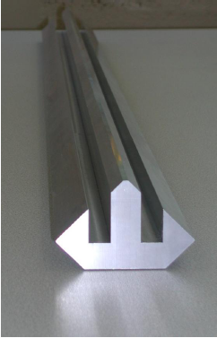
9.3.1.: Stabilisation/LAPP
The study of different damping devices has been performed, in particular in the context of the instrumentation needed. Different sensors have been characterized and used in an active damping device. However, the most promising sensors have shown some long term effects of degradation. The study of the sensors will need some more attention. The conclusion of this study can be found in a published report.
In addition, work has been done towards the advancement of the procurement of a test MB quadrupole. Simulations have been done on the current MB magnet and have shown that the first vibration modes are at high enough a frequency.

Slide 13
9.3.1.: Pre-alignment/CERN
Three solutions were considered for the repositioning system. It was found that:
Hexapod structures provide low rigidity and low eigenfrequency.
Wedge systems can provide larger contact surface, which leads to higher contact friction, which is not recommended in micrometric active alignment.
For these reasons, cam based alignment systems are proposed for the repositioning of the CLIC MB Quad. The cam based alignment system is a 3-point alignment system, with 4 interfaces with the settlement, providing 5 degrees of freedom (DOF). In the CLIC case, this system is mandatory to pre-align actively the MB quads with respect to the other components within a few µm, inside a sliding window of 200 m, all along the linacs, to allow the first beam to be sent.
With the solution for repositioning now chosen, we need to improve the existing solution to fulfil the CLIC micrometric requirements. A 1-DOF cam based system will be studied first. The manufacturing drawings are ready, and cost studies are being performed by the CERN main workshop. The market research on an alternative hardware is in progress: encoders and stepper motors will be ordered soon.

Slide 14
9.3.1.: Magnets/CERN
During the 1st half year of EuCARD, the activity on the procurement of the magnet prototypes for the CLIC stabilization studies has started and has reached advanced status compared to the milestones planned.
In April 2009 we have completed the design “For Tendering” of the Main Beam quadrupole prototypes.
Between May and July 2009 we have completed the procurement of the material for the above mentioned prototypes (Copper hollow conductor and low-carbon steel),
In July 2009 we have placed the order for the coils.
In September 2009 we have placed the order for the ultra-precise
machining of the poles (quadrants)

Slide 15
9.3.2 Interferometry/UOXF-DL
Progress has been made with developing the MONALISA system towards the ATF2 application. We have to operate our interferometer in vacuum to achieve the required resolutions. We custom-built a vacuum system between the ATF2 final focus quadrupole magnet and the Shintake table. This system uses vacuum bellows to allow adjusting the position of the quadrupole, but is designed to be essentially force-free. The system was brought to ATF2 and installed for a test. It was shown that the increase in vibrations between the Shintake table and QD0 is minimal and also that the Shintake monitor performance is not affected.
We also have interacted with the CLIC effort for quadrupole stabilization to plan for a MONALISA monitoring system on the CLIC mock-up quadrupole magnet project. A new digital feedback board has been fabricated and is undergoing testing.
NB.: This is advancing well, but the milestone 9.3.3, “Installation of ATF2 Final Focus Alignment Monitoring System”, which was due 9/2009, is late.
“A full installation of the MONALISA system has been delayed until the ATF2 experiment (in particular the Shinake monitor) is ready. The expected delay is 2 months.”

Slide 16
Task 9.4: Beam Delivery System
Sub-tasks:
ATF2 tuning and CLIC IR (UNIMAN, STFC)
High Precision BPMs (RHUL)
Laser-wire (RHUL)

Slide 17
9.4.1.: ATF2 tuning and CLIC IR (1/2)
Calculation of electromagnetic backgrounds at the IP of the established post-IP optics and layout for CLIC interaction region (R. Appleby, M. Salt/UNIMAN).
Publication at PAC09 (WE6PFP070) focusing on the IP photon background from the 1st post-IP collimator.
Subsequent work has implemented new forms of electromagnetic cascade biasing in GEANT4 and BDSIM to let this work be extended to the downstream collimators and the intermediate dump.
A full understanding of the post-IP radiation field and backgrounds is a critical part of an optimised design and milestone 1 of this Subtask, and essential for the post-IP part of the CLIC CDR.
James Jones (ASTeC) and Deepa Angal-Kalinin (ASTeC) have been working on the design of a dogleg to pass the photons from the undulator to the target in the ILC BDS. This work has provided an important input to the new baseline considerations for ILC.

Slide 18
9.4.1.: ATF2 tuning and CLIC IR (2/2)
The design has been presented at ILC-CLIC LET workshop, CERN, June 2009 with preliminary tolerance requirements on the magnets.
Overall matched lattices and layouts were presented at ALCPG09 (D. Angal-Kalinin), September’09, Albuquerque. The layout drawings were made by Daresbury engineering staff interacting with J. Jones and D. Angal-Kalinin.
The work on orbit correction at ATF2 continued till July’09 (A. Scarfe, Ph.D. student @Manchester). The dispersion correction algorithms are being studied by J. Jones. D. Angal-Kalinin visited ATF2 in April 2009 to understand the tuning procedures. A paper was presented on “ATF2 spot size tuning using the rotation matrix”, A. Scarfe, R. Appleby, J. Jones and D. Angal-Kalinin at PAC09.
The work on the development of CLIC extraction line and integration to IR region is now very well advanced, with the optics of the extraction line baseline frozen and optimised. The design was published in PRST earlier this year. This milestone will be met, and fully documented. The IR integration will happen with K.Elsener and A. Sailer, who are working on a complete model of the IR.

Slide 19
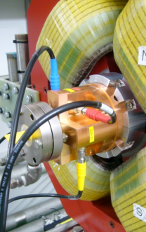
9.4.2.: Cavity BPM’s/RHUL
The ATF2 cavity BPM system has been installed at KEK and commissioning has started. Most C-band BPMs were tested with beam over this reporting period.
Numerous hardware and system integration problems were resolved and the preliminary results were presented at PAC09.
The full ATF2 BPM system was completed. The system
has been tested with radio frequency test tones without
beam and is achieving expected performance.
A complete analysis and control system has been
developed to process data from the approximately
40 BPMs (Boogert). The raw and processed data has
been distributed to the ATF1/2 control system and
lattice-tuning operations such as beam based alignment
and dispersion correction have started. Commissioning
has started.

Slide 20
9.4.3.: Laserwire/RHUL
The laser-wire at PETRAIII was installed in Spring 2009 and first data was successfully taken over the summer.
Significant improvements to the DAQ system have enabled some of the work to be performed remotely.
Work is ongoing to integrate the DAQ fully into the PETRA online system. The ATF2 laser-wire system has been relocated to its new location.
The laser system has also been relocated and is awaiting the interlocks to be checked and approved by KEK.

Slide 21
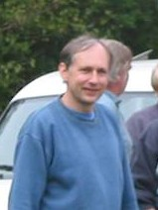
9.5: Drive Beam Phase control
Subtasks:
RF Monitor (INFN/CERN)
Electro-Optical Monitor (PSI/CERN)
We’re all immensely saddened by the death of Jonathan Sladen on May 19th 2009!
21

Slide 22
9.5.1. RF Monitor /INFN
Specification of the monitor is completed. The BW should be about 30-50 MHz. This would allow the correction of the bunch phase also along the pulse (241ns long) coming out of the Combiner Ring 2. To limit the SNR, no amplifiers will be used for the pick-up output signal. Then its level should be of the order of few watts. The prototype will be tested in CTF3 chicane region upstream of the Delay Line. The pick-up dimensions should fit the mechanical constraints of this region.
The electromagnetic design of the pick-up is in progress. A system to reject all the possible modes of propagation of the RF noise has been studied and designed. The coupling between RF noise and the pick-up is below -40 dB.

Slide 23
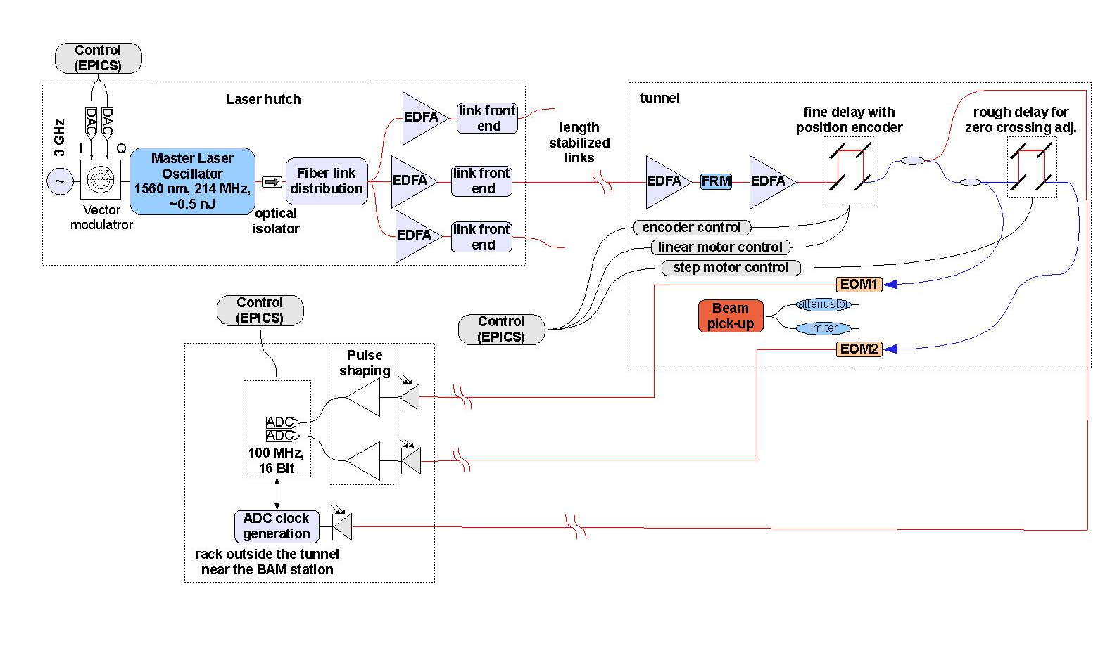
9.5.2. Electro-optical system/PSI
The activity of this subtask concerns the so called Beam Arrival-Time Monitor (BAM). It is a part of a more complex optical system, which synchronizes diverse laser, RF and diagnostic stations.
The development of a BAM prototype includes the design and assembly of one complete chain, consisting of the master laser oscillator, a length stabilized fibre link and the BAM itself. A layout of the system is shown in the figure below.
Status:
Conceptual design for the overall
system: finished.
Pickup: Electrical and mechanical
design finished, fabrication
started.
Optical link and stabilization:
All components ordered
BAM front end:
  Design finished
  One prototype for stepper motor ordered and under evaluation

Slide 24
9.5.1 and 2. Electronics/CERN
Work has started on acquiring parts for the detection electronics at 12 GHz. A low noise local oscillator has been identified, and will be purchased in 2010. Preliminary test of mixers have been performed and devices adequate to the task tentatively identified.
The work for subtasks 1 and 2 is progressing according to schedule. The electronics development for both has however received a major setback by the sudden death of Jonathan Sladen. We do not see a possibility to replace him very soon; Alexandra Andersson has kindly accepted to dedicate 10 % of her time. However, an impact on the overall progress must be anticipated.
We’re hoping to take advantage of synergies with advances of the relevant electronics at light sources (PSI, X-FEL, …)

Slide 25
Summary WP9 - NCLinac
NCLinac has had a good start.
Milestone 9.3.3 is late by approx. 2 months,
… all other tasks and subtasks make progress according to plan.
More than 20 publications during the first semester!
9.5/electronics needs attention, we have sadly lost one key member of our team at CERN.

