Slide 1
wP5: HiRadMat@SPS – Status report
Outline
HiRadMat – overview/reminder
Project : status – work plan
Web pages - Open access
Summary
I. Efthymiopoulos – CERN
EUCARD Steering Committee Meeting
INFN-Frascati, November 4-5, 2009

Slide 2
The HiRadMat Facility
What is it?
Study the impact of intense pulsed beams on materials
Thermal management (heating)
material damage even below melting point
material vaporization (extreme conditions), cavitation
Radiation damage to materials – change of properties
Thermal shock - beam induced pressure waves
Test bed, important for the design validation of LHC near-beam components before installation in the machine
Requires LHC-type beam from pilot to 288 nominal bunches
Foreseen clients : LHC collimators, protection devices, machine components, material studies (bulk, superconductors), high-power targetry, irradiation tests of electronics

Slide 3
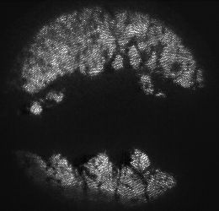
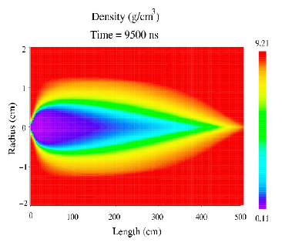
The HiRadMat Facility
Examples
High-intensity beam on a solid target
MERIT experiment: High-intensity beam on a liquid Hg-target
LHC collimator: Displacement analysis – 500kW load case for 10s
Loss rate 4x10¹¹ p/s (Beam Lifetime 12min)
High Energy Density Plasma formation, proton “Tunneling Effect”

Slide 4
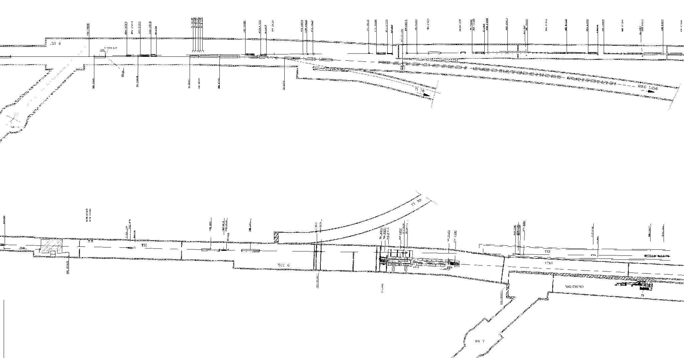
The HiRadMat Facility
Primary beam layout
TT60
Beam
SPS
TT66 line (new)
TI 2
Beam
End of common part
with TI 2 transfer line
50 m
T9 target area / TNC
C. Hessler, 26/01/09

Slide 5
The HiRadMat Facility
Primary proton/ion beam parameters
Beam in shared mode during SPS operations
Parameter | Unit | Value (proton beam) | Value (lead ion beam)
Beam energy | GeV | 450 | 36.9×10³ (177.4 GeV/n)
Bunch intensity | particles | 5×10⁹ to 1.15(1.75)×10¹¹ | 5×10⁹ to 4.1×10¹⁰
Bunch length | cm | 11.2 | 11.2
Number of bunches | - | 1 – 288 | 1 – 592
Bunch spacing | ns | 25 | ≥ 25
Pulse energy | MJ | 2.4 | 28×10⁻³
Pulse length | μs | 7.2 | 7.2
Peak power | GW | 340 | 2.3
Normalized emittance (1σ) | μm | 3.5 | 1.4
σ_{x} × σ_{y} at exp. (baseline) | mm² | 1.0 | 1.0
σ_{x} × σ_{y} at exp. (request) | mm² | 0.25 – 4.0 | 0.25 – 4.0
Integrated beam intensity (protons) |  | 10¹⁶ protons/year 10 experiments × 10¹⁵ protons(max)/exp ~30÷100 extractions/exp

Slide 6
The HiRadMat Facility
Irradiation area layout: TT66 line & TNC tunnel
Test area
~10 m long. space upstream the T9 target
[1.5,3.0] m lateral space
Possibility for fast installation of experiments
Cool-down space downstream the TNC tunnel
If requested, areas for test of electronics or component irradiation can be prepared

Slide 7
The HiRadMat Facility
Design parameters for the experimental area
Specification document
Parameter | Value
Experiments per year | 10
Maximum intensity per experiment | 1×10¹⁵ protons <30 full intensity pulses
Waiting time after experiment for de-installation | ≥ 2 weeks
Access during experiment (except urgent interventions) | no
Control of experiment and data taking | remote
Maximum intensity per year | 1×10¹⁶ protons
Parameter | Value
Installed experiments | 1
Material exposed to beam | C, CFC, Cu, W, hBN, Al, Be, …, advanced composite materials
Volume of exposed material | ≤ 16,800 cm³
Equipment size Length (flange-to-flange) Width Height below beam line Height above beam line | ≤ 7.0 m ≤ 1.0 m 1.1 m ≤ 0.8 m
Weight | ≤ 4,000 kg
Handling zone (L × W × H) | 15 × 2.0 × 2.2 m³
Equipment support | comes with experiment – quick installation interface required
Cool-down space | see equipment size
Crane support | mobile cranes sufficient
Handling | prepare fast handling and remote installation with crane
Additional requirements for the exp. area will depend on the type of equipment and test planned
Safety and RP constraints should come in addition

Slide 8
The HiRadMat Project
Overview - reminder
The facility was originally proposed by R. Assmann in 2006 and included as part of the new initiatives program of CERN. A working group, coordinated by R. Assmann, did a conceptual design. The results were presented to A&T sector management in February 2009, and a summary specification document is under publication.
The creation of the HiRadMat facility was included and recommended in the summary Memo from the CERN Irradiation Facilities WG (Lucie Linssen/PH – chair)
The HiRadMat Project was approved in summer’09 and included in the CERN MTP for 6MCHF
Project leader : Ilias Efthymiopoulos (EN/MEF)
Target dates : First beam in the facility by June 2011 then two months of commissioning, first users by Q4 2011
HiRadMat is also included in the EUCARD/FP7 project as Transnational Access
http://eucard.web.cern.ch/EuCARD/activities/access/
Funds available to support EU users for the exploitation of the facility – within limits!

Slide 9
The HiRadMat Project
Project structure
A & T Sector Mgmt
HiRadMat Facility Project
Project Leader : I. Efthymiopoulos
Deputy PL : S. Evrard
IEFC Committee
Project Team
Operation
User Selection Panel
Primary beam WG
M. Meddahi, C. Hessler
Beam Commissioning
M. Meddahi
WANF Dismantling WG
S. Evrard, Hel. Vincke
Operation & Maintenance
CCC, M. Lazzaroni (superintendent)
Irradiation area WG
A. Pardons, S. Evrard
User support Team
EN/MEF
SPS & LHC Physics coordinators & scientific committees
Safety:, L. Bruno, GS, E. Paulat
RP issues: Y. Algoet, L. Ulrici
Planning : H. Gaillard, N. Gilbert
Integration : M. Lazzaroni
External collaborators : SLAC team
Users : invited/informed (R. Assmann, B. Goddard, R. Schmidt, J. Blanco-Sancho…)

Slide 10
The HiRadMat Facility
Status
Ongoing work to finalize the functional specifications for the facility.
First contact to (known) users for Beam Request Survey
WGs starting their work : prepare work packages and contact various groups for resources and budget estimates
Project review January 19-20, 2010
A doctoral student funded by EUCARD will start on April’10 – focus on RP issues for the design and operation of the faclity
Schedule guidelines:
Access in BA7/TCC6 is limited due to LHC operation. Try to profit the most from the foreseen LHC technical stops (~3 days/month) → flexibility !!!
Plan :
dismantling from WANF equipment completed in 2009/2010 → access limitations
installation of new TT66 beam line and irradiation area in TNC in 2010/2011 shutdown → competition with other shutdown works in the injectors after the 20month operation
Very challenging!

Slide 11
The HiRadMat Facility
Tentative schedule
Preliminary &
Very challenging !!!

Slide 12
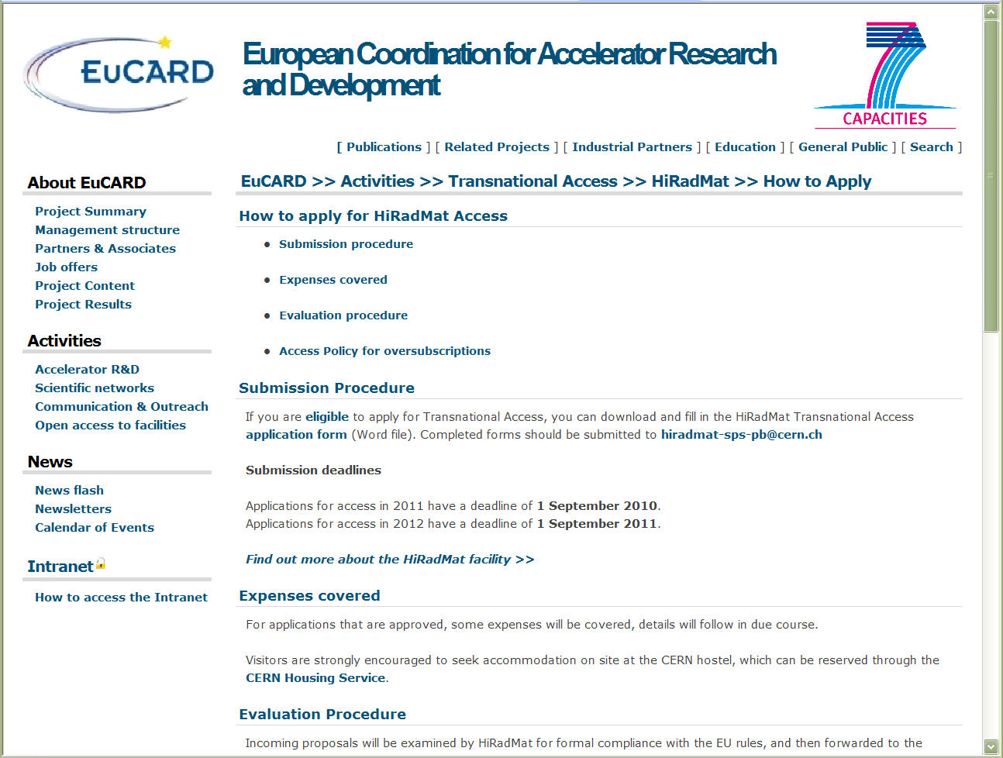
EUCARD/WP5 – HiRadMat Facility @SPS
Status
Web pages for project and open access available
http://cern.ch/hiradmat - http://eucard.web.cern.ch/EuCARD/activities/access/
Article in CERN Courier in 2010 to advertize the facility? – other ideas?

Slide 13
EUCARD/WP5 – HiRadMat Facility @SPS
Status
First contact with the users
Known colleagues (~35) from CERN and outside labs
LHC equipment: obstacles, vacuum, beam instrumentation, electronics
Target R&D : isolde, neutrino beams
Material R&D
Asked to fill BeamRequestSurvey form as feedback for the design specifications of the facility → stakeholders
Doctoral student funded by WP5 selected
Will start on April’10 with FLUKA simulations for RP characterization and access conditions for the facility
Most likely his Ph.D will be submitted at EPFL (Prof. L.Rivkin)

Slide 14
EUCARD/WP5 – HiRadMat Facility @SPS
Summary
The HiRadMat project is getting into shape
Excellent team and WG coordinators
Project review last week of January 2010
Q4 2011 as target date for user access remains, but the schedule is very challenging – we’ll do our best to make it!
Leaves ~7(11) weeks in 2011 + full 2012 run for users/open access
WP5/Transnational Access EUCARD web pages done
First official announcement to users for Beam Request Survey → 8 replies so far, more to come…
Next step: finalize user selection procedures and related documentation
Thank you!

