Slide 1

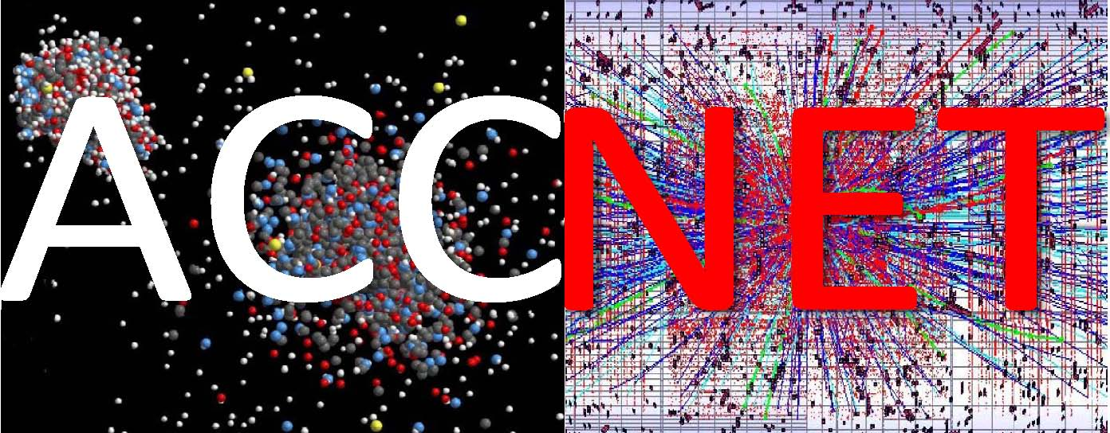
EuCARD WP4 Accelerator Networks
Walter Scandale, Alessandro Variola,
Frank Zimmermann
EuCARD Steering Committee Meeting
Frascati, 4 November 2009

Slide 2
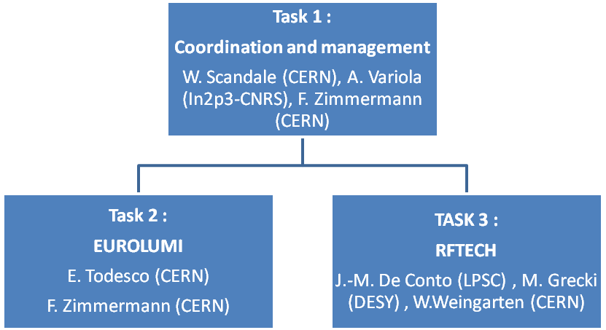
network structure

Slide 3
tasks & participants
Task 1. AccNet Coordination and communication
oversee and coordinate the EuroLumi and RFTECH networks; ensure the consistency of WP work according to the project plan; organization of AccNet internal steering meetings; reporting to project management; organization of activity workshops with participants from inside and outside tconsortium
Task 2. EuroLumi
European forum for discussing performance limitations of high-intensity high-brightness accelerators, with emphasis on hadron facilitieshelp analyze and optimize proposed upgrades; also explore advanced future schemes such as proton driven plasma acceleration and medical applications of accelerators; coordinate and integrate activities of accelerator and particle physics communities towards realizing full potential of LHC, by means of LHC luminosity upgrades and new or enhanced LHC injectors; also support the SIS upgrade and the FAIR project at GSI ; interface to US-LARP -
institutes with interest: BINP (RU), BNL (USA), Bologna U (IT), CERN (International Organization), CI (UK), CINVESTAV (Mexico), CNRS-LAL (FR), CNRS-LPSC (FRS), CSIC-IFIC (ES), DESY (DE) , FNAL (USA), GSI (DE), IHEP (RU), INFN–LNF (IT), INFN-NA (IT), JINR (RU), KEK (JP), RCC KI (RU), LBNL (USA), MPP (DE), RHUL (UK), Sannio University (IT), SLAC (USA), STFC (UK), TEMF (DE), Texas A&M (USA), TU Berlin (DE), UJF (FR), UOM (M), UPSA (SE).
Task 3. RFTECH:
coordinate and integrate the European development of RF technology for future particle accelerators; all aspects of RF technology, e.g. klystron development, RF power distribution system, cavity design, and low-level RF system, for linear accelerators and storage rings, including transversely deflecting (crab) cavities and financial aspects such as costing tools -
institutes with interest:: BNL (USA), CEA-DSM (FR), CERN (International Organization), CI (UK), CNRS-LPNHEP (FR), CNRS-LPSC (FR), DESY (DE) , FNAL (USA), GSI (DE), INFN –LNF (IT), JLAB (USA), KEK (JP), LBNL (USA), IFJ PAN (PO), SLAC (USA), STFC (UK), TEMF (DE), THALES (FR), TSDA (DE), TU Berlin (DE), TUL (PO), UJF (FR), UOM (M), UPSA (SE), UROS (DE), WUT (PO).

Slide 4
AccNet achievements & issues
(invited) talks at PAC 2009, EPS HEP2009 & LLRF09 conferences
AccNet workshop on LHC crab cavities, LHC-CC09, September 2009
AccNet-EuroLumi workshop on anti-e-cloud coatings, AEC’09, Oct ‘09
AccNet web site at LAL, including possibility of editorial access
AccNet mailing lists
contact persons from all participating institutes for both networks
man power and budget plans (preliminary)
new contacts with plasma acceleration and medical accelerators
AccNet dissemination
two articles in 2nd EuCARD newsletter (LHC-CC09+AccNet &proton plasma acceleration
two seminar talks at DESY and University of Heidelberg
CERN Academic Training lecture series on LHC upgrade
AccNet outstanding issues
publication of EuCARD documents, man power changes, payments,
reimbursement procedures and rules, especially for external experts

Slide 5
AccNet deliverables
D.4.1.1 - Continually updated AccNet web site http://accnet.lal.in2p3.fr/ )
D.4.2.1 - A continually updated EuroLumi web site (http://accnet.lal.in2p3.fr/Tasks/Eurolumi/ )
D.4.3.1 - A continually updated EuroLumi web site (http://accnet.lal.in2p3.fr/Tasks/Rftech/ )
The AccNet web sites are documented in a report https://edms.cern.ch/file/1001866/4/EuCARD-Del-D4.1.1-D4.2.1-D4.3.1-1001866-v3.0.pdf
The completed deliverables are publicly available from the web link http://cern.ch/EuCARD/about/results/deliverables/ .

Slide 6
AccNet milestones
M.4.1.1
– 1st RFTech videoconference steering meeting 30 March
– general AccNet Steering meeting during this 2nd EuCARD Steering Committee meeting in November 2009 at Frascati.
M4.2.1:
– Instead of a general annual EuroLumi workshop, 3-5 topical mini-workshops are being organized and supported during this first year (high efficiency of topical workshops; minimum interference with LHC consolidation and re-commissioning): LHC-CC09, AEC’09, CrystalCollimation’09, medical applications, proton plasma acceleration
– first major EuroLumi workshop in spring or fall 2010
M4.3.1:
– Annual RFTECH workshop. Deadline March 2010 (month 12).

Slide 7
AccNet man power
originally 1 person-month / year / coordinator
(12 person months for CERN)
CERN man power cut to 11 person-months during the
proposal iteration
integration of SRF test facilities (addt’l coordinator)
at CERN rematching of budget and FTE
(~2% of FTE per coordinating task)
Grant Agreement Annex I:
CERN 11 p-m, CNRS 4 p-m, DESY 3.6 p-m, UJF 5.6 p-m
(4-5 coord.’s, 1 coord., 1 coord., 1 coord.)
RFTech total coordinating manpower: 60 h (3 institutes)
(of which 16 h for CERN)

Slide 8
AccNet man power
Period: |  |  |  | 1.04.2009 - 30.09.2009
Task 1 of WP 4
 |  |  | man-power used
CERN |  |  | 40% (0.60 of 1.52 person-months)
CNRS |  |  | 100%? (of 0.50 person-months)
DESY |  |  | 61% (of 0.45 person-months)
UJF |  |  | 61% (of 0.70 person-months)
numbers in IR should be revised
I do not understand how the CERN budget numbers add up?!

Slide 9
AccNet expenses
per diem for Mexican summer student H. Maury (2 months)
travel support of CCAB member Georg Hoffstaetter
for LHC-CC09
travel support of visiting expert David Seebacher for AEC’09
moderate support for LHC-CC09 and AEC’09 workshops
travel expenses for 4 persons (DESY, WUT) attending LLRF’09
travel costs of coordinators for attending 2nd SC mtg.
have all these actually been charged to AccNet budget(s)?
(my impression is no …)

Slide 10
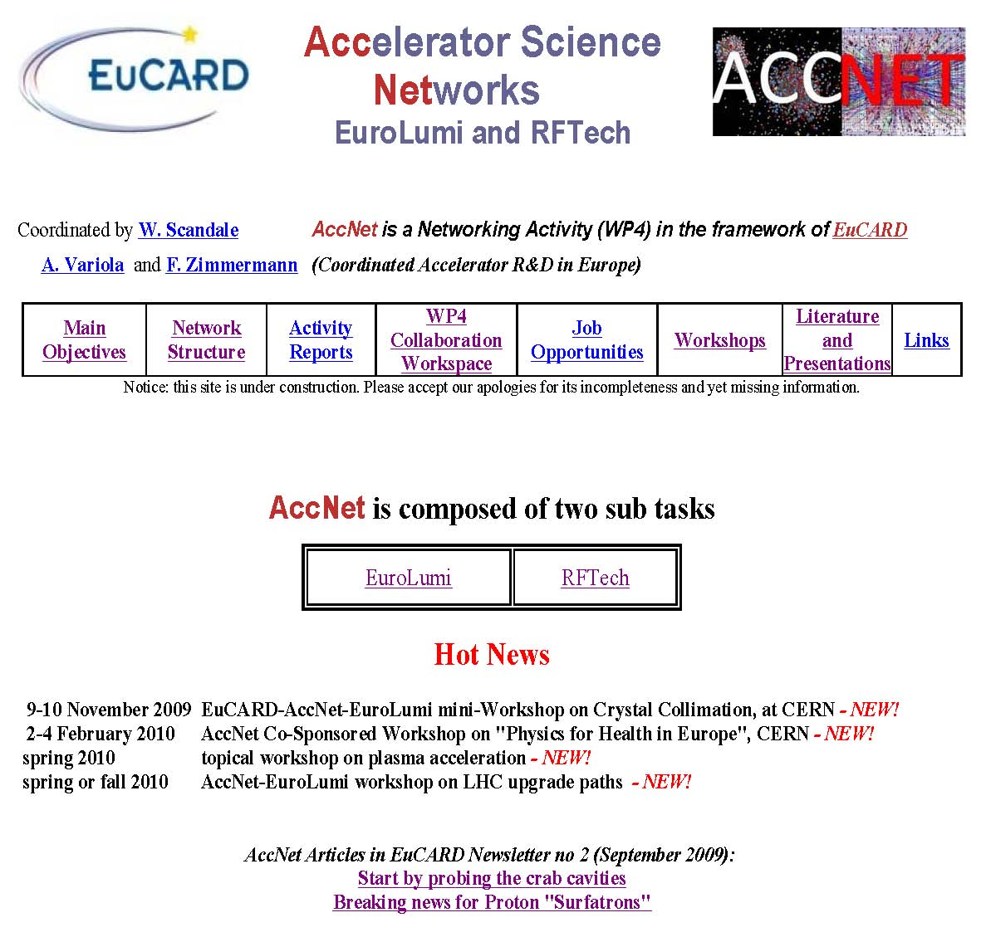
http://accnet.lal.in2p3.fr/
AccNet web site
created & maintained
by Bernard Mouton,
Serge Du, J. Yuan, and
Alessandro Variola (LAL)
updated by
Frank Zimmermann
(CERN)

Slide 11
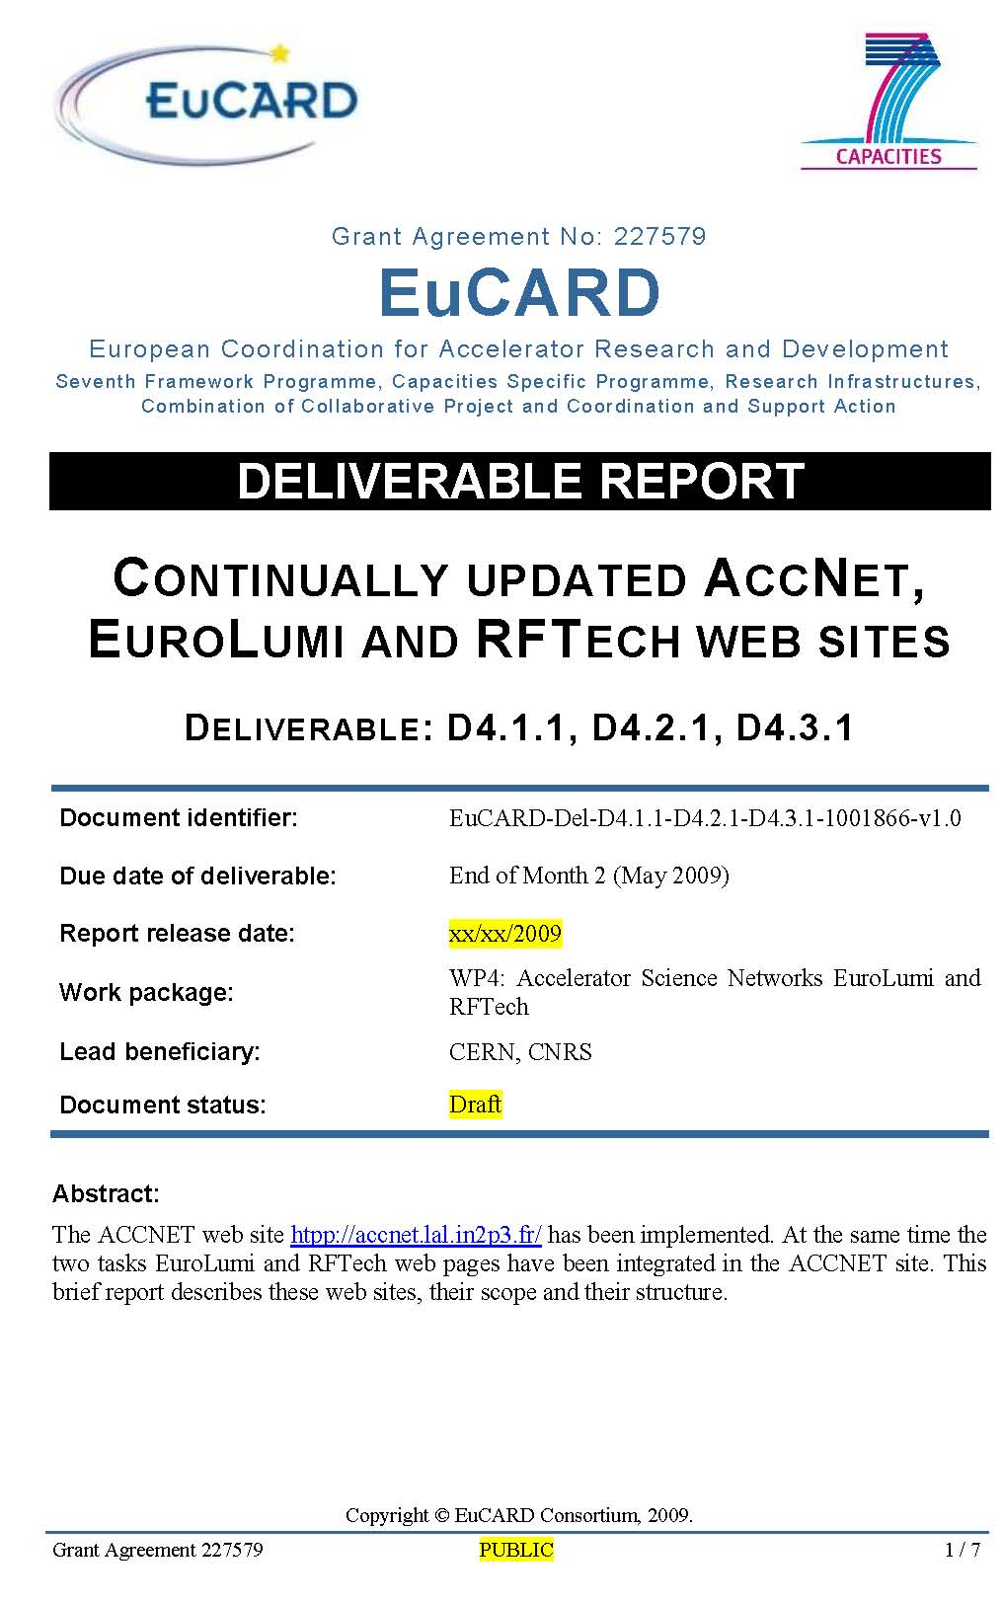
AccNet deliverables - documentation
“
Authored by B. Mouton
Edited by B. Mouton and K. Kahle
Reviewed by A. Variola
Approved by Steering Committee
“

Slide 12
AccNet list of contacts
Participating institutes
BNL (EUROLUMI)
CEA-DSM (RFTECH)
CERN (EUROLUMI, RFTECH)
CI (EUROLUMI, RFTECH)
CNRS-LAL (EUROLUMI, RFTECH)
CNRS-LPSC (EUROLUMI)
CSIC-IFIC (EUROLUMI)
DESY (EUROLUMI, RFTECH)
FNAL (EUROLUMI)
GSI (EUROLUMI, RFTECH)
INFN-LNF (EUROLUMI, RFTECH)
INFN-NA (EUROLUMI)
KEK (EUROLUMI, RFTECH)
LBNL (EUROLUMI)
MPP (EUROLUMI)
TEMF (EUROLUMI, RFTECH)
TSDA (RFTECH)
TUBE (EUROLUMI, RFTECH)
UJF (EUROLUMI, RFTECH)
UOM (EUROLUMI)
UPSA (EUROLUMI, RFTECH)
UROS (RFTECH)
USAN (EUROLUMI)
Linkpersons
BNL
• Rama Calaga, Wolfram Fischer, Steve Peggs, Angelika Drees,
CEA-DSM
• Romuald Duperrier,
CERN
• Walter Scandale, Ezio Todesco, Luca Bottura,Wolfgang Weingarten, Maurizio Vretenar, Frank Zimmermann,
CI
• Swapan Chattopadhyay, Peter McIntosh,
CNRS-LAL
• Bernard Mouton, Alessandro Variola,
CNRS-LPSC
• Maud Baylac
CSIC-IFIC
• Angeles Faus Golfe,
DESY
• Mariusz Grecki, Helmut Mais, Stefan Simrock,
FNAL
Chandra Bhat, Tanaji Sen, Vladimir Shiltsev, Alexander Valishev,
GSI
Oliver Boine-Frankenheim, Peter Huelsmann,
INFN-LNF
• Marica Biagini, Andrea Ghigo,Luigi Palumbo, Bruno Spataro,
INFN-NA
• Vittorio Vaccaro,
KEK
• Kazuhito Ohmi,
LBNL
• Miguel Furman,
MPP
• Allen Caldwell, Guoxing Xia,
TEMF
• Wolfgang F.O. Müller, Thomas Weiland,
TSDA
• Ralf Eichhorn,
TUBE
• Warner Bruns, Heino Henke,
UJF
• Jean-Marie De Conto,
UOM
• Nicholas Sammut,
UPSA
• Tord Ekelof,
UROS
• Hans-Walter Glock,Ulla van Rienen,
USAN
• Stefania Petracca

Slide 13
EuroLumi exchanges & joint studies
Mexican summer student Humberto Maury (CINVESTAV)
- e-cloud simulations for LHC upgrade scenarios
US-LARP physicist Chandra Bhat (FNAL)
- generation and stability of long flat bunches for LPA upgrade
US-LARP physicist Rama Calaga (BNL)
- LHC crab cavities
Austrian physicist David Seebacher (TU Graz & U. Vienna)
- impedance of anti-e-cloud coatings
US expert Georg Hoffstaetter
- LHC crab cavities
German experts Allen Caldwell, Guoxing Xia (MPI Munich)
- proton-driven plasma acceleration

Slide 14

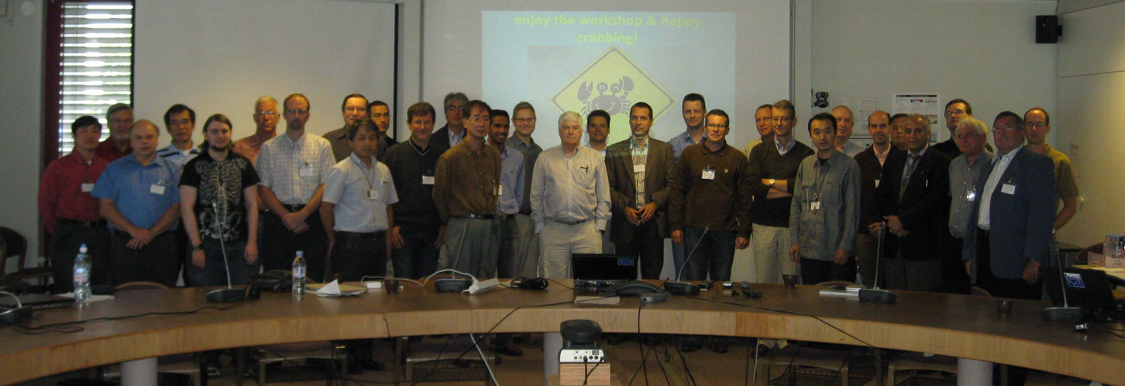
LHC-CC09 workshop
LHC Crab Cavity Workshop, jointly organized by CERN, EuCARD-ACCNET, US-LARP, KEK, & Daresbury Lab/Cockcroft Institute
CERN, 16-18 September 2009
~50 participants, LHC Crab Cavity Advisory Board established

Slide 15
CC-AB recommendations
KEKB success →“foolish” not to pursue crab cavities for LHC
Demonstration experiments to focus on differences between electrons and protons (e.g. effect of crab-cavity noise with beam-beam, impedance, beam loading) and on reliability & machine protection which are critical for LHC; beam test with (KEKB?) crab cavity in another proton machine (SPS?) useful and sufficient
Future R&D focus: compact cavities
Modifications of Interaction Region 4 during the 2013/14 shutdown
Crab cavity infrastructure to be kept in mind for all other LHC upgrades
Possible show-stopper: machine protection - effect of cavity trip; another issue is impedance
→ →→→→→
official statement from CERN management on LHC crab cavities
creation of task force for crab cavity prototype test in SPS

Slide 16
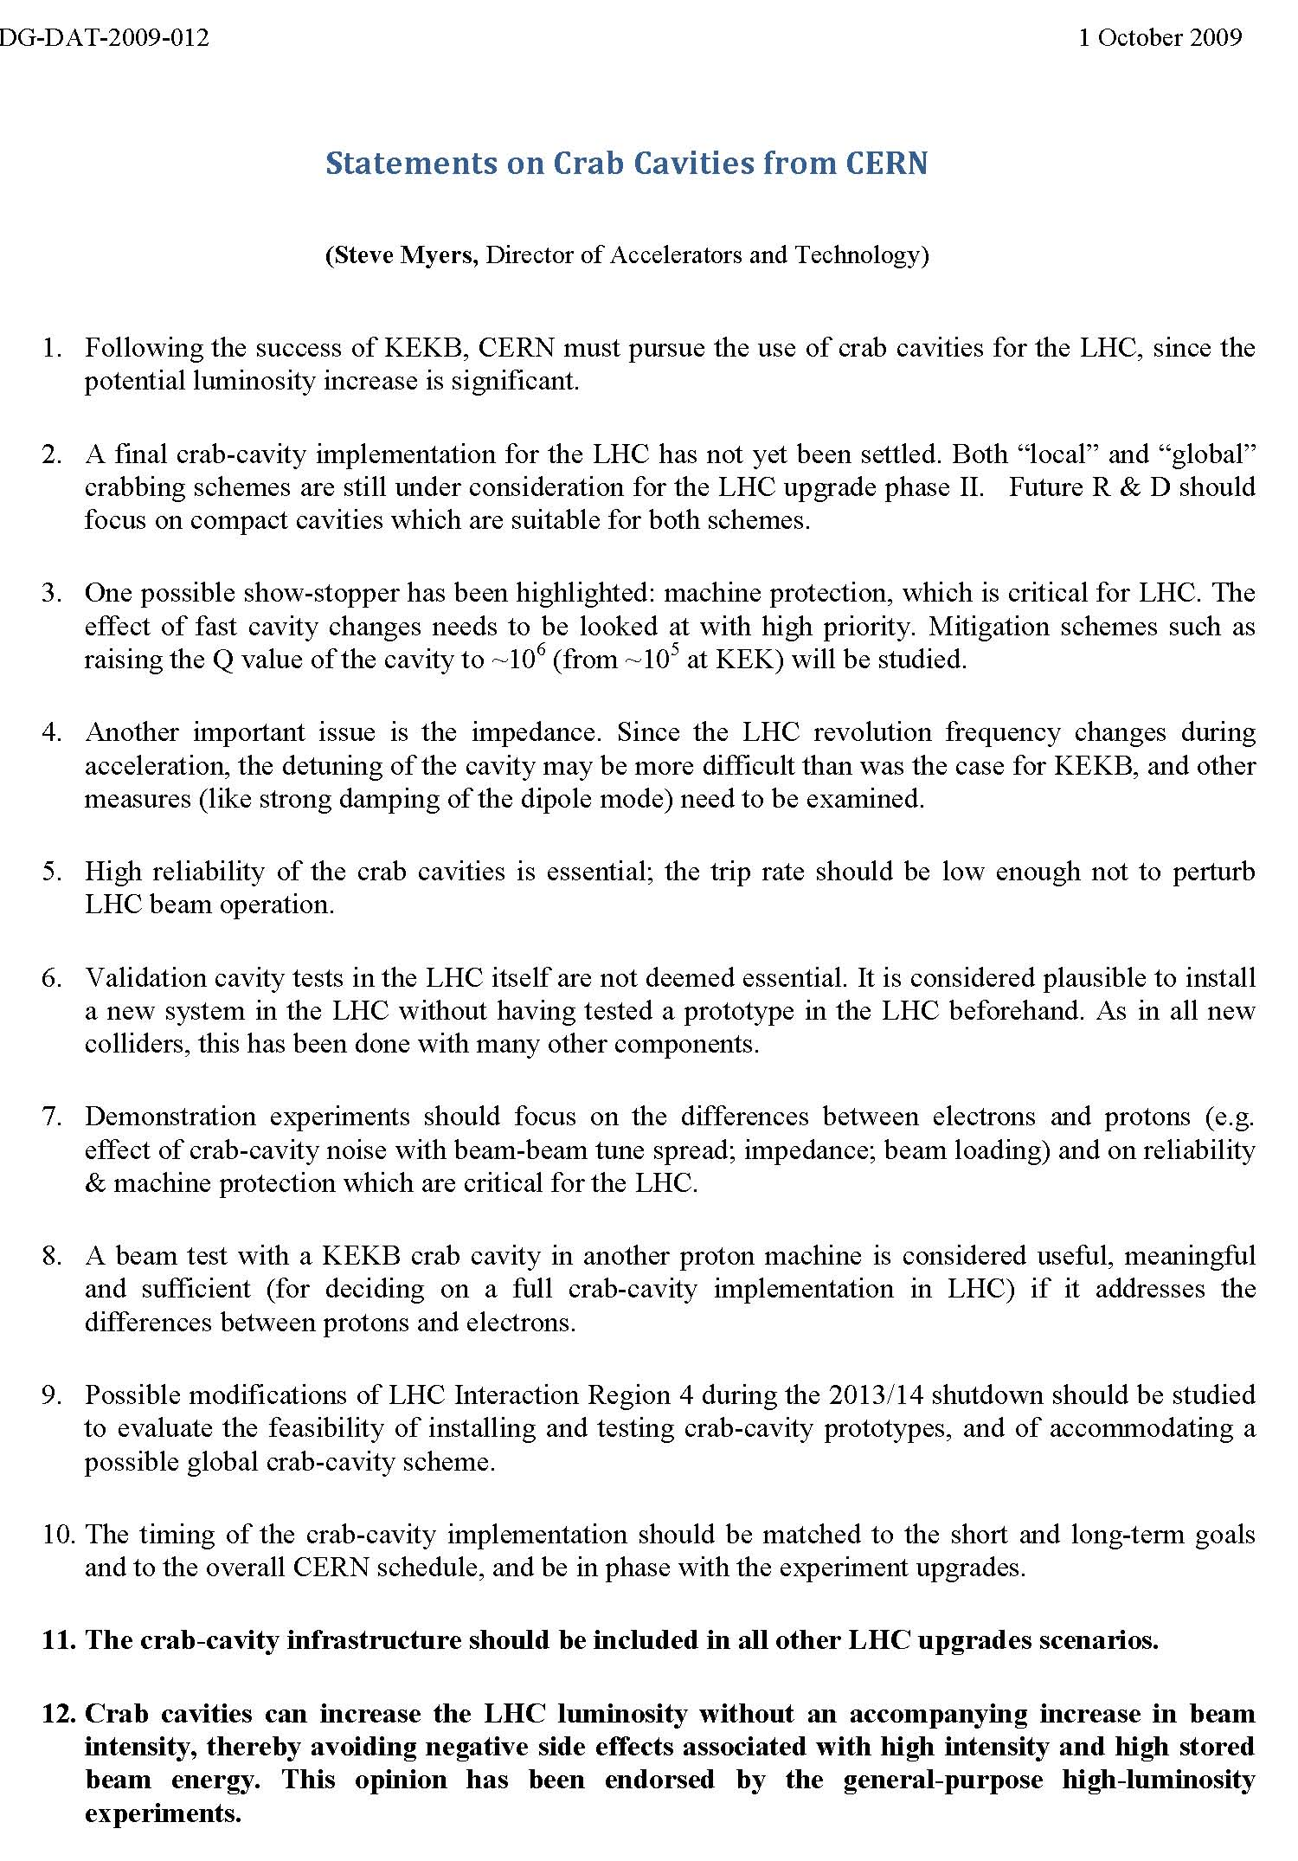
CERN statement on
LHC crab cavities issued after
AccNet
LHC-CC09 workshop

Slide 17
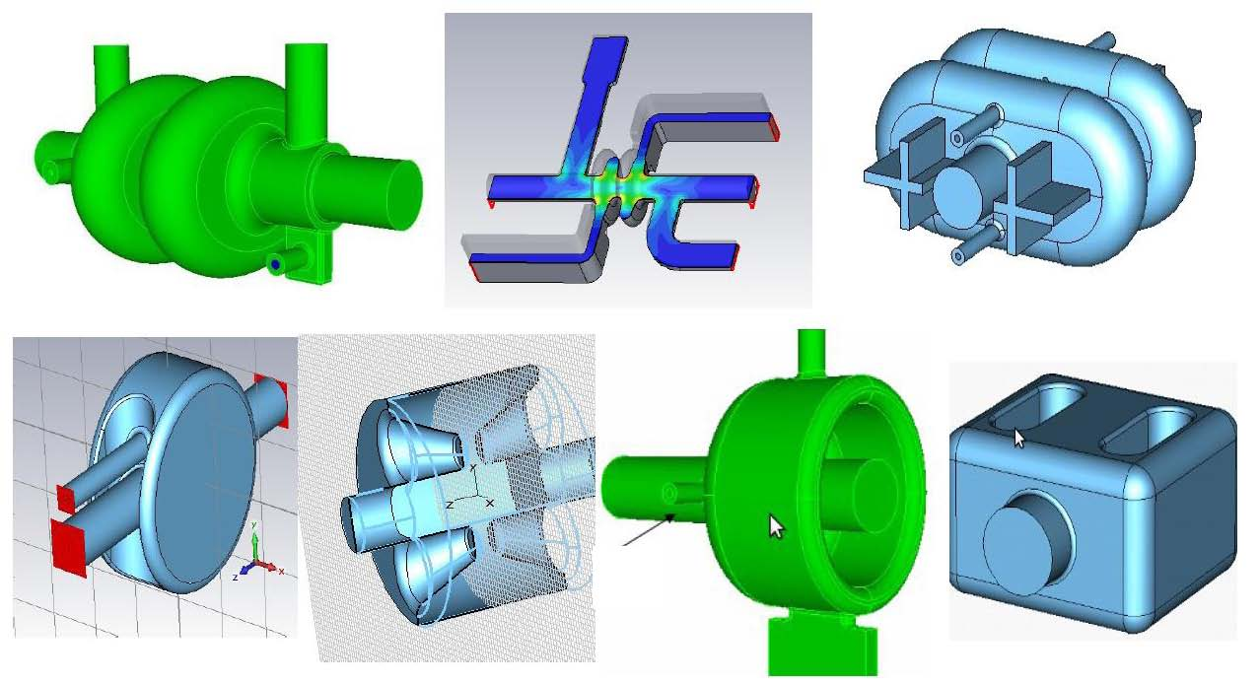
CC designs presented at LHC-CC09

Slide 18

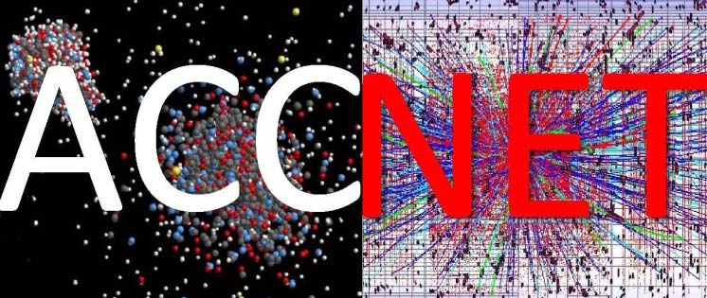

AEC’09 workshop on
Anti e-Cloud Coatings
http://indico.cern.ch/conferenceDisplay.py?confId=62873
organized by EuCARD-AccNet-EuroLumi
and SPS Upgrade Study Team
http://eucard.web.cern.ch/EuCARD/index.html
http://accnet.lal.in2p3.fr/
http://paf-spsu.web.cern.ch/paf-spsu/
41 participants

Slide 19
novel aec-coatings presented at AEC’09
diamond-like
carbon (DLC)
S. Kato
(KEK)
extremely low SEY by coating with insulating micro-particles
Al particle
Al₂O₃ particle
Gold coated
I. Montero
ICM-CSIC
(ESA research)
Surface top view

Slide 20
RFTech activities
joint organization of LHC-CC09 together with EuroLumi
sLHC upgrade studies for Superconducting Proton Linac:
established contacts to European and worldwide experts on SRF
created international working group on SRF cavities and accessories
Members: CERN, CNRS-IPN-Orsay, CEA-Saclay (France), BNL (USA), TRIUMF (Canada), and University of Rostock (Germany)
This working group participated in two SPL collaboration meetings. 3rd meeting is scheduled for November 2009
http://indico.cern.ch/conferenceDisplay.py?confId=63935

Slide 21
AccNet publications
F. Zimmermann, CERN, “CERN Upgrade Plans for the LHC and Its Injectors” , Proceedings EPS HEP2009 Krakow 17 July 2009
C. Bhat, FNAL; F. Caspers, H. Damerau, S. Hancock, E. Mahner, F. Zimmermann, CERN, “Stabilizing Effect of a Double-Harmonic RF System in the CERN PS”, PAC'09 Vancouver
R. Calaga, R. De-Maria, BNL; R. Assmann, J. Barranco, F. Caspers, E. Ciapala, T. Linnecar, E. Metral, Y. Sun, R. Tomas, J. Tuckmantel, T. Weiler, F. Zimmermann, CERN; N. Solyak, V. Yakovlev, FNAL; Y. Funakoshi, N. Kota, O. Yukioshi, A. Morita, Y. Morita, KEK; G. Burt, Lancaster U; J. Qiang, LBNL; P .A. McIntosh, DL/ASTeC); A. Seryi, Z. Li, L. Xiao, SLAC, “Status of LHC Crab Cavity Simulations and Beam Studies” , PAC'09 Vancouver
Y.-P. Sun, F. Zimmermann, R. Tomas, “Tune Shift Due to Crossing Collision and Crab Collision”, PAC'09 Vancouver
Y.-P. Sun, R. Assmann, J. Barranco, R. Tomas, T. Weiler, F. Zimmermann, CERN; R. Calaga, BNL; A. Morita, KEK, “Study with One Local Crab Cavity at IR4 for LHC”, PAC'09 Vancouver
J.P. Koutchouk, F. Zimmermann, “LHC Upgrade Scenarios” , PAC'09 Vancouver

Slide 22
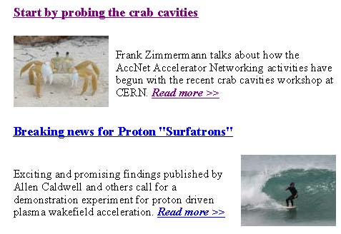
AccNet in EuCARD Newsletter no. 2
F. Zimmermann, K. Kahle, CERN, “Start by probing the crab cavities”
A. Caldwell, G. Xia, MPI München; K. Lotov, BINP; A. Pukhov, Heinrich-Heine-Universität Düsseldorf; R. Aßmann, K. Kahle, F. Zimmermann, CERN, “Breaking news for Proton "Surfatrons "”

Slide 23
AccNet plans for next ~6 months
future workshops
AccNet mini-workshop on crystal collimation, 2nd week of Nov.’09
RFTech participation in 3rd SPL meeting
workshop on contributions from the high-energy physics community to medical accelerator developments, Feb.’10
organization of the first RFTech workshop in 1st quarter 2010
workshop on plasma acceleration in spring 2010
major EuroLumi workshop on LHC upgrade spring or fall 2010
contributions to CERN Chamonix’10 workshop (3 sessions on the
  LHC upgrade)
  major reviews of LHC upgrade scenarios
  beam parameters, magnet parameters, collimation limits
  luminosity evolution
  injector upgrade paths

Slide 24
AccNet conclusions
AccNet start was excellent
EuroLumi has big impact on LHC upgrade
Crab Cavity Advisory Board,
endorsement of LHC crab cavities,
task force preparing SPS tests,
LPA scenario, e-cloud impact,
revision of LHC upgrade plans
RFTech approaching cruising speed
AccNet is breaking new grounds
medical accelerators
plasma acceleration,…
some organizational matters to be settled

Slide 25
makes a difference
for accelerators in Europe
and across the globe

