Slide 1
CNAO and CTF3 activity at LNF
Fabio Marcellini

Slide 2
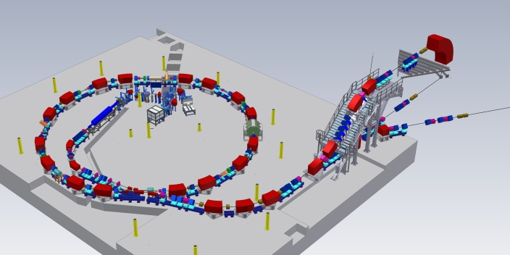
CNAO
Centro Nazionale di Adroterapia Oncologica in Pavia
CNAO Fundation: no profit organisation created in 2001 to build the national center for hadrontherapy designed by TERA Foundation.
Construction begun in 2004

Slide 3
Collaborations
NATIONAL
INFN | co-direction, involvement/responsibility in many technical issues (15), formation
Town of Pavia | land and authorisations
University of Milan | medical coordination and formation
Polytechnic of Milan | patient positioning, radioprotection and authorisations
University of Pavia | electrical plant, power supplies and betatron, safety, formation
Province of Pavia | logistics and authorisation
University of Turin | interface beam-patient, TPS
INTERNATIONAL
CERN | special magnets, dipole measurements and diagnostics (+ PIMMS heritage)
GSI | linac and special components
LPSC (Grenoble) | optics, betatron, low-level RF, control system
NIRS (Chiba) | medical activities, formation

Slide 4
LNF Involvement in CNAO
TASK
LNF-1 | Conventional Magnets | Finished
LNF-2 | Power Supplies | Finished
LNF-3 | Vacuum System | Finished
LNF-4 | Installation | Finished
LNF-5 | Electrical Plant | Finished
LNF-6 | Cooling Plant | Finished
LNF-7 | Radioprotection | Finished
LNF-9 | Commissioning | Active

Slide 5
CNAO commissioning team
M. Pullia¹, S. Alpegiani¹, G. Baccaglioni¹, G. Balbinot¹, G. Bazzano¹,
D. Bianculli¹, C. Biscari², J. Bosser¹, E. Bressi¹, G. Burato¹, G. Butella¹,
M. Caldara¹, L. Celona², E. Chiesa¹, V. Chimenti², G. Ciavola²,
G. Clemente⁵, A. Clozza², M. Donetti¹, L. Falbo¹, A. Ferrari¹, M. Ferrarini¹, L. Frosini^{1,4}, S. Gammino², F. Generani¹, F. Gerardi¹, S. Gioia¹,
E. Giroletti^{1,4}, C. Kleffner⁵, L. Lanzavecchia¹, M. Maier⁵, F. Maimone²,
R. Monferrato¹, V. Mutti¹, M. Nodari¹, A. Parravicini¹, M. Pelliccioni^{1,2},
M. Pezzetta¹, A. Pisent², P.A. Posocco², C. Priano¹, A. Reiter⁵,
C. Roncolato² , S. Rossi¹, C. Sanelli², B. Schlitt⁵ , M. Scotti¹, F. Sgamma²,
S. Sironi¹, M. Spairani¹, E. Vacchieri¹, G. Venchi^{1,4}, W. Vinzenz⁵, S. Vitulli¹ , H. Vormann⁵
1 - CNAO
2 - INFN
3 - PoliMI
4 - UniPV
5 -GSI

Slide 6
CNAO layout
Three Treatment Rooms
LEBT
RFQ
LINAC
7MeV/u
Ion Sources
p / Carbon ( 8keV/u)
HEBT
MEBT
Synchrotron
Protons from 60 yo 250 MeV
Carbon Ions from 120 to 400 MeV/u
Few mA

Slide 7
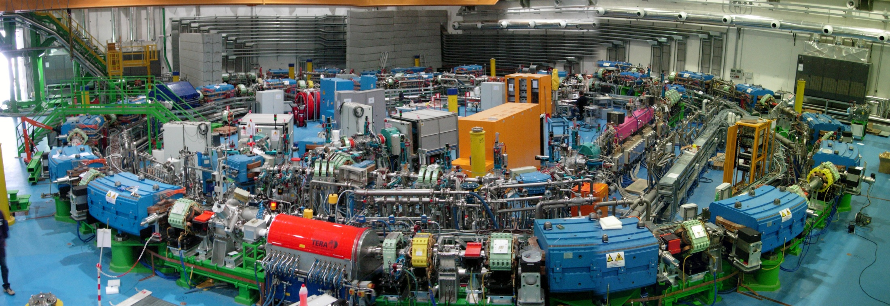
Synchrotron hall (October 09)

Slide 8
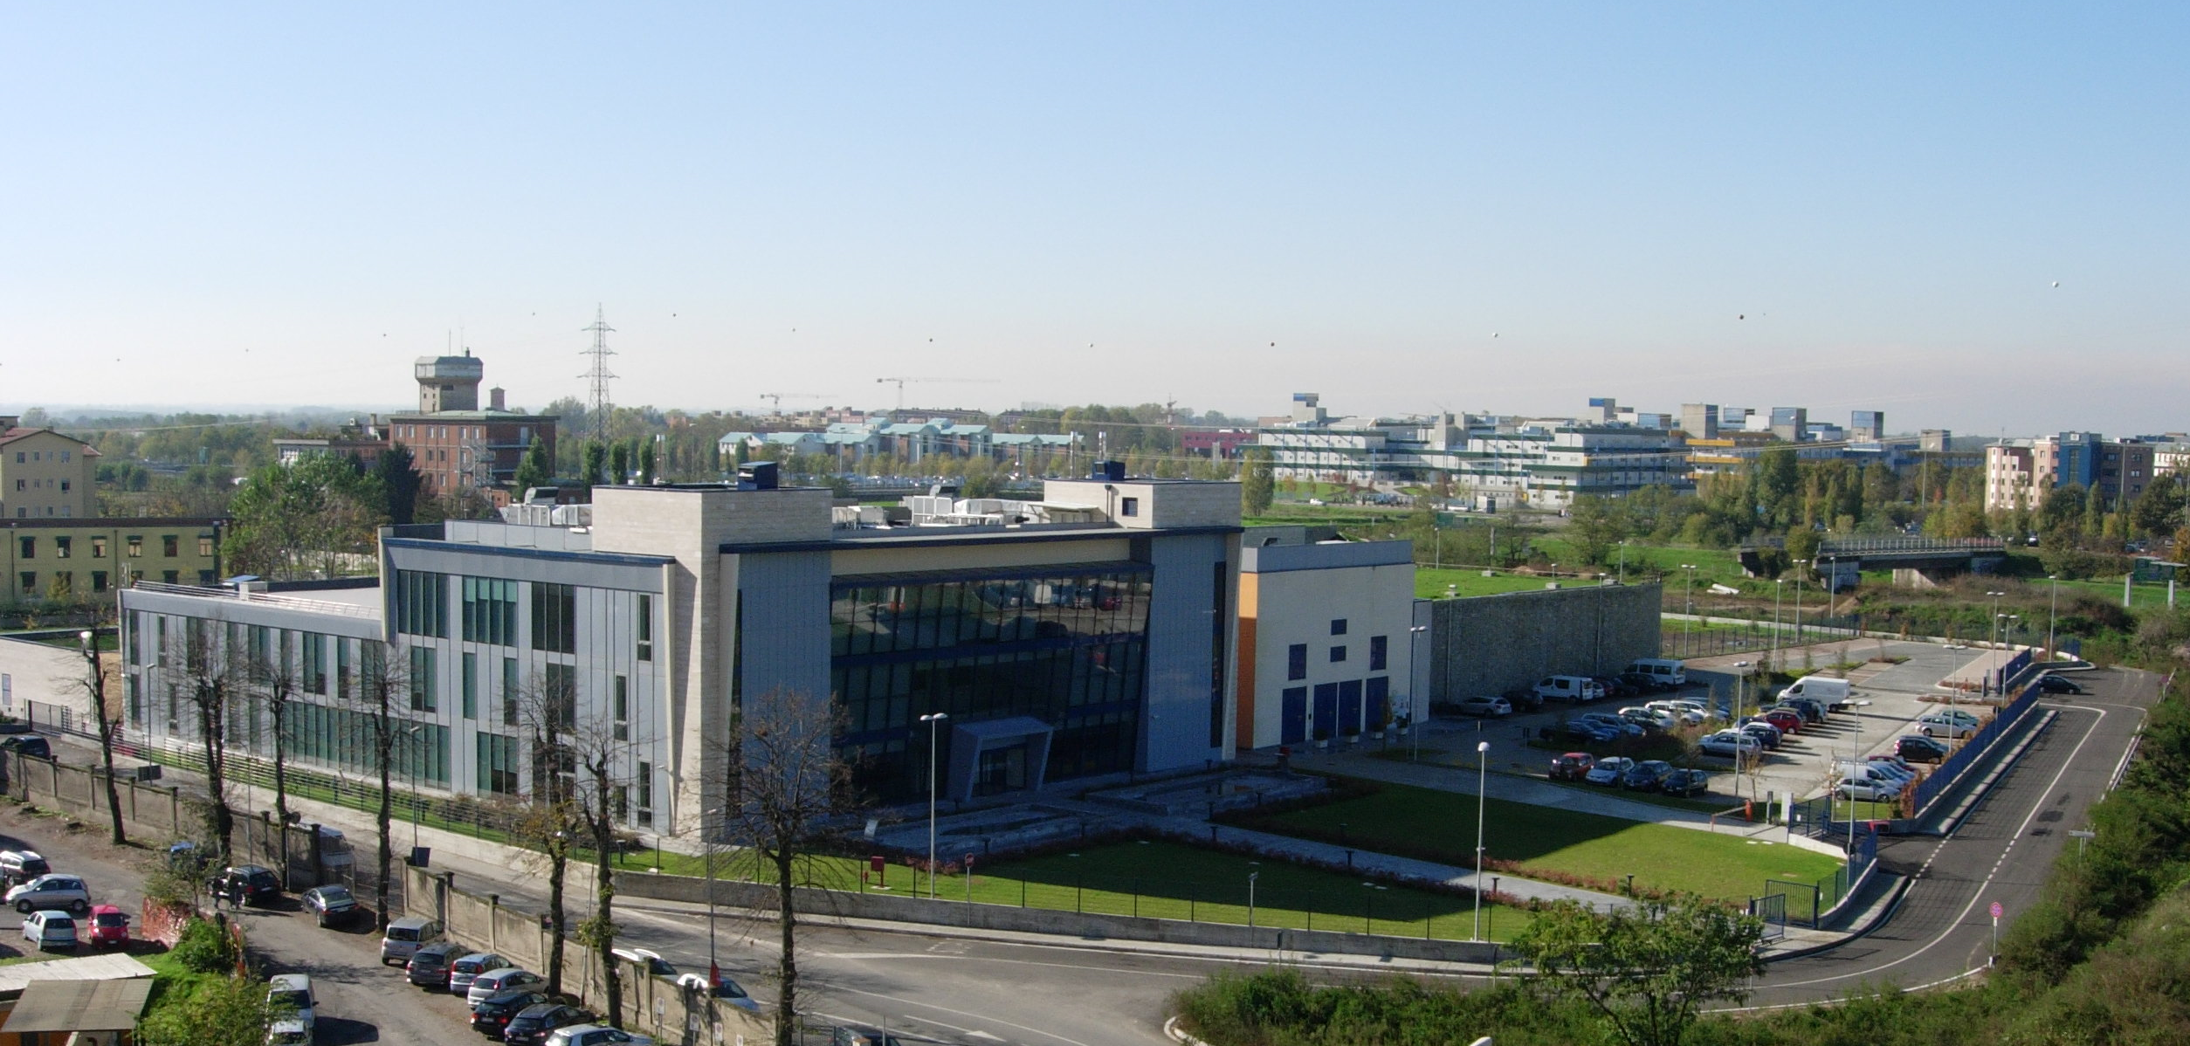
CNAO buildings

Slide 9
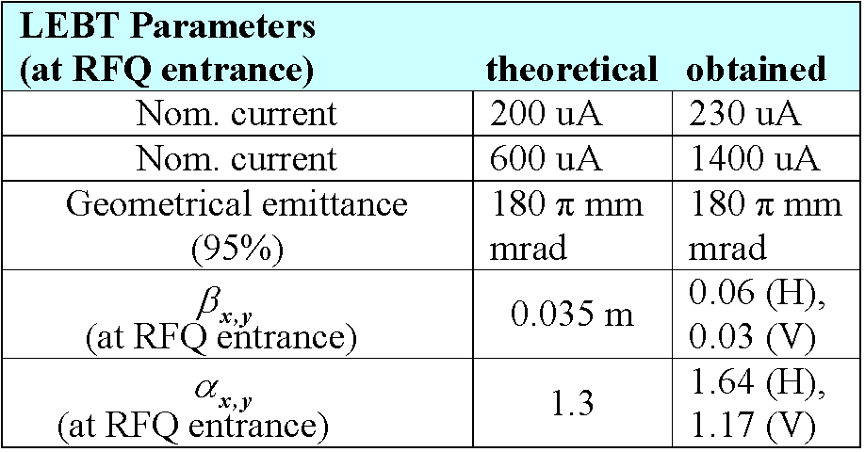
Injector commissioning results – July 09
C
p
Request at LINAC exit | measured | nominal
current for C6+ (7 MeV/u) | 135 μA | 120 μA
current for H+ (7 MeV) | 1.2 mA | 0.75 mA

Slide 10
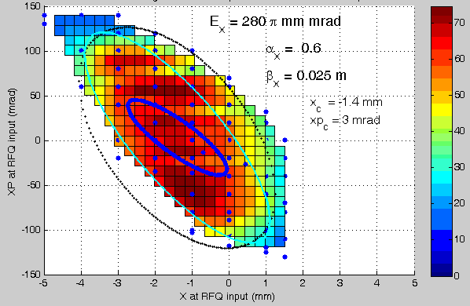
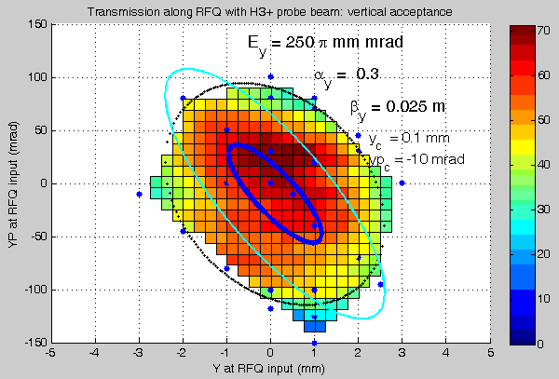
RFQ acceptance measurements (8 keV/u)
Transmission efficiency through RFQ of H3+ Probe Beam (low current, very small emittance) as a function of position in phase space
Horizontal plane
Vertical plane
Blue: full beam measured rms emittance
Cyan: nominal RFQ acceptance
Black: fitted RFQ acceptance from measurements

Slide 11
Next future
November 09 – Start commissioning MEBT, Synchrotron and HEBT
End 2010 – One treatment room ready for first patients.

Slide 12
Back up slides

Slide 13
Comparison of the depth dose profiles
Inverse dose profile
Photons
Electrons
Carbon ions
Longitudinal - Spread Out Bragg Peak

Slide 14
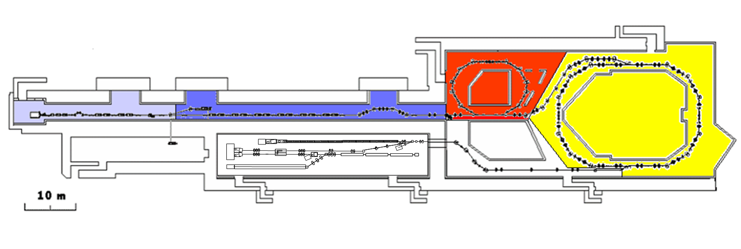
CTF3 – CLIC Test Facility
demonstrate CLIC RF power source Drive Beam generation
(fully loaded acceleration, bunch frequency multiplication 8x)
Test CLIC accelerating structures
Test power production structures (PETS)
30 GHz “PETS Line”
Bunch length
chicane
Delay Loop – 42m
Combiner Ring – 84m
Linac
RF deflector
TL1
Injector
3.5A – 1.2µs
150 MeV
Laser
Photoinjector test area
28A – 140ns
150 MeV
CLEX
TL2

Slide 15






















World-wide CLIC&CTF3 Collaboration
33 Institutes involving
22 funding agencies and 18 countries
Aarhus University (Denmark)
Ankara University (Turkey)
Argonne National Laboratory (USA)
Athens University (Greece)
BINP (Russia)
CERN
CIEMAT (Spain)
Cockcroft Institute (UK)
Gazi Universities (Turkey)
Helsinki Institute of Physics (Finland)
IAP (Russia)
IAP NASU (Ukraine)
INFN / LNF (Italy)
Instituto de Fisica Corpuscular (Spain)
IRFU / Saclay (France)
Jefferson Lab (USA)
John Adams Institute (UK)
JINR (Russia)
Karlsruhe University (Germany)
KEK (Japan)
LAL / Orsay (France)
LAPP / ESIA (France)
NCP (Pakistan)
North-West. Univ. Illinois (USA)
Oslo University (Norway)
Patras University (Greece)
Polytech. University of Catalonia (Spain)
PSI (Switzerland)
RAL (UK)
RRCAT / Indore (India)
SLAC (USA)
Thrace University (Greece)
Uppsala University (Sweden)

Slide 16
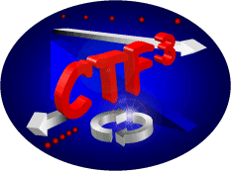
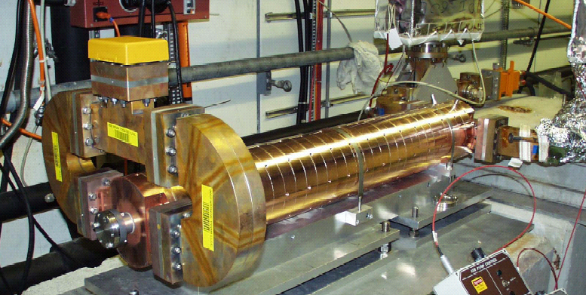
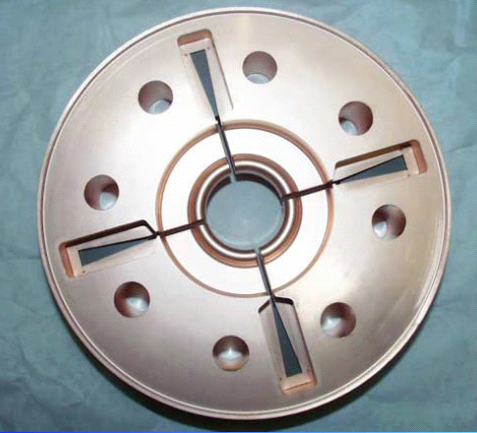
“Full” Beam Loading operation in CTF3
Dipole modes suppressed by slotted iris damping (first dipole’s Q factor < 20)
and HOM frequency detuning
Damping
slot
1.5 μs
RF Power at output
of accelerating structure
Beam off
Beam on
Beam Pulse
length
SiC load
Beam current 4 A
Beam pulse length 1.5 μs
Power input/structure 35 MW
Ohmic losses (beam on) 1.6 MW
RF power to load (beam on) 0.4 MW
RF-to-beam efficiency ~ 94%

Slide 17
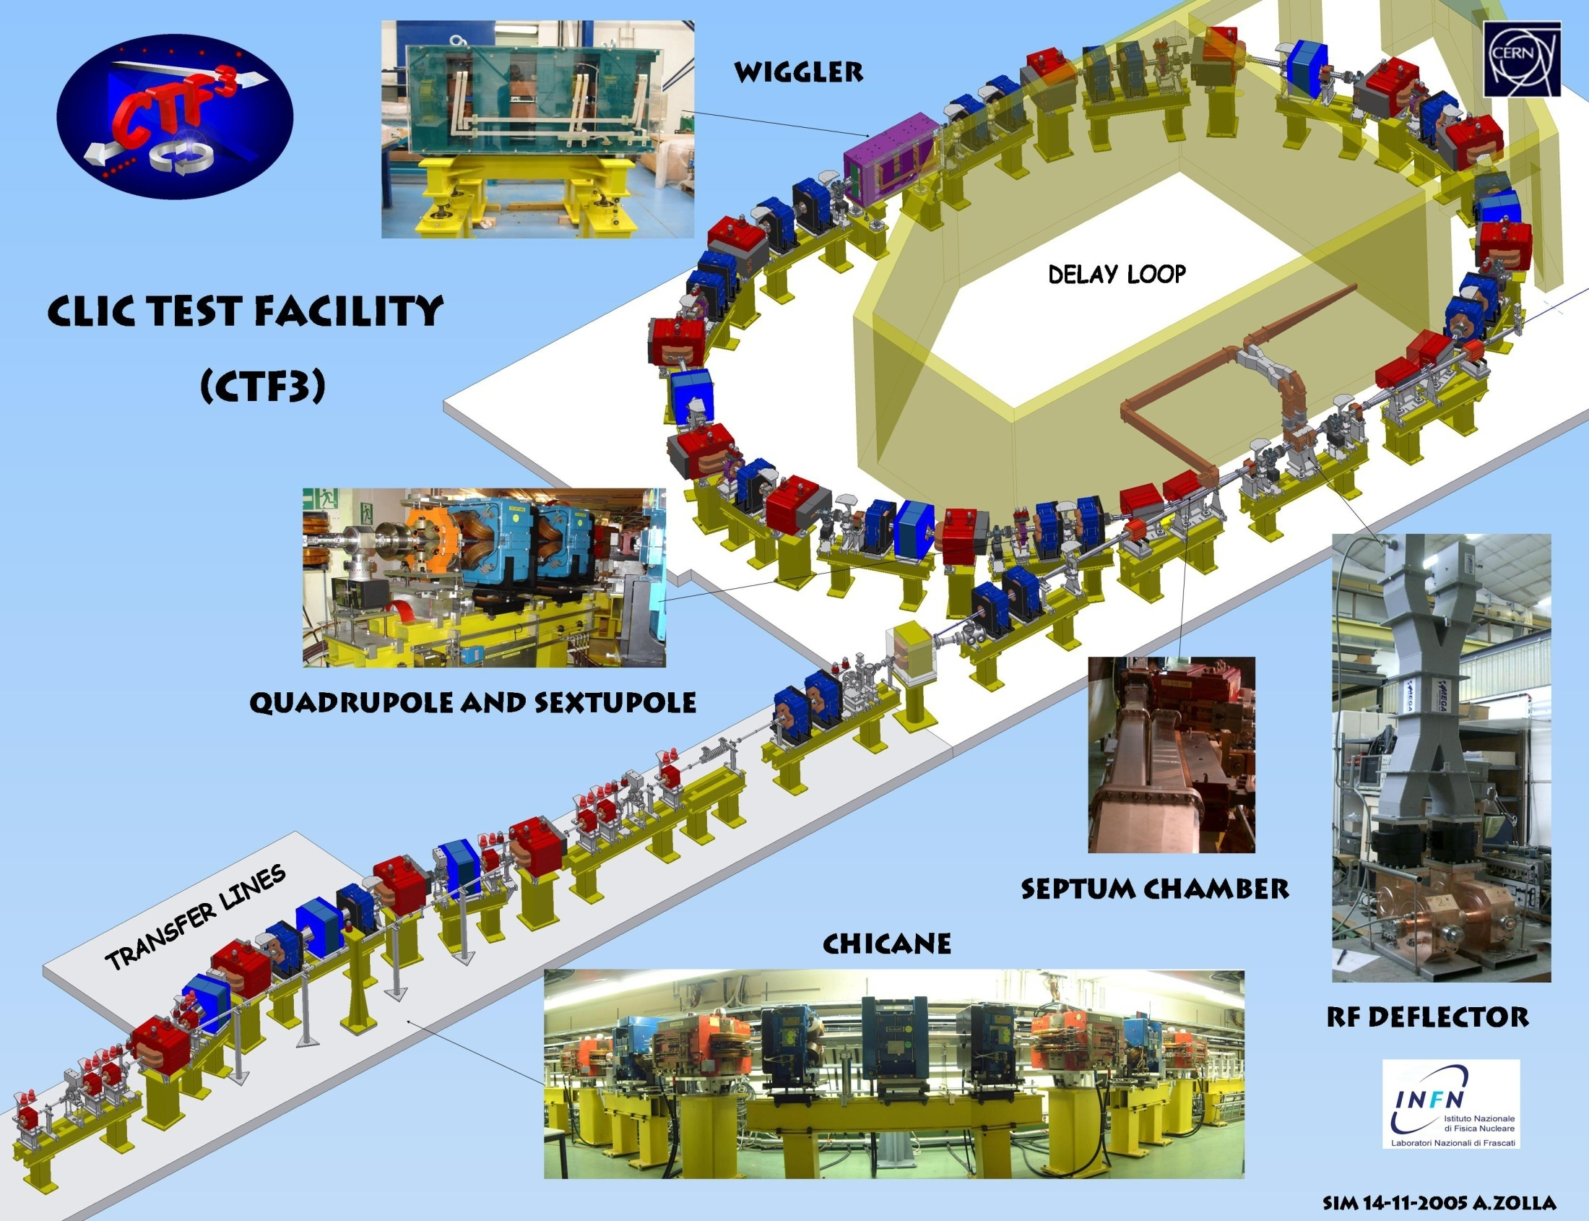

Slide 18
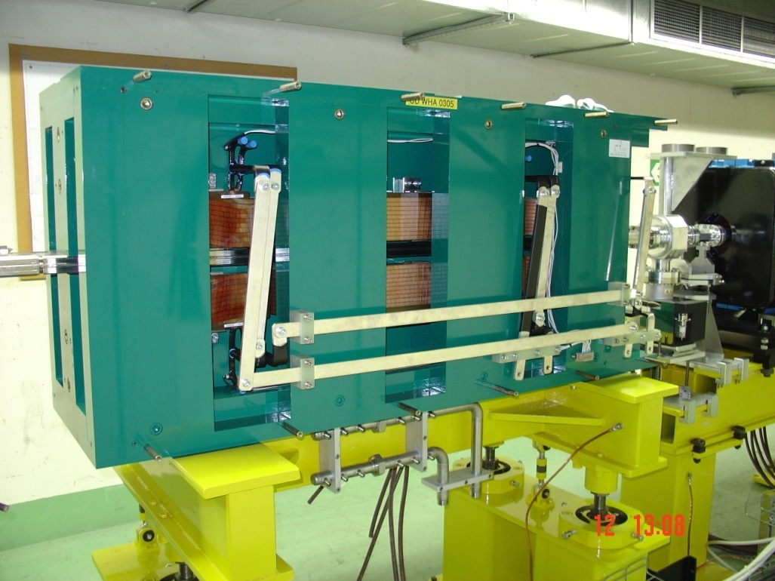
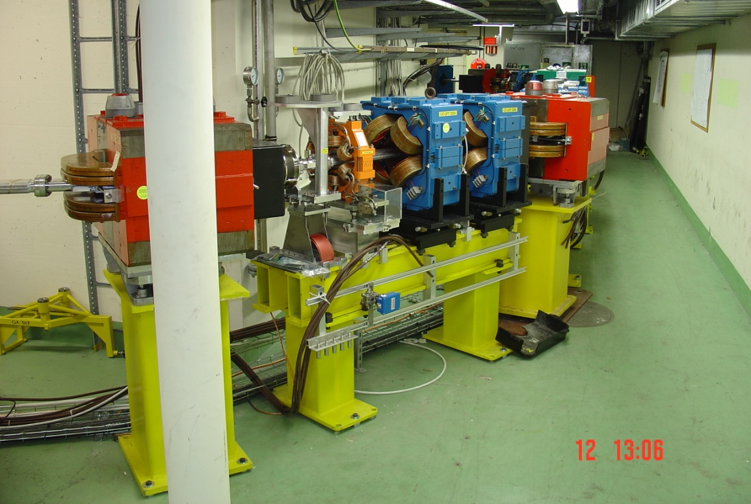
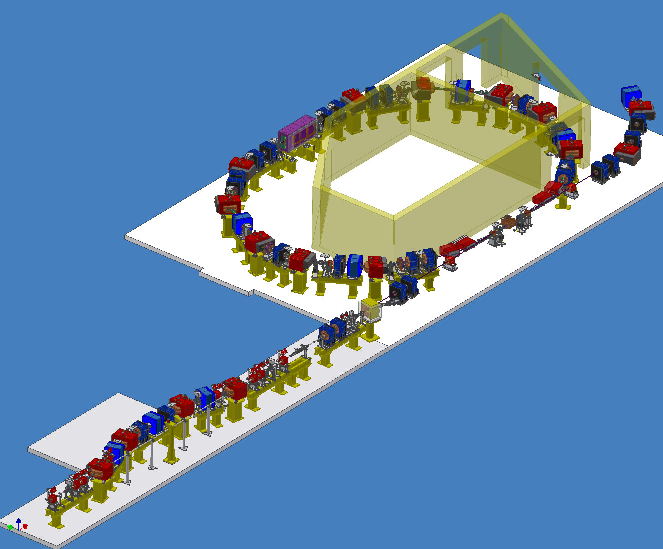
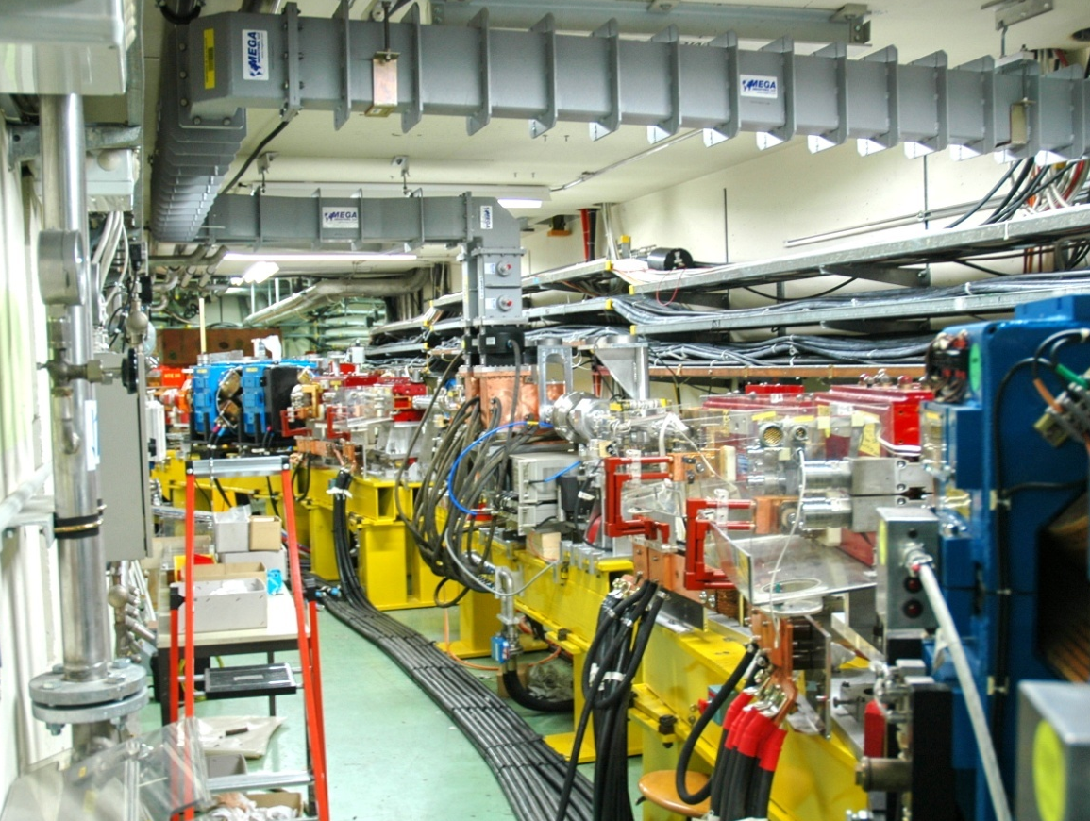
Delay Loop

Slide 19
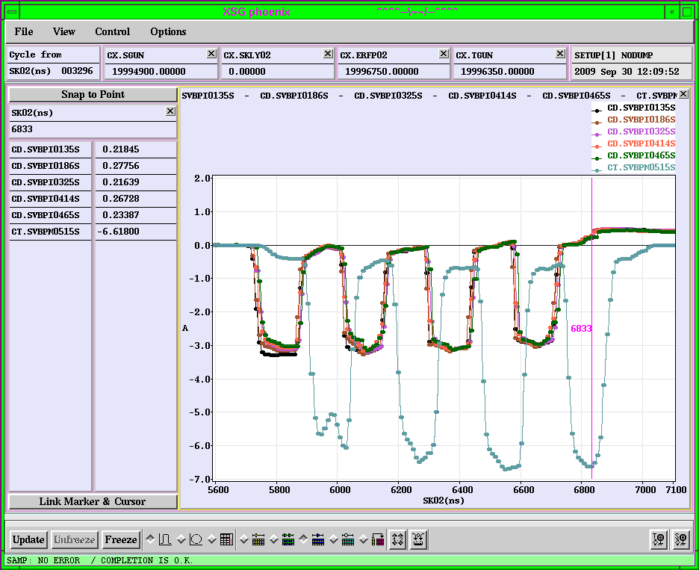
Delay loop: the recombination
2007

Slide 20
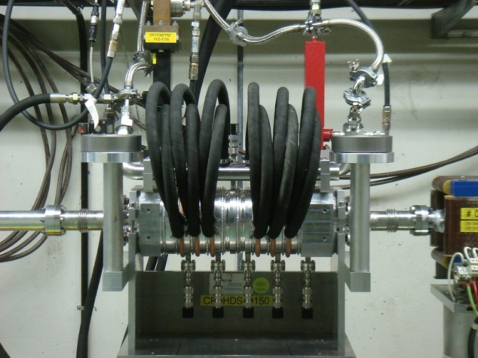
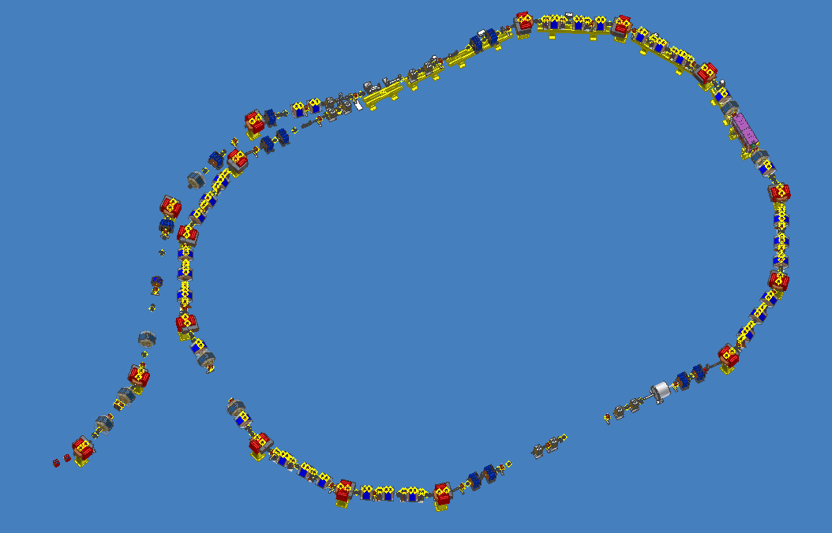
Combiner Ring Layout
New damped deflectors
CERN Layout, infrastructure, cabling,
magnets, installation
CIEMAT Septa magnets, sextupoles,
correctors, extraction Kickers
INFN RF deflectors, wiggler, vacuum
chambers, BPM
LAPP BPM electronics
LURE quadrupoles
BINP magnet realization

Slide 21
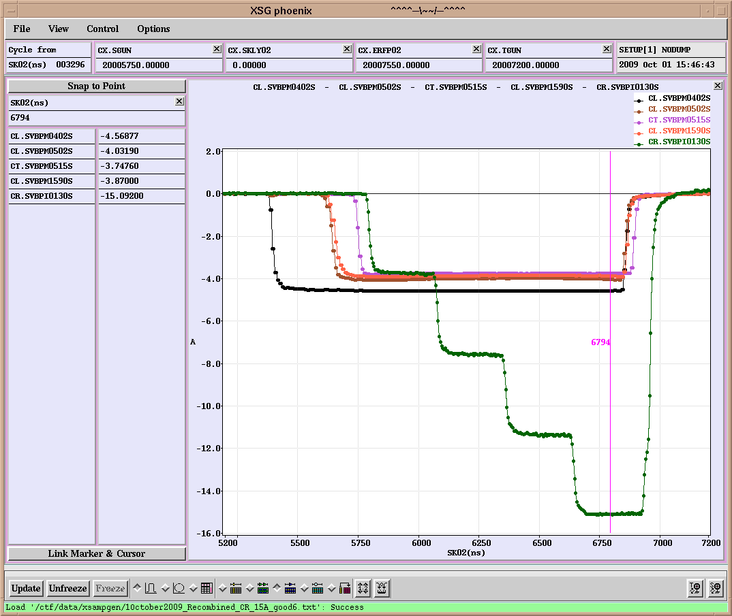
Combiner Ring

Slide 22
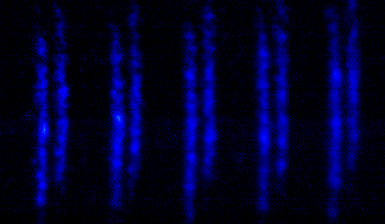
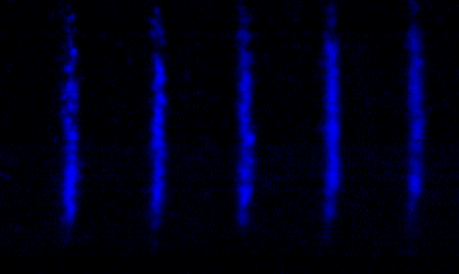
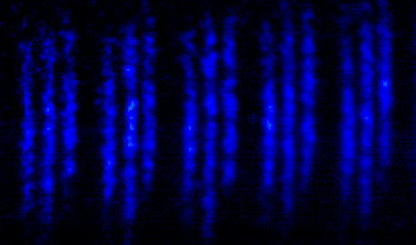
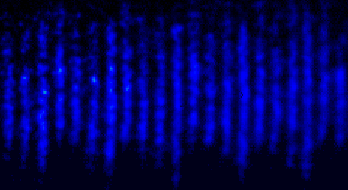
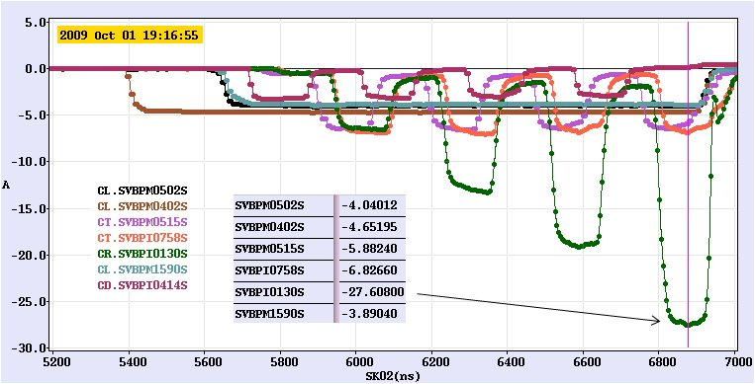
x
Delay Loop & Combiner Ring:
the recombination
333 ps
t

Slide 23
WP9: NC Linac
Task 5: Drive Beam Phase Control
Partners: LNF, CERN and PSI.
Phase error control
In the two beam acceleration scheme is important to synchronize precisely the Main Beam with respect to the RF power produced by the Drive Beam.
Timing errors lead to energy variations in the Main Linac and would have an impact on the collider performance (luminosity reduction).
Control of the drive beam phase errors within about 0.1° (23fs @ 12GHz).

Slide 24
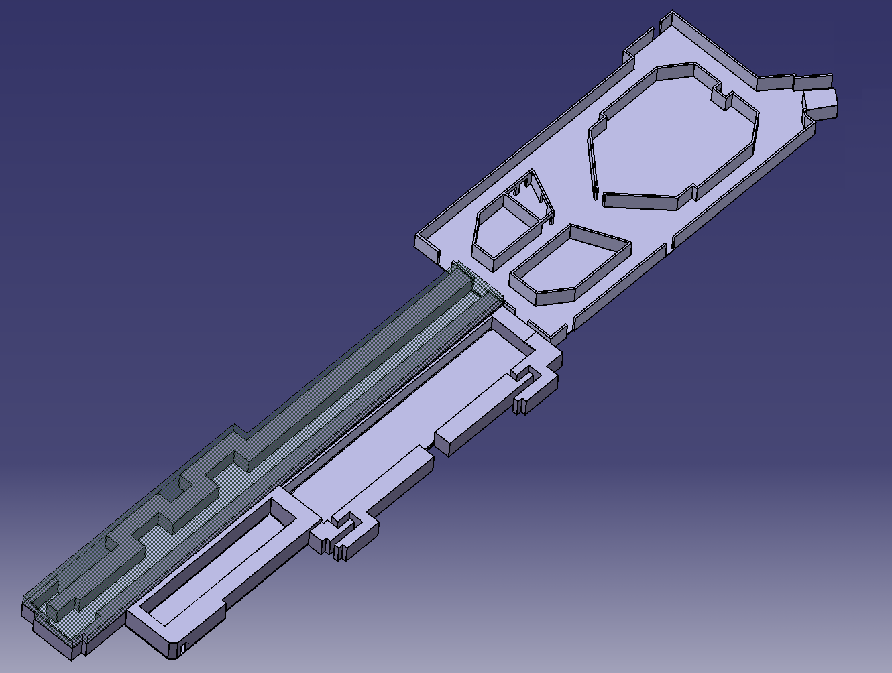
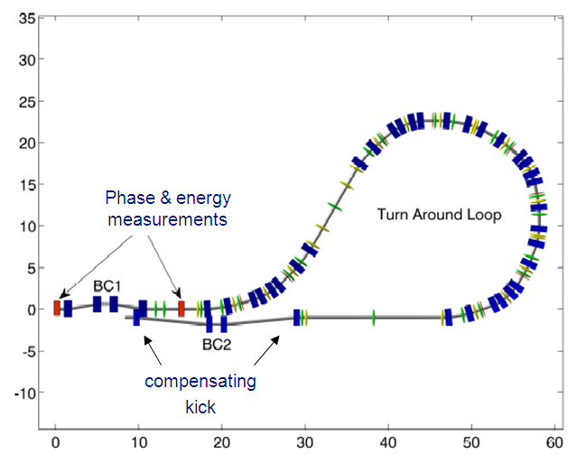
Phase stability measurements & feed-forward could be tested in the CTF3
DELAY
LOOP
Phase & energy measurement
COMBINER
RING
Fast feed-forward kicker in final compression line
DRIVE BEAM
LINAC
10 m
CLEX
CLIC Experimental Area

Slide 25
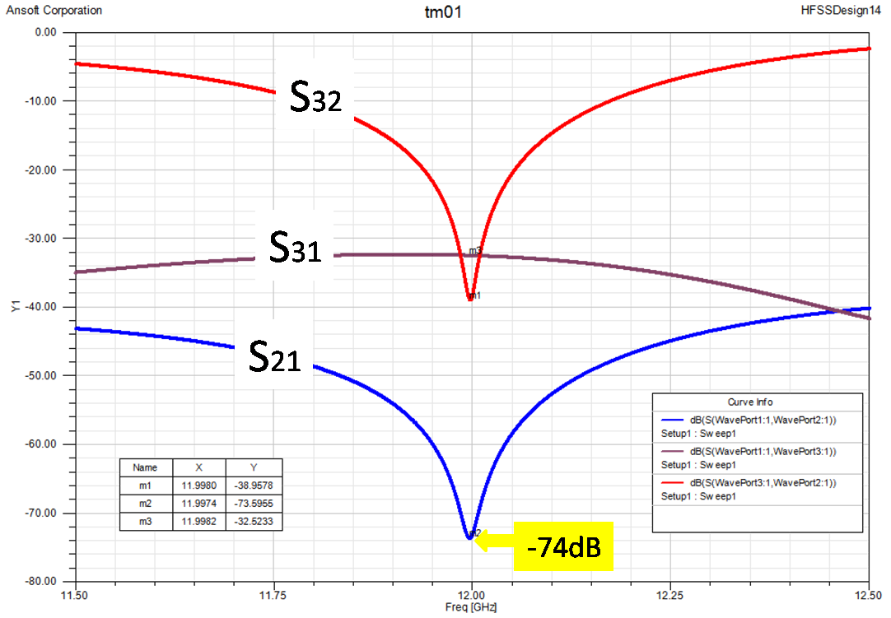
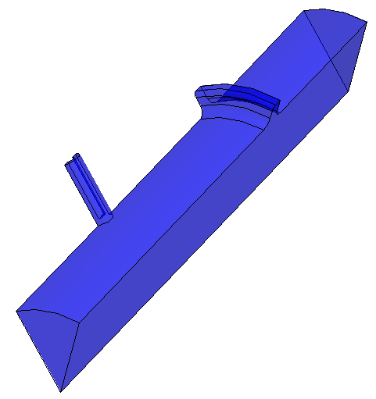
Phase monitor main requirements
Resolution of the order of 20 fs.
Very low coupling impedance.
Rejection of RF noise and weak fields in the beam pipe (they could affect the measurements).
Detection at 12 GHz.
2
1
3
Notch filter for TM01
Centered at 12 GHz, rejection is ≈-40dB.
Pipe to single antenna coupling ≈ -45dB.
Different kind of signal pick-up than coax antenna can be considered. Example: waveguide inserted in the pipe.

Slide 26
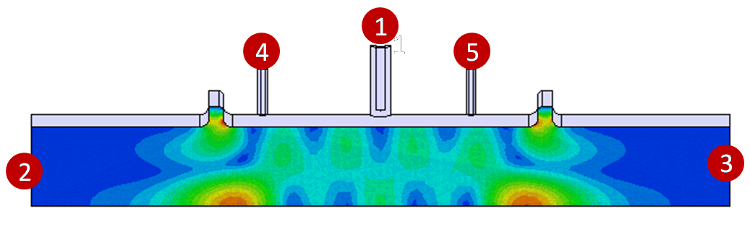
1
The “double mirror” concept
RF noise has to be filtered at both the pick-up sides.
12 GHz component of beam generated field after the first filter could be reflected back by the second filter and detected again.
Multi-reflection process could start and affect measurement.
Unless the distance between the filters is chosen to define a volume resonating at 12 GHz.
The pick-up is positioned in correspondence of zero crossing standing wave field.
3
S21
S31

Slide 27
Next steps
Complete the design
  Study for multimode notch filters
  Impedance evaluation
  Fine tuning of Q, notch frequency and “cavity” frequency.
Mechanical drawings
Construction
Lab tests and measurements
EuCARD task schedule still respected.

