Slide 1
EuCARD Steering Committee Meeting
5 November 2009, Frascati
WP10-SRF
SC RF technology for higher intensity proton
accelerators & higher energy electron linacs

Slide 2
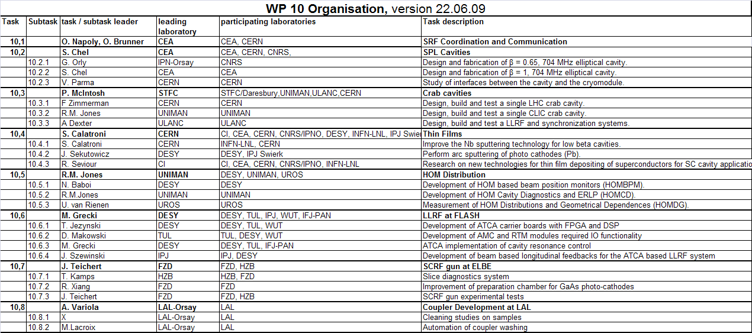
SRF Task Organization

Slide 3
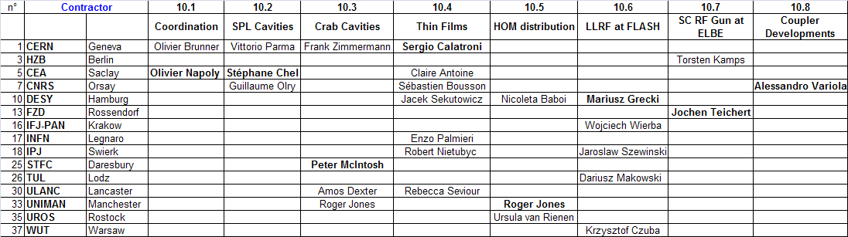
SRF Task Matrix
Task Coordinators
SRF Deputy and Task Contact Persons

Slide 4
Deliverables : first 24 months

Slide 5
Milestones : first 12 months

Slide 6
WP10.1: Coordination
SRF Steering Group is formed from Task Leaders:
  1 teleconference organized for the IAR preparation
Interim Activity Report (7Mo) sent on October 23 (??) to JPK (+ Svet, Ralph, OB)
Industrial Partners
  Contact with Research instrument (ex ACCEL) on hold.
    A visit was scheduled or November: no more feedback from RI.
To do:
  SRF Public Web Portal
  First Annual SRF Meeting at Cockroft Institute (Daresbury).
  The date needs to be fixed, few weeks before the EuCARD Annual Meeting

Slide 7
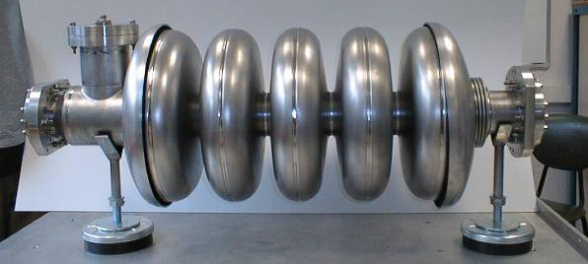
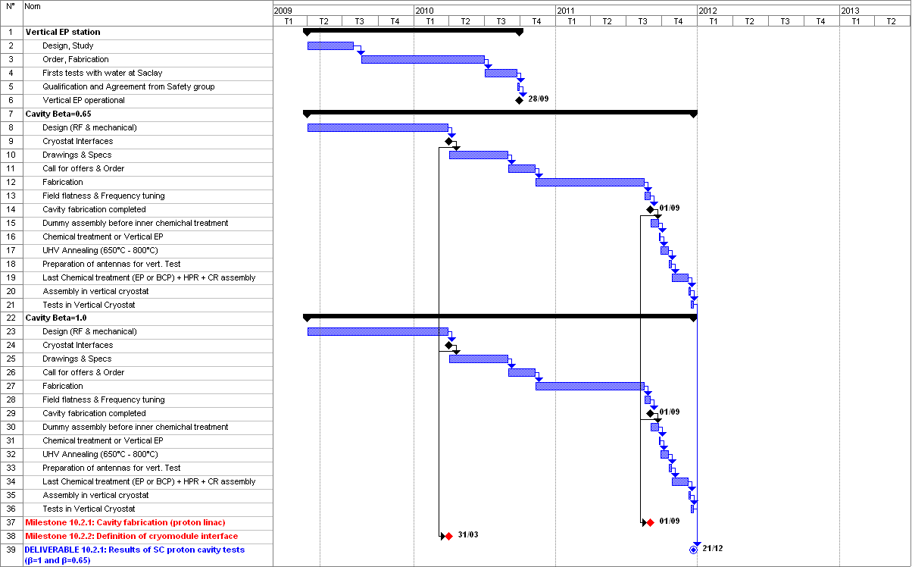
WP10.2: SPL Cavities

Slide 8
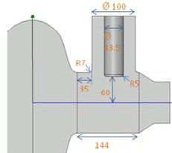
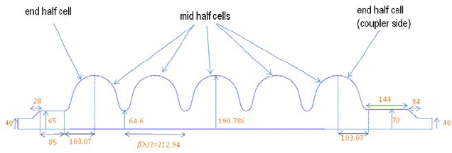
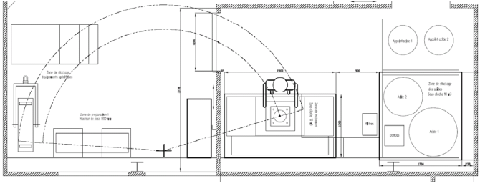
WP10.2: SPL Cavities
Description of the Work
Task 2.1 (IPN-Orsay) :
design stage: 3D model of a β=0.65, 704 MHz cavity :
Epk/Eacc = 2.75, Bpk/Eacc = 5.13 mT/MV/m
Task 2.2 (CEA-Saclay)
  design stage: RF optimisation of β=1 704 MHz cavity shape and higher order modes
  call for tender for Vertical EP design launched May’09
    Final Design expected in Nov ’09
Task 2.3 (CERN, INP-Orsay, CEA)
  joint meetings (19 June 19th , Sept. 4th, Sept. 30th 2009) on cryomodule interfaces
  Interface document due in March 2010
Publications: none

Slide 9
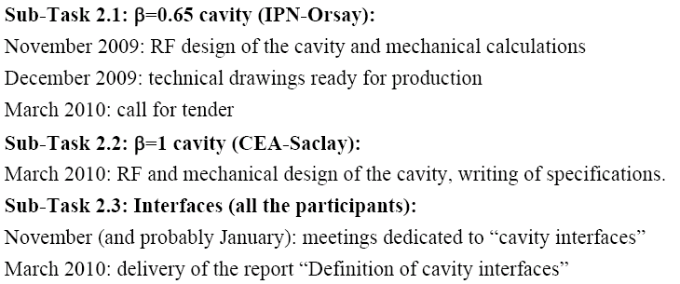
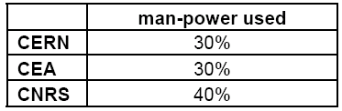
WP10.2: SPL Cavities
Milestones : no delays expected
Deliverables : no delays expected
Next Semester:
Status Manpower:
Work essentially done during the last 3 months
(unavailability of projectors, OK now)

Slide 10
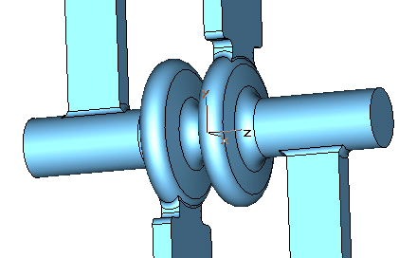
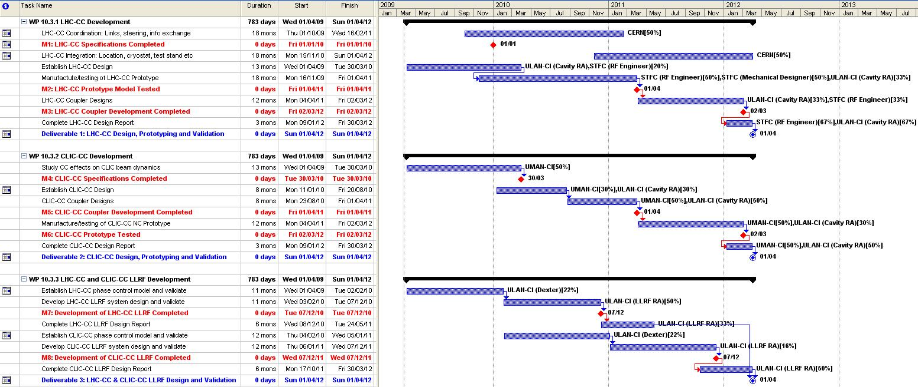
WP10.3: Crab Cavities

Slide 11
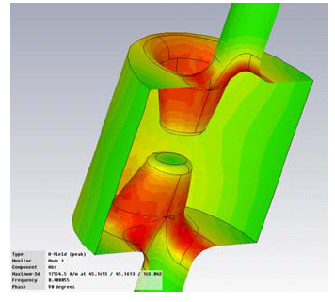
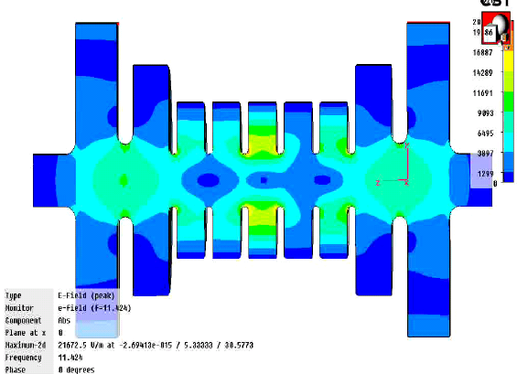
WP10.3: Crab Cavities
Description of the Work
Task 3.1 : LHC Crab Cavity
Major Advance: the compact ‘4-rod’ 400 MHz cavity has been selected, design inspired by CEBAF NC cavity.
The design must include both cavity and RF coupler
Task 3.2 : CLIC Crab Cavity
Major Advance: RF design sufficiently advances to launch the fabrication, by Shakespeare Engineering, of a TW 12 GHz prototype cavity for high power test. Delivery Jan’10.
Task 3.3 : LLRF systems for LHC and CLIC
Work not started for LHC system
Full priority to CLIC cavity LLRF system design to be
ready for the high power cavity validation.

Slide 12
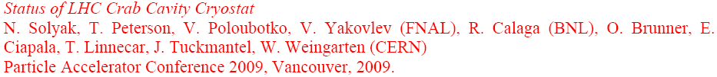
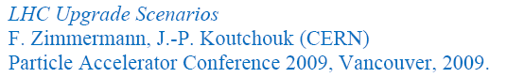
WP10.3: Crab Cavities
Publications (8 offered)
  1 includes EuCARD mention
  1 not received
  5 PAC09 , include CARE mention, but not EuCARD
  + 4 …
  1 Oral Review presentation at SRF’09, Berlin

Slide 13
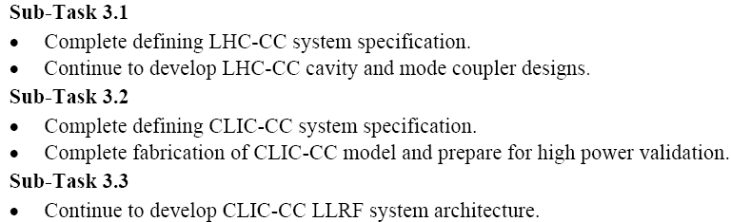
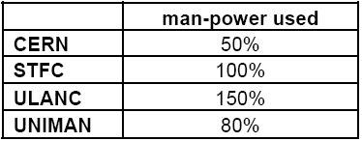
WP10.3: Crab Cavities
Milestones :
  M10.3.2 for LHC OM-couplers design complete must now precede M10.2.3 for cavity design complete
  M10.3.5: delay expected for CLIC Beam dynamics studies due to late UNIMAN PDRA appointment
  M10.3.7 and M.10.3.8 for LHC and CLIC LLRF system development, swapped
Deliverables : no delays expected
Next
Semester:
Status Manpower:
Appointment of CERN fellow delayed to Nov’09.
Appointment of UNIMAN PDRA just awarded.

Slide 14
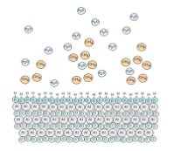
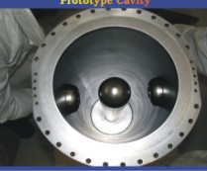
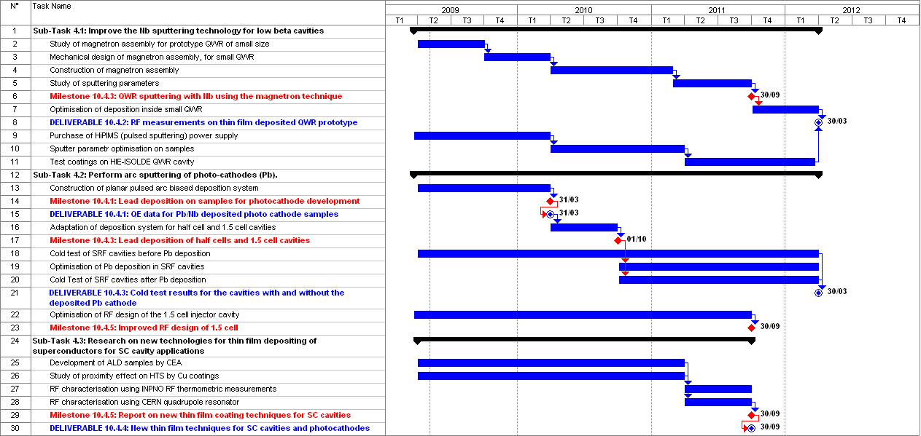
WP10.4: Thin Films

Slide 15
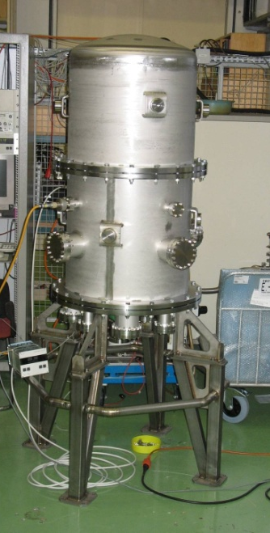
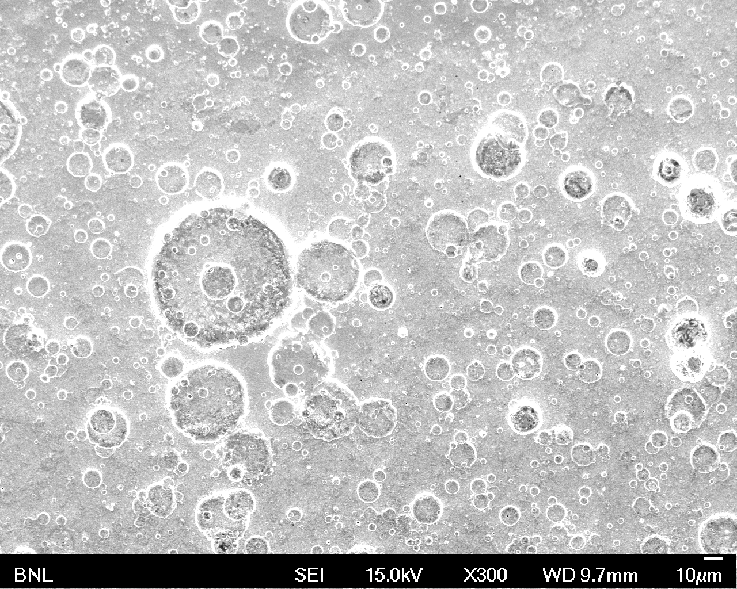
WP10.4: Thin Films
Description of the Work
Task 4.1 : Quarter Wave Resonator Niobium Sputtering
Preparatory Work: at CERN (coating system of HIE-ISOLDE QWR) and at Legnaro (coating jar and magnetron)
Task 4.2 : Pb/Nb Photo-cathodes
Advance : ‘Knee shape’ micro-droplet filter effective . Some samples already coated
Task 4.3 : Novel Thin Film Techniques for SCRF
Experimental work:
  progress at IPN-Orsay on TE011 cavity measurement setup
  progress at CEA, ULANC and CERN on fabrication of thin deposited layers (10 nm NbN at CEA, 2 nm Nb at ULANC-CERN) by sputtering methods.
Droplets

Slide 16
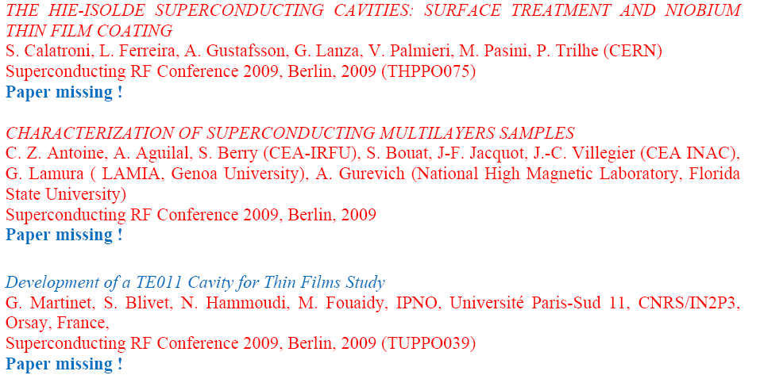
WP10.3: Crab Cavities
Publications (3 offered)

Slide 17
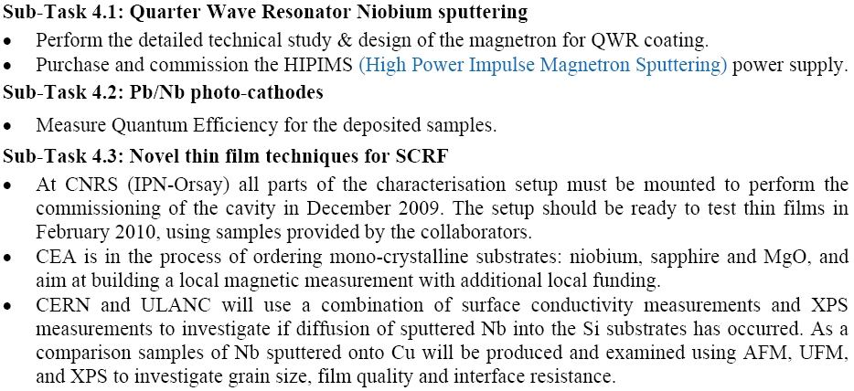
WP10.4: Thin Films
Next Semester:

Slide 18
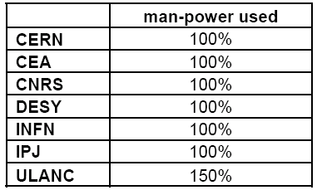
WP10.4: Thin Films
Milestones: no delays expected
  M10.4.1: Report on “Lead Deposition on Samples”, due M12
Deliverables: no delays expected
Status Manpower:
a PhD student hired at CERN.
an engineer will be hired at LNL (Jan’10)

Slide 19
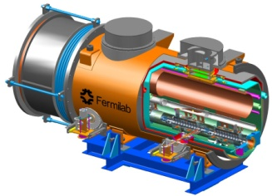
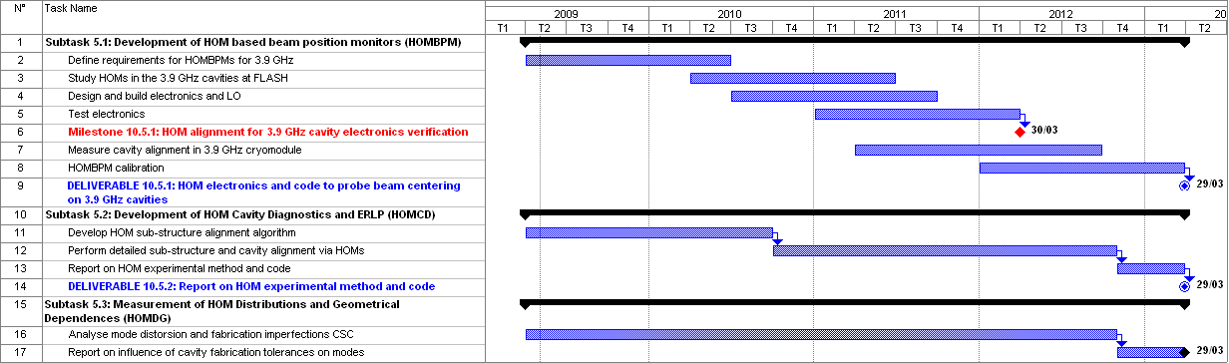
WP10.5: HOM Distribution

Slide 20

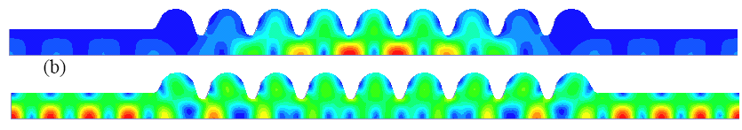
WP10.5: HOM Distribution
Description of the Work
Task 5.1 : HOM Beam Based Position Monitor
Major Advance:
FNAL 3.9 GHz module cold test successful.
First measurement of HOM at 2K at DESY.
Task 5.2 : HOM Cavity Diagnostics
Design Work: HOM passbands (monopole, dipole and sextupole) calculated.
Fabrication errors
modelled to study
influence on field flatness
Task 5.3 : HOM Distribution and Geometrical Dependencies
Preparation Work: code developments (Mathematica, CST) for Coupled S-Parameter Calculation (CSC)

Slide 21

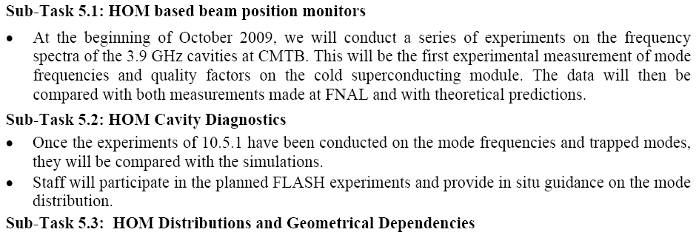
WP10.5: HOM Distribution
Publications: 1 offered, includes EuCARD mention.
Next Semester:

Slide 22
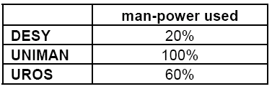
WP10.5: HOM Distribution
Milestones : no delays expected
Deliverables : no delays expected
Status Manpower:
Appointment of DESY PhD student awaiting.

Slide 23
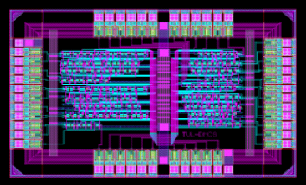
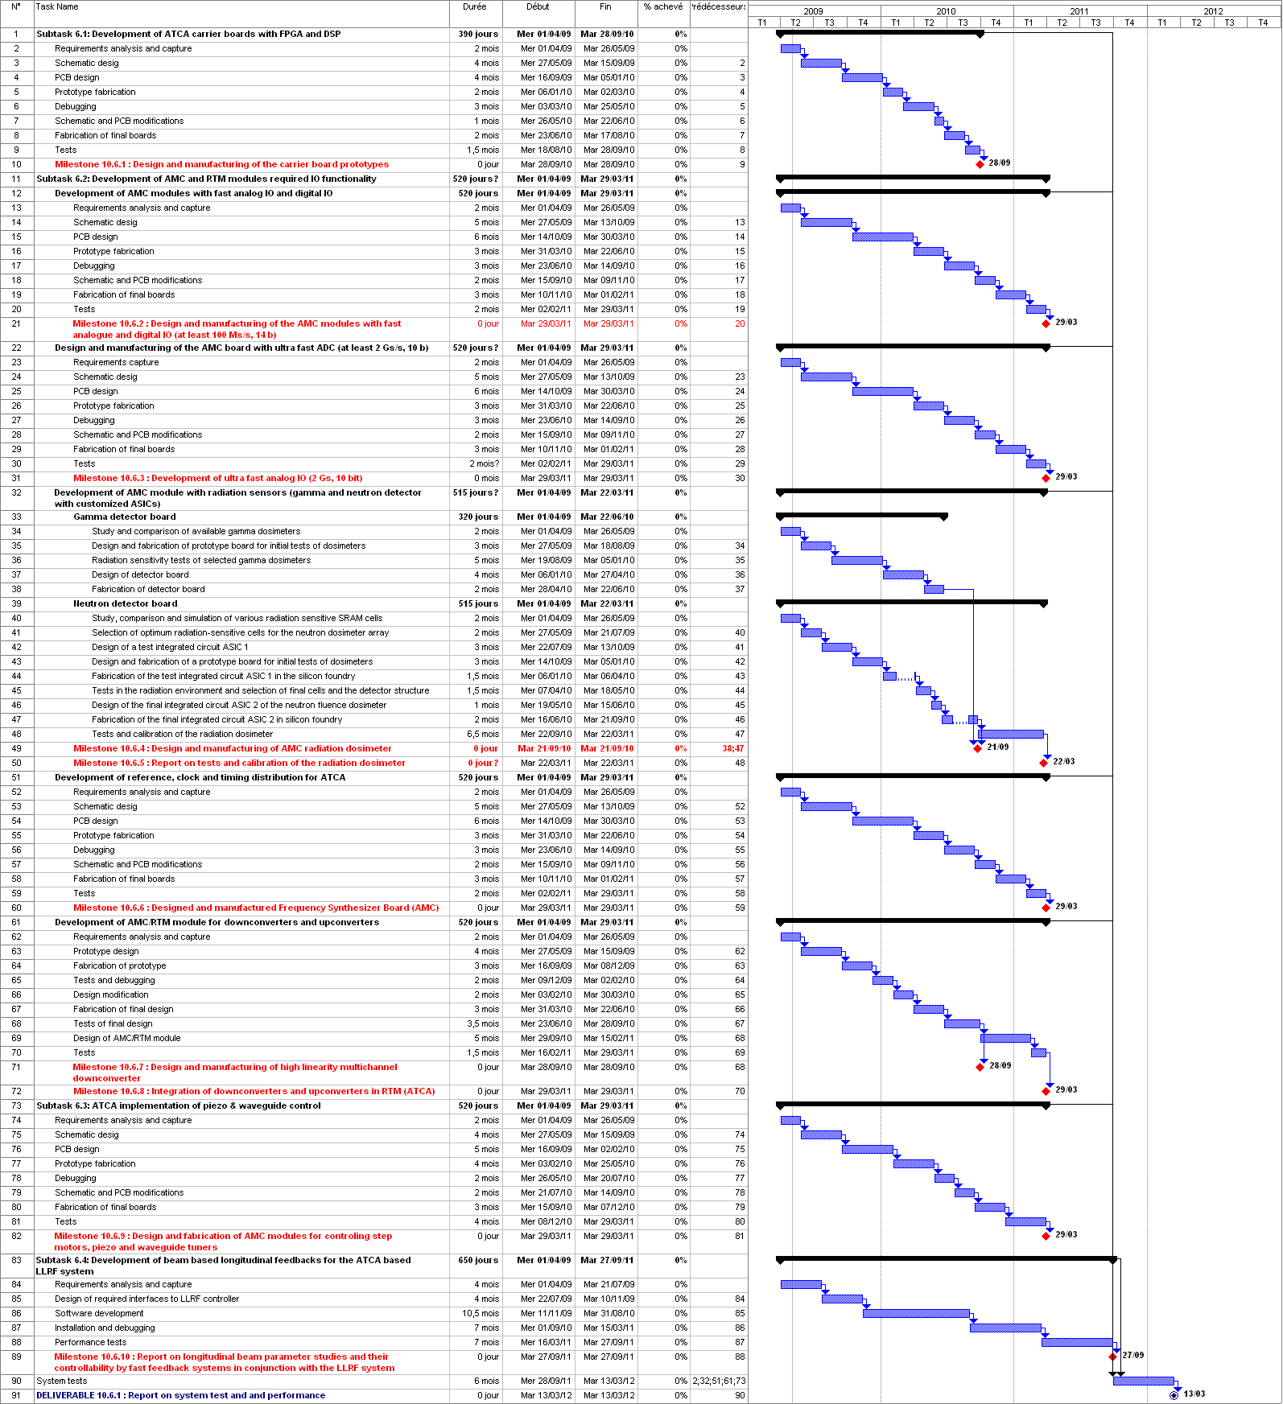
WP10.6: LLRF at FLASH

Slide 24
WP10.6: LLRF at FLASH

Slide 25
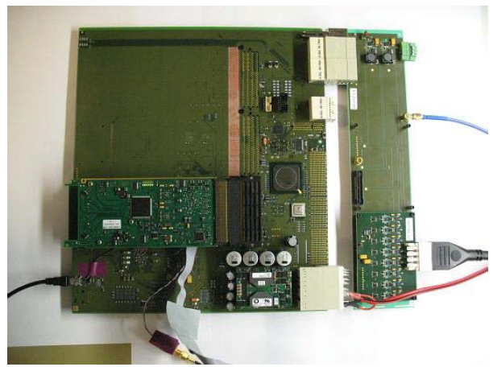
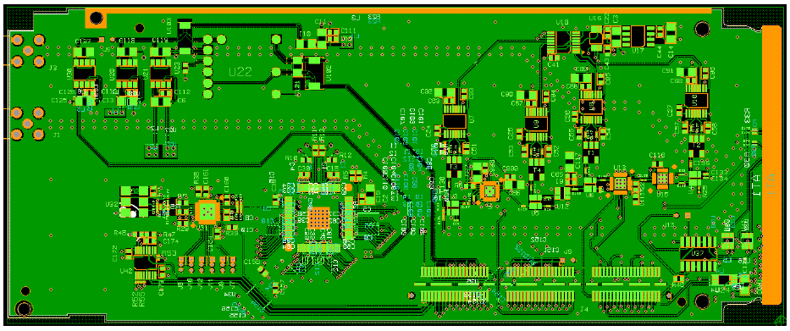
WP10.6: LLRF at FLASH
Description of work
- Task 6.1: ATCA developments of carrier boards with FPGA and DSP
Prototyping : ACTA carrier board
- Task 6.2: Development of AMC (Advanced Mezzanine Card) and RTM (Rear Transition Module) modules
Prototyping : AMC module boards
- Task 6.3: Development of special power drivers for AMC modules
Preparation work : electronics, collecting specifications
- Task 6.4: Development of beam based feedback
No Work : started in Oct’09, bibliography, organisation.

Slide 26
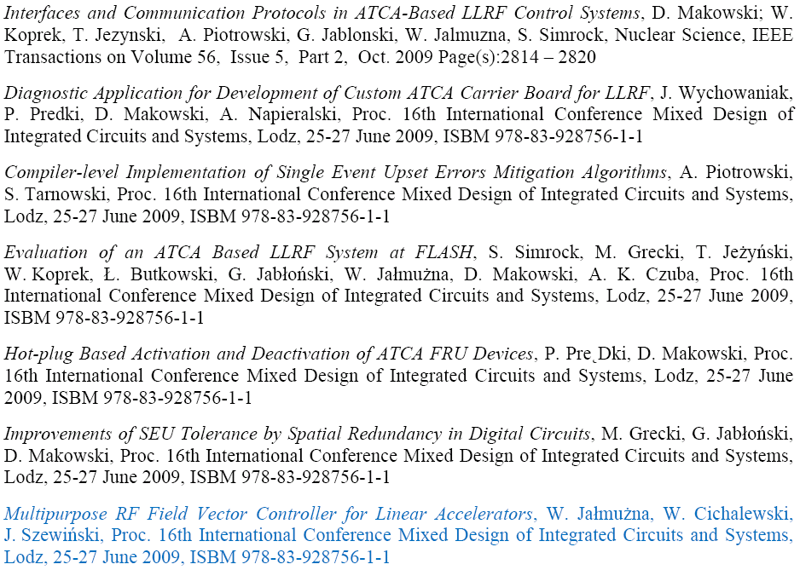
WP10.6: LLRF at FLASH
Publications (1 Nuclear Science IEEE + 13 MIXDES Conference):

Slide 27
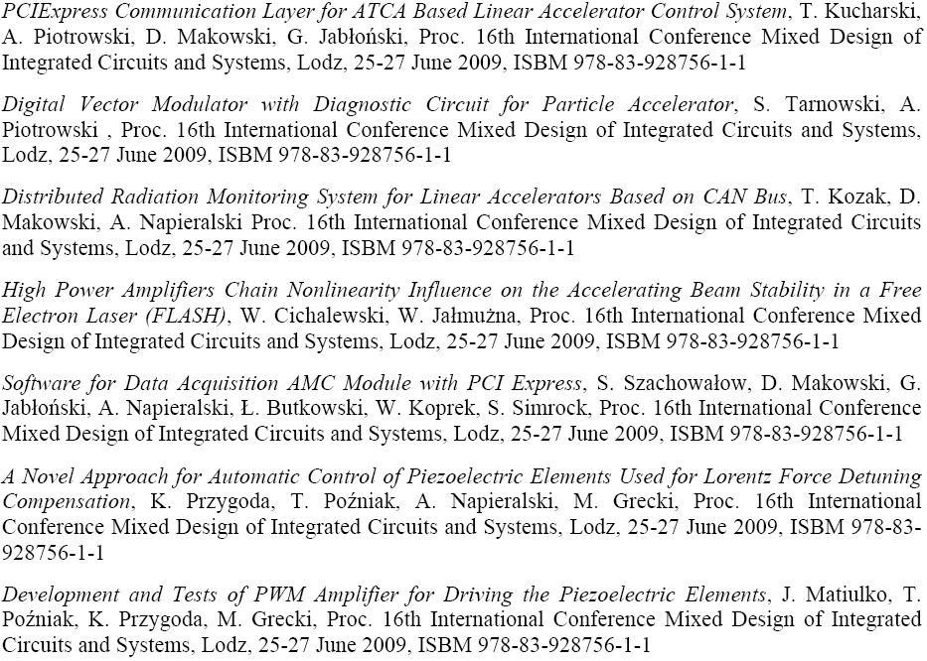
WP10.6: LLRF at FLASH

Slide 28
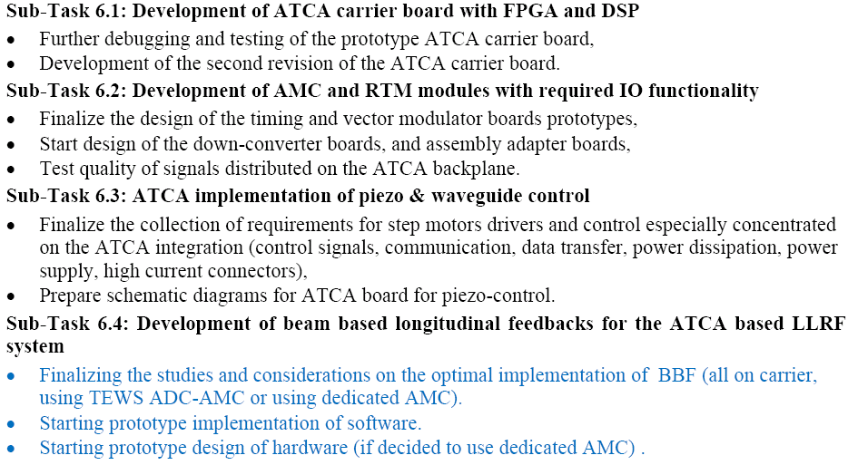
WP10.6: LLRF at FLASH
Next Semester:

Slide 29
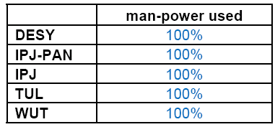
WP10.6: LLRF at FLASH
Milestones : no delays expected
Deliverables : no delays expected
Status Manpower:

Slide 30
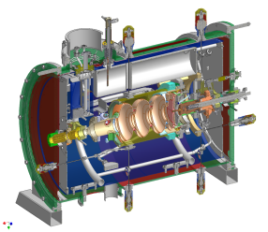
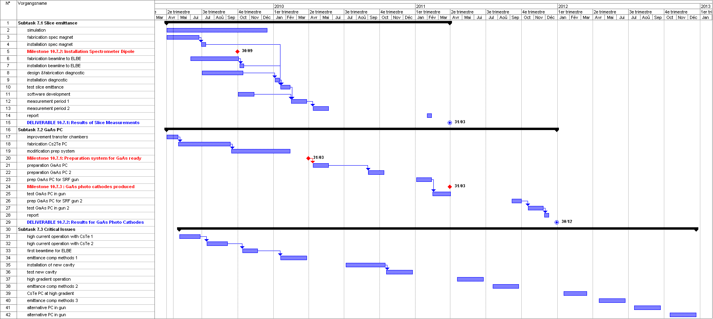
WP10.7: SC RF Gun at ELBE

Slide 31
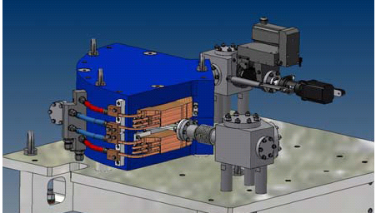
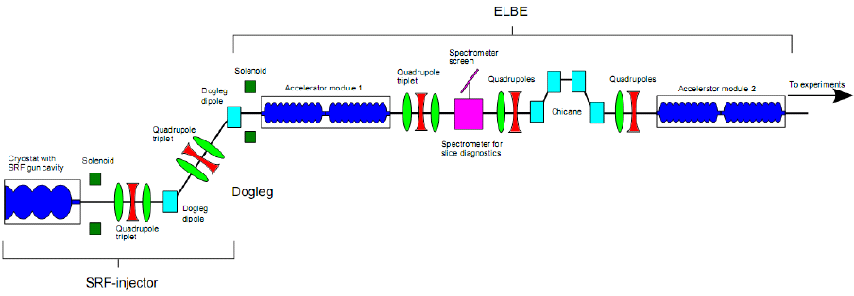
WP10.7: SC RF Gun at ELBE
Description of the Work
Task 7.1 : Slice Emittance Measurements
Major Advance: the spectrometer magnet is designed
and under fabrication at RI.
Optimal location on ELBE beam line identified.
Task 7.2 : GaAs Photo-cathodes
Preparation work: repair of the cathode transfer system (vacuum)
Fabrication of the GaAs preparation chamber (with DALINAC)
Task 7.3 : Critical Issues for SRF Gun Operation
Preparation work: first beam operation of diagnostic tool for transverse (slit mask) and longitudinal (streak camera) profiles.

Slide 32
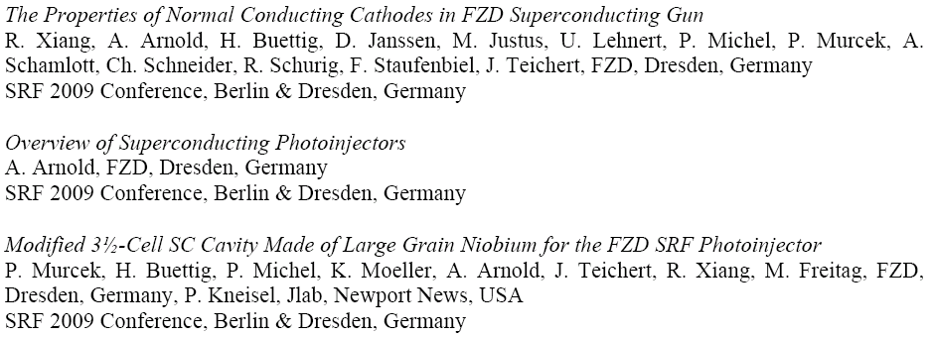
WP10.7: SC RF Gun at ELBE
Publications: 3 SRF’09 Conference, including EuCARD mentions (and CARE).

Slide 33
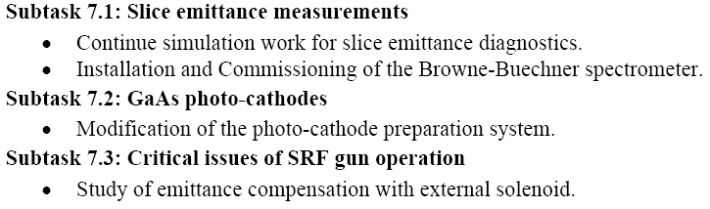
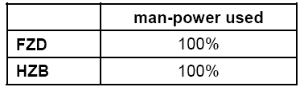
WP10.7: SC RF Gun at ELBE
Milestones : no delays expected
Deliverables : no delays expected
Next Semester :
Status Manpower:

Slide 34
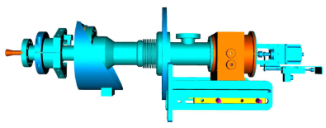
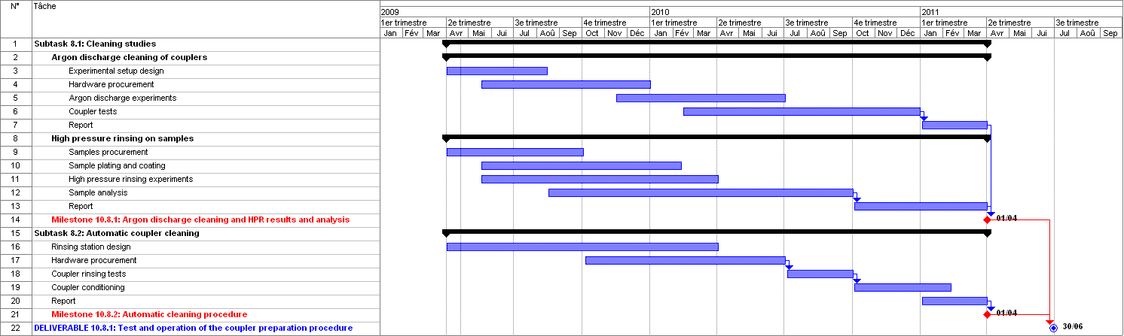
WP10.8: Coupler Development at LAL

Slide 35
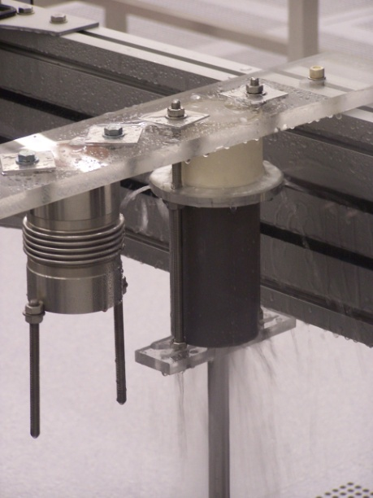
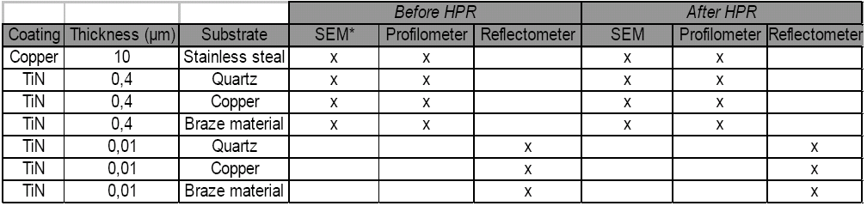
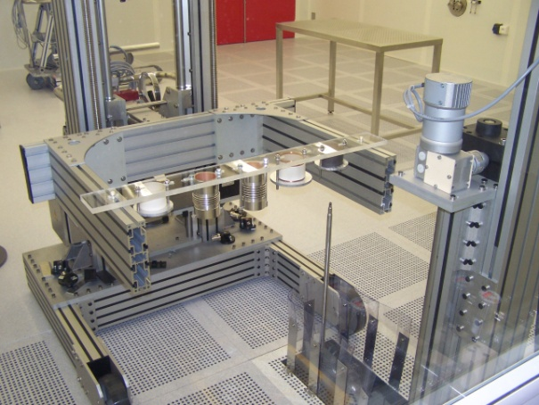
WP10.8: Coupler Development at LAL
Description of the Work
Task 8.1 : Cleaning Studies
Major Difficulty: Task leader has left the LAL-Orsay laboratory.
Activity on hold : on Argon Discharge cleaning of coupler surface.
Experimental Work: HPR cleaning of samples is going on, in collaboration with IPN-Orsay.
An experimentation programme worked out.
Task 8.2 : Automatic Coupler Cleaning
Design work: conceptual design of the cleaning robot, and detailed cleaning procedure worked out.

Slide 36

WP10.8: Coupler Development at LAL
Publications : none
Next Semester :

Slide 37

WP10.8: Coupler Development at LAL
Milestones :
M10.8.1 on Argon and HPR cleaning: several month delay expected
M10.8.2 on Automated cleaning: no delay expected
Deliverables :
D10.8.1 on Test and Operation of Coupler Cleaning Procedure : several month delay expected
Status Manpower:
Leaving of Subtask leader.
Hope to open temporary position in Jan’10.

Slide 38

WP10-SRF: Conclusions

