Slide 1
Gamma-ray Bursts An Overview
Julie McEnery
NASA/GSFC

Slide 2
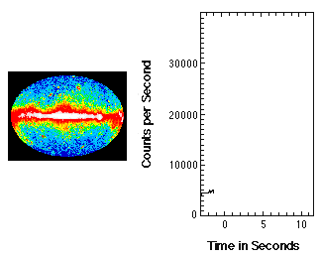
Briefly the brightest gamma-ray source in the sky
After the burst itself, afterglow emission in radio, optical and X-ray is observed for days (and sometimes months and years) which decays with time.

Slide 3
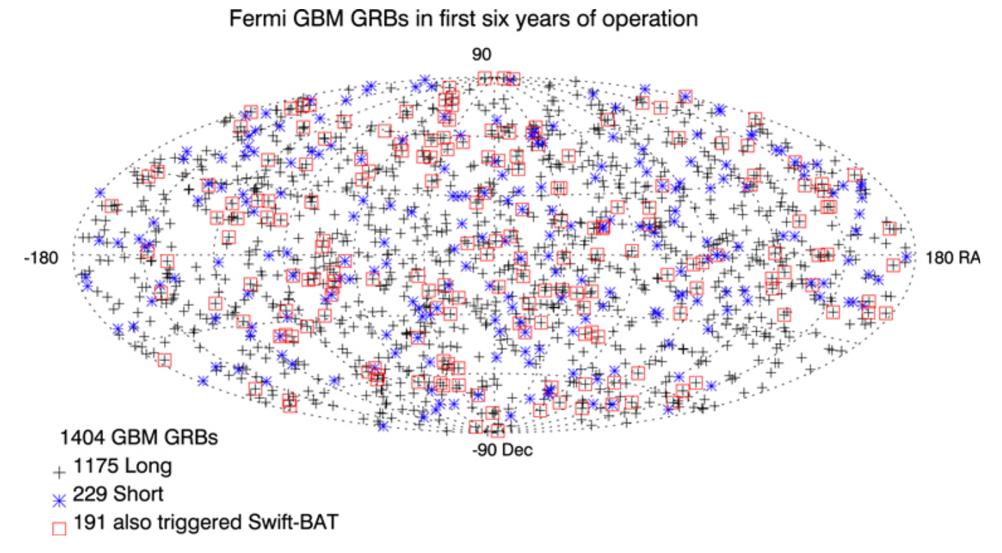
Distributed Isotropically Across the Sky
Bhat et al 2016

Slide 4
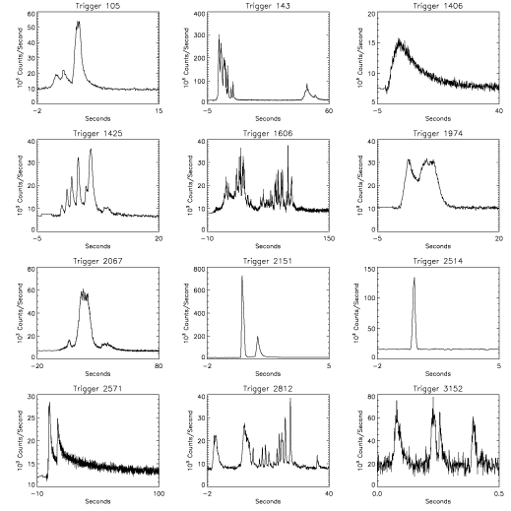
Gamma-ray Lightcurves
Durations from fractions to 1000’s of seconds
Wide variation in lightcurve properties

Slide 5
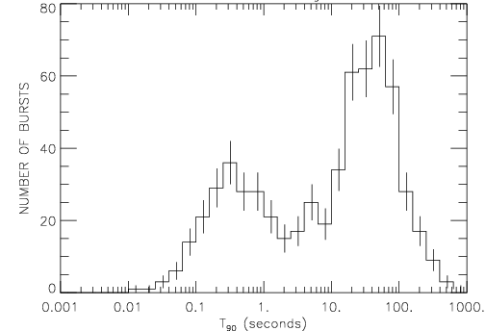
Duration distributions - two classes?
Paciesas et al 2003
Kouveliotou et al 1993
Two distinct populations
  Short <~2s
  Long >2 s

Slide 6
Current GRB Observations
Bursts from Aug 2008-May 2018
  ~1000 Swift GRBs (~100 short)
  ~2300 Fermi-GBM GRBs (~400 short)
  ~150 Fermi-LAT GRBs
  ~1000 Other (AGILE, Suzaku, Konus, INTEGRAL, etc.)
Limitations
  ~300 Swift GRBs with no high energy (>150 keV) observations
  ~1200 poorly localized GRBs without afterglow observations
Best Observed Subset
  Those with both high and low energy coverage

Slide 7
Gamma-ray Spectra
Fermi
XRT
BAT
Swift
GRB spectra typically fit with smoothly broken power-law, but more detailed studies enabled by Fermi have uncovered deviations

Slide 8
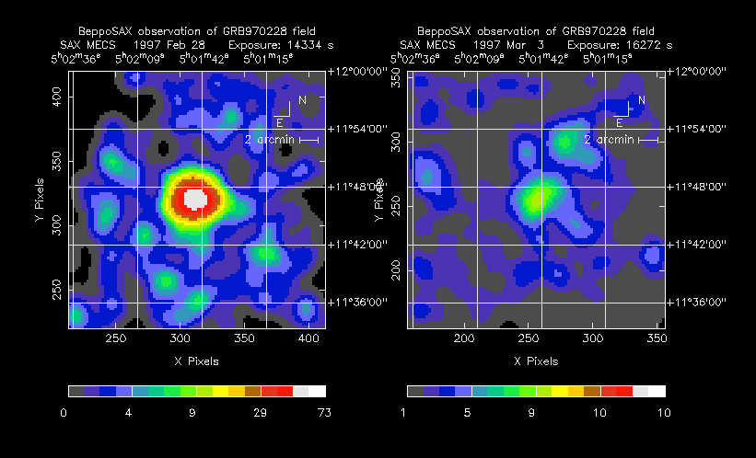
GRB Afterglows
GRB leave behind a faint declining echo at lower wavelengths.
Important as it allows us to better measure the location of the source
Faint, fading X-ray, optical or radio afterglows.
Identification of absorption or emission lines in afterglow or host galaxy allows determination of distance.
Implies that GRB are enormously energetic: 10⁴⁸ -10⁵⁴ ergs.
(c.f. Solar rest mass = ~2 x 10⁵⁴ ergs)

Slide 9
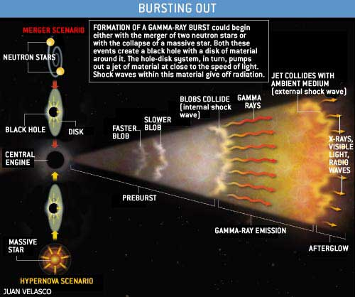
Fireball model

Slide 10
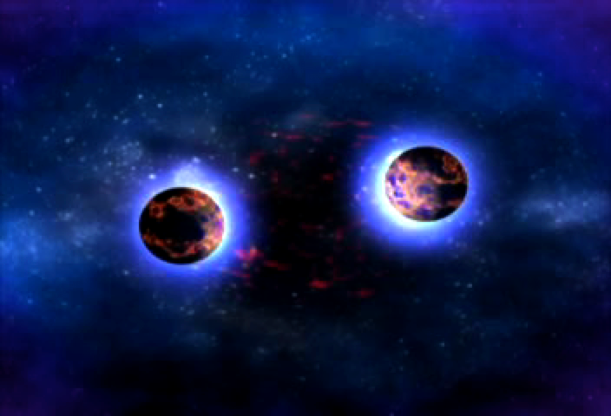
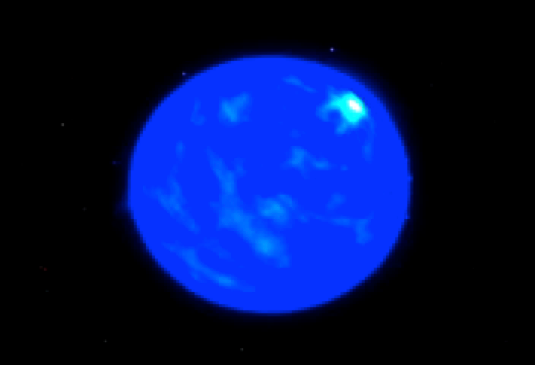
Gamma-ray bursts
Huge flux of gamma-rays lasting from 0.1-1000’s seconds
Compact Mergers: Two neutron stars, or a neutron star and a black hole, collide and merge, producing a jet.
Collapsars: A rapidly spinning stellar core collapses and produces a supernova, along with relativistic jets.

Slide 11
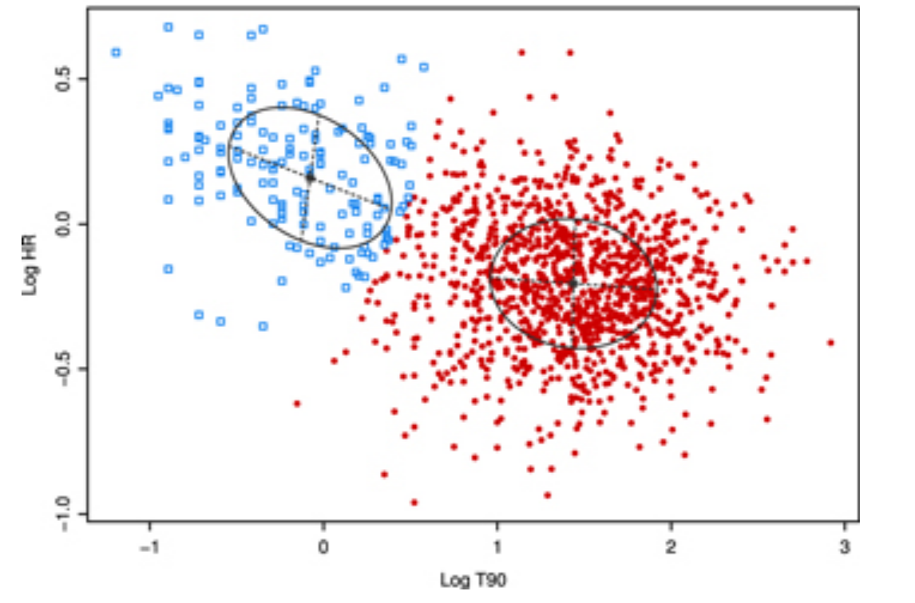
Prompt GRB Categories
Short Hard GRBs
  Harder Spectra
  T90 < 2 s
  Associated with old stellar populations on outskirts of old galaxies
  Consistent with picture of Neutron star – Neutron star merger or Neutron star – blackhole merger
Long Soft GRBs
  Softer Spectra
  T90 > 2 s
  Associated with young stellar populations in star forming regions
  Consistent with picture of massive star collapsing into blackhole
  Associated supernovae

Slide 12
Broadband Observations of GRBs
Chandra et al. 2011 Ackermann et al. 2013
Kann et al. 2011
Racusin et al. 2009
•
Sari 1998

Slide 13
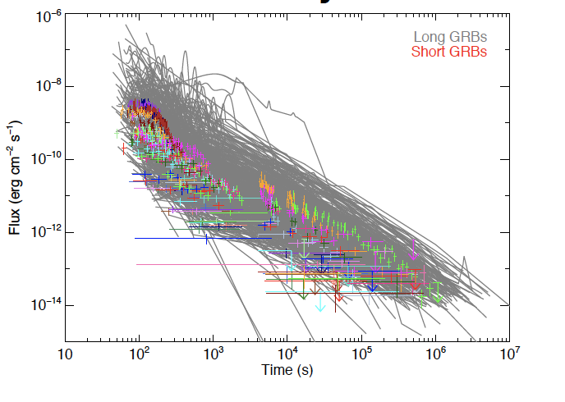
Afterglows
Optical
Kann et al 2011
X-ray
External shock interacting with surrounding environment
Depends on:
  density and profile of gas/dust
  electron spectrum
  magnetic field
  energy input
  bulk Lorentz factor
  jet structure
  viewing angle
Kann et al 2011
Racusin et al 2011
Radio
GeV Gamma-ray
Ackermann et al 2011
Chandra et al 2011

Slide 14
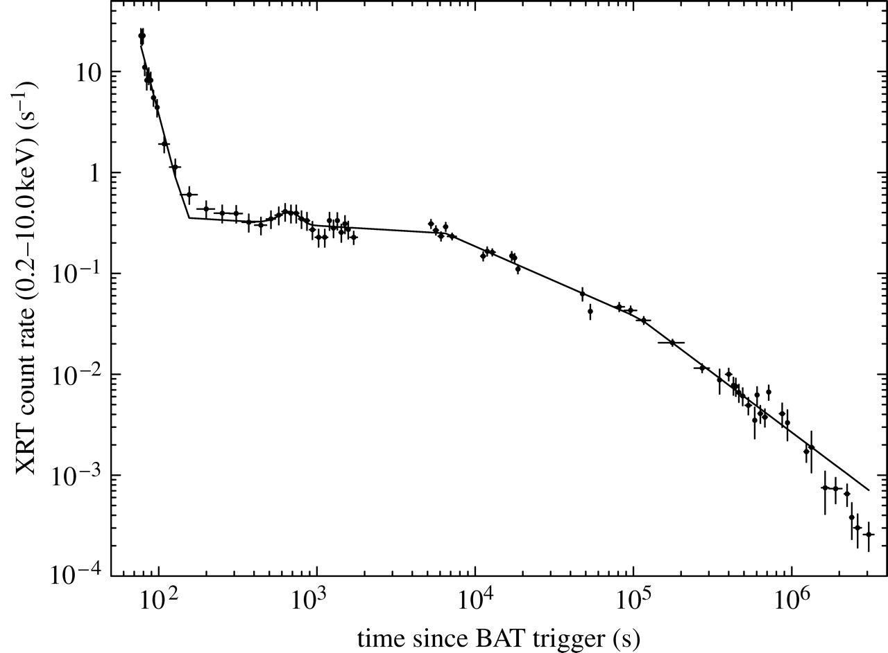
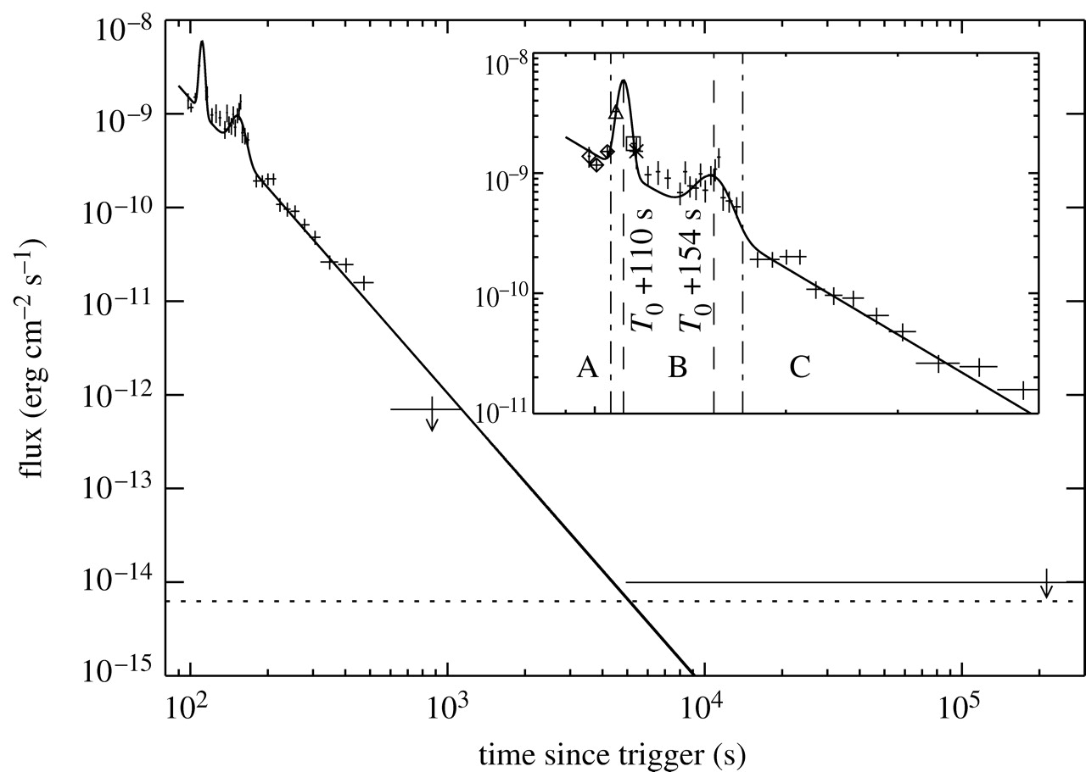
X-ray flares and Plateaus
GRB 060428A
GRB 050421
Burrows et al 2006
Intense X-ray flares during afterglow suggest additional energy injection
  Hard to explain with simple decelerating external shock
  Implies additional energy injection at late times in some GRB
    Perhaps progenitor for some GRB collapses to a Magnetar that continues to inject energy into the system?

Slide 15
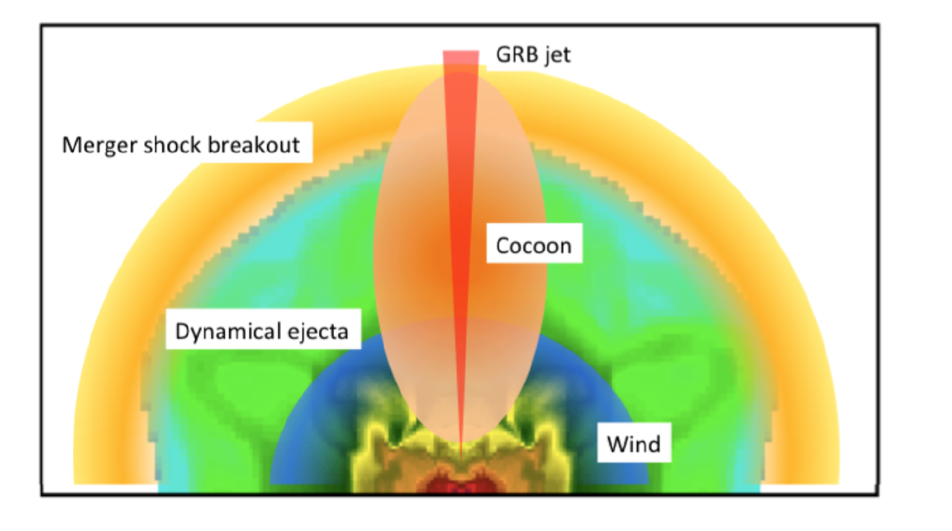
More possible complexities
Jet can interact with surrounding ejecta to produce mildly relativistic “cocoon”
  Predicts soft spectrum/thermal gamma-rays or X-rays
    This component will be less collimated than the jet emission

Slide 16
New Spectral Features

Slide 17
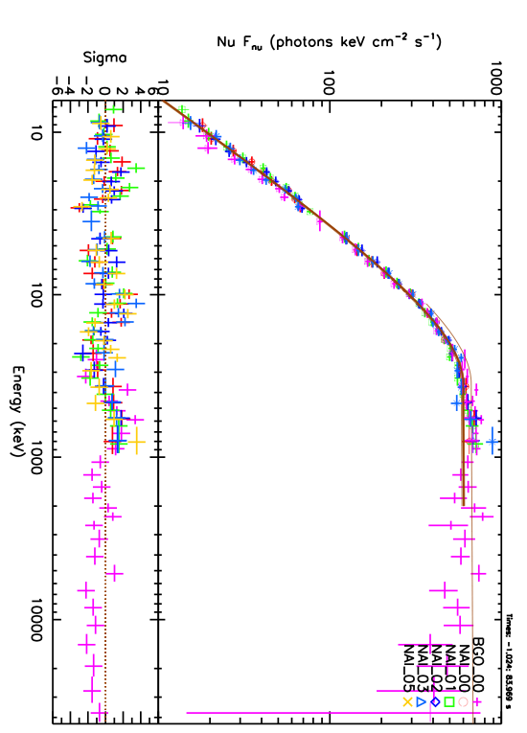
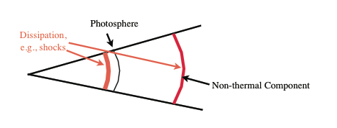
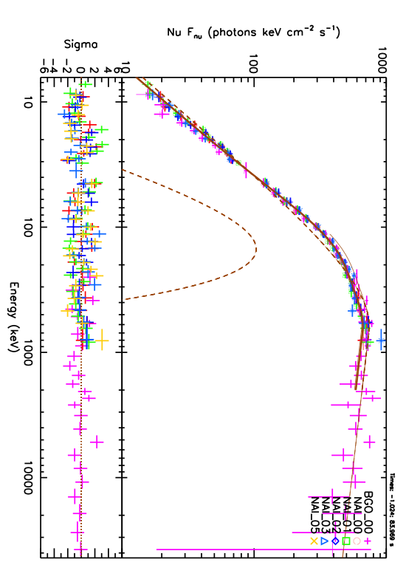
Fermi-GBM Spectra - Thermal Components
GRB100724B - brightest GBM burst
Non thermal
Expect thermal/blackbody component from photosphere
Total
Non thermal
Thermal(kT≈38keV)
Black body components have been fit in several GRB - GRB080916C, GRB090902, GRB100724B…
Guiriec et al, 2011, Ryde et al 2011
kT~constant, evolving non-thermal component

Slide 18
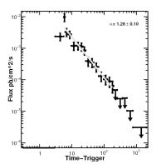
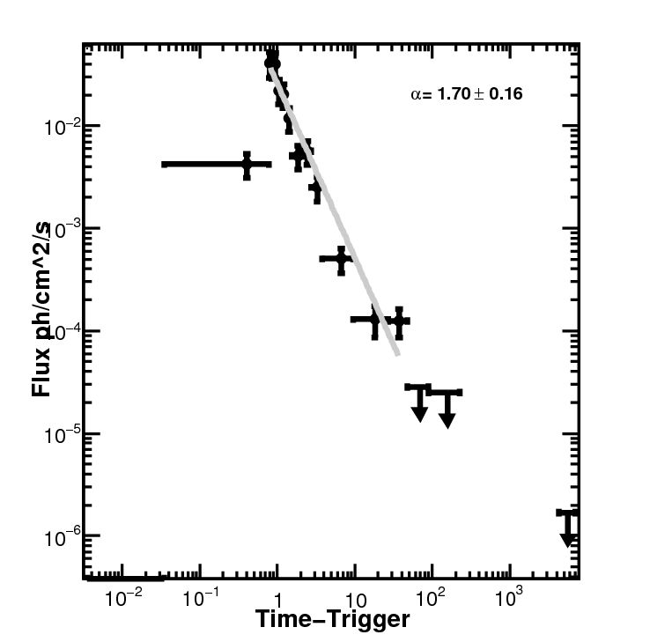
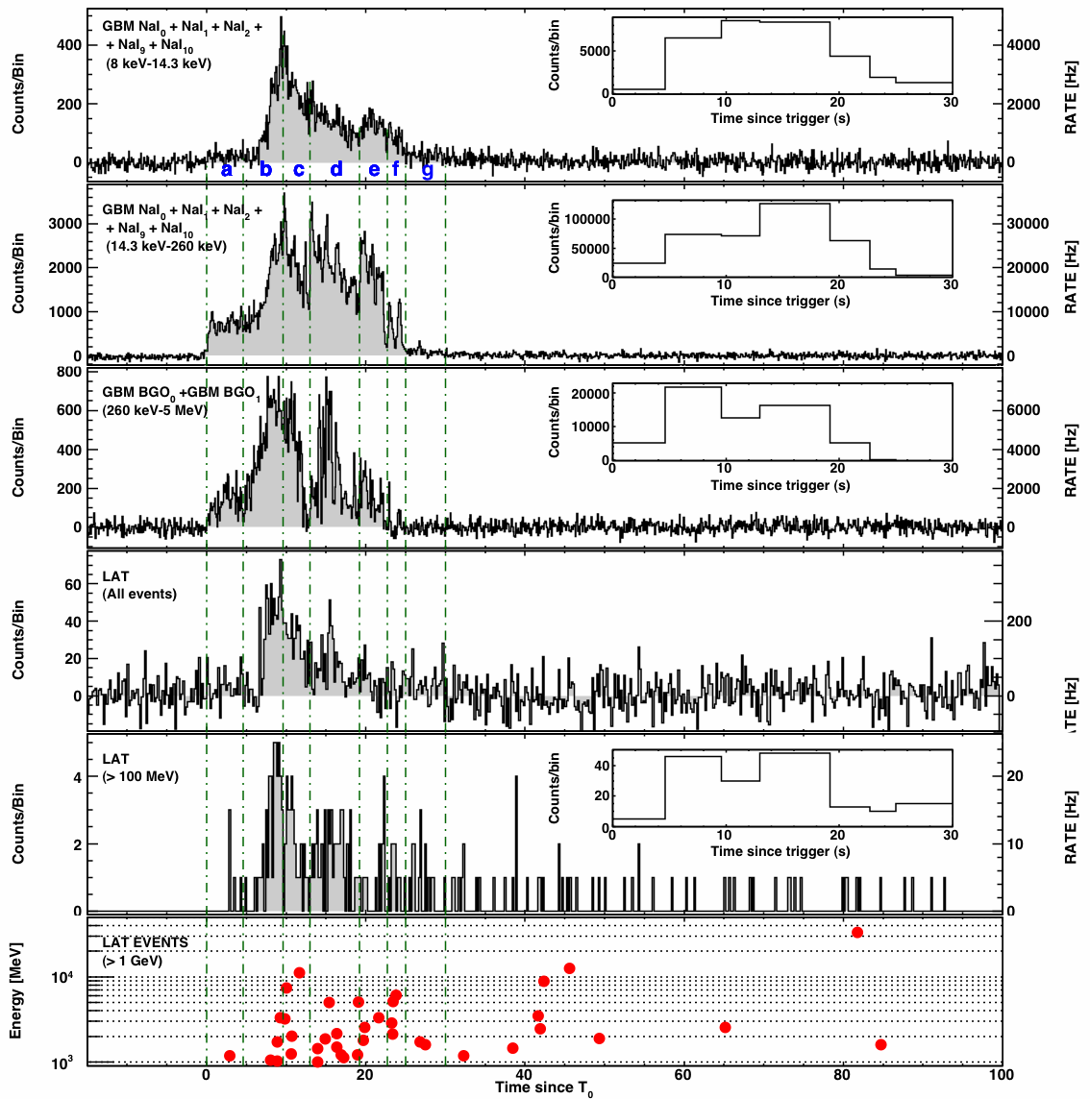
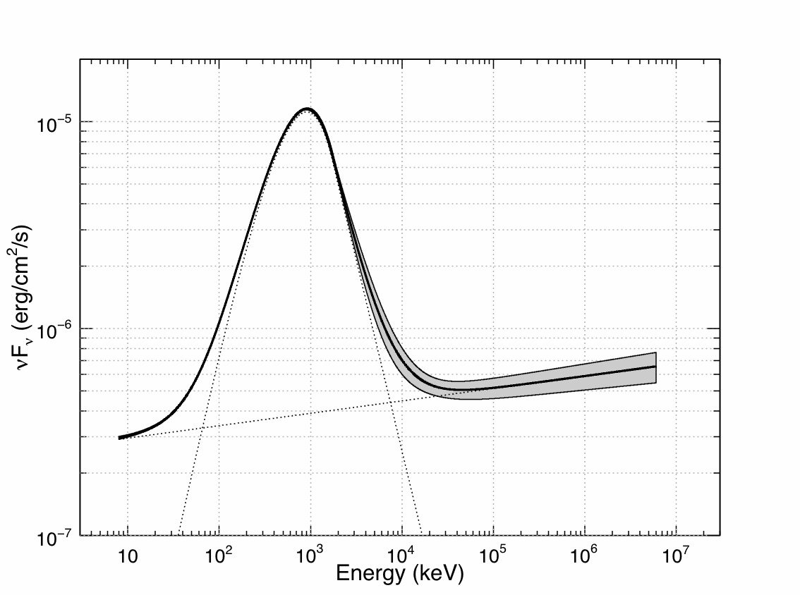
GeV GRB Properties
GeV Afterglow with Powerlaw decay
Delayed onset of prompt emission
Extra Spectral Component
Remarkably, these features are seen in most bright LAT-detected GRB!

Slide 19
GeV Emission Origin
Leptonic: inverse-Compton (or synchrotron self-Compton)?
  Hard to produce a delayed onset longer than spike width
  Hard to account for the different photon indices of the HE component & the Band spectrum at low energies
  Hard to produce a low-energy power-law
Hadronic: (pair cascades, proton synchrotron)?
  Late onset: time to accelerate protons+develop cascades?
  Hard to produce the observed sharp spikes that coincide with those at low energies in some GRB (+ a longer delay in the onset)
  Synchrotron emission from secondary e+/e- pairs can naturally explain the power-law at low energies

Slide 20
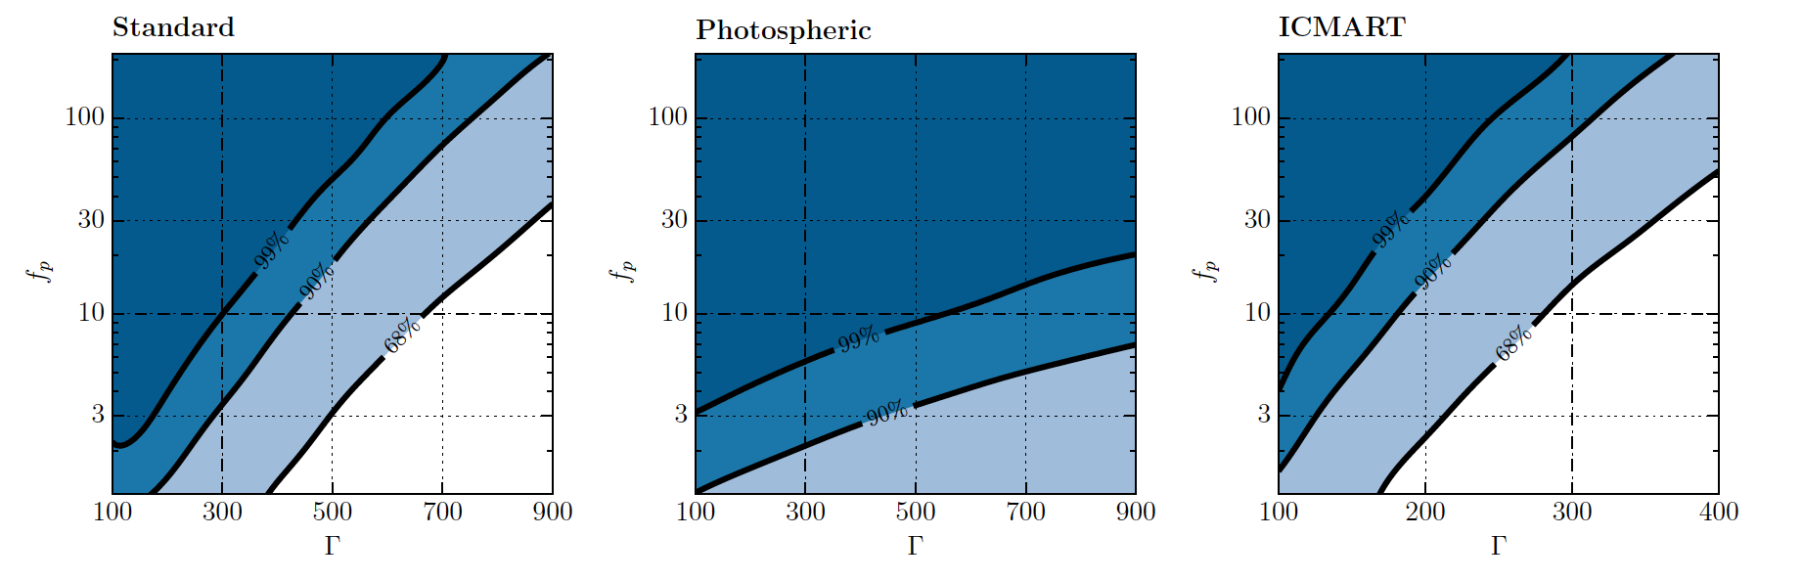
Multimessenger Synergies - Neutrinos
If GRB accelerate a population of protons (as suggested by the GeV observations) then this will also result in high energy neutrinos
IceCube non detection of muon neutrinos during prompt phase of 1172 GRB yield constraints on hadron fraction as a function of jet Doppler factor.

Slide 21
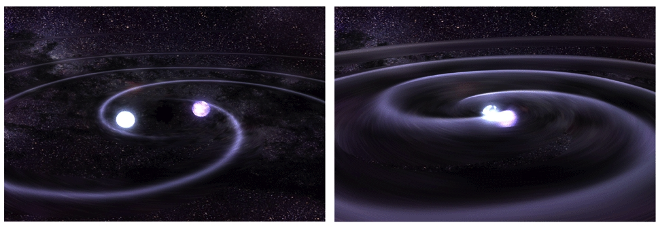
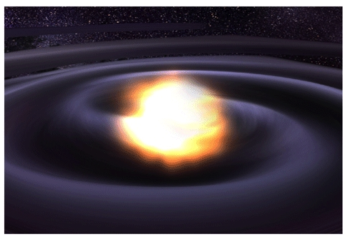
Gravitational Waves
LIGO/Virgo sensitive to gravitational waves produced in merger of compact objects (NS-NS, NS-BH and BH-BH)
Compact mergers are presumed progenitors for short GRBs
EM and GW observations bring complementary information: Gravitational radiation → inspiral characteristics; EM → jet properties & environment

Slide 22
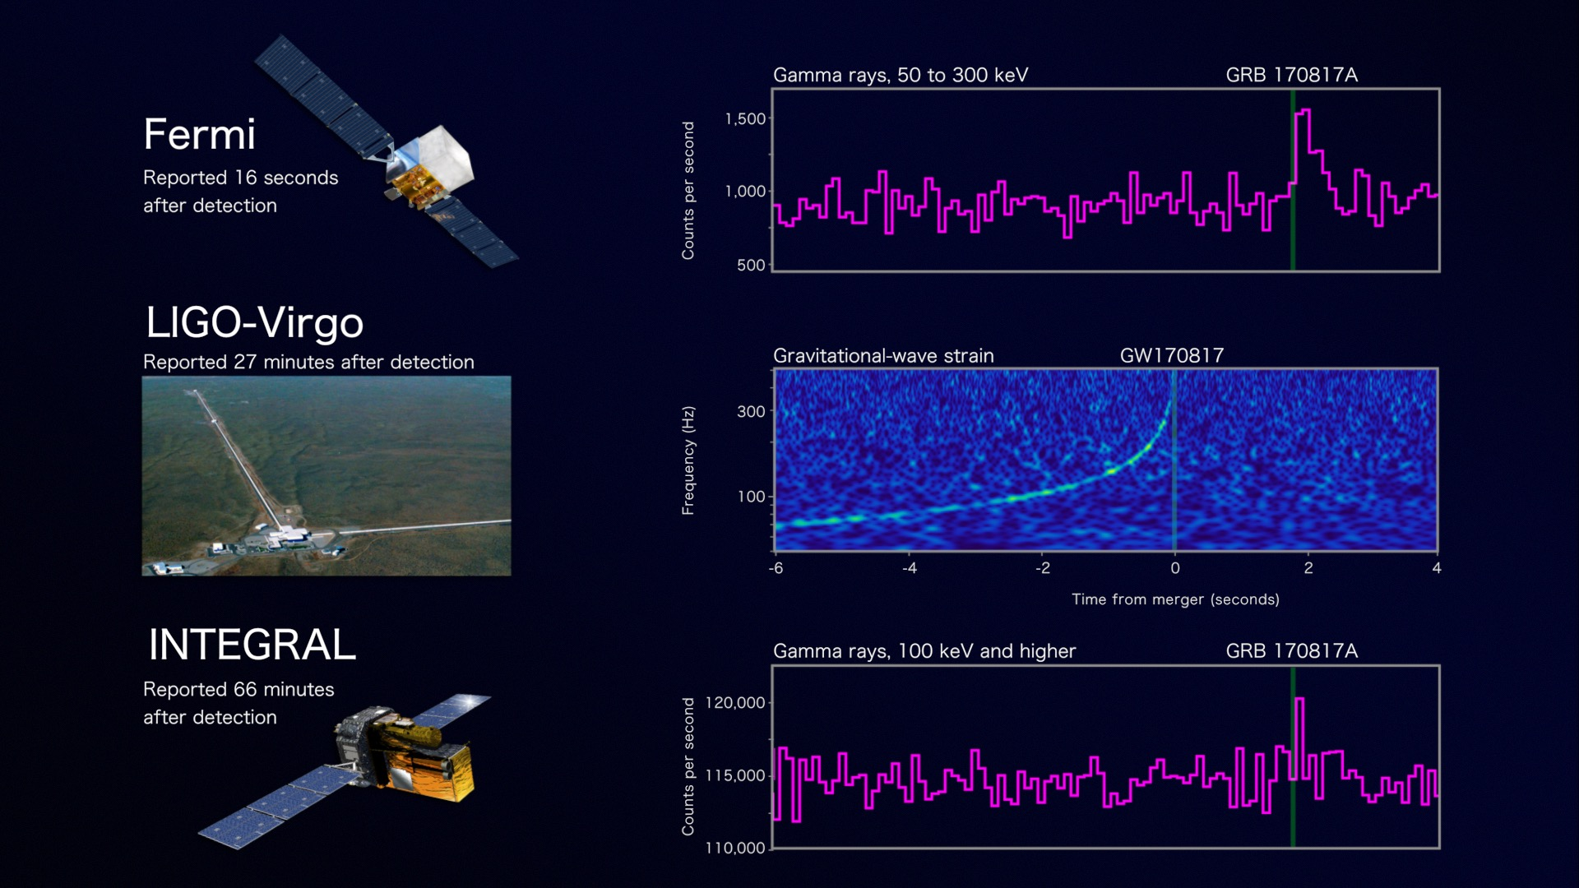
GRB 170817A
vx

Slide 23
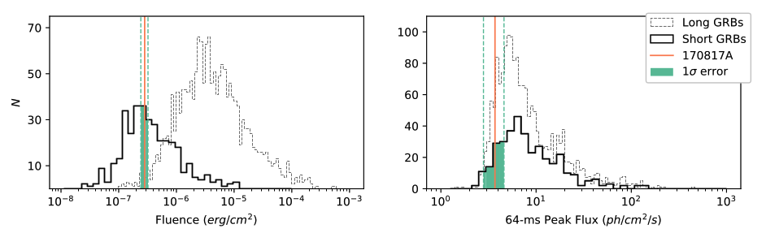
GRB 170817 was a normal short GRB
Falls right in the middle of the distribution for energy release for a short GRB
Not strongly peaked, so peak flux is low compared to bursts with comparable fluence
But, we know that this burst was more than 10 times closer than any other with a measured distance.

Slide 24
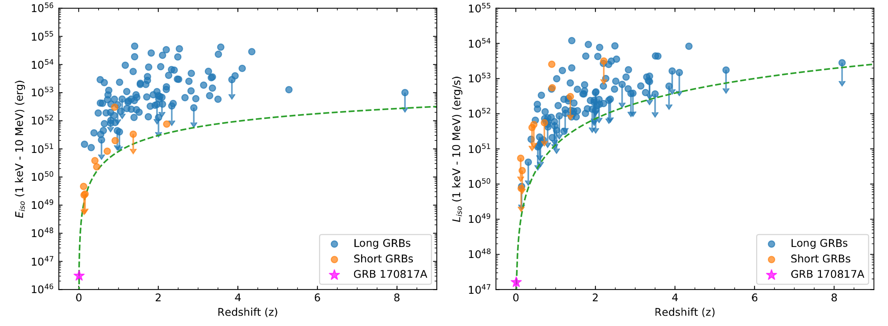
The GRB is Exceedingly Dim
Using known distance, GRB 170817A is sub-luminous by 2-6 orders of magnitude.

Slide 25
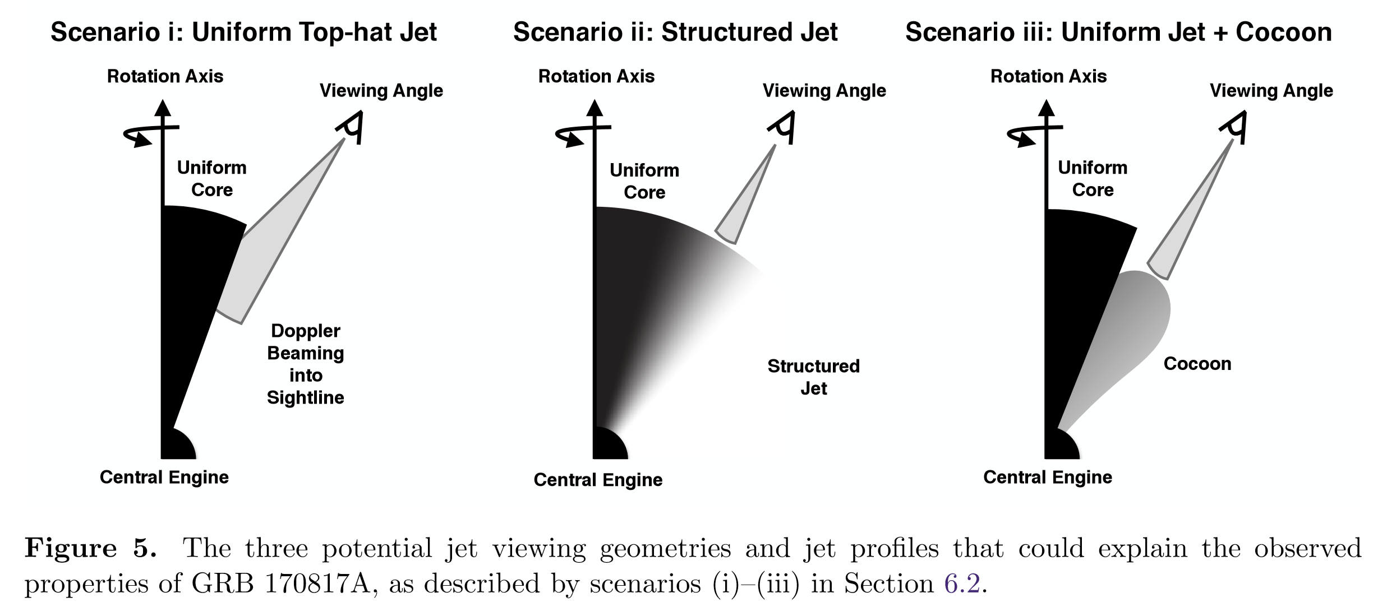
Structured Jet or Cocoon

Slide 26
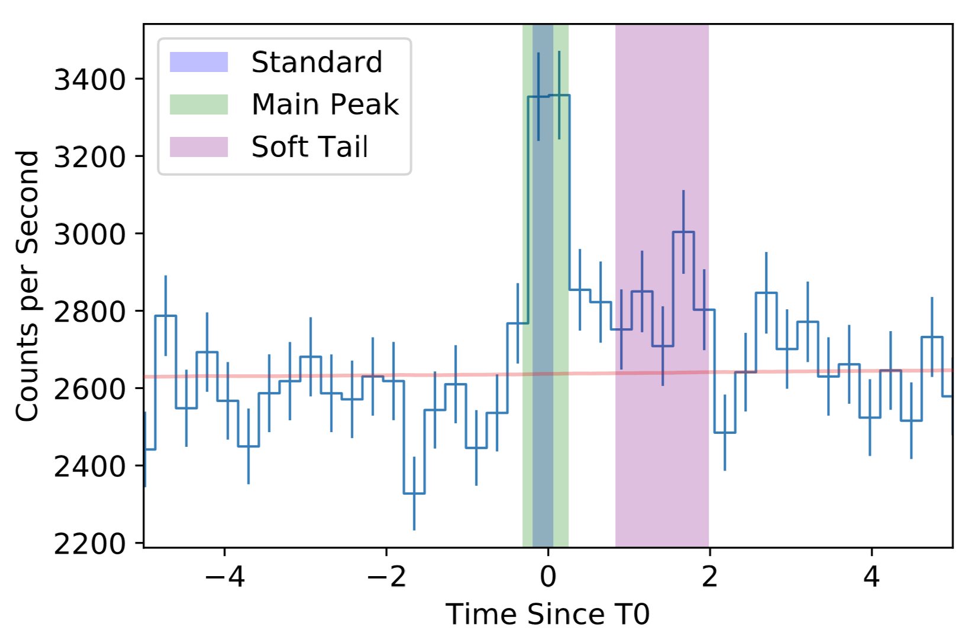
Some details – two gamma-ray components
Main Peak (~0.5 s)
  E_{peak} = (185 ± 62) keV
  (3.1±0.7)x10⁻⁷ erg s⁻¹ cm⁻²
  (1.8±0.4)x10⁻⁷ erg cm⁻²
Soft Tail (~few s)
  k_{B}T = (10.3±1.5) keV
  (0.5±0.1)⁻⁷ erg s⁻¹ cm⁻²
  (0.6±0.1)⁻⁷ erg s⁻¹

Slide 27
Origin of the Gamma-rays
The short hard spike can be explained reasonably by:
  internal shocks and, assuming the entire time delay is due to the jet propagation time, we can set upper limits on the radius of the jet and the emitting region.
  external shocks and, assuming the entire time delay is the time until external shocks occur, we can set limits on the deceleration radius and the bulk Lorentz factor of the jet
The thermal tail can be explained as arising from:
  photospheric emission (with the delay the time until it is optically thin)
  cocoon emission, which matches the UV detection from Swift

Slide 28
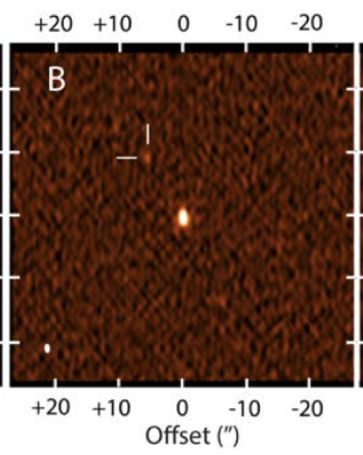
Late onset of X-ray and Radio
X-ray appeared after 9 days
Radio appeared after 16 days
Both slowly rising
X-ray spectroscopy cannot distinguish between thermal and non-thermal, however:
  Non-thermal spectrum with photon index Γ~1.5 can account for the X-ray and radio emission

Slide 29
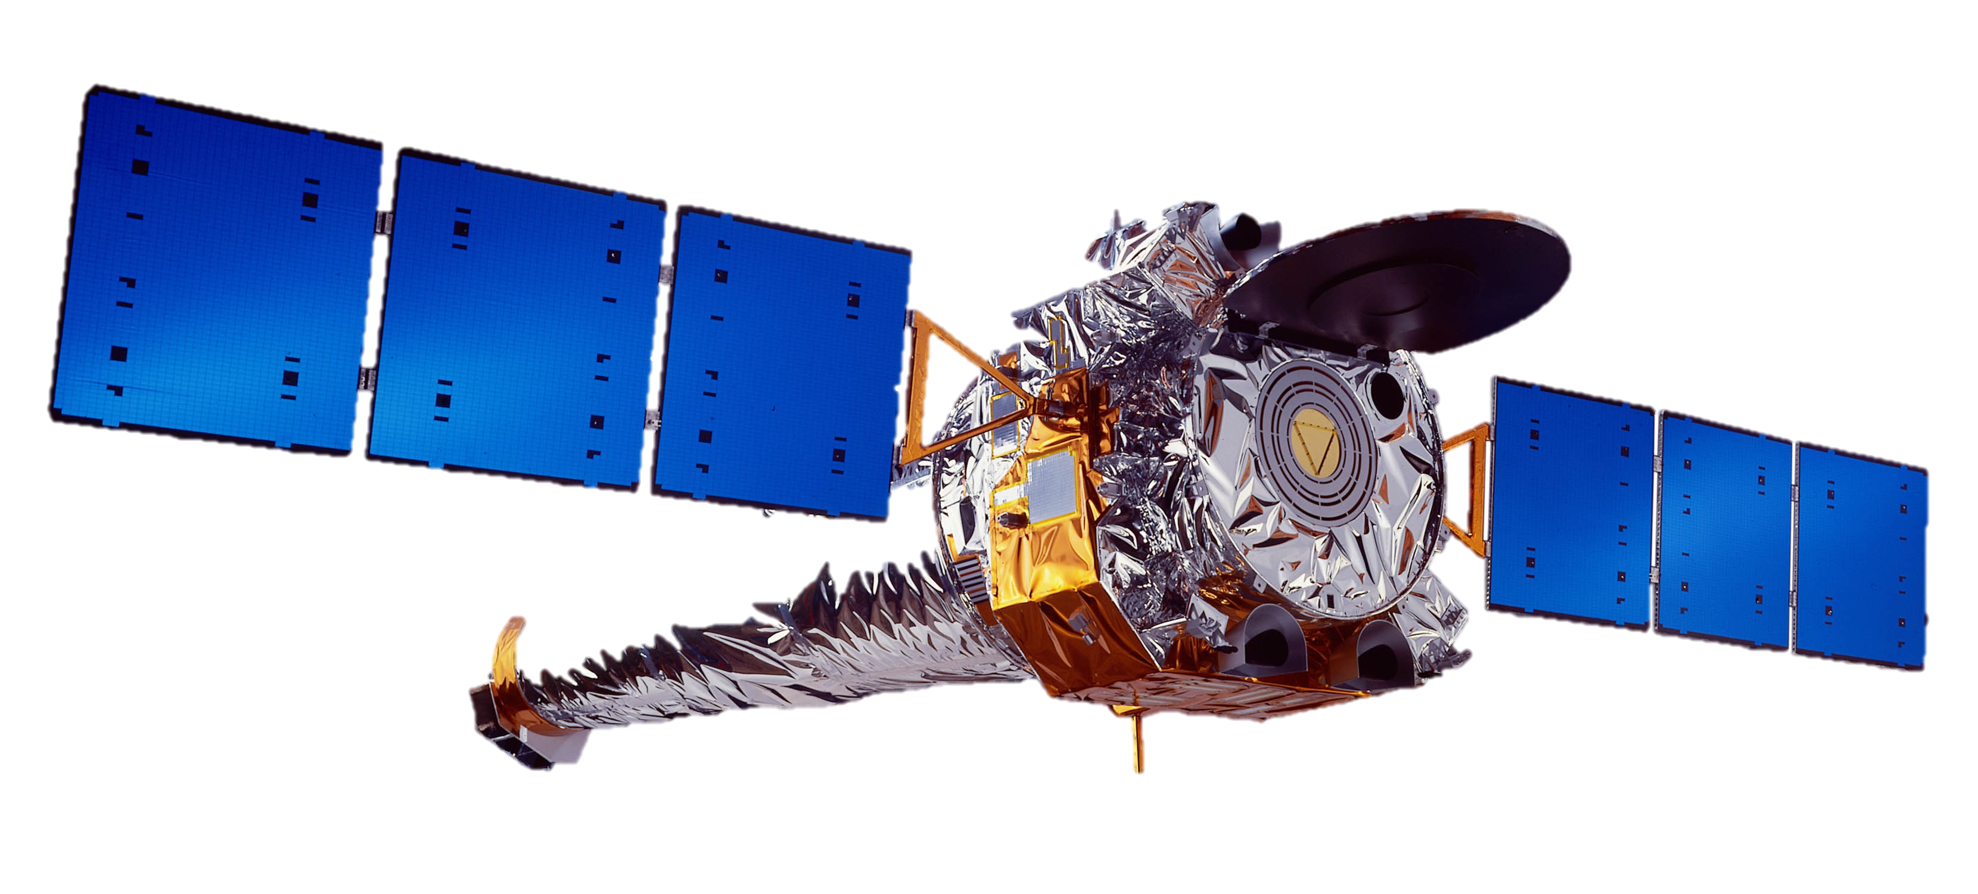
On-axis jet
X-ray on-axis

Slide 30
Off-axis Jet

Slide 31
Off-axis Jet

Slide 32
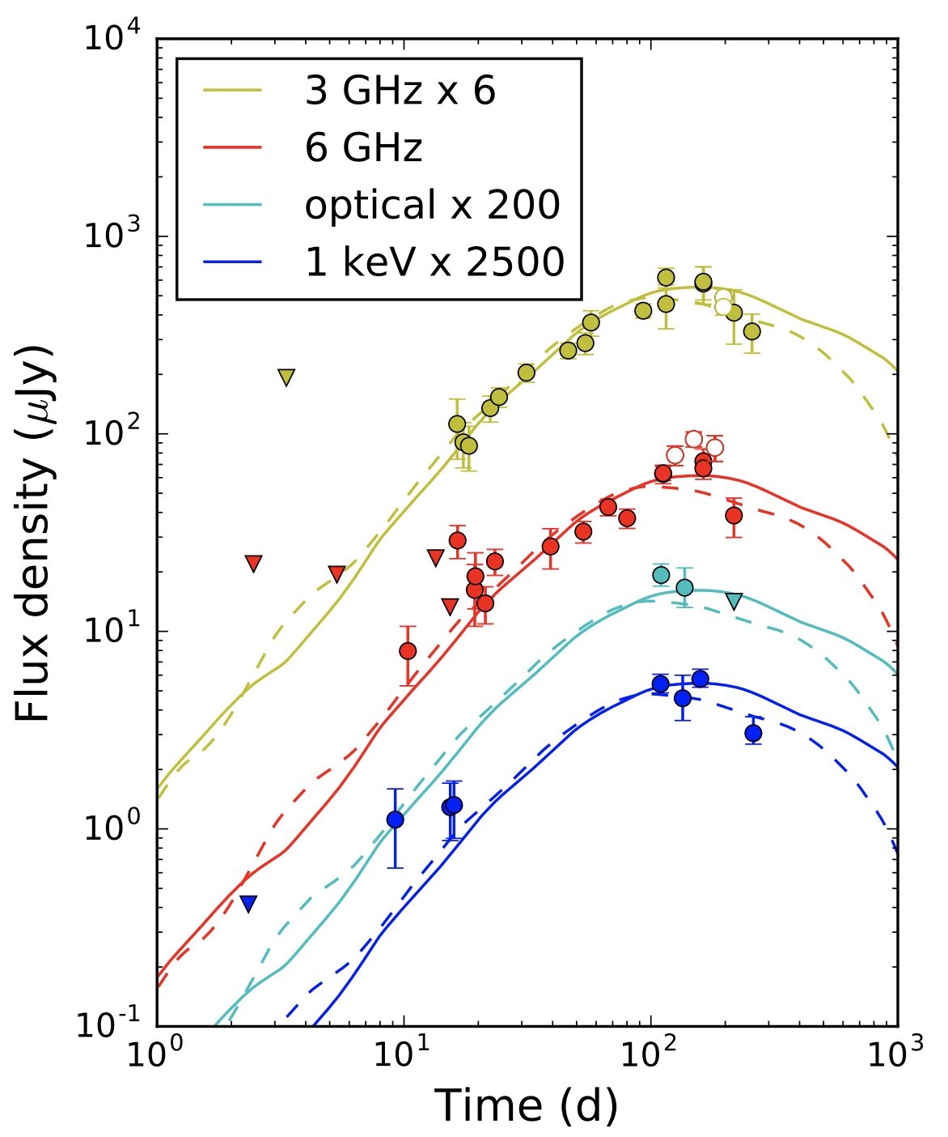
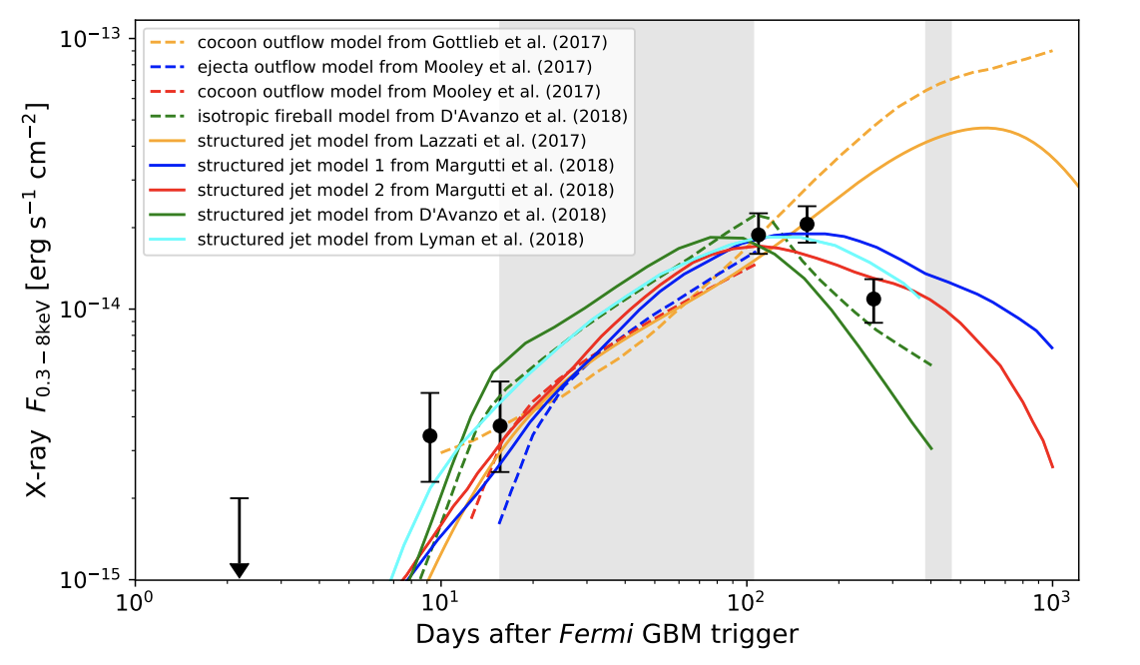
X-ray, Optical and Radio emission rise and finally decline…
Cocoon and off-axis jet models have both been fit to the data

Slide 33
The Future

Slide 34
Gamma-ray Counterparts to GW events
Current Facilities
Selected Proposed Future Facilities
Instrument | Energy range | GRB/year | localization
Fermi-GBM | 8 keV – 40 MeV | 240 (trig) | 5-15 deg
Swift-BAT | 15 keV – 150 keV | 90 | arcmin
Fermi-LAT | 50 MeV – 300 GeV | 10 | ~<0.5 deg
Insight-HMXT | 200 keV – 5 MeV |  | 5-15 deg
INTEGRAL-IBIS | 15 keV – 10 MeV | 2-5 | arcmin
Instrument | Energy range | GRB/year | localization
AMEGO* | 200 keV – 10 GeV | 500 | 0.5-2 deg
TAP/TAO/Nimble/Burstcube | 10 keV – 1 MeV | 240 | 5-15 deg
SVOM-eclairs | 4 keV – 120 keV | 80 | arcmin
* Very similar to eAstroGAM proposed to M5

Slide 35
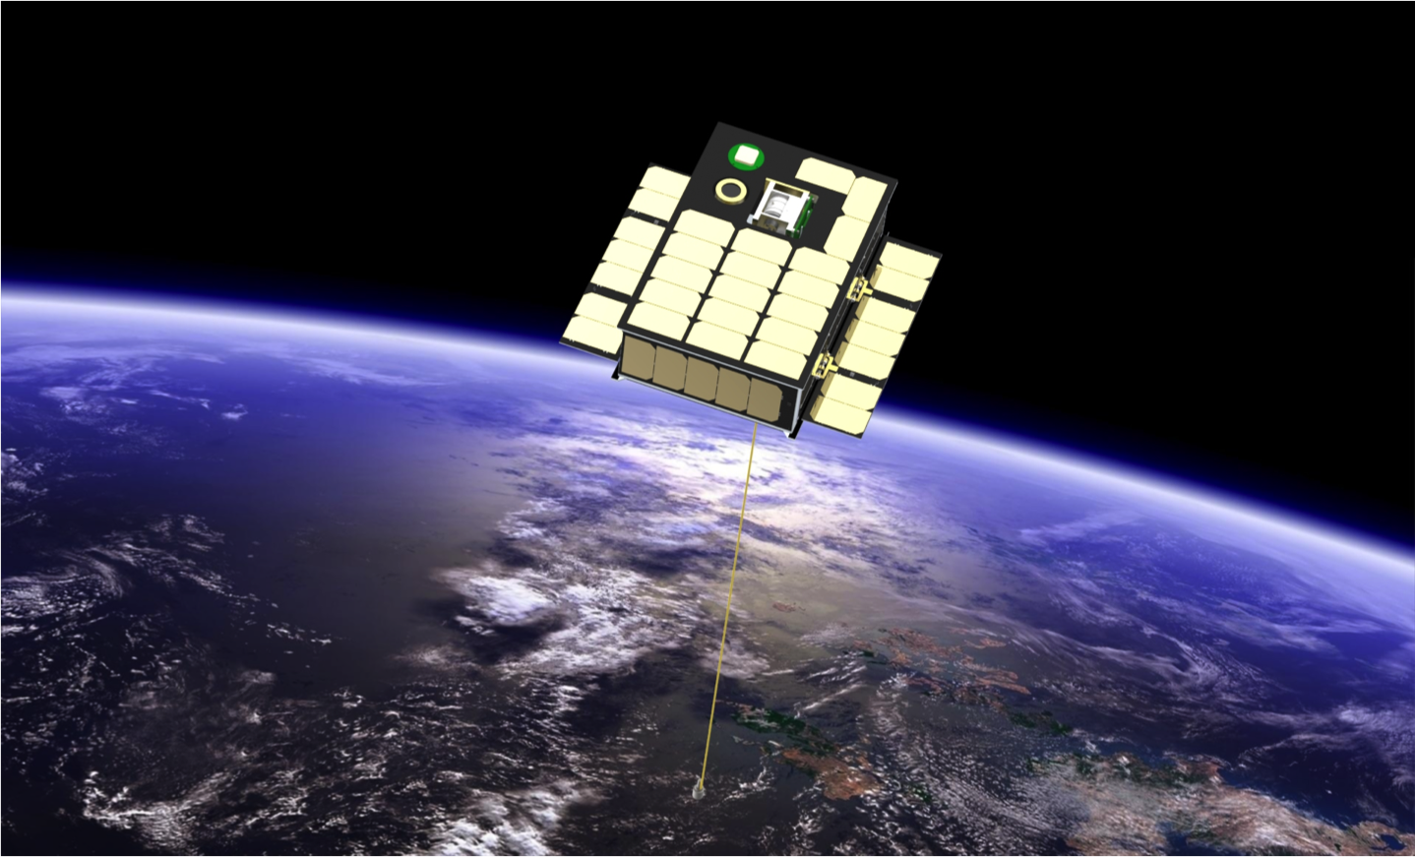
BurstCube
A CubeSat for Gravitational Wave Counterparts
PI: Jeremy S. Perkins (NASA/GSFC), Judith L. Racusin (NASA/GSFC), Michael S. Briggs (UAH), Georgia de Nolfo (NASA/GSFC), John Krizmanic (NASA/GSFC/CRESST), Regina Caputo (NASA/GSFC/CRESST), Julie E. McEnery (NASA/GSFC), Peter Shawhan (UMD), David Morris (UVI), Collaborators: Valerie Connaughton (USRA), Dan Kocevski (NASA/MSFC), Colleen Wilson-Hodge (NASA/MSFC), Michelle Hui (NASA/MSFC), Lee Mitchell (NRL), Sheila McBreen (UCD), & Dieter Hartmann (Clemson)

Slide 36
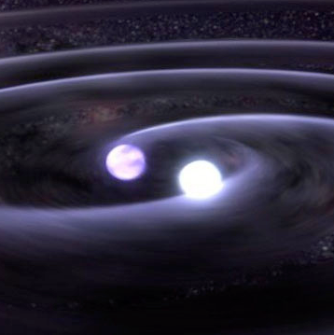
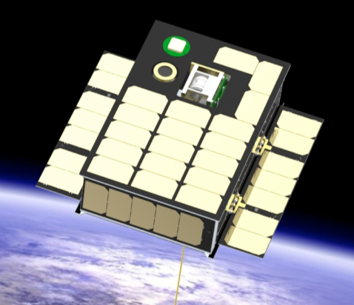
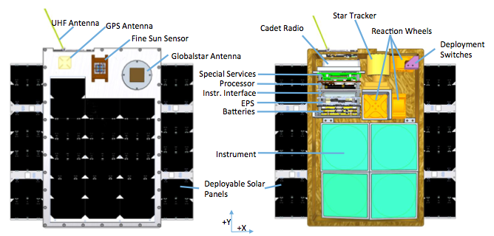
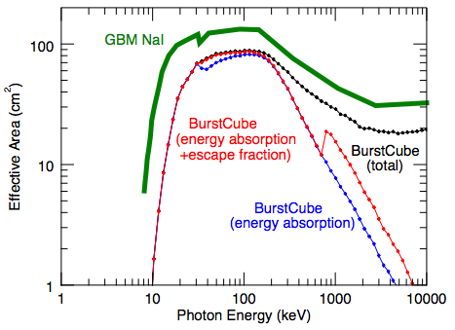
BurstCube: A CubeSat for Gravitational Wave Counterparts
PI: Jeremy Perkins (661)
BurstCube: a novel 6U CubeSat that will detect and localize GRBs
Will detect these with four CsI scintillators coupled with arrays of compact low-power Silicon photomultipliers (SiPMs).
Spacecraft based on GSFC Dellingr design, includes off-the-shelf components and a straightforward design and implementation.
Complement to existing facilities (Swift, Fermi) and could be an interim GRB instrument before next generation missions fly.
The ultimate configuration of BurstCube would be a set of ~5 CubeSats providing all-sky coverage for a very low cost.
Approved for launch in 2021

Slide 37
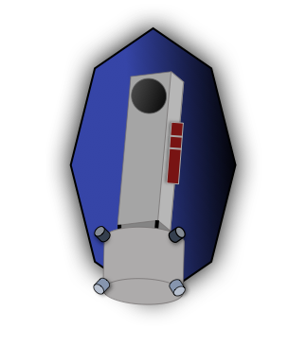
Nimble:
The Time Domain Explorer
PI: Joshua Schlieder (NASA/GSFC)
(abstruse GSFC codes included on purpose)
Judy Racusin (661), Maxime Rizzo (667), Brad Cenko (661), Qian Gong (550), Mike McElwain (667), Eric Lopez (693), Giada Arney (693), Jeremy Perkins (661), Allison Youngblood (667), Shawn Domagal-Goldman (699), Padi Boyd (667), Stephen Rinehart (665), Julie McEnery (661), Sarah Logsdon (667)
Notes:
The GSFC ‘codes’ are abstruse if you aren’t deeply embedded in NASA/GSFC. But this illustrates a very Neil project.

Slide 38
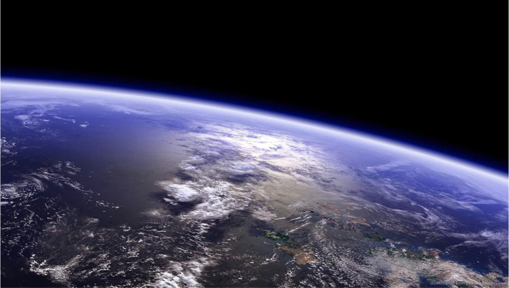
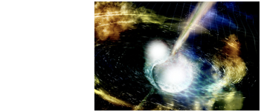

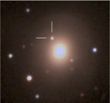
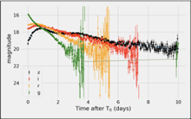
Nimble Concept of Operations
High-energy All-sky Monitor (HAM)
Similar to GBM/BurstCube
  CsI scintillation crystals with silicon photo-multiplier (SiPM) detector arrays
  ~100-1000 keV energy sensitivity
  5 deg radius localization
  Continuously monitor large portion of sky for gamma-ray transients
Small UV-Opt-IR Telescope (SUVOIR)
30 cm aperture
Wide and Narrow field modes
2 channels - UV/Opt, Opt/IR
  250 - 2500 nm wavelengths

Slide 39
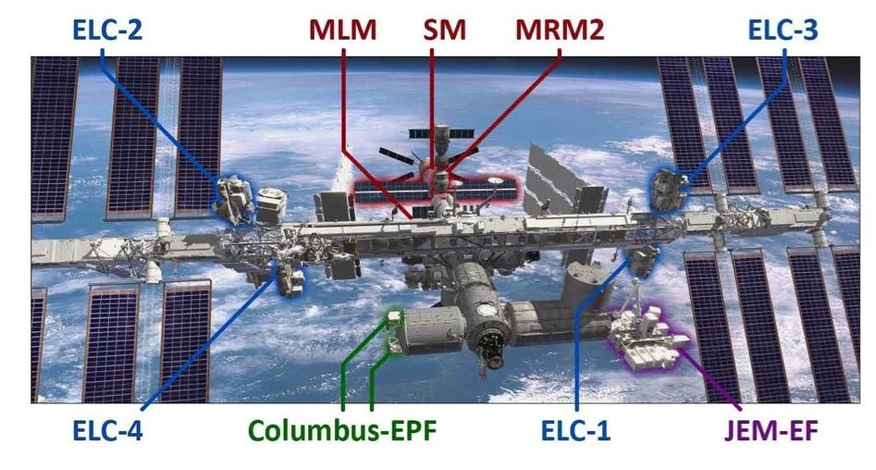
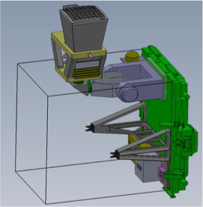
Transient Astrophysics Observatory (TAO-ISS)
PI: Jordan Camp (GSFC)
ISS payload to be installed on the Express Logistics Carrier (ELC) 2 or 3
ISS provides
  “free” launch
  “free” power
  continuous uplink/downlink 80% of the time, with sufficient data rates
Instruments
  Gamma-ray Transient Monitor (GTM)
  Wide-field Imager (WFI)
Operations:
  Sky Survey & Target of Opportunity
  Rapid autonomous repointing to new transients
3 year mission (5 year goal)
launch in 2021
Selected for phase A study in 2016 Explorer MoO

Slide 40

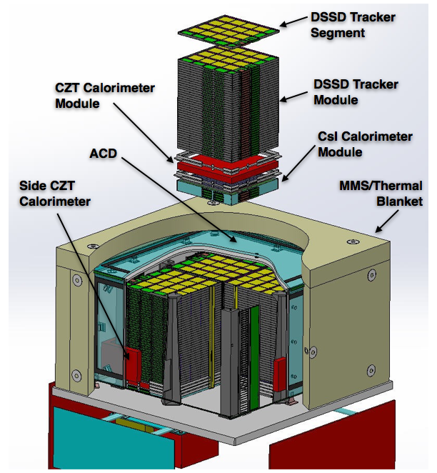
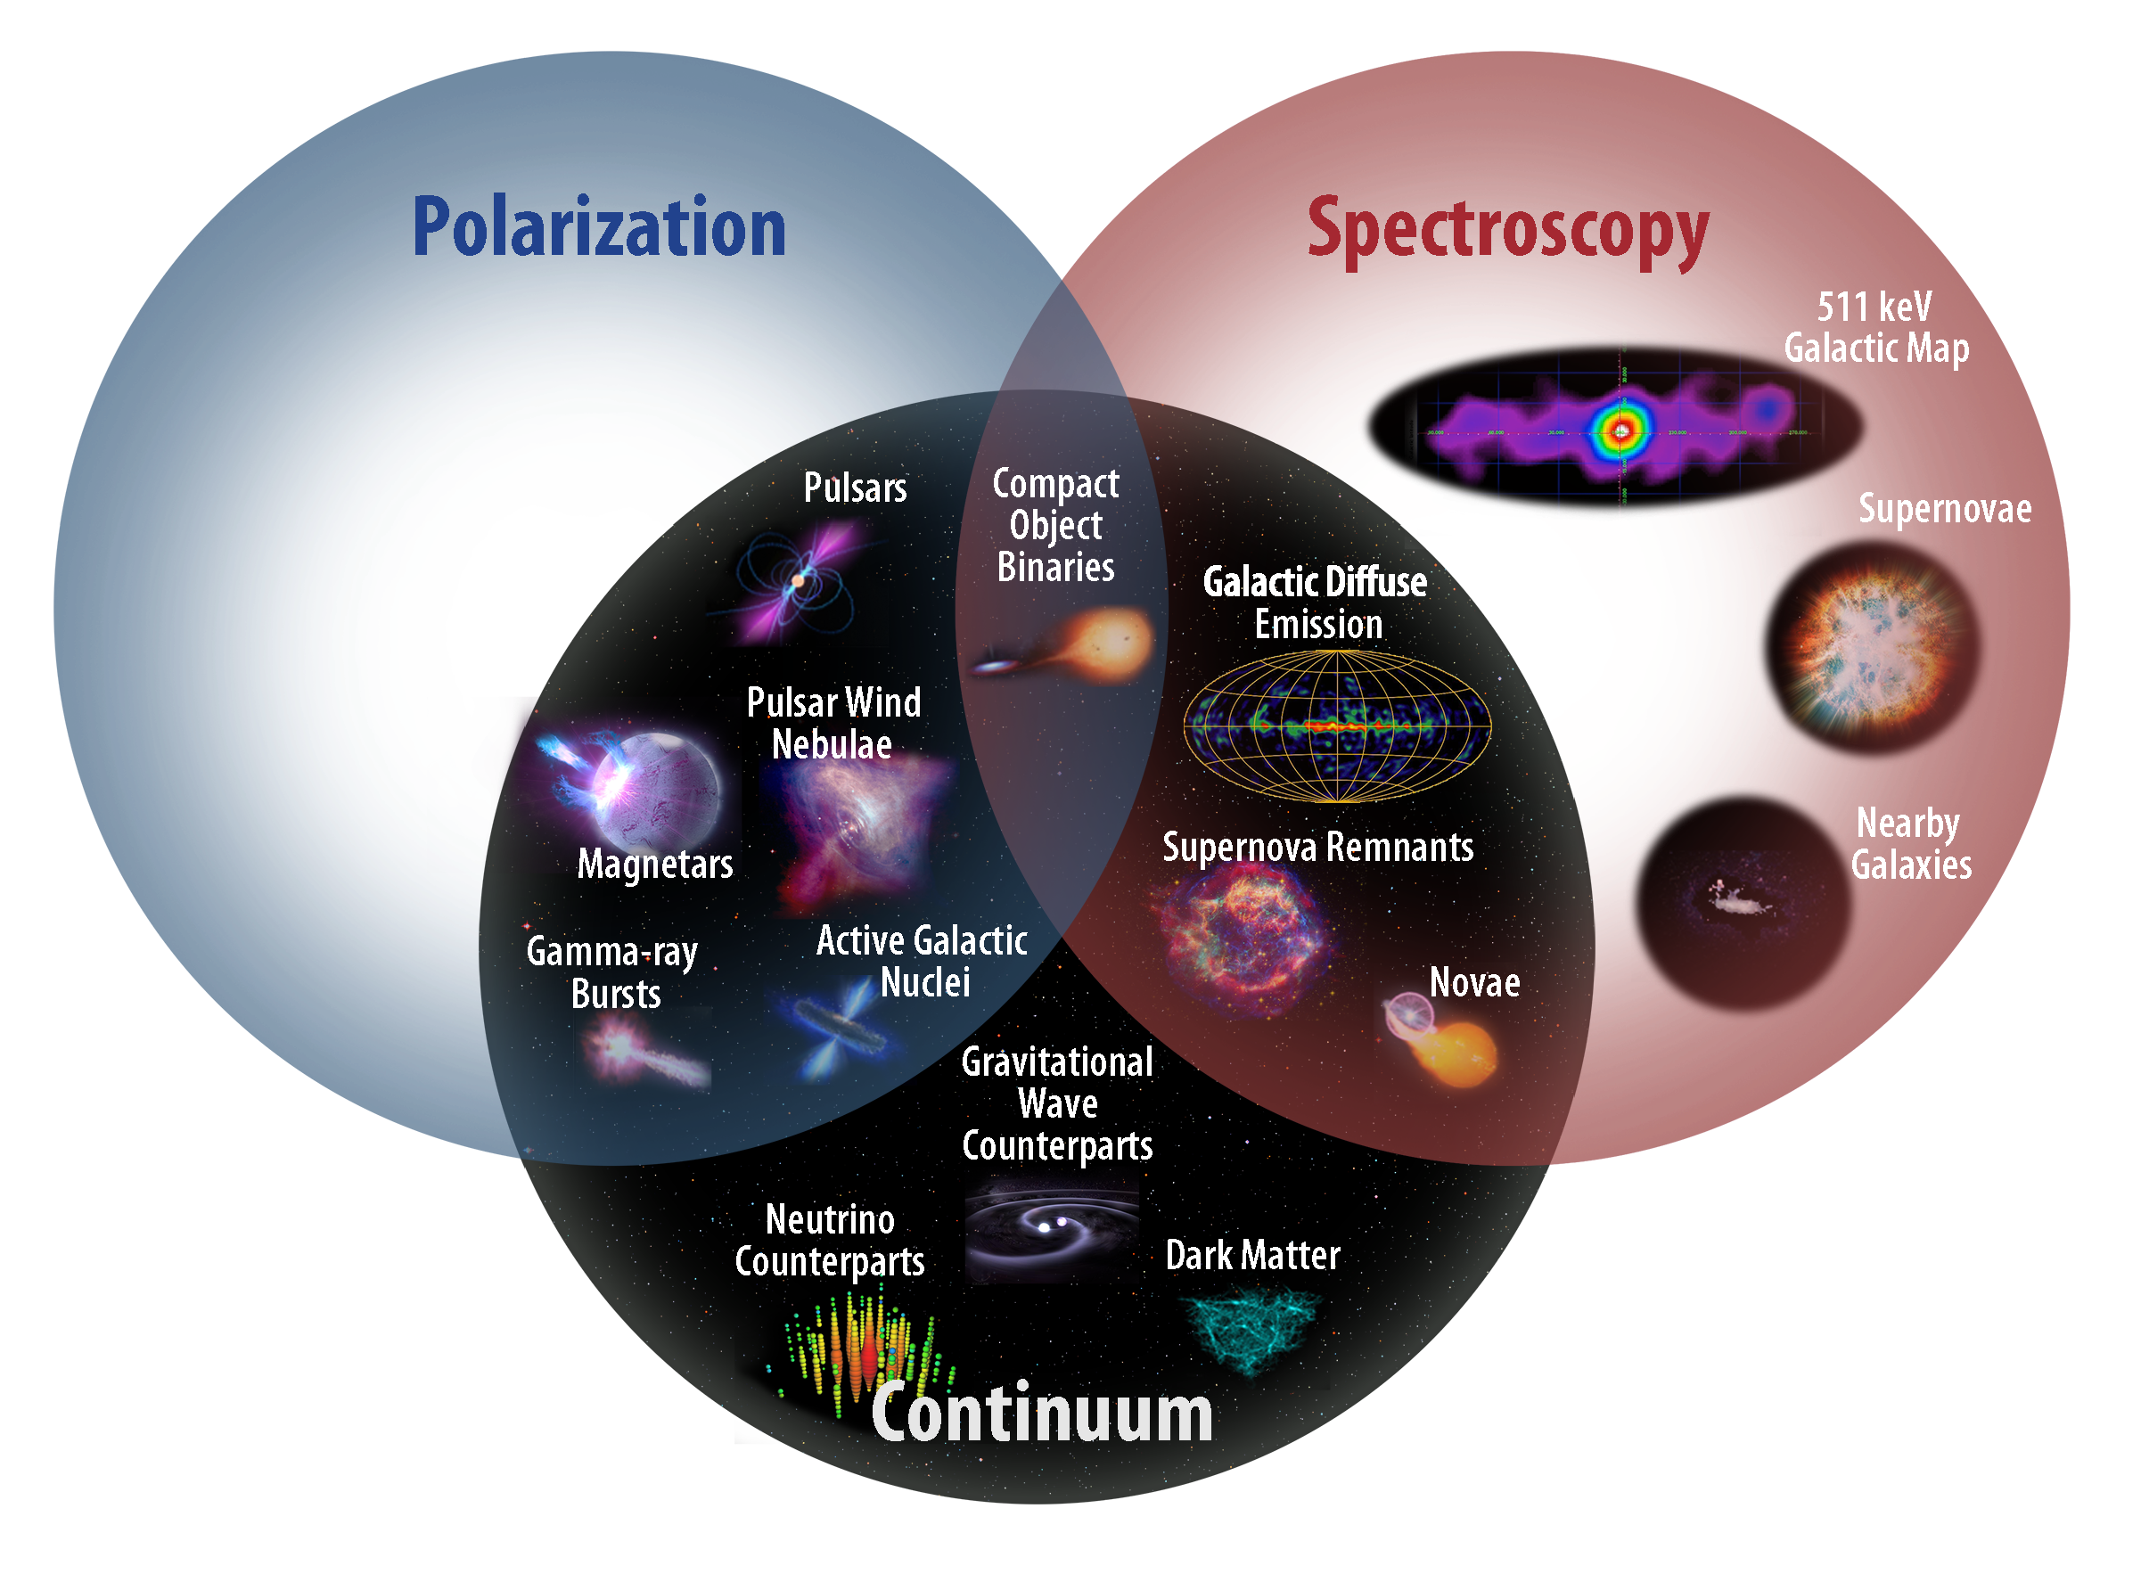
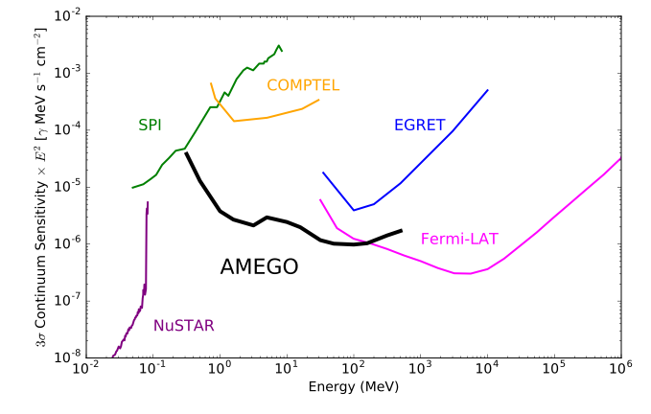
All-sky Medium Energy Gamma-ray
Observatory (AMEGO)
PI: Julie McEnery (GSFC)
Probe concept to be submitted to 2020 Decadal Survey
200 keV - 10 GeV
60 deg radius FoV
All-sky coverage every 2 orbits
Nuclear line spectroscopy and polarization capability
Will address many open questions from Fermi, and well-suited for multi-messenger follow-up

Slide 41
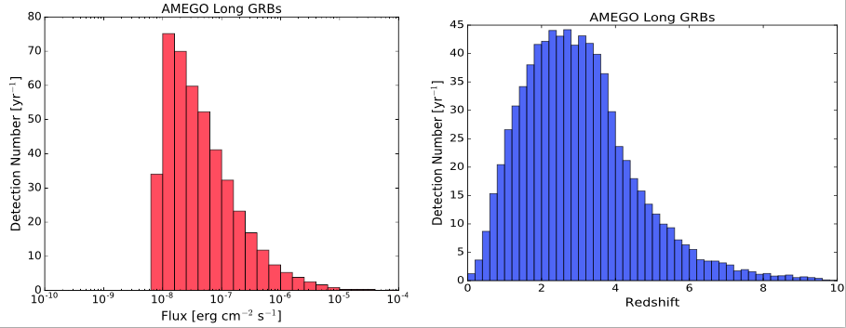
AMEGO and GRB
440 long GRB/year (determined using method of Lien et al 2014)
  19.2/year with z>6
  All with localization
Polarization! - 20% MDP for brightest 1% of AMEGO GRB
  AMEGO observations will probe the GRB emission mechanism and jet composition
~80 short GRB/year (by scaling short/long ratio from GBM)
  Important implications for gravitational wave counterpart searches

Slide 42
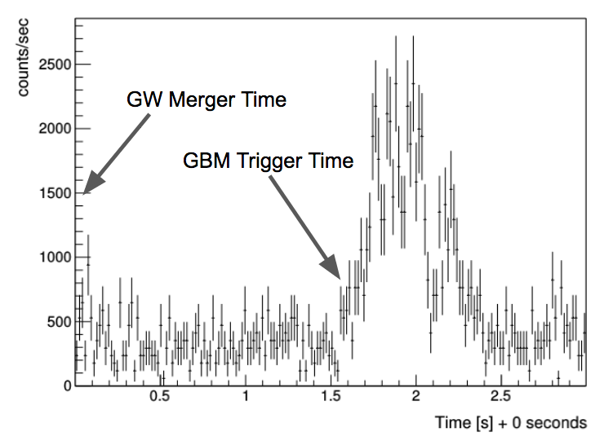
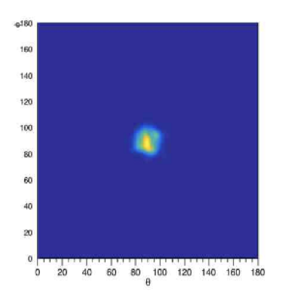
GRB 170817A
GRB 170817 is the EM counterpart to GW 170817 at 43 Mpc
With AMEGO:
Detectable out to 130 Mpc
<2 deg localization (with very preliminary analysis
~20% probability being within the FoV
GRB170817A with AMEGO
GRB170817A with AMEGO

Slide 43
The End

Slide 44

Lorentz Invariance Violation
There is a fundamental scale (Planck scale λ_{Pl}≈10⁻³⁵ m) at which quantum gravity (QG) effects are expected to strongly affect the nature of space-time.
Lorentz symmetry implies a scale-free space-time
QG effects might cause violations of Lorentz Invariance (LIV) → υ_{γ}(E_{γ})≠c :
LIV terms are typically described using a Taylor series:

Slide 45

Lorentz Invariance Violation
QG effects might cause violations of Lorentz Invariance (LIV) → υ_{γ}(E_{γ})≠c
The now energy-dependent speed of light can be expressed as:
There are many models that allow such Lorentz-Invariance violations, and some others that actually predict them (e.g. stringy-foam model J. Ellis et al. 2008).
If the speed of light depends on its energy → then two photons of different energies emitted together will arrive at different times.
Usually n=1 or 2 (linear and
quadratic LIV respectively).
s_{n}=+1 or -1 for speed retardation or acceleration with an increasing photon energy.
LIV perturbation term we would like to constrain

Slide 46

LAT – E vs T
GRB090510 as seen by Fermi
Top: Energy versus Time plot for the events detected by the LAT.
Light curves: GRB's emission at different energies.
The GRB started with a precursor event, that caused the GBM trigger.
After about half a second the bulk of the main emission started.
How was this GRB used to constrain LV?
  Using the 31GeV photon and an assumption for its maximum time delay.
  Based on its tens-of-ms narrow pulses and searching for spectral lags
GBM NaI
8-260keV
GBM BGO
0.26-5MeV
LAT All events
LAT >100MeV
LAT >1GeV

Slide 47
Fermi-LAT Constraints from GRB090510
Extract dispersion information from all the detected LAT photons (detected energy range 35MeV – 31GeV).
  Performed multiple trials, in which it moved each photon time according to a trial spectral lag coefficient (in ms/GeV), find the lag that maximises the sharpness of the lightcurve.
  The spectral lag coefficient was found to be consistent with zero.
Perform a bootstrap analysis to gauge the statistical errors of that measurement, which produced our final result:
  a symmetric upper limit on the spectral lag coefficient
|Δt/ΔΕ|<30ms/GeV ↔ M_{QG,1}>1.22M_{Pl}
(99% CL) on possible linear (n=1) dispersion of either sign (s_{n}=±1).
Pulsar
(Kaaret 99)‏
GRB
(Ellis 06)‏
AGN
(Biller 98)‏
GRB
(Boggs 04)‏
AGN
(Albert 08)‏
GRB080916C
Planck mass
min M_{QG}
(GeV)‏
1.8x10¹⁵
0.9x10¹⁶
4x10¹⁶
10¹⁷
1.8x10¹⁷
0.2x10¹⁸
1.5x10¹⁸
10¹⁹
1.2x10¹⁹
10¹⁵
10¹⁶
10¹⁸

