Slide 1



Electronics for Large Arrays of Photodetectors
NEPTUNE 2018 - Napoli

Slide 2


Network of Companies
Founded in 1979, CAEN SpA (Costruzioni Appearecchiature Elettroniche Nucleare) is an important industrial spin-off of the INFN.
Core business: Electronic Instrumentation for physics experiments (world leader)
Spin-off activities:
> RFID (2003),
> CAENels (2010),
> CAENqS (2012),
> CAEN SyS (2016)
^{Total Employees: 120}
Reproduction, transfer, distribution of part or all of the contents in this document in any form without prior written permission of CAEN S.p.A. is prohibited

Slide 3
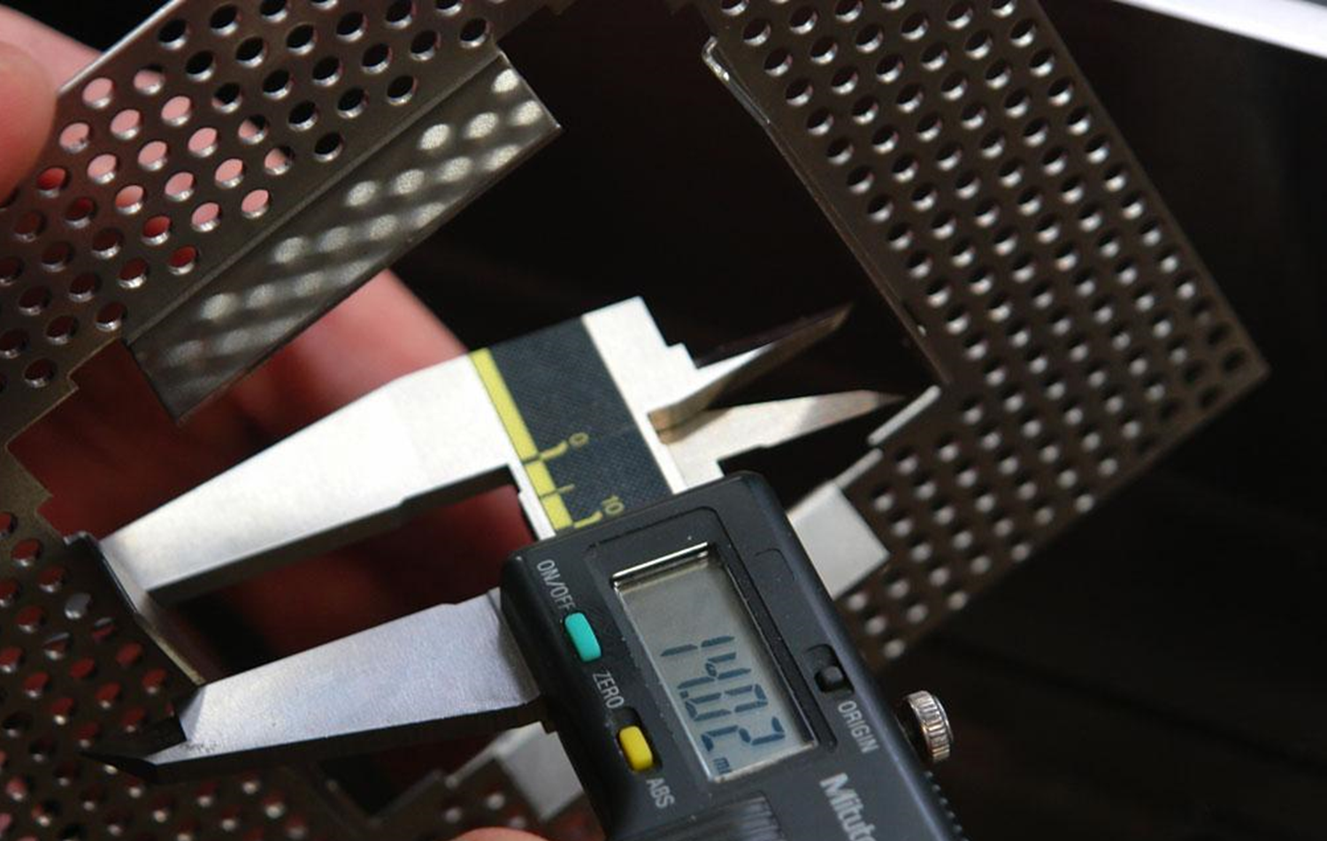

Quality Certification
Reproduction, transfer, distribution of part or all of the contents in this document in any form without prior written permission of CAEN S.p.A. is prohibited

Slide 4
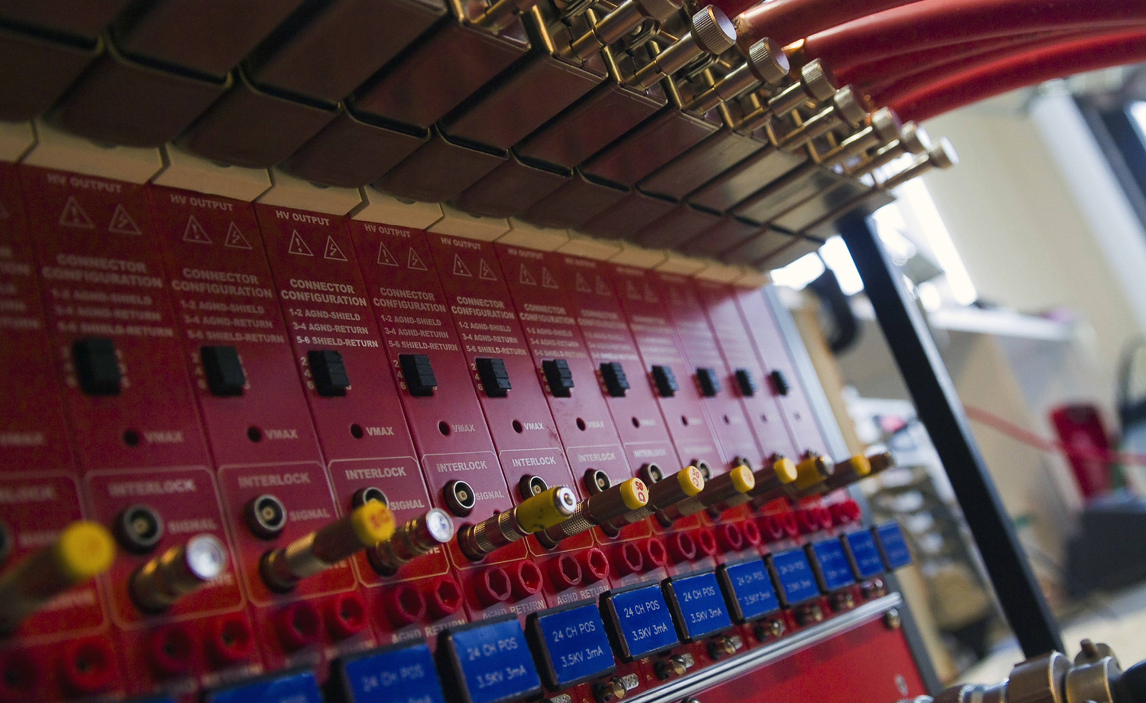
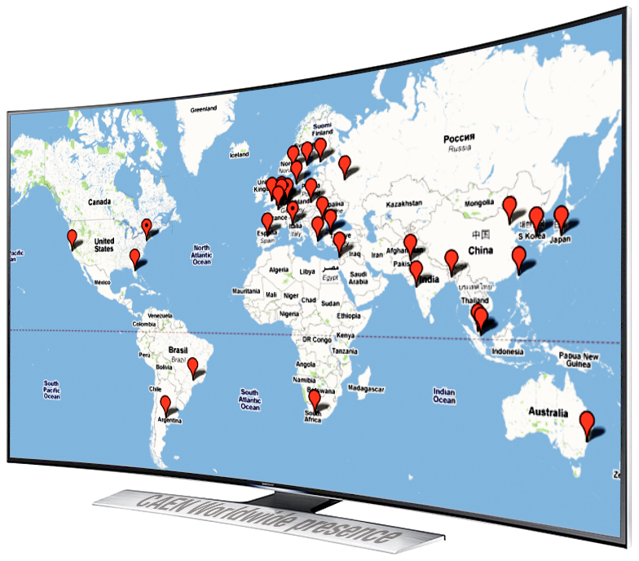
Worldwide presence
Worldwide sales network offices in Italy, Germany, USA, Distributors in more than 30 countries.
Portfolio: > 5000 customers
Customers Include all world leading research centres as:
  Europe: CERN, INFN, CEA, CNRS; GSI, ESO, ISIS, Ganil, PSI, …
  USA: FNAL, SLAC, Los Alamos, BNL, Jlab, …
  Asia: J-Park, KEK, Riken, IHEP, TIFR, …
  Africa: iThemba Labs, …
And private companies:
  GE, Siemens, SAIC, L3, Raytheon, Lockheed…
Reproduction, transfer, distribution of part or all of the contents in this document in any form without prior written permission of CAEN S.p.A. is prohibited

Slide 5

Market
For more than 35 years CAEN has been providing Scientists and Engineers with the most advanced electronic instrumentation for any particle or radiation detectors
Strong of an extremely close collaboration with the world major research laboratories CAEN is proud to produce the best tools for:
^{> High Energy Physics}
^{> Astrophysics}
^{> Neutrino Physics}
^{> Dark Matter Investigation}
^{> Nuclear Physics}
^{> Material Science}
^{> Medical Applications}
^{> Homeland Security}
^{> Industrial Applications}
Reproduction, transfer, distribution of part or all of the contents in this document in any form without prior written permission of CAEN S.p.A. is prohibited

Slide 6
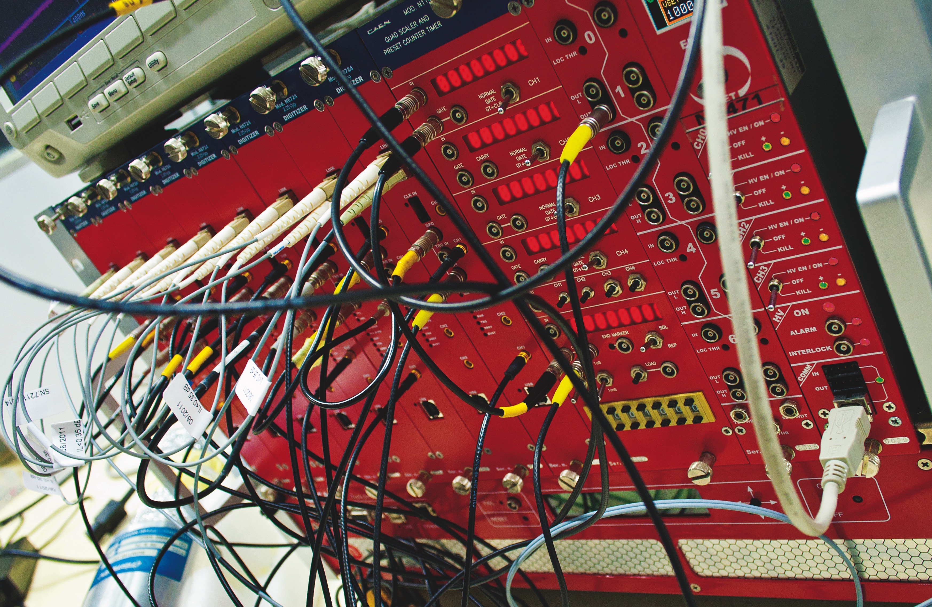
Key strengths
> Product Development
- R&D
- System Integration
- Custom Design
> Test and Calibration
> After sales Services
- Maintenance
- Support
Reproduction, transfer, distribution of part or all of the contents in this document in any form without prior written permission of CAEN S.p.A. is prohibited

Slide 7
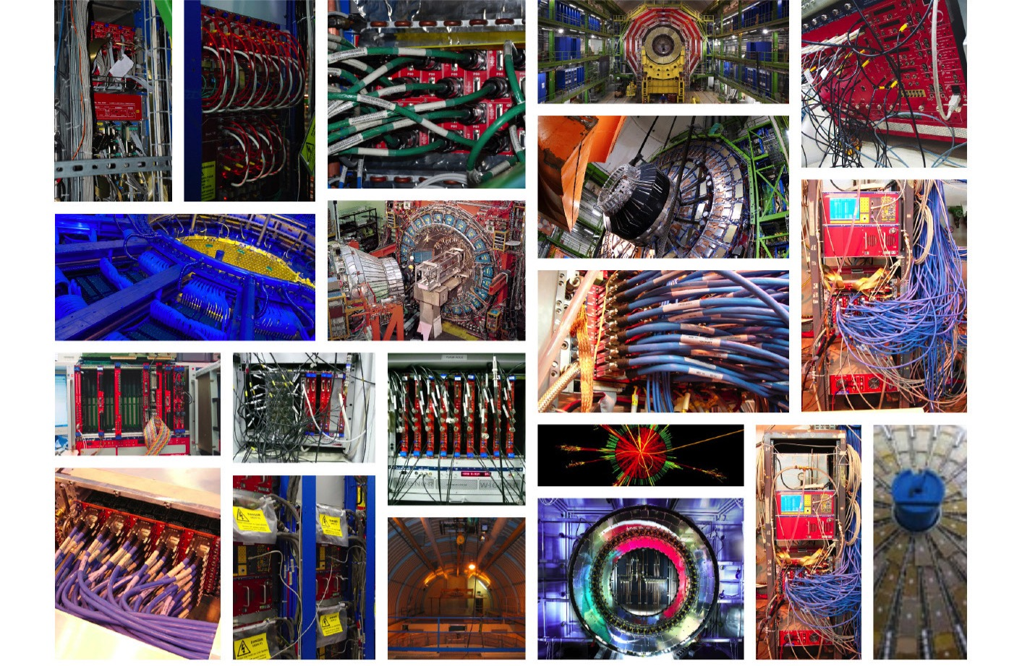
Product Development
The R&D division is strong of 50 high level Physicists and Engineers who adopt forefront technologies to design innovative products
Ongoing collaborations with important institutes such as: INFN, Elettra, CEA, CNRS (LAL, IRES..), PSI …
Reproduction, transfer, distribution of part or all of the contents in this document in any form without prior written permission of CAEN S.p.A. is prohibited

Slide 8
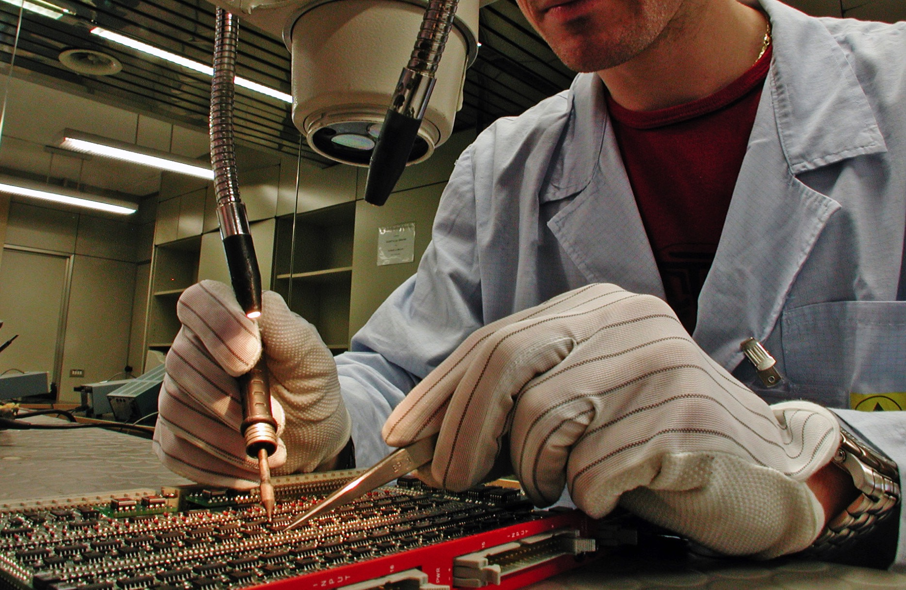
Test
All assembling activities are outsourced
Experienced group of 20 engineers dedicated to in-house Test and Calibration of the entire production
Capability: 500 complex modules/month
All procedures are ISO certified providing the complete traceability of the products
Reproduction, transfer, distribution of part or all of the contents in this document in any form without prior written permission of CAEN S.p.A. is prohibited

Slide 9
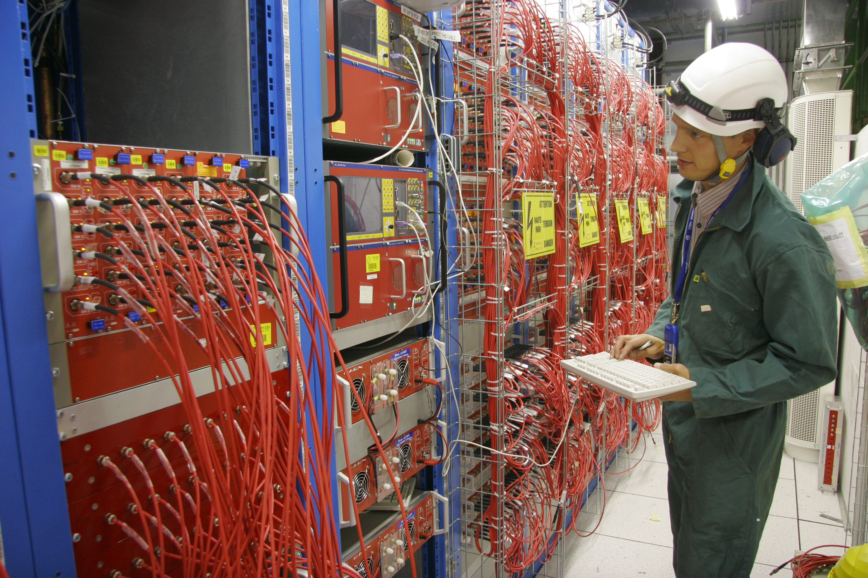
Maintenance and Support services
Excellent pre - and after - sales support
Strong maintenance division
(25 engineers)
Long Term Maintenance Contract
(CERN 10 years and more)
On line support service
Short intervention time (on request, on-site within one day only in Europe)
Short delivery (on request worldwide)
Reproduction, transfer, distribution of part or all of the contents in this document in any form without prior written permission of CAEN S.p.A. is prohibited

Slide 10

CAEN Expertise
CAEN is specialized in multi channel electronics for physic experiments with an excellent price performance ratio. Our product lines cover any need of a modern experiment, from the detector output to the computer.
Our offer includes:
Front End Electronics
Data Acquisition and digitiIization
High Voltage and Low Voltage power supplies

Slide 11
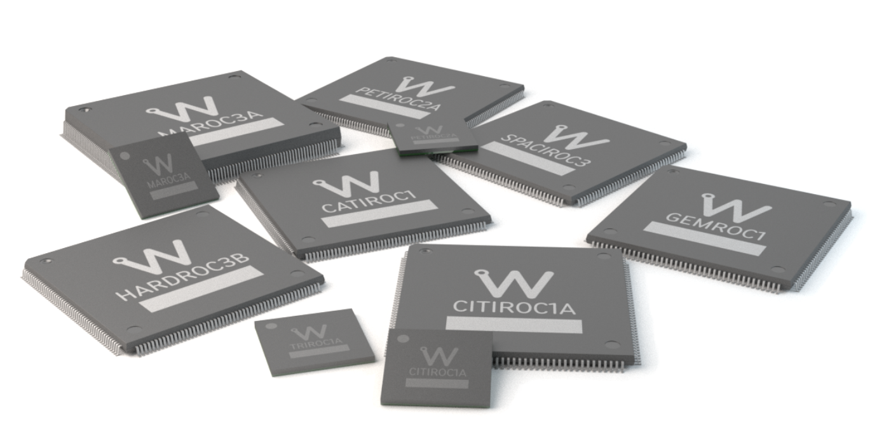
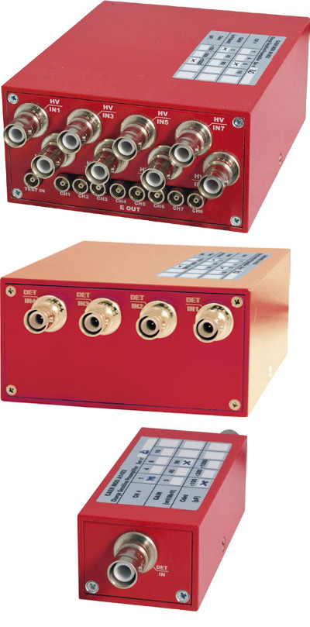
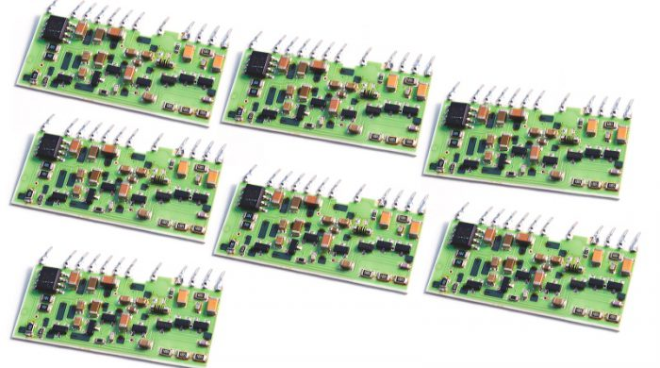
Front End Electronics
CAEN through the years introduced electronics with increased capability in terms of channel density and performance
Today our catalogue offer single channel, multichannel and “hybrid” preamplifier, and, thank to our recent agreement with WEEROC, we can propose ASICS to handle signals up to thousands of channel
NUMBER OF CHANNELS
FEW TENS
HUNDREDS THOUSAND

Slide 12
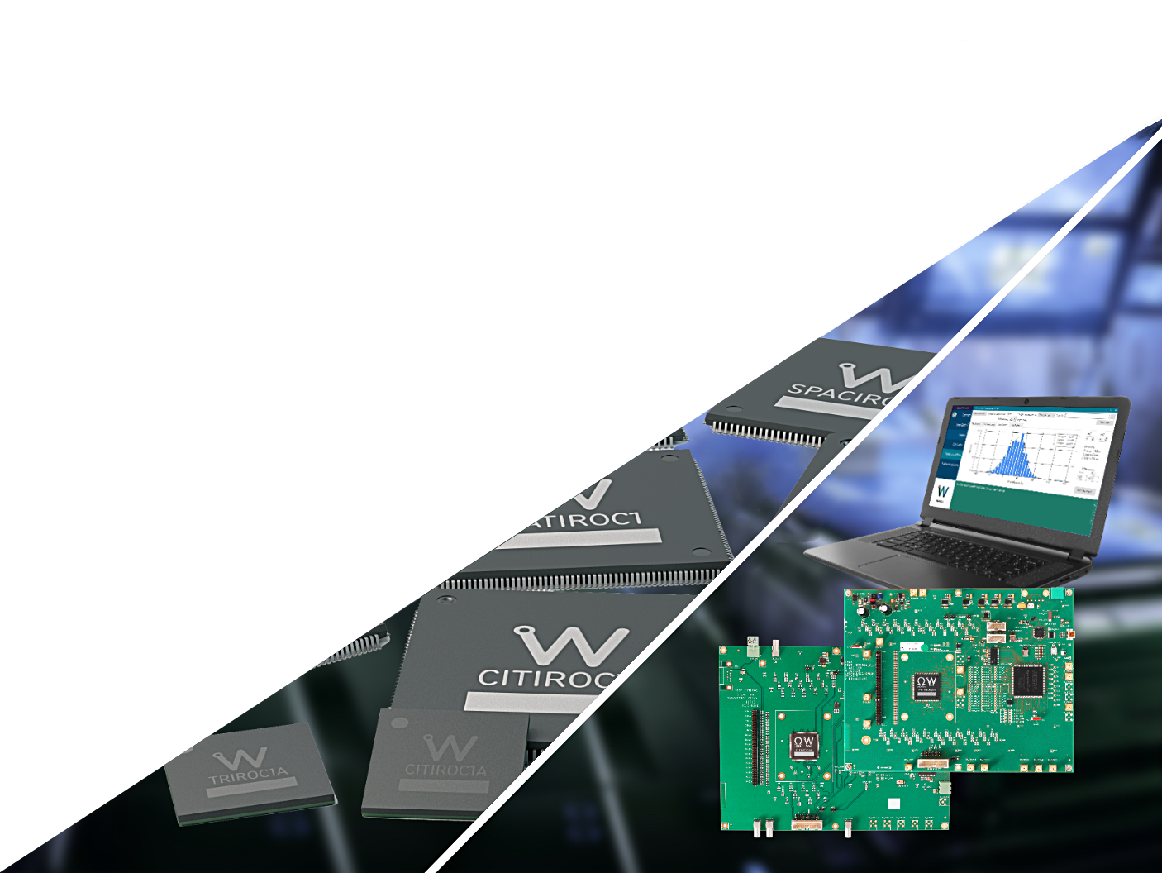
Weeroc worldwide distributor
Signal Conditioning, Read-out Electronics - interface between the experiment and the scientist: from detector signals to visualization of data!
Waveform Digitizers & Digital Pulse Processing
FPGA algorithms for the Digital Pulse Processing
Analog Pulse Processing
Programmable Trigger module
Multichannel Analyzer
Preamplifiers
Custom project

Slide 13
Weeroc products
Off-the-shelf programmable analogue and mixed-signal ASIC
Whole family for photodetector read-out

Slide 14
Why read-out chips ?

Slide 15
Photodetector read-out
We help you determine the best ASIC for your application

Slide 16

Pulse Processing Expertise
Signal Conditioning, Read-out Electronics - interface between the experiment and the scientist: from detector signals to visualization of data!
Waveform Digitizers & Digital Pulse Processing
FPGA algorithms for the Digital Pulse Processing
Analog Pulse Processing
Programmable Trigger module
Multichannel Analyzer
Custom project!

Slide 17

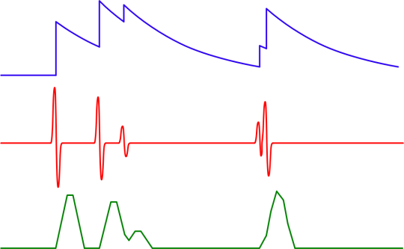
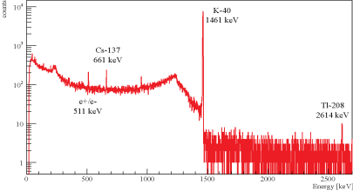
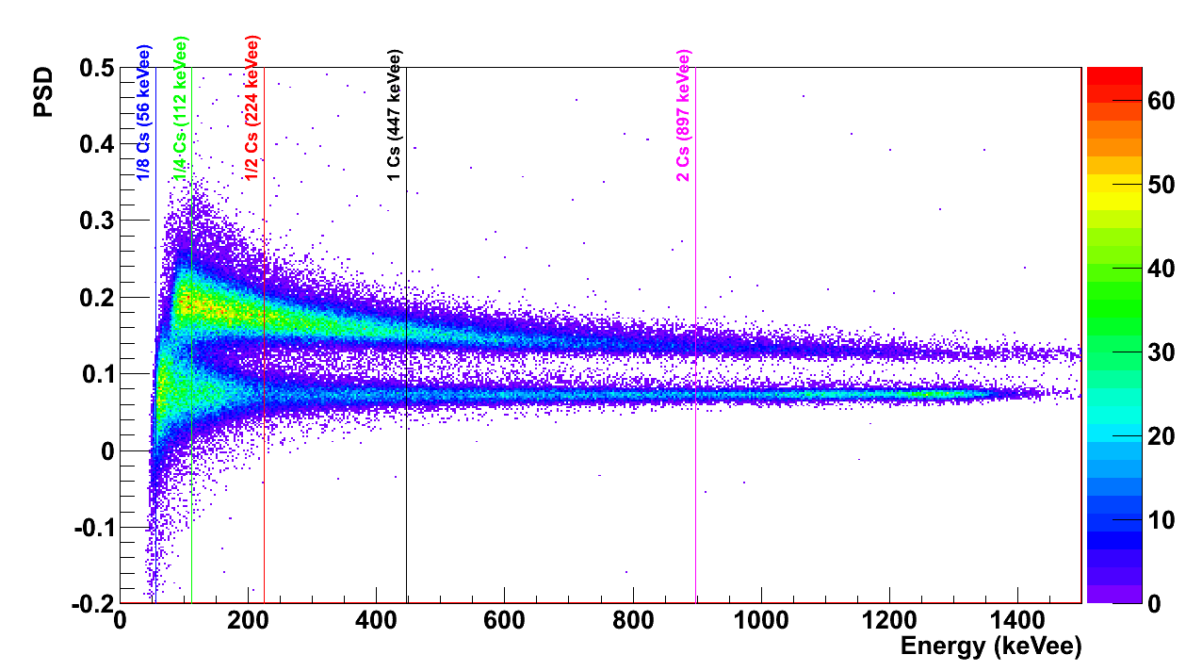
Digital Acquisition Chain
ANALOG
DIGITAL
Ext or Self
Trigger
100M - 1GB/s
10-100 MB/s
100k-1MB/s
1kB/s
FADC
samples
Waveform
Recorder
waveforms
Pulse
Processor
events
CPU
spectra
01100101
s1, s2, …
T,E,S
Histo
Oscilloscope
Mode
Multi-Parametric
List Mode
Digital
Spectrometer
12334
234
0.55
134567
1034
0.95
234456
12334
234
0.55
34
0.66
134567
1034
0.95
345664
12334
234
0.55
2234
0.45
234456
34
0.66
378902
134567
1034
0.95
123
0.57
345664
2234
0.45
435872
234456
34
0.66
22
0.15
378902
123
0.57
567342
345664
2234
0.45
3345
0.17
435872
22
0.15
634652
378902
123
0.57
623
0.88
567342
3345
0.17
435872
22
0.15
634652
623
0.88
567342
3345
0.17
634652
623
0.88
Configuration &
Monitoring
Post Process,
Event building
Analysis,
Identification

Slide 18
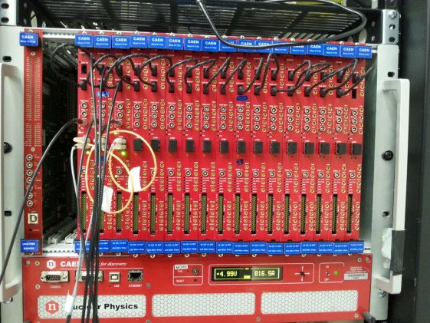
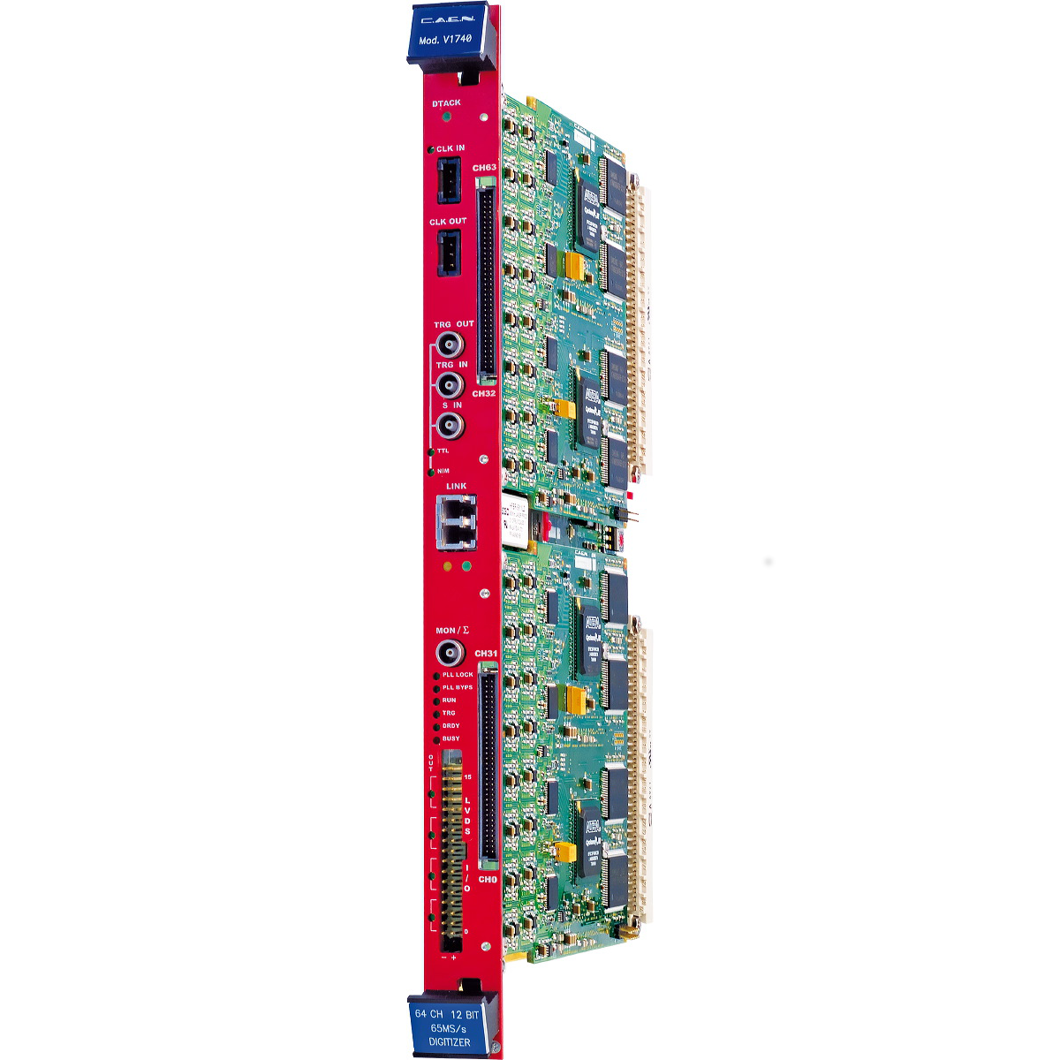
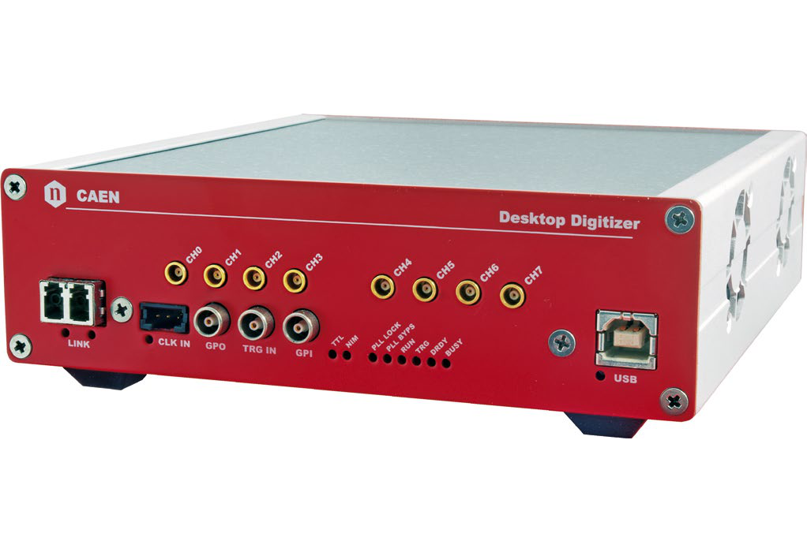
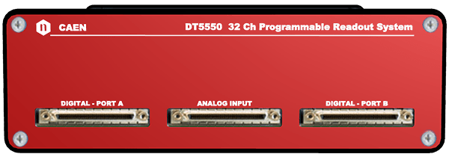
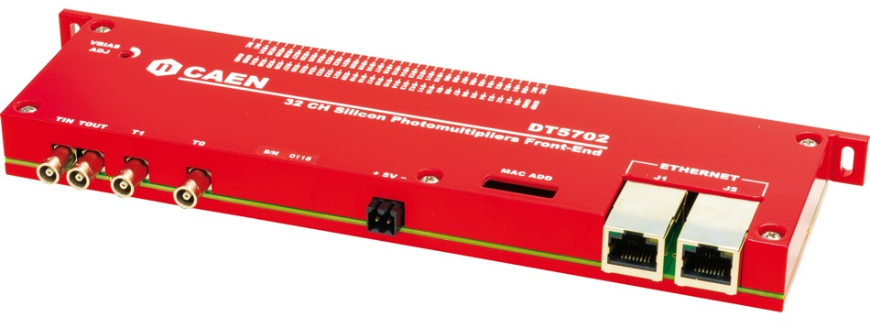
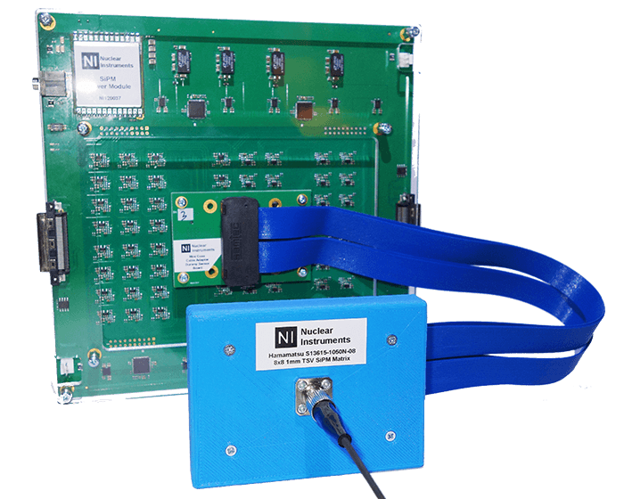
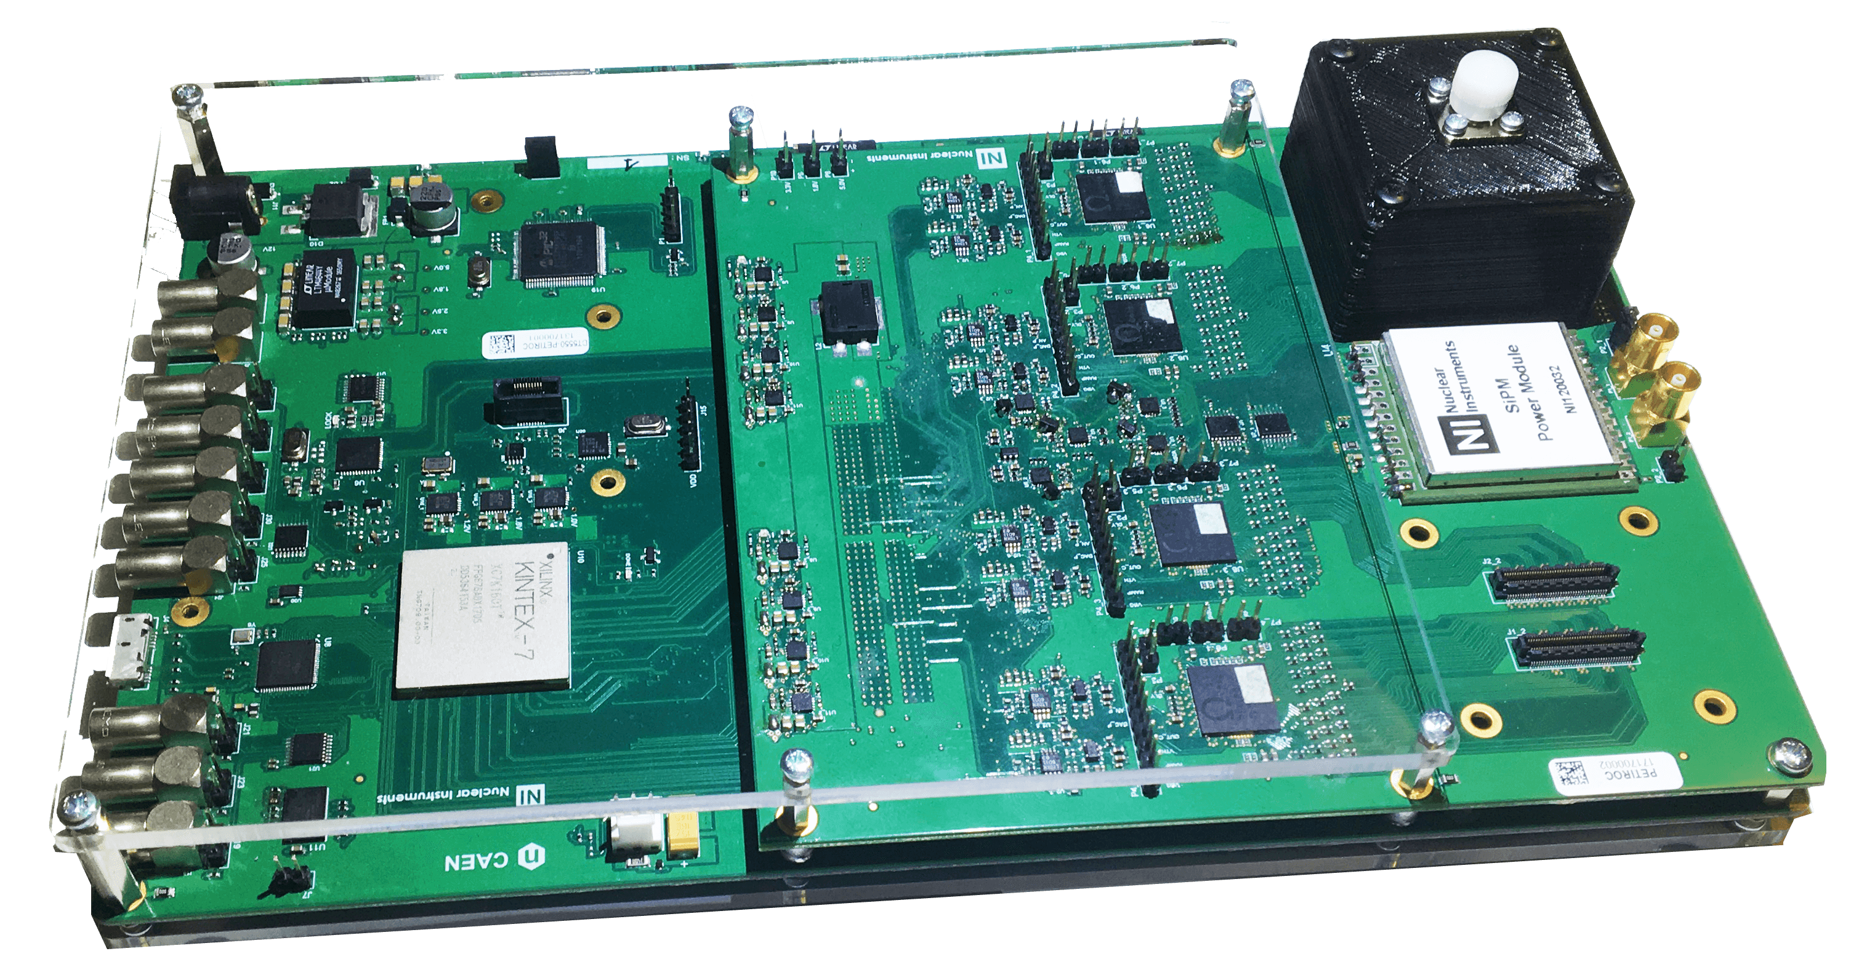
Scalable system
Digitizers + custom designed front-end
Desktop Digitizers
NUMBER OF CHANNELS
FEW TENS
HUNDREDS THOUSAND
Digital Read-Out system
Digital DAQ
for ASICS
A1702
DT5550W

Slide 19
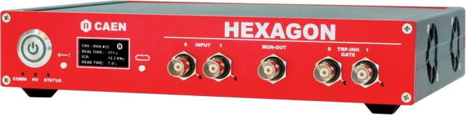
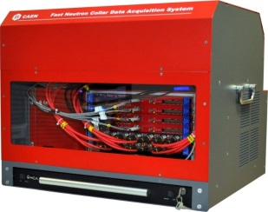
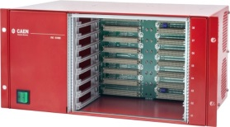


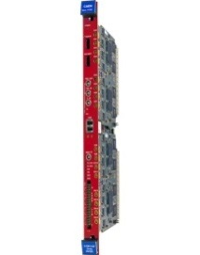




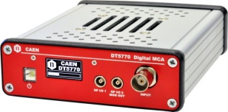
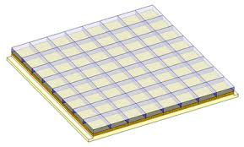
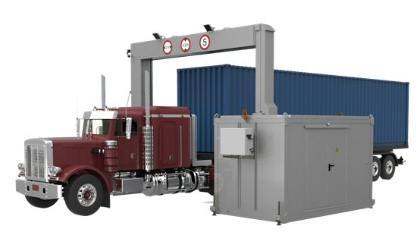
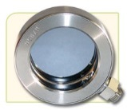
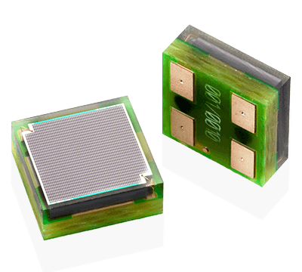

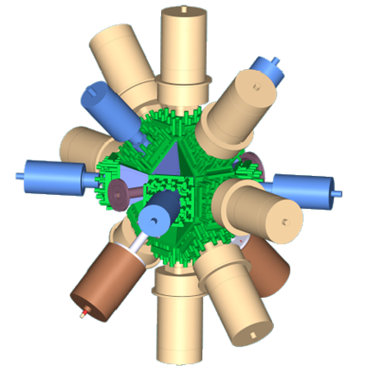
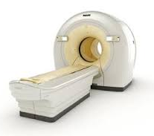
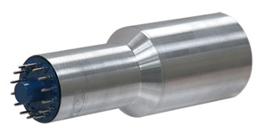
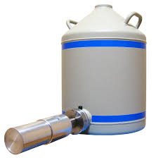
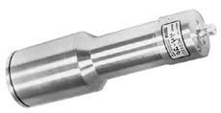
Scalable Solution
Desktop / Handheld
Mini crates / enclosures
Crates / Racks / Distributed
NUMBER OF CHANNELS
FEW TENS
HUNDREDS THOUSAND

Slide 20
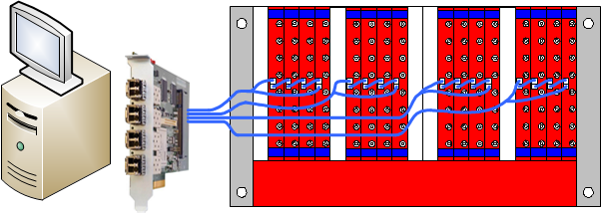
Multi-Board Readout
CAEN digitizers are designed to work as a single unit as well in large experiments. Multiple boards can be synchronized and controlled as a big single system. High speed serial link on the front panel guarantee a big transfer rate.
An example (Xmass):
16 digitizers in one VME crate read out by 1 computer @ 350 MB/s
One 4 link A3818 PCIe card. Each link reads 4 digitizers in daisy chain
~22 MB/s per digitizer (can be 4 times higher in a P-to-P topology)
VME crate just for power and mechanics (no backplane communication)

Slide 21
Power Supplies Expertise
High Voltage & Low Voltage Power Supplies for Particle Physics Experiments and Laboratories providing:
Integration: Multi-Channel CAEN Systems (up to 768 HV ch/system)
Granularity: NIM, VME Modules, Rack-Mount And Desktop
Devices (from 1 ch to 8 ch/module)
Custom: Stand-alone Power Supplies
HV Components: PCB mountable HV DC-DC
converters
Hostile Area developments for LHC

Slide 22
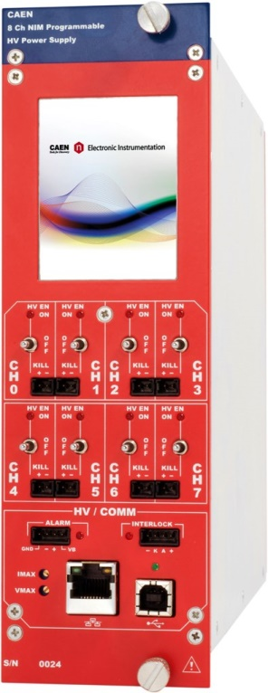
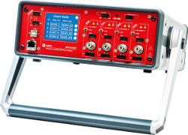
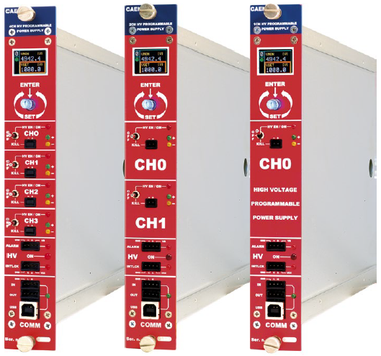
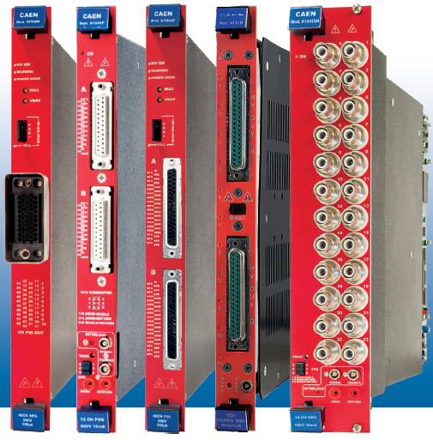
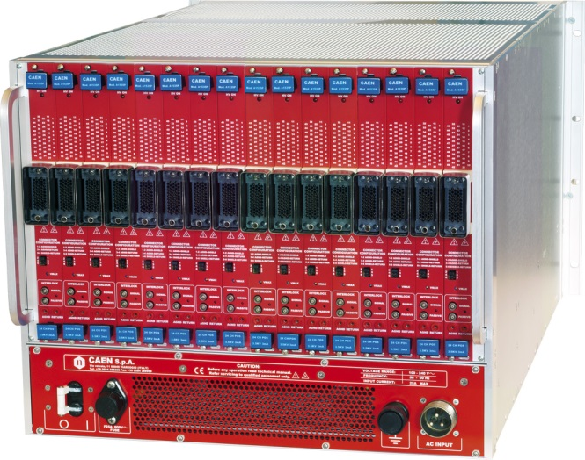
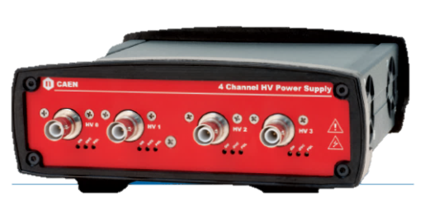
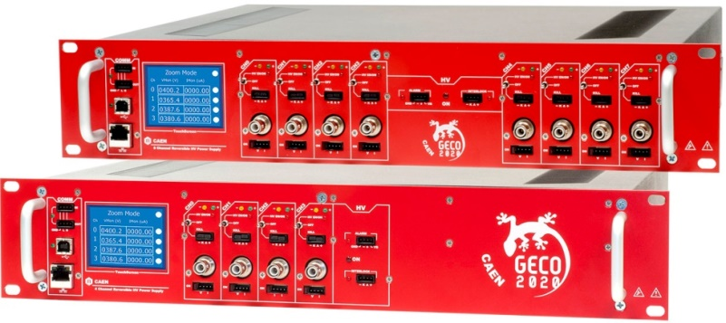

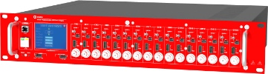
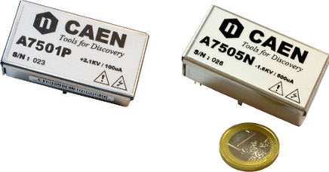
Scalable system
Desktop, NIM, VME, USB
Multichannel board
Universl Multichannel System
NUMBER OF CHANNELS
FEW TENS
HUNDRED THOUSAND
19’’ Rack mountable
PCB mount for distributed systems

Slide 23
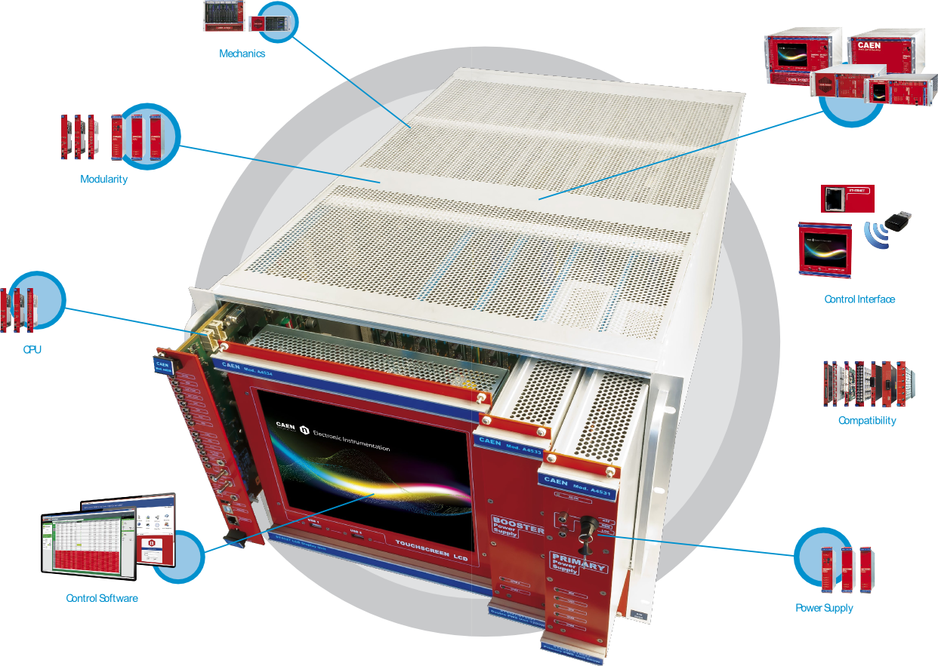
Universal Multichannel System

Slide 24
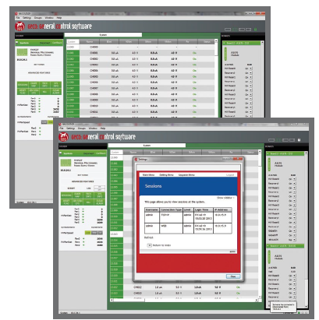
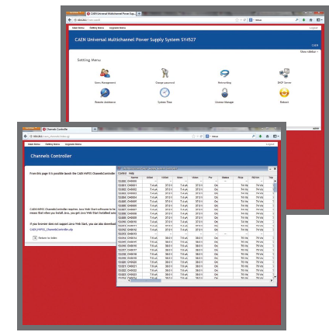
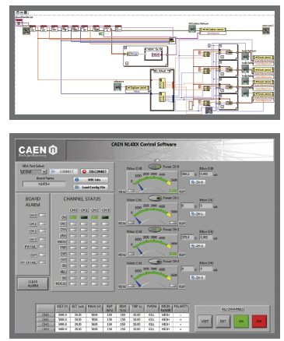
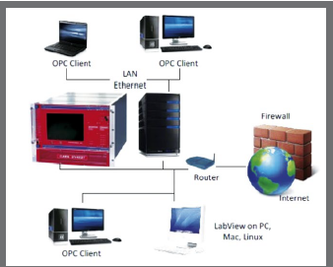






Power Supply Control Software
CAEN provides a wide family of software tools to easily configure and
control its Power Supplies:
GECO2020
(General Control Software for CAEN HV Power Supplies)
HiVoCS
(Web based control software for SY4527/5527 Systems)
CAEN HV Wrapper
(Library for CAEN Power Supply Control)
N14xx LabVIEW Instrument Driver
(for NIM and NDT only)
OPC Server
EPICS Input/Output Controller
(for SY4527/5527 Systems only)

Slide 25

Custom Developments: Case History
Strong capability to manage complex custom solutions
- High Voltage
- Digital and Analog Pulse Processing

Slide 26


LV Power Supply for ALMA (ESO)
Design of custom LV Power Supply System for ALMA
86 Complex LV Systems delivered (688 power channels)
Harsh environmental condition (desert at 5,000 m altitude)
Designed to operate for at least 30 years; 24/7 (24 hours a day, seven days a week)
San Pedro de Atacama (5000 meters above sea level), Chajnantor plateau Chile.
The most complex ground-based astronomical observatory in the world.

Slide 27

NA62@CERN
CAEN was contract-awarded to design and manufacture the Calorimeter REAdout Module (CREAM)
for the NA62@CERN Liquid Krypton Calorimeter (LKr)
VME 6U form factor
  32 channel
  14 bit 50 MS/s ADC
  2 Vpp input dynamics (differential)
  14-bit programmable DC offset adjustment (±1V)
  Memory buffer:
    26 MB circular buffer
    5.2 GB event buffer
  Gbit Ethernet port for data readout
  VME64X compliant interface
455 modules - 13,249 read-out channels

Slide 28

XMass @ Kamioka, Japan
Dark Matter experiment using a liquid Xenon TPC
Equipped with 84 digitizers modules
672 channels - 10 bit @ 1GHz
Readout Bandwidth = ~2 MB/s/ch
Total aggregate throughput = ~ 1GB/s

Slide 29



Pierre Auger Observatory
Based on A7501 PCB mount HV DC-DC converter
Extended Temperature working range:
-10°C ÷70°C
Designed for long working life in harsh environment
High efficiency
2100 V/100 µA output ranges
Available with positive or negative polarity
Stand alone architecture
Compact package: 34,5 x 62,9 x 119 mm3
A detection area of 3.000 km² (the size of Luxembourg)
Mendoza Province (Argentina)
A tailored solution for Large Area experiments in harsh environment: A7501PB

Slide 30

CERN/LHC Electronics in Hostile Environments
“EASY” Multi Function System
2 kGauss magnetic field
1*10¹¹ p/cm² TD - 15 kRad TID
2*10¹² n/cm² TD
Designed with COTS components to work in “hostile” areas

Slide 31



CAEN & LHC Experiments
1998 – 2016
SYNERGY for SUCCESS
18 years of joint efforts to achieve top performances
8.500
electronic devices
250.000
boards/sub-boards
CAEN has received the ”CMS Crystal Award” for the development and production of the power system for the CMS/LHC Tracker

Slide 32
Thank You!
Contact us:
Tel: +39 0584 388398
info@caen.it
Address:
Via Vetraia 11
55049 Viareggio (LU)
ITALY

