Slide 1

Le aspettative della Terapia
Paola Anna Erba, MD, PhD
Nuclear Medicine
Department of Translational Research and New Technology in Medicine
University of Pisa
paola.erba@unipi.it
Dai radionuclidi ai radiofarmaci: La Fisica Nucleare incontra la Radiofarmacia
INFN, Laboratori Nazionali di Legnaro - Legnaro (Padova)
Venerdì 13 Aprile 2018

Slide 2
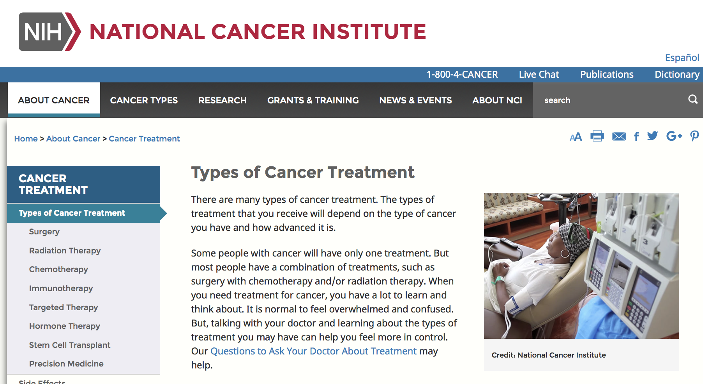

Slide 3
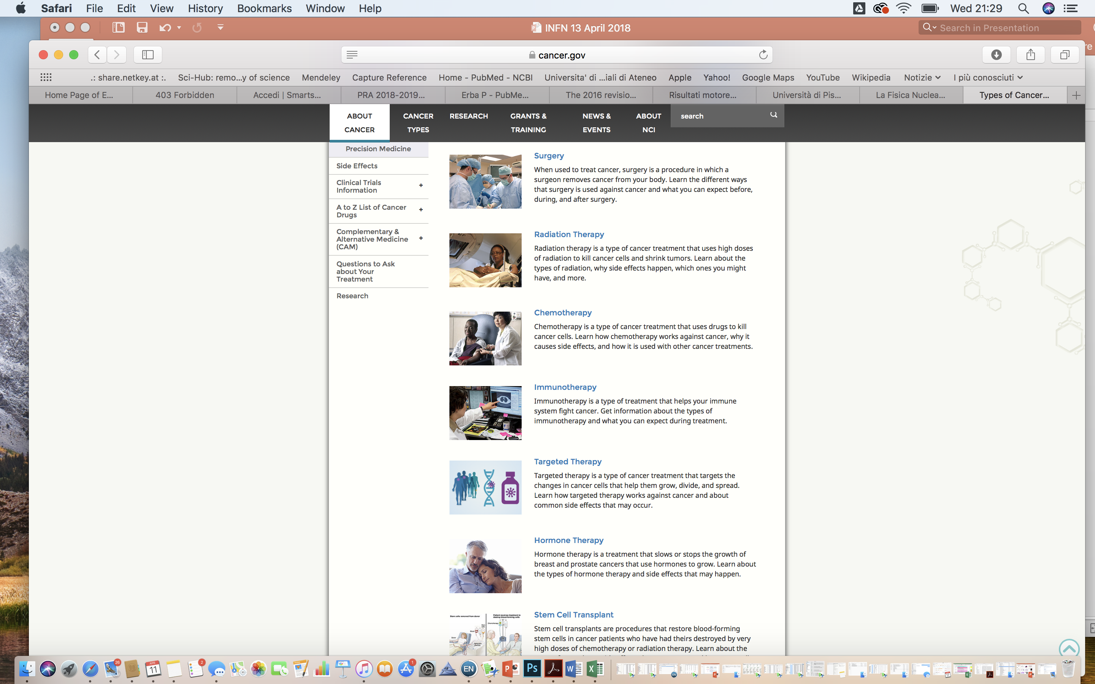
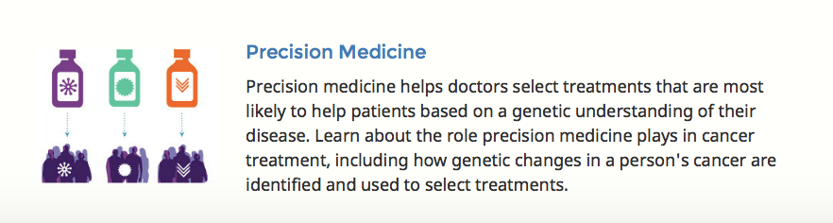

Slide 4
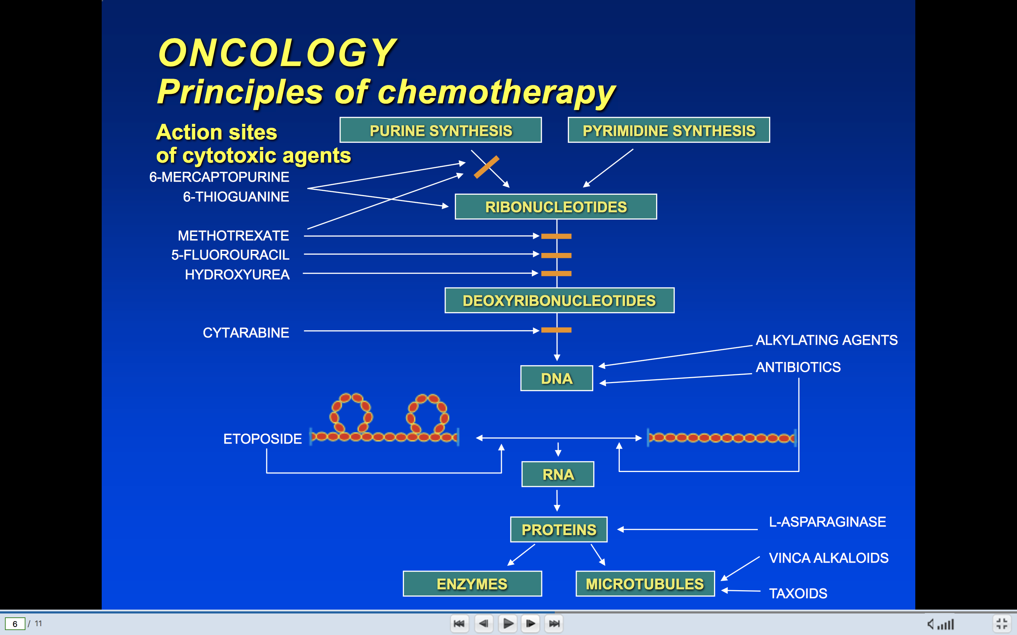
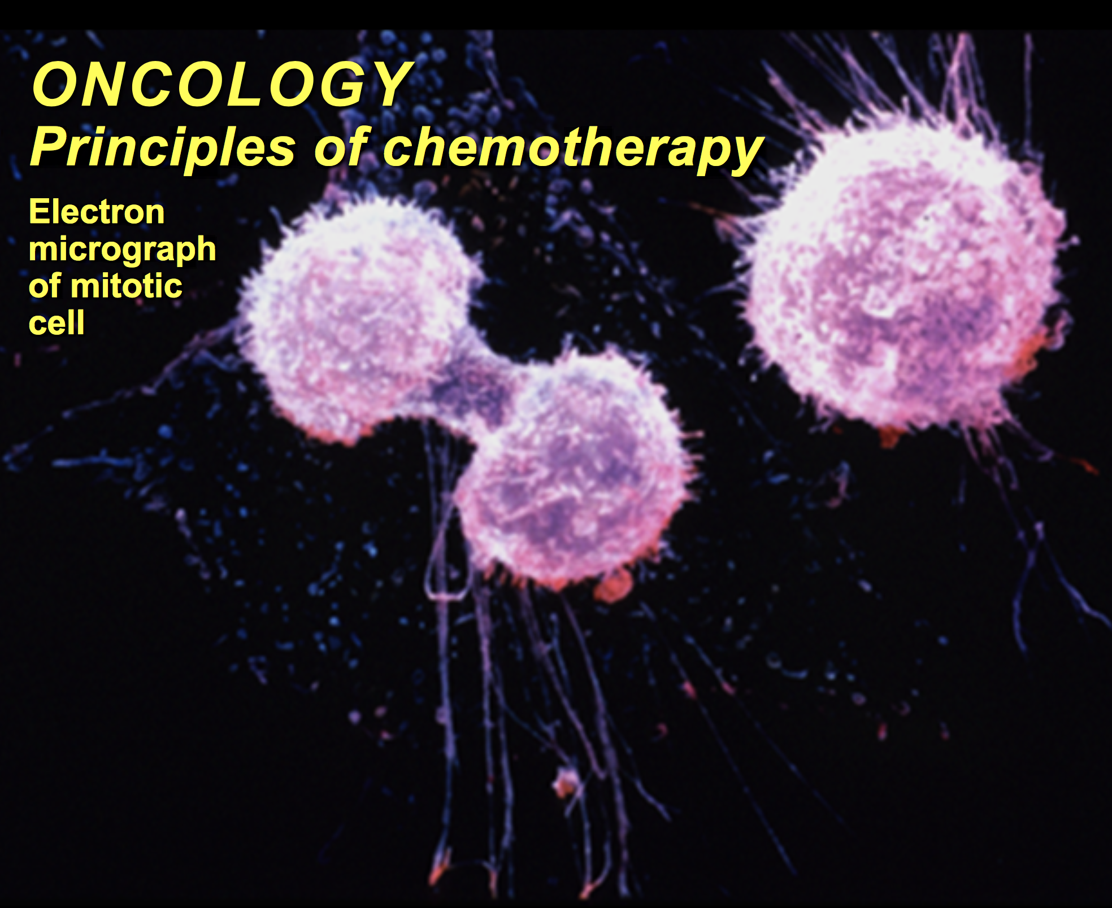
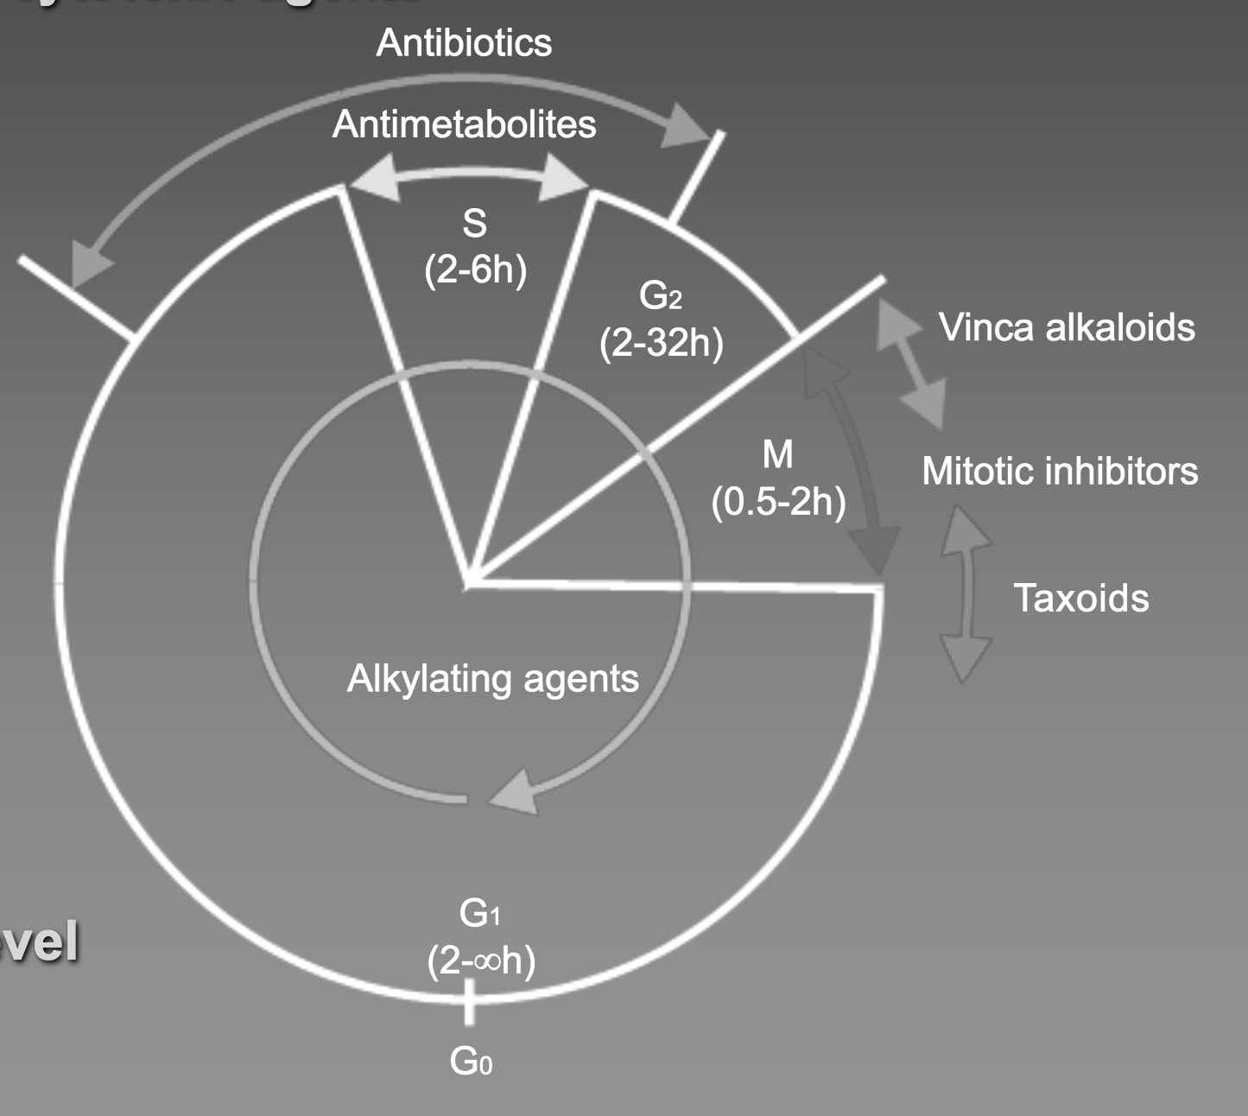

Slide 5
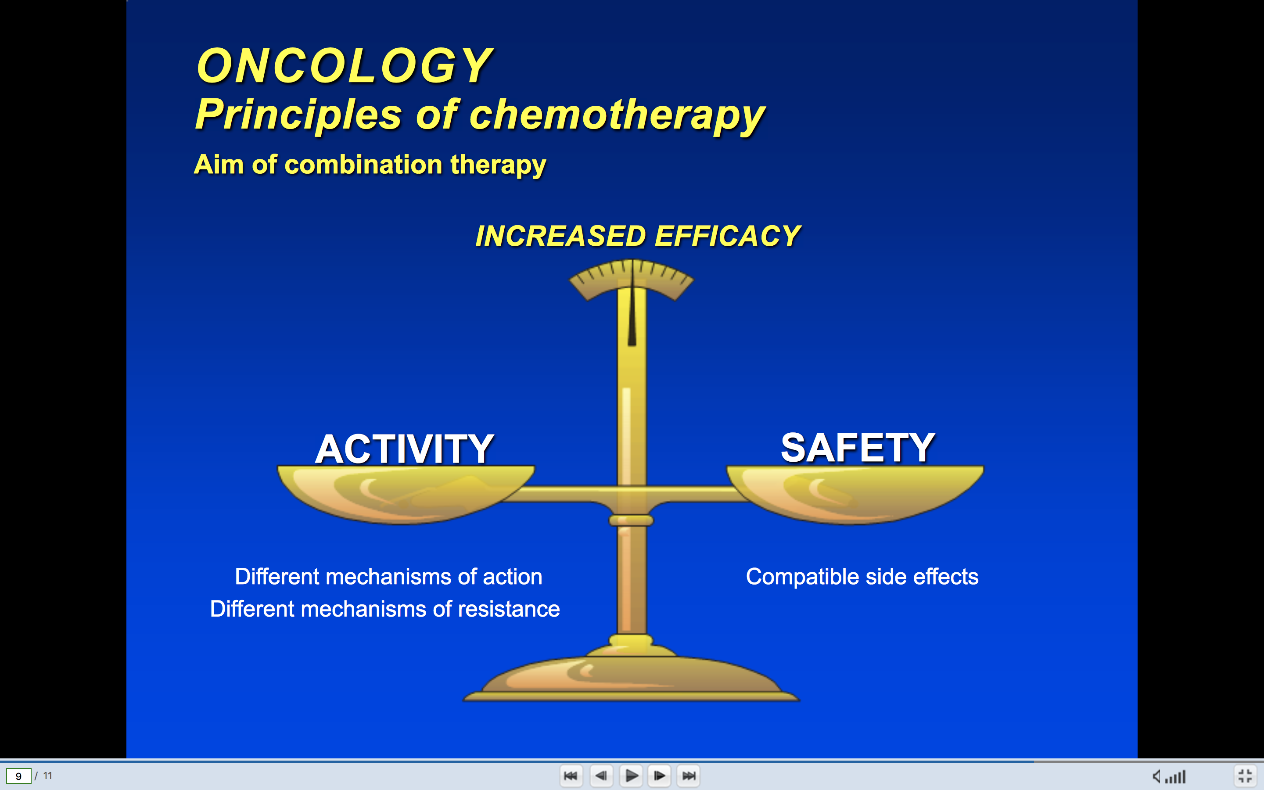

Slide 9
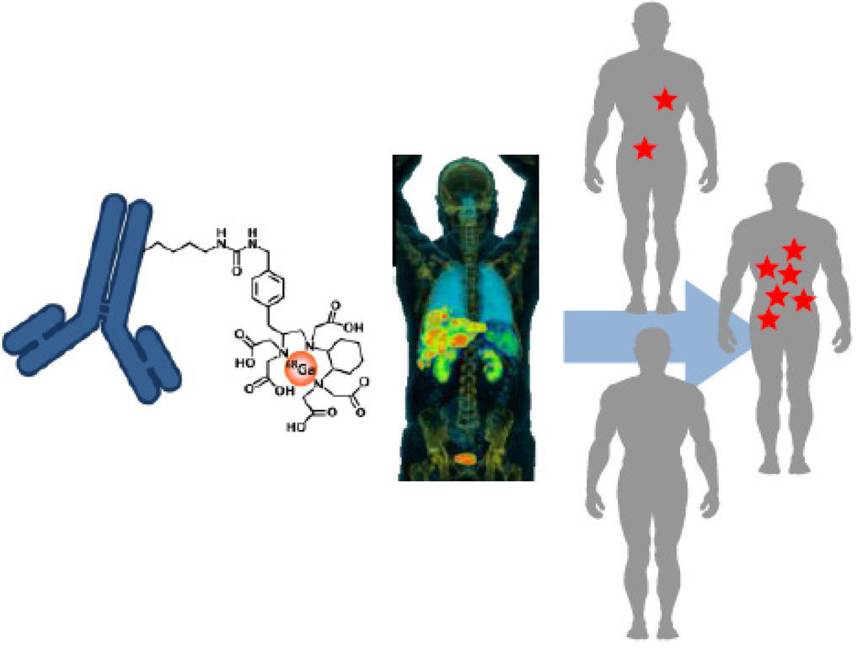
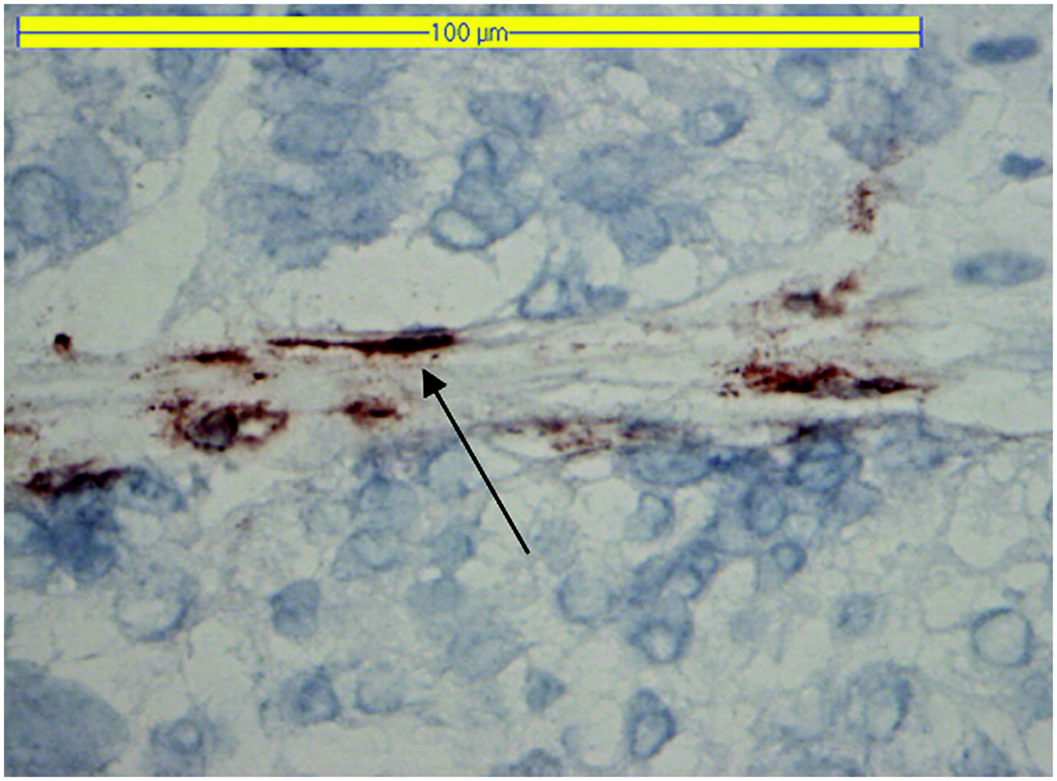
Companion diagnostic
TREAT
TREAT
DRUG
DRUG
In vitro testing
In vivo testing
noTREAT
noTREAT
DRUG*

Slide 10
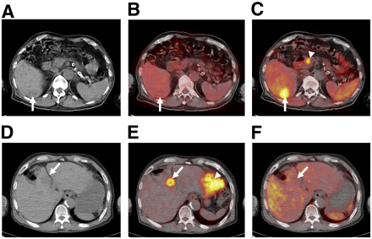
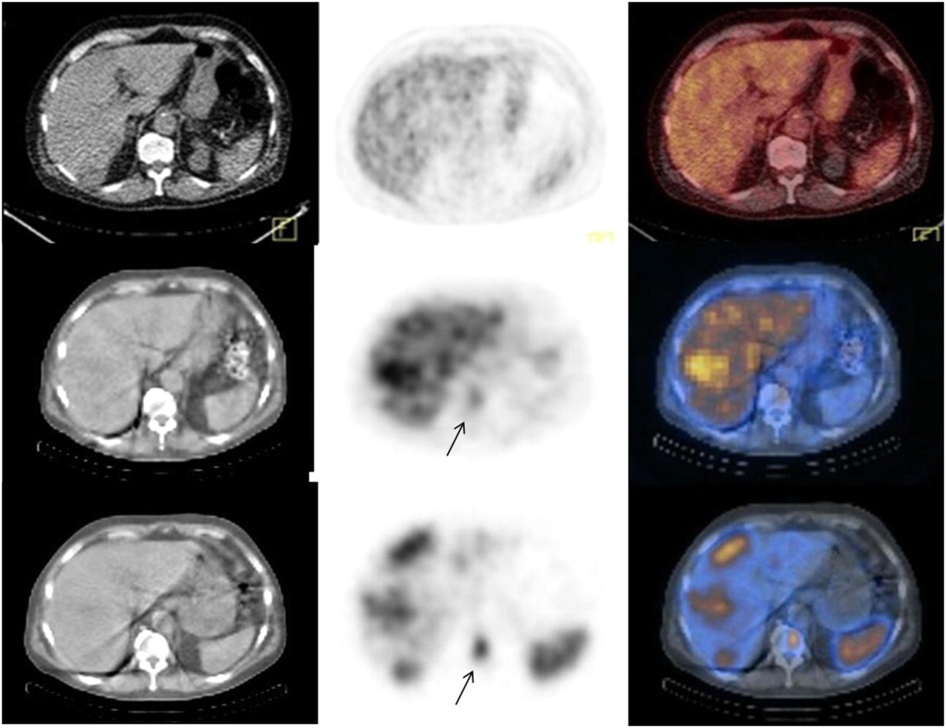
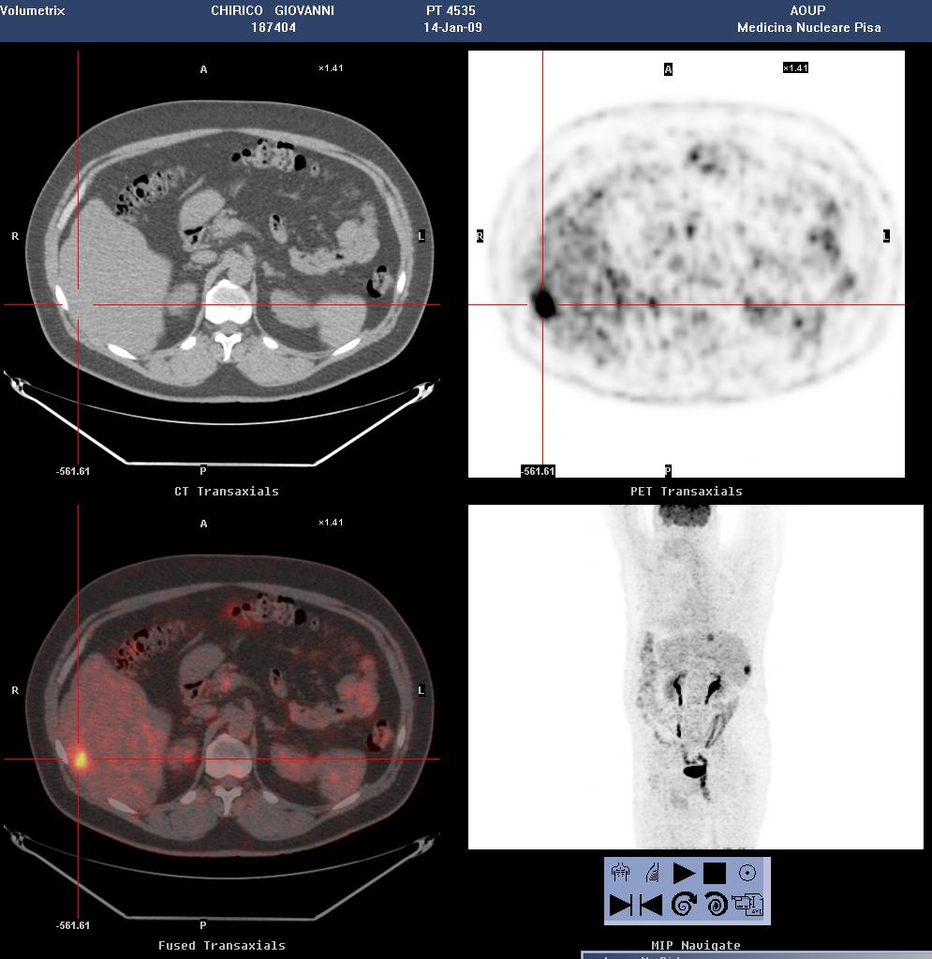
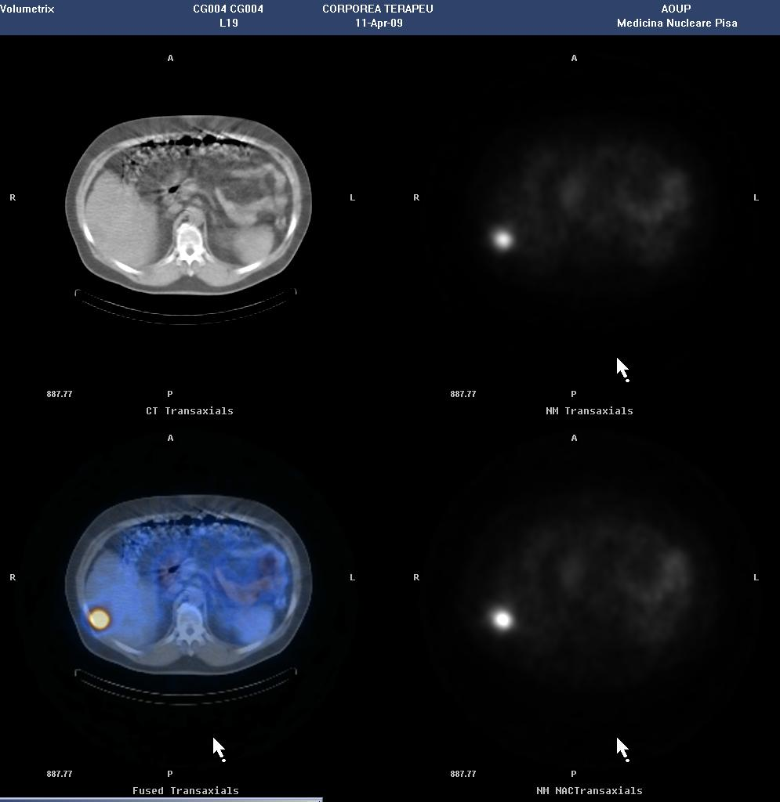
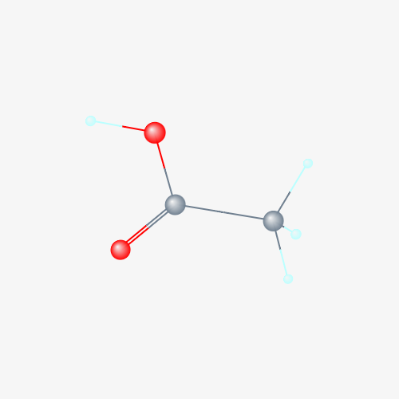
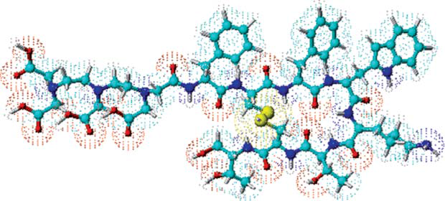
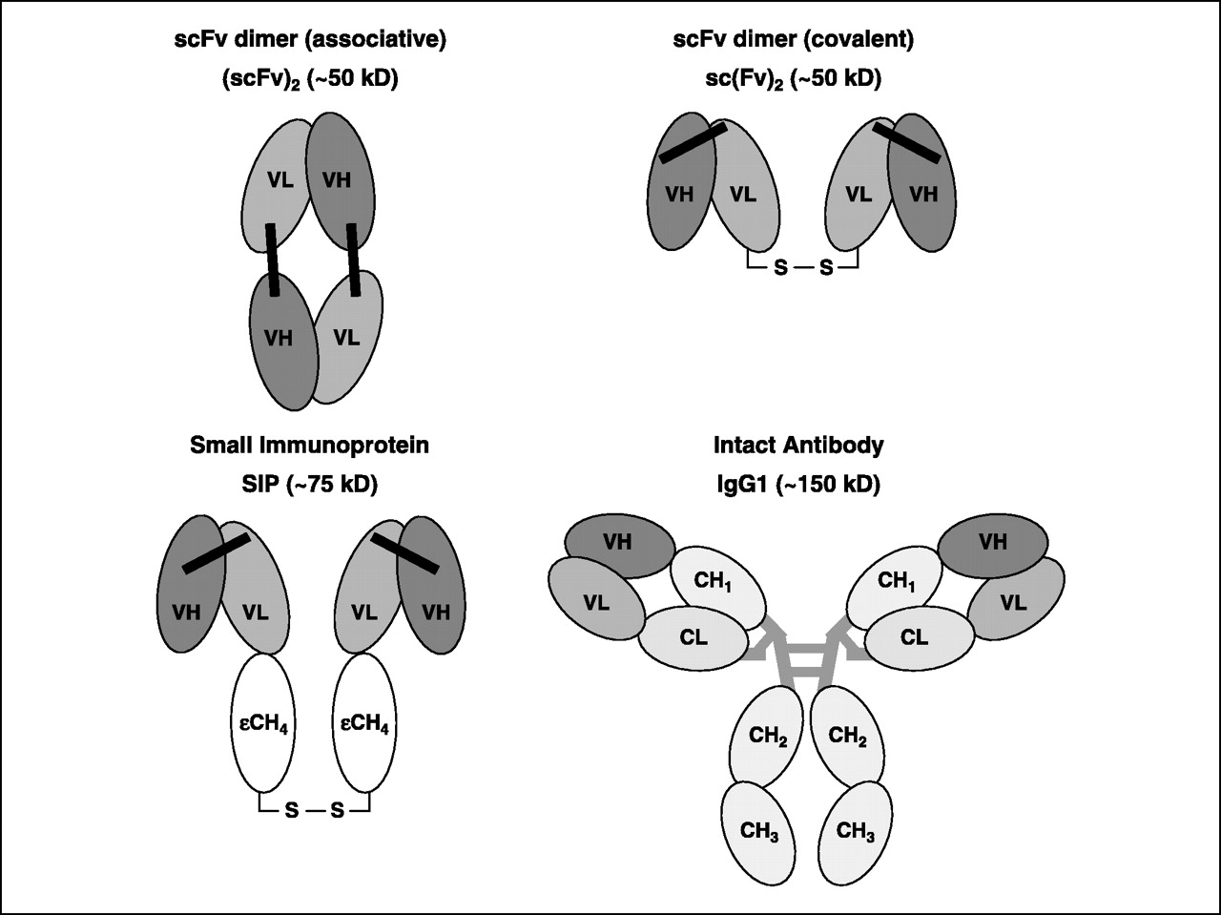
Surrogate markers, imaging biomarkers
and
theranostic agents

Slide 11
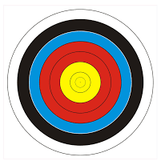
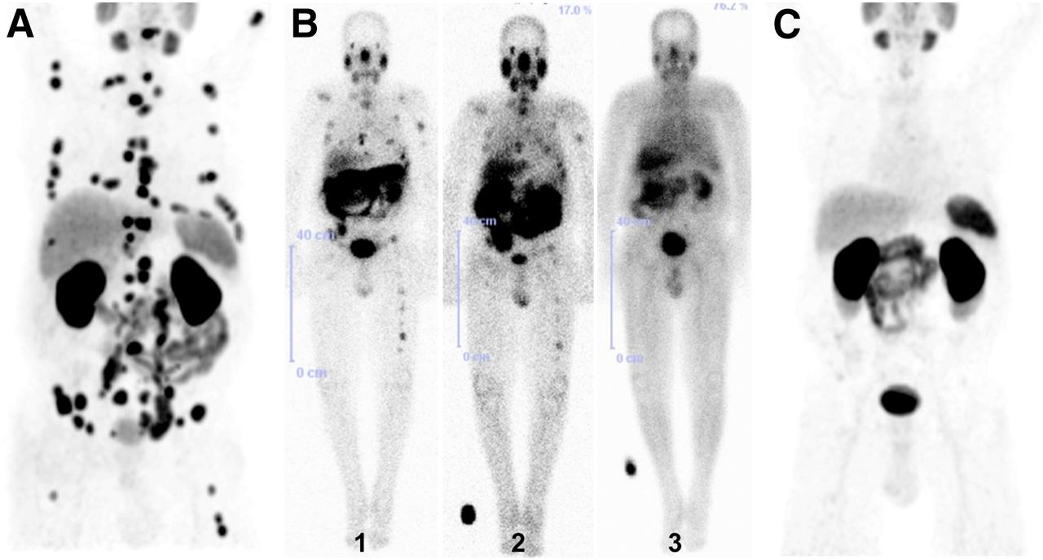
Applications - Efficacy
⁶⁸Ga
¹⁷⁷Lu
  PSMA
Beta(+)-
emitting isotope
Beta(-)-emitting isotope
MOLECULAR
RADIOTHERAPY
PET/CT
Richard P. Baum et al. J Nucl Med 2016;57:1006-1013
Notes:
For treatment of systemic malignancies, when external radiation therapy is not applicable, radionuclide therapy can be an alternative. In this form of therapy, radionuclides are administered to the patient, often in a form where the radionuclide is labelled to a molecule that plays the active part in the localization of the tumor.
76-y-old patient after external-beam radiation therapy to bone metastases and hormone therapy.
(A) ⁶⁸Ga-PSMA PET/CT revealed progressive bone and lymph node metastases. (B) ¹⁷⁷Lu-PSMA scintigraphy demonstrated resolution of metastases after first (1), second (2), and third (3) RLT cycles. (C) ⁶⁸Ga-PSMA PET/CT showed excellent molecular response (RECIST 1.1 and EORTC criteria), with disappearance of most PSMA-avid metastases, after 3 PSMA RLT cycles.
Richard P. Baum et al. J Nucl Med 2016;57:1006-1013

Slide 12

Applications – Treatment response monitoring
⁶⁸Ga-PSMA-PET/CT
End-of-treatment
Baseline
PET/CT
PET/CT
Richard P. Baum et al. J Nucl Med 2016;57:1006-1013

Slide 13

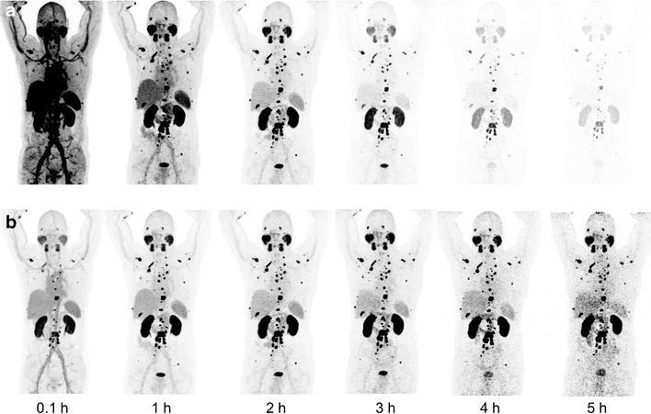
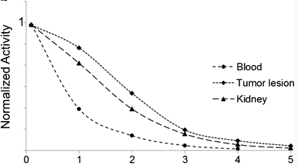
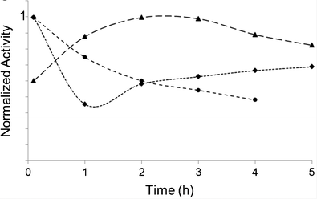
Applications - Safety
Radiation Dosimetry in Nuclear Medicine
Different nuclide distribution taking into account the half-life of ²¹³Bi or ²²⁵Ac extrapolated form ⁶⁸Ga-PSMA-617 PET scans
²¹³Bi
²²⁵Ac
Kratochwil et al. Eur J Nucl Med Mol Imaging (2017). https://doi.org/10.1007/s00259-017-3817-y

Slide 14
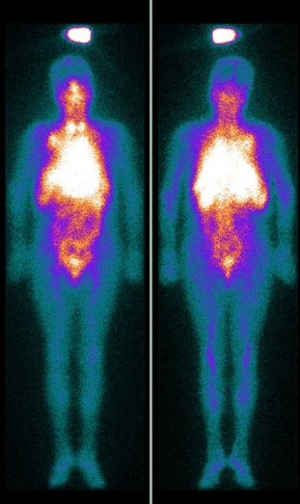
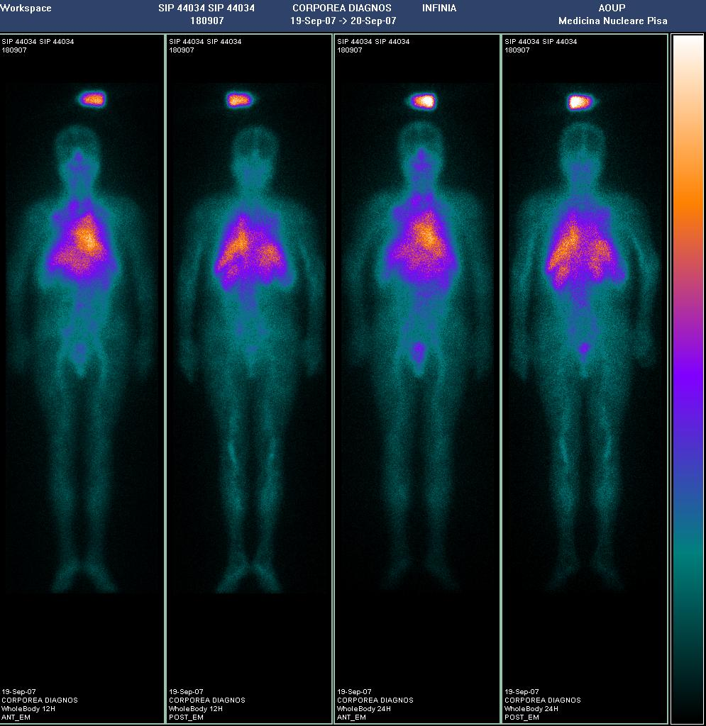

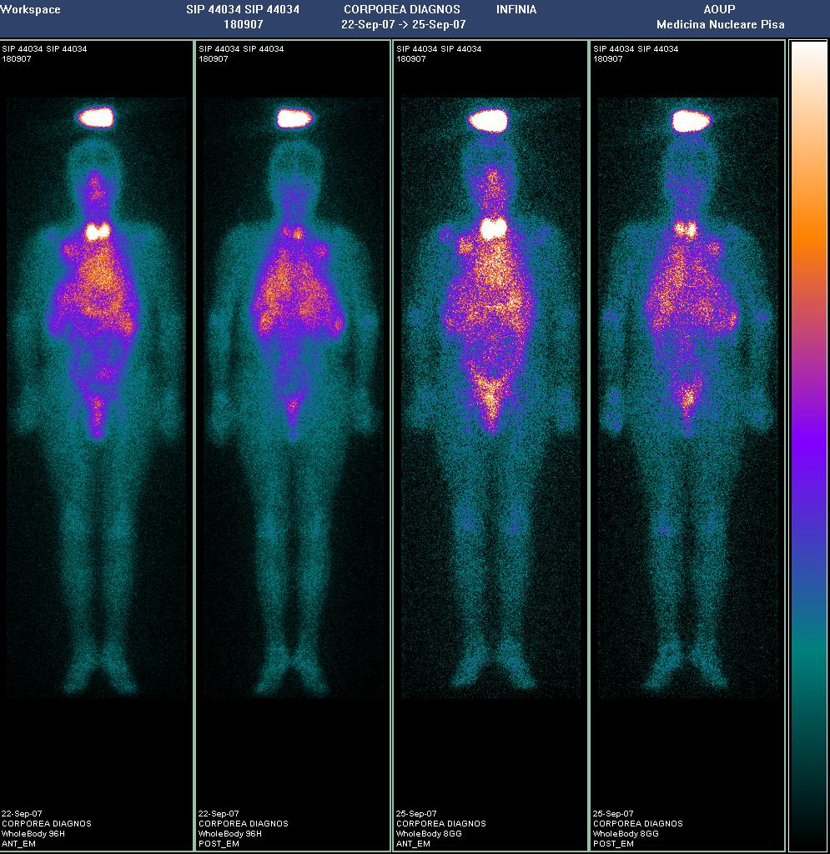
Dosimetry: WB scintigraphy and blood-derived bone marrow irradiation
6 h
24 h
48 h
72 h
96 h
192 h

Slide 15
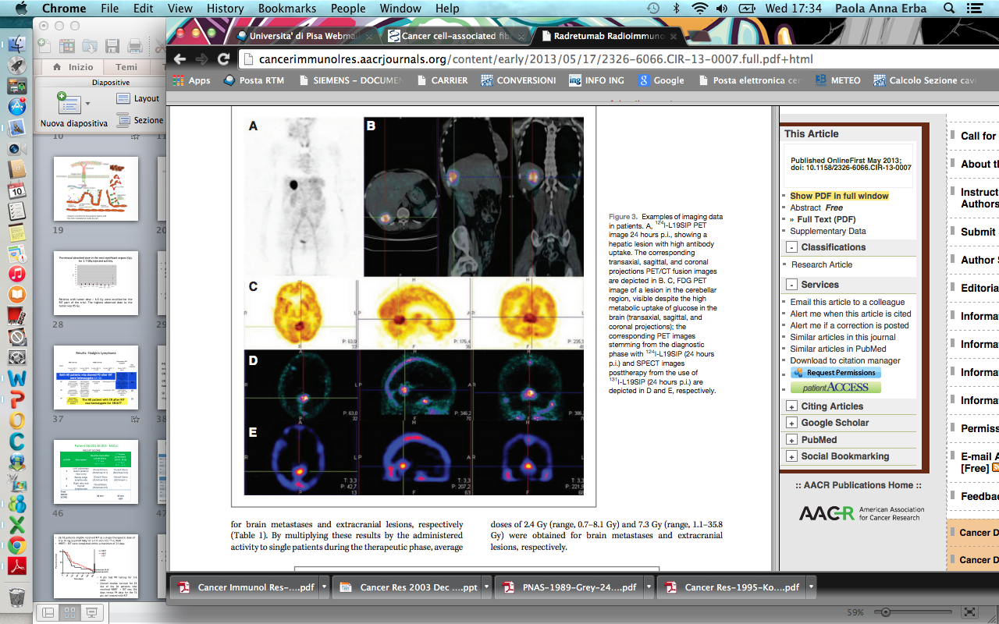
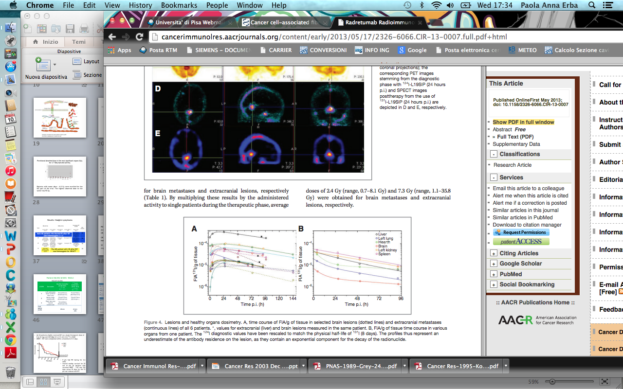
Poli et al. Cancer Immunol Res. 2013 Aug:134-43
Notes:
Dosimetric data in brain lesion (dotted lines) and extracranial mts (continous line) and in various organ, rescaling the diagnostic value od 124I to match the physical half life of 131I

Slide 16
Radionuclide Therapy
Molecular Radiotherapy
Peptide RadioReceptor Therapy (PRRT)
Radioimmunotherapy (RIT)
Theragnostic

Slide 17
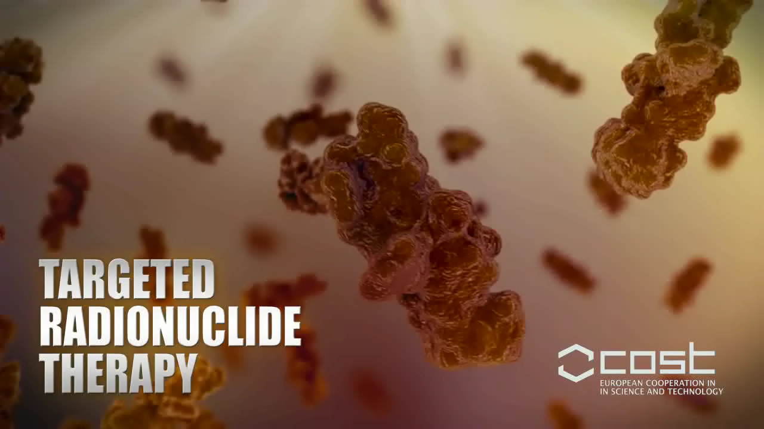

Slide 18
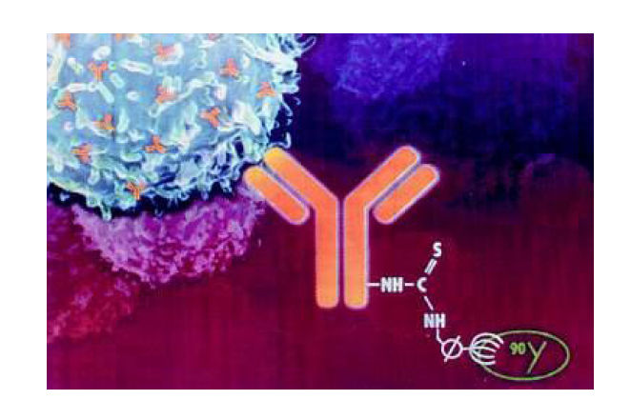

Pre-requisite for radionuclide therapy
¹³¹I, ¹¹¹In, ^{99m}Tc,
⁹⁰Y, ¹⁷⁷Lu

Slide 19
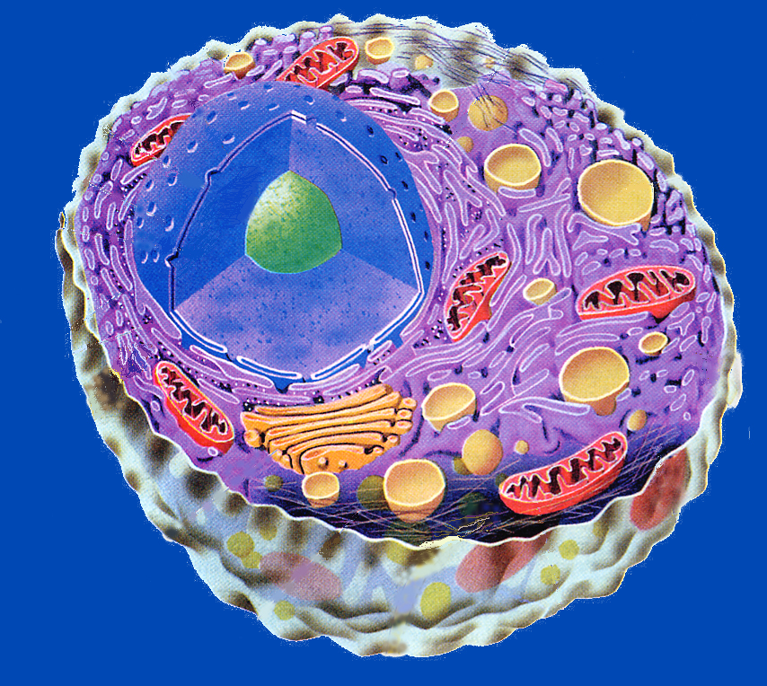
rec. ormoni steroidei
(*I-Estr./Prog.)
precursori
metabolici
(*I; *I-Colest.)
rec. peptidi diversi
(¹²³I/^{99m}Tc-VIP . . .)
recettori
transferrina
(⁶⁷Ga)
TAA
(*R-MoAb)
rec. fattori crescita
(¹¹¹In-Octreotide)
Na/K
(²⁰¹Tl)
substrati energetici
(*I-Ac. grassi)
mediatori
(*I-MIBG)
“farmaci”
(^{99m}Tc-MIBI)

Slide 21
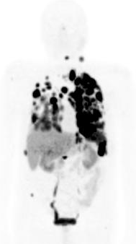
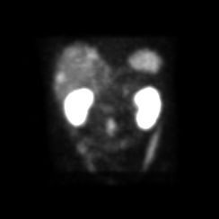
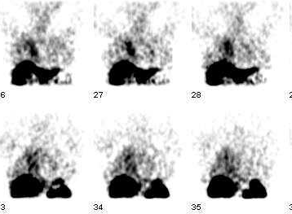
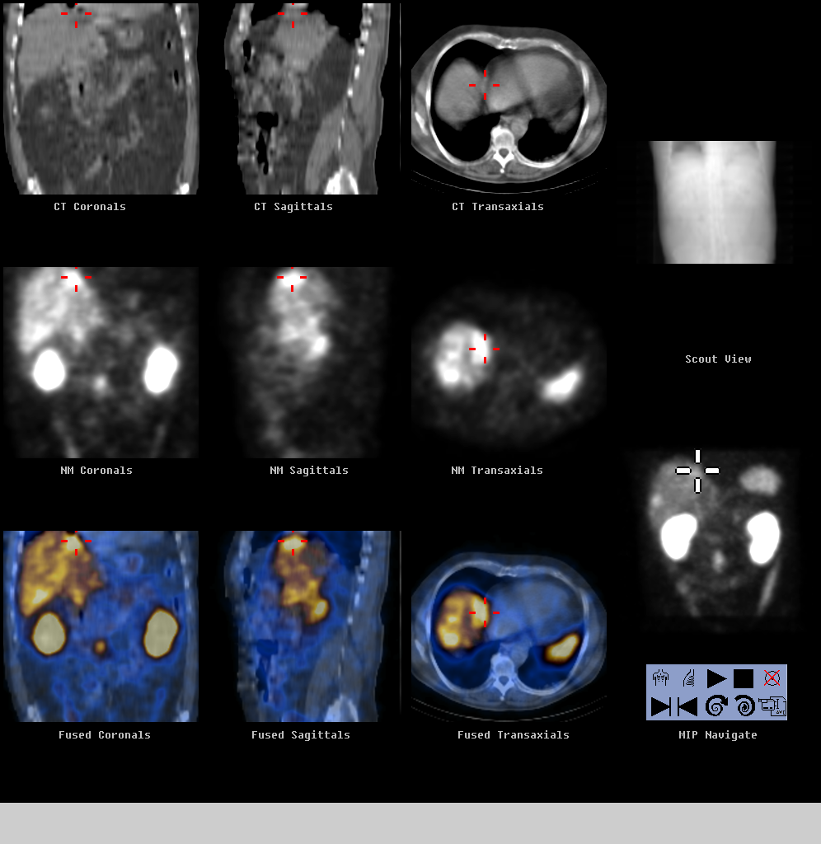
PRRT theragnostic approach
Octreotide (¹¹¹In-)
⁶⁸Ga-DOTATOC/DOTATATE
⁹⁰Y⁻¹⁷⁷Lua-DOTATOC/DOTATATE

Slide 22
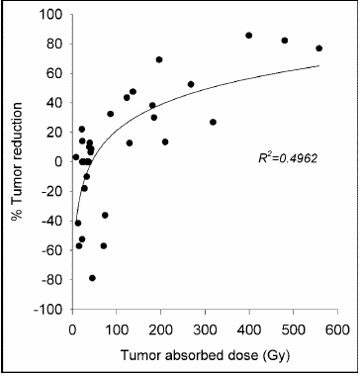
Radiosensitivity:
growth pattern
• DNA repair
Radioactivity concentration on tumor absorbed dose: dose-response relationship

Slide 23
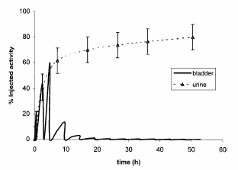
Pharmacokinetics:
– rapid plasma clearance:
– excretion/catabolism by the kidney:

Slide 25
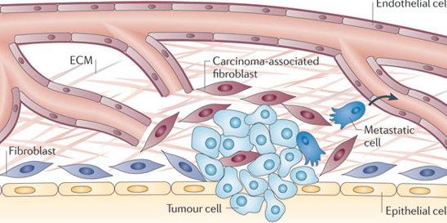
…from cellular to stromal targeting…
adapted from Lambert et al. Nature Reviews Cancer 2011; 11: 375-382

Slide 26
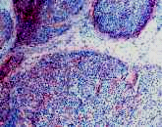
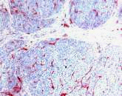

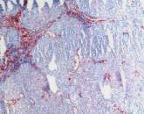
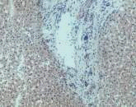
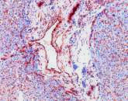
Expression and distribution of ED-B FN
ED-B FN is not expressed in
most normal adult tissues
ED-B FN expression is associated with newly formed vasculature in tumor and fetal tissues, and in
tissues undergoing remodeling
ED-B FN is expressed in many
types of human malignancies
and is therefore an attractive
target for anti-tumor therapies
ED-B FN
CD31
HCC
Liver
cirrhosis
Normal
liver
HCC, hepatocellular carcinoma

Slide 27
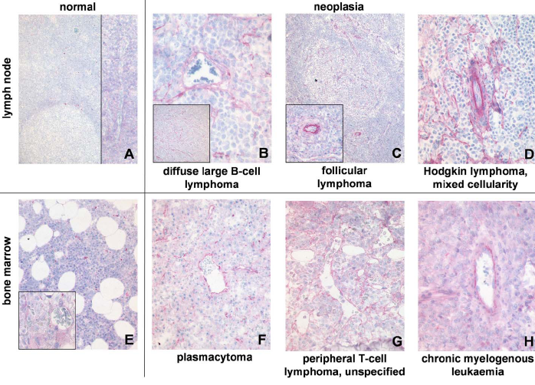
In Lymphoma

Slide 28
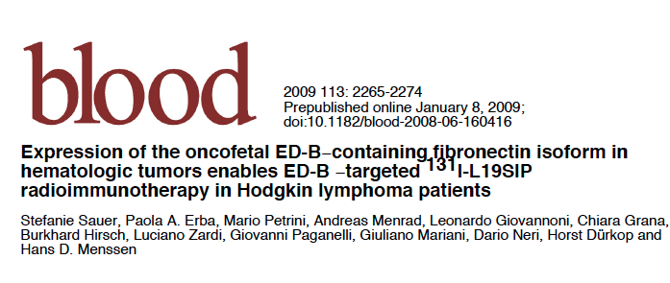
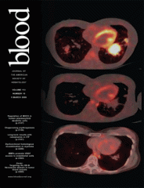

Slide 29
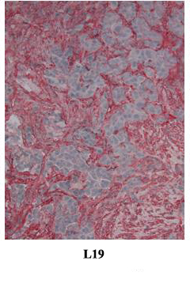
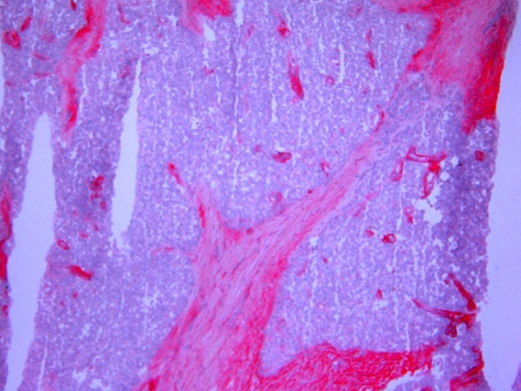
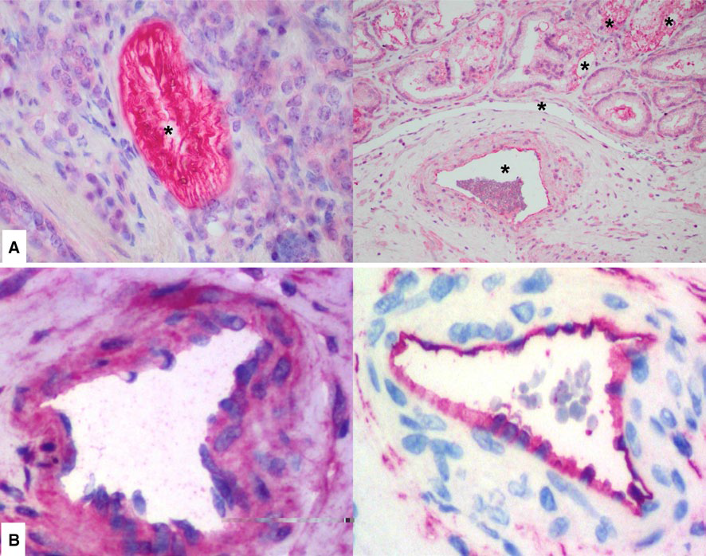
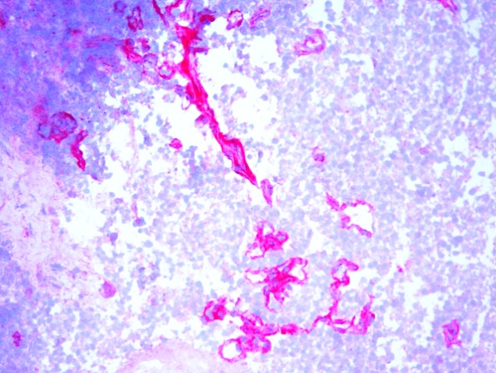
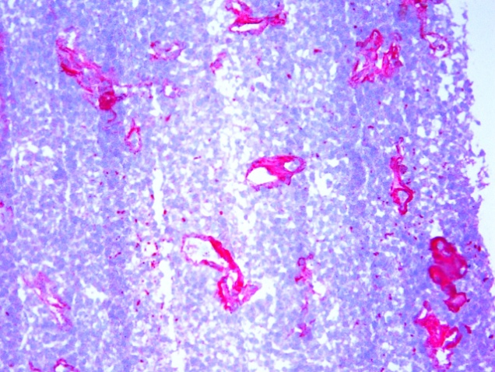
EB-D in Malignant mesothelioma

Slide 30
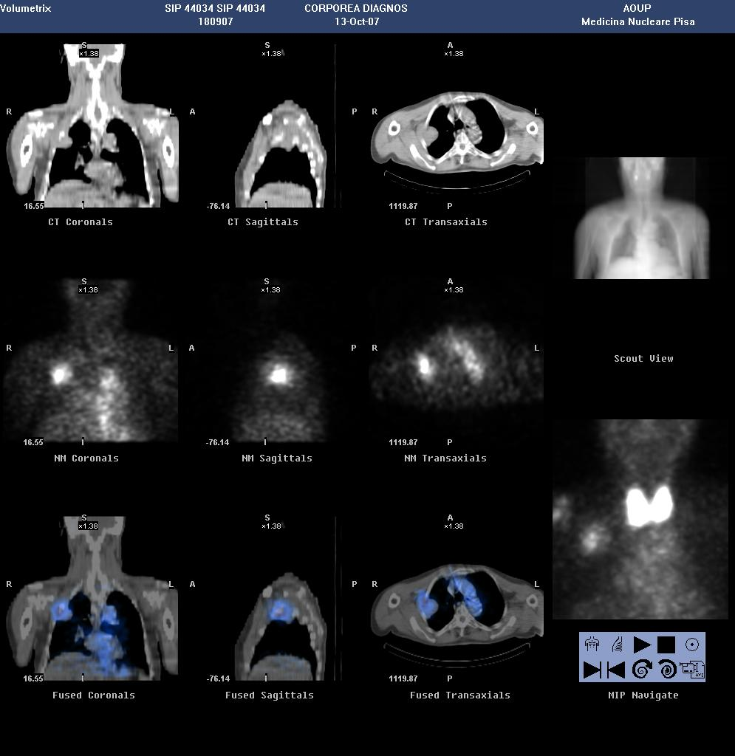
Diagnostic ¹³¹I-L19SIP SPECT-CT (72hrs after administration 5mCi)
GG44034: pleural mesothelioma
Post treatment ¹³¹I-L19SIP SPECT-CT (8 days after administration 150mCi)

Slide 31







Baseline PET/CT
14/07/09
Diagnostic ¹³¹I-L19SIP SPECT/CT
Post RIT
¹³¹I-L19SIP SPECT/CT
1° TA PET/CT 09/09/09
ET06010G011

Slide 32


Patient 06.001.M.001- NSCLC
Tumor assessment
PET/CT baseline 24/08/2010 PET/CT 20/01/11

Slide 33















Radioisotopi

Slide 34
Emissione beta
(606 keV)
Emissione alfa
(5,87 MeV)

Slide 35
Effetto radiobiologico modesto
(localizzazione mitocondriale)
Emissione di elettroni Auger
Effetto radiobiologico pressoché assente
(legame di membrana)
Effetto radiobiologico potente
(localizzazione intranucleare)

Slide 36


Slide 37


Slide 38

Tumor control probability (TCP) for various radionuclides. TCP = 0.9 versus tumor mass. The optimal TCP for various tumor masses when treated with ²¹¹At, ¹⁷⁷Lu, ¹³¹I, and ⁹⁰Y. This corresponds to approximately 10^{–5}, 10^{–2}, 0.1, and 10 g, respectively.

Slide 40


Slide 41
Schematic representation of the so-called crossfire
effect for particle-emitting radionuclides employed for
therapy (assumed to be β particles for this representation).
Because of delivery of energy within a certain range from
the point of emission, the radiotoxic effect is not limited to
the cells that specifically accumulate the radiopharmaceutical
but also involves nearby cells (either they be neoplastic
or tumor cells). In this representation, it is assumed that
the radiopharmaceutical has accumulated at three specific
locations within a tumor lesion (the uptake points are
indicated by the radioactivity symbol). The red area with
decreasing intensity from the center depicts the range in
tissue along which the particles travel and deposit their
energy, with maximum in the center and decreasing delivery
of energy toward the periphery. The arrows indicate the
tissue zones between the different radionuclide localization
points; these are the cells exposed to the crossfire effect
(From Volterrani D, Erba PA, Mariani G, eds. Fondamenti
di medicina nucleare—tecniche e applicazioni. Milan
(Italy): Springer; 2010, with permission)

Slide 42


Slide 43
directly or through the intermediacy
of oxygen-containing radicals, creates damage
which is lethal or repairable

Slide 44

Notes:
argeted effects are caused by one or more particles traversing irradiated cells and can be divided in DNA and non-DNA-centered effects. Non-targeted effects describes the effects observed in cells that have not been directly traversed by particles but that are close to irradiated cells, as well as long-distance effects. DNA, mitochondria, and the cell membrane are the main sensitive targets of radiation. Following targeted and non-targeted effects, cells can survive (lesions are effectively repaired), they can die (lesions are not repaired) or they can be transformed. The dose–effect relationship of targeted effects is commonly fitted by linear or linear-quadratic models.
ROS and RNS participate in physiological processes including cell signaling, immune response, inflammation, apoptosis, and cell growth, and also in the cell response to radiation (8). These endogenous and exogenous reactive species can cause cellular damage, when imbalance occurs between their production and their destruction by the cell enzymatic and non-enzymatic defense systems. For instance, O⋅−2O2⋅− can be reduced to H₂O₂ by the enzyme superoxide dismutase. H₂O₂ can in turn be reduced to water by the catalase or glutathione peroxidase enzymes, or can be used, in the presence of metal ions, such as Fe²⁺, to produce ⋅OH through the Fenton reaction. Superoxide dismutase, catalase, and glutathione peroxidase are part of the enzymatic defense system developed by cells to keep the level of these endogenous ROS as low as possible. Several intracellular components, particularly glutathione, urates, bilirubin, and vitamin E and C, can also act as radical scavengers. When the balance is tilted in favor of reactive species, all cell compartments (cell membrane, mitochondria, and particularly the nucleus) and constituents (DNA, lipids, and proteins) may be harmed and their functions altered.

Slide 45


Slide 46






New radiopharmaceuticals
phase I
phase II
phase III
Basic
Laboratory
design
Pre clinical
development
Clinical
development
registration
A.I.C
optimization
phase IV)

Slide 47


