Slide 1


International Conference
on Frontier in Diagnostic Technologies
INFN Frascati, Italy
October 03-05, 2018
Ultra-Intense X-rays in PW laser plasma –
generation, transport and application to study
radiation dominated and warm dense matter
Sergey A. Pikuz
Joint Institute for High Temperatures RAS
National Research Nuclear University MEPhI
Notes:
http://www.kansai.qst.go.jp/icxrl2016/

Slide 2





Collaboration
Joint Institute for High Temperatures RAS, Russia - I.Yu. Skobelev,
M.A. Alkhimova, S.N. Ryazantsev, E.D. Filippov, S.S. Makarov, A.S. Martynenko
Open and Transdisciplinary Research Initiative and
Graduated School of Engineering, Osaka University, Japan
A.Ya. Faenov, T.A. Pikuz, Y. Sentoku, A. Zhidkov, M. Hata, R. Kodama
CELIA, University of Bordeaux, CNRS-CEA, France
G. Boutoux, L. Giuffrida, T. Sakaki, J.J. Santos, A. Sauterey, D. Batani
GSI Helmholtzzentrum für Schwerionenforschung, Germany P. Neumayer, K. Li, D. Khaghani, V. Bagneux
York Plasma Institute, University of York, UK
P. Durey, L. Doehl, L. Antonelli, P.D. Farley, C. Baird, C.D. Murphy,
K. Lancaster, N. Woolsey
Kansai Photon Research Institute QST, Japan
M. Nishiuchi, H. Sakaki, A.S. Pirozhkov, A. Sagisaka, N.P. Dover,
Ko. Kondo, K. Ogura, Y. Fukuda, H. Kiriyama, M. Kando, K. Kondo
CLF, STFC Rutherford Appleton Laboratory, UK N. Booth, D. Heathcote, C. Spindloe

Slide 3





Collaboration
Goethe University Frankfurt, Germany
A. Schoenlein, A. Franz, J. Jacoby, O. Rosmej
SUPA, Department of Physics, University of Strathclyde, UK
N.M.H. Butler, R.J. Dance, P. McKenna
Sandia National Laboratories, Albuquerque, USA
S.B. Hansen
Interdisciplinary Graduate School of Engineering Sciences,
Kyushu University, Japan - K. Nishitani, T. Miyahara, Y. Watanabe
ETSI Aeronauticos, UPM, Madrid, Spain
J.J. Honrubia
CEA DAM DIF, Bruyères-le-Chatel, France
A. Debayle
Racah Institute of Physics, Hebrew University of Jerusalem, Israel – A. Zigler
Institute for Kernphysics, TU Darmstadt, Germany
N. Neumann, M. Roth

Slide 4
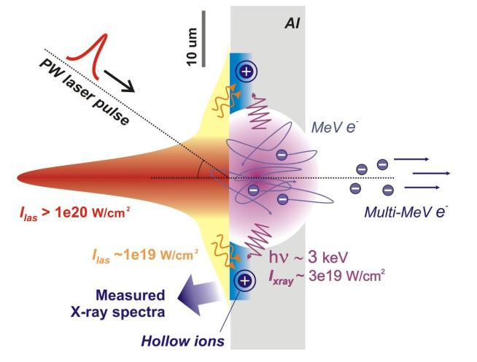
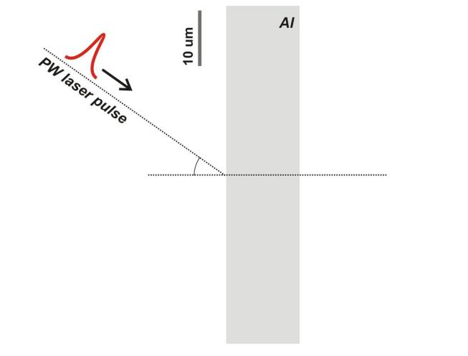
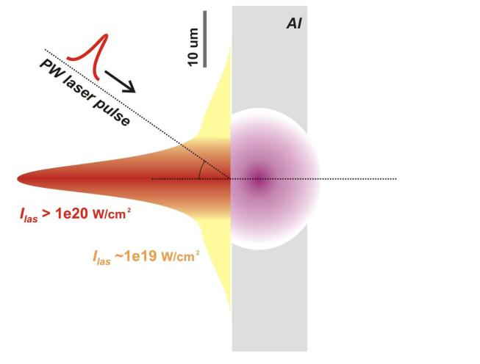
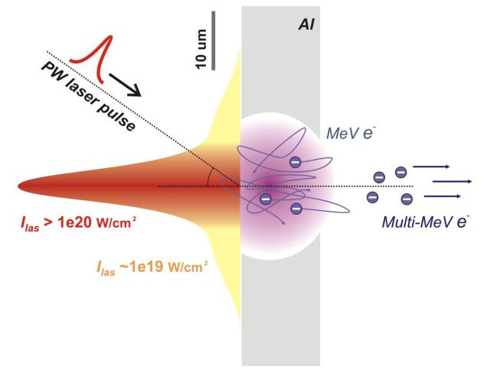
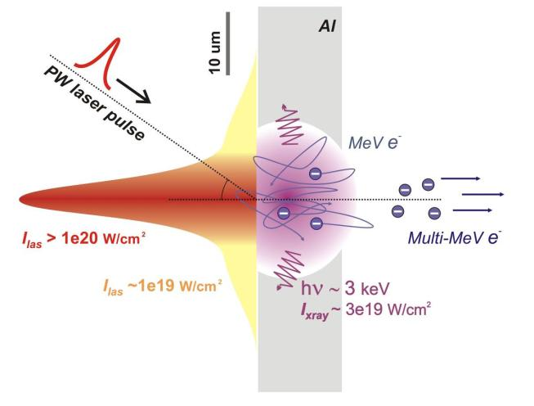
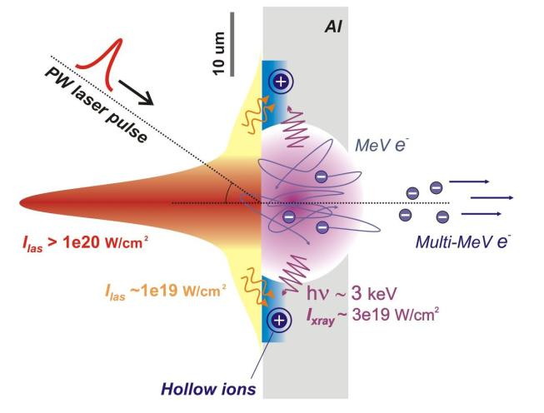
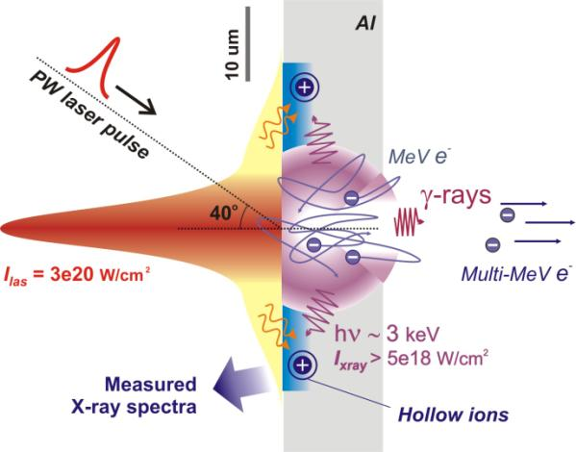
Hollow atom generation in PW plasma
X-rays in ultra-relativistic laser plasma:
Generation – Transport – States of matter

Slide 5
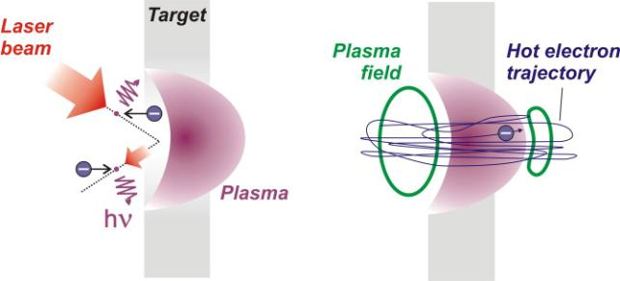
Ultra intense source of X-rays in keV range
Radiation friction force
L. Landau, & E. Lifshitz The classical theory of fields (1961)
f_{R} ≠ 0 when E means:
E_{laser}, i.e. Thomson scattering
at incident laser radiation
E_{plasma-transv}, i.e. Bremsstrahlung
in a plasma during refluxing
With I_{Las} = 3e20 W/cm² I_{Xray} ~ 5e18 W/cm² to be estimated

Slide 6
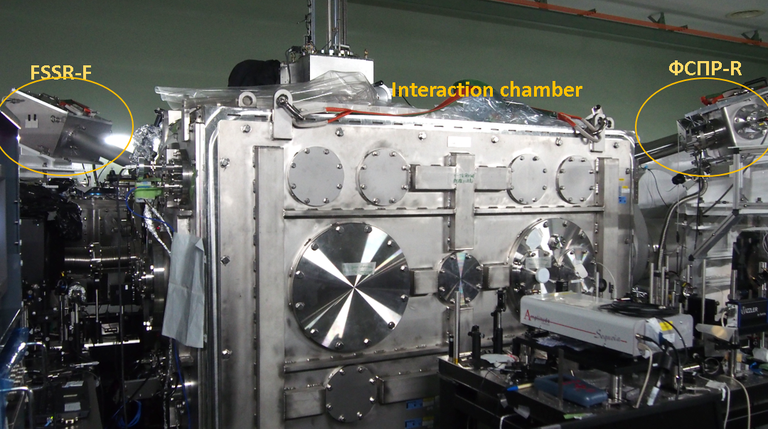
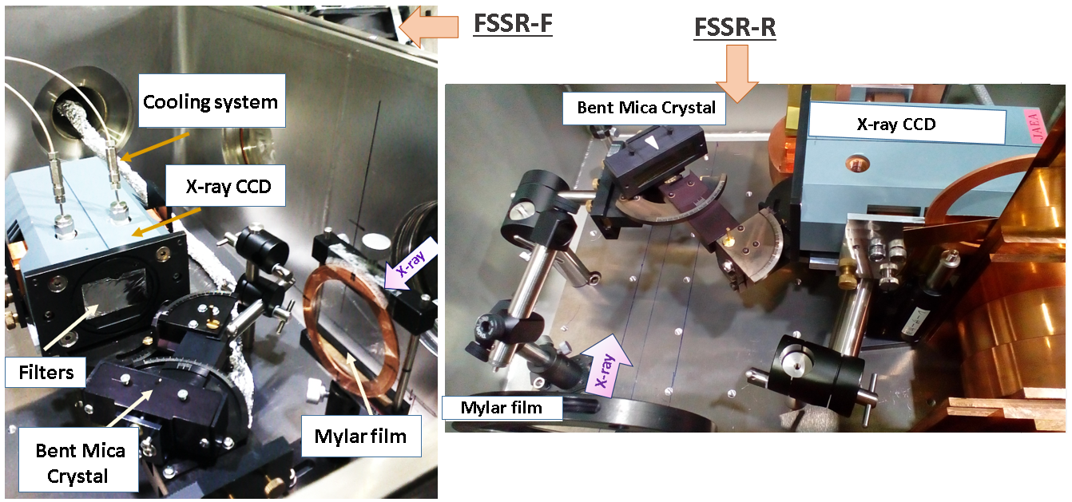
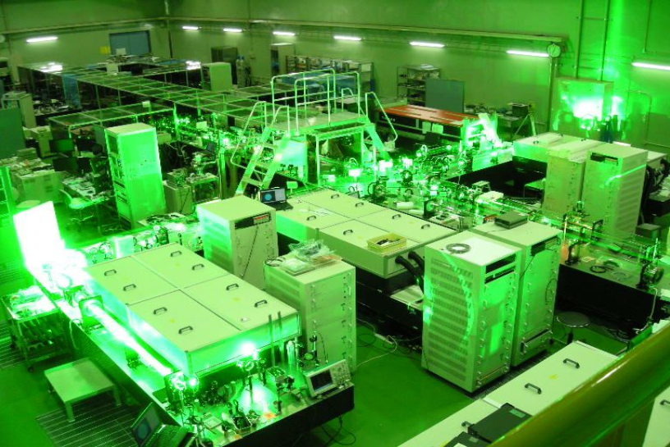
Experiments with J-KAREN-P Laser facility
Experiments at J-KAREN-P (since march 2016)
Kansai Photon Science Institute, Kyoto, Japan
J-KAREN-P laser facility:
High resolution X-ray spectrometers coupled with CCDs, 2 channels
Ti:Sapphire, OPCPA
Wavelength λ= 800 nm
Laser power Plaser= 0.35 PW
Laser contrast up to Claser ~ 10¹²
Pulse duration τ ~ 40 fs
Energy on target up to Е~ 14 J
FSSR in vacuum chamber

Slide 7
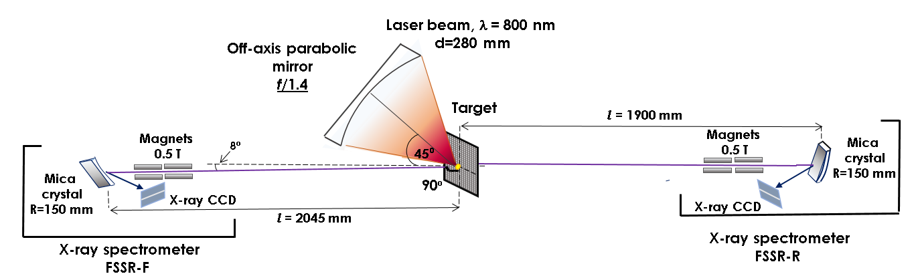
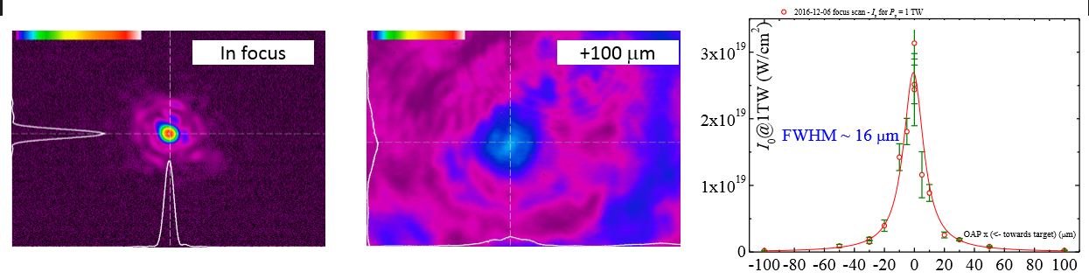
Experimental Setup J-KAREN-P laser facility
Sharp laser focusing with f/1.4 parabola. Focal spot diameter ~1,5 μm
Focal spot snaps
Laser intensity on target vs target shift

Slide 8
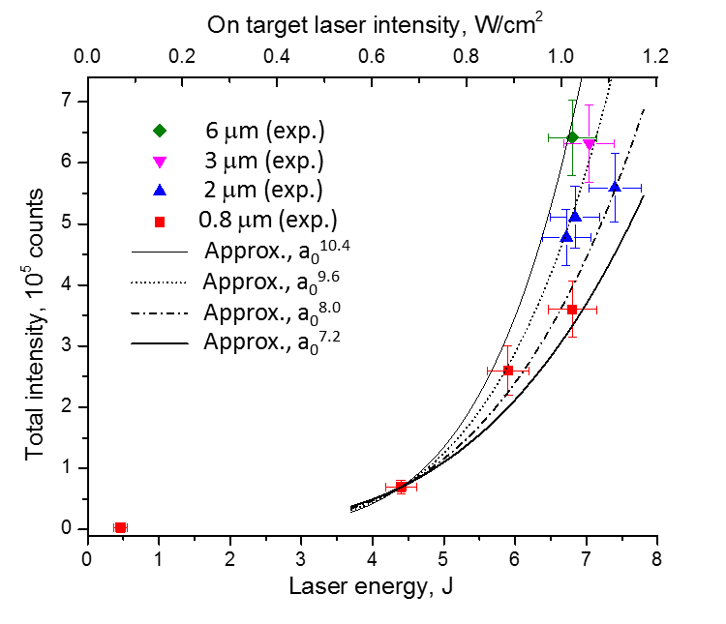
Al x-ray spectra measurements/J-KAREN
Nonlinear growth of X-ray intensity in 1.5-2 keV band is observed
for laser intensity I_{las} ranged from 2e20 W/cm² to 1.1e21 W/cm²
I_{X-ray} ~ a₀⁸, or I_{X-ray} ~ E_{las}⁴
$$normalized laser field −a_{0}= eE_{Las}/ mcω$$
A.Ya. Faenov et al., Scientific Reports. 5, (2015)
Notes:
In some sense similar picture was observed with PW femtosecond laser pulses in our experiment at J-KAREN facility.
Here the same Al targets were exposed to over6e20 W/cm2 intensities. The difference in the spectra is in the shift from KK to KL hollow ion states abundance. The effect is easily predictable, as short pulses effectively generates fast electrons, and electron distribution in plasma becomes far less Maxwellian. So KL hollow ion geneation by fast electrons competes with KK hollow ion production by X-rays. But what is more important, that in this campaign we were able to test how the overall observed X-ray yield depends on the intensity of the laser field. And - the predicted power dependence of E^4-5 was experimentally confirmed.

Slide 9
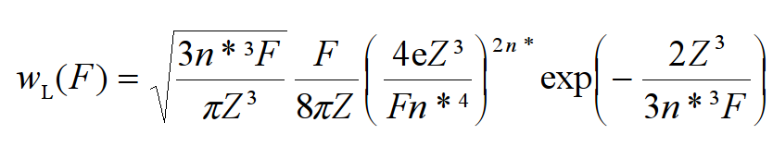
Generation of multicharged K-ions in a laser-produced plasma
1) by optical field ionization (OFI)
2) by electron impact ionization (CI)
OFI
An atom is ionizated by a strong laser field in tunneling regime if the Keldysh parameter ω(2E_{i})^{1/2}/F is less than 1. (E_{i} - the ionization potential, F - the field strength, ω – the laser frequency)
The ionization rate is
where Z - spectroscopic symbol, n* = Z/(2E_{i})^{1/2} - effective principal quantum number
The dependence on the laser field strength or intensity has a threshold behavior.
For obtaining Li-like Ar XVI I_{las} > 10¹⁹ W/cm² is necessary
For obtaining He-like Ar XVII I_{las} > 10²⁰ W/cm² is necessary
For obtaining H-like Ar XVIII I_{las} > 2.5x10²¹ W/cm² is necessary
Along isoelectronic sequence I_{las} ~ Z⁶.
For obtaining He-like Fe XXV I_{las} > 10²¹ W/cm² is necessary.
For obtaining H-like Fe XXVI I_{las} > 2.x10²² W/cm² is necessary

Slide 10
Electron impact ionization
C_{i}N_{e}τ_{plasma} > 1
Here C_{i} is collisional ionization rate, which is strongly dependent on T_{e}
τ_{plasma} ~ L_{plasma}/v_{T}
where L_{plasma} is plasma dimension and v_{T} is plasma expansion speed
T_{e} must be not smaller then E_{i}/4 high I_{las} must be used
To obtain high I_{las} :
1) increase E_{las} expensive
2) decrease R_{focal spot} decreasing of L_{plasma} and τ_{plasma}
The best solution is
to use maximal possible value N_{e} (solid state value)
Very high laser contrast I_{pulse}/I_{prepulse} > 10¹⁰ is necessary

Slide 11
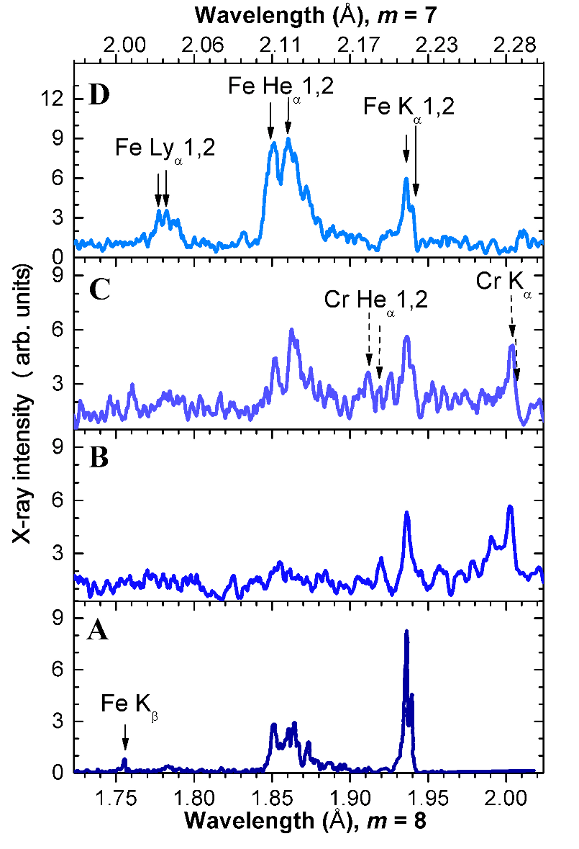
X-ray spectra depend on laser contrast
X-ray spectra of steel plasma allowed to observe laser contrast improvement, which results in appearance of transitions in multi-charged Fe and Cr ions and growth of its relative intensities.
Laser contrast ~10 ¹²
I_{las} = 9e21 W/cm²
Laser contrast ~10 ¹²
I_{las} = 3e21 W/cm²
Laser contrast ~10 ⁶
I_{las} = 3e21 W/cm²
Laser contrast >10 ¹⁰
I_{las} = 1e21 W/cm²

Slide 12
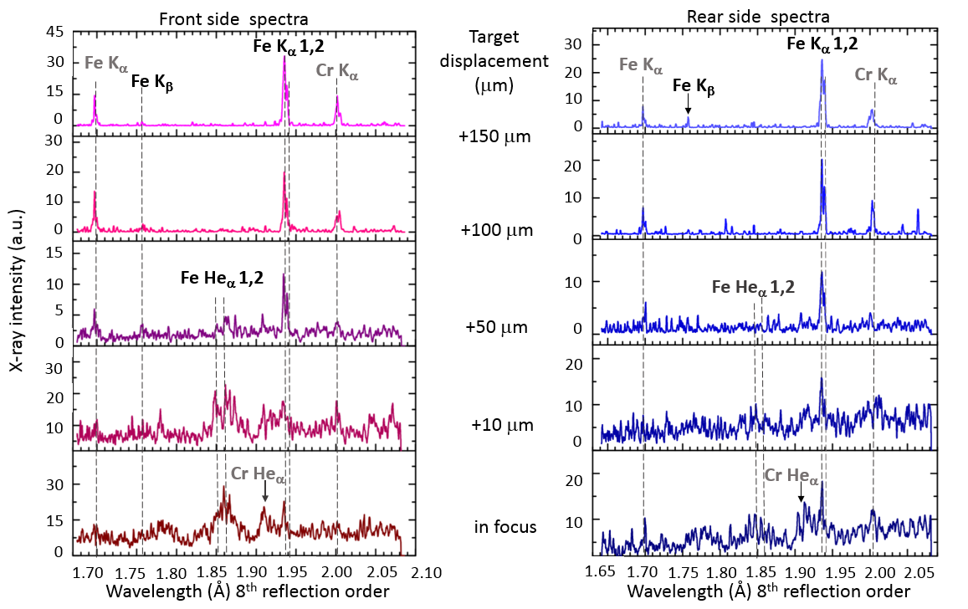
X-ray Fe spectra measurements/J-KAREN-P
X-ray spectra emitted from from and rear sides of 5 μm thickness stainless steel (SUS) foils

Slide 13
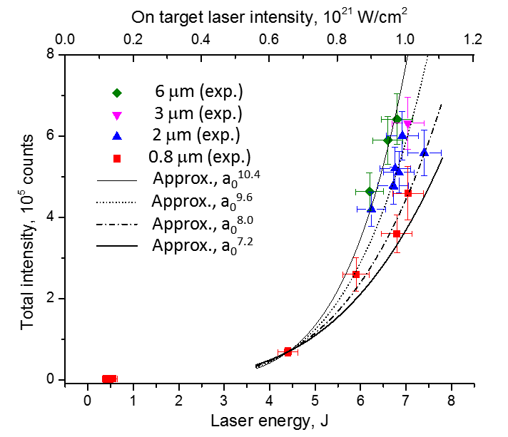
X-ray yield on energy of laser pulse (spectral range 6.05 – 7 keV)
0.5
1.1
2.3
4.4
6.2
x 10²¹ W/cm²
0.5
1.1
2.3
4.4
6.2
x 10²¹ W/cm²
a₀^{3.0}
a₀^{5.8}
Front side
Rear side
Al target
Low Z (Al); 1.5-2.0 keV range:
I_{X-ray} ~ a₀⁸
High Z (Fe); 6 – 7 keV range:
I_{X-ray} ~ a₀³⁻⁵
Spectral ranges
1.45 – 1.85keV +
2.2 – 2.75keV
Faenov et al. Sci. Rep. 5, 13436 (2015)
Notes:
SIF traces 2017-03-16.opj Folder: Dependences of integral intensity

Slide 14
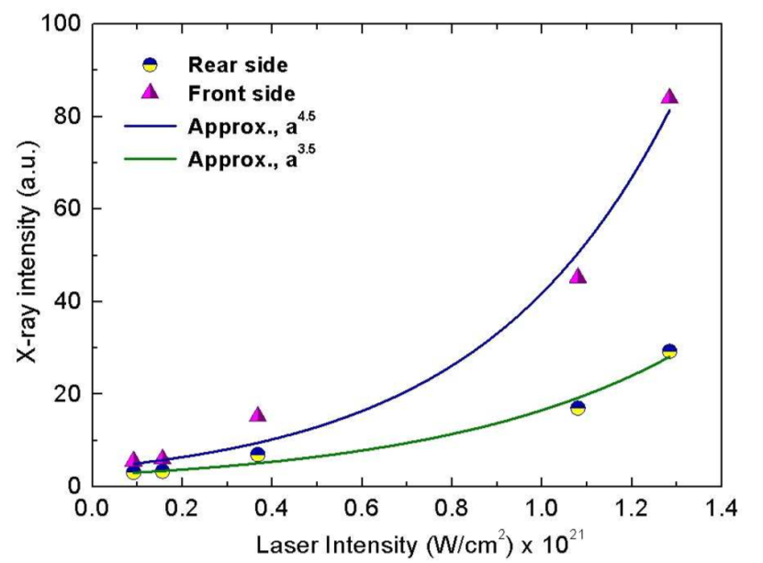
Ultra-intense X-rays generation - Summary
First experiments at J-KAREN-P at 1e22 W/cm² intensity domain
Non-linear increase in X-ray yield caused by effective radiation friction force is observed, leading to 10¹⁷-10¹⁸ W/cm² X-ray intensities achieved
The mechanisms of ultra-intense X-ray generation and plasma deep ionization is considered.
The emission of highly charged ions of high-Z elements
is acquired, showing critical sensitivity to laser contrast
i.e. one of the evidence that EII is still dominated over
OFI even at 1e22 W/cm² intensities
Experimental confirmation that laser pulse of
~ 10²² W/cm² is absorbed in relativistic critical density of ~ 5x10²² cm⁻³

Slide 15
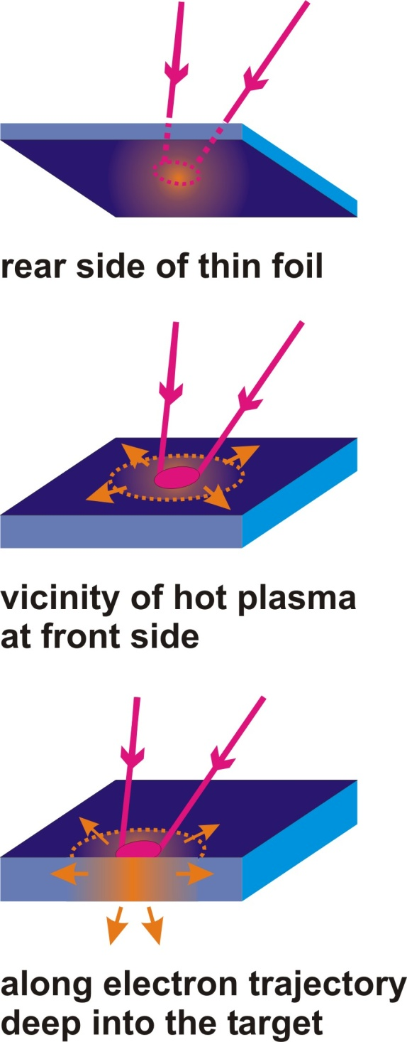
X-ray transport and WDM studies using optical lasers
Hot plasma (T_{e} ~ 1 keV), commonly in laser focus
WDM – (T_{e} ~ 10-100 eV, N_{e}~10²³ cm⁻³)
Hot plasma
T_{e}^{hot} ~ 500 – 5000 eV
X-rays
hot
electrons
Warm plasma
T_{e}^{warm} ~ 1 - 30 eV
X-rays
By means of X-ray spectroscopy
T_{e}^{warm} can be determined when over 10 eV.
Spatial resolution is of crucial importance.

Slide 16
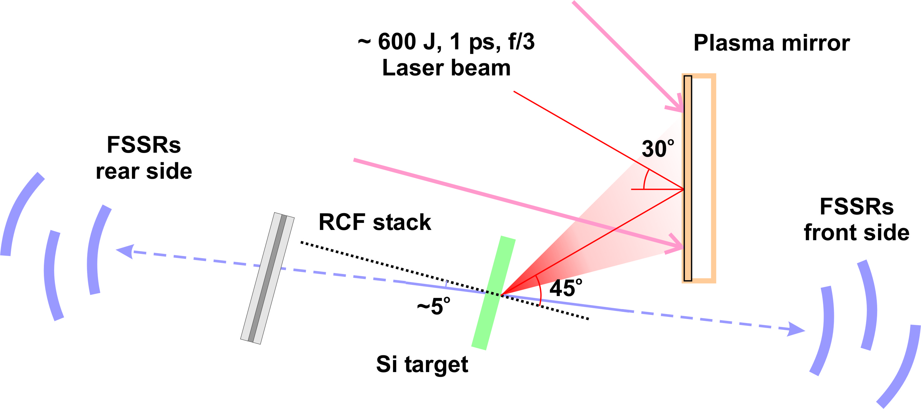
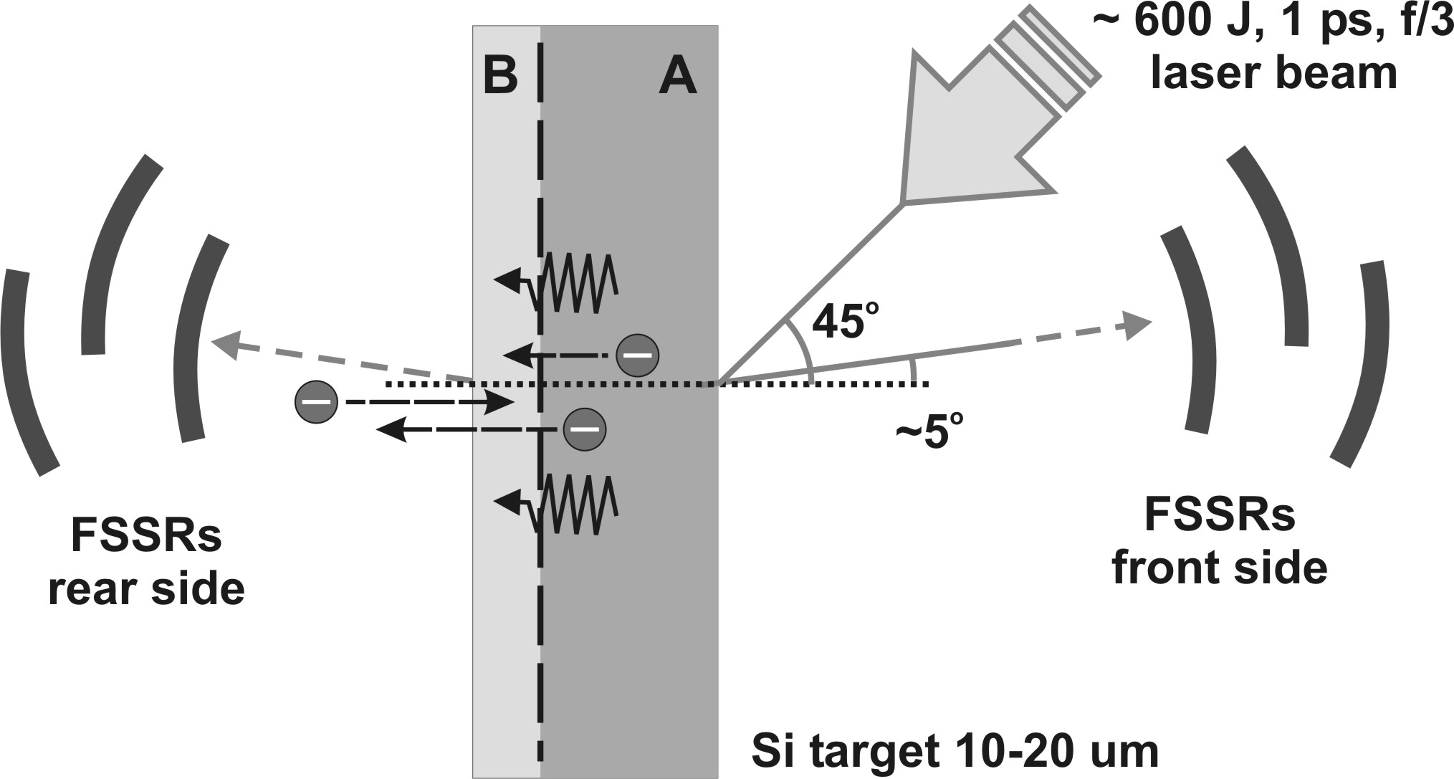
Absorption spectroscopy
Experiment @ Vulcan PW: 5e20 W/cm2, 600J @1ps,
OPCPA + plasma mirror to ensure ultra high pulse contrast
Combination of 3 FSSRs at each side aligned at merged bands
in order to cross-calibrate and combine the spectra.

Slide 17
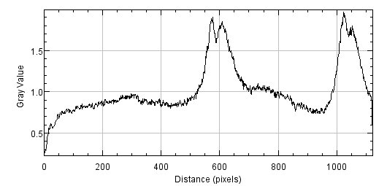
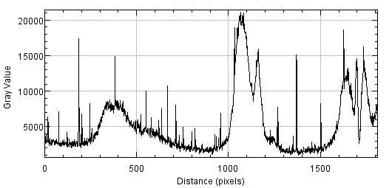
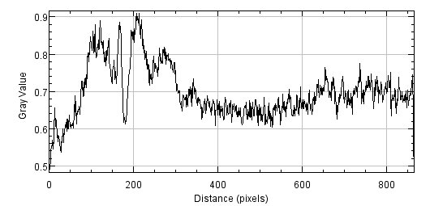
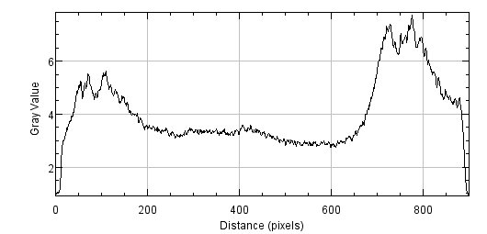
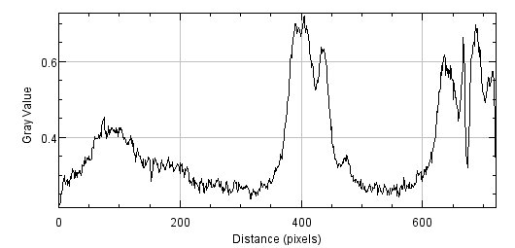
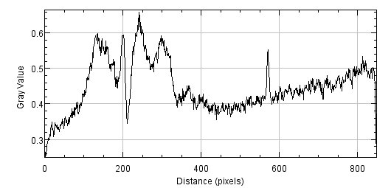
Shot 23
Target: CH 3um + Si 2um + CH 3um | Energy: 550.1 J | Focal spot diameter: 7 um | Pulse length : 1.9 ps
FShort
FMiddle (CCD)
FLong
RShort
RMiddle
RLong

Slide 18
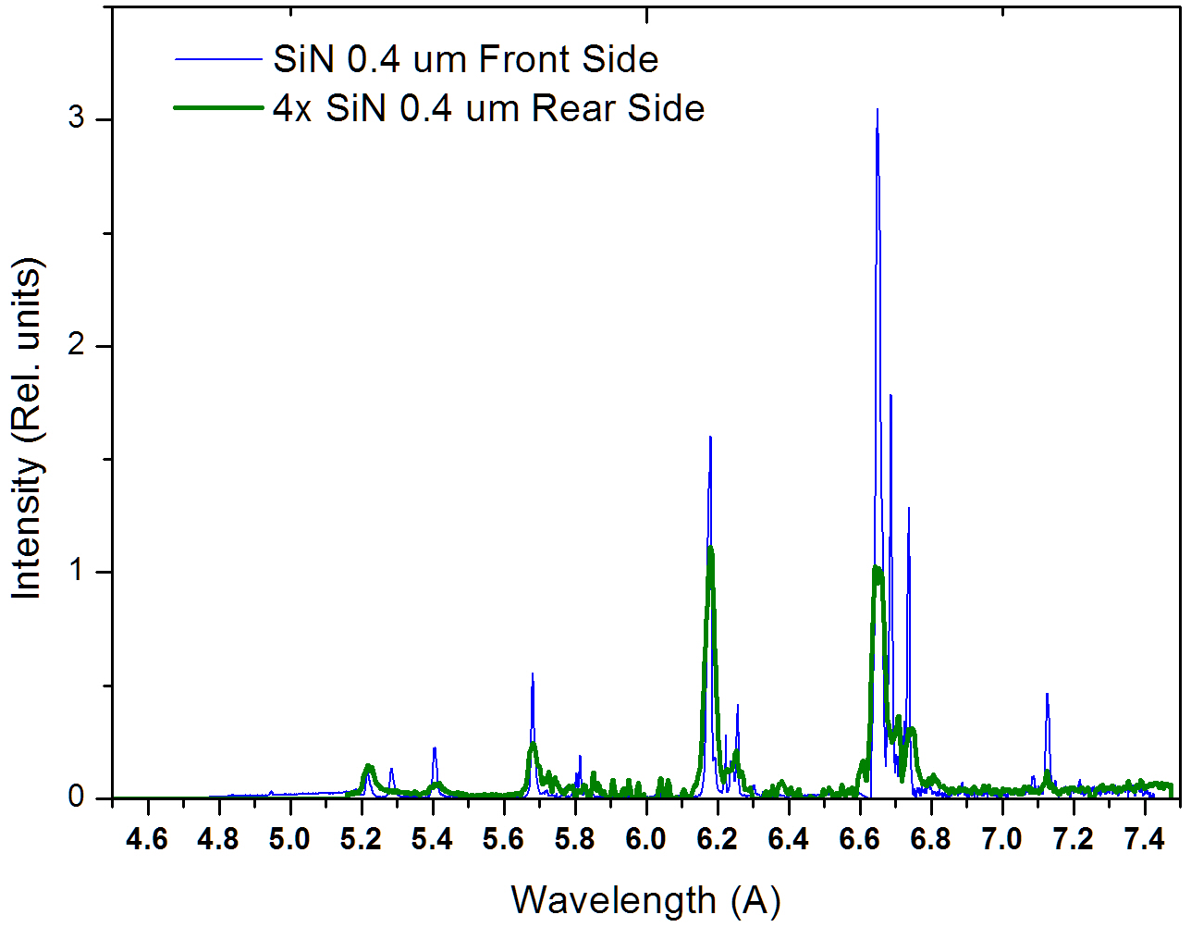
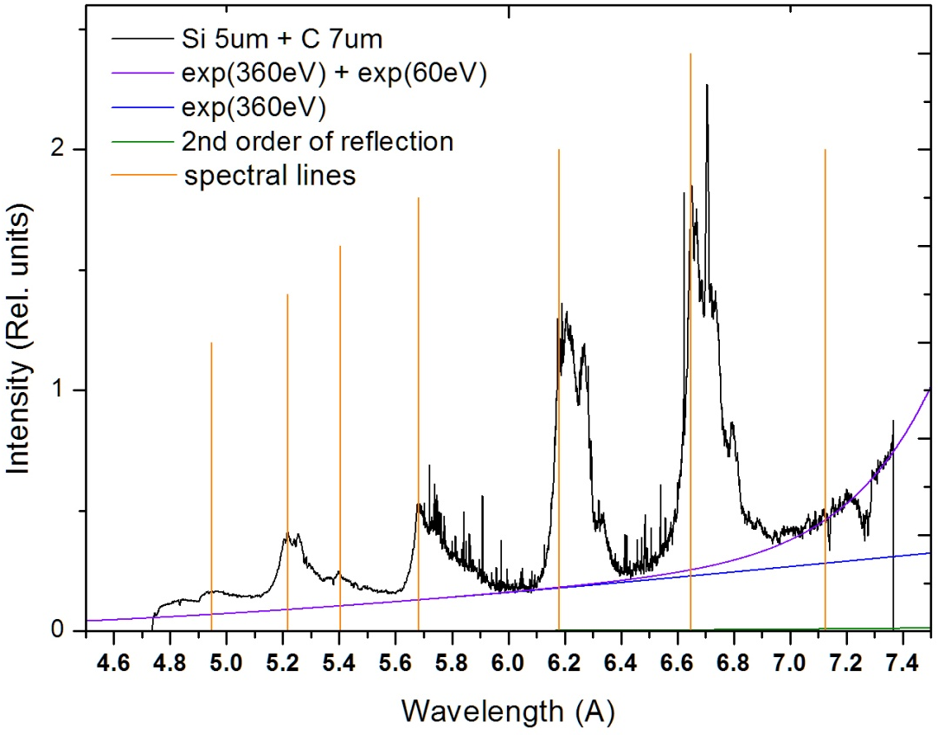
Absorption spectroscopy
Si Heα
SiLyα
SiKα
SiHeβ
SiLyβ
SiHeγ

Slide 19
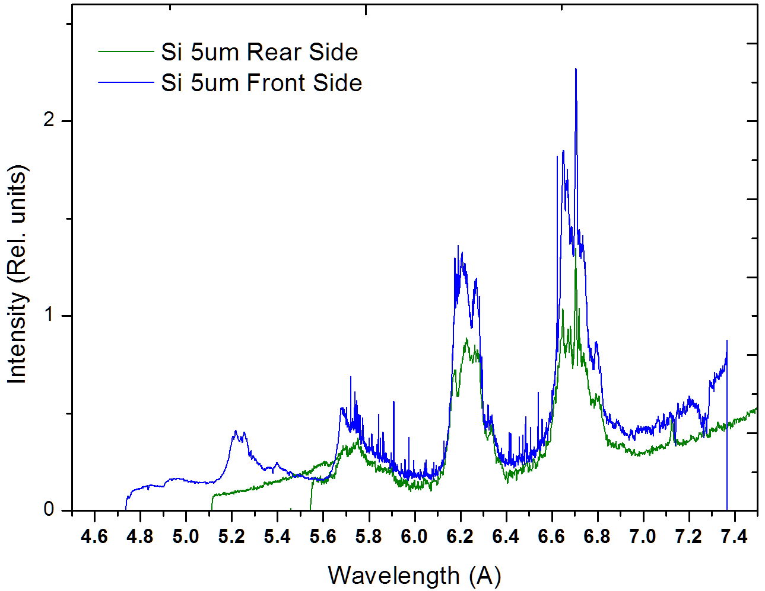
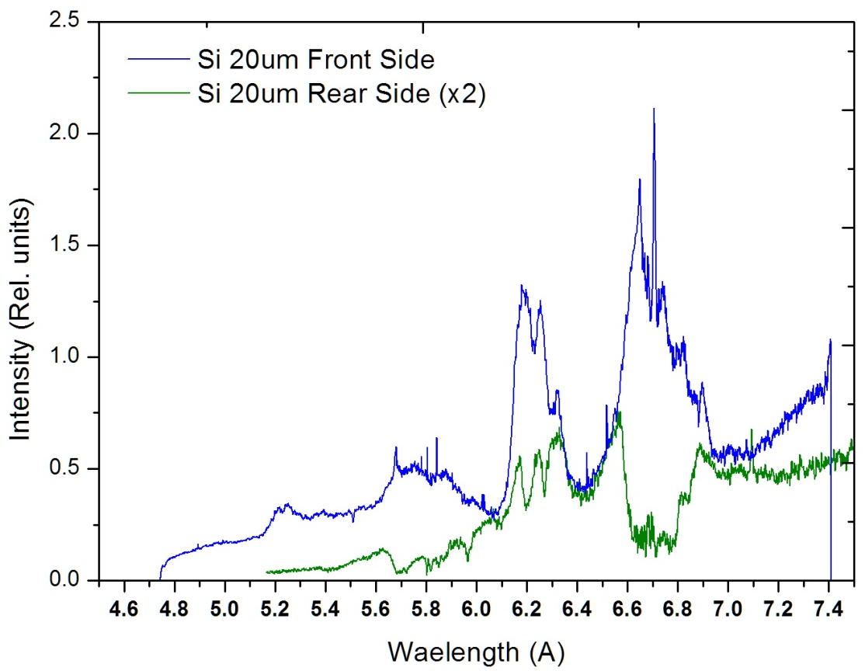
Absorption spectroscopy

Slide 20
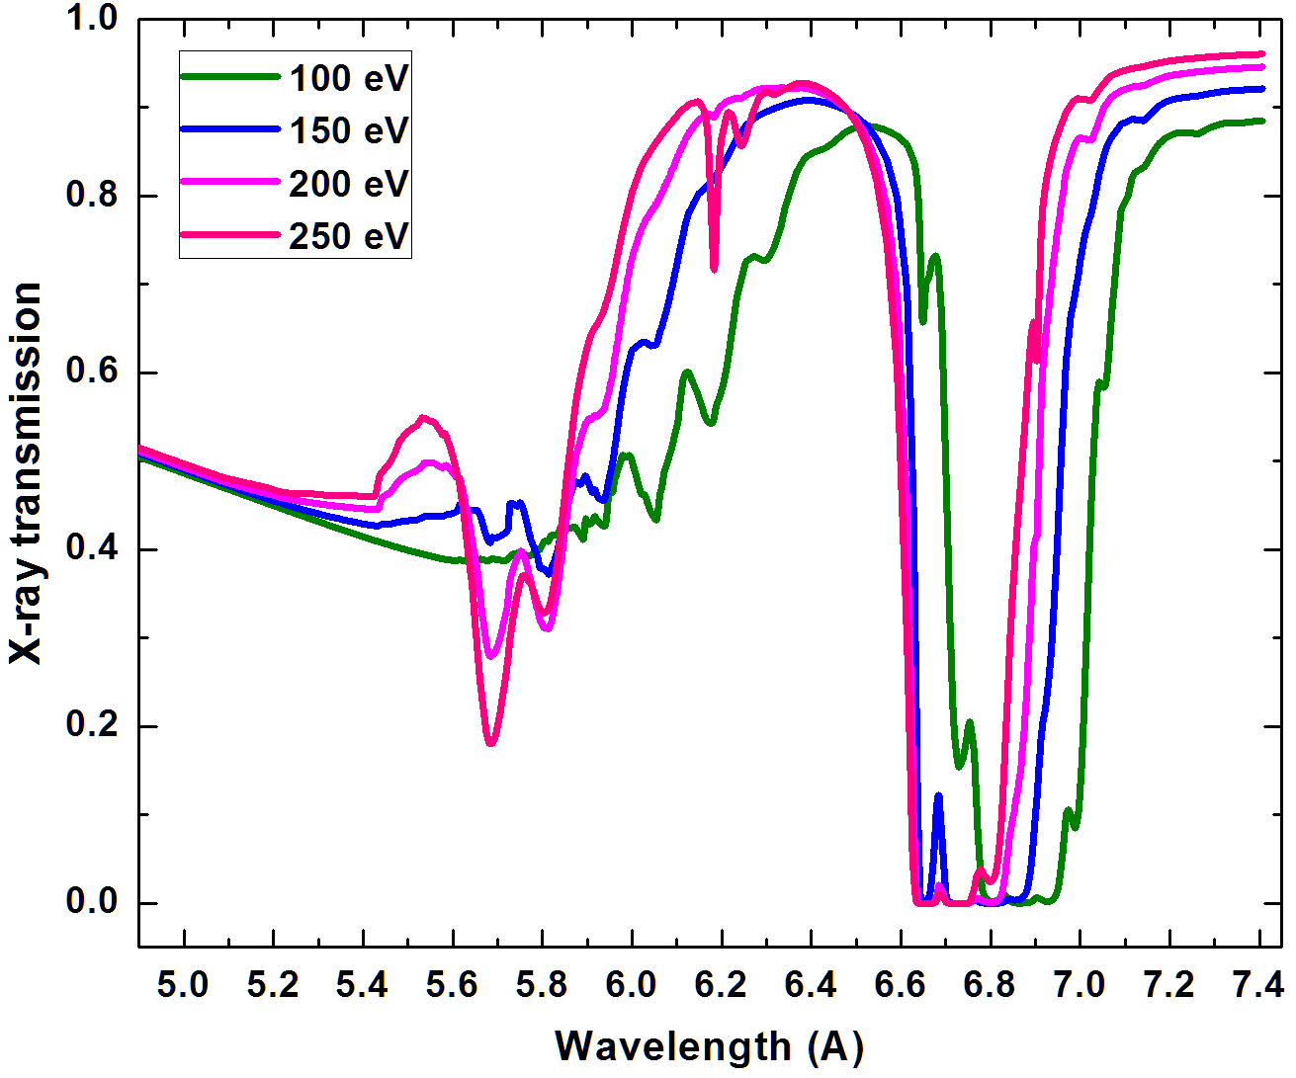

Absorption spectroscopy
Si Heα
Si Heβ
T_{e} up
T_{e} up

Slide 21
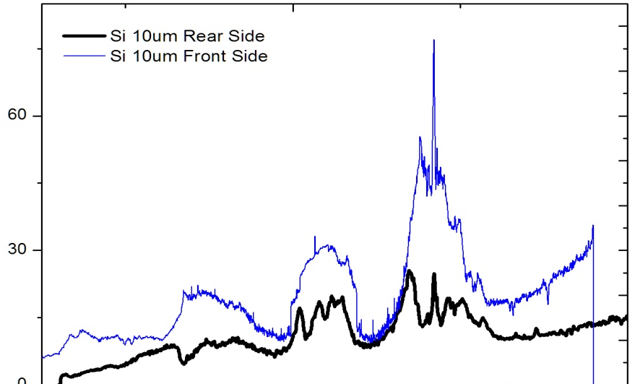
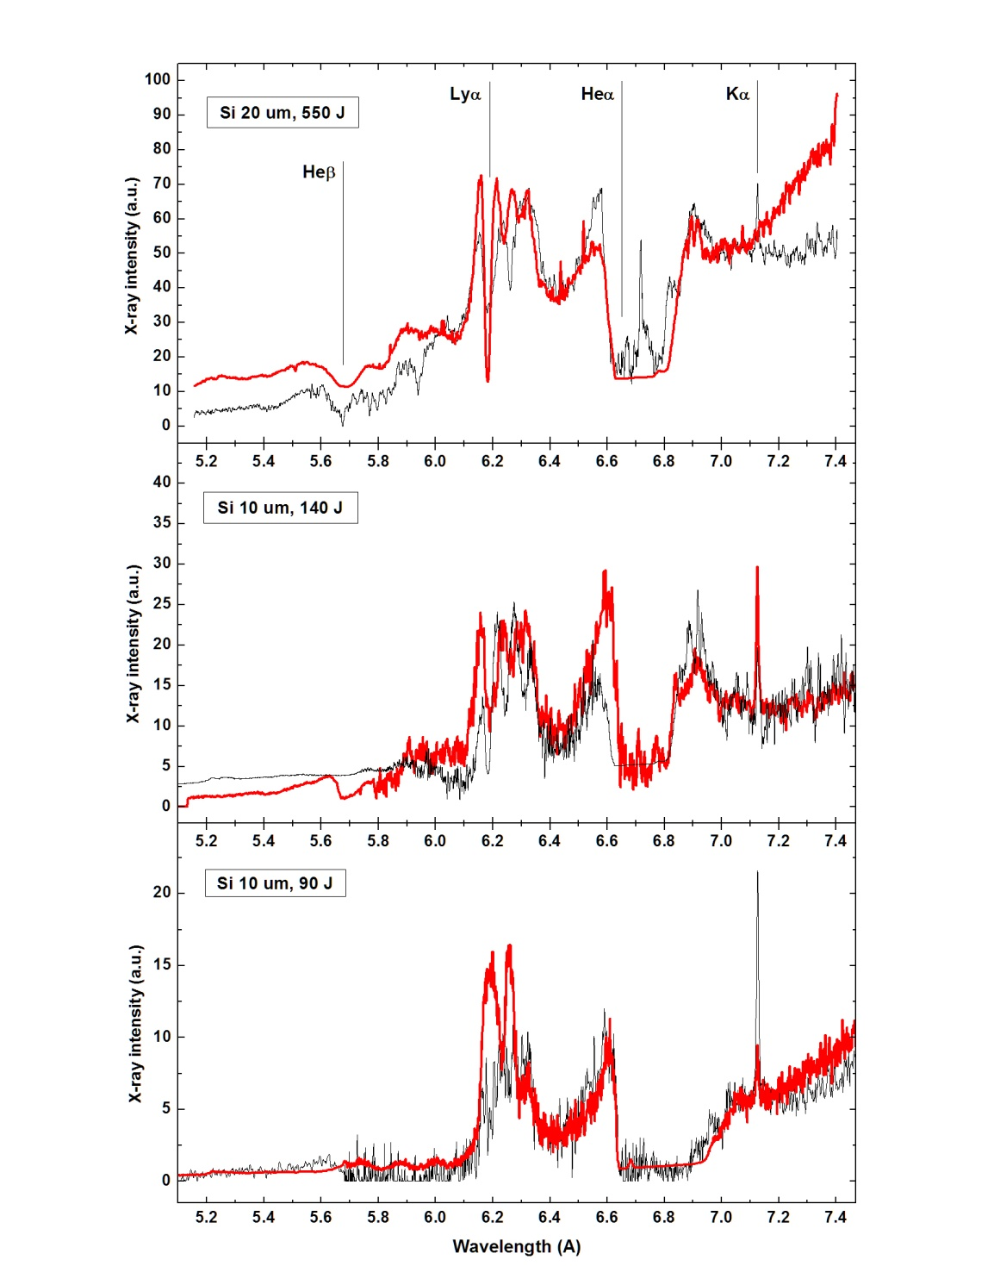
Absorption spectroscopy
The spectra from the rear
are simulated with use of PrismSPEC
absorption mode, when the initial
front side spectra is taken for the source
T_{e} = 320 eV (20 um, 550 J pulse)
d_{b} = 5 um
T_{e} = 300 eV (10 um, 140 J pulse)
d_{b} = 5 um
T_{e} = 140 eV (10 um, 90 J pulse)
Often, the spectra could not be described
in-full by a single Te – as H-like and He-like
lines are absorbed differently, i.e.
by different plasma zones.

Slide 22
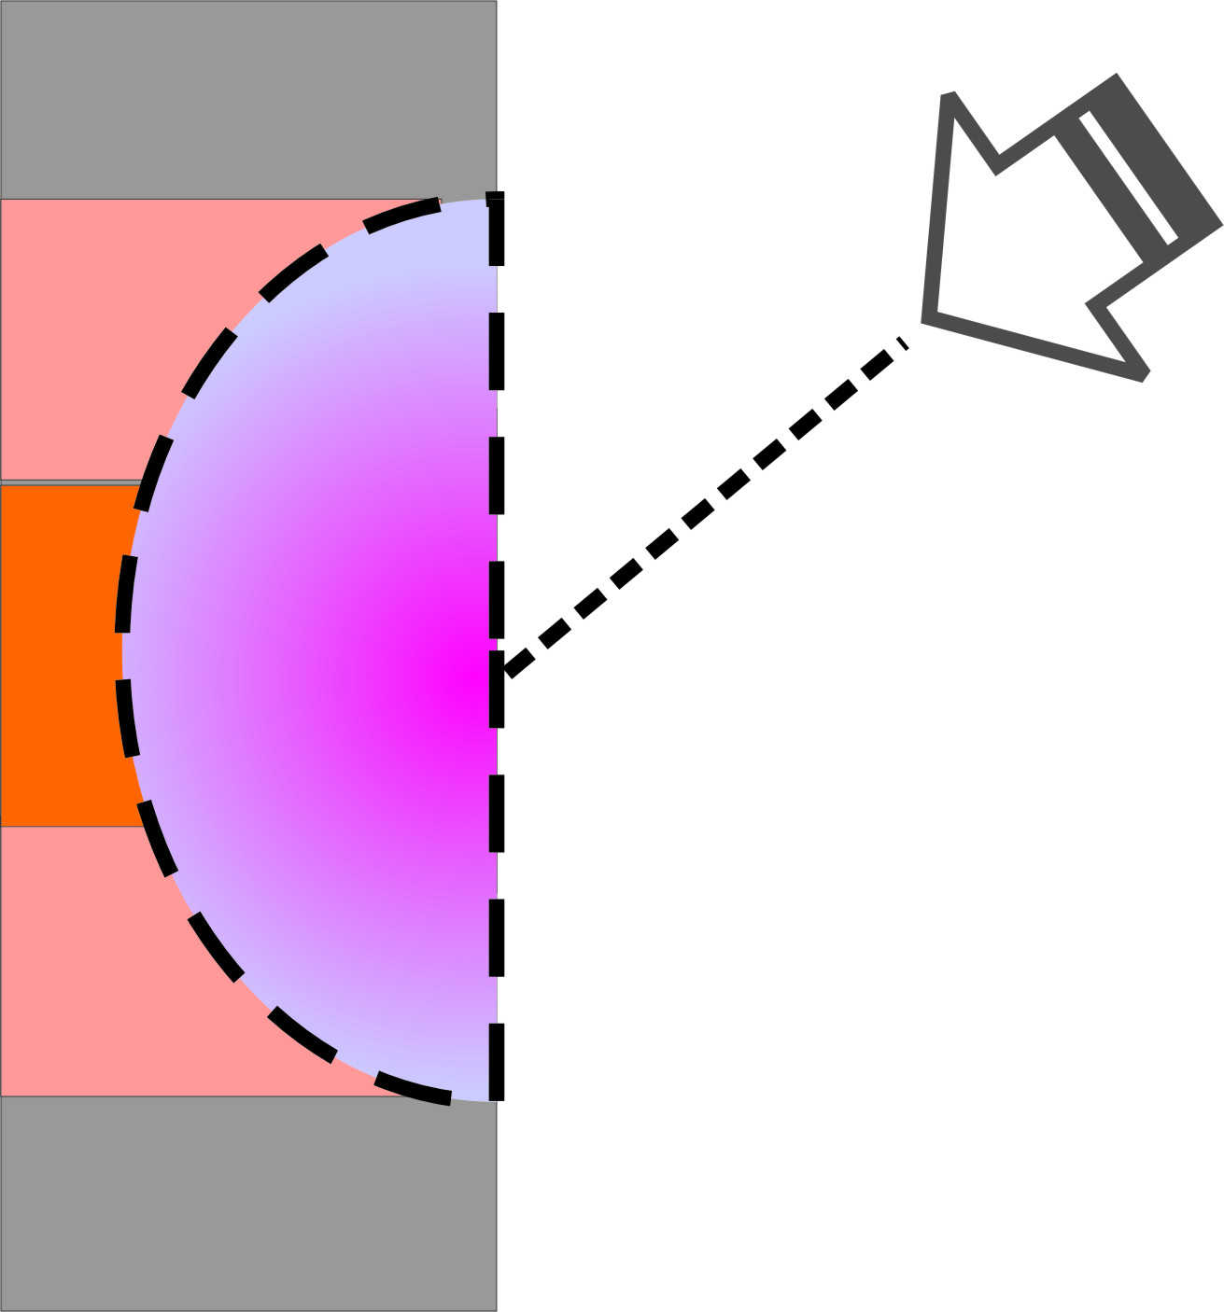
Model is developing…

Slide 23
WDM absorption spectroscopy - Summary
Method of absorption X-ray spectroscopy is developed to study the heating of a matter irradiated by the emission of relativistic laser plasma.
The core idea is in the comparison of front and rear side spectra measured with exactly the same technique and then in simulation of spectral features caused by absorption effect using PrismSpect code.
The electron temperature of warm dense matter created at rear side of flat 10-20 um Silicon foils by 0.5 – 1.5 ps ultra-high contrast laser pulses of 1 – 5 х 10²⁰ W/cm² intensities is estimated to be in the range of
140-320 eV depending on laser energy.
The advantage of the method include the possibility to study a WDM with a low self emmisivity, as for homogeneous as for layered targets.
Further development is seeing implementing multiple-zones concept, where the plasma zones with different parameters are considered to contribute to the absorption of a certain spectral components (related to a particular ion charge states)

Slide 24
Radiation dominated matter
Radiation Dominated Regime of matter -
when plasma radiation dominates particle dynamics
// C.P. Ridgers et al. PRL 108, 165006 (2012). L.L. Ji et al. PRL 112, 145003 (2014), ….many
+ up to 30% of optical laser radiation could be transformed to γ -ray flash)
To reach RDR – the laser field should reach 1e23-1e24 W/cm² intensity ☹
Radiation Dominated Kinetic Regime -
when plasma radiation processes dominate atomic kinetics
// J. Colgan et al., PRL 110, 125001 (2013)
To reach RDKR – the laser field of ~ 1e21 W/cm² should be enough ☺
Plasma produced by intense XFEL beam is a good example of RDKR.

Slide 25
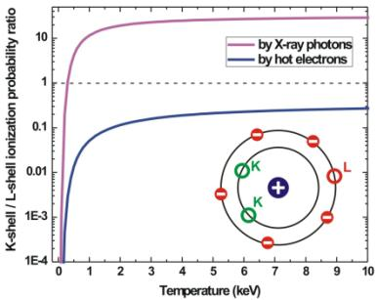
High-temperature plasma under external intense X-rays
X-Ray photons preferentially ionize inner shells rather than outer shells
Exotic hollow atom states – the states with a number of K and/or L shell vacancies, but still populated outer shells
KK Hollow ion spectra can be dominant in the plasma emission
if there is an ultra-bright X-ray source

Slide 26
WDM with exotic atomic states due to intense X-rays
1. Direct excitation by ultra-intense X-ray laser or XFEL pulses
Production of Hollow ions in warm dense matter by inner shell photoionization
XFEL X-ray radiation
2. Indirect excitation by visible ultra-intense laser pulses
Production of Hollow ions in warm dense matter by electron or ions collisions or inner shell photoionization
Ultra-intense optical laser
radiation
Relativistic plasma –generation of ultra-intense fast electrons and X-ray beams
Warm dense plasma

Slide 27
Hollow atom states and radiation transitions in
H-like
He-like
Li-like
Spectral map
3l
3lnl
2l
3lnl²
Resonance and Rydberg resonance transitions
2lnl
Ly_{α}
He_{α}
2l3l
Ly_{β}
He_{β}
Ly_{α}
Ly_{β}
2l²
Satellites
1s
.
1snl
.
.
1s3l
1snl²
Rydberg
satellites
1s2l
1s3lnl
1s2l3l
KK-Hollow ion transitions
He_{α}
He_{β}
1s2l²
KK-Rydberg
hollow ion transitions
1s²
.
.
1s²nl
.
1s²3l
5.2
5.6
6.0
6.4
6.8
resonance transitions
Rydberg resonance transitions
satellites
Rydberg satellites
1s²2l
hollow ion transitions
Rydberg hollow ion transitions
Notes:
Sent to Colgan 2015-11-27.
answer 2015-1-30: Hi Anatoly,
I haven’t yet had a chance to start the paper, but I hope to towards the end of this week. I plan to first make the figures
that we will show and once I have those I’ll send them to you for your comment. Your figure looks good !
James

Slide 28
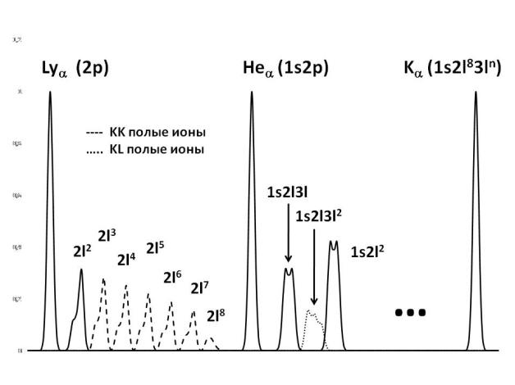
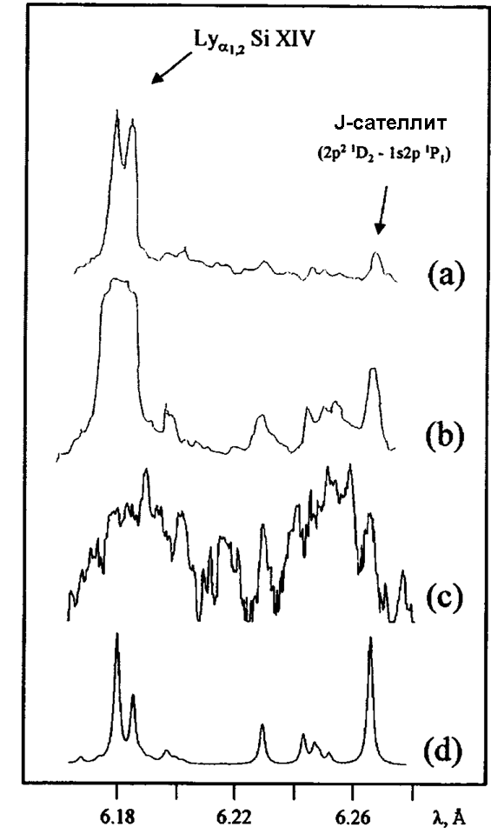
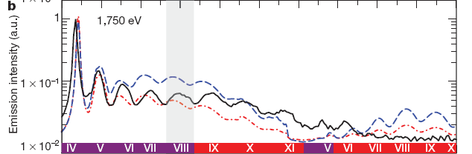
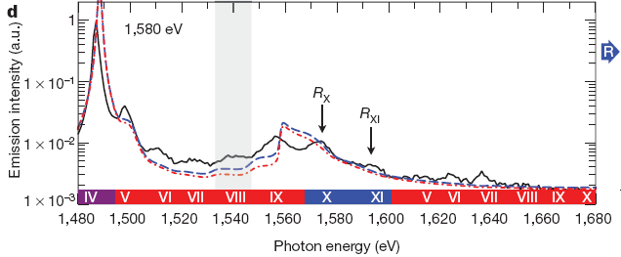
Hollow atom spectroscopy, principles
e
e
Exotic hollow atom states may be created
by hot electron flow or X-ray radiation
(external beam or plasma itself of)
e
e
+
e
+
e
First observation in laser plasma
– 1997, LANL, 1e19 W/cm2
e
e
e
e
Hollow atom spectral lines induced by intense
quasi-monocromatic X-ray radiation of LCLS
KK hollow
atom lines
KL hollow
atom lines
// S.M. Vinko et al., Nature 482, 59 (2012)
Becomes very significant for high intensity lasers

Slide 29
Hollow atom generation in PW plasma
Refluxing is very important to increase the electron flux inside the plasma.
Thin (~ μm) targets is more effective due to higher electron oscillation frequency.

Slide 30
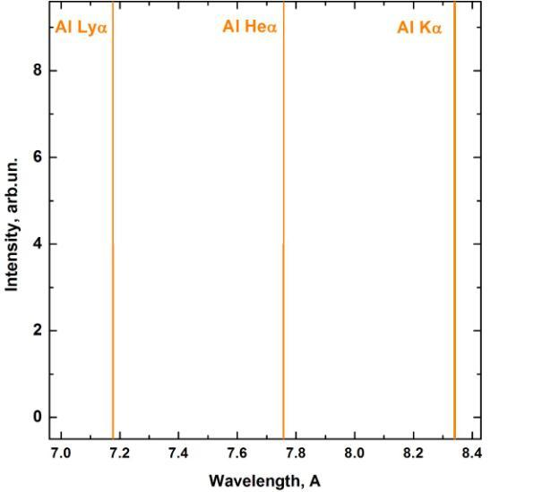

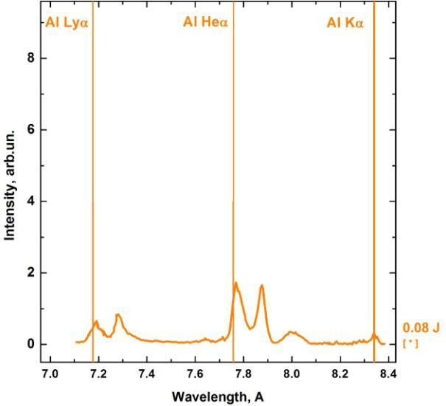
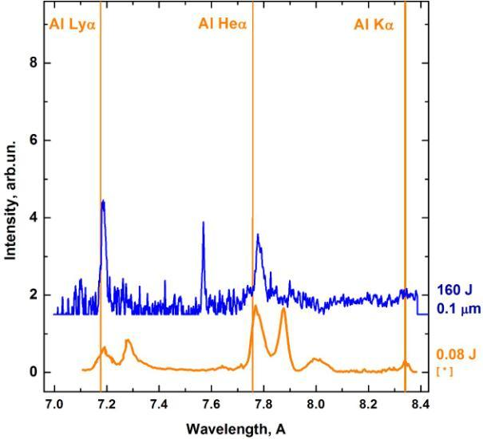
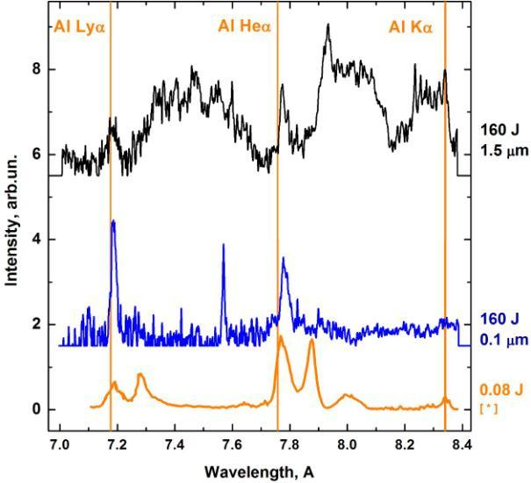
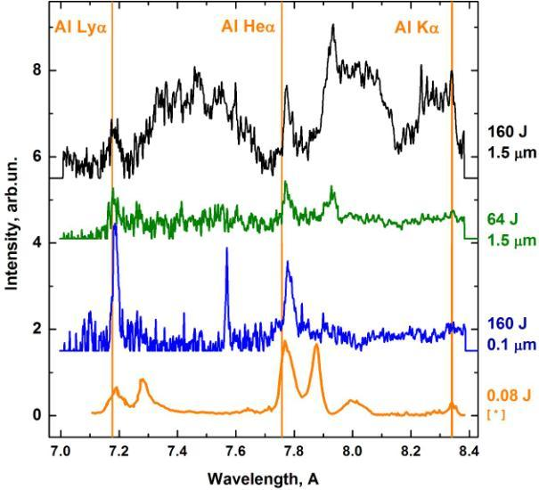
Hollow atom spectra observation
KK hollow
atom lines
KL hollow
atom lines
KK hollow
KL hollow
I _{max}= 3×10²⁰ W/cm²
Laser energy – 160 J on target
Pulse duration – 0.7 - 1.2 ps
1ω = 1054 nm
High contrast of OPCPA
Vulcan PW laser
[*] U. Andiel et al., Appl. Phys. Lett. 80, 198 (2002)

Slide 31
Modeling of Al spectra by ATOMIC code
Mixed Unresolved Transition Array (MUTA) method (Mazevet & Abdallah) :
The key principle :
- The most strong transitions calculated in details
( Detailed level accounting - DLA approach)
- The remain lines as a massive of unresolved
( Unresolved transition array - UTA approach )
Configurations of the type K⁻¹LM⁺¹, KL⁻¹M⁺¹, K⁻²LM⁺², K⁻¹L⁻¹M⁺², K⁻²L⁻¹M⁺³, K⁻¹L⁻²M⁺³,
the n = 1 sub- shell, L represents the n = 2 sub-shells, M represents the n = 3 sub-shells, and the notation K⁻² signifies a 1s⁰ sub-sheK⁻²L⁻²M⁺⁴, K⁻¹L⁻³M⁺⁴, K⁻²L⁻³M⁺⁵, and K⁻¹L⁻⁴M⁺⁵ were included. In this notation K represents ll. Rydberg configurations up to n=7 were also included. This procedure resulted in over 21 000 atomic configurations (for all ion stages of Al) that were included in atomic kinetics calculations.
Other features:
Calculations include all relevant atomic processes, that is, photoionization, collisional ionization, autoionization, collisional and radiative excitation and de-excitation, and all recombination processes.
- Energy of levels, oscillator strengths, cross-sections - calculated by CATS
program developed as an improvement of R. Cowan code
- Collision ionizations, photo ionization, auto ionization – calculated by GIPPER code
- Time dependent radiative collision kinetics – calculated by code ATOMIC
J. Colgan et al. Phys. Rev. Lett. 110, 125001 (2013)

Slide 32

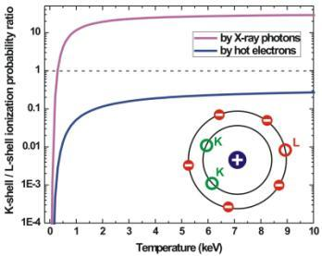
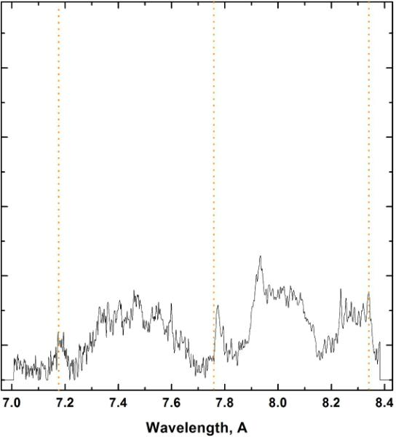
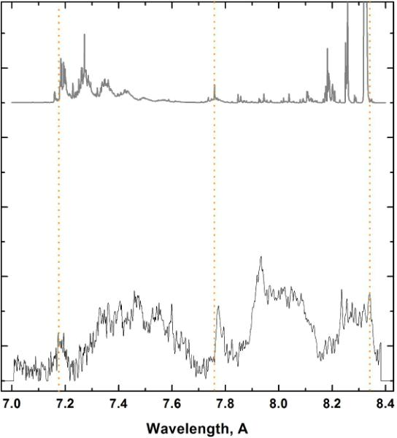
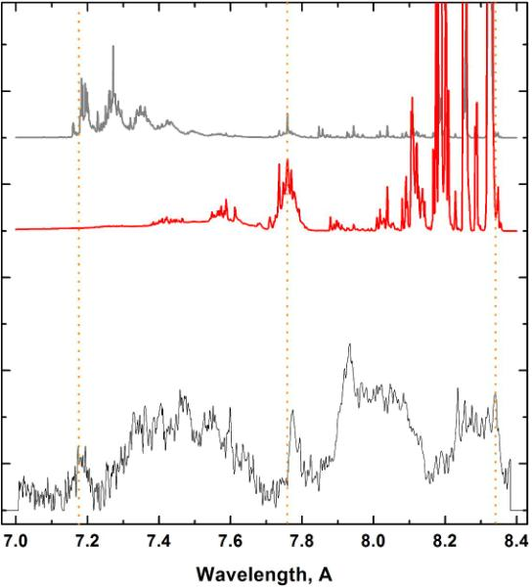




NLTE ATOMIC spectra simulations
// J. Colgan et al. High Energy Density Physics 7, 77 (2011)
No X-ray radiation, No hot electrons
5 keV electrons tail, No X-rays
Ultra intense keV X-rays
bulk T_{e} = 55 eV
N_{e} = 3x10²³ cm⁻³
5% of 5 keV electrons
Combined

Slide 33


Parameters of X-ray source via hollow atom spectra
Radiation temperature
Source brightness
Varying Trad in 0.5 – 5 keV range
Testing Dilution factor in 0.01 – 1 range
Confirms the source of I_{xray} > 1E18 W/cm² intensity and T_{rad} ~ 3 kev existing

Slide 34
Hollow atom states and radiation transitions in
H-like
He-like
Li-like
Spectral map
3l
3lnl
2l
3lnl²
Resonance and Rydberg resonance transitions
2lnl
Ly_{α}
He_{α}
2l3l
Ly_{β}
He_{β}
Ly_{α}
Ly_{β}
2l²
Satellites
1s
.
1snl
.
.
1s3l
1snl²
Rydberg
satellites
1s2l
1s3lnl
1s2l3l
KK-Hollow ion transitions
He_{α}
He_{β}
1s2l²
KK-Rydberg
hollow ion transitions
1s²
.
.
1s²nl
.
1s²3l
5.2
5.6
6.0
6.4
6.8
resonance transitions
Rydberg resonance transitions
satellites
Rydberg satellites
1s²2l
hollow ion transitions
Rydberg hollow ion transitions
Notes:
Sent to Colgan 2015-11-27.
answer 2015-1-30: Hi Anatoly,
I haven’t yet had a chance to start the paper, but I hope to towards the end of this week. I plan to first make the figures
that we will show and once I have those I’ll send them to you for your comment. Your figure looks good !
James

Slide 35


The scheme of the experiment on the observation Rydberg Hollow ions satellites in the laser-produced Si plasma
(a)
(b)
Vulcan Petawatt laser parameters: λ = 1054 nm, τ~1 ps, E = 114 J on the target, I = 3x10²⁰ W/cm², Laser contrast ~ 10⁹, laser spot size on the target ~ 7 μm
Target: 1.6 μm CH + 2 μm Si + 1.6 μm CH
J. Colgan et al., EPL (2016), accepted

Slide 36
Rydberg hollow ion spectra
He_{α}
Ly_{α}
Ly_{γ}
Ly_{β}
He_{γ}
Ly_{β}
He_{γ}
He_{α}
Ly_{γ}
Ly_{α}
Modeling parameters include: 6 μm optical thickness, 1% hot electrons and also
Zone I - N_{e}=10²² cm⁻³, bulk T_{e}= 550 eV for Front and 400 eV for Rear spectrometers
Zone II - N_{e}=3x10²³ cm⁻³,T_{e}= 180 eV and T_{e}= 90 eV, kT_{r} = 2 KeV
Zone III - N_{e}=3x10²³ cm⁻³,T_{e}= 10 eV, kT_{r} = 3 KeV + kT_{r} = 3 KeV enchanced by factor of 5
J. Colgan et al.,
EPL (2016), accepted

Slide 37
Modeling of Si hollow ion spectra vs radiation temperature and hot e
Observed spectra could not be explained only by influence of hot electrons.
The photo pumping by external X-ray source should be introduced in modeling
J. Colgan et al., EPL (2016)

Slide 38
Efficiency of hollow ions photoionization
A(1s2l^{n}) + ħω → A(2l^{n}) + e
Ion in the
autoionizing state
Hollow ion
N(2l^{n})/N(1s2l^{n}) ≈ (I_{X-ray}/ħω)σ^{ph}(1s2l^{n} → 2l^{n})/ Γ(2l^{n})
N(2l^{n}) – population of hollow ions
N(1s2l^{n}) – population of usual autoionizing states
I_{X-ray} and ħω – intensity and energy of X-ray photons
σ^{ph}(1s2l^{n} → 2l^{n}) – photoionization cross section
(2l^{n}) – autoionization probability
For ions with different Z: ω ~ Z², σ^{ph} ~ Z⁻², G ~ const, and
N(2l^{n})/N(1s2l^{n}) ~ Z⁻⁴

Slide 39
Efficiency of hollow ions photoionization by external X-rays
The fact of observation of Hollow ions of different ions allowed to estimate the value of X-ray source intensity
Al
Si
N(hollow ion state)/N(autoionizing state)
Ti
Fe
I_{X-Ray}, W/cm²

Slide 40

Attempt to acquire hollow atoms in high-Z targets
I_{las} = 9e21 W/cm² – Fe/Cr target
Zone | 1 | 2.1 | 2.2 | 3
Ni (cm⁻³) | 5×10²¹ | 8×10²² | 8×10²² | 8×10²²
N_{e} (cm⁻³) | 9×10²² | 1.9×10²⁴ | 1.5×10²⁴ | 2.3×10²³
T_{e} (eV) | 2800(±120) | 1600(±100) | 400(±50) | 50(±5)
T_{hot} (keV) | 0.1%, 10 keV | 0.1%, 10 keV | 0.1%, 10 keV | 0.1%, 10 keV
Electron energy density (J/cm³) | 2.5× 10⁷ | 4.8 ×10⁸ | 6×10⁷ | 1.8 ×10⁶

Slide 41


X-rays in PW laser plasma - Summary
Studies on radiative properties of laser plasma at
10²⁰-10²² W/cm² intensities at J-KAREN-P and Vulcan PW:
Non-linear increase in X-ray yield caused by effective radiation friction force is observed, leading to 10¹⁷-10¹⁸ W/cm² X-ray intensities achieved
Method of absorption X-ray spectroscopy is developed to study the radiation transport or/and the heating of a matter irradiated by the emission of relativistic laser plasma. Si WDM created at rear side of 10-20 um foils by laser pulses of 1 – 5 х 10²⁰ W/cm² intensities is estimated to be in the range of 140-320 eV
Radiation dominated kinetics and corresponding
prominent concentration of hollow atoms is achieved
for Al/Si targets, though not yet for high Z elements
The method of hollow atom spectroscopy proves its unique capabilities to characterize both X-ray emissivity of relativistic plasma and the states of matter with radiation dominated kinetics / particle dynamics

Slide 43



The need for “multiple-zones” concept

Slide 44




Al x-ray spectra modeling by ATOMIC /J-KAREN
Multiple-zone approach for spectra modeling:
zones 2 and 3 do include 1% hot electrons and an 1.5 keV X-ray pump source.
$T_{e}=320 эВ$, $N_{e}=2×{10}^{23}{см}^{−3}$
Zone 1
Zone 2
Zone 3
// A.Ya. Faenov et al., Scientific Reports. 5, (2015)
//Colgan, J. et al. Phys. Rev. Let. 110, 125001 (2013)
Notes:
Suggest to skip this slide.

Slide 45





Plasma with strong gradients – multiple zones approach
Zone 1 (Te ~ 2-3 keV)
High temperature plasma created by laser pulse on the focal spot area. Generation of MeV electrons oscillated though the target and bright x-ray photons
Zone 2 (Te ~ 0.5-1 keV)
Plasma with Ne close to solid and Te below than plasma in 1 Zone.
Zone 3 (Te ~ 10-30 eV)
Target regions heated mostly be hot electrons from zone 1. Plasma with lowest Te.
Temperature and electron density relations for plasma zones approach:
High temperature gradient:
Electron densities relations:

Slide 46
Summary of the laser parameters for different experimental campaign
Parameters | J-KAREN(until 2013) | J-KAREN-P Dec. 2015 –March 2016 | J-KAREN-P Dec. 2016 – March 2017
Peak power (TW) | ~ 200 | ~ 350 | ~ 250
Energy on target (J) | ~ 7 | ~ 14 | ~ 10
Pulse duration (fs) | ~ 30 | ~ 36 | ~ 40
Contrast ratio | > 10¹⁰ | 10¹⁰ | ~ 3x10¹²
Peak irradiance (W/cm²) | ~ 10²¹ | ~ 3 x 10²¹ | ~ 9 x 10²¹
Ref. M. Nishiuchi et al., Prague SPIE Proceedings (2017)
M. Nisiuchi et al., PoP 22, 033107 (2015))
Fe K_{α}
Cr K_{α}
Fe He_{α}
Fe K_{α}
Fe K_{α}
Fe He_{α}
Fe Ly_{α}
Fe Ly_{α}
Fe He_{α}
Fe Ly_{α}
The best laser contrast
Notes:
Fe 2013 Jan 17-18 exp.opj
KPSI experiments Fe and Al best shots.opj (in folder Alkhimova)
SIF traces 2017-03-16.opj Book 9 40 fs Front energy scan

Slide 47




High-resolution SUS x-ray spectra modeling for relativistic laser intensity case ( $I_{lt}$~ 3×10²¹ W/cm² )
Choose Plasma density for Zone 1:
Using relative intensities of lines Fe Heα1/Heα2
Target in focus:
Relativistic laser intensity on target : $I_{lt}$~ 3.2×10²¹ W/cm²
cm
cm
Best matching for
cm
cm
N_{e1} ~ 5x10²² cm ⁻ ³ , d₁ =2 μm
cm
cm
cm
cm
cm
cm
Wavelength (Å)
Wavelength (Å)
Optically Thin case
Optically Thick case
Measured spectrum compared with modelling only in the thick plasma case and
when N_{e1}~ 10²² -10²³ cm ⁻ ³ > N_{cr}

Slide 48
Plasma with strong gradients – multiple zones approach
Zone 1 (Te ~ 2-3 keV)
High temperature plasma created by laser pulse on the focal spot area. Generation of MeV electrons oscillated though the target and bright x-ray photons
Zone 2 (Te ~ 0.5-1 keV)
Plasma with Ne close to solid and Te below than plasma in 1 Zone.
Zone 3 (Te ~ 10-30 eV)
Target regions heated mostly be hot electrons from zone 1. Plasma with lowest Te.
Temperature and electron density relations for plasma zones conception:
High temperature gradient:
Electron densities relations:

Slide 49



Determination on plasma parameters for Zones 1, 2 and 3
Wavelength 7th ref. order (Å)
Emission of Li, Be, B-like satellites to
Fe Heα 2
Zones 2.1 и 2.2.
To choose electron density
Zones 2.1 и 2.2.
Electron temperature
Zone 1.
Electron temperature
Zone 3
Emission lines: Fe Kα, Cr Kα
eV
N_{e1} ≤ N_{e2.1} ~ N_{e2.2} ≤ N_{solid} N_{e2} = 5×10²³ cm⁻³
T_{e1} = 2200 eV
T_{e3} = 20 eV и N_{e3}= 2.3×10²³ cm⁻³
T_{e2.1} = 1100 eV, T_{e2.2} =300 eV
eV
X-ray Intensity (a.u.)
eV
Wavelength (Å)
Emissive Fe spectrum calculated for : T_{e} = 900 eV, d = 2 μm and various electron densities Ne2 including hot electrons with T_{hot} = 10 keV.
Wavelength 8th ref. order (Å)
Emissive Fe spectrum calculated for : N_{e} = 5·10²³ cm⁻³, d = 2 μm and various electron temperatures
Measured spectrum compared with modeling results, obtained for various temperatures of Zone 1.

Slide 50

Integrated spectra and revealed plasma parameters
I_{las} = 3e21 W/cm²
Zone | 1 | 2.1 | 2.2 | 3
N_{i} (cm⁻³) | 2×10²¹ | 8×10²² | 8×10²² | 8×10²²
N_{e} (cm⁻³) | 5×10²² | 5×10²³ | 5×10²³ | 2.3×10²³
T_{e} (eV) | 2200 (±120) | 1100(±100) | 300(±50) | 20 (±5)
T_{hot} (keV) | 0.1%, 10 keV | 0.1%, 10 keV | 0.11%, 10 keV | 0.1%, 10 keV
Electron energy density (J/cm³) | 1.04 ×10⁷ | 1.6 ×10⁸ | 5×10⁷ | 9.3×10⁵

Slide 51




Plasma parameters in the laser focal spot
Wavelength 7th ref. order (Å)
X-ray Intensity (a.u.)
Zone | 1 | 2.1 | 2.2 | 3
Ni (cm⁻³) | 5×10²¹ | 8×10²² | 8×10²² | 8×10²²
N_{e} (cm⁻³) | 9×10²² | 5×10²³ | 5×10²³ | 2.5×10²³
T_{e} (eV) | 2800(±120) | 1600(±100) | 400(±50) | 50(±5)
T_{hot} (keV) | 0.1%, 10 keV | 0.1%, 10 keV | 0.1%, 10 keV | 0.1%, 10 keV
Electron energy density (J/cm³) | 2.5× 10⁷ | 4.8 ×10⁸ | 6×10⁷ | 1.8 ×10⁶
Wavelength 8th ref. order (Å)
A key conclusion is that the zone with highest electron temperature and ionization does not correspond to the classical critical electron plasma density (N_{e,cr.}~ 10²¹ cm⁻³) but a much higher electron density, namely relativistic critical density

Slide 52
X-ray spectra of SUS target: dependence on target displacement
In focus
Laser
f/1.4
Pulse duration: 40 fs
Front X-ray
Focus
Laser energy (on target): 9 J
45°
Laser intensity:
in focus 6.1x10²¹ W/cm²
Δ f = 20 µm 0.9x10²¹ W/cm²
Front
SUS 5 µm
Fe He_{α}
- 160 µm
+ 140 µm
Rear X-ray
- 20 µm
+ 20 µm
Fe K_{α}
Defocus 140 µm
Front side spectra:
Fe Ly_{α}
Fe K_{α}
K_{α}
Fe
He_{α}
Front
K_{α}
Fe
Fe
Fe
K_{α}
Fe
K_{α}
K_{α}
He_{α}
He_{α}
(Quartz, 2nd order)
Ly_{α}
Rear
Fe K_{α}
Cr
K_{α}
(Quartz, 2nd order)
Rear side spectra:
Rear
Fe K_{α}
Fe
Fe
Fe
Fe
Fe
K_{α} (8)
K_{α} (8)
K_{α} (8)
K_{α} (8)
Cr
K_{α} (8)
Fe
K_{α} (8)
K_{α} (7)
Cr
K_{α}
Cr
Cr
Fe K_{α} (7th order)
Fe
K_{α} (8)
K_{α} (8)
K_{α} (7)
(Mica, 8th order)
(Mica, 8th order)
Notes:
SIF traces 2017-03-16.opj

Slide 53
X-ray spectra of SUS target: dependence on target displacement
In focus
Laser
f/1.4
Pulse duration: 40 fs
Front X-ray
Focus
Laser energy (on target): 9 J
45°
Laser intensity:
in focus 6.1x10²¹ W/cm²
Δ f = 20 µm 0.9x10²¹ W/cm²
Front
SUS 5 µm
Fe He_{α}
- 160 µm
+ 140 µm
Rear X-ray
- 20 µm
+ 20 µm
Fe K_{α}
Defocus 140 µm
Front side spectra:
Fe Ly_{α}
Fe K_{α}
K_{α}
Fe
He_{α}
Front
K_{α}
Fe
Fe
Fe
K_{α}
Fe
K_{α}
K_{α}
He_{α}
He_{α}
(Quartz, 2nd order)
Ly_{α}
Rear
Fe K_{α}
Cr
K_{α}
(Quartz, 2nd order)
Rear side spectra:
Rear
Fe K_{α}
Fe
Fe
Fe
Fe
Fe
K_{α} (8)
K_{α} (8)
K_{α} (8)
K_{α} (8)
Cr
K_{α} (8)
Fe
K_{α} (8)
K_{α} (7)
Cr
K_{α}
Cr
Cr
Fe K_{α} (7th order)
Fe
K_{α} (8)
K_{α} (8)
K_{α} (7)
(Mica, 8th order)
(Mica, 8th order)
Notes:
SIF traces 2017-03-16.opj

Slide 54



X-ray source intensity depends on laser intensity on target changed by target displacement along laser axis due to focal spot non-uniformity
Laser intensity (W/cm2)
X-ray intensity (a.u.)
Displacement (μm)
Laser intensity on the target vs magnitude of target mirror displacement
X-ray spectra (raw data) measured for all mica reflection orders

Slide 55
Dependence of x-ray yield on target displacement (spectral range 6.05 – 7 keV)
Front side
Rear side
Laser intensity focus scan:
x (microns)
Courtesy A. Pirozhkov
Notes:
SIF traces 2017-03-16.opj Folder: Dependences of integral intensity

Slide 56
Dependence of x-ray spectra on energy of laser pulse
(target SUS, thickness 5 µm; target in the focal plane)
J-KAREN-P (Dec. 2015 –March 2016)
J-KAREN (until 2013)
M. Nisiuchi et al., PoP 22, 033107 (2015))
Worse laser contrast
Better laser contrast

Slide 57
Dependence of x-ray spectra on energy of laser pulse (J-KAREN-P March 2017)
(target SUS, thickness 5 µm; target in the focal plane)
From the front side of the target
From the rear side of the target
Fe He_{α}
Fe
9.2 J
K_{α} (8)
( 6.2·10²¹ W/cm² )
1200 eV
1100 eV
Fe K_{α}
Cr K_{α}
6.5 J
Fe He_{α}
( 4.4·10²¹ W/cm² )
Cr He_{β}
1000 eV
900 eV
Fe
3.4 J
K_{α} (7)
( 2.3·10²¹ W/cm² )
700 eV
600 eV
Fe Ly_{α}
1.7 J
( 1.1·10²¹ W/cm² )
400 eV
300 eV
0.75 J
( 0.5·10²¹ W/cm² )
----
----
The best laser contrast
Notes:
SIF traces 2017-03-16.opj for Front
ImPro_2017-03-016_duration_SUS_Q11-20-2ver.opj Book 19

Slide 58



Nonlinear growth of X-ray intensity with laser intensity on target
Total x-ray emission intensities as a function of diﬀerent laser intensities on target. Intensity of X-ray emission integrated over the wavelength range 1.7–2.1 Å.
X-ray spectra measured at best focusing conditions, and bulk electron temperature estimation with the assumption of bremsstrahlung radiation contribution in measured x-ray spectra.
Temperature estimation is made with the assumption of bremsstrahlung radiation to be registered from 5th and 7th mica reﬂection orders

Slide 59

Bulk electron temperature on dependence of target displacement
(SUS target; thickness 5 µm )
$d\left[ln\left(I_{brms}\left(E_{ph}\right)\right)\right]dE_{ph}=−1/kT_{e}$
From the front side of the target
On-target laser energy: 9 J
From the rear side of the target
kTe_{fr} :
kTe_{r} :
Fe He_{α}
1.2 keV
1.1 keV
Fe
6.1·10²¹
K_{α} (8)
Fe K_{α}
Cr K_{α}
1.1 keV
0.9 keV
0.92·10²¹
Fe He_{α}
Cr He_{β}
1.0 keV
0.8 keV
Fe Ly_{α}
0.90·10²¹
Fe
K_{α} (7)
W/cm²
Defocus:
- 20 µm
0
+ 20 µm
Higher laser intensity – higher bulk T_{e} – higher X-ray emission intensity

Slide 60
Dependence of x-ray spectra on duration of laser pulse (preliminary)
(target in the focal plane)
On-target laser intensity:
6.1
1.2
0.6
0.006
x 10²¹ W/cm²
Front side spectra:
Rear side spectra:
Front
Fe
Fe He_{α}
Negative
chirp
K_{α} (8)
Cr K_{α}
Fe K_{α}
Fe He_{α}
40 fs
Fe
K_{α} (7)
Fe Ly_{α}
40 fs
Rear
200 fs
200 fs
Negative
chirp
1 ps (NC)
1 ps (NC)
400 fs
400 fs
1 ps
1 ps
Target: Stainless-steel SUS, thickness 5 µm
Notes:
SIF traces 2017-03-16.opj for Front
ImPro_2017-03-016_duration_SUS_Q11-20-2ver.opj Book 19

Slide 61
Hollow ions line position shifts to shorter wavelength
as atom ionizes
КК – Hollow ion
(2 vacancies in K – shell)
КL – Hollow ion
(1 vacancy in К - shell
and 1 vacancy in L – shell)
Hollow ions spectra are very sensitive to temperature and density

Slide 62


Theoretical modeling matched to experimental data from laser experiments performed at JKAREN facility
(Laser preplasma)
(Main laser pulse)
(Periphery of laser spot)
a) 3500 eV and 8x10²² cm⁻³ modeling matches Heα and Lyα transitions. b) 700 eV and 1.8x10²⁴ cm⁻³ modeling matches B-like and C-like structures between 1.88 and 1.9 Å. c) Modeling for cold K_{α} and K_{β} transitions suggest 10 eV electron temperatures with a 8x10²² cm⁻³ electron density. All models include 0.1% hot electrons described with a Gaussian distribution at 10 keV with a 50 eV half width at half max (HWHM).
Combination of theoretical models shown above demonstrate a very good matched to the experimental spectrum

Slide 63
High-temperature plasma created by fast charged particles
Hot electrons preferentially ionize outer shells rather than inner shells
During ion collisions with hot electrons, hollow ions are formed, but their abundance is lower than abundance of the usual ions. Thus,
KK hollow ion spectra are very weak, but
KL hollow ion spectra can play important role
in the X-Ray plasma emission

