Slide 1
PIX-based detectors
F.Murtas
INFN - Laboratori Nazionali di Frascati and CERN
Timepix as user friendly silicon detector
Installation of Timepixes and Timepix3 in Ua9-SPS at CERN
Instrumentation for extracted beams
Diamondpix : higly pixelated diamond detector
GEMpix : a gas chamber for hadron therapy quality controls
Future programs

Slide 2
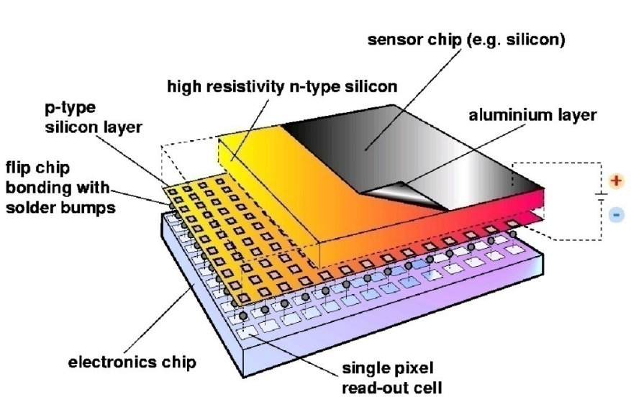
Hybrid Silicon Pixel Detectors
Standard CMOS can be used allowing on-pixel signal processing
Sensor material can be changed according to the application(Si, GaAs, CdTe..)
Notes:
Mention signal generation Add X section?

Slide 3
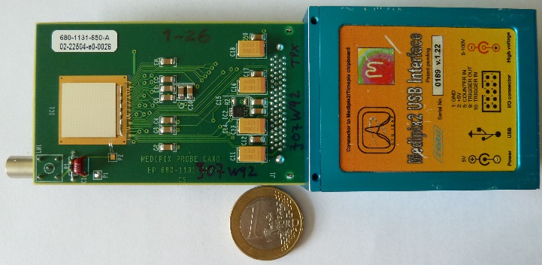
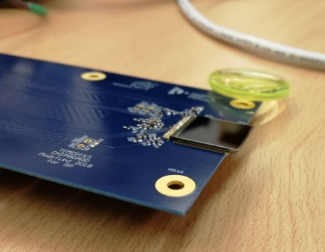
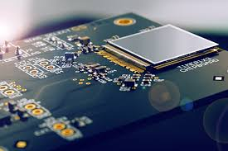
Timepix family
Timepix :
Time frame oriented
Counting mode or
Time of arrival or
Charge
Dead Time
> 5 keV
10 ns resolution
kB/s
Timepix3
Pixel oriented
Counting mode and
Time of arrival and
Charge
Continous measurement
> 3 keV
1.5 ns resoution
MB/s
High Temperature
Timepix2
Pixel oriented
Time frame oriented
?
?

Slide 4
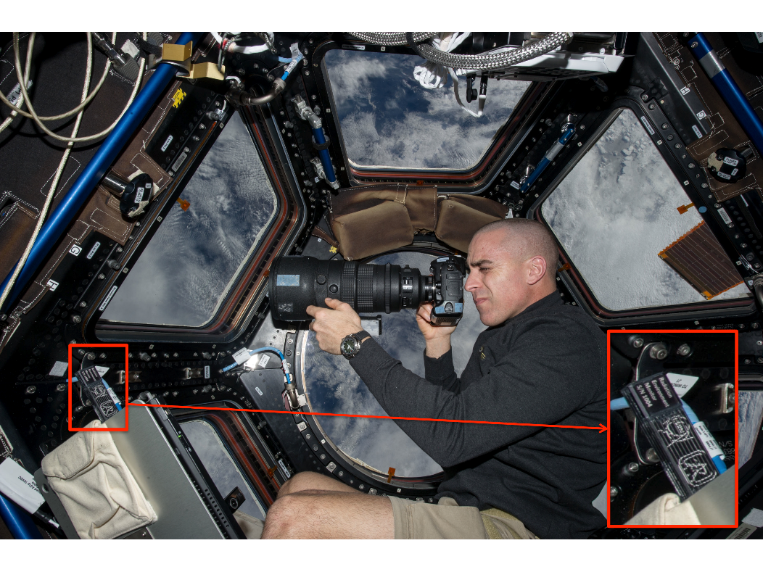
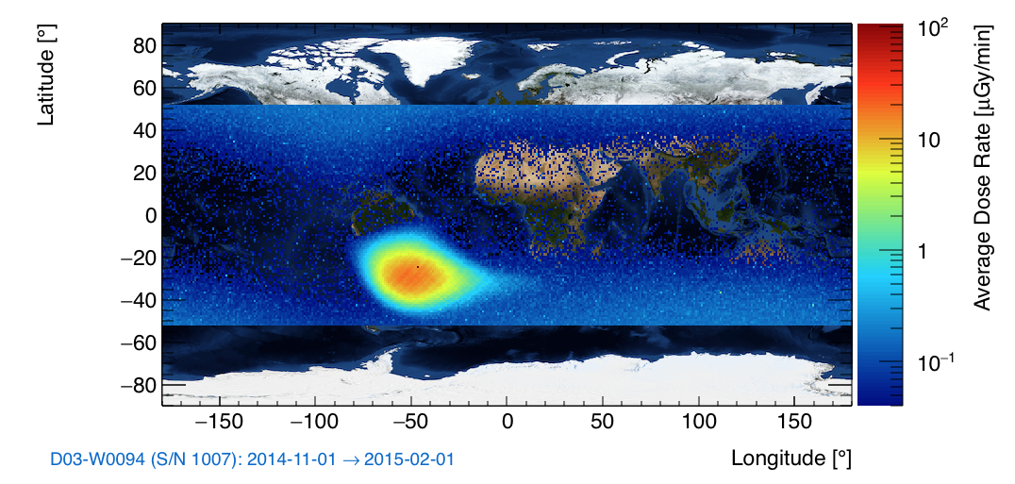
Timepix on ISS
0.3 mGy/d
Image of the astronaut Chris Cassidy working near the Timepix USB on the International Space Station (Courtesy of NASA, photo ref. no. iss036e006175)
5.5 mGy/d
University of Houston, IEAP Prague, NASA

Slide 5
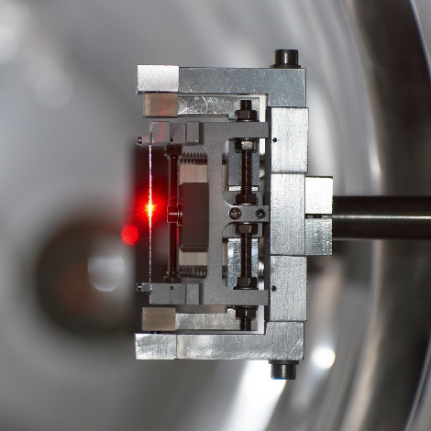
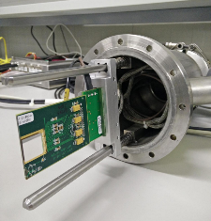
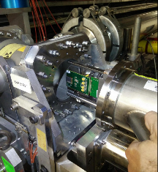
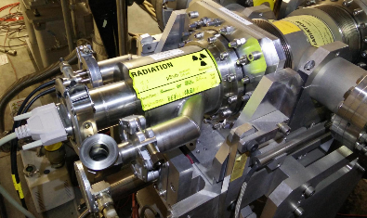
The UA9 SPS experimental setup 2017
~ 50 m
~ 43 m
~ 85 m
2 Timepixes
Crystal
1 2
Crystal
3 4
Collimator
Graphite 1m
RP1
RP3
Beam Pipe
QF 52210
QF 52010
QD 52310
Primary Beam
QD 52110
Absorber
W 60cm
Absorber
W 100cm
IHEP
GONIO1
IHEP
GONIO2
Collimator
Graphite 1m
RP1
CpFM
RP3
BLM
BLM
BLM
BLM
BLM
BLM
BLM
M
L
B
1 new Timepix
3 Timepix installed inside the beam pipe in secondary vacuum Roman Pot

Slide 6
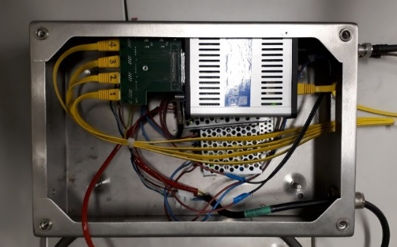
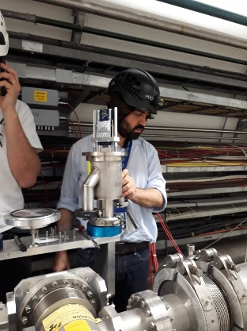
The UA9 SPS experimental setup 2018
~ 44 m
~ 6 m
~ 43 m
~ 85 m
Crystal
1 2
2 Timepixes
Crystal
3 4
Collimator
Graphite 1m
1 Timepix3
2 Timepixes
RP0
RP1
RP3
Beam Pipe
QF 52210
QF 52010
QD 52310
Primary Beam
QD 52110
Absorber
Absorber
W 60cm
Absorber
W 100cm
IHEP
GONIO1
RP0
IHEP
GONIO2
RP1
CpFM
RP3
BLM
BLM
Collimator
Graphite 1m
BLM
BLM
BLM
BLM
BLM
M
L
B
1 Timepixes
We doubled the number of Timepix detectors
A third Roman Pot was installed on
January 2018 with 2 Timepixes
A new Timepix3 has been installed in June
on Roman Pot 1 external side
Katrine readout of Timepix3
(P. Burian)

Slide 7
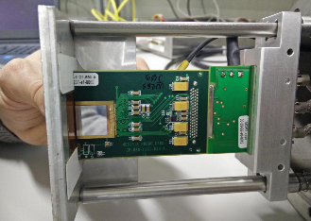
The UA9 detectors : Timepix
Based on silicon sensor 300 μm thick
About 20 readouts per seconds
  200 μs with 20 ns resolution or
  2 ms with 200 ns resolution
Cluster reconstruction offline (was online in 2016)
Synchronized readout with SPS Radiofrequency
We have five assemblies installed with 14x14 mm² active area (2 cm²)
2 Timpixes on Roman pot #0 (after the first Gonio crystals 1 and 2 image of the channeled beam)
1 Timepix on Roman pot #1 (after the second Gonio crystals 3 and 4 image of the double channeled beam)
2 Timpixes on Roman pot #3 (dispersive area for extracted beam image)
The detector is read in ToA (Time of Arrival) to measure the particle flux versus time
with a memory of 10 or 100 beam turns and Medipix mode for a high statistic images.
Rate of 10-20 fames per second with dead time (can be improved )

Slide 8

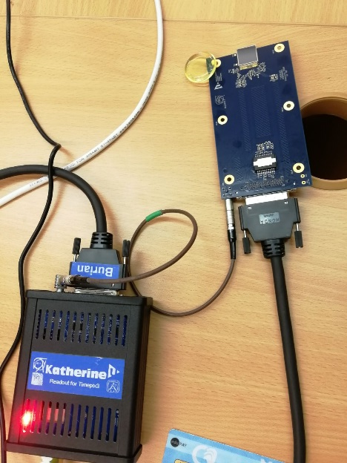
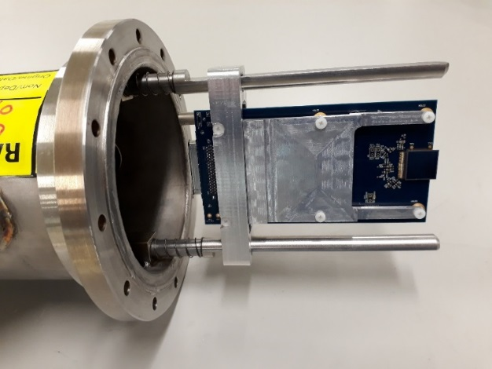
The UA9 detectors : Timepix3
Based on silicon sensor 300 μm thick 14x14 mm² active area (2 cm²)
Chips provided by Medipix Collaboration
Timepix3 board designed and built by University of West Boemia and IEAP in Prague
Also the holder was realized by the same group
designed also for the chip heat extraction
Data acquisition with time frame and continuous
  1.56 ns resolution
  charge and time at the same time
Possibility to read the beam without dead time
(Data Driven Mode)
Petr Burian (Technical Coordinator)
Pavel Broulím (HW designer)
Lukáš Pušman, (mechanics designer)
Benedikt Ludwig Bergmann (data evaluation)
holder
Timepix3 data acquisition system

Slide 9
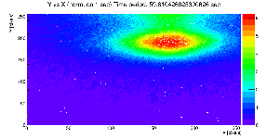
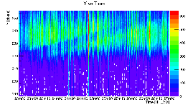
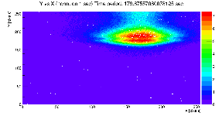
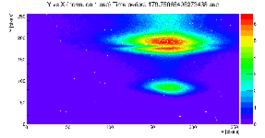
Double Channelling seen by Timepix in UA9
Beam Characteristics :
Single bunch
Intensity 1.2 10¹¹ p/bunch
Momentum 270 GeV/c
User LHCMD3 Qh =20.13 Qv= 20.18
Vertical
14mm
Main
Beam
On October 17th double crystal experiment was performed :
a second crystal was inserted in the channeled beam
Horizontal 14mm
2nd crystal shadow
on channeled beam
2nd crystal shadow
set for channeling
Horizontal 14mm
2nd crystal shadowduring insertion
Time
2nd channeled beam
Horizontal profile vs time
F.Murtas, A. Natochi, W.Scandale

Slide 10
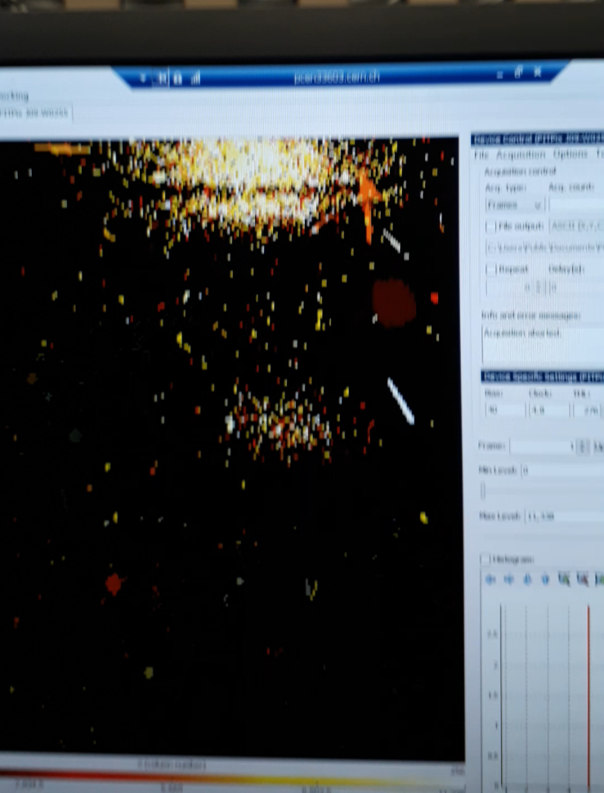
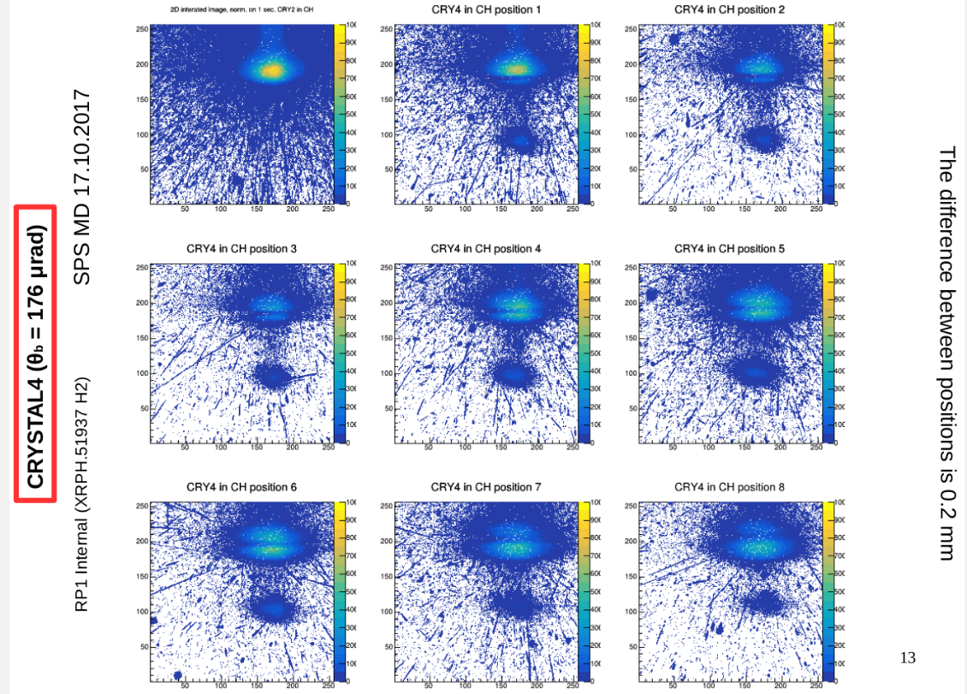
Online double channeling monitoring
F.Murtas, A. Natochi, W.Scandale

Slide 11
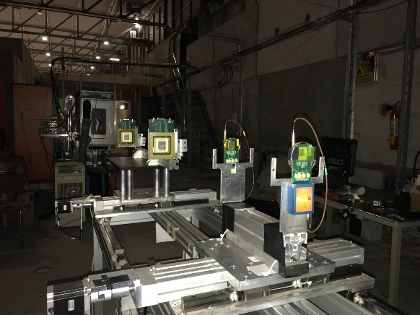
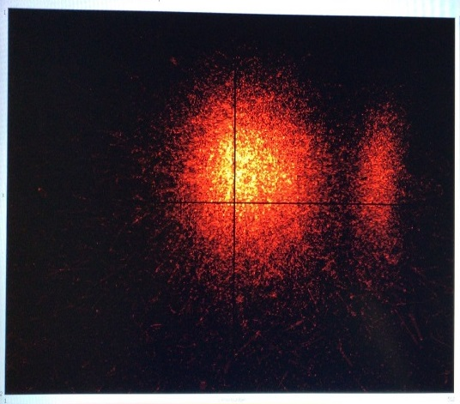
Timepix telescope for crystal tests
We have used two quads and two timepix as telescope
for measurements with track reconstruction using the ToA mode.
The telescope was 100 meters from the crystals
The result are comparable with the CMS tracker used up to now
This is the image of main and the channeled beam
produced by the crystal on test.

Slide 12
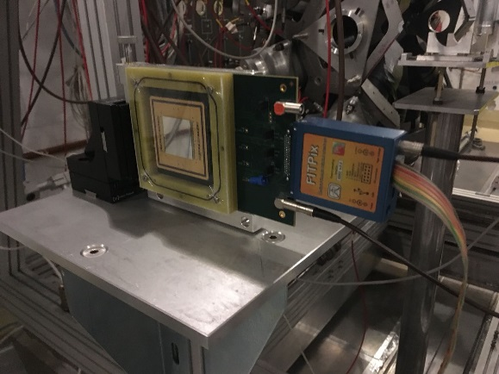
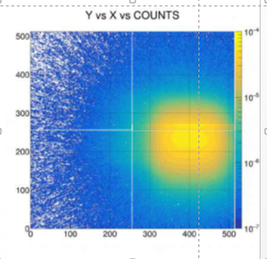
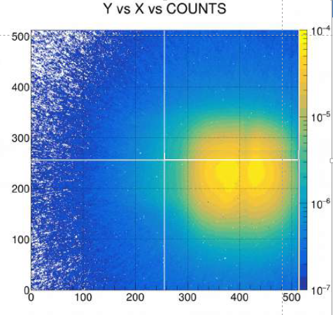
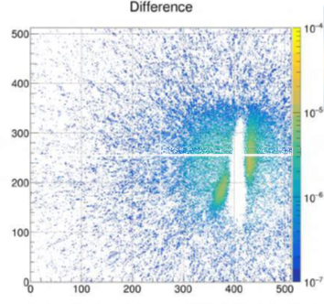
TimepixQuad detector for test on beam extraction
Without any object
on the beam
Crystal in VR
+ septum
subtraction
We have used two quads as beam monitor near the crystals
in counting mode for studies on beam extraction
Image subtraction
Volume
Reflection
Chanelling
F.Murtas, A. Natochi, W.Scandale

Slide 13
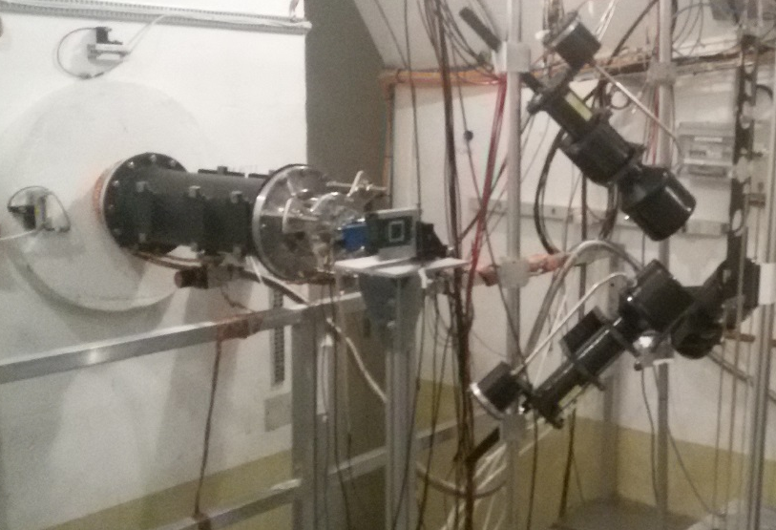
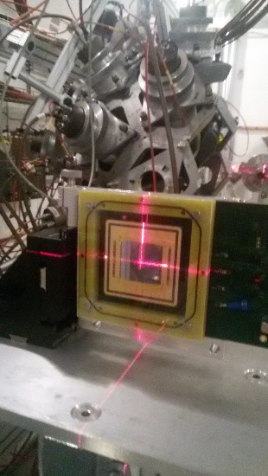
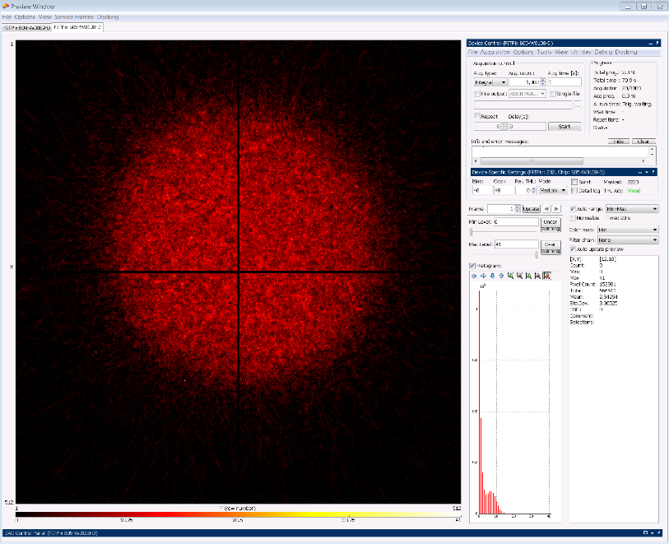
Measurements on neutron beam (nTOF@CERN)
There is a big interest in the Neutron Spallation Source
for a good monitoring of beam position and intensity
The Timepix-quad has been recently
used for the beam alignment at nTOF faclity at CERN

Slide 14
DIAMONDPix
Higly pixelated diamond detector

Slide 15
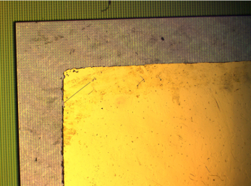
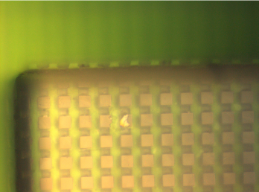
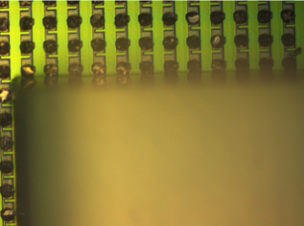
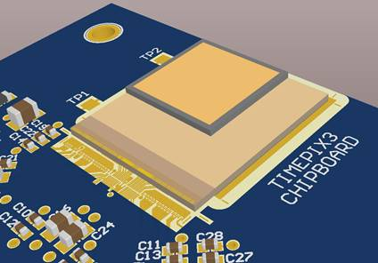
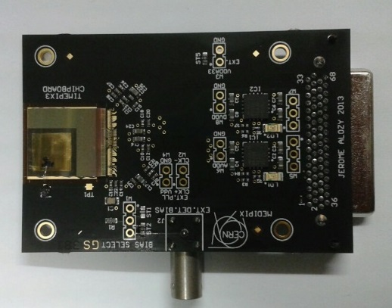
Diamondpix : a radiation hardness detector
Made by Element6 and Fraunhofer IZM
Gold cathode on diamond
upward surface
Pads on diamond
downward surface
Timepix3 Pads
Recently two Diamondpix have been tested on
charged and neutron beam for future applications.

Slide 16
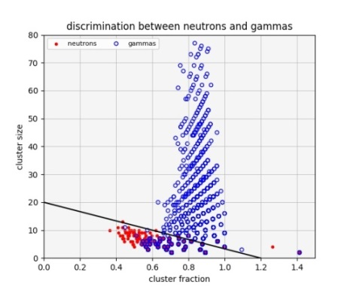
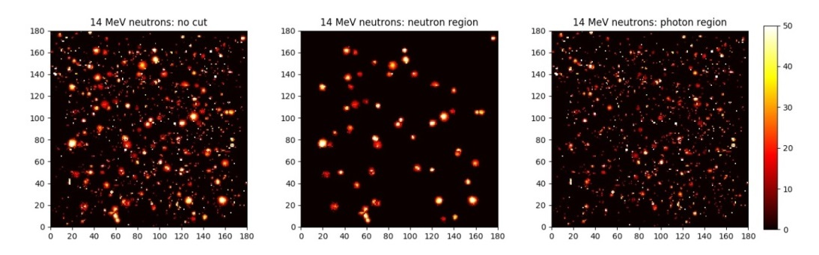
Diamondpix : a radiation hardness detector
Beam image
Neutrons
Gammas
Neutron / Gamma discrimination
G.Claps, F, Cordella, C.Digiulio, L. Foggetta
Details on :
Diamondpix: a CVD diamond detector with Timepix3 chip interface TNS 00581-2018-R1

Slide 17
GEMPix
Higly pixelated 3GEM detector

Slide 18

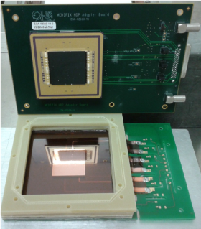
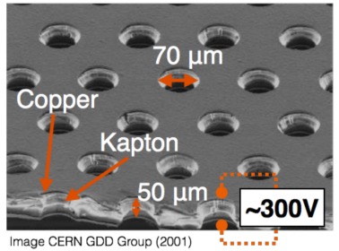
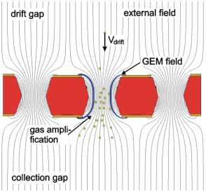
GEMPix: triple-GEM + Timepix ASIC
3 GEMs:
Kapton foil with thin copper layers
Gas amplification in holes (large field)
Total gain of max 10⁵
4 Timepix chips:
512 x 512 pixels
each 55µm x 55 µm
detection threshold per pixel of 1000 electrons

Slide 19

GEMPix: triple-GEM + Timepix ASIC
Particles to be analysed
Head-on
Triple GEM
Mylar window
Side-on
Gas flux AR CO₂
Length analysed
Triple GEM
Particles
to be analysed
Gas flux

Slide 20
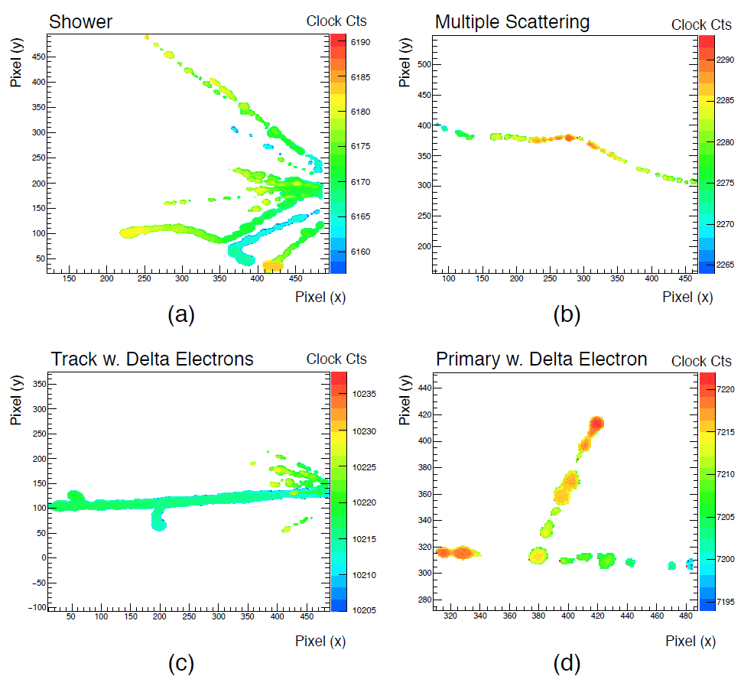
3D Track Reconstruction (TOA)
3x3 cm²
Z coordinate (1 cm)
Possibility to study single particles
→ lateral measurements
→ secondaries
Z coordinate (1 cm)
Stuart P.George, F.Murtas, M. Silari

Slide 21
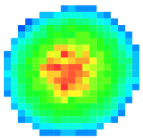
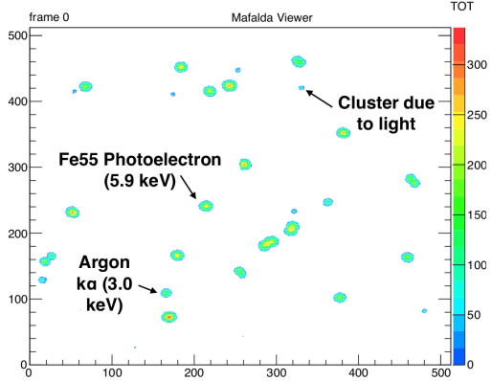
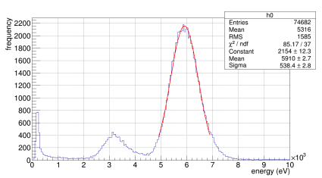
Charge Measurement (TOT)
X-ray detection: 6 keV from ⁵⁵Fe (1s frame)
Single 6 keV X-Ray
20% energy resolution for 6 keV
20% energy resolution
Stuart P.George, F.Murtas, M. Silari

Slide 22
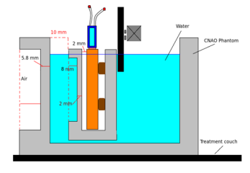
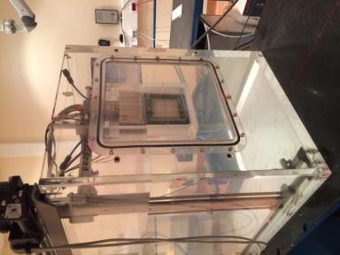
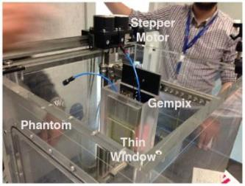
GEMPix in CNAO water phantom, ¹²C-ion beam
Beam
GEMPix
Water phantom
Background: ion chambers in a water phantom are commonly used for
quality assurance in radiation therapy, good reliability but bad spatial resolution
(state of the art: array of ICs with some mm spatial resolution)
GEMPix inserted in water phantom with 3D positioning system
3D energy deposition obtained (2D images at different depths)
J Leidner, F.Murtas, M. Silari

Slide 23
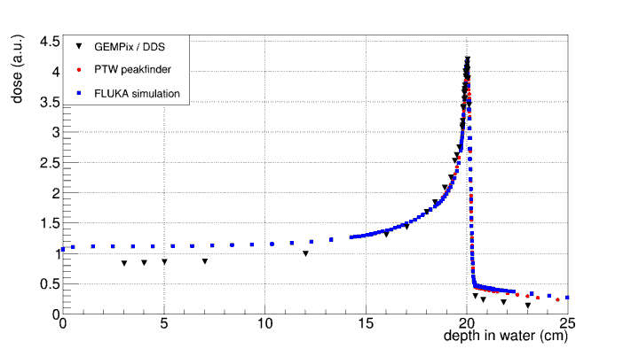
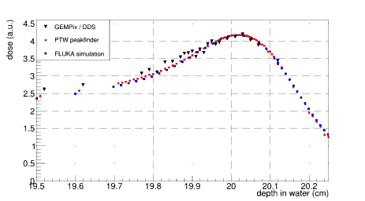
Depth Scan: Bragg Curve
Zoom to Bragg peak
Beam
GEMPix measurement normalized to dose delivery system of CNAO (DDS), integral of the 2D images (previous slide) summed per depth position -> Bragg curve
In general: good agreement with FLUKA simulations and measurements with PTW peakfinder (commercial device to find Bragg peak position, based on ion chambers)
Our results: Underestimation in plateau, fluctuations in peak, underestimation in tail
Improvements: TP correction for GEMPix and new, integrated system
J Leidner, F.Murtas, M. Silari

Slide 24
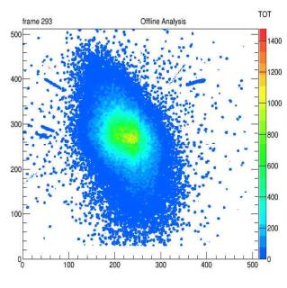


2D beam images
Plateau
Peak
Tail
X/Y axes: position on detector
Z axis (color): deposited energy
Beam spot taken on Plateau, Bragg Peak and Tail
Frame length: 20 ms / 100 ms (before / after the Bragg Peak)
Beam halo: single particle reconstruction

Slide 25

3D energy deposition
Beam
Bragg Peak
Fragmentation Tail
Reconstructed 3D energy deposition (smoothed)
Unique imaging technology

Slide 26
Summary
Timepixes (Timepix, Timepix3, Quads, Diamondpix, GEMPix )
show good performances in high intensity beam monitoring.
They have been installed successfully in different facility
(UA9, NToF @CERN and CNAO and BTF in Italy …. but also in ISS)
and they provide useful information on beam characteristics
and they become important for future project .
Improvement on acquisition software are fundamental
Waiting Timepix2 test and results on performances

