Slide 1
Diagnostic of fast-ion energy spectra and densities in magnetized plasmas
Mirko Salewski
Technical University of Denmark
Department of Physics
M. Nocente, B. Madsen, I. Abramovic, G. Gorini, A.S. Jacobsen, V.G. Kiptily, S.B. Korsholm, D. Moseev, J. Rasmussen, M. Tardocchi, B. Geiger, J. Eriksson, the JET Contributors, the ASDEX Upgrade Team, and the EUROfusion MST1 Team
5th International Conference on Frontiers in Diagnostic Technologies, Frascati, Rome, 3-5 October 2018

Slide 2
Main message of this talk
Alpha particle density and energy spectrum measurements at ITER will be possible by solution of inverse problems: velocity-space tomography, energy spectrum inference, model fitting
Outline
ITER measurement requirements
High-resolution fast-ion measurements
Velocity-space coverage of fast-ion measurements
Velocity-space tomography at JET and ASDEX Upgrade
Prospects for alpha diagnostic at ITER: Velocity-space tomography, energy spectrum inference, model fitting
Conclusions
Add Presentation Title in Footer via ”Insert”; ”Header & Footer”

Slide 3
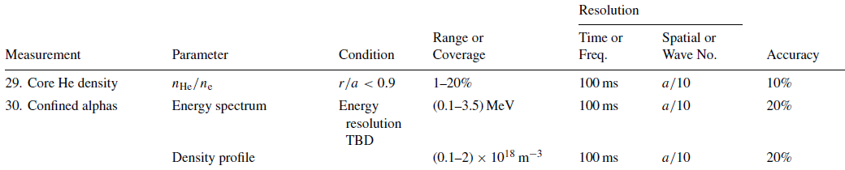
ITER measurement requirements
Donne et al. (2007) NF. Progress in the ITER Physics Base, Ch.7: Diagnostics
Now in the ITER measurement requirements database
Title | Range Value Coverage | Condition | Time Res. | Spatial Res. | Accuracy
30. Confined alphas and fast ions - alpha density profile | (0.1 - 2) E¹⁸ m⁻³ | (blank) | 100ms | a/10 | 20%
30. Confined alphas and fast ions - alpha energy spectrum | 0.1 - 3.5 MeV, | Energy res. 10 % | 100ms | a/10 | 20%
30. Confined alphas and fast ions - D, T, H, He3 energy spectrum | 0.1 - 1 MeV | Energy res. 10 % | 100ms | a/20 | 20%

Slide 4
Outline
ITER measurement requirements
High-resolution fast-ion measurements
Velocity-space coverage of fast-ion measurements
Velocity-space tomography at JET and ASDEX Upgrade
Prospects for alpha diagnostic at ITER: Velocity-space tomography, energy spectrum inference, model fitting
Conclusions
Add Presentation Title in Footer via ”Insert”; ”Header & Footer”

Slide 5
Neutron emission and gamma-ray spectrometry at JET
Perpendicular view
Φ=90°(LOS, B)
Oblique view Φ=47°(LOS, B)
Eriksson et al (2015) NF

Slide 6
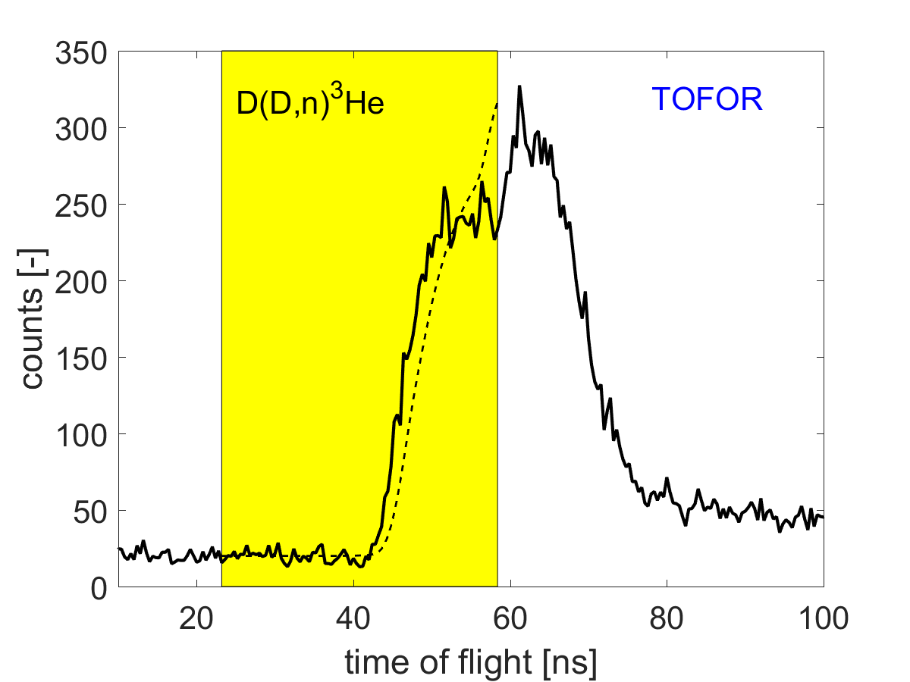
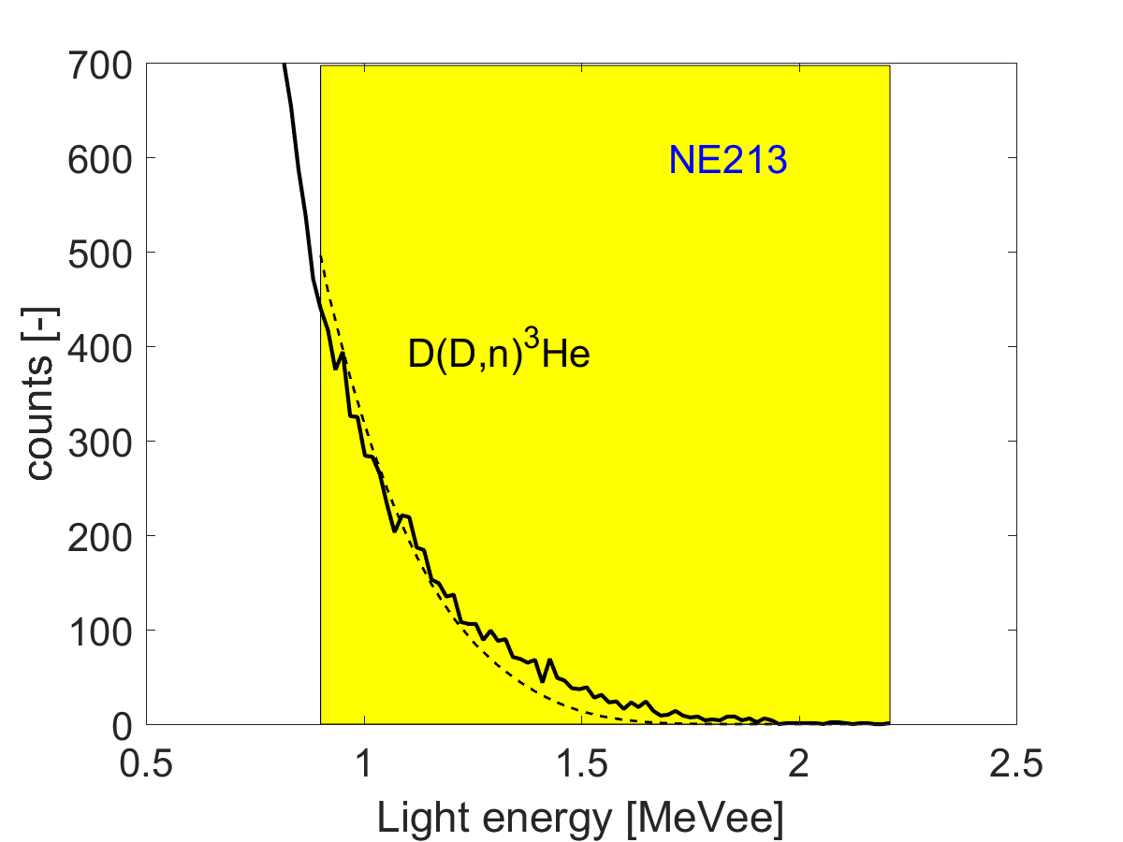
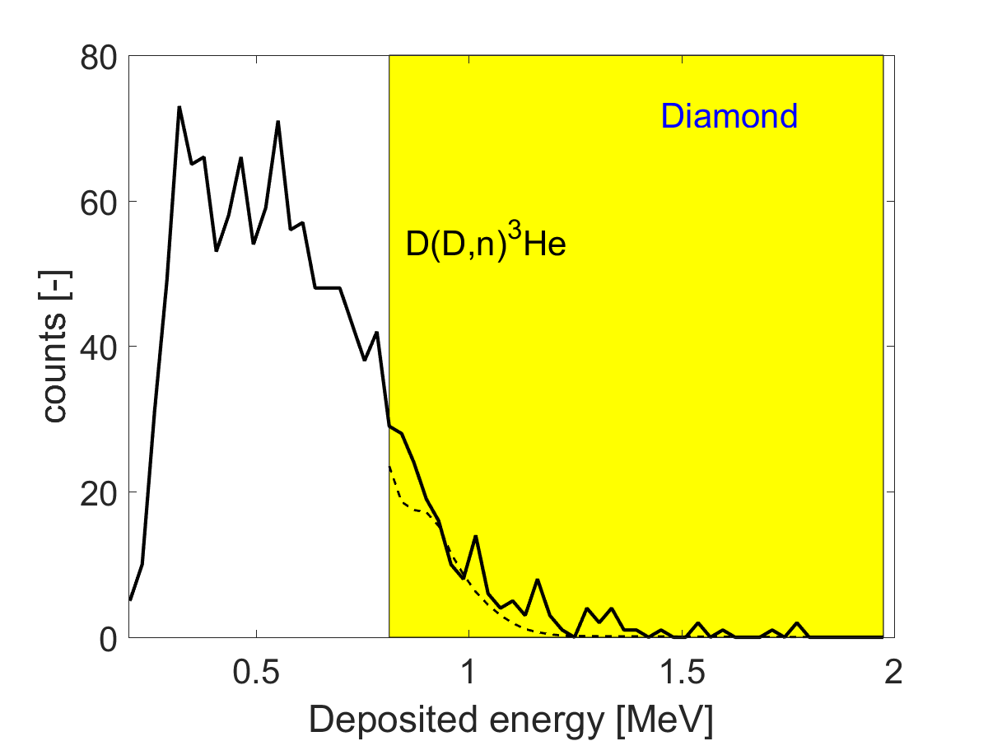
NES measurements
3 simultaneously measured spectra in JET #86459
4.5 MW NBI + 3 MW 3rd harmonic ICRF-heating
Yellow: Used for inversion
Measure spectra of various quantities
Salewski et al (2017) NF

Slide 7
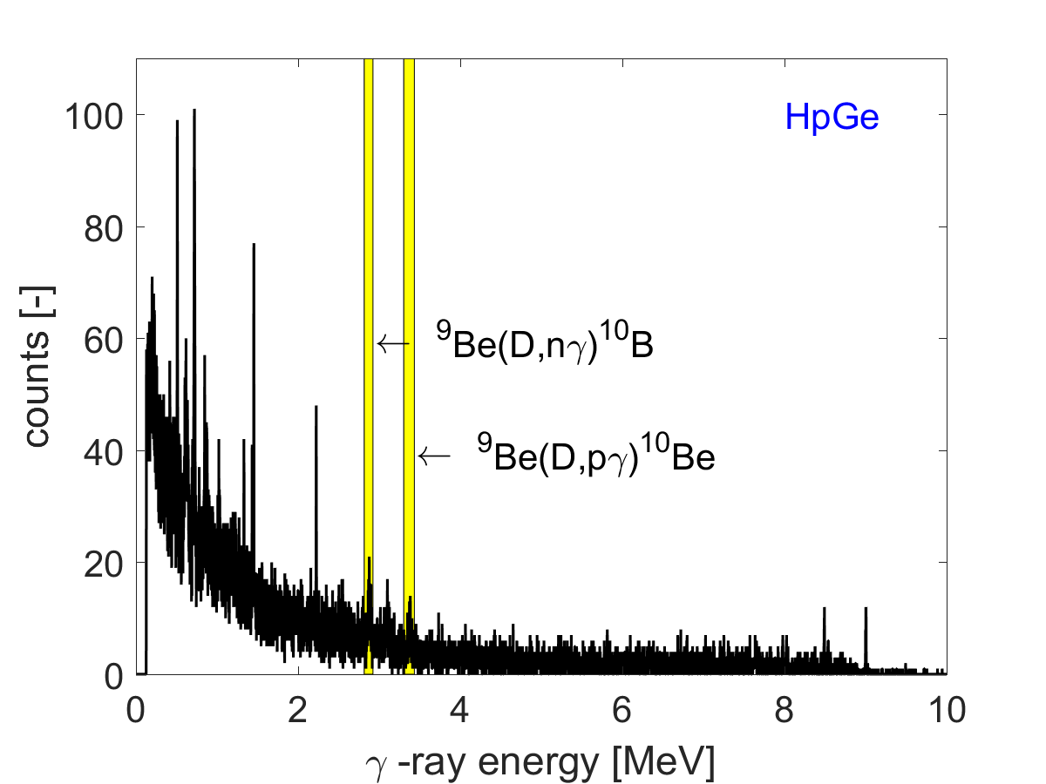
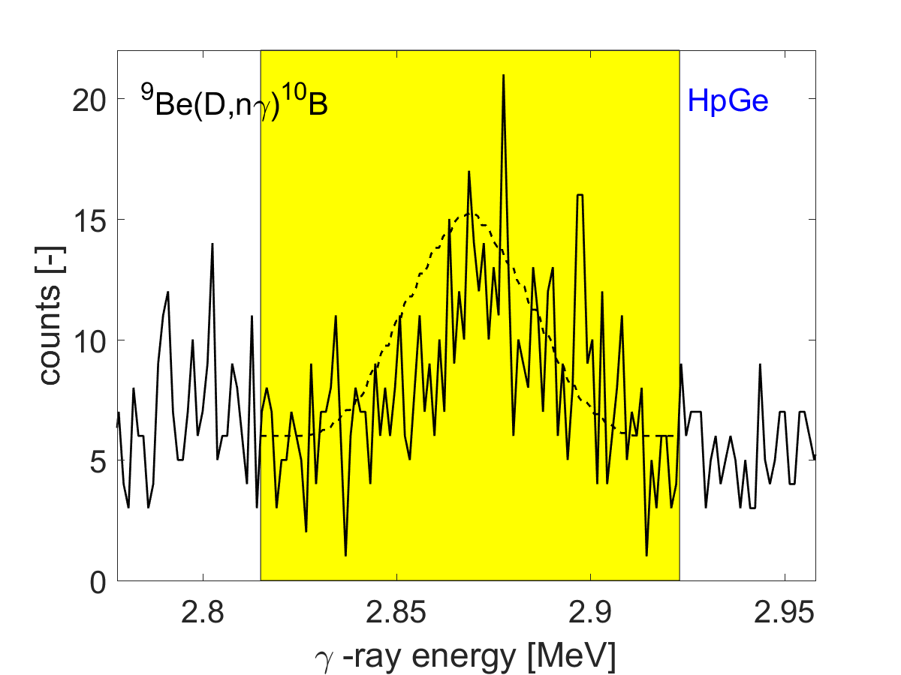
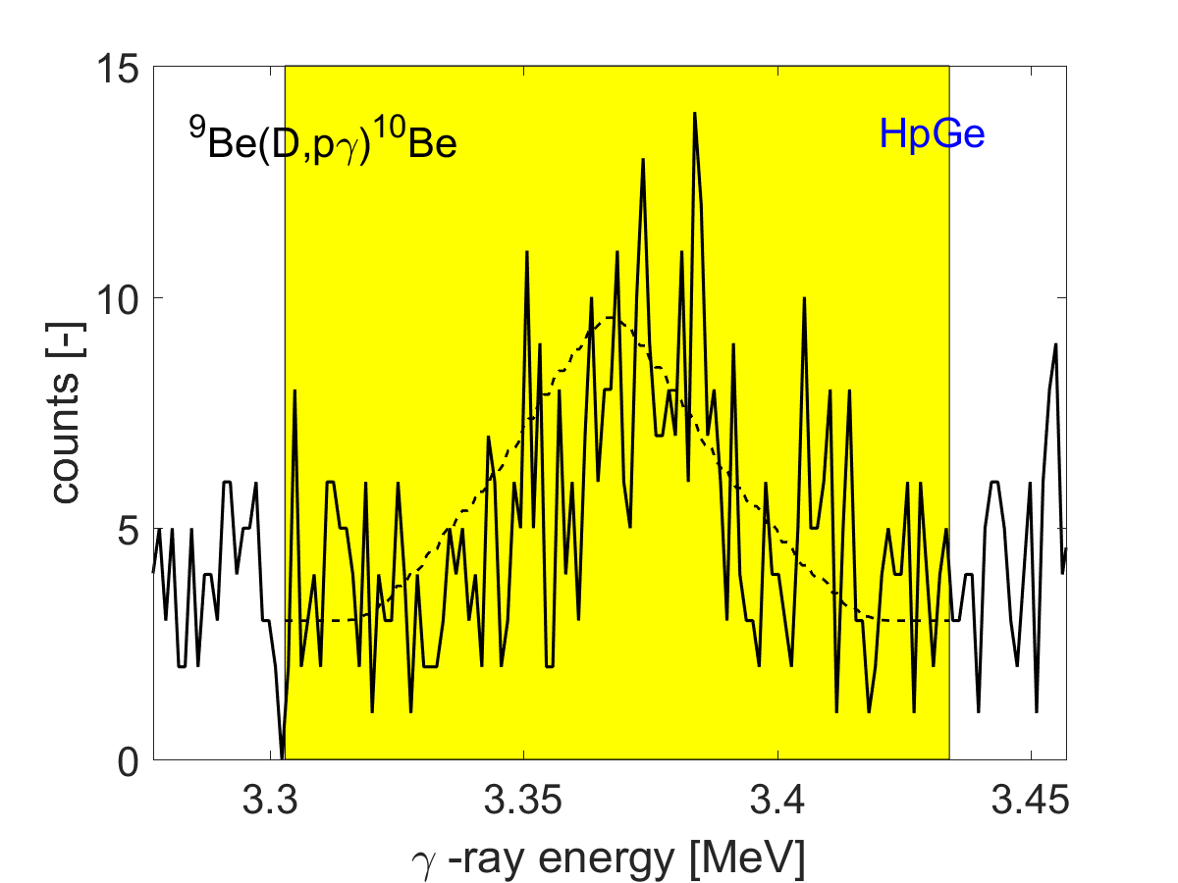
GRS measurements
2 GRS spectra in JET #86459
High-resolution High-purity Germanium detector (1keV over 10 MeV)
Two competing reactions
Measure gamma-ray energies
Salewski et al (2017) NF

Slide 8
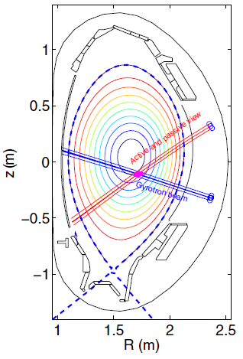
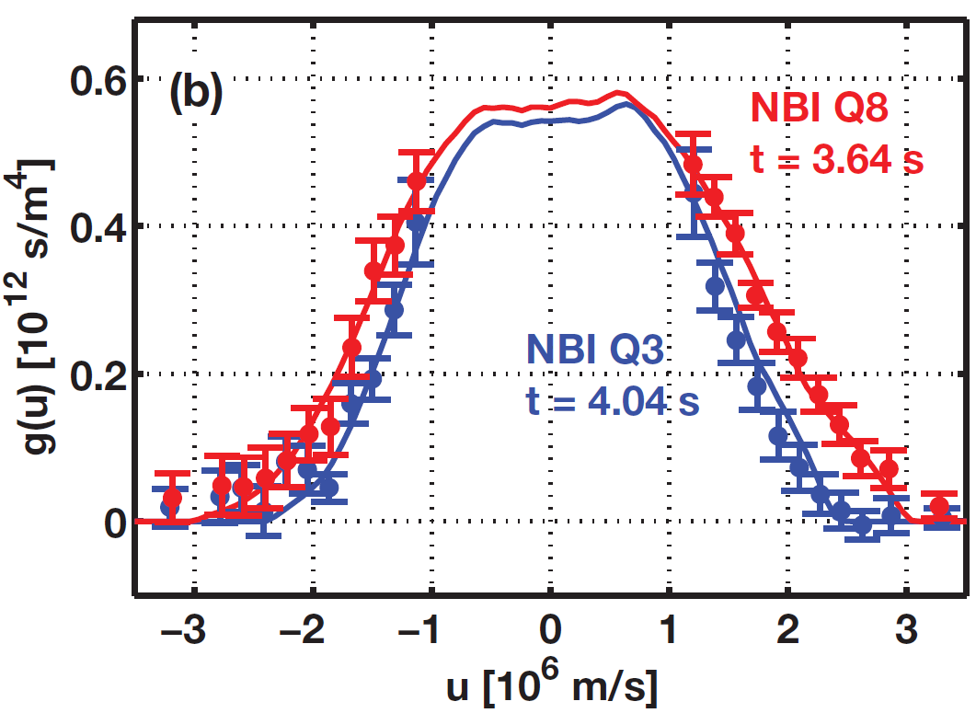
Collective Thomson scattering measurement at ASDEX Upgrade
CTS measures velocities projected along a resolved direction u.
Data
− Sim
Rasmussen et al. (2015) PPCF

Slide 9
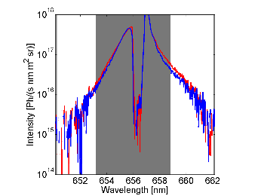
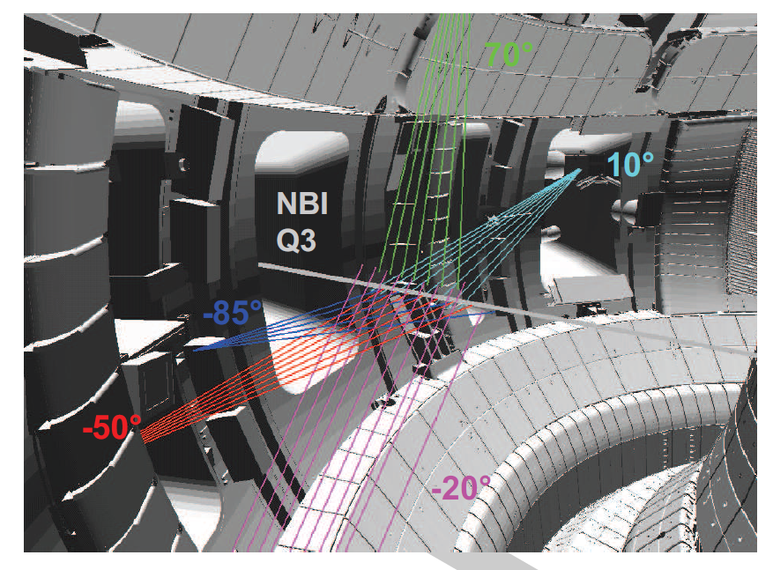
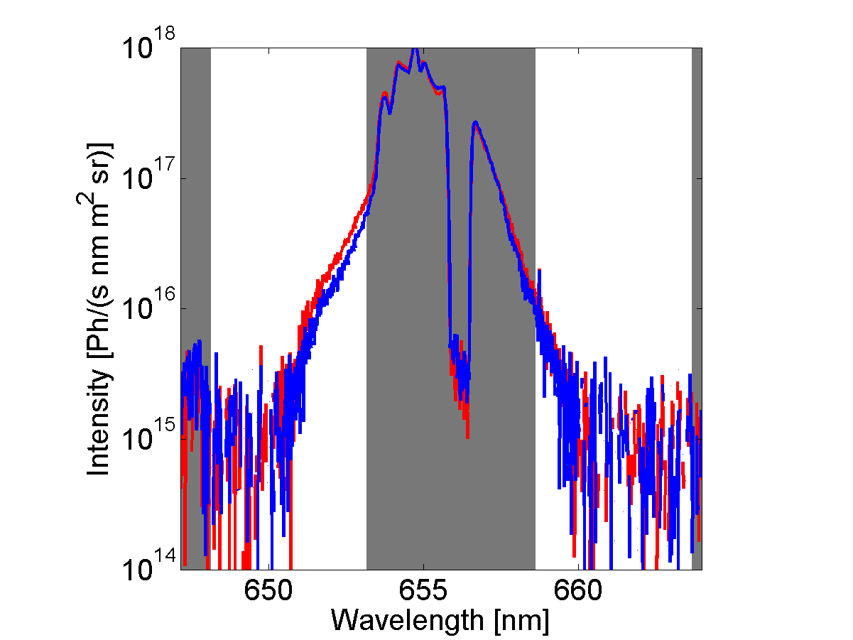
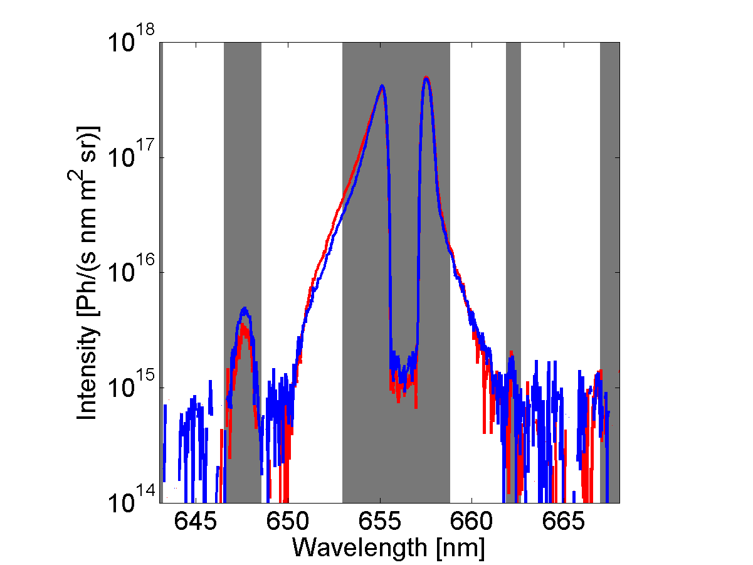
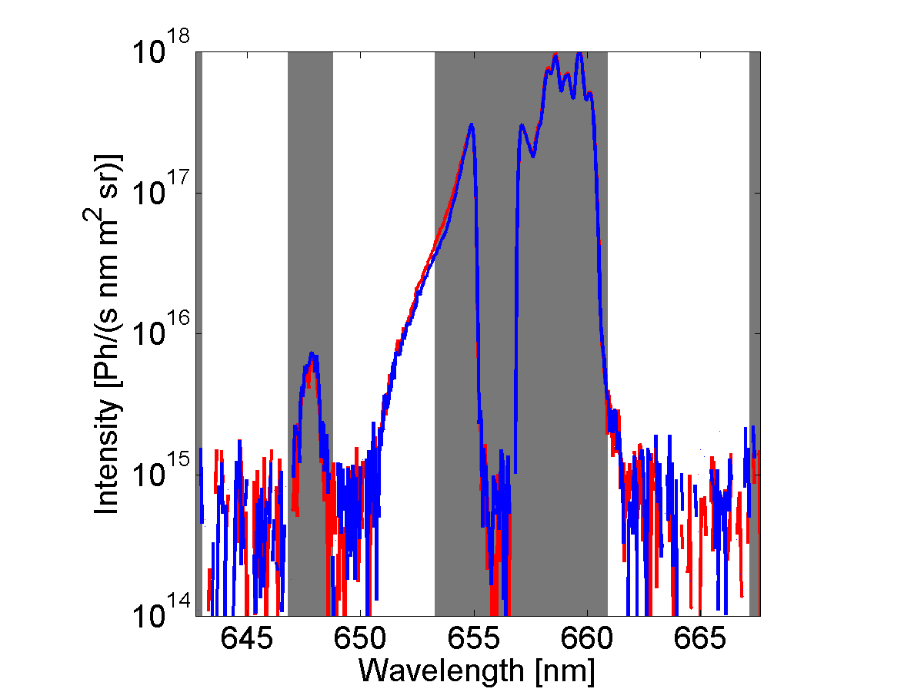
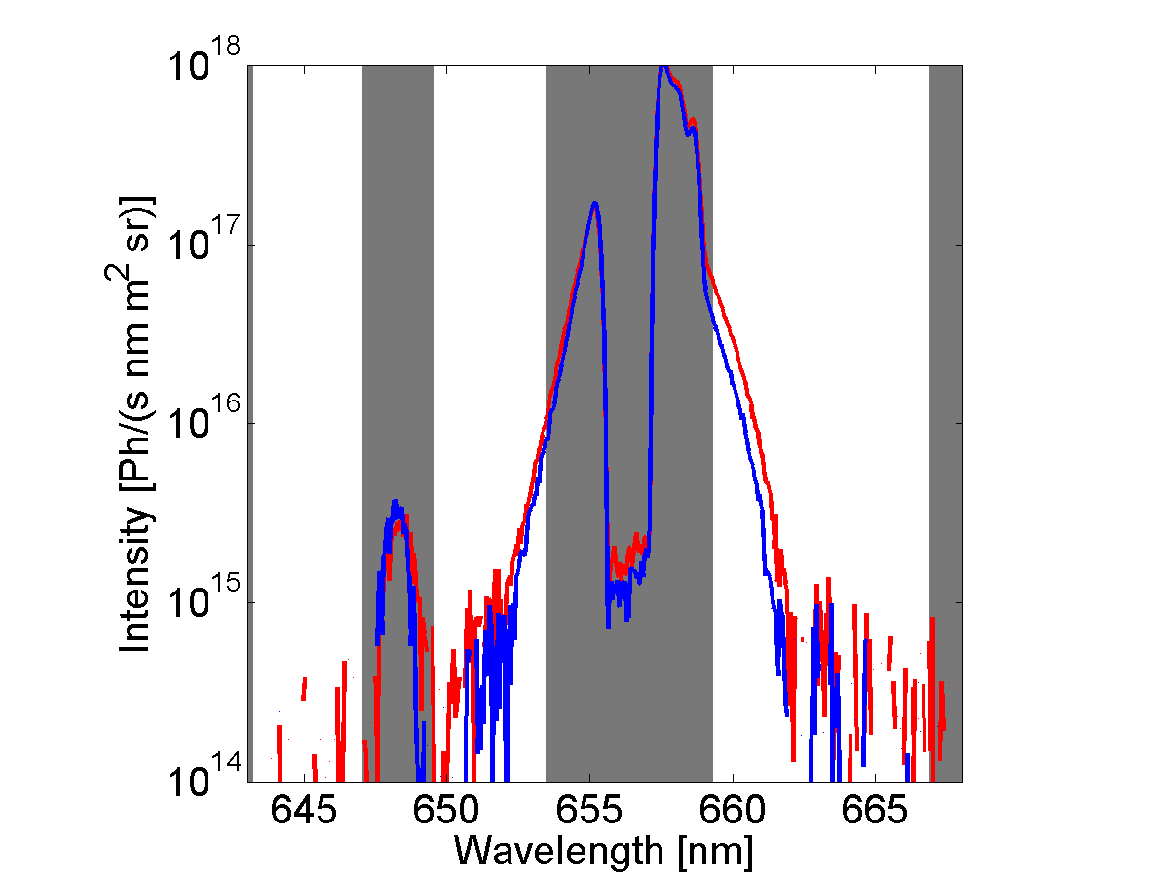
Fast-ion D-alpha spectroscopy at ASDEX Upgrade
Weiland et al (2016) PPCF
Add Presentation Title in Footer via ”Insert”; ”Header & Footer”

Slide 10
Outline
ITER measurement requirements
High-resolution fast-ion measurements
Velocity-space coverage of fast-ion measurements
Velocity-space tomography at JET and ASDEX Upgrade
Prospects for alpha diagnostic at ITER: Velocity-space tomography, energy spectrum inference, model fitting
Conclusions
Add Presentation Title in Footer via ”Insert”; ”Header & Footer”

Slide 11
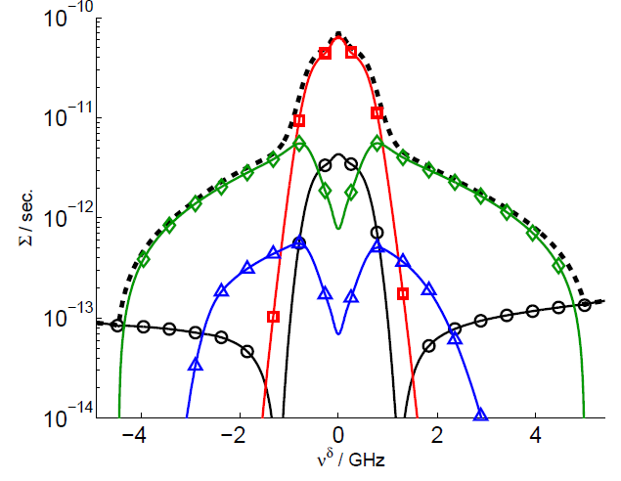
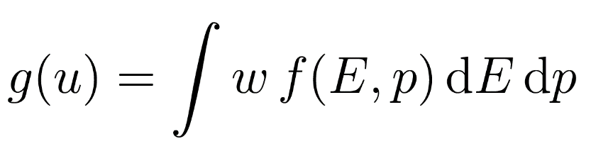
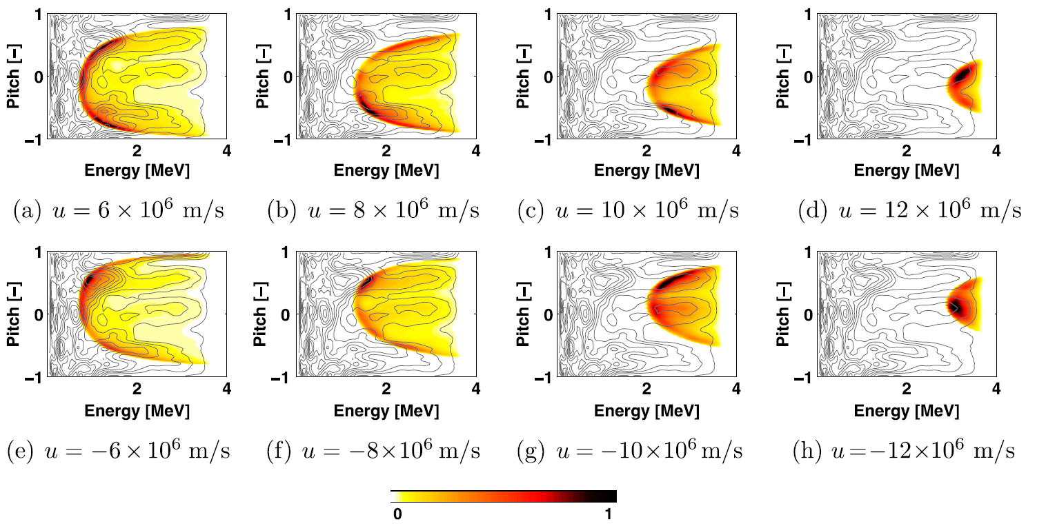
Velocity-space origin of the CTS signal
Shape of w is implied by energy and momentum conservation
Salewski et al. (2011) NF

Slide 12
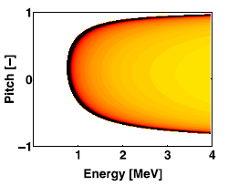


Alpha densities and energy spectrum
Weight function suggests incomplete velocity-space coverage and no energy resolution.
no direct densities
Signal/ion varies
f(E,p) is incompletely diagnosed
no direct energy resolution
Signal from E>E_{min} for given u

Slide 13
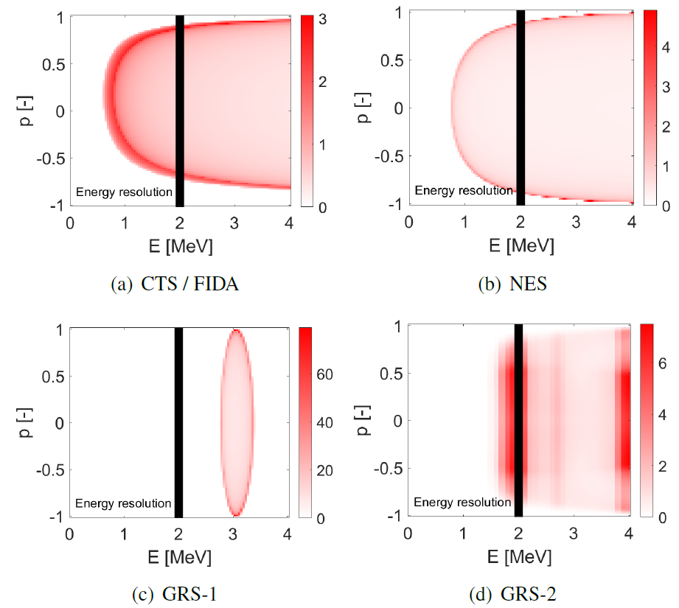
Alpha energy spectra and densities cannot be determined directly by CTS, GRS or NES

Slide 14
Options for alpha-particle energy spectrum and density measurements
Measure 2D velocity distribution function by velocity-space tomography
  Integrate to get energy spectrum
  Integrate again to get density
Measure 1D energy spectrum by velocity-space tomography with prior: isotropy
  - Integrate to get density
Fit a model, e.g. slowing-down distributions
  - Spectrum is assumed, not measured.

Slide 15
Outline
ITER measurement requirements
High-resolution fast-ion measurements
Velocity-space coverage of fast-ion measurements
Velocity-space tomography at JET and ASDEX Upgrade
Prospects for alpha diagnostic at ITER: Velocity-space tomography, energy spectrum inference, model fitting
Conclusions
Add Presentation Title in Footer via ”Insert”; ”Header & Footer”

Slide 16
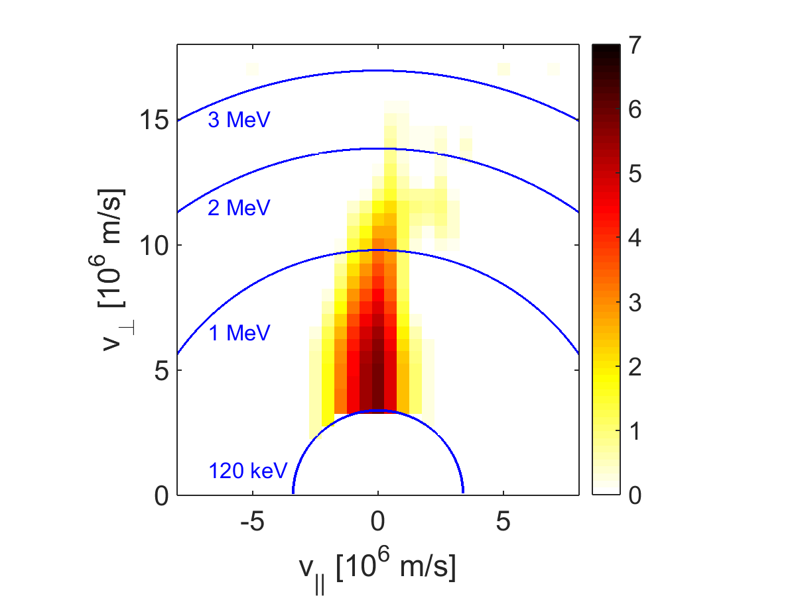
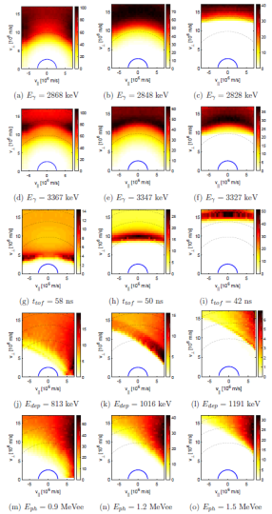
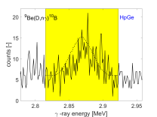
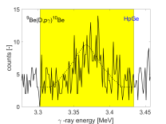
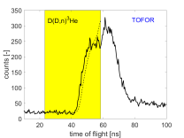


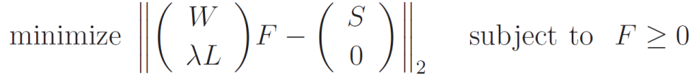

Introduction to velocity-space tomography
Forward problem
$$WF=S$$
Distribution function F
Matrix W
Measurements S
Salewski et al
(2011,12,13,14,15,16,17,18) NF
Inverse problem
Add Presentation Title in Footer via ”Insert”; ”Header & Footer”

Slide 17
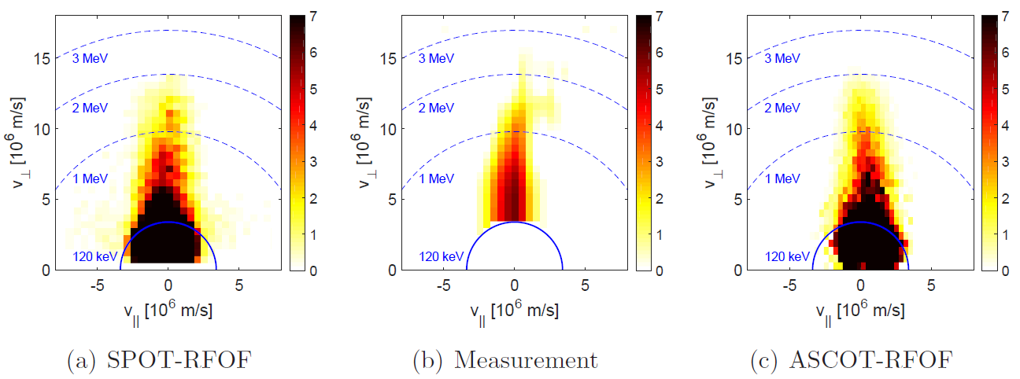
Velocity-space tomography vs. Simulation at JET
4.5 MW NBI + 3 MW 3rd harmonic ICRF measured by GRS/NES
Basic features agree: Tail length, tail width.
Barrier region suggests low densities above 2 MeV.
Velocity-space tomography confirms the barrier experimentally.
[a.u.]
[a.u.]
[a.u.]
Salewski et al (2017) NF

Slide 18
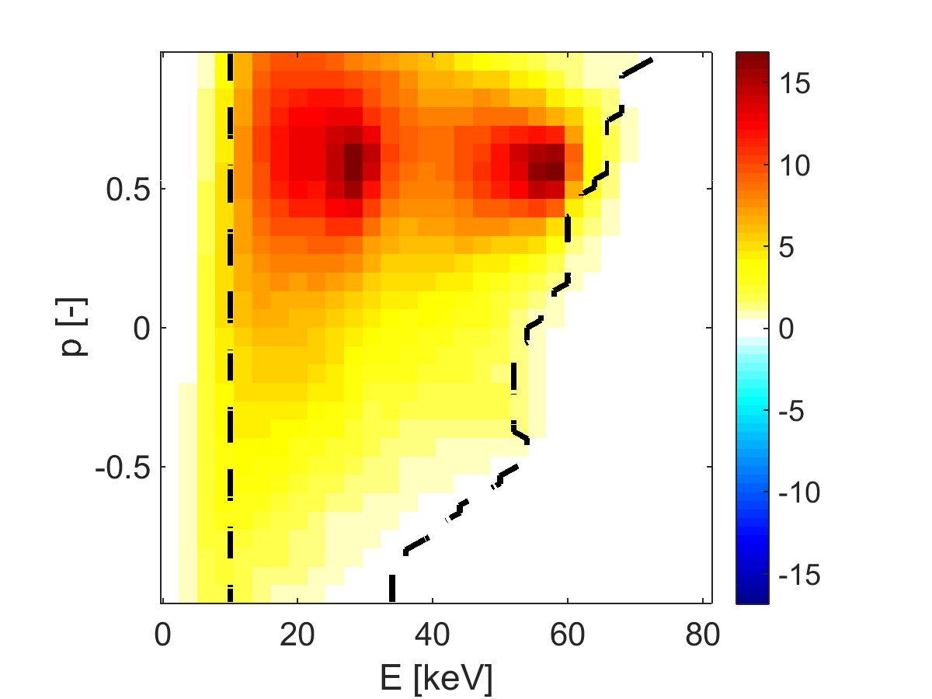
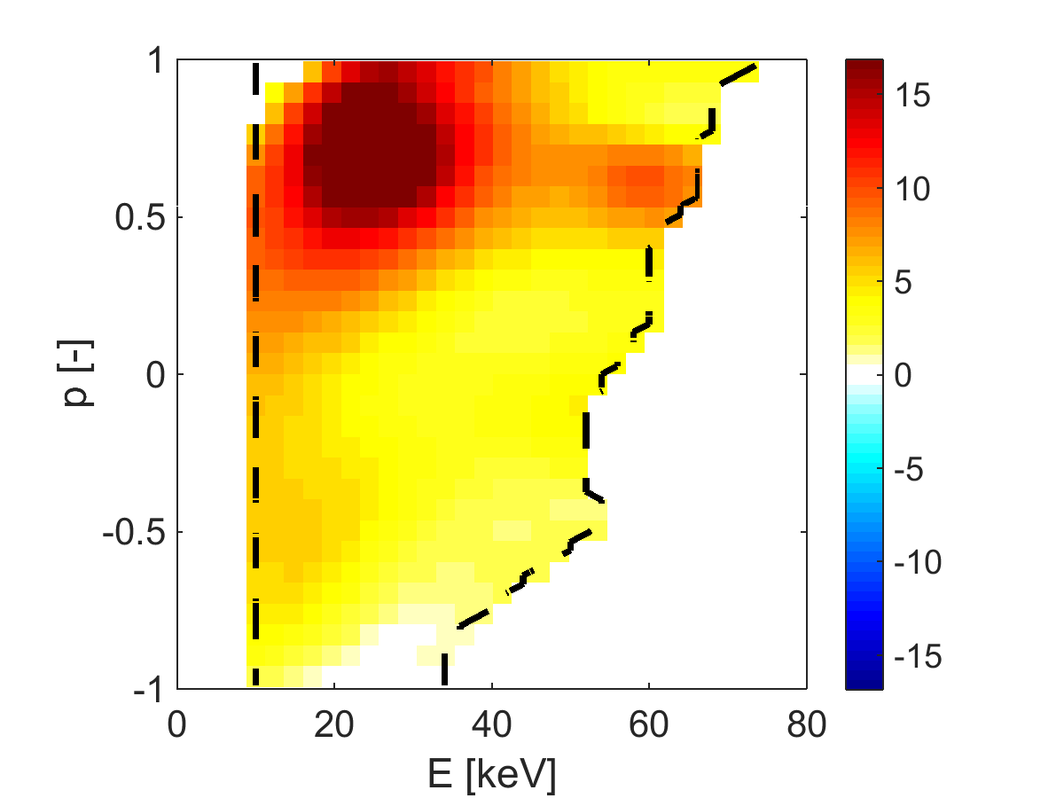
Velocity-space tomography vs. simulation at ASDEX Upgrade
2.5 MW NBI measured by 5-view fast-ion D-alpha spectroscopy
Simulation
Measurement
Salewski et al (2016b) NF
Add Presentation Title in Footer via ”Insert”; ”Header & Footer”

Slide 19
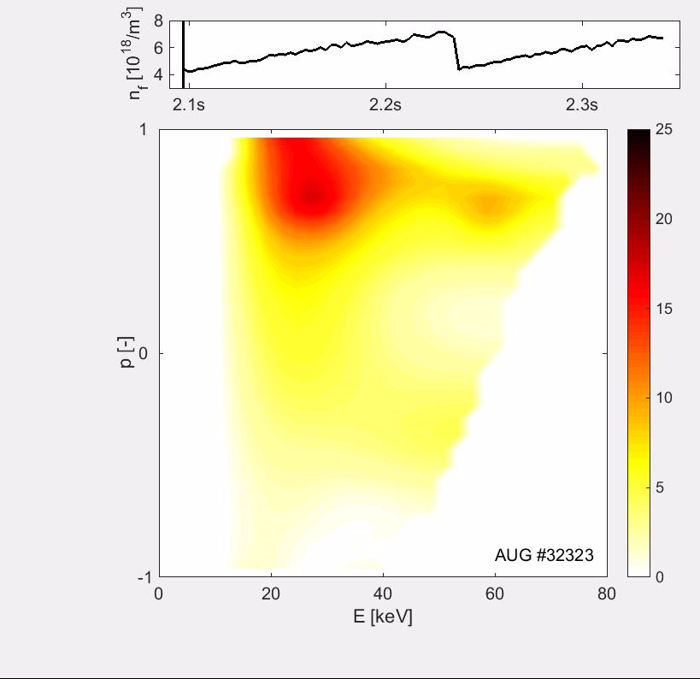
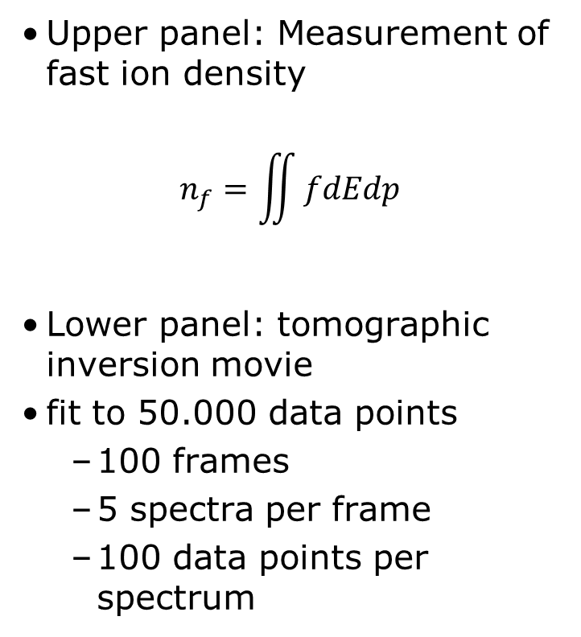
Tomography movie of a sawtooth crash
Upper panel: Measurement of fast ion density
$$n_{f}=\iint{fdEdp}$$
Lower panel: tomographic inversion movie
fit to 50.000 data points
  100 frames
  5 spectra per frame
  100 data points per spectrum
Salewski et al (2016b) NF
Add Presentation Title in Footer via ”Insert”; ”Header & Footer”

Slide 20
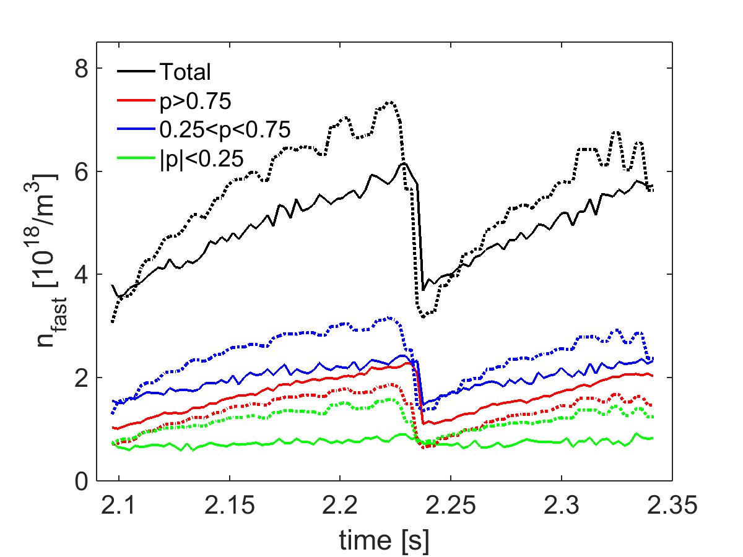
Sawteeth: FIDA tomography vs. TRANSP
Fairly good agreement
Measured crashes smaller than simulated crashes.
No measured crashes for |p|<0.25 in agreement with Kolesnichenko (1996) NF and disagreement with TRANSP.
TRANSP
FIDA
AUG #32323
Salewski et al (2016b) NF
Add Presentation Title in Footer via ”Insert”; ”Header & Footer”

Slide 21
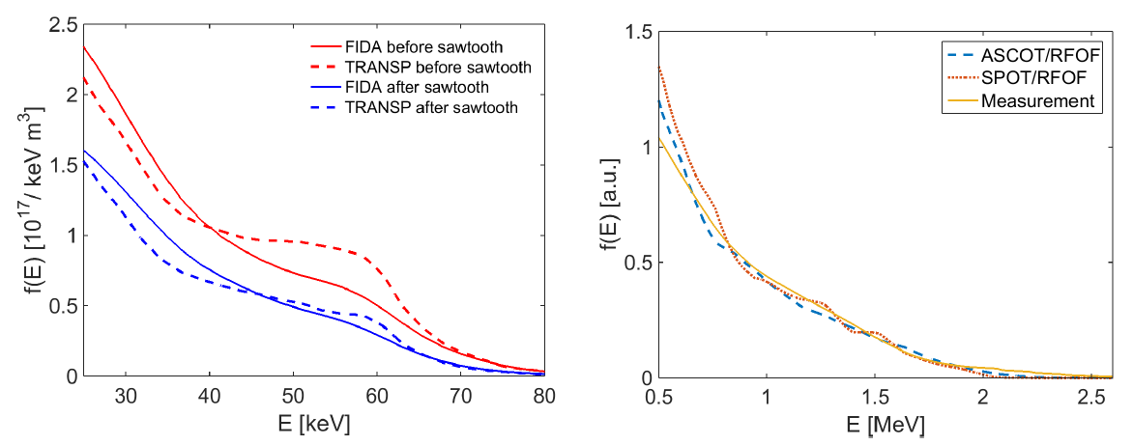
Energy spectrum measurements at JET and ASDEX Upgrade
ASDEX Upgrade
JET
Fast-ion density and energy spectrum measurements are now demonstrated at current machines.

Slide 22
Outline
ITER measurement requirements
High-resolution fast-ion measurements
Velocity-space coverage of fast-ion measurements
Velocity-space tomography at JET and ASDEX Upgrade
Prospects for alpha diagnostic at ITER: Velocity-space tomography, energy spectrum inference, model fitting
Conclusions
Add Presentation Title in Footer via ”Insert”; ”Header & Footer”

Slide 23
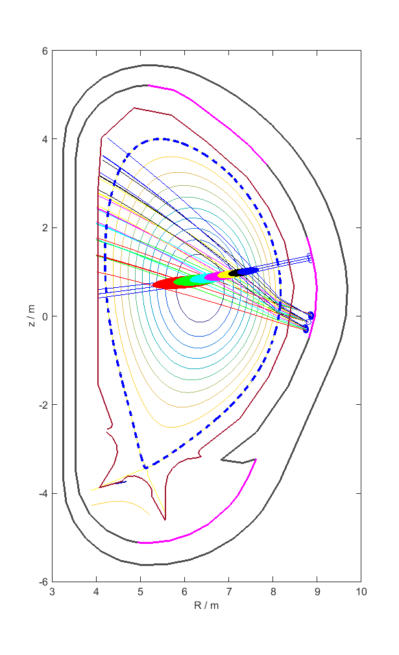
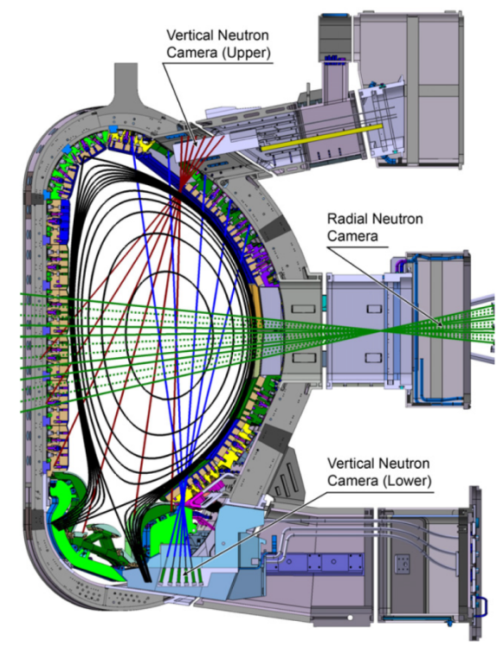
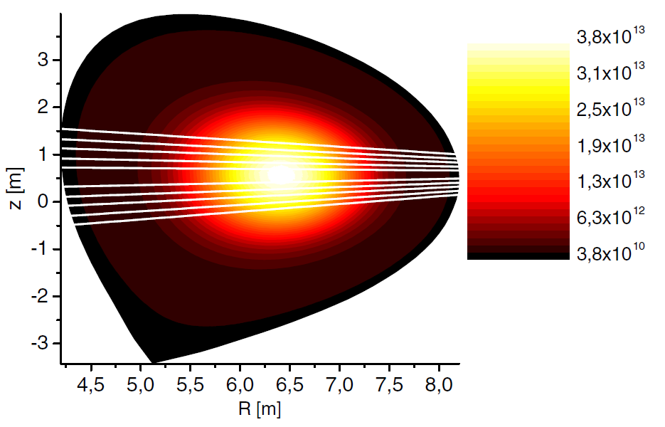
Alpha velocity-space diagnostic at ITER
2 gamma-ray views and 1 CTS view in the center
All lines-of-sight almost perpendicular to B.
GRS: 90°, CTS: 97°
Shevelev et al. (2013) NF
Nocente et al. (2017) NF
Salewski et al. (2016) ITPA-EP

Slide 24
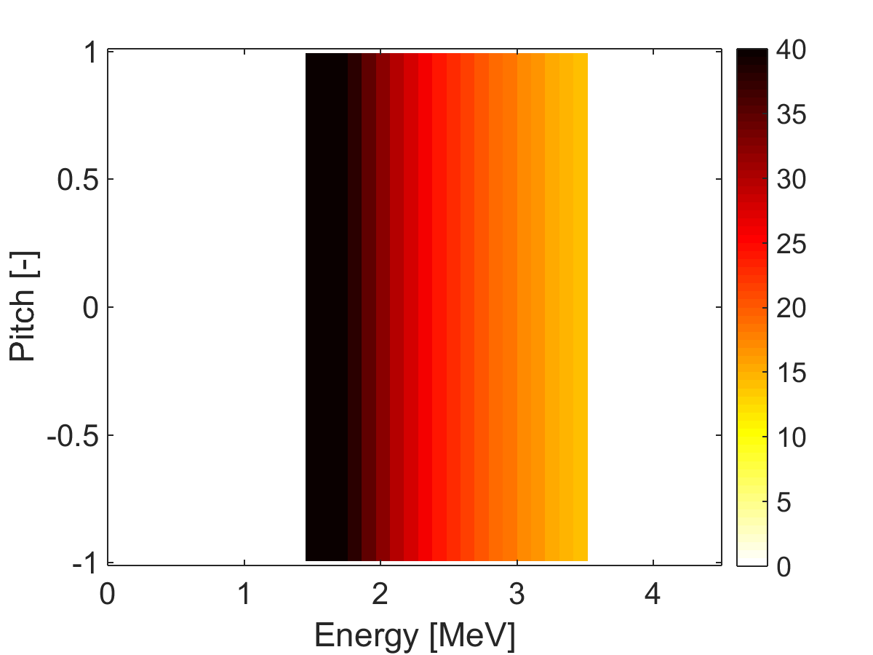
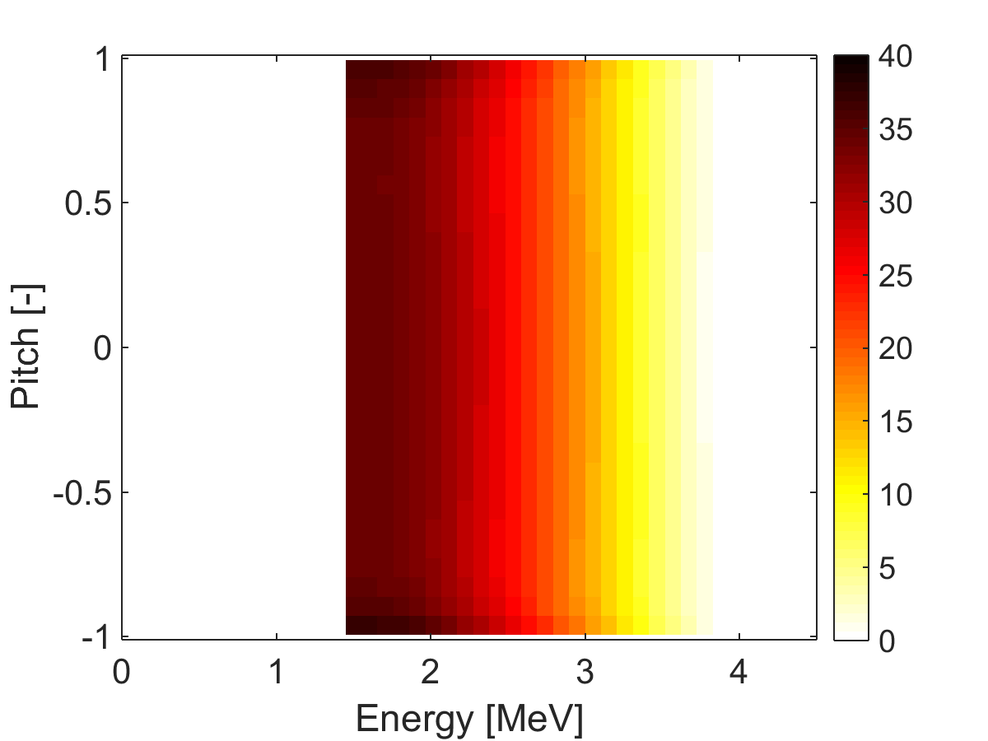

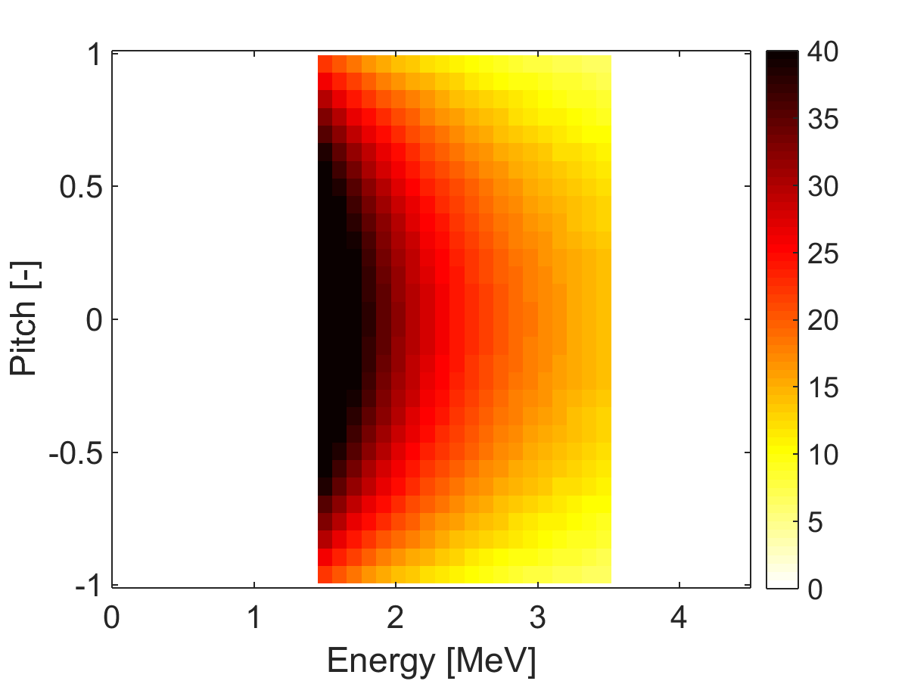
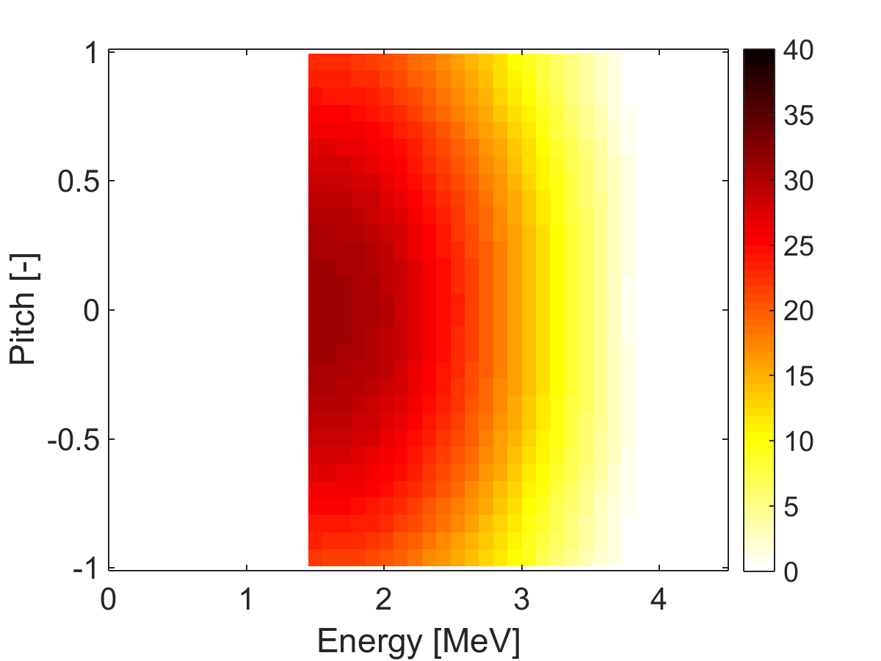
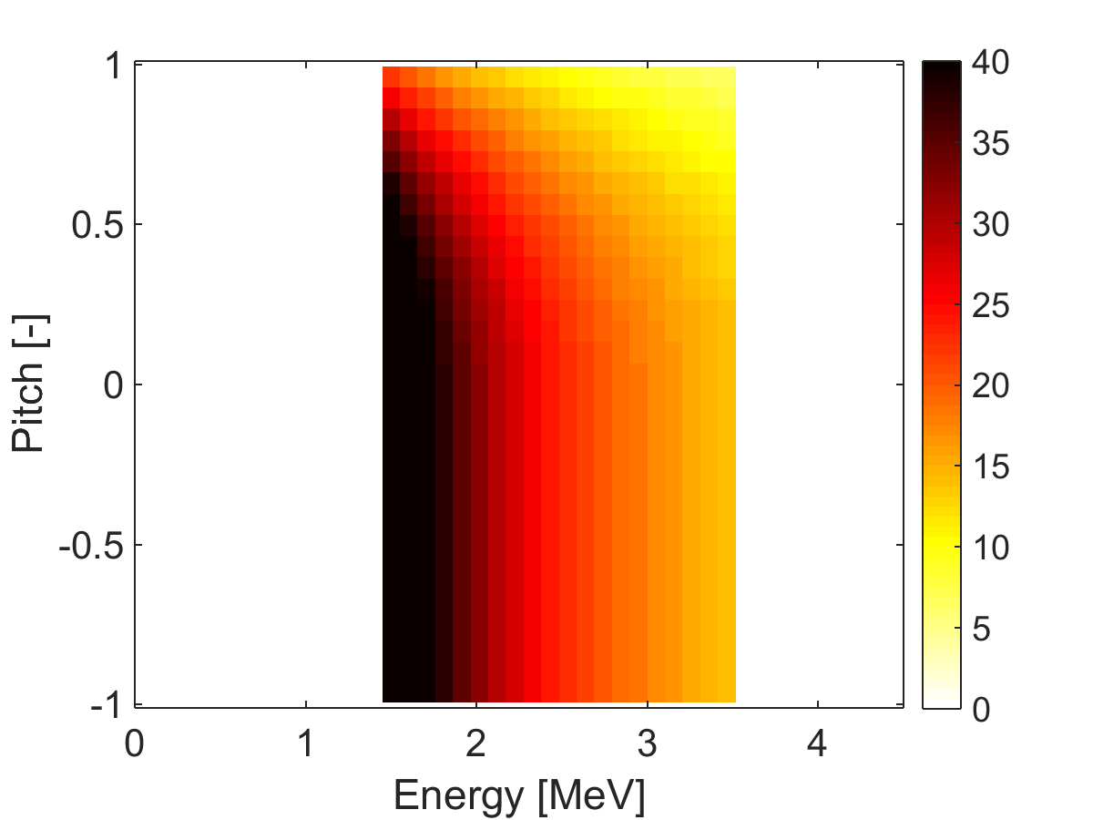
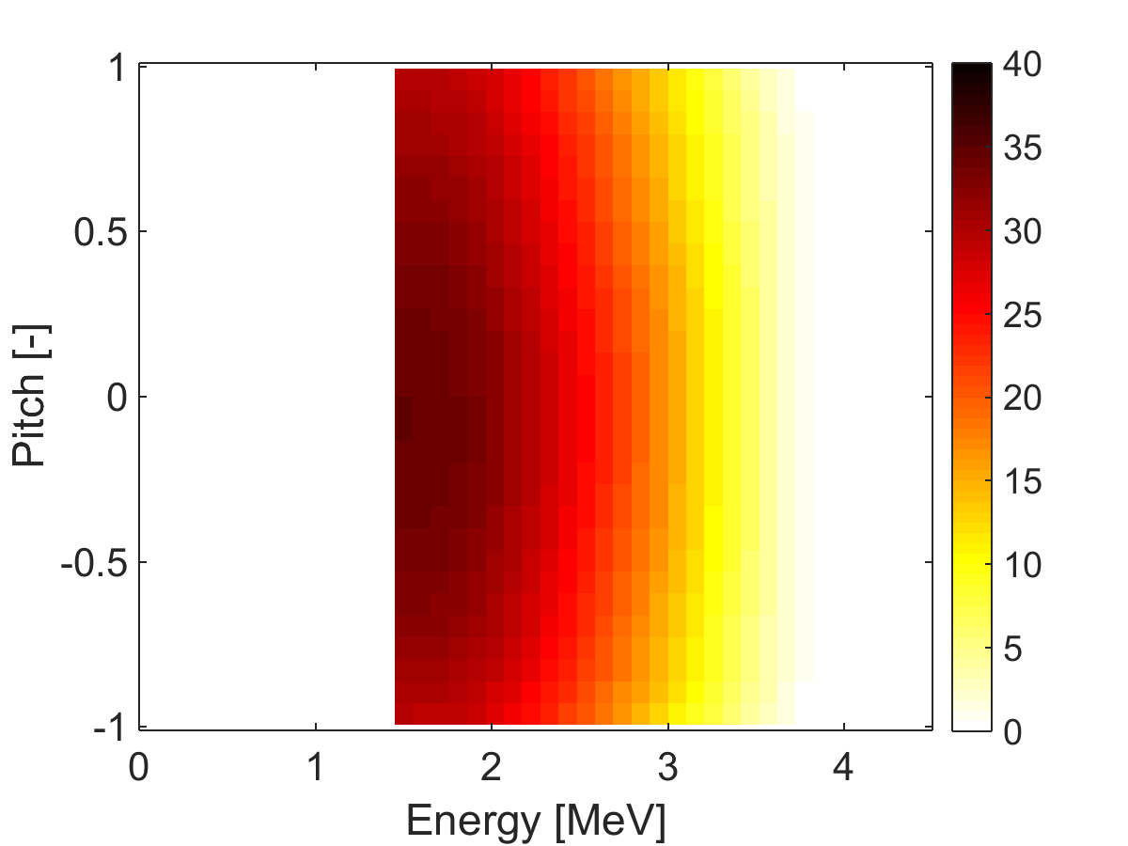
E>1.7 MeV: Velocity-space tomography
Ground truth
Tomography
Alpha slowing-down
Co- and counter-passing ejected, but not trapped
Can’t tell co- and counter-going ions apart!
(E,|p|)-coordinates
Co-passing ejected, but not trapped and counter-passing

Slide 25
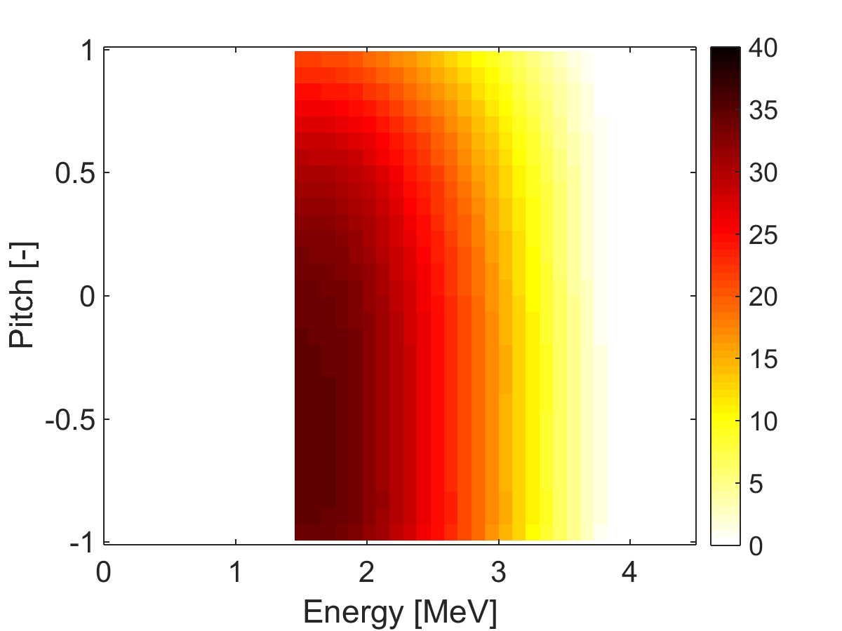
Oblique views tell co-/counter-going ions apart
Ground truth
GRS 2x90+ CTS
Inversion with an additional 30°GRS detector
Anisotropy could then be tracked.

Slide 26
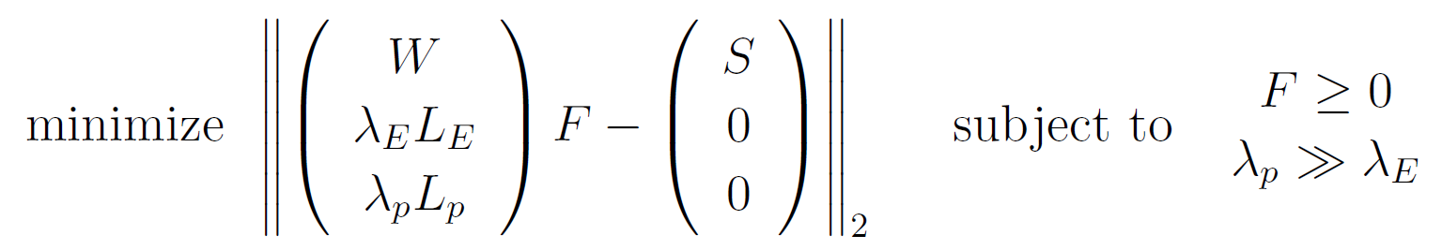
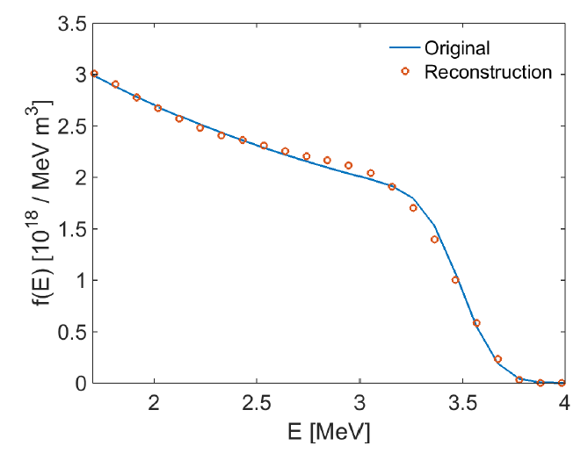
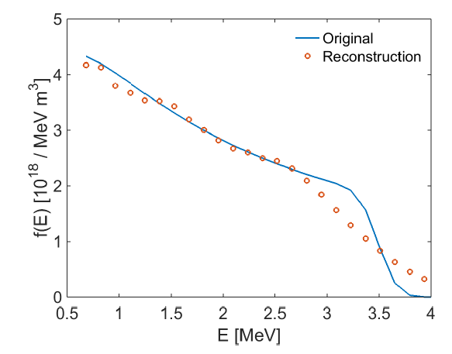
E<1.7 MeV: Energy spectrum inference assuming isotropy
Combined gamma-ray spectroscopy and collective Thomson scattering (>1.7 MeV)
Collective Thomson scattering only (>0.5 MeV)

Slide 27
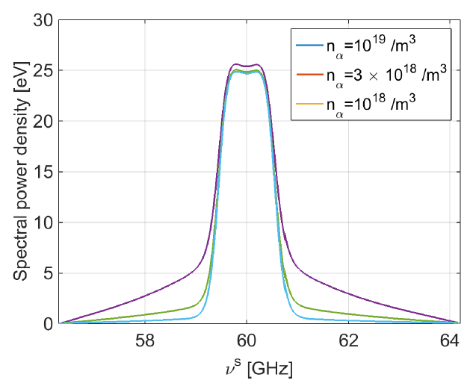
Alpha densities by fitting a model to the data
Compute expected spectrum for various alpha densities of an alpha-particle slowing down distribution

Slide 28
Conclusions
ITER measurement requirements on alpha energy spectra and densities can be fulfilled by solving inverse problems.
2D velocity-distribution functions by velocity-space tomography
  E>1.7 MeV in (E,|p|), requires oblique GRS detector to get (E,p)
Energy spectra
  Integrate 2D velocity distribution function over pitch
  Velocity-space tomography assuming isotropy
Alpha densities
  Integration of energy spectra above
  Fit a model to the measurements, e.g. isotropic slowing-down distribution
Velocity-space tomography experimentally demonstrated on JET and ASDEX Upgrade.
Thank you for your attention!

