Slide 1
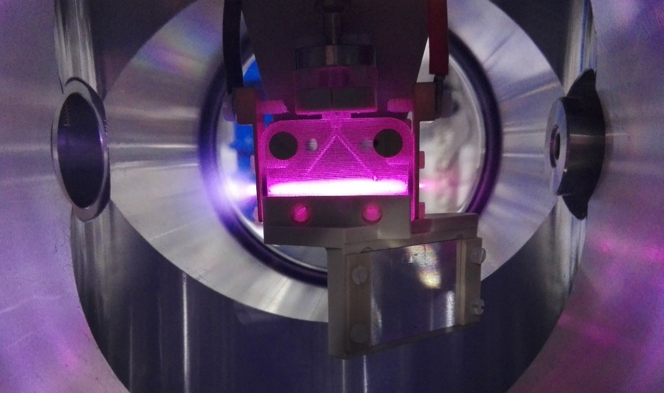
Temperature analysis in the shock waves regime for gas-filled plasma capillaries in plasma-based accelerators
Biagioni
On behalf of SPARC_LAB
collaboration
ICFDT5 3–5 October 2018, LNF Frascati Angelo.Biagioni@lnf.infn.it

Slide 2
Outline
Motivations
Plasma discharge capillaries as accelerating and focusing modules
Gas-filled capillary plasma source
Experimental set-up
Effect on electron beam parameters
Shock Wave method to measure plasma properties
Conclusions
ICFDT5 3–5 October 2018, LNF Frascati Angelo.Biagioni@lnf.infn.it

Slide 3
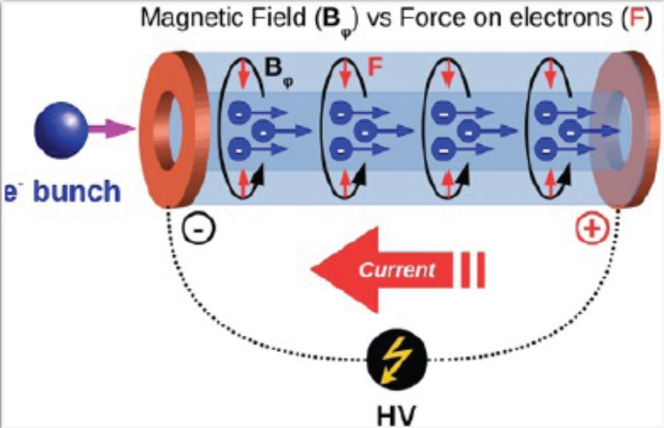
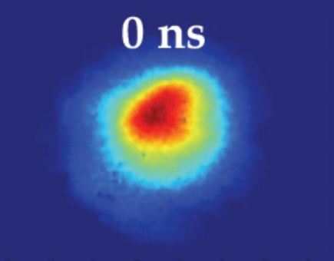
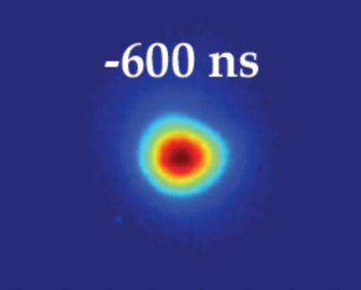
Plasma discharge capillary applications
n_{e} = 10¹⁶-10¹⁸ cm⁻³
V = 15-20 kV
Imax = 240 A
R = 500 μm
L = 1-3 cm
PWFA
Plasma lens
Focusing (Compactness)
90 μm
25 μm
B_{φ} > 500 T/m
Angelo.Biagioni@lnf.infn.it

Slide 4
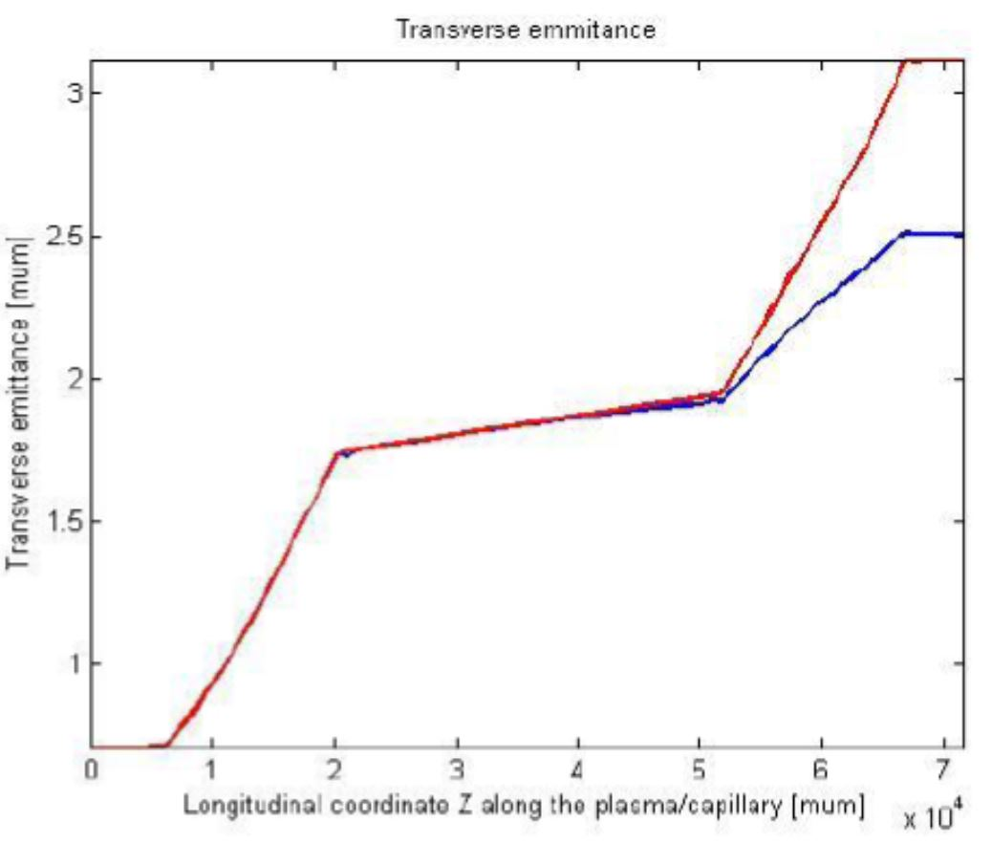
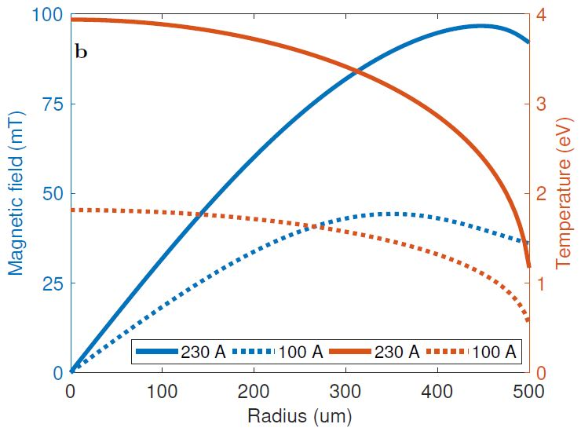
Motivations: Emittance Growth in Plasma Lenses
ε_{nx} = 1.4 μm
ε_{ny} = 1.6 μm
Plasma lens theoretical model,
courtesy of R. Pompili
Simulations by Architect,
courtesy of V. Shpakov
Capillary
Plamsa plumes
Transverse emittance (μm)
Stronger emittance
growth
ε_{nx} = 0.9 μm
ε_{ny} = 1.15 μm
Longitudinal coordinate Z (cm)
Emittance: we observe a stronger emittance growth during the plasma supersonic expansions until the plume density and the bunch density are comparable (plasma plume properties: pressure, temperature and density)
Temperature: the plasma temperature inside the capillary affects the magnetic field along the radius and so the electron beam focusing
Angelo.Biagioni@lnf.infn.it

Slide 5
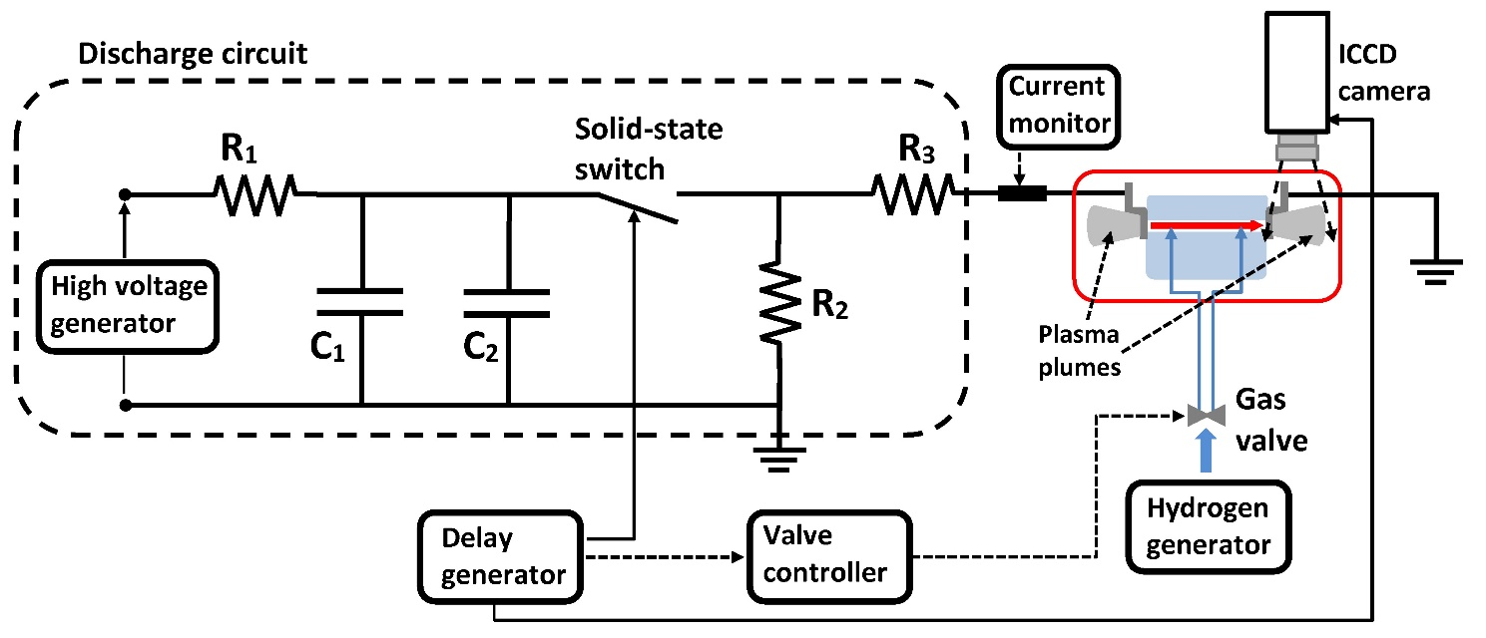
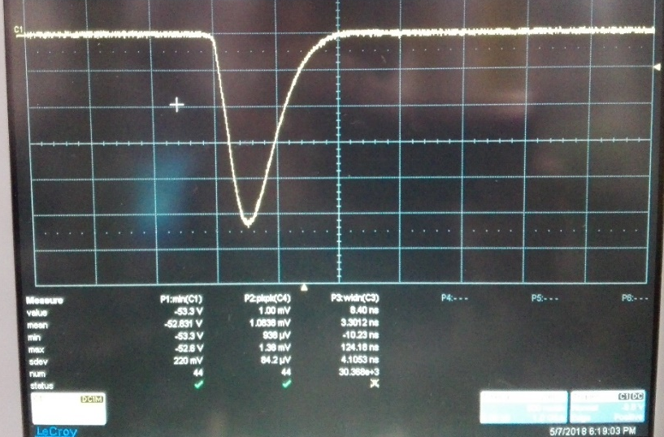
Plasma-discharge capillaries
Electrodes
Measured current pulse
Gas
outflow
I=240 A
V=20 kV
ICFDT5 3–5 October 2018, LNF Frascati Angelo.Biagioni@lnf.infn.it

Slide 6
Plasma plumes
20 images separated by 100 ns, so 2 µs of total observation time of the plasma plumes
The ICCD camera area is 1024 x 256 pixel
Vacuum
Discharge voltage 18 kV
Capillary
20 mm/2 μs
Plasma channel
Electrode
Both plama plumes can reach a total expansion length around 40 mm (20 mm each one) that is comparable with the channel length of 30 mm, so they can strongly affect the beam properties that passes through the capillary
Temperature, pressure and plasma density, inside and outside the gas-filled capillary plasma source, represent essential parameters that have to be investigated to understand the plasma evolution and how it can affect the electron beam.
Angelo.Biagioni@lnf.infn.it

Slide 7
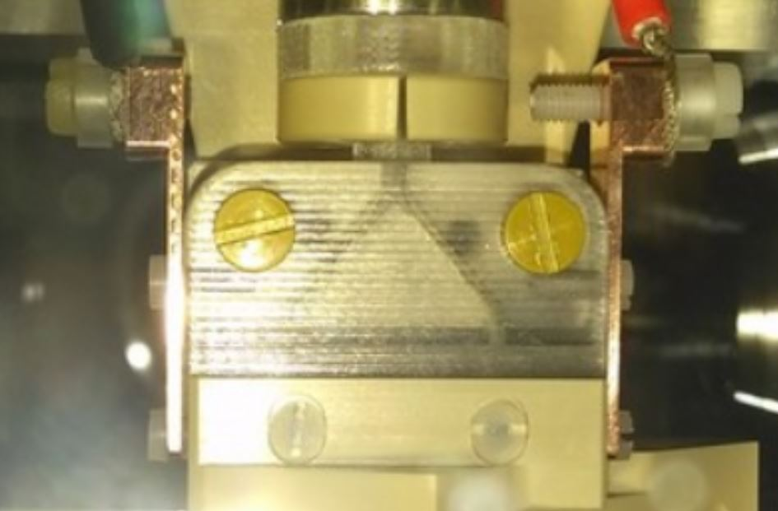
Shock regime in different capillary geometries
It has been studied how different geometrical properties can affect the termodynamc properties of the plasma (mixture of plasma, ions and neutral gas) and so the beam dynamics within the capillary
Both capillaries:
Voltage discharge: 18 kV
Opening time of the electrovalve: 3 ms (frequency 1 Hz)
H₂
H₂
Gas expansions will be different inside of two capillaries
(Turbulence, density, pressure, temperature…)
One inlet is placed in the center of the capillary
Inlet Ø = 0.5 mm
Plasma channel length = 10 mm
Plasma channel Ø = 1 mm
Two inlets are placed at 2/3 of the plasma channel length
Inlets Ø = 0.3 mm
Plasma channel length = 30 mm
Plasma channel Ø = 1 mm
Notes:
Indicare il tempo di apertura dell’elettrovalvola puo’ aver senso se prima dici che c’e’ un’elettrovalvola

Slide 8
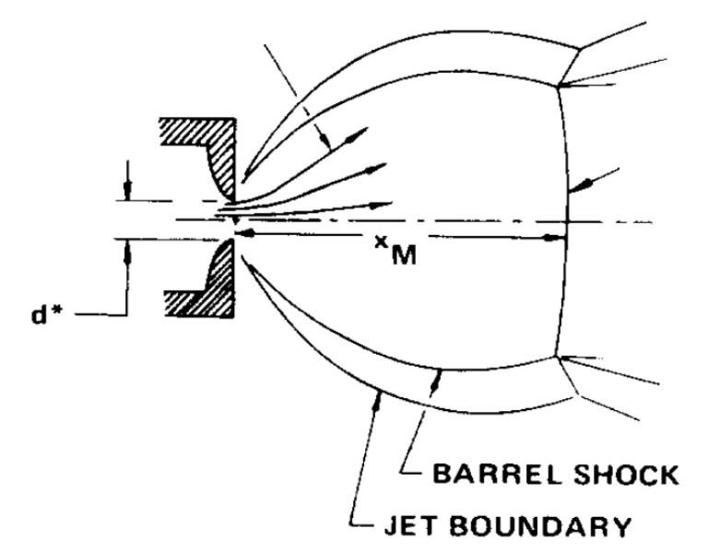
Free-jet shock structure
Background pressure (vacuum)
streamline
H2 gas inlets
Mack
disk
Capillary
M=1
M<1
Zone of silence (M>1)
Jet boundary
In the shock regime formation, the outflow velocity u will increase because the thermal energy of the gas inside capillary is converted in kinetic energy when it goes into vacuum (adiabatic),
The gas temperature decreases and therefore the characteristic sound speed will decrease along the plume axis.
The shock wave creation has to be described by using the Mach number M=u/c, so this parameter will increase while the plasma plume expands.

Slide 9
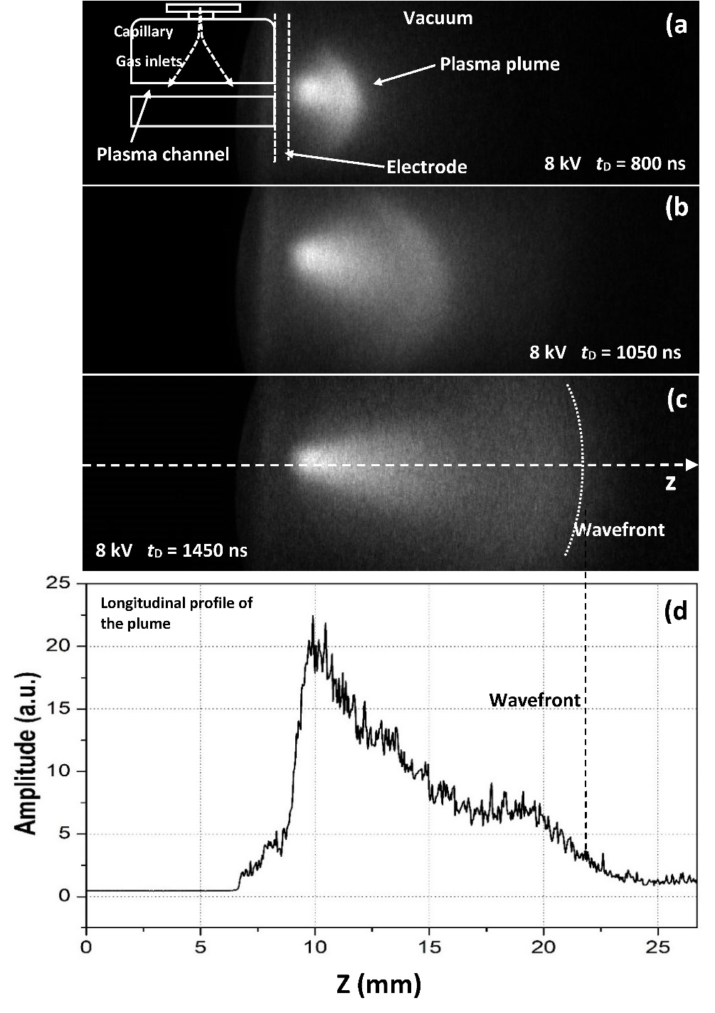
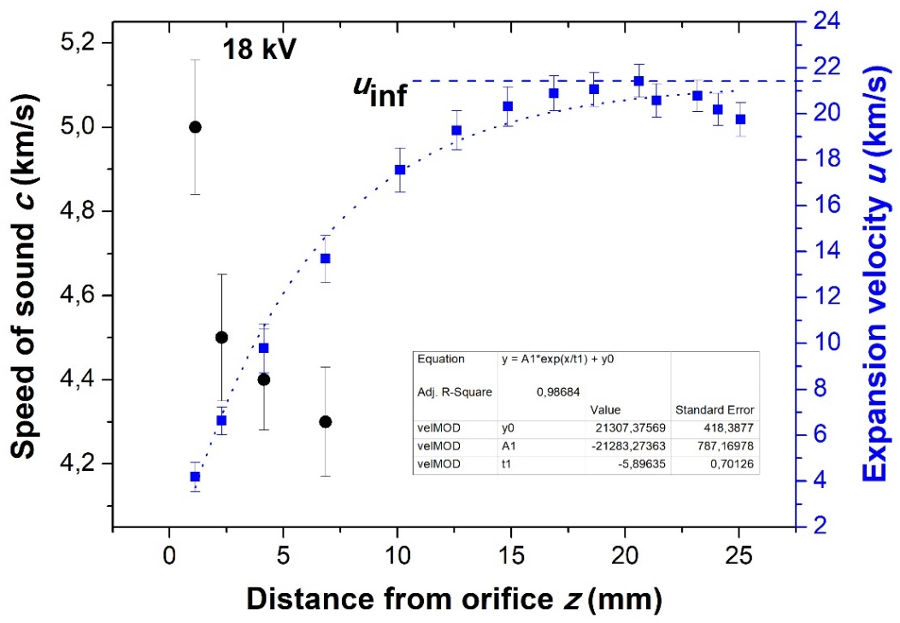
Shock regime analysis
ɣ_{H2} = 7/5
18 kV
18 kV
18 kV
The outflow velocity u will increase because the thermal energy of the gas inside capillary is converted in kinetic energy when it goes into vacuum (adiabatic)
The gas temperature decreases and therefore the characteristic sound speed will decrease along the plume axis.
Angelo.Biagioni@lnf.infn.it

Slide 10
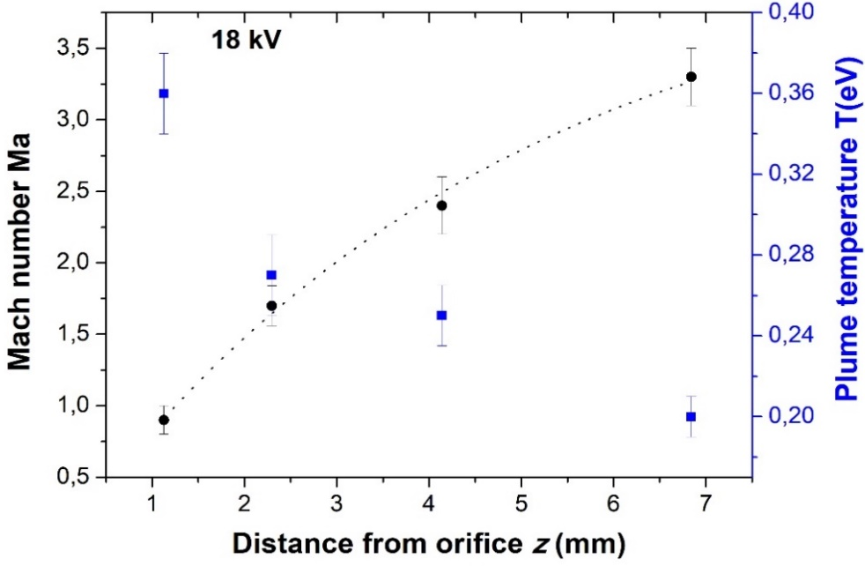
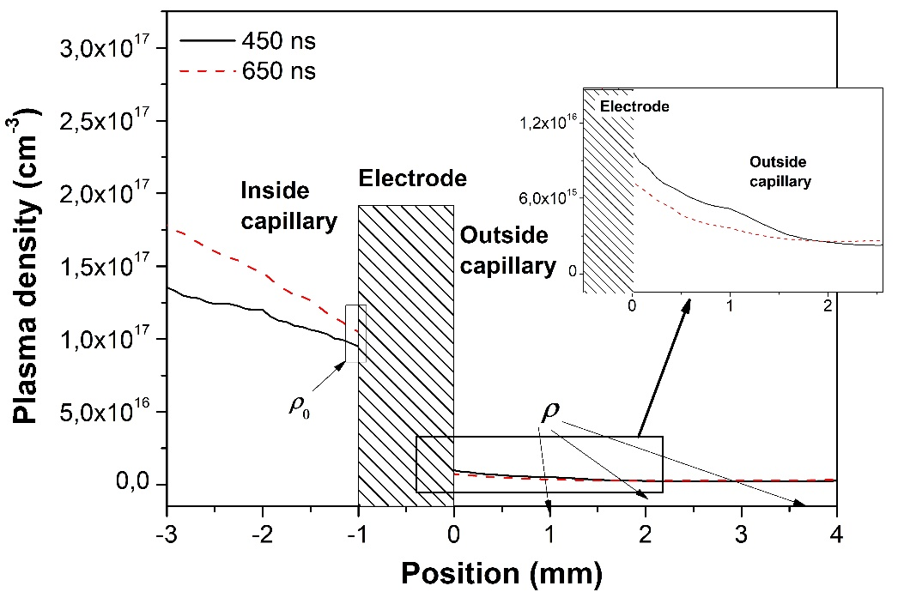
Shock regime analysis
Stark broadening
F. Saint-Laurent et al, Fusion Engineering and Design 89 (2014) 3022–3038
Alexander Naß and Erhard Steffens, NIMA, 598 (3), 2009 653-666

Slide 11
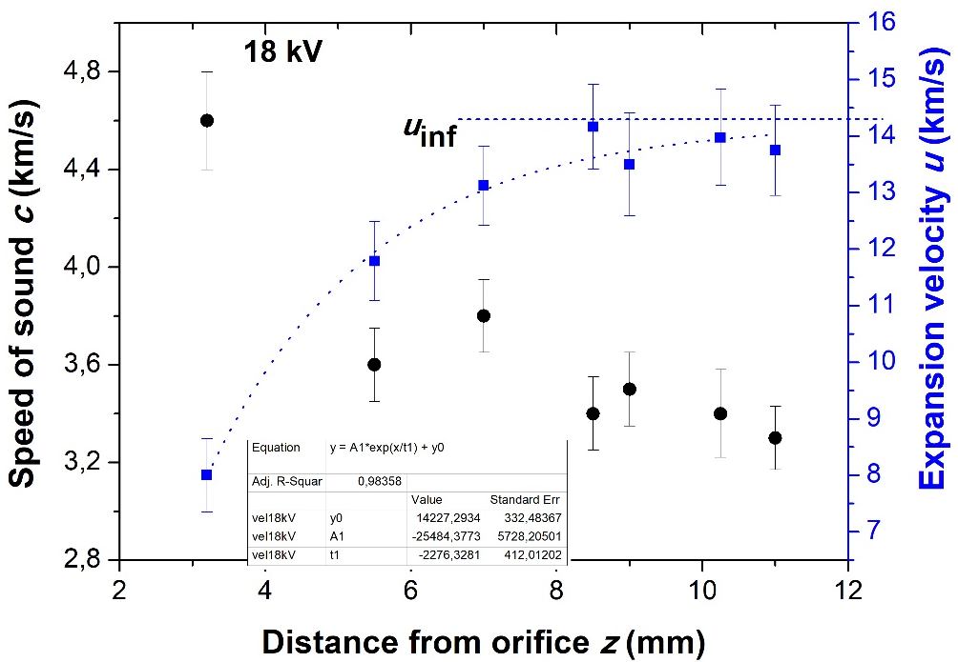
Discussion of results (I)
Short capillary (1cmx1mm)
Long capillary (3cmx1mm)
u∞ = 15 km/s
T₀ = 0.7 eV
c_{orifice} = 4.6 km/s
c_{capillary} = 6.9 km/s
L_{plume} = 11 mm
Plasma lens results:
e_{t} = 0.8 μm
σ ≈ 100x100 μm
e_{t} = 1.4 μm
σ = 22x24 μm
u∞ = 21 km/s
T₀ = 1.4 eV
c_{orifice} = 5 km/s
c_{capillary} = 9.4 km/s
L_{plume} = 20 mm
Plasma lens results:
e_{t}= 0.8 μm
σ ≈ 100x100 μm
e_{t} = 1 μm
σ = 18x20 μm
Different geometric properties of the capillary and the gas inside lead to different properties of the shock regime produced at the exits of the capillary itself
By analysing the plume’s thermodynamic properties it is possible to get important informations about how the capillary could affect the beam dynamics

Slide 12
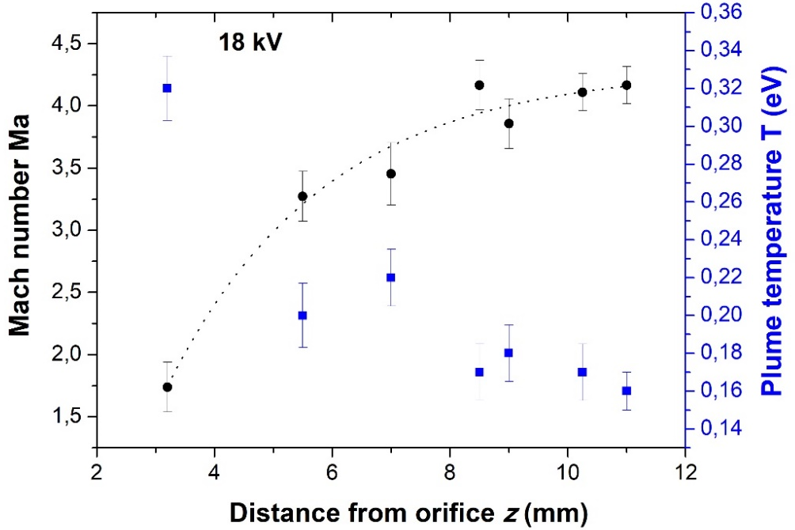
Discussion of results (II)
Short capillary (1cmx1mm)
Long capillary (3cmx1mm)
T₀ = 0.7 eV
T_{plume} = 0.32 -0.2 eV
M = 1.7 – 3.5 (max 4.1)
p_{capillary} = 60 mbar
p_{plume} = 4 - 1 mbar
T₀ = 1.4 eV
T_{plume} = 0.37 – 0.2 eV
M = 0.9 – 3.3
p_{capillary} = 150 mbar
p_{plume} = 2.5 - 1 mbar
Inside capillary we can suppose a sonic regime (Ma ≈ 1): the higher is the temp T₀, the higher is pressure p_{capillary}
Outside capillary there is a supersonic regime (1<Ma<5) but will be different between two capillaries: L_{plume}, ΔT_{plume}, Δp_{plume}
The turbolent regime inside capillary plays a crucial role for the thermodynamic properties f fluid motion characterized by chaotic changes in pressure and flow velocity

Slide 13
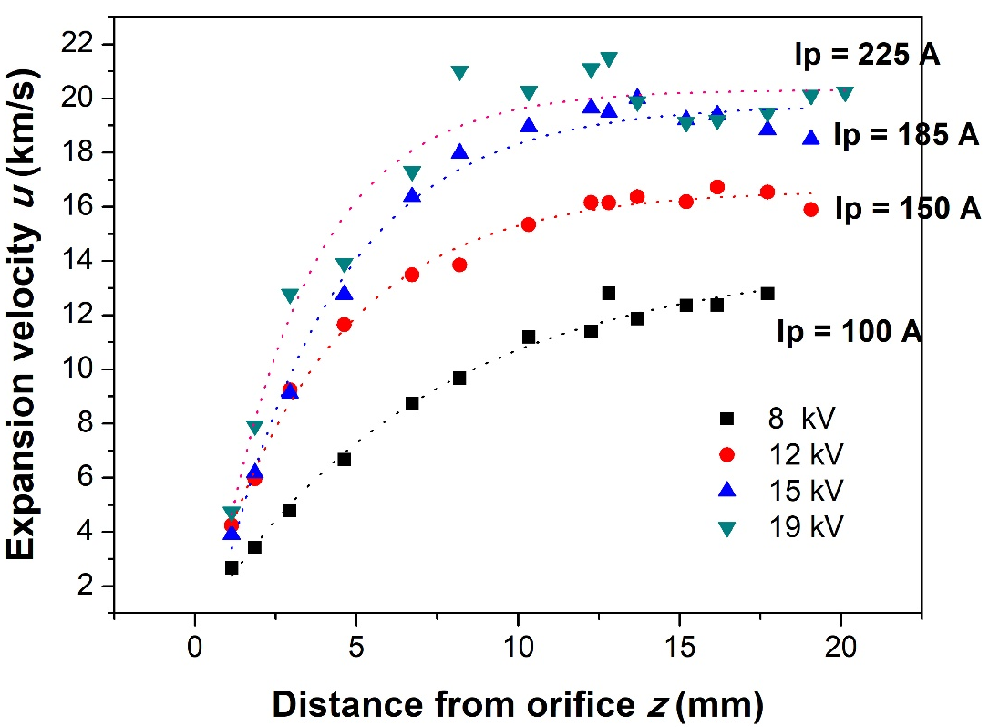
Discussion of results (III)
Long capillary (3cmx1mm)
Different current Ip inside the capillary will produce different temperature values that can be detected by using the shock regime at the ends of the capillary
Ip = 100 A, T₀ = 0.5 eV
Ip = 150 A, T₀ = 0.85 eV
Ip = 185 A, T₀ = 1.1 eV
Ip = 225 A, T₀ = 1.4 eV

Slide 14
Conclusions
The plasma confinement for plasma-based accelerators by mean of gas-filled capillary represents a good solution but several parameters have to be monitored to preserve the beam quality
Thermodynamic properties, as temperature, pressure, density, particles velocities and gas turbulence, can evolve at different regime inside and outside the capillary, which in turn affect the beam dnamics
By analyzing plasma plumes coming out from the orifices we have obtained the following results:
This thermodynamic properties assume a crucial role for the LWFA, because the laser will be affected by temperature, speed and pressure changing both at entrance and exit of the capillary
An accurate study of the turbulent regime inside the capillary should be made to understand how the plasma properties can evolve
T₀ in the capillaries, close to the ends and on axis, is 0.8-1.4 eV
The temperature T outside the capillary shows an exponential decay
Also the pressure p outside the capillary decreases exponentially with the distance from orifice
The pressure in the capillary p₀ depends on the capillary shape (50-160 mbar) and accords with the sound speed inside capillary (6.9 km/s – 9.4 km/s)
Angelo.Biagioni@lnf.infn.it

Slide 15
Thank you
for your attention
ICFDT5 3–5 October 2018, LNF Frascati Angelo.Biagioni@lnf.infn.it

Slide 16
Limits of applicability: Knudsen number
The Knudsen number (Kn) is defined as the ratio of the molecular mean free path length (λ) to a representative physical length scale. This length scale could be, in our case, the capillary length (L)
Kn defines our flow regime:
Viscous fluid, Kn < 0,01
Molecular fluid, Kn > 1
Transition regime, 0,01 < Kn < 1
In fluid dynamics, the Knudsen number is used to define the limits of applicability of the continuum mechanics to the fluids and so the applicability of the Navier-Stokes equations
If Kn < 0.01, we can apply the previous theory to our gas expansion, considering it as a continuum fluid (we can use N-S eqs, that is continuity equation, first and second laws of thermodynamics)
In the zone of silence:
Shorter capillary
Longer capillary
In our region of interest, the zone of silence, the Knudsen number is always < 0.01

Slide 17
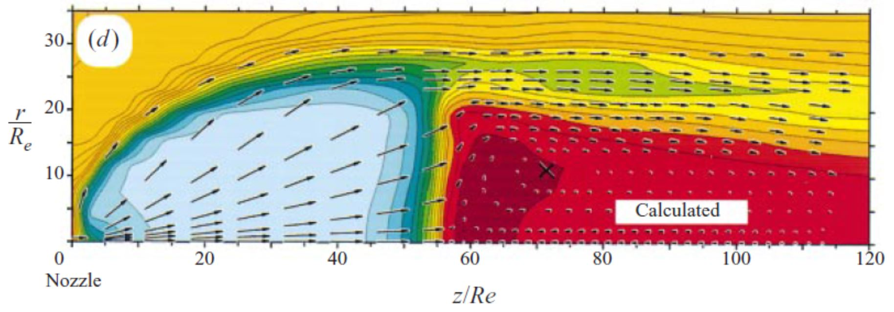
On axis-symmetric free-jet gas expansions
A free-jet atomic or molecular flow can be produced by a supersonic gas expansion from a high-pressure gas source into a low pressure background, for this regime:
If , the flow will exit supersonically (G≤2.05, for all gases)
the flow parameters in the zone of silence are independent of boundary conditions (walls, p_{b}), which is caused by the fact that information propagates at the speed of sound, whereas the gas moves faster

Slide 18
Temperature by using Stark effect
Plasma density determination using Stark broadening of spectral lines is a well established and reliable technique in the range of number density10¹⁴–10¹⁸ cm⁻³
The electron temperature is an equally important plasma parameter which can be determined spectroscopically from the ratio of integrated line intensities
where ε(λ) is the emissivity, α(λ) is the absorption coefficient in cm⁻¹, and L is the plasma length along the line of sight to the observer
When we want to measure a temperature, the system should be in a thermodynamic
equilibrium; since it is rarely complete, we can consider a useful approximation, local thermodynamic equilibrium (LTE):
So far, we were not able to obtain the plasma temperature because we were not able
to measure the line intensities

