Slide 1
Frontier Applications of Metamaterials to Magnetic Confinement Fusion
F.A. Volpe
Columbia University, New York, NY
Presented at ICFDT5 – 5th International Conf. on Frontiers in Diagnostic Technologies, Frascati, Itay
October 4, 2018

Slide 2
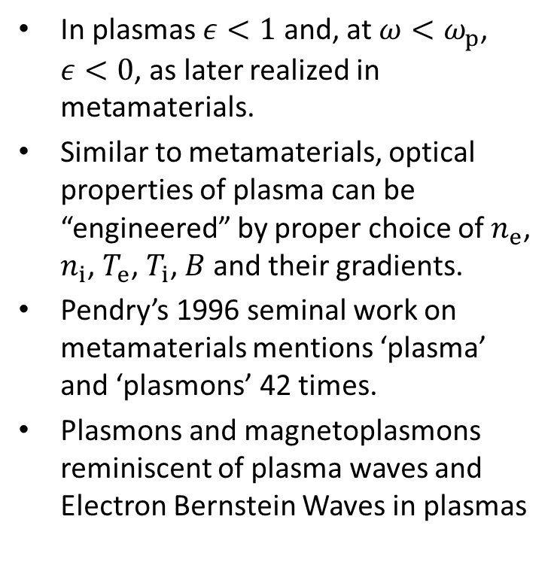
Plasmas and metamaterials have a long history of flirting with each other
In plasmas $ε<1$ and, at $ω<ω_{p}$, $ε<0$, as later realized in metamaterials.
Similar to metamaterials, optical properties of plasma can be “engineered” by proper choice of $n_{e}$, $n_{i}$, $T_{e}$, $T_{i}$, $B$ and their gradients.
Pendry’s 1996 seminal work on metamaterials mentions ‘plasma’ and ‘plasmons’ 42 times.
Plasmons and magnetoplasmons reminiscent of plasma waves and Electron Bernstein Waves in plasmas
Artificial dielectrics [Kock 1946] applied to plasma diagnostics in 1980-90’s (e.g. [Volpe-Laqua 2003] and refs. therein).

Slide 3
Outline
Motivation
Reverse chromatic aberration
Metamaterial lens
Numerical opimization
Ink-jet manufacturing
Rapid frequency-controlled steering

Slide 4
Example of special needs of plasma diagnostics that can be addressed by metamaterials
Electron Cyclotron Emission is microwave emission from gyrating electrons in magnetized plasmas
Important for temperature measurement
Emission at different frequencies f originates at different locations → Challenge for focusing:
focal length should vary dramatically (increase) with f
This “reverse” chromatic aberration cannot be obtained with convergent lenses of conventional materials.
It can be obtained with a metamaterial lens.

Slide 5
High sensitivity of focus to f might find application in survey, satellite observations, directed energy.
If object to be detected/irradiated is
  Moving
  Non-monochromatic
And sensor/receiver is rapidly (electrically) tunable
Then rapid change of f → rapid change of focus
No moving parts in the optics

Slide 6
Control of chromatic aberration at design stage and rapid inexpensive ink-jet manufacturing also have numerous applications
Reverse chromatic aberration lens can compensate for regular chromatic aberration of other lenses in optical system
Flat lens of zero chromatic aberration can be designed and manufactured by same methods
Ink-jet printing can be applied to RF IC circuits, antennas, magnetic sensors, etc.
It can allow rapid prototyping, manufacturing and customization to specific frequency, polarization, focus etc.

Slide 7
What is “reverse” Chromatic Aberration?

Slide 8
What is “reverse” Chromatic Aberration?

Slide 9
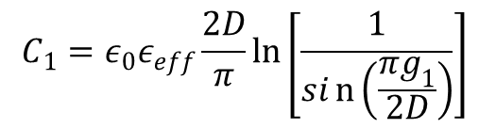
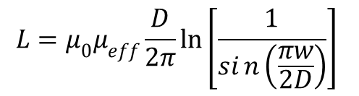
Sandwiches of inductive and capacitive layers behave like LC transmission lines
$$C_{1}=ε_{0}ε_{eff}\frac{2D}{π}\ln\left[\frac{1}{sin\left(\frac{πg_{1}}{2D}\right)}\right]$$
$$L=μ_{0}μ_{eff}\frac{D}{2π}\ln\left[\frac{1}{sin\left(\frac{πw}{2D}\right)}\right]$$

Slide 10
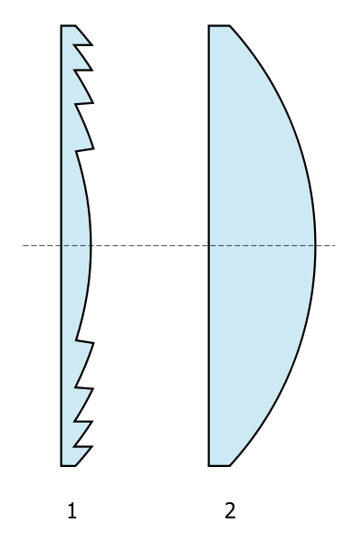
2D array of LC filters imparting different Δφ behaves like a Fresnel lens

Slide 11
2D array of LC filters imparting different Δφ behaves like a Fresnel lens
Designed, built and testing a 7 zone RCA lens for 8-12 GHz.
Designed an 83 zone RCA lens for 80-130 GHz.

Slide 12
Reverse Chromatic Aberration is obtained by imposing vast zone-to-zone variation of Δφ at low f and more uniform response at high f

Slide 13
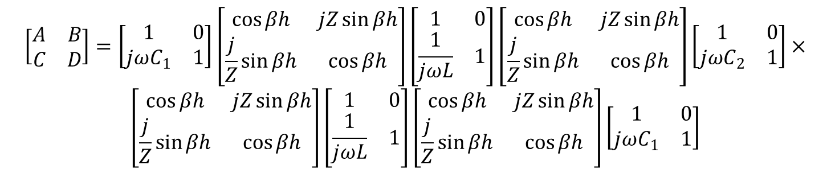
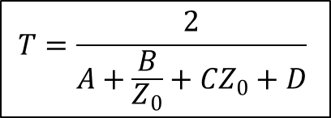
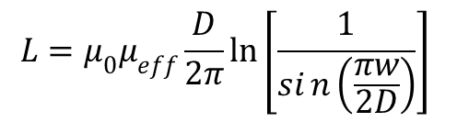
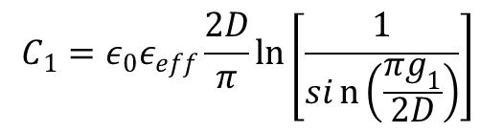
Geometrical dimensions can be analytically optimized to obtain desired Δφ(f) in each zone
$$L=μ_{0}μ_{eff}\frac{D}{2π}\ln\left[\frac{1}{sin\left(\frac{πw}{2D}\right)}\right]$$
$$C_{1}=ε_{0}ε_{eff}\frac{2D}{π}\ln\left[\frac{1}{sin\left(\frac{πg_{1}}{2D}\right)}\right]$$
$$T=\frac{2}{A+\frac{B}{Z_{0}}+CZ_{0}+D}$$
$$\left[\begin{matrix}A & B \\ C & D\end{matrix}\right]=\left[\begin{matrix}1 & 0 \\ jωC_{1} & 1\end{matrix}\right]\left[\begin{matrix}\cos{βh} & jZ\sin{βh} \\ \frac{j}{Z}\sin{βh} & \cos{βh}\end{matrix}\right]\left[\begin{matrix}1 & 0 \\ \frac{1}{jωL} & 1\end{matrix}\right]\left[\begin{matrix}\cos{βh} & jZ\sin{βh} \\ \frac{j}{Z}\sin{βh} & \cos{βh}\end{matrix}\right]\left[\begin{matrix}1 & 0 \\ jωC_{2} & 1\end{matrix}\right]×$$
$$\left[\begin{matrix}\cos{βh} & jZ\sin{βh} \\ \frac{j}{Z}\sin{βh} & \cos{βh}\end{matrix}\right]\left[\begin{matrix}1 & 0 \\ \frac{1}{jωL} & 1\end{matrix}\right]\left[\begin{matrix}\cos{βh} & jZ\sin{βh} \\ \frac{j}{Z}\sin{βh} & \cos{βh}\end{matrix}\right]\left[\begin{matrix}1 & 0 \\ jωC_{1} & 1\end{matrix}\right]$$

Slide 14
…or problem can be solved numerically
Single cell of dimensions D, w, g₁, g₂, etc. is modeled with finite element code (CST).
Transmittance T and phase-shift Δφ at various frequencies f₁, f₂, etc. are stored.
Calculation is repeated for various D, w, g₁, g₂, etc. Database is built.
For each zone, we pick D, w, g₁, g₂, etc. yielding best match between calculated T and Δφ and desired T and Δφ
Contours of Δφ(deg) at f=10GHz
(mm)
(mm)
(mm)

Slide 15
Numerically optimized Δφ(f) matches desired Δφ(f) for RCA at f=8-12GHz
W.J. Capecchi et al., Optics Express 20, 8761 (2012)

Slide 16
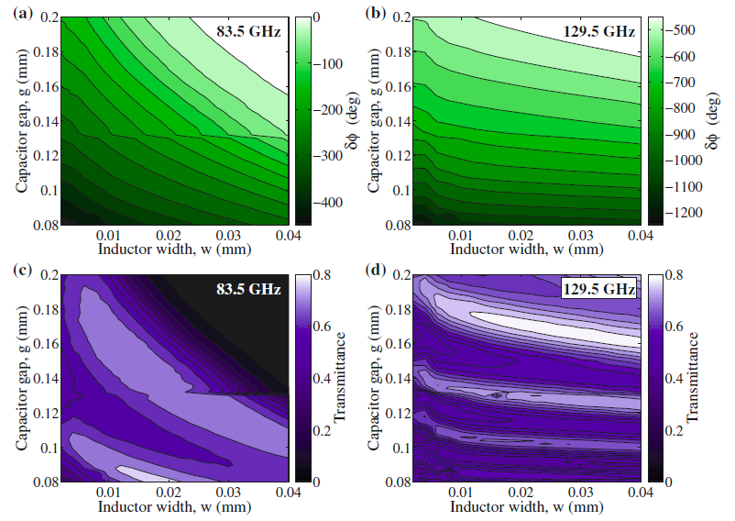
Database was also built for f=80-130 GHz (ECE at DIII-D)

Slide 17
Relaxing constraints on absolute phase improves agreement with desired Δφ(f)
Only relative phase (zone-to-zone) matters
G=“Goal function” (the smaller the better)
K.C. Hammond et al., J Infrared Milli Terahz Waves 34, 437 (2013)

Slide 18
Individual fine-tuning of geometrical parameters in each layer further improves the agreement

Slide 19
Optimized cells put together and treated as attenuated and delayed dipole-emitters → Interference pattern → Global lens response

Slide 20
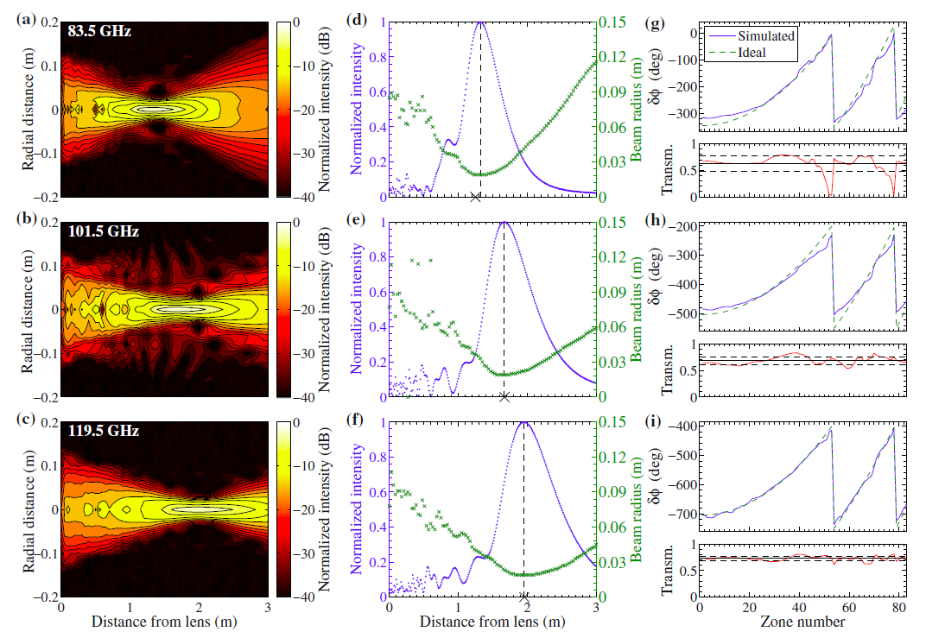
Obtained desired RCA for maximum transverse resolution in ECE at at DIII-D.
A single lens focuses different f at different locations where that f is EC-emitted.

Slide 21
Sidelobes were explained with non-uniform transmissivity across zones → grating → diffraction maxima

Slide 22
Simulations show that varying the lens aperture changes its focal length → a diaphragm acting as a zoom!

Slide 23
EC-emitting locations are always in focus, with metamaterial lens. They are not in focus with present mirror.
B=-2.0T
B=-1.56T
EC-emitting locations
Regions of good focusing

Slide 24
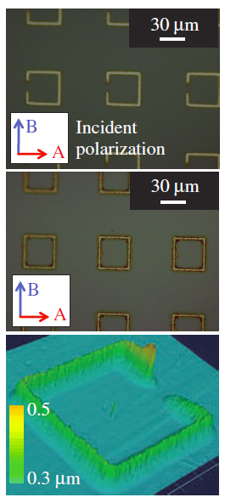
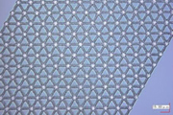
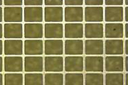
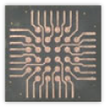
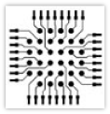
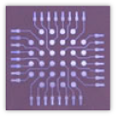
Ink-jet printing is capable of 1-5μm details
Silver, lines: 3μm, spacing: 15μm
Gold, lines: 5μm, spacing: 50μm
Conventional printer CAD Super-fine Printer
K. Takano et al., Applied Phys. Expr. 2010
Sjctechnology.com

Slide 25
Low-power 8-12 GHz lens manufactured using an ink-jet printer and silver-nanoparticle ink
(show samples)
Ink = liquid suspension of ~5nm Ag nanoparticles
Resistivity 3μΩcm after 1h sintering at 150-200ºC (bulk Ag 1.6μΩcm).
Printed circuit board (PCB) techniques (e.g., laser) also under consideration
80-130 GHz might require lithography, laser raster or integrated circuit (IC) nano/microfabrication techniques
Tests of 8-12 GHz lens starting soon

Slide 26
Extension to high power requires modified design and materials
Some motivations:
  Tunable gyrotrons
  Rapid steering of ECCD for NTM stabilization w/o moving mirrors in vessel
  Collective Thomson Scattering
Simple! Replace:
  plastic dielectric → recirculating cooling fluid (freon FC-75)
  Square patches → stripes (2 sets, orthogonal)

Slide 27
Frequency-controlled Steering
Same num. technique can be used:
  Prescribe Δφ(f) for each cell
  Different spatial profiles of Δφ(f)
“Super-diffractor”: diffraction grating of metamaterial-enhanced resolving power
High sensitivity to f important

Slide 28
Conclusions
Proper array of microfabricated phase-shifters acts as a lens.
Optimizing its dimensions allows to match a desired dependence of focal length on frequency, including extreme and reverse chromatic aberration.
Numerical example for 8-12 and 80-130 GHz.
Lens for 8-12 GHz was manufactured by ink-jet printing (with silver nanoparticle ink) on dielectric substrate.
  Inexpensive, fast, suited for low-power, low-frequency.
  Alternatives at high-power and/or high-frequency were discussed.
Numerical technique can be extended to:
  aberration-free lens
  rapid frequency-controlled steering
With different designs and materials, manufacturing can be extended to high-power heating, current drive & active diagnostics.

