Slide 1


ANTARES highlights and recent multi-messenger studies
V. Kulikovskiy (INFN Genova)

Slide 2
Neutrino as a messenger
hadronic
accelerator
source
surrounding
Neutrino detection provides a strong indication of hadronic acceleration in astrophysical sources.
Should be connected wit gamma-rays emission for the most sources.
Neutrinos
  electrically neutral -> trajectory not affected
  by magnetic fields, point back to the source
  stable -> travel long distances
  weakly interacting -> penetrate regions which are opaque to photons
at source
at Earth

Slide 3

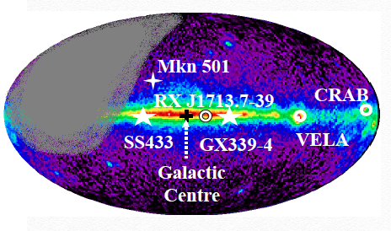
ANTARES
June 18th
Angular resolution
0.3-0.4º (median)
Effective area ~1 m² @ 30 TeV
Visibility ¾ of the sky, most of the galactic plane.
40 km offshore from Toulon
Three-dimensional array of 885 PMTs
12 vertical lines, 25 storeys
3 PMTs per storey
PMT facing 45° downwards

Slide 4
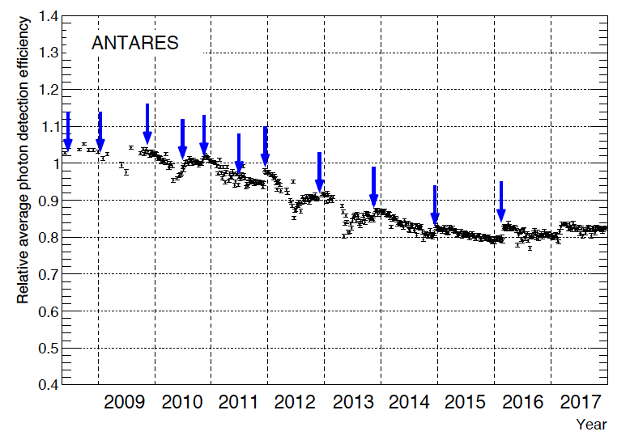
ANTARES
June 18th
Only 20% OM efficiency decrease.
Still running with 11/12 lines

Slide 5
High E_{ν}: Neutrino events reconstruction
Angular resolution:
<0.4º (E>10 TeV)
Energy resolution:
<0.5 (log E_{μ})
μ
ν_{μ}
track-like events ν_{μ}(CC)
Angular resolution:
~3º (E>10 TeV)
Energy resolution (E_{ν}):
~25%
ν
shower-like events
ν_{μ}(NC), ν_{e,} ν_{τ}
21/06/18
ANTARES highlights and recent multi-messenger studies, V. Kulikovskiy, CRIS
5

Slide 6
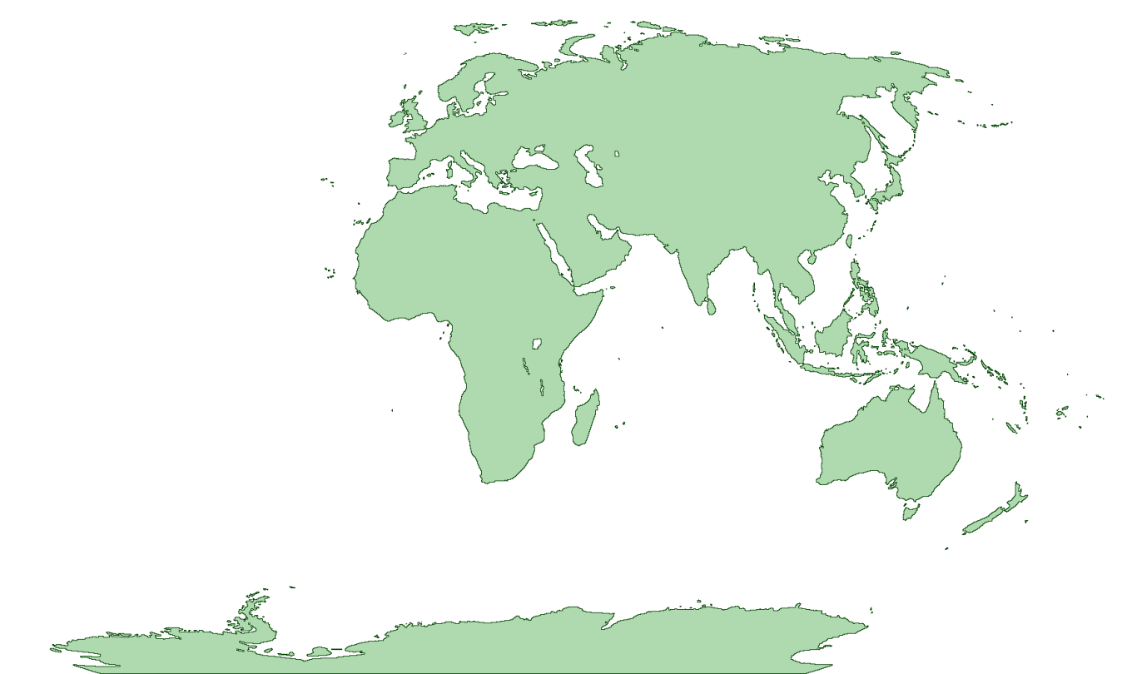



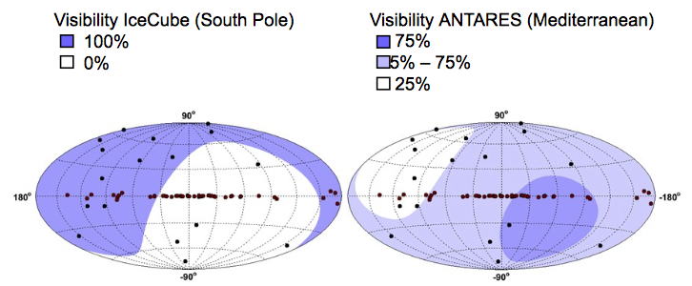

Global Neutrino Network (GNN)
ANTARES and KM3NeT
  Mediterranean Sea
IceCube
  Antarctic Ice
Baikal
  Lake Baikal
~ 3.5π sr sky coverage

Slide 7

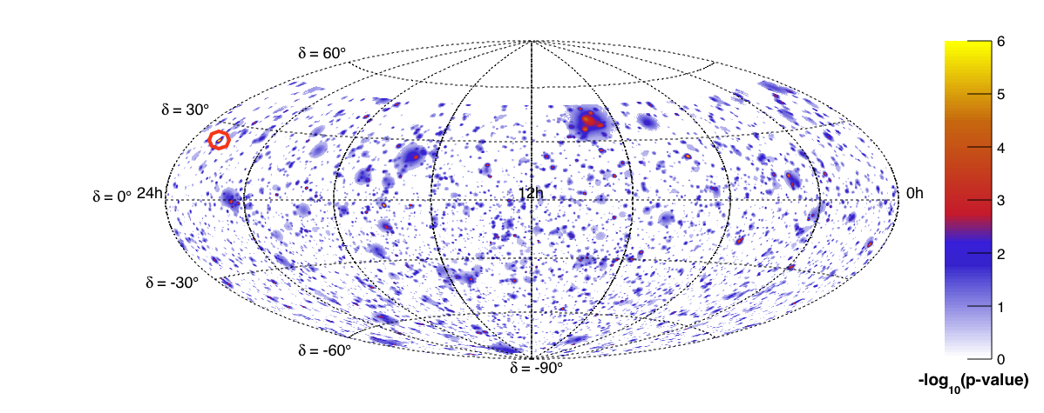
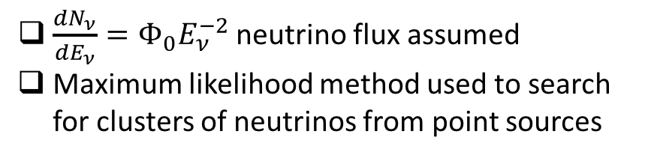
Point sources
Phys. Rev. D 96, 082001
$\frac{dN_{ν}}{dE_{ν}}=Φ_{0}E_{ν}^{−2}$neutrino flux assumed
Maximum likelihood method used to search for clusters of neutrinos from point sources
Sample:
2007 - 2015
2424 days of lifetime
First all-flavour analysis
7622 tracks, 180 showers
Full-sky search
  1°x1° squares over ANTARES visible sky
Candidate list searches
  106 known astrophysical objects (Pulsars, SNRs, …)
  13 IceCube HESE tracks
Most significant cluster
1.9σ significance
Sky map in equatorial coordinates of pre-trial p-values

Slide 8
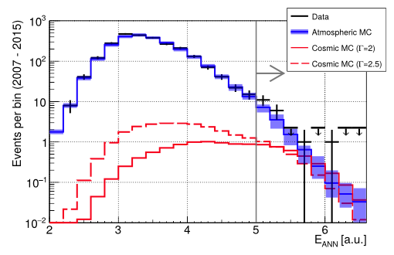
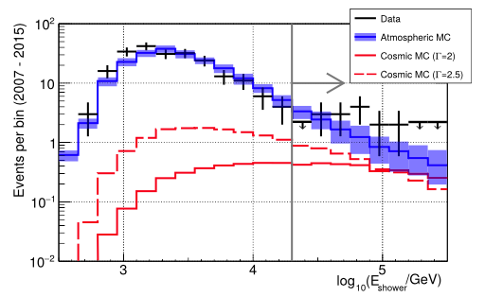
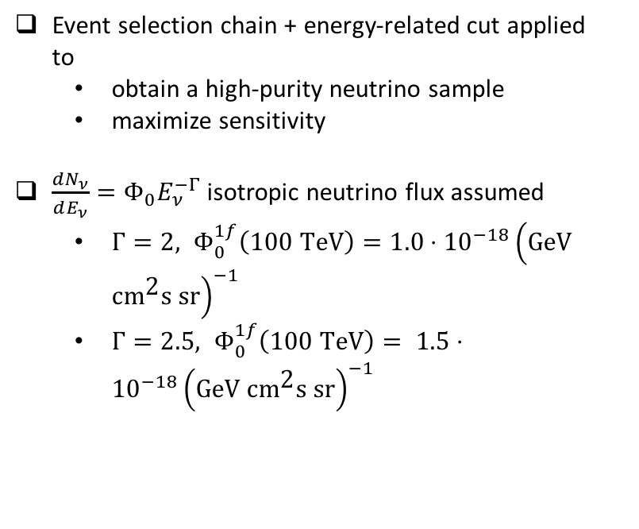
ANTARES – Diffuse flux
ApJL 853, L7 (2018)
Sample:
2007 - 2015 (2450 days of lifetime)
All-flavour analysis
Event selection chain + energy-related cut applied to
  obtain a high-purity neutrino sample
  maximize sensitivity
$\frac{dN_{ν}}{dE_{ν}}=Φ_{0}E_{ν}^{−Γ}$isotropic neutrino flux assumed
  $Γ=2, Φ_{0}^{1f}\left(\text{100 }\text{TeV}\right)=1.0⋅{10}^{−18}{\left(\text{GeV} \text{c}{\text{m}}^{\text{2}}\text{s} \text{sr}\right)}^{−1}$
  $Γ=2.5, Φ_{0}^{1f}\left(\text{100 }\text{TeV}\right)= 1.5⋅{10}^{−18}{\left(\text{GeV} \text{c}{\text{m}}^{\text{2}}\text{s} \text{sr}\right)}^{−1}$
TRACKS
Results:
33 events (19 tracks + 14 showers) in data
24 ± 7 (stat.+syst.) events in background MC
1.6σ excess, null cosmic rejected at 85% CL
SHOWERS

Slide 9
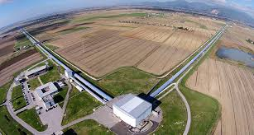
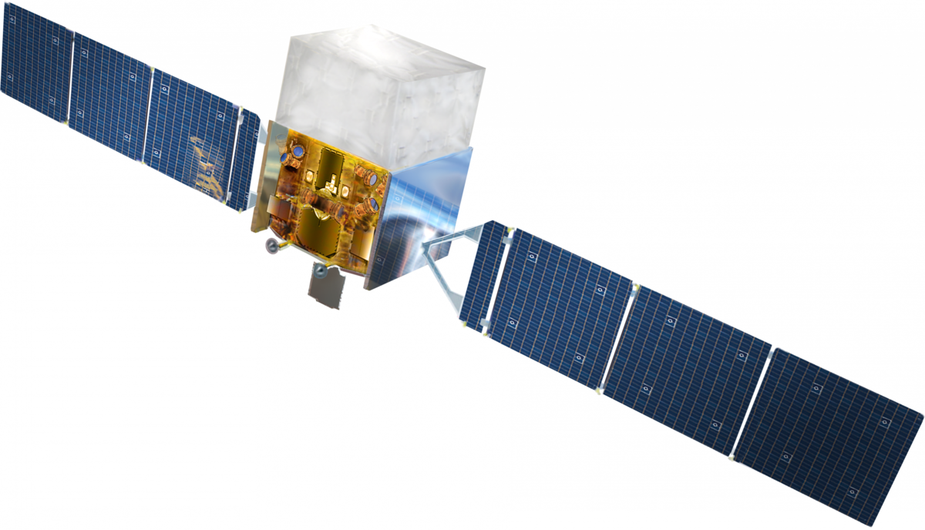
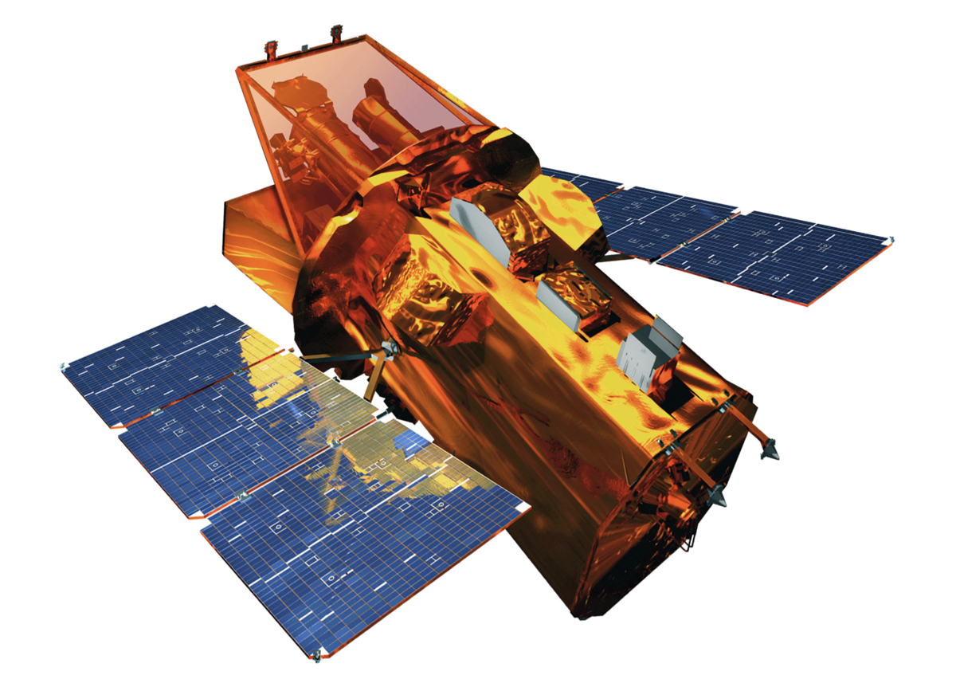
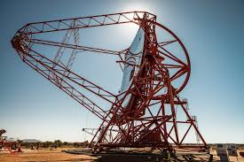
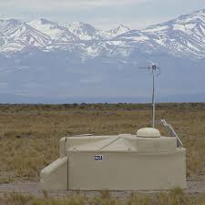
ANTARES – Multi-messenger
Two(+) approaches
Real-time analysis
Alert triggering
Online alert
Offline data
Prompt search Offline analyses
+ …

Slide 10
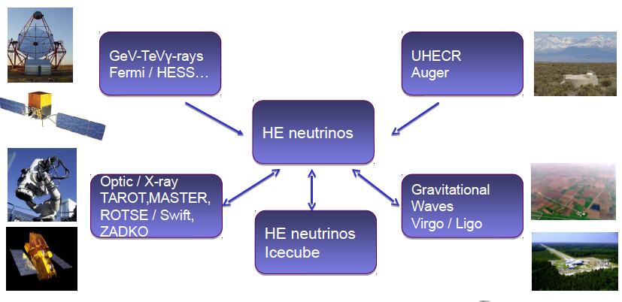

Multi-messenger programs
* participation to
+SNEWS for low E_{ν}:
receiving alerts for ANTARES
sending with KM3NeT?
Bringing together the astronomy, astrophysics and particle astrophysics communities.

Slide 11
ANTARES neutrino alerts
Real-time analysis
Alert triggering
+ …

Slide 12
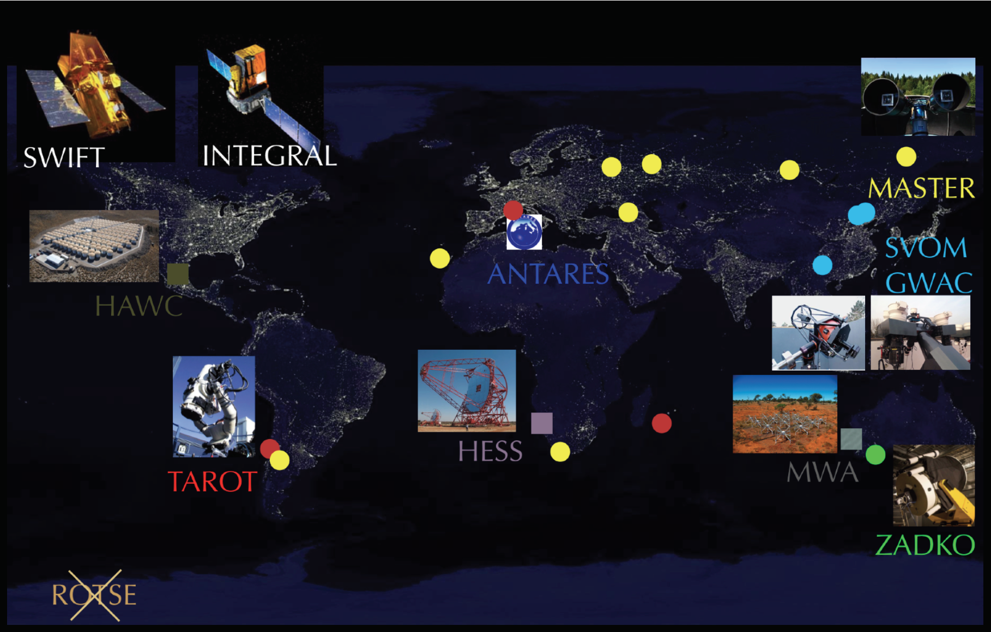
Real-time neutrino alerts
Optical
X-ray
Radio
GeV ɣ-rays
TeV ɣ-rays
MWA
TAROT
ZADKO
MASTER
GWAC
Swift
INTEGRAL
Fermi
HESS
HAWC
Triggers:
Doublet of neutrinos (<3º, <15 min): ~0.04 events/yr
Single neutrino with direction close to local galaxies: ~1 TeV, ~10 events/ yr
Single HE neutrinos: ~5 TeV, 20 events/ yr
Single VHE neutrinos: ~30 TeV, ~3-4 events/ yr
Performances:
Time to send an alert: ~5 s
Median angular resolution: ~ 0.4°
277 to robotic telescopes
+15 to Swift
+8 to INTEGRAL
+~22 to MWA
+2 to HESS
Sent neutrino alerts
(2009-2018)

Slide 13
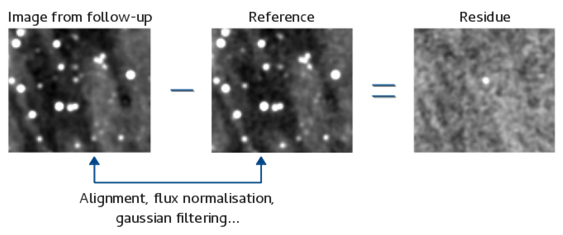
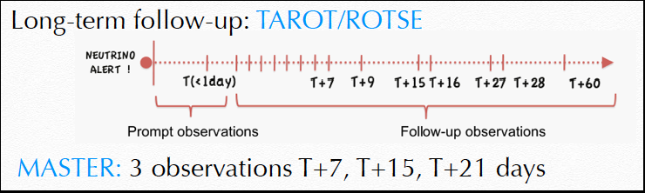
Optical+X-ray follow-up
Adrian-Martinez S. et al., JCAP 02 (2016) 062
Optical: 161 alerts 01/2010-07/2017 by TAROT, ROTSE,MASTER (63% of all alerts) =>24 alerts with delay <1min
X-ray (SWIFT XRT): 14 alerts 06/2013-08/2017 => average delay ~5-6h
➡ No candidate associated to neutrinos, constrain a GRB origins.
177 alerts with a “rather good” long-term follow-up (01/2010-07/2017).
No SN (and no interesting transient) associated with neutrinos.
  N_{exp}(SN) = 0.3-0.4 [SN rate=2.4 10-4 yr⁻¹Mpc⁻³]
Notes:
Grey lines: corrected R magnitude as a function of time for 301 GRB afterglows observed
from 1997 to 2014 by optical telescopes. Red & blue dots: upper limits on GRB magnitudes for
neutrino alerts observed by TAROT and ROTSE respectively. Each point represents the rst image
of the observation, corresponding to an exposure of 180 seconds for TAROT images, and 20 or 60
seconds for ROTSE images. The horizontal dashed line corresponds to the maximum sensitivity of
the telescopes
Grey lines: 689 X-ray afterglow fuxes in the energy band from 0.3 to 10 keV detected
by the Swift -XRT from 2007 to 2015 as a function of time. The upper limits on GRB fuxes for
13 neutrino alerts are represented by red triangles.

Slide 14
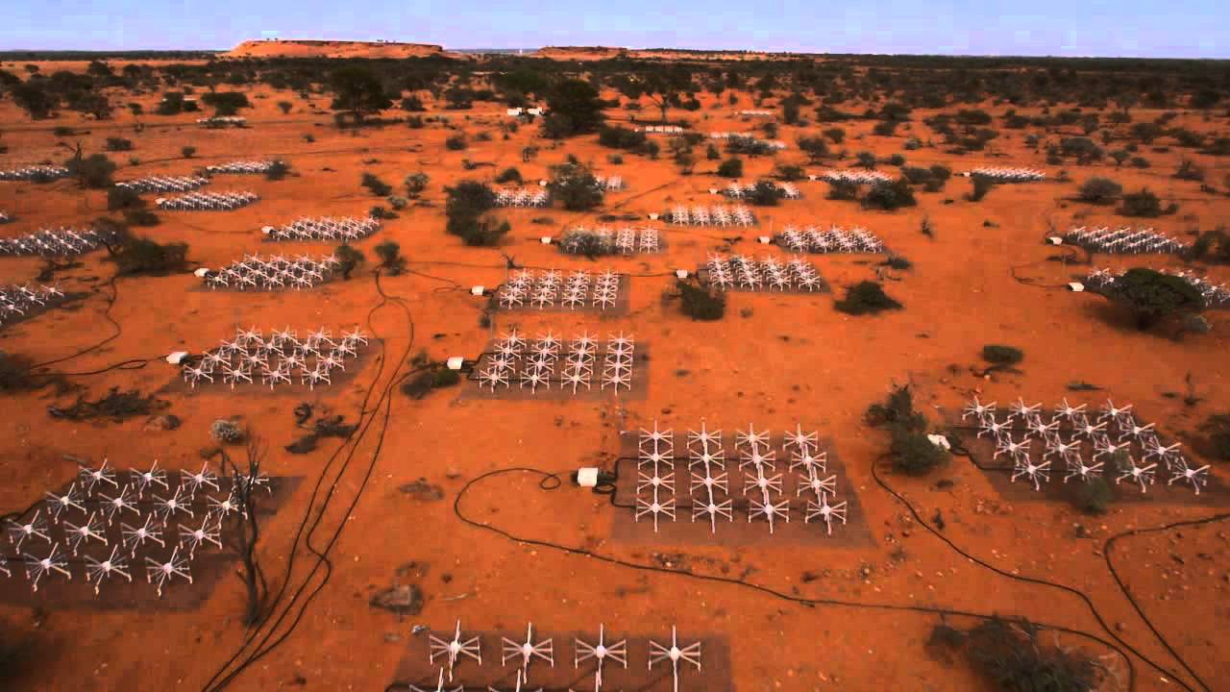
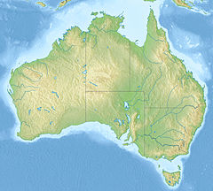
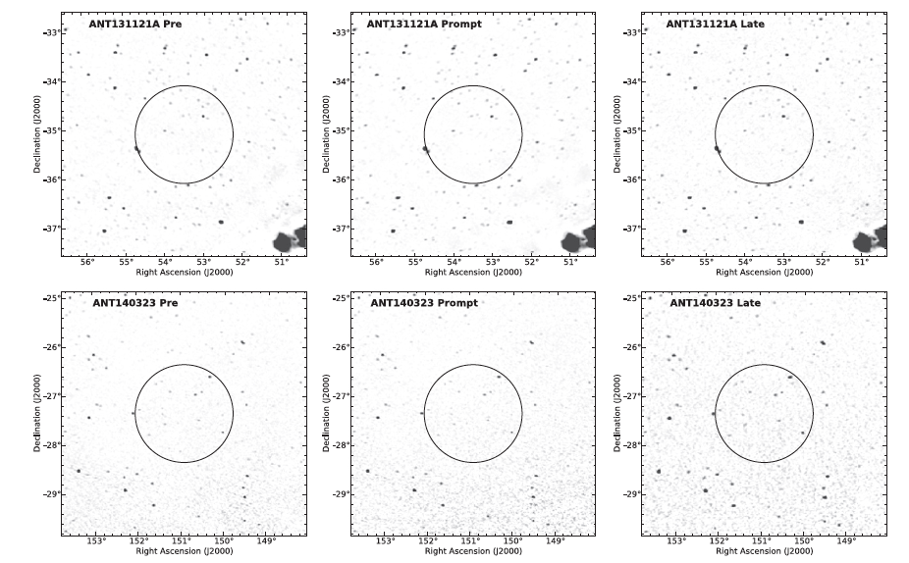
Radio follow-up
Murchison
Widefield
Array
2 alerts followed over a year with M.W.A. (2013-14)
➡ No interesting transient associated with the neutrinos
Croft S. et al, ApJ 820 (2016) 24
M.W.A. alerts (2015-18): analysis on-going

Slide 15
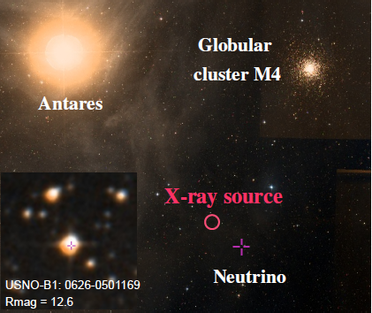
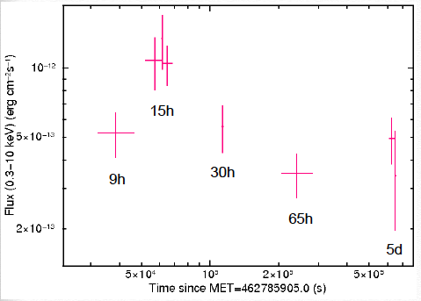
ANT150901A
Alert VHE (Sept. 1, 2015) E~50 TeV
Swift XRT coincidence after 9h! ATEL#7987
Later associated with USNO-B1.0 0626-0501169 (young accreting G-K star or flaring binary system).
H.E.S.S.: No VHE transient source
Φ(E > 320 GeV; 99% C.L.) < 2.7x10⁻⁸m⁻²s⁻¹
ANT170130A: follow-up after 32s by H.E.S.S
No VHE transient source (Preliminary)

Slide 16
ANTARES – external alerts follow up
Online alert
Prompt search
+ …

Slide 17
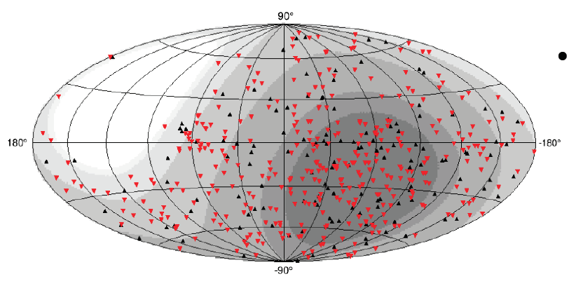
Real time follow-up (GRB/FRB, HENs)
Real time follow-up:
600+ GRBs detected by Swift and Fermi followed in real time so far and around
~10 FRB alerts.
Search within ±500 s and 2° from the source
No neutrino associated with GRB/FRB
7 IceCube HESE/EHE public alerts in ANTARES FoV
No counterparts were detected within ±1 hour.
▼Fermi
▲Swift
IC170922A
Positions of the the GRBs followed by ANTARES and its visibility map.
Field-of-view of the ANTARES neutrino telescope at the event time and the IC event.
Keane E F et al., MNRAS, 473 (2018) 116-135, Bhandari S. Et al, MNRAS, 475 (2018) 1427-1438, Petroff E et al., MNRAS, 469 (2017) 4465-4482
D. Dornic A. Coleiro ATel 9324, 9449,
9715,10189, 10773, 10854.

Slide 18
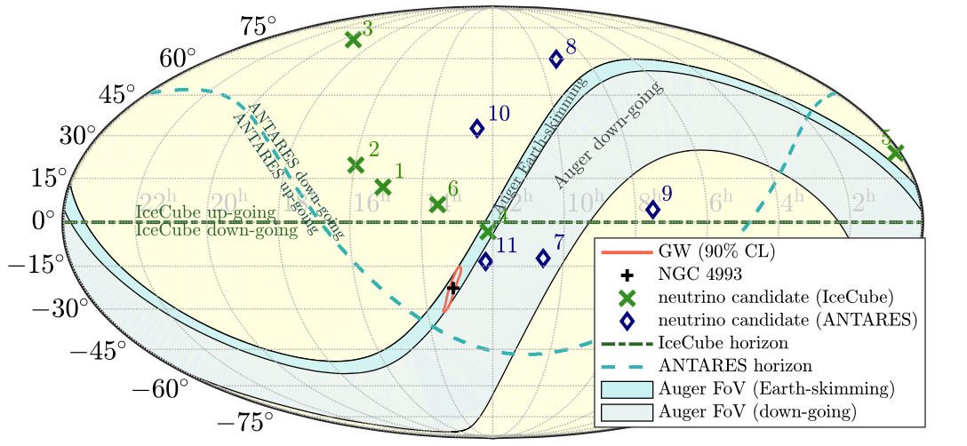
Gravitational waves +HENs
Phys.Rev. D93 (2016) 122010
Phys.Rev. D96 (2017) 022005
Eur.Phys.J. C77 (2017) 911
Astrophys.J. 850 (2017) L35
Astrophys.J. 848 (2017) L12
High-energy neutrino follow-up on several GW events/candidates:
  GW150914 (BBH merger)
  GW151226 (BBH merger)
  LVT151012 (candidate)
  GW170104 (BBH merger)
  GW170817 (BNS merger)
ANTARES, IceCube, Pierre Auger Observatory.
In case of detection:
  Prove of hadronic acceleration.
  More precise location of the source.
On-line and offline searches.
  ±500 s window around the GW transient.
No neutrino candidates in 90% C.L. area
  Rapidly rotating NS -> relativistic wind model
  constrained and expected neutrino fluency (GRB’s extended emission)
Notes:
observational constraints with the expected neutrino fluency from the GRB’s extended emission for different viewing angles

Slide 19
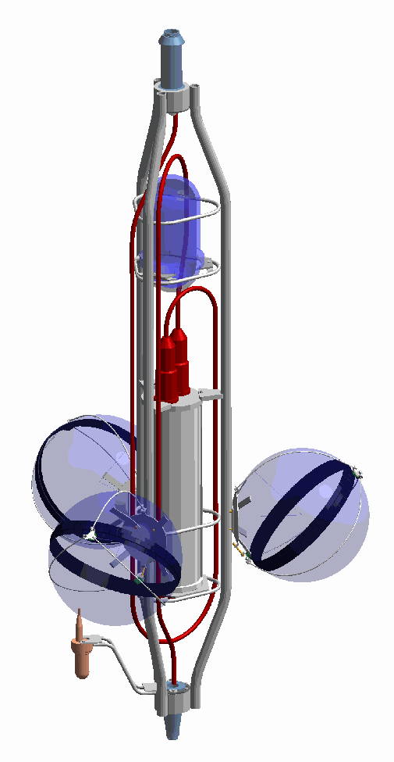
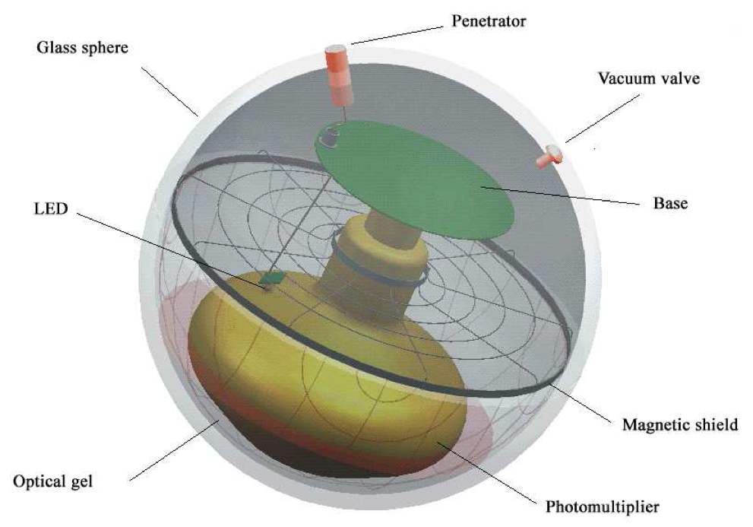
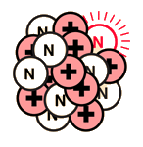
Supernova detection
Proceedings of ICRC2011
Double coincidence rates due to ⁴⁰K decay (~1.3 MeV e⁻) are extensively used in ANTARES for PMT efficiency and time calibration.
This rate depends on the water salinity and it is extremely stable in time.
e⁺ due to SN increase PMT coincidence rates.
Alert reception from SNEWS is implemented.
𝛾
⁴⁰K
𝛾
e⁻
5 σ sensitivites
ANTARES highlights and recent multi-messenger studies, V. Kulikovskiy, CRIS
19

Slide 20
ANTARES – offline analyses
Offline data
Offline analyses
+ …

Slide 21
Offline analyses
Object | Messenger | Telescope
Flaring Blazars | Gamma | FERMI/LAT
Flaring X-ray binaries | X & gamma-ray | Swift, MAXI, RXTE/ASM, Fermi/LAT
Flares from Mrk 421 and Mrk 501 | Gamma | HAWC
HAWC 2-year catalog | Gamma | HAWC
Gamma Ray Bursts | Gamma | Swift, Fermi, GCN
IceCube Events | Neutrino | IceCube
UHECR | CR | Auger, TA
Galactic Plane | CR & gamma-ray | Fermi, Milagro
Fast Radio Bursts | Radio | SUPERB@Parkes
Fermi Bubbles | Gamma | Fermi
Galactic Plane | CR | HAWC
BH/NS mergers | Gravitational waves | Ligo/Virgo (+ IceCube and Pierre Auger Observatory)

Slide 22
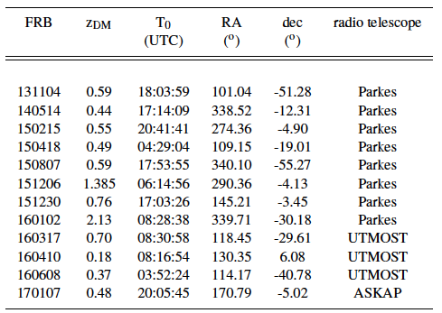
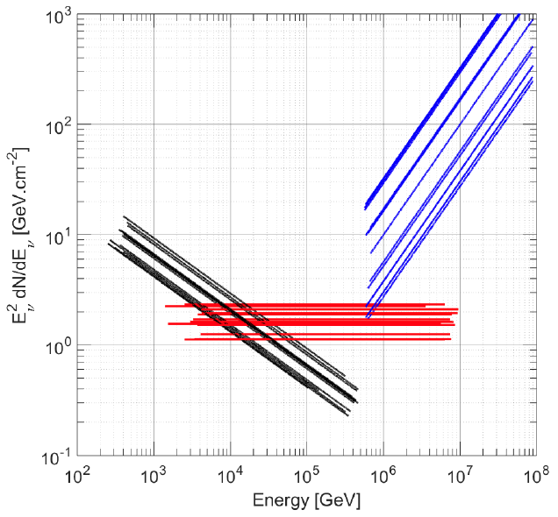
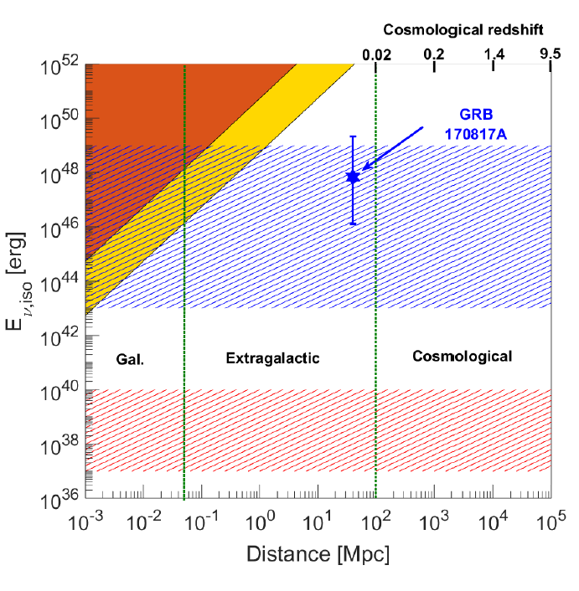
Fast Radio Burst study
Paper to be submitted to MNRAS
Jan. 2013 – Jan. 2017 analysis.
16 FRB (Parkes, UTMOST, ASKAP) -> 12 in the FoV during the data taking.
+/-6h search period in 2º.
Event selection optimization:
1 seen neutrino = 3 σ discovery.
No events found -> limits set.
90% C.L. for E^{-ɣ}
ɣ = 1.0
ɣ = 2.0
ɣ = 2.5
ɣ = 2.5
ɣ = 1.0
Predictions from short GRBs (standard internal shock model).
Predictions from
magnetar/young neutron star neutrino flares.

Slide 23
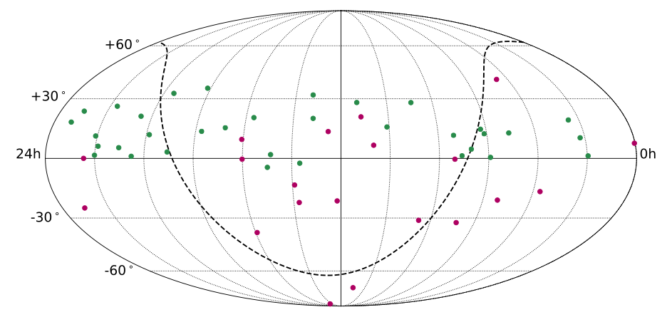
Time correlation with IceCube events
Paper in preparation
Search for correlations with 54 IceCube neutrino events.
𝑑𝑁_{𝜈}/𝑑𝐸_{𝜈} =Φ₀ 𝐸_{𝜈}^{−2.5} neutrino flux assumed.
Maximum likelihood method for time and spatial clustering search.
Gaussian signal time PDF assumed with σ (emission duration) fitted in the likelihood maximization within 0.1 and 120 days.
34 from the IceCube up-going tracks sample
20 from the IceCube HESE sample
No excess observed
Upper limits on fluency to be provided

Slide 24
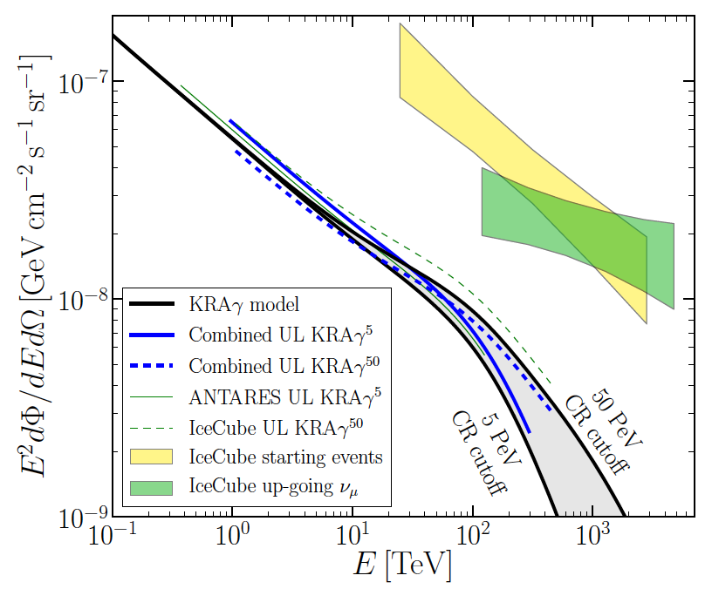
Galactic Plane
Phys.Rev. D96 (2017), 062001
New paper with IC to be published
Sample:
IceCube 7 years (2431 days)
  730,130 tracks
ANTARES 2007 – 2016 (2780 days of livetime)
  7850 tracks, 218 showers
Search strategy:
Signal map according to KRA_{ɣ} models (5 PeV and 50 PeV cutoffs).
Likelihood ratio test method.
  Joint IC tracks + ANTARES tracks + ANTARES showers likelihood.
Insignificant excess.
90% flux limits for ref models:
< 1.19 ɸ(5 PeV)
< 0.9 ɸ(50 PeV) constrained!
Discards Galactic origin for the IceCube spectral anomaly.
Suggests a limit on maximum energy reachable by the Galactic sources.

Slide 25
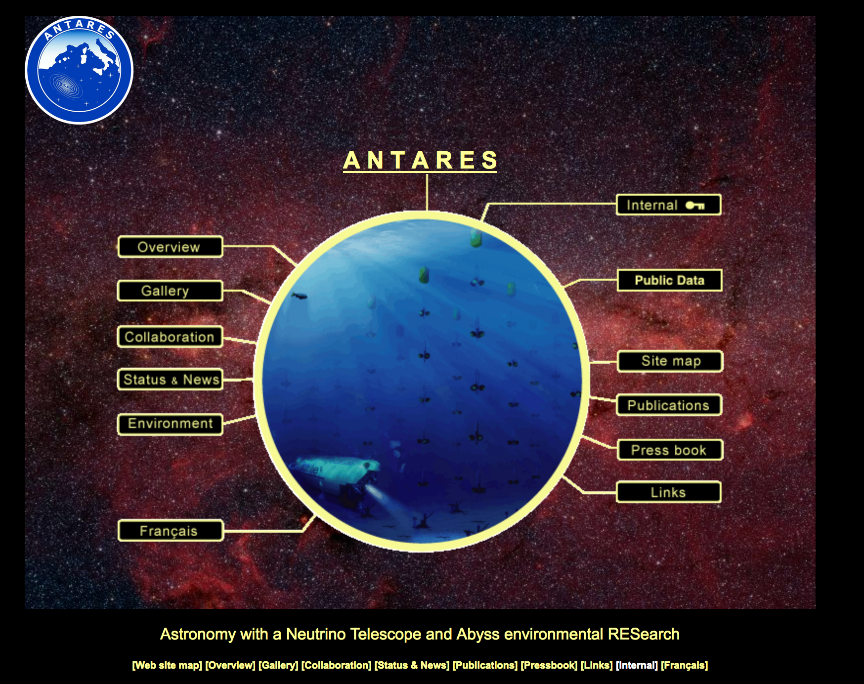
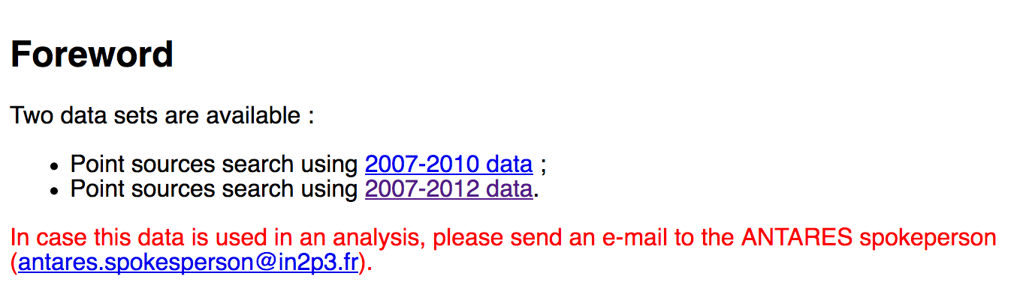
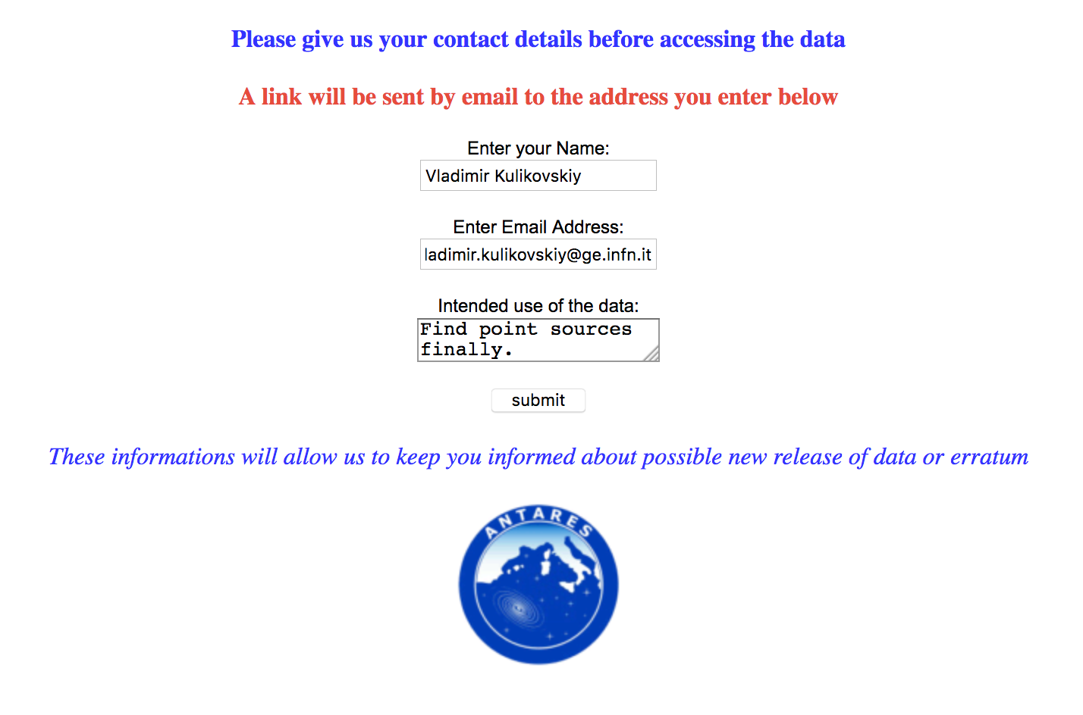
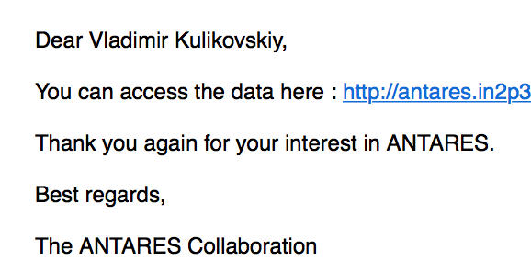

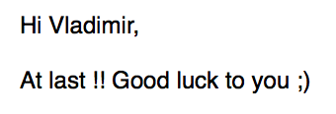
ANTARES data becomes more open

Slide 26



Summary and Perspectives
More than 10 years of continuous data taking!
… and still stably ongoing!
Solid results from various searches of neutrino emission.
  (point-like, diffuse, dark matter, …)
Active multi-messenger program:
  Neutrino alerts distribution
  External alerts reception (raw data buffer), prompt analysis (fast detector calibration and events reconstruction, ad-hoc simulation if needed).
  Offline multi-messenger analysis.
  Combined analyses with IceCube (point sources, galactic plane, time correlation…).
Best practice and multi-messenger collaborations are/will be ported to KM3NeT!

Slide 27
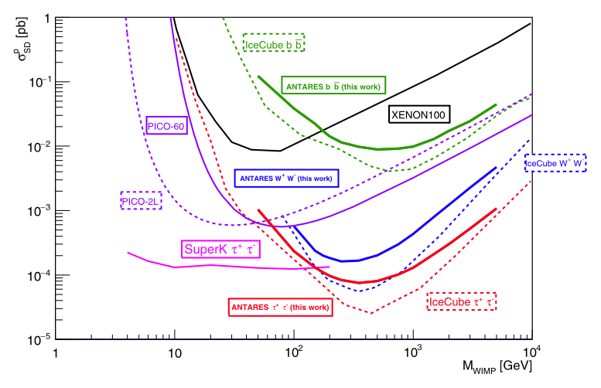
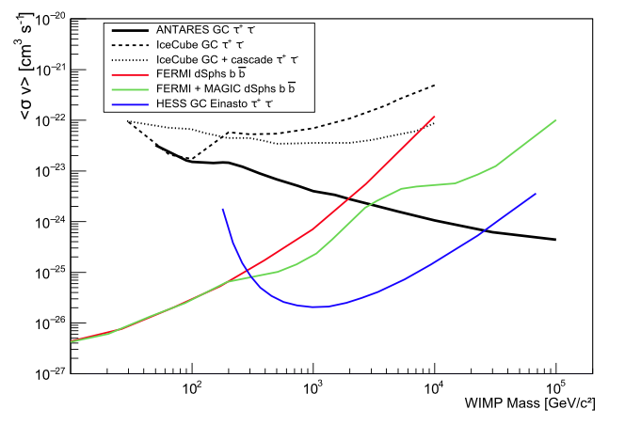
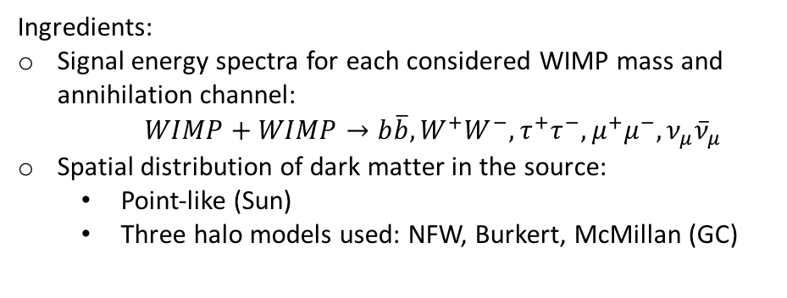
Dark Matter
Phys. Lett. B 759 (2016) 69-74
Phys. Lett. B 769 (2017) 249
SUN
Spin-dependent
2007 – 2012
WIMPs tend to accumulate in massive celestial objects (Sun, Galactic Centre, …)
Neutrinos could be produced in WIMP-WIMP annihilation
Clean signal and low expected background
Ingredients:
Signal energy spectra for each considered WIMP mass and annihilation channel:
$WIMP+WIMP→b\overline{b}, W^{+}W^{−}, τ^{+}τ^{−}, μ^{+}μ^{−}, ν_{μ}{\overline{ν}}_{μ}$
Spatial distribution of dark matter in the source:
  Point-like (Sun)
  Three halo models used: NFW, Burkert, McMillan (GC)
GC
NFW profile
2007 – 2015
No significant excess above background observed
Upper limits on
  spin-(in)dependent WIMP-nucleon scattering cross-section (Sun)
  thermally averaged annihilation cross-section (GC)
as a function of the WIMP mass

Slide 28
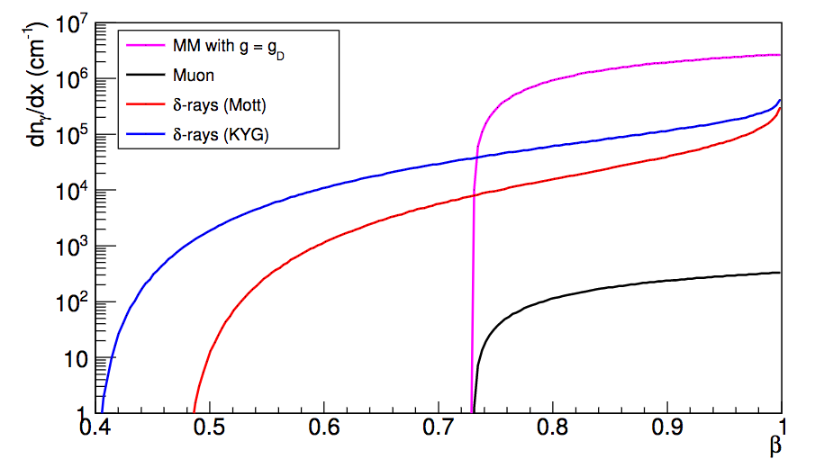

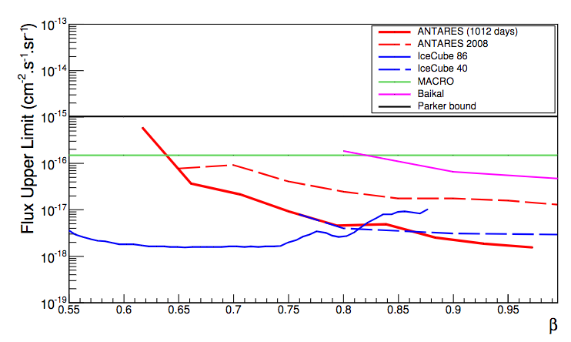
Magnetic monopoles
JHEP 07 (2017) 054
The concept of a particle with a magnetic charge introduced by P. Dirac to explain quantization of electric charge. Magnetic charge can be derived as:
Search pattern: higher light yield respect to the muons is expected. Light production at lower velocities (slow monopoles).
No excess over expected muon background was seen for various velocity fits.
Limits are set for more pessimistic light production model (Mott).

