Slide 1
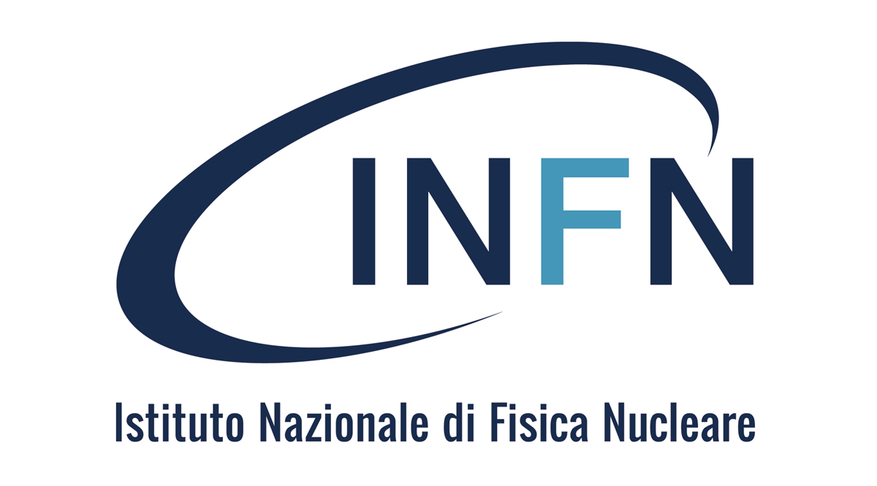

Dissemination about natural radioactivity through Work-Based Learning experiences
Mariagabriella Pugliese*°, Giuseppe La Verde*° and Vincenzo Roca*°
*INFN, Sezione di Napoli, Italy
°Dipartimento di Fisica «E. Pancini», Università degli Studi di Napoli Federico II, Italy
CRIS 2018 18-22 June 2018, Portopalo di Capo Passero (SR) - Italy

Slide 2
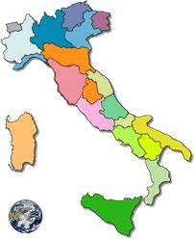

Radiolab Project
Involves 10 sections of INFN
To carry out an effective action to spread scientific culture, and in particular nuclear physics, through the involvement of high school students in environmental radioactivity measurements.
Promote the knowledge of one's own territory, in particular with reference to environmental radioactivity and radon.
Develop new ways of training and disseminating knowledge.
Highlighting the links between science and society.
CRIS 2018 18-22 June 2018, Portopalo di Capo Passero (SR) - Italy

Slide 3

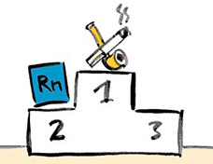
Radiolab project versus
Work-Based Learning experiences
School is the main and most significant common ground for students, teachers, scientists and researchers in science education where they can work together with their different expertise and sensibilities to improve the learning and teaching of physics.
we have decided to offer other students the opportunity to approach the problem of human exposure to radioactivity of natural origin
CRIS 2018 18-22 June 2018, Portopalo di Capo Passero (SR) - Italy

Slide 4
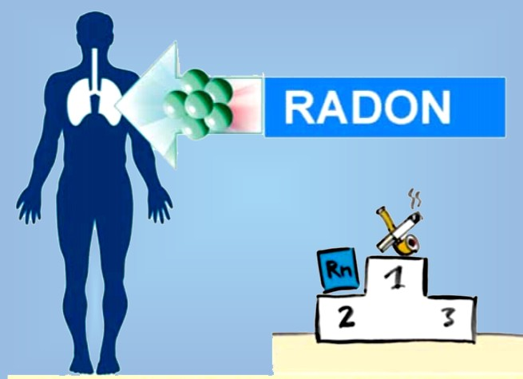
Why the radon gas?
INTERDISCIPLINARY CHARACTER geology, chemistry, biology, mathematics and computer science
Radon is a radioactive gas that is odorless and colorless and it often accumulates in our houses or office school
The Radon is present almost everywhere in soil and rocks
It is produced by the uranium's radioactive decay.
In a closed environment, Radon can accumulate and reach hazardous concentrations.
The World Health Organization has determined that Radon gas is the second cause of lung cancer after tobacco smoke
CRIS 2018 18-22 June 2018, Portopalo di Capo Passero (SR) - Italy

Slide 5
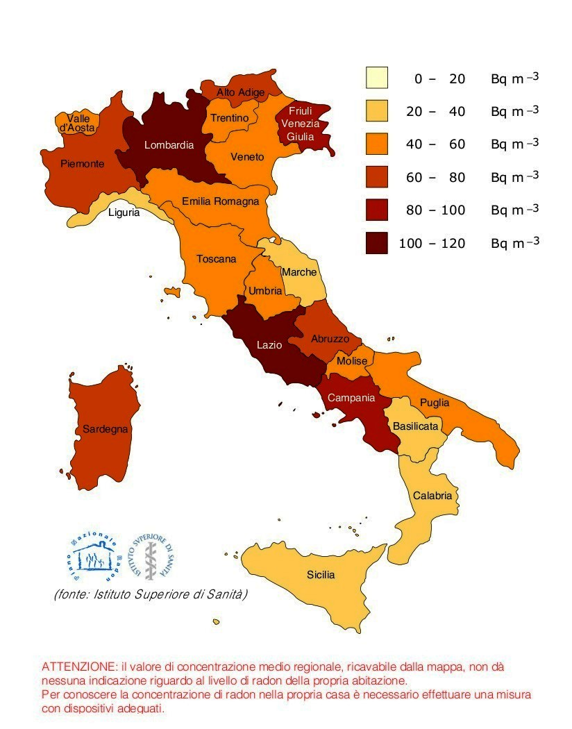
Radon in Campania region
In the Campania soil and building materials there are volcanic characteristics due to the eruptions of the Caldera Phlegrean Fields and Vesuvius, the volcano.
Educational activities on natural radioactivity and its effects on areas where there are high levels of radioactivity stimulate interest among teachers, students and their families and this offers the opportunity to reach a wide audience and so enhance the role of scientific knowledge.

Slide 6
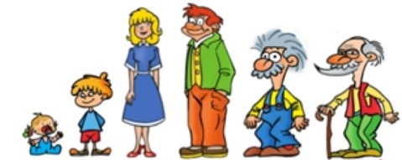
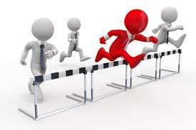
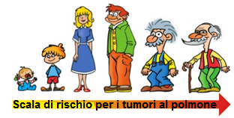
What’s The role of young people
Importance of awareness of the risk due to exposure to natural radioactivity
Young people are more sensitive to radiation
Relationship between the world of the school and their families, science and society so as to recognize the social value for scientific knowledge
It is important in view of the transposition of the Euratom Directive 59/2013 which makes radon measurements mandatory in all working environments and in all homes
CRIS 2018 18-22 June 2018, Portopalo di Capo Passero (SR) - Italy

Slide 7
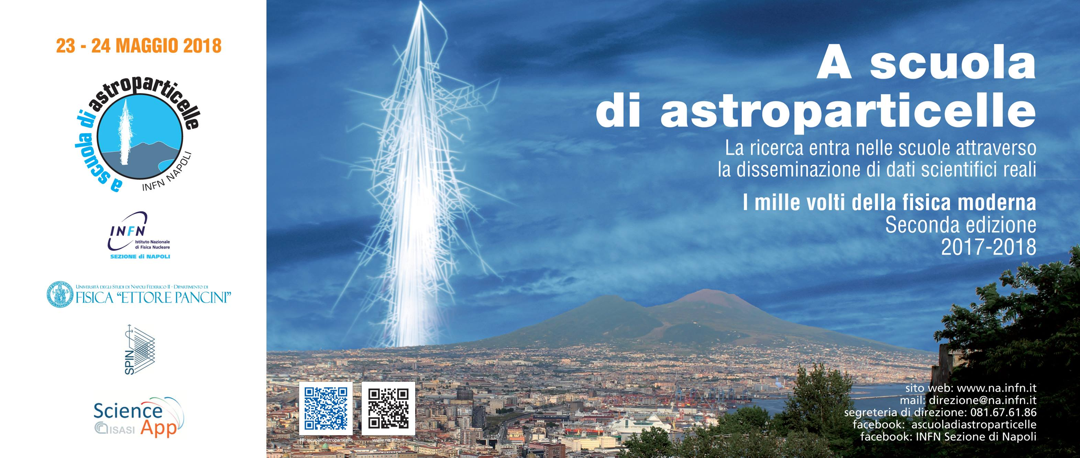
Schools involved in Work-Based Learning experiences
Liceo C. Colombo, Marigliano
tutor: Prof. Fortuna De Martino
Prof. Salvatore De Lucia
Liceo Statale di Ischia
            tutor: Prof. Agostino Mazzella
            Prof. Paola Ambrosino
I.T.I. A. Pacinotti, Scafati
tutor: Prof. Maurizio Fimiani
Prof. Rosario Randino
A Scuola di Astroparticelle
CRIS 2018 18-22 June 2018, Portopalo di Capo Passero (SR) - Italy

Slide 8
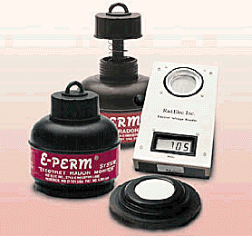
What the students had to do 1.
Radon measurements Passive detectors E-Perm devices
Electrostatically charged disk (electret) is placed in small chamber
Radon diffuses into chamber and emits alpha particles during decay
Alpha particles ionize the air molecules
Ions move to charged surface of electret, thus reducing its initial charge
Voltage meter measures initial and final voltages
Rate of change of charge is proportional to concentration of radon in air
CRIS 2018 18-22 June 2018, Portopalo di Capo Passero (SR) - Italy

Slide 9
Results 1.
Radon survey in Liceo C. Colombo
Mean value of radon concentration 85 Bq/m³
In labs the radon concentration values are higher than in classrooms (ventilation)
The radon concentration is higher at ground floor (main source is the soil)
The project has led to the opportunity to learn science through a real physics experiment.
CRIS 2018 18-22 June 2018, Portopalo di Capo Passero (SR) - Italy

Slide 10
What the students had to do 2.
Education, training and information
Liceo Statale di Ischia
I.T.I. A. Pacinotti, Scafati
CRIS 2018 18-22 June 2018, Portopalo di Capo Passero (SR) - Italy

Slide 11
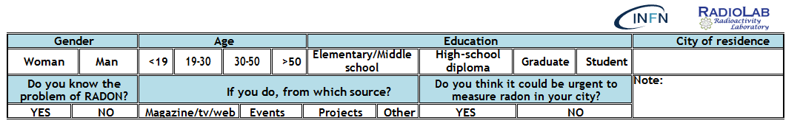
Results 2.
a questionnaire was given to the population on the knowledge of the radon problem
papery
electronic I've invited you to fill in the following form: Rischio Radon: se lo conosci lo vinci To fill it in, visit: https://docs.google.com/forms/d/e/1FAIpQLScfGLv-C-GaFtvzlOgfGE6nyzypY8JtUuhqy1GQ--JNKXdmOg/viewform?c=0&amp;w=1&amp;usp=mail_form_link

Slide 13
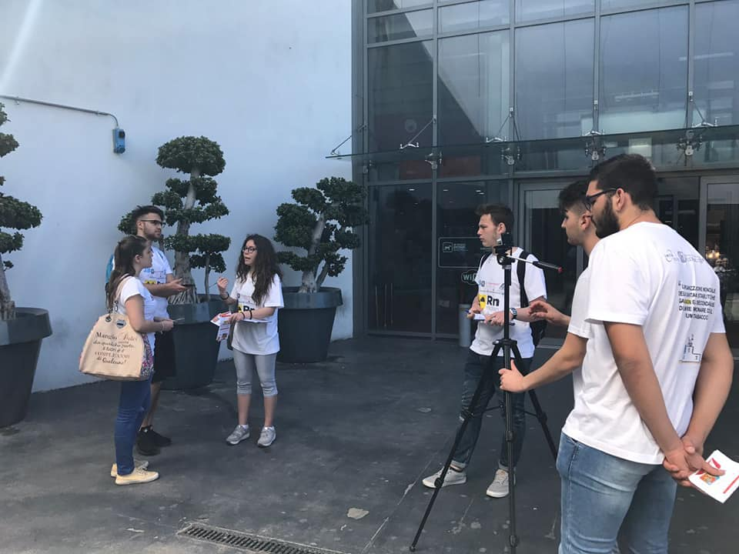
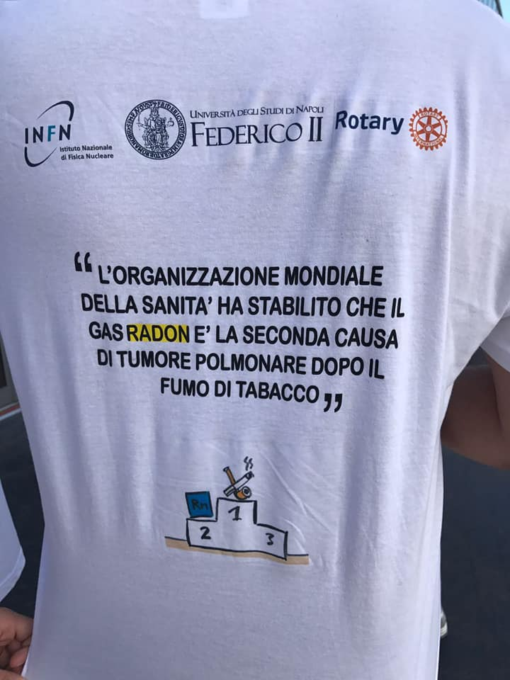
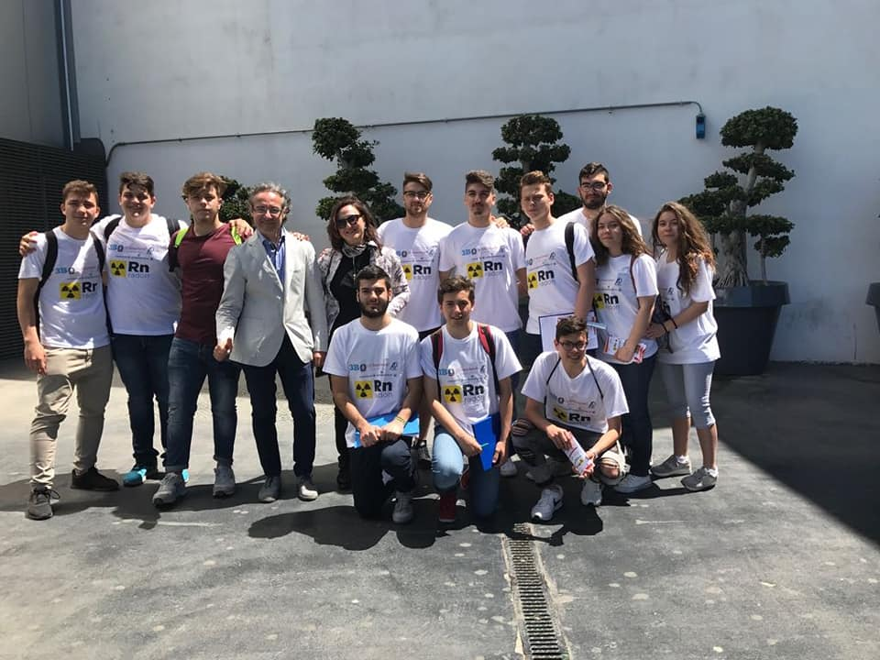

Slide 14
perception of risk and effectiveness of information
we compared the degree of information of the population on the radon problem, making a comparison between the results of the questionnaires obtained in the countries where the Radon project has been going on in schools for years and those where it has just begun or where nothing has been done yet.
This is to evaluate the effectiveness of the project.

Slide 15
SORRENTO
Radon project since 2003
Dissemination: YES
SOURCES
CRIS 2018 18-22 June 2018, Portopalo di Capo Passero (SR) - Italy

Slide 16
ISCHIA
Radon project since 2003
Dissemination: YES
SOURCES
CRIS 2018 18-22 June 2018, Portopalo di Capo Passero (SR) - Italy

Slide 17
SCAFATI
Radon project since 2017
Dissemination: just started
SOURCES
CRIS 2018 18-22 June 2018, Portopalo di Capo Passero (SR) - Italy

Slide 18
OTHER CITIES
Radon project: NO
Dissemination: NO
SOURCES
CRIS 2018 18-22 June 2018, Portopalo di Capo Passero (SR) - Italy

Slide 19
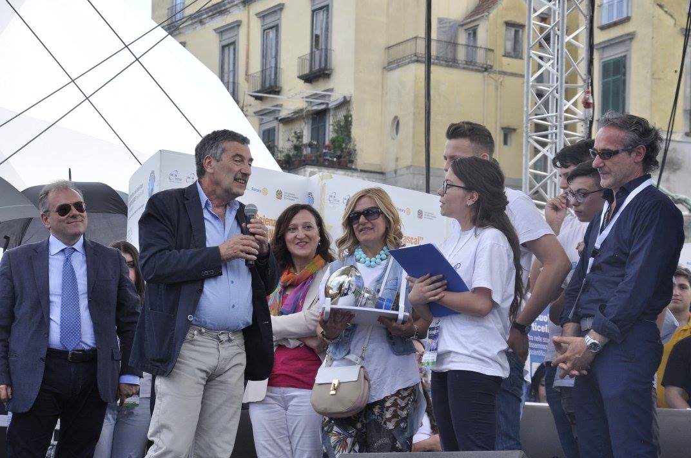
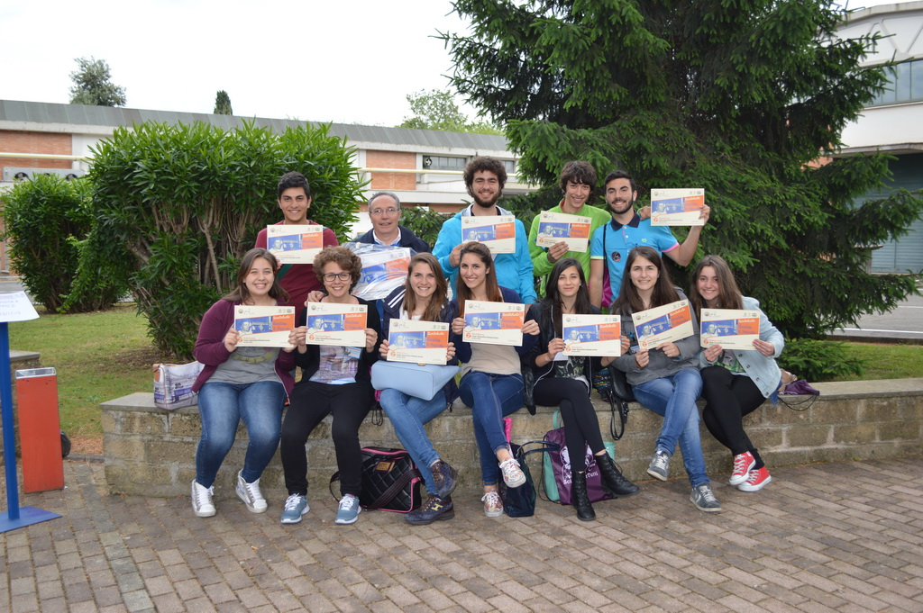
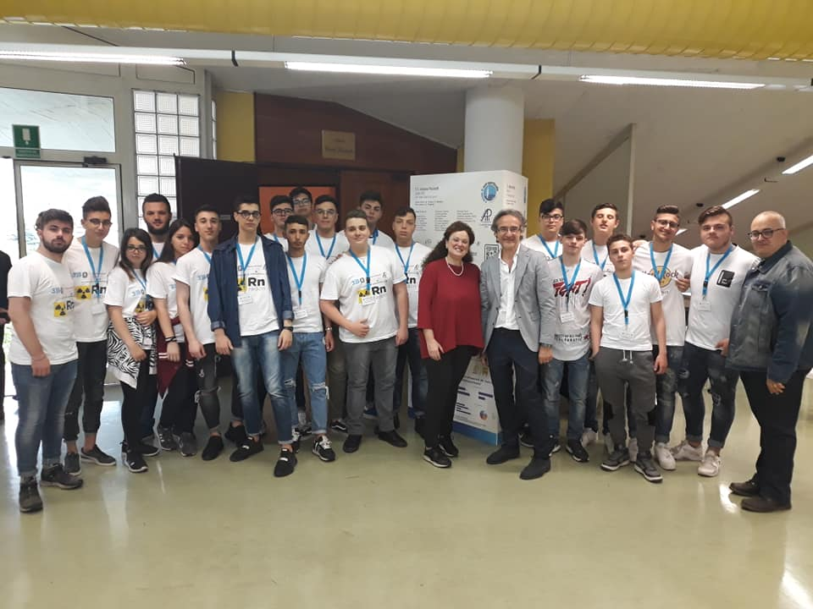
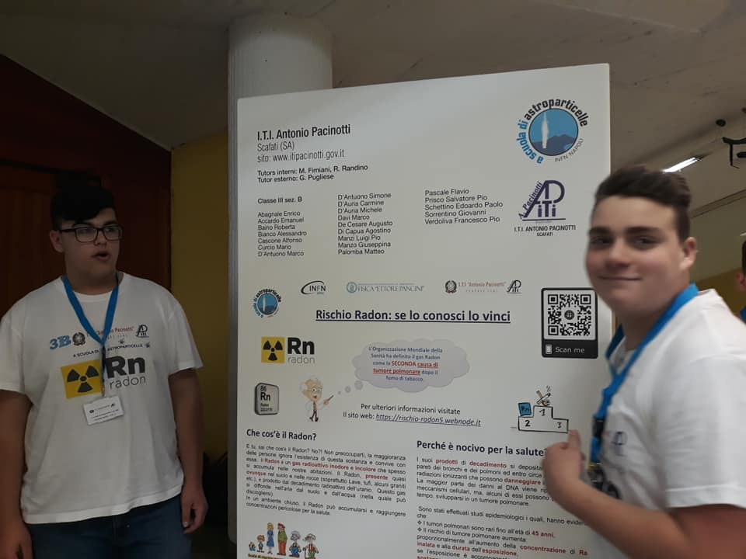
participation in events and days of scientific dissemination
CRIS 2018 18-22 June 2018, Portopalo di Capo Passero (SR) - Italy

Slide 20

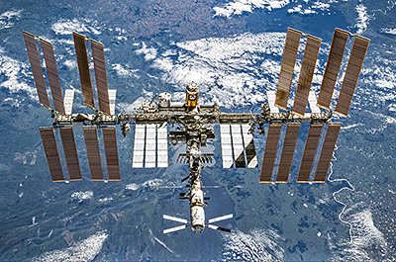
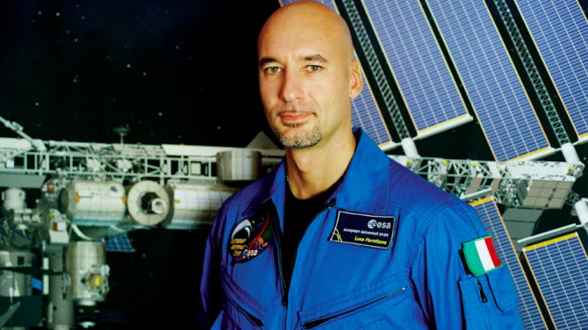
the answer to the question: did the students like the project?
Yes!
Pacinotti's students decided to take part in the ASI YiSS 2019 competition, which involves the students in an experiment to be carried on board the ISS when astronaut Luca Parmitano will lead the space mission in May 2019.
CRIS 2018 18-22 June 2018, Portopalo di Capo Passero (SR) - Italy

Slide 21
Some considerations
Dissemination of useful information to improve the management of radon risk
The importance of Education, Training and Information
  Encouraging scientific approach
  Implementing the sense of responsibility in the activities carried out
  Stimulating the student's intrinsic motivation
Thanks for your attention!
CRIS 2018 18-22 June 2018, Portopalo di Capo Passero (SR) - Italy

