Slide 1
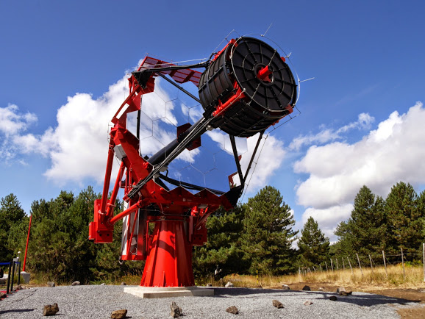
CRIS 2018
Universidade de São Paulo
Instituto de Astronomia, Geofisica
e Ciencias Atmosferica
The ASTRI Camera Control Software
Pierluca Sangiorgi – INAF / IASF PALERMO
for the CTA ASTRI project
P. Sangiorgi – INAF / IASF PALERMO – CRIS 2018 – Portopalo di Capo Passero (SR), Italy, 18-22 June 2018

Slide 2
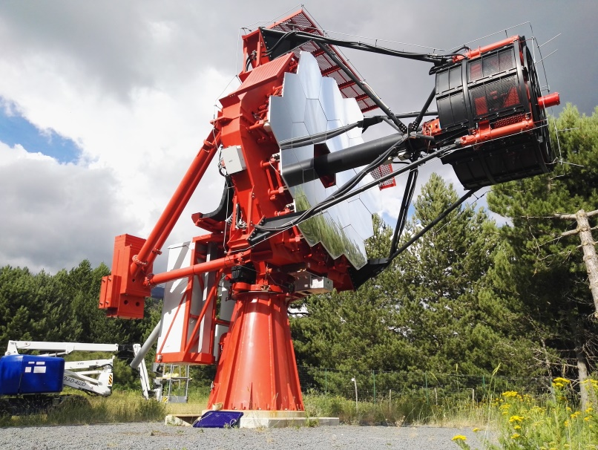
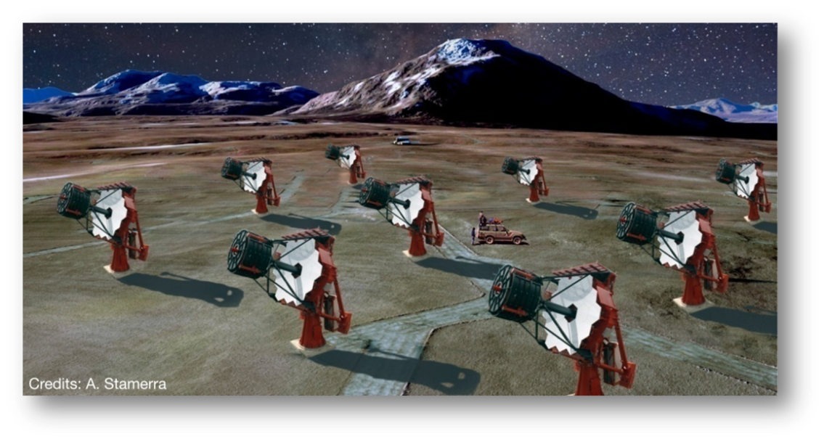
The ASTRI CTA Project
Telescopes and detectors for ground based gamma-ray astronomy at very high energies
Initially funded by the Italian Ministry of Education, University, and Research (MIUR) as ‘Flagship Project’
led by the Italian National Institute for Astrophysics (INAF)
within a large international project currently under development: the Cherenkov Telescope Array (CTA)
CTA Observatory will be composed of more than one hundred telescopes of different sizes, exploring the sky by means of the Imaging Atmospheric Cherenkov Technique (IACT), located in two sites, one for each hemisphere
http://www.cta-observatory.org/
First Step
Realization of a prototype of the CTA small size telescopes, ASTRI SST-2M, currently completing the commissioning phase
end-to-end approach. Includes development of structure, mirrors, camera and calibration system, archive system, software for hardware control and for data analysis
Future
Production of (at least) nine ASTRI telescopes proposed for the CTA southern site.
ASTRI SST-2M, installed at the “M.G. Fracastoro” INAF observing station in Serra La Nave on the Etna Mountain, Sicily, Italy.
P. Sangiorgi – INAF / IASF PALERMO – CRIS 2018 – Portopalo di Capo Passero (SR), Italy, 18-22 June 2018

Slide 3
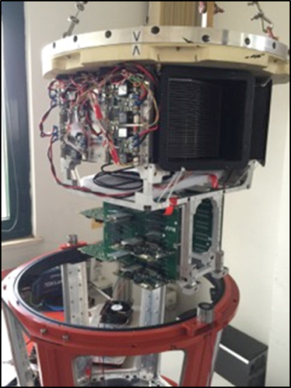
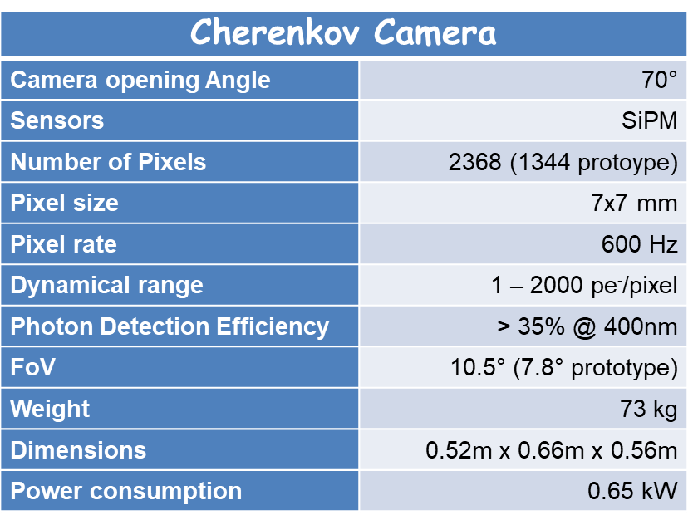
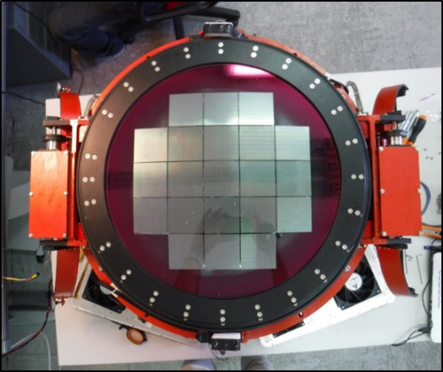
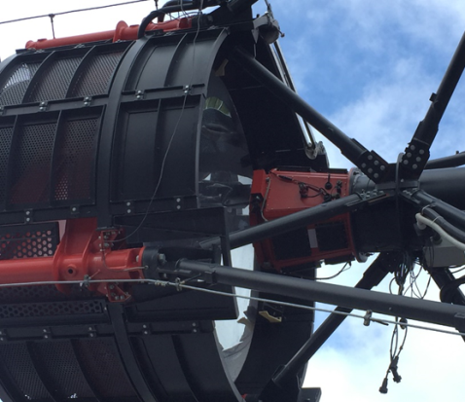
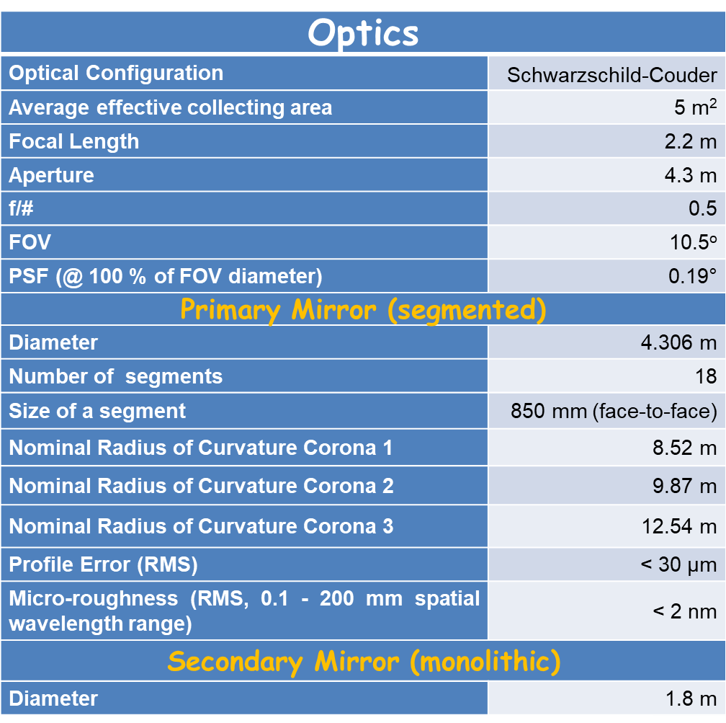
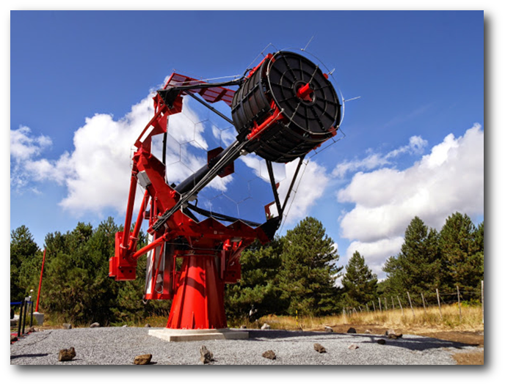
Specifications
Cherenkov Camera:
Innovative design based on SiPM sensors and specifically designed front-end electronics for signal capture
Fully compliant with the CTA requirements
Optical Design:
Based on dual-mirror Schwarzschild-Couder configuration
Excellent imaging across a wide field of view
Small plate scale (allows a compact camera)
P. Sangiorgi – INAF / IASF PALERMO – CRIS 2018 – Portopalo di Capo Passero (SR), Italy, 18-22 June 2018

Slide 4
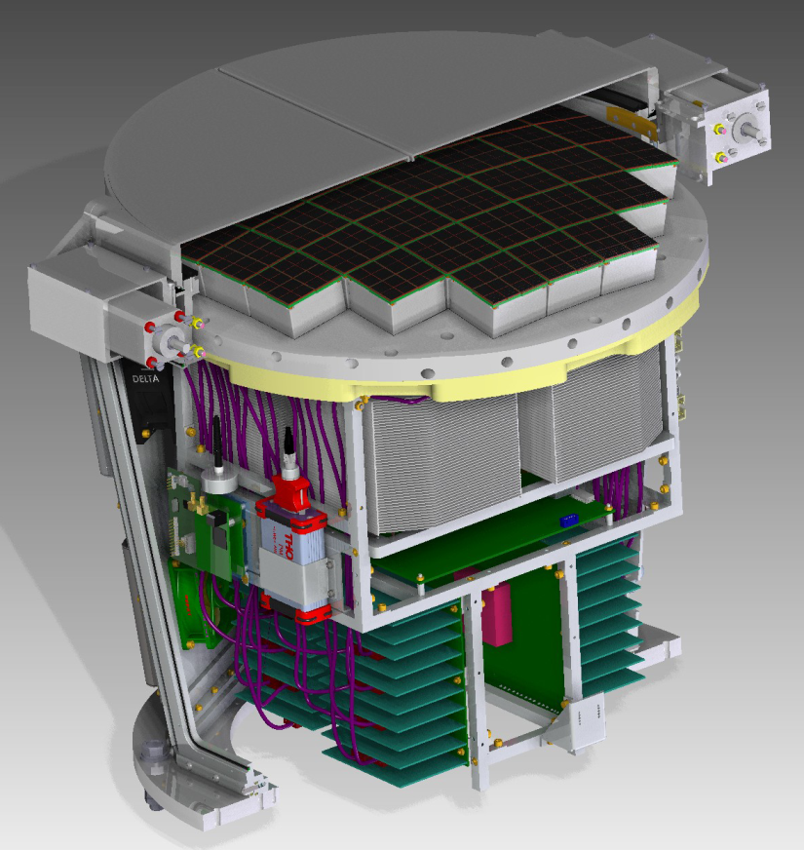
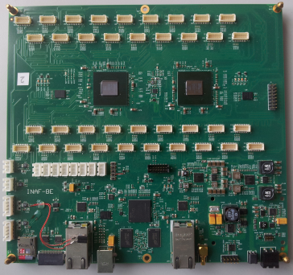
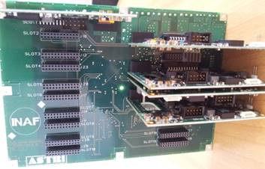
How It’s Made
37 (21) Photo Detection Module (PDM) units containing
SiPM board with 9 embedded temperature sensors
Front End Electronics (FEE) board with 2 CITIROC ASIC
PDM FPGA Board (Xilinx Artix 7)
Back End Electronics (BEE) unit
Custom built solution based on the Xilinx Zynq-7000 All Programmable SoCs.
Dual ARM® Cortex™-A9 Processing System and FPGA Programming Logic.
Custom built Linux distribution Debian Wheezy
PDM Voltage Distribution Box (PDM VDB)
Custom built boards (2 mainboards with 19 daughterboards for each) to provide power
(Low and Hi Voltages) to the PDMs with real-time control and monitor functionalities
Set of auxiliary devices like GPS for synchronization, Fiber Pulser and Energy Meter for calibration, Motor Lid and Thermal controllers (provided by several vendors)
P. Sangiorgi – INAF / IASF PALERMO – CRIS 2018 – Portopalo di Capo Passero (SR), Italy, 18-22 June 2018

Slide 5
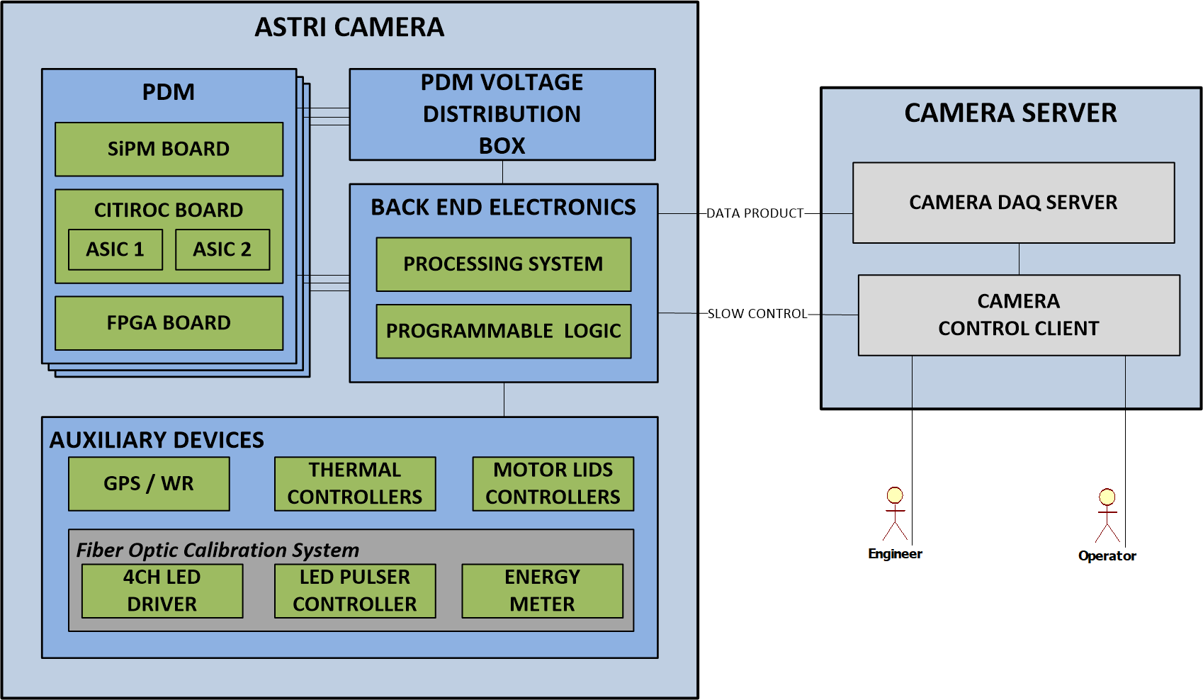
How It’s Connected
All the devices and systems are interconnected by the BEE, which is the main elaboration unit of the camera, managing all its functions:
Receive commands from the camera control client
Control and monitor the auxiliary devices
Manage and acquire data from the PDMs
Prepare and send packets to the Camera Data Acquisition Server
P. Sangiorgi – INAF / IASF PALERMO – CRIS 2018 – Portopalo di Capo Passero (SR), Italy, 18-22 June 2018

Slide 6
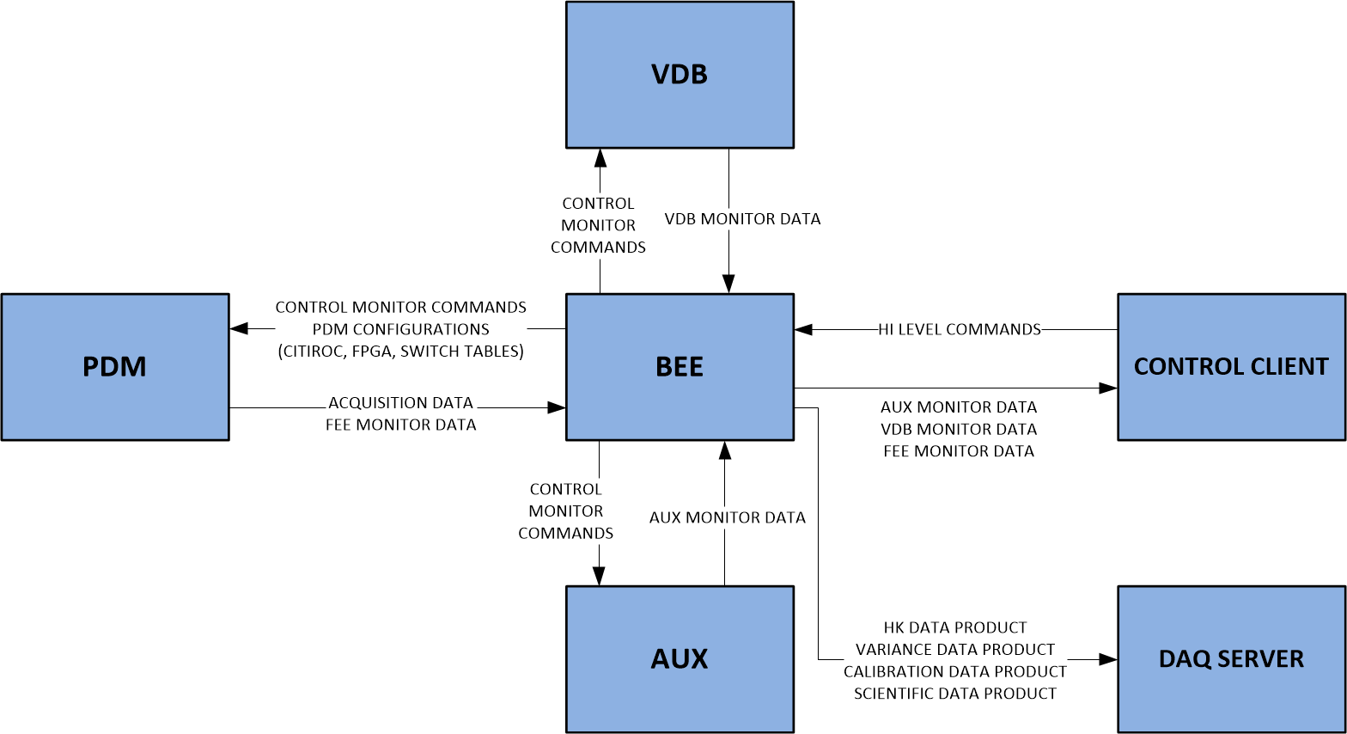
Components & Interfaces
P. Sangiorgi – INAF / IASF PALERMO – CRIS 2018 – Portopalo di Capo Passero (SR), Italy, 18-22 June 2018

Slide 7
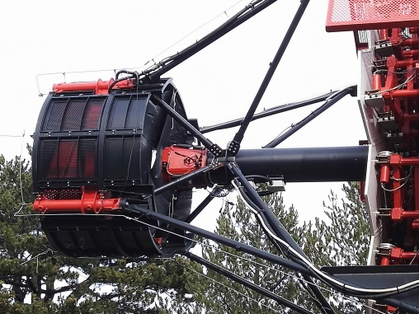
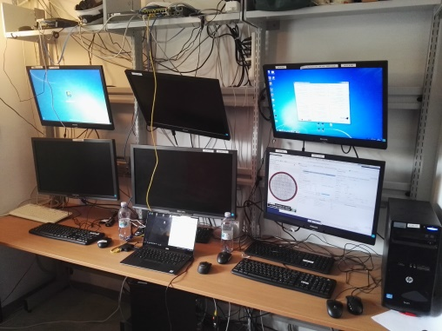
Basic Architecture
ASTRI CAMERA CONTROL SOFTWARE
SERVER COMPONENT
CLIENT COMPONENT
Deployed on board (inside the BEE)
Directly manage all the hardware
Deployed on the control client in the control room
Manage the interaction with the user
Communication stack managed by the industrial standard protocol OPC-UA
P. Sangiorgi – INAF / IASF PALERMO – CRIS 2018 – Portopalo di Capo Passero (SR), Italy, 18-22 June 2018

Slide 8
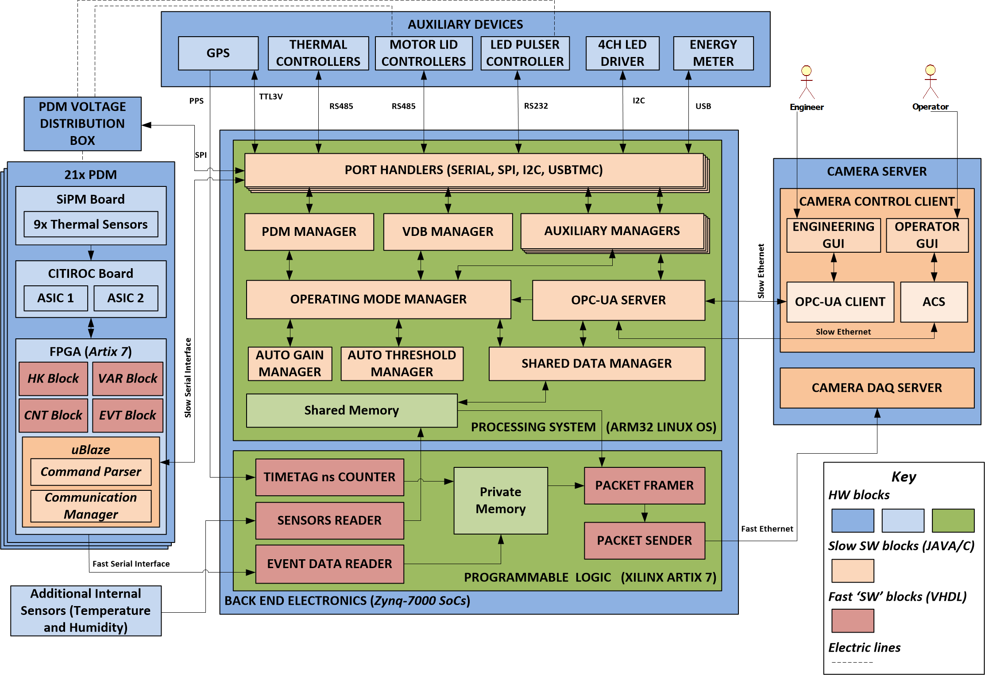
Architecture and Design
P. Sangiorgi – INAF / IASF PALERMO – CRIS 2018 – Portopalo di Capo Passero (SR), Italy, 18-22 June 2018

Slide 9
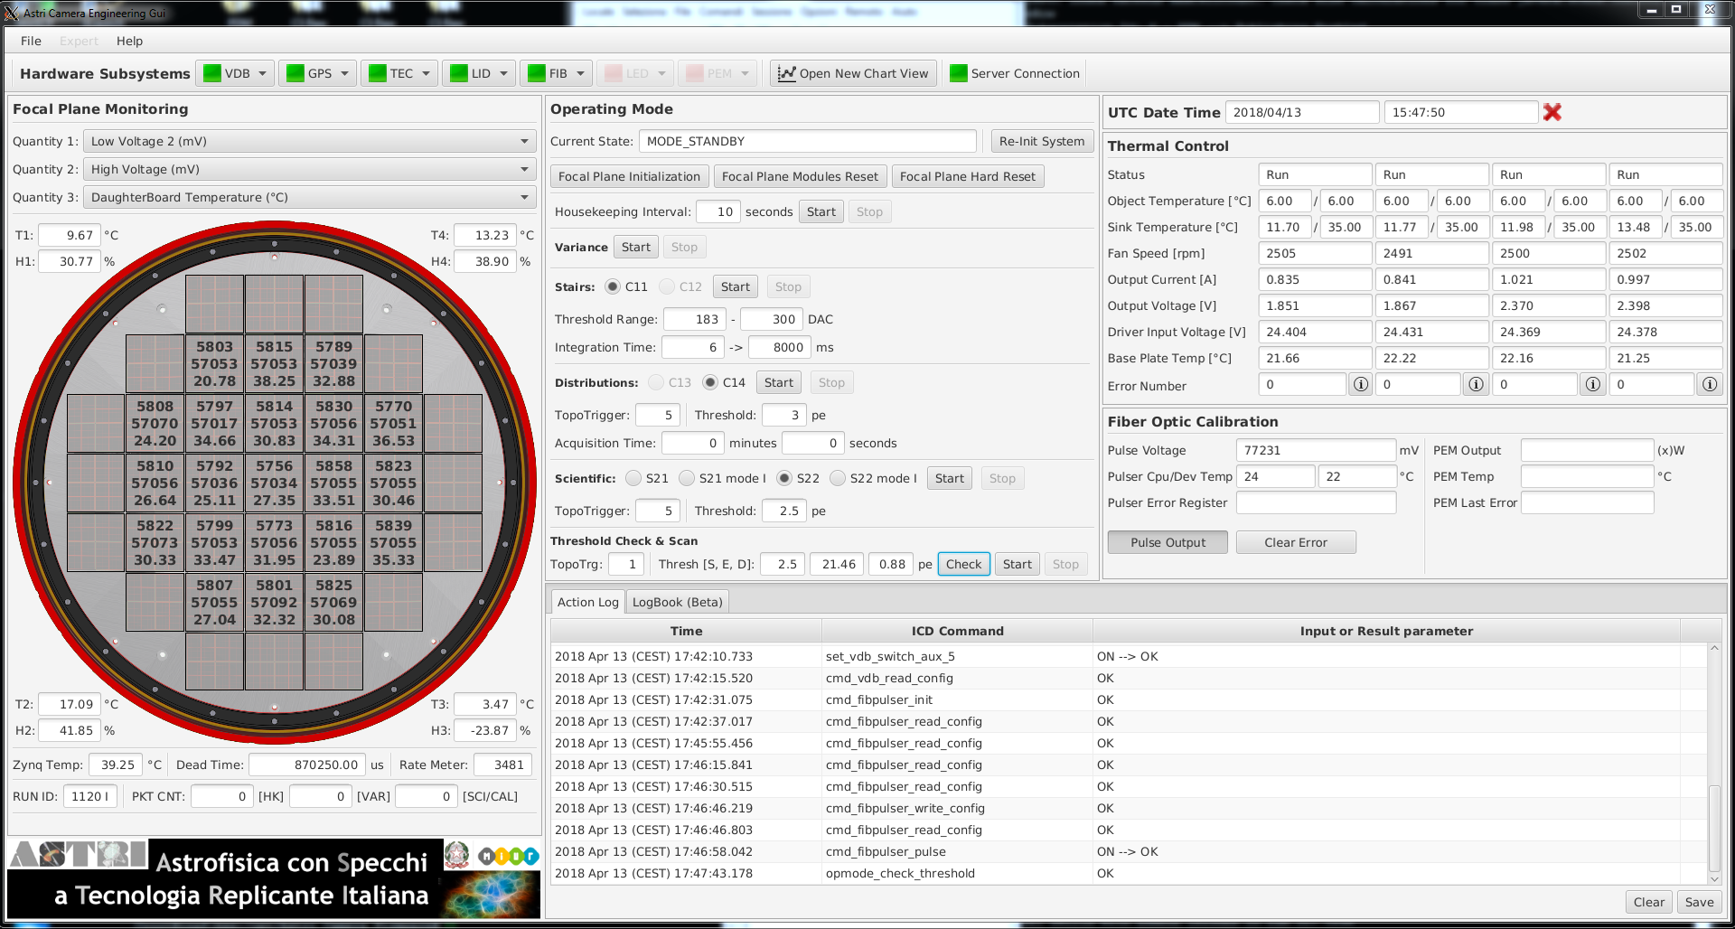
Main Engineering GUI
Every high level commands (GET, SET, CMD) must be accessible from the Engineering GUI
Lots of controls and information for expert users, but must be user friendly
One single Main GUI with information and commands frequently useful
P. Sangiorgi – INAF / IASF PALERMO – CRIS 2018 – Portopalo di Capo Passero (SR), Italy, 18-22 June 2018

Slide 10
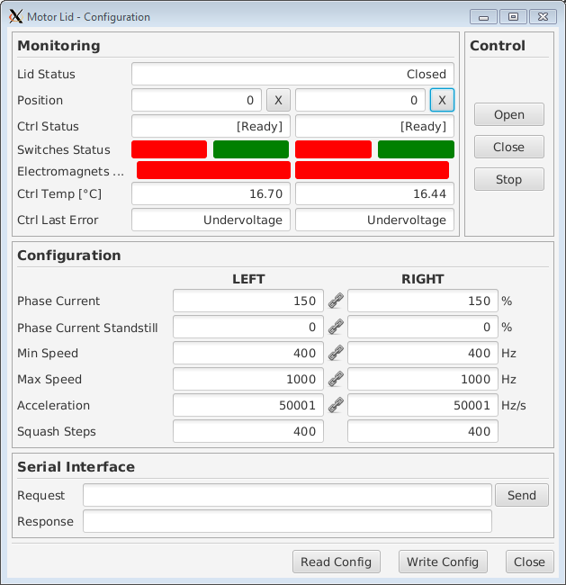
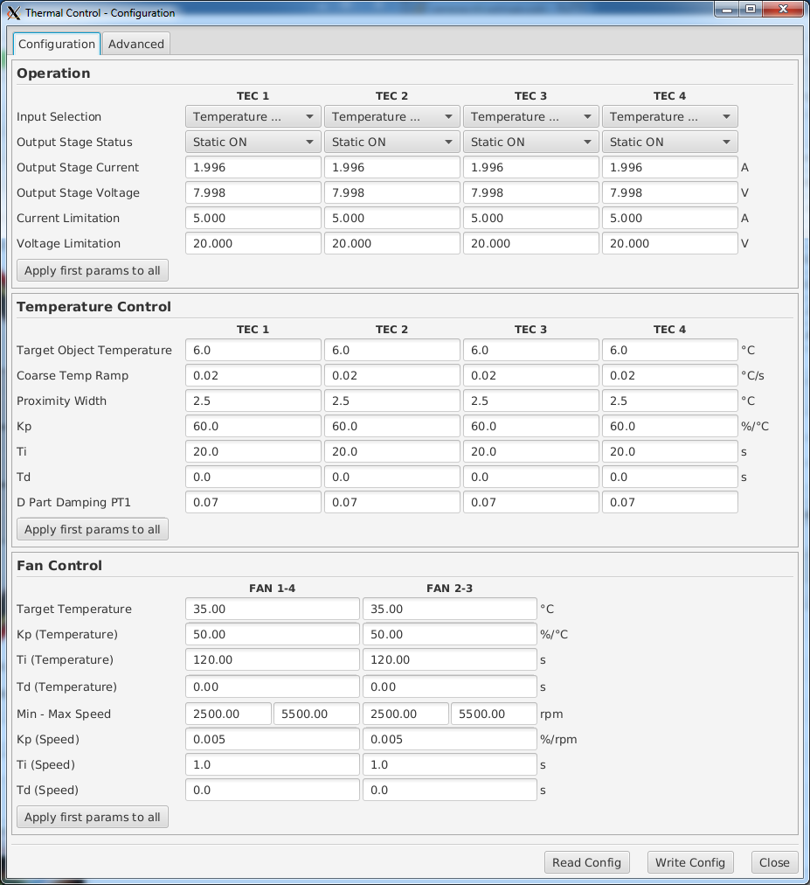
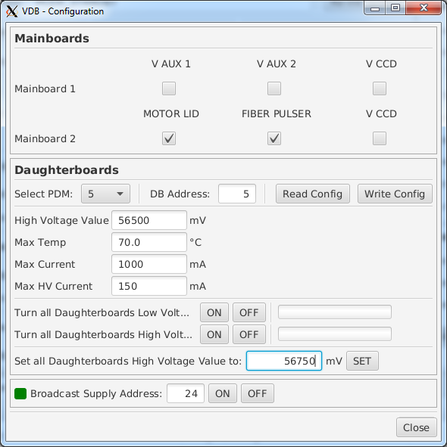
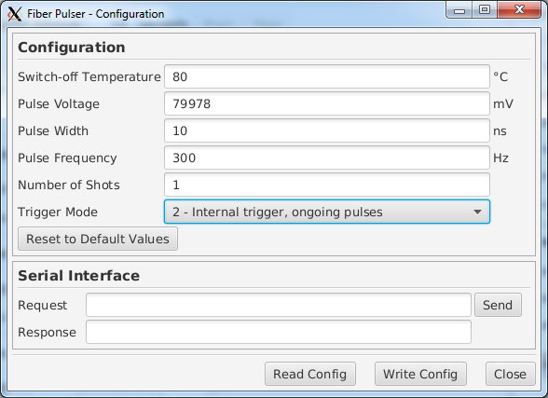
Sub Control GUI
P. Sangiorgi – INAF / IASF PALERMO – CRIS 2018 – Portopalo di Capo Passero (SR), Italy, 18-22 June 2018

Slide 11
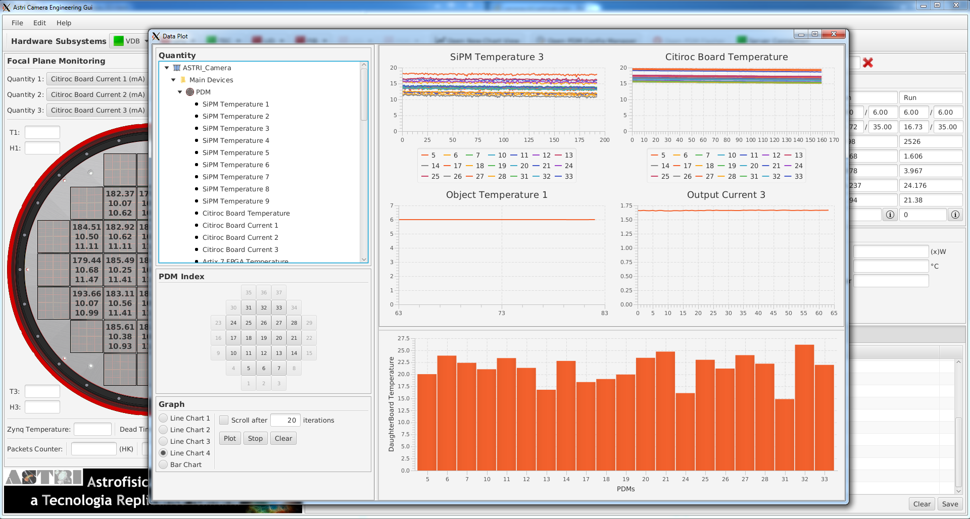
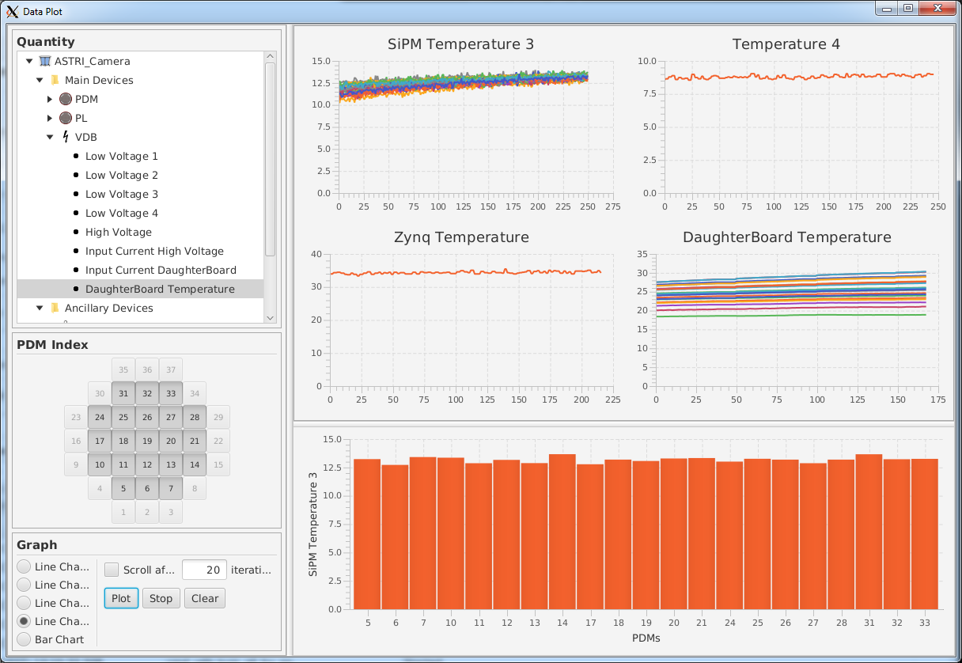
HouseKeeping Plots
A dedicated window shows in real-time all the HK information in different graph types
P. Sangiorgi – INAF / IASF PALERMO – CRIS 2018 – Portopalo di Capo Passero (SR), Italy, 18-22 June 2018

Slide 12
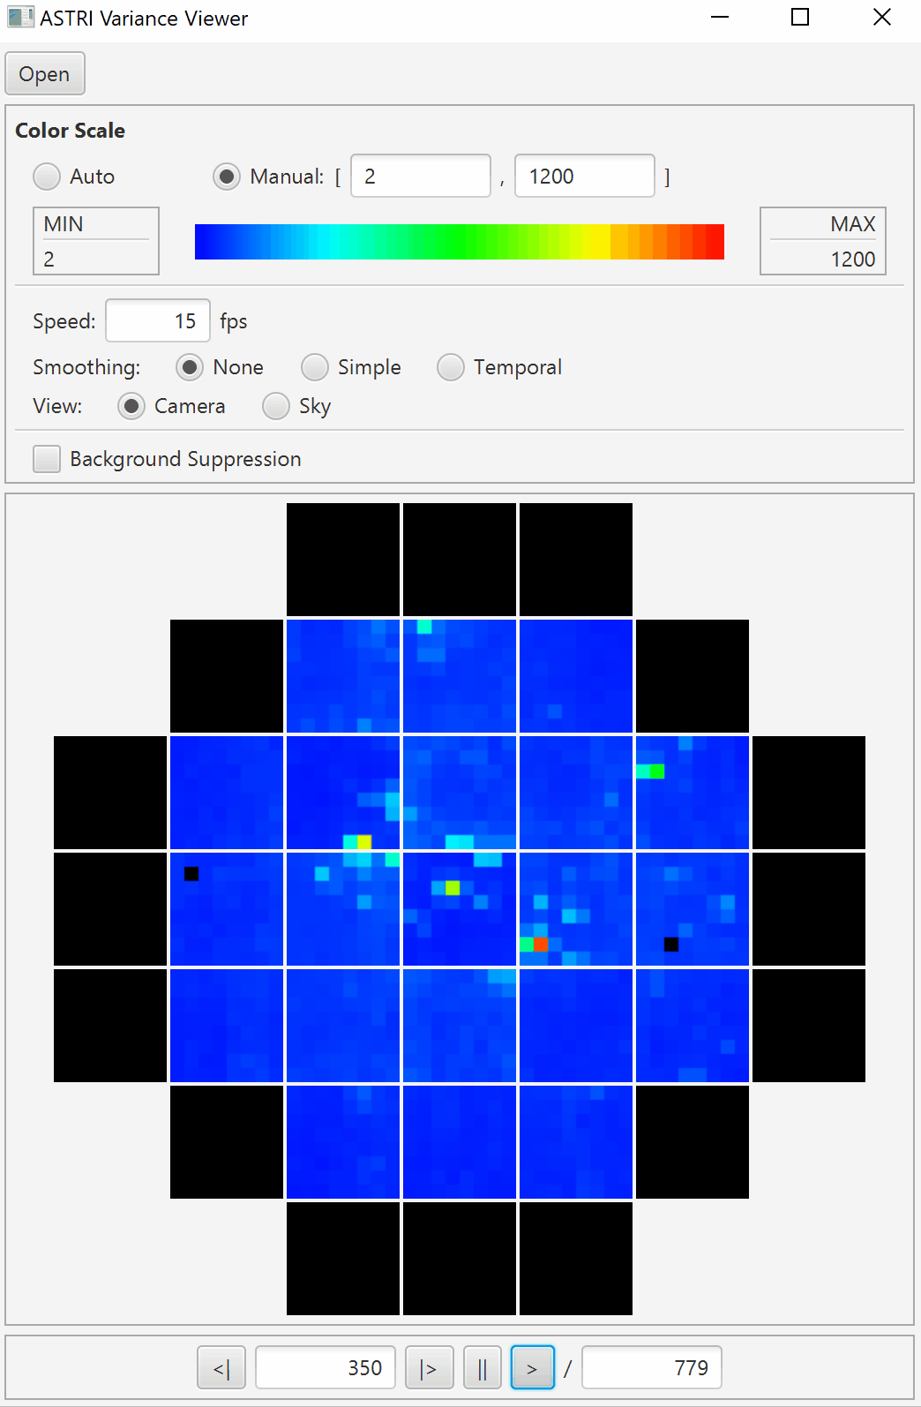
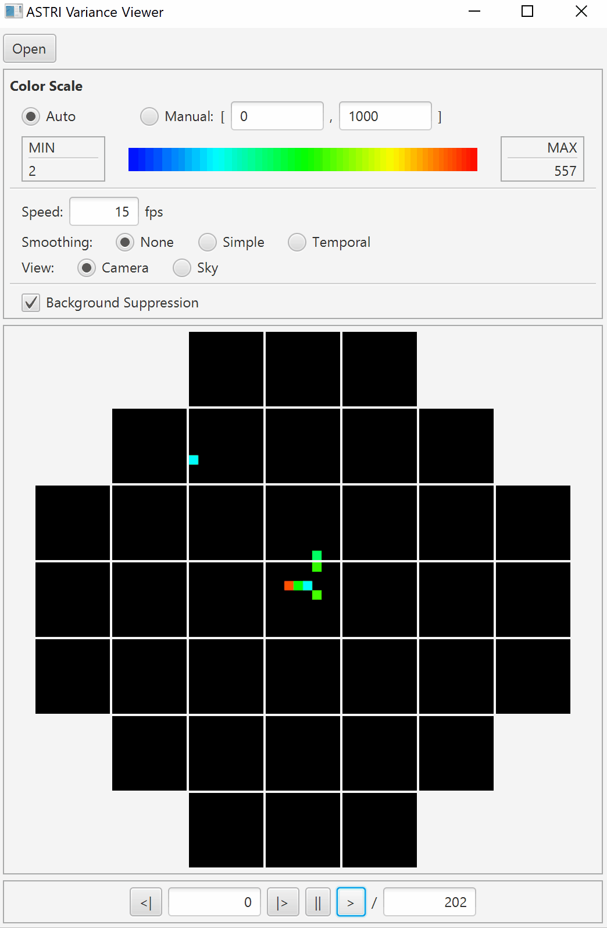
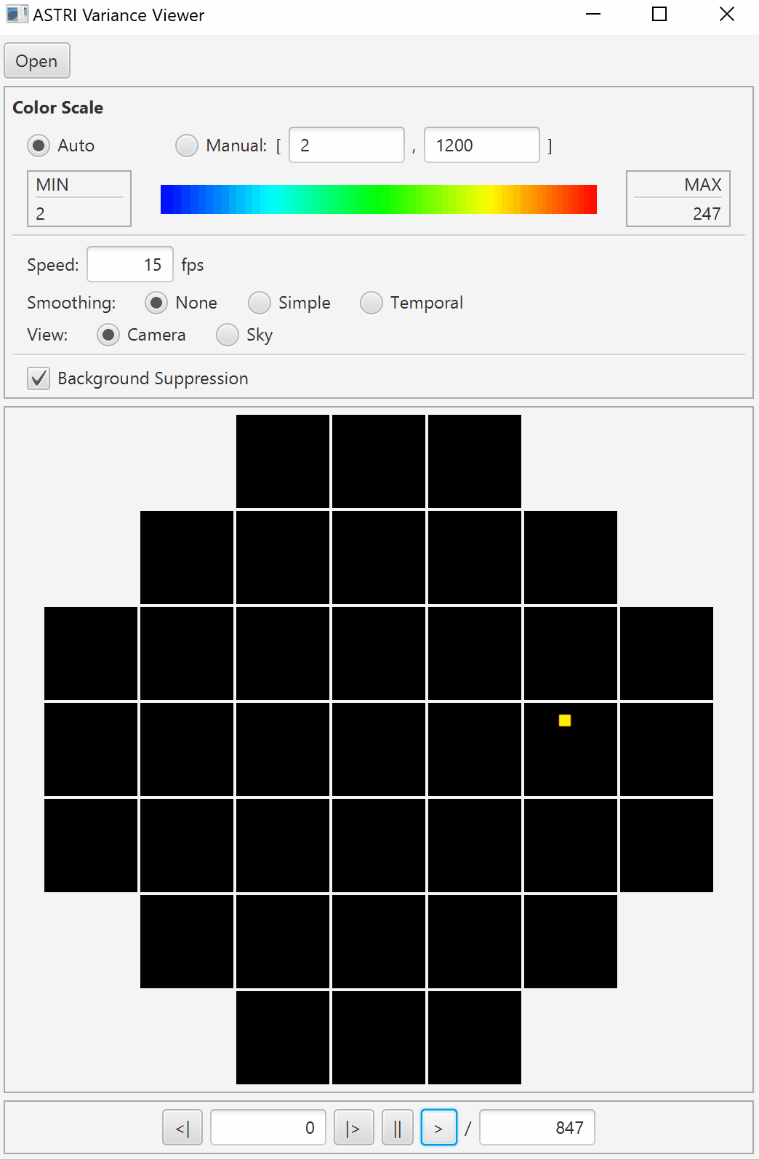
Real Time Variance Visualization
Integrated real-time viewer of Variance data
Allow us to evaluate:
Effective Pointing of the telescope
Presence of clouds
Mirror alignment
Electronics Health Status
See Talk by
Alberto Segreto
@13.10
Example animations (15 fps) created using three different pointing:
a) Orion’s Belt
b) Capella (bg suppression)
c) Fixed point at Az, El (bg suppression)
P. Sangiorgi – INAF / IASF PALERMO – CRIS 2018 – Portopalo di Capo Passero (SR), Italy, 18-22 June 2018

Slide 13
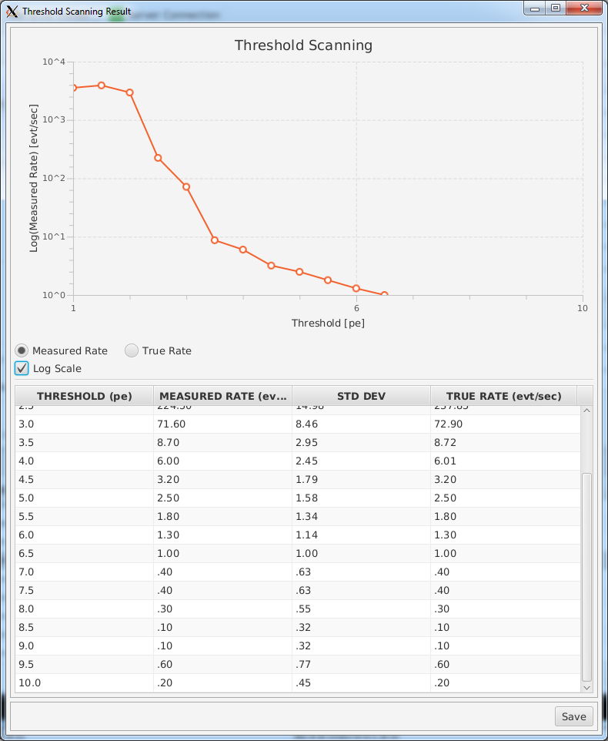
Threshold Scanning
Evaluates the trigger rate of the camera at different values of threshold.
No data acquired and processed for fast computation.
The result provides an easy way to evaluate the NSB region and select the right threshold value for observation.
P. Sangiorgi – INAF / IASF PALERMO – CRIS 2018 – Portopalo di Capo Passero (SR), Italy, 18-22 June 2018

Slide 14
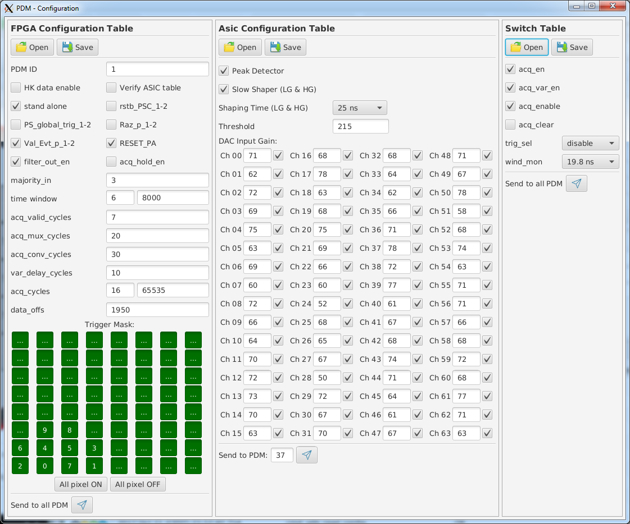
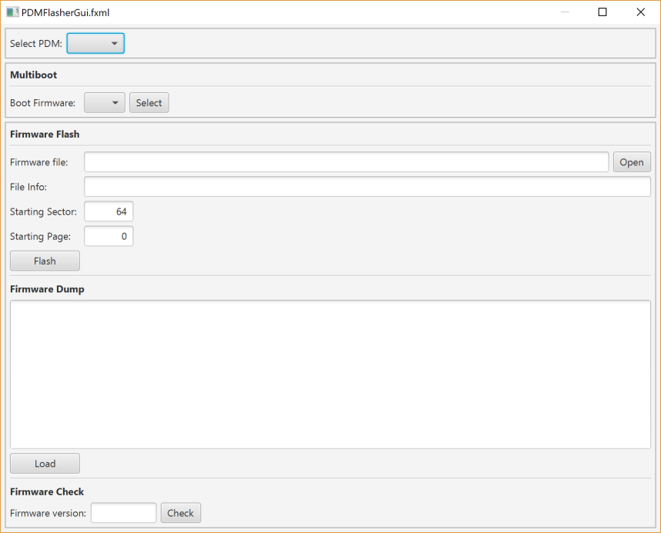
Engineering Tools
The software integrates additional engineering tools for system configuration and calibration:
PDM configuration manager for FPGA, CITIROC, SWITCH tables creation
PDM FPGA remote flash manager
SiPM temperature sensors calibration
Automatic stairs and distributions data analysis for PDM E2E relative gain calibration
P. Sangiorgi – INAF / IASF PALERMO – CRIS 2018 – Portopalo di Capo Passero (SR), Italy, 18-22 June 2018

Slide 15
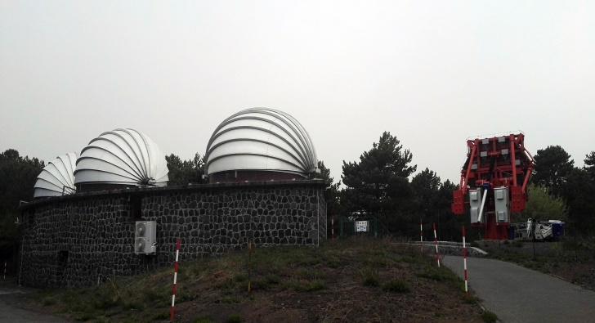
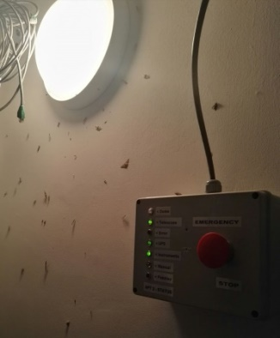
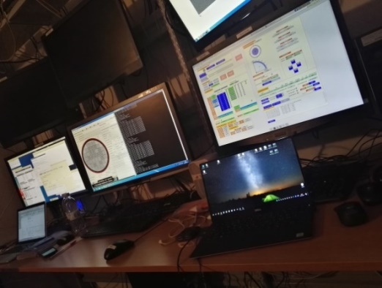
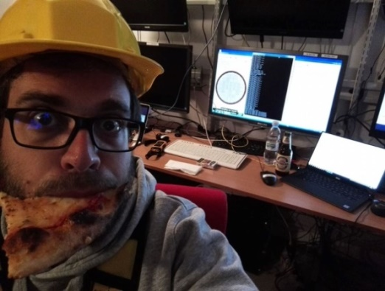
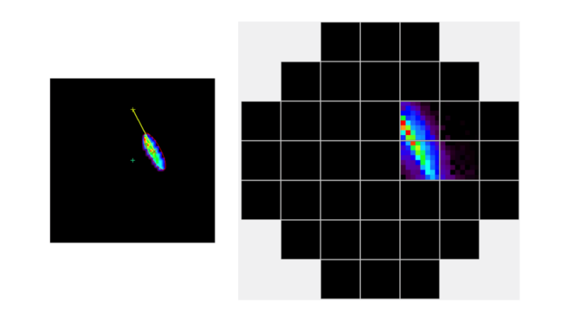
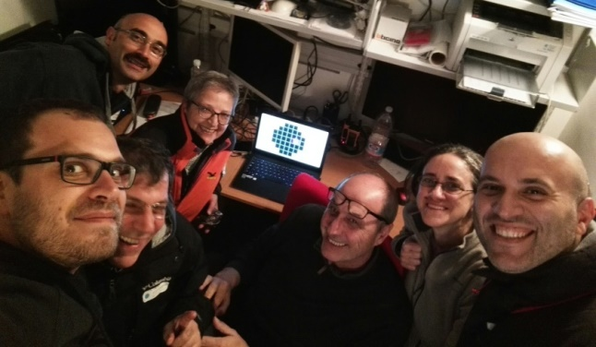
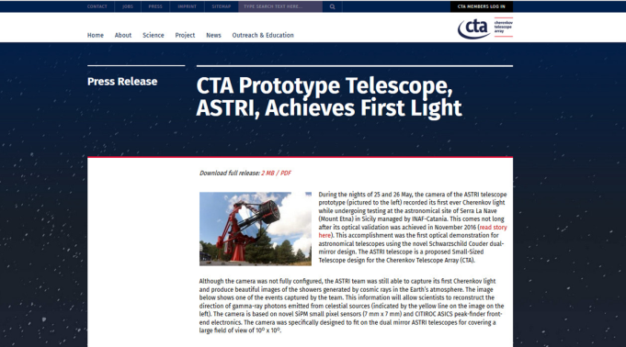
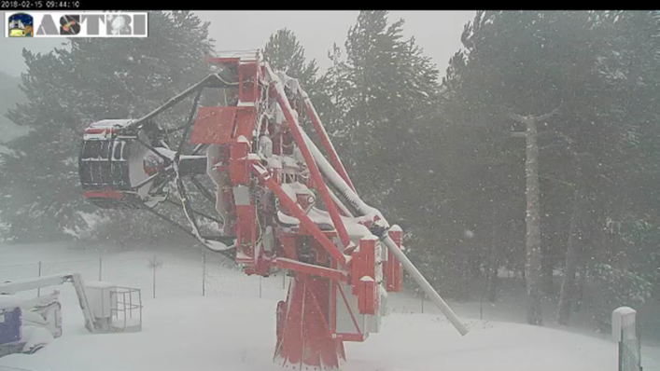
Testing
We started the engineering test at the astronomical site of Serra La Nave (Mount Etna) in Sicily…
…spending cold nights around bugs and lots of hard work, pizza and beer
25 and 26 May 2017: the ASTRI camera recorded its first ever Cherenkov light…
So… it works!
Optimizations and improvements continue during the commissioning phase also in extreme conditions…
P. Sangiorgi – INAF / IASF PALERMO – CRIS 2018 – Portopalo di Capo Passero (SR), Italy, 18-22 June 2018

Slide 16
BACKUP SLIDES
P. Sangiorgi – INAF / IASF PALERMO – CRIS 2018 – Portopalo di Capo Passero (SR), Italy, 18-22 June 2018

Slide 17
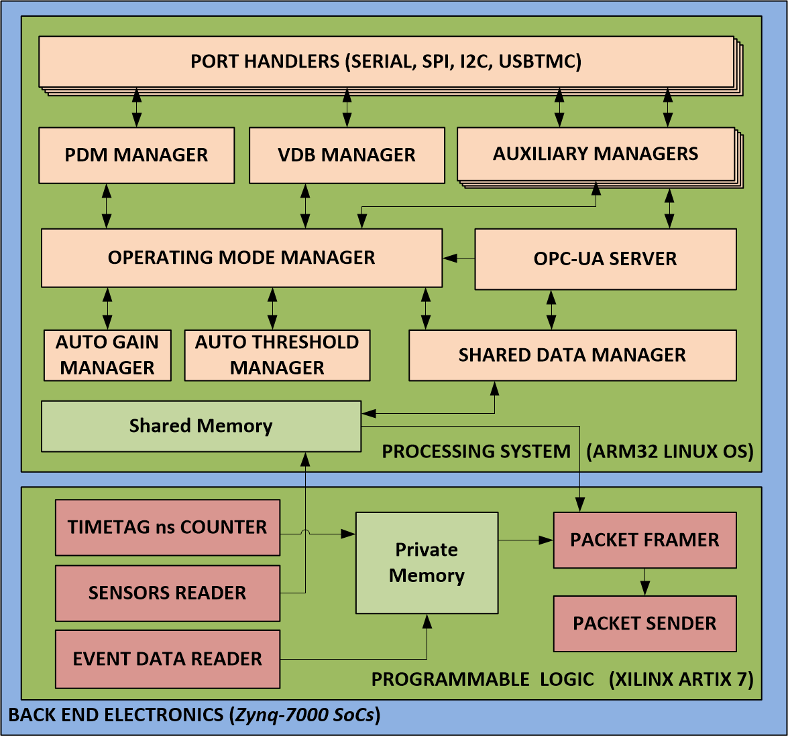
Architecture and Design
Port Handlers
Manages the physical ports of the BEE implementing their handling, configuration, sending and receiving of data.
PDM Manager
Implements a custom communication protocol to inizialize the PDMs and manages their acquisition functionalities by sending commands and the configurations for the ASICs and the FPGA.
VDB Manager
Responsible of the monitoring and control of the power supply (Low and Hi Voltages) management of the PDMs.
Auxilary Managers
Implement the proper vendors communication protocols of the auxiliary devices to perform their control and contiuous monitoring.
OPC-UA Server
The industrial-standard Process Control Unified Architecture is used for the interface with the higher level. This module translates high level commands to low level directives for the hardware subsystems in order to provide the functionalities to the users.
Auto Gain Manager
Periodically controls the SiPM temperatures variations of the PDMs in order to dinamically adjust the HV values with the VDB Manager.
Operating mode manager
Manages all the operations needed for the execution of each camera operational mode: receives the command by the user; prepares the proper configurations for the FEE and FPGA to be dispatched by the PDM Manager; performs other operations requested by each particular mode calling other modules (e.g. the Auxiliary managers).
Auto Threshold Manager
Periodically controls the acquisition rate in order to dinamically adjust the thresholds to keep it inside desired range.
Packet Framer and Packet Sender
Data collected from the FEEs are formatted according to the data format compliant with the telemetry specification.
Formatted packets are then sent to the Camera Server through the Fast Ethernet Channel.
Shared Data Manager
Manages the exchange of data between PS and PL parts of BEE writing memory registers.
P. Sangiorgi – INAF / IASF PALERMO – CRIS 2018 – Portopalo di Capo Passero (SR), Italy, 18-22 June 2018

Slide 18
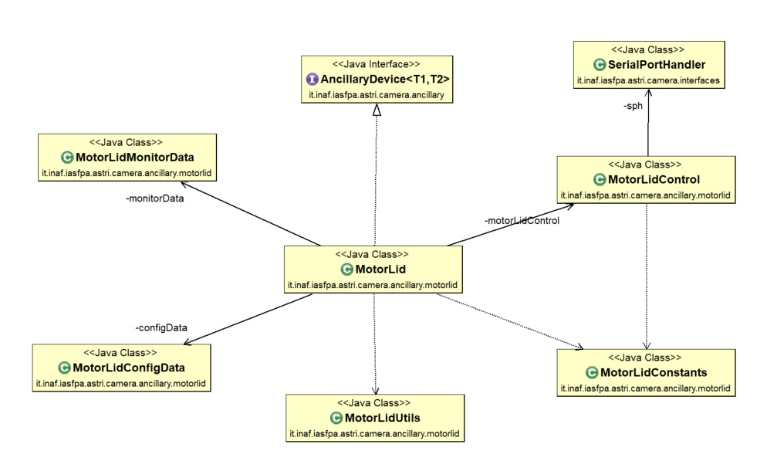
Design and Development
P. Sangiorgi – INAF / IASF PALERMO – CRIS 2018 – Portopalo di Capo Passero (SR), Italy, 18-22 June 2018

