Slide 1
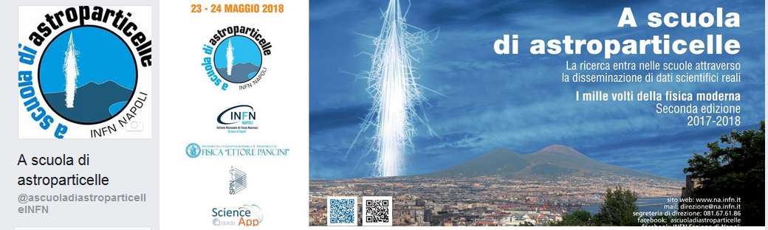
«A scuola di astroparticelle» a competition for high school students!
M. Ambrosio, C. Aramo, L. Consiglio, G. Pepe, I. Testa
INFN, Sezione di Napoli
Università Federico II Napoli, Dipartimento di Fisica
CNR-Spin , Napoli

Slide 2
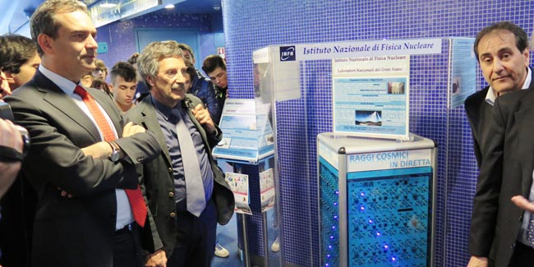
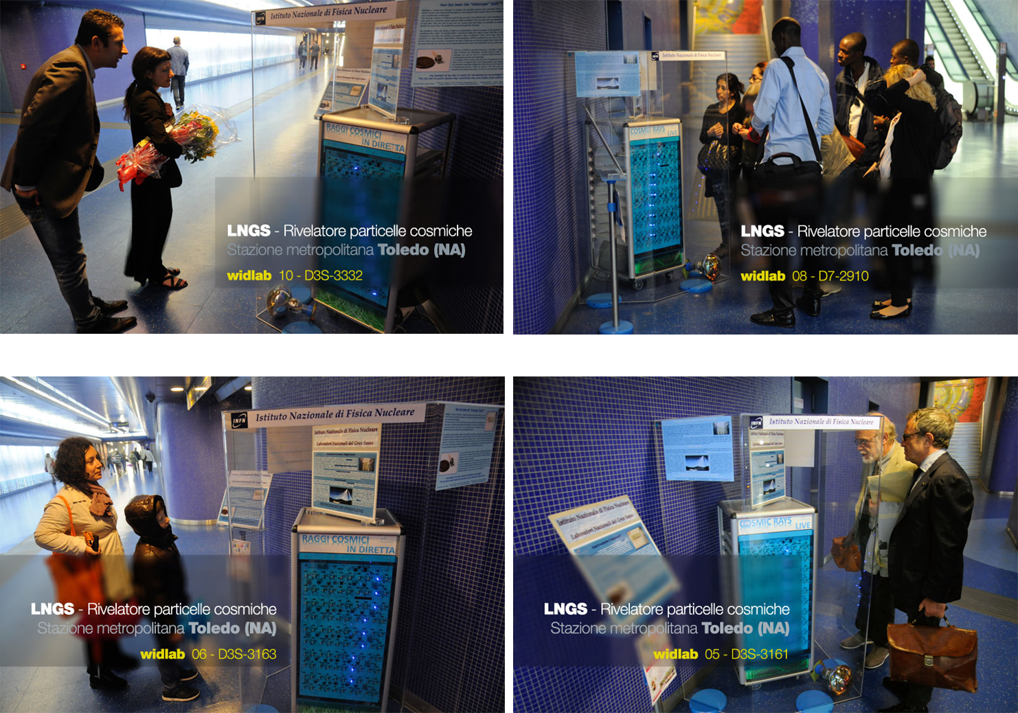
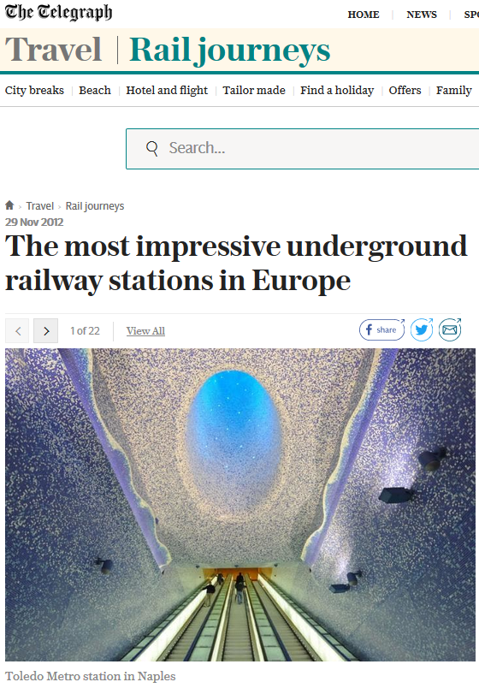
The installation of the underground cosmic ray telescope at the Toledo Metro Station in Napoli in May 2014 had a good impact, many people stop to look!

Slide 3
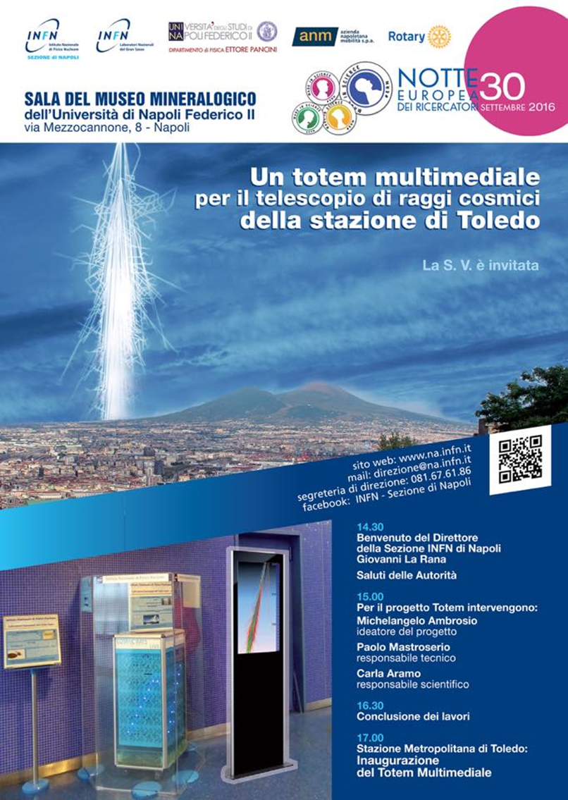
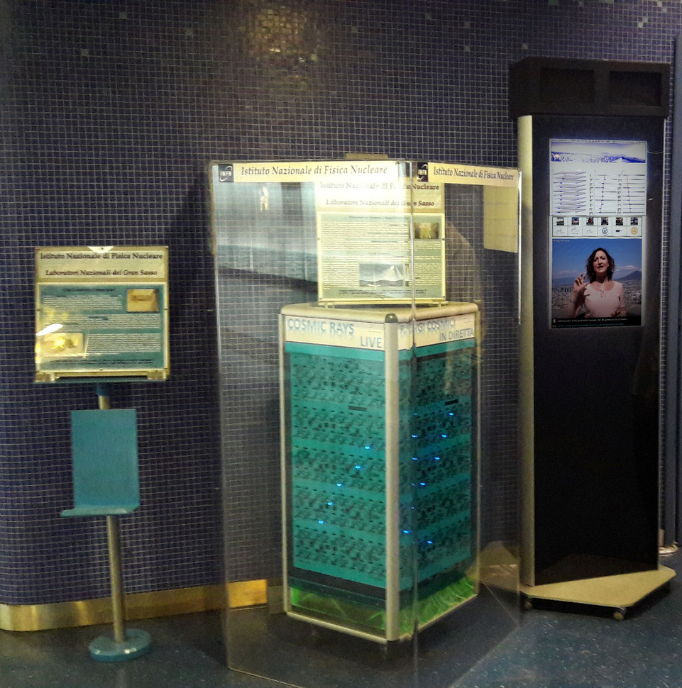
The telescope, composed of 10 xy scintillator planes 40x40 cm², read by SiPM, allows observing the muons that reach 40 meters of depth in the Metro Station through the LEDs that indicate the trajectory of the particles.
At the end of September 2016, as part of European researchers' night, the telescope was upgraded with a multimedia Totem, which provides videos on cosmic ray physics, as well as on the activities of INFN and other project partners through multimedia links.

Slide 4
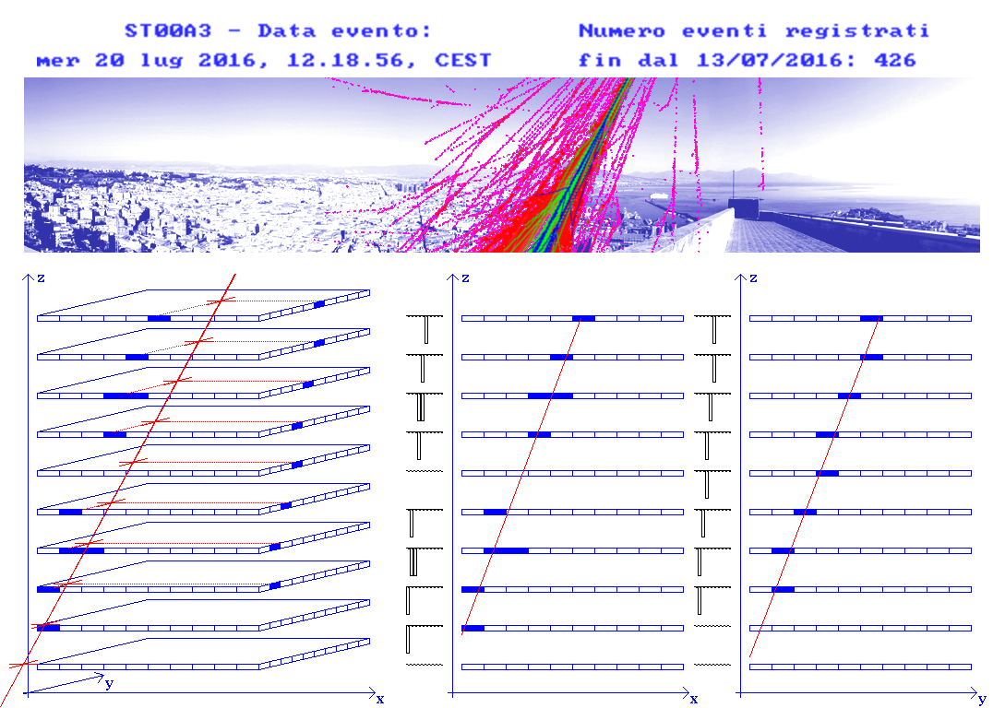
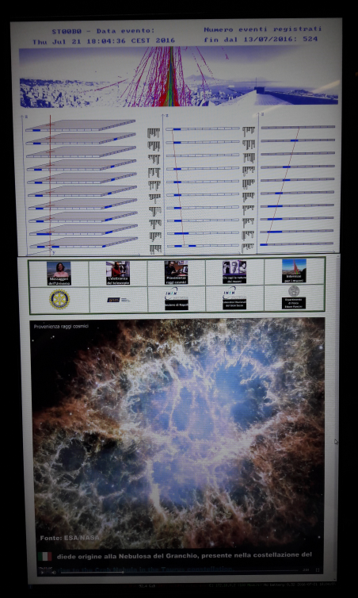
Telescope analysis data
An important aspect is the real-time analysis of telescope data, which are transmitted to the web site of INFN-NA, and accessible to the students for educational purposes.

Slide 5
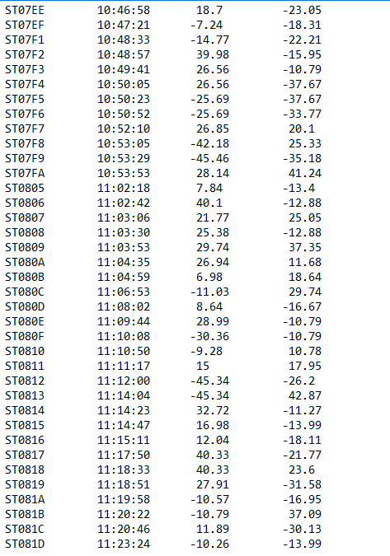
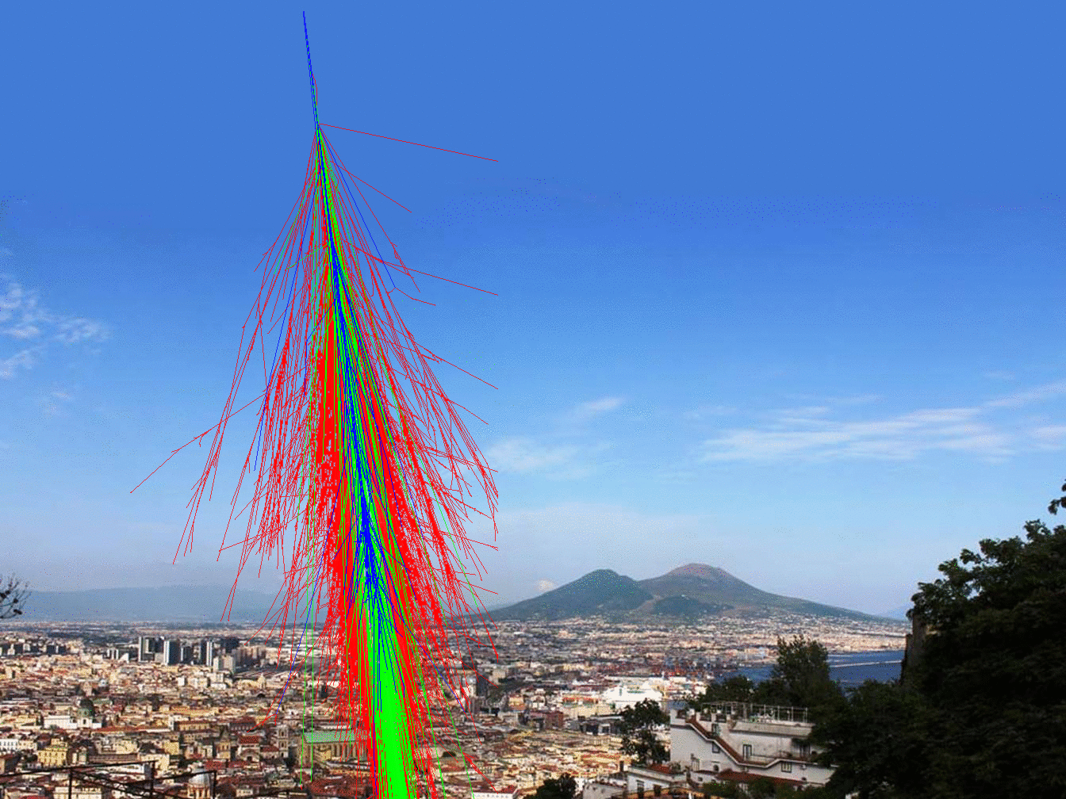
Events
N. ev. Time Angle θ Angle φ
Since September 2016, more than 700.000 events have been recorded: about 2000 events per day
The Telescope data are at the link http://people.na.infn.it/~totem/Eventi/

Slide 6
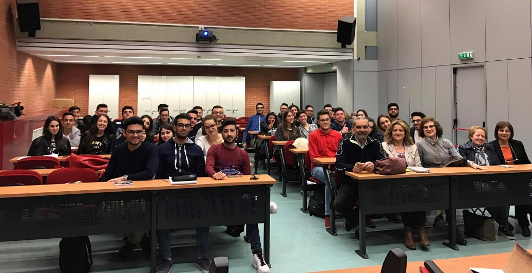
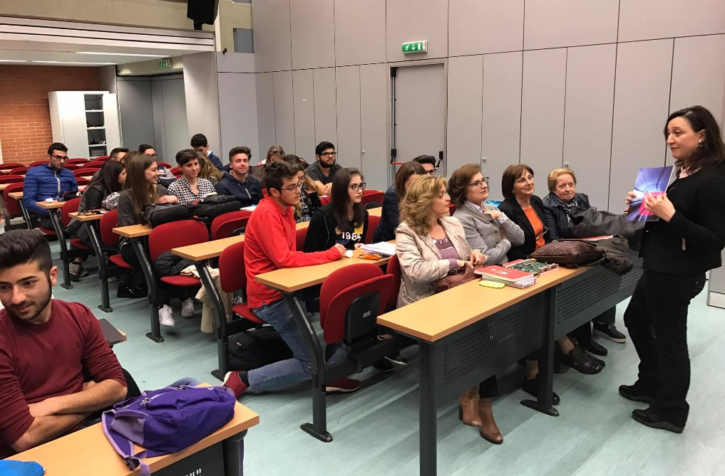
2016→ A pilot competition was launched for high-schools, sponsored by Campania Ufficio Scolastico Regionale (USR), with the aim to engaging teachers and students in astroparticle physics projects.
500 students and 140 ASL
“Go to the astroparticle physics school”
Participation of students with seminars and laboratory activities.
Realization of posters, videos, artefacts and experiments presented to the public exhibition named “Futuro Remoto” at Piazza del Plebiscito – Napoli.
Prize: one day stage @ LNF
School–Work Alternation
A way to realize training and educational pathways, implemented and evaluated by the schools in partnership with business-organizations, guaranteeing young people, both the basic knowledge, and the acquisition of skills that they can use in the world of work → mandatory for all students of Italian high-schools.

Slide 7
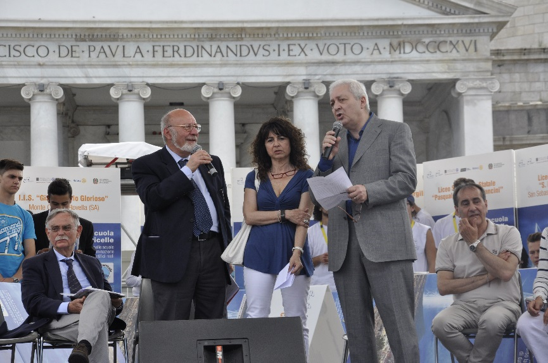
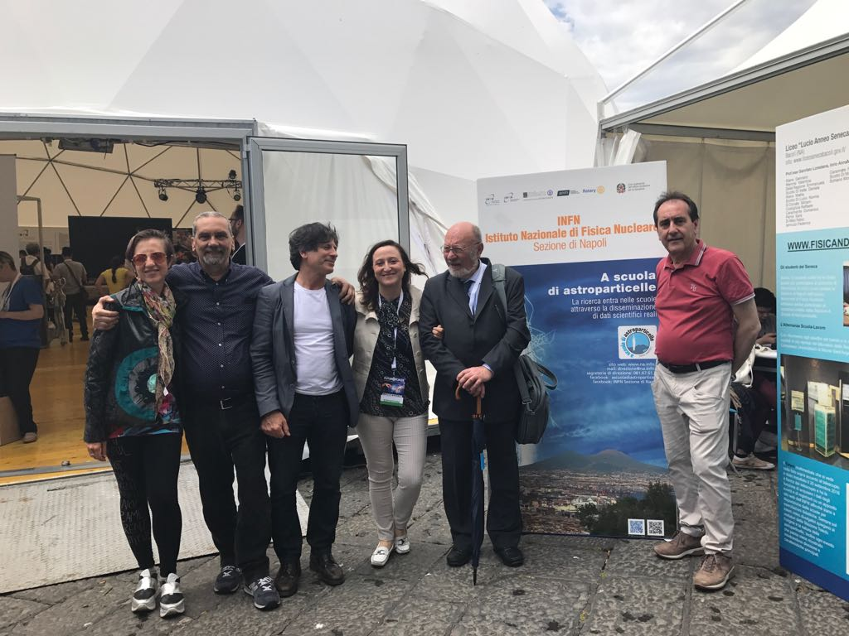
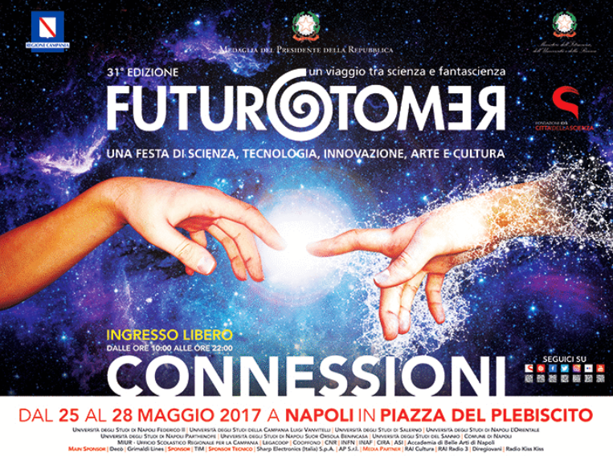
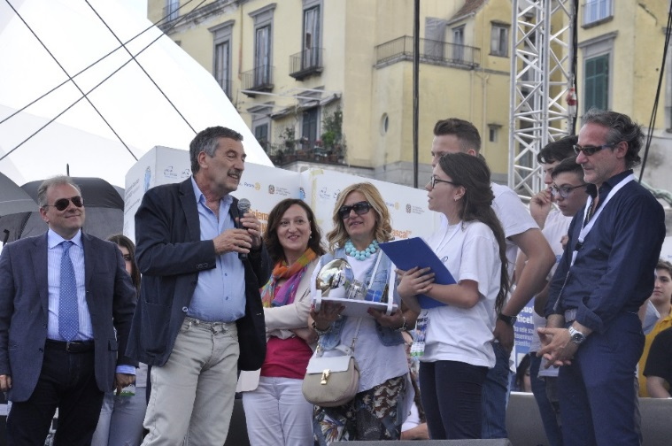
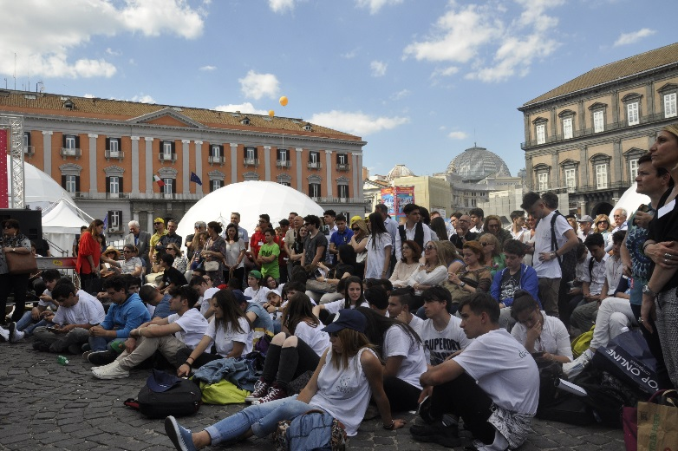
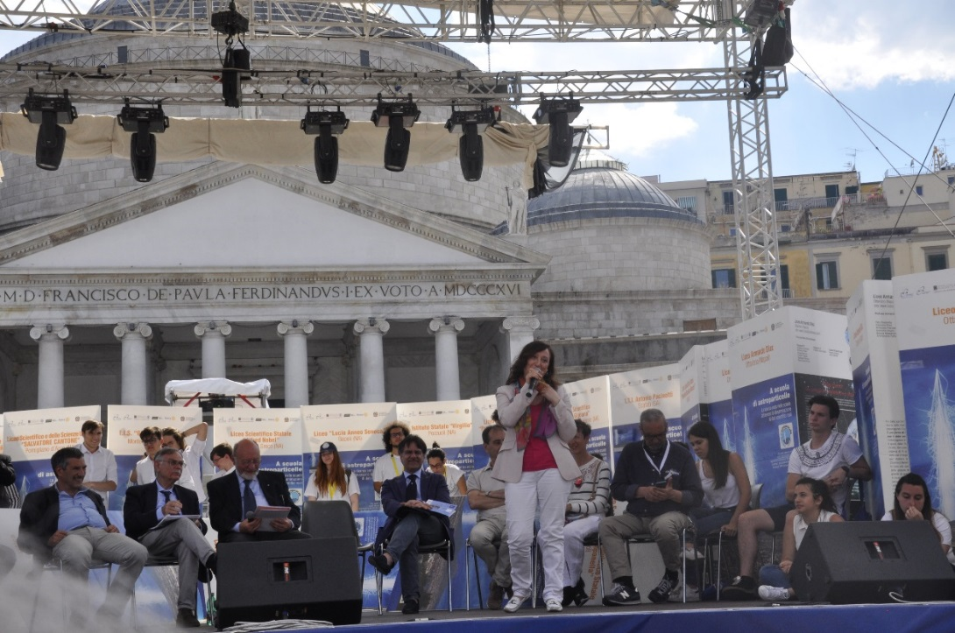
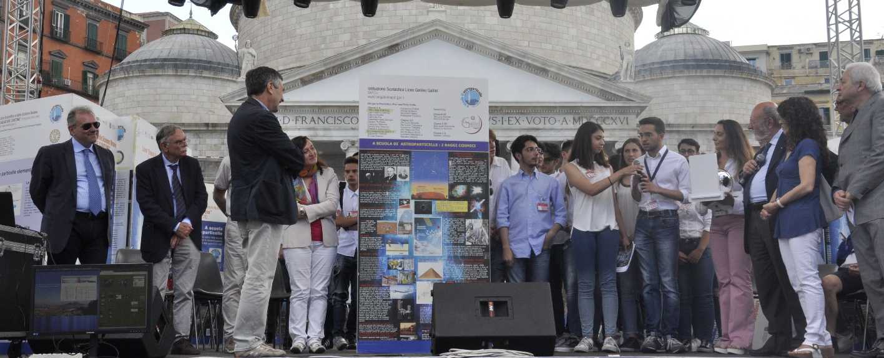
Piazza del Plebiscito - Napoli
The award ceremony - 2017

Slide 8
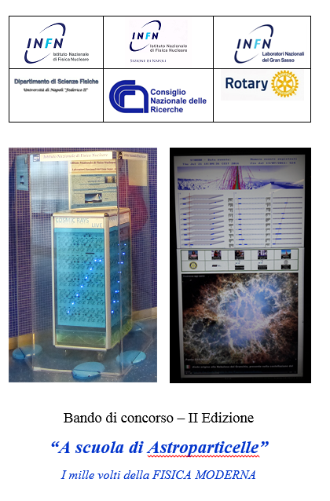
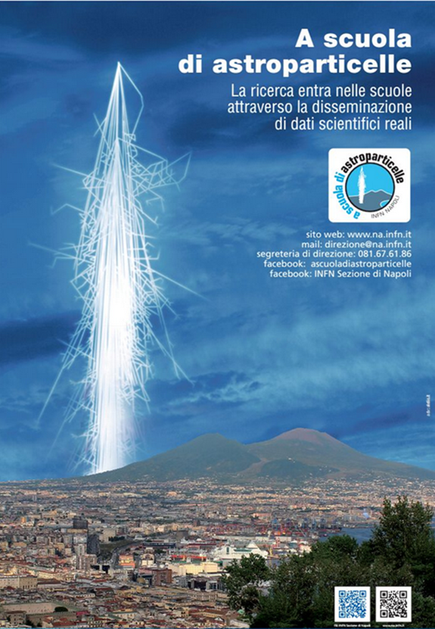
« A scuola di astroparticelle»
2017-2018→ II Edition

Slide 9
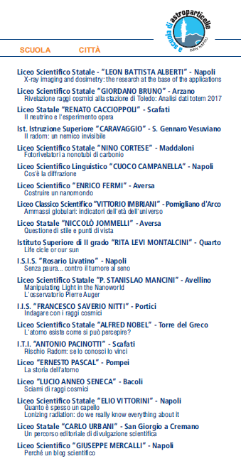
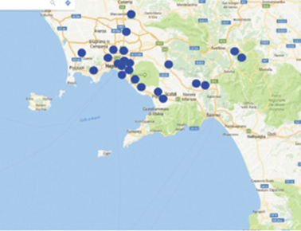
20 schools with 600 students and 900 hours of ASL!

Slide 10
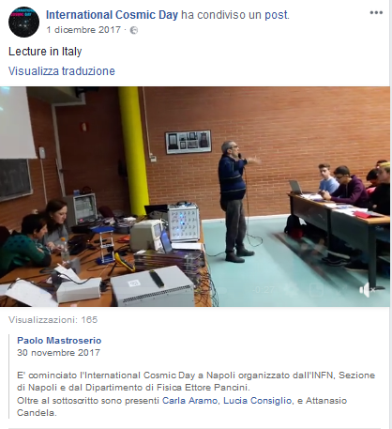
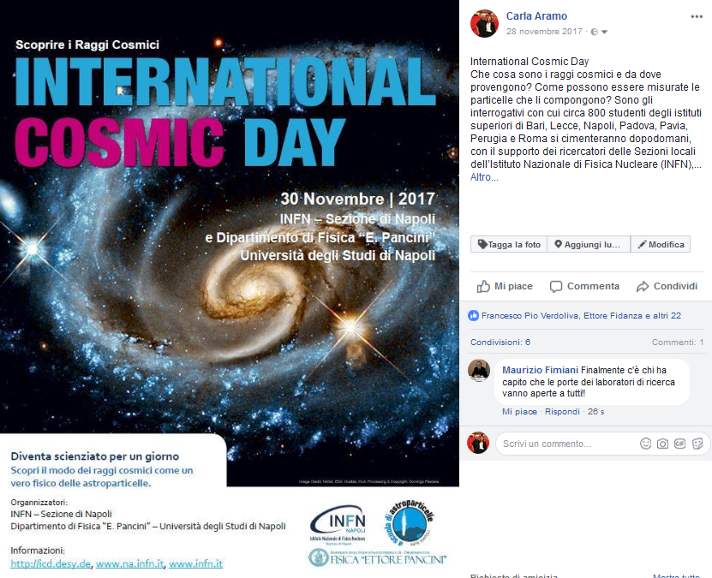
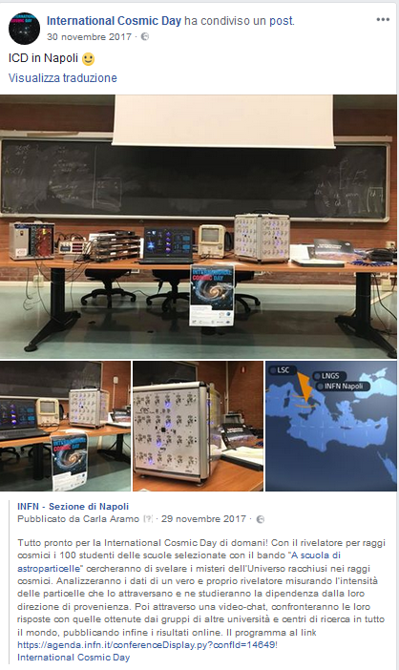

Slide 11
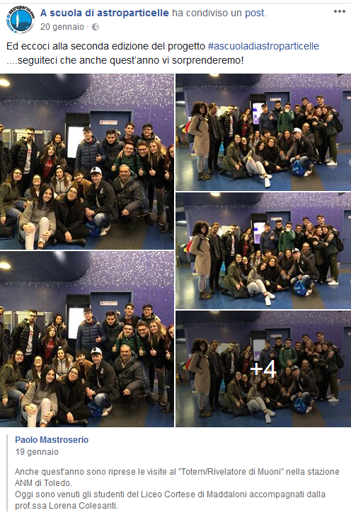
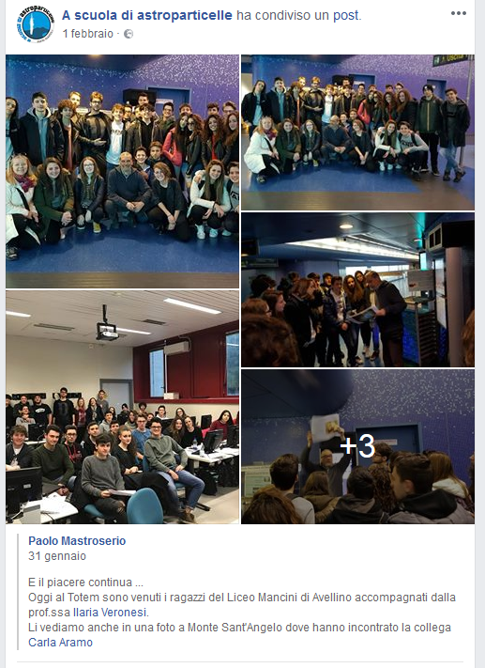
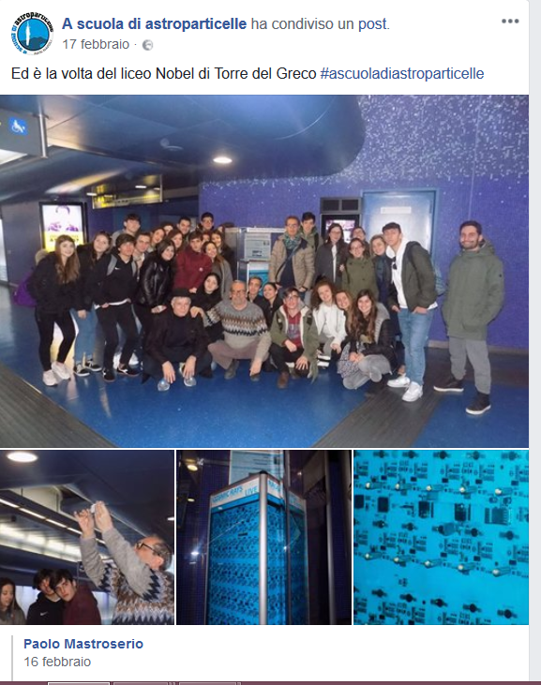
Students visit
@TOLEDO Telescope

Slide 12
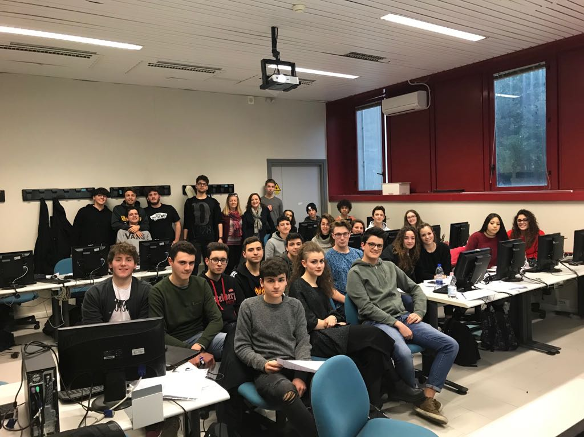
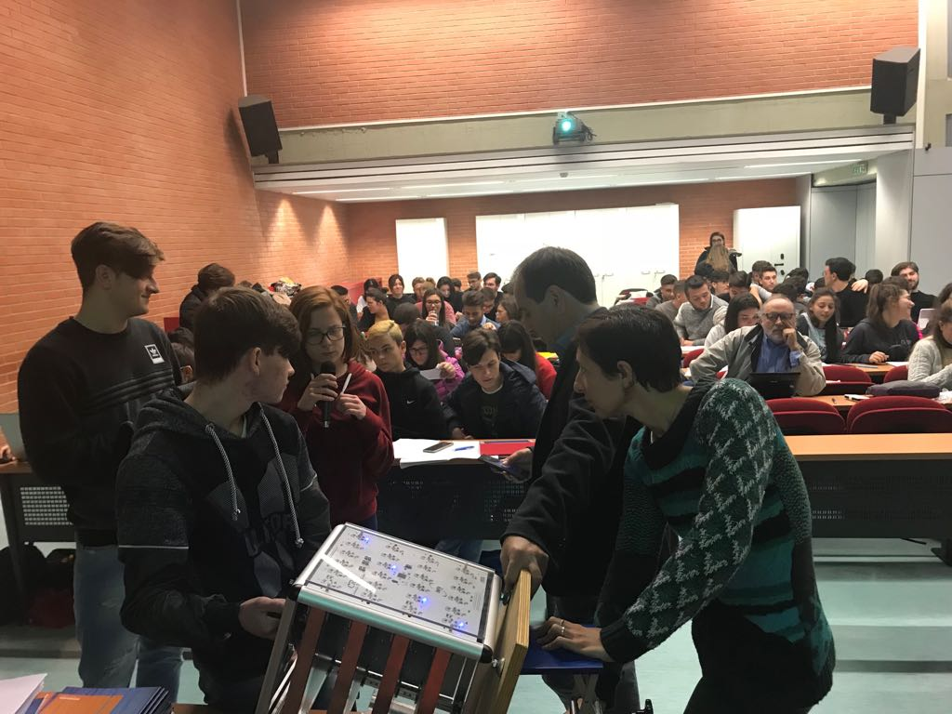
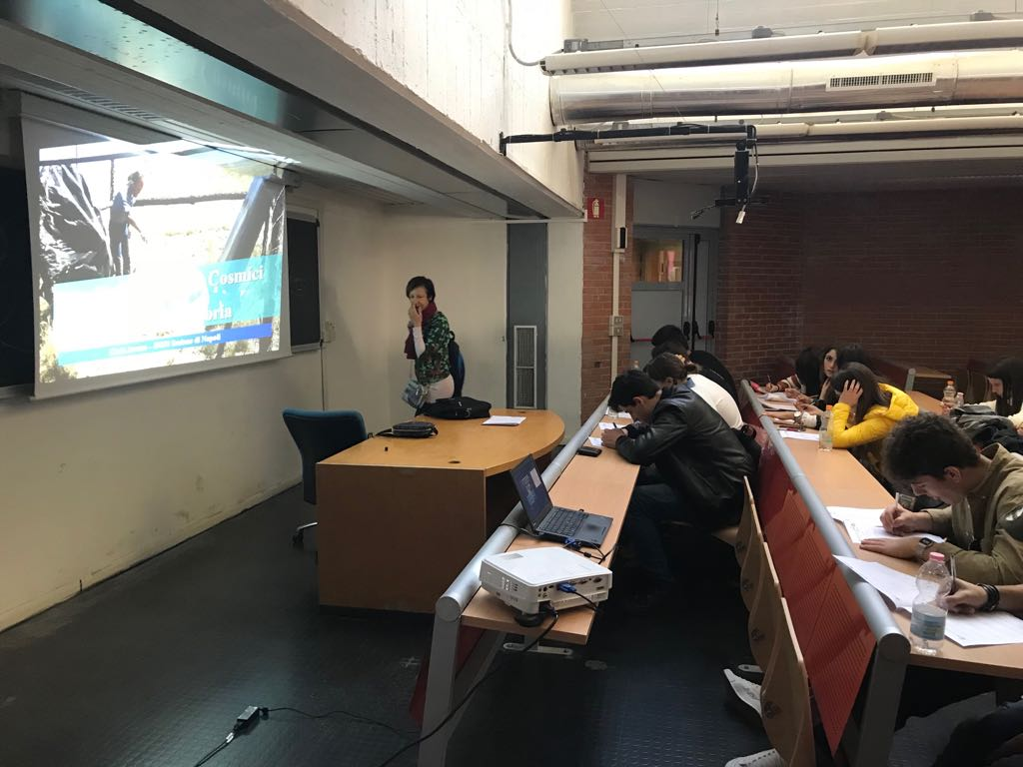
Laboratory activities

Slide 13
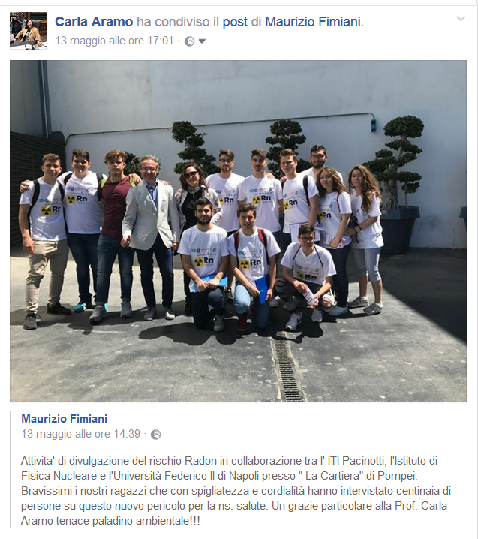
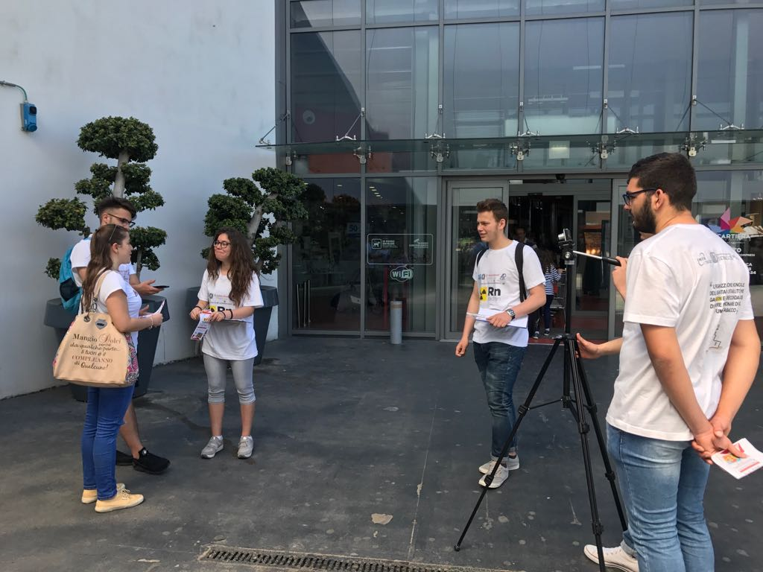
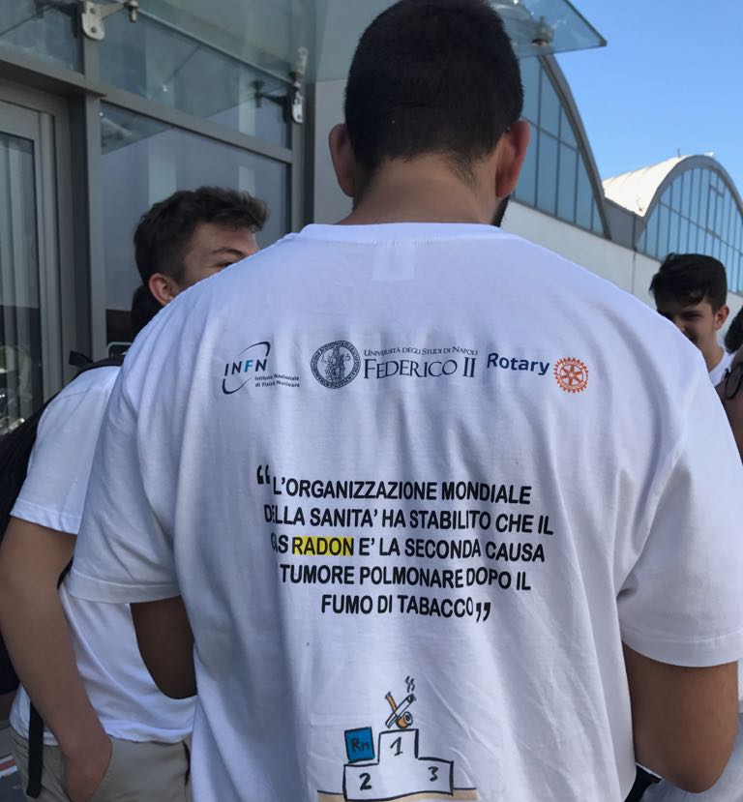
An example of School–Work Alternation:
Hundreds interviews at “La Cartiera” shopping centre in Pompei: RADON – Invisible Danger!

Slide 14
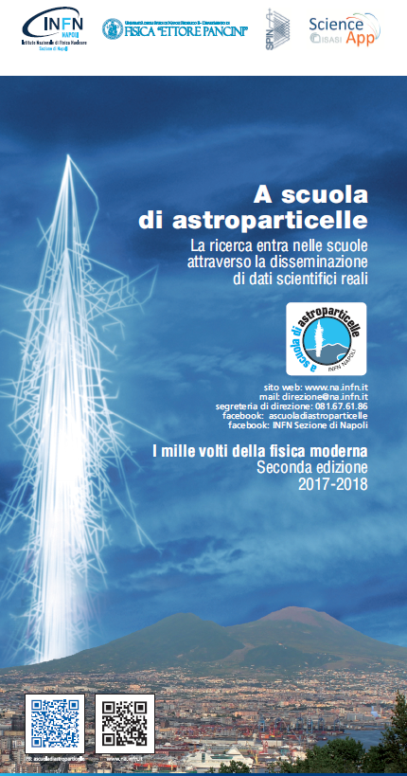
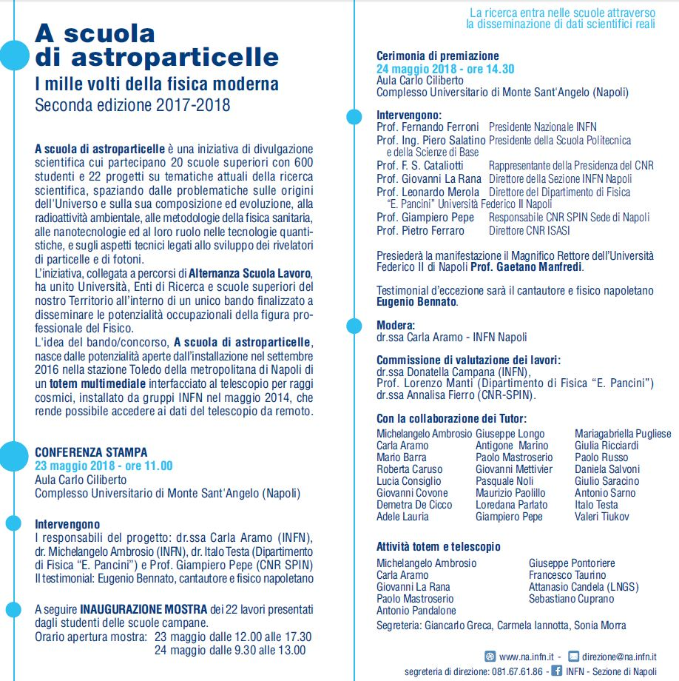

Slide 15
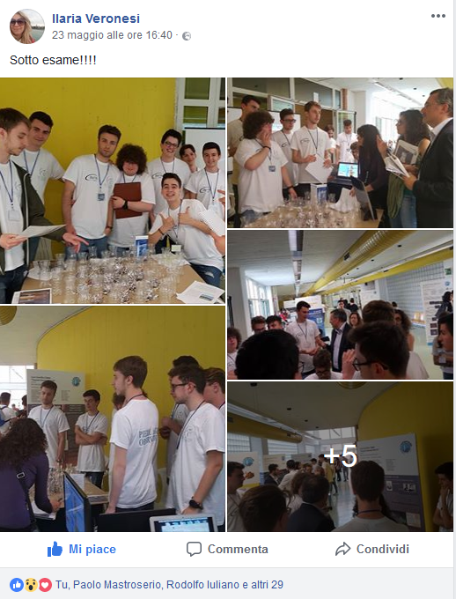
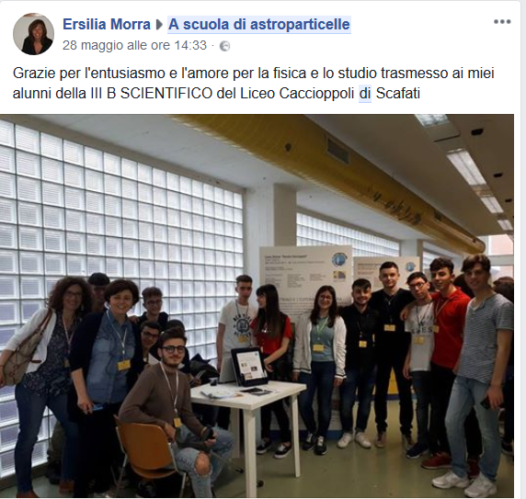
Students @work!
https://www.facebook.com/ascuoladiastroparticelleINFN/

Slide 16
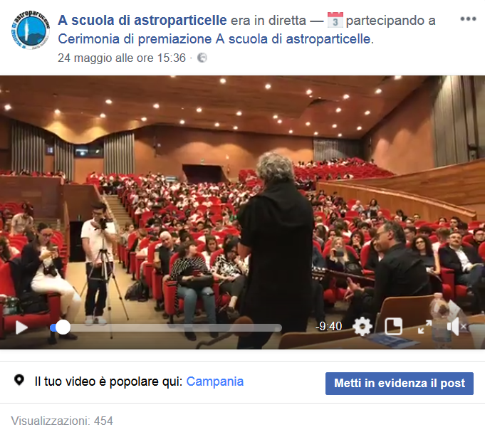
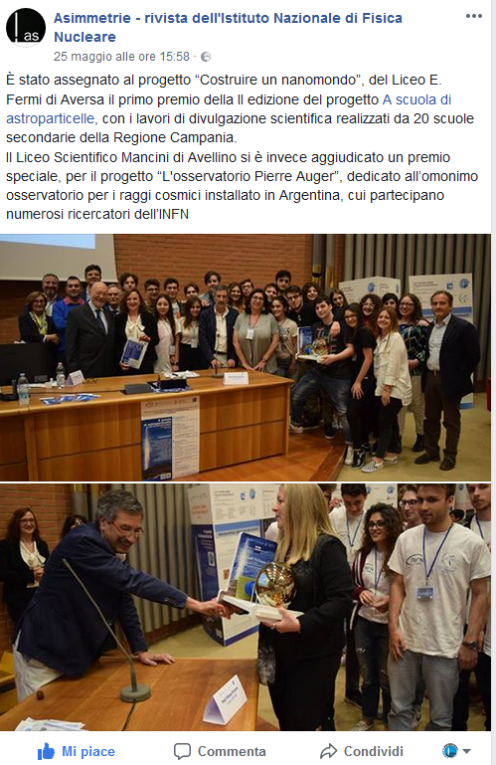
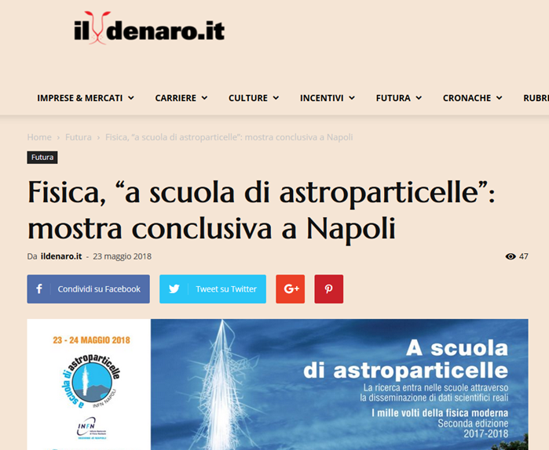
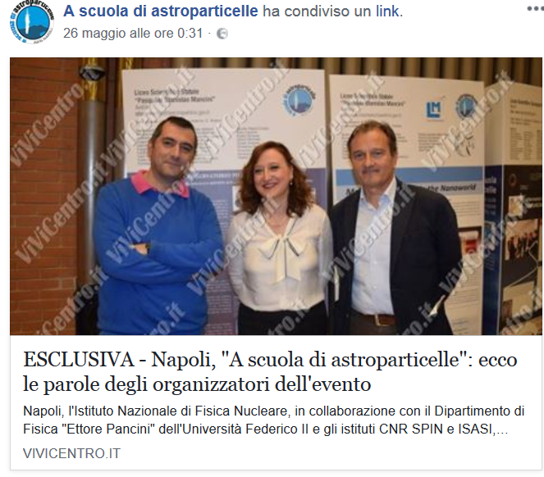
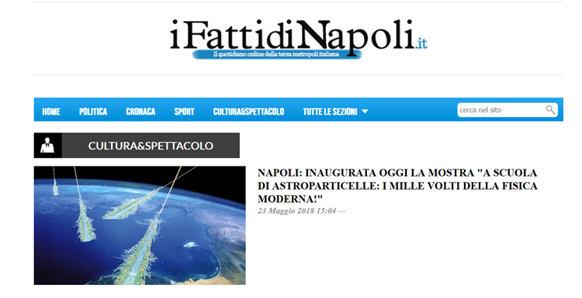

Slide 17
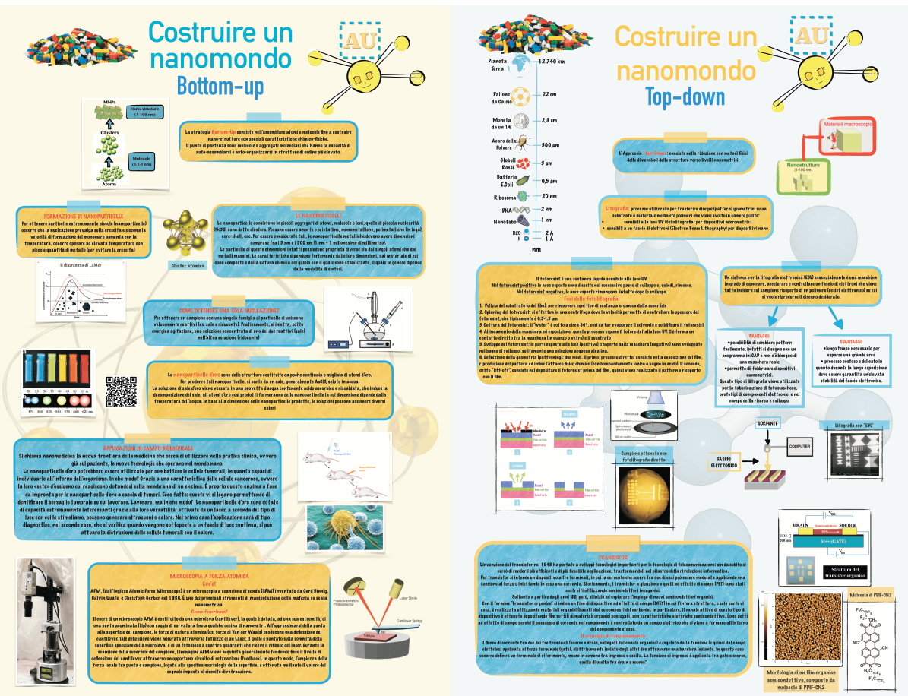
High school
FERMI
Aversa

Slide 18
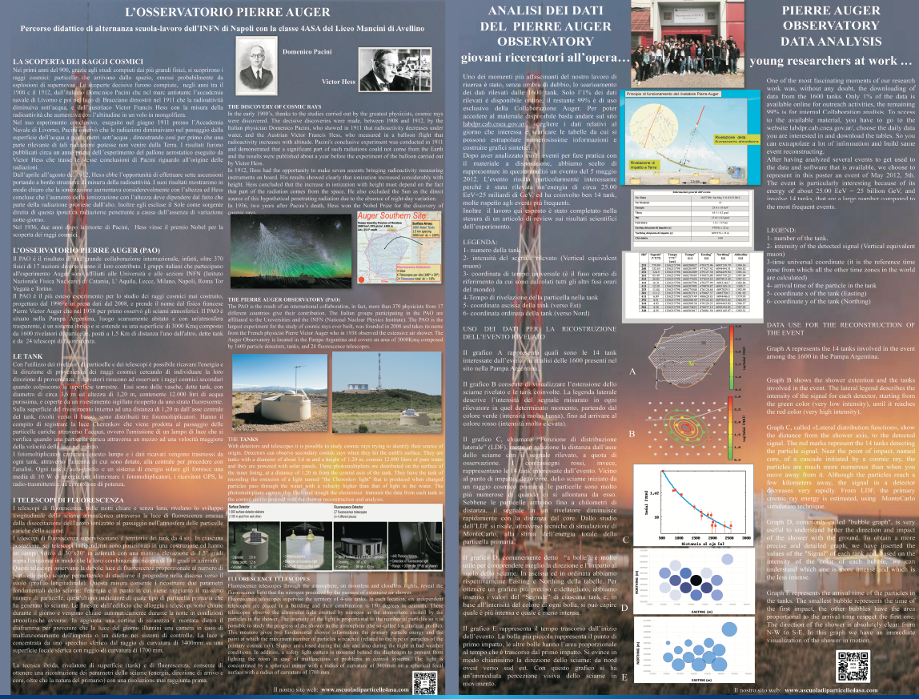
High school
MANCINI
Avellino
Test for Pierre Auger Observatory
Masterclass

Slide 19
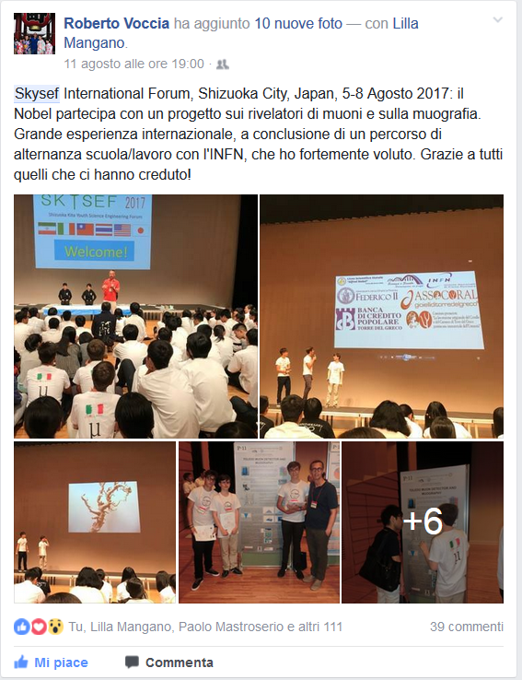
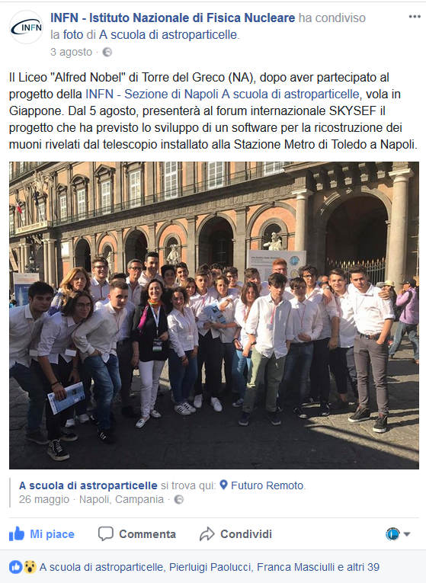
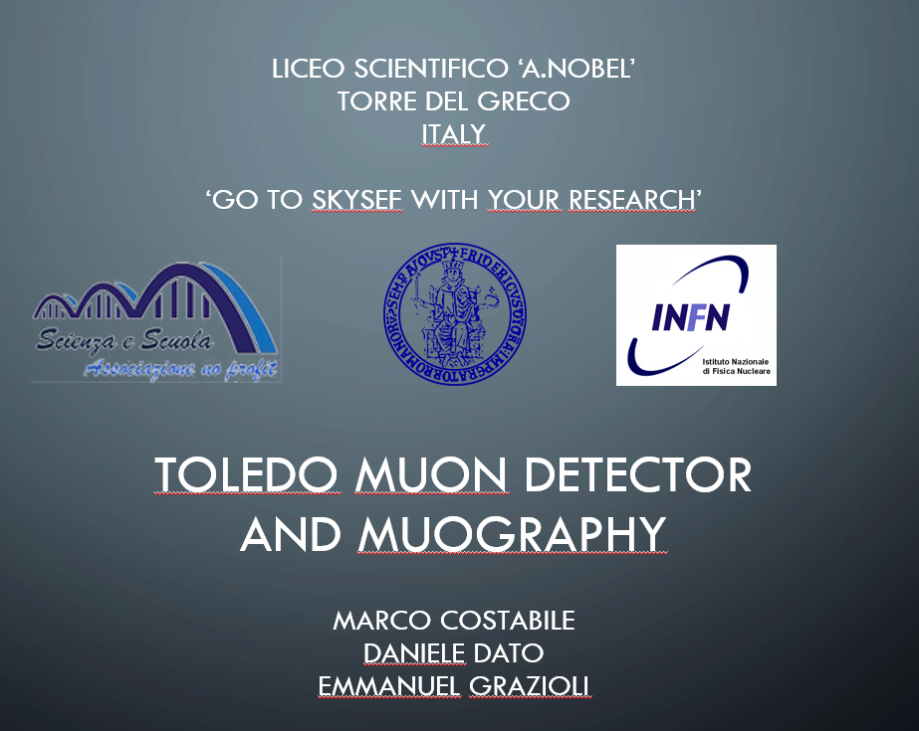
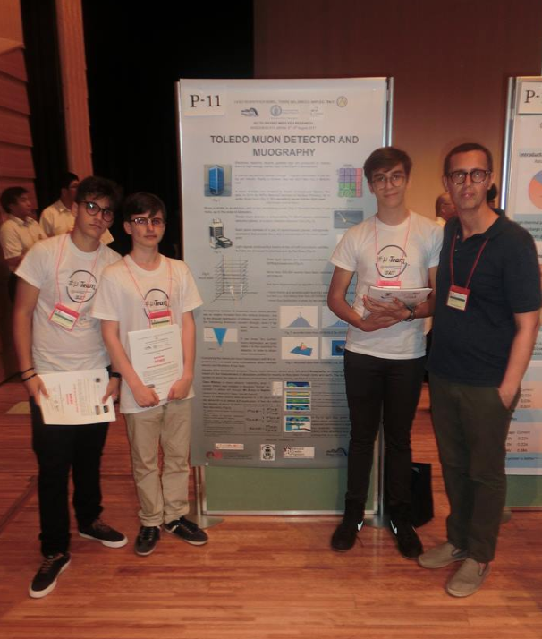
SKYSEF – Japan for Liceo Nobel di Torre del Greco

Slide 20


Slide 21




Slide 22




Physics Education

Slide 23








https://agenda.infn.it/conferenceDisplay.py?confId=15895
https://youtu.be/3B5KmNemOPI

Slide 24


The award ceremony
Facebook LIVE
https://www.facebook.com/ascuoladiastroparticelleINFN/
Conclusions
The Telescope/Totem is very useful instrument for outreach activity thanks to the possibility to remotely access for the schools
The school-work alternation program has been highly valued by all participants both for organization and activities.
Not just astroparticle physics but also radioactivity, nano-optics, biosensors, accelerators, theoretical physics, data acquisition techniques, etc.→ more then 20 researchers have been involved.
The Totem and its connection to the Toledo telescope open new perspectives for communication and dissemination of scientific culture, through the technique of learning by doing, especially for high-school students.
New way to perform school-work alternation program.
Stay tuned for the next edition….

