Slide 1







Smart phones as particle detectors: the
Distributed Electronic Cosmic-ray Observatory (DECO)
Justin Vandenbroucke (University of Wisconsin)
CRIS 2018, Portopalo di Capo Passero
June 21, 2018
Notes:
Questions received:
What is the battery consumption?
How are the countries ranked? Normalized by population?
What about detecting air showers with coincidence?
Do you run it just face down on a table?

Slide 2
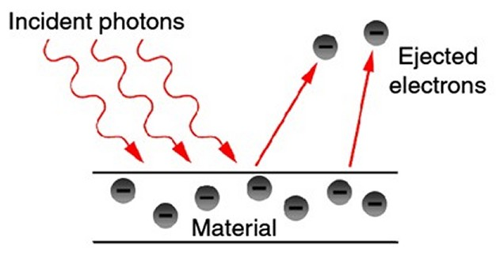
Digital cameras are designed to be particle detectors
Usually the particles are visible photons
Light hits the sensor, knocking loose electrons (charge): photoelectric effect
Charge is collected by (CCD or CMOS) camera image sensor
Notes:
Einstein Nobel, 1921 for 1905 paper

Slide 3
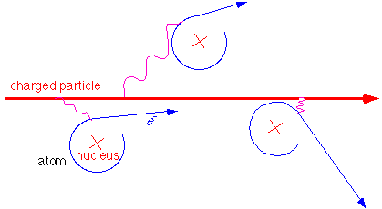
Other particles can also knock loose electrons
High energy photons (gamma rays)
Charged particles (electrons, muons, protons, …)
Digital camera image sensors can therefore detect any of these high energy particles (ionizing radiation)
Camera sensors can detect both
  Cosmic rays
  Background (terrestrial) radiation

Slide 4
DECO: the idea
Ionizing radiation (high energy particles) passing through a camera image sensor (CCD or CMOS) result in track-like images
True for cameras of all sizes, from telescopes to cell phones
A nuisance for telescopes
Interesting as a handheld detector for education, outreach, science: cover lens with tape and analyze dark images for tracks
The ionizing radiation can be created by cosmic rays, radioactivity in the environment, or a radioactive source
Can be used to teach cosmic rays, particle physics, nuclear physics, astrophysics, radiation
Similar detection principle to huge detectors built by hundreds of physicists (e.g. at LHC, Fermi), but in a handheld ubiquitous device
Single-classroom projects
Multi-classroom projects enabled by a central database
2013: Number of mobile devices in world exceeded number of toilets
2014: Number of mobile devices surpassed number of people

Slide 5
The app
DECO: Distributed Electronic Cosmic-ray Observatory
App for Android publicly available; iOS in beta testing
App automatically uploads/syncs data to central database
Database aggregates images and associated data (timestamp, geolocation, magnetic field measurements, …)
Database can be queried/analyzed by users
DECO can be used in the classroom and by interested public
Can also be used with radioactive sources
Download at http://wipac.wisc.edu/deco
Data automatically synced to a central repository
Users/public can browse and analyze repository

Slide 6
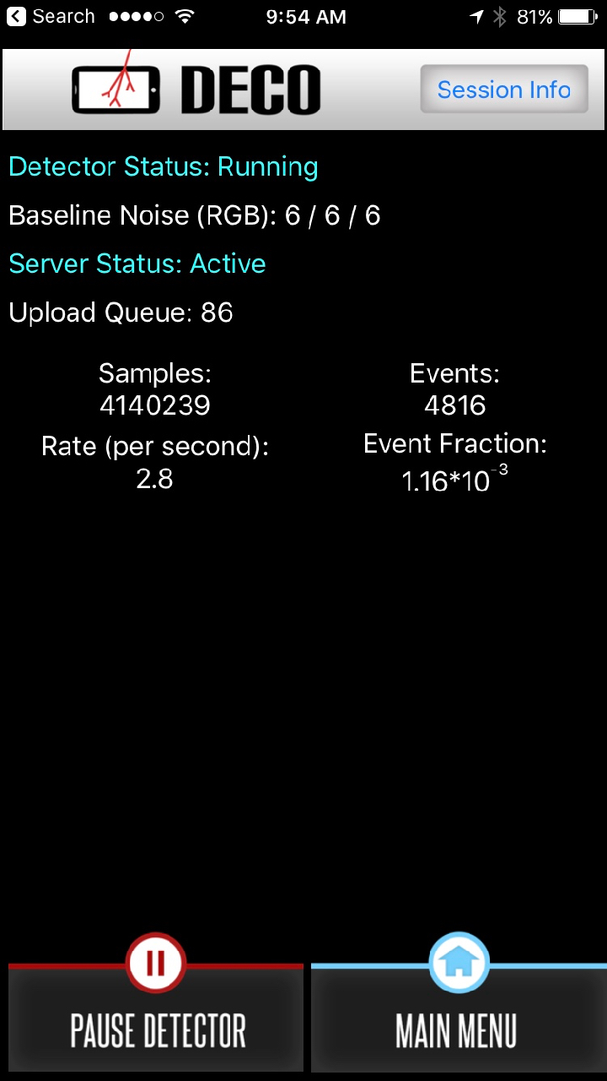
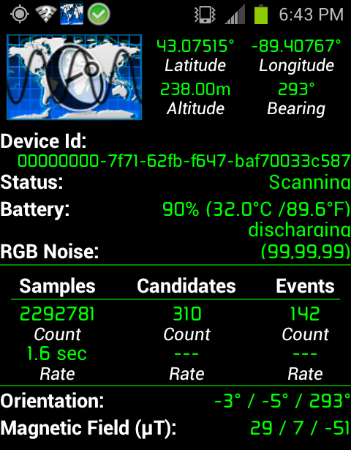
The App
iOS
Android

Slide 7
The app algorithm
Expose sensor as long as possible (depends on cell phone model and Android version, typically ~50 ms)
Analyze to see if a particle was detected (can take up to 1 sec)
Repeat
Every 5 minutes, keep an image, whether it passed the selection or not (“minimum bias” data set: a control for comparison to images with particle events)
How do we determine if a particle was detected?
  When app first starts, calibrate the sensor noise level to choose brightness thresholds; then for each image:
  First check a low resolution version: did at least N_{low} pixels have brightness above threshold T_{low}?
  If so, check a high resolution version: did at least N_{high} pixels have brightness above threshold T_{high}?
Notes:
low resolution (fast): 1 to 20 bright pixels passes
high resolution (slow): 5 to 100 bright pixels passes

Slide 8
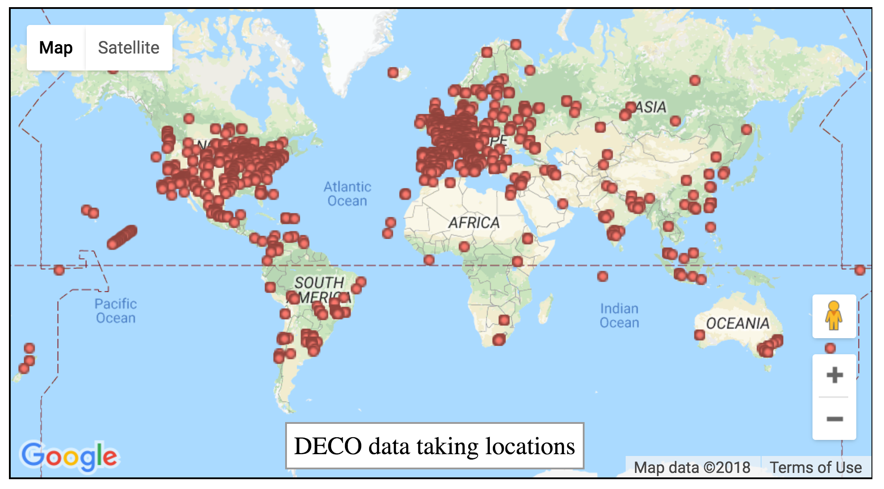
The Sun never sets on DECO
As of June 19, 2018
https://wipac.wisc.edu/deco/data

Slide 9
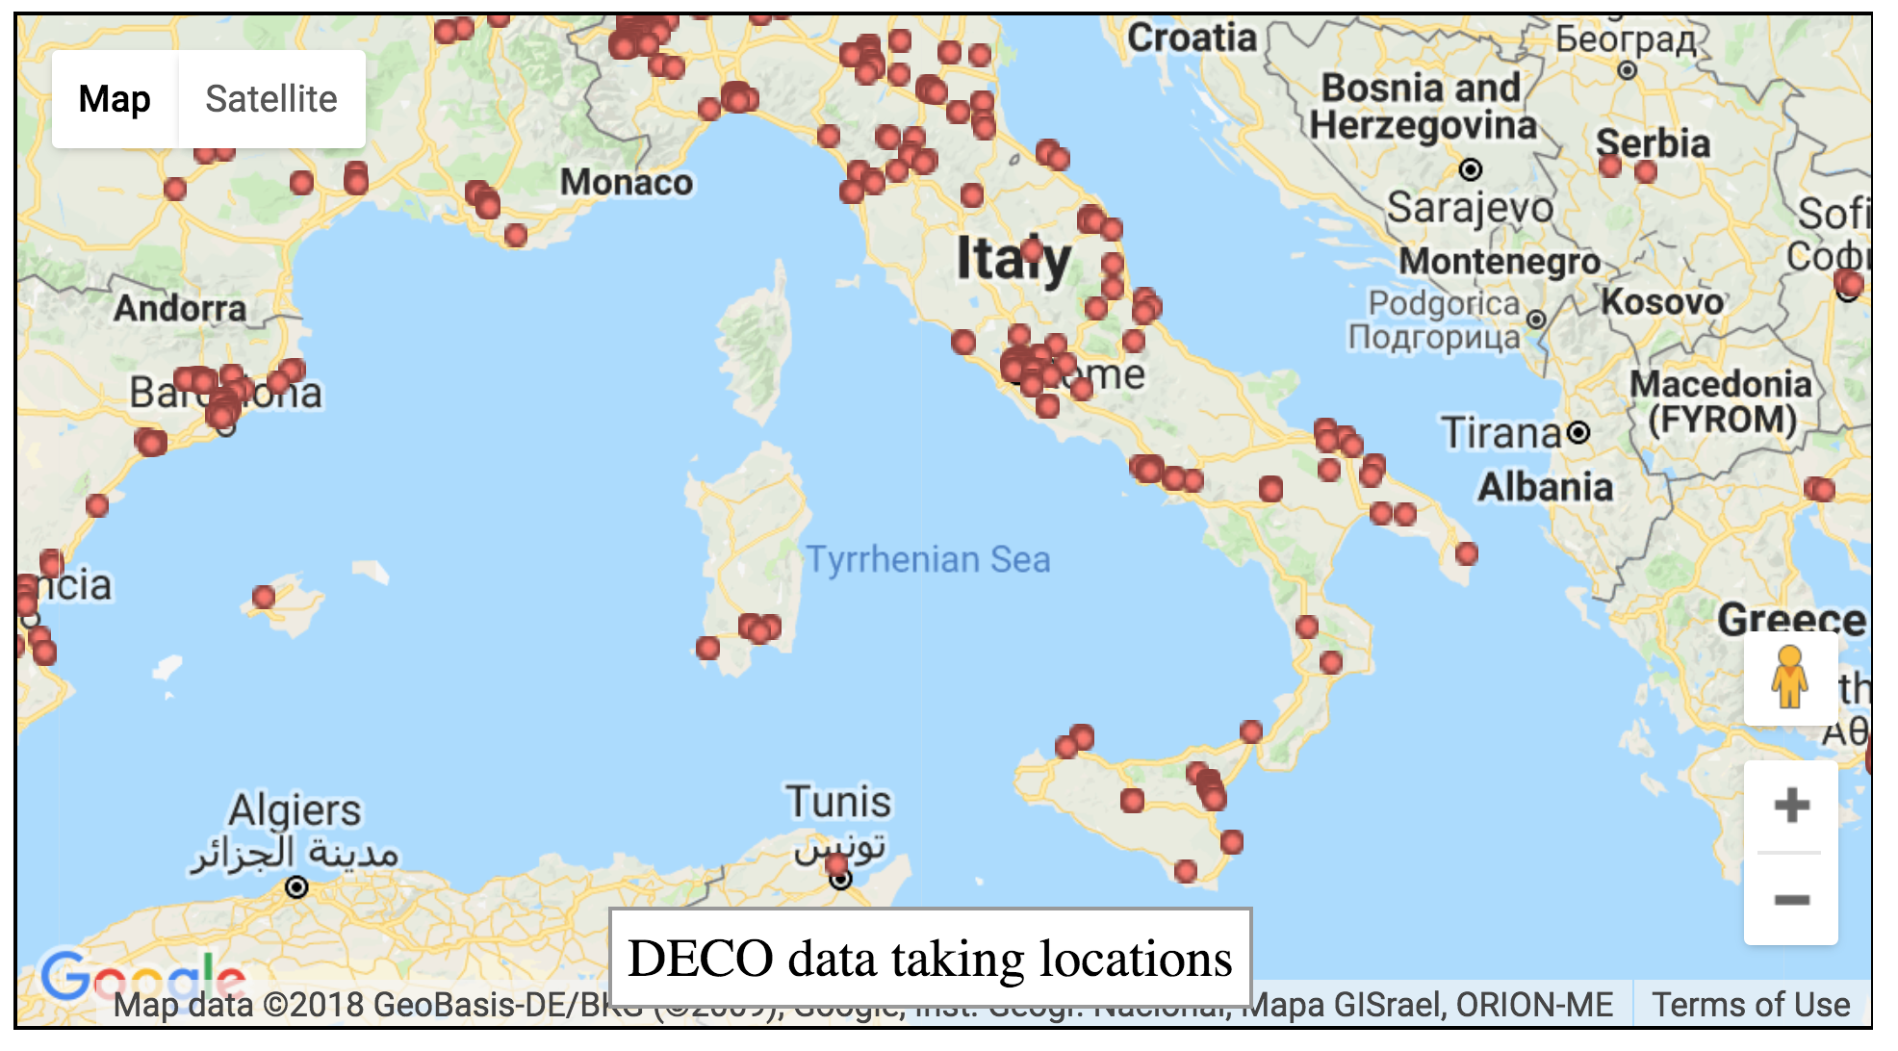
DECO in Italia

Slide 10
DECO users in 80 countries
1) USA | 21) Australia | 41) Slovakia | 61) Morocco
2) Italy | 22) China | 42) Indonesia | 62) Venezuela
3) Germany | 23) Andorra | 43) Ireland | 63) Bolivia
4) Mexico | 24) Norway | 44) United Arab Emirates | 64) Panama
5) Poland | 25) Chile | 45) Thailand | 65) Estonia
6) Russia | 26) India | 46) Armenia | 66) Antigua
7) Spain | 27) Taiwan | 47) Hungary | 67) Bangladesh
8) United Kingdom | 28) Austria | 48) Nepal | 68) South Korea
9) France | 29) Ukraine | 49) Czechia | 69) Latvia
10) Greece | 30) Luxembourg | 50) Lithuania | 70) Iceland
11) Netherlands | 31) Malaysia | 51) Peru | 71) Angola
12) Canada | 32) Belgium | 52) Iran | 72) Jordan
13) Finland | 33) Colombia | 53) Cybrus | 73) Pakistan
14) Sweden | 34) Argentina | 54) Syria | 74) Kenya
15) Turkey | 35) Bulgaria | 55) Portugal | 75) Serbia
16) Brazil | 36) Israel | 56) Croatia | 76) Kyrgyzstan
17) Algeria | 37) Uruguay | 57) New Zealand | 77) Ecuador
18) Switzerland | 38) Egypt | 58) Ethiopia | 78) Afghanistan
19) Slovenia | 39) Philippines | 59) Tunisia | 79) Albania
20) Denmark | 40) Antarctica | 60) Romania | 80) Cameroon

Slide 11
Web-based public data browser
Publicly accessible: part of main DECO page
Events available within a couple hours of detection
Query database based on device ID, time, latitude/longitude, altitude, device model, and particle identity
First 50 events returned by query displayed on web table
All events returned by query can be downloaded to .csv (metadata)
Zoomed, processed (for privacy) image available for each event
Link to google map location of each event, with resolution degraded to 0.01°(~1 km) for privacy

Slide 12
Astronomers are familiar with identifying charged particles in camera images
National Optical Astronomy Observatory
from (GeV) cosmic rays
electrons from Compton scattering of gamma rays from MeV radioactive days
Don Groom, “(Unwanted) radiation events in astronomical CCD images”, SPIE 2002

Slide 13
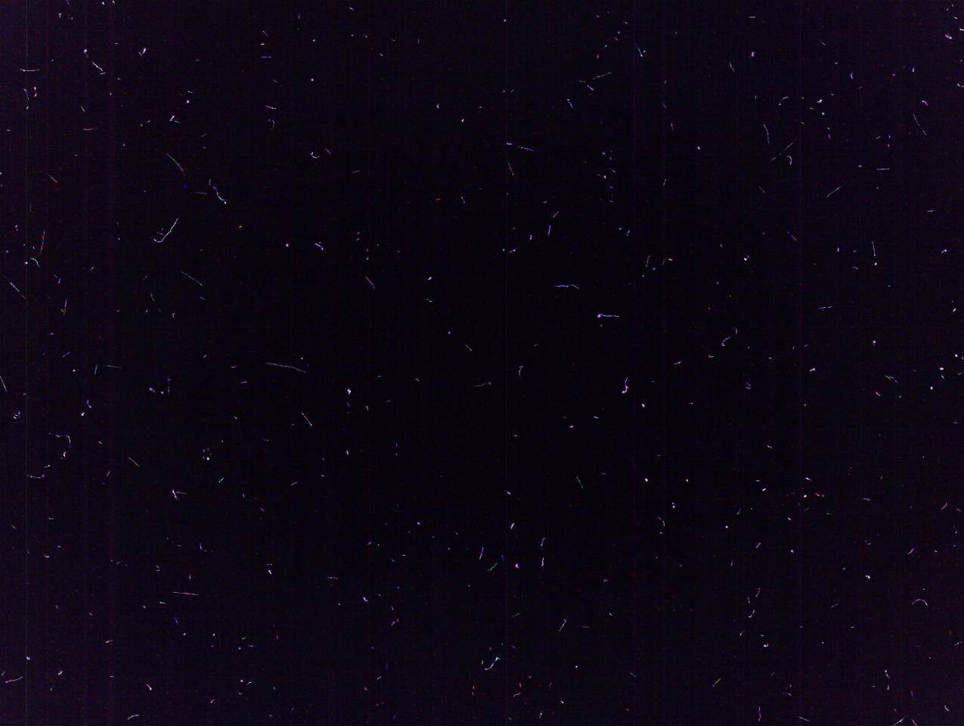
DECO image stack (sum of 379 images from one day)
Notes:
One day of data: February 21, 2013

Slide 14
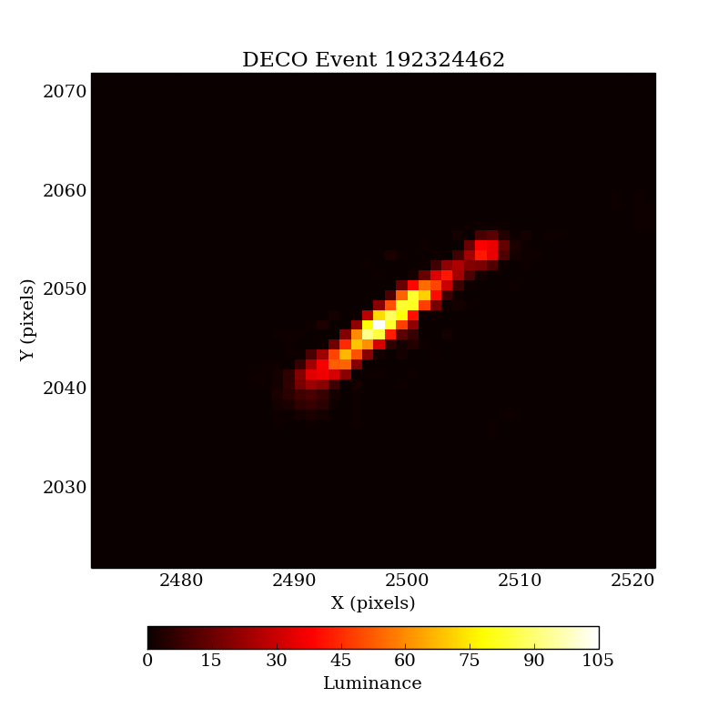
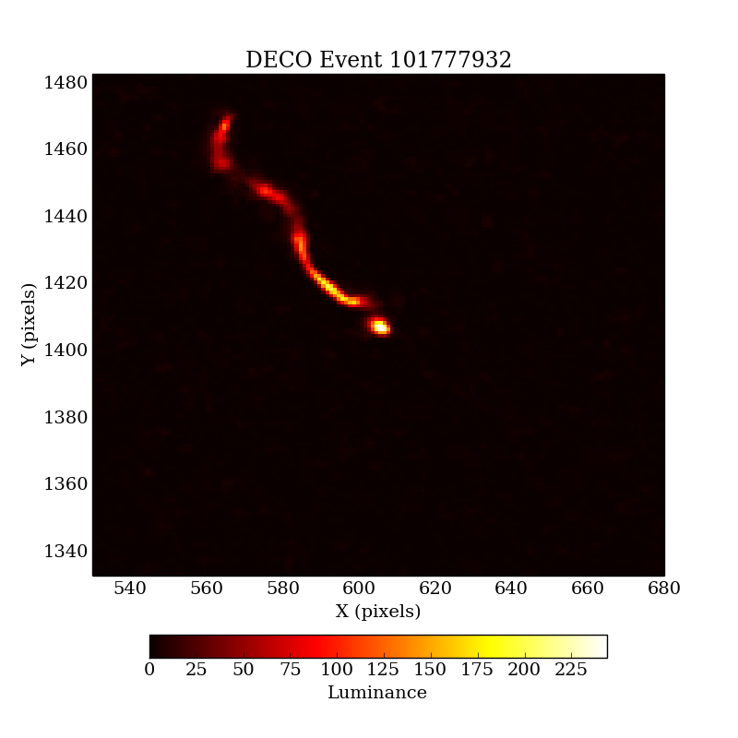
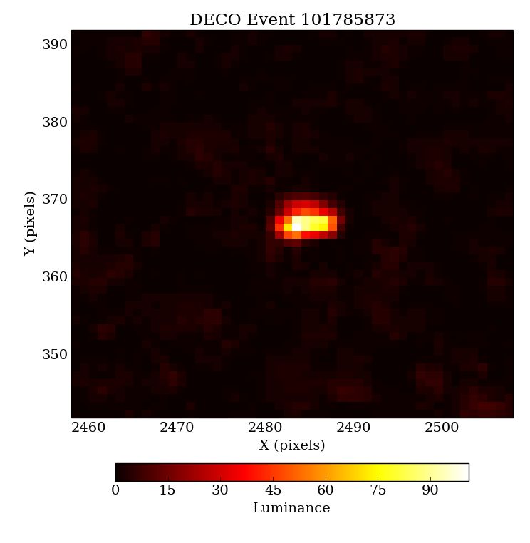
Example DECO signals: 3 categories
(2) worm
(1) track
track
cosmic-ray muon
low-energy electron
multiple scattering
(3) spot
very low energy electron
from Compton scatter
Notes:
101765957

Slide 15
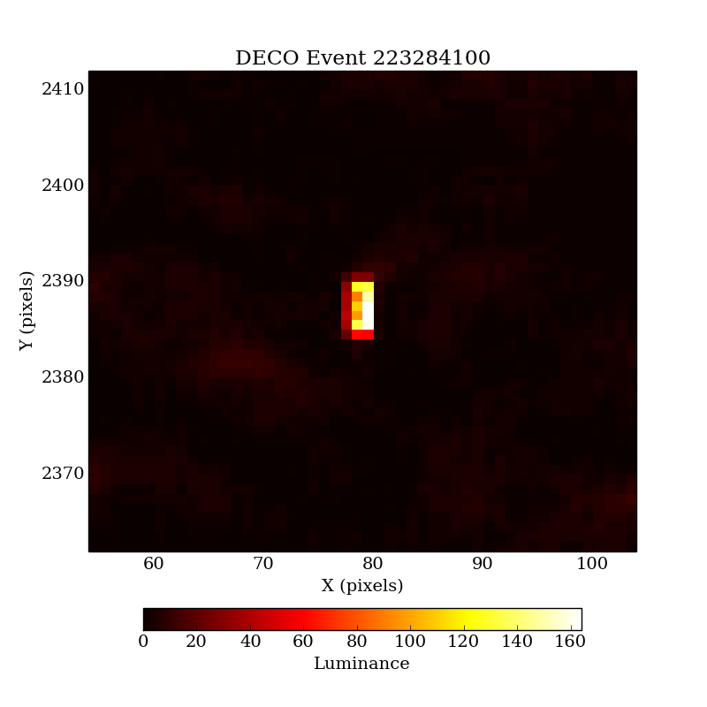
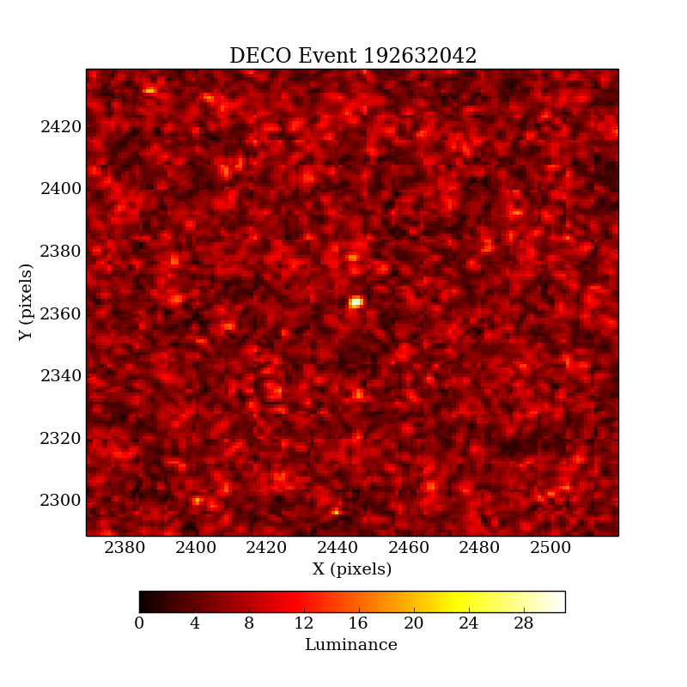
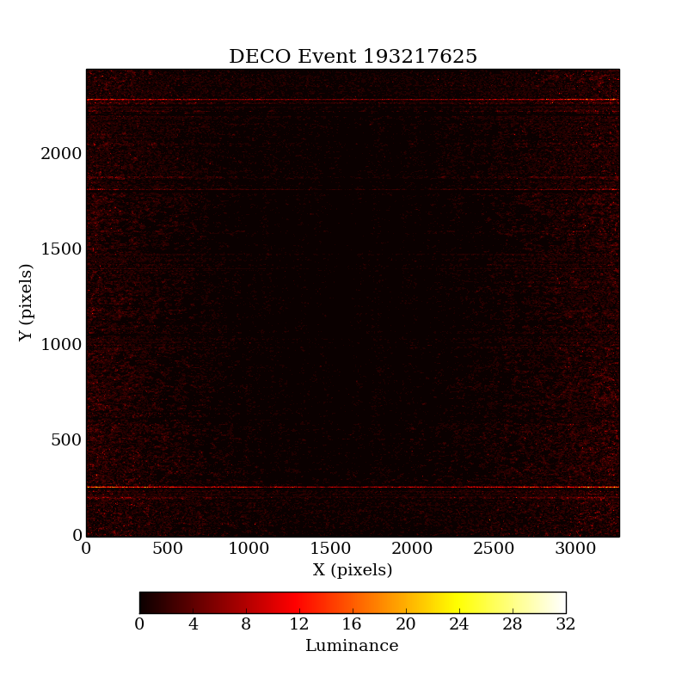
Example DECO backgrounds: 3 categories
worm
track
(5) (thermal) noise
track
(4) hot spot
spot
(6) camera artifacts
Notes:
101765957

Slide 16
Cell phone camera image sensor sizes
(= particle collection area)
Sensor format | Area (mm²) | Phone models
1/4.0” | 7.68 | Galaxy Nexus, Nexus 4
1/3.6” | 12.00 | Nokia Lumia 720
1/3.2” | 15.50 | iPhone 5, Nexus 5
1/3” | 17.30 | iPhone 5S, iPhone 6
Notes:
http://en.wikipedia.org/wiki/Image_sensor_format
http://www.anandtech.com/show/7517/google-nexus-5-review/6

Slide 17
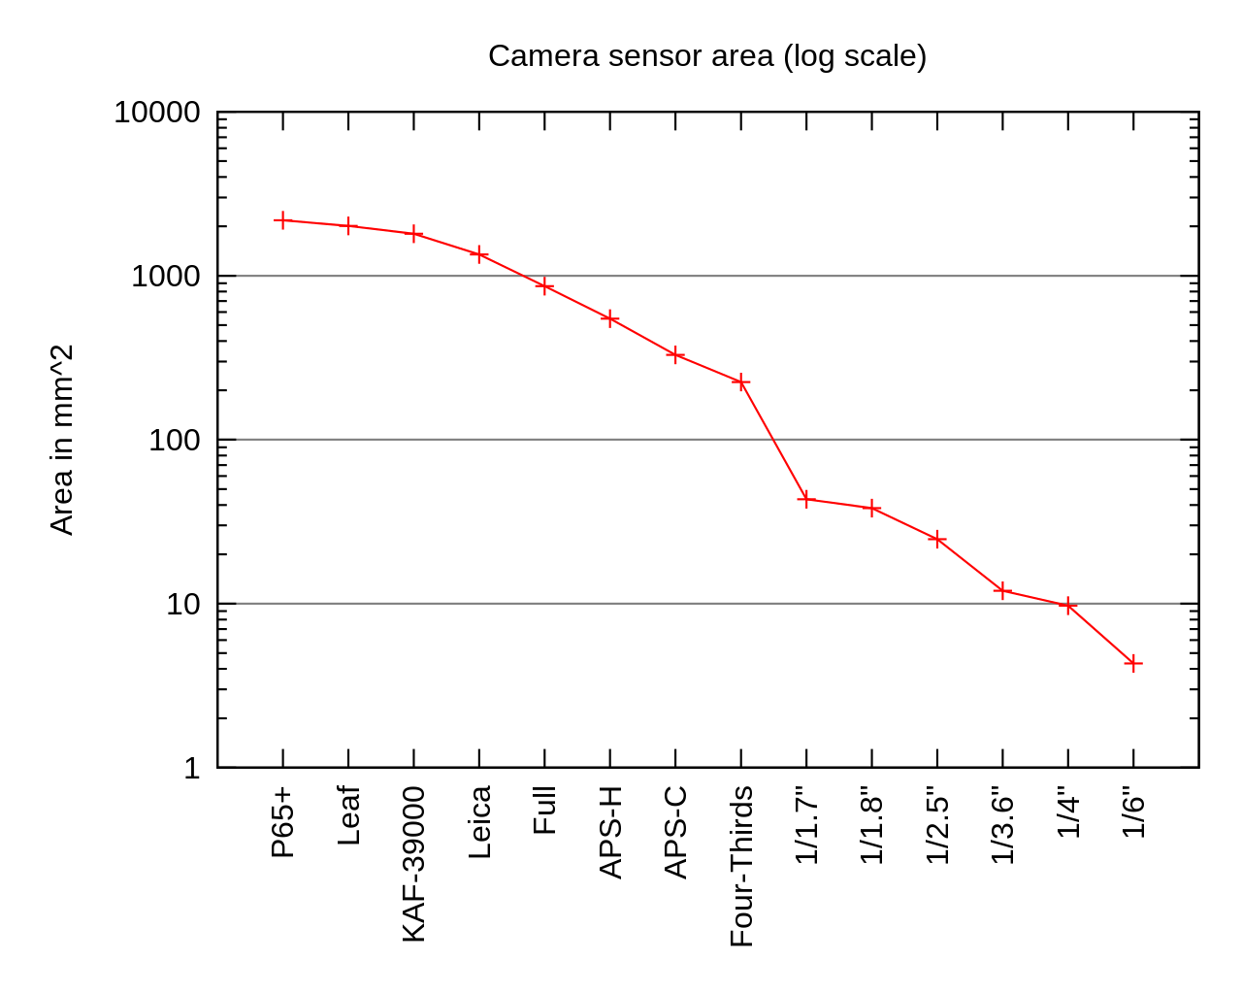
Larger camera image sensors also available
Tablets (most have same sensor size as cell phones, but could increase in future)
  If running Android, can run DECO
  iPads: iOS will be available in future
Compact and SLR (factor 10-100 greater sensor size than cell phones) digital cameras: beginning to run Android, or images could be acquired and analyzed by hand
DSLR
Area (mm²)
compact digital
cameras
cell phones
Notes:
http://en.wikipedia.org/wiki/Image_sensor_format
1/1.7”: Pentax Q7 compact digital
http://www.dpreview.com/articles/2681655989/pentax-announces-q7-with-larger-1-over-1-point-seven-inch-12mp-bsi-cmos-sensor
4/3” (Four-thirds): DSLR
http://en.wikipedia.org/wiki/Four_Thirds_system

Slide 18
Cosmic ray rate vs. altitude
30,000 ft: airplanes
17,000 ft: Victor Hess
8,000 ft: high mountain towns
Notes:
8 kft = 2.4 km
5.3 km Victor Hess
30,000 kft = 9.1 km
5.3 km
Figure 27.4: Vertical fluxes of cosmic rays in the atmosphere with E > 1 GeV estimated from the nucleon flux of Eq. (27.2). The points show measurements of negative muons with Eμ > 1 GeV [39–43].s

Slide 19
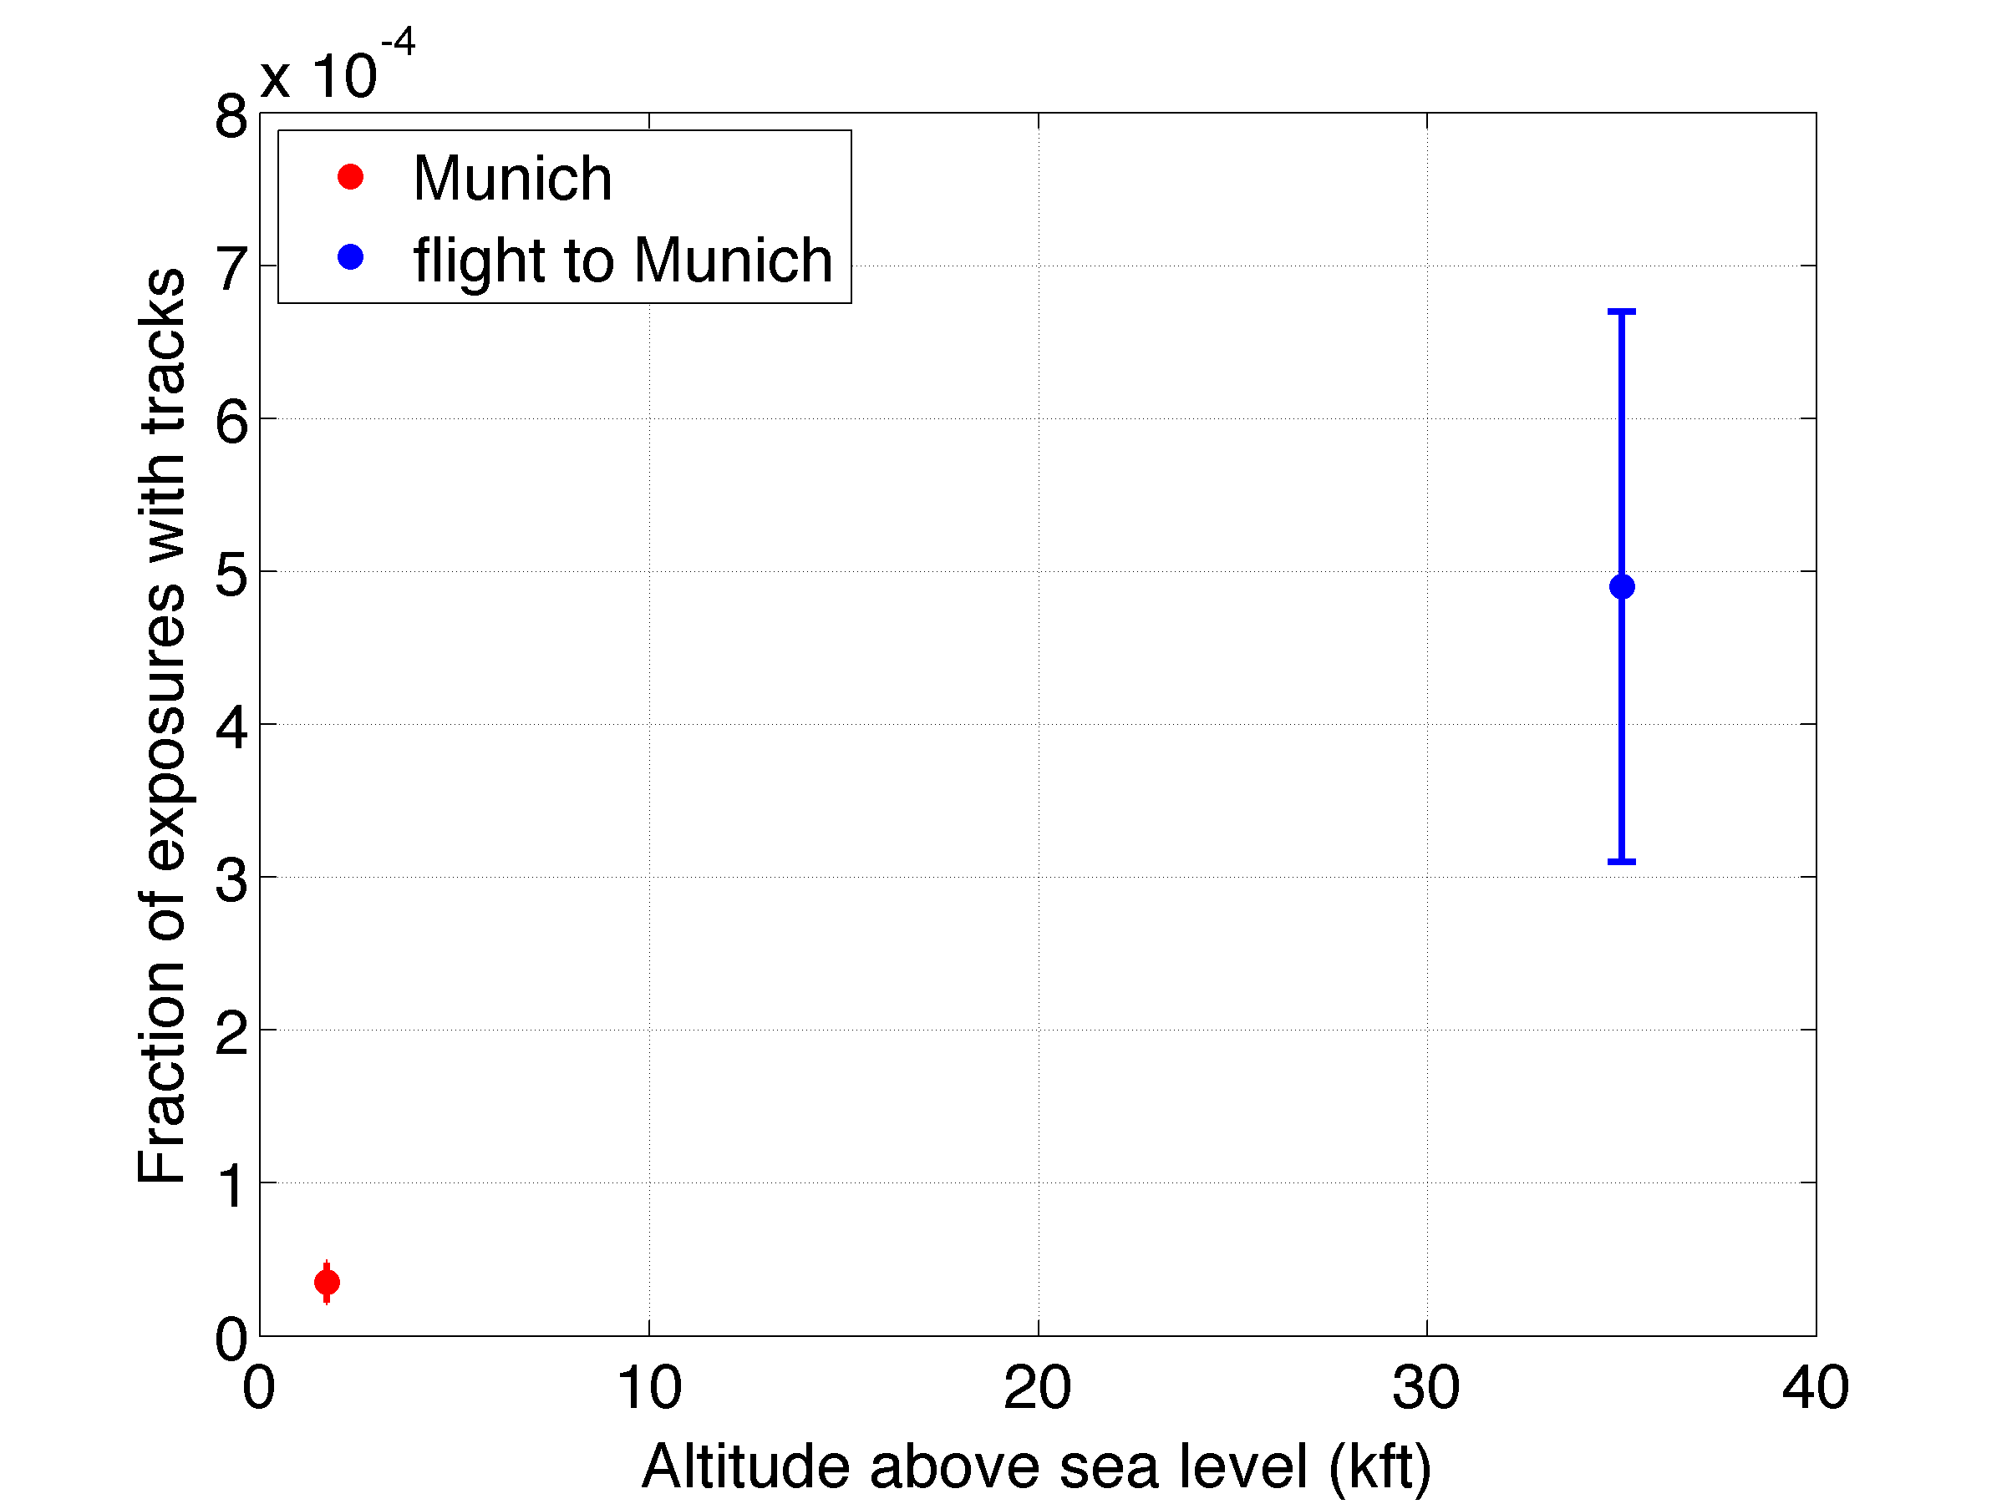
A modern take on Victor Hess: now with airplanes and cell phones
High rate, mostly protons
Low rate, mostly secondary muons

Slide 20
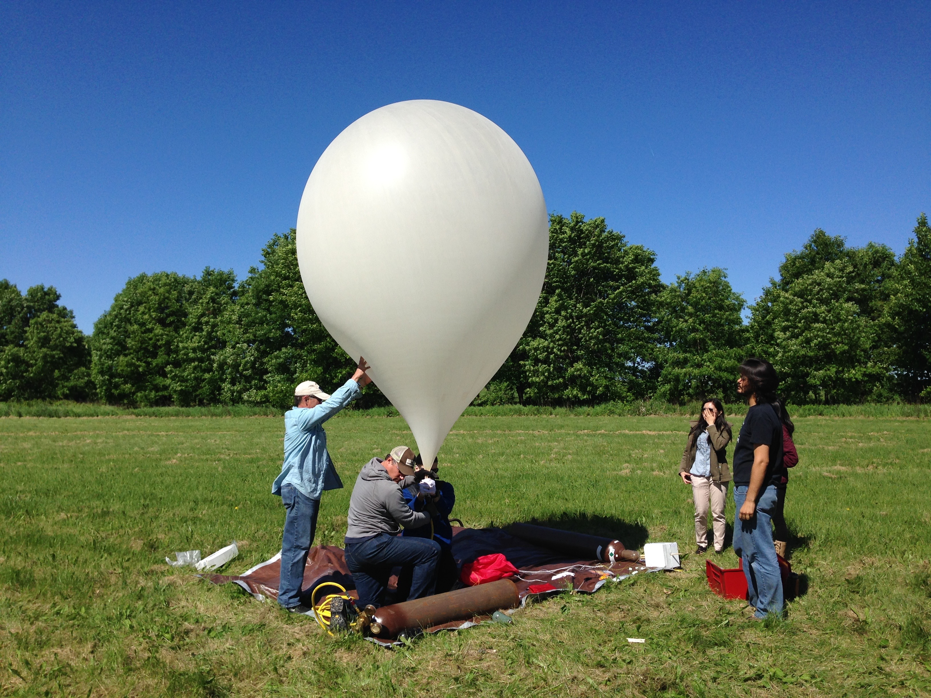
Stratospheric (near-space) balloon flight in Madison, Wisconsin
0.5 hr flight time
Maximum altitude: 100 thousand feet (30 km): 3x airplane altitude

Slide 21
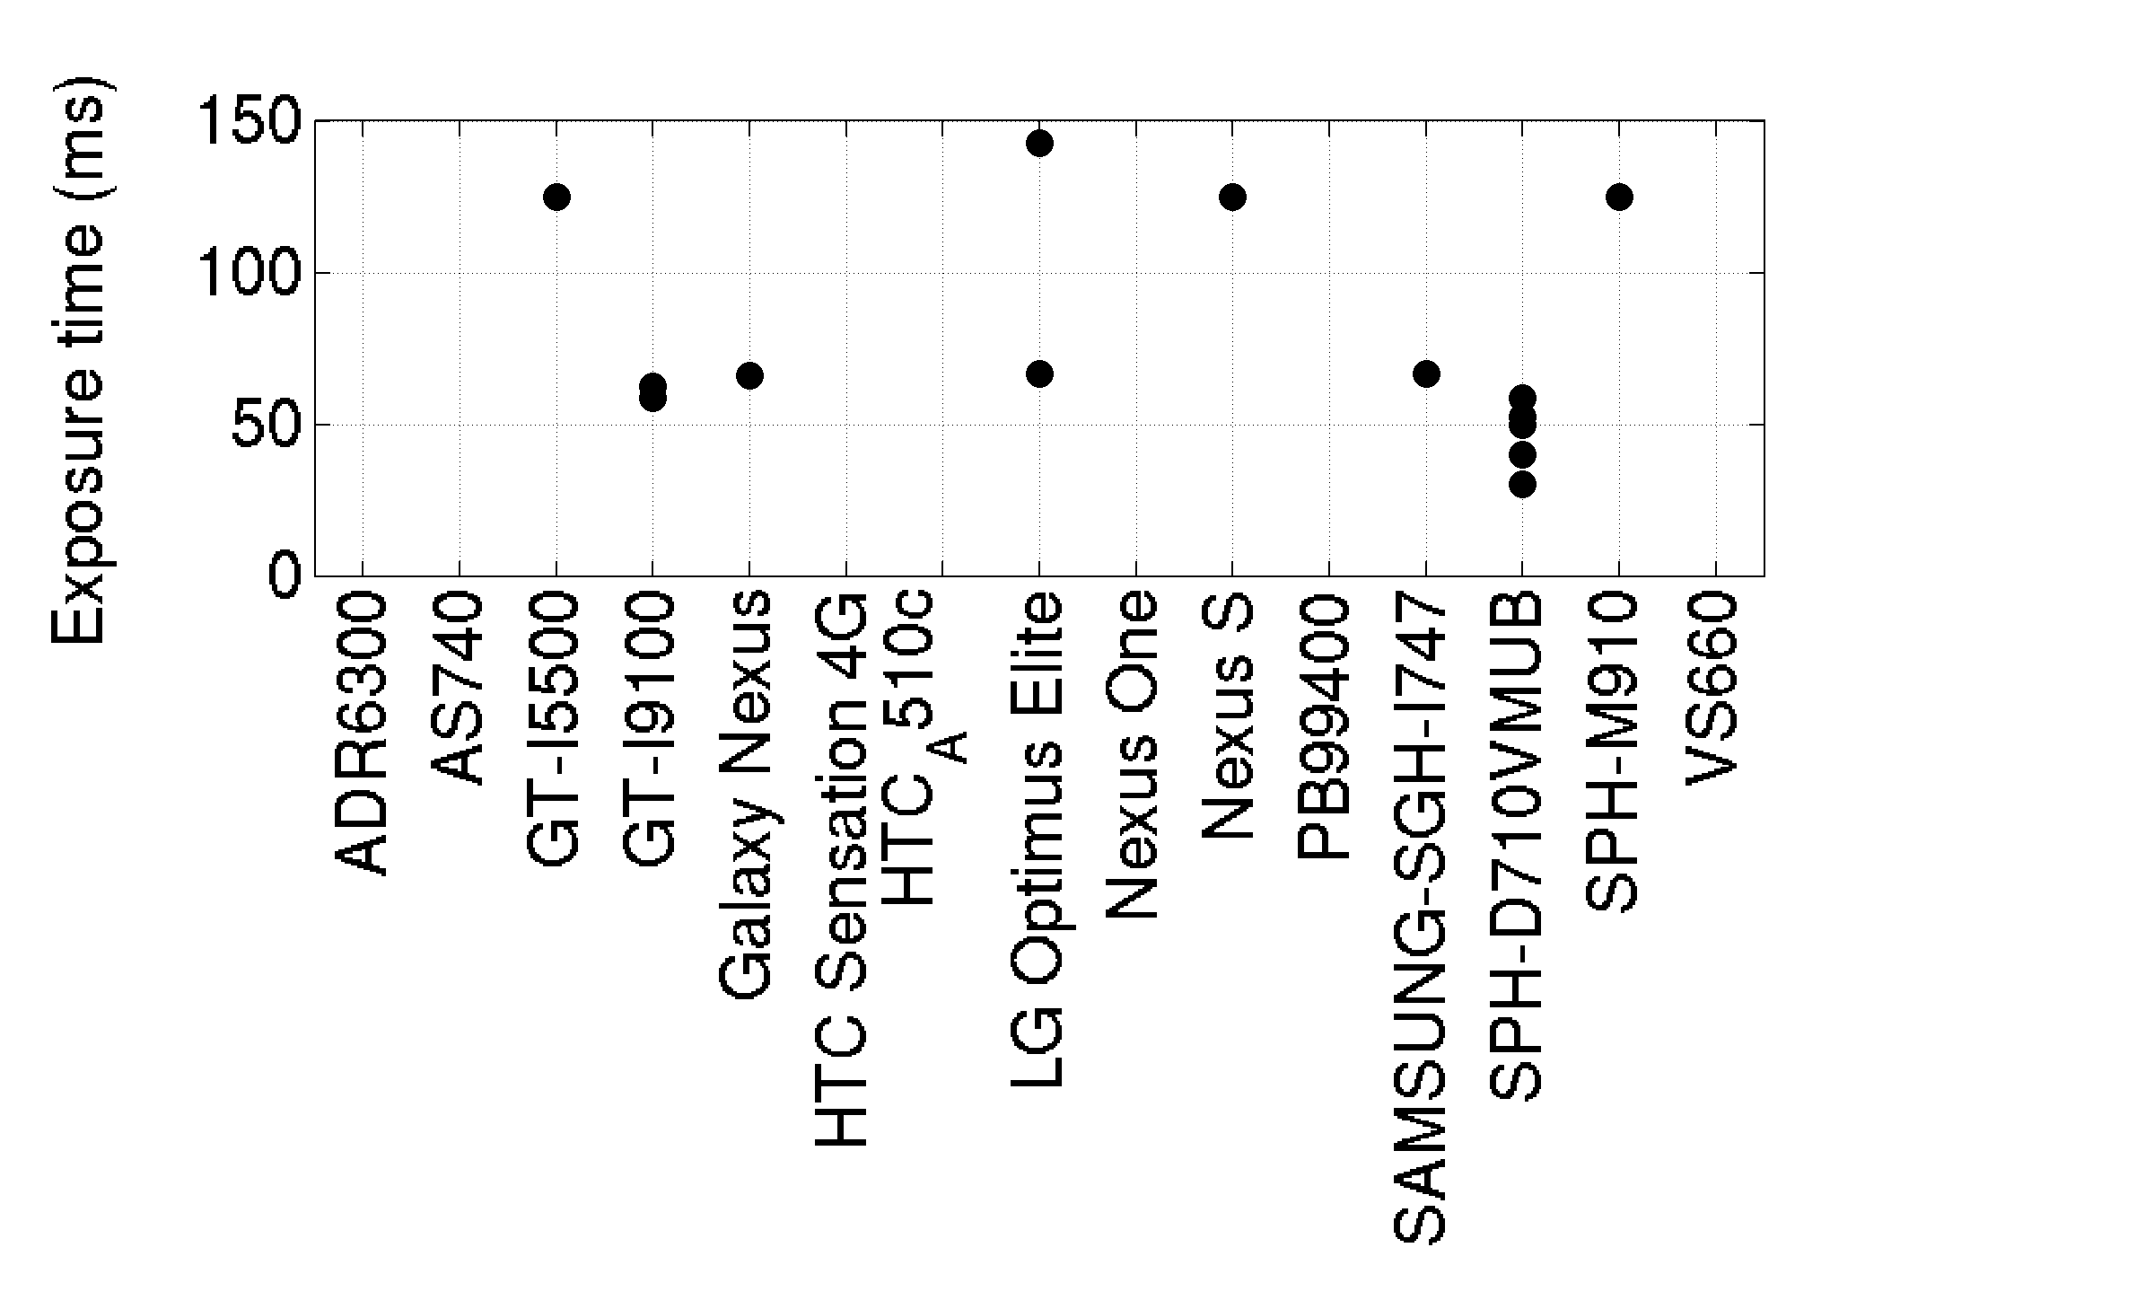
Different models have different range of exposure times (especially short in Android versions <5)
These exposure times are from image header (EXIF) data, not measured
Some models provide this data and some do not

Slide 22
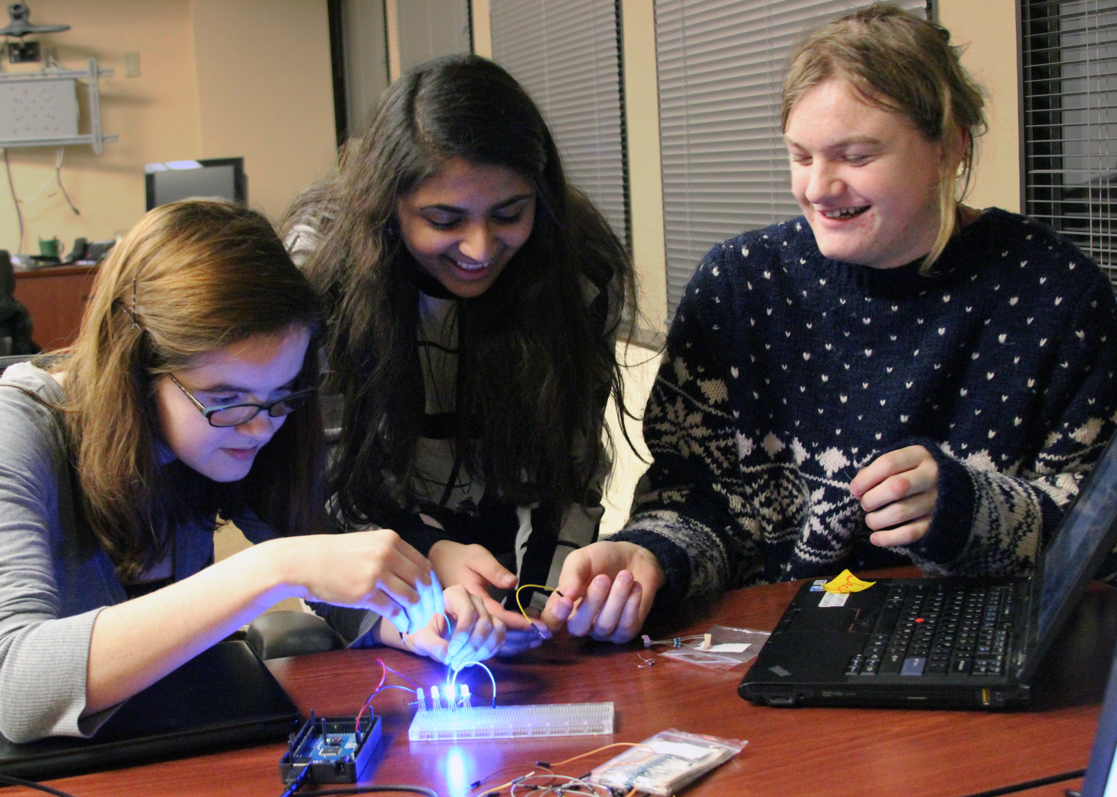
University of Wisconsin QuarkNet High school interns building an Arduino LED array to measure DECO exposure time

Slide 23
Individual sensor areas and event rates are small
Cosmic-ray muon rate at sea level: 1 per minute per cm²
Camera image sensors have area ~0.16 cm²
Therefore expect 230 muons passing through sensor per 24 hrs
If sensor is only exposed 50 ms every 1 sec, livetime is 5%
Only 230 * 0.05 = 12 muons per 24 hrs pass through sensor while it is exposed
Additional efficiency factor: what fraction of muons passing through sensor, during exposure, deposit enough charge and pass selection algorithm?
Efficiency depends on phone model (camera image sensor and noise cleaning)

Slide 24
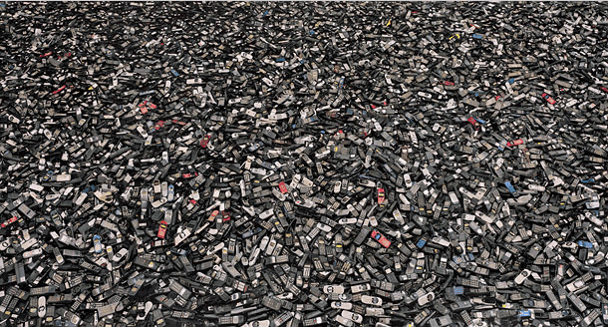
Worldwide sensor area in cell phones
Smart phones: 2 x 10⁹
Sensor area per phone: 10 mm² = 10⁻⁵ m²
Total: 2 x 10⁴ m² = 2 x 10⁻² km²
(rough estimate) plus non-smart phones, front facing cameras, compact and SLR cameras, tablets, laptops, webcams, …

Slide 25
Comparison to silicon trackers used by professional physicists
Worldwide smartphones •
Fermi LAT •
Notes:
Moore’s law published 1965 based on few years of silicon transistors
ATLAS:
61 m^2 of microscrips (Semi-Conductor Tracker) plus Pixel Detector
1.7 m^2 of pixel detector area
http://www.atlas.ch/pixel-detector.html

Slide 26
Measurement of image sensor depletion thickness
7 dof
p=0.008
7 dof
p=0.45
26.6 ± 1.4 µm
J. Vandenbroucke et al., J. Inst. 11 P04019 (2016), 1511.00660

Slide 27
Distinguishing tracks, worms, and spots

Slide 28
Classifying images with computer vision
(convolutional neural network optimized with deep learning)
M. Winter et al., 1803.04493
“Particle Identification In Camera Image Sensors Using Computer Vision”

Slide 29
Classifying images with computer vision
(convolutional neural network optimized with deep learning)
Column-normalized confusion matrix
M. Winter et al., 1803.04493
“Particle Identification In Camera Image Sensors Using Computer Vision”

Slide 30

Advertisement: ICRC 2019 in Madison, Wisconsin
July 25 – August 1, 2019

Slide 31
DECO article in INFN’s Asimmetrie magazine
(October 2017)
Delia Tosi & Justin Vandenbroucke
https://www.asimmetrie.it/as-illuminazioni-raggi-cosmici-in-tasca

Slide 32
More information
Public site http://wipac.wisc.edu/deco
Paper #1 https://arxiv.org/abs/1510.07665
Paper #2 https://arxiv.org/abs/1511.00660
Paper #3 https://arxiv.org/abs/1708.01281
Paper #4 https://arxiv.org/abs/1803.04493
Public Google Group “deco-users” https://groups.google.com/forum/#!forum/deco-users
Physics World: http://live.iop-pp01.agh.sleek.net/2014/12/17/dialling-up-the-cosmos/
Symmetry: http://www.symmetrymagazine.org/article/reading-the-heavens-with-your-phone
UW Madison news: http://news.wisc.edu/23166
Kurzweil AI: http://www.kurzweilai.net/how-to-turn-your-android-phone-into-a-cosmic-ray-detector
Universe Today: http://www.universetoday.com/115066/how-to-turn-your-phone-into-a-cosmic-ray-detector/
Discovery: http://news.discovery.com/tech/gear-and-gadgets/turn-your-smartphone-into-a-cosmic-ray-detector-141009.htm
Huffington Post: http://www.huffingtonpost.com/2014/10/11/phone-cosmic-ray-detector_n_5958630.html
CERN Courier: http://cerncourier.com/cws/article/cern/69889
INFN’s Asimmetrie: https://www.asimmetrie.it/as-illuminazioni-raggi-cosmici-in-tasca

Slide 33
Thank you to my DECO collaborators
Segev BenZvi
James Bourbeau
Silvia Bravo
Felipe Campos
Kenny Jensen
Peter Karn
Matt Meehan
Jeffrey Peacock
Matthew Plewa
Tyler Ruggles
Marcos Santander
Cassidy Schneider
David Schultz
Ariel Levi Simons
Delia Tosi
Miles Winter
Graduate students
Undergraduates

Slide 34
Thank you to the supporters of DECO
University of Wisconsin
Knight Foundation
QuarkNet
National Science Foundation
American Physical Society
Simon-Strauss Foundation
Wisconsin IceCube Particle Astrophysics Center
Opportunities for collaboration at many levels: Contact me if interested!
justin.vandenbroucke@wisc.edu

Slide 35
Additional slides

Slide 36
Power consumption
Running the camera (and image analysis) continuously is battery intensive
In normal use, should be plugged in to wall power
Typically lasts a few hours on battery
An external battery pack can boost this to 10-20 hrs (e.g. on a long plane flight)
In 24 hours, consumes ~100 Watt-hours (costs ~1¢ on electricity bill)

